Slide 1
Notes:
OK everyone get ready to learn a new vocabulary term.

Slide 2
Electromagnetic Waves
Notes:
Today we are going to be defining electromagnetic waves.

Slide 3
Radiant Energy
Notes:
Radiant Energy

Slide 4
Wavelength (λ)
Notes:
Wavelength

Slide 5
Frequency (ƒ)
Notes:
Frequency

Slide 6
Speed
Notes:
And speed

Slide 7
Notes:
Before we define the terms, let’s review some other words that you already learned, and make sure you are firm in your understanding.

Slide 8
Waves: disturbances that transfer energy
Notes:
Waves are disturbances that transfer energy.

Slide 9
Medium
Notes:
A medium is any material that waves can travel through.

Slide 10
Energy: ability to cause change
Notes:
Energy is the ability to cause change.

Slide 11
Electric Current: movement of electrically charged particles
Notes:
The movement of electrically charged particles.

Slide 12
Magnetic: exerting a strong, attractive force
Notes:
Magnet- exerting a strong attractive force.

Slide 13
wavelength: the distance between two like points on a wave
Notes:
Wavelength is the distance between two like points on a wave.

Slide 14
frequency: the number of wavelengths that pass a set point per second.
Notes:
Frequency is the number of wavelengths that pass a set point, per second.

Slide 15
Notes:
Now let’s pause for a moment to review the information we have covered already.

Slide 16
Energy is the ability to cause ____?
Notes:
Change.

Slide 17
Charged particles move in a _____?
Notes:
Electric Current

Slide 18
Electromagnetic
Waves
Notes:
Now, let’s define what electromagnetic waves means

Slide 19
Electromagnetic Wave
Notes:
Electromagnetic Waves are made of two parts.

Slide 20
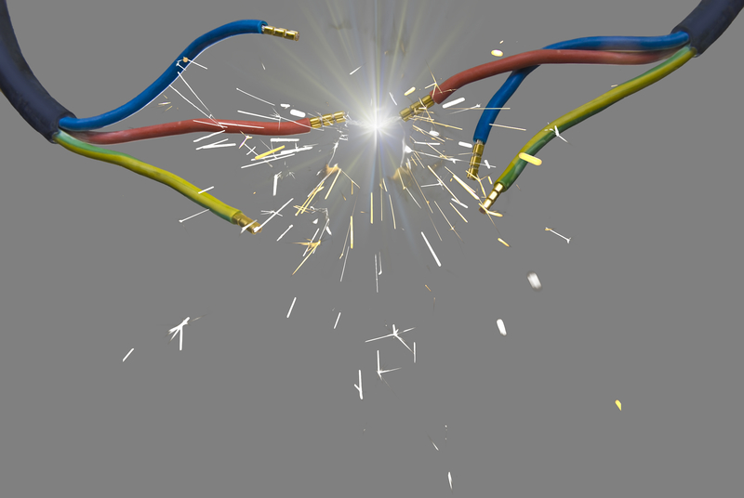
Electric Field
Notes:
The first is the electric field which is the red line. This is the movement of a charged particle

Slide 21
Magnetic Field
Notes:
The second is the magnetic field.

Slide 22
Notes:
Electromagnetic waves do not need a medium to be seen.

Slide 23
Notes:
Here are some examples of electromagnetic waves.

Slide 24
Visible Light
Notes:
Visible light is a form of electromagnetic waves. It is why we can see the stars. Visible light can travel without a medium.

Slide 25
X-Rays
Notes:
X-rays, which allow us to look at broken bones, are also electromagnetic waves.

Slide 26
Radio Waves
Notes:
Radio waves are also electromagnetic waves. They transmit sound over a distance.

Slide 27
Non
Notes:
Here are some non-examples of electromagnetic waves. These are things that might seem similar but do not fit the definition of electromagnetic waves.

Slide 28
Sound Waves
Notes:
Sound waves are not an example of electromagnetic waves. Sound waves are mechanical energy and need a medium.

Slide 29
Notes:
Let’s pause and review what we’ve just learned.

Slide 30
What 2 parts make up an electromagnetic wave?
Magnetic Field and Electric Field
Positive Field and Negative Field
Electrons and Protons

Slide 31
What 2 parts make up an electromagnetic wave?
Magnetic Field and Electric Field
Positive Field and Negative Field
Electrons and Protons

Slide 32
Notes:
So what similarities do all these waves have?

Slide 33
Radiant Energy
Notes:
Now, let’s define what radiant energy is.

Slide 34
Electromagnetic Radiation
Notes:
Radiant energy can also be called electromagnetic radiation.

Slide 35
Notes:
Now, let’s take a look at some common examples of radiant energy.

Slide 36
Radiant Energy
Notes:
The earth receives radiant energy from the sun.

Slide 37
Notes:
Microwaves also use radiant energy to increase the temperature of your food.

Slide 38
Notes:
Let’s pause and review what we’ve just learned.

Slide 39
Radiant energy is carried in ____?
Sound Waves
Ocean Waves
Electromagnetic Waves

Slide 40
Radiant energy is carried in ____?
Sound Waves
Ocean Waves
Electromagnetic Waves

Slide 41
Speed of light
Notes:
Now, let’s define speed of light.

Slide 42
Speed of Light (c)
Notes:
This is known as the speed of light (c).

Slide 43
c = λ x ƒ
Speed of Light = Wavelength x Frequency
Notes:
The speed of light equals wavelength times frequency. Here we can look at the symbols for wavelength and frequency.

Slide 44
c = λ x ƒ
Speed of Light = Wavelength x Frequency
Notes:
First lets take a look at wavelength

Slide 45
c = λ x ƒ
Speed of Light = Wavelength x Frequency
Notes:
Now lets look at frequency.

Slide 46
c = λ x ƒ
Speed of Light = Wavelength x Frequency
Notes:
So therefore, speed of light = wavelength times frequency.

Slide 47
Notes:
Let’s review everything we’ve covered today.

Slide 48
Sound is an electromagnetic wave?
Notes:
No.

Slide 49
True or False: Electromagnetic waves need a medium to travel.

Slide 50
True or False: Electromagnetic waves need a medium to travel.

Slide 51
What is the relationship between frequency and energy in electromagnetic waves?
Notes:
The higher the frequency the higher the energy.

Slide 52
Remember!!!
Notes:
So remember!
<keep this slide>

Slide 53
Electromagnetic Waves: can travel in empty space and in matter
Notes:
Electromagnetic waves are waves that can travel in empty space and through matter.

Slide 54
Radiant Energy: energy carried by electromagnetic waves.
Notes:
Radiant energy is the energy that is carried by electromagnetic waves.

Slide 55
speed of light = 300,000 km/s
Notes:
All electromagnetic waves travel through space at 300,000 km/s.

Slide 56
Notes:
Thanks for watching, and please continue watching CAPs available from this website.

Slide 57
This Video Created With Resources From:
Cooperative Agreement # R324B130023
Curry School Foundation’s Research and Development Fund
Questions or Comments to Michael Kennedy, Ph.D.
MKennedy@Virginia.edu

