Slide 1
Notes:
OK everyone get ready to learn a new vocabulary term.

Slide 2
Electric Charge
Notes:
Today we are going to define electric charge.

Slide 3
Static Charge
Notes:
We are going to define static charge.

Slide 4
Notes:
Before we define these terms, let’s review some other words that you already learned, and make sure you are firm in your understanding.

Slide 5
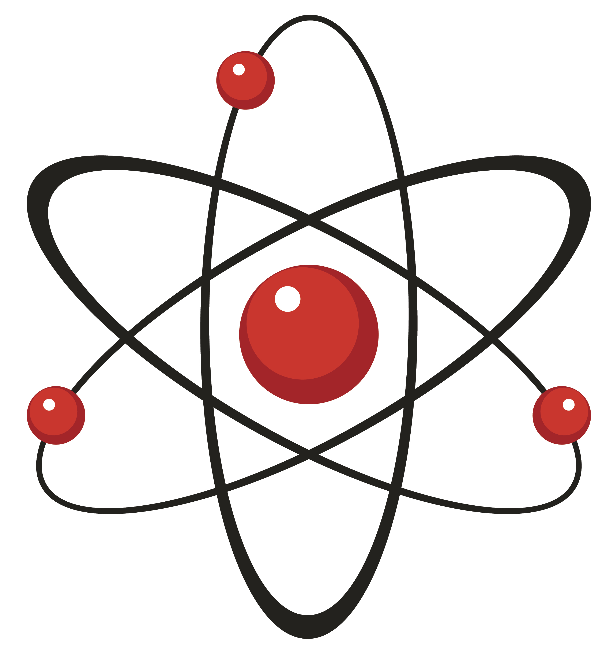
Matter:
has mass and takes up space
Notes:
First, remember that matter is anything that has mass and takes up space.

Slide 6
Atom: Smallest Whole Unit of Matter
Atom
Atom
Atom
Atom
Atom
Notes:
Remember that an atom is the smallest whole unit of matter.

Slide 7
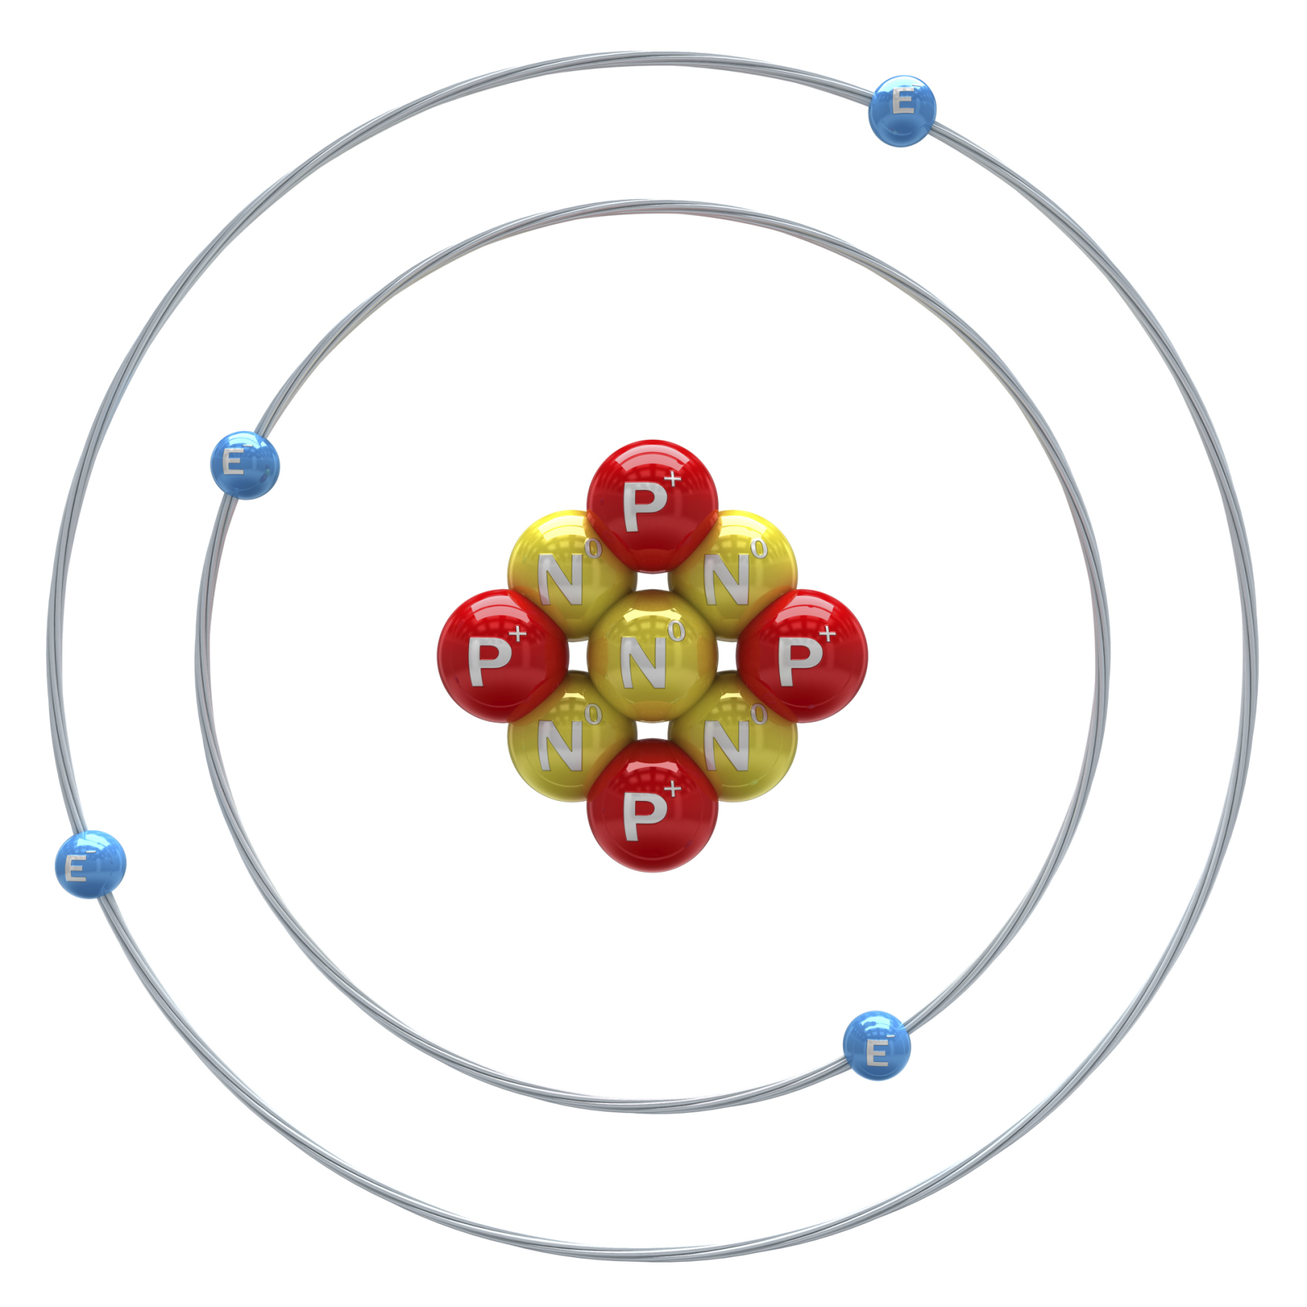
Protons
Proton
Nucleus
Notes:
Protons are positively charged subatomic particles.

Slide 8
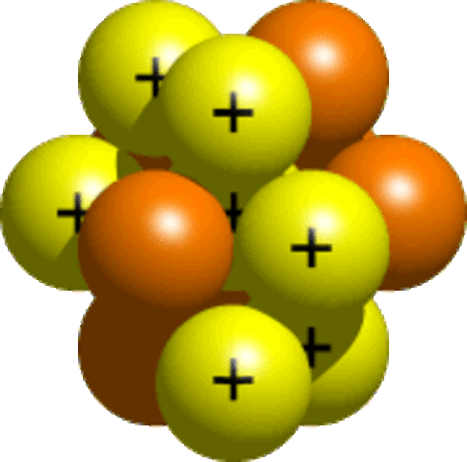
Neutrons
Notes:
Neutrons are neutrally charged subatomic particles.

Slide 9
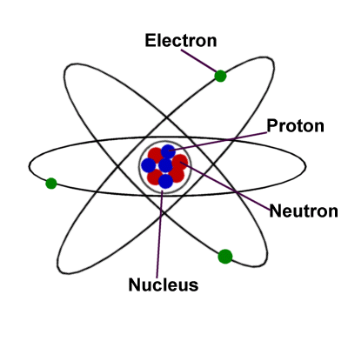
Electron
Notes:
Electrons are negatively charge subatomic particles.

Slide 11
What are the 3 subatomic particles found in an atom?
Notes:
Proton, neutron, electron.

Slide 12
electric charge
Notes:
Now, let’s define what electric charge means.

Slide 13
electric charge: protons and electrons have an electric charge.
Notes:
Like electric charges, static charges can interact.

Slide 14
Positive Charge
Notes:
There are positive charges.

Slide 15
Protons
Notes:
Positive charges are created when there are fewer electrons than protons. Remember protons are found in the nucleus.

Slide 16
Negative Charge
Notes:
And there are negative charges.

Slide 17
Electrons
Notes:
Negative charges are created when there are more electrons than protons. Electrons are found in the electron cloud on the outside of the nucleus.

Slide 18
Like Charges Repel
Notes:
2 protons or 2 electrons repel each other

Slide 19
Different charges attract.
Notes:
A electron or proton will attract each other

Slide 21
What 2 types of charges are there?
Notes:
Negative and positive.

Slide 22
What subatomic particles have an electric charge?
Protons
Neutrons
Electrons

Slide 23
What subatomic particles have an electric charge?
Protons
Neutrons
Electrons

Slide 24
static charge
Notes:
Now, let’s define what electric charge means.

Slide 25
static charge: when an object has an unbalanced number of protons or electrons.
Notes:
A static charge is caused by having an unbalanced number or either protons or electrons.

Slide 26
Static charges can interact
Notes:
Static charges interact like electric charges.

Slide 27
Positive Charge
Notes:
The positive charge builds up in the sky.

Slide 28
Negative Charge
Notes:
The ground has negative charge.

Slide 29
static charge → lightning
Notes:
When enough has static charge has built up, a static charge is created in the form of lightning.

Slide 30
Notes:
Now let us review what we have learned.

Slide 31
Can static charges interact?
Notes:
yes

Slide 32
Why does lightening strike?
Notes:
There is a build up of static charge in the sky. When it overloads the sky interacts with the ground creating lightening between them.

Slide 33
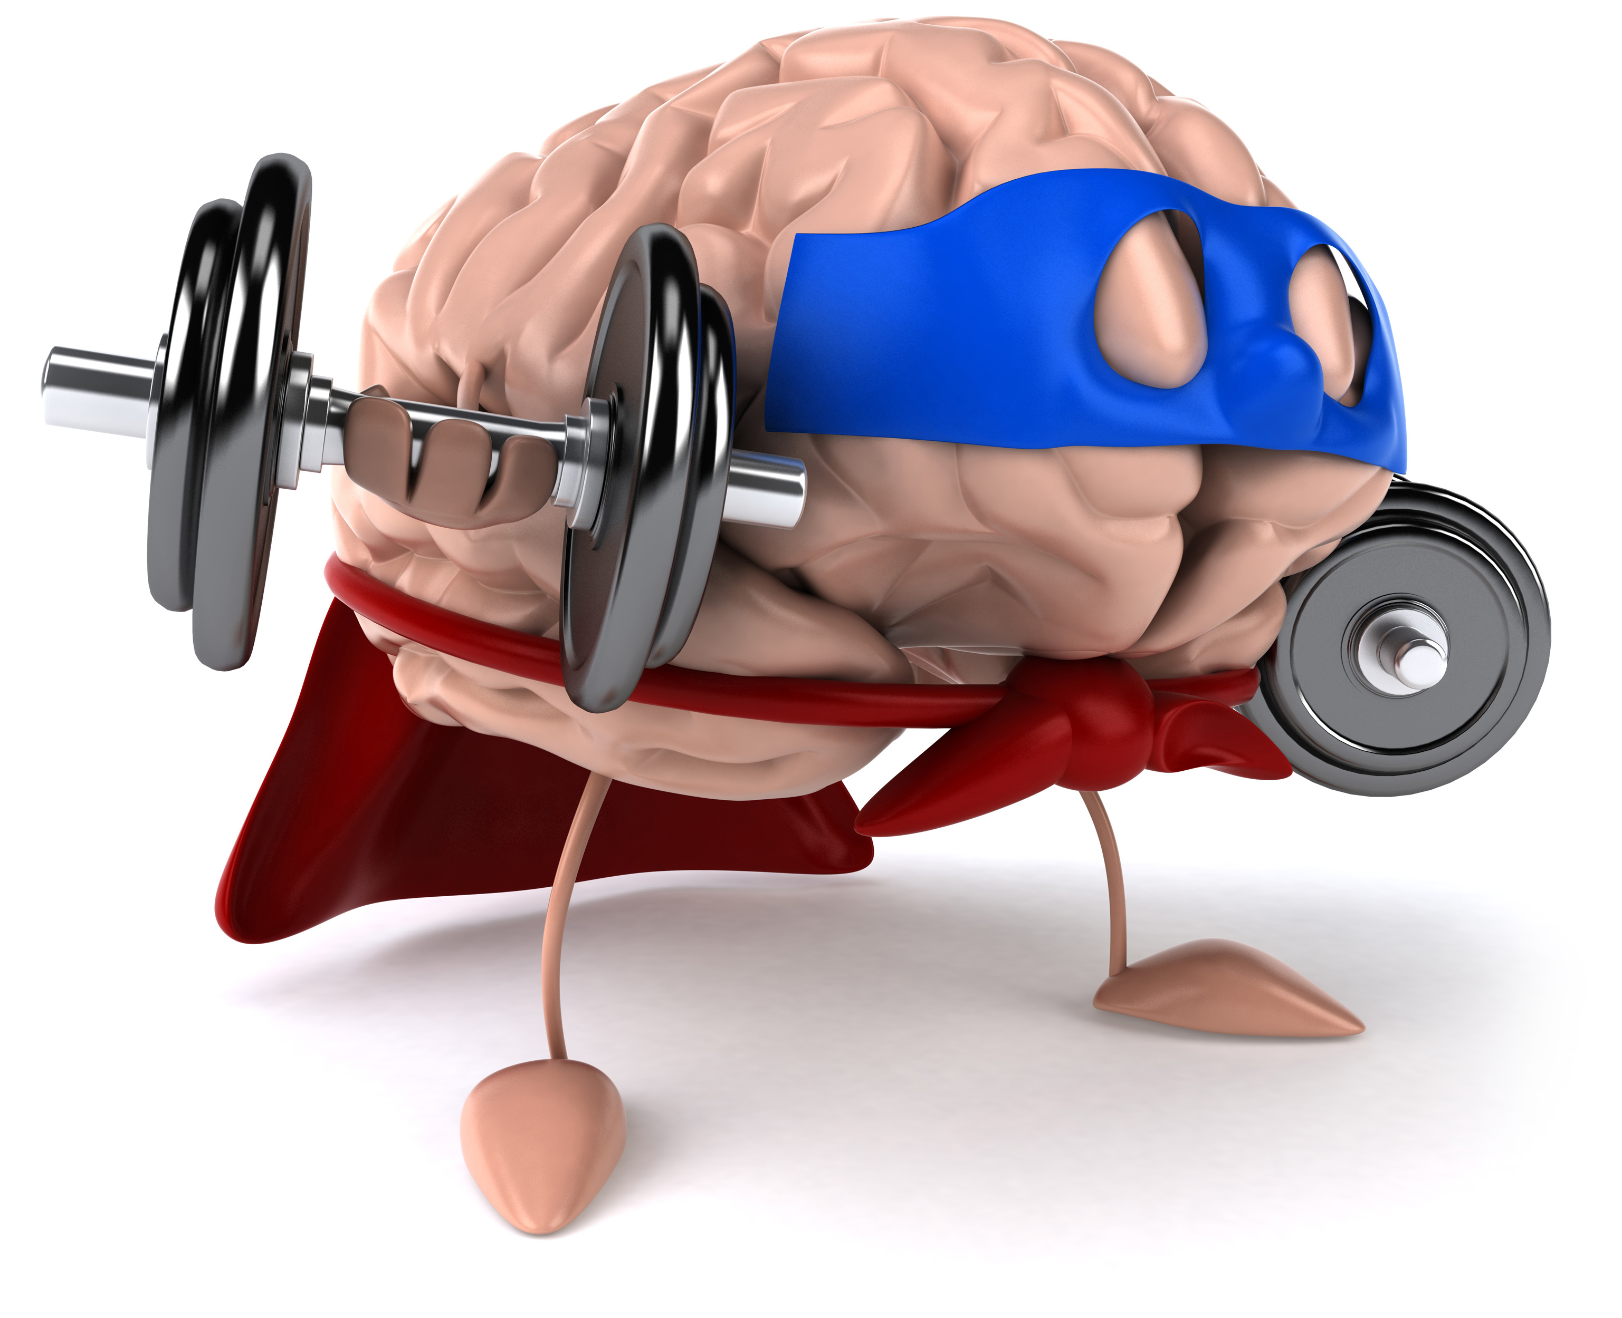
Remember!!!
Notes:
So remember!
<keep this slide>

Slide 34
electric charge: protons and electrons have an electric charge.
Notes:
Like electric charges, static charges can interact.

Slide 35
static charge: when an object has an unbalanced number of protons or electrons.
Notes:
A static charge is caused by having an unbalanced number or either protons or electrons.

Slide 36
Notes:
Thanks for watching, and please continue watching CAPs available from this website.

Slide 37
This Video Created With Resources From:
Cooperative Agreement # R324B130023
Curry School Foundation’s Research and Development Fund
Questions or Comments to Michael Kennedy, Ph.D.
MKennedy@Virginia.edu

Slide 38
Activity
Objective: Students will understand the build up of static charge.
Activity: The teacher will demonstrate what happens when a balloon interacts with different objects.
Materials:
2 balloons
Sweater
Assorted materials (tissue paper, aluminum foil, cardboard scrap, paper scrap, yarn string, pom pom, pipe cleaner, ribbon, cloth, foam)
Resources:
http://kidsactivitiesblog.com/26688/static-electricity

