Slide 1
Notes:
OK everyone get ready to learn a new vocabulary term.

Slide 2
Energy
Notes:
Today we are going to be defining energy.

Slide 3
Potential Energy
Notes:
We are also going to define potential energy.

Slide 4
Kinetic Energy
Notes:
And kinetic energy.

Slide 5
Notes:
Before we define the terms, let’s review some other words that you already learned, and make sure you are firm in your understanding.

Slide 6
Motion
Notes:
Motion is the movement of change.

Slide 7
Change
Notes:
Change occurs when something becomes different.

Slide 8
Notes:
Moving location is an example of change.

Slide 9
Notes:
Let us review what we have learned.

Slide 10
What is change?
Notes:
Change occurs when something becomes different.

Slide 11
What change is occurring here?
Notes:
A plane is flying and moving from the ground to air. The location of the plane is moving.

Slide 12
Energy
Notes:
So what is energy?

Slide 13
Energy: the ability to cause change.
Notes:
Energy is the ability to cause change.

Slide 14
Notes:
An ice cube melts because energy is being added.

Slide 15
Solid
Liquid
Notes:
Here a solid is melting into a liquid.

Slide 16
Notes:
Lets look closer at energy.

Slide 17
What activities require energy?
Melting ice cream
Sleeping at night
Eating a cookie
Driving a car

Slide 18
What activities require energy?
Melting ice cream
Sleeping at night
Eating a cookie
Driving a car
Notes:
All of these activity require energy! Even sleeping at night your body is constantly performing different processes.

Slide 19
Notes:
There are 2 different kinds of energy defined by motion.

Slide 20
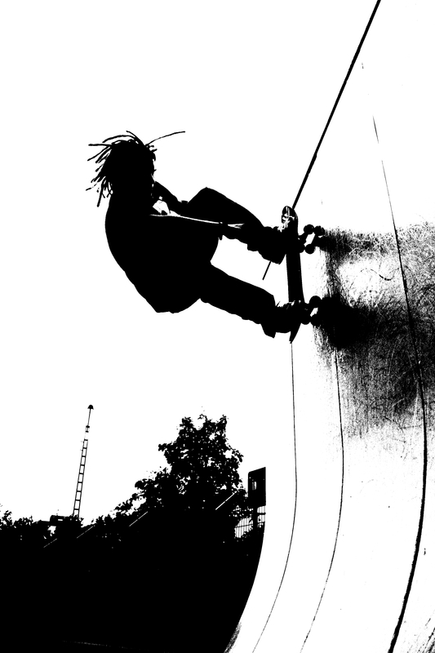
Types of Energy
Potential Energy
Kinetic Energy
Notes:
The two types of energy related to motion are potential and kinetic energy.

Slide 21
Potential Energy
Notes:
The first energy we are going to look is potential energy.

Slide 22
Potential Energy
Notes:
Now, let’s define what potential energy means

Slide 23
Potential Energy: stored energy
Notes:
Potential energy is stored energy. Stored energy is energy you have that can be used.

Slide 24
Notes:
Lets look at a ramp to determine the potential energy of a skateboarder.

Slide 25
Height
Notes:
How high the ramp is from the ground affects the potential energy.

Slide 26
Notes:
Lets look at this closer example.

Slide 27
Notes:
The higher the ramp, the more potential energy an object has. Which hiker has the most potential energy?

Slide 28
Notes:
Hiker 01 has the most potential energy because he is the highest from the ground. Who has the least potential energy?

Slide 29
Notes:
Hiker 10 has the least amount of potential energy compared against the others because they are closest to the ground.

Slide 30
Notes:
Let’s look at a some problems.

Slide 31
If you have an object at rest, does it have potential energy?
Notes:
Yes. An object at rest has potential energy.

Slide 32
As height of an object increases, the amount of potential energy ______.
Notes:
Increases.

Slide 33
Kinetic Energy
Notes:
The other type of motion energy is kinetic energy.

Slide 34
Kinetic Energy
Notes:
Now, let’s define what kinetic energy means

Slide 35
Kinetic Energy: energy of an object in motion

Slide 36
Notes:
As a skateboard moves down a ramp he uses kinetic energy.

Slide 37
Notes:
Lets look at a closer example.

Slide 38
Biking
Notes:
As you bike outside you are using kinetic motion because you are using energy to move the bicycle forward.

Slide 39
Notes:
Lets think about this.

Slide 40
Notes:
What type of energy does this rock have right now?

Slide 41
Potential Energy
Notes:
Yes, right now this rock as potential energy.

Slide 42
Notes:
What if potential energy was changed into kinetic energy? What would have to happen?

Slide 43
It would roll!
Notes:
If the potential energy would change into kinetic energy it would roll because kinetic energy is due to motion!

Slide 44
Notes:
Lets look at a couple of questions.

Slide 45
Which energy is changed by the height of the object?
Potential
Kinetic

Slide 46
Which energy is changed by the height of the object?
Potential
Kinetic

Slide 47
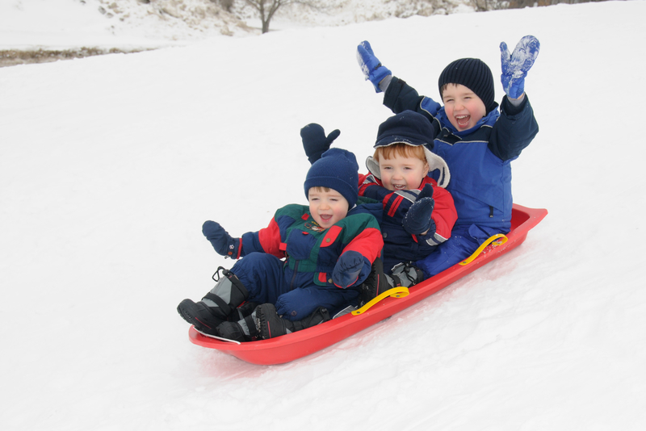
What type of energy is present here as these children sled down the hill?
Notes:
Kinetic, it is energy due to motion.

Slide 48
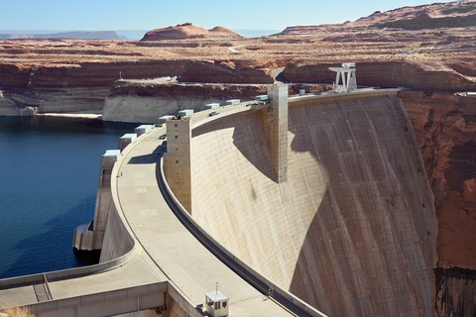
INCREASED PRESSURE
Potential energy is like water behind a dam
Notes:
Potential energy, or stored energy, is like water behind a dam. Imagine all of that water building. As more and more water builds up, the pressure on the dam increases.
(make sure you write out the analogy and then provide an extended context/explanation)

Slide 49
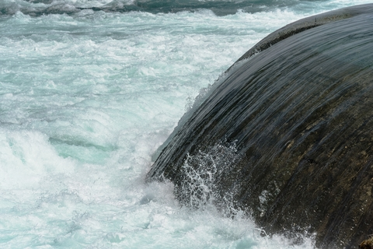
Kinetic Energy = Energy of Motion
Potential
Energy
Notes:
If the dam were to break, all of that water would be released. Think of the energy those rushing waves would have! The energy would no longer be stored. Now it would be the energy of motion, or kinetic energy!

Slide 50
Can you think of an analogy for potential energy?
Notes:
Can you think of an analogy for potential energy?
Follow up with a cue for students to think about an analogy and for teacher to provide feedback

Slide 51
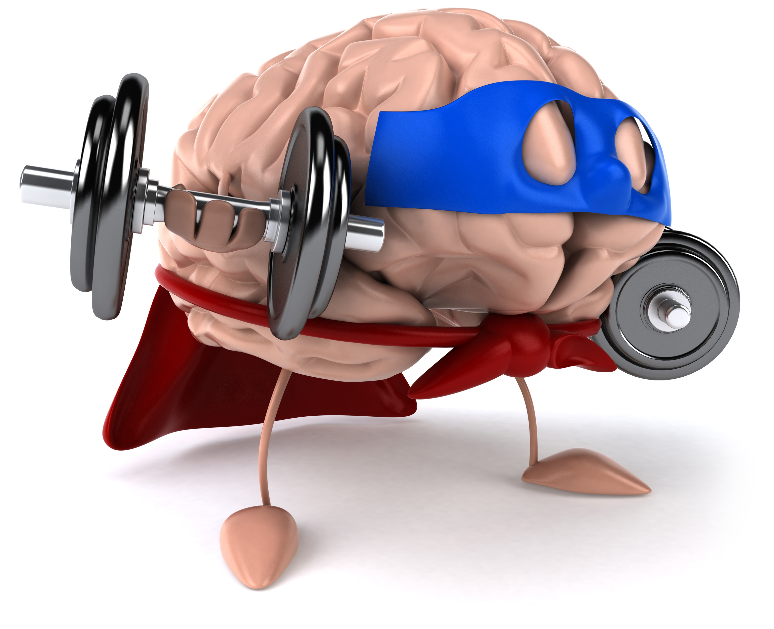
Remember!!!
Notes:
So remember!
<keep this slide>

Slide 52
Potential Energy: stored energy
Notes:
Potential energy is stored energy. Stored energy is energy you have that can be used.

Slide 53
Kinetic Energy: energy of an object in motion

Slide 54
Notes:
Thanks for watching, and please continue watching CAPs available from this website.

Slide 55
This Video Created With Resources From:
Cooperative Agreement # R324B130023
Curry School Foundation’s Research and Development Fund
Questions or Comments to Michael Kennedy, Ph.D.
MKennedy@Virginia.edu

Slide 56
Activity
Objective: Students will understand the difference between potential and kinetic energy and how it transfers. Great demo before the lesson to expose the students to the vocabulary.
Activity: Throw a beach ball around the classroom. As it is in the air call out kinetic. As students catch it, call out potential.
Materials:
Beach Ball
Resources:
http://sbsciencematters.com/6th/physical-energy/6.2Potential&KineticEnergy.pdf

