Slide 1
Notes:
OK everyone get ready to learn a new vocabulary term.

Slide 2
Energy
Notes:
Today we are going to be learning about energy.

Slide 3
potential energy
Notes:
Specifically we are going to look at potential energy,

Slide 4
gravitational potential energy
Notes:
gravitational potential energy,

Slide 5
chemical energy
Notes:
chemicalenergy,

Slide 6
nuclear energy
Notes:
and nuclear energy.

Slide 7
Notes:
Before we define these terms, let’s review some other words that you already learned, and make sure you are firm in your understanding.

Slide 8
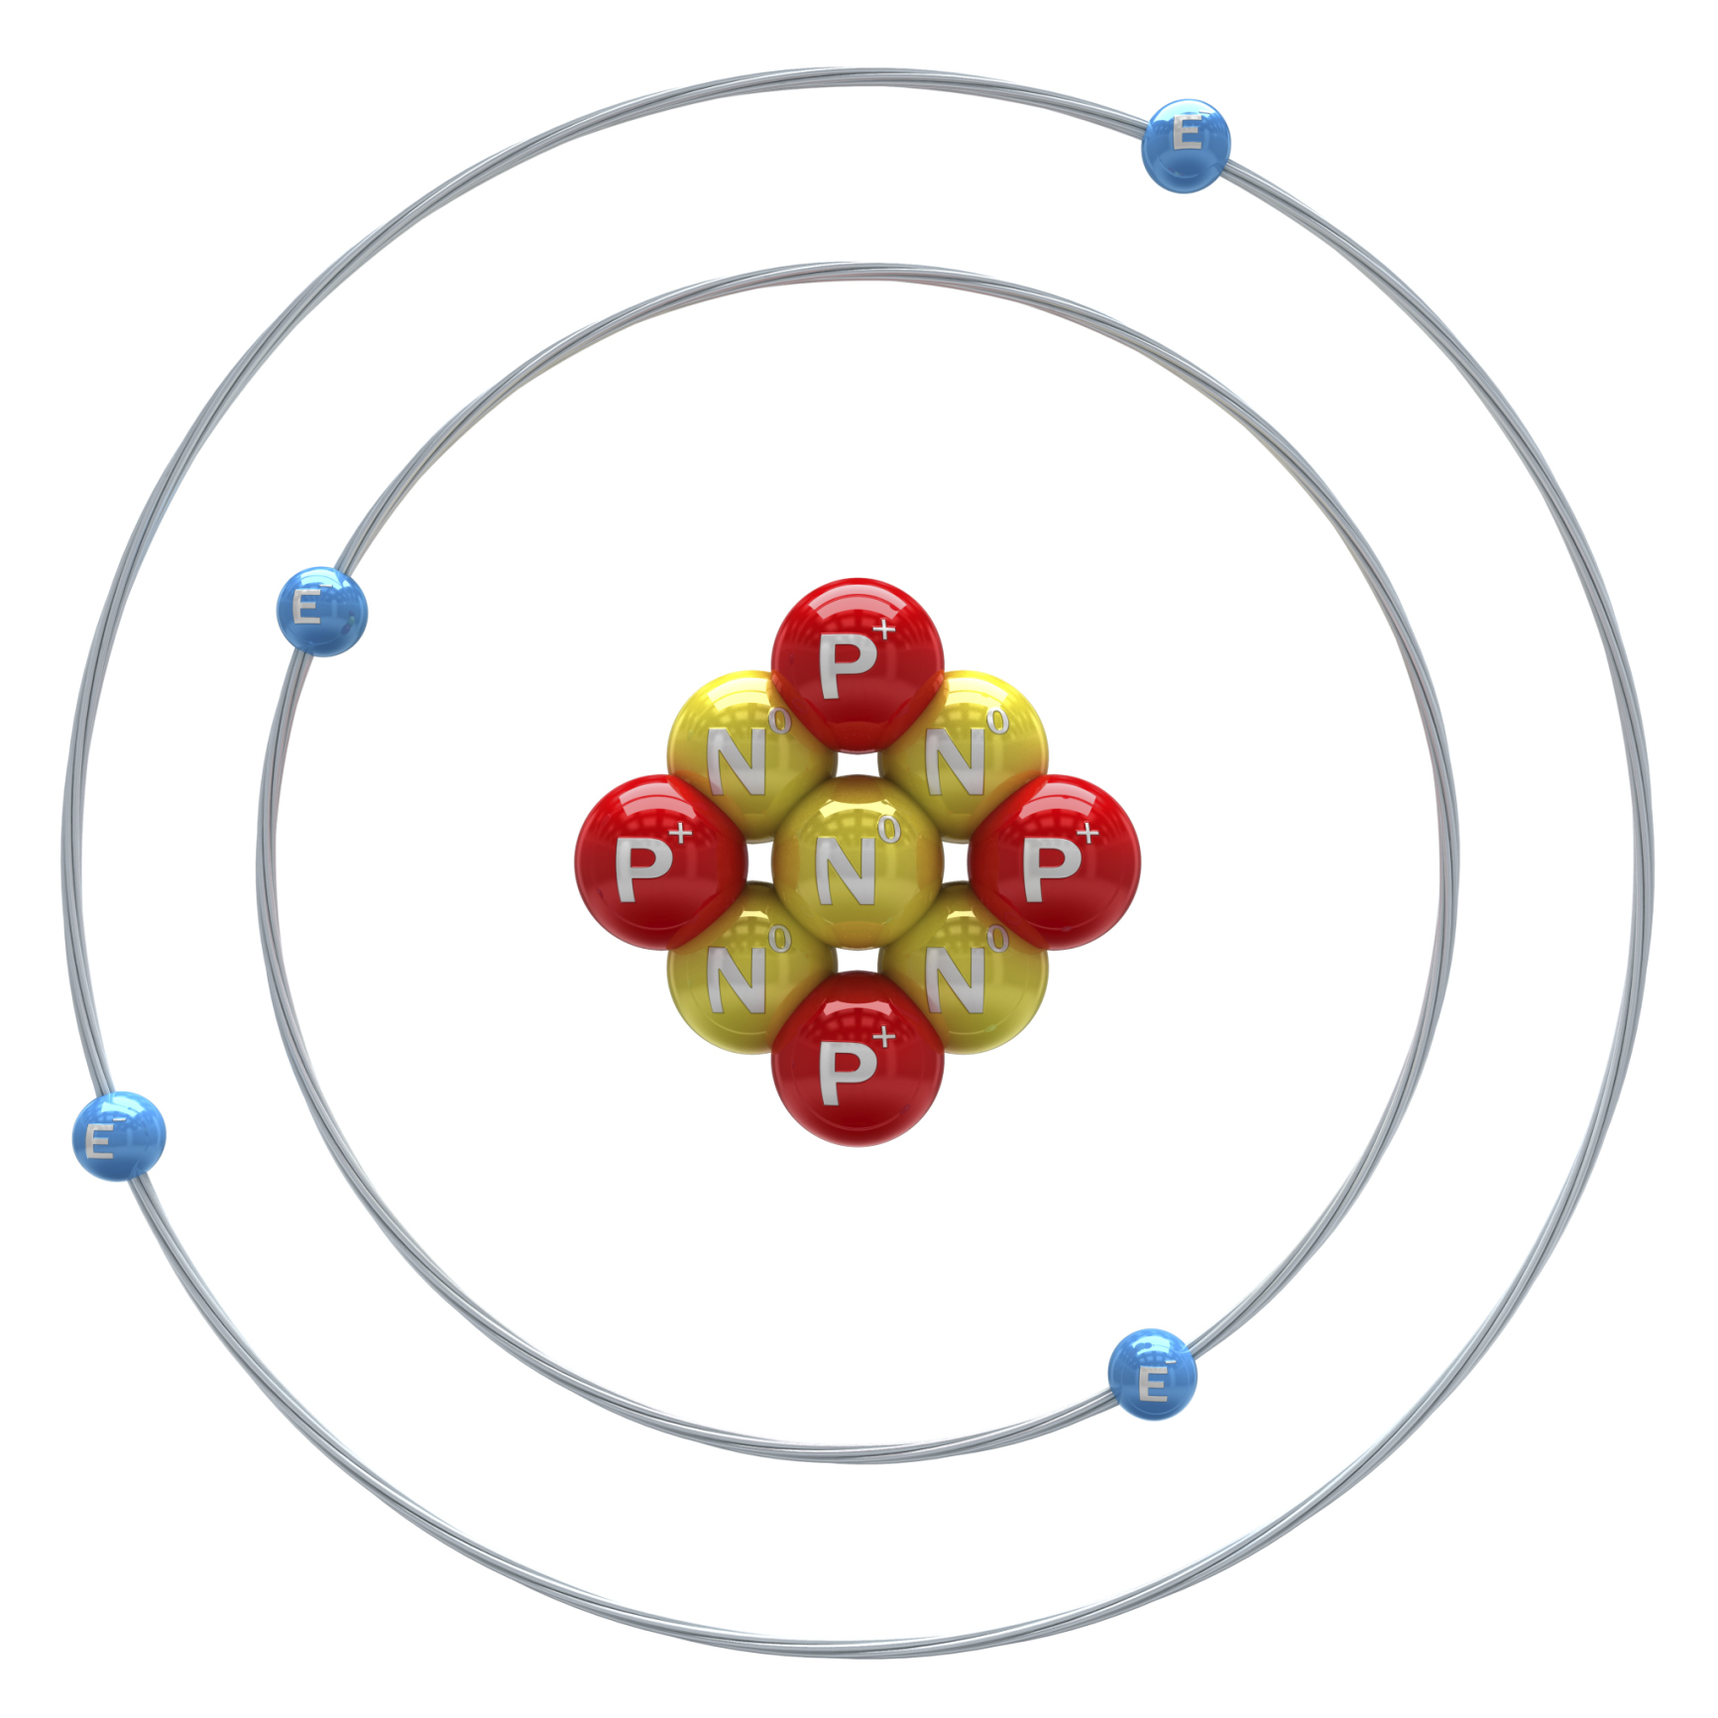
Nucleus
Notes:
The nucleus is made up of protons and neutrons held together by nuclear interactions.

Slide 9
Protons
Proton
Notes:
Protons have a positive charge.

Slide 10
Neutrons
Neutrons
Notes:
Neutrons have a neutral charge and are also in the nucleus.

Slide 11
Compound
Notes:
A compound is a substance that is made up of two or more atoms from DIFFERENT elements that are chemically bonded together.

Slide 12
Molecule
OR
SAME
Different
Notes:
A molecule is a particle containing 2 or more atoms of the same OR different elements

Slide 13
Notes:
Compounds and molecules are held together by bonds.

Slide 14
Notes:
Now let’s pause for a moment to review the information we have covered already.

Slide 15
What is a nucleus?
Notes:
What is a nucleus?
Provide wait time and give specific feedback based on student responses.

Slide 16
What is a bond?
Notes:
What is a bond?
Provide wait time and give specific feedback based on student responses.

Slide 17
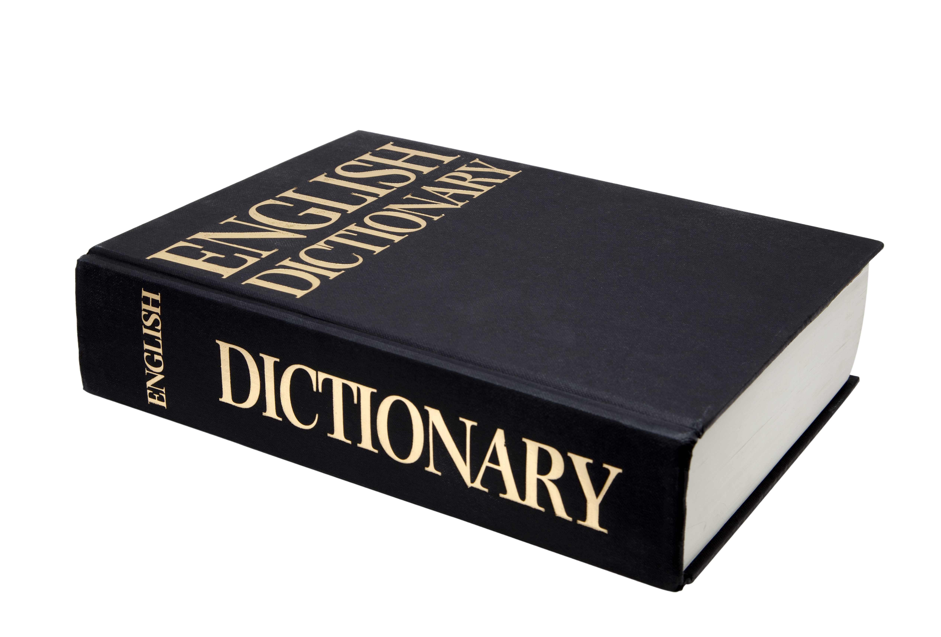
energy
Notes:
Now, let’s define energy.

Slide 18
energy: the ability to cause change
Notes:
Energy is the ability to cause change.

Slide 19
Notes:
Energy is the ability to cause change.

Slide 20
Notes:
This means that energy is needed for things to move.

Slide 21
Energy
Potential Energy
Kinetic Energy
Notes:
There are 2 different categories of energy we will be focusing on.

Slide 22
Energy
Potential Energy
Kinetic Energy
Notes:
Today, we will be looking at potential energy.

Slide 23
potential energy
Notes:
Now, let’s define potential energy.

Slide 24
Potential energy: stored energy
Notes:
Potential energy is stored energy.

Slide 25
Let’s Think About an Analogy
Notes:
Cues Instruction
See above
Clear Language
Extended Comparison
The comparison is full and complete, usually with multiple steps or layers, not just an off-hand comment or quick reference. Includes an explanation or opportunity to discuss. It is truly designed to enhance understanding of the term.

Slide 26
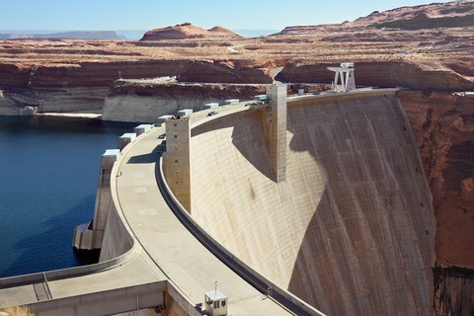
INCREASED PRESSURE
Potential energy is like water behind a dam
Notes:
Potential energy, or stored energy, is like water behind a dam. Imagine all of that water building. As more and more water builds up, the pressure on the dam increases.
(make sure you write out the analogy and then provide an extended context/explanation)

Slide 27
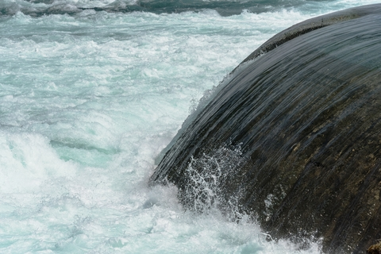
Kinetic Energy = Energy of Motion
Potential
Energy
Notes:
If the dam were to break, all of that water would be released. Think of the energy those rushing waves would have! The energy would no longer be stored. Now it would be the energy of motion, or kinetic energy!

Slide 28
Can you think of an analogy for potential energy?
Notes:
Can you think of an analogy for potential energy?
Follow up with a cue for students to think about an analogy and for teacher to provide feedback

Slide 29
Energy
Potential Energy
Chemical
Energy
Nuclear
Energy
Gravitational Potential
Energy
Notes:
There are 3 different types of potential energy.

Slide 30
Energy
Potential Energy
Chemical
Energy
Nuclear
Energy
Gravitational Potential
Energy
Notes:
First we are going to look at potential energy.

Slide 31
gravitational potential energy
Notes:
Now, let’s define electrical energy.

Slide 32
gravitational potential energy: the energy an object has because of its position in a gravitational field
Notes:
Gravitational potential energy is the energy an object has because of its position in a gravitational field.

Slide 33
Gravity
Notes:
Gravity is a force the exists between all objects with mass. This is why apples fall to the earth. They are being pulled in by the earths gravity.

Slide 34
Gravitational potential energy depends on the object’s:
MASS
Notes:
The amount of gravitational potential energy an object has depends on its mass,

Slide 35
Gravitational potential energy depends on the object’s:
MASS
DISTANCE
Notes:
and its distance from the Earth.

Slide 36
Notes:
Here there is gravitational potential energy.

Slide 37
Mass
Notes:
There is gravitational potential energy because the apple and earth have mass.

Slide 38
Distance
Notes:
There is gravitational potential energy because the apple is “x” distance from the earth.

Slide 39
Notes:
As the apple begins to fall, it loses potential energy because it is closer to the ground.

Slide 40
Notes:
Let’s review what we have learned so far.

Slide 41
What is energy?
Notes:
What is energy?

Slide 42
What are the two main types of energy?
Potential
Physical
Motor
Kinetic

Slide 43
What are the two main types of energy?
Potential
Physical
Motor
Kinetic

Slide 44
What two factors affect gravitational
potential energy?
Notes:
Distance and mass

Slide 45
Energy
Potential Energy
Chemical
Energy
Nuclear
Energy
Gravitational Potential
Energy
Notes:
Now we are going to look at chemical energy, which is another type of potential energy.

Slide 46
chemical energy
Notes:
Let’s define chemical energy.

Slide 47
Bonds
Notes:
Bonds between molecules or compounds must be present for chemical energy to exist.

Slide 48
Notes:
Bonds store and release energy.

Slide 49
Formed Bond = Energy Stored
Notes:
If a bond is formed, energy is stored.

Slide 50
Broken Bond = Energy Released
Notes:
If a bond is broken, energy is released.

Slide 51
Where is chemical energy stored?
Notes:
Where is chemical energy stored?

Slide 52
Which two of these have chemical energy?
atoms
gases
molecules
nucleus
Notes:
Which two of these have chemical energy?

Slide 53
Which two of these have chemical energy?
atoms
gases
molecules
nucleus
Notes:
Atoms and molecules can have chemical energy.

Slide 54
Energy
Potential Energy
Chemical
Energy
Nuclear
Energy
Gravitational Potential
Energy
Notes:
Now we are going to look at a third type of potential energy: nuclear energy.

Slide 55
nuclear energy
Notes:
Let’s define nuclear energy.

Slide 56
nuclear energy: energy stored in the nucleus of an atom
Notes:
Nuclear energy is energy stored in the nucleus of an atom.

Slide 57
Notes:
Nuclear energy can be extremely explosive when used. The sun is powered by nuclear energy.

Slide 58
Notes:
Nuclear energy holds the nucleus of an atom together. It keeps protons and neutrons next to each other.

Slide 59
Nuclear
Nucleus
Notes:
Here we can see how the word ”nuclear” comes from the word “nucleus.”

Slide 60
Notes:
Now we are going to review what we have learned today.

Slide 61
What is potential energy?
Notes:
What is potential energy?

Slide 62
What is energy?
Notes:
What is energy?

Slide 63
Which one is not a form of potential energy?
Gravitational Potential Energy
Kinetic Energy
Chemical Energy
Nuclear Energy
Notes:
Which one is NOT a form of potential energy?

Slide 64
Which one is not a form of potential energy?
Gravitational Potential Energy
Kinetic Energy
Chemical Energy
Nuclear Energy
Notes:
Kinetic energy is not a form of potential energy.

Slide 65
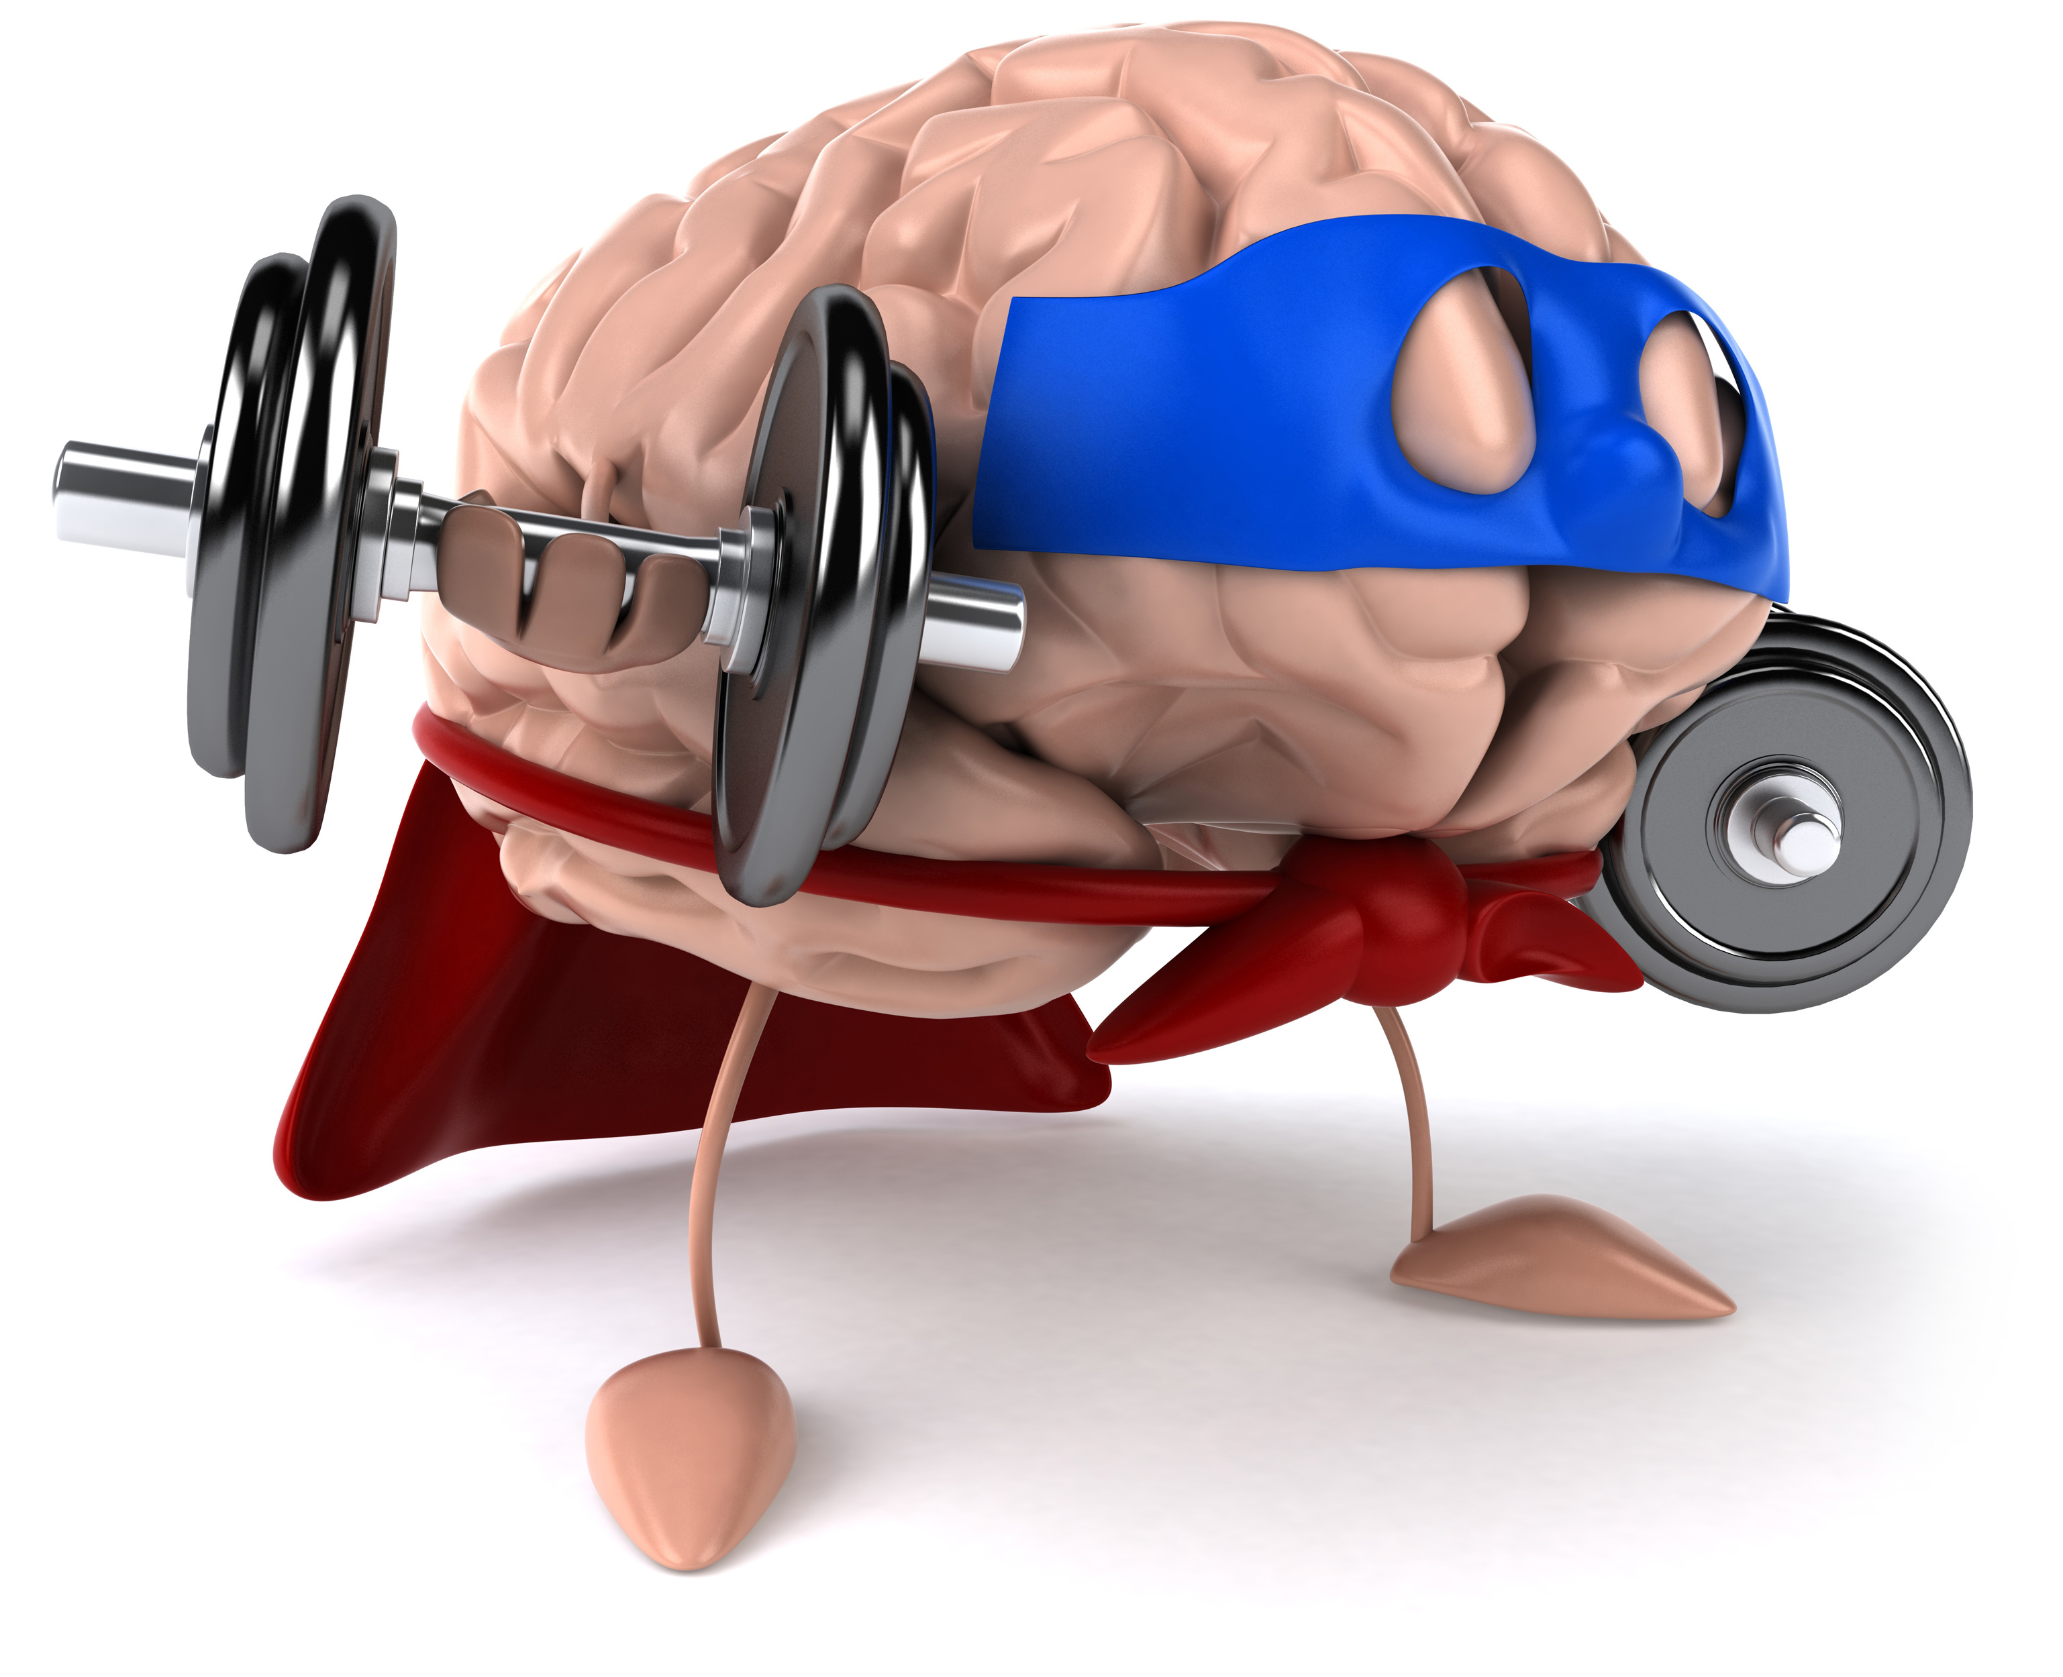
Remember!!!
Notes:
So remember!

Slide 66
Energy
Notes:
Energy is the ability to cause change.

Slide 67
potential energy
Notes:
One type of energy is potential energy, or stored energy.

Slide 68
gravitational potential energy
Notes:
Gravitational Potential Energy is the energy an object has because of its position in a gravitational field.

Slide 69
chemical energy
Notes:
Chemical energy is found within chemical bonds.

Slide 70
nuclear energy
Notes:
Nuclear energy is found within the nucleus of an atom.

Slide 71
Notes:
Thanks for watching, and please continue watching CAPs available from this website.

Slide 72
This Video Created With Resources From:
Cooperative Agreement # R324B130023
Curry School Foundation’s Research and Development Fund
Questions or Comments to Michael Kennedy, Ph.D.
MKennedy@Virginia.edu

Slide 73
Activity
Objective: Students will understand what potential energy is and how mass and distance effect it.
Activity: The teacher will lead a demo. The teacher will hold a bouncy ball in each hand. One hand will be 1 foot higher than the other. The teacher will ask students which has more potential energy why? Which bounces higher.
Materials:
2 Bouncy Balls
Resources:
http://www.brighthubeducation.com/lesson-plans-grades-3-5/38728-teaching-what-potential-energy-is/

