Slide 1
Notes:
OK everyone get ready to learn a new vocabulary term.

Slide 2
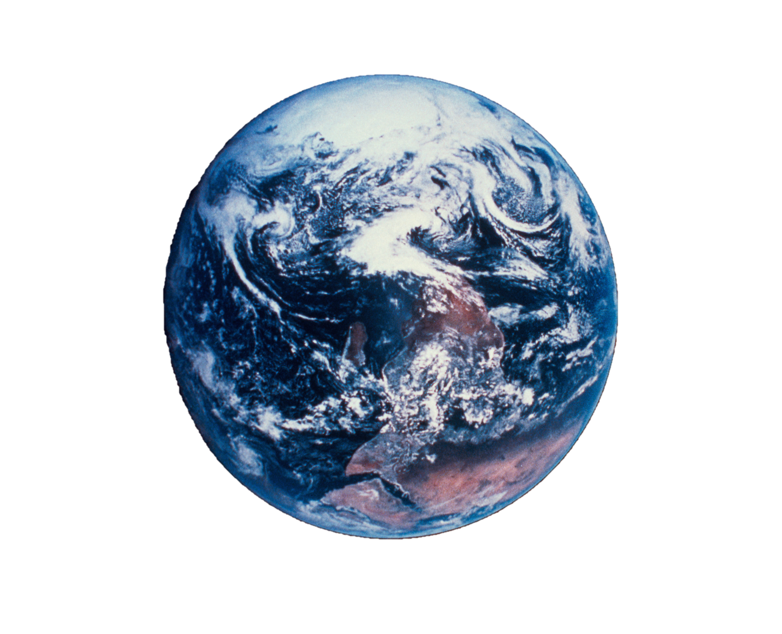
Radiation
Notes:
Today we are going to learn about radiation.

Slide 3
Notes:
Before we define the term radiation, let’s review some other words that you already learned, and make sure you are firm in your understanding.

Slide 4
Energy Transfer
Conduction
Convection
Radiation
Notes:
There are three ways that energy can be transferred. They are conduction, convection, and radiation.

Slide 5
Energy Transfer
Conduction
Convection
Radiation
Notes:
Today, we are going to focus on radiation.

Slide 6
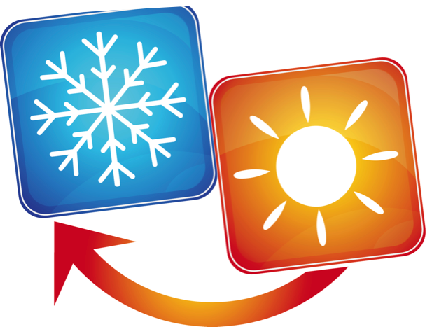
Notes:
Before we begin, remember that energy can be transferred from one object to another. When a thermal, or heat transfer occurs, heat moves from the warmer object to the colder object.

Slide 7
radiation
Notes:
Let’s define the term.

Slide 8
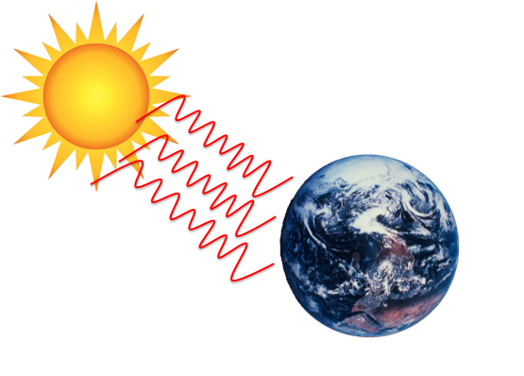
radiation: the transfer of energy as waves
Notes:
Radiation is the transfer of energy as waves.

Slide 9
Notes:
That is the basic definition, but there is a bit more you need to know.

Slide 10
Notes:
Radiation energy travels as waves, which includes the forms of energy that make up the electromagnetic spectrum. A few examples of these forms of energy are radio waves, visible light, infrared (or heat), and X-rays.

Slide 11
Notes:
Infrared waves are used in remote controls.

Slide 12
Notes:
Visible light is what we humans are able to see.

Slide 13
Notes:
Ultraviolet light is emitted by the sun.

Slide 14
radiation
Notes:
To think about the definition of radiation, it is helpful to look at its word parts.

Slide 15
radiation
Notes:
The term radiation has the word radiate in it…

Slide 16
radiation
radiate: to emit or give off
Notes:
Which means to emit or give off. So radiant energy radiates from one object to another.

Slide 17
Notes:
Let’s review the definition of radiation.

Slide 18
What is the radiation?
Notes:
What is radiation?
Radiation is the transfer of energy in wave form.

Slide 19
Can radiation travel through outer space?
Notes:
Can radiation travel through outer space?
Yes. Sunlight is a form of radiation and travels through space to reach us.

Slide 20
Notes:
An important idea to note is that unlike conduction or convection, radiation can travel through empty space, meaning that it does not need a medium, such as a liquid, gas, or a solid, to carry energy. That’s how energy from the Sun can reach Earth—the energy released from the Sun travels as waves through space, to Earth and the solar system.

Slide 21
Notes:
As you’ll remember, conduction requires two or more objects in direct contact to transfer heat energy.

Slide 22
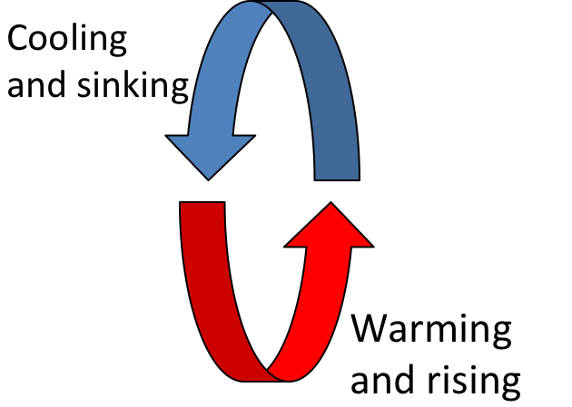
Notes:
And convection is the heating and cooling of a liquid or gas in a circular manner.

Slide 23
Notes:
Like we just learned, radiation is the transfer of energy as waves. This energy includes heat that we can feel, which is called infrared radiation.

Slide 24
Notes:
Now, let’s talk about some things that are examples of radiation.

Slide 25
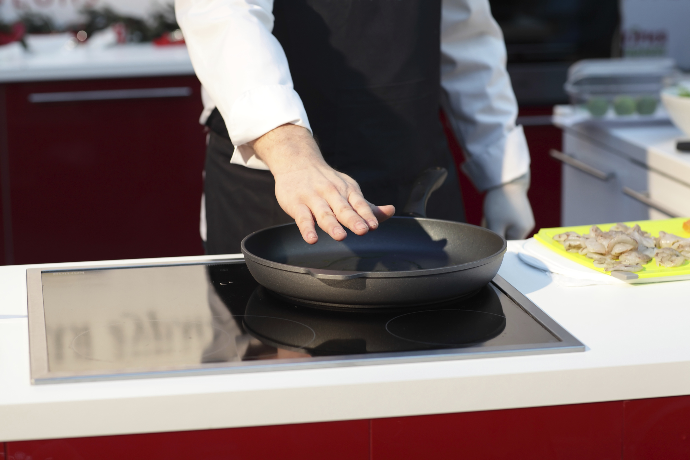
Notes:
An example of this form of radiation is observed when you hold your hand over a hot stove. Although your hand is not actually touching the stove, you know that it is hot because you can feel the heat radiating from it.

Slide 26
Notes:
Visible light is an example of energy that radiates from the light source.

Slide 27
Notes:
Radiation of light is why we can see the stars. Visible light can travel in space.

Slide 28
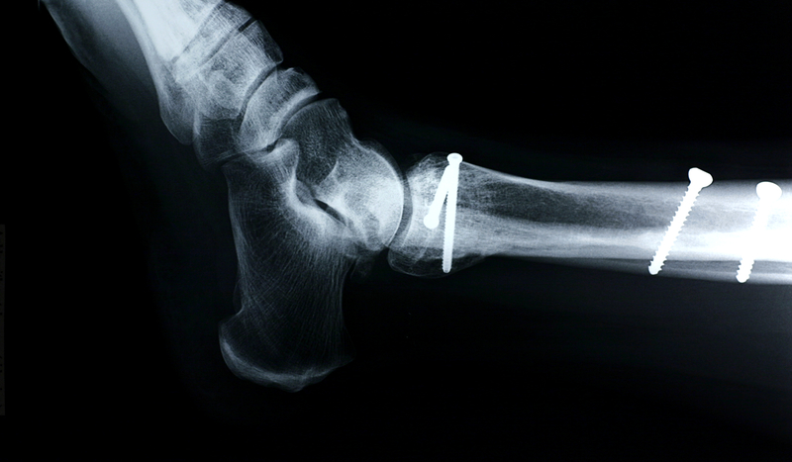
Notes:
X-rays are another example of radiation.

Slide 29
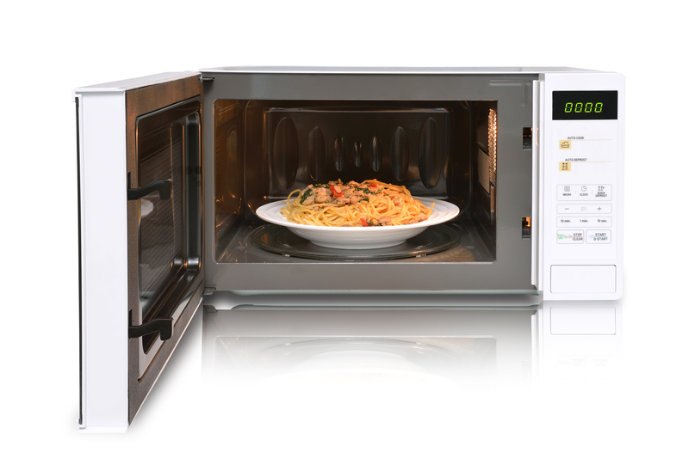
Notes:
Microwave ovens use another kind of radiation to cook food.

Slide 30
NON
Notes:
Let’s talk about some non-examples of radiation. These are things that might seem similar but do not fit with the definition of radiation.

Slide 31
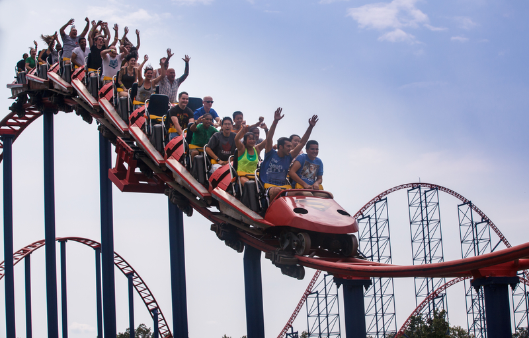
Roller coasters are not radiation.
Notes:
Roller coasters are not an example of radiation.

Slide 32
Notes:
Let’s review what we have learned one more time.

Slide 33
What is radiation?
A). light moving in a wave
B). the transfer of energy as waves
C). the movement of waves in
the ocean
D). the energy given off by a
battery
Notes:
What is radiation?
A). light moving in a wave
B). the transfer of energy as waves
C). the movement of waves in the ocean
D). the energy given off by a battery

Slide 34
What is radiation?
A) light moving in a wave
B) the transfer of energy as waves
C) the movement of waves in
the ocean
D) the energy given off by a
battery
Notes:
Radiation is the transfer of energy as waves.

Slide 35
Which one is not an example of radiation?
light coming from a light bulb
hot air rising
using a microwave oven
getting X-rays at the hospital
Notes:
Which one is not an example of radiation?
light coming from a light bulb
hot air rising
using a microwave oven
getting x-rays at the hospital

Slide 36
Which one is not an example of radiation?
light coming from a light bulb
hot air rising
using a microwave oven
getting X-rays at the hospital
Notes:
Hot air rising is not an example of radiation.

Slide 37
How does radiation travel?
in straight lines
in waves
through a medium (solid, liquid, or gas)
in living organisms
Notes:
How does radiation travel?
in straight lines
in waves
through a medium (solid, liquid, or gas)
in living organisms

Slide 38
How does radiation travel?
in straight lines
in waves
through a medium (solid, liquid, or gas)
in living organisms
Notes:
Radiation travels in waves.

Slide 39
Remember!!!
Notes:
So remember!

Slide 40
radiation: the transfer of energy as waves
Notes:
Radiation is the transfer of energy as waves

Slide 41
Notes:
Thanks for watching, and please continue watching CAPs available from this website.

Slide 42
This Video Created With Resources From:
Cooperative Agreement # R324B130023
Curry School Foundation’s Research and Development Fund
Questions or Comments to Michael Kennedy, Ph.D.
MKennedy@Virginia.edu

Slide 43
Activity
Objective: Students will understand the difference between conduction, convection, and radiation.
Activity: The teacher will demonstrate conduction, convection, and radiation using a hot plate. The teacher will heat up a beaker of water and wait for it boil. The teacher will then explain how the beaker is being heated by conduction, the water is being heated by convection, and the air is being heated by radiation.
Materials:
Beaker
Hot plate
water

