Slide 1
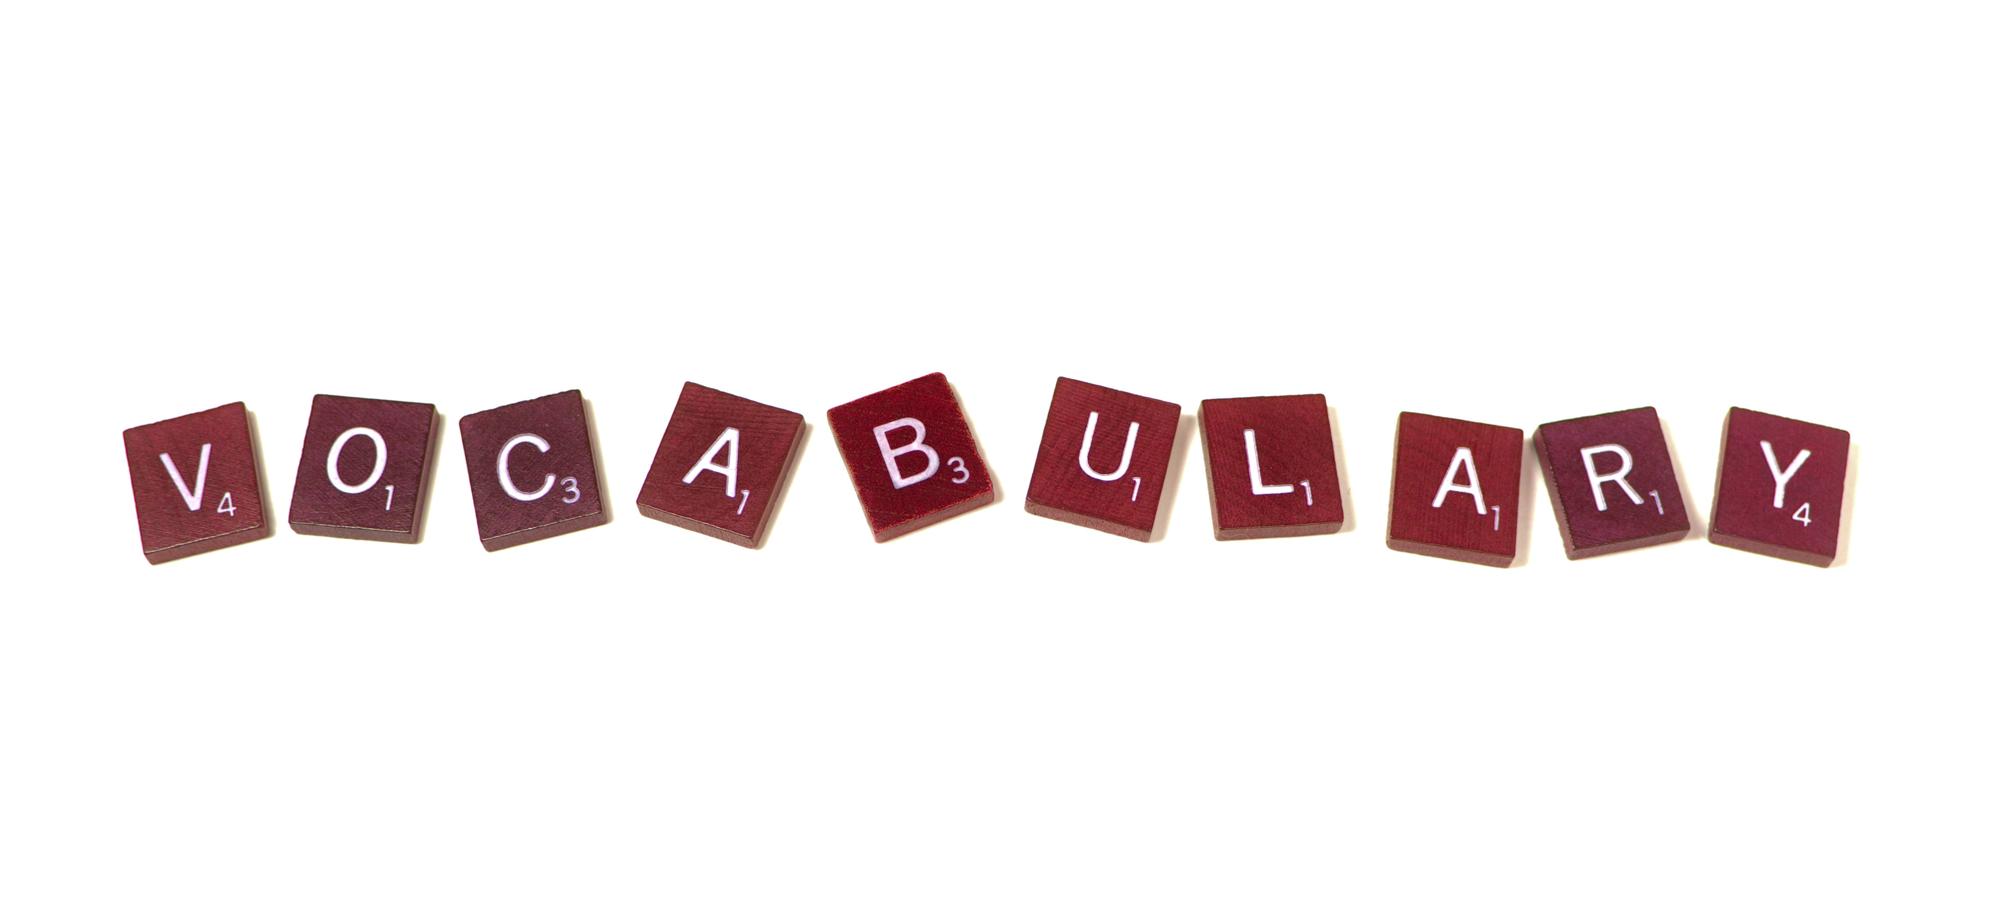
Notes:
OK everyone get ready to learn a new vocabulary term.

Slide 2
Electric Insulator
Notes:
Today we are going to learn about electric insulators,

Slide 3
Electric Conductor
Notes:
electric conductors,

Slide 4
Polarization
Notes:
polarization,

Slide 5
Electric Discharge
Notes:
and electric discharge.

Slide 6
Notes:
Before we define these terms, let’s review some other words that you already learned, and make sure you are firm in your understanding.

Slide 7
Electrons
Notes:
Electrons have a negative charge.

Slide 8
electric charge
Notes:
Protons and electrons have electric charge.

Slide 9
static charge
Notes:
A static charge happens when an object has an unequal number of either protons or electrons.

Slide 10
Interactions
Notes:
Both electric charges and static charges interact between negative and positively charged particles.

Slide 12
What is a static charge?
Notes:
When an object as more or less electrons creating a negative or positive charge.

Slide 13
What charges does an electron have?
Notes:
Negative

Slide 14
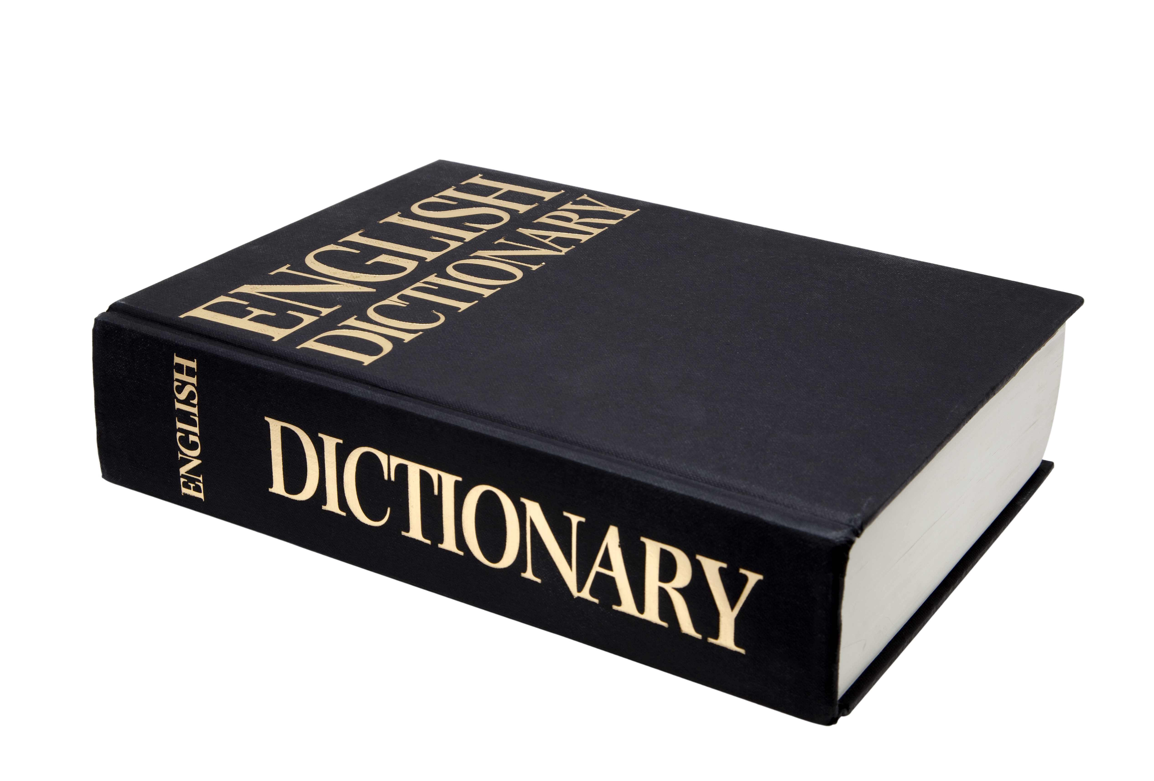
electric insulator
Notes:
Now, let’s define what an electric insulator is.

Slide 15
electric insulator: material in which electrons can not move around easily
Notes:
An electric insulator is a material in which electrons cannot move around easily.

Slide 16
Notes:
We are going to look at examples of insulators.

Slide 17
Glass
Notes:
Glass is an example of an insulator.

Slide 18
Rubber
Notes:
Rubber is an example of an insulator.

Slide 19
Non
Notes:
We are going to look at examples of insulators.

Slide 20
Metal
Notes:
Most metal is not an example of a insulator. Most metals are conductors.

Slide 21
Notes:
Let’s review what we’ve covered so far.

Slide 22
Can electrons move in an insulator?

Slide 23
Which is not an insulator
House Insulation
Wool
Cotton
Iron

Slide 24
Which is not an insulator
House Insulation
Wool
Cotton
Iron
Notes:
Iron is an example of a conductor.

Slide 25
electric conductor
Notes:
Now, let’s define what an electric conductor is.

Slide 26
electric conductor: material in which electrons can easily move around
Notes:
An electric conductor is a material in which electrons can easily move around.

Slide 27
Notes:
We are going to look at examples of insulators.

Slide 28
Copper
Notes:
Copper is a good conductor.

Slide 29
Aluminum
Notes:
Aluminum is an example of a conductor.

Slide 30
Non
Notes:
We are going to look at examples of insulators.

Slide 31
Wood
Notes:
Wood is not an example of a conductor. Wood is an insulator.

Slide 32
Power Cords
conductor
Insulator
Notes:
Power cords use both. The insulator to wrap the wire and the conductor to allow the electric current to run

Slide 33
Notes:
Let’s review what we just covered.

Slide 34
What is the difference between a conductor and an insulator?
Notes:
A conductor allows electrons to flow freely while insulators do not allow electrons to flow freely.

Slide 35
polarization
Notes:
Now, let’s define what polarization means.

Slide 36
polarization: occurs when electrons are concentrated at one end of an object.

Slide 37
How does polarizing happen?

Slide 38
Notes:
Lets lookat an example

Slide 39
Balloon
Soda Can
Notes:
If you bring a negatively charged balloon closer to a soda can.

Slide 40
Balloon
Soda Can
Notes:
The negative charge will then move to the opposite side of the soda can.

Slide 41
Balloon
Soda Can
Notes:
The soda can is now polarized because all the negative charge is on one side of the can.

Slide 43
When an object becomes polarized, the charge _______.
Stays balanced
Becomes unbalanced
Leaves

Slide 44
When an object becomes polarized, the charge _______.
Stays balanced
Becomes unbalanced
Leaves

Slide 45
electric discharge
Notes:
Now, let’s define what electric discharge is.

Slide 46
electric discharge: process of an unbalanced charge becoming balanced.

Slide 47
Notes:
Now we are going to look at an example of electric discharge.

Slide 48
Lightening
Notes:
As we have discussed lightening occurs as a build up of charge in the sky.

Slide 49
Lightening
Notes:
As lightening strikes it releases an electric discharge and creates a balanced system.

Slide 51
An electric discharge causes an unbalanced charge to become ______.
Notes:
Unbalanced.

Slide 52
Subatomic particles that attract each other are ________.
One proton and one neutron
One proton and one electron
Two protons
One electron and one neutron

Slide 53
Subatomic particles that attract each other are ________.
One proton and one neutron
One proton and one electron
Two protons
One electron and one neutron

Slide 54
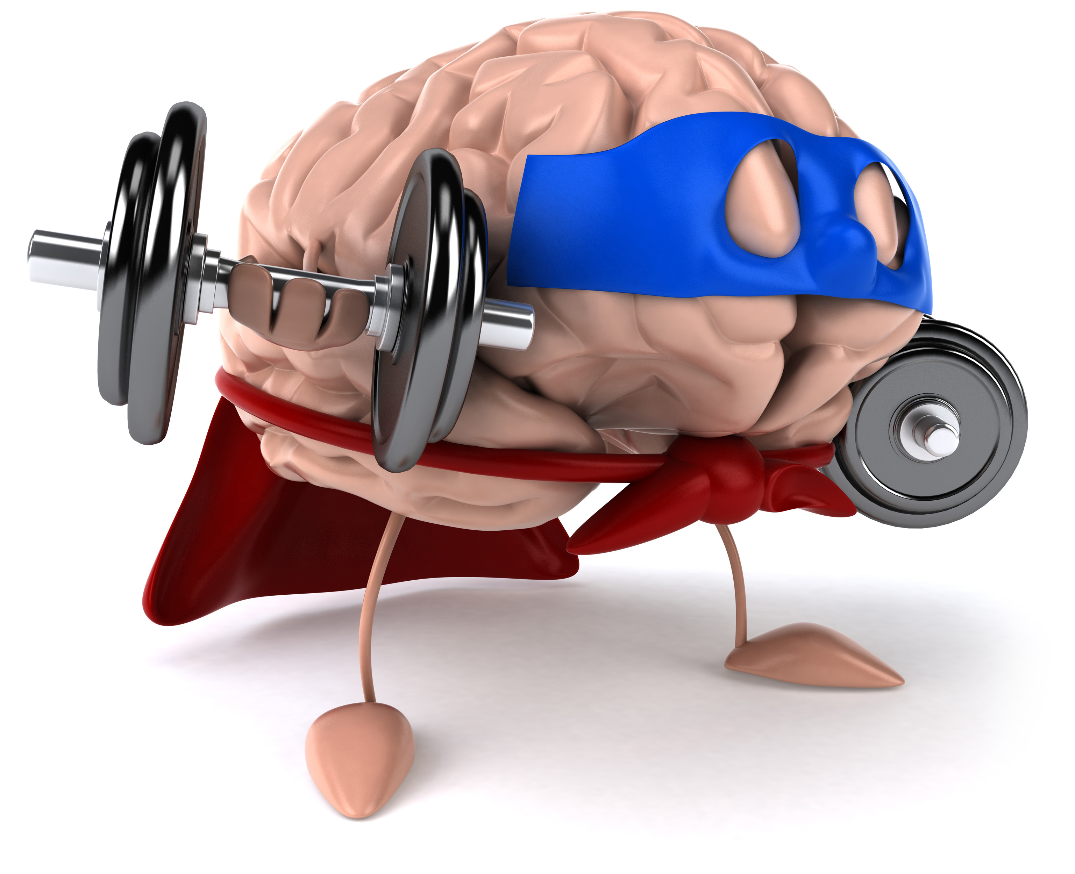
Remember!!!
Notes:
So remember!
<keep this slide>

Slide 55
electric insulator: material in which electrons can not move around easily
Notes:
An electric insulator is a material in which electrons cannot move around easily.

Slide 56
electric conductor: material in which electrons can easily move around
Notes:
An electric conductor is a material in which electrons can easily move around.

Slide 57
polarization: occurs when electrons are concentrated at one end of an object.

Slide 58
electric discharge: process of an unbalanced charge becoming balanced.

Slide 59
Notes:
Thanks for watching, and please continue watching CAPs available from this website.

Slide 60
This Video Created With Resources From:
Cooperative Agreement # R324B130023
Curry School Foundation’s Research and Development Fund
Questions or Comments to Michael Kennedy, Ph.D.
MKennedy@Virginia.edu

Slide 61
Activity
Objective: Students will understand that electrons cannot travel in insulators but can travel in conductors.
Activity: The teacher will create a demonstration for students. The teacher will create a short circuit and show how you need the conductor to allow electricity to flow. The teacher will demonstrate this by using a piece of strong and seeing the light bulb not light up and using a wire and the light bulb lights up.
Materials:
Wire
String
Light bulb
Battery

