Slide 1
Notes:
OK everyone get ready to learn a new vocabulary term.

Slide 2
Electric Current
Notes:
Today we will define electric current,

Slide 3
Electric Resistance
Notes:
electric resistance,

Slide 4
Voltage
Notes:
voltage,

Slide 5
Ohm’s Law
Notes:
and Ohm’s Law.

Slide 6
Notes:
Before we define these terms, let’s review some other words that you already learned, and make sure you are firm in your understanding.

Slide 7
Electrons
Notes:
Electrons have a negative charge.

Slide 8
electric charge
Notes:
Protons and electrons have electric charges. Protons have a positive charge, while electrons have a negative charge.

Slide 9
static charge
Notes:
Static charge happens when an object has an unequal number of either protons or electrons.

Slide 10
Interactions
Notes:
Both electric charges and static charges interact between negatively and positively charged ions.

Slide 11
Electric insulator
Notes:
An electric insulator keeps electrons from being able to move around easily.

Slide 12
Electric conductor
Notes:
In an electric conductor, electrons are able to move around easily.

Slide 13
Notes:
Let’s review before we move on to new terms.

Slide 14
Electrons can move in an _______?
Electric Insulator
Electric Conductor

Slide 15
Electrons can move in an _______?
Electric Insulator
Electric Conductor

Slide 16
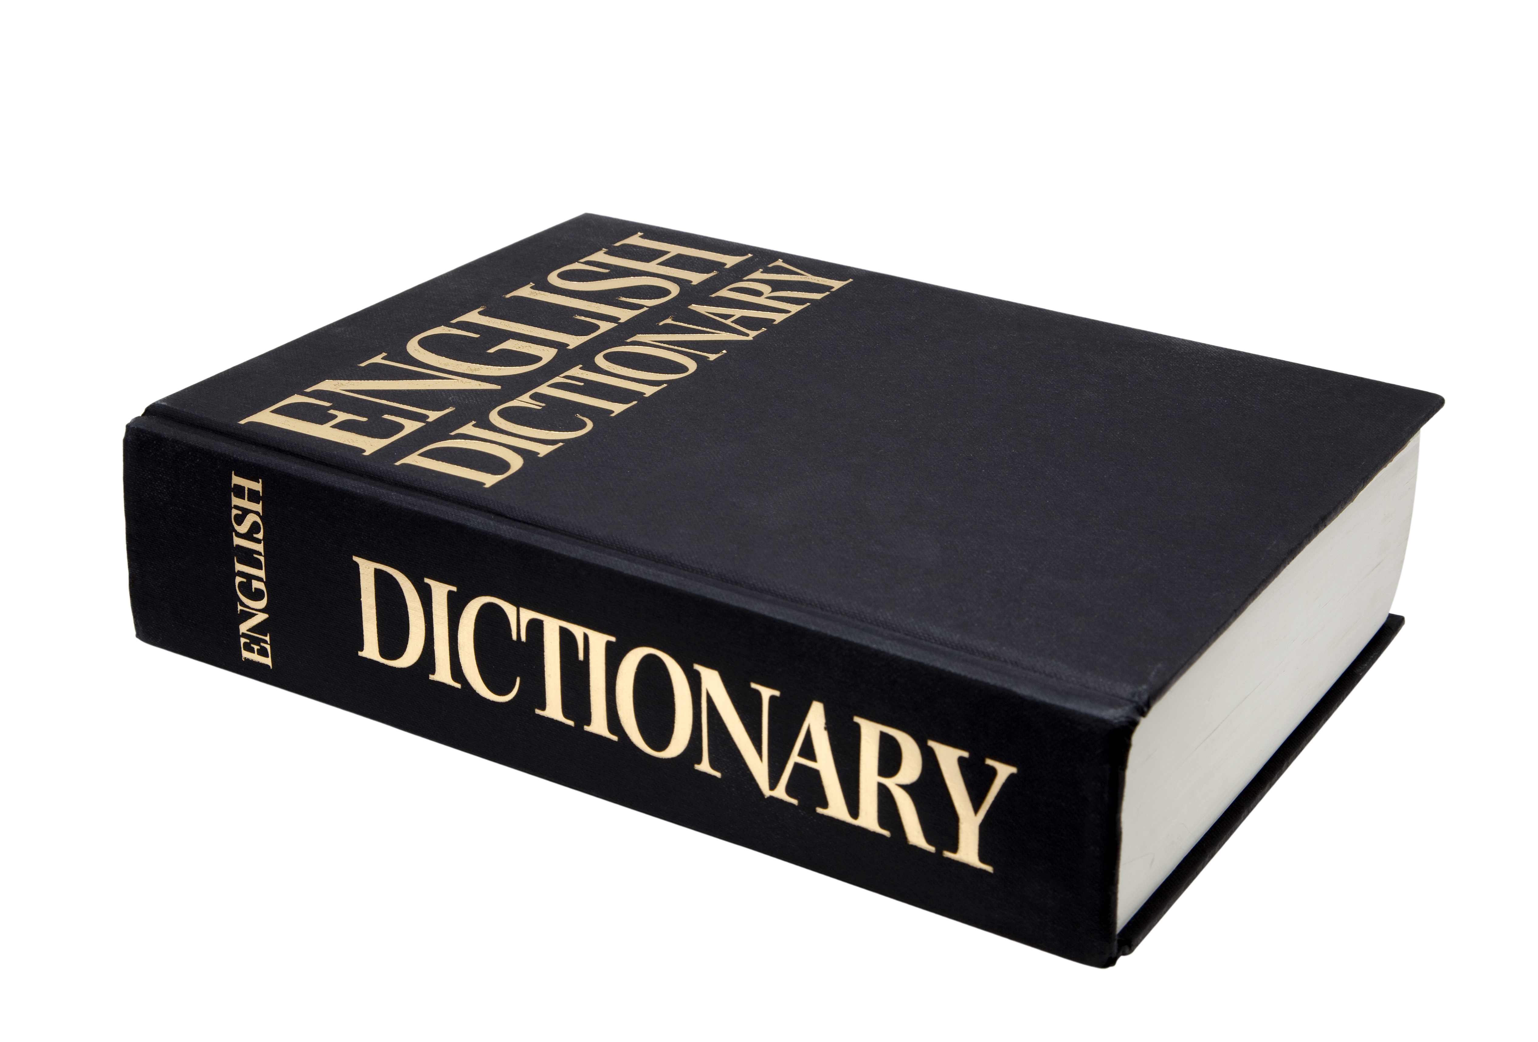
electric current
Notes:
Now, let’s define what electric current means.

Slide 17
electric current: movement of electrically charged particles
Notes:
An electric current is the movement of electrically charged particles.

Slide 18
Notes:
That is the basic definition, but there is a bit more you need to know.

Slide 19
Amp (A)
Notes:
Electric current is measured in amps

Slide 20
Closed Circuit
Notes:
Electric currents flow in a closed circuit.

Slide 21
Current Flowing
Notes:
When the light bulb is on, an electric current is flowing.

Slide 22
Current Off
Notes:
When the circuit is open, the current cannot get to the lightbulb and it is off.

Slide 23
Power Source
Notes:
They travel to and from a source of power.

Slide 24
Notes:
Now we will look at an example.

Slide 25
Hairdryers
Notes:
A hairdryer uses about 10A of electric current to work.

Slide 26
Light bulb
Notes:
A light bulb uses 1A of power.

Slide 27
Notes:
Let’s review what we’ve covered so far.

Slide 28
What is movement of charged particles called?
Notes:
Electric current.

Slide 29
In a closed circuit with a light bulb, how do you know when a current is flowing?
The light bulb is on
The light bulb is off
The wires are hot

Slide 30
In a closed circuit with a light bulb, how do you know when a current is flowing?
The light bulb is on
The light bulb is off
The wires are hot

Slide 31
electric resistance
Notes:
Now, let’s define what electric resistance means.

Slide 32
electric resistance: how difficult it is for an electric current to flow in a material
Notes:
Electric resistance is a measure of how difficult it is for an electric current to flow in a material.

Slide 33
Notes:
That is the basic definition, but there is a bit more you need to know.

Slide 34
Ohm (Ω)
Notes:
Electric resistance is measured in ohms.

Slide 35
Length
Notes:
Resistance is also affected by length of the material. The longer the material the more resistance.

Slide 36
Thickness
Notes:
The thickness of a material also affects the material’s resistance. The thicker the material, the more resistance a material has.

Slide 37
Conductors
Notes:
Conductors have low electric resistance, which means that current can easily flow through them.

Slide 38
Insulators
Notes:
Insulators have high electric resistance, which means that current cannot easily flow through them.

Slide 39
Notes:
Let’s review what we’ve covered so far.

Slide 40
Which has a higher resistance: a conductor or a resistor?
Notes:
resistor

Slide 41
Resistance of is affected by ________, __________and _______.
Notes:
Thickness; length; material

Slide 42
If you have a piece of wood and a piece of copper, which has the higher resistance?
Notes:
The piece of wood.

Slide 43
voltage
Notes:
Now, let’s define what voltage means.

Slide 44
voltage: the measure of how much energy is needed in the circuit.
Notes:
Voltage is the measure of how much energy is needed in an electric circuit.

Slide 45
Notes:
That is the basic definition, but there is a bit more you need to know.

Slide 46
high voltage = more energy produced
Notes:
The higher the voltage in a circuit, the more electrical energy that is transformed into thermal or light energy.

Slide 47
Volts (V)
Notes:
Voltage is measured in volts.

Slide 48
How are voltage, current and resistance related?

Slide 49
Ohm’s Law
Notes:
Now, let’s define what Ohm’s Law is.

Slide 50
Ohm’s Law: shows the relationship between voltage, current, and resistance
Notes:
Ohm’s Law is an equation that shows the relationship between voltage, current, and resistance.

Slide 51
Voltage = Current x Resistance
V = IR
Notes:
Ohm’s law states that voltage = current x resistance.

Slide 52
Resistance = Voltage/Current
R = V/I
Notes:
You can move variables around like in math and also have resistance = voltage/ current.

Slide 53
Current = Voltage/Resistance
I = V/R
Notes:
You can move variables around like in math and also have current = voltage/resistance.

Slide 54
Notes:
Lets look at an example problem.

Slide 55
If you run a current of .5A through a 210 Ω resistance light bulb, what is the voltage?

Slide 56
V = IR
V = .5 A x 210 Ω
= 105V

Slide 57
Notes:
Now it it your turn.

Slide 58
In a circuit with a voltage of 100 V and a current of 1.5 A, what would the resistance be?
Notes:
150 A

Slide 59
How would you determine the voltage given the current and resistance?
Notes:
V = IR

Slide 60
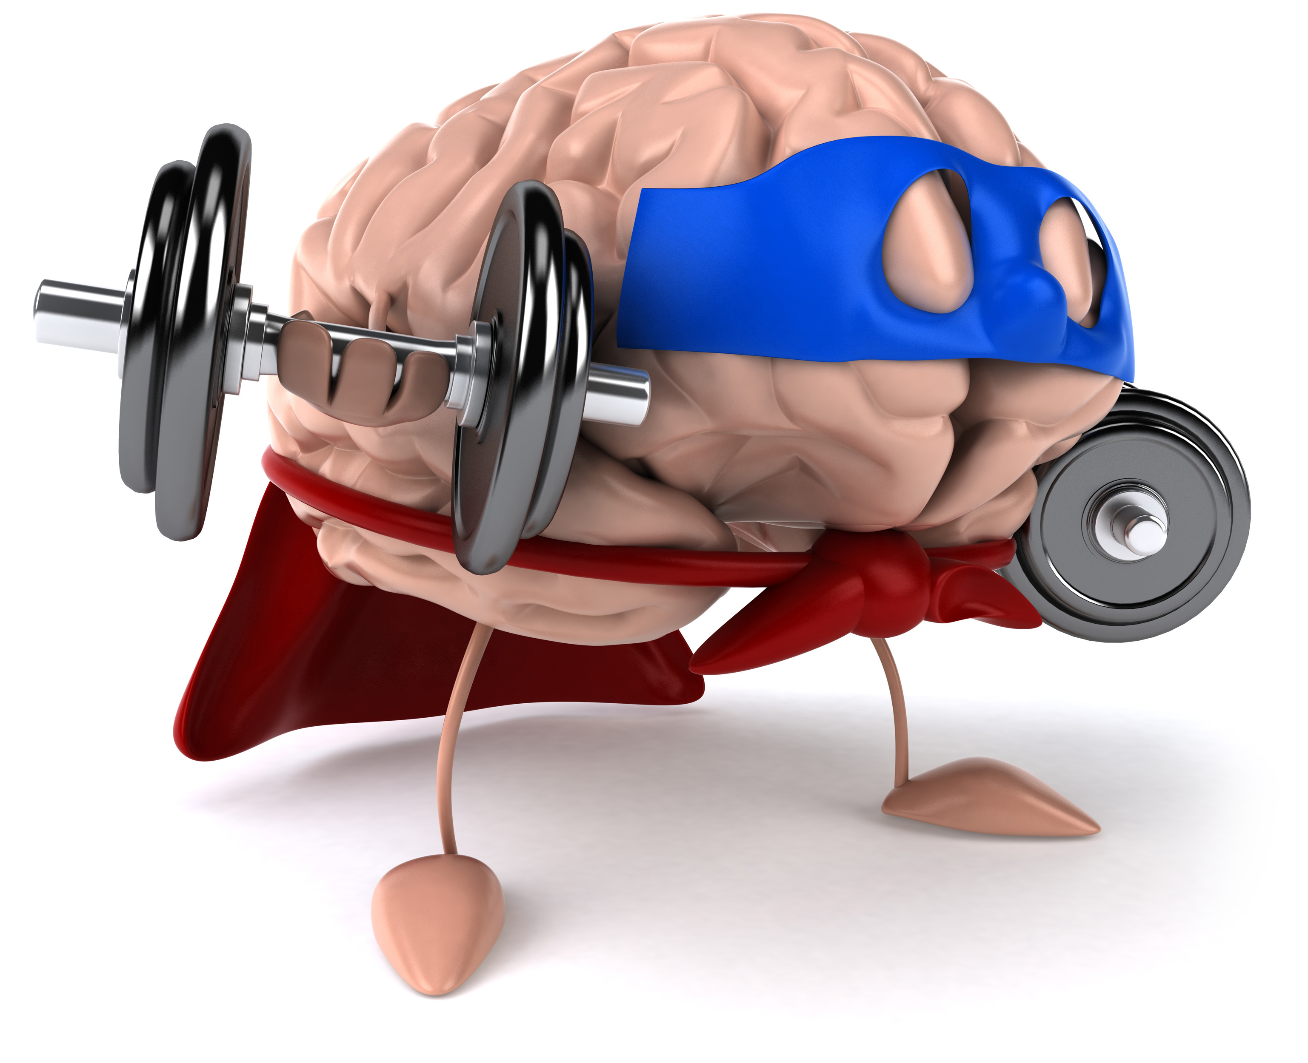
Remember!!!
Notes:
So remember!
<keep this slide>

Slide 61
electric current: movement of electrically charged particles
Notes:
An electric current is the movement of electrically charged particles.

Slide 62
electric resistance: how difficult it is for an electric current to flow in a material
Notes:
Electric resistance is a measure of how difficult it is for an electric current to flow in a material.

Slide 63
voltage: the measure of how much energy is needed in the circuit.
Notes:
Voltage is the measure of how much energy is needed in an electric circuit.

Slide 64
Ohm’s Law: shows the relationship between voltage, current, and resistance
Notes:
Ohm’s Law is an equation that shows the relationship between voltage, current, and resistance.

Slide 65
Notes:
Thanks for watching, and please continue watching CAPs available from this website.

Slide 66
This Video Created With Resources From:
Cooperative Agreement # R324B130023
Curry School Foundation’s Research and Development Fund
Questions or Comments to Michael Kennedy, Ph.D.
MKennedy@Virginia.edu

Slide 67
Activity
Objective: Allow students to understand the relationship between voltage, current, and resistance.
Activity: The teacher will demo the relationship between voltage, current and resistance using a phet simulation.
Materials:
projector
Resources:
https://phet.colorado.edu/en/simulation/ohms-law

