Slide 1
Notes:
OK everyone get ready to learn a new vocabulary term.

Slide 2
Exothermic Reaction
Notes:
Today we are going to learn about exothermic reactions.

Slide 3
Endothermic Reaction
Notes:
And endothermic reactions.

Slide 4
Notes:
Before we define these terms, let’s review some other words that you already learned, and make sure you are firm in your understanding.

Slide 5
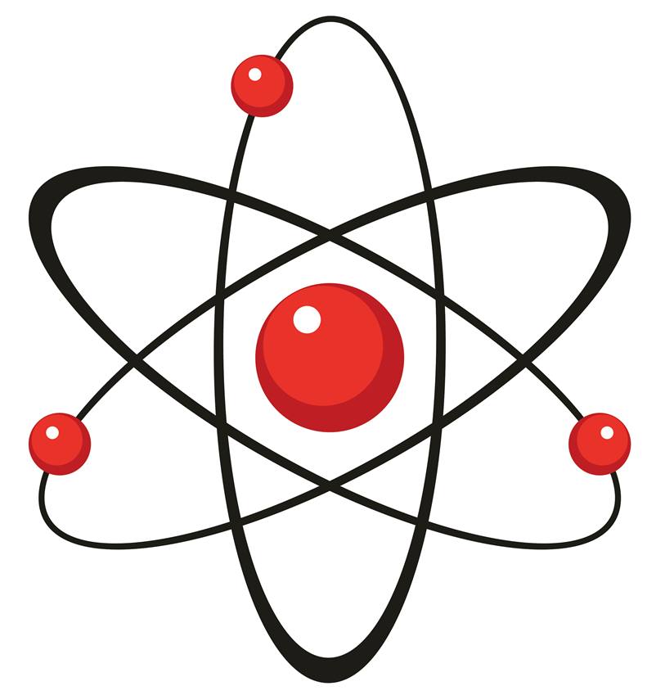
Atom
Notes:
All substances are made of atoms and atoms are the smallest whole unit of matter.

Slide 6
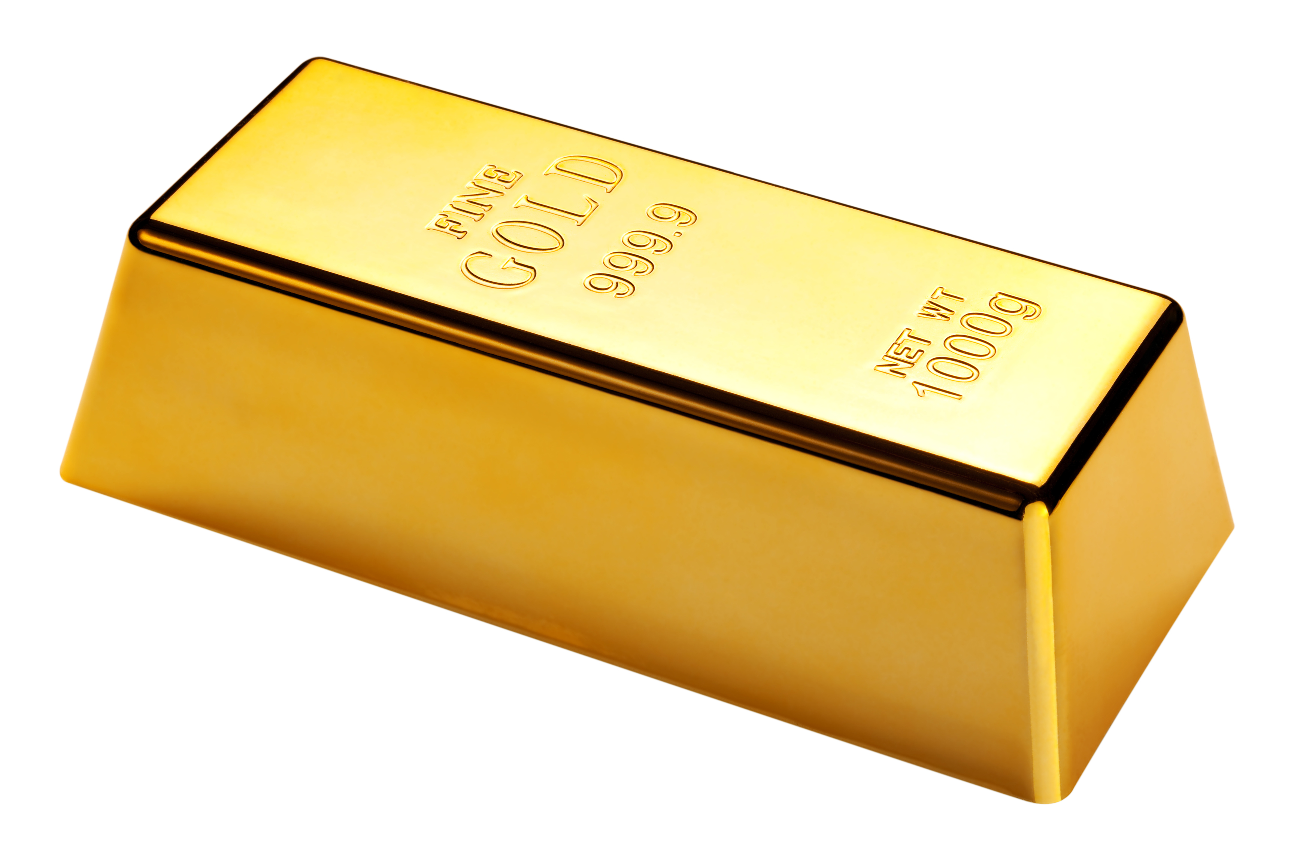
element
Notes:
An element is a pure substance containing only one type of atom.

Slide 7
chemical symbol
Notes:
The atomic, or chemical symbol is the abbreviation of an element’s name. It is either one or two letters, and the first one is always capitalized.

Slide 8
compound
Notes:
A compound is a substance that is made up of two or more DIFFERENT elements that are chemically bonded together.

Slide 9
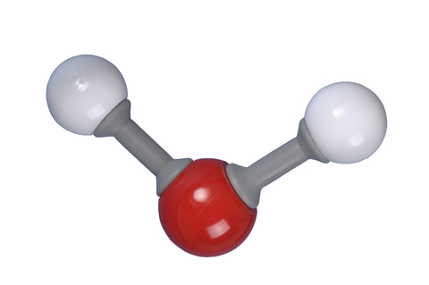
molecule
Notes:
A molecule is a particle containing 2 or more atoms of the same OR different elements. Molecules are the smallest pieces of compounds.

Slide 10
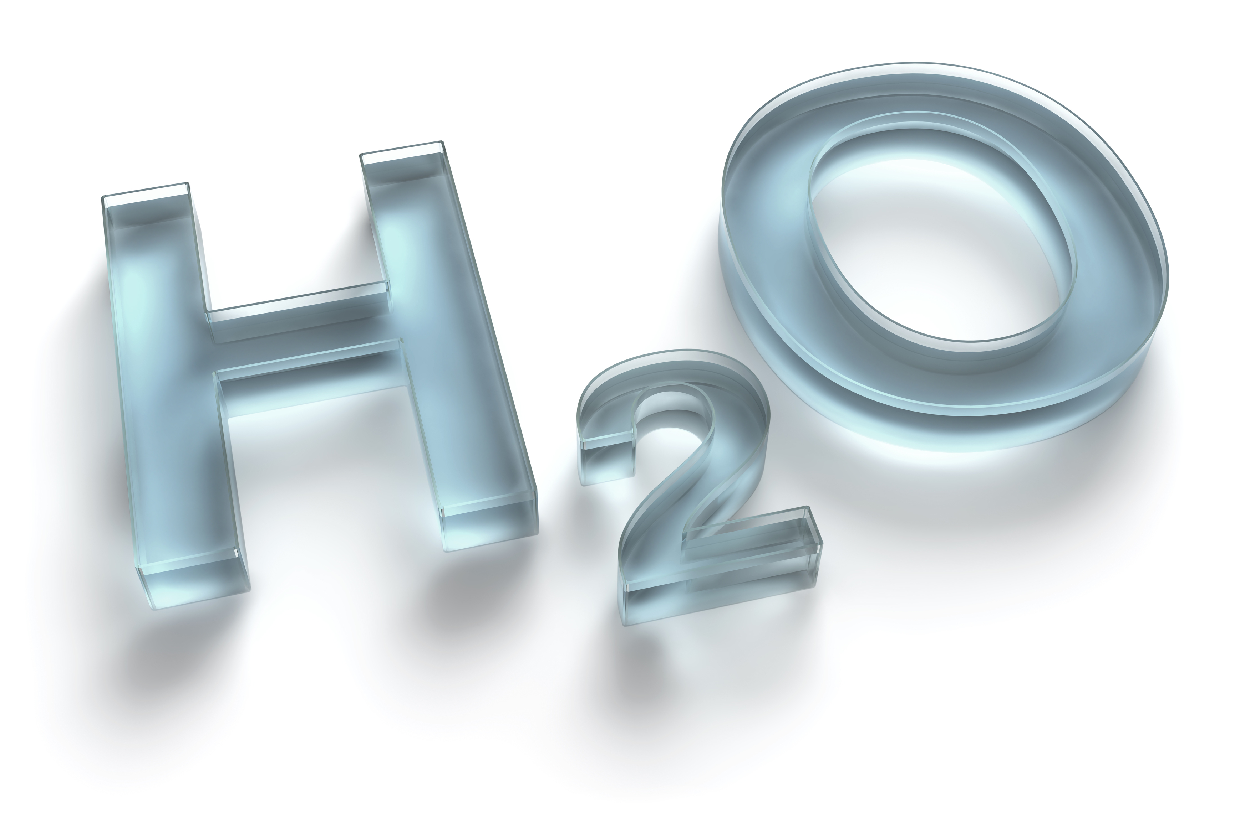
chemical formula
Notes:
Lastly, a chemical formula uses chemical symbols to represent a compound or molecule.

Slide 11
Element
Chemical Symbol
Compound/
Molecule
Chemical Formula
Notes:
To put it all together, a chemical symbol represents an element while a chemical formula uses chemical symbols to represent molecules and compounds.

Slide 12
chemical reaction
Notes:
A chemical reaction is made up of chemical changes that happen when two or more elements are combined.

Slide 13
chemical equation
2H₂ + O₂ → 2H₂O
Notes:
A chemical equation is the representation of a chemical reaction using chemical formulas.

Slide 14
Rate of Reaction
Notes:
In a chemical reaction, the rate of reaction is how long it takes for the product to form.

Slide 15
Notes:
Now let’s pause for a moment to review the information we have covered already.

Slide 16
What is an element?
Notes:
What is an element?

Slide 17
What is a compound?
Notes:
What is a compound?

Slide 18
What does a chemical formula tell you?
Notes:
What is a compound?

Slide 19
What does a chemical equation tell you?
Notes:
What is a compound?

Slide 20
Chemical Reactions
Exothermic
Endothermic
Notes:
Chemical reactions can be divided into 2 different types: exothermic and endothermic.

Slide 21
heat transfer & release
Notes:
The differences between endothermic and exothermic reactions are based on how heat is released from the reaction.

Slide 22
Chemical Reactions
Exothermic
Endothermic
Notes:
First we are going to look at exothermic reactions.

Slide 23
exothermic reaction
Notes:
Now, let’s define what an exothermic reaction is.

Slide 24
exothermic reaction: releases energy into its surrounding environment
Notes:
An exothermic reaction is a a chemical reaction that releases energy into its surrounding environment.

Slide 25
Reactants
Products
Energy
Notes:
An exothermic reaction results in products, such as a new compound, and energy.

Slide 26
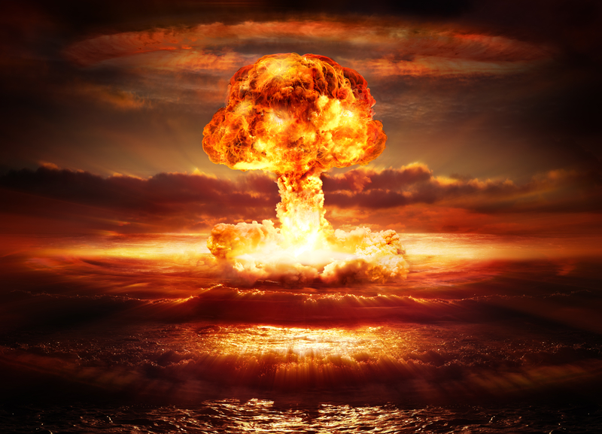
Reactants
Products
Energy
Notes:
Energy is a product of an exothermic reaction.

Slide 27
heat energy
Notes:
The energy given off in an exothermic reaction often takes the form of heat, as in an explosion.

Slide 28
exothermic
Notes:
The word exothermic has word parts that give us a clue to its meaning. Let’s look at what these word parts are and how they can help you.

Slide 29
Exo thermic
Notes:
Endothermic has the word parts exo and therm.

Slide 30
Exo thermic
Notes:
Exo means outside

Slide 31
Exo thermic
Notes:
Therm means heat

Slide 32
Exo thermic
Heat
Notes:
So exothermic means heat outside of the reaction. In other words, it means that heat or energy is being released during the reaction.

Slide 33
Notes:
Now, let’s talk about some examples of exothermic reactions.

Slide 34
Notes:
Any reaction that produces fire is an exothermic reaction.

Slide 35
Notes:
For example, propane is one type of fuel that when it reacts with oxygen, fire is produced. Propane is used in gas grills and fireplaces

Slide 36
Reactants
Products
2C₃H₈+ 7O₂ →6CO₂ + 8H₂O + Heat
Notes:
In other words, energy is a product of the reaction. In the reaction on the screen, propane is reacting with oxygen to produce carbon dioxide, water, and heat

Slide 37
NON
Notes:
Let’s look at a non-example of exothermic reactions. These are things that might seem similar but do not fit the definition of exothermic reaction.

Slide 38
Notes:
Cooking is not an example of an exothermic reaction. If you cook over a fire, or on a grill, you are using the heat energy from an exothermic reaction to cook your food, but the actual cooking process going on inside your food is not exothermic.

Slide 39
Notes:
Let’s review what we have learned so far.

Slide 40
What is an exothermic reaction?
Notes:
What is a an exothermic reaction?

Slide 41
Chemical Reactions
Exothermic
Endothermic
Notes:
Now we are going to learn about endothermic reactions.

Slide 42
endothermic reaction
Notes:
Now, let’s define what an endothermic reaction is.

Slide 43
endothermic reaction: absorbs energy from its environment
Notes:
An endothermic reaction is a a chemical reaction that absorbs energy from its environment.

Slide 44
Energy
Reactants
Products
Notes:
An endothermic reaction uses energy from its environment to fuel the reaction.

Slide 45
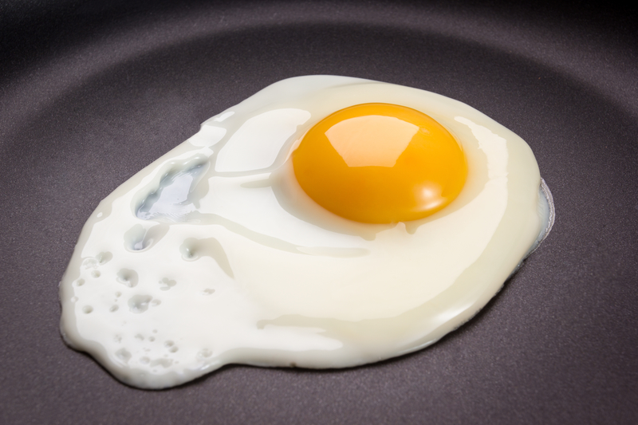
Energy
Reactants
Products
Notes:
Energy is needed in the reaction. Energy is not a product of an endothermic reaction.

Slide 46
heat
Notes:
In cooking, heat transferred from the heat source and the pan is needed to cook the food.

Slide 47
endothermic
Notes:
The word endothermic has word parts that give us a clue to its meaning. Let’s look at what these word parts are and how they can help you.

Slide 48
Endo thermic
Notes:
Endothermic has the word parts endo and therm.

Slide 49
Endo thermic
Notes:
Endo means within

Slide 50
Endo thermic
Notes:
Therm means heat

Slide 51
Endo thermic
Notes:
So endothermic means heat within in the reaction. In other words, it means that heat or energy is absorbed during the reaction.

Slide 52
Notes:
Now, let’s talk about an example of an endothermic reaction.

Slide 53
Notes:
In photosynthesis, plants use energy from the sun to convert carbon dioxide and water into glucose (a sugar) and oxygen. We can write this reaction as an equation.

Slide 54
Notes:
For photosynthesis to work, energy is needed. Plants absorb this energy from the sun.

Slide 55
Reactants
Products
Energy + 6CO₂ + 6H₂O → C₆H₁₂O₆+ 6O₂
Notes:
Here is the chemical equation for photosynthesis. The energy that the plant absorbs from the sun causes the endothermic reaction to occur.

Slide 56
NON
Notes:
Let’s look at a non-example of endothermic reactions. These are things that might seem similar but do not fit the definition of endothermic reaction.

Slide 57
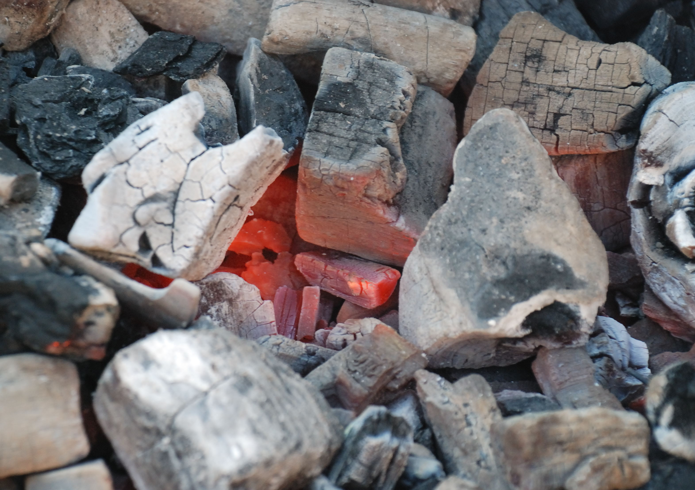
Notes:
The fire that you might use to cook food on a grill is not caused by an endothermic reaction. Fire is usually the product of an exothermic reaction.

Slide 58
Notes:
Let’s review everything we’ve learned today.

Slide 59
What is an endothermic reaction?
Notes:
What is an endothermic reaction?

Slide 60
Which of the following is an example of an exothermic reaction?
putting an ice cube in a glass of water
cooking an egg
an explosion
photosynthesis
Notes:
Which of the following is an example of an exothermic reaction?
putting an ice cube in a glass of water
cooking an egg
an explosion
photosynthesis

Slide 61
Which of the following is an example of an exothermic reaction?
putting an ice cube in a glass of water
cooking an egg
an explosion
photosynthesis
Notes:
An explosion is an example of an exothermic reaction.

Slide 62
Which of the following is an example of an endothermic reaction?
putting an ice cube in a glass of water
starting a car engine
an explosion
photosynthesis
Notes:
Which of the following is an example of an endothermic reaction?
putting an ice cube in a glass of water
starting a car engine
an explosion
photosynthesis

Slide 63
Which of the following is an example of an endothermic reaction?
putting an ice cube in a glass of water
starting a car engine
an explosion
photosynthesis
Notes:
Photosynthesis is an example of an endothermic reaction.

Slide 64
Remember!!!
Notes:
So remember!
<keep this slide>

Slide 65
exothermic reaction: releases energy into its surrounding environment
Notes:
An exothermic reaction is a a chemical reaction that releases energy into its surrounding environment.

Slide 66
endothermic reaction: absorbs energy from its environment
Notes:
An endothermic reaction is a a chemical reaction that absorbs energy from its environment.

Slide 67
Notes:
Thanks for watching, and please continue watching CAPs available from this website.

Slide 68
This Video Created With Resources From:
Cooperative Agreement # R324B130023
Curry School Foundation’s Research and Development Fund
Questions or Comments to Michael Kennedy, Ph.D.
MKennedy@Virginia.edu

Slide 69
Activity
Objective: Students will understand the difference between endothermic and exothermic and will be able to classify reactions based on temperature
Activity: Students will work through 1 endothermic and 1 exothermic reaction to find similarities and differences based on data gathered.
Materials:
Vinegar
Baking soda
Calcium chloride
Water
Thermometer
4 small clear plastic cups
1 cup measuring cup
Measuring spoons
Resources:
https://www.google.com/url?sa=t&rct=j&q=&esrc=s&source=web&cd=11&ved=0ahUKEwiX4IGblKfUAhUE0iYKHQOmBOEQFghSMAo&url=http%3A%2F%2Fhighschoolenergy.acs.org%2Fcontent%2Fhsef%2Fen%2Fhow-can-energy-change%2Fexothermic-endothermic-chemical-change%2F_jcr_content%2Ftoparticleparsys%2Fcolumnsbootstrap%2Fcolumn1%2Facscontainer%2FcontainerPar%2Fdownload%2Ffile.res%2FTeacher&usg=AFQjCNFeOXT6nlA6PYFNPIdZBgU4GDmknw

