Slide 1
Notes:
OK everyone get ready to learn a new vocabulary term.

Slide 2
Probability
1 4
2 4
3 4
4 4
Notes:
In this video we discuss probability

Slide 3
Notes:
Before we define the term probability, let’s review some other words that you already learned, and make sure you are firm in your understanding.

Slide 4
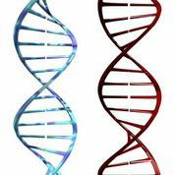
DNA: hereditary material in
almost all organisms
Notes:
First, remember that DNA is the hereditary material in almost all organisms

Slide 5
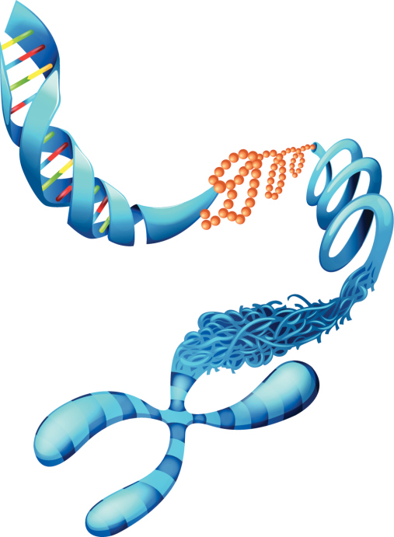
Notes:
Genes are sections of DNA which carry information that determines your traits

Slide 6
Notes:
Chromosomes are tightly wound strands of DNA, which contain those genes.

Slide 7
Chromosomes
DNA
Genes
Notes:
To put it all together, chromosomes are made of DNA and DNA is made of genes.

Slide 8
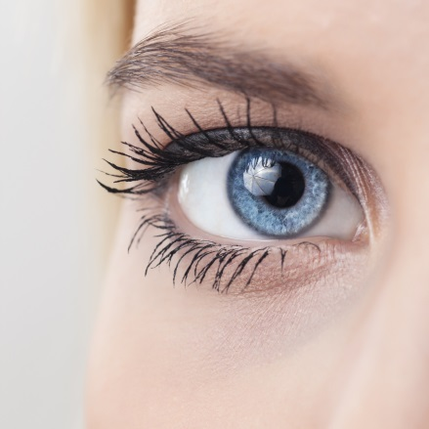
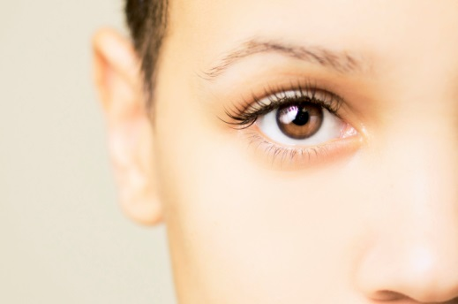
different forms of a gene
Notes:
Moreover, alleles are different variations of a gene. For example, for the gene that determines eye color, one allele, or variation, is brown color and the other is blue color

Slide 9
Alleles
Dominant
Recessive
Notes:
Alleles can either be dominant or recessive.

Slide 10
Alleles
Dominant
Recessive
Notes:
Dominant alleles will show their trait even if only passed to the child by ONE parent.

Slide 11
Alleles
Dominant
Recessive
Notes:
Recessive alleles show their traits ONLY when passed to the child by BOTH parents.

Slide 12
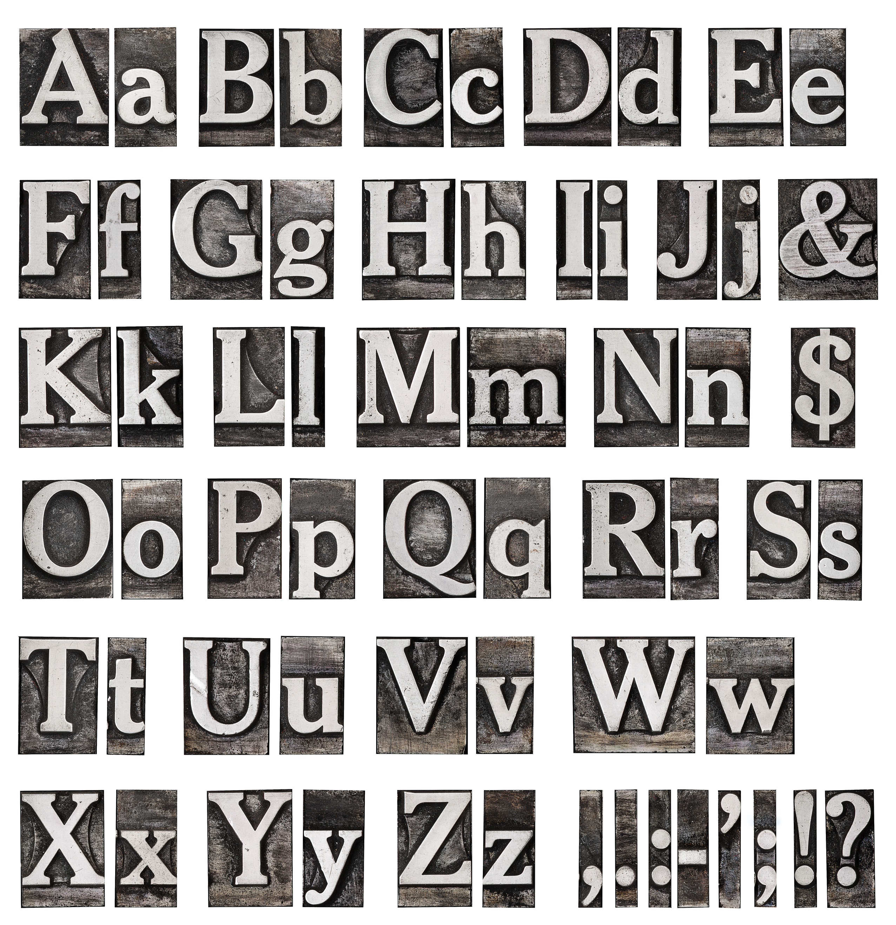
Notes:
To know what alleles an organism has, we need a way to symbolize the alleles. Scientists do this by using uppercase and lowercase letters. An uppercase letter is used for dominant alleles while the SAME letter only lowercase symbolizes the corresponding recessive allele.

Slide 13
The specific alleles of a gene
that an organism carries
RR
Rr
rr
Notes:
A genotype is the specific alleles of a gene that an organism carries

Slide 14
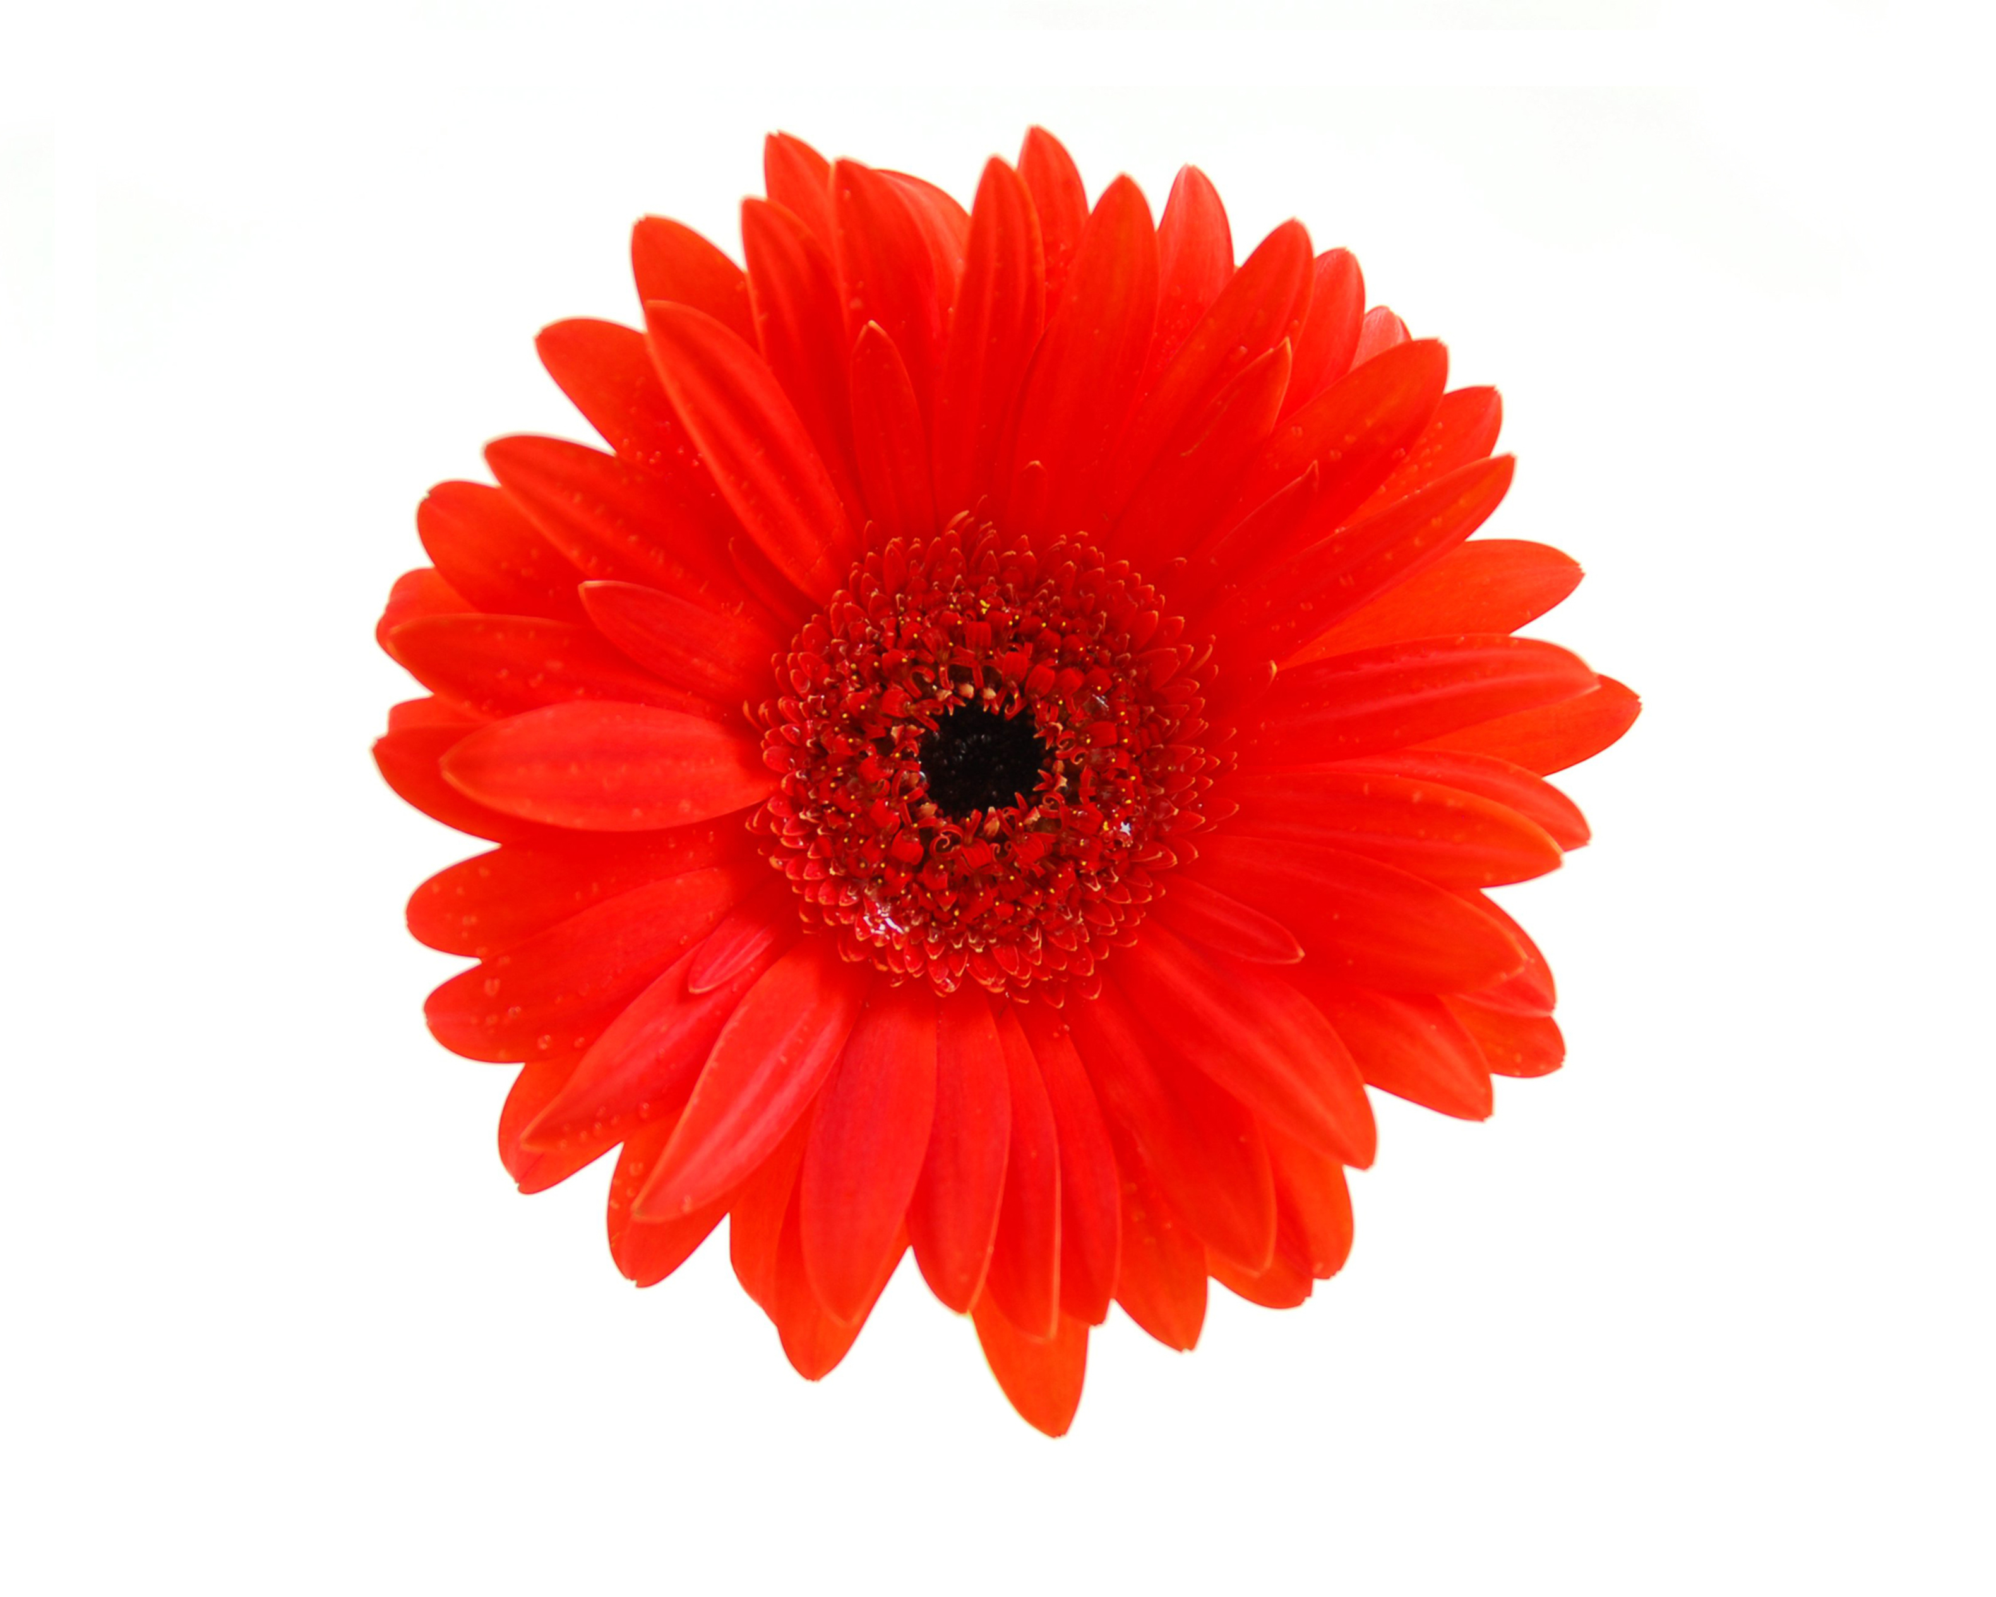
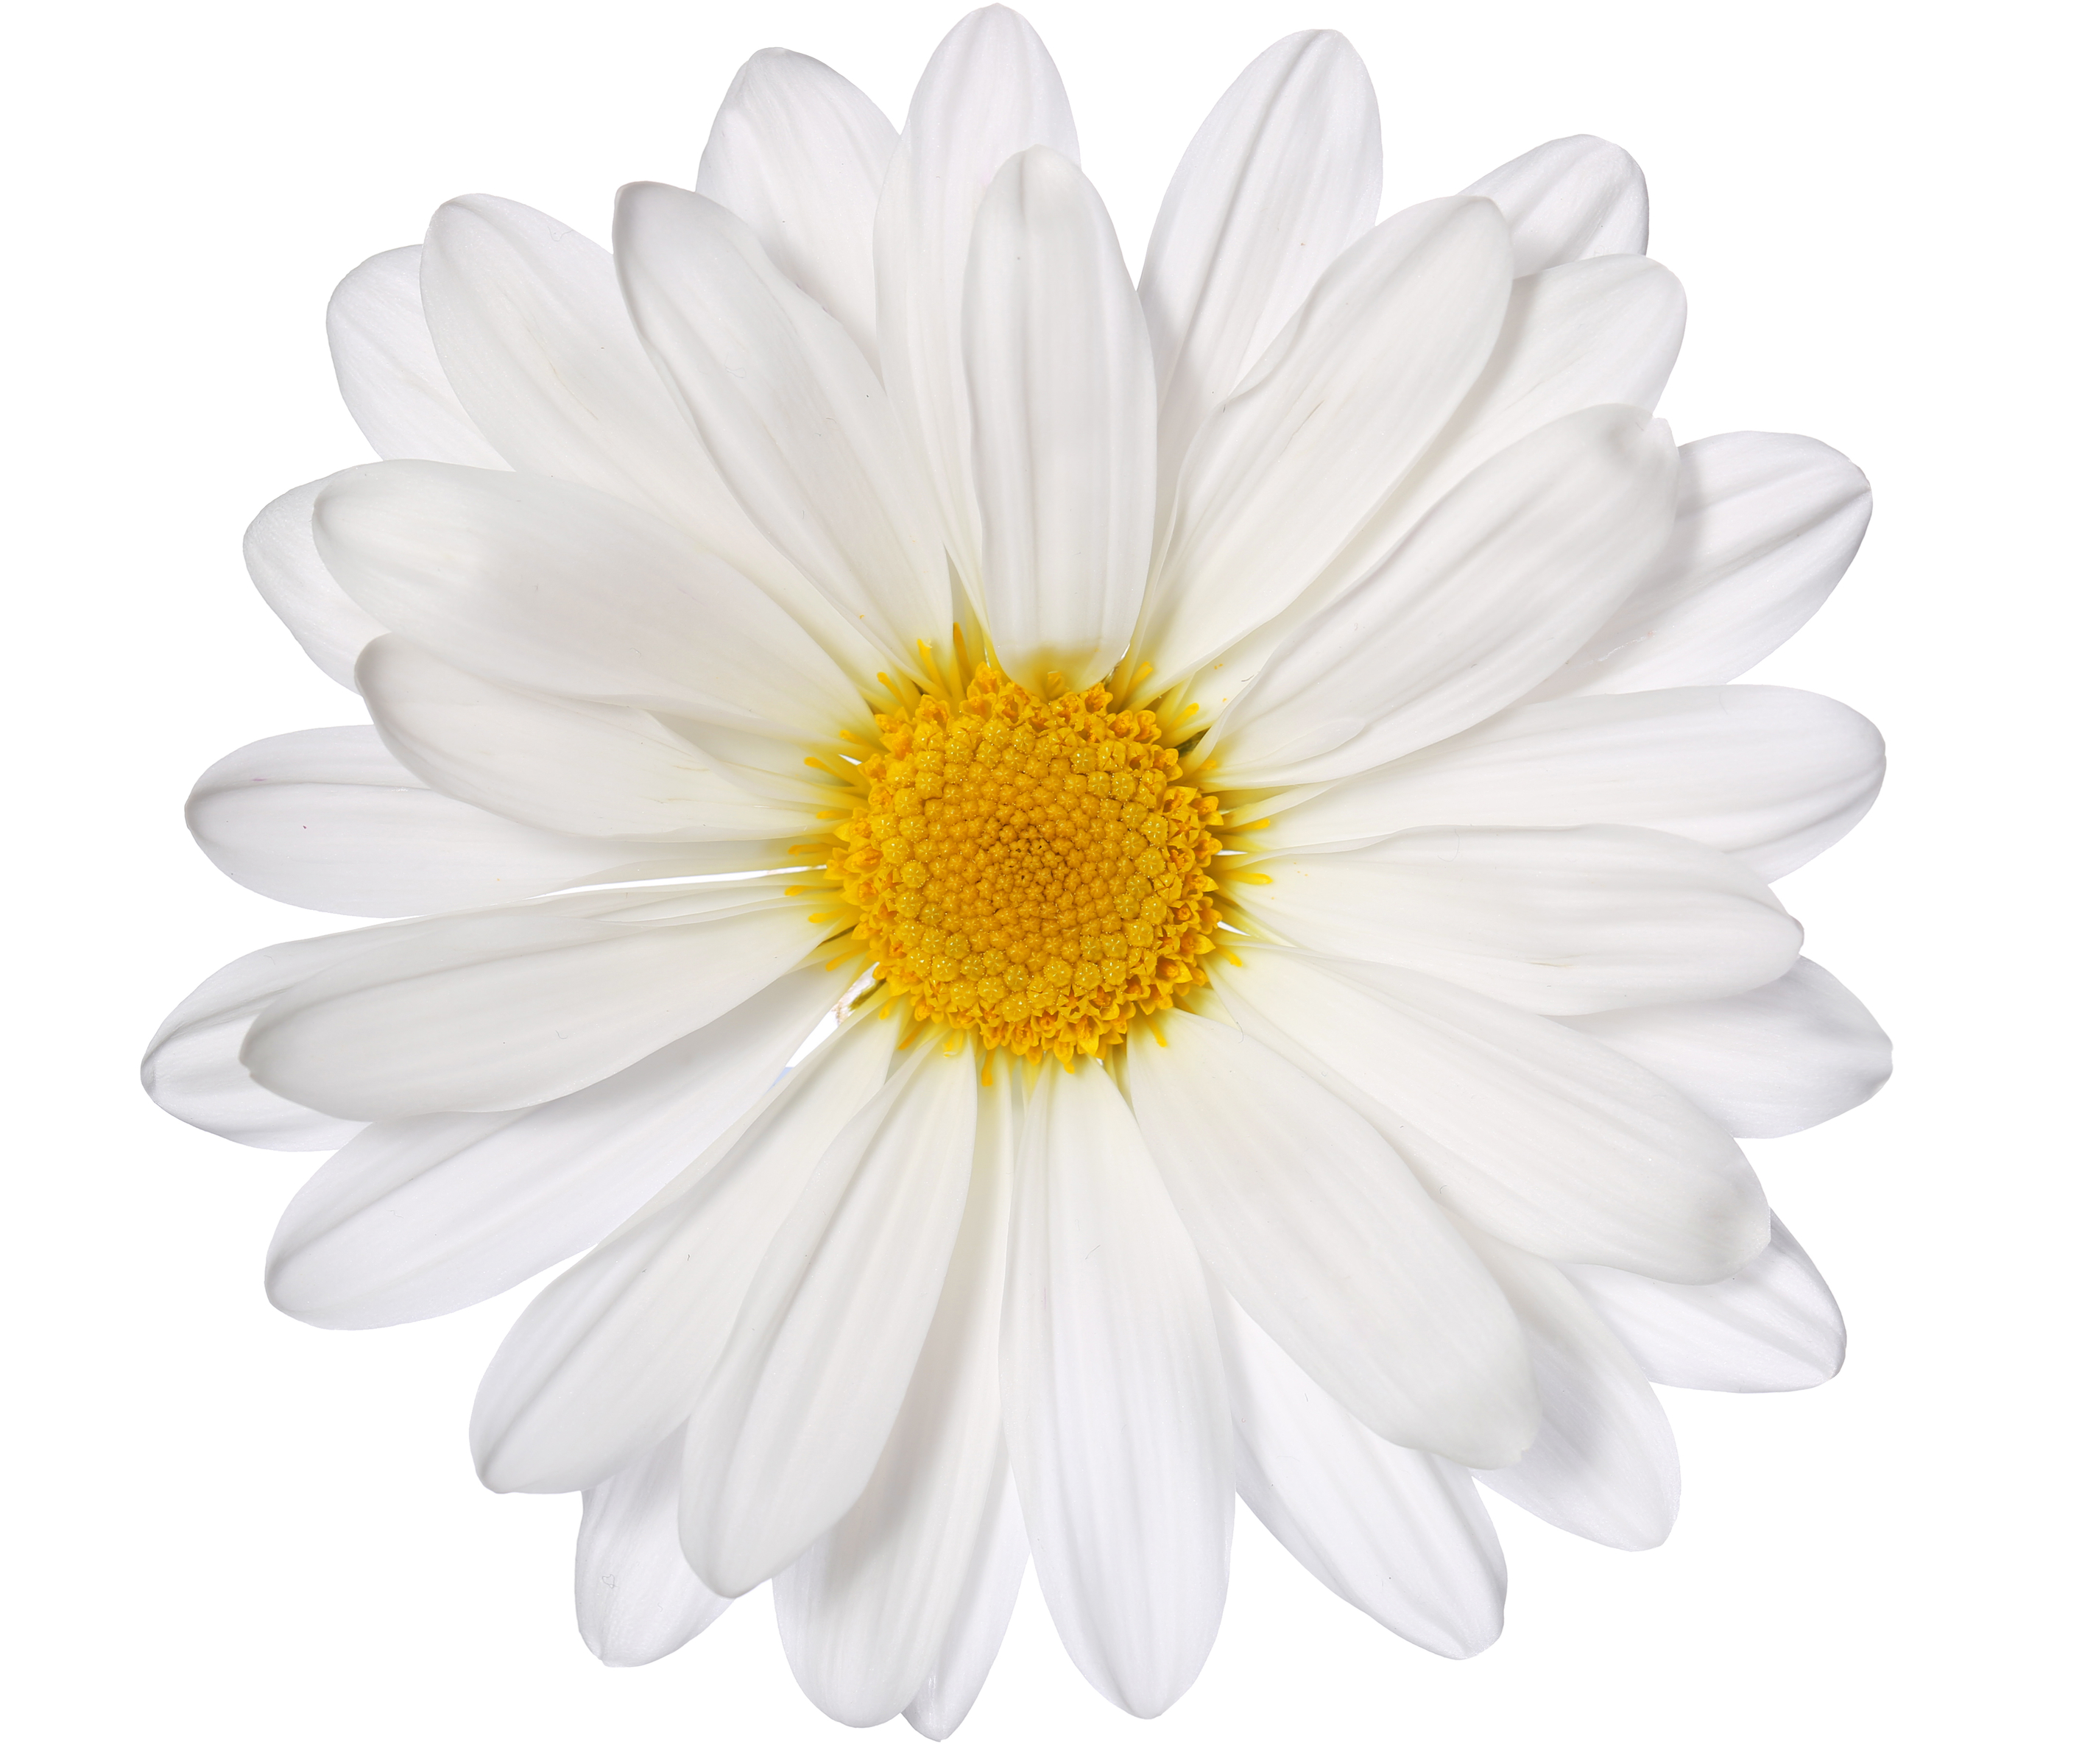
Observable traits of an organism
Phenotype Red Red White
Genotype RR Rr rr
Notes:
While a phenotype is the observable traits of an organism

Slide 15
Punnett Square
diagram that shows the possible genotypes of an offspring given the genotypes of the two parents.
B b
b
b
Bb
bb
Bb
bb
Notes:
Lastly, a Punnett Square is a diagram that shows the possible genotypes of an offspring given the genotypes of the two parents.

Slide 16
Notes:
Now let’s pause for a moment to review the information we have covered already.

Slide 17
What is the difference between
genotype and phenotype?
Notes:
Question about review information

Slide 18
What is a Punnett Square?
Notes:
Question about review information

Slide 19
Probability
Notes:
Now, let’s define what probability means

Slide 20
Probability: the likelihood that an offspring will have a certain phenotype
1 4
2 4
3 4
4 4

Slide 21
Notes:
That is the basic definition, but there is a bit more you need to know.

Slide 22
Notes:
To calculate probability in genetics we will use a Punnett Square
Remember that a Punnett Square is divided into four equal squares

Slide 23
1/4
1/4
1/4
1/4
Notes:
Each square represents ¼ of the whole big square

Slide 24
1/4
1/4
1/4
1/4
Notes:
Two squares equals ¼ +1/4, which equals 2/4ths

Slide 25
1 4
1 4
2 4
2 4
2 2 4 2
1 2
Notes:
2/4ths simplifies to ½. If any of this is confusing, feel free to review fractions or ask your teacher for a refresher before continuing.

Slide 26
1/4
1/4
1/4
1/4
Notes:
Three squares equals ¼ +1/4+1/4, which equals 3/4ths

Slide 27
1/4
1/4
1/4
1/4
Notes:
And four squares of course equals 4/4ths, or just 1

Slide 28
Notes:
Before we go into an example, let’s review how fractions relate to percents

Slide 29
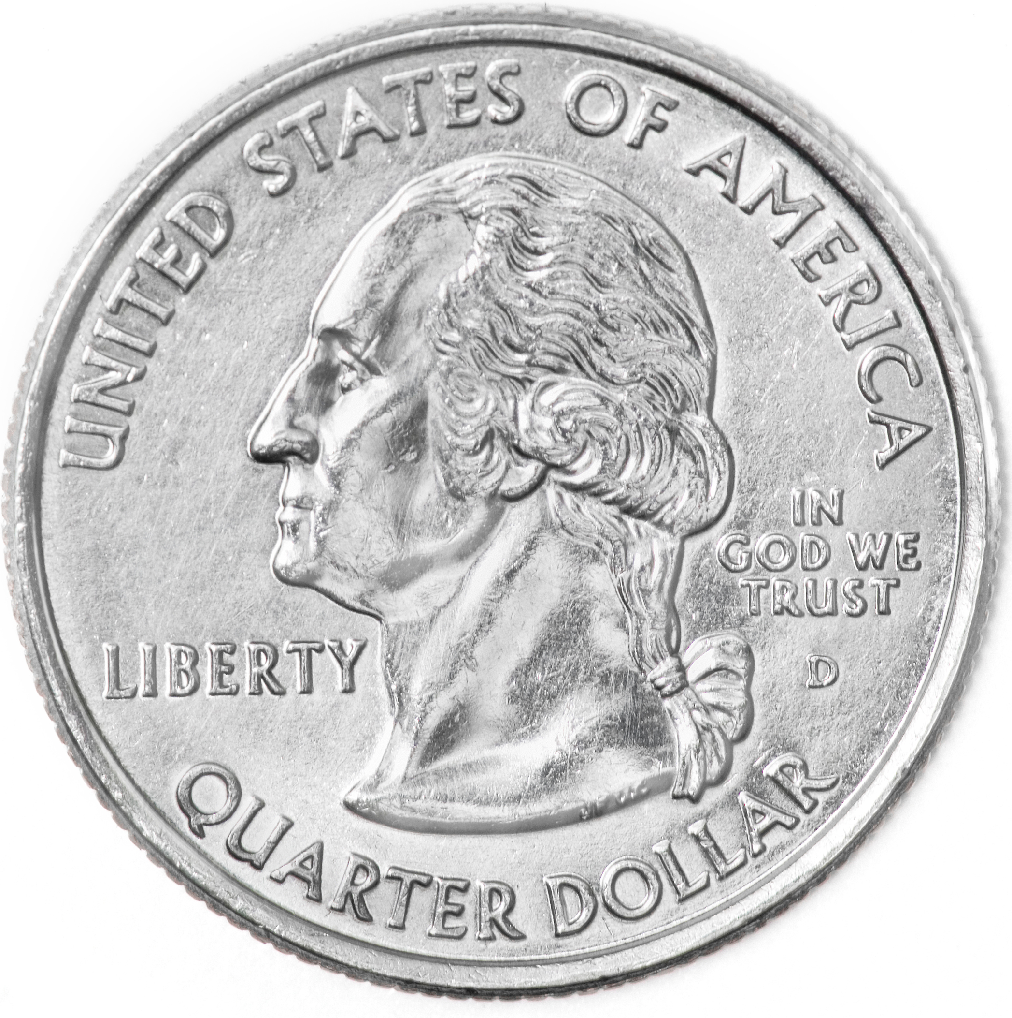
1 4
25%
25¢
Notes:
Remember that 1/4th is equal to 25%. You can remember this because you need 4 quarters, or 4 25 cents, to make one whole dollar.

Slide 30
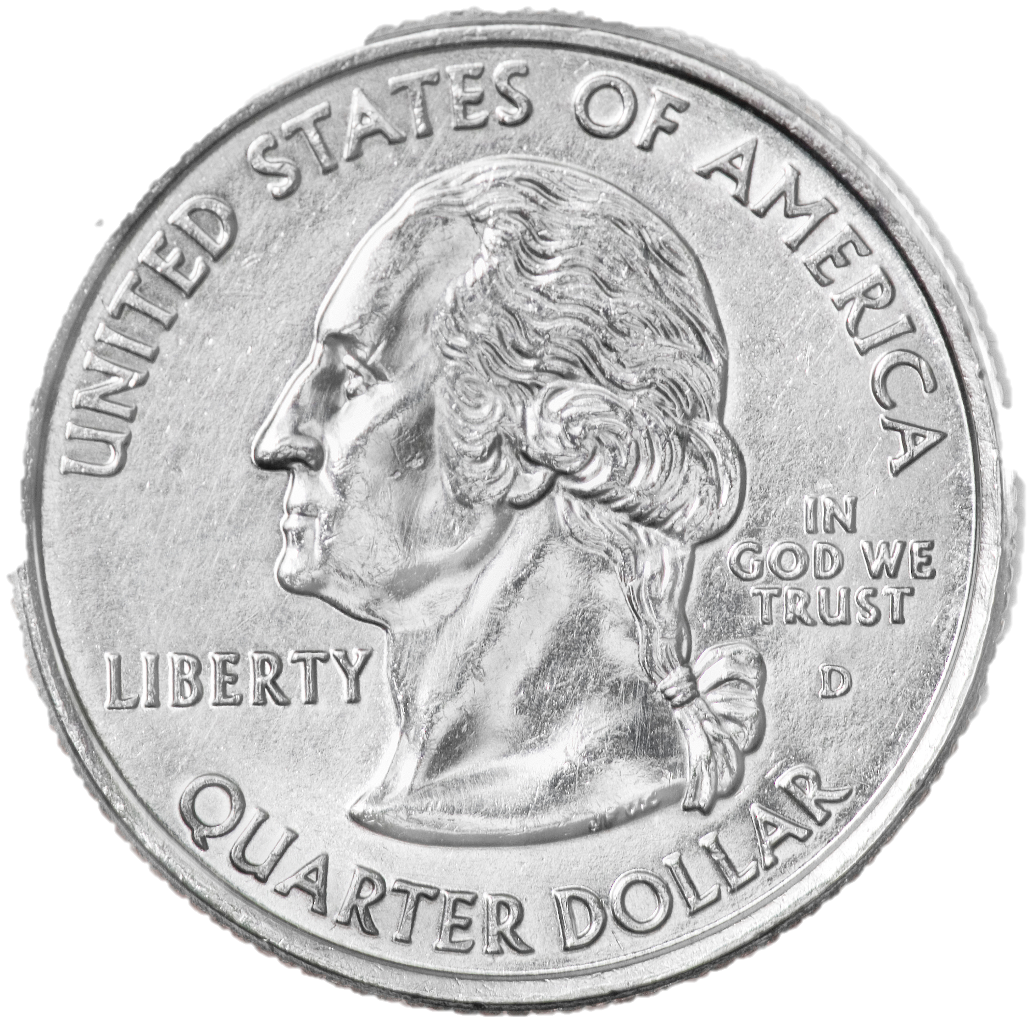
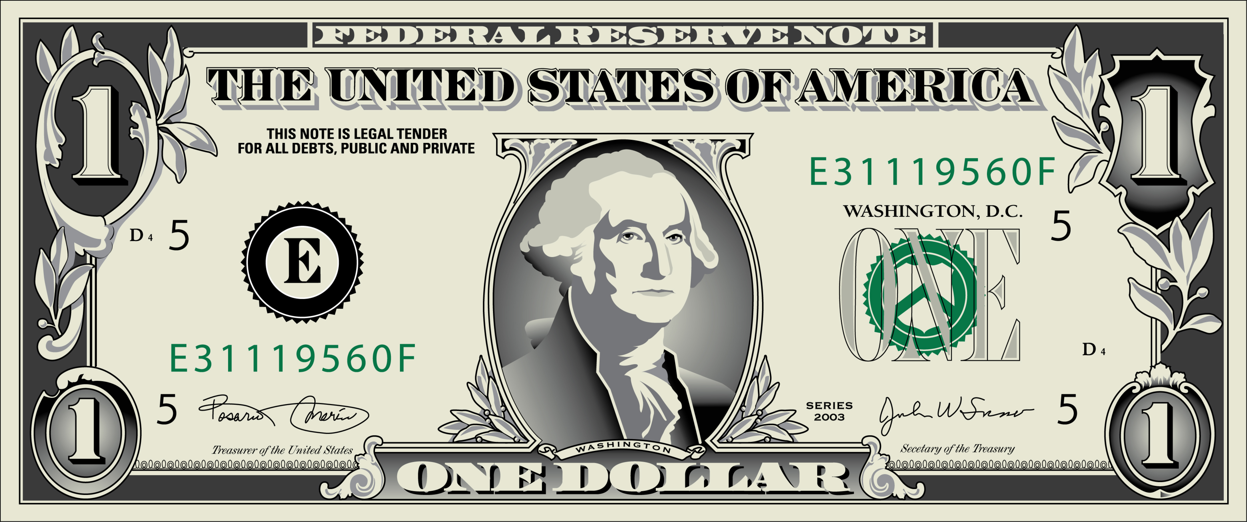
2 4
50%
3 4
75%
4 4
100%
Notes:
2/4ths then equals 25+25=50%
3/4ths equals 75%
And 4/4ths = 100%
Insert pics of quarters

Slide 31
Notes:
Now, it’s finally time to talk through an example of how we can apply fractions and percents to genetics

Slide 32
B
b
Notes:
Let’s use eye color as an example again. Remember that there are two alleles—brown and blue and that blue is the dominant allele.

Slide 33
B B
B
B
Notes:
For our first Punnett Square, both parents have the genotype BB and thus both have the phenotype of brown eyes. We want to know the probability of their baby having brown eyes as well. So let’s first complete the Punnett Square

Slide 34
B B
B
B
BB
BB
BB
BB
Notes:
This is the completed square. All the possible genotypes for the offspring is BB, so all of the offspring will have brown eyes. This means the probability of the offspring having brown eyes is 4/4ths, which is equal to 100%
This also means that the probability of the offspring having blue eyes is 0%

Slide 35
B b
B
b
Notes:
But what if both parents still had brown eyes, but their genotypes were Bb instead of BB? What would the probability of their child having brown eyes be now?

Slide 36
B b
B
b
BB
Bb
Bb
bb
Notes:
This is what the completed Punnett Square looks like. Let’s count up how many phenotypes for brown eyes there are.
There are 3! So three out of the four possibilities, or 3/4ths, would have brown eyes.
Remember 3/4ths equals 75%, so there is a 75% chance that the offspring of these parents would have brown eyes

Slide 37
B b
B
b
BB
Bb
Bb
bb
Notes:
Meanwhile, only one box out of four has blue eyes. Thus, ¼th of the possible phenotypes is blue eyes, so there is a 25% chance the baby will have blue eyes.

Slide 38
Notes:
Are you starting to see how we find probability? If you want the probability of a phenotype, count up the boxes of that phenotype, put that number as a fraction over four, and that’s your answer! Let’s go over one last example.

Slide 39
B b
b
b
Notes:
What if one of the parents had blue eyes? And the other parent still had brown eyes but the genotype Bb? Then the Punnett Square would look like this. What is the likelihood that the baby of these two parents will have blue eyes?

Slide 40
B b
b
b
Bb
bb
Bb
bb
Notes:
First we have to complete the square and put down what each phenotype would be.

Slide 41
B b
b
b
Bb
bb
Bb
bb
Notes:
Then count up the number of boxes with blue eyes—2. Put 2 over 4 for the fraction 2/4ths. 2/4ths equals 50% so there is a 50% probability that the baby will have blue eyes.

Slide 42
Notes:
Let’s review the definition of probability

Slide 43
What is probability?

Slide 44
Each box in a Punnett Square is
what fraction of the whole square?
1/4
2/4
1/3
1
Notes:
a.) 1/4
b.) 2/4
c.) 1/3
d.) 1

Slide 45
If three out of the four boxes are the same
Phenotype then there is a [blank]% chance
that the offspring will have that phenotype?
25
50
75
0
Notes:
a.) 25
b.) 50
c.) 75
d.) 0

Slide 46
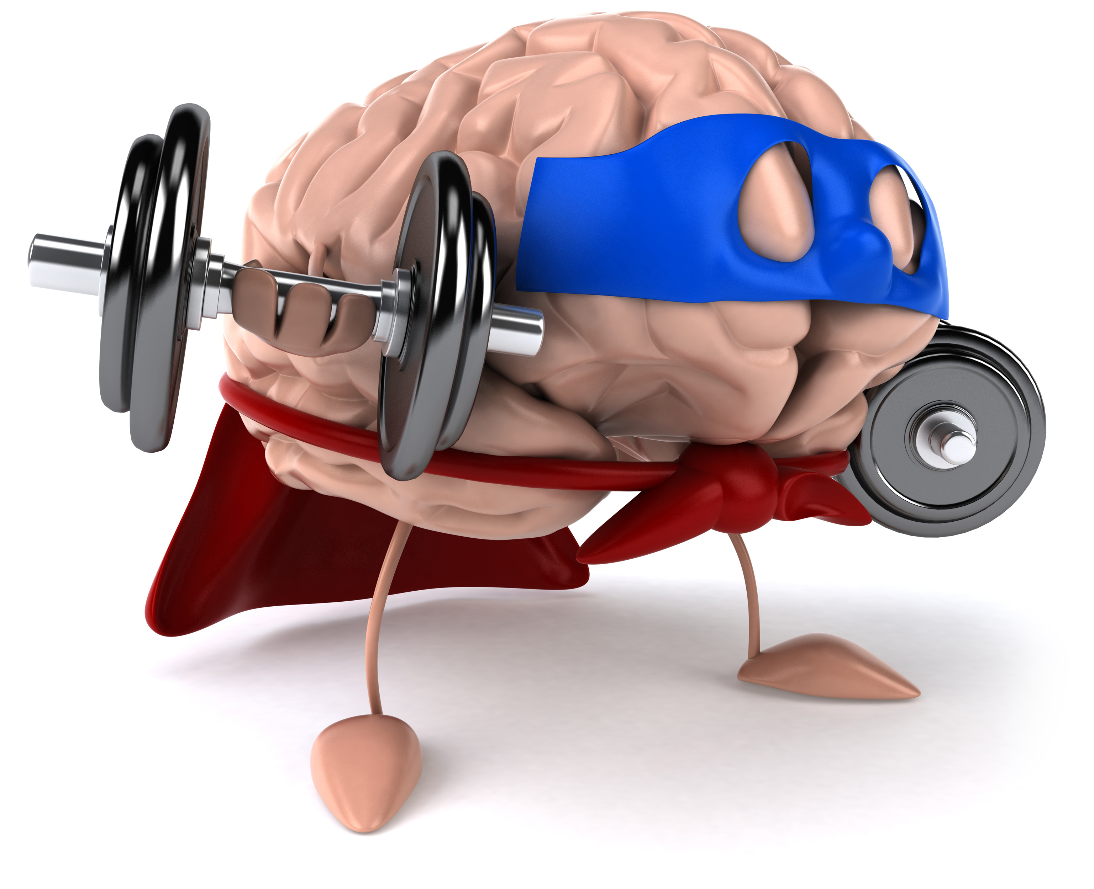
Remember!!!
Notes:
So remember!

Slide 47
Probability: the likelihood that an offspring will have a certain phenotype
1 4
2 4
3 4
4 4

Slide 48
Activity
Activity: Create your own Punnett square
Have students create their own Punnett Squares with various characteristics.
Ex: eye colors, hair colors, or other characteristics (i.e., tail or no tail)
Students can also use this website to see how the probabilities
Materials:
Paper and pencil
Markers
iPad/computer (optional)
Resources:
https://www.dnalc.org/resources/genescreen/punnett-empty.html
Notes:
https://www.dnalc.org/resources/genescreen/punnett-empty.html

Slide 49
Notes:
Thanks for watching, and please continue watching CAPs available from this website.

Slide 50
This Video Created With Resources From:
Cooperative Agreement # R324B130023
Curry School Foundation’s Research and Development Fund
Questions or Comments to Michael Kennedy, Ph.D.
MKennedy@Virginia.edu

