Slide 1
Notes:
OK everyone get ready to learn some new vocabulary terms.

Slide 2
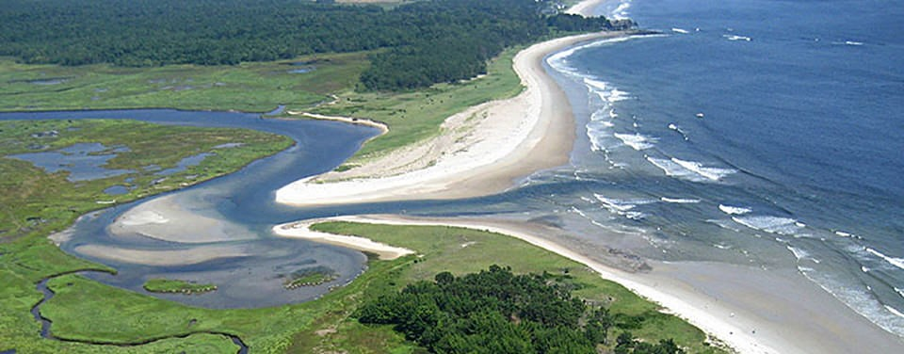
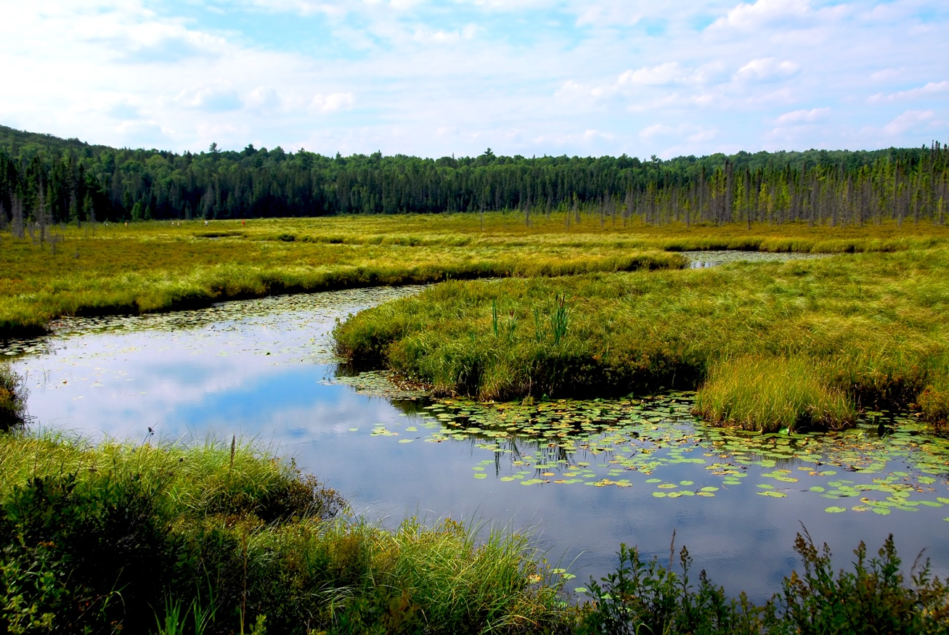
Wetlands, watersheds, and estuaries
Notes:
Today we will discuss wetlands, watersheds, and estuaries.

Slide 3
Notes:
Before we define the terms estuary, wetland, and watershed, let’s review some other words that you already learned, and make sure you are firm in your understanding.

Slide 4
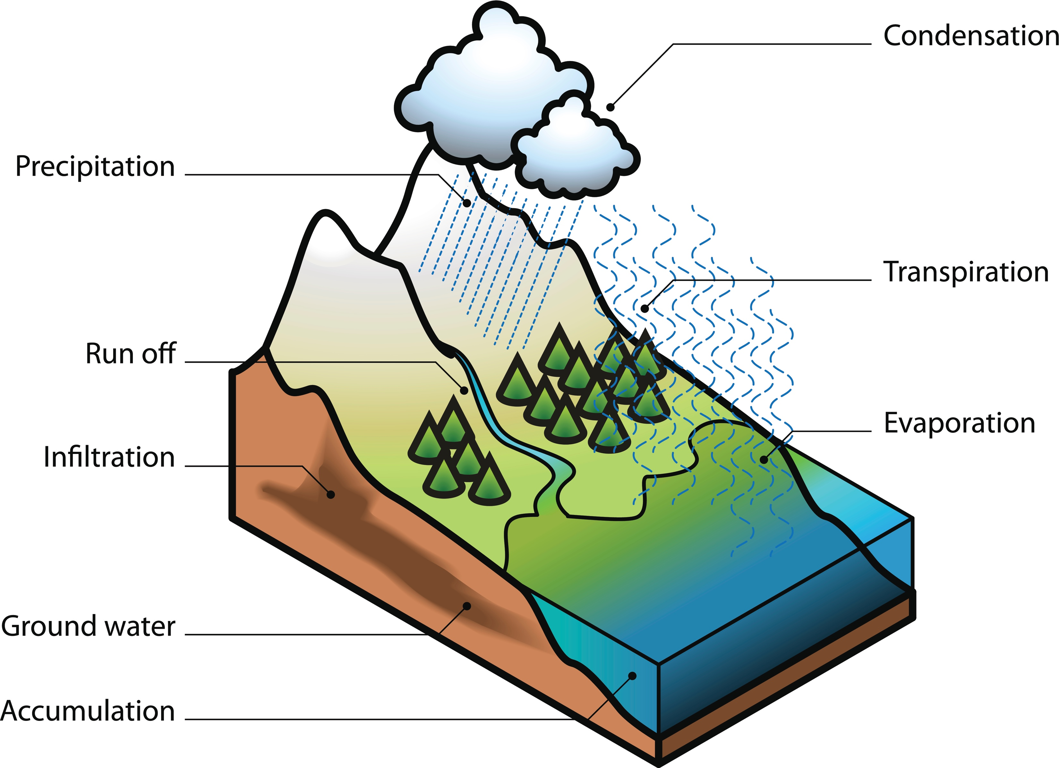
Aquifer
Photo # 176666463 or scan a drawing.
Aquifer
Notes:
An aquifer is water stored under the ground. We sometimes refer to aquifers as ground water.

Slide 5
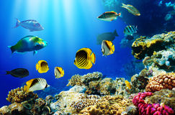
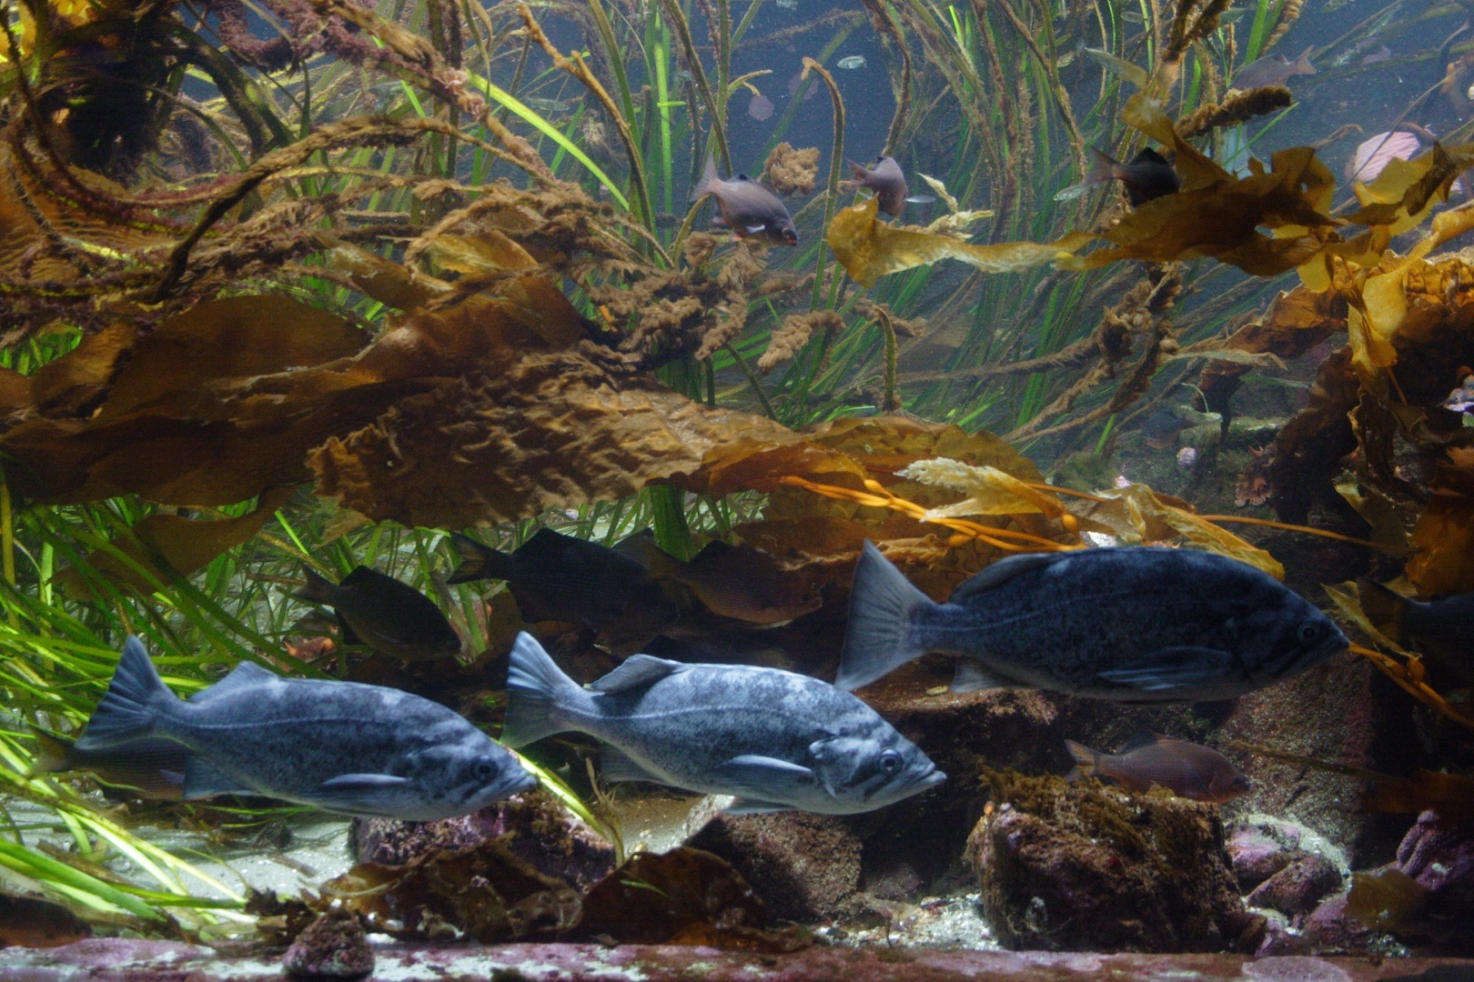
Ocean has Salt Water
Freshwater does NOT
contain salt
Notes:
Also, remember that ocean water has salt in it while freshwater does NOT contain salt.

Slide 6
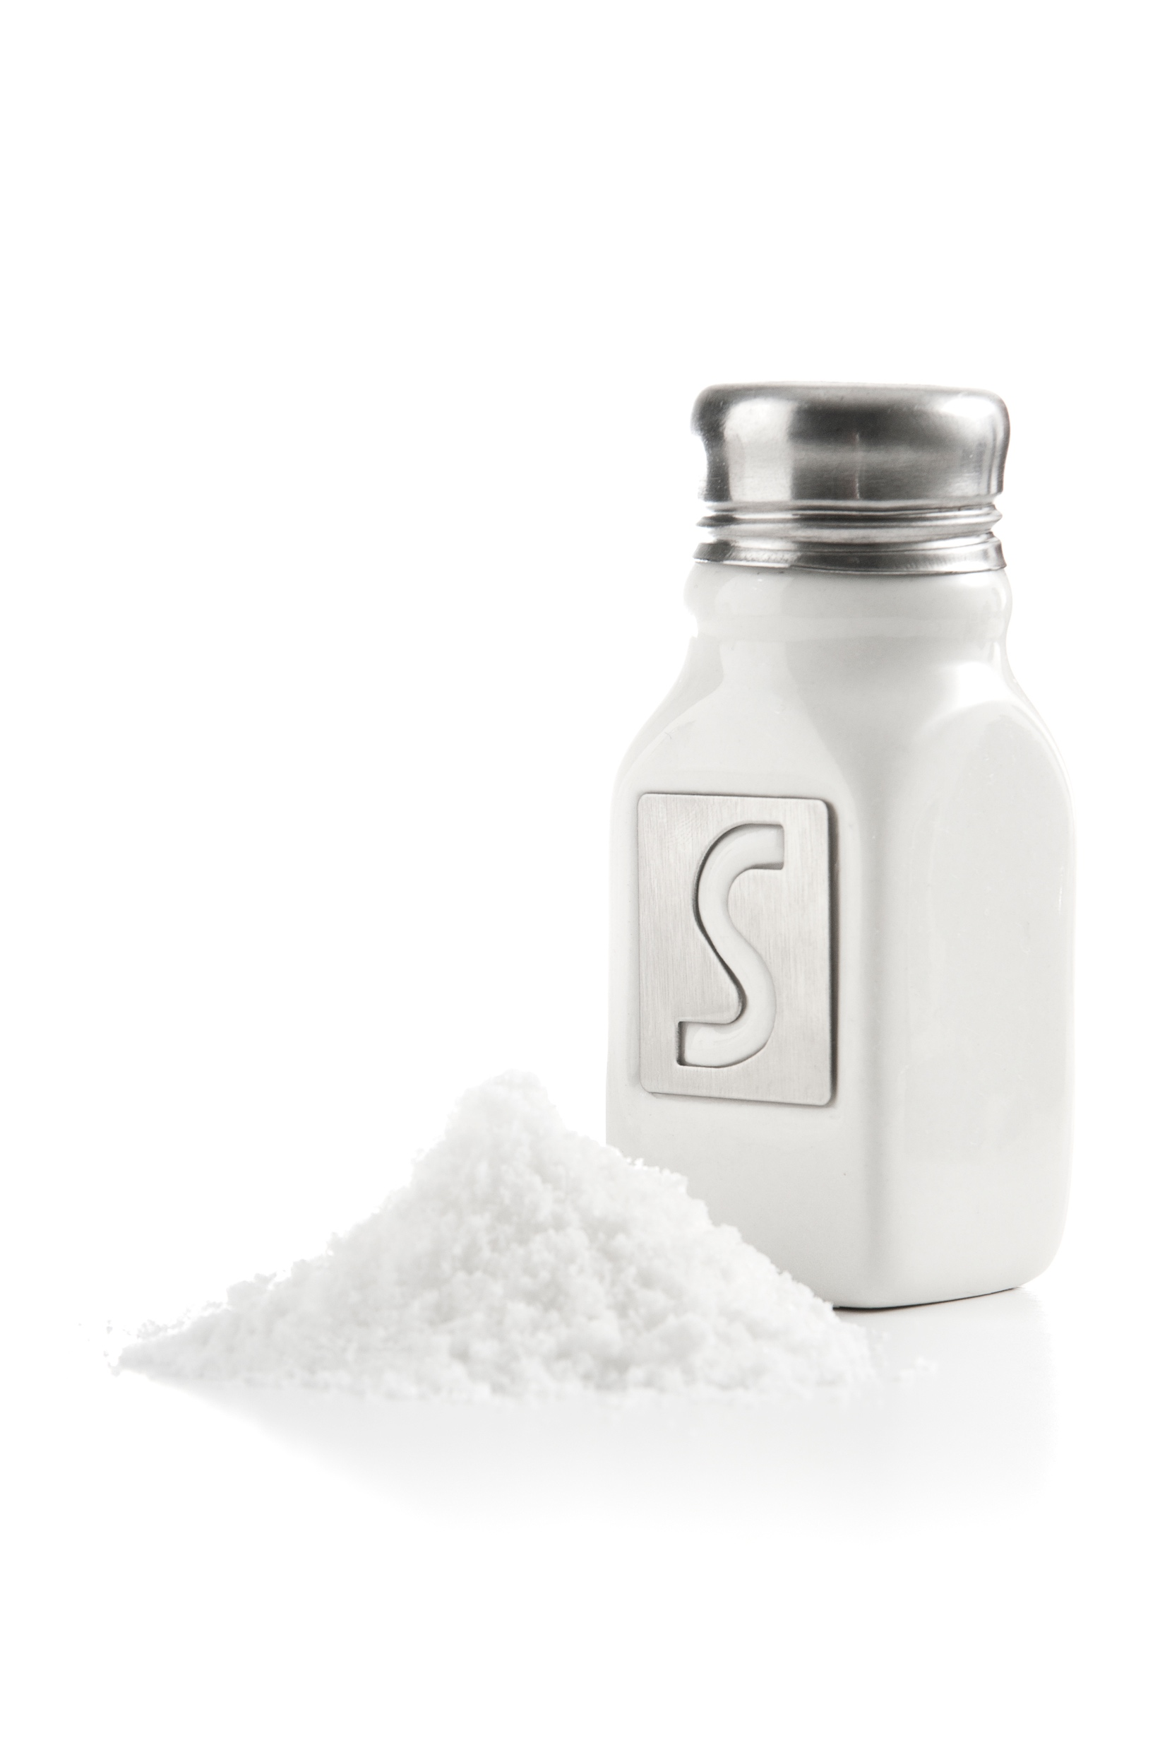
Salinity
Notes:
Finally, remember that salinity is the amount of salt in the water.

Slide 7
Wetland
Estuary
Watershed
Notes:
Let’s focus in on wetlands, estuaries, and watersheds.

Slide 8
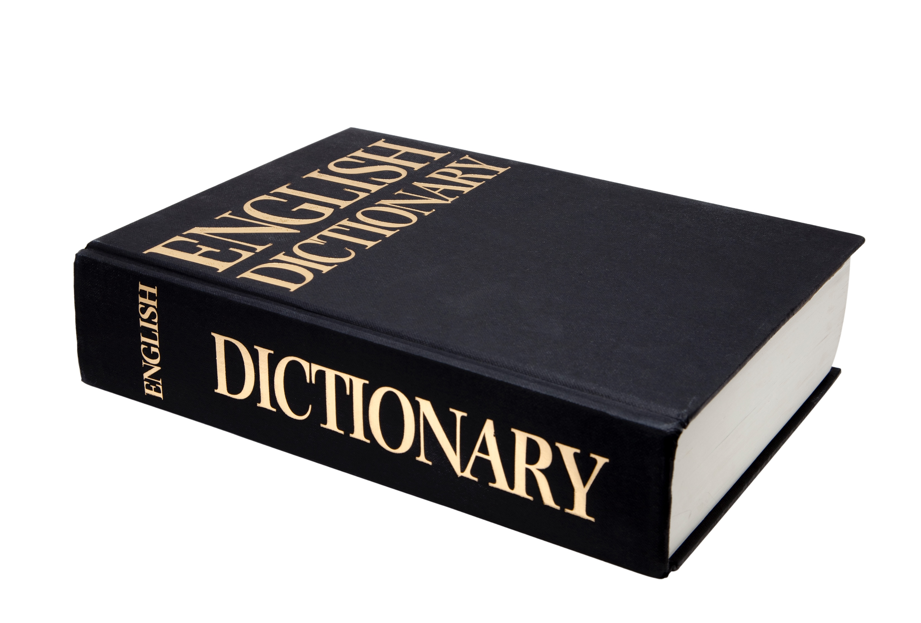
Wetland
Notes:
Let’s define the term wetland

Slide 9
Wetland
An area that is saturated with water for at least part of the year
Notes:
A wetland is an area that is saturated with water for at least part of the year.

Slide 10
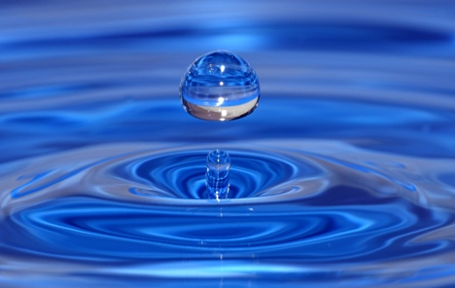
Wetlands
An area that is saturated with water for at least part of the year

Slide 11
Wetlands
An area that is saturated with water for at least part of the year
Very Wet
Thoroughly Soaked
Notes:
An area that is saturated is very wet or thoroughly soaked. So wetlands are soaked in water

Slide 12
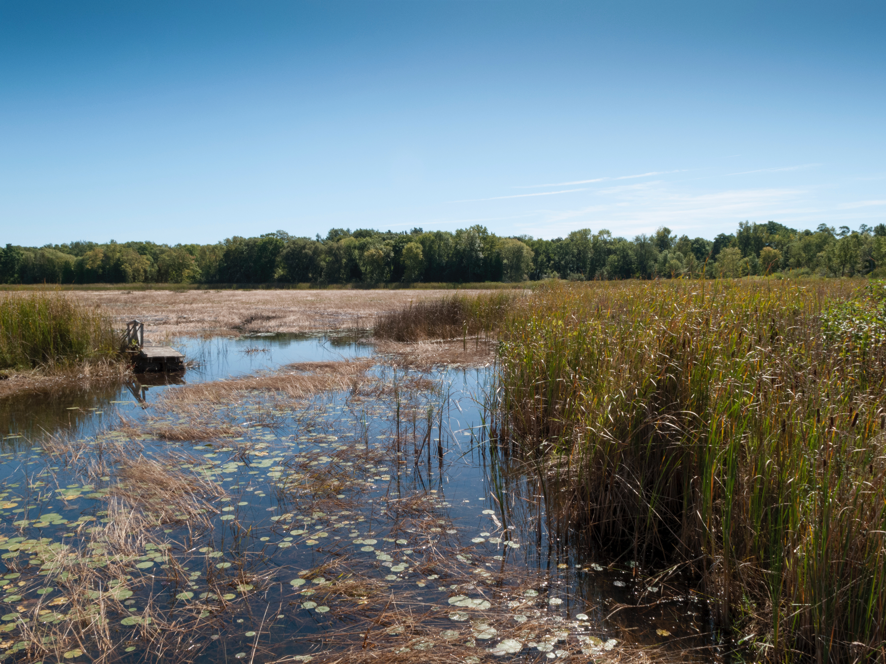
Wet
Land
Notes:
Basically, it is very wet land.

Slide 13
Types of wetlands:
Swamp
Notes:
There are many different kinds of wetlands. The main types of wetlands include swamps,

Slide 14
Types of wetlands:
Swamp
Bog
Notes:
Bogs,

Slide 15
Types of wetlands:
Swamp
Bog
Marsh
Notes:
and marshes.

Slide 16
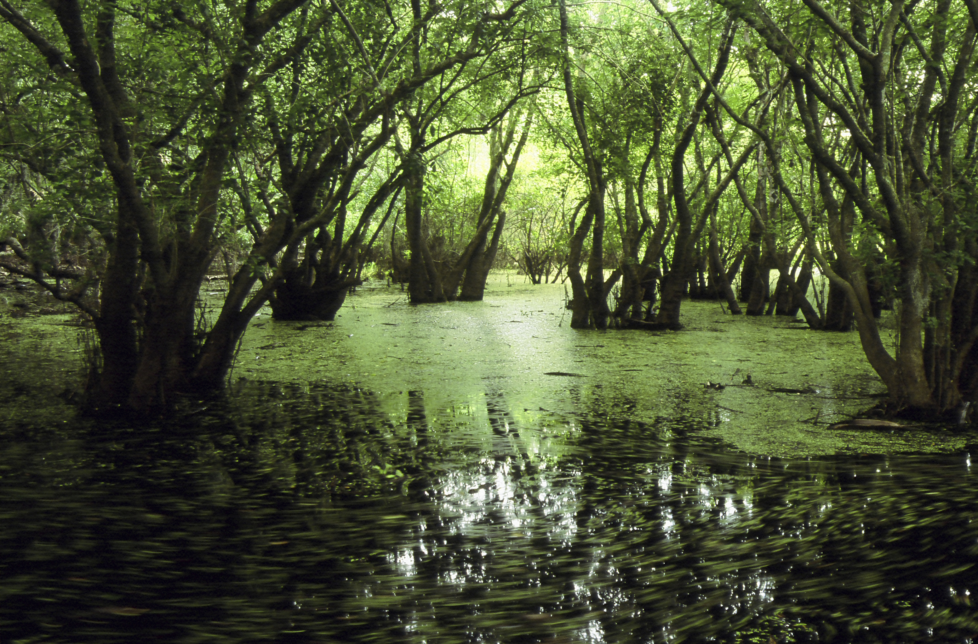
Swamp
Trees
Notes:
Swamps have lots of trees,

Slide 17
Swamp
Standing Water
Notes:
standing water,

Slide 18
Swamp
Plants and Animals
Notes:
and lots of plants and animals.

Slide 19
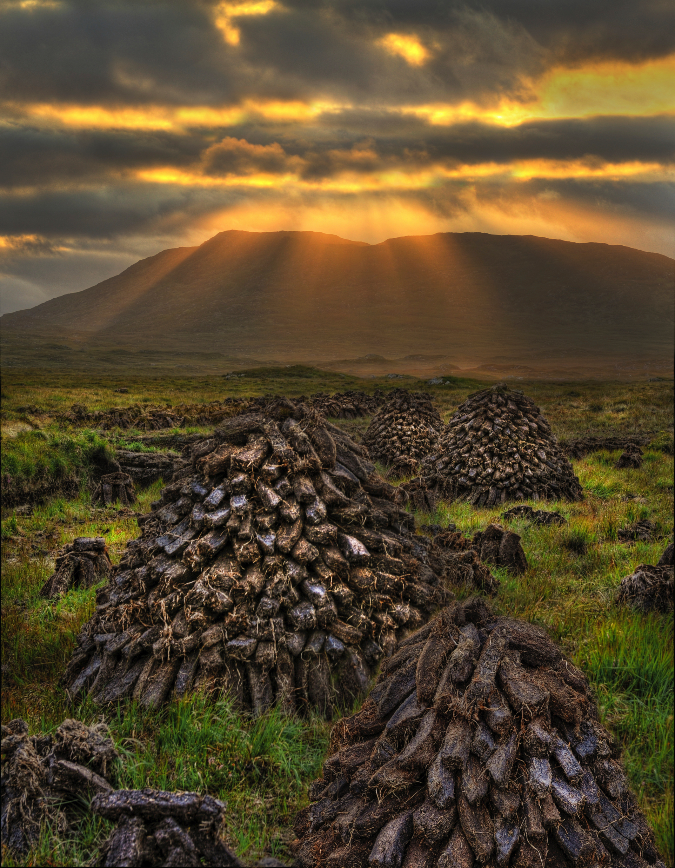
Bog
Peat
Notes:
Bogs have deep layers of rotting vegetation called peat,

Slide 20
Bog
Few trees
Notes:
few trees,

Slide 21
Bog
and many
plants and
animals
Notes:
and many plants and animals.

Slide 22
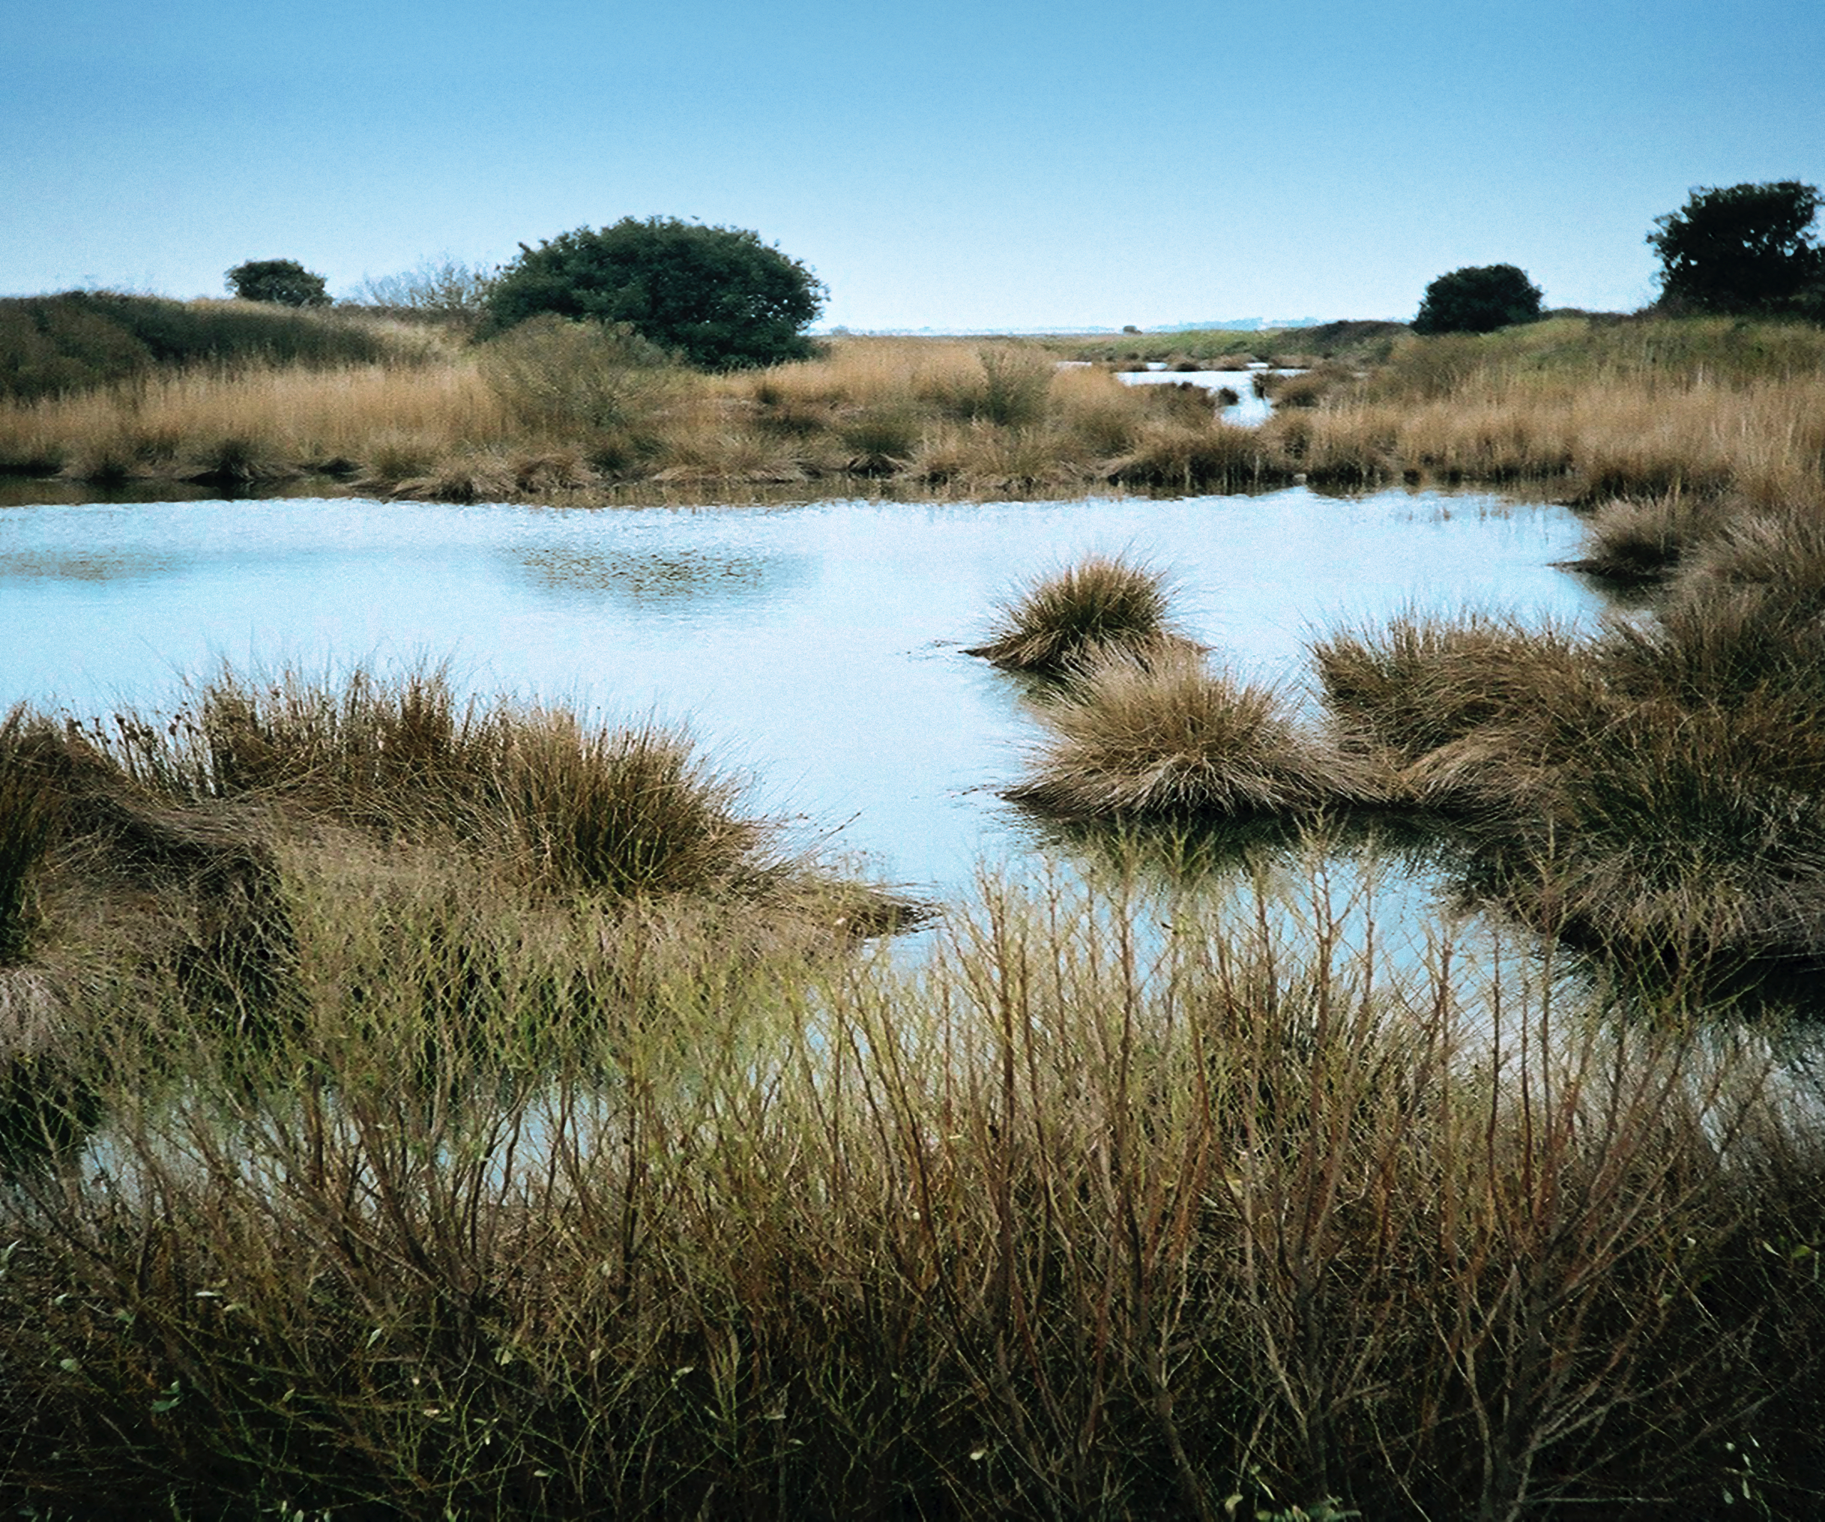
Marsh
Shallow Water
Notes:
Marshes have lots of shallow water,

Slide 23
Marsh
Few Trees
Grasses
Notes:
Lots of grasses with few trees,

Slide 24
Marsh
and many plants and animals
Notes:
and many plants and animals.

Slide 25
Notes:
Explicit cue to review examples of wetlands.
Now, let’s talk about some examples of wetlands.

Slide 26
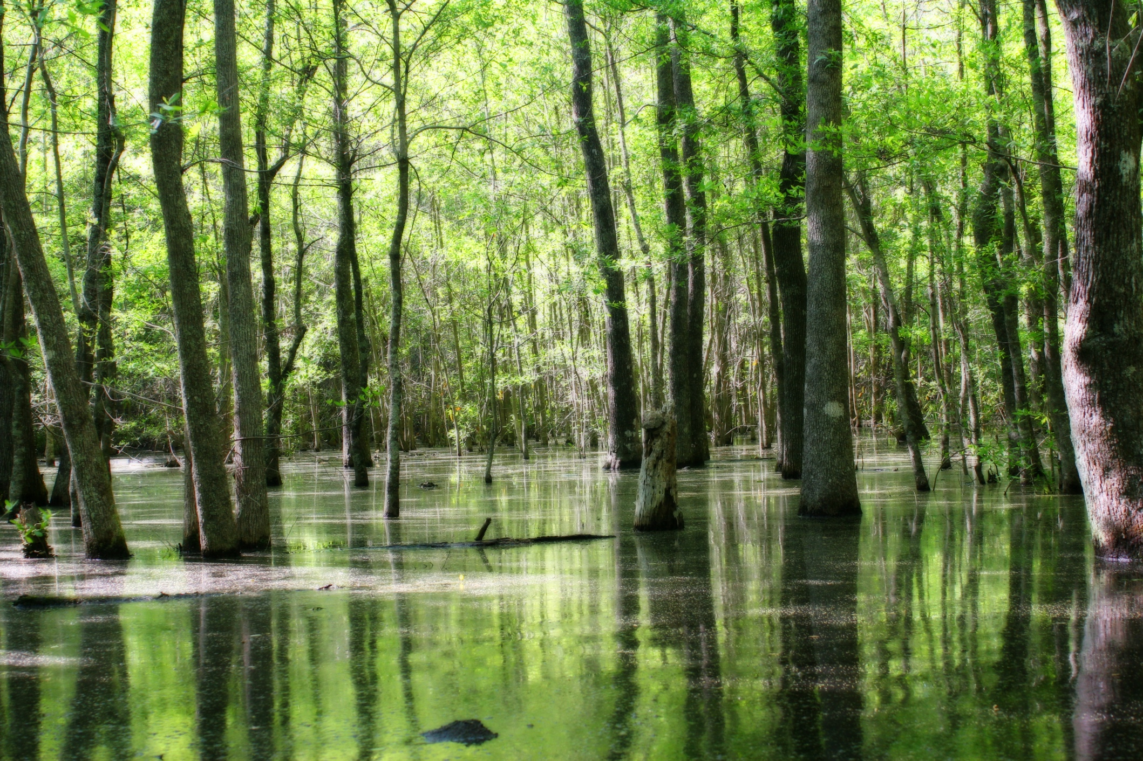
YES
Notes:
Swamps and bogs are examples of wetlands

Slide 27
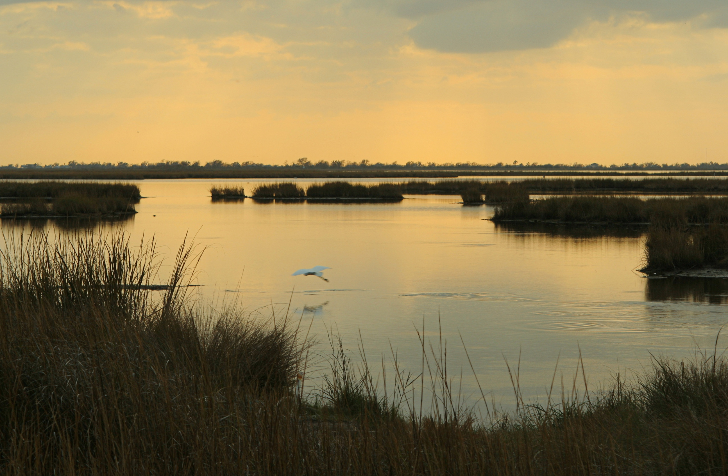
YES
Notes:
Marshes are types of wetlands

Slide 28
NON
Notes:
Let’s talk about some non-examples of wetlands.

Slide 29
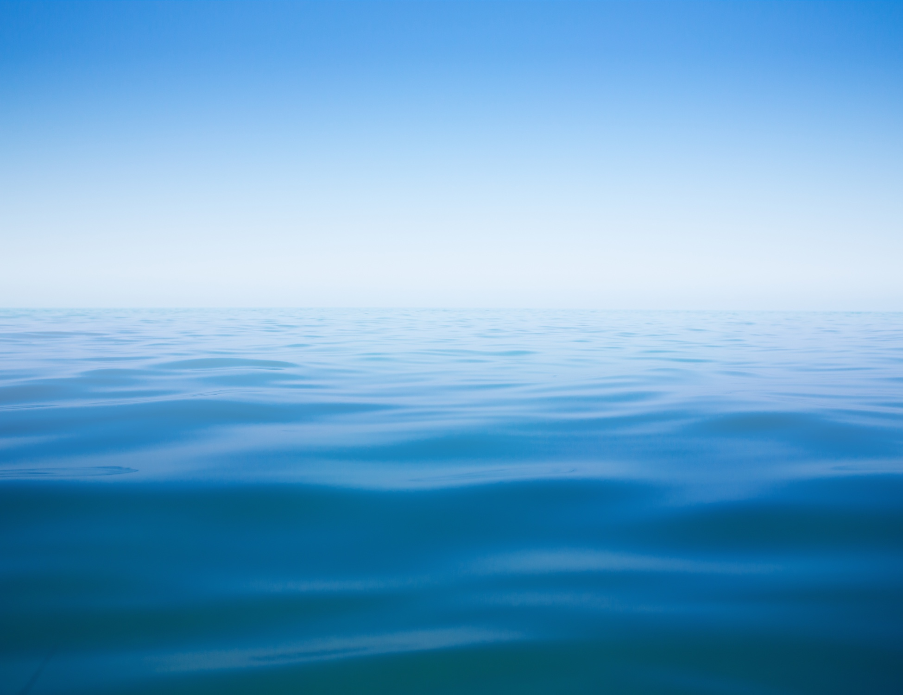
NO
Notes:
Wetlands are areas of land, so oceans are not wetlands.

Slide 30
What is a wetland?
Notes:
An area that is saturated with water for at least part of the year

Slide 31
Which of the following is not an example of a wetland?
Swamps
Marshes
River
Bogs
Notes:
C

Slide 32
Which of the following is not an example of a wetland?
Swamps
Marshes
River
Bogs

Slide 33
Estuary
Notes:
Let’s define the term estuary.

Slide 34
Estuary
Partially enclosed body of water formed where a river flows into an ocean

Slide 35
Estuary
Body of water formed where a river flows into an ocean

Slide 36
Estuary
Partially enclosed body of water formed where a river flows into an ocean
Estuary

Slide 37
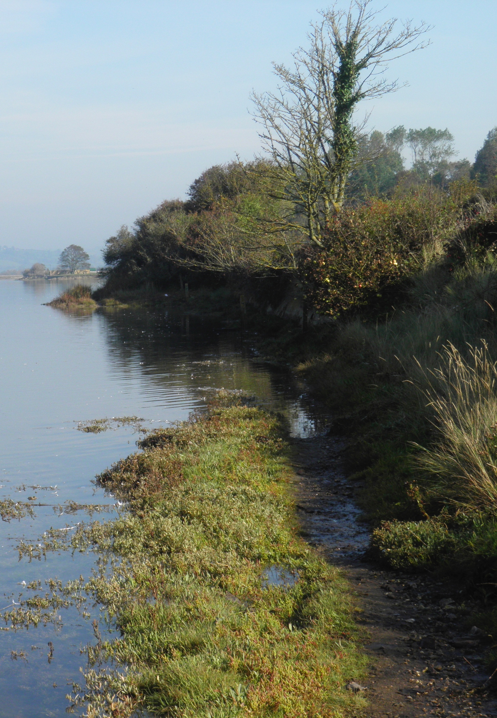
Photo # 497301675
Notes:
An estuary will often have wetland swamps and marshes along its edges.

Slide 38
Aquifer
Photo # 176666463 or scan a drawing.
Aquifer
Notes:
Estuaries have large aquifers underneath them where groundwater collects.

Slide 39
Notes:
That is the basic definition, but there is a bit more you need to know.

Slide 40
Photo # 503455659
Photo # 177390453 salt shaker
Mixture
Notes:
Estuaries have a mixture of fresh water and salt water. Recall that salinity describes how salty the water is.

Slide 41
Fresh water from rivers
Gradient of salinity
Salt water from the ocean
Notes:
Estuaries have a gradient of salinity. This means that the amount of salt in the water changes as you travel through the estuary.

Slide 42
Fresh water from rivers
Very Little Salt
Gradient of salinity
Lots of Salt
Salt water from the ocean
Notes:
The fresh river water has very little salt. The amount of salt increases as you get closer to the ocean.

Slide 43
Notes:
Now, let’s talk about some common examples of estuaries.

Slide 44
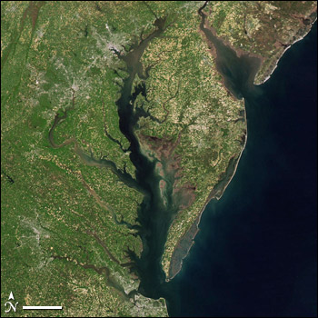
Chesapeake Bay
Estuary
Notes:
The largest estuary on the East Coast is the Chesapeake Bay.

Slide 45
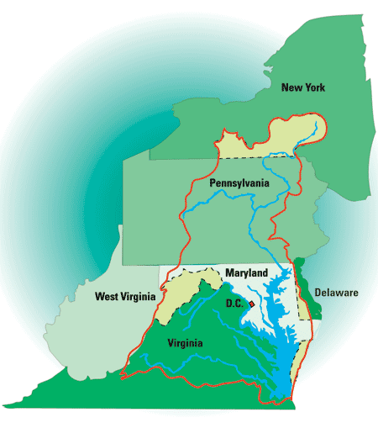
Chesapeake Bay
Watershed
Chesapeake Bay
Estuary
From: Fish and Wildlife Service website http://www.fws.gov
Notes:
The Chesapeake Bay estuary is part of the Chesapeake Bay watershed.

Slide 46
Notes:
So the freshwater runoff from the land outlined in red ends up in bodies of water that flow into the Chesapeake Bay estuary where it mixes with the salt water from the ocean.

Slide 47
NON
Notes:
Let’s talk about some non-examples of estuaries. These are things that might seem similar but do not fit the definition of estuary

Slide 48
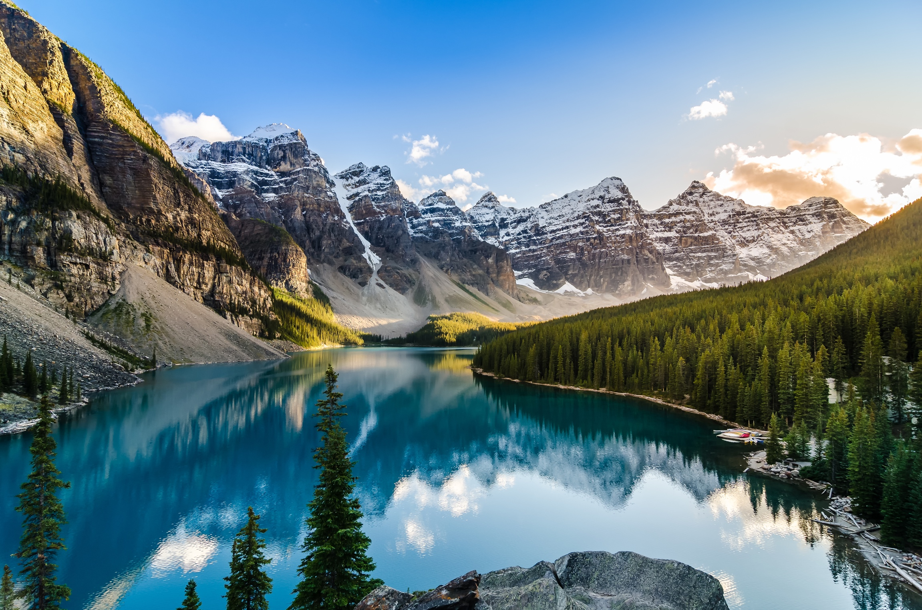
All freshwater
NOT an estuary
Notes:
A non-example is this mountain-top lake. There is NOT a mix of salt water and freshwater here. It is all freshwater so it is NOT an estuary.

Slide 49
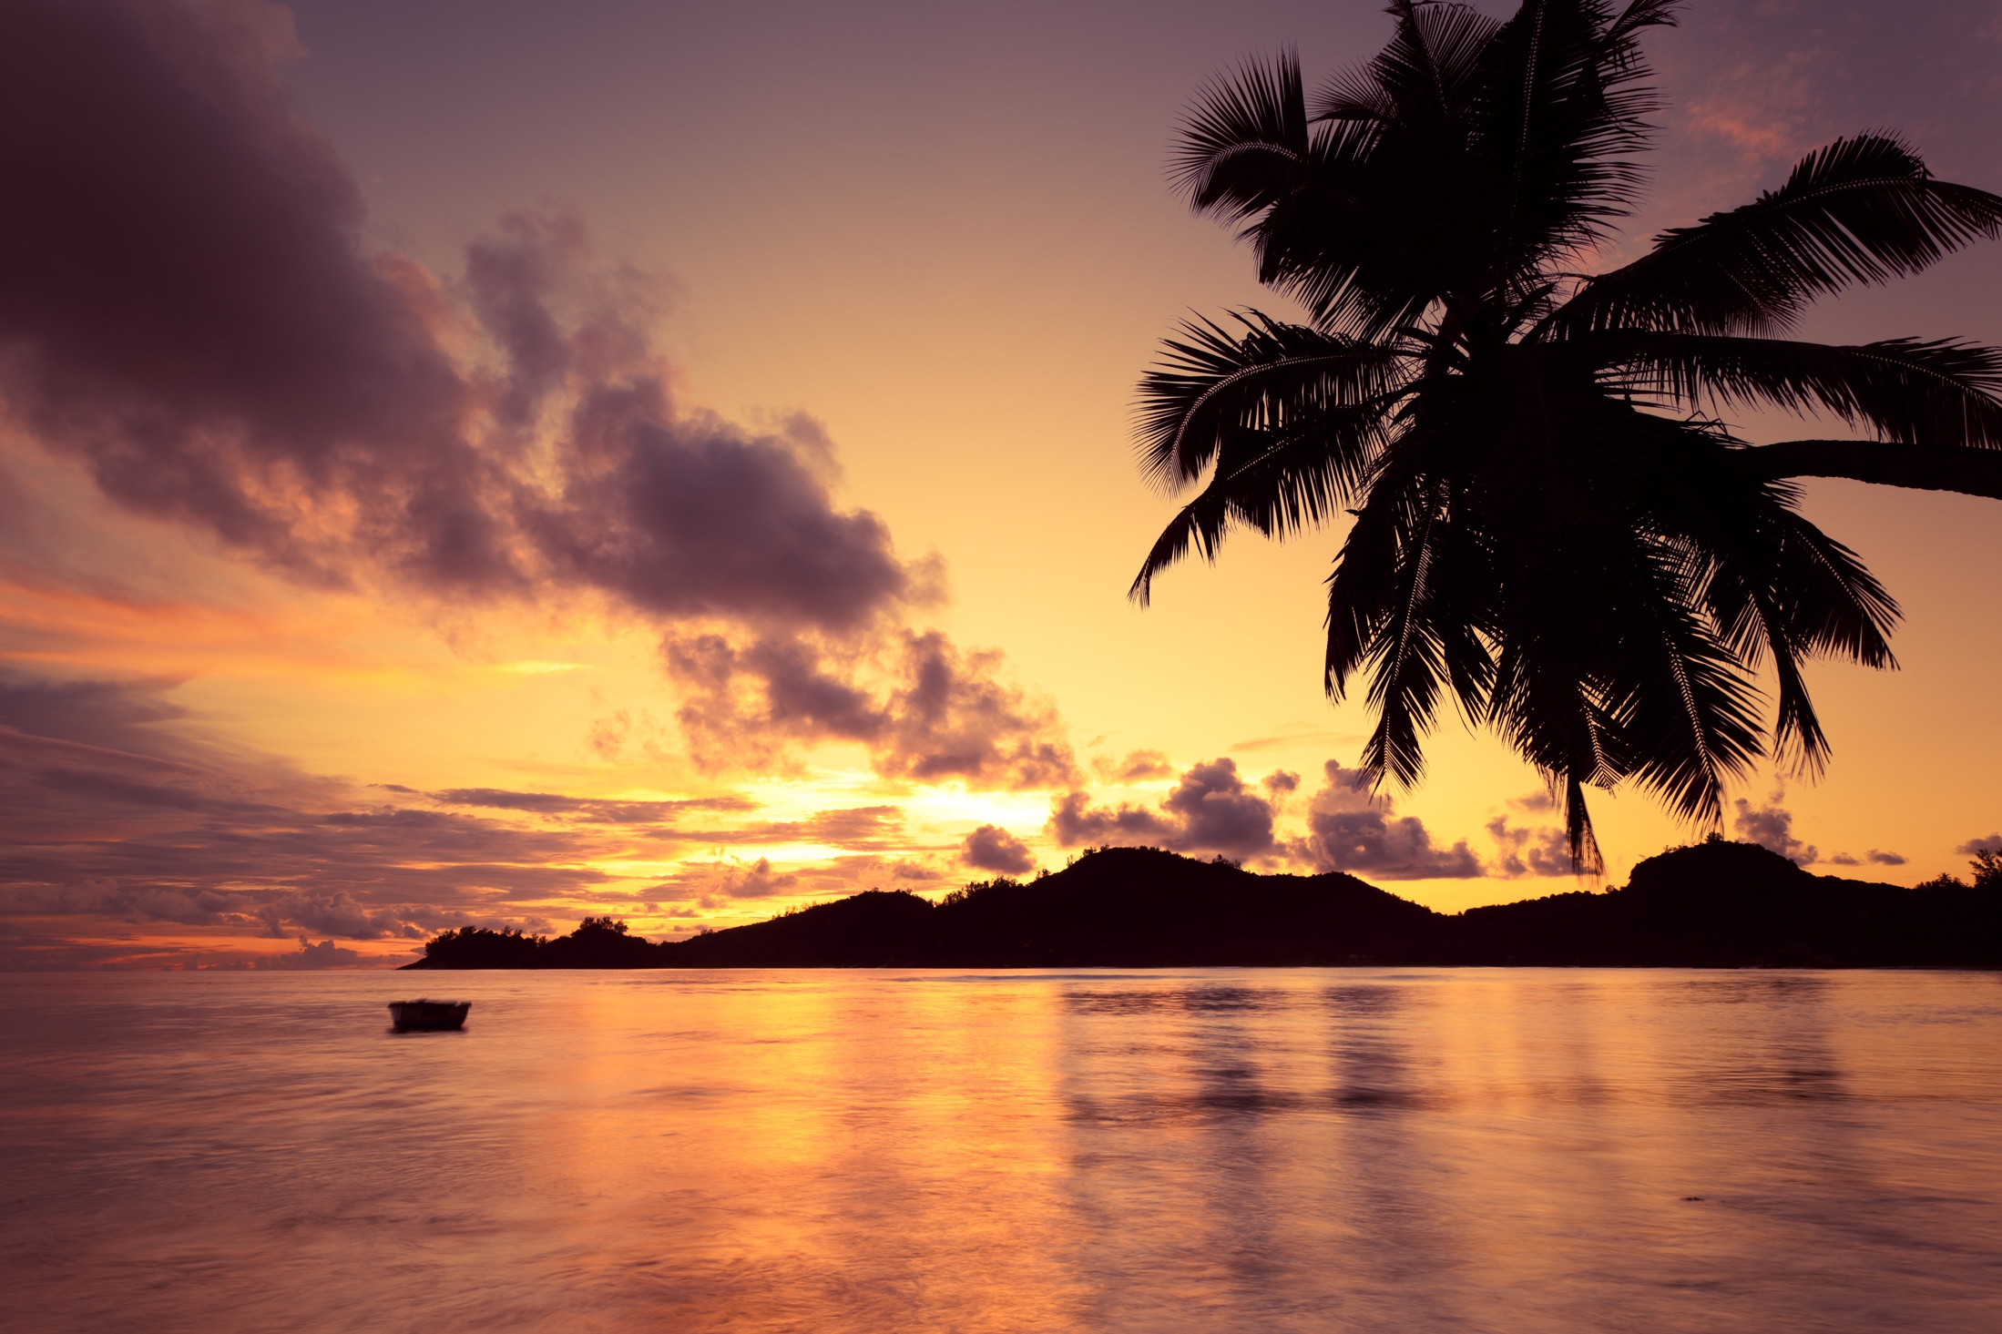
All salt water
NOT an estuary
Notes:
The ocean surrounding this island is NOT an example of an estuary.
It is ALL salt water so it is NOT an estuary.

Slide 50
Notes:
Let’s try a practice question

Slide 51
Estuaries are bodies of water where a(n) ________ flows into a(n) _________.
River; stream
Stream; ocean
Ocean; river
River; ocean
Pond; lake
Notes:
D

Slide 52
Estuaries are bodies of water where a ________ flows into a _________.
River; stream
Stream; ocean
Ocean; river
River; ocean
Pond; lake

Slide 53
Watershed
Notes:
Let’s define the term, watershed.

Slide 54
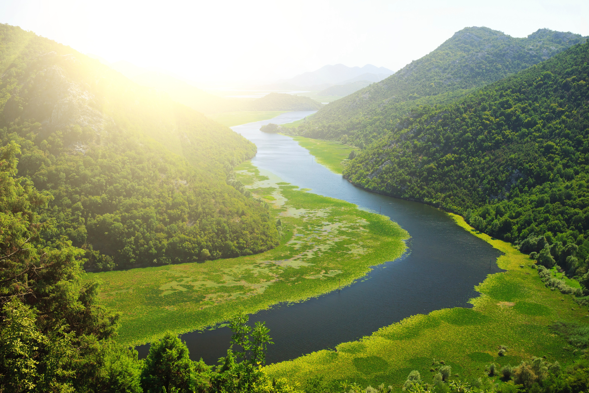
An area of land where
all of the runoff flows downhill
into the same body of water
Notes:
A watershed is an area of land where all of the runoff flows downhill into the same body of water.

Slide 55
An area of land
Land + Water = Watershed
All of the runoff flows downhill into the river.
Notes:
A watershed includes the water and the land. It is not only the water.

Slide 56
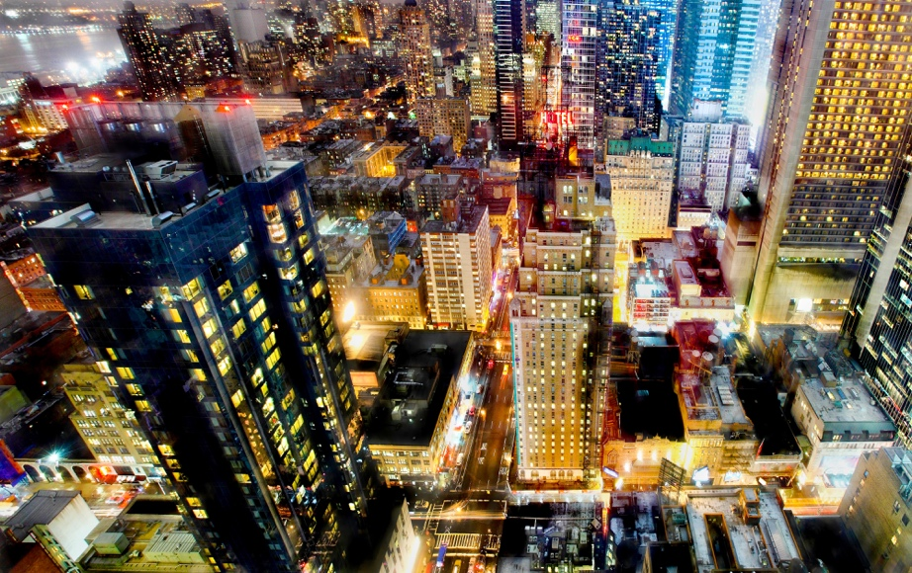
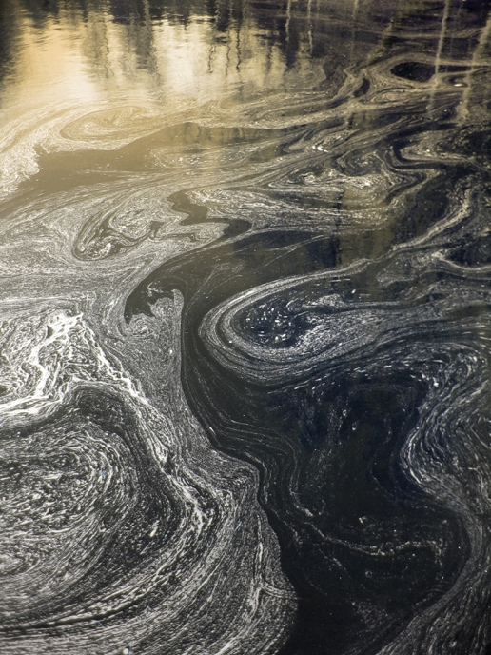
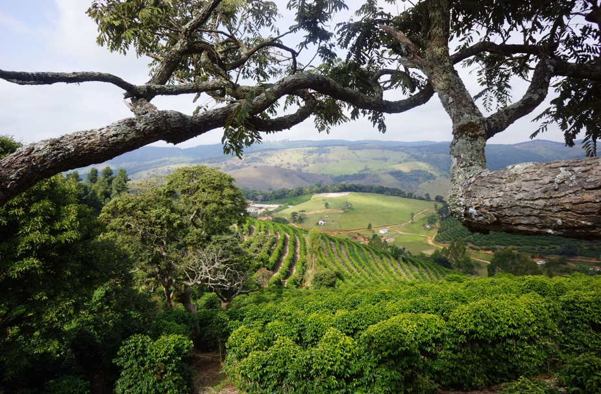
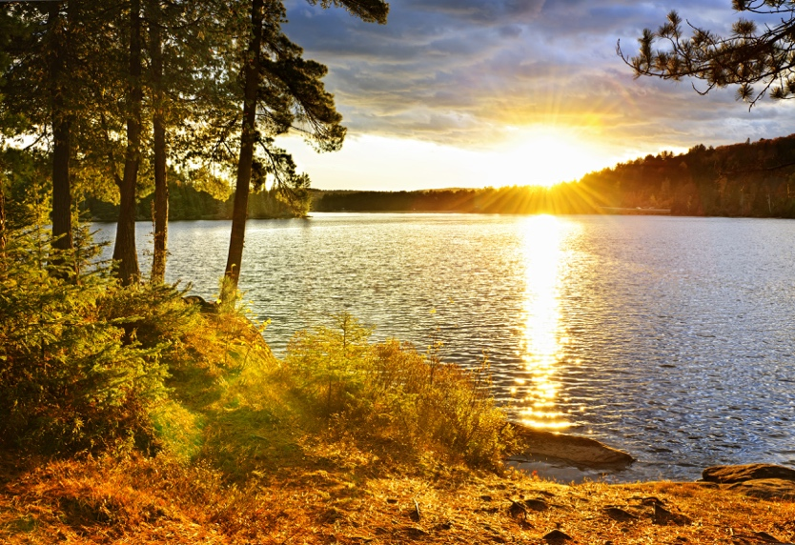
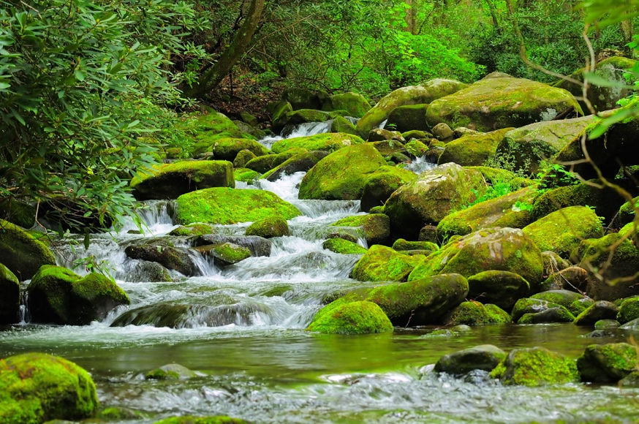
Watershed
Notes:
The watershed includes all sources of water, clean or polluted, and all the land that drain into a watershed

Slide 57
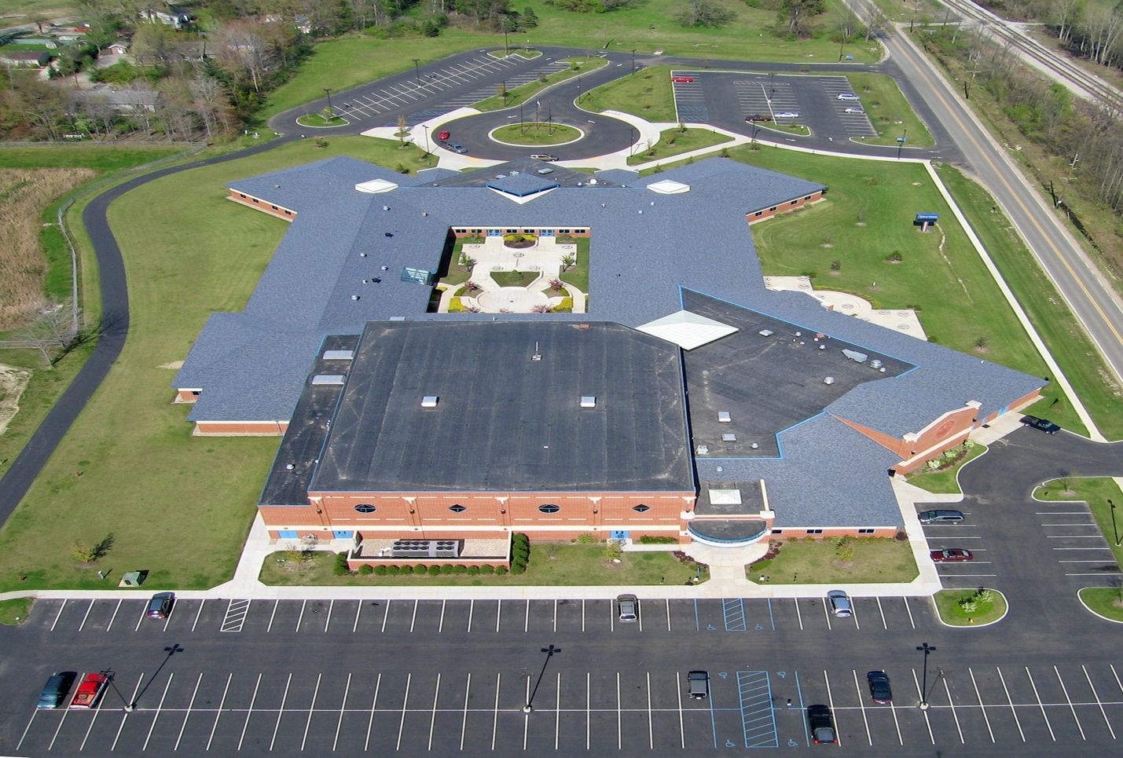
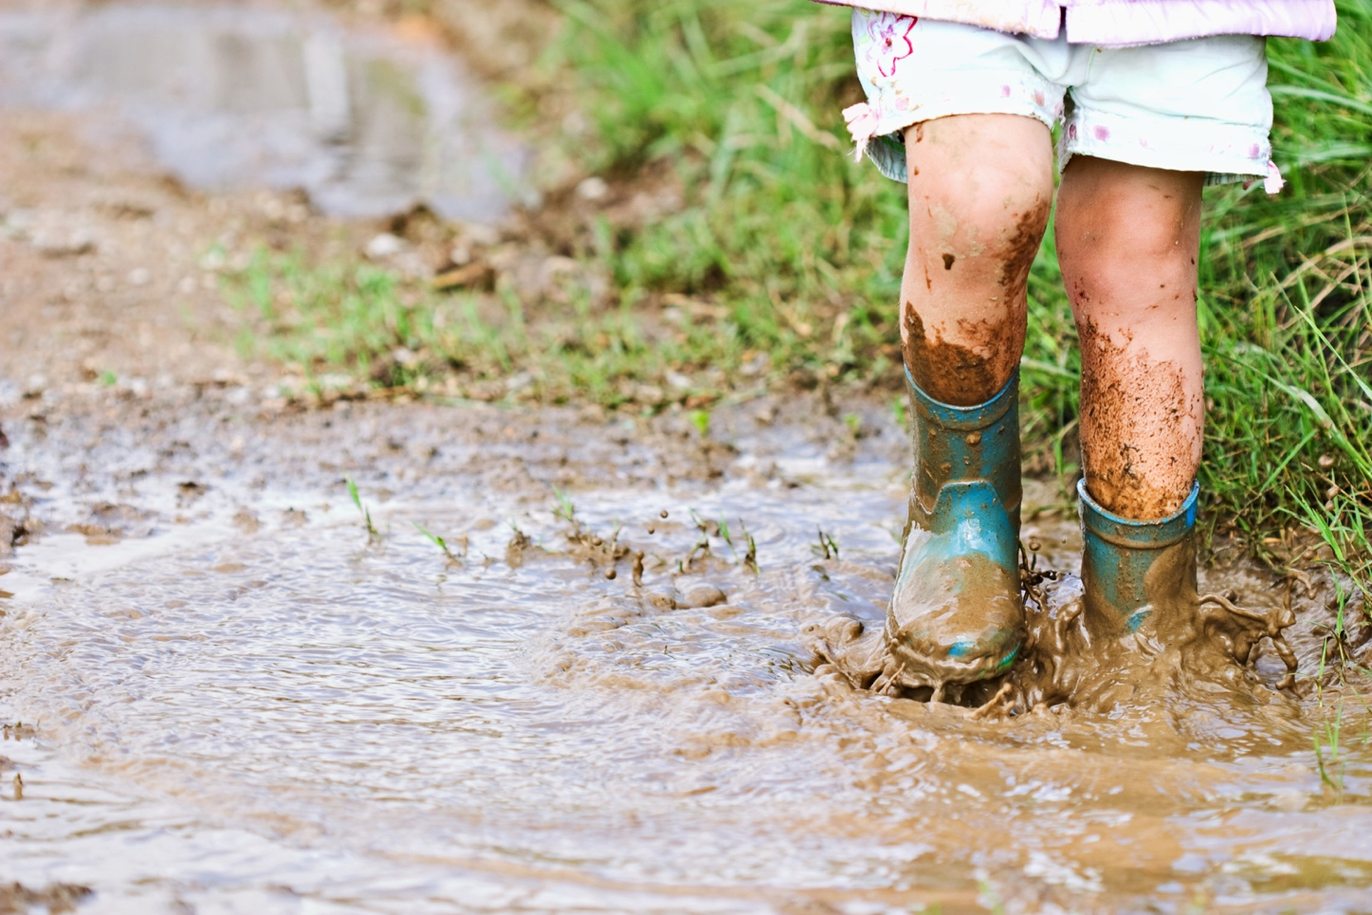
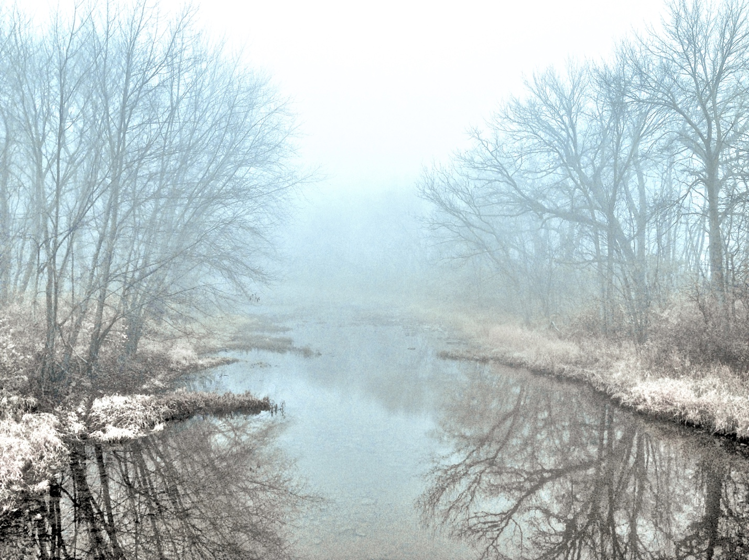
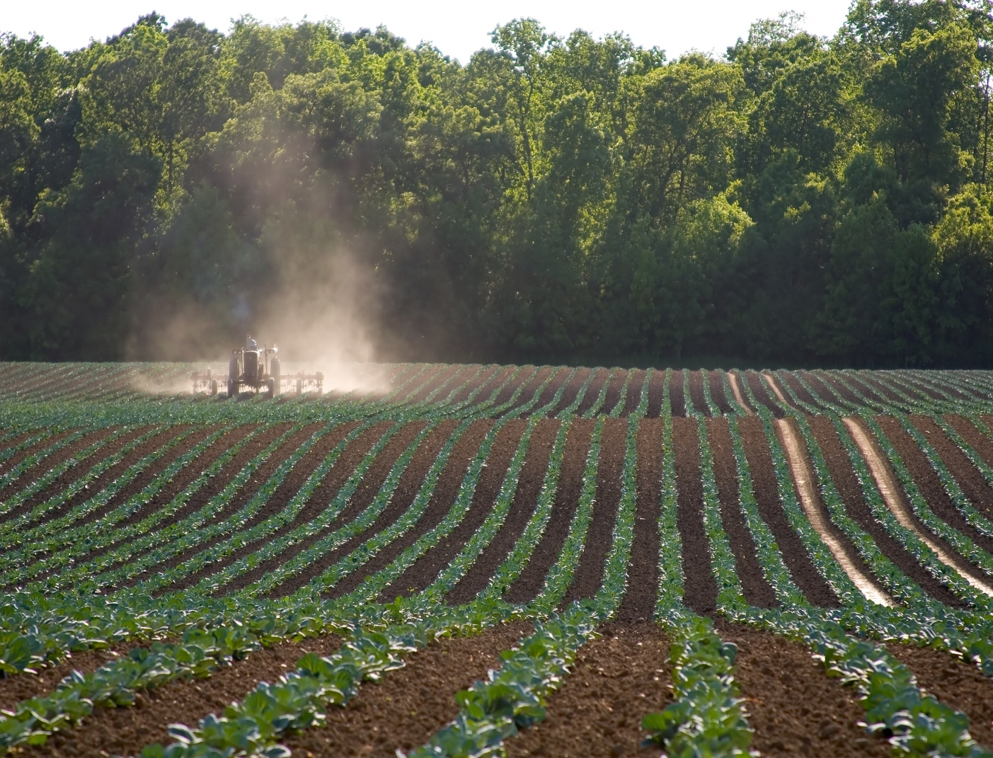
Notes:
So your school parking lot, this puddle, this creek, and this farm are all part of a watershed. All of these eventually drain into a single body of water.

Slide 58
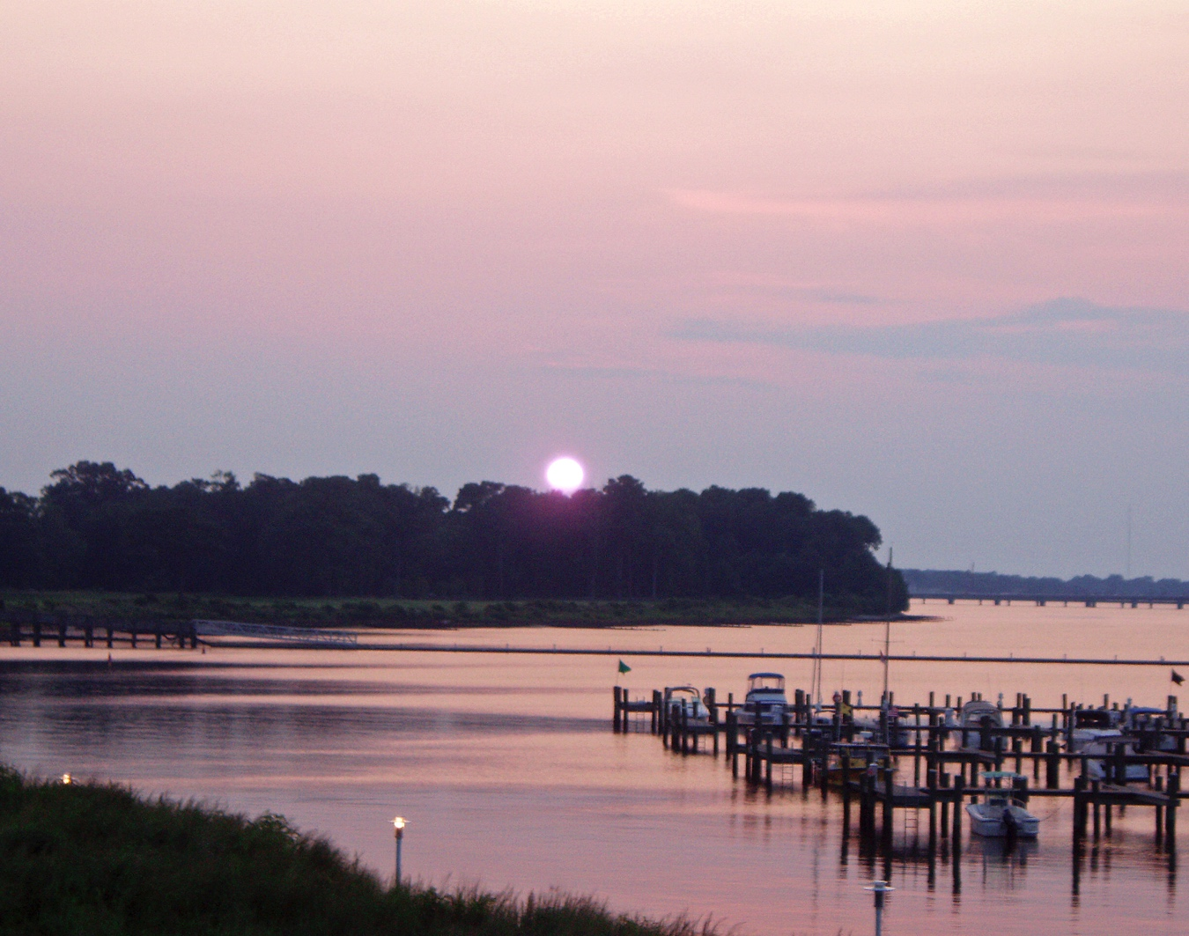
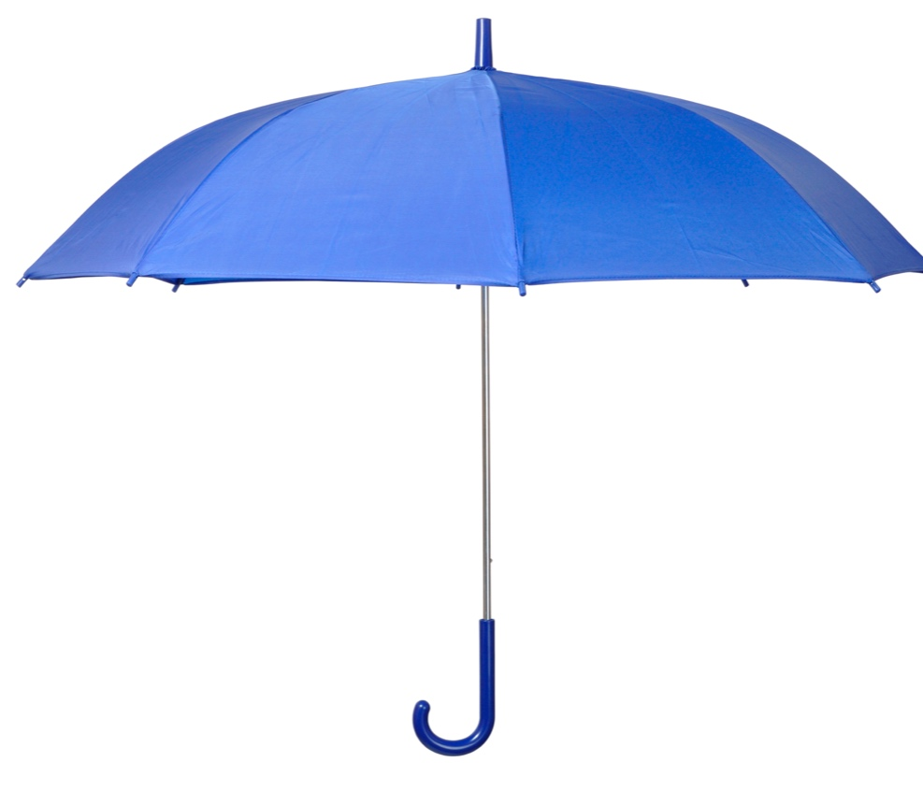
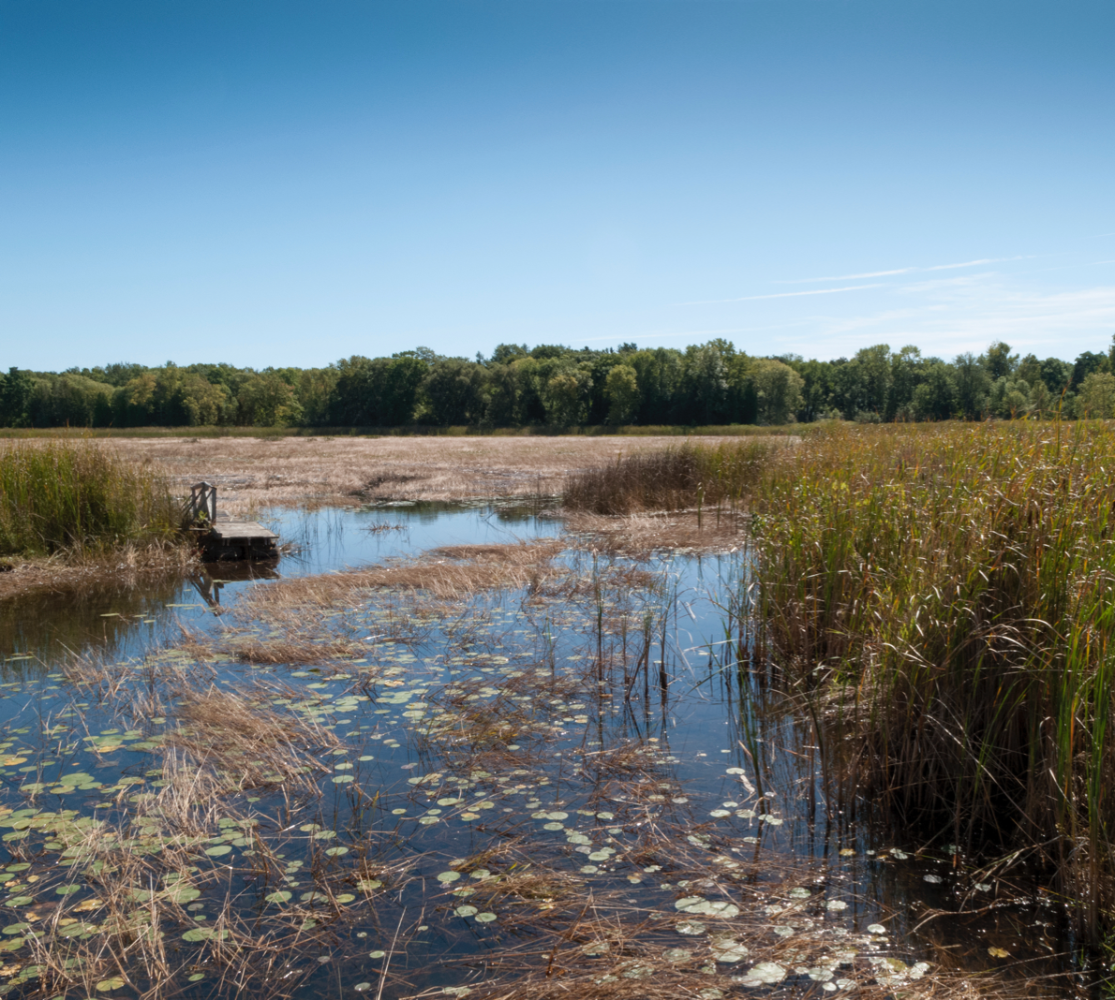
Estuary
Watershed
Wetland
Aquifer
Notes:
Wetlands and estuaries are parts found in many watersheds. Aquifers are found in the soil and rock below most watersheds.

Slide 59
Notes:
Let’s review the definition of watershed.

Slide 60
What is a watershed?
Notes:
What is a watershed?

Slide 61
What are parts that can be found in a watershed?
Notes:
What are parts that can be found in a watershed?

Slide 62
Notes:
Now, let’s talk about some common examples of watersheds.

Slide 63
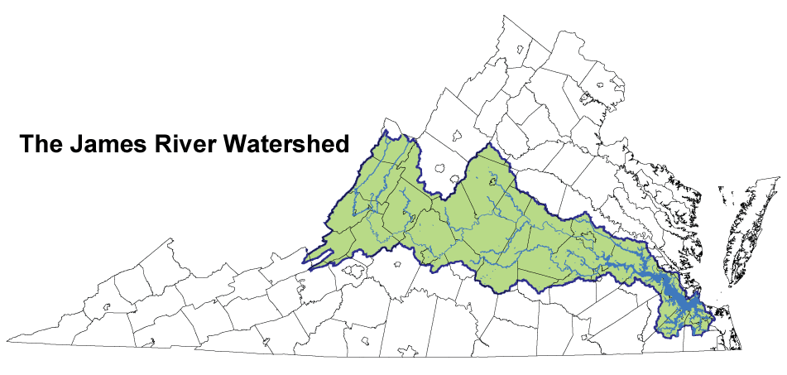
Notes:
An example of a watershed is the James River Watershed.
The watershed includes all the water AND land in that area.

Slide 64
Chesapeake Bay
Watershed
Notes:
Another example of a larger watershed is the Chesapeake Bay Watershed.
The watershed includes all the water AND land in that area.

Slide 65
James River
Watershed
Notes:
The James River watershed exists within the larger Cheasepeake Bay watershed so that is included in BOTH watersheds.

Slide 66
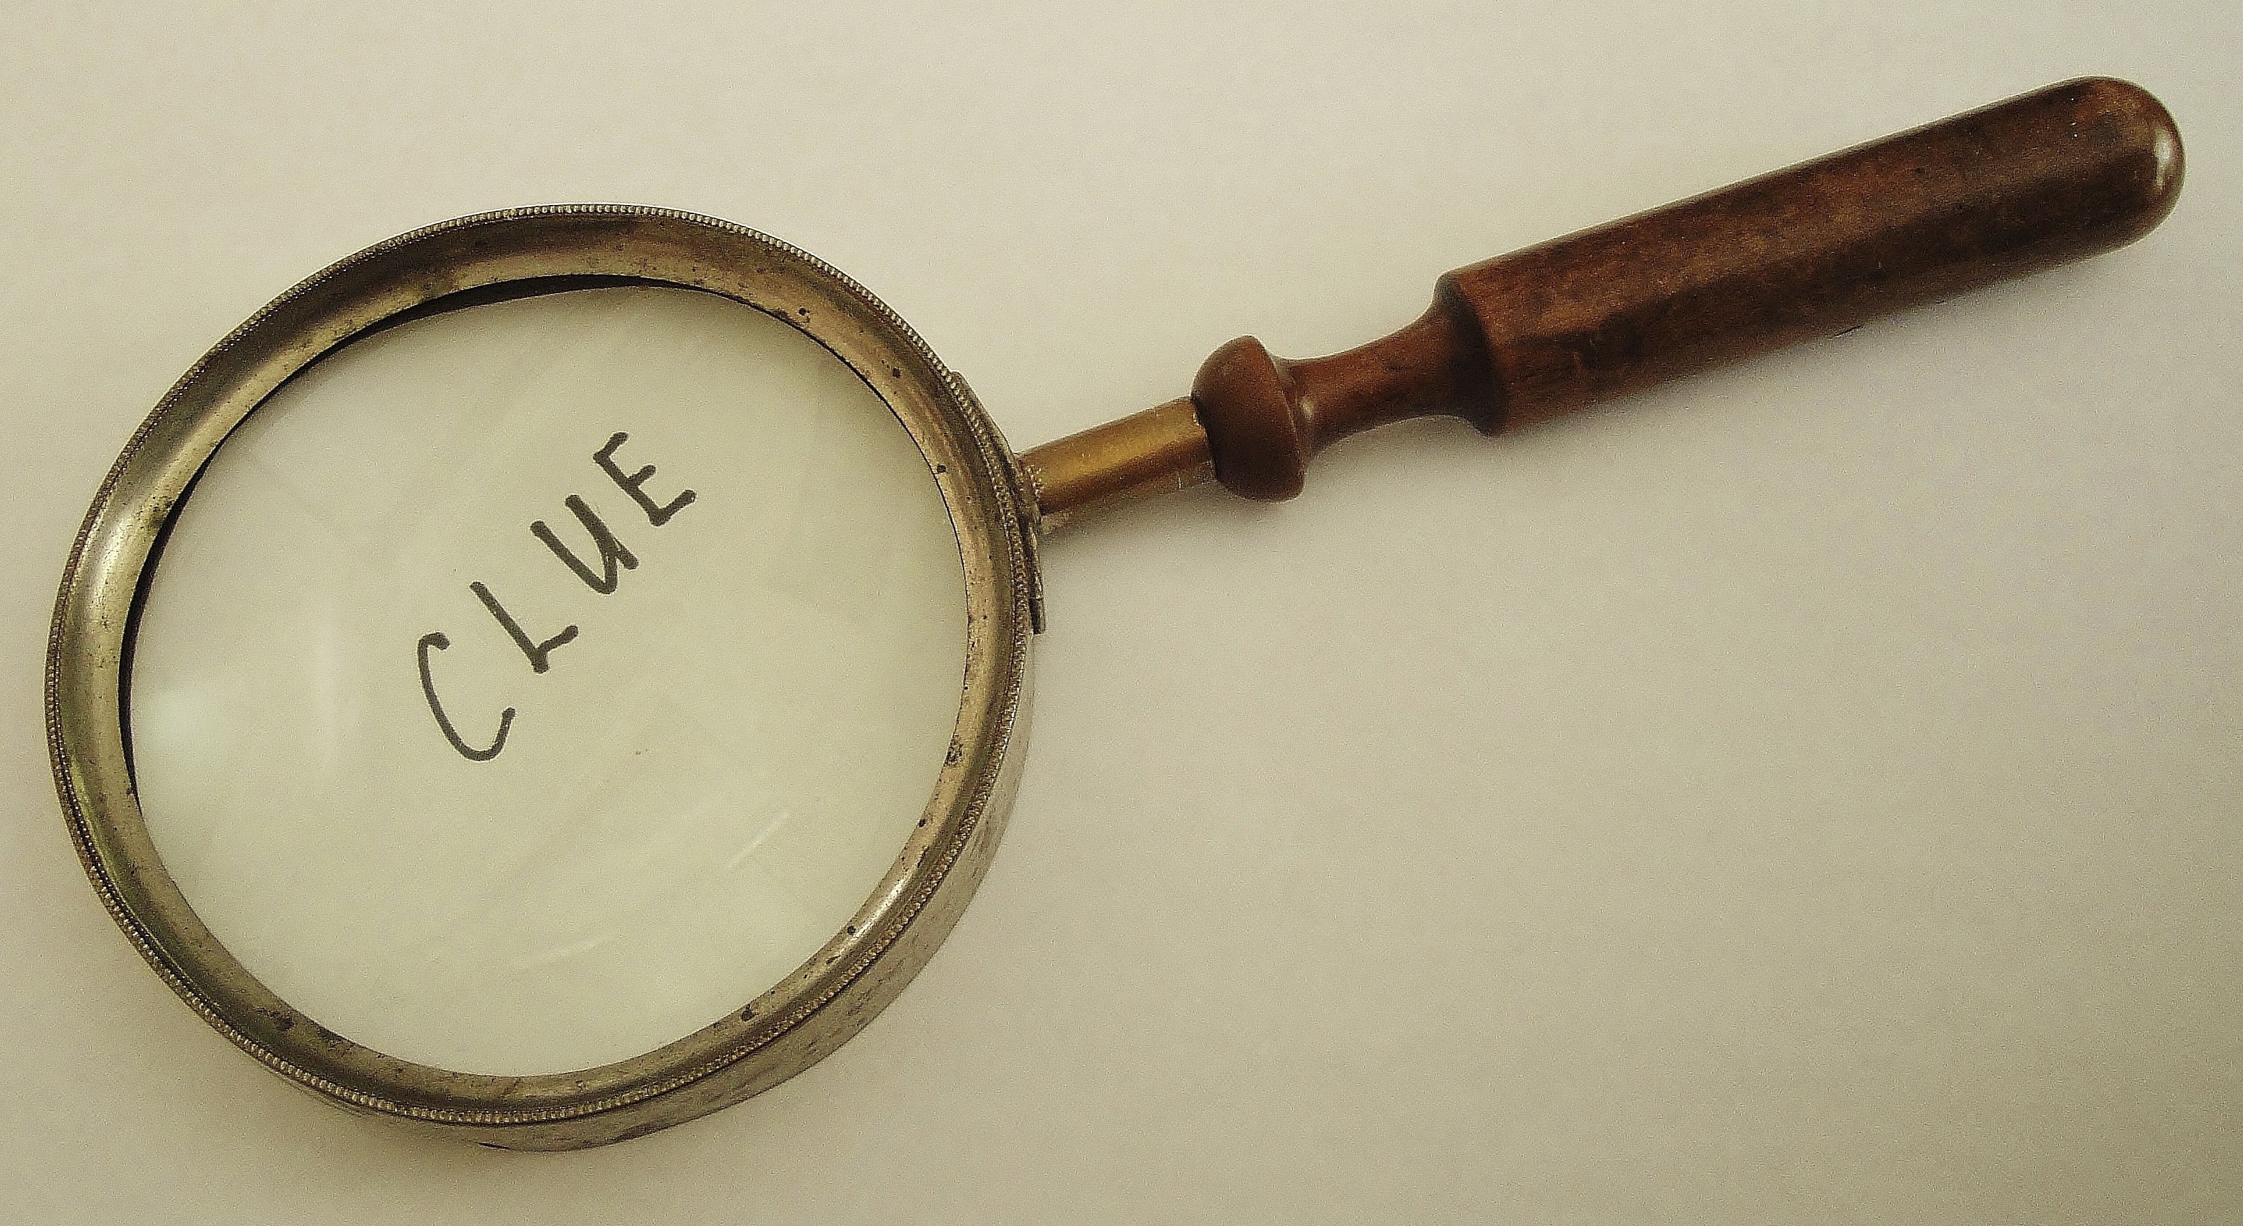
Notes:
Now I’m going to give you a clue to help you remember the term watershed

Slide 67
Watershed
Notes:
We can break the word down to help remember what it means. Watershed begins with water. Water flows through the watershed.

Slide 68
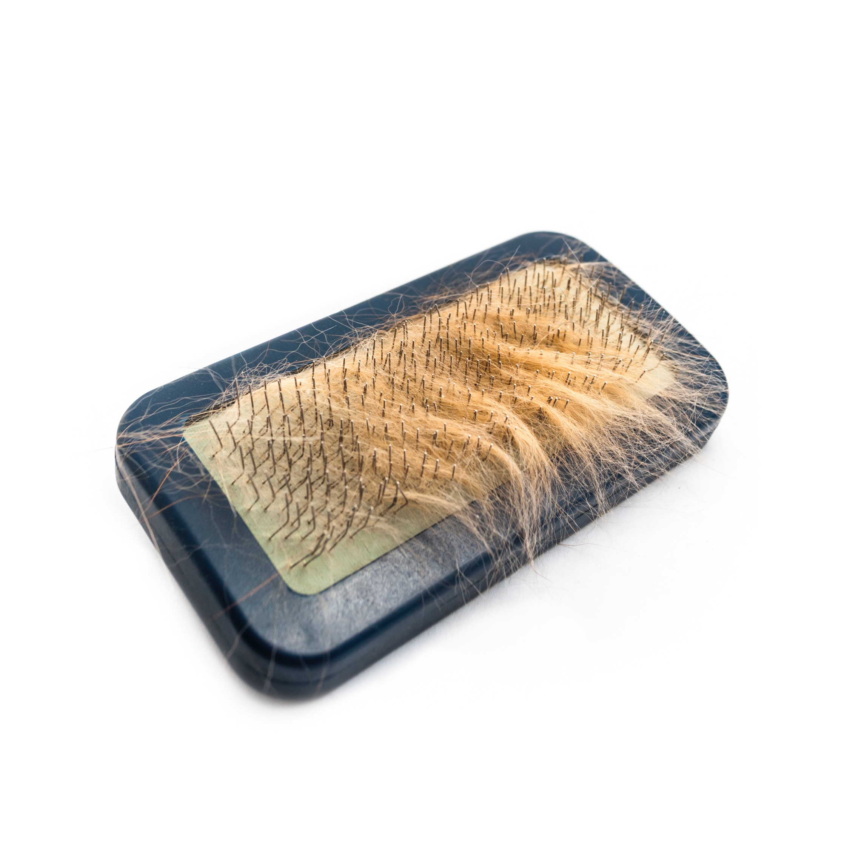
Watershed
Notes:
Watershed ends in shed. Shed can mean to cast off or to let fall. A dog sheds its fur.

Slide 69
Watershed
Notes:
Likewise, a watershed sheds the rainwater that falls on it. This rainwater all collects in the same location.

Slide 70
Body of water | What is it?
Estuary | ?
Wetland | ?
Watershed | ?
Notes:
Summary

Slide 71
Body of water | What is it?
Estuary | Partially enclosed body of water formed where a river flows into an ocean
Wetland | An area that is saturated with water for at least part of the year
Watershed | An area of land where all of the runoff flows downhill into the same body of water
Notes:
Summary

Slide 72
REVIEW QUESTIONS
Notes:
Let’s take a minute to review some questions.

Slide 73
Which body of water is often protected naturally from storms by barrier islands and contains a mixture of fresh water and salt water?
Estuary
Ocean
Lake
Wetland
Notes:
Estuary
Ocean
Lake
Wetland

Slide 74
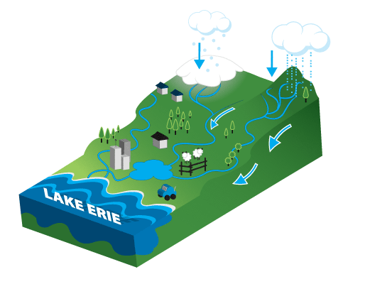
The picture below can be best described as a(n) --
Estuary
Pond
Wetland
Watershed
Notes:
Estuary
Pond
Wetland
Watershed

Slide 75
Which organism would you most likely not find in a wetland?
Frogs
Alligators
Moss
Cactus
Notes:
Frogs
Alligators
Moss
Cactus

Slide 76
Remember!!!
Notes:
So remember!

Slide 77
Wetland
An area that is saturated with water for at least part of the year
Notes:
A wetland is an area that is saturated with water for at least part of the year.

Slide 78
Estuary
Partially enclosed body of water formed where a river flows into an ocean

Slide 79
An area of land where
all of the runoff flows downhill
into the same body of water
Notes:
A watershed is an area of land where all of the runoff flows downhill into the same body of water.

Slide 80
Notes:
Thanks for watching, and please continue watching CAPs available from this website.

Slide 81
This PowerPoint was Created With Resources From:
Cooperative Agreement # R324B130023
Curry School Foundation’s Research and Development Fund
Questions or Comments to Michael Kennedy, Ph.D.
MKennedy@Virginia.edu

Slide 82
Activity
Activity: Sensational Wetlands!
Students will be able to differentiate wetlands from others habitats and list some plants and animals that live in wetlands
Go to this link for the procedure
Materials:
Picture of wetlands
Items to create model: large tray, clay, sponges, and water in container
Blindfold
Containers of dirt, water, and soil from wetland
Recordings of sounds from wetland; foods from wetlands
Resources:
https://wetlandslive.pwnet.org/pdf/1.1_SensationalWetlands.pdf
Notes:
See procedure at: https://wetlandslive.pwnet.org/pdf/1.1_SensationalWetlands.pdf

