Slide 1
Notes:
OK everyone get ready to learn a new vocabulary term.

Slide 2
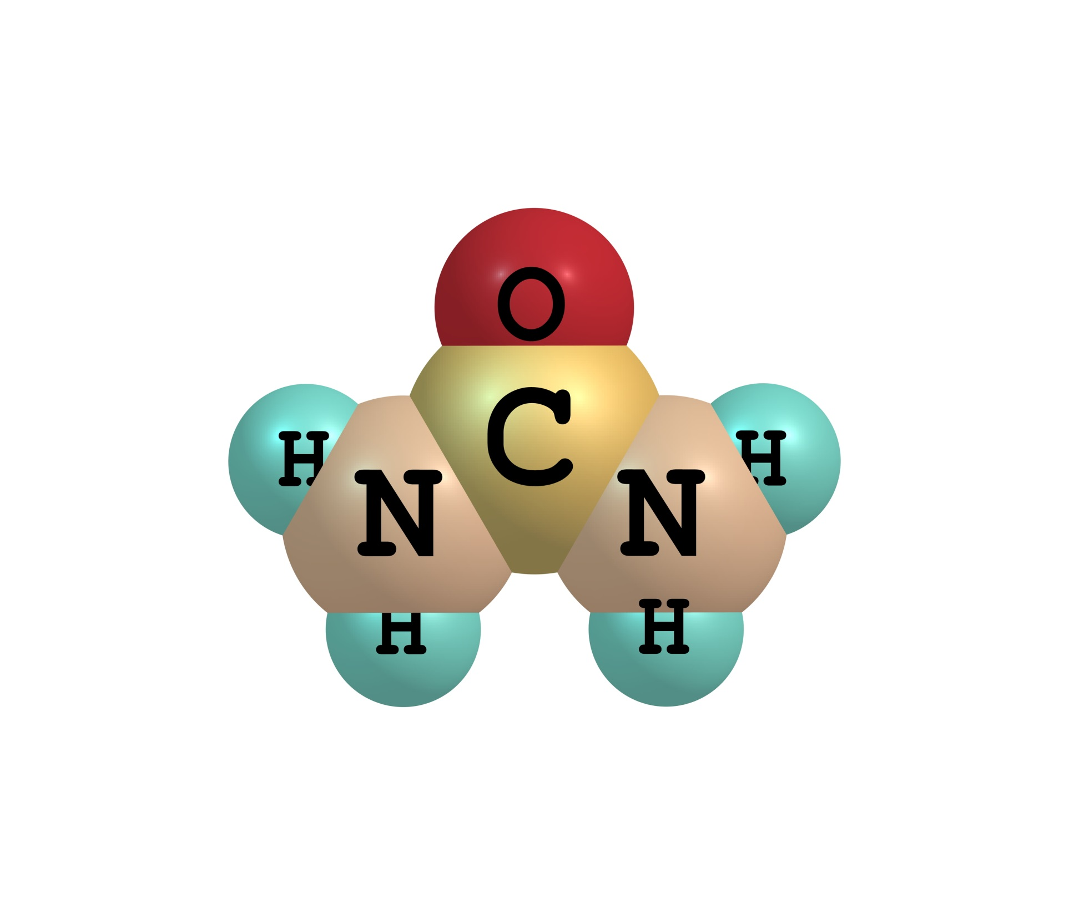
Organic:
Any compound that has Carbon
Inorganic:
Any compound that does not have Carbon
Notes:
In this video we talk about inorganic and organic compounds.

Slide 3
Notes:
Before we define these terms, we need to review some other words we have discussed already.

Slide 4
Matter:
has mass and takes up space
Notes:
First, remember that matter is anything that has mass and takes up space.

Slide 5
Atom: Smallest whole unit of matter
Notes:
Also, remember that an atom is the smallest whole unit of matter. All matter is made up of atoms.

Slide 6
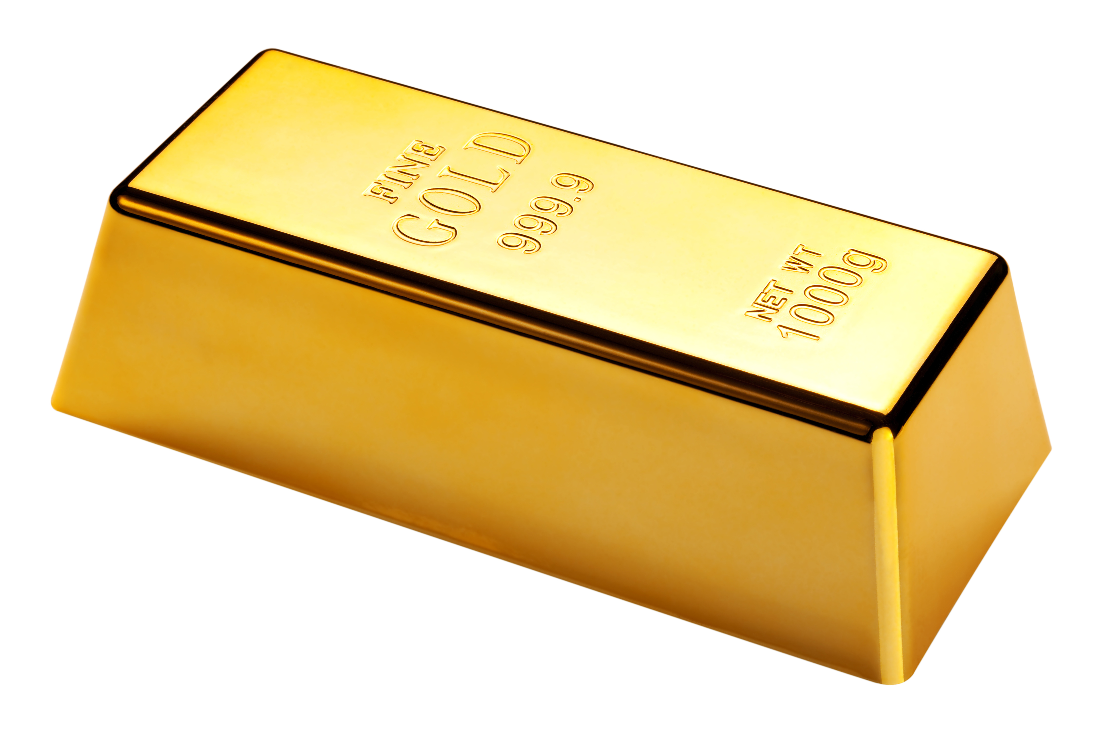
Element: A pure substance containing only 1 type of individual atoms
Notes:
And also recall that an element is a pure substance containing only 1 type of individual atoms

Slide 7
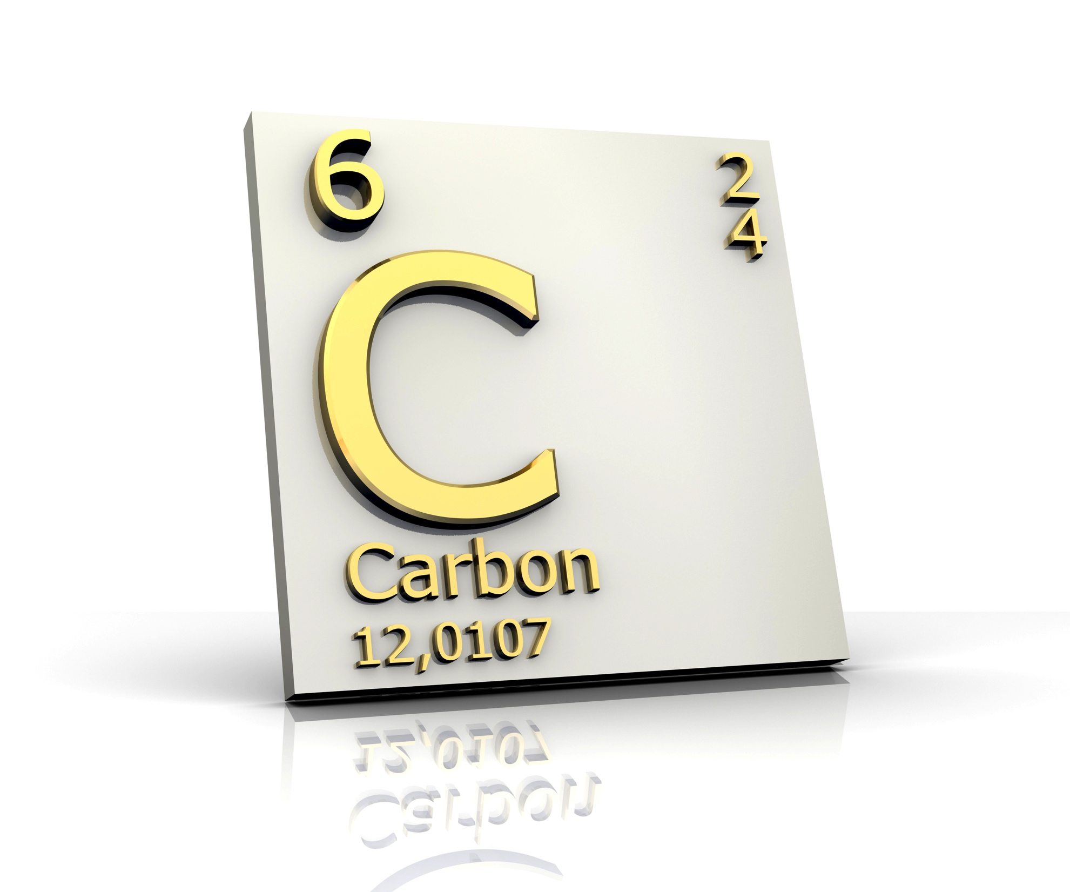
Notes:
One example of an element is carbon, which has the symbol C. Carbon is going to be an important element for us to think about today!

Slide 8
Compound: molecule containing atoms of at least two different elements
Different
Notes:
Lastly, a compound is a type of molecule that is made up of two or more atoms from DIFFERENT elements

Slide 9
Notes:
Now let’s pause for a moment to review the information we have covered already.

Slide 10
What is an element?
Notes:
What is an element?
A pure substance containing only 1 type of individual atoms

Slide 11
What is a compound?
Notes:
What is a compound?
A molecule containing atoms of at least two different elements

Slide 12
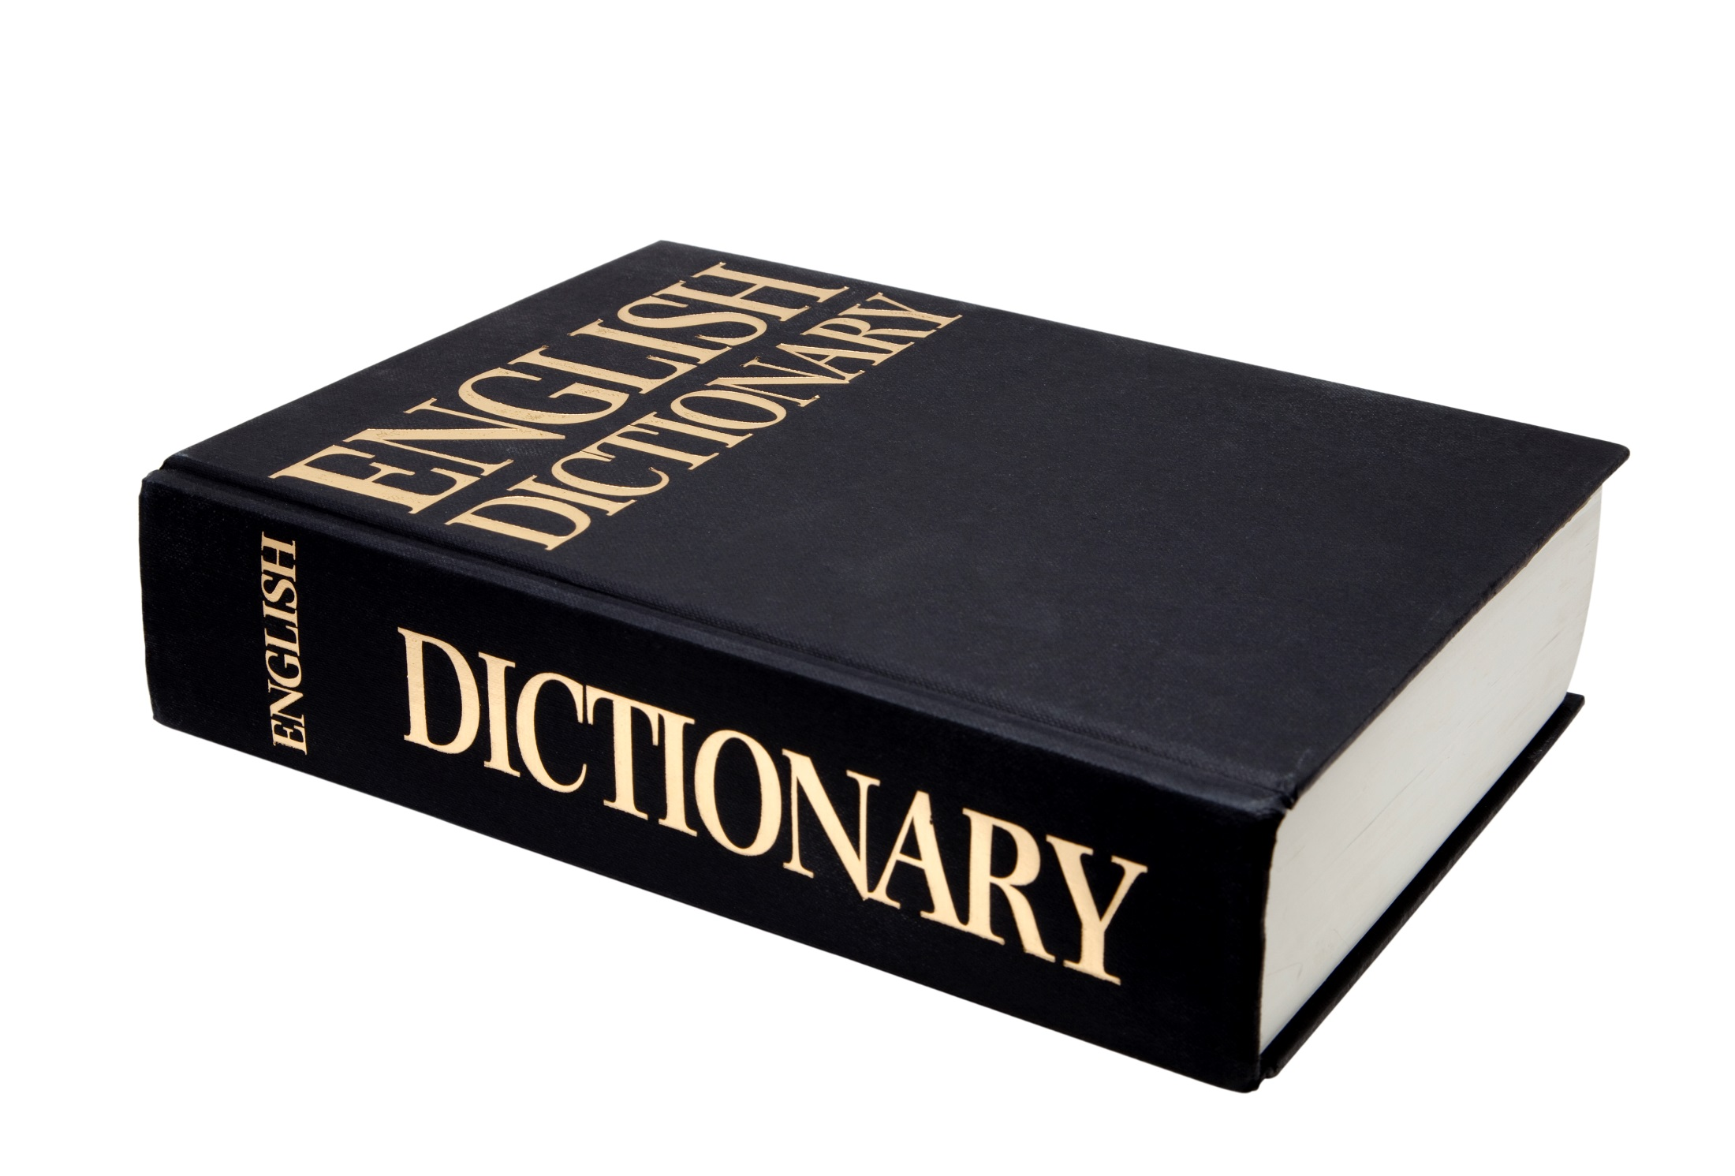
Organic Compound
Notes:
Now, let’s define the term organic compound.

Slide 13
Organic:
Any compound that has Carbon
Notes:
An organic compound is any compound whose molecules contain Carbon

Slide 14
Notes:
Now let’s look at some examples for organic compounds.

Slide 15
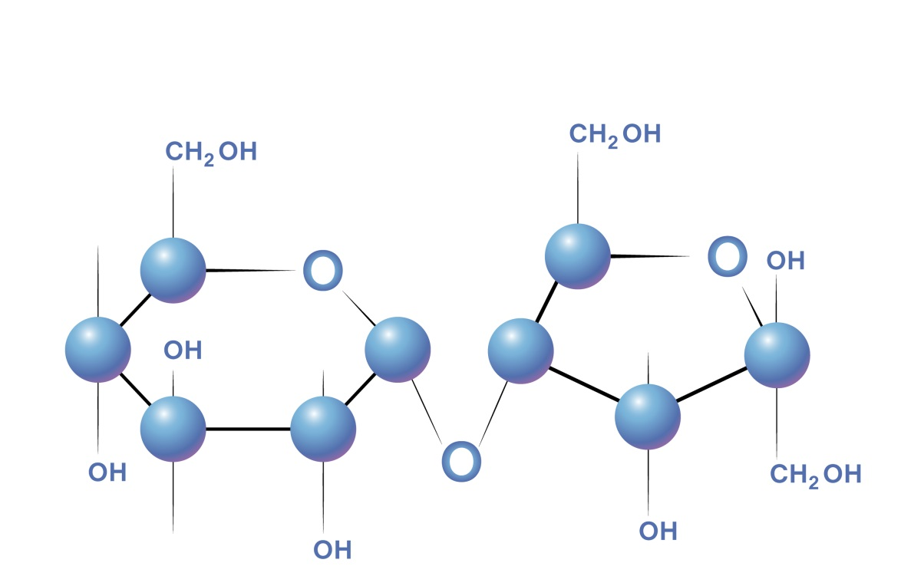
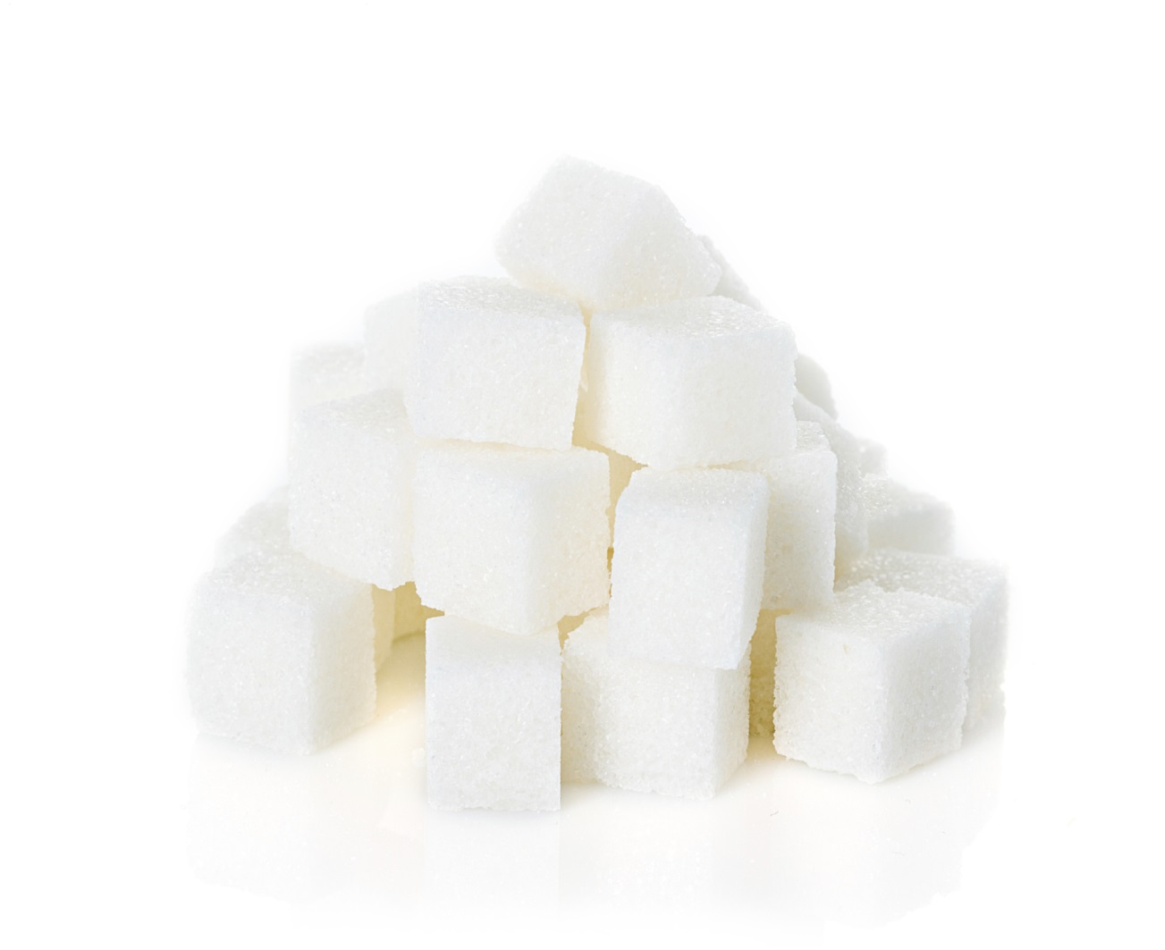
Sucrose = C₁₂H₂₂O₁₁
Notes:
Sucrose, or sugar, is an example of an organic compound because it has carbon in it. Look at the formula at the top. Notice how it contains 12 atoms of carbon. Because it has the element carbon it is an organic compound

Slide 16
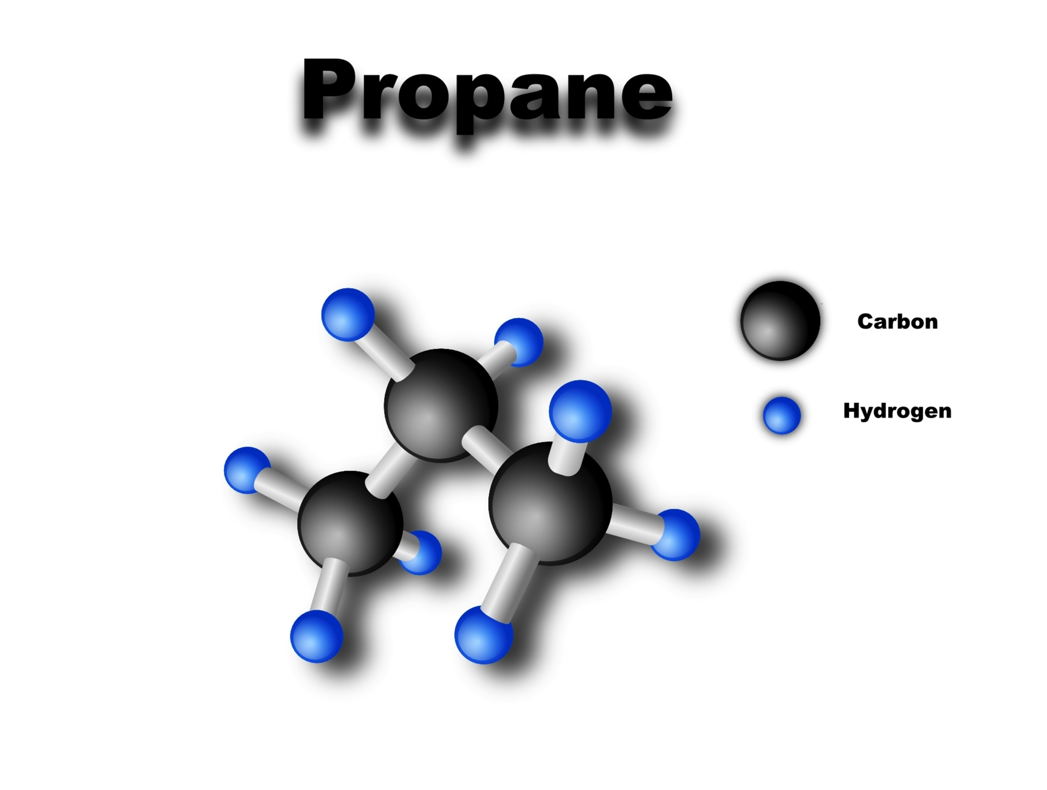
Notes:
Propane is another example of a organic compound because a propane compound has carbon atoms in it. Propane is a gas that is used for fuel

Slide 17
Notes:
Let’s review the definition of organic compound

Slide 18
What is an organic compound?
Notes:
What is an organic compound?

Slide 19
Inorganic Compound
Notes:
Now, let’s define the term inorganic compounds

Slide 20
Inorganic:
Any compound that does not have Carbon
Notes:
An organic compound is any compound whose molecules do not have Carbon

Slide 21
Notes:
Let’s review the definition of organic and inorganic compound

Slide 22
What is an inorganic compound?
Notes:
What is an inorganic compound?

Slide 23
How is an organic compound different than a nonorganic compound?
Notes:
What is an inorganic compound?

Slide 24
Inorganic
Notes:
The word inorganic has word parts that give us a clue to its meaning. Let’s look at what these word parts are and how they can help you.

Slide 25
In
+
Organic
Not
+
Containing Carbon
Notes:
Inorganic has the word parts in and organic.
In is a prefix that means not
In chemistry, organic means containing carbon
Together, inorganic means not containing carbon.

Slide 26
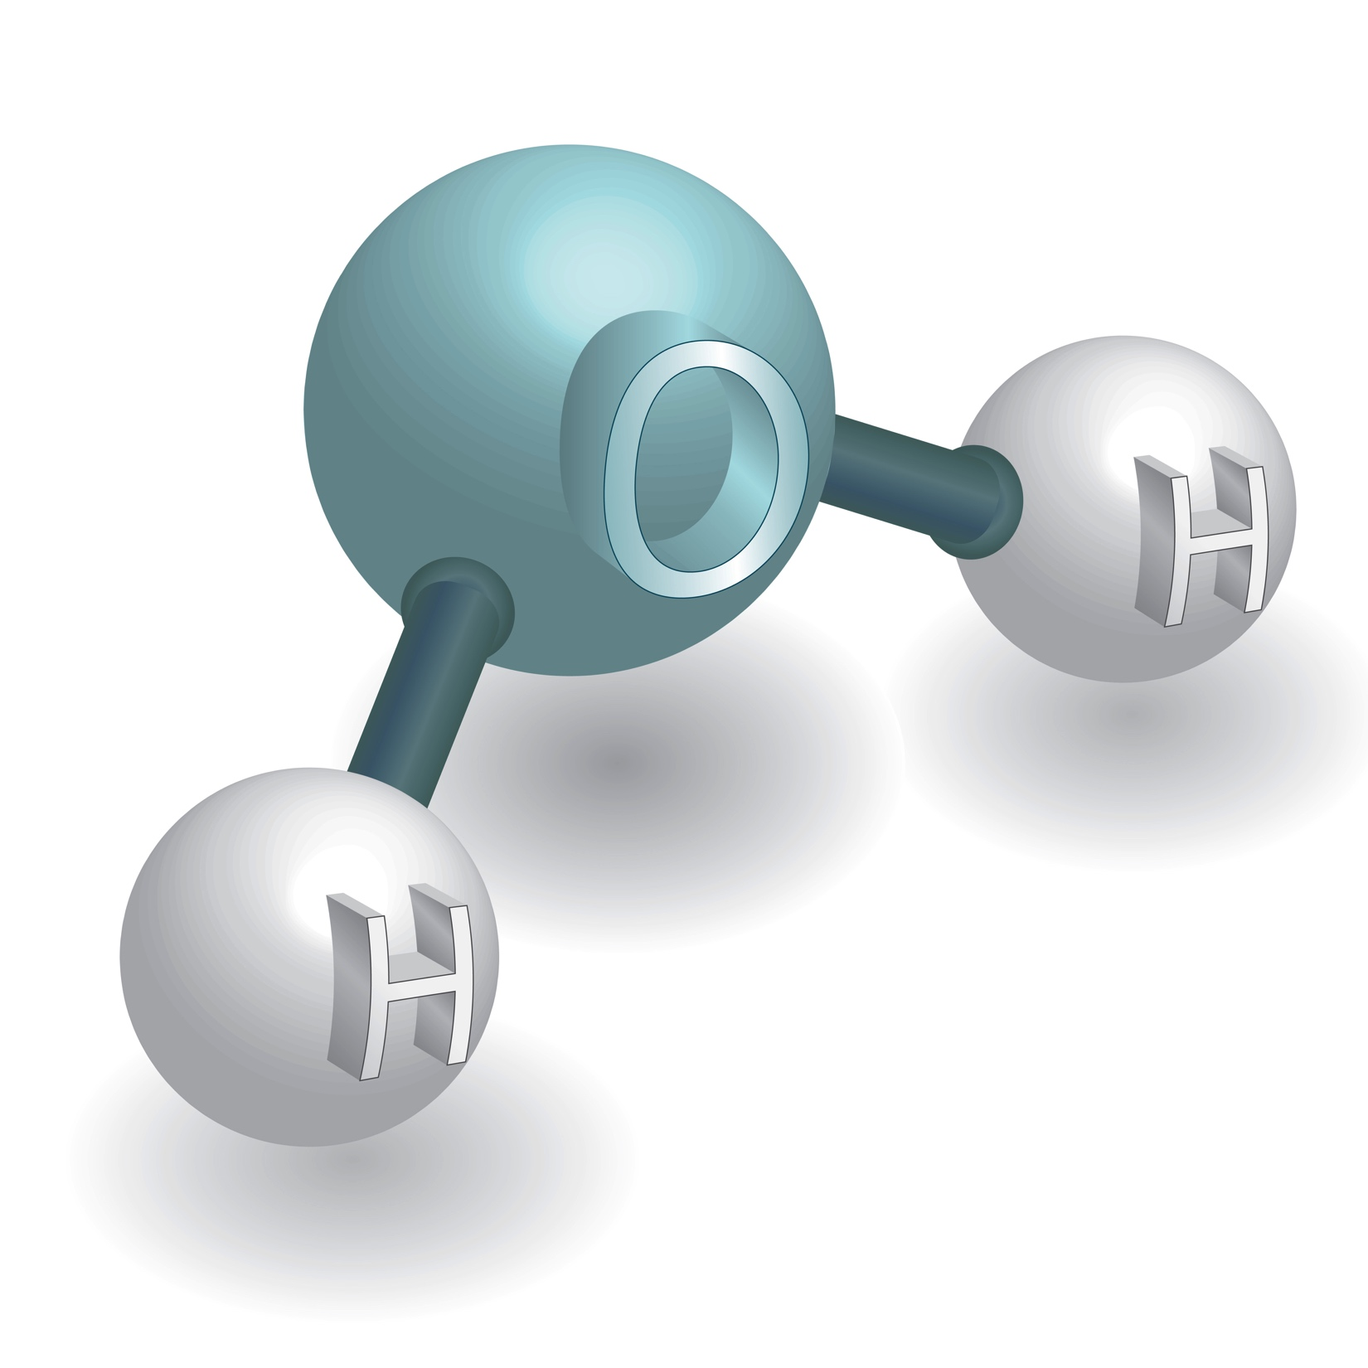
Water
=
H₂0
Notes:
Water is an example of an inorganic compound because it does not have carbon in it.

Slide 27
Notes:
Let’s review what we have learned one more time.

Slide 28
What is an organic compound?
Notes:
What is an organic compound?

Slide 29
What is an inorganic compound?
Notes:
What is an inorganic compound?

Slide 30
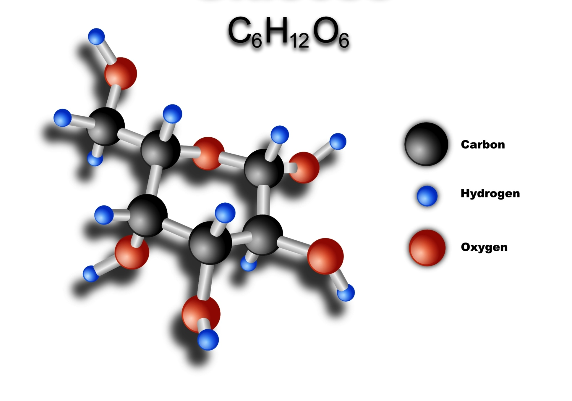
Notes:
Is this an organic or inorganic compound?

Slide 31
Notes:
This an organic compound because it contains carbon atoms.

Slide 32
Notes:
Is this an organic or inorganic compound?

Slide 33
Notes:
This an inorganic compound. It does not contain any carbon atoms.

Slide 34
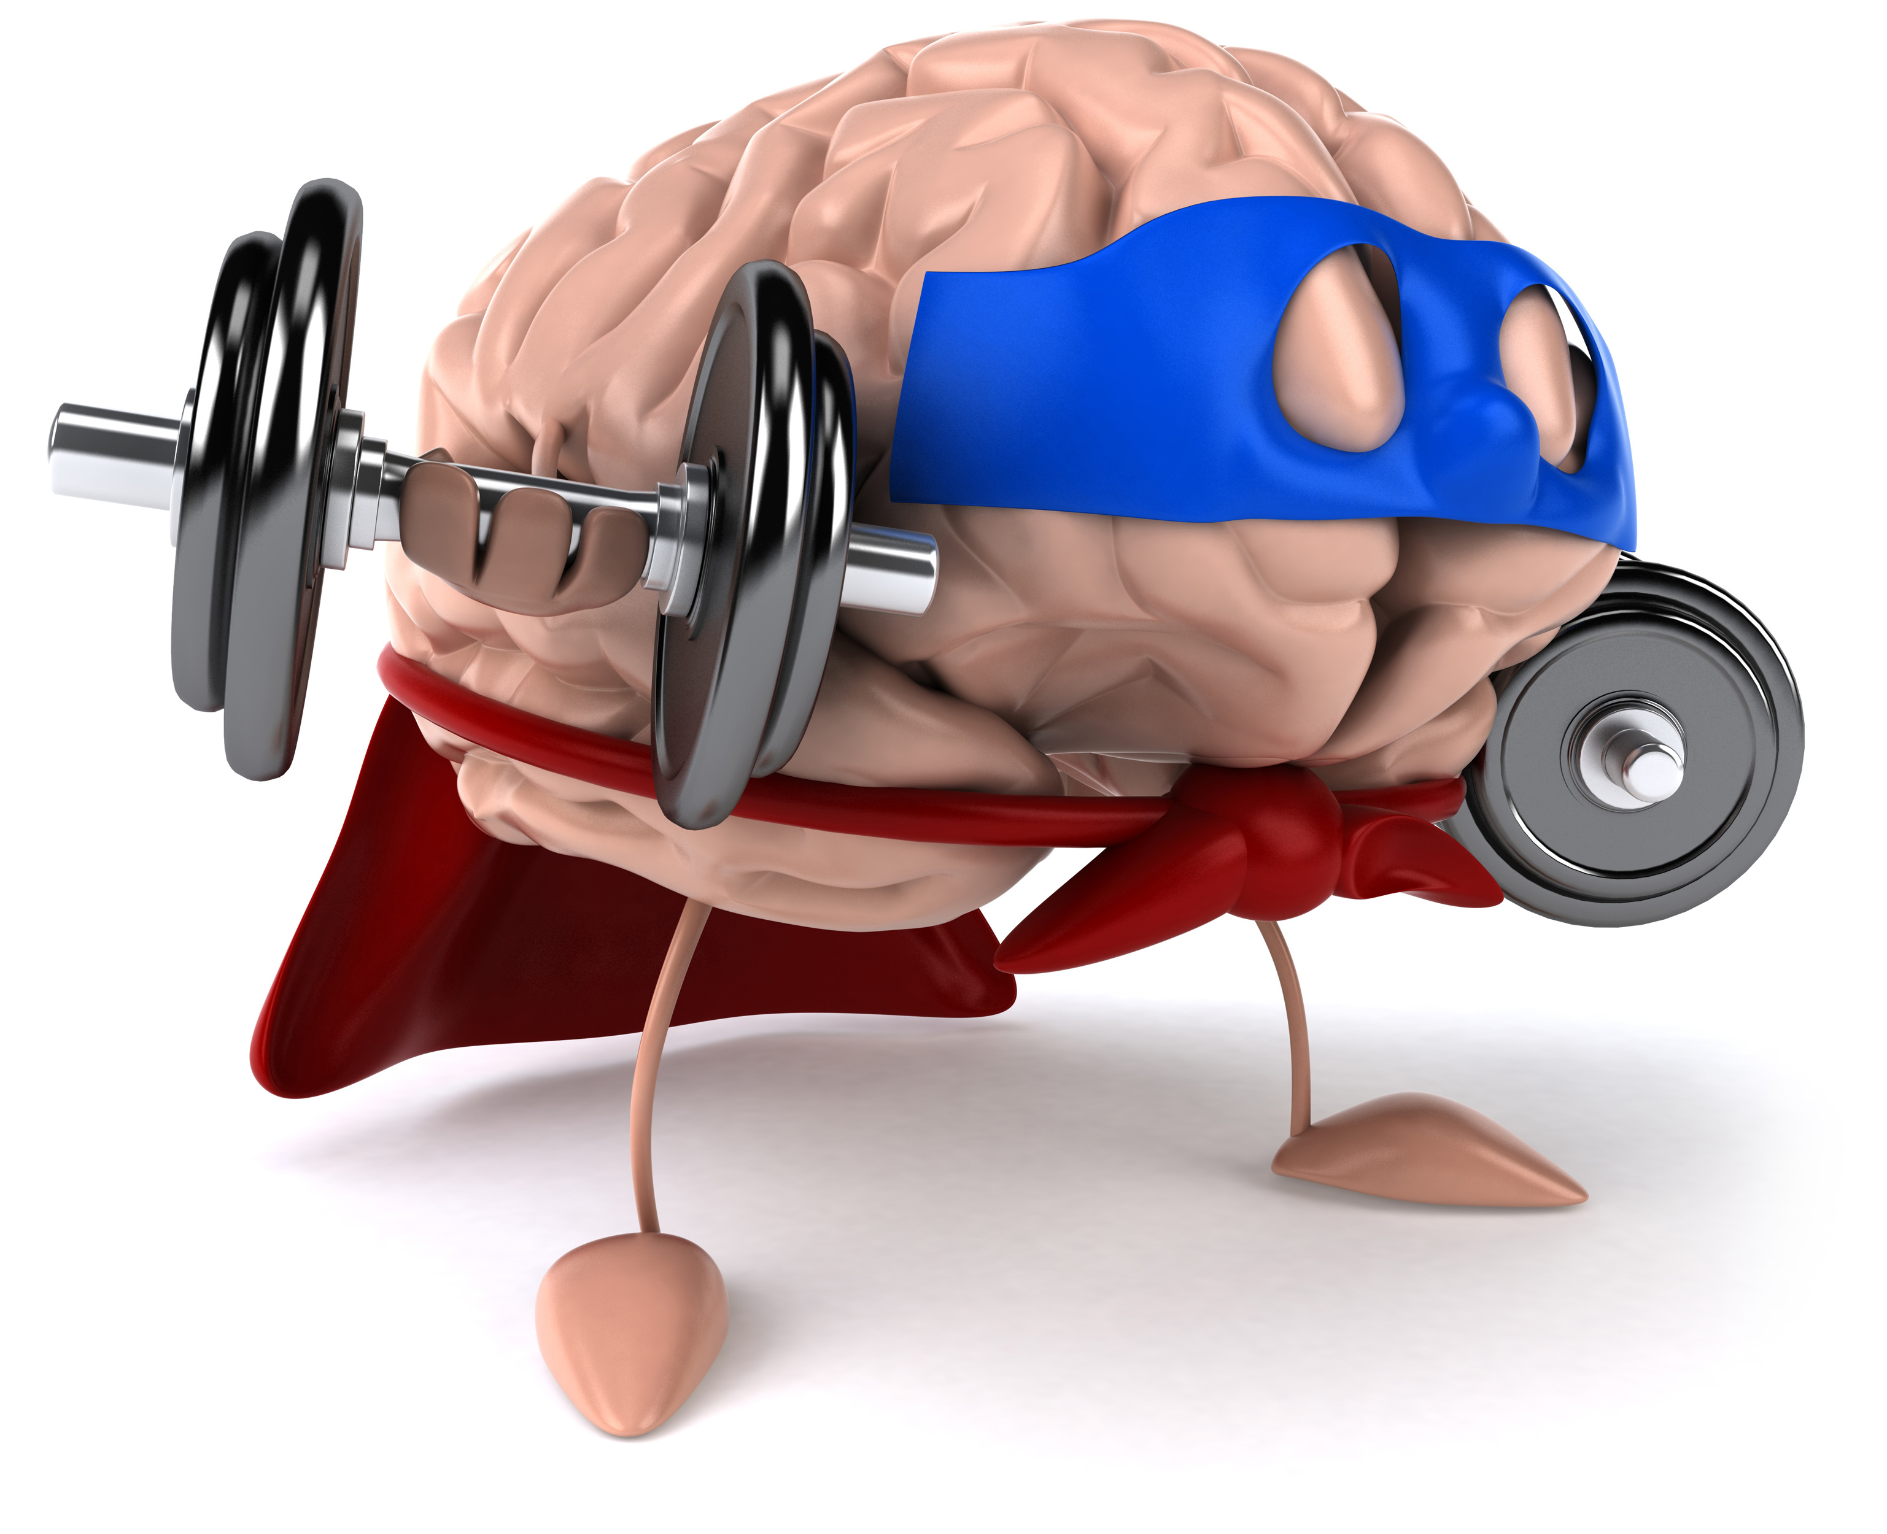
Remember!!!
Notes:
So remember!

Slide 35
Organic:
Any compound that has Carbon
Notes:
An organic compound is any compound whose molecules contain Carbon

Slide 36
Inorganic:
Any compound that does not have Carbon
Notes:
An organic compound is any compound whose molecules do not have Carbon

Slide 37
Notes:
Thanks for watching, and please continue watching CAPs available from this website.

Slide 38
This Video Created With Resources From:
Cooperative Agreement # R324B130023
Curry School Foundation’s Research and Development Fund
Questions or Comments to Michael Kennedy, Ph.D.
MKennedy@Virginia.edu

