Slide 1
Notes:
OK everyone get ready to learn a new vocabulary term.

Slide 2
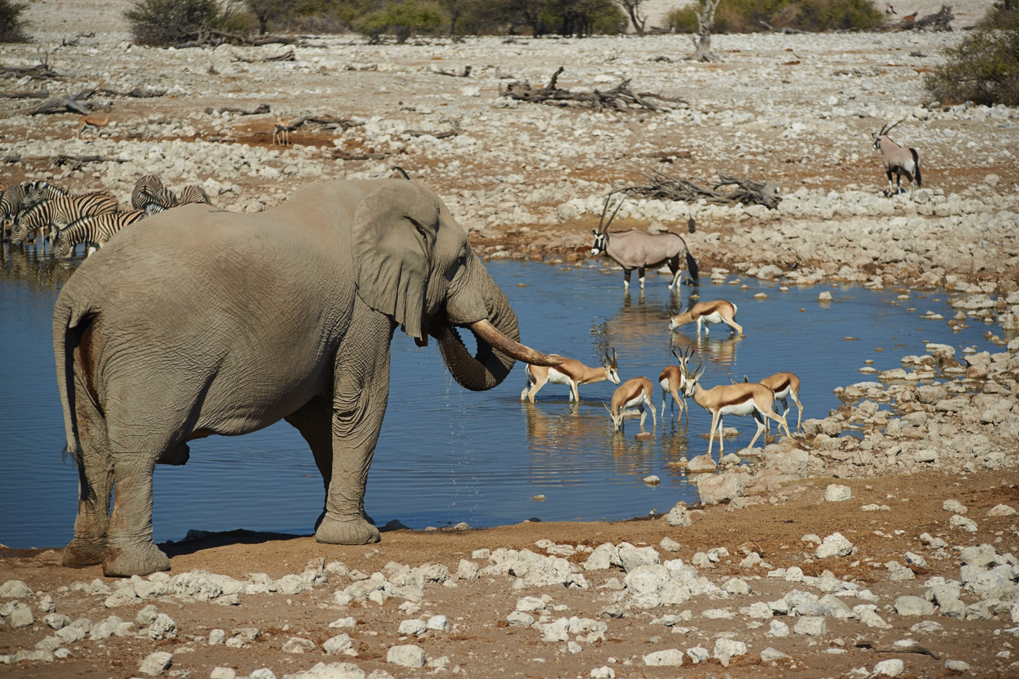
Species

Slide 3
Scientific Classification
Notes:
First, recall that we use a classification system to organize different types of living things according to their different characteristics.

Slide 4
Ecology
Biome
Ecosystem
Community
Population
Species
Notes:
In ecology, there are five levels of organization.

Slide 5
Ecology
Biome
Ecosystem
Community
Population
Species
Notes:
This lesson addresses species.

Slide 6
Species
Notes:
Now, let’s define species.

Slide 7
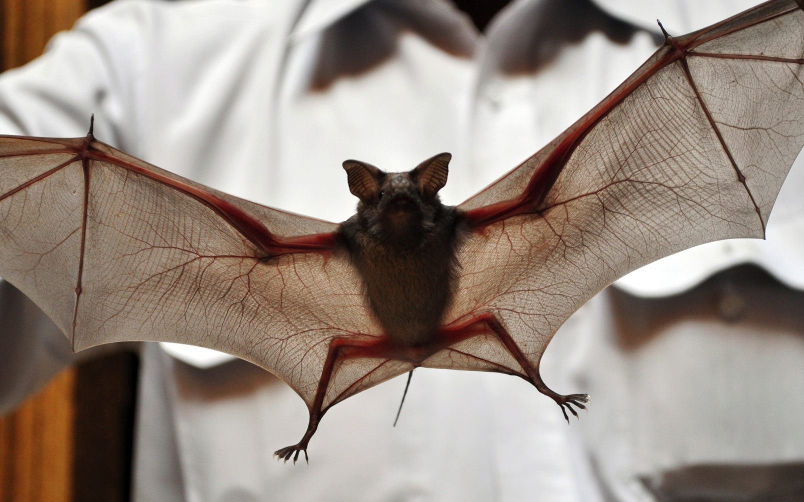
Species: a type of organism that can reproduce viable offspring, which means the offspring can also produce offspring
Notes:
A species is a type of organism that can reproduce viable offspring, which means the offspring can also produce offspring.

Slide 8
“Reproduce viable offspring”
Offspring can also produce offspring
Notes:
A species is a type of organism that can reproduce viable offspring, which means the offspring can also produce offspring.

Slide 9
Notes:
Let’s review the definition of species.

Slide 10
What is a species?
Notes:
What is a species?
-a community of animals or people
-a type of organism that can reproduce viable offspring
-an organism that cannot reproduce
-a group of different kinds of animals that all live in the same ecosystem

Slide 11
Notes:
Now, let’s talk about some examples of species.

Slide 12
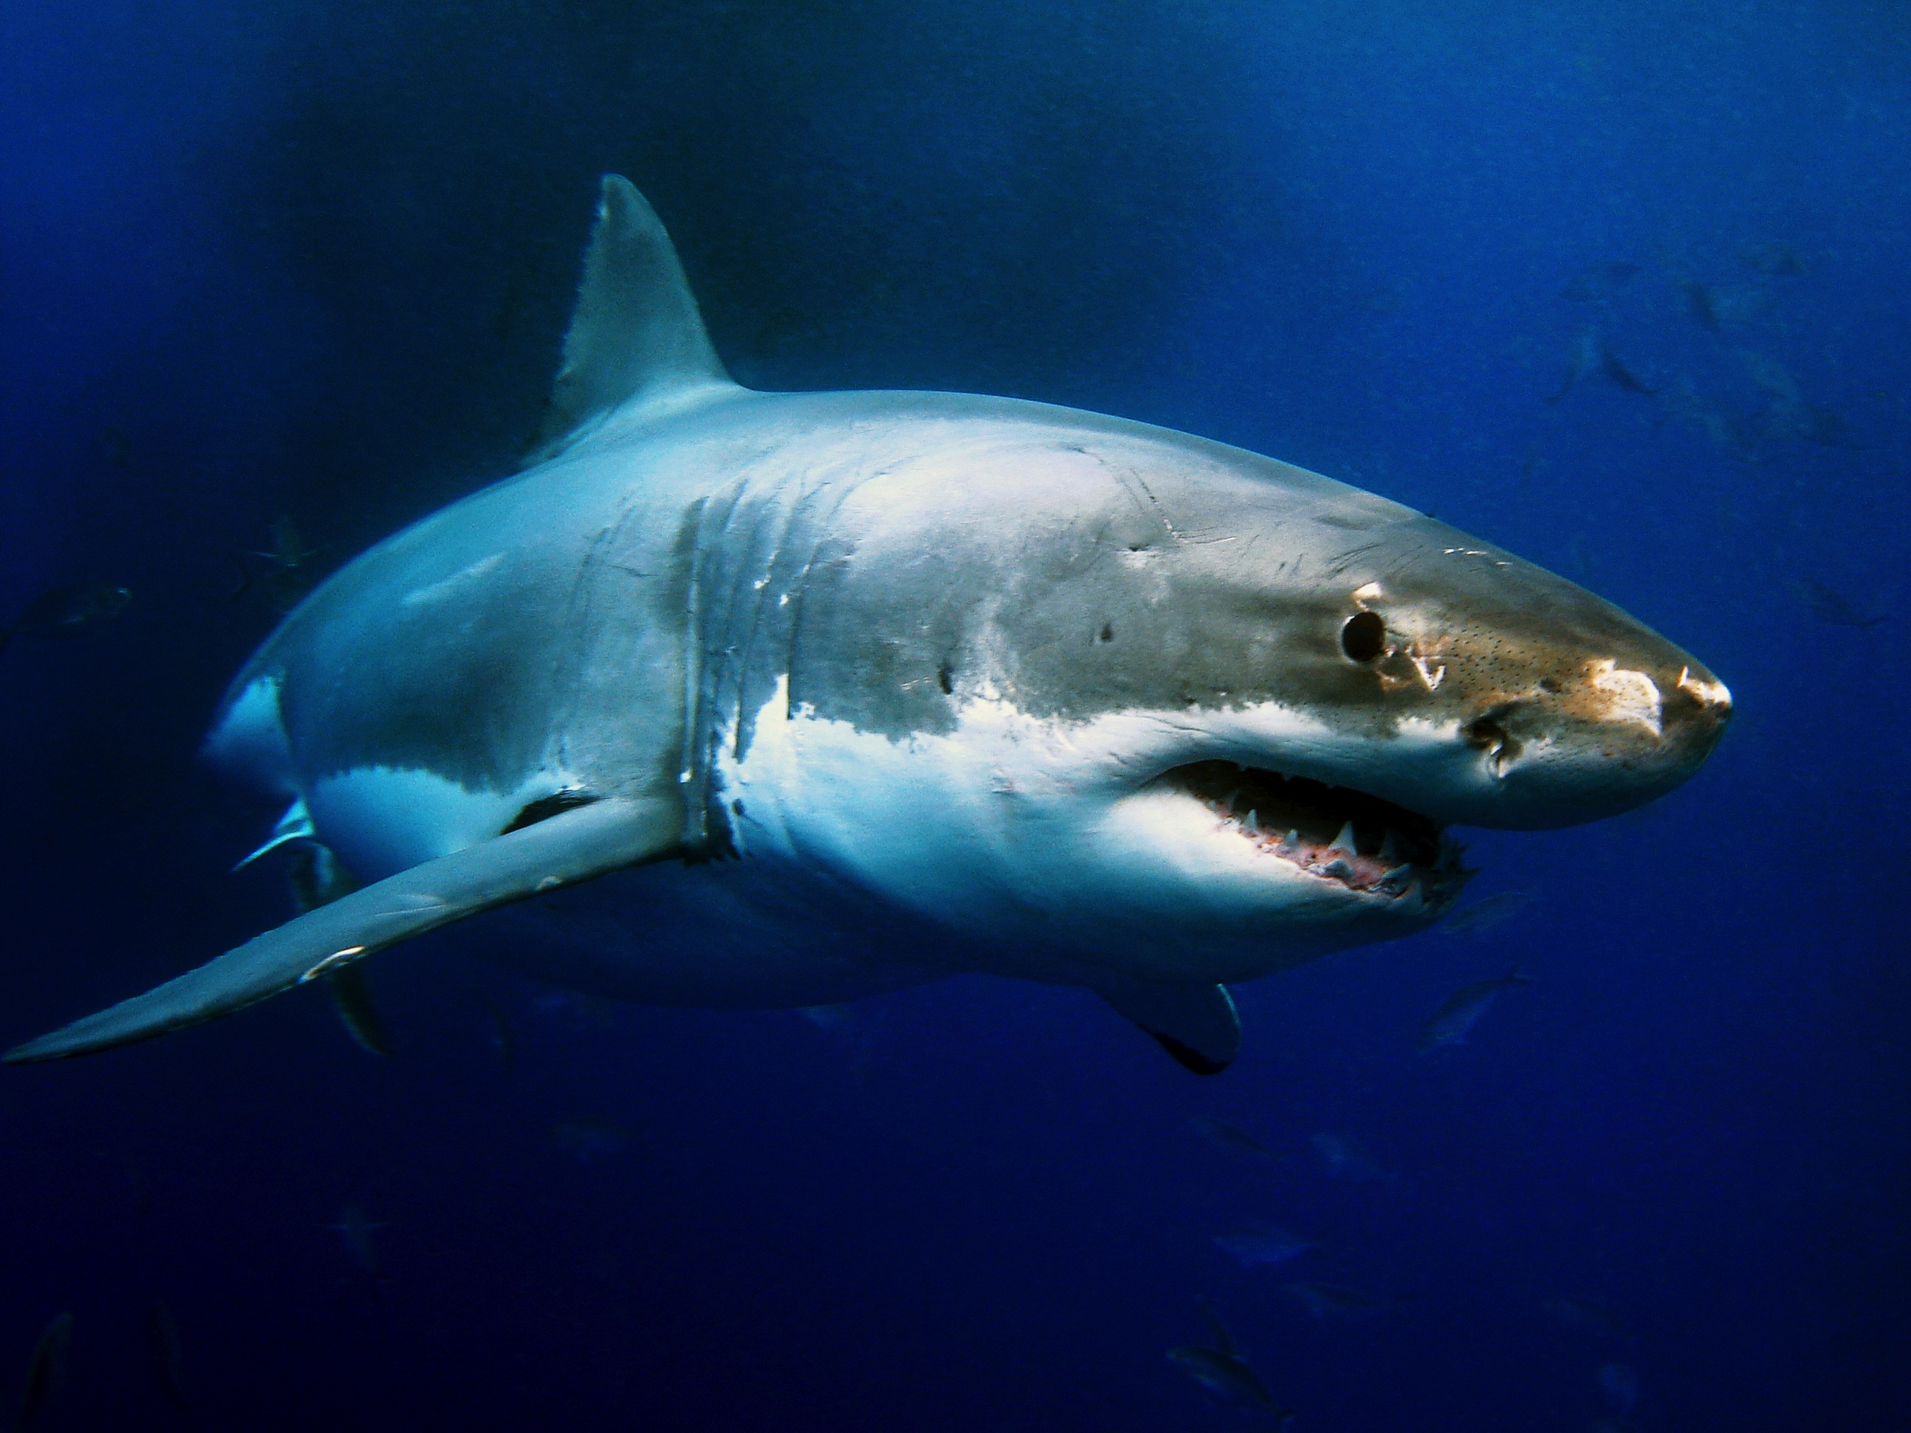
Notes:
This is a picture of a great white shark. It is an example of a species.

Slide 13
Notes:
In this picture of a watering hole, there are several species. The elephant is one example of a species. The antelope is another species.

Slide 14
NON
Notes:
Let’s talk about some non-examples of species. These are things that might seem similar but do not fit the definition of species.

Slide 15
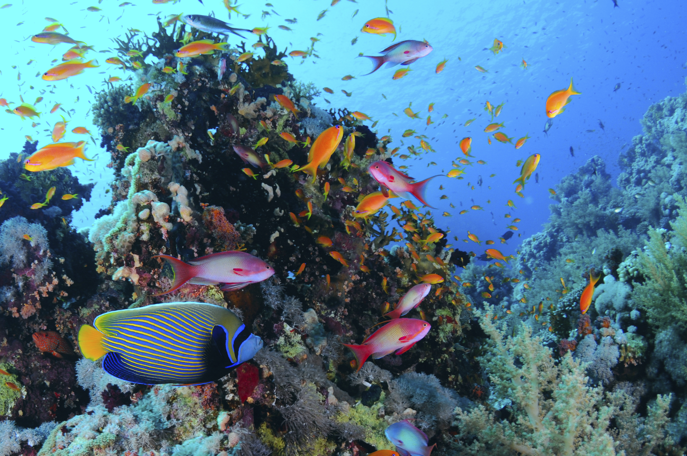
Many different species
Notes:
This is a group of fish. It is not an example of species. There are many different species within the group of fishes.

Slide 16
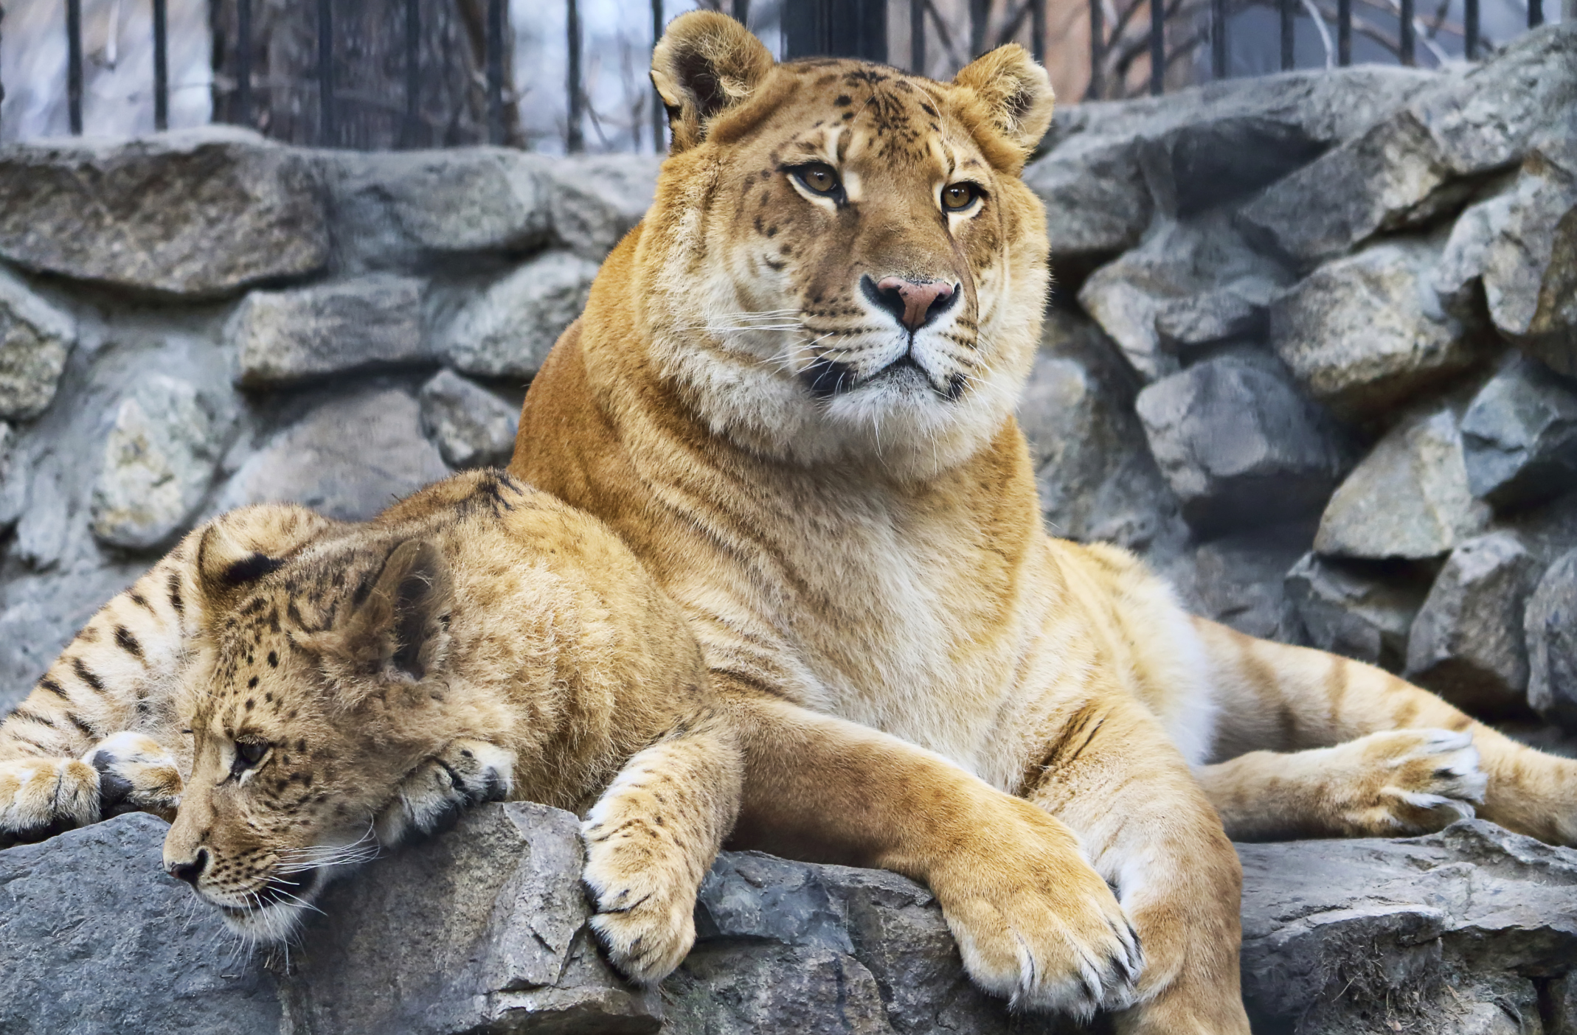
Notes:
A liger is also NOT a species. It is the offspring of a tiger and lion, but the liger cannot reproduce itself.

Slide 17
Species
Notes:
Remember: A species is a type of organism that can reproduce viable offspring, which means the offspring can also produce offspring.

Slide 18
What is a species?
a.) a group of different kinds of animals that all live in the same ecosystem
b.) a community of animals or people
c.) an organism that cannot reproduce
d.) a type of organism that can reproduce viable offspring
Notes:
What is a species?
-a group of different kinds of animals that all live in the same ecosystem
-a community of animals or people
-an organism that cannot reproduce
-a type of organism that can reproduce viable offspring

Slide 19
What is a species?
a.) a group of different kinds of animals that all live in the same ecosystem
b.) a community of animals or people
c.) an organism that cannot reproduce
d.) a type of organism that can reproduce viable offspring
Notes:
What is a species?
-a group of different kinds of animals that all live in the same ecosystem
-a community of animals or people
-an organism that cannot reproduce
-a type of organism that can reproduce viable offspring

Slide 20
Why is this not an example of the term species?

Slide 21
Remember!!!
Notes:
So remember!
<keep this slide>

Slide 22
Species: a type of organism that can reproduce viable offspring, which means the offspring can also produce offspring
Notes:
A species is a type of organism that can reproduce viable offspring, which means the offspring can also produce offspring.

Slide 23
Notes:
Thanks for watching, and please continue watching CAPs available from this website.

Slide 24
This PowerPoint was Created with Resources From:
Cooperative Agreement # R324B130023
Curry School Foundation’s Research and Development Fund
Questions or Comments to Michael Kennedy, Ph.D.
MKennedy@Virginia.edu

