Slide 1
Notes:
OK everyone get ready to learn a new vocabulary term.

Slide 2
Electron Microscope
Notes:
Today we are going to learn about the electron microscope,

Slide 3
Light Microscope
Notes:
And the light microscope.

Slide 4
Notes:
Electron microscope and light microscope are important terms in our discussion of cells. Be sure you record this information in your notes.

Slide 5
Notes:
Before we define these terms, let’s review some other words that you already learned, and make sure you are firm in your understanding.

Slide 6
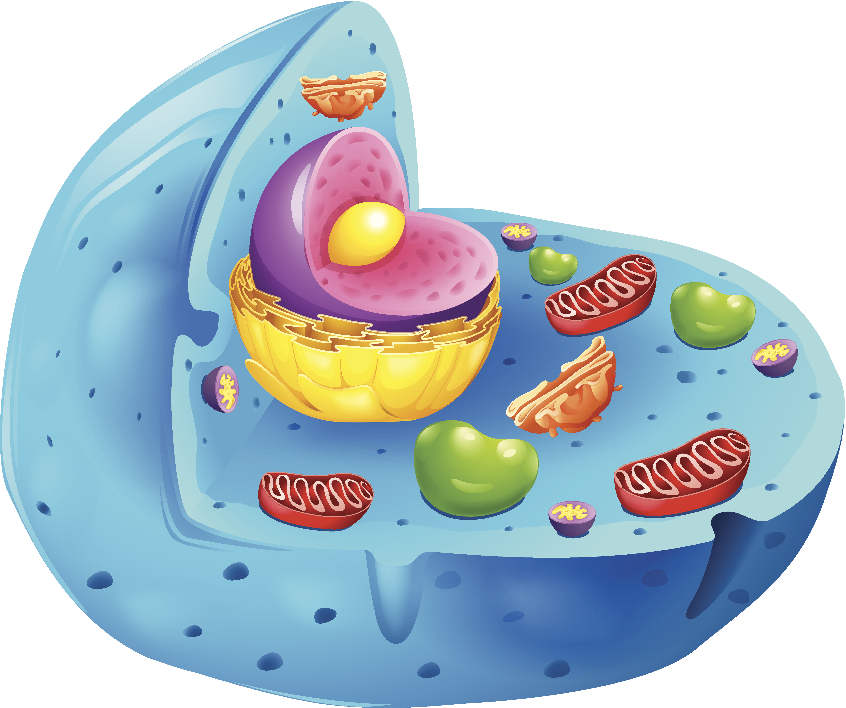
Cell: the basic unit of life
Notes:
A cell is the basic unit of life.

Slide 7
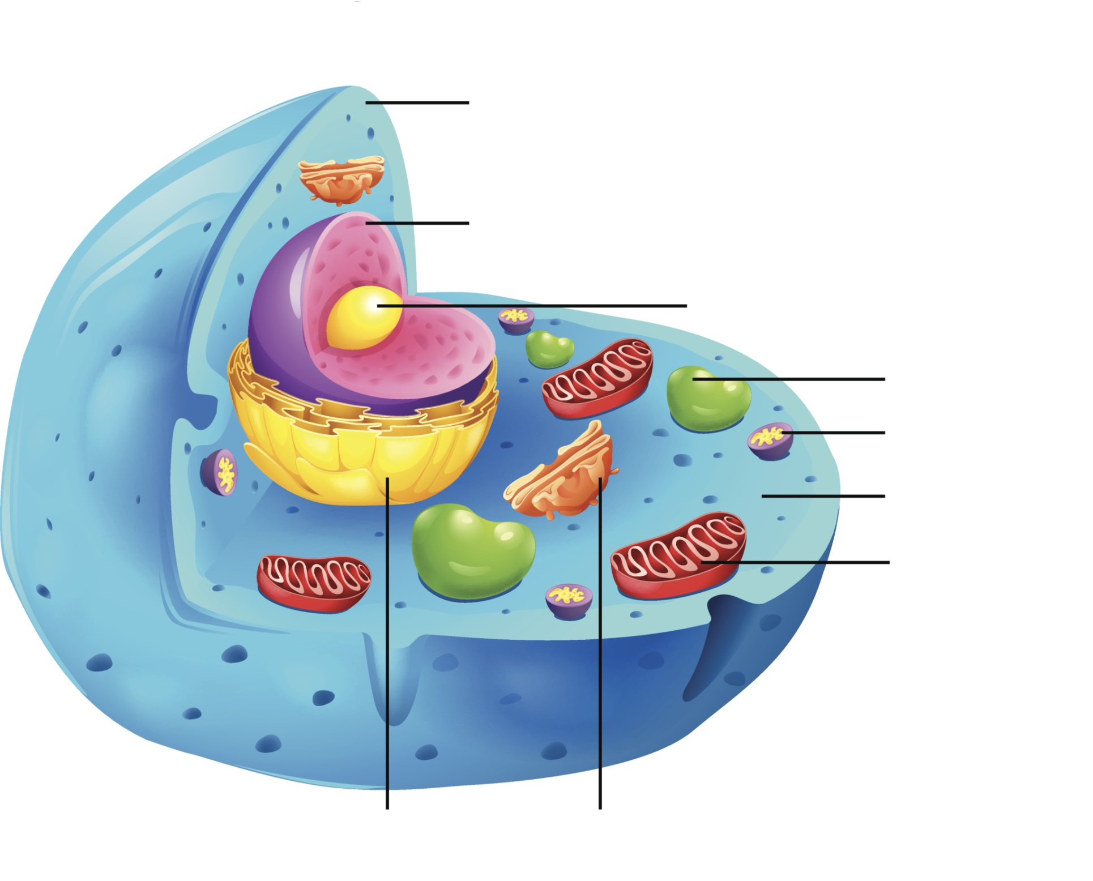
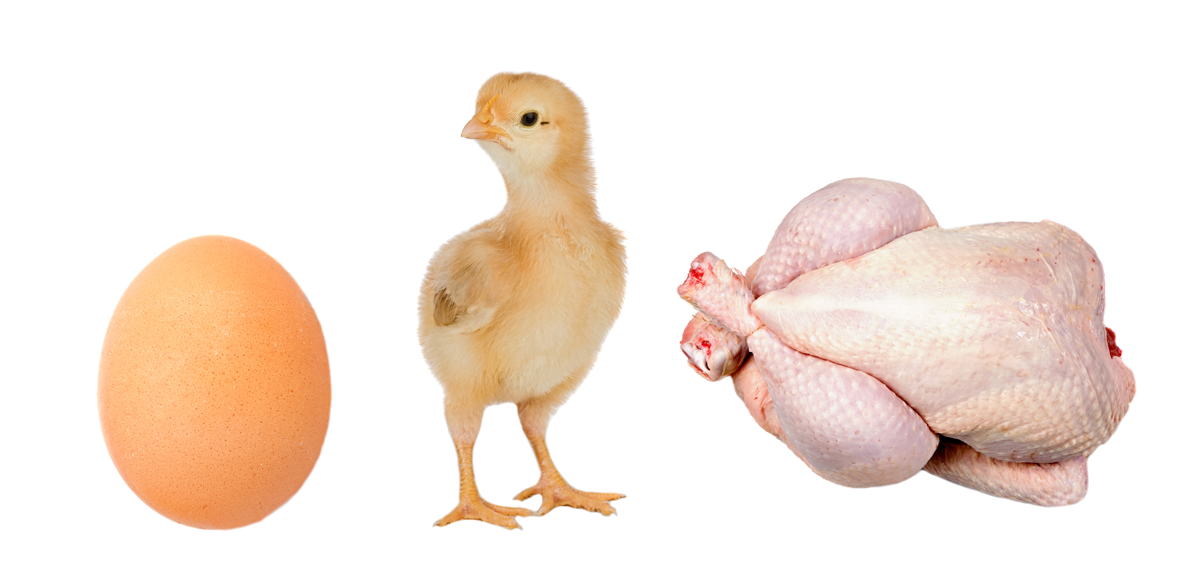
animal cell: the type of cell that all animals are made up of
Notes:
An animal cell is the type of cell that all animals are made up of.

Slide 8
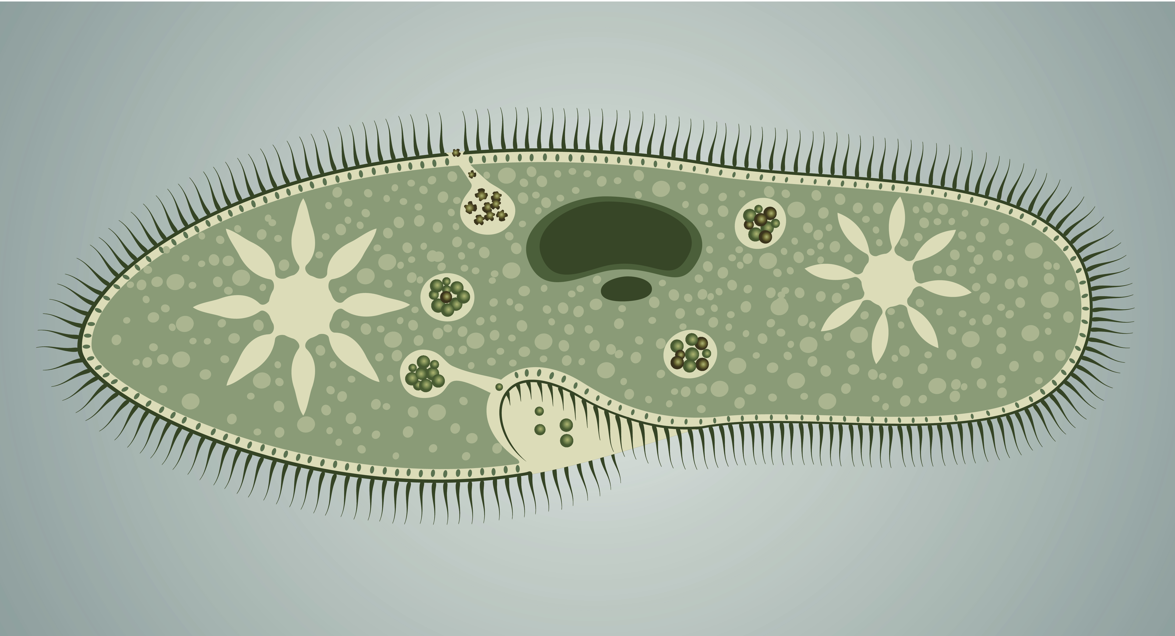
plant cell: the type of cell that all plants are made up of
Notes:
A plant cell is the type of cell that all plants are made up of. They have some parts that make them different from animal cells.

Slide 9
Robert Hooke
Notes:
Robert Hooke was the first to observe cells under the microscope and name them “cells”.

Slide 10
Invention of the Microscope
Notes:
The invention of the microscope allowed scientists to begin exploring the microscopic world by making it possible to see objects to small to see with the naked eye. An example is cells. You need a microscope to see individual cells within a tissue.

Slide 11
Notes:
Let’s review what we’ve discussed so far.

Slide 12
What is an animal cell?
Notes:
What is an animal cell?
[An animal cell is what animals are made up of. They have no cell wall, chloroplasts, of large vacuoles.]

Slide 13
What is a plant cell?
Notes:
What is a plant cell?
[A plant cell is what plants are made up of. They have chloroplasts, cell walls, and 1 large vacuole.]

Slide 14
What does a microscope do?
Notes:
What does a microscope do?
[A microscope allows us to see objects to small to be seen with the naked eye.]

Slide 15
Electron Microscope
Notes:
Now we are going to learn about the electron microscope.

Slide 16
electron
microscope
Notes:
Let’s define the term.

Slide 17
electron microscope: uses a beam of electrons to magnify an object.
Notes:
An electron microscope uses a beam of electrons to magnify an object.

Slide 18
magnifying = making an object larger
Notes:
Magnifying is making an object larger. This image shows how a magnifying lens makes a fingerprint larger.

Slide 19
An electron microscope can see an object the size of an atom.
Notes:
An electron microscope is very powerful and can see an object the size of an atom. That means it can magnify, or show, an object or atom up to 10,000,000 times its actual size.

Slide 20
Notes:
Let’s review what we’ve discussed so far.

Slide 21
How does an electron microscope magnify an object?
Notes:
How does an electron microscope magnify an object?
[An electron microscope magnifies an object by shooting a beam of electrons at the object.]

Slide 22
What microscope will we use in class?
Notes:
Since we will be looking at objects larger than an atom, mainly cells, what microscope will we use?

Slide 23
Light Microscope
Notes:
Now we will learn about the light microscope.

Slide 24
light
microscope
Notes:
Let’s define the term.

Slide 25
light microscope: uses 2 or more lenses and a light source to magnify an object.
Notes:
Light microscopes use 2 or more lenses and a light source to magnify an object.

Slide 26
Cells
Notes:
Light microscopes are used to look at cells.

Slide 27
Notes:
That is the basic definition, but there is a bit more you need to know.

Slide 28
light source
Notes:
The light source is at the base of the microscope and directs light upwards towards the object you are looking at.

Slide 29
Objective Lens
Notes:
One of the lenses on the microscope is the objective lenses. The objective lens gather light from the specimen.

Slide 30
Objective Lens
10X
40X
4X
Notes:
The objective lens can either be 4x, 10x, or 40x magnification.

Slide 31
Ocular Lens
Notes:
The other lens is the ocular lens which magnifies the image of the cell. This is where you look when you are using the microscope.

Slide 32
Coarse Focus
Fine Focus
Notes:
You can make small adjustment to the magnification using the fine and coarse focus knobs.

Slide 33
Animal cells
Notes:
The light microscope will allow you to see the differences between animal and plant cells. In this image, we can see animal cells.

Slide 34
Plant cells
Notes:
In this image, we can see plant cells. Notice how they are shaped differently from animal cells.

Slide 35
Notes:
Let’s review.

Slide 36
How does a light microscope magnify cells?
Notes:
How does a light microscope magnify cells?
[It uses 2 or more lenses and a light source to magnify cells.]

Slide 37
Which type of microscope would you use to look at a plant or animal cell?
electron microscope
light microscope
Notes:
Which type of microscope would you use to look at a plant or animal cell?

Slide 38
Which type of microscope would you use to look at a plant or animal cell?
electron microscope
light microscope
Notes:
[We use a light microscope for looking at cells.]

Slide 39
Which type of microscope would you use to look at an atom?
electron microscope
light microscope
Notes:
Which type of microscope would you use to look at an atom?

Slide 40
Which type of microscope would you use to look at an atom?
electron microscope
light microscope
Notes:
[An electron microscope is used to look at objects smaller than cells, such as an atom.]

Slide 41
Remember!!!
Notes:
So remember!

Slide 42
electron microscope: uses a beam of electrons to magnify an object.
Notes:
An electron microscope uses a beam of electrons to magnify an object.

Slide 43
light microscope: uses 2 or more lenses and a light source to magnify an object.
Notes:
Light microscopes use 2 or more lenses and a light source to magnify an object.

Slide 44
Notes:
Thanks for watching, and please continue watching CAPs available from this website.

Slide 45
This Video Created With Resources From:
Cooperative Agreement # R324B130023
Curry School Foundation’s Research and Development Fund
Questions or Comments to Michael Kennedy, Ph.D.
MKennedy@Virginia.edu

Slide 46
Potential Activity
Objective: design an investigation from a testable question related to animal and plant cells. The investigation may be a complete experimental design or may focus on systematic observation, description, measurement, and/or data collection and analysis.
Activity: Here students will design a lab around using the microscope to determine observable difference between animal and plant cells. Students will create their own hypothesis, observation and conclusions.
Materials:
Light Microscope
Slide
Coverslip
Water dropper
Onion
Tooth pick
Iodine
Pencil
Worksheet
Methylene blue
Resources: https://www.google.com/url?sa=t&rct=j&q=&esrc=s&source=web&cd=1&ved=0ahUKEwjoxIu1l_fTAhVEeCYKHW6DAv8QFggiMAA&url=http%3A%2F%2Famrita.olabs.edu.in%2F%3Fsub%3D79%26brch%3D15%26sim%3D125%26cnt%3D1&usg=AFQjCNHZXab8bL_NH9C1LLkWInh8N5UGfw

