Slide 1
Notes:
OK everyone get ready to learn some new vocabulary terms.

Slide 2
Physical Property
Notes:
Today we are going to learn about physical properties.

Slide 3
Chemical Property
Notes:
We are also going to learn about chemical properties.

Slide 4
Notes:
Before we define the terms Physical and Chemical Properties, let’s review some other words that you already learned, and make sure you are firm in your understanding.

Slide 5
Matter:
has mass and takes up space
Notes:
First, remember that matter is anything that has mass and takes up space.

Slide 6
Atoms:
Smallest whole unit of matter
Notes:
All matter is made of atoms. Atoms are the smallest whole unit of matter.

Slide 7
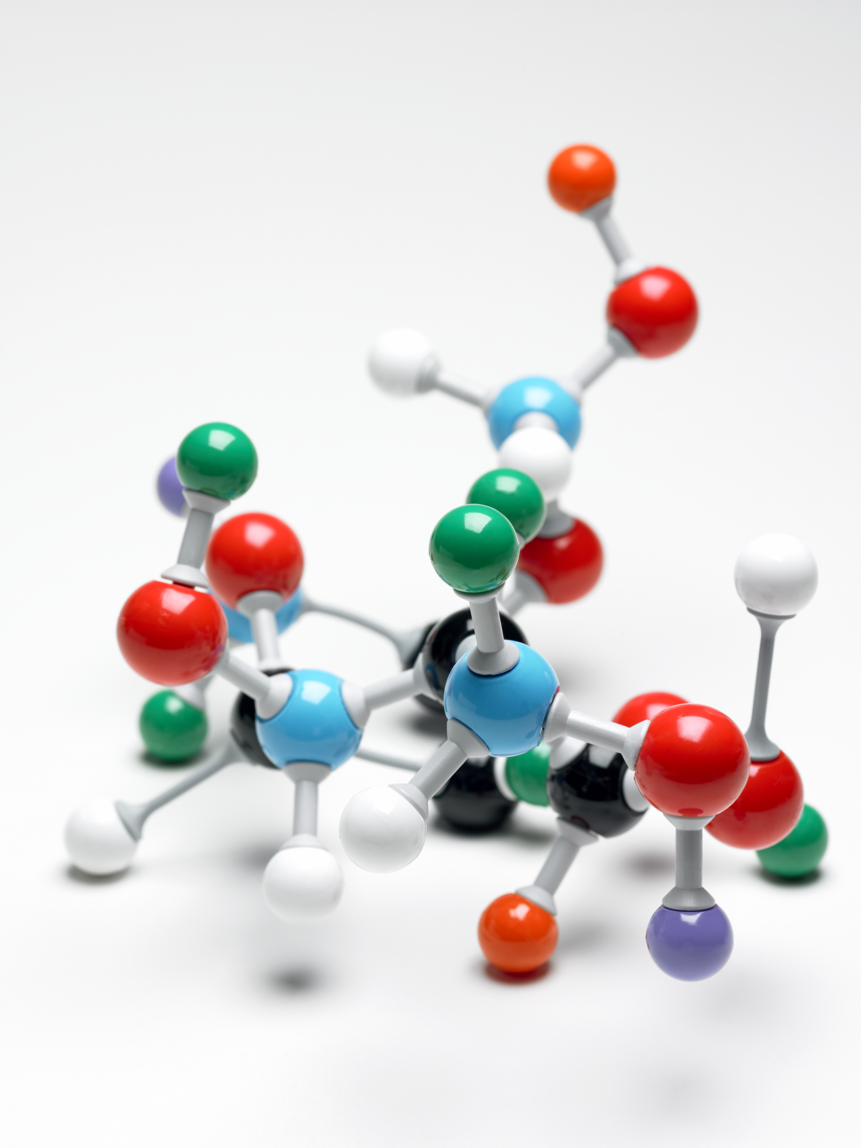
Notes:
All substances have unique properties because of the atoms they are made of.

Slide 8
Property
chemical
physical
Notes:
Properties are observed characteristics.

Slide 9
Property
chemical
physical
Notes:
Properties can either be defined by their physical or chemical characteristics. They are used to describe what you see.

Slide 10
Notes:
Now let’s pause for a moment to review the information we have covered already.

Slide 11
What is an atom?
Notes:
What is an atom?

Slide 12
What is a property?
Notes:
What is a property?

Slide 13
Physical
Property
Notes:
First we are going to look at physical properties.

Slide 14
Physical Property:
Can be measured without
changing the substance
Anchor image
Notes:
Physical properties can be measured without changing the substance.

Slide 15
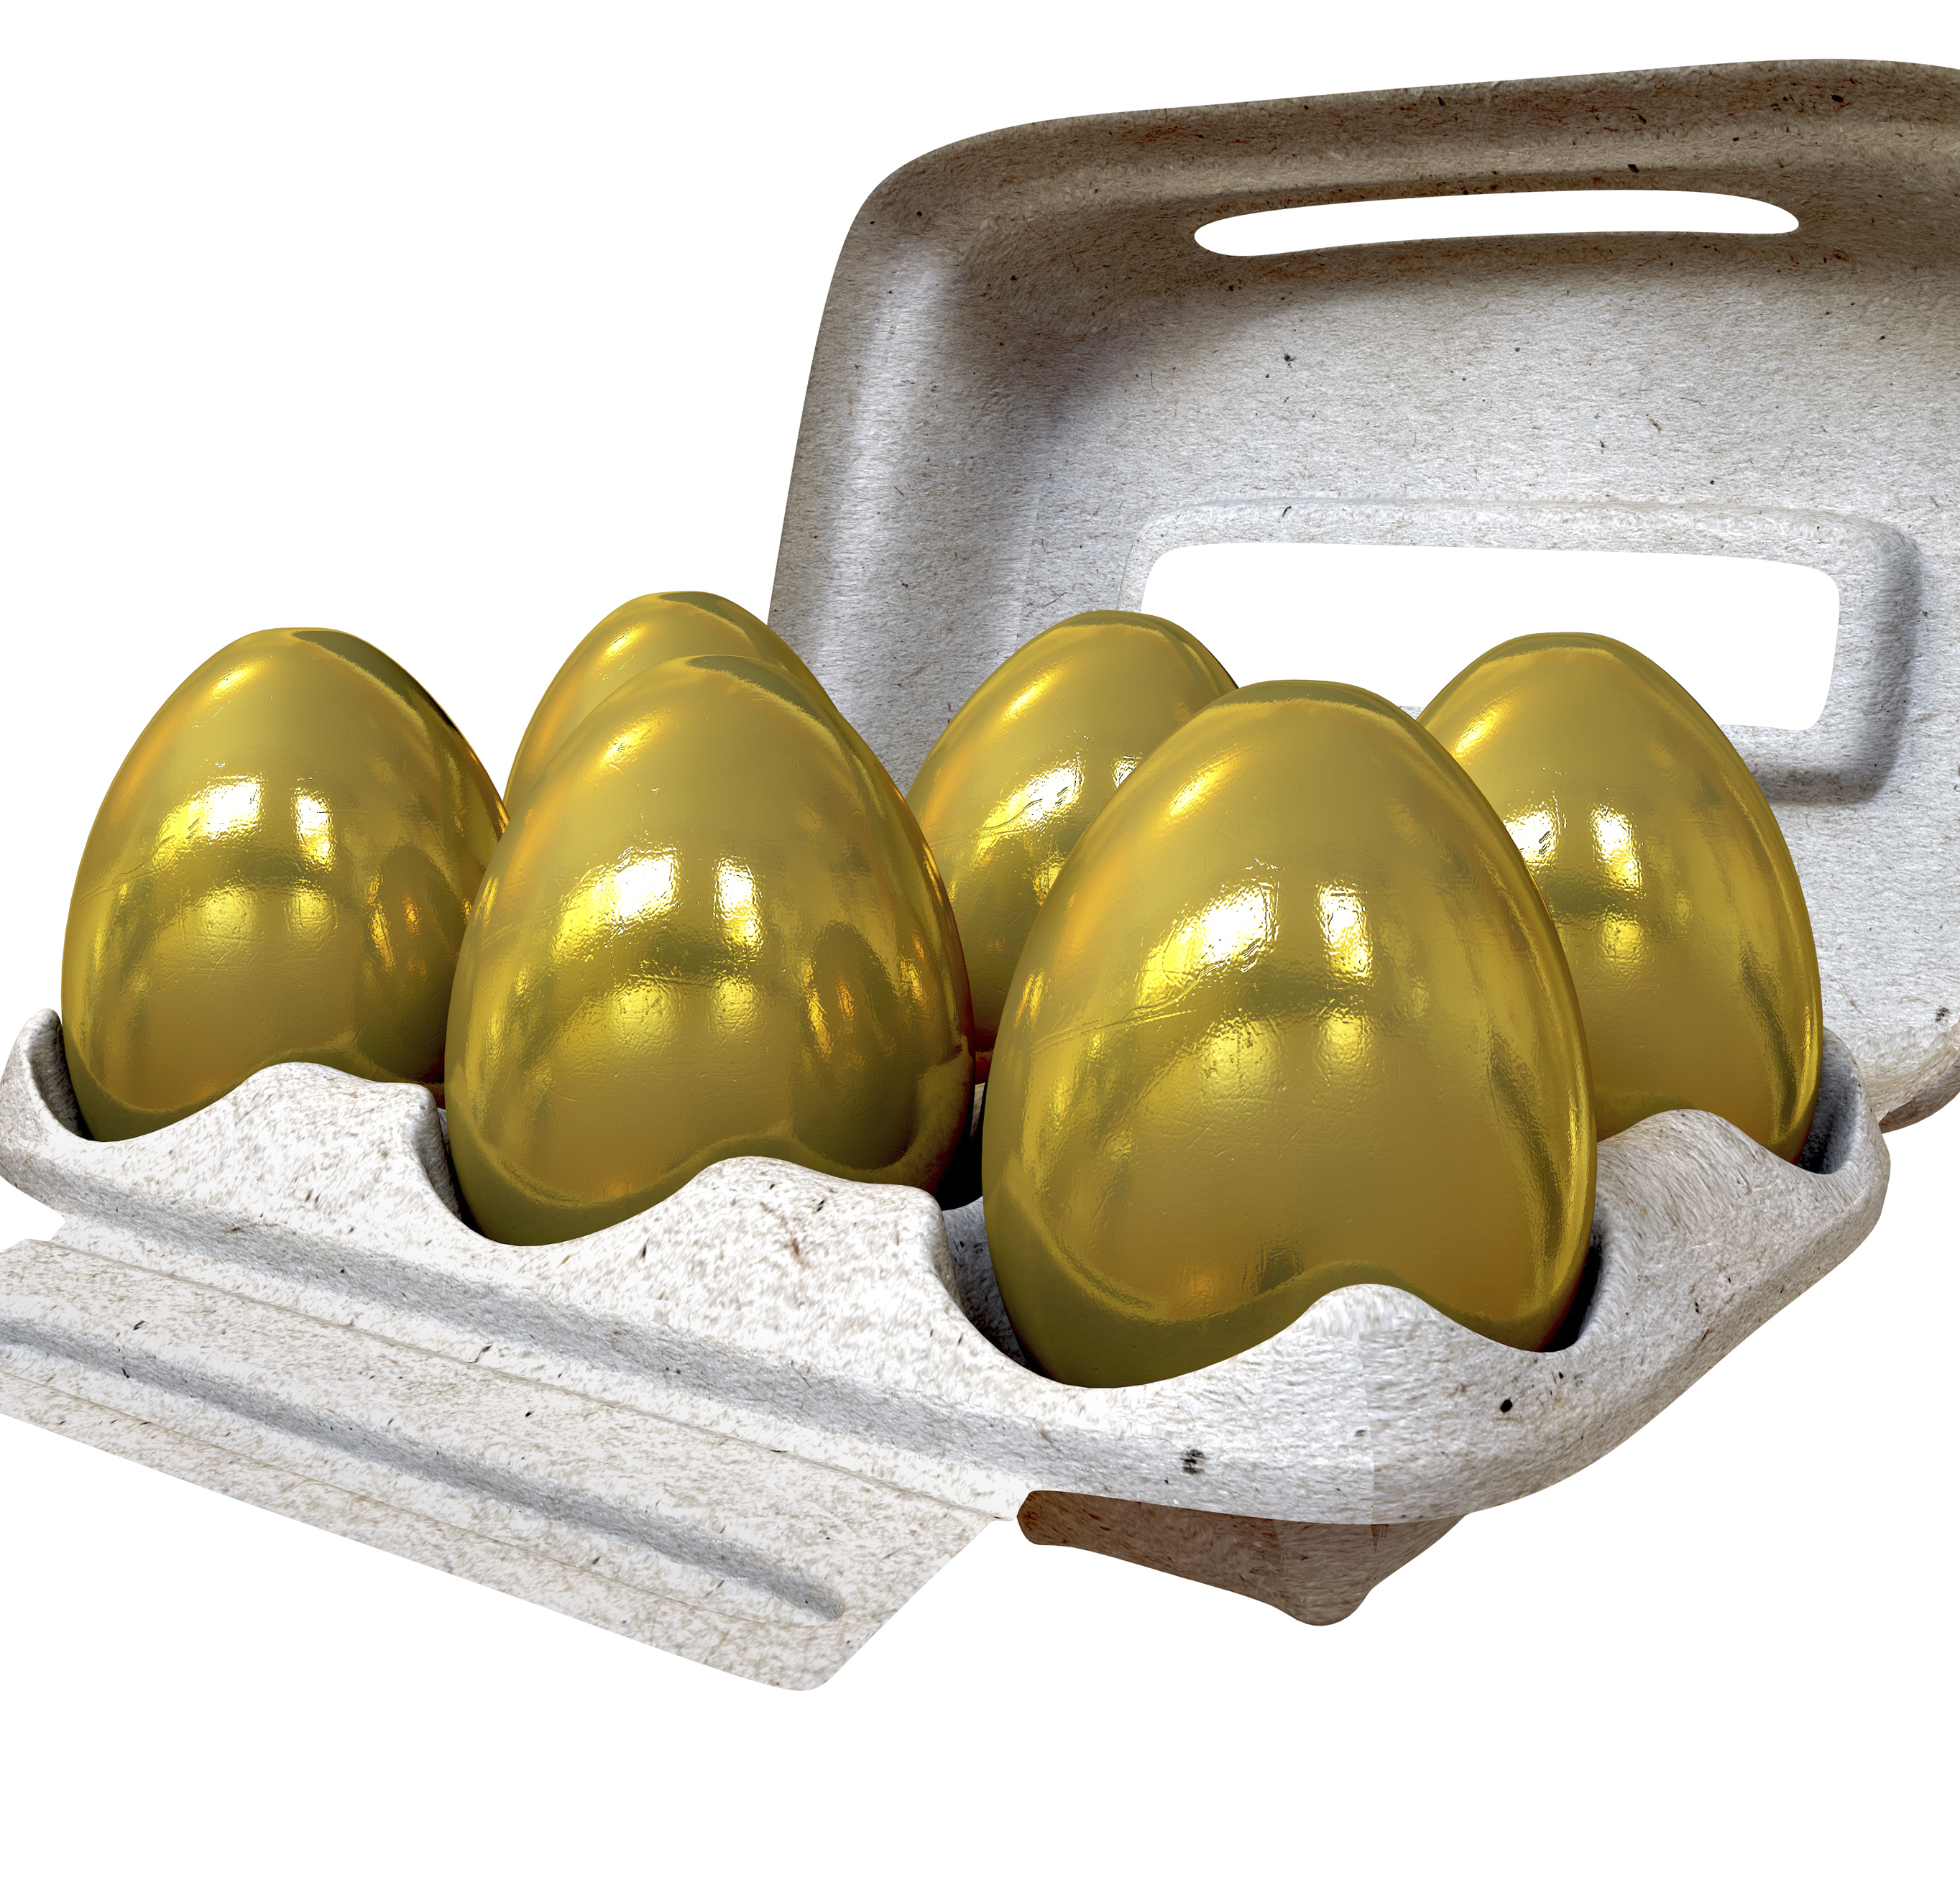
Color
Shape
Luster
Notes:
Often times physical properties describe the physical makeup of a substance. For example color, shape, and luster, or shininess, are all physical properties.

Slide 16
Units of Measure
Notes:
Other examples include units of measure.

Slide 17
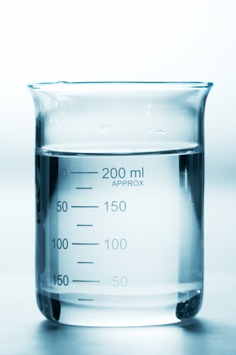
Units of Measure
Notes:
Other examples include units of measure like length, mass, volume, weight and density.

Slide 18
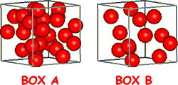
Density
Notes:
In particular we will look at density. Density is an example of an observable physical property.

Slide 19
Density:
Mass per unit of volume
Notes:
Density is the mass per unit of volume of a substance. This will always remain constant---or the same---for a compound or element.

Slide 20
Notes:
Let’s review the definition of physical property

Slide 21
What is a physical property?
Notes:
What is a physical property?

Slide 22
What is density?
Notes:
What is density?

Slide 23
Notes:
Now, let’s talk about some common examples of physical properties

Slide 24
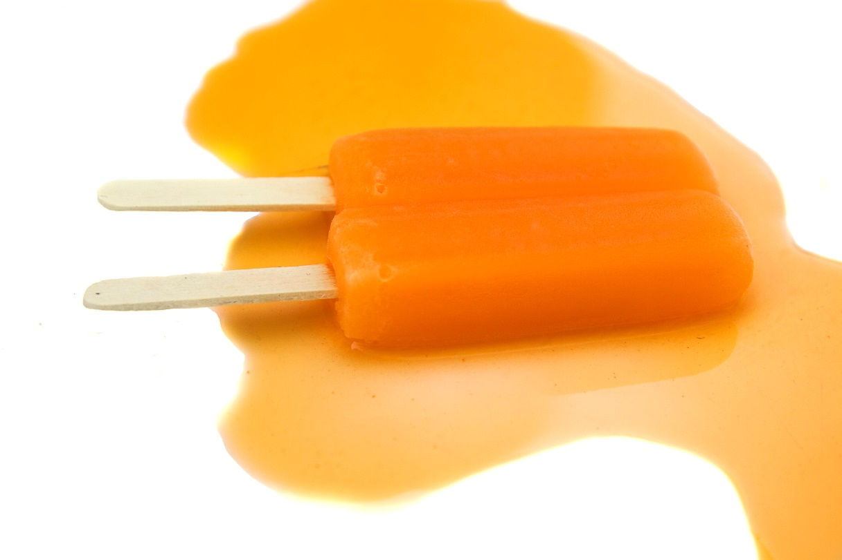
Melting point
Notes:
Melting point, the temperature at which a substance will melt, is a physical property because you can measure it the point in which a substance melts.

Slide 25
NON
Notes:
Let’s talk about some non-examples of physical properties. These are things that might seem similar but do not fit the definition of physical properties.

Slide 26
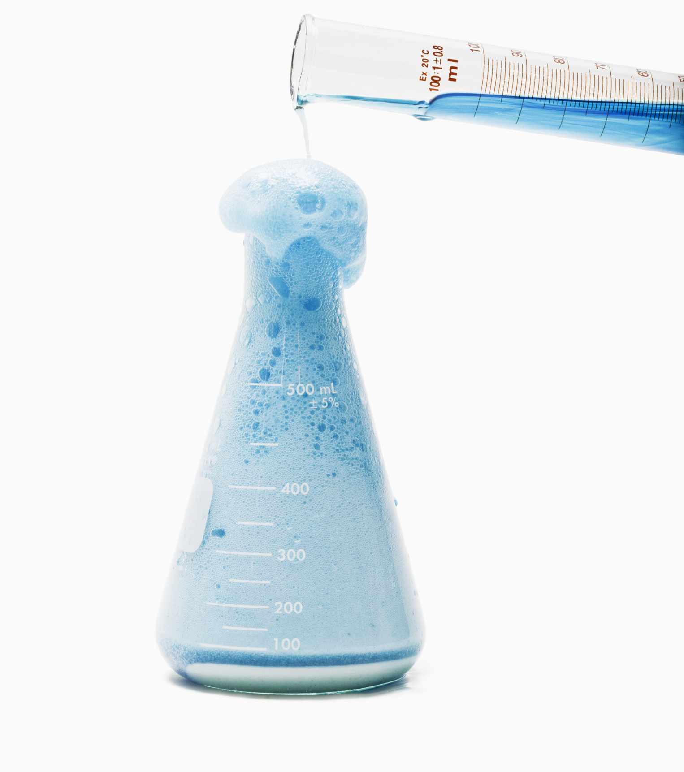
Notes:
Reactivity is not a physical property because when you mix the two reactants together a new product is formed. This has a different chemical formula, giving it a new identity. Remember than in a physical property the identity is not changed.

Slide 27
Physical Property or No?
Notes:
Now, let’s look at a few pictures and decide if they are examples of physical properties.

Slide 28
Physical Property or No?
Notes:
Is odor a physical property or no?

Slide 29
Physical Property or No?
Notes:
Yes! You can describe how a substance smells without changing the substance.

Slide 30
Physical Property or No?
Notes:
Is flammability, the ability to burn, a physical property?

Slide 31
Physical Property or No?
Notes:
No! To measure flammability, you would have to set the substance on fire to see if it burns. If a substance burns, then its identity changes, so flammability is not a physical property.

Slide 32
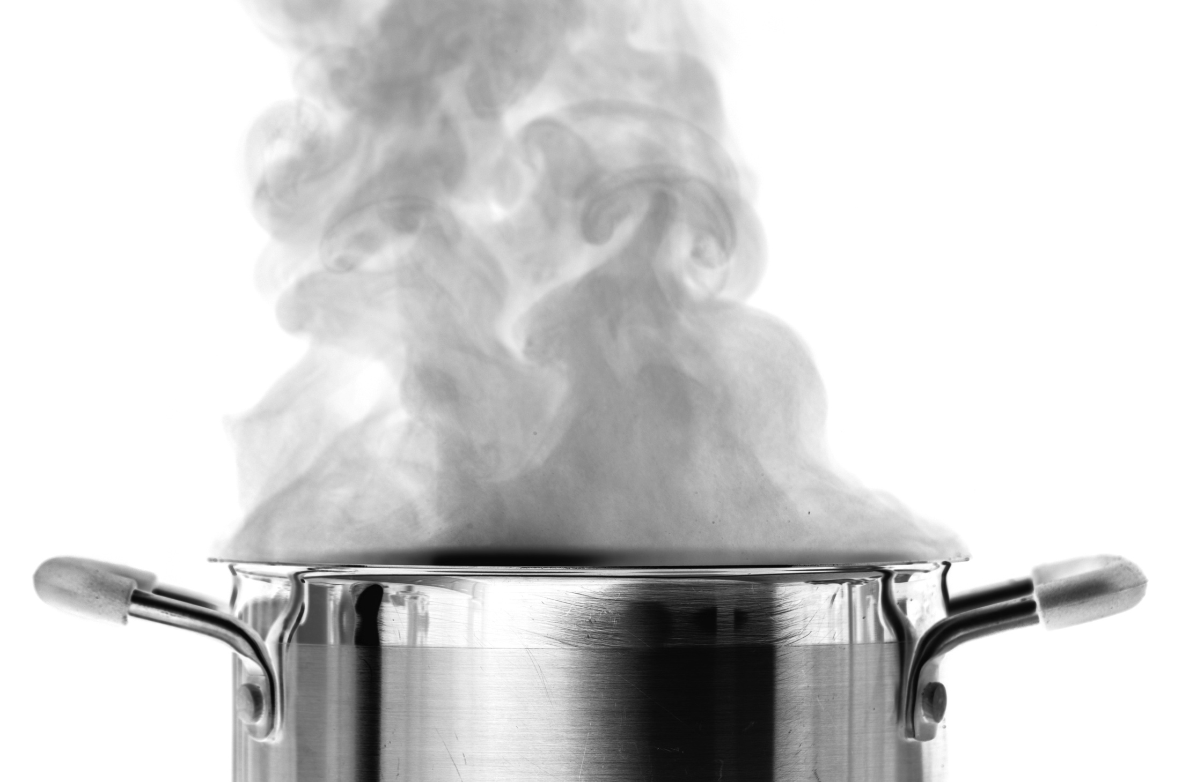
Physical Property or No?
Notes:
Is boiling point, the temperature in which a substance boils, a physical property or no?

Slide 33
Physical Property or No?
Notes:
Yes! You can measure a substance’s boiling point without changing the substance.

Slide 34
Physical Property: Can be measured without changing the substance
Anchor image
Notes:
Physical properties of a substance can be measured without changing the substance.

Slide 35
Chemical
Property
Notes:
Now, let’s look at chemical properties.

Slide 36
Chemical Property:
characteristics that can only be observed during a reaction
Notes:
Chemical properties are characteristics that can only be observed during a reaction. They result in the formation of a new substance.

Slide 37
Old Substances
New Substances
Notes:
Molecules interact with one another and sometimes the interaction results in new substances. This is called a chemical reaction—when one or more substances change into one or more different substances.

Slide 38
Notes:
Chemical properties can only be seen during or after a chemical reaction. They are not immediately seen like color or shape or able to be measured like density.

Slide 39
Notes:
Let’s review the definition of chemical property

Slide 40
What is a chemical property?
Notes:
What is a chemical property?

Slide 41
Notes:
Now, let’s talk about some common examples of chemical properties

Slide 42
Notes:
Flammability is an example of a chemical property. It describes how likely something is to react with something and catch on fire. You cannot know if a substance is likely to catch fire by measuring something or looking at it. It is something you have to test to observe, so it is a chemical property.

Slide 43
Notes:
Combustion is another example of a chemical property. It describes how likely a substance is to react with oxygen. You can only observe a substance’s combustion by observing how it reacts oxygen, so combustion is a chemical property.

Slide 44
NON
Notes:
Let’s talk about some non-examples of chemical properties. These are things that might seem similar but do not fit the definition of chemical properties.

Slide 45
Color
Shape
Luster
Notes:
Color, shape, and luster are all characteristics but these characteristics that can be observed without the substance reacting with another substance so they are not chemical properties.

Slide 46
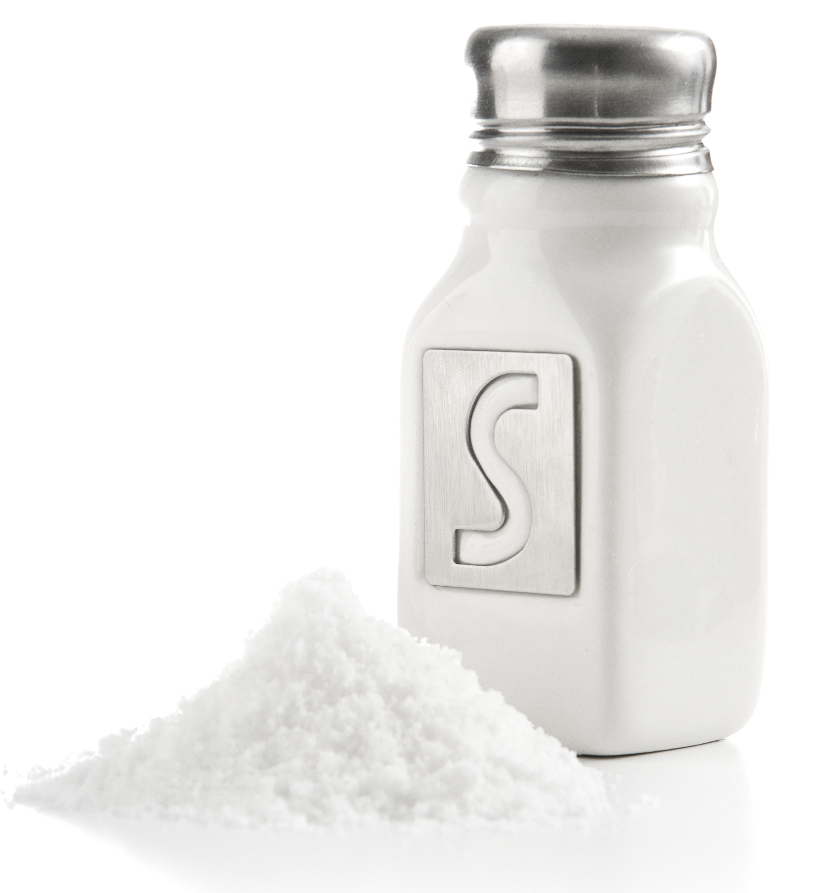
Notes:
The ability of salt to dissolve in water is not a chemical property because the salt is not reacting with the water. The salt does not change during this process.

Slide 47
Chemical Property or No?
Notes:
Now, let’s look at a few pictures and decide if they are examples of chemical properties.

Slide 48
Chemical Property or No?
Notes:
Is boiling point, the temperature in which a substance boils, a chemical property or no?

Slide 49
Chemical Property or No?
Notes:
Nope! A substance boiling is not a chemical reaction as steam molecules and liquid molecules are the same—they do not change.

Slide 50
Chemical Property or No?
Notes:
Is toxicity, or the ability of a substance to damage an organism, a chemical property?

Slide 51
Chemical Property or No?
Notes:
Yes! To measure toxicity one would have to observe how a substance reacts to an organism to see if it has harmful effects. Since this can only be observed after a chemical reaction, toxicity is a chemical property.

Slide 52
Notes:
Let’s review what we have learned one more time.

Slide 53
What is a chemical property?
Notes:
What is a chemical property?

Slide 54
Which of the following is a chemical property?
a.) color
b.) odor/smell
c.) shape
d.) flammability

Slide 55
Which of the following is a chemical property?
a.) color
b.) odor/smell
c.) shape
d.) flammability
Notes:
Flammability is a chemical property. When you test for flammability, you are chemically changing the substance.

Slide 56
What is a physical property?
Notes:
What is a physical property?

Slide 57
Which of the following is a physical property?
a.) melting point
b.) reactivity
c.) flammability

Slide 58
Which of the following is a physical property?
a.) melting point
b.) reactivity
c.) flammability
Notes:
Melting point is a physical property. When you measure the melting point, you are not changing the actual substance. You are just changing it’s state of matter from a solid to a liquid.

Slide 59
Physical Properties
Chemical Properties
Ionic Bond
Metallic Bond
Notes:
Now let’s talk about how the physical and chemical properties are related. Let’s think about how these terms are similar and different.

Slide 60
Observable
Physical Property
Chemical Property
Notes:
Both are observable

Slide 61
Observable
Notes:
But there is an important difference.

Slide 62
Measured without changing substance
Can only be observed during a chemical reaction
Observable
Physical
Property
Chemical
Property
Notes:
While physical properties can be measured without changing the substance, chemical properties can only be observed during a chemical reaction.

Slide 63
Remember!!!
Notes:
So remember!

Slide 64
Physical Property:
Can be measured without
changing the substance
Anchor image
Notes:
Physical properties can be measured without changing the substance.

Slide 65
Chemical Property:
characteristics that can only be observed during a reaction
Notes:
And chemical properties are characteristics that can only be observed during a reaction. They result in the formation of a new substance.

Slide 66
Notes:
Thanks for watching, and please continue watching CAPs available from this website.

Slide 67
This Video Created With Resources From:
Cooperative Agreement # R324B130023
Curry School Foundation’s Research and Development Fund
Questions or Comments to Michael Kennedy, Ph.D.
MKennedy@Virginia.edu

Slide 68
Activity
Objective: Have student know the difference between chemical and physical properties.
Activities: Students will sort cards as either chemical or physical changes.
Materials:
Sorting cards
scissors
Resources:
https://middleschoolscience.com/2015/07/06/physical-and-chemical-changes-sorting-activity/

