Slide 1
Notes:
OK everyone get ready to learn a new vocabulary term.

Slide 2
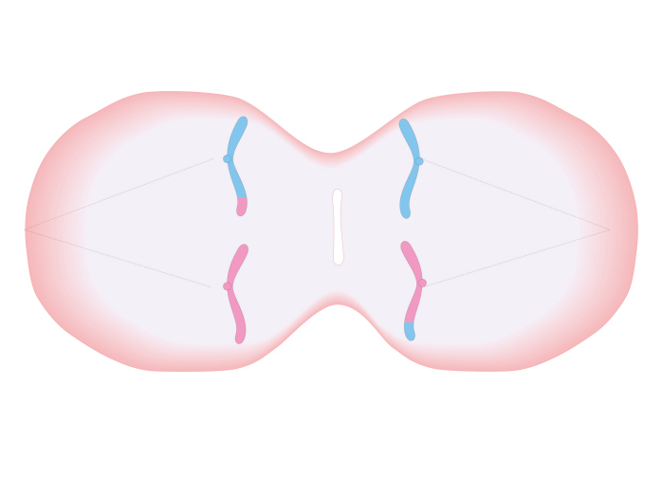
Meiosis
Notes:
Today we are going to learn about meiosis.

Slide 3
Notes:
Meiosis is an important term in our discussion of cells and the cell cycle. Be sure you record this information in your notes.

Slide 4
Notes:
Before we define the term meiosis, let’s review some other words that you already learned, and make sure you are firm in your understanding.

Slide 5
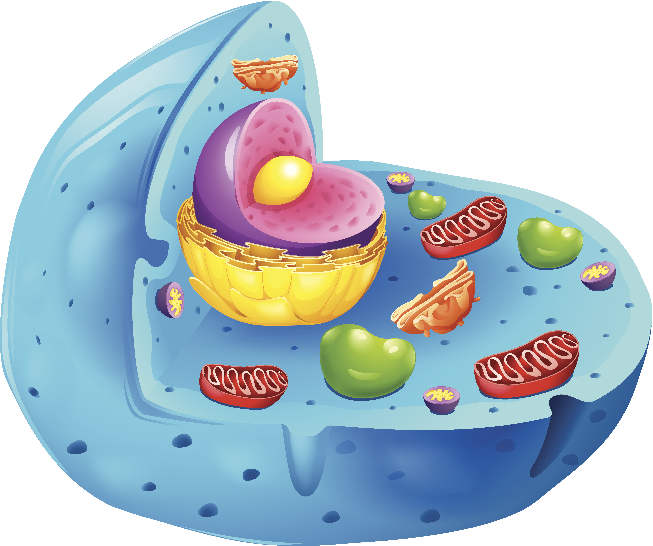
Cell: the basic unit of life
Notes:
A cell is the basic unit of life.

Slide 6
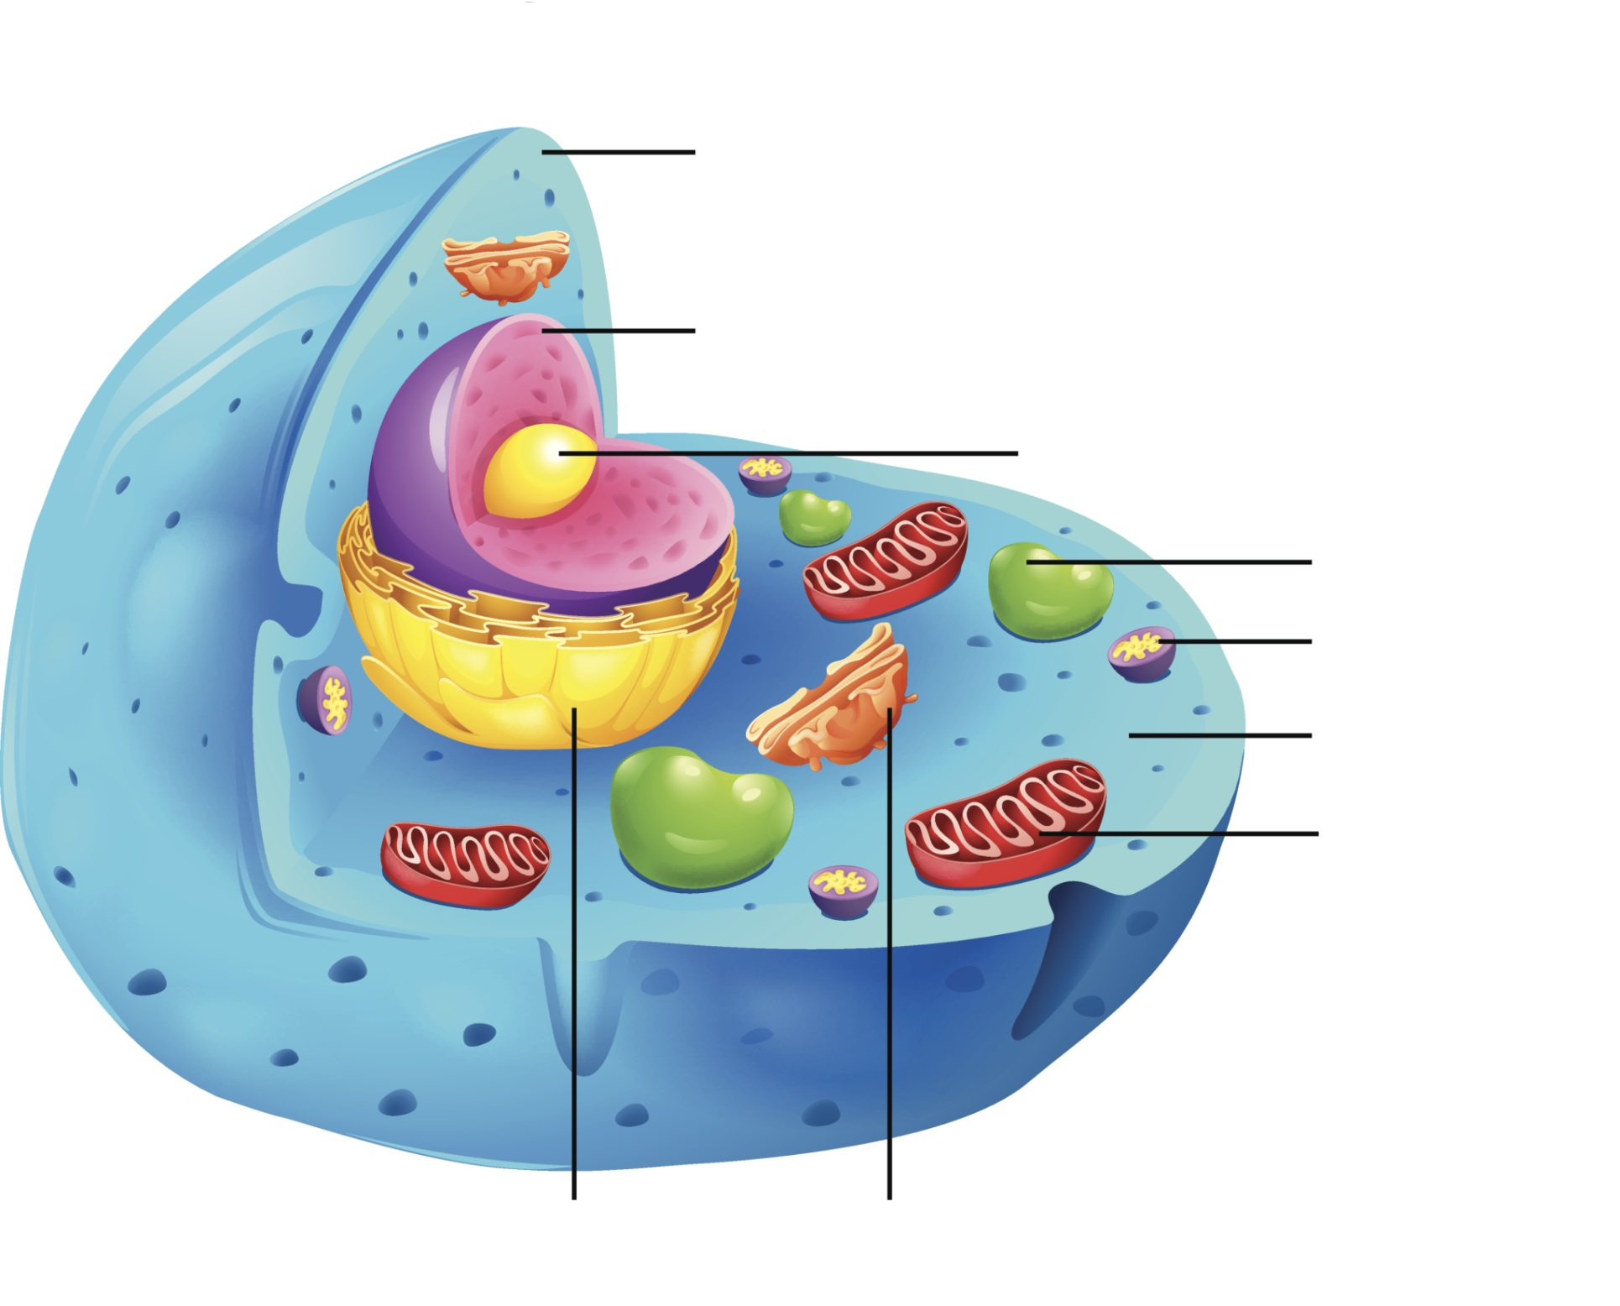
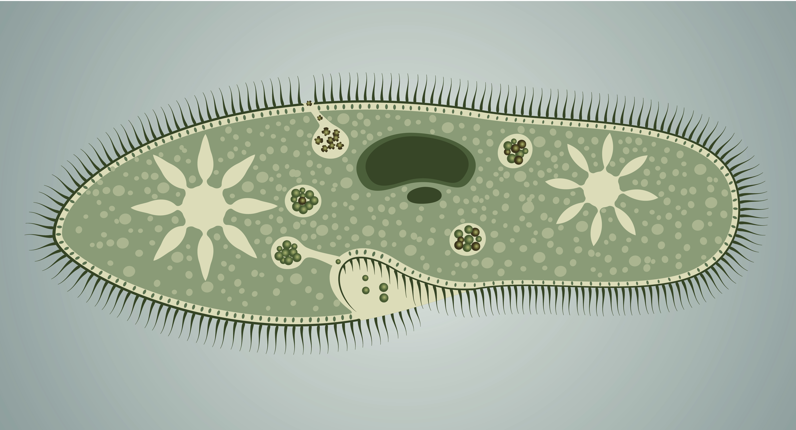
Nucleus: Control Center
Notes:
Inside the cell there is a nucleus which acts as the control center of the cell.

Slide 7
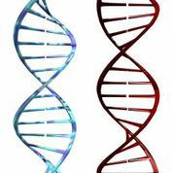
Duplicates All DNA
DNA
Same DNA
Same DNA
Notes:
The nucleus contains genetic material called DNA which has all of the information it needs to function. Before a cell divides it copies all of its DNA.

Slide 8
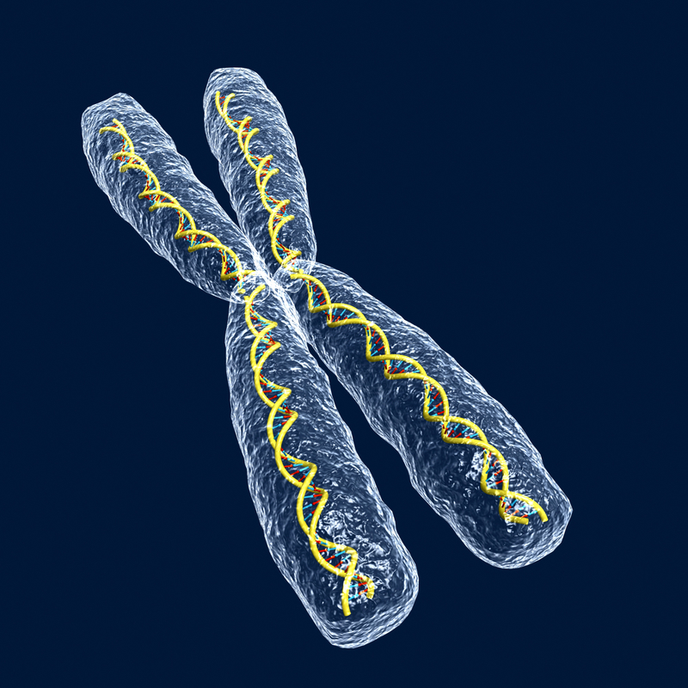
chromosomes
Sister chromatid
Sister chromatid
Notes:
DNA is made up of chromosomes, and a sister chromatid is two chromosomes linked together.

Slide 9
Cell Division
Mitosis Meiosis
Notes:
There are three terms that describe the ways new cells are made that you need to learn. They include cell division, mitosis, and meiosis.

Slide 10
Cell Division
Mitosis Meiosis
Notes:
Today, we will focus on meiosis.

Slide 11
Notes:
Now let’s pause for a moment to review the information we have covered already.

Slide 12
What is a nucleus?
the control center of the cell
the outer wall of a plant cell
where the cell stores and digests waste
where the cell makes proteins
Notes:
What is a nucleus?
-the control center of the cell
-the outer wall of a plant cell
-where the cell stores and digests waste
-where the cell makes proteins

Slide 13
What is a nucleus?
the control center of the cell
the outer wall of a plant cell
where the cell stores and digests waste
where the cell makes proteins
Notes:
The nucleus is the control center of the cell.

Slide 14
How does the nucleus get ready
for cell division?
it disappears
it copies all of the cell’s DNA
it expands
it shrinks
Notes:
How does the nucleus get ready for cell division?
-it disappears
-it copies all the cell’s DNA
-it expands
-it shrinks

Slide 15
How does the nucleus get ready
for cell division?
it disappears
it copies all of the cell’s DNA
it expands
it shrinks
Notes:
The nucleus prepares for cell division by copying all of the cell’s DNA.

Slide 16
What is the process of the nucleus copying DNA called?
cell theory
nuclear division
centromere
mitosis
Notes:
What is the process of the nucleus copying DNA called?
-cell theory
-nuclear division
-centromere
-mitosis

Slide 17
What is the process of the nucleus copying DNA called?
cell theory
nuclear division
centromere
mitosis
Notes:
The process of the nucleus copying DNA is called mitosis.

Slide 18
Meiosis
Notes:
Now we’re going to learn about meiosis.

Slide 19
Meiosis
Notes:
Let’s define meiosis.

Slide 20
meiosis: makes cells with half of the genetic material that will be used for sexual reproduction
HALF
HALF
Notes:
Meiosis makes cells with half of the genetic material that will be used for sexual reproduction. Like mitosis, meiosis is a specific type of cell division with a specific purpose.

Slide 21
The cells created from meiosis are called sex cells.
Notes:
The cells created from meiosis are called sex cells because they have half the number of chromosomes and need to fuse with another sex cell to create an organism.

Slide 22
Notes:
Here’s a clue to help you remember the meaning of meiosis.

Slide 23
Meiosis
ME
Notes:
An easy way to remember the meaning of meiosis is: MEiosis made me.

Slide 24
Notes:
That is the basic definition of meiosis, but there is a bit more you need to know.

Slide 25
Haploid: having half the amount of DNA.
Notes:
Sex cells are haploid. Haploid is having half the amount of DNA. In humans we have 23 pairs of chromosomes (or 46 chromosomes). The haploid number is 23 chromosomes because they are unpaired.

Slide 26
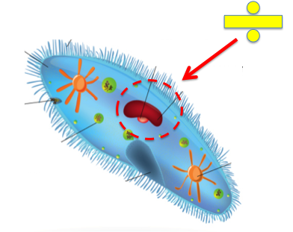
Divides the Nucleus
Notes:
Meiosis divides the nucleus of the cell and happens in two phases each with four main steps.

Slide 27
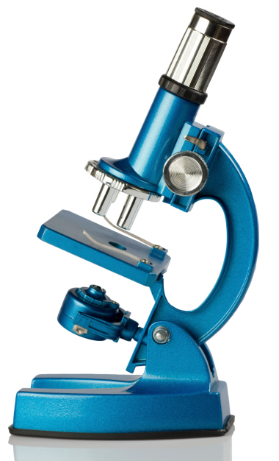
Meiosis I
Prophase I
Metaphase I
Anaphase I
Telophase I
Notes:
The first phase is called Meiosis 1 and follows the steps prophase 1, metaphase 1, anaphase 1, and telophase 1.
<<NOTE: The “correct” names include Roman numerals, which are in the slides. In the script/notes, I’ve used regular numbers for easier reading. –KP>>

Slide 28
Meiosis I
Notes:
Meiosis 1 is the first phase of Meiosis.

Slide 29
Prophase I
Notes:
In prophase 1, each chromosome makes an exact copy of itself, forming two halves called chromatids.

Slide 30
Chromatids
chromatid
Notes:
A chromatid is one of the 2 identical halves of a chromosome.

Slide 31
Metaphase I
Homologous chromosomes
Notes:
The next phase of Meiosis 1 is metaphase 1. In metaphase 1, each chromosome is now made up of 2 identical chromatids. Chromosome pairs line up in the middle of the cell. These are called homologous chromosome pairs.

Slide 32
Homologous Chromosomes
Homologous Chromosomes
Notes:
Homologous Chromosomes are 2 sets of the same numbered chromosome. One chromosome comes from your mother’s DNA and one chromosome comes from your fathers DNA. While they are not identical, they carry alleles for the same traits.

Slide 33
Metaphase I
Meta and Middle both start with “M”
Notes:
You can remember metaphase because “meta” and “middle both start with “m”. During metaphase the homologous pairs line up in the middle.

Slide 34
Anaphase I
Notes:
The next phase of Meiosis 1 is anaphase 1. In anaphase 1, the chromosomes separate from their homologous partners and move apart from each other.

Slide 35
Anaphase I
Ana and Apart both star with “A”
Notes:
You can remember anaphase because “ana” and “apart” both start with “a”. During this phase, homologous chromosomes move apart from each other.

Slide 36
Telophase I
Notes:
The last phase of Meiosis 1 is telophase 1. During this phase, the nuclear envelope splits into two. The two nuclear envelopes reform, but the two sister chromatids are still joined.

Slide 37
Notes:
Lets review what we’ve learned about Meiosis 1.

Slide 38
During which phase do the chromosomes make exact copies of themselves?
Prophase I
Metaphase I
Anaphase I
Telophase I
Notes:
During which phase do the chromosomes make exact copies of themselves?
-Prophase 1
-Metaphase 1
-Anaphase 1
-Telophase 1

Slide 39
During which phase do the chromosomes make exact copies of themselves?
Prophase I
Metaphase I
Anaphase I
Telophase I
Notes:
The chromosomes make exact copies of themselves during Prophase 1.

Slide 40
During which phase do homologous chromosome pairs line up in the middle of the cell?
Prophase I
Metaphase I
Anaphase I
Telophase I
Notes:
During which phase do homologous chromosome pairs line up in the middle of the cell?
-Prophase 1
-Metaphase 1
-Anaphase 1
-Telophase 1

Slide 41
During which phase do homologous chromosomes line up in the middle of the cell?
Prophase I
Metaphase I
Anaphase I
Telophase I
Notes:
Homologous chromosomes line up in the middle of the cell during Metaphase 1.

Slide 42
During which phase are the homologous chromosomes pulled apart?
Prophase I
Metaphase I
Anaphase I
Telophase I
Notes:
During which phase are the homologous chromosomes pulled apart?
-Prophase 1
-Metaphase 1
-Anaphase 1
-Telophase 1

Slide 43
During which phase are the homologous chromosomes pulled apart?
Prophase I
Metaphase I
Anaphase I
Telophase I
Notes:
The homologous chromosomes are pulled apart during Anaphase 1.

Slide 44
Meiosis II
Prophase II
Metaphase II
Anaphase II
Telophase II
End Result
Notes:
Now we are going to learn about Meiosis 2.

Slide 45
Meiosis II
Prophase II
Metaphase II
Anaphase II
Telophase II
End Result
Notes:
Meiosis 2 follows the steps prophase 2, metaphase 2, anaphase 2, and telophase 2. At the end of Meiosis 2 the original cell divides to create 4 cells with half of the original genetic material.

Slide 46
Meiosis II
Notes:
Meiosis II happens after Meiosis 1. Remember that in Meiosis 1, daughter cells are created with half the amount of genetic information as their parent cell.

Slide 47
Prophase II
Homologous Pair
Notes:
The first step of Meiosis 2 is prophase 2. In prophase 2, each cell now contains 1 member of the homologous pair. No replication occurs.

Slide 48
Metaphase II
Sister chromatids
Notes:
The next phase is metaphase 2. In metaphase 2, the chromosomes line up in the middle of the cell. This is just like metaphase 1 but there are no homologous pairs.

Slide 49
Anaphase II
Sister chromatids
chromatid
Notes:
In the next phase, anaphase 2, sister chromatids are pulled apart. Remember that a sister chromatid is two chromosomes linked together.

Slide 50
Telophase II
daughter cell
daughter cell
daughter cell
daughter cell
Notes:
The final phase of Meiosis 2 is telophase 2. In telophase 2, the nuclear envelope begins to reform and 4 new daughter cells are created. Each daughter cell has half the amount of genetic information as the parent cell.

Slide 51
Correct Amount of Genetic Material
Notes:
The new cells created by meiosis are used during sexual reproduction to create a new organism with the correct amount of genetic material.

Slide 52
End of Meiosis
Parent Cell (2n)
Daughter Cells (n)
Notes:
At the end of meiosis, we now have 4 cells with half the amount of genetic information that the parent cell had. This can be denoted at 2n (parent) and n (daughter)

Slide 53
Notes:
Let’s review what we’ve just learned.

Slide 54
During which phase do the chromosomes line up in the middle of the cell?
Prophase II
Metaphase II
Anaphase II
Telophase II
Notes:
During which phase do the chromosomes line up in the middle of the cell?
-Prophase 2
-Metaphase 2
-Anaphase 2
-Telophase 2

Slide 55
During which phase do the chromosomes line up in the middle of the cell?
Prophase II
Metaphase II
Anaphase II
Telophase II
Notes:
The chromosomes line up in the middle of the cell during metaphase 2.

Slide 56
During which phase are the sister chromatids pulled apart?
Prophase II
Metaphase II
Anaphase II
Telophase II
Notes:
During which phase are the sister chromatids pulled apart?
-Prophase 1
-Metaphase 1
-Anaphase 1
-Telophase 1

Slide 57
During which phase are the sister chromatids pulled apart?
Prophase II
Metaphase II
Anaphase II
Telophase II
Notes:
The sister chromatids are pulled apart during anaphase 2.

Slide 58
Notes:
Let’s review what we’ve learned about meiosis today one more time.

Slide 59
What is meiosis?
the nucleus of the cell
the first phase of cell division
the process of combining cells
the process of making cells with half of the genetic material that will be used for sexual reproduction
Notes:
What is meiosis?
-the nucleus of the cell
-the first phase of cell division
-the process of combining cells
-the process of making cells with half of the genetic material that will be used for sexual reproduction

Slide 60
What is meiosis?
the nucleus of the cell
the first phase of cell division
the process of combining cells
the process of making cells with half of the genetic material that will be used for sexual reproduction
Notes:
What is meiosis?
-the nucleus of the cell
-the first phase of cell division
-the process of combining cells
-the process of making cells with half of the genetic material that will be used for sexual reproduction

Slide 61
How many new cells are created by the end of meiosis?
one
two
four
six
Notes:
How many new cells are created by the end of meiosis?
-one
-two
-four
-six

Slide 62
How many new cells are created by the end of meiosis?
one
two
four
six
Notes:
There are 4 new cells created by the end of meiosis. They are called daughter cells.

Slide 63
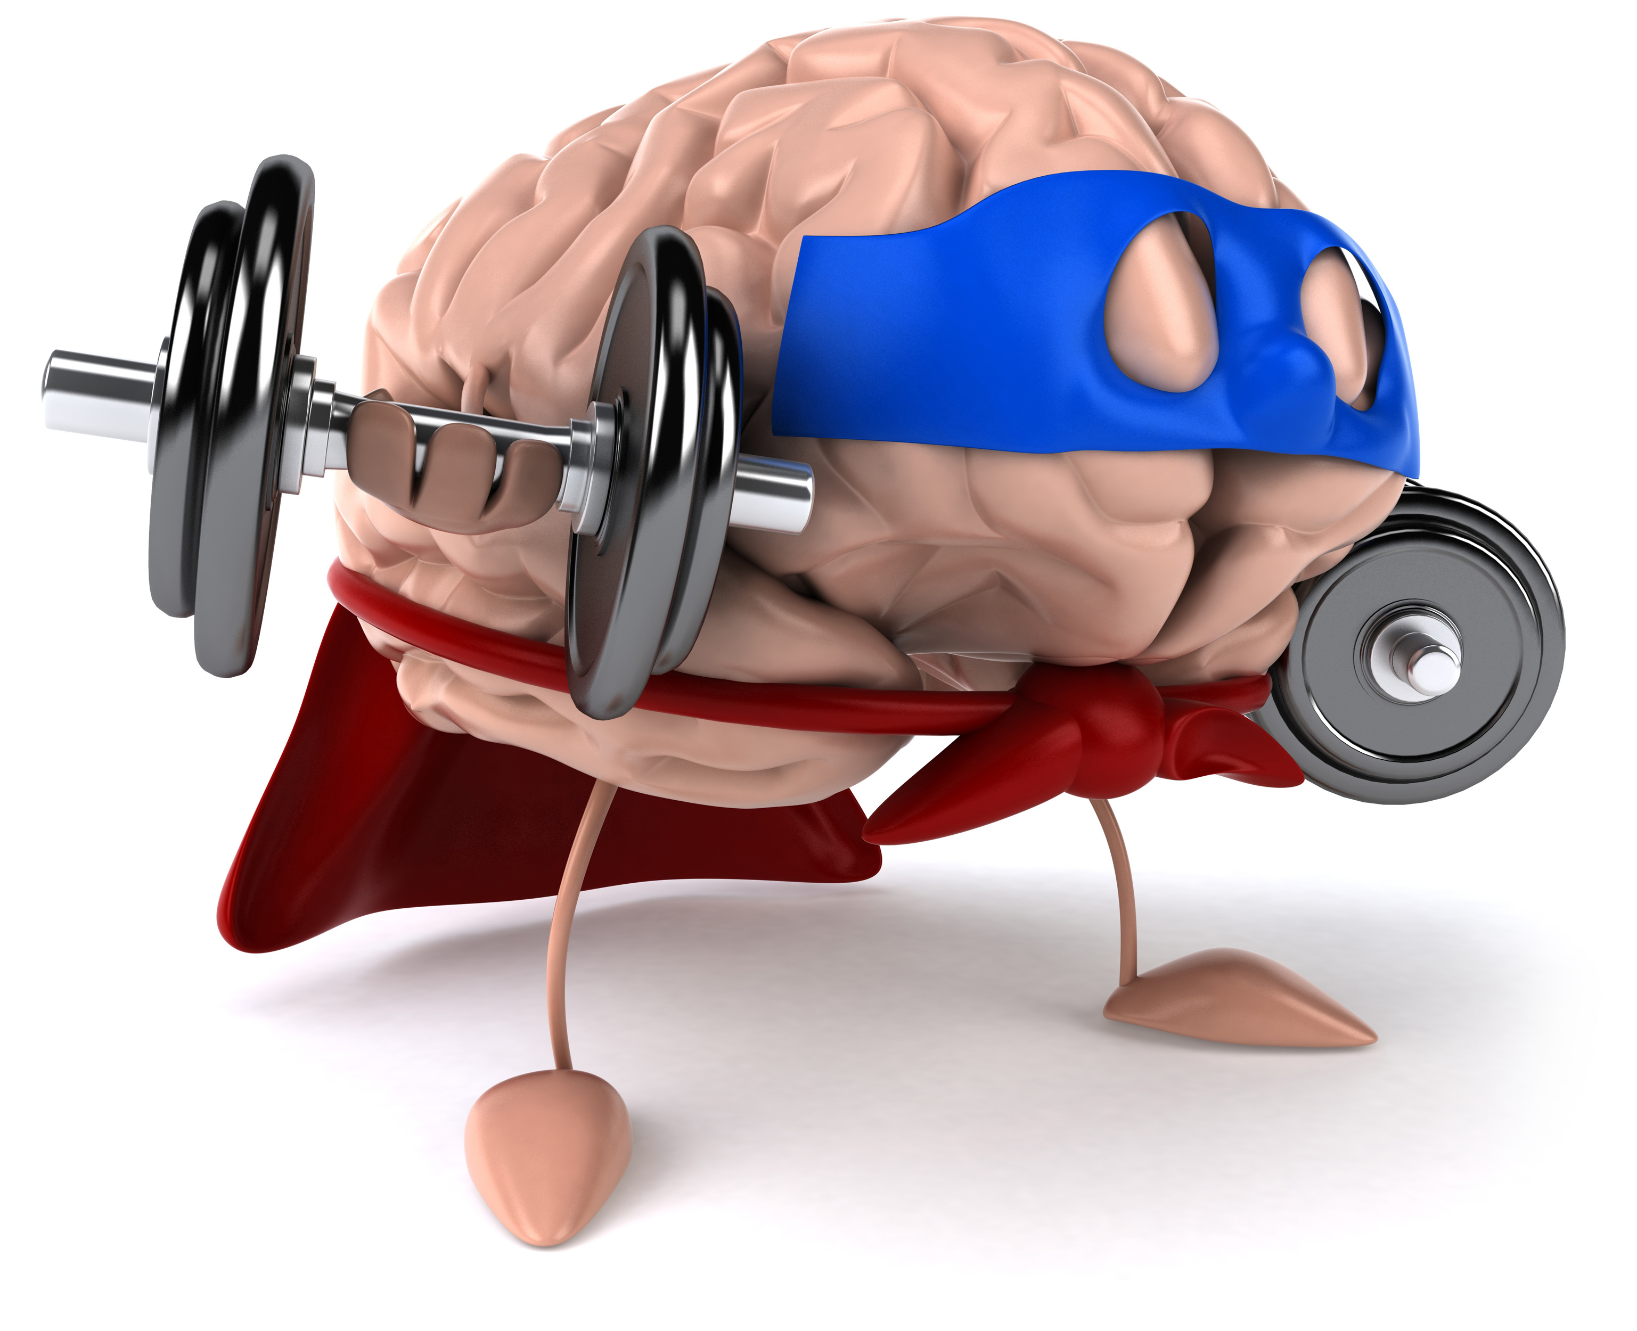
Remember!!!
Notes:
So remember!

Slide 64
meiosis: makes cells with half of the genetic material that will be used for sexual reproduction
HALF
HALF
Notes:
Meiosis makes cells with half of the genetic material that will be used for sexual reproduction. Like mitosis, meiosis is a specific type of cell division with a specific purpose.

Slide 65
Notes:
Thanks for watching, and please continue watching CAPs available from this website.

Slide 66
This Video Created With Resources From:
Cooperative Agreement # R324B130023
Curry School Foundation’s Research and Development Fund
Questions or Comments to Michael Kennedy, Ph.D.
MKennedy@Virginia.edu

Slide 67
Activity
Objective: For students to understand the process of Meiosis and how sex cells are formed.
Activity: Supply students with either pipe cleaners or strings of beads. Students will work through modeling each phase of Meiosis with their pipe cleaners or beads. Student should be able to describe each step in reference to the phase (i.e. anaphase 1) and the “state” of the DNA (sister chromatids, homologous chromosomes, n, 2n).
Modification
Remove directions related to crossing over of DNA
Materials
Pipecleaners
Beads
String
Scissors
Paper
Pencil
Resources
https://www.somsd.k12.nj.us/site/handlers/filedownload.ashx?moduleinstanceid=3123&dataid=9016&FileName=Meiosis%20simulation-pop%20beads.pdf
https://www.youtube.com/watch?v=TmRwnxqRCIc

