Slide 1
Notes:
OK everyone get ready to learn some new vocabulary terms.

Slide 2
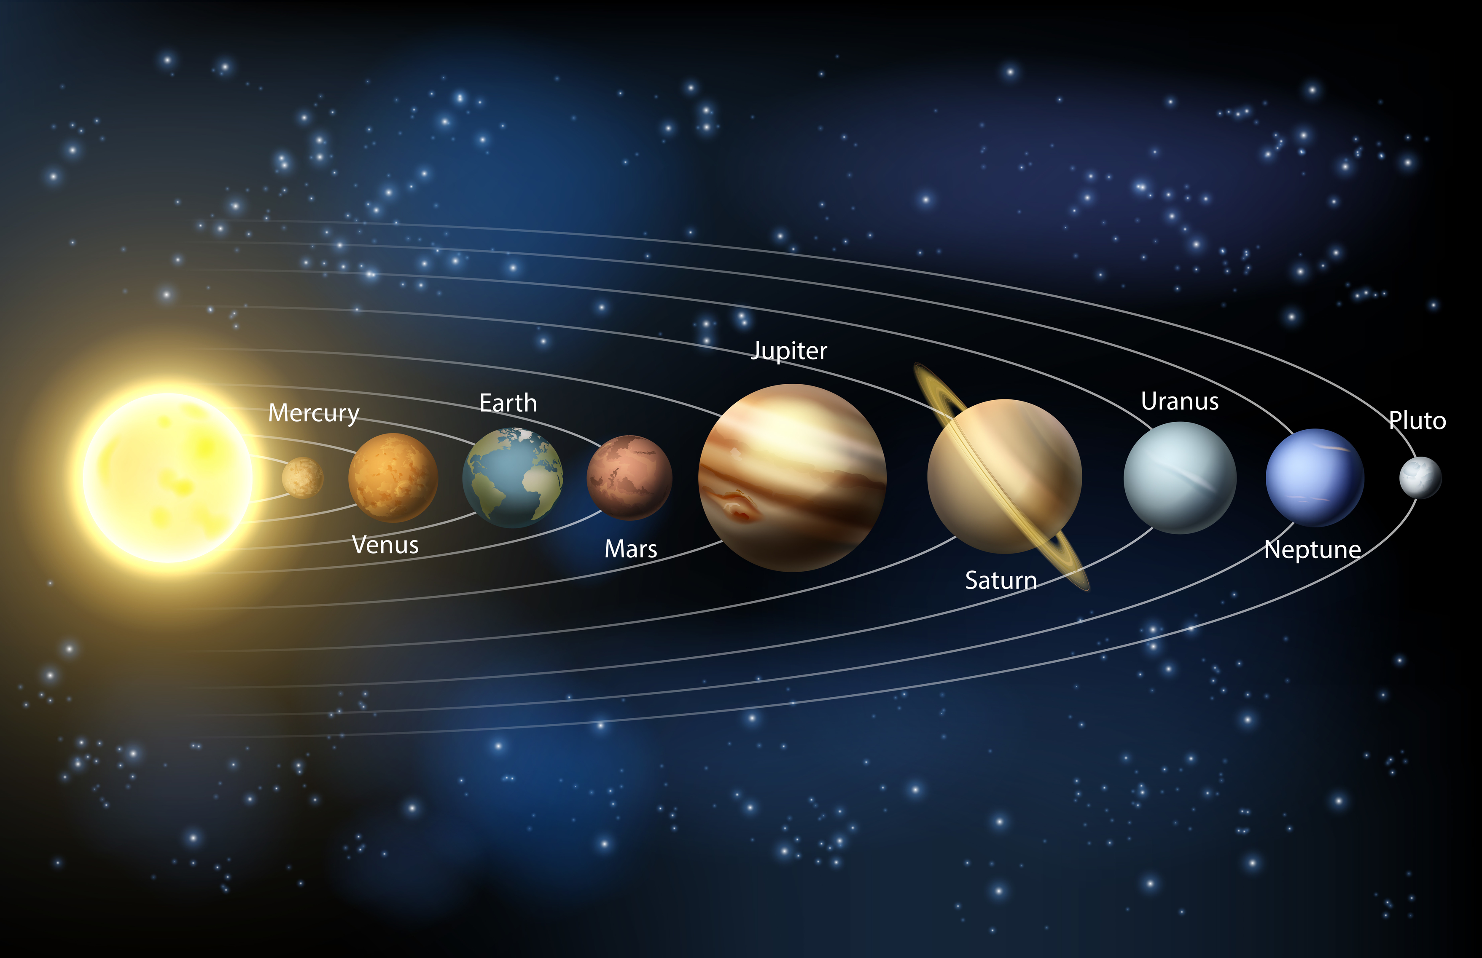
Earth Properties and Seasons
Notes:
Today we are going to learn about the properties of the planet Earth and seasons.

Slide 3
Notes:
Before we define these terms, let’s review some other words that you already learned, and make sure you are firm in your understanding.

Slide 4
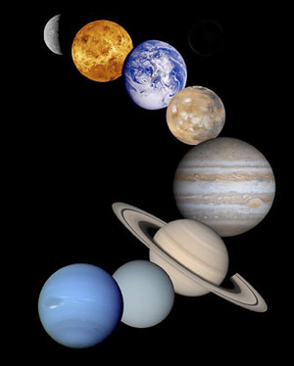
Planet
A body in space that revolves around a star
Notes:
A planet is a body in space that revolves around a star.

Slide 5
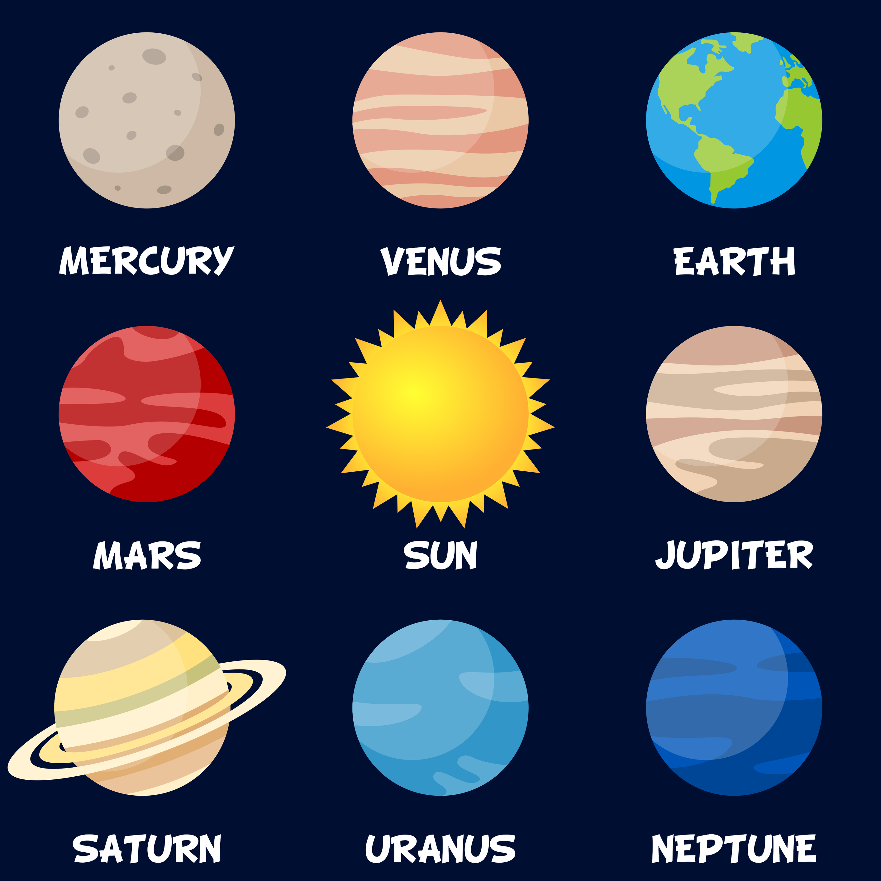
Notes:
Our solar system has 8 planets.

Slide 6
Earth
Notes:
Earth is the 3rd planet from the sun.

Slide 7
atmosphere
Notes:
The atmosphere is the layers of gas surrounding the earth’s surface. Sometimes the atmosphere is called a “blanket” of gases.

Slide 8
Notes:
Now let’s pause for a moment to review the information we have covered already.

Slide 9
How many planets are in our solar system?
Notes:
How many planets are in our solar system?
(Bonus – name them in order!)

Slide 10
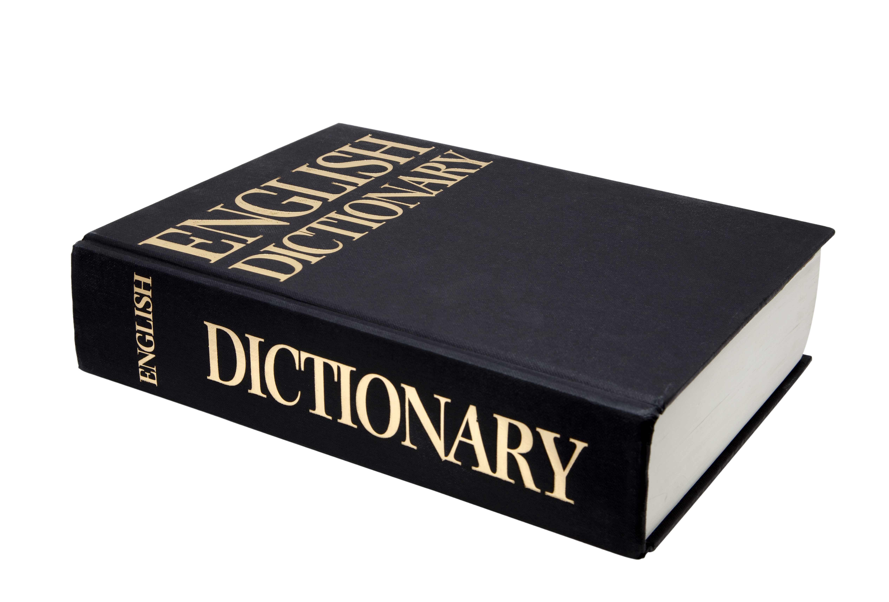
properties of Earth
Notes:
Now, let’s define what the properties of Earth are.

Slide 11
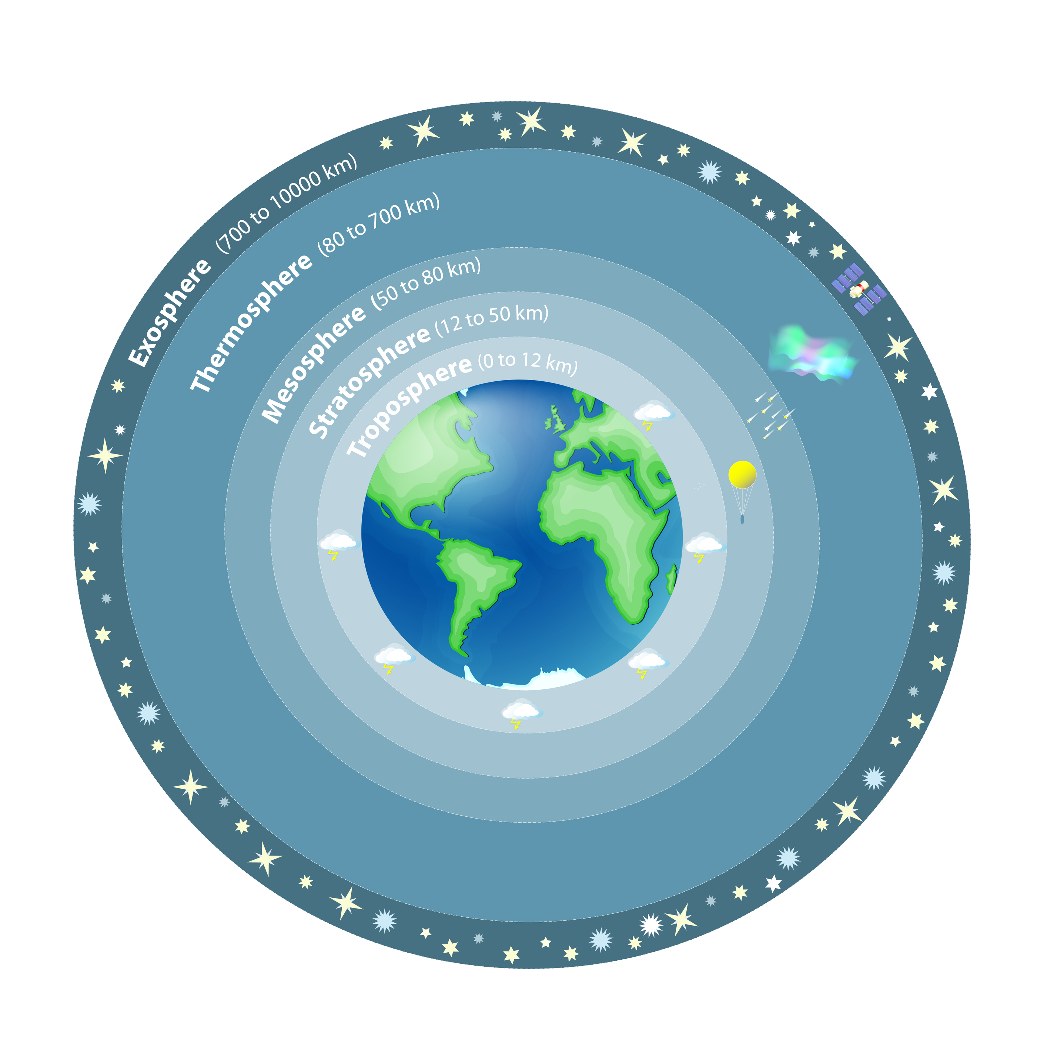
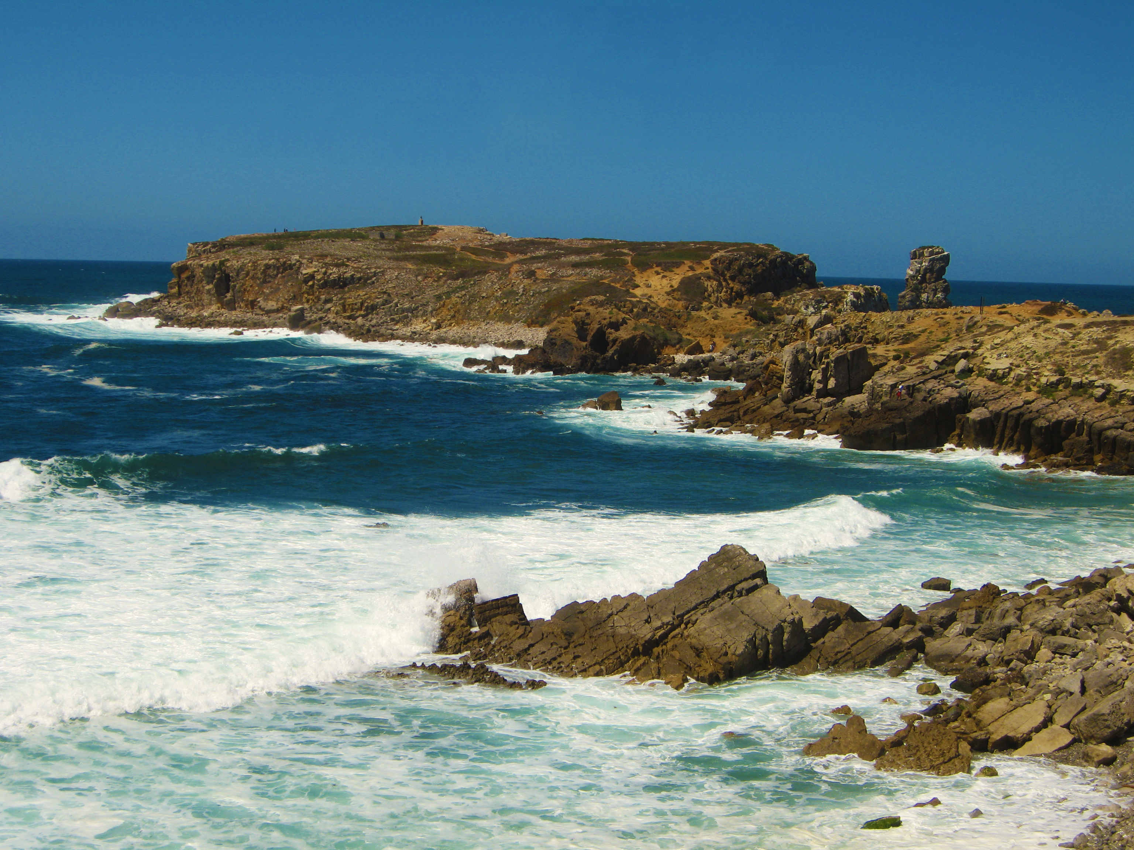
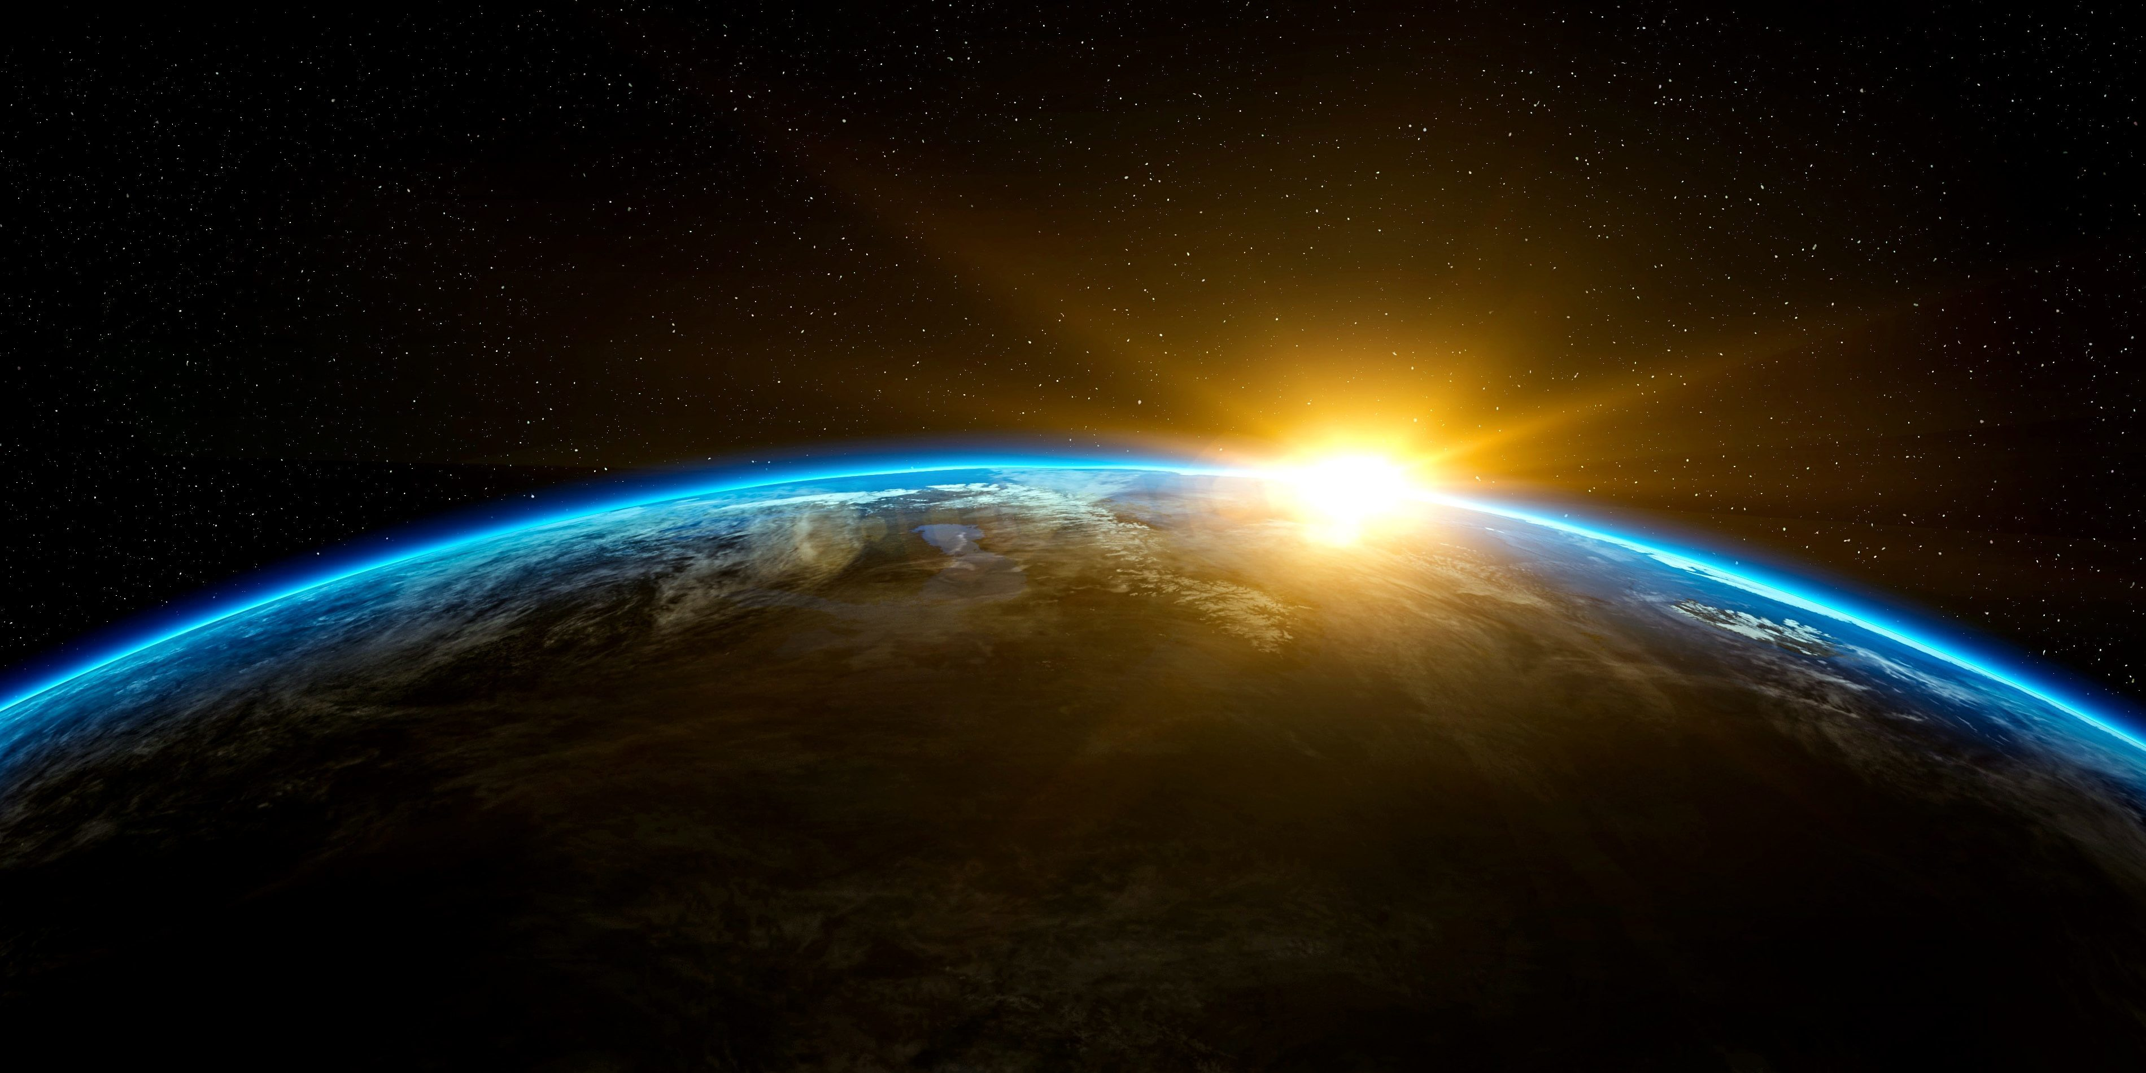
properties of Earth: important characteristics that make Earth different from other planets
1. Protective Atmosphere
2. Rocky surface, mostly water
3. 4.5 billion years old
Notes:
There are 3 important properties, or characteristics, of the planet Earth that make it different from other planets. We will learn about each of these now.

Slide 12
1. Protective Atmosphere
Notes:
First, the earth has a protective atmosphere.

Slide 13
protective atmosphere
Mostly Oxygen and Nitrogen
Notes:
Earth’s atmosphere is made up of gases, mostly nitrogen and oxygen.

Slide 14
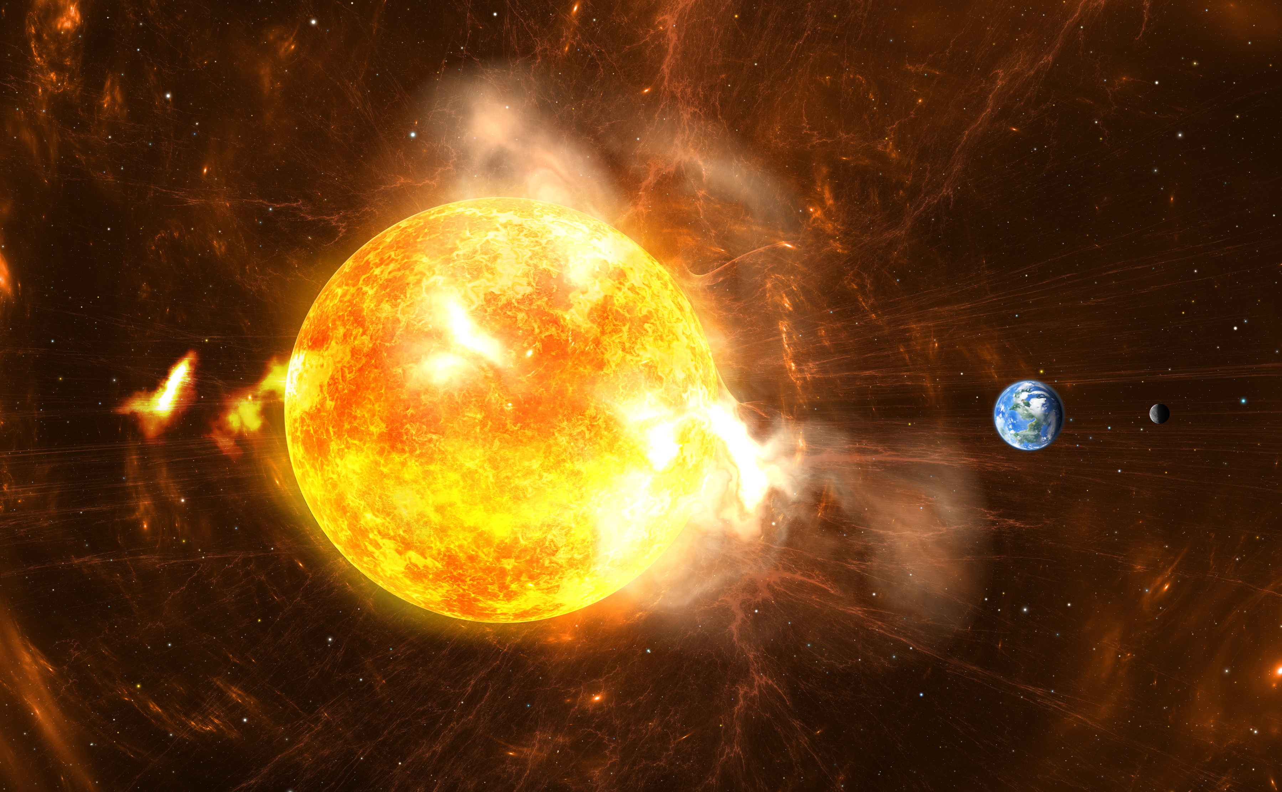
protective atmosphere
Notes:
The many layers of Earth’s atmosphere protect it from harmful ultraviolet radiation from the sun.

Slide 15
2. Earth is rocky and mostly covered with water
Notes:
The second property of Earth is that it has a rocky surface and is mostly covered with water.

Slide 16
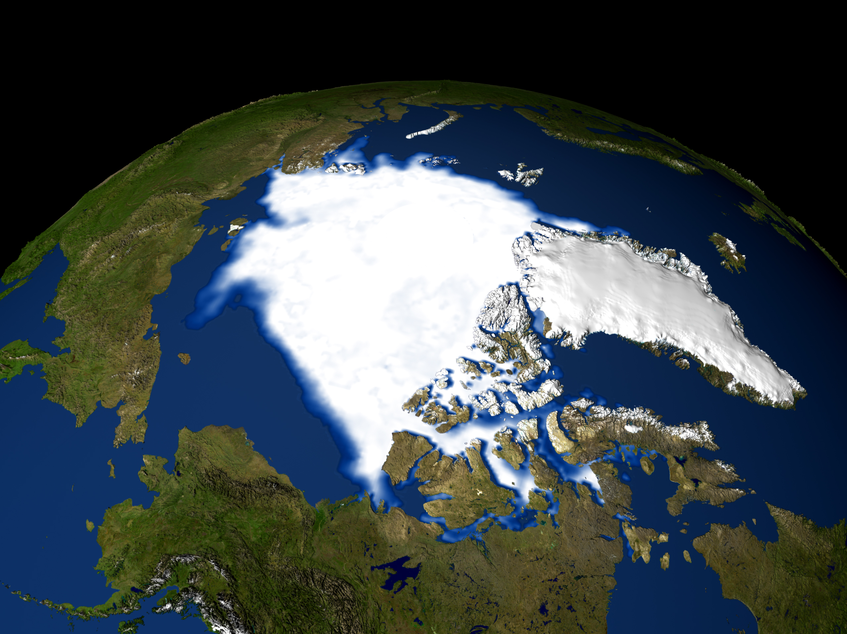
This water is frozen at the poles
Notes:
Most of the water on Earth is frozen at the North and South poles, in the polar ice caps.

Slide 17
3. Earth is about 4.5 billion years old
Notes:
The third property of Earth is that it is about 4.5 billion years old.

Slide 18
= 4,500,000,000 years
Notes:
That’s a long time!

Slide 19
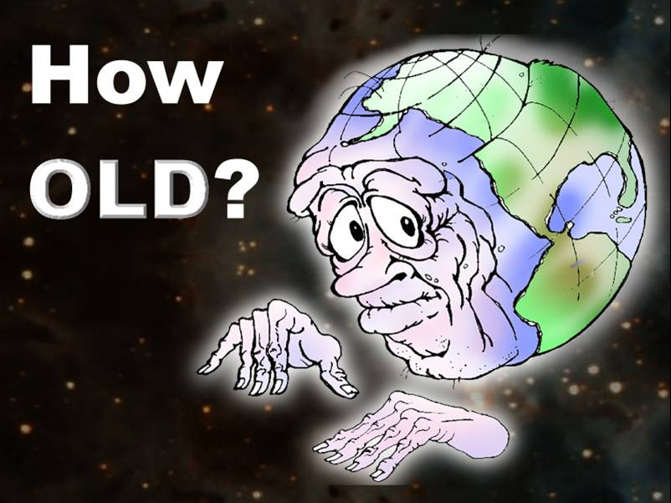
Earth Properties
Rocky
Covered with water
Frozen ice caps
Protective Atmosphere
~4.5 billion years old

Slide 20
Notes:
Let’s take a minute to review what we’ve covered so far.

Slide 21
Which of the following is not true of Earth?
It is mostly covered with water
It is the 3rd planet from the sun
The atmosphere is mostly composed of carbon
It is about 4.5 billion years old
Notes:
Which of the following is NOT true of Earth?
It is mostly covered with water
It is the 3rd planet from the sun
The atmosphere is mostly composed of carbon
It is about 4.5 billion years old

Slide 22
Which of the following is not true of Earth?
It is mostly covered with water
It is the 3rd planet from the sun
The atmosphere is mostly composed of carbon
It is about 4.5 billion years old
Notes:
Earth’s atmosphere is mostly made of nitrogen and oxygen.

Slide 23
Earth’s Seasons
Notes:
Now we are going to learn about seasons.

Slide 24
seasons
Notes:
First, let’s define what seasons are.

Slide 25
seasons: divisions of the year that have different weather patterns due to the Earth’s changing position
Notes:
Seasons are divisions of the year that have different weather patterns due to the Earth’s changing position.

Slide 26
Notes:
Seasons change when the Earth changes its position on its axis so that it is either closer to or farther away from the sun.

Slide 27
Notes:
Explicit cue to review examples of seasons:
Now, let’s talk about some common examples of seasons.

Slide 28
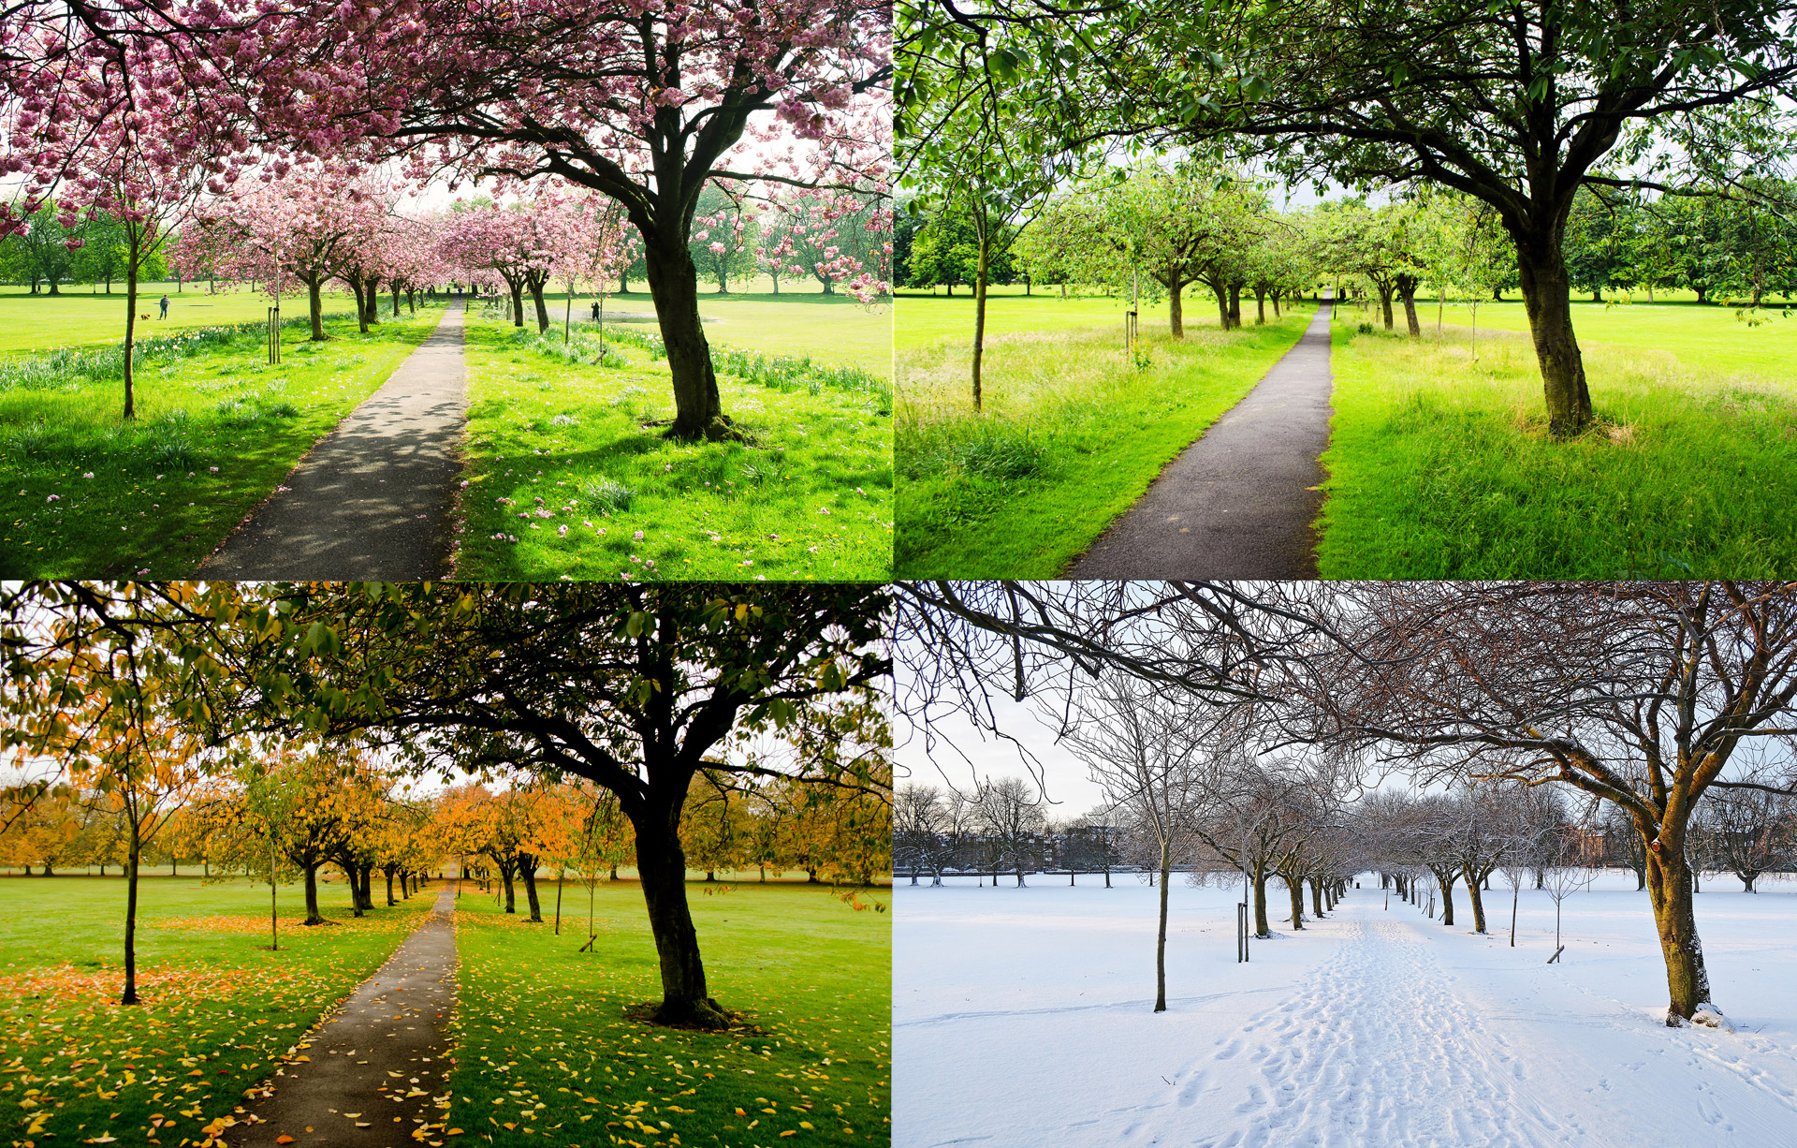
Notes:
Spring, summer, fall, and winter are examples of seasons.

Slide 29
NON
Notes:
Let’s talk about some non-examples of seasons. These are things that might seem similar but do not fit the definition of seasons.

Slide 30
Notes:
Earth’s rotation on its axis is not a season. When the Earth makes one rotation on its axis, that is one day.

Slide 31
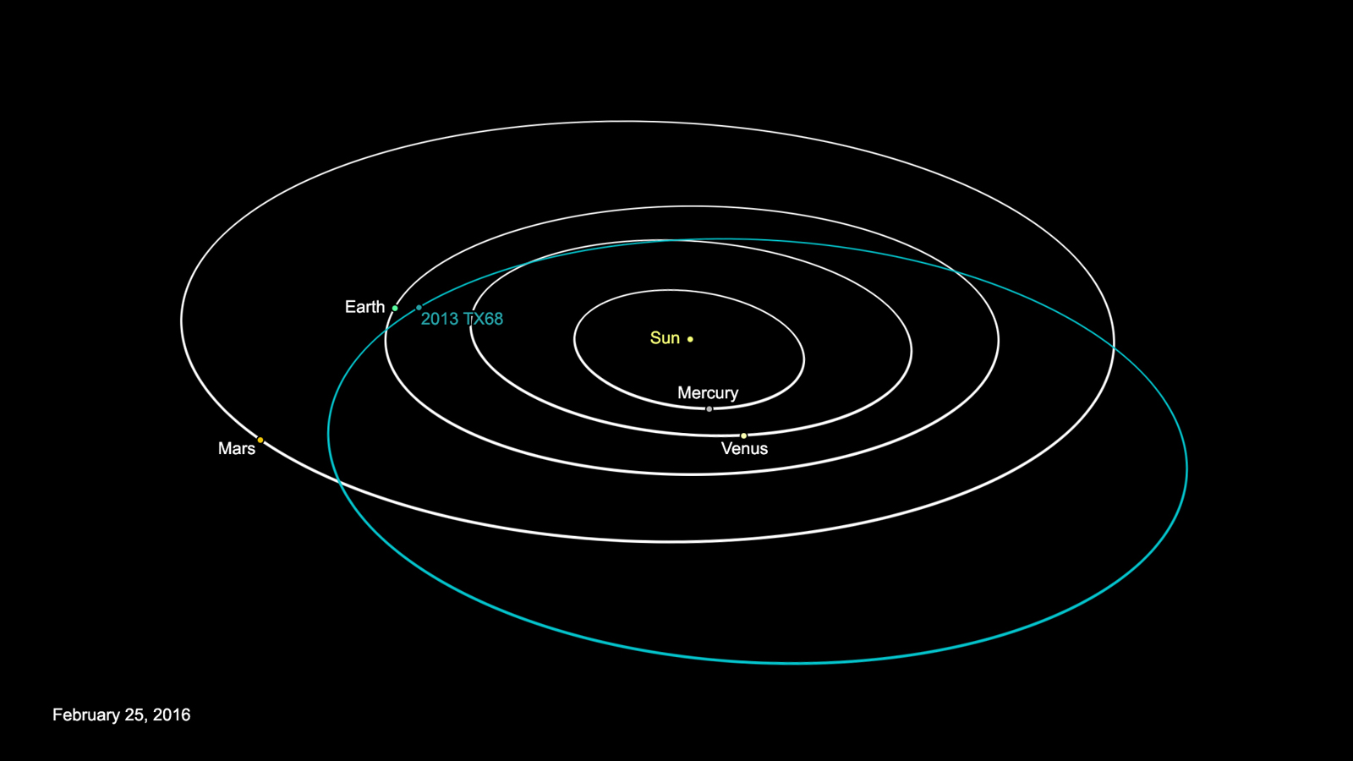
Notes:
Earth’s revolution around the sun is not a season. When the Earth makes one revolution around the sun, that is one year.

Slide 32
Notes:
Let’s review what we have learned today.

Slide 33
Earth’s __________ protects it from solar radiation from the sun.
atmosphere
moon
oceans
rocky surface
Notes:
Earth’s __________ protects it from solar radiation from the sun.
atmosphere
moon
oceans
rocky surface

Slide 34
Earth’s __________ protects it from solar radiation from the sun.
atmosphere
moon
oceans
rocky surface
Notes:
Earth’s atmosphere protects it from solar radiation from the sun.

Slide 35
Where is most of Earth’s water stored?
in rivers and lakes
in the oceans
underground
in the polar ice caps
Notes:
Where is most of Earth’s water stored?
in rivers and lakes
in the oceans
underground
in the polar ice caps

Slide 36
Where is most of Earth’s water stored?
in rivers and lakes
in the oceans
underground
in the polar ice caps
Notes:
Most of Earth’s water stored in the polar ice caps.

Slide 37
Remember!!!
Notes:
So remember!
<keep this slide>

Slide 38
properties of Earth: important characteristics that make Earth different from other planets
1. Protective Atmosphere
2. Rocky surface, mostly water
3. 4.5 billion years old
Notes:
There are 3 important properties, or characteristics, of the planet Earth that make it different from other planets. We will learn about each of these now.

Slide 39
seasons: divisions of the year that have different weather patterns due to the Earth’s changing position
Notes:
Seasons are divisions of the year that have different weather patterns due to the Earth’s changing position.

Slide 40
Notes:
Thanks for watching, and please continue watching CAPs available from this website.

Slide 41
This PowerPoint was Created With Resources From:
Cooperative Agreement # R324B130023
Curry School Foundation’s Research and Development Fund
Questions or Comments to Michael Kennedy, Ph.D.
MKennedy@Virginia.edu

