Slide 1
Notes:
OK everyone get ready to learn a new vocabulary term.

Slide 2
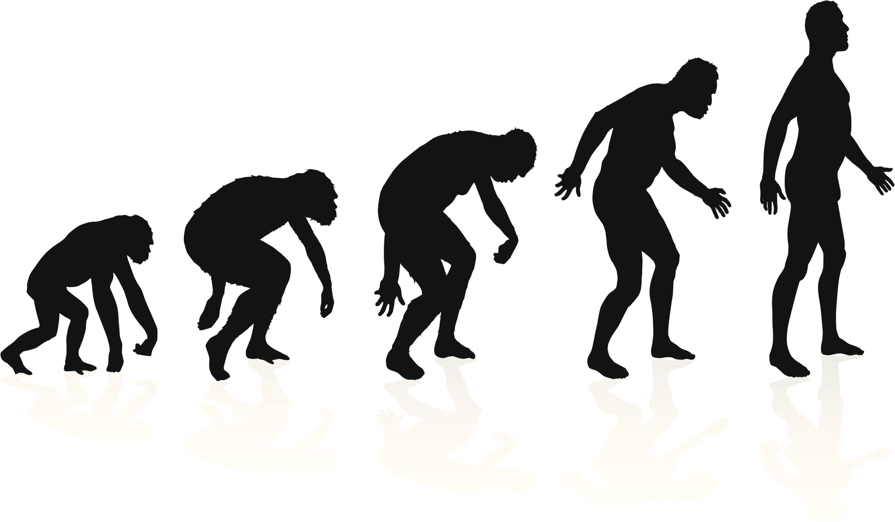
Evolution
Notes:
In this lesson we talk about evolution.

Slide 3
Notes:
Before we define the term evolution, let’s review some other words that you already learned, and make sure you are firm in your understanding.

Slide 4
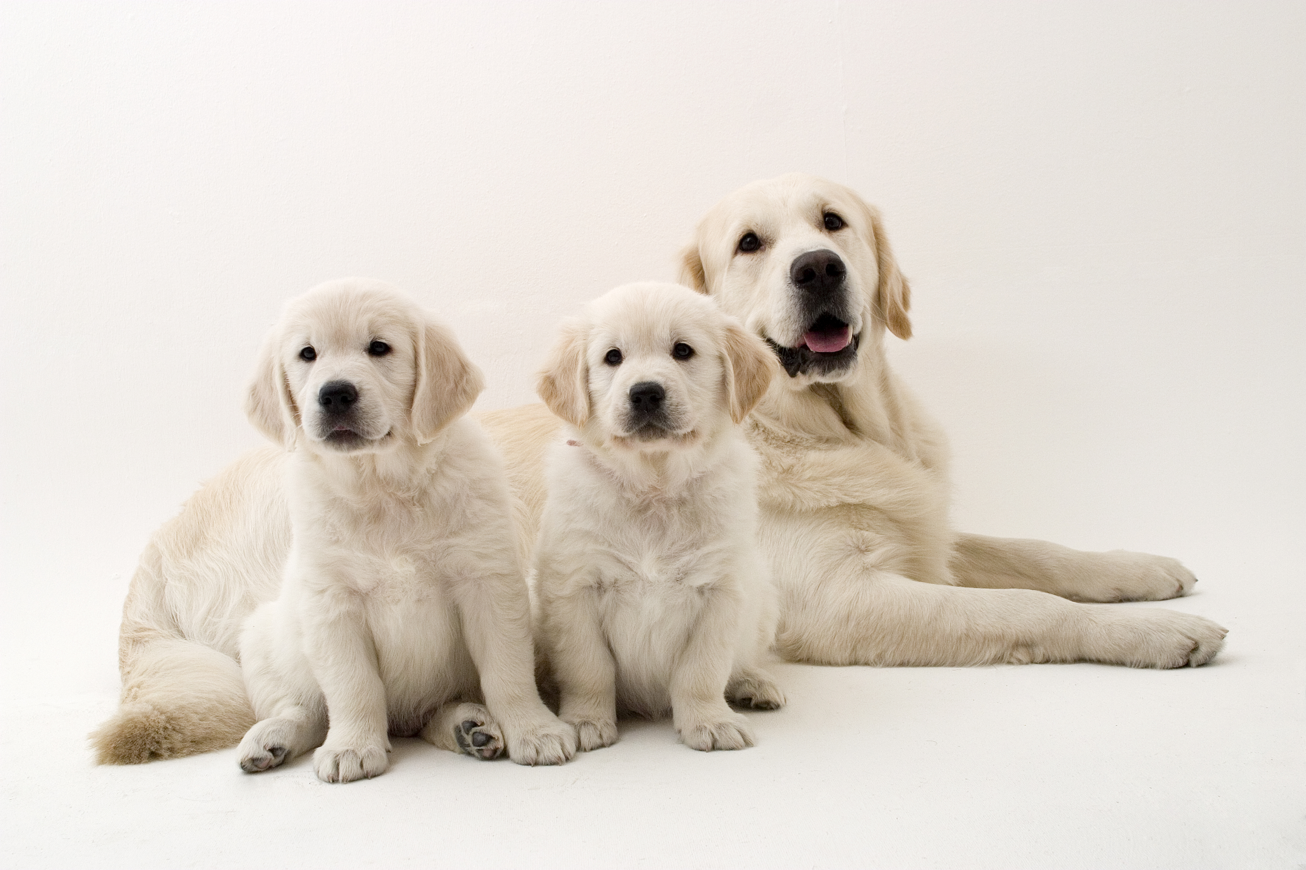
Hereditary
Notes:
Remember that parents’ hereditary material give traits—such as eye color, hair color, blood type, or height—to their offspring, or their children.
Humans have hereditary traits. So do animals, plants, and other organisms.

Slide 5
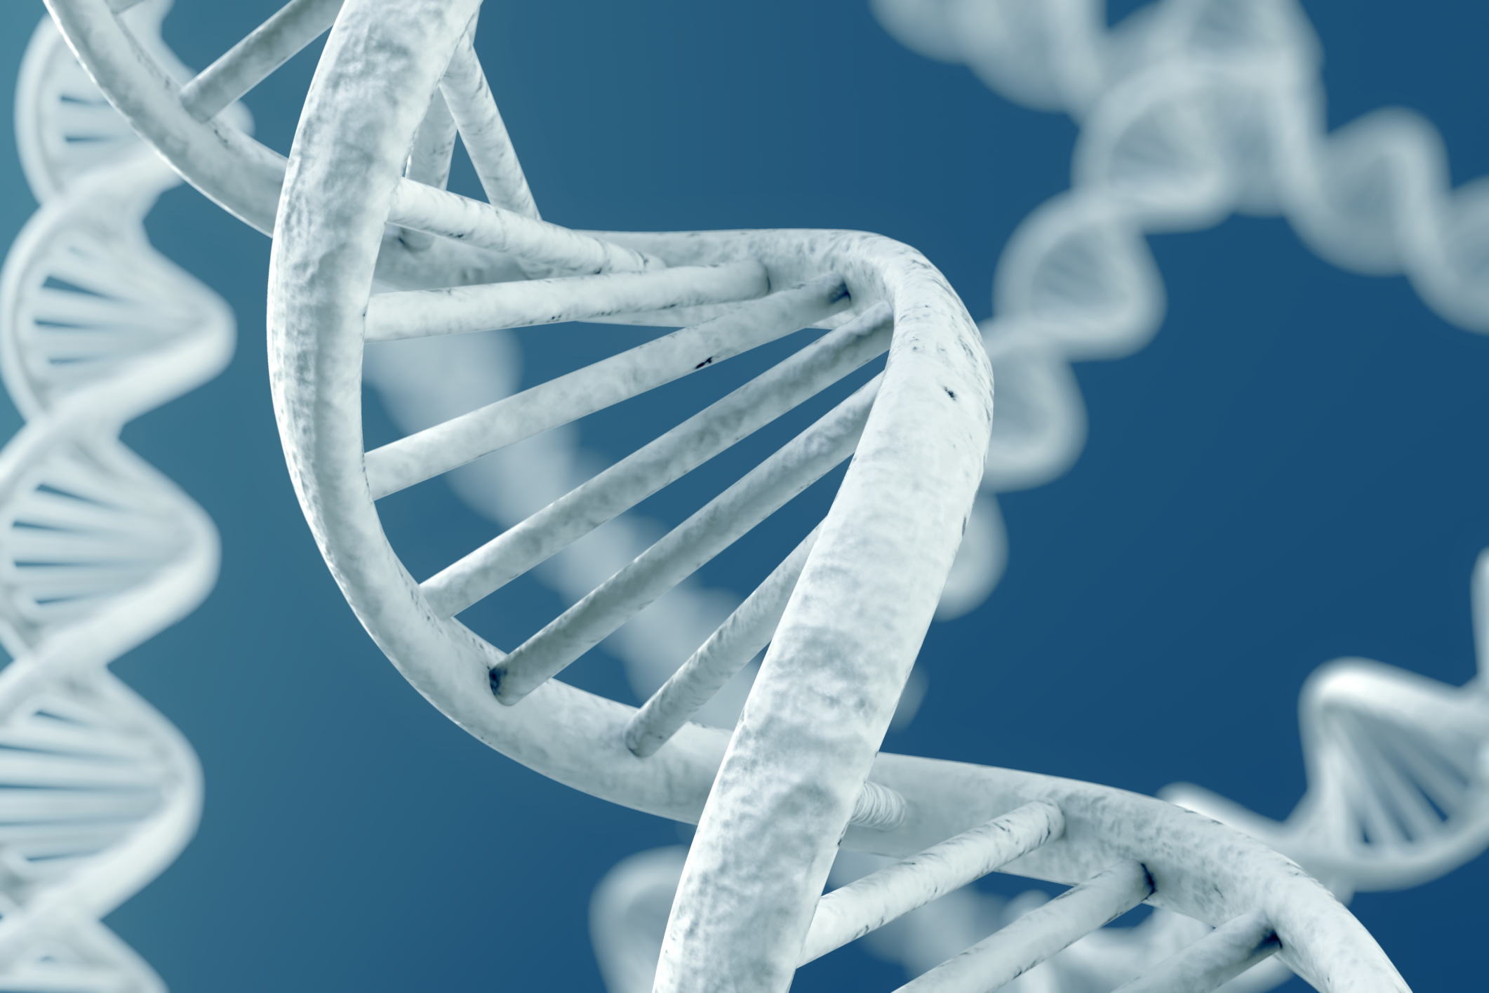
DNA: The hereditary material in
almost all organisms
Notes:
Also, remember that DNA is the hereditary material in all organisms.

Slide 6
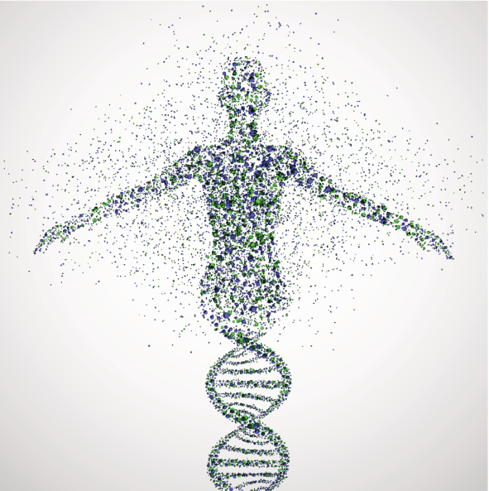
Genes: Parts of DNA that carry
information that determines your
traits
Notes:
And genes are the parts of DNA that carry the information that determines your traits—such as hair color, height, baldness, and blood type.

Slide 7
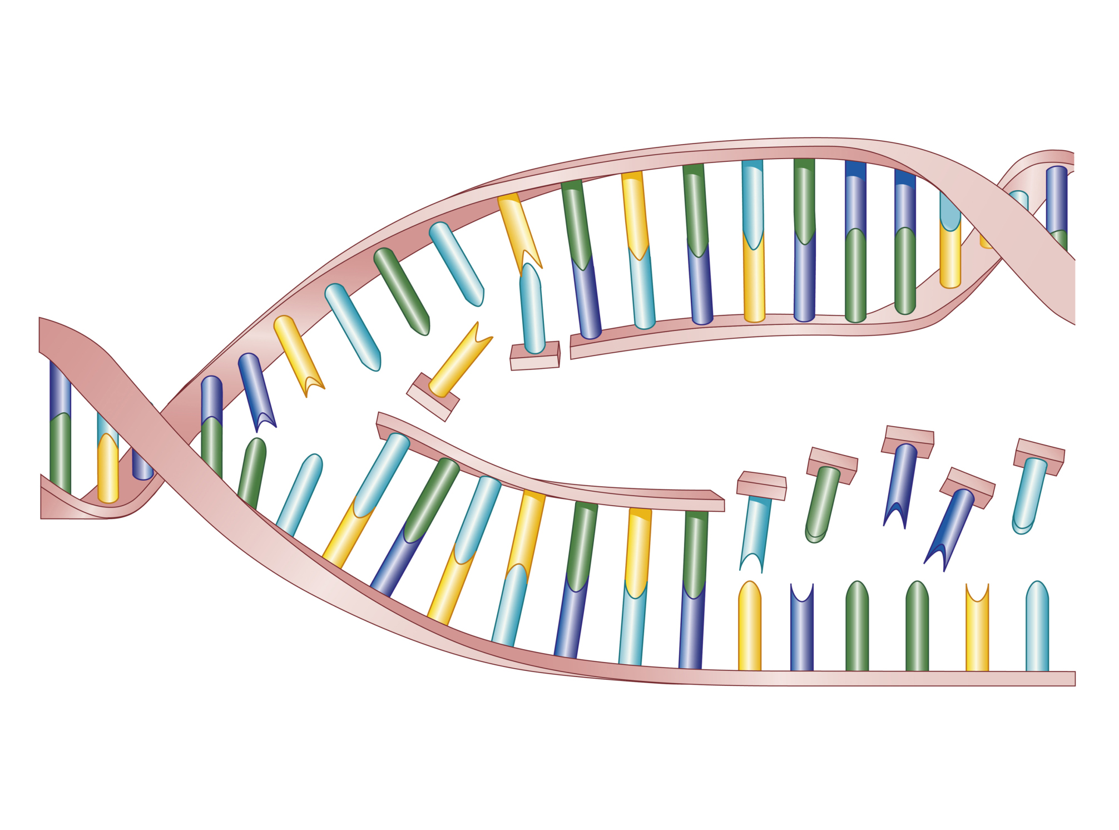
Mutation
Notes:
A mutation is a permanent change in the DNA sequence that makes up a gene.

Slide 8
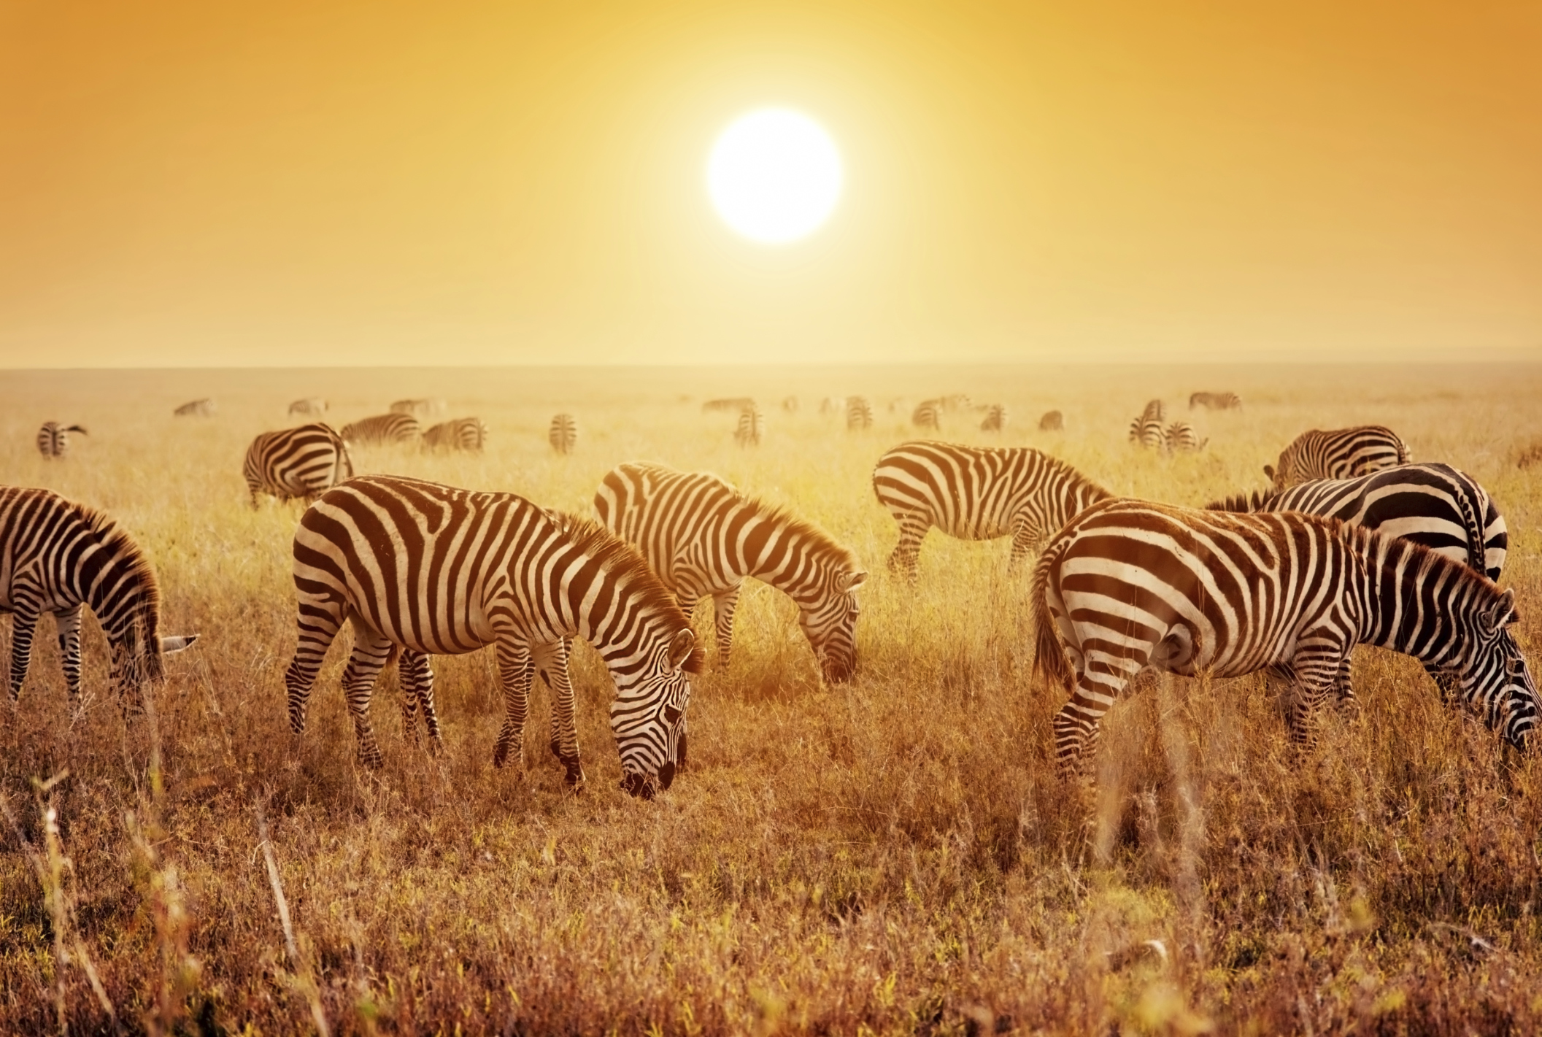
Species
Notes:
Also, remember that species is one unique type of organism.

Slide 9
Notes:
Now let’s pause for a moment to review the information we have covered already.

Slide 10
What does hereditary mean?
Notes:
Question about review information

Slide 11
What is DNA?
Notes:
Question about review information

Slide 12
Notes:
If you need to, please review this section again, or go watch the CAPs on those topics.

Slide 13
Evolution
Notes:
Let’s define the term.

Slide 14
Evolution:
process that changes species genetically over time
Notes:
Evolution is the process that changes species genetically over time.

Slide 15
Notes:
That is the basic definition, but there is a bit more you need to know.

Slide 16
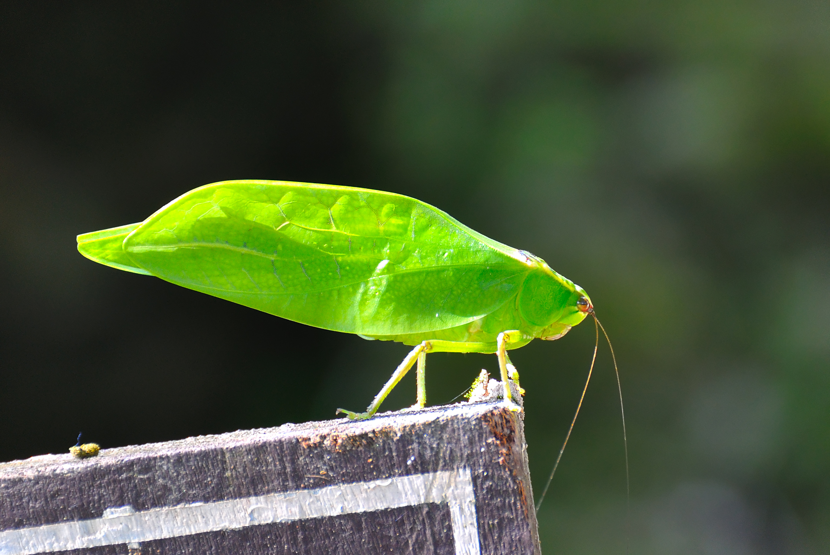
Notes:
Evolution comes from mutations in an organisms’ DNA.
These mutations can be helpful. They can help an organism survive or live longer so they can pass on their genes to their offspring. This insect’s green color and shape is an example of evolution. Since the color and shape helped the insect hide from their predators and survive, they were more likely to live long enough to reproduce and pass these traits on to offspring.

Slide 17
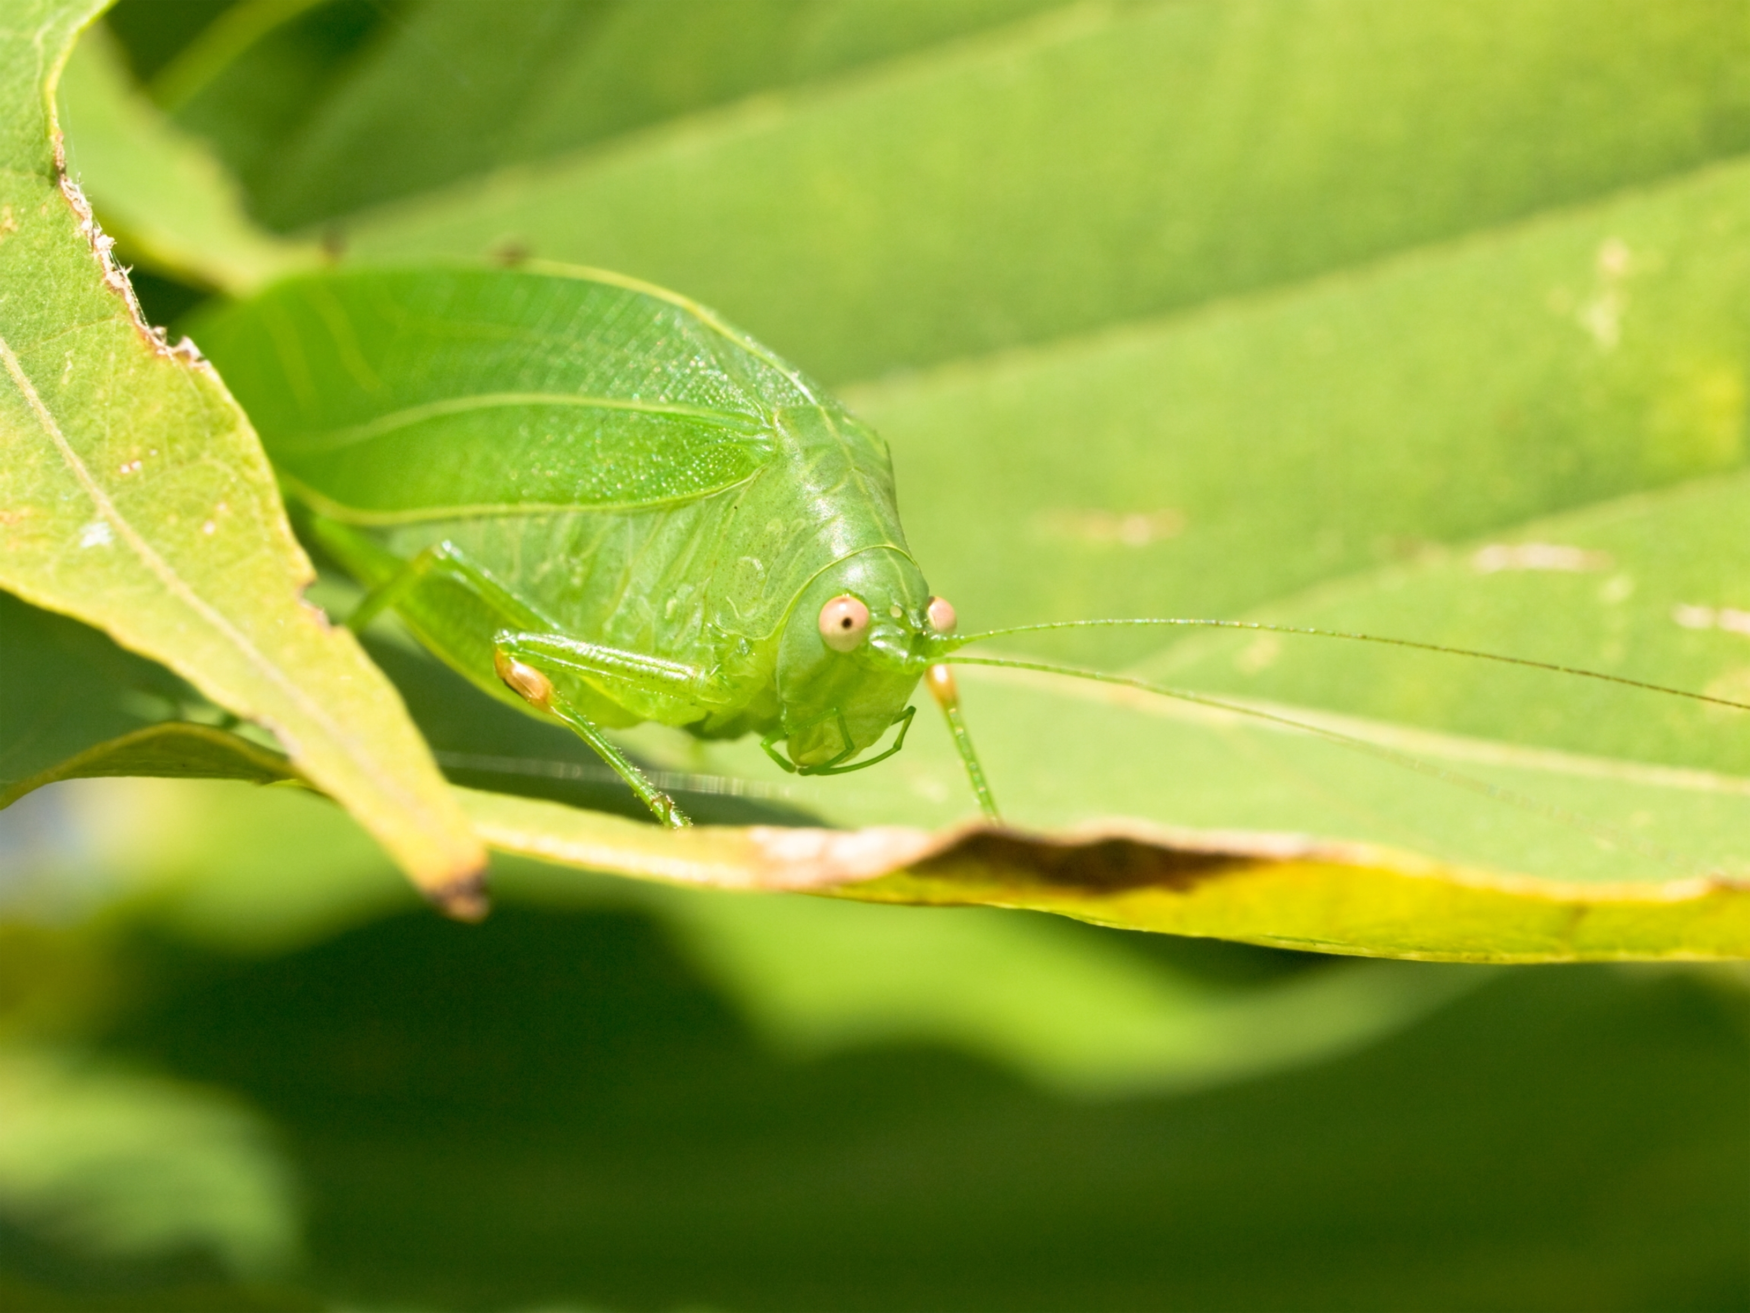
Notes:
When enough of the population has this new trait we say that a change has taken place in the species.
This change is called evolution.
Through evolution, this insect changed to have the same color and shape as a leaf to hide from predators.

Slide 18
Notes:
Evolution takes many generations to see a change in a species’ genetic makeup.
It can take a long time depending on how quickly the species reproduces.

Slide 19
Notes:
Let’s take a moment to review the definition of evolution.

Slide 20
What is evolution?

Slide 21
Notes:
Now, let’s talk about some examples of evolution.

Slide 22
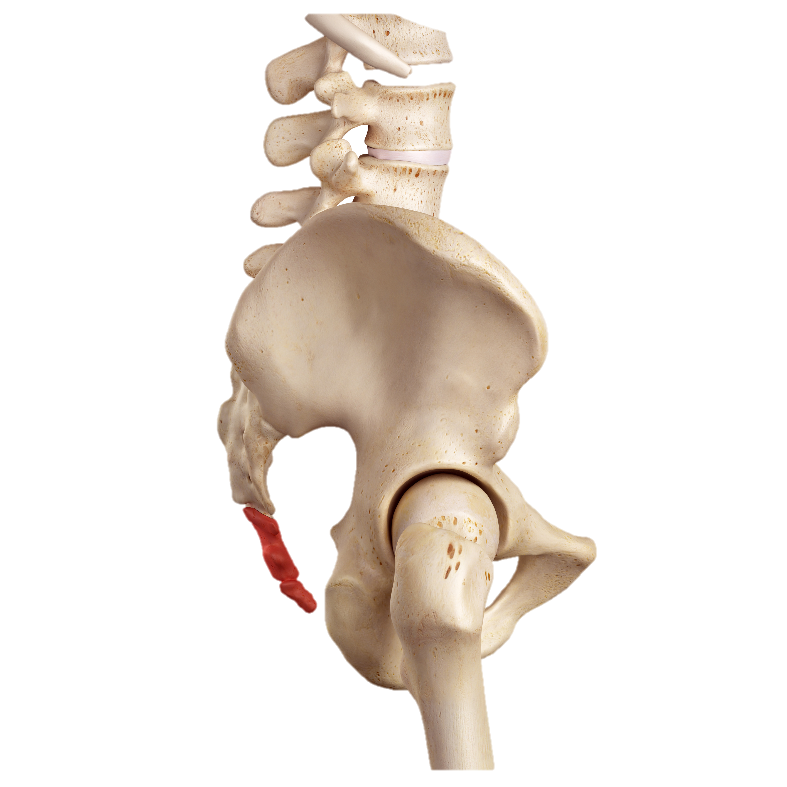
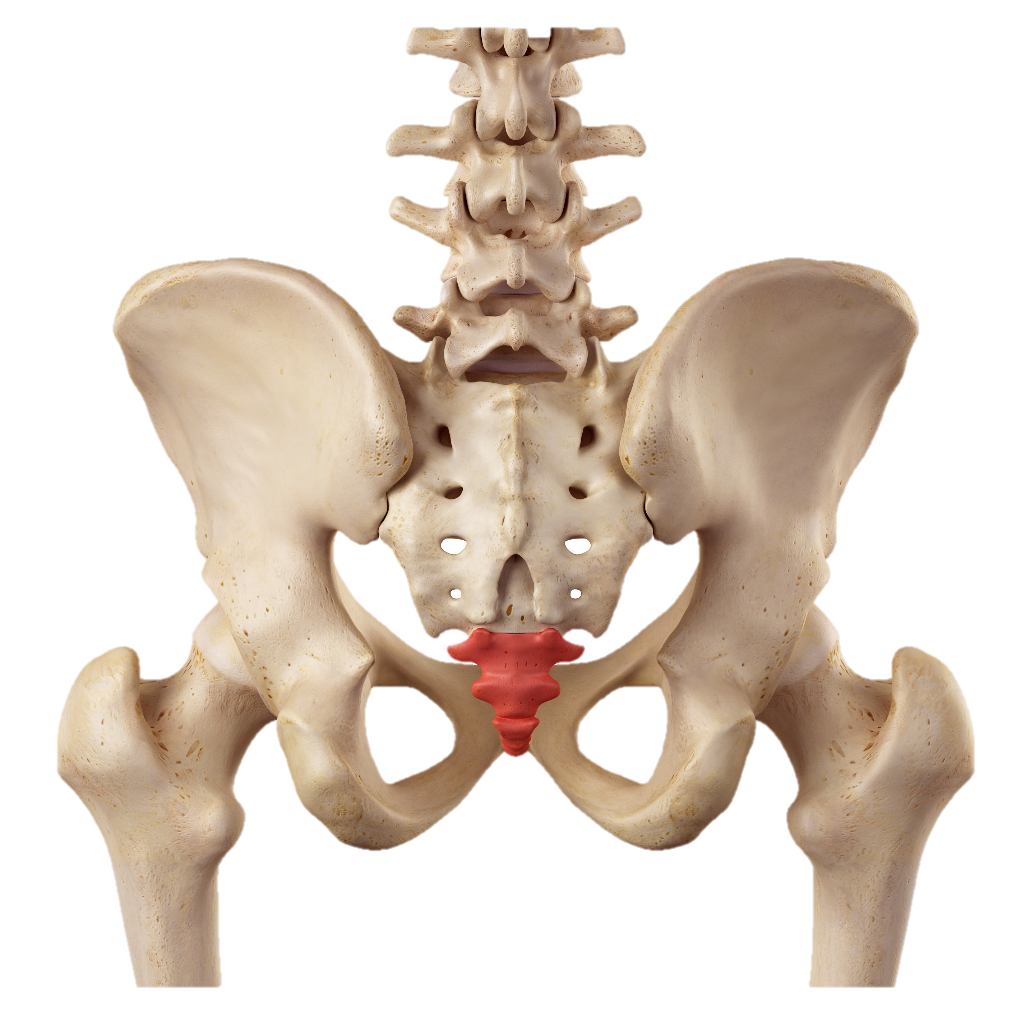
Notes:
An example of evolution can be seen in the human body.
Many, many, many generations ago, a species from which humans evolved most likely had tails.

Slide 23
Notes:
Over time a long period of time, humans evolved to not have tails.
What is left over is called the tail bone, but we do not have tails any more.

Slide 24
Slow!
Notes:
Humans reproduce slowly so it takes a long time for evolution to happen in the human body.

Slide 25
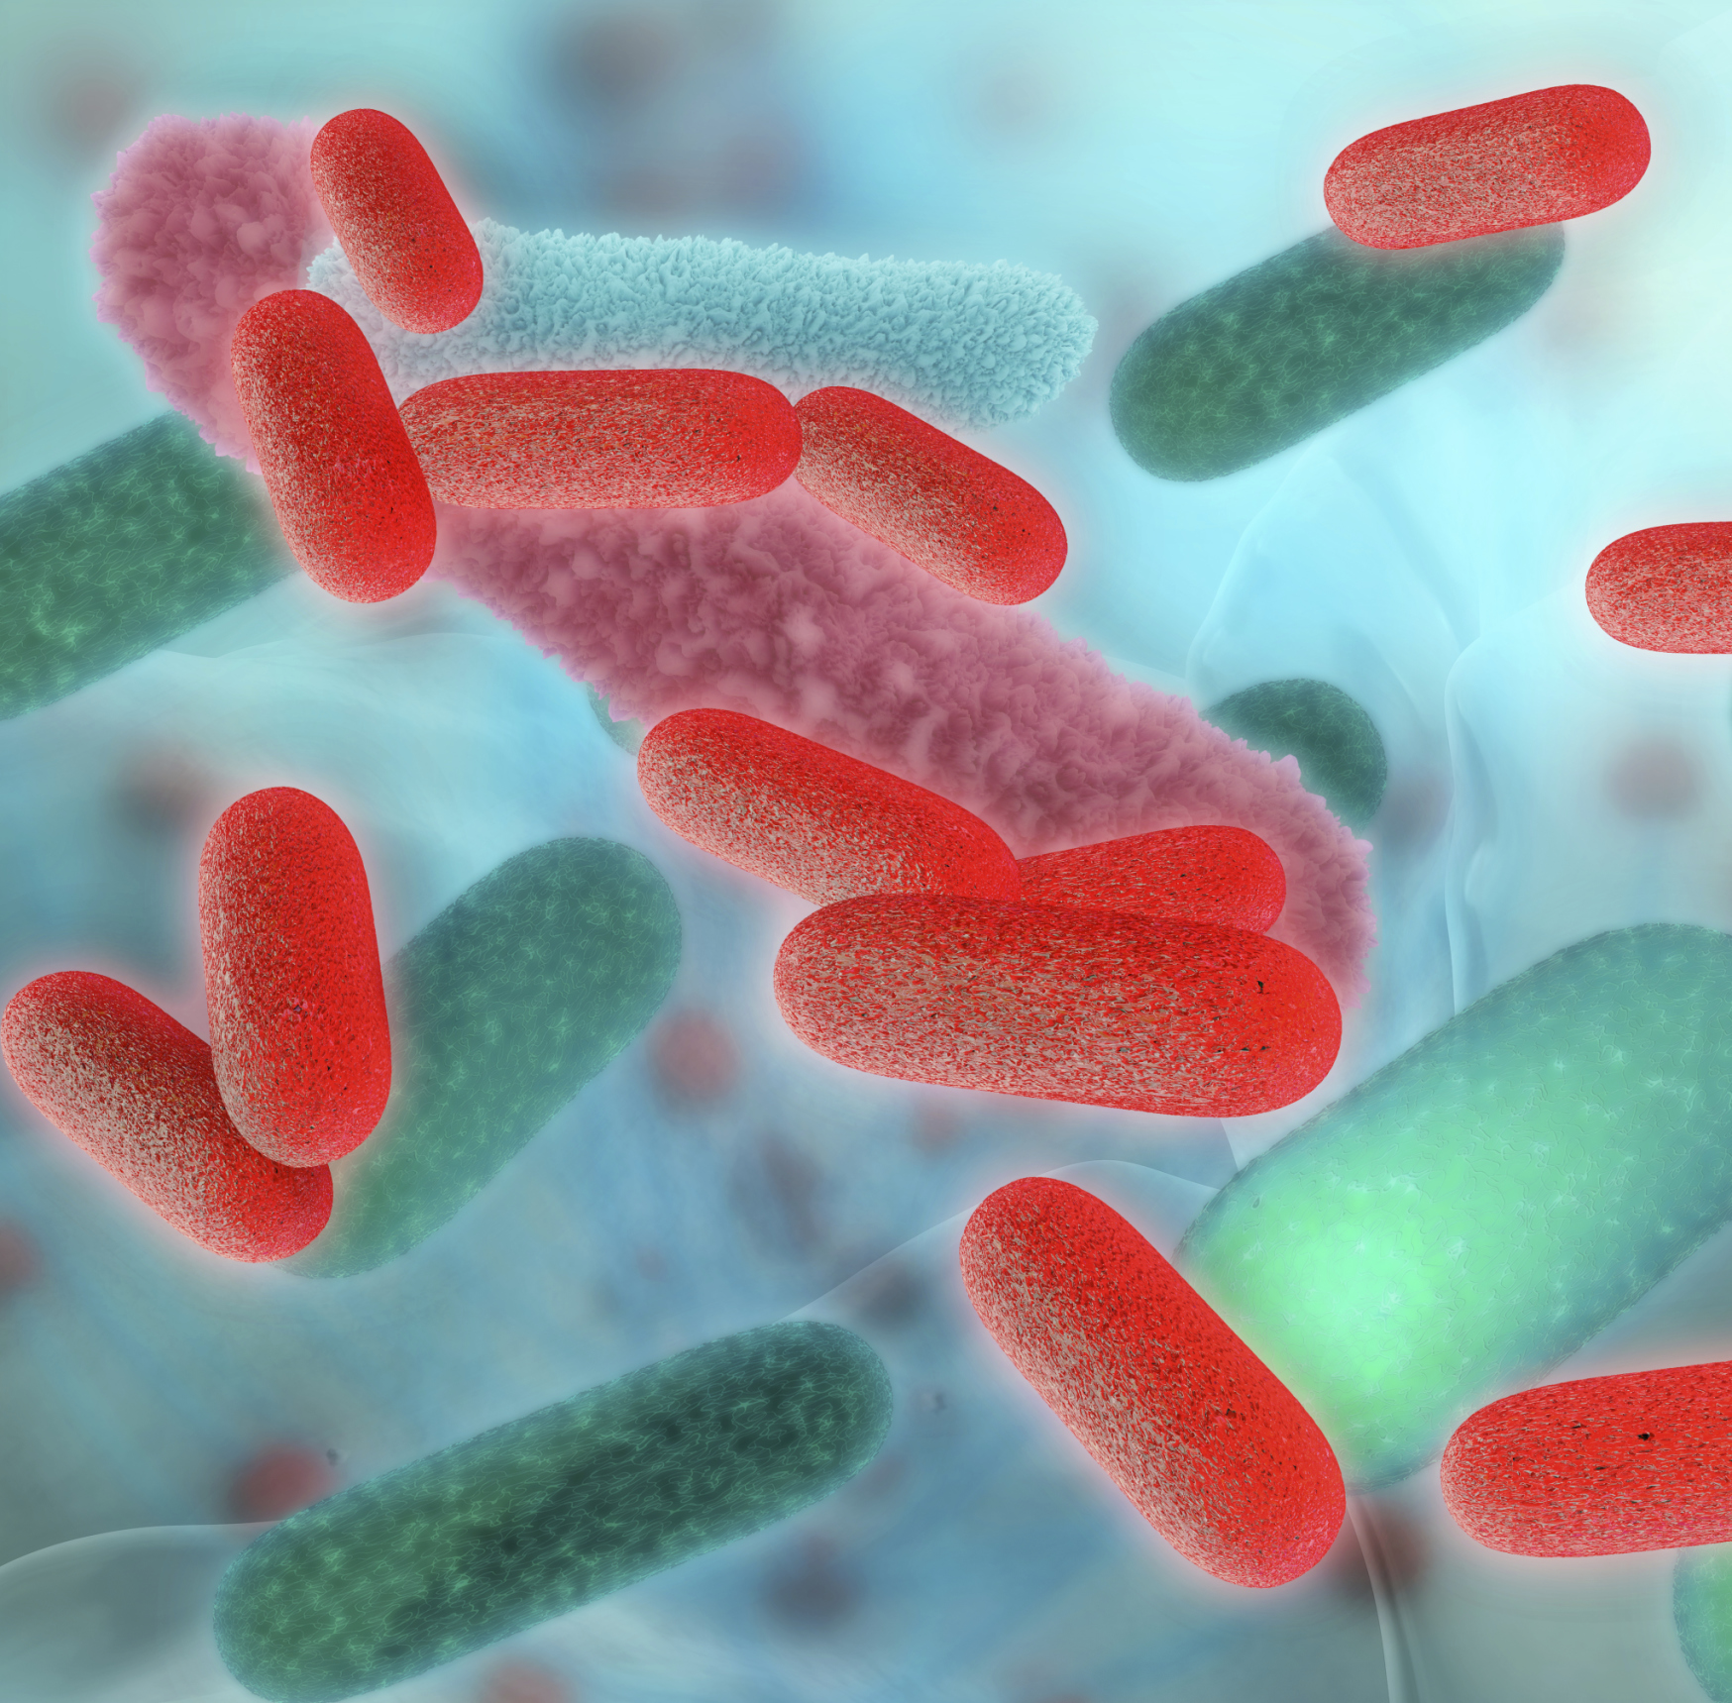
Notes:
Another example of evolution is the increase in the number of bacteria that can survive even when you take medicine, or antibiotics.

Slide 26
Notes:
Certain bacteria had a mutation, or a change in their DNA, that stopped them from being killed by the antibiotics.

Slide 27
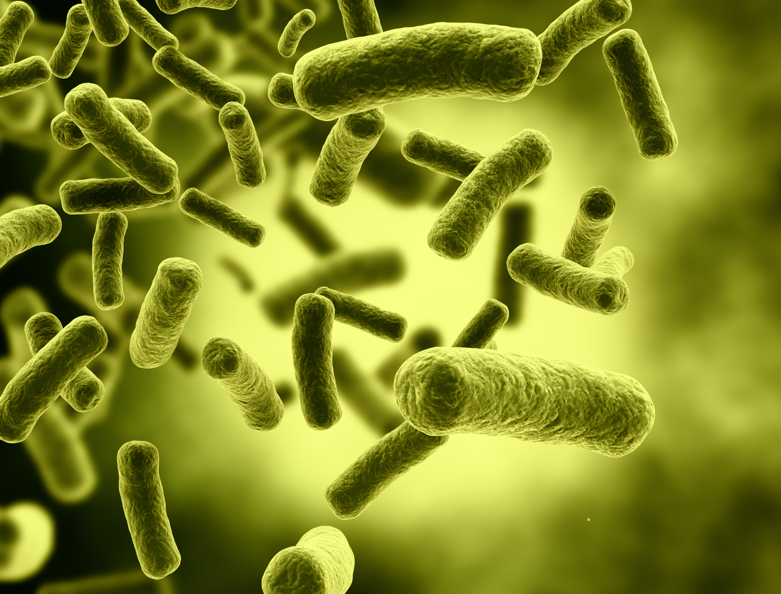
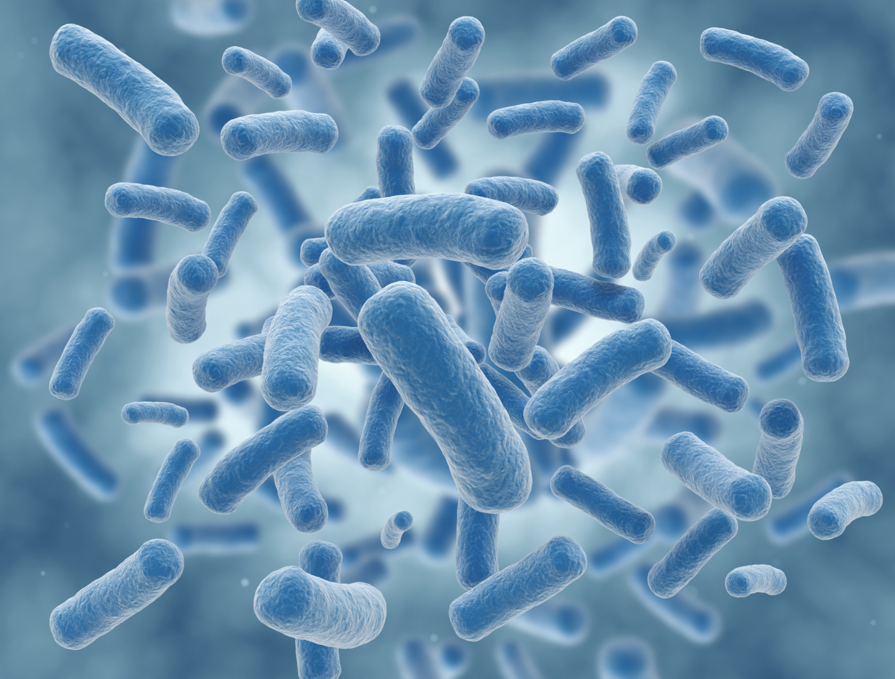
Notes:
Over time this antibiotic resistant gene has spread to more individuals in the bacteria population.

Slide 28
Fast!
Notes:
Bacteria reproduce very quickly so you can have many generations of bacteria in a short period of time.
Because of this, we can see a change in the whole species’ genetic makeup quickly.

Slide 29
NON
Notes:
Let’s talk about some non-examples of evolution. These are things that might seem similar but do not fit the definition of evolution.

Slide 30
Does not pass on to offspring
Not evolution
Notes:
A non-example of evolution is exercise. If you exercise a lot, your muscles will get big. However, this will not pass on to your offspring. They will have to work just as hard to get the same big muscles.

Slide 31
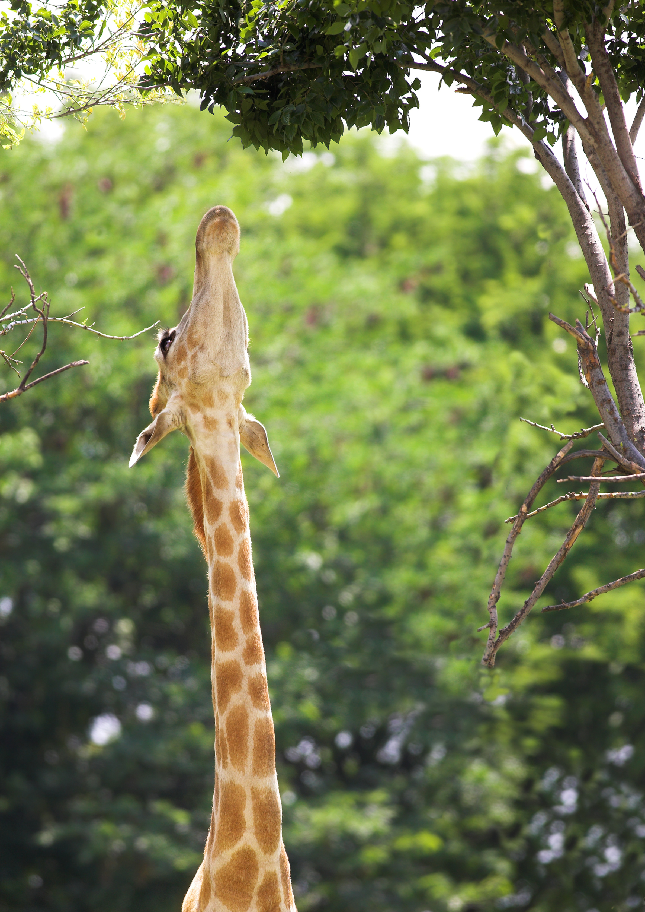
Does not pass on to offspring
Not evolution
Notes:
Another non-example of evolution is a giraffe’s long neck. The giraffe stretching its neck to reach plants will not lead to it evolving by getting a longer neck.

Slide 32
Evolution
Notes:
Let me give you a clue to remember what happens during evolution.

Slide 33
Evolve
Change
Notes:
The word evolve means to change. Evolution changes a species over time.

Slide 34
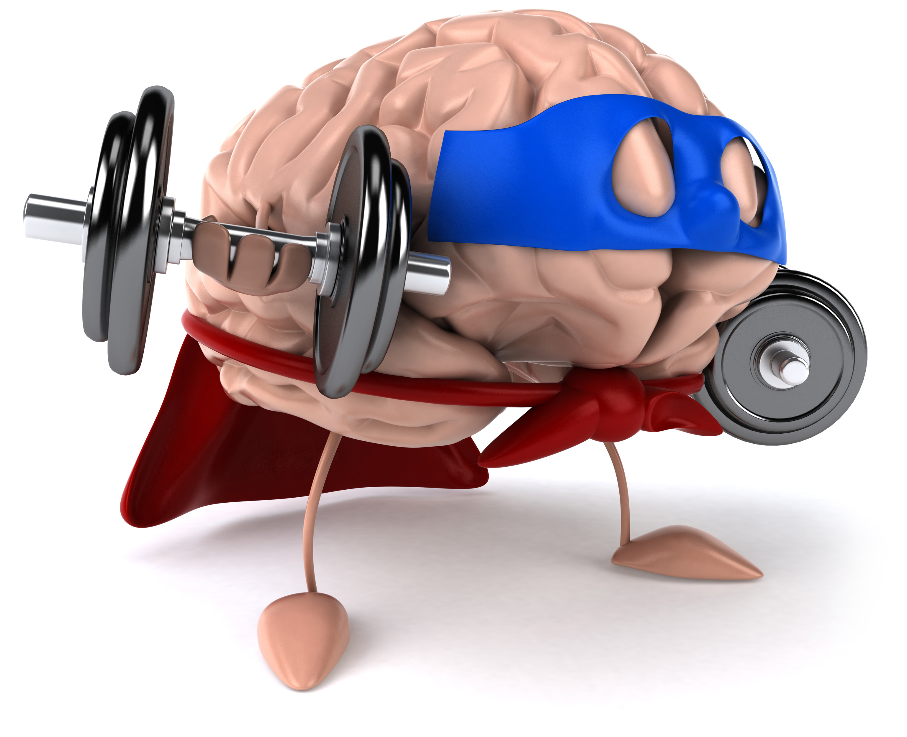
Remember!!!
Notes:
So remember!

Slide 35
Notes:
Let’s review what we have learned one more time.

Slide 36
Evolution
Notes:
Remember that evolution is the process that changes species genetically over time.

Slide 37
What is evolution?
a.) A change in a species that happens slowly
b.) A skill you gain with hard work
c.) Something that happens when you get older
Notes:
What is evolution?
a.) A change in a species that happens slowly
b.) A skill you gain with hard work
c.) Something that happens when you get older

Slide 38
Notes:
If you need to, please review this section again

Slide 39
Notes:
This concludes the video on evolution.

Slide 40
This Video Created With Resources From:
Cooperative Agreement # R324B130023
Curry School Foundation’s Research and Development Fund
Questions or Comments to Michael Kennedy, Ph.D.
MKennedy@Virginia.edu

