Slide 1
Intro
“Big Idea” Question
Review Concepts
Check-In Questions
Teacher Engagement
Vocabulary
Student-Friendly Definition
Examples & Non-Examples
Morphological Word Parts
Frayer Model
Simulation/Activity
Notes:
OK everyone, get ready for our next lesson. Just as a reminder, these are the different components that our lesson may include, and you’ll see these icons in the top left corner of each slide so that you can follow along more easily!

Slide 2
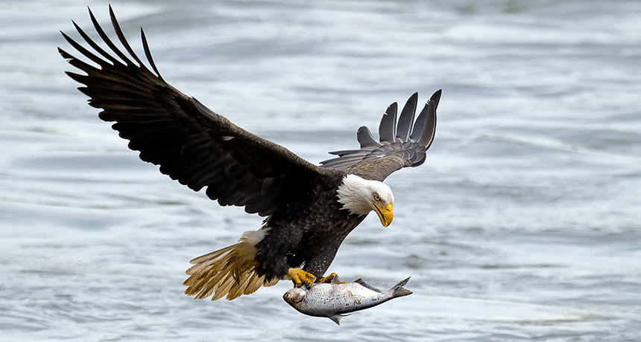
Intro
Niche
Notes:
Today, we’ll be learning about the word: Niche.

Slide 3
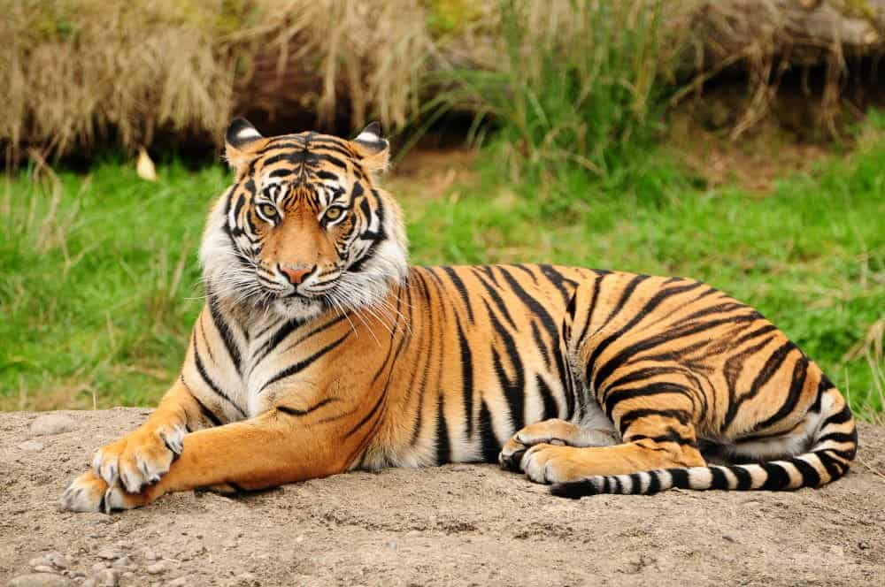
Big Question: How do plants and animals interact with their environments?
Notes:
Our “big question” is: How do plants and animals interact with their environments?
[Pause and illicit predictions from students.]
I love all these thoughtful scientific hypotheses! Be sure to keep this question and your predictions in mind as we move through these next few lessons, and we’ll continue to revisit it.

Slide 4
Notes:
Before we move on to our new topic, let’s review some other words & concepts that you already learned and make sure you are firm in your understanding.

Slide 5
Organism: any living thing
Notes:
An organism is any living thing.

Slide 6
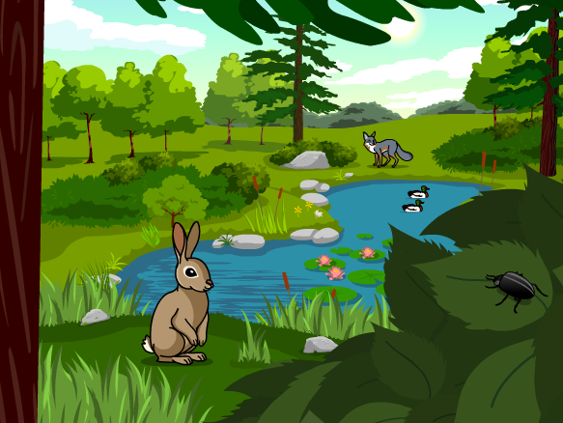
Ecosystem: an area where living and nonliving things interact.
Notes:
An ecosystem is an area where living and nonliving things interact.

Slide 7
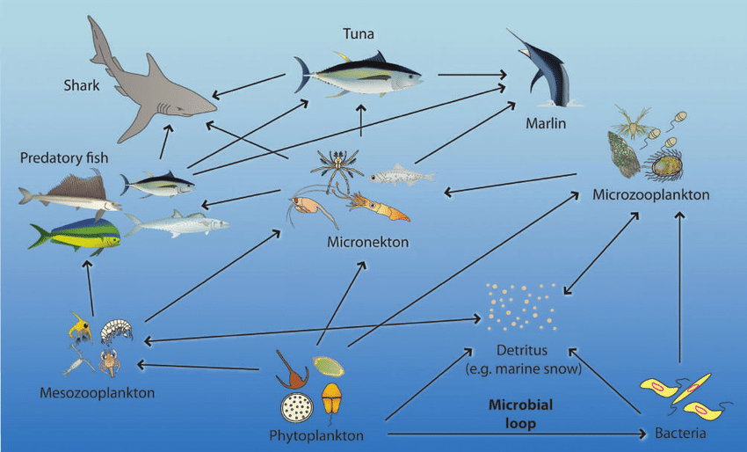
Food Web: shows overlapping food chains in an ecosystem
Notes:
Food webs show overlapping food chains in an ecosystem.

Slide 8
Community: a group of different populations living in the same place
Notes:
Community is a group of different populations living in the same place.

Slide 9
Notes:
Now let’s pause for a moment to review the information we have covered already.

Slide 10
True or false: An organism is any non-living thing.
True
False
Notes:
True or false: An organism is any non-living thing.
[B. False]

Slide 11
True or false: An organism is any non-living thing.
True
False
Notes:
True or false: An organism is any non-living thing. False. An organism is any living thing.
[B. False]

Slide 12
What is another word for an area where living and nonliving things interact?
System
Ecosystem
Economy
Notes:
What is another word for an area where living and nonliving things interact?
[B. Ecosystem]

Slide 13
What is another word for an area where living and nonliving things interact?
System
Ecosystem
Economy
Notes:
What is another word for an area where living and nonliving things interact? B. Ecosystem

Slide 14
True or false: A food web shows overlapping food chains in an ecosystem.
True
False
Notes:
True or false: A food web shows overlapping food chains in an ecosystem.
[A. True]

Slide 15
True or false: A food web shows overlapping food chains in an ecosystem.
True
False
Notes:
True or false: A food web shows overlapping food chains in an ecosystem. True.
[A. True]

Slide 16
What is another word for a group of different populations living in the same place?
Relationship
Species
Community
Notes:
What is another word for a group of different populations living in the same place?.
[C. Community]

Slide 17
What is another word for a group of different populations living in the same place?
Relationship
Species
Community
Notes:
What is another word for a group of different populations living in the same place? C. Community

Slide 18
Niche
Notes:
Now that we’ve reviewed, let’s define the word niche.

Slide 19
Niche: the function or role that an organism performs in the food web of that community
Notes:
Niche is the function or role that an organism performs in the food web of that community.

Slide 20
Notes:
Let’s check-in for understanding.

Slide 21
What is niche?
Notes:
What is niche?
[The function or role that an organism performs in the food web of that community.]

Slide 22
Notes:
That is the basic definition, but there is a bit more you need to know.

Slide 23
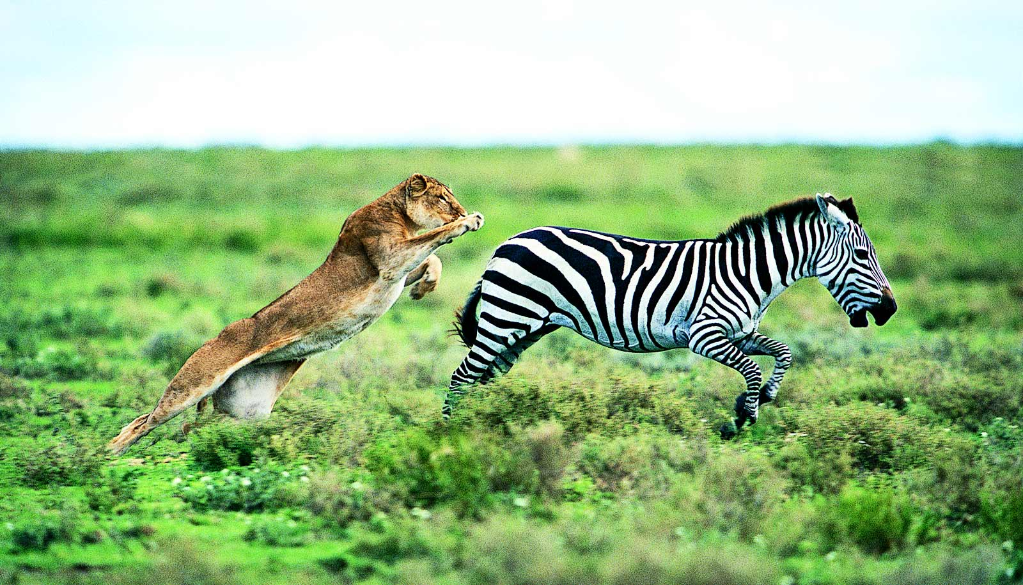
Each organism has a specific niche that supports life processes.
Notes:
Each organism has a specific niche that supports life processes. For example, this picture shows the lion’s niche as a predator. The lion needs to use its predatory skills to support its own life.

Slide 24
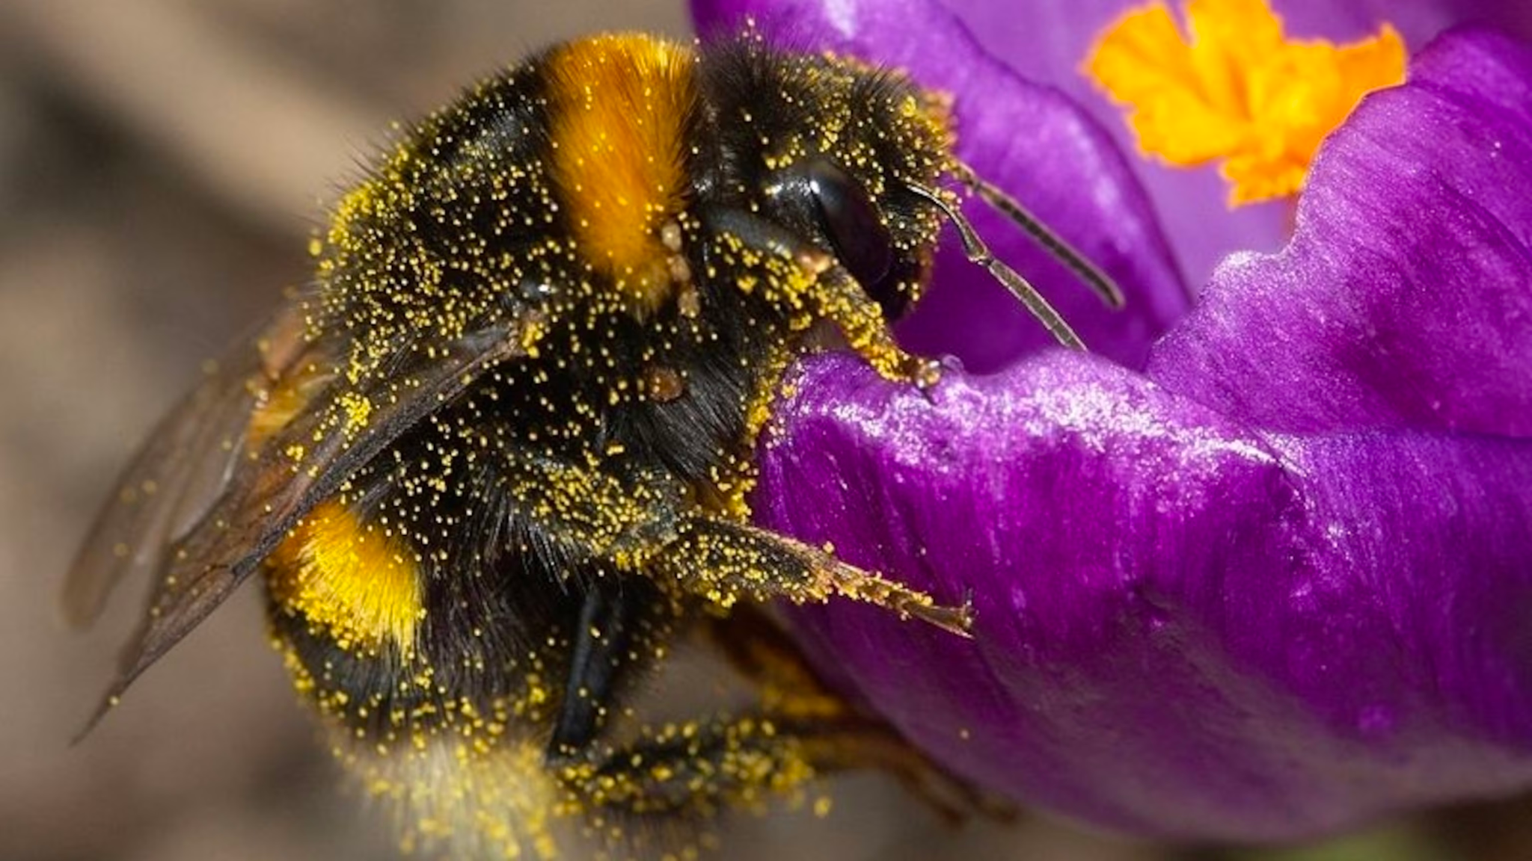
A niche also includes what an organism eats and how it interacts with other organisms and the nonliving factors in its environment.
Notes:
A niche also includes what an organism eats and how it interacts with other organisms and the nonliving factors in its environment. For example, the bee in the picture is eating the nectar that the flower produces. While eating, the bee interacts with the flower organism and the pollen (the nonliving factors) in its environment.

Slide 25
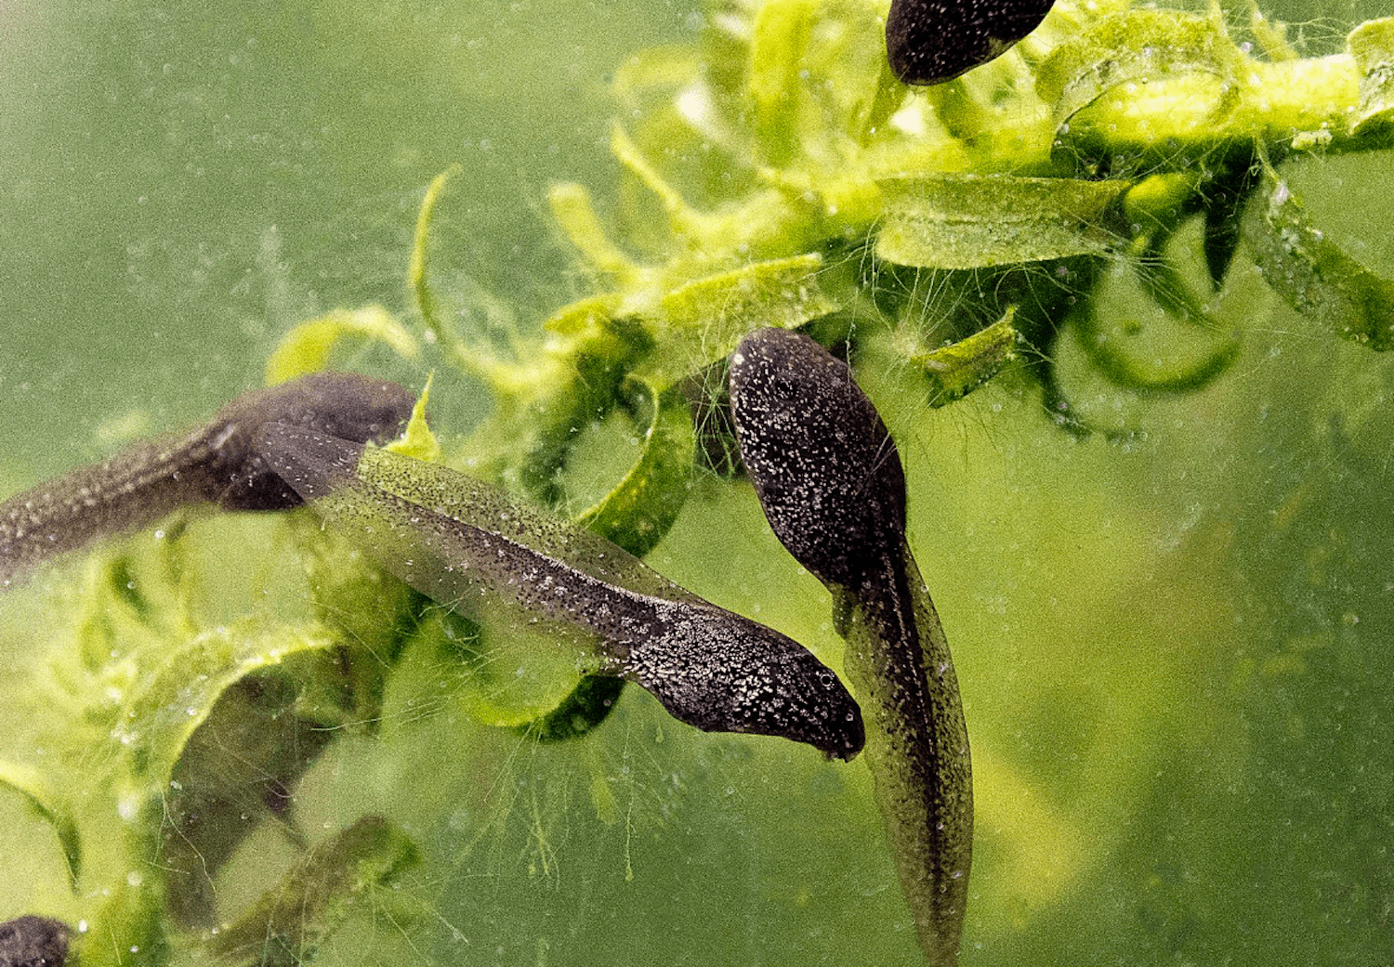
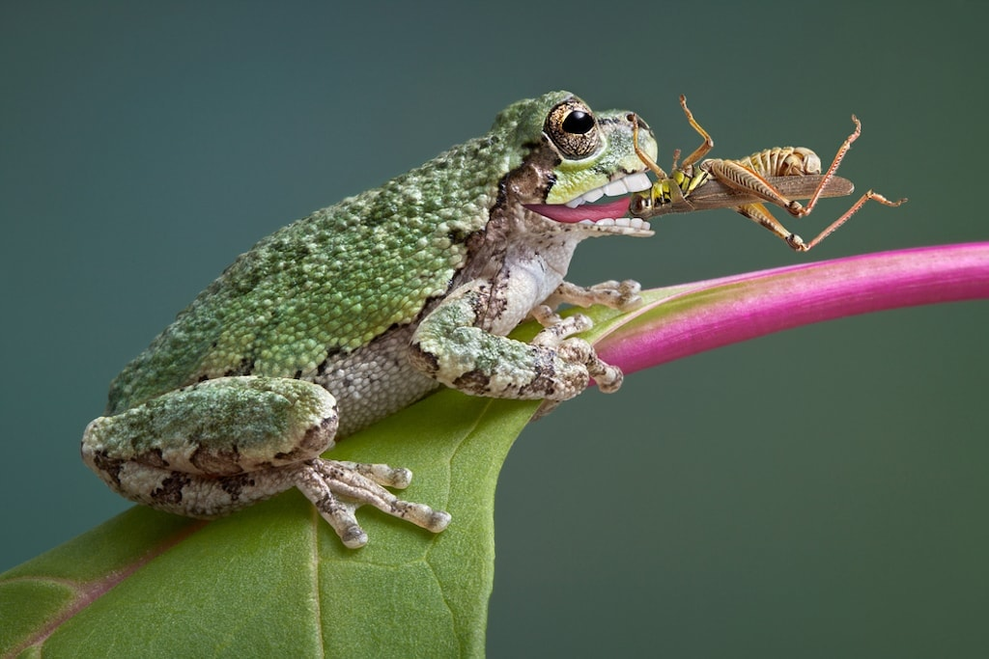
During its life cycle, an organism’s niche may change.
Tadpole in water
Frog on land
Notes:
During its life cycle, an organism’s niche may change. For example, tadpoles live in water, breathe through gills, and generally are herbivores (eat algae). However, adult frogs live primarily on land, breathe with lungs, and are carnivores (eat bugs).

Slide 26
Notes:
Let’s check-in for understanding.

Slide 27
Each organism has a specific niche that ________ life processes.
Supports
Hinders
Accepts
Notes:
Each organism has a specific niche that __________ life processes.
[A. Supports]

Slide 28
Each organism has a specific niche that ________ life processes.
Supports
Hinders
Accepts
Notes:
Each organism has a specific niche that supports life processes.
[A. Supports]

Slide 29
True or false: A niche also includes what an organism eats and how it interacts with other organisms and the nonliving factors in its environment.
True
False
Notes:
True or false: A niche also includes what an organism eats and how it interacts with other organisms and the nonliving factors in its environment
[A. True]

Slide 30
True or false: A niche also includes what an organism eats and how it interacts with other organisms and the nonliving factors in its environment.
True
False
Notes:
True or false: A niche also includes what an organism eats and how it interacts with other organisms and the nonliving factors in its environment
[A. True]

Slide 31
True or false: During its life cycle, an organism’s niche does not change.
True
False
Notes:
True or false: During its life cycle, an organism’s niche does not change.
[B. False]

Slide 32
True or false: During its life cycle, an organism’s niche does not change.
True
False
Notes:
True or false: During its life cycle, an organism’s niche does not change. False. An organism’s niche may change during its life cycle - like a frog.
[B. False]

Slide 33
Notes:
Now, let’s talk about some examples of niche.

Slide 34
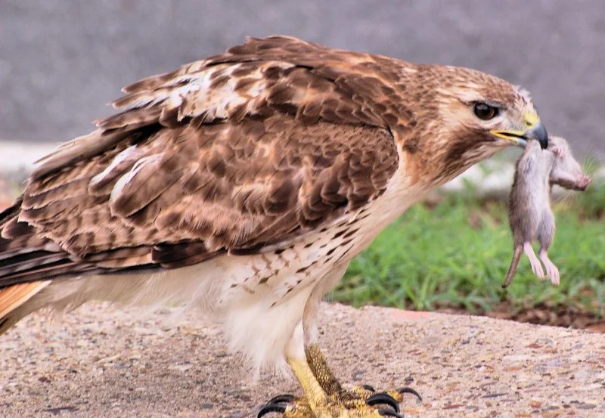
Notes:
Here is an example of a niche. This picture shows the niche of a hawk. Hawks are daytime predators in the food web. Here, the hawk has hunted the mouse.

Slide 35
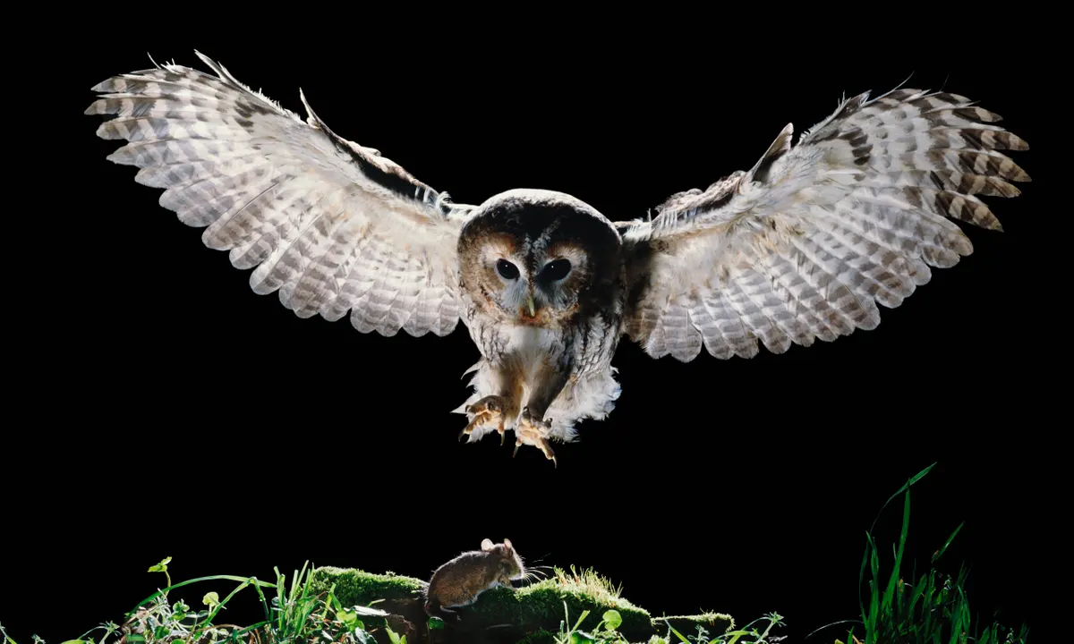
Notes:
Here is another example of a niche. This picture shows the niche of an owl. Owls are nighttime (nocturnal) predators in the food web. Here, the owl is hunting the mouse.

Slide 36
Notes:
Here is another example of a niche. This picture shows the niche of the great white shark. Great white shark are ocean predators in the food web. Here the great white shark (Bruce) is hunting the other fish (Nemo and Dory).

Slide 37
Notes:
Now, let’s talk about some non-examples of niche.

Slide 38
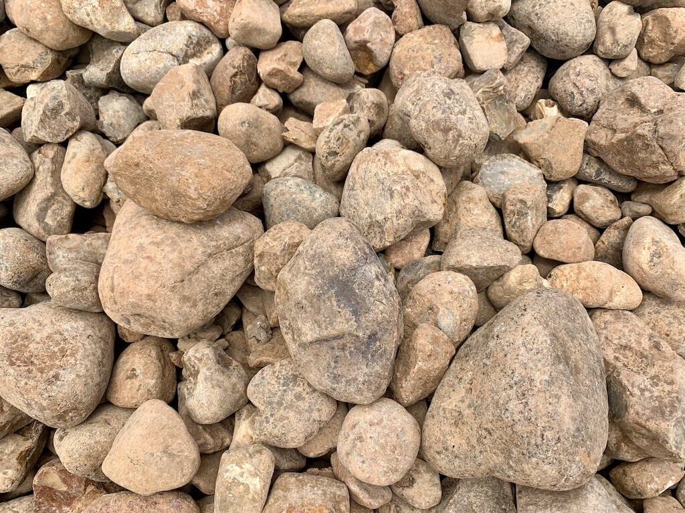
Notes:
This is a non-example of a niche. The rocks are non-living things and we know that a niche is assigned to organisms or living things. The rocks do not have a role or function in the food web.

Slide 39
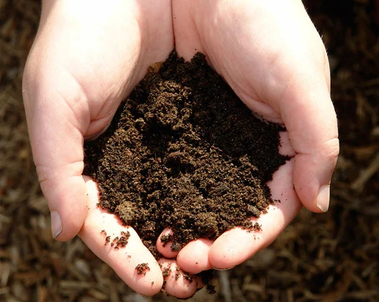
Notes:
This is also a non-example of a niche. Dirt is a non-living thing and we know that a niche is assigned to organisms or living things. The dirt does not have a role or function in the food web.

Slide 40
Notes:
Now let’s pause for a moment to check your understanding.

Slide 41
Which one is NOT an example of a niche?
Dirt
Hawk
Great white shark
Notes:
Which one is NOT an example of a niche?
[Dirt]

Slide 42
Which one is NOT an example of a niche?
Dirt
Hawk
Great white shark
Notes:
Which one is NOT an example of a niche? Dirt. Dirt is a non-living thing and does not have a role or function in the food web.
[Dirt]

Slide 43
Remember!!!
Notes:
So remember!

Slide 44
Niche: the function or role that an organism performs in the food web of that community
Notes:
Niche is a function or role that an organism performs in the food web of that community.

Slide 45
Notes:
We will now complete this concept map, called a Frayer model, to summarize and further clarify what you have learned about the term niche.

Slide 46
Definition
Picture
Niche
Example
How does niche impact my life?
Notes:
To complete the Frayer model, we will choose from four choices the correct picture, definition, example, and response to the question, “How does niche impact my life?” Select the best response for each question using the information you just learned. As we select responses, we will see how this model looks filled in for the term niche.

Slide 47
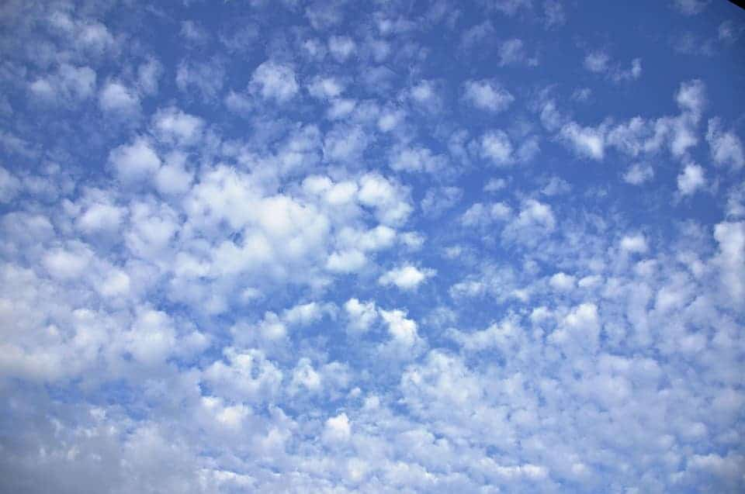
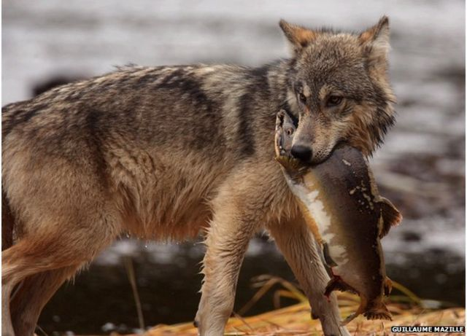
Directions: Choose the correct picture of niche from the choices below.
A
B
C
D
Notes:
Choose the one correct picture of niche from these four choices.

Slide 48
Directions: Choose the correct picture of niche from the choices below.
A
B
C
D
Notes:
This is the picture that shows niche.

Slide 49
Definition
Picture
Niche
Example
How does niche impact my life?
Notes:
Here is the Frayer model filled in with a picture of niche.

Slide 50
Directions: Choose the correct definition of niche from the choices below.
A
The function or role that an organism performs in the food web of that community
B
The specific ecosystem that an organism has to live in
C
The ability of an organism to reproduce
D
The way that an organism fits in with other similar organisms in a community
Notes:
Choose the one correct definition of niche from these four choices.

Slide 51
Directions: Choose the correct definition of niche from the choices below.
A
The function or role that an organism performs in the food web of that community
B
The specific ecosystem that an organism has to live in
C
The ability of an organism to reproduce
D
The way that an organism fits in with other similar organisms in a community
Notes:
“The function or role that an organism performs in the food web of that community” is correct! This is the definition of niche.

Slide 52
Definition
Picture
The function or role that an organism performs in the food web of that community
Niche
Example
How does niche impact my life?
Notes:
Here is the Frayer Model with a picture and the definition filled in for niche: The function or role that an organism performs in the food web of that community.

Slide 53
Directions: Choose the correct example of niche from the choices below.
A
A collection of stones in a stream
B
A group of sea shells on a beach
C
A pot with dirt in it
D
A bear hunting fish in a stream
Notes:
Choose the one correct example of niche from these four choices.

Slide 54
Directions: Choose the correct example of niche from the choices below.
A
A collection of stones in a stream
B
A group of sea shells on a beach
C
A pot with dirt in it
D
A bear hunting fish in a stream
Notes:
“A bear hunting fish in a stream” is correct! This is an example of niche.

Slide 55
Definition
Picture
The function or role that an organism performs in the food web of that community
Niche
A bear hunting fish in a stream
Example
How does niche impact my life?
Notes:
Here is the Frayer Model with a picture, definition, and an example of niche: A bear hunting fish in a stream.

Slide 56
Directions: Choose the correct response for “how does niche impact my life?” from the choices below.
A
Niche gives us a way to name the parts of plants
B
Niche allows us to interact with the food web as we eat food
C
Niche helps us to understand the differences in producers and consumers
D
Niche gives us the ability to describe non-living things
Notes:
Choose the one correct response for “how does niche impact my life?” from these four choices.

Slide 57
Directions: Choose the correct response for “how does niche impact my life?” from the choices below.
A
Niche gives us a way to name the parts of plants
B
Niche allows us to interact with the food web as we eat food
C
Niche helps us to understand the differences in producers and consumers
D
Niche gives us the ability to describe non-living things
Notes:
“Niche allows us to interact with the food web as we eat food” That is correct! This is an example of how niche impacts your life.

Slide 58
Definition
Picture
The function or role that an organism performs in the food web of that community
Niche
A bear hunting fish in a stream
Niche allows us to interact with the food web as we eat food
Example
How does niche impact my life?
Notes:
Here is the Frayer Model with a picture, definition, example, and a correct response to “how does niche impact my life?”: Niche allows us to interact with the food web as we eat food.

Slide 59
Remember!!!
Notes:
So remember!

Slide 60
Niche: the function or role that an organism performs in the food web of that community
Notes:
Niche is the function or role that an organism performs in the food web of that community.

Slide 61
Big Question: How do plants and animals interact with their environments?
Notes:
Let’s reflect once more on our big question. Our “big question” is: How do plants and animals interact with their environments?
Does anyone have any additional examples to share that haven’t been discussed yet?

Slide 62
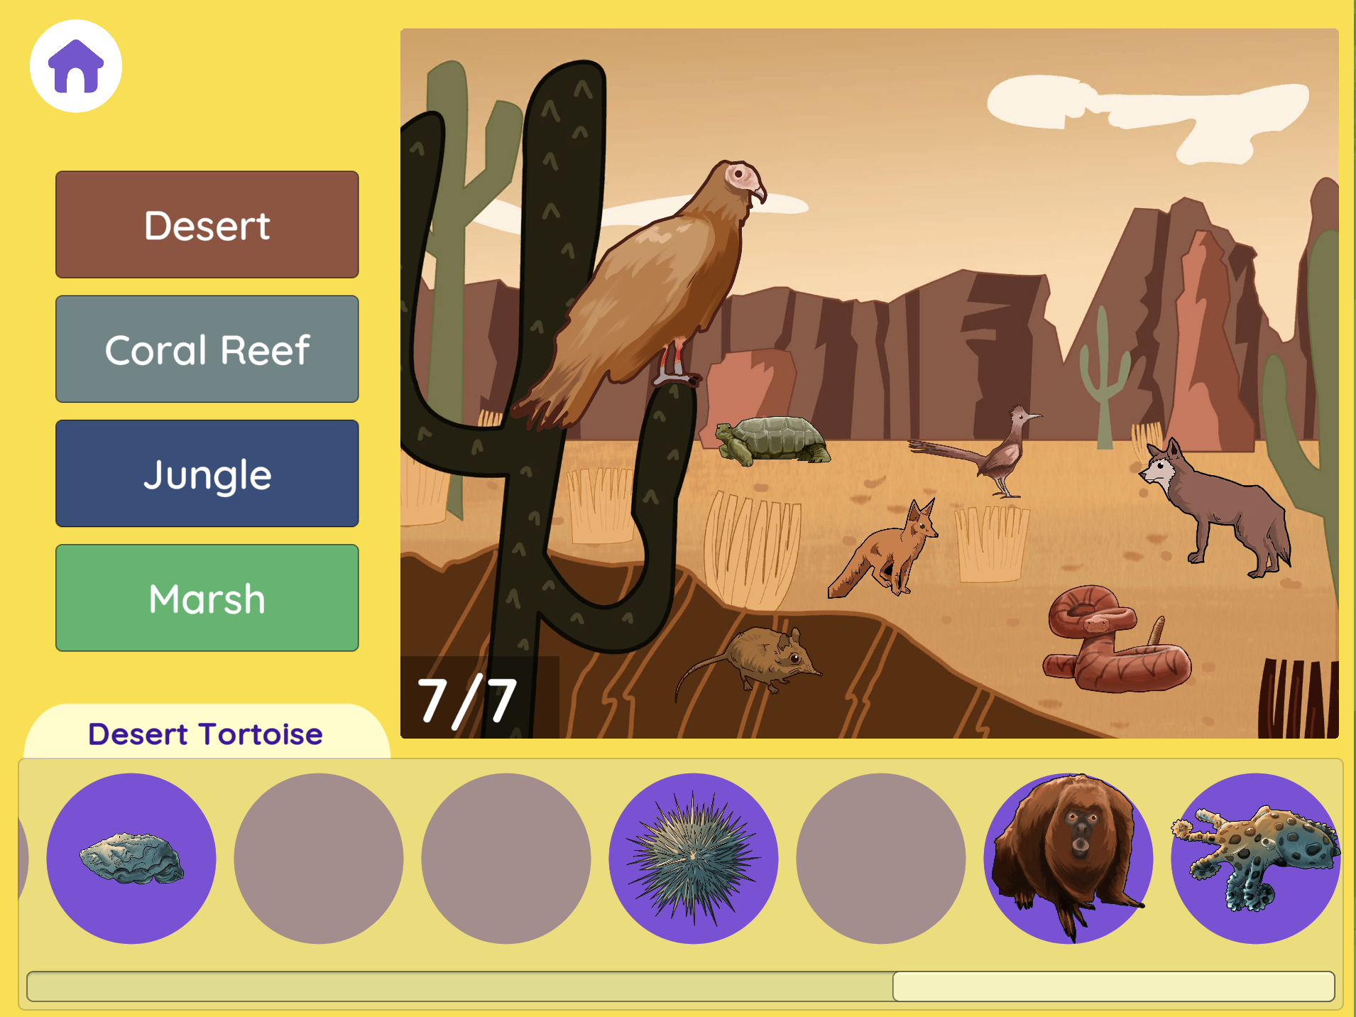
Niche Simulation
Niche Simulation (Smithsonian)
Click the link to engage with a simulation where your task is to put animals in their appropriate habitats.
After putting the animals in their habitat, have students brainstorm the niche of each animal in the habitat.
Notes:
Click the link to engage in a niche simulation with your students. Have students place animals in the correct habitats (desert, coral reef, jungle, marsh). Please note the scroll bar at the bottom of the activity that scrolls through more animals. After the animals are in their correct habitats, have students brainstorm the niche of each animal in the habitat. Discuss the hypothesized niches of each animal.

Slide 63
Notes:
Thanks for watching, and please continue watching CAPs available from this website.

Slide 64
This Was Created With Resources From:
Questions or Comments
Michael Kennedy, Ph.D. MKennedy@Virginia.edu
Rachel L Kunemund, Ph.D. rk8vm@virginia.edu

