Slide 1
Intro
“Big Idea” Question
Review Concepts
Check-In Questions
Teacher Engagement
Vocabulary
Student-Friendly Definition
Examples & Non-Examples
Morphological Word Parts
Frayer Model
Simulation/Activity
Notes:
OK everyone, get ready for our next lesson. Just as a reminder, these are the different components that our lesson may include, and you’ll see these icons in the top left corner of each slide so that you can follow along more easily!

Slide 2
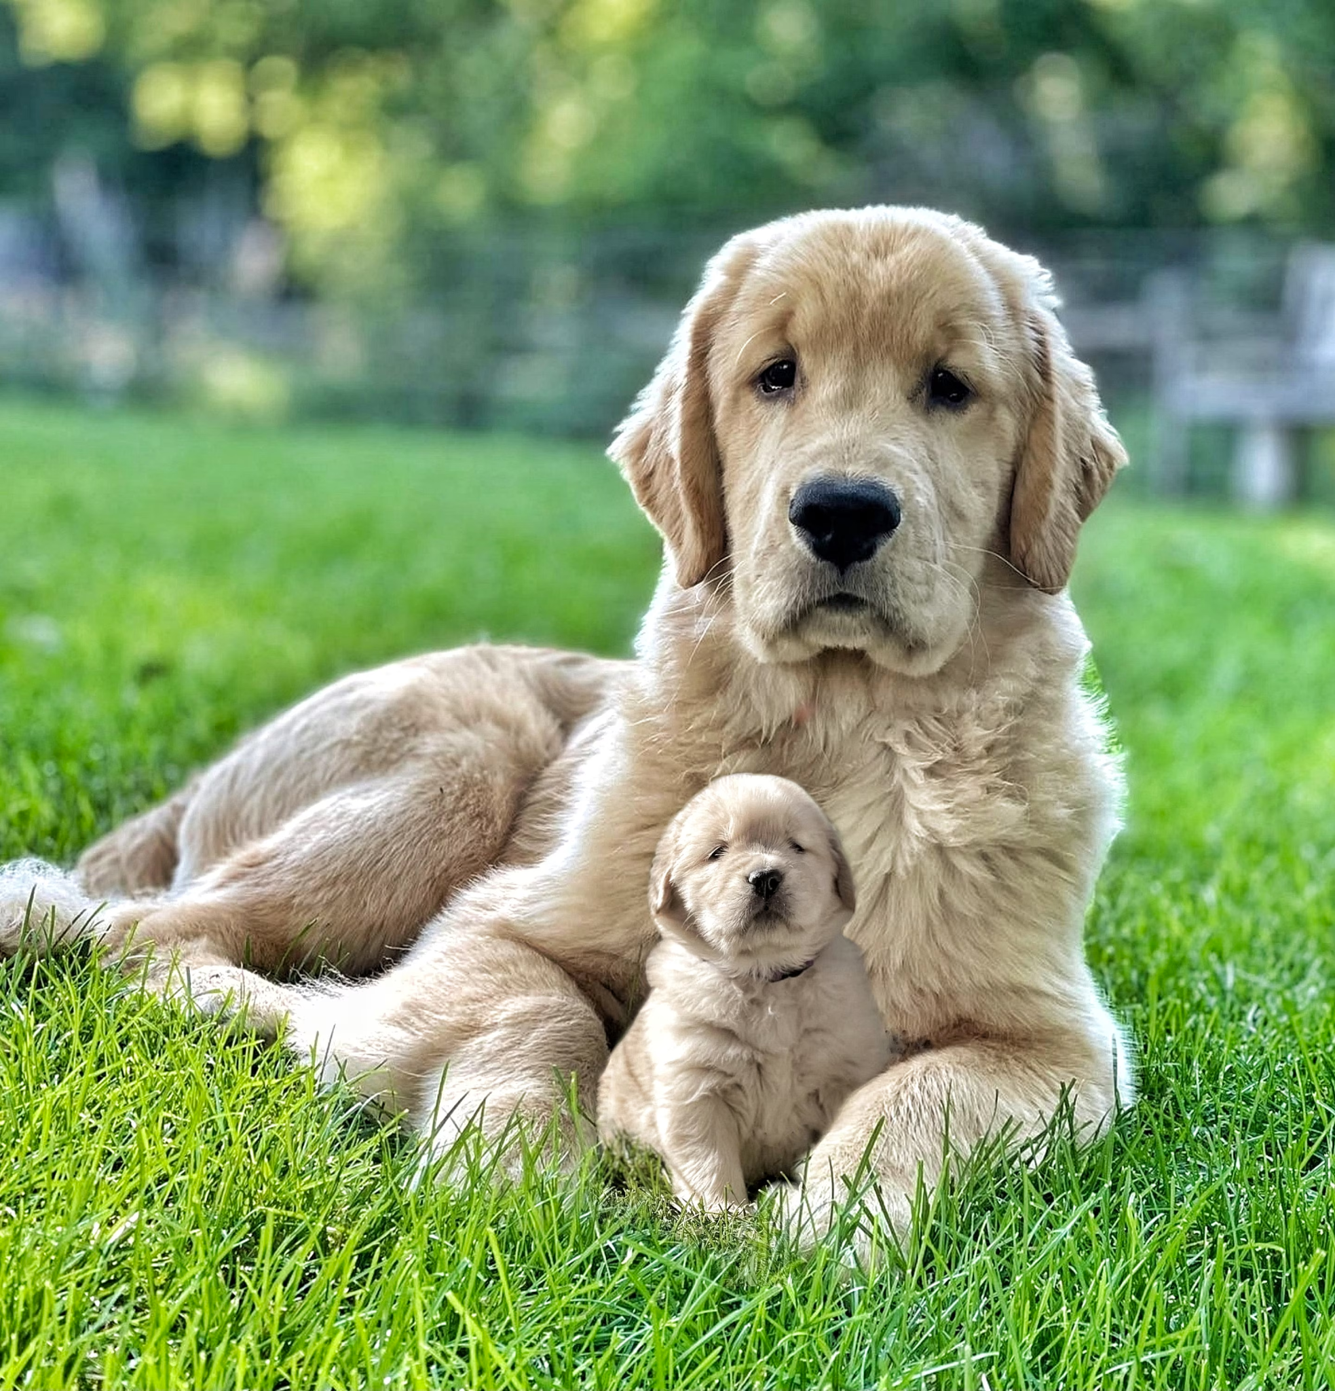
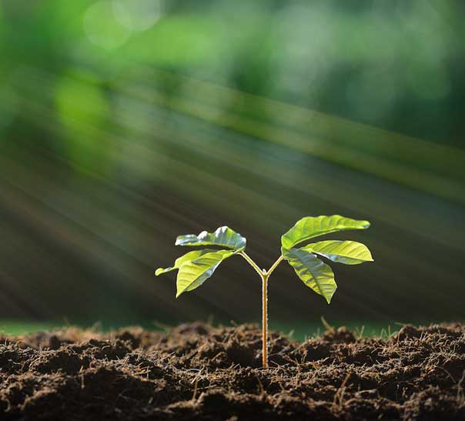
Intro
Offspring
Notes:
Today, we’ll be learning about the word: Offspring.

Slide 3
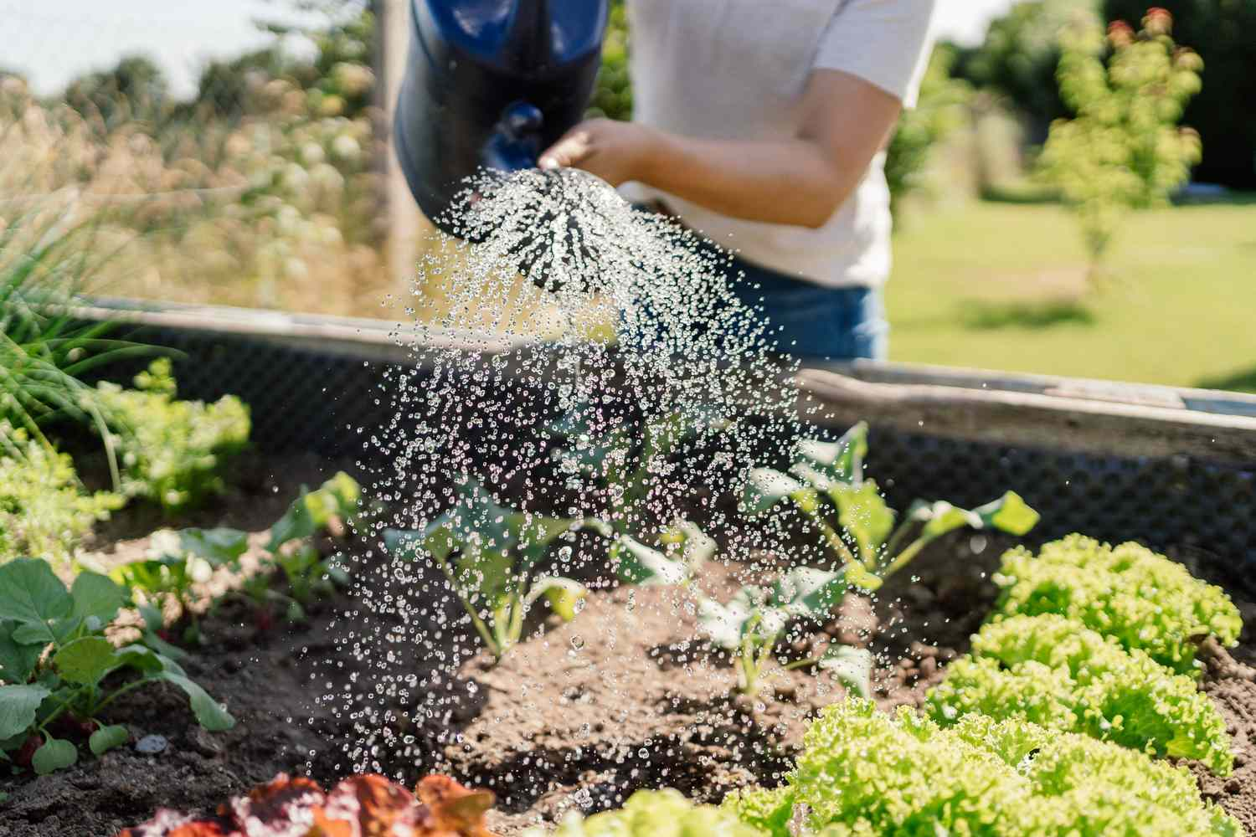
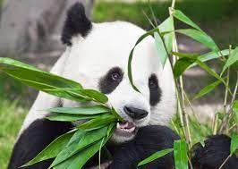
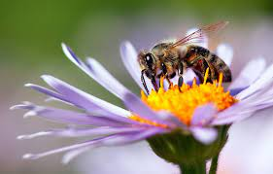
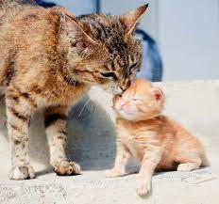
Big Question: What do plants and animals need to survive?
Notes:
Our “big question” is: What do plants and animals need to survive?
[Pause and illicit predictions from students.]
I love all these thoughtful scientific hypotheses! Be sure to keep this question and your predictions in mind as we move through these next few lessons, and we’ll continue to revisit it.

Slide 4
Notes:
Before we move on to our new topic, let’s review some other words & concepts that you already learned and make sure you are firm in your understanding.

Slide 5
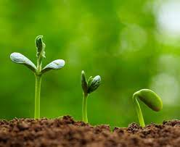
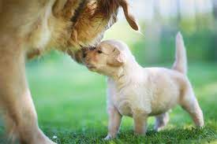
Living Thing: organisms that move, grow, change, and respond to its environment
Notes:
Living things are organisms that grow, change, and respond to its environment.

Slide 6
Reproduction: the process by which living things create more of their own kind.
Notes:
Reproduction is the process by which living things create more of their own kind.

Slide 7
Notes:
Now let’s pause for a moment to review the information we have covered already.

Slide 8
_________ __________ are organisms that move, grow, change, and respond to the environment
Abiotic Factors
Nonliving things
Living things
Notes:
______ _______ are organisms that move, grow, change, and respond to the environment.
[C. Living things]

Slide 9
_________ __________ are organisms that move, grow, change, and respond to the environment
Abiotic Factors
Nonliving things
Living things
Notes:
Living things are organisms that move, grow, change, and respond to the environment.

Slide 10
What is the process by which living things create more of their own kind?
Photosynthesis
Reproduction
Precipitation
Notes:
What is the process by which living things create more of their own kind?
[B. Reproduction]

Slide 11
What is the process by which living things create more of their own kind?
Photosynthesis
Reproduction
Precipitation
Notes:
What is the process by which living things create more of their own kind? B. Reproduction

Slide 12
Offspring
Notes:
Now that we’ve reviewed, let’s define the phrase offspring.

Slide 13
Offspring: the young of a living thing
Notes:
Offspring are the young of a living thing.

Slide 14
Notes:
Let’s check-in for understanding.

Slide 15
What is offspring?
Notes:
What is offspring?
[The young of a living thing]

Slide 16
Notes:
That is the basic definition, but there is a bit more you need to know.

Slide 17
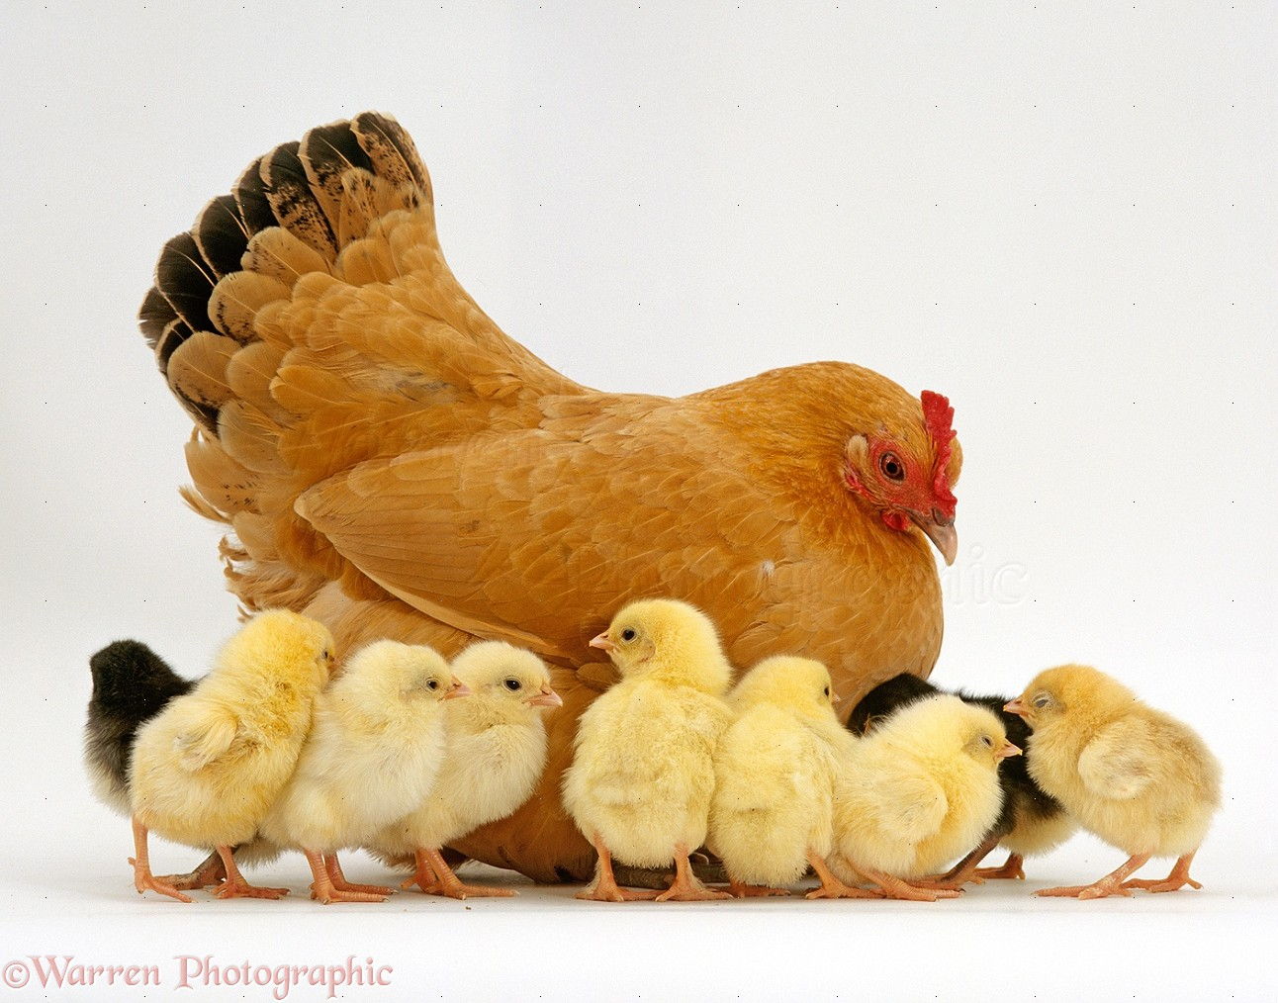
Offspring help plants and animals continue to survive.
Notes:
Offspring are the babies of living things. All living things, like plants and animals, need to create more offspring so their species can survive in the future. Without offspring, plants and animals would all die out!

Slide 18
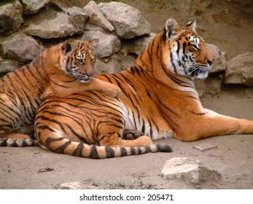
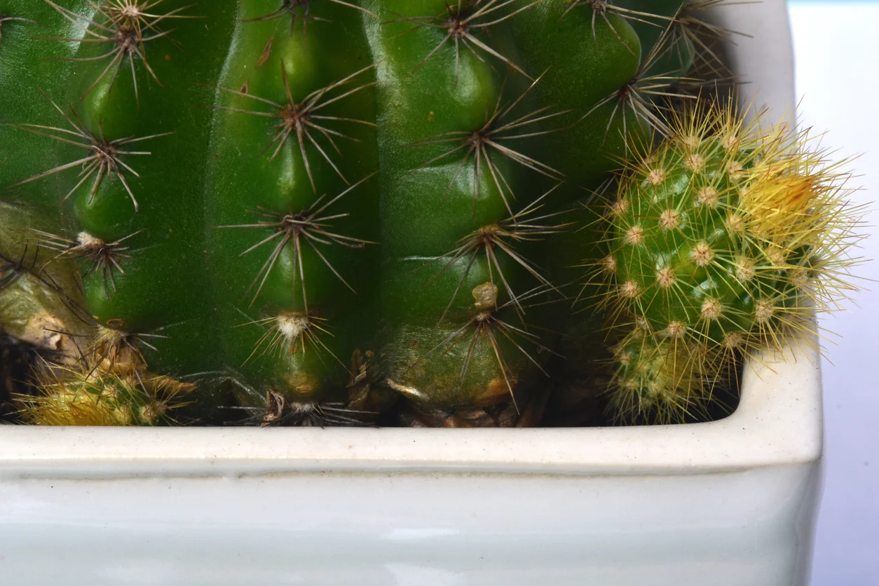
Offspring usually looks similar to its parents.
Notes:
Offspring are often very similar to their parents. Animals may have the same hair color or patterns or similar markings. Plants may have the same shape leaves or similar flower color.

Slide 19
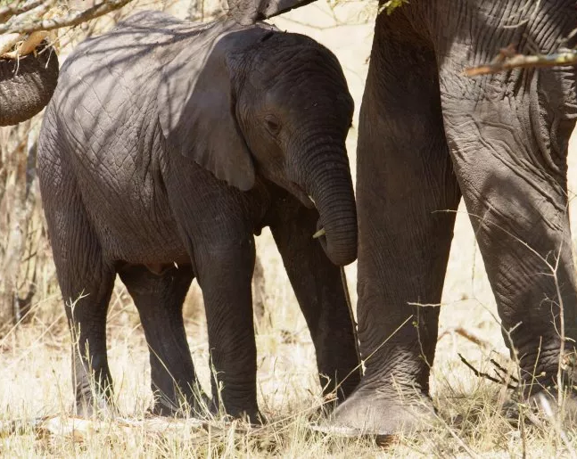
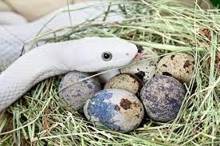
Animals care for their offspring in different ways.
Notes:
Animals take care of their offspring in different ways. Some, like elephants, require lots of protection and care from their parents. Others, like snakes, leave their eggs as soon as they are laid.

Slide 20
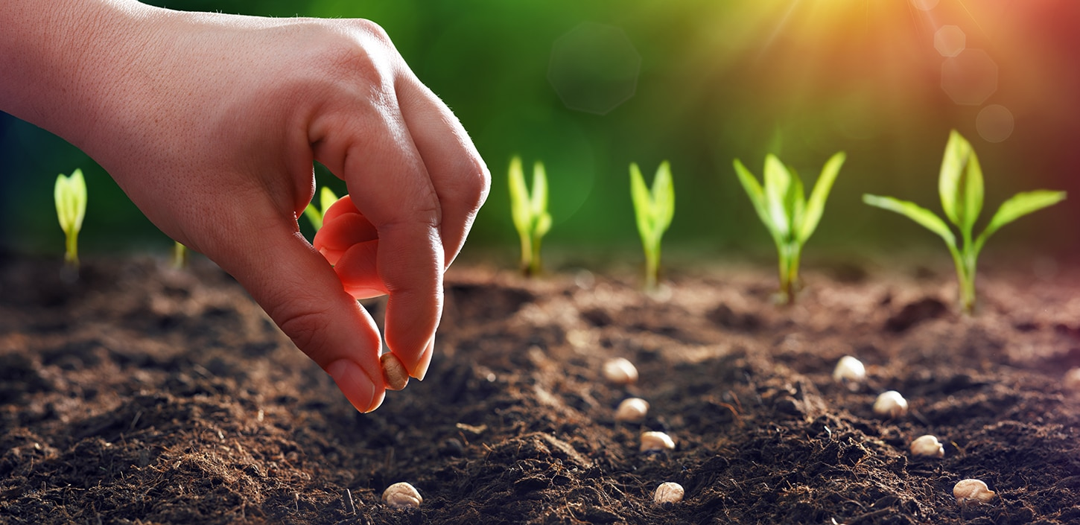
A plant’s offspring comes from seeds.
Notes:
In plants, offspring comes from seeds. These seeds are produced through a process called pollination. A plant seed has all the information it needs to grow into an adult plant on its own.

Slide 21
Notes:
Let’s check-in for understanding.

Slide 22
Offspring are important for the survival of living things.
True
False
Notes:
Offspring are important for the survival of living things.
[A. True]

Slide 23
Offspring are important for the survival of living things.
True
False
Notes:
Offspring are important for the survival of living things. A. True

Slide 24
Offspring look similar to their ___________.
Notes:
Offspring look similar to their _________.
[Parents]

Slide 25
Offspring look similar to their parents.
Notes:
Offspring look similar to their parents.

Slide 26
All animals must care for their offspring in the same way.
True
False
Notes:
All animals must care for their offspring in the same way.
[False]

Slide 27
All animals must care for their offspring in the same way.
True
False
Notes:
All animals must care for their offspring in the same way. False

Slide 28
What are a plant’s offspring called?
Notes:
What are a plant’s offspring called?

Slide 29
Notes:
Now, let’s talk about some examples of offspring.

Slide 30
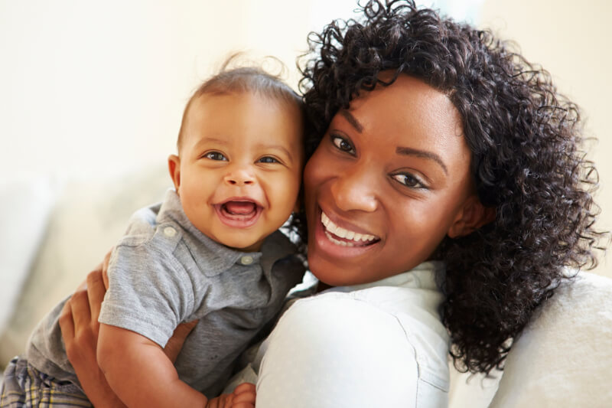
Notes:
Here is an example of offspring. A human’s offspring is called a baby.

Slide 31
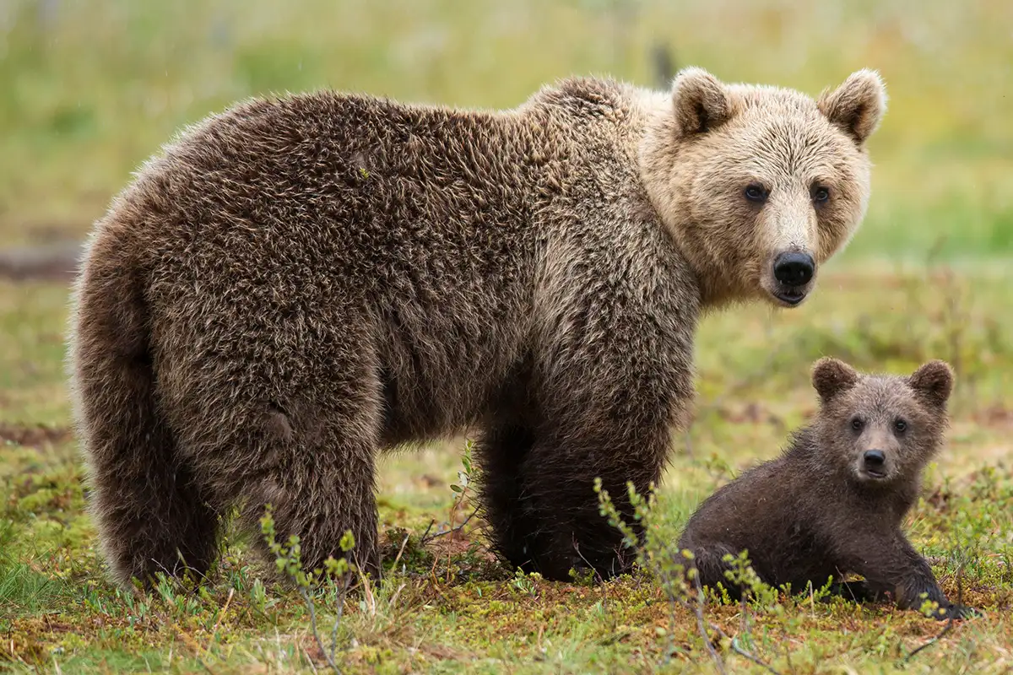
Notes:
Here is another example of offspring. The bear’s offspring is called a cub.

Slide 32
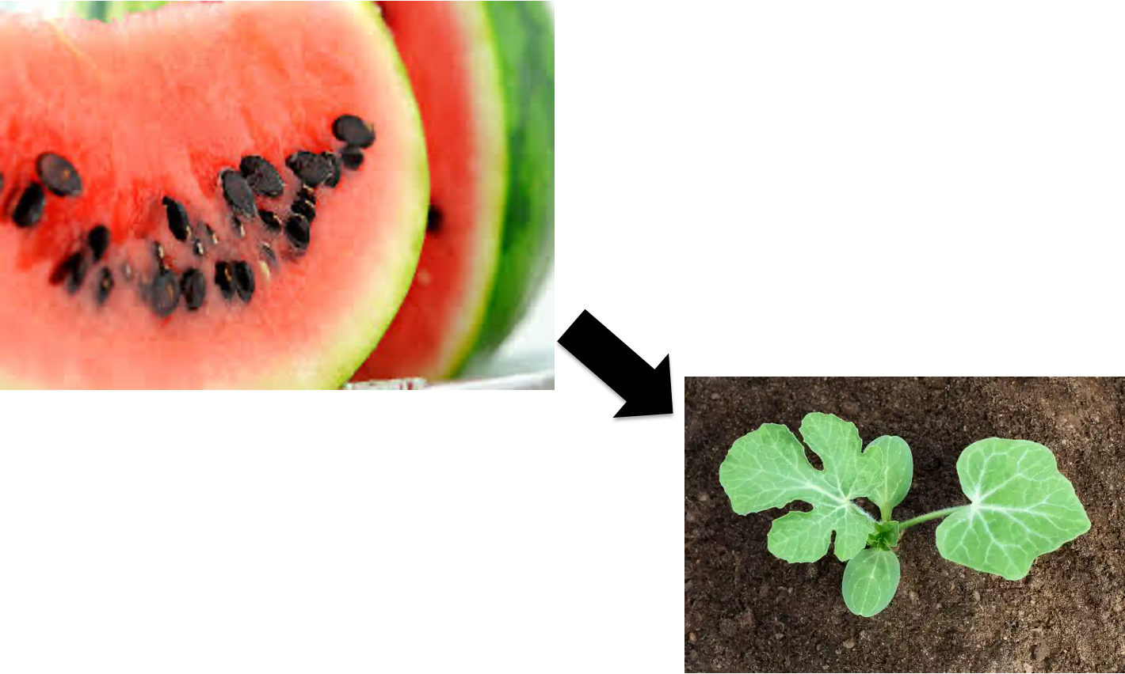
Notes:
Here is an example of plant offspring. The watermelon seed is planted and can grow into another watermelon.

Slide 33
Notes:
Now, let’s talk about some non-examples of offspring.

Slide 34
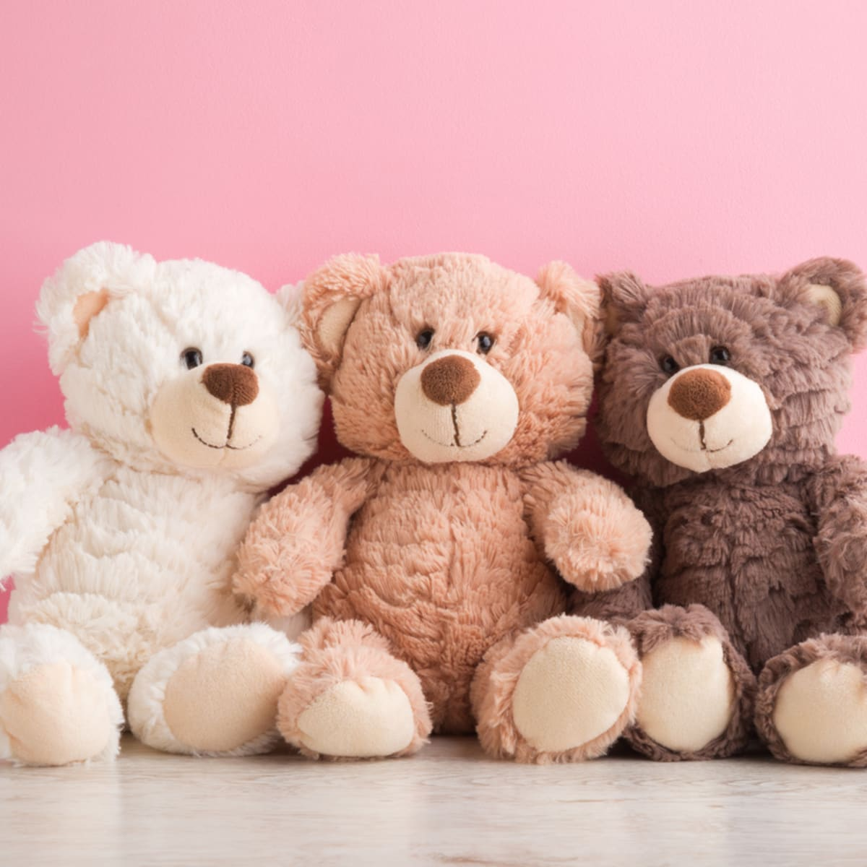
Notes:
This is a non-example of offspring. Teddy bears are non-living things, so they are not able to produce more of their own kind.

Slide 35
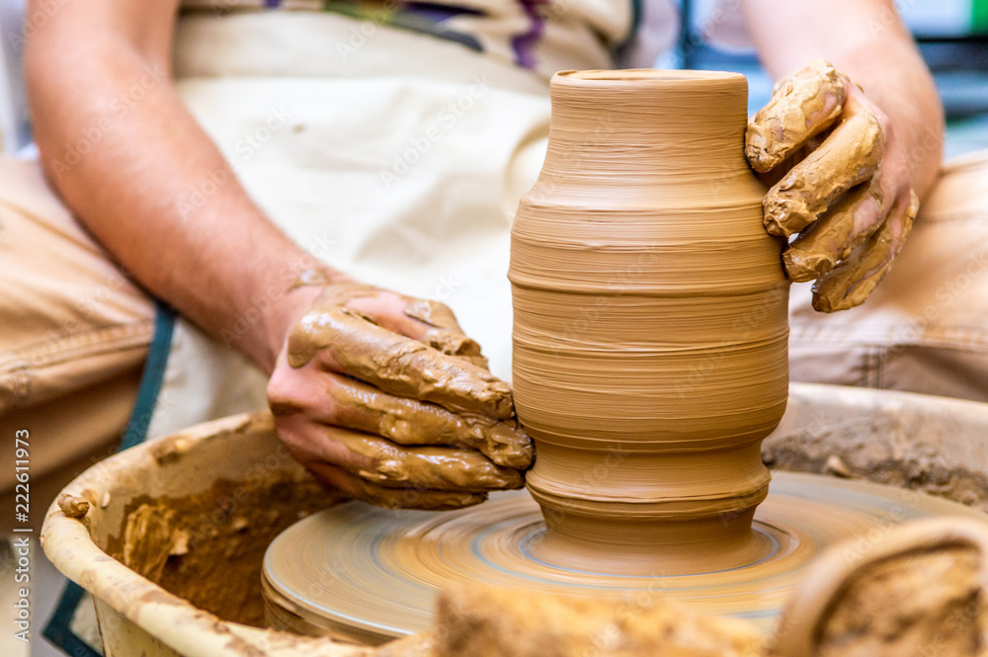
Notes:
This is also a non-example of offspring. A pot that an artist creates is not alive, so it cannot be offspring.

Slide 36
Notes:
Now let’s pause for a moment to check your understanding.

Slide 37
Which one is NOT an example of offspring?
Bear Cub
Teddy Bear
Watermelon
Seeds
Notes:
Which one is NOT an example of offspring?
[Teddy Bear]

Slide 38
Which one is NOT an example of offspring?
Bear Cub
Teddy Bear
Watermelon
Seeds
Notes:
Which one is NOT an example of offspring? Teddy Bear

Slide 39
Remember!!!
Notes:
So remember!

Slide 40
Offspring: the young of a living thing

Slide 41
Notes:
We will now complete this concept map, called a Frayer model, to summarize and further clarify what you have learned about the term offspring.

Slide 42
Definition
Picture
Offspring
Example
How does offspring impact my life?
Notes:
To complete the Frayer model, we will choose from four choices the correct picture, definition, example, and response to the question, “How does offspring impact my life?” Select the best response for each question using the information you just learned. As we select responses, we will see how this model looks filled in for the term offspring.

Slide 43
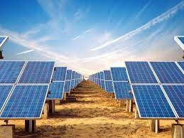
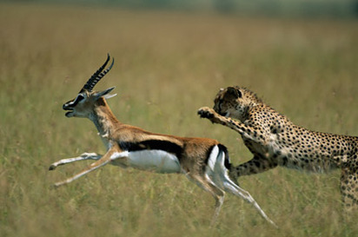
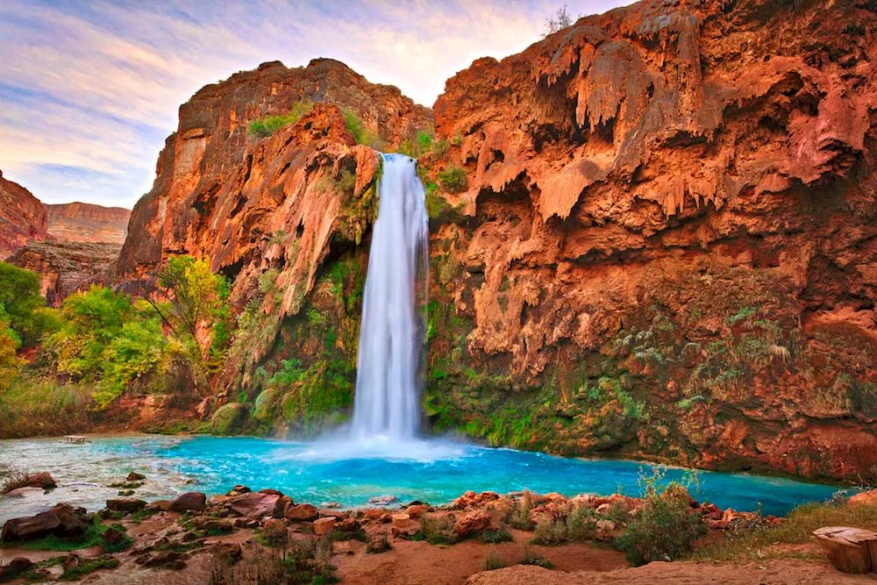
Directions: Choose the correct picture of offspring from the choices below.
A
B
C
D
Notes:
Choose the one correct picture of offspring from these four choices.

Slide 44
Directions: Choose the correct picture of offspring from the choices below.
A
B
C
D
Notes:
This is the picture that shows offspring.

Slide 45
Definition
Picture
Offspring
Example
How does offspring impact my life?
Notes:
Here is the Frayer model filled in with a picture of offspring.

Slide 46
Directions: Choose the correct definition of offspring from the choices below.
A
The process of breaking down rock over long periods of time
B
Green pigment found in plants
C
Energy of mass in motion
D
The young of a living thing
Notes:
Choose the one correct definition of offspring from these four choices.

Slide 47
Directions: Choose the correct definition of offspring from the choices below.
A
The process of breaking down rock over long periods of time
B
Green pigment found in plants
C
Energy of mass in motion
D
The young of a living thing
Notes:
“The young of a living thing” is correct! This is the definition of offspring.

Slide 48
Definition
Picture
The young of a living thing
Offspring
Example
How does offspring impact my life?
Notes:
Here is the Frayer Model with a picture and the definition filled in for offspring: The young of a living thing

Slide 49
Directions: Choose the correct example of offspring from the choices below.
A
A soccer ball sitting in a field
B
A man riding his bicycle in the park
C
A mother cat with her kitten
D
A panda bear eating bamboo
Notes:
Choose the one correct example of offspring from these four choices.

Slide 50
Directions: Choose the correct example of offspring from the choices below.
A
A soccer ball sitting in a field
B
A man riding his bicycle in the park
C
A mother cat with her kitten
D
A panda bear eating bamboo
Notes:
“A mother cat with her kitten” is correct! This is an example of offspring.

Slide 51
Definition
Picture
The young of a living thing
Offspring
A mother cat with her kitten
Example
How does offspring impact my life?
Notes:
Here is the Frayer Model with a picture, definition, and an example of offspring: A mother cat with her kitten

Slide 52
Directions: Choose the correct response for “how does offspring impact my life?” from the choices below.
A
Offspring keeps the Earth orbiting in the Sun and creates all the seasons that we experience each year.
B
Offspring create heat energy that can power our homes, schools, and transportation in our communities.
C
Offspring creates rain and snow that provides plants and animals the water they need to live.
D
Offspring help plants and animals, like humans, continue to survive by creating more of each kind.
Notes:
Choose the one correct response for “how does offspring impact my life?” from these four choices.

Slide 53
Directions: Choose the correct response for “how does offspring impact my life?” from the choices below.
A
Offspring keeps the Earth orbiting in the Sun and creates all the seasons that we experience each year.
B
Offspring create heat energy that can power our homes, schools, and transportation in our communities.
C
Offspring creates rain and snow that provides plants and animals the water they need to live.
D
Offspring help plants and animals, like humans, continue to survive by creating more of each kind.
Notes:
“Offspring help plants and animals, like humans, continue to survive by creating more of each kind” That is correct! This is an example of how offspring impacts your life.

Slide 54
Definition
Picture
The young of a living thing
Offspring
Offspring help plants
and animals, like humans, continue to survive by creating more of each kind.
A mother cat with her kitten
Example
How does offspring impact my life?
Notes:
Here is the Frayer Model with a picture, definition, example, and a correct response to “how does offspring impact my life?”: Offspring help plants and animals, like humans, continue to survive by creating more of each kind.

Slide 55
Remember!!!
Notes:
So remember!

Slide 56
Offspring: the young of a living thing
Notes:
Offspring are the young of a living thing.

Slide 57
Big Question: What do plants and animals need to survive?
Notes:
Let’s reflect once more on our big question. Our “big question” is: What do plants and animals need to survive?
Does anyone have any additional examples to share that haven’t been discussed yet?

Slide 58
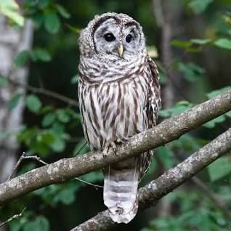
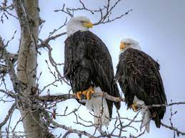
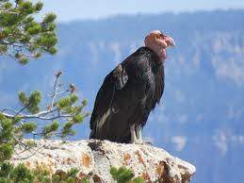
Observation Activity
Select one bird and its offspring to observation for the next week:
Barred Owls
Decorah Eagles
California Condors
As you observe, make notes to answer this question:
“What does the parent do to help the offspring survive?”
Notes:
In this activity, we will select one kind of bird to observe. As you observe, make notes about how the parent helps the offspring survive. Why is caring for the offspring important?

Slide 59
Notes:
Thanks for watching, and please continue watching CAPs available from this website.

Slide 60
This Was Created With Resources From:
Questions or Comments
Michael Kennedy, Ph.D. MKennedy@Virginia.edu
Rachel L Kunemund, Ph.D. rk8vm@virginia.edu

