Slide 1
Intro
“Big Idea” Question
Review Concepts
Check-In Questions
Teacher Engagement
Vocabulary
Student-Friendly Definition
Examples & Non-Examples
Frayer Model
Simulation/Activity
Notes:
OK everyone, get ready for our next lesson. Just as a reminder, these are the different components that our lesson may include, and you’ll see these icons in the top left corner of each slide so that you can follow along more easily!

Slide 2
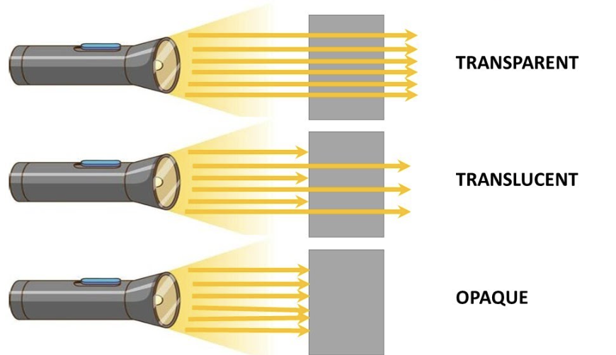
Intro
Opaque
Notes:
Today we’re going to learn about visible light.

Slide 3
Big Question: How do things that are opaque influence the way we experience the world around us?
Notes:
Before we start, let’s think about our “big question”: How do things that are opaque influence the way we experience the world around us?
[Pause and illicit predictions from students.]
I love all these thoughtful scientific hypotheses! Be sure to keep this question and your predictions in mind as we move through these next few lessons, and we’ll continue to revisit it.

Slide 4
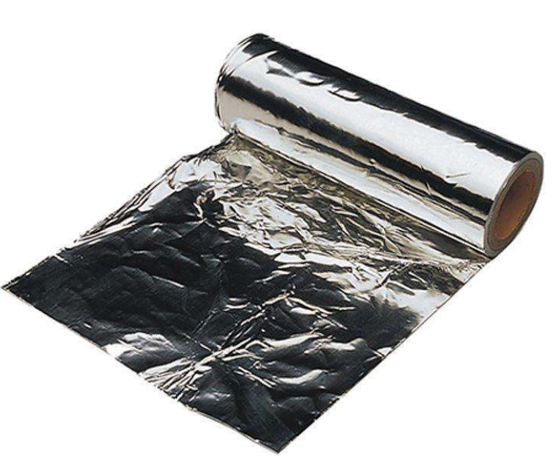
Demonstration
Transparent/Translucent/Opaque
TEACHER DIRECTIONS:
Before viewing: Ask students what they already know about things that are opaque. Tell students today they will be learning about the things that are opaque.
During: Discuss the differences between transparent, translucent, and opaque materials based on the experiment. Encourage students to think of other materials they encounter in daily life that fall into these categories.
After: Tell students that today they will be learning more about the term opaque.
Notes:
Materials Needed:
Clear glass or plastic container
Water
Clear plastic cup
Wax paper
Aluminum foil
Flashlight
Instructions:
Transparent Container:
Fill a clear glass or plastic container with water. Explain to the students that the container is transparent because they can see through it and light passes through it.
Transparent Plastic Cup:
Show a clear plastic cup to the students. Explain that it's also transparent because it lets light pass through. Hold the against a light source to demonstrate this.
Translucent Material - Wax Paper:
Take a piece of wax paper and hold it up to the light. Explain that wax paper is translucent because it allows some light to pass through, but not as clearly as transparent materials.
Opaque Material - Aluminum Foil:
Take a piece of aluminum foil and hold it up to the light. Explain that aluminum foil is opaque because it doesn't allow light to pass through at all.
Experiment:
Shine a flashlight from behind each material (transparent container, plastic cup, wax paper, and aluminum foil) to demonstrate how light behaves differently with each material. Students can observe how much light passes through or if it's blocked entirely.
Discussion:
Discuss the differences between transparent, translucent, and opaque materials based on the experiment. Encourage students to think of other materials they encounter in daily life that fall into these categories.
This hands-on experiment provides a clear visual demonstration of how different materials interact with light, helping students understand the concept of transparency in a practical and engaging way.

Slide 5
Notes:
Before we move on to our new vocabulary term, let’s review some other words & concepts that you already learned and make sure you are firm in your understanding.

Slide 6
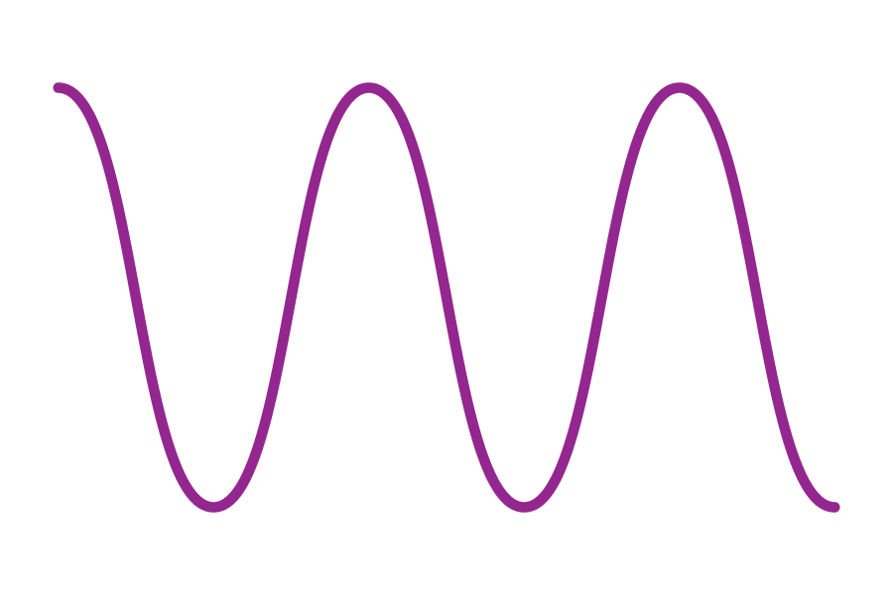
Waves: disturbances that travel through a medium, transporting energy from one location to another without transporting matter
Notes:
Waves are disturbances that travel through a medium, transporting energy from one location to another without transporting matter.

Slide 7
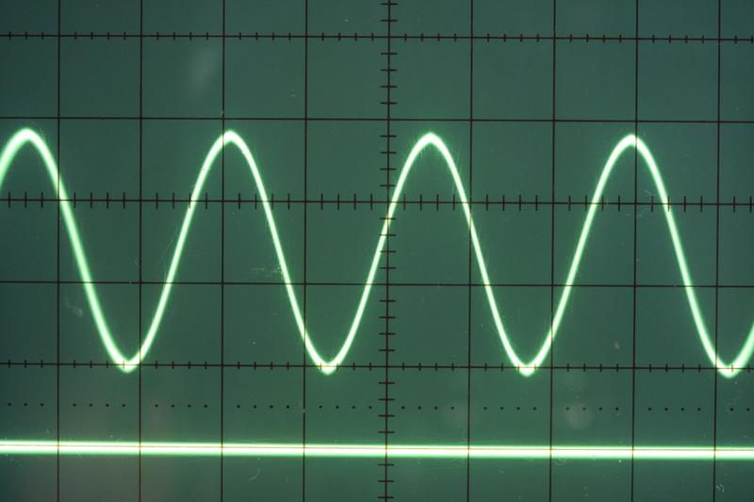
Transverse Waves: waves that travel perpendicularly to the direction they are moving
Notes:
Transverse waves are waves that travel perpendicularly to the direction they are moving.

Slide 8
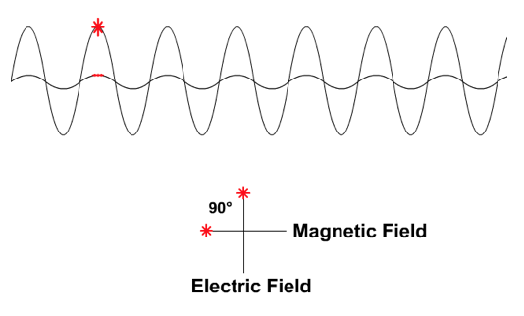
Electromagnetic Waves: waves that are created as a result of vibrations between an electric field and a magnetic field
Notes:
Electromagnetic waves are waves that are created as a result of vibrations between an electric field and a magnetic field.

Slide 9
Electromagnetic Spectrum: range of all types of electromagnetic waves
Notes:
The electromagnetic spectrum is the range of all types of magnetic waves.

Slide 10
Visible Light: wavelengths on the electromagnetic spectrum that people can see with their eyes
Notes:
Visible light are wavelengths on the electromagnetic spectrum that people can see with their eyes
Feedback: When providing more student-friendly definitions, it is helpful to provide students with cues so that they can be prepared and know what to expect and be ready to copy down the information.

Slide 11
Visible Light Spectrum: the range of all wavelengths that create colors that we can see with our eyes.
Notes:
The Visible Light Spectrum is the range of all wavelengths that create colors that we can see with our eyes.

Slide 12
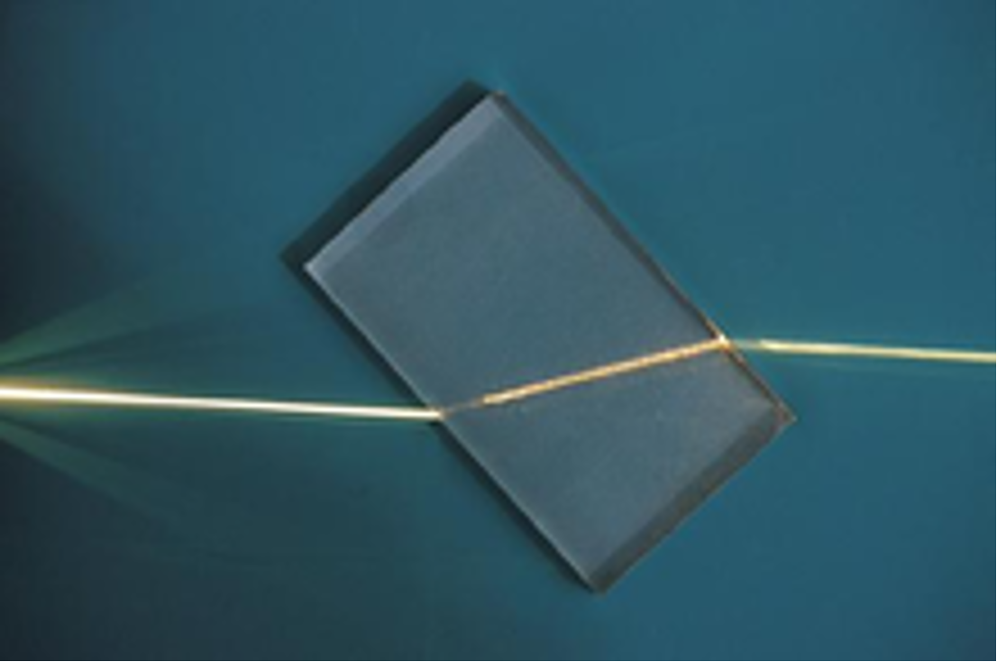
Refraction: bending of light waves when the wave moves from one medium to another
Notes:
Refraction is the bending of light waves when the wave moves from one medium to another.

Slide 13
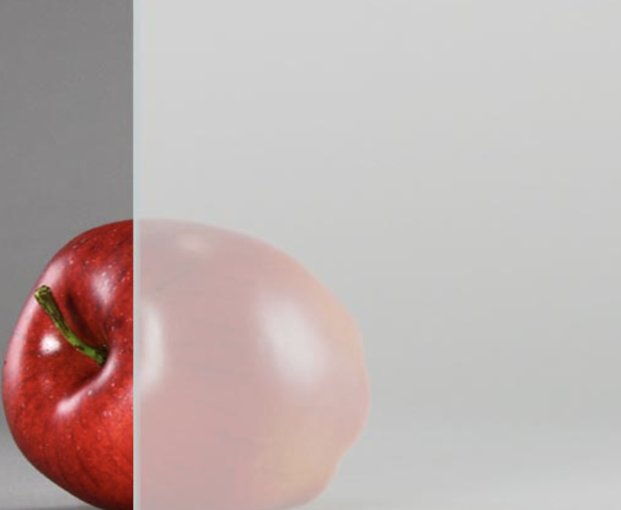
Translucent: when some light can pass through an object, but you can’t see clearly through it
Notes:
Translucent means when some light can travel through an object, but you can’t see clearly through it

Slide 14
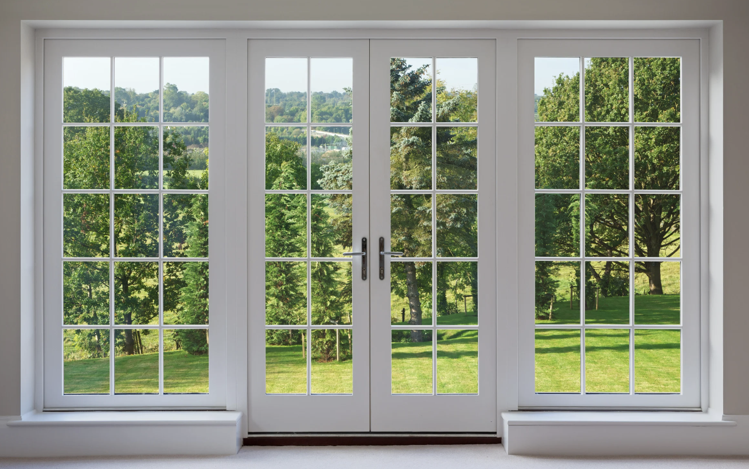
Transparent: when light can travel through an object, and you can see clearly through it
Notes:
Transparent: when light can travel through an object, and you can see clearly through it

Slide 15
Notes:
Now let’s pause for a moment to check your understanding.
Feedback: It's really important to make sure that you're providing students with frequent opportunities to respond as you're activating prior knowledge – it will save so you so much time if you confirm understanding before asking them to try something independently.

Slide 16
What is the difference between waves and transverse waves?
Notes:
What is the difference between waves and transverse waves?
[Transverse waves are simply a type of wave that moves perpendicularly to the direction they are moving. This is not the case for all waves.]

Slide 17
What are electromagnetic waves?
Notes:
What are electromagnetic waves?
[Electromagnetic waves are waves that are created as a result of vibrations between an electric field and a magnetic field.]

Slide 18
What is the electromagnetic spectrum?
Notes:
What is the electromagnetic spectrum?
[The electromagnetic spectrum is the range of all types of electromagnetic waves. These are created as result of vibrations between an electric field and a magnetic field.]

Slide 19
is the bending of light waves when the wave moves from one medium to another
Notes:
[Refraction] is the bending of light waves when the wave moves from one medium to another.

Slide 20
Refraction is the bending of light waves when the wave moves from one medium to another
Notes:
[Refraction] is the bending of light waves when the wave moves from one medium to another.

Slide 21
The range of all wavelengths that create colors that we can see with our eyes is:
The Visible Light Spectrum
The Electromagnetic Spectrum
The Microwave Spectrum
Notes:
The range of all wavelengths that create colors that we can see with our eyes is:
The Visible Light Spectrum
The Electromagnetic Spectrum
The Microwave Spectrum
[The Visible Light Spectrum]

Slide 22
The range of all wavelengths that create colors that we can see with our eyes is:
The Visible Light Spectrum
The Electromagnetic Spectrum
The Microwave Spectrum
Notes:
The range of all wavelengths that create colors that we can see with our eyes is: The Visible Light Spectrum

Slide 23
Transparent: when can travel through an object, and you can see through it
Notes:
Transparent: when can travel through an object, and you can see through it

Slide 24
Transparent: when light can travel through an object, and you can see clearly through it
Notes:
Transparent: when can travel through an object, and you can see through it

Slide 25
Opaque
Notes:
Now that we’ve reviewed, let’s define our new term, visible light.

Slide 26
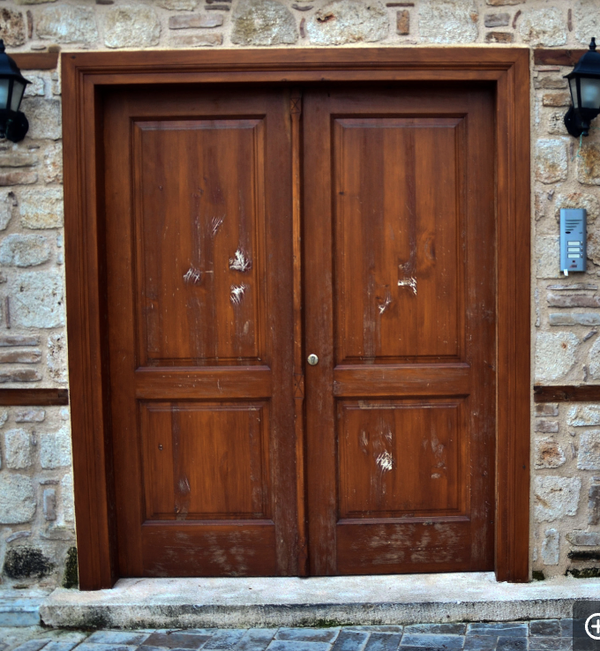
Opaque: when no light can pass through something, and you can not see through it
Notes:
Opaque: when no light can pass through something, and you can not see through it
Feedback: When providing more student-friendly definitions, it is helpful to provide students with cues so that they can be prepared and know what to expect and be ready to copy down the information.

Slide 27
Notes:
Let’s check-in for understanding.

Slide 28
What does opaque mean?
Notes:
What is does opaque mean?
[when no light can pass through something, and you can not see through it]

Slide 29
Notes:
That is the basic definition, but there is a bit more you need to know.

Slide 30
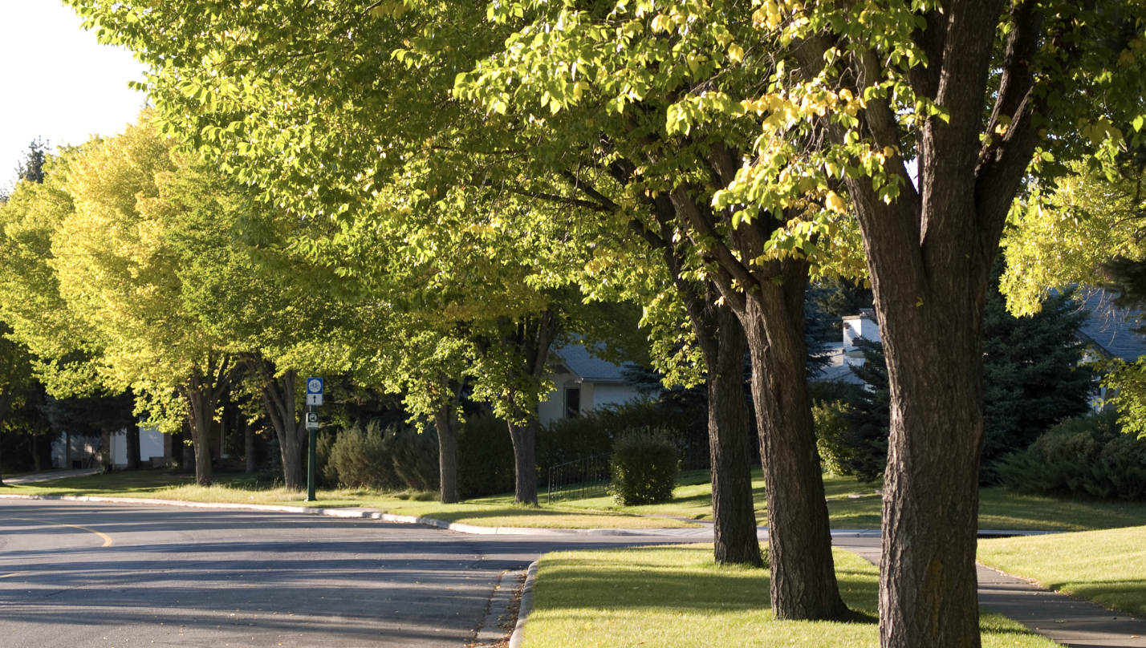
Opaque objects block light and create shadows
Notes:
Opaque objects block light, casting shadows on the ground. Think about how trees create cool spots under their shade on a sunny day. This is because their leaves are opaque, preventing sunlight from passing through.

Slide 31
Books, toys, clothes, and walls in our homes are usually opaque
Notes:
Many of the objects we see daily are opaque. Books, toys, clothes, and walls in our homes are usually opaque.

Slide 32
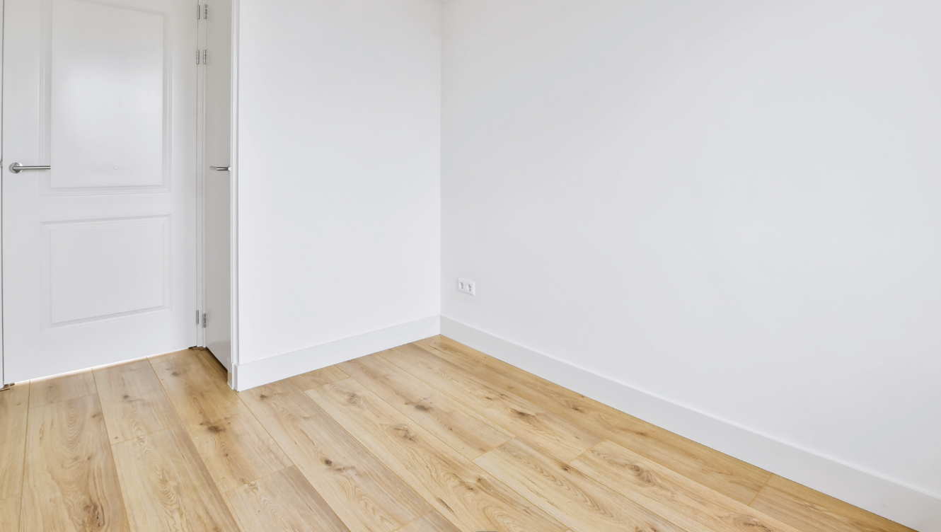
Opaque walls keep the indoor spaces warm or cool by blocking external heat or cold
Notes:
Opaque materials are used in buildings for insulation and privacy. Opaque walls keep the indoor spaces warm or cool by blocking external heat or cold.

Slide 33
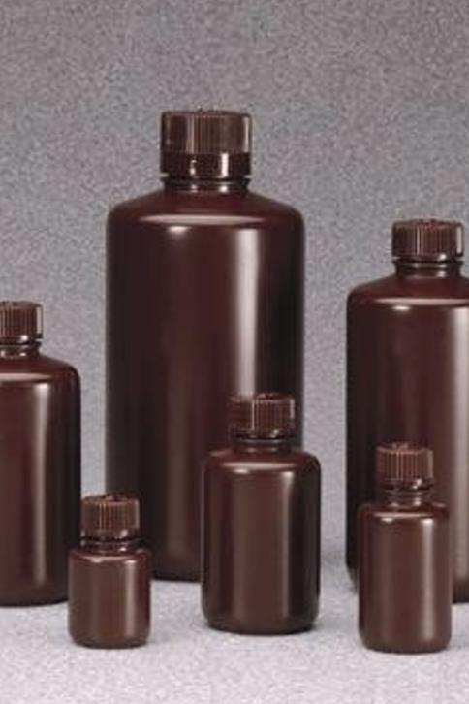
Opaque materials are used in scientific experiments.
Notes:
Opaque materials are used in scientific experiments. In laboratories, opaque containers are used to prevent light from affecting the reactions happening inside, making sure that results are accurate.

Slide 34
Notes:
Let’s check-in for understanding.

Slide 35
Opaque objects block light and create
.
Notes:
Opaque objects block light and create .
[shadows]

Slide 36
Opaque objects block light and create shadows
Notes:
Opaque objects block light and create shadows

Slide 37
Opaque walls keep the indoor spaces warm or cool by external heat or cold
Notes:
Opaque walls keep the indoor spaces warm or cool by external heat or cold
[blocking]

Slide 38
Opaque walls keep the indoor spaces warm or cool by blocking external heat or cold
Notes:
Opaque walls keep the indoor spaces warm or cool by blocking external heat or cold

Slide 39
Notes:
Now, let’s talk about some examples of visible light.
Feedback: It's good to pick a variety of examples to work through with your students. This prepares them for some types that might trip them up when they try it on their own.

Slide 40
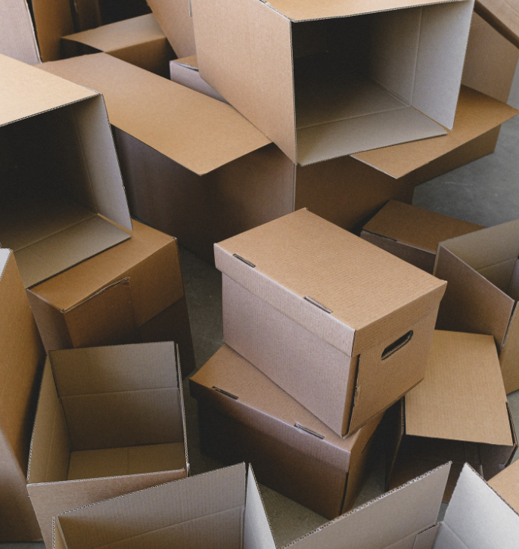
Cardboard is an example of something that is opaque
Notes:
Cardboard is an example of something that is opaque. No light can pass through it.

Slide 41
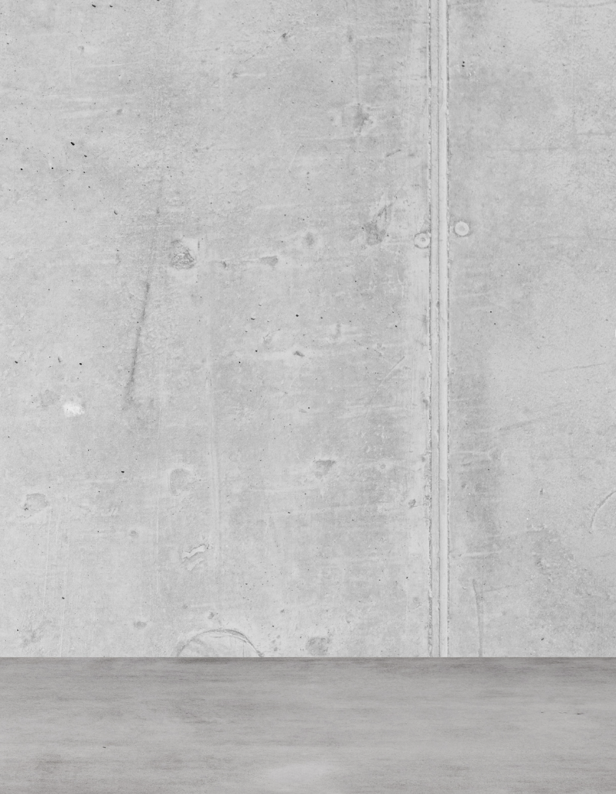
Concrete is another example of something that is opaque
Notes:
Concrete is another example of something that is opaque

Slide 42
Notes:
Next, let’s talk about some non-examples of visible light.

Slide 43
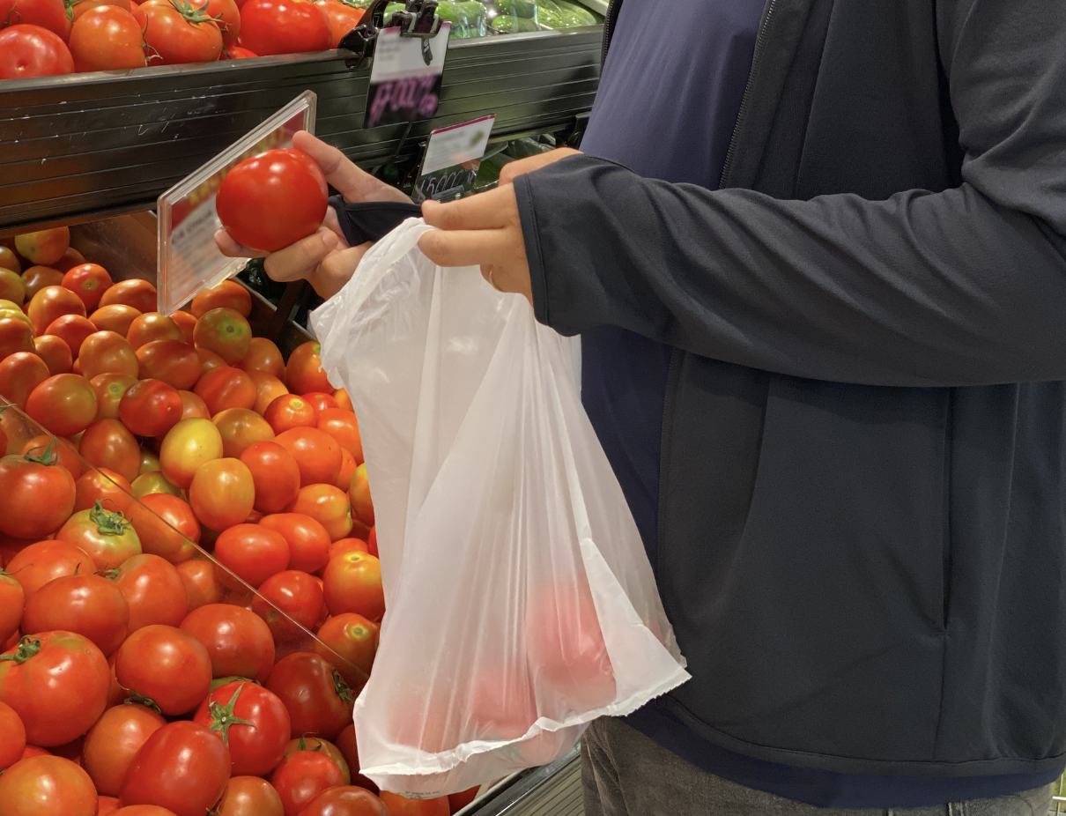
Grocery story plastic bags are NOT an example of something opaque
Notes:
Grocery story plastic bags are NOT an example of something opaque. They are translucent, some light can through the bags, but you cannot see clearly through them.
Feedback: Non-examples often need some explanation to make it clear to students the difference. Using clear and simple language can help with this.

Slide 44
Car windshields are NOT an example of something opaque
Notes:
Car windshields are another nonexample of something opaque. Car windshields are transparent, they let light pass through, and you can clearly see through them.

Slide 45
Notes:
Let’s check-in for understanding.

Slide 46
What are examples of things that are opaque?
Notes:
What are examples of things that are opaque?
[Cardboard, concrete, brick, people, blackout curtains]

Slide 47
True/False: Plastic grocery bags are NOT opaque.
Notes:
True/False: Plastic grocery bags are NOT opaque.
[True]

Slide 48
True/False: Plastic grocery bags are NOT opaque.
Notes:
True/False: Plastic grocery bags are NOT opaque. Plastic grocery bags are translucent, meaning light passes through them, but you cannot see clearly through them.

Slide 49
Notes:
We will now complete this concept map, called a Frayer model, to summarize and further clarify what you have learned about the term opaque.

Slide 50
Definition
Picture
Opaque
How do things that are opaque impact my life?
Example
Notes:
To complete the Frayer model, we will choose from four choices the correct picture, definition, example, and response to the question, “How do things that are opaque impact my life?” Select the best response for each question using the information you just learned. As we select responses, we will see how this model looks filled in for the term opaque.

Slide 51
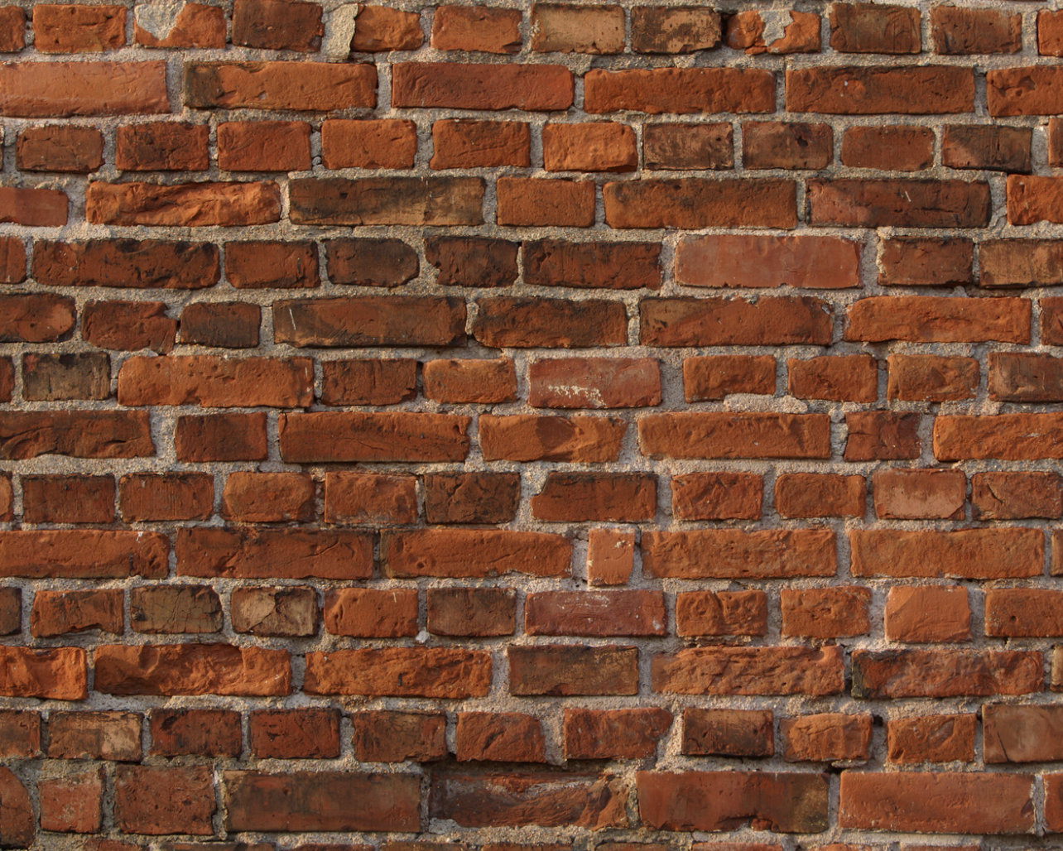
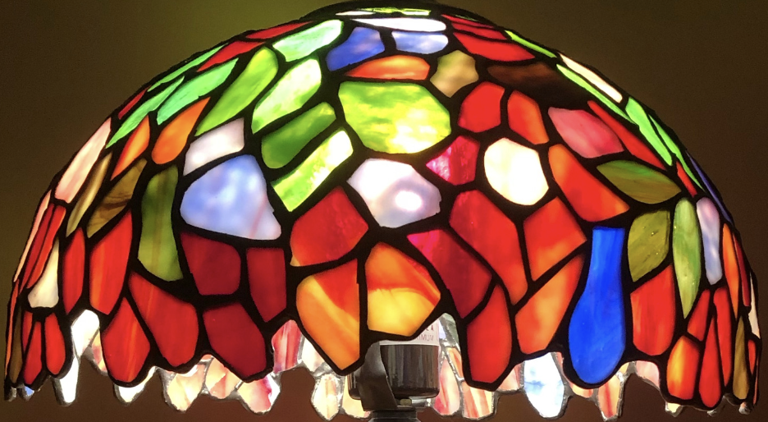
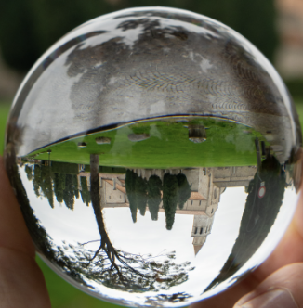
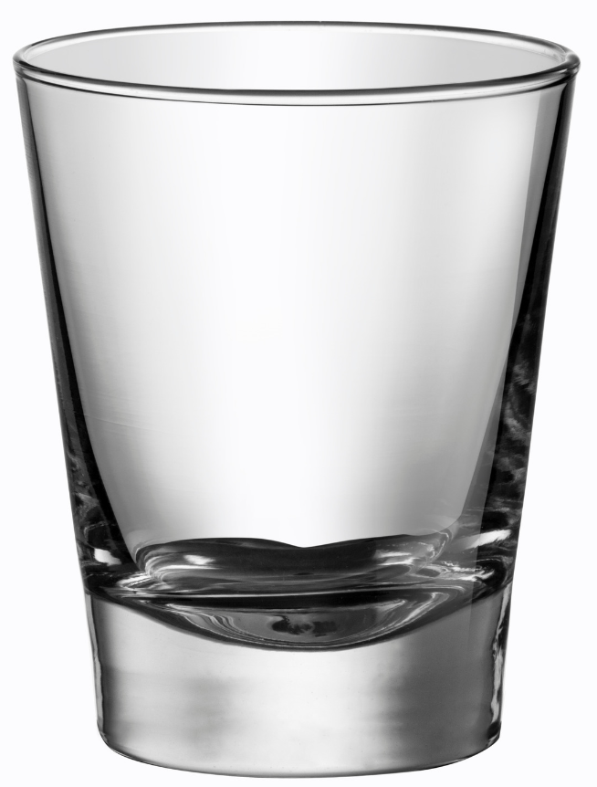
Directions: Choose the correct picture of something opaque from the choices below.
A
B
C
D
Notes:
Choose the one correct picture of something opaque from these four choices.

Slide 52
Directions: Choose the correct picture of something opaque from the choices below.
A
B
C
D
Notes:
This is the picture that shows something opaque. This is a brick wall; no light can pass through it.

Slide 53
Definition
Picture
Opaque
How do things that are opaque impact my life?
Example
Notes:
Here is the Frayer model filled in with a picture of something opaque.

Slide 54
Directions: Choose the correct definition of opaque from the choices below.
A
When light can travel through an object, and you can see clearly through it
B
When some light can pass through an object, but you can’t see clearly through it
C
The bending of light waves when the wave moves from one medium to another
D
When no light can pass through something, and you can not see through it
Notes:
Choose the one correct definition of opaque from these four choices.

Slide 55
Directions: Choose the correct definition of opaque from the choices below.
A
When light can travel through an object, and you can see clearly through it
B
When some light can pass through an object, but you can’t see clearly through it
C
The bending of light waves when the wave moves from one medium to another
D
When no light can pass through something, and you can not see through it
Notes:
“When no light can pass through something, and you can not see through it.” is correct! This is the definition of opaque.

Slide 56
Definition
Picture
When no light can pass through something, and you can not see through it
Opaque
How do things that are opaque impact my life?
Example
Notes:
Here is the Frayer Model with a picture and definition of opaque: When no light can pass through something, and you can not see through it

Slide 57
Directions: Choose the correct example of something opaque from the choices below.
A
Car windshield
B
A metal garage door
C
Wax paper
D
A clean sliding glass door
Notes:
Choose the one correct example of something opaque from these four choices.

Slide 58
Directions: Choose the correct example of something opaque from the choices below.
A
Car windshield
B
A metal garage door
C
Wax paper
D
A clean sliding glass door
Notes:
“A metal garage door” is correct! This is an example of something opaque.

Slide 59
Definition
Picture
When no light can pass through something, and you can not see through it
Opaque
A metal garage door
How do things that are opaque impact my life?
Example
Notes:
Here is the Frayer Model with a picture, definition, and an example of something opaque: A metal garage door.

Slide 60
Directions: Choose the correct response for “how do things that are opaque impact my life?” from the choices below.
A
Opaque things, such as walls and doors, give me privacy and make me feel safe at home and in school.
B
Opaque things like frosted glass provide privacy in bathrooms or other spaces, allowing me to see and enjoy the light from outside, but preventing people outside to see clearly inside.
I see my reflection in the mirror every morning. The mirror is always opaque, letting me clearly see how I look and helping me get ready for the day.
C
D
When I take a selfie the camera lens is opaque which allows it to capture how I look at the time.
Notes:
Choose the correct response for “how do things that are opaque impact my life?” from these four choices.

Slide 61
Directions: Choose the correct response for “how do things that are opaque impact my life?” from the choices below.
A
Opaque things, such as walls and doors, give me privacy and make me feel safe at home and in school.
B
Opaque things like frosted glass provide privacy in bathrooms or other spaces, allowing me to see and enjoy the light from outside, but preventing people outside to see clearly inside.
I see my reflection in the mirror every morning. The mirror is always opaque, letting me clearly see how I look and helping me get ready for the day.
C
D
When I take a selfie the camera lens is opaque which allows it to capture how I look at the time.
Notes:
“Opaque things, such as walls and doors, give me privacy and make me feel safe at home and in school..” That is correct! This is an example of how things that are opaque impact your life.

Slide 62
Definition
Picture
When no light can pass through something, and you can not see through it
Opaque
Opaque things, such as walls and doors, give me privacy and make me feel safe at home and in school.
A metal garage door
How do things that are opaque impact my life?
Example
Notes:
Here is the Frayer Model with a picture, definition, example, and a correct response to “How do things that are opaque impact my life?”: Opaque things, such as walls and doors, give me privacy and make me feel safe at home and in school.

Slide 63
Remember!!!
Notes:
So remember!
Feedback: A good general strategy for information retention is: 1) tell them what you're going to teach them, 2) teach them, and 3) tell them what you just taught them. Make sure to include the third and final step. While it is easy to think a quick review of what you just went over is unnecessary, it can be incredibly useful in helping the students remember the information over the long term.

Slide 64
Opaque: when no light can pass through something, and you can not see through it
Notes:
Opaque: when no light can pass through something, and you can not see through it

Slide 65
Big Question: How do things that are opaque influence the way we experience the world around us?
Notes:
Let’s reflect once more on our big question. Our “big question” is: How do things that are opaque influence the way we experience the world around us?
Does anyone have any additional examples to share that haven’t been discussed yet?

Slide 66
Notes:
Thanks for watching, and please continue watching CAPs available from this website.

Slide 67
This Video Was Created With Resources From:
Questions or Comments
Michael Kennedy, Ph.D. MKennedy@Virginia.edu
Rachel L Kunemund, Ph.D. rk8vm@virginia.edu

