Slide 1
Intro
“Big Idea” Question
Review Concepts
Check-In Questions
Teacher Engagement
Vocabulary
Student-Friendly Definition
Examples & Non-Examples
Morphological Word Parts
Frayer Model
Simulation/Activity
Notes:
OK everyone, get ready for our next lesson. Just as a reminder, these are the different components that our lesson may include, and you’ll see these icons in the top left corner of each slide so that you can follow along more easily!

Slide 2
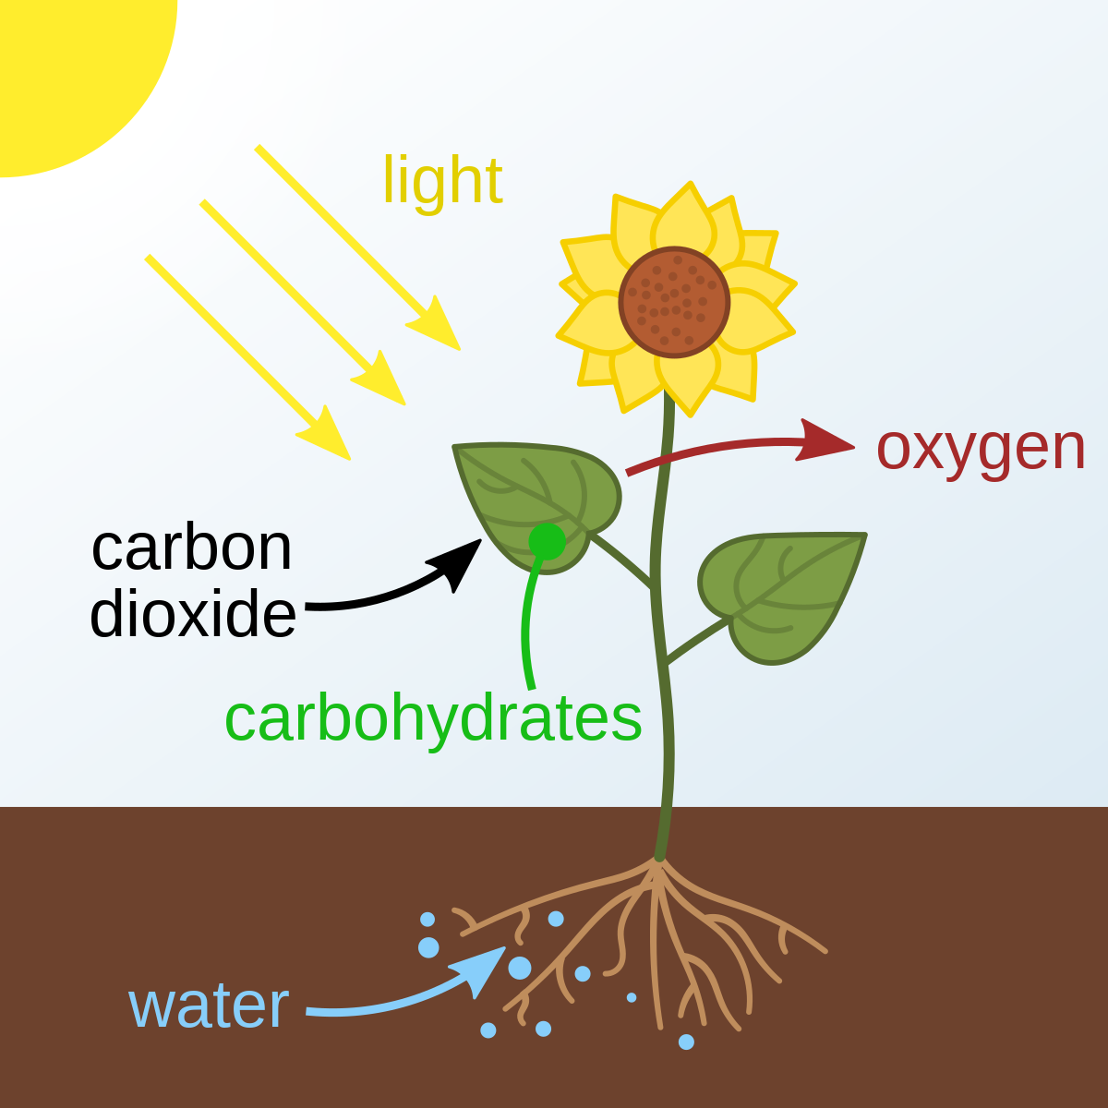
Intro
Photosynthesis
Notes:
Today, we’ll be learning about the word: Photosynthesis.

Slide 3
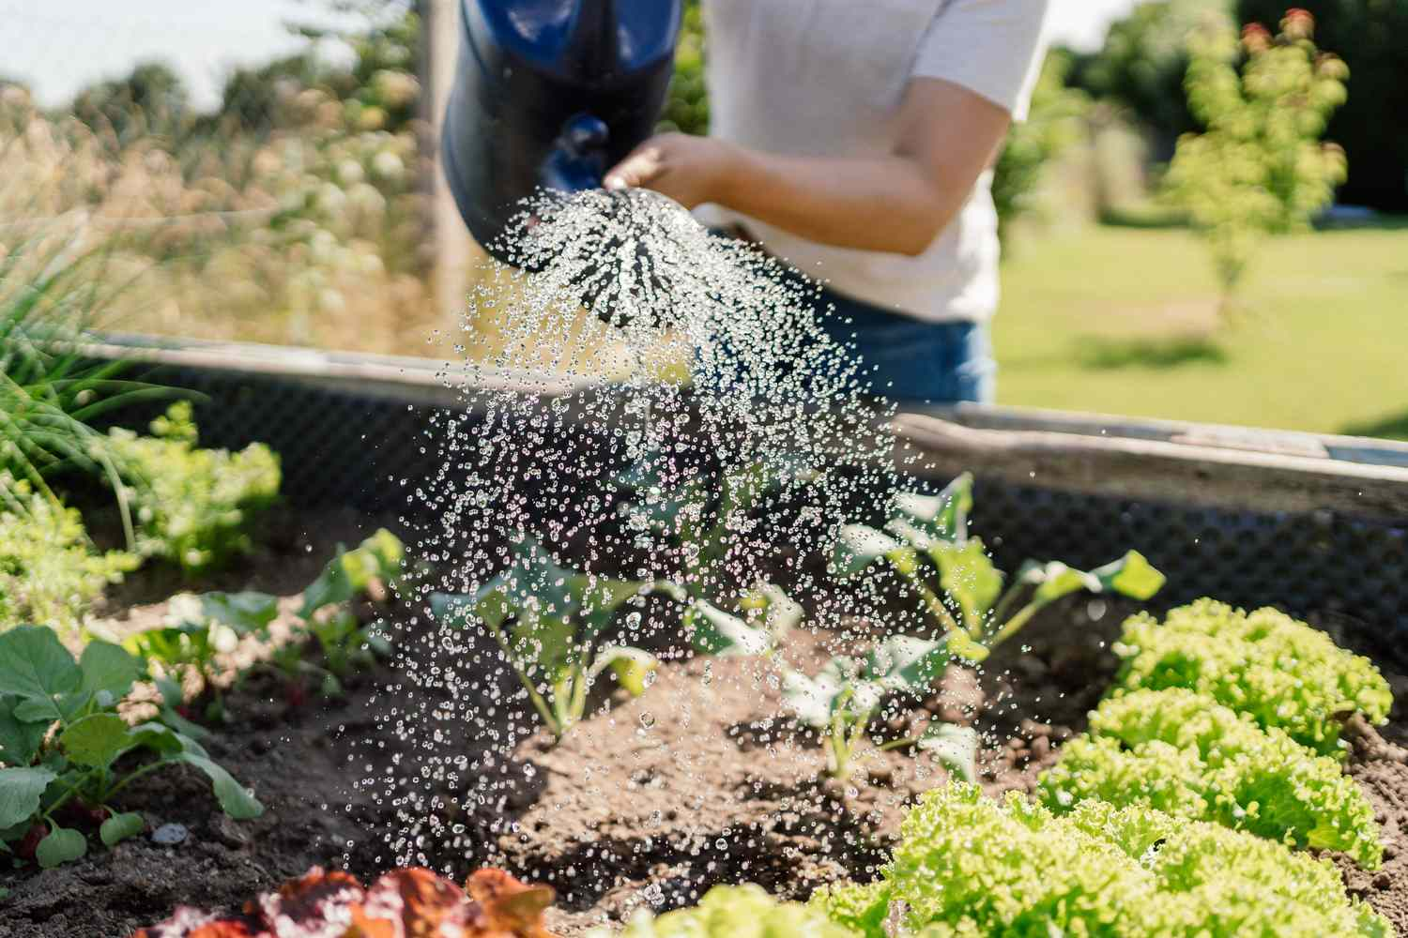
Big Question: What do plants need to survive?
Notes:
Our “big question” is: What do plants need to survive?
[Pause and illicit predictions from students.]
I love all these thoughtful scientific hypotheses! Be sure to keep this question and your predictions in mind as we move through these next few lessons, and we’ll continue to revisit it.

Slide 4
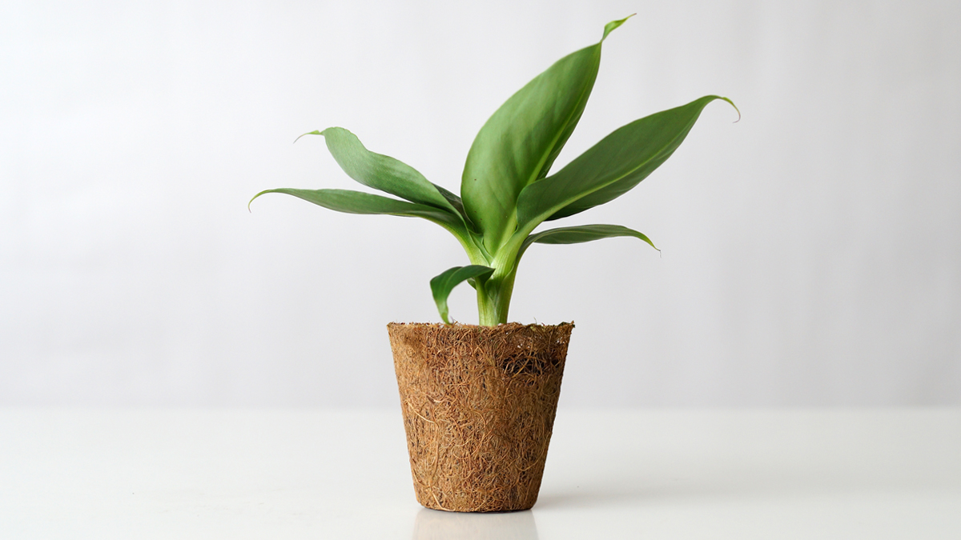
Demonstration
Plant With and Without Sun Comparison
For this topic one optional demonstration would involve preparing two of the same plant - one grown with access to sunlight and the other grown without access to sunlight. You can use these to explain the importance of sunlight in help plants to grow. Alternatively, you can bring in a healthy plant and talk about how the green pigments are chlorophyll in the chloroplast. We see many plants as green because green is the wavelength of light that chlorophyll do not absorb.
Notes:
Feedback: Alternatively, you can also provide students a virtual investigation where students engage in a simplified computer science program to control the growing of plants based on changing different variables: https://scratch.mit.edu/studios/9323539/

Slide 5
Notes:
Before we move on to our new topic, let’s review some other words & concepts that you already learned and make sure you are firm in your understanding.

Slide 6
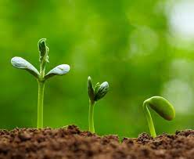
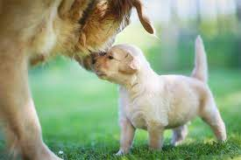
Living Thing: organisms that move, grow, change, and respond to its environment
Notes:
Living things are organisms that grow, change, and respond to its environment.

Slide 7
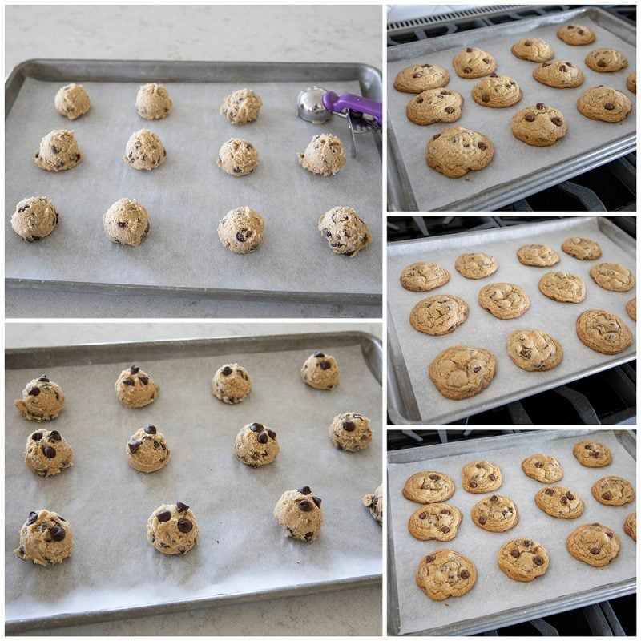
Convert: to change something
Notes:
Convert means to change something. For example, when you bake cookie dough, you change the liquidy cookie dough into solid cookies.

Slide 8
Consume: to use something
Notes:
Convert means to change something. For example, when you eat a cookie, you use it to not feel hungry anymore.

Slide 9
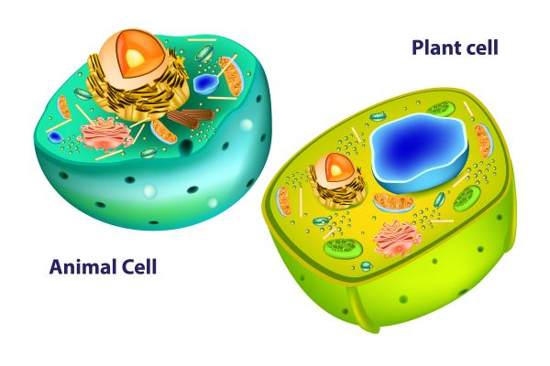
Cell: tiny “building block” of life that makes up plants and animals
Notes:
A cell is a tiny “building block” of life that makes up plants and animals.

Slide 10
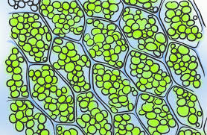
Chlorophyll: green pigment found in plants
Notes:
Chlorophyll is a green pigment found in plants.

Slide 11
Notes:
Now let’s pause for a moment to review the information we have covered already.

Slide 12
______ is to change something and ______ is to use something.
Convert, consume
Consume, convert
Notes:
______ is to change something and _______ is to use something.
[Convert, consume]

Slide 13
______ is to change something and ______ is to use something.
Convert, consume
Consume, convert
Notes:
Convert is to change something and consume is to use something.

Slide 14
Cells make up both plants and animals.
True
False
Notes:
Cells make up both plants and animals.
[True]

Slide 15
Cells make up both plants and animals.
True
False
Notes:
Cells make up both plants and animals.
[True]

Slide 16
_________ is the green pigment found in plants.
Cells
Chlorophyll
Notes:
__________ is the green pigment found in plants.
[B. Chlorophyll]

Slide 17
_________ is the green pigment found in plants.
Cells
Chlorophyll
Notes:
[Chlorophyll] is the green pigment found in plants.

Slide 18
Photosynthesis
Notes:
Now that we’ve reviewed, let’s define the phrase photosynthesis.

Slide 19
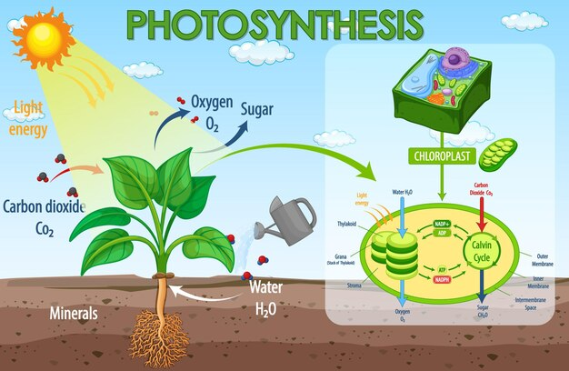
Photosynthesis: the process that green plants use to make their own food
Notes:
Photosynthesis is the process that green plants use to make their own food.

Slide 20
Notes:
Let’s check-in for understanding.

Slide 21
What is photosynthesis?
Notes:
What is photosynthesis?
[The process that green plants use to make their own food.]

Slide 22
Notes:
That is the basic definition, but there is a bit more you need to know.

Slide 23
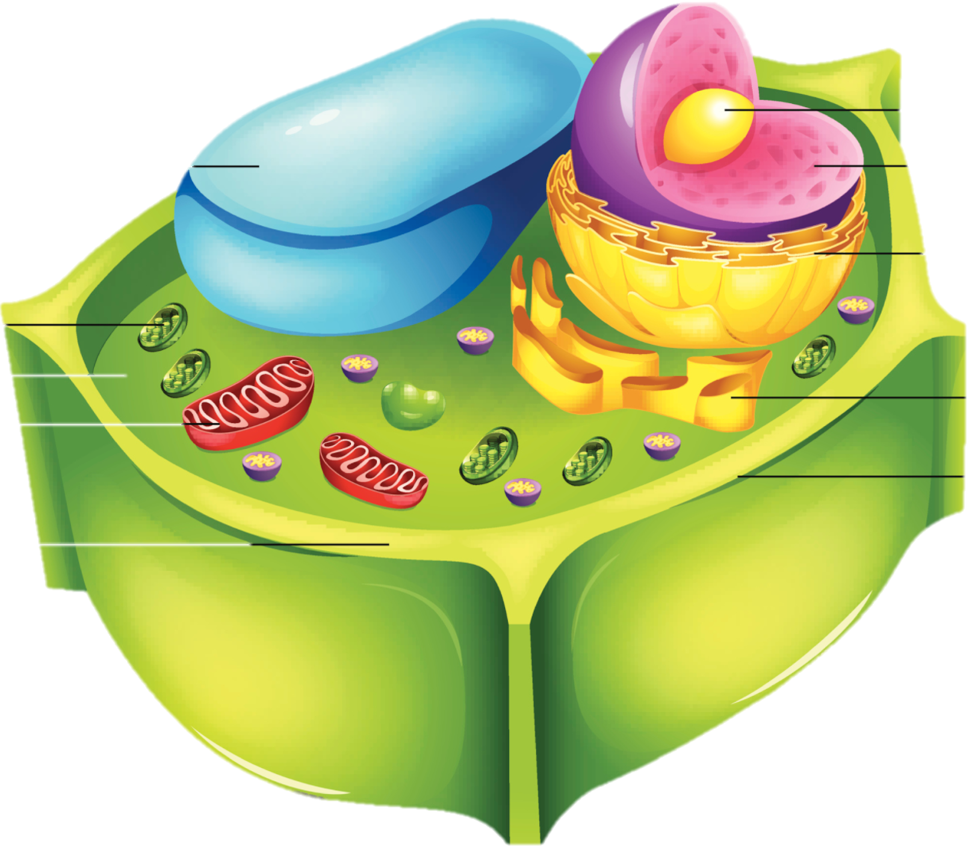
Photosynthesis happens in the plant cell part known as the chloroplast, which contain chlorophyll.
Chloroplasts
Notes:
Photosynthesis happens in the plant cell part known as the chloroplast, which contain chlorophyll.

Slide 24
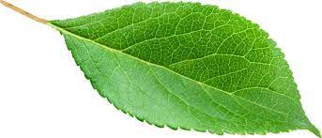
Chlorophyll helps the plant absorb light energy from the Sun during photosynthesis.
Notes:
Chlorophyll helps the plant absorb light energy from the SUn during photosynthesis. It captures the sun’s light energy so it can be used to make a food for the plant.

Slide 25
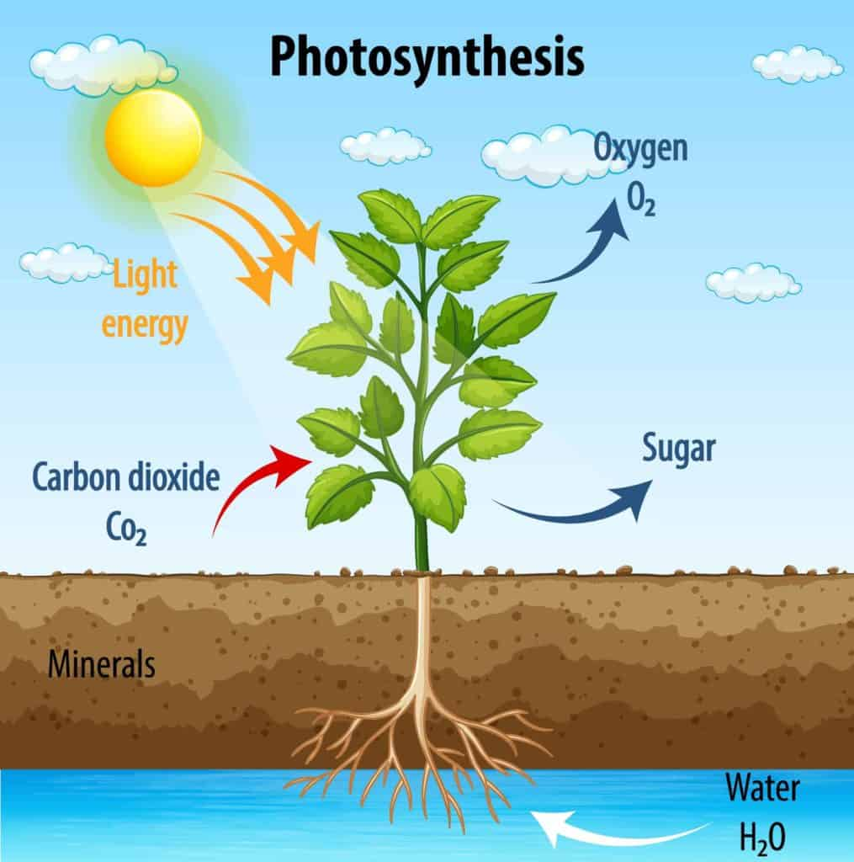
In photosynthesis, green plants use chlorophyll, carbon dioxide, water, and sunlight to make their own food.
Notes:
In photosynthesis, green plants use chlorophyll, carbon dioxide, water, and sunlight to make their own food.

Slide 26
The leaves of the plant make the food. The food, or sugar, is also known as glucose.
Notes:
The leaves of the plant make the food. The food, or sugar, is also known as glucose.

Slide 27
Oxygen is also made during photosynthesis.
Notes:
Oxygen is also made during photosynthesis and is released by the plant.

Slide 28
Notes:
Let’s check-in for understanding.

Slide 29
Why is chlorophyll important during photosynthesis?
Notes:
Why is chlorophyll important during photosynthesis?
[Chlorophyll helps the plant absorb light energy from the Sun. This helps the plant make food, or glucose.]

Slide 30
Photosynthesis takes place in the _________, which contain ________.
Notes:
Photosynthesis takes place in the ____________, which contain ______________.
[Chloroplasts, chlorophyll]

Slide 31
Photosynthesis takes place in the chloroplasts which contain chlorophyll.
Notes:
Photosynthesis takes place in the [chloroplasts], which contain [chlorophyll].

Slide 32
In photosynthesis, green plants use or take in:
Sunlight through chlorophyll, carbon dioxide, and water
Glucose (sugar) and oxygen
Notes:
In photosynthesis, green plants use or take in:
[Sunlight through chlorophyll, carbon dioxide, and water]

Slide 33
In photosynthesis, green plants use or take in:
Sunlight through chlorophyll, carbon dioxide, and water
Glucose (sugar) and oxygen
Notes:
In photosynthesis, green plants use or take in: Sunlight through chlorophyll, carbon dioxide, and water.

Slide 34
In photosynthesis, green plants use or take in:
Sunlight through chlorophyll, carbon dioxide, and water
Glucose (sugar) and oxygen
Notes:
In photosynthesis, green plants use or take in:
[Glucose (sugar) and oxygen]

Slide 35
In photosynthesis, green plants use or take in:
Sunlight through chlorophyll, carbon dioxide, and water
Glucose (sugar) and oxygen
Notes:
In photosynthesis, green plants use or take in: Glucose (sugar) and oxygen

Slide 36
Notes:
Now, let’s talk about some examples of photosynthesis.

Slide 37
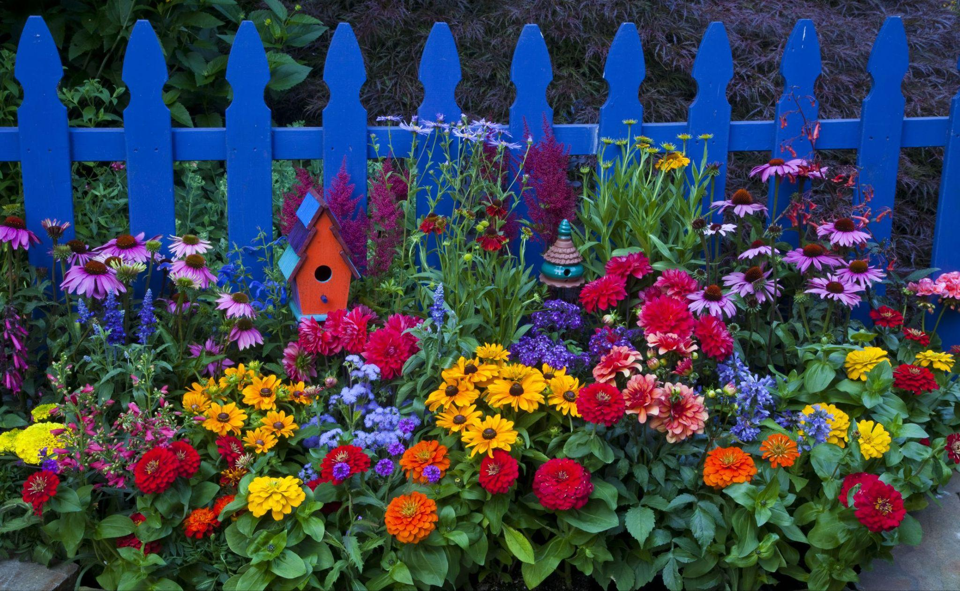
Flowers in a garden are an example of plants that use photosynthesis.
Notes:
An example of photosynthesis is flowers in a garden. The flowers take in sunlight, water, and carbon dioxide. They make glucose which helps them grow and eventually bloom.

Slide 38
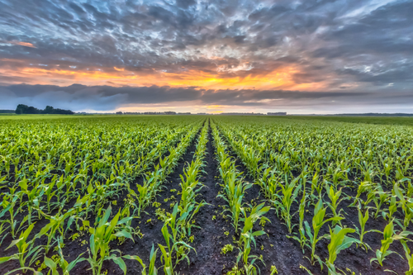
Crops in a field are an example of plants that use photosynthesis.
Notes:
Another example of photosynthesis is crops in a field. They take in the sunlight, water, and carbon dioxide to make glucose. The glucose helps them grow into fruit, vegetables, and other crops that humans and other organisms can eat.

Slide 39
Notes:
Now, let’s talk about some non-examples of photosynthesis.

Slide 40
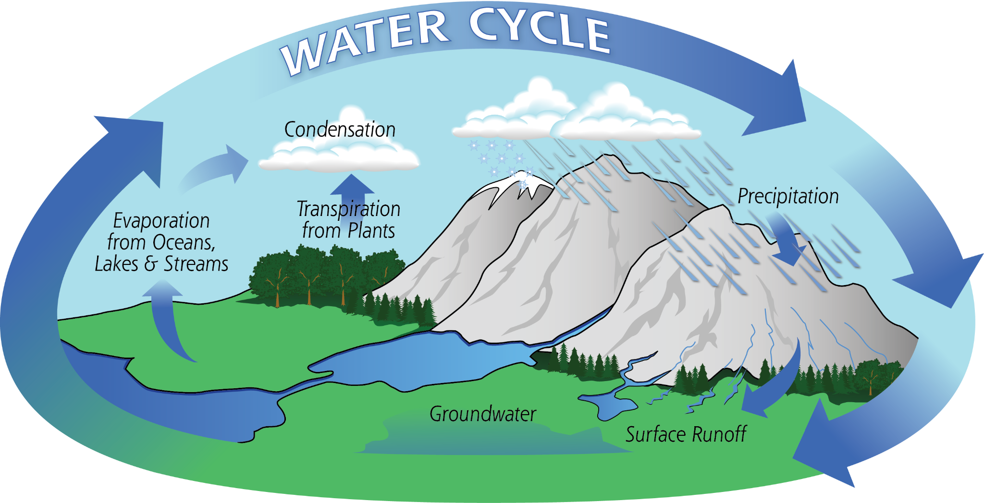
The water cycle, which shows how water moves in our environment, is not an example of photosynthesis.
Notes:
The water cycle is not an example of photosynthesis. The water cycle shows how water moves through our environment, not how plants make food.

Slide 41
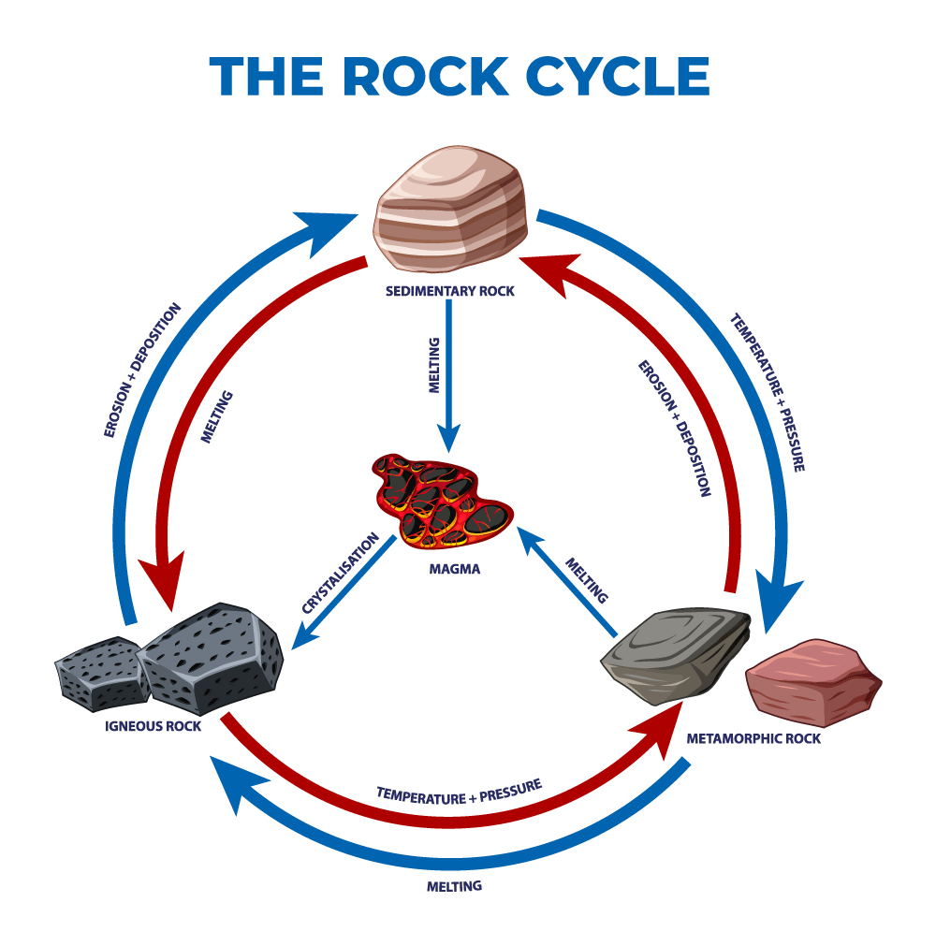
The rock cycle, which shows how rocks are formed , is not an example of photosynthesis.
Notes:
The rock cycle is not an example of photosynthesis. It shows how different types of rocks are formed, not how plants make their own food.

Slide 42
Notes:
Now let’s pause for a moment to check your understanding.

Slide 43
Why are the water and rock cycles not examples of photosynthesis?
Notes:
Why are the water and rock cycles not examples of photosynthesis?
[The water cycle shows how water moves through the environment. The rock cycle shows how different types of rocks are made. Neither show how plants make their own food, which is what photosynthesis is.]

Slide 44
Notes:
We can also break down the term photosynthesis into different word parts to help us remember the meaning. Let’s take a look!

Slide 45
Photosynthesis
(prefix)
(root)
Notes:
We can break up the term photosynthesis into two parts: a prefix and a root.

Slide 46
Photosynthesis
Photo synthesis
light
Notes:
The prefix, photo, means light.

Slide 47
Photosynthesis
Photo synthesis
Putting two or more things together to make something new
Notes:
The suffix, synthesi, means putting two or more things together to make something new.

Slide 48
Photo synthesis
Photosynthesis
Using light to put together
Notes:
Photosynthesis means using light to put together. Photosynthesis uses light energy to put together sugar so the plant can grow.

Slide 49
Notes:
Let’s check-in for understanding.

Slide 50
How can we use the word parts of photosynthesis to help us remember the definition of the term?
Photosynthesis
Photo synthesis
Notes:
How can we use the word parts of photosynthesis to help us remember the definition of the term?
[Photo = light
Synthesis = to put two or more things together
In photosynthesis, light is used to build the sugars that plants need.]

Slide 51
Remember!!!
Notes:
So remember!

Slide 52
Photosynthesis: the process that green plants use to make their own food
Notes:
Photosynthesis is the process that green plants use to make their own food.

Slide 53
Notes:
We will now complete this concept map, called a Frayer model, to summarize and further clarify what you have learned about the term photosynthesis.

Slide 54
Definition
Picture
Photosynthesis
Example
How does photosynthesis impact my life?
Notes:
To complete the Frayer model, we will choose from four choices the correct picture, definition, example, and response to the question, “How does photosynthesis impact my life?” Select the best response for each question using the information you just learned. As we select responses, we will see how this model looks filled in for the term photosynthesis.

Slide 55
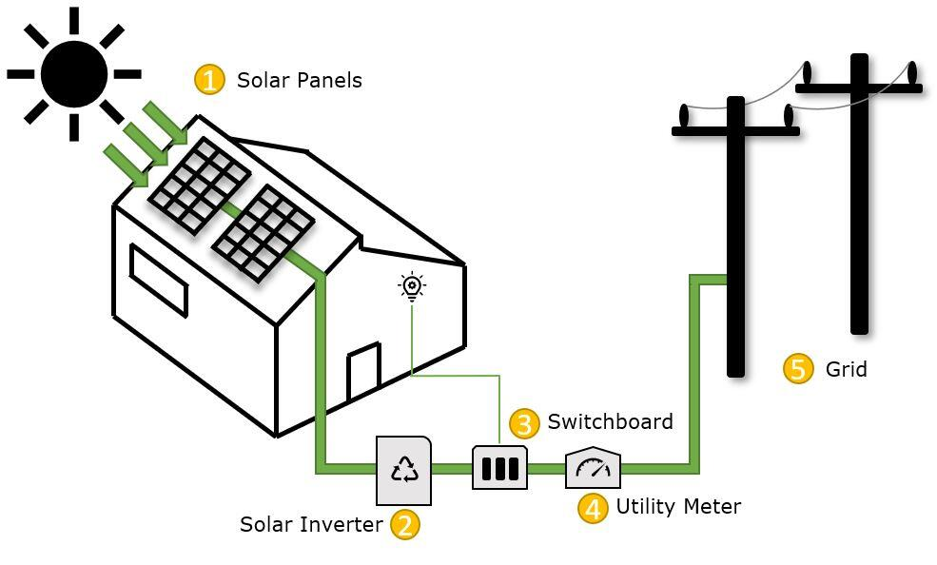
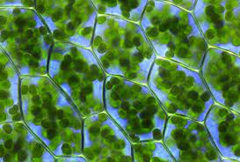
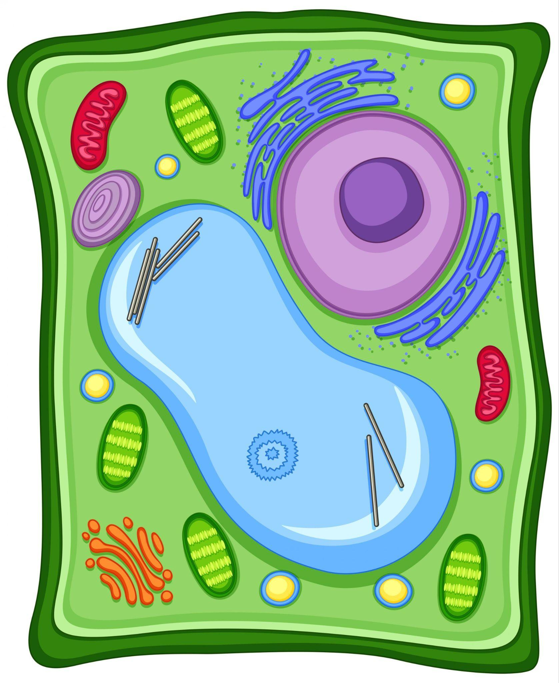
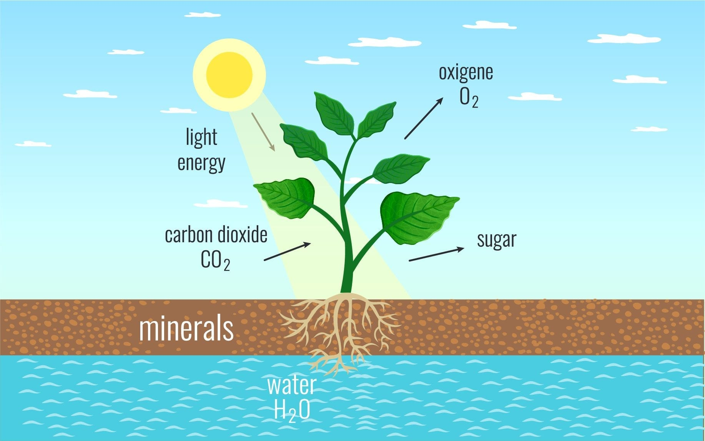
Directions: Choose the correct picture of photosynthesis from the choices below.
A
B
C
D
Notes:
Choose the one correct picture of photosynthesis from these four choices.

Slide 56
Directions: Choose the correct picture of photosynthesis from the choices below.
A
B
C
D
Notes:
This is the picture that shows photosynthesis.

Slide 57
Definition
Picture
Photosynthesis
Example
How does photosynthesis impact my life?
Notes:
Here is the Frayer model filled in with a picture of photosynthesis.

Slide 58
Directions: Choose the correct definition of photosynthesis from the choices below.
A
How water freezes, melts, and evaporates
B
The process of human bodies breathing oxygen
C
How animals breathe underwater
D
The process that green plants use to make their own food
Notes:
Choose the one correct definition of photosynthesis from these four choices.

Slide 59
Directions: Choose the correct definition of photosynthesis from the choices below.
A
How water freezes, melts, and evaporates
B
The process of human bodies breathing oxygen
C
How animals breathe underwater
D
The process that green plants use to make their own food
Notes:
“The process that green plants use to make their own food is correct” is correct! This is the definition of photosynthesis.

Slide 60
Definition
Picture
The process that green plants use to make their own food
Photosynthesis
Example
How does photosynthesis impact my life?
Notes:
Here is the Frayer Model with a picture and the definition filled in for photosynthesis: the process that green plants use to make their own food.

Slide 61
Directions: Choose the correct example of photosynthesis from the choices below.
A
A baby crawling for the first time
B
A daisy making its own food
C
A fish swimming in a lake
D
A bird flying in the sky
Notes:
Choose the one correct example of photosynthesis from these four choices.

Slide 62
Directions: Choose the correct example of photosynthesis from the choices below.
A
A baby crawling for the first time
B
A daisy making its own food
C
A fish swimming in a lake
D
A bird flying in the sky
Notes:
“A daisy making its own food” is correct! This is an example of photosynthesis.

Slide 63
Definition
Picture
The process that green plants use to make their own food
Photosynthesis
A daisy making its own food
Example
How does photosynthesis impact my life?
Notes:
Here is the Frayer Model with a picture, definition, and an example of photosynthesis: A daisy making its own food.

Slide 64
Directions: Choose the correct response for “how does photosynthesis impact my life?” from the choices below.
A
Photosynthesis makes food for plants. We eat plants as food or use them for other things like medicine in our daily lives.
B
Photosynthesis explains how we use light energy in our daily lives including light bulbs and other uses.
C
Photosynthesis makes sure we always take flattering photographs.
Photosynthesis is the process of using photos to make film, which we use for movies and television shows that keep us entertained and informed.
D
Notes:
Choose the one correct response for “how does photosynthesis impact my life?” from these four choices.

Slide 65
Directions: Choose the correct response for “how does photosynthesis impact my life?” from the choices below.
A
Photosynthesis makes food for plants. We eat plants as food or use them for other things like medicine in our daily lives.
B
Photosynthesis explains how we use light energy in our daily lives including light bulbs and other uses.
C
Photosynthesis makes sure we always take flattering photographs.
Photosynthesis is the process of using photos to make film, which we use for movies and television shows that keep us entertained and informed.
D
Notes:
“Photosynthesis makes food for plants. We eat plants as food or use them for other things like medicine in our daily lives.” That is correct! This is an example of how photosynthesis impacts your life.

Slide 66
Definition
Picture
The process that green plants use to make their own food
Photosynthesis
A daisy making its own food
Photosynthesis makes food for plants. We eat plants as food or use them for other things like medicine in our daily lives.
Example
How does photosynthesis impact my life?
Notes:
Here is the Frayer Model with a picture, definition, example, and a correct response to “how does photosynthesis impact my life?”: Photosynthesis makes food for plants. We eat plants as food or use them for other things like medicine in our daily lives.

Slide 67
Remember!!!
Notes:
So remember!

Slide 68
Photosynthesis: the process that green plants use to make their own food
Notes:
Photosynthesis is the process that green plants use to make their own food.

Slide 69
Big Question: What do plants need to survive?
Notes:
Let’s reflect once more on our big question. Our “big question” is: What do plants need to survive?
Does anyone have any additional examples to share that haven’t been discussed yet?

Slide 70
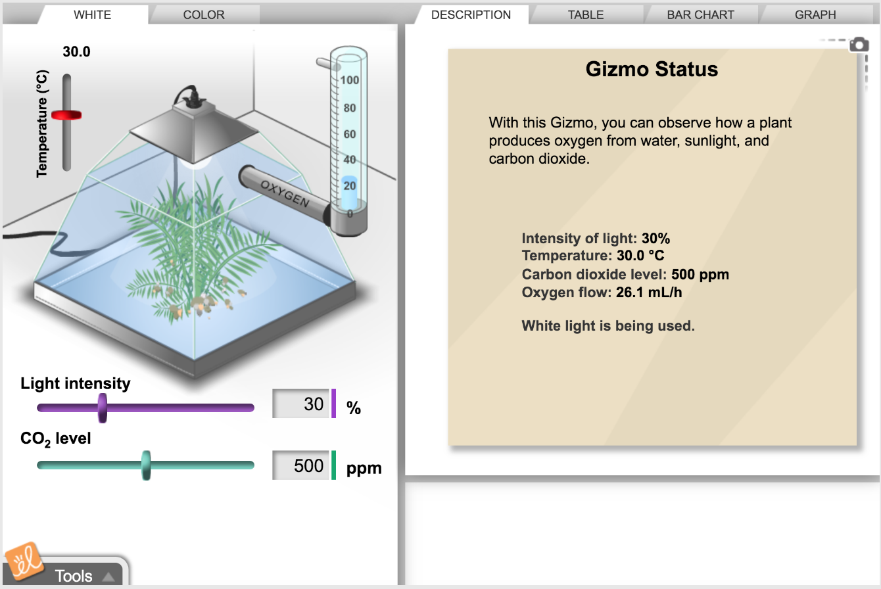
Simulation Activity
Photosynthesis Lab
(Gizmos)
Click the link above for a simulation to deepen your understanding of photosynthesis.
Notes:
Click the link above for a simulation to deepen your understanding of photosynthesis.
Feedback: Providing a simulation activity is a great way to make science thinking visible. In this simulation, students have the opportunity to make predictions and apply an idea to a new situation by changing the variables in the simulation (i.e., light intensity).

Slide 71
Notes:
Thanks for watching, and please continue watching CAPs available from this website.

Slide 72
This Was Created With Resources From:
Questions or Comments
Michael Kennedy, Ph.D. MKennedy@Virginia.edu
Rachel L Kunemund, Ph.D. rk8vm@virginia.edu

