Slide 1
Intro
“Big Idea” Question
Review Concepts
Check-In Questions
Teacher Engagement
Vocabulary
Student-Friendly Definition
Examples & Non-Examples
Morphological Word Parts
Frayer Model
Simulation/Activity
Notes:
OK everyone, get ready for our next lesson. Just as a reminder, these are the different components that our lesson may include, and you’ll see these icons in the top left corner of each slide so that you can follow along more easily!

Slide 2
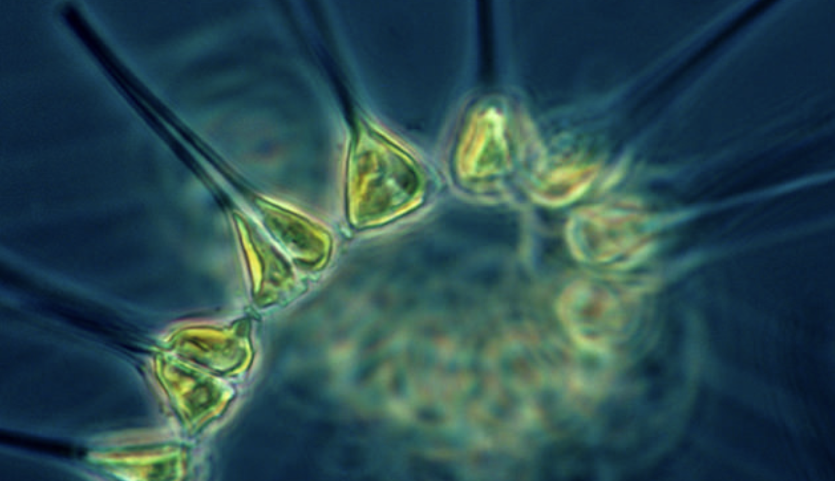
Intro
Phytoplankton
Notes:
Today, we’ll be learning about the word: Phytoplankton.
Image Source: https://oceanservice.noaa.gov/facts/phyto.html

Slide 3
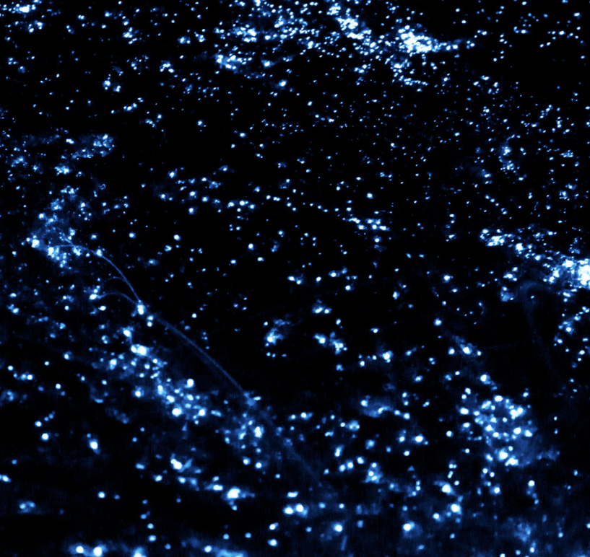
Big Question: How does the world of plankton, play an important role in helping life in the ocean and influencing the health of our entire planet?
Notes:
Our “big question” is: Big Question: How does the world of plankton, play an important role in helping life in the ocean and influencing the health of our entire planet
[Pause and illicit predictions from students.]
I love all these thoughtful scientific hypotheses! Be sure to keep this question and your predictions in mind as we move through these next few lessons, and we’ll continue to revisit it.

Slide 4
Notes:
Before we move on to our new topic, let’s review some other words & concepts that you already learned and make sure you are firm in your understanding.

Slide 5
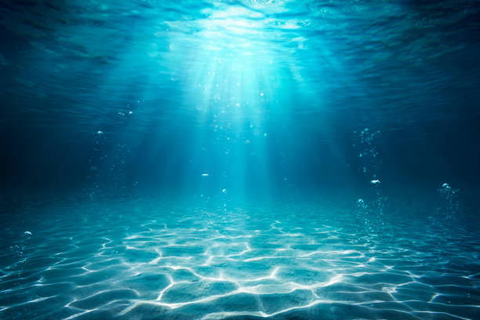
Aquatic: living, growing, or often found in the water
Notes:
Aquatic means something living, growing, or often found in water.

Slide 6
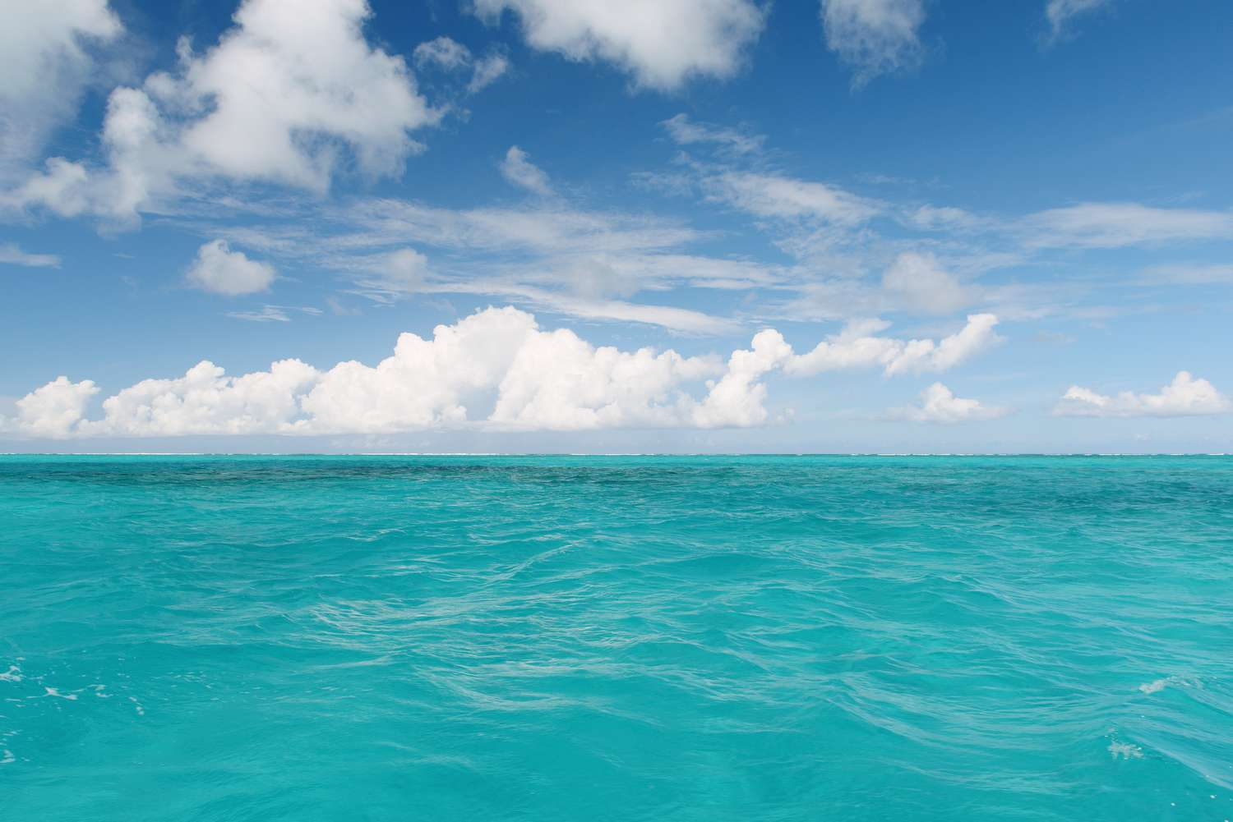
Ocean: A giant body of saltwater.
Notes:
An ocean is a giant body of saltwater.

Slide 7
Organism: any living thing
Notes:
An organism is any living thing.

Slide 8
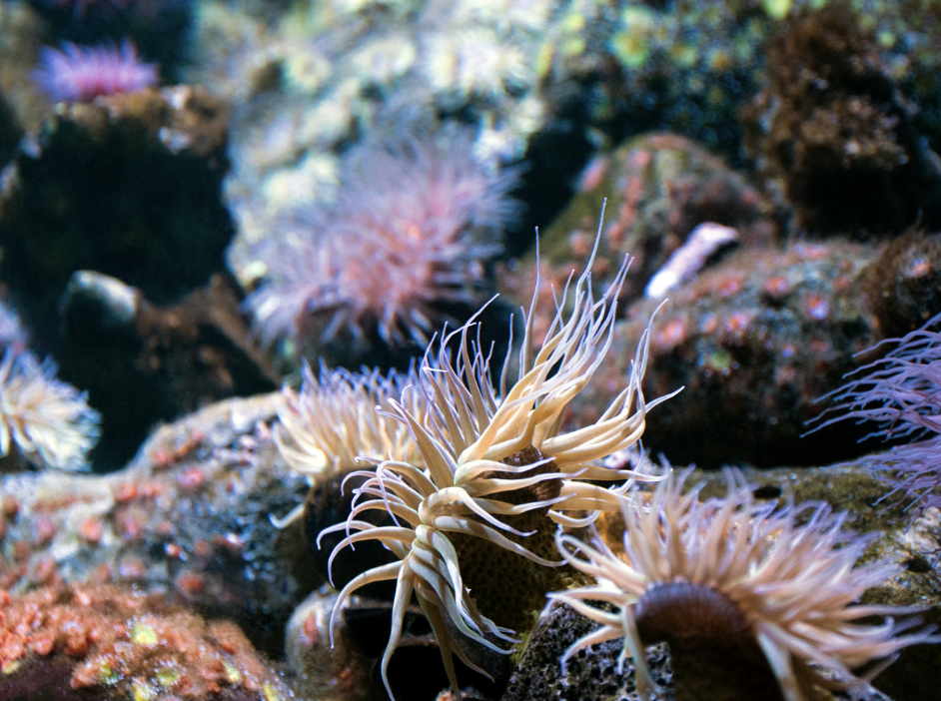
Marine Organism: any living thing that lives in the ocean
Notes:
Marine Organism: any living thing that lives in the ocean

Slide 9
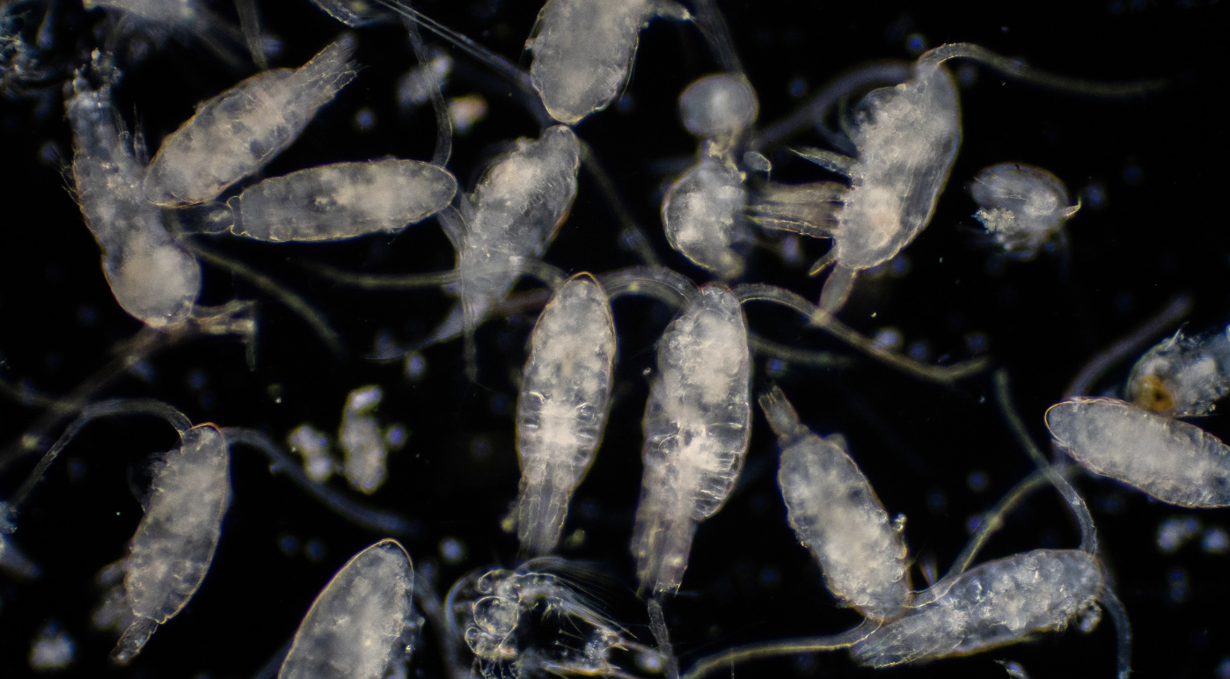
Plankton: tiny organisms that float or drift in the water
Notes:
Plankton: tiny organisms that float or drift in the water

Slide 10
Notes:
Now let’s pause for a moment to review the information we have covered already.

Slide 11
Aquatic means living, growing, or often found in/on…
land
water
Notes:
Aquatic means living, growing, or often found in/on…
[water]

Slide 12
Aquatic means living, growing, or often found in/on…
land
water
Notes:
Aquatic means living, growing, or often found in/on…
[water]

Slide 13
True or False: An ocean is a giant body of fresh water.
Notes:
True or False: An ocean is a giant body of fresh water.
[False]

Slide 14
True or False: An ocean is a giant body of fresh water.
Notes:
False: An ocean is a giant body of saltwater.

Slide 15
Organism: any thing
Notes:
An organism is any thing.
[living]

Slide 16
Organism: any thing
Notes:
Organism: any living thing.

Slide 17
True or False: a marine organism is any living thing that lives on land
Notes:
True or False: a marine organism is any living thing that lives on land
[false]

Slide 18
True or False: a marine organism is any living thing that lives on land
Notes:
False: a marine organism is any living thing that lives in the ocean

Slide 19
Plankton: organisms that float or drift in the water
Notes:
Plankton: organisms that float or drift in the water
[tiny]

Slide 20
Plankton: tiny organisms that float or drift in the water
Notes:
Plankton: tiny organisms that float or drift in the water

Slide 21
Phytoplankton
Notes:
Now that we’ve reviewed, let’s define the term phytoplankton.

Slide 22
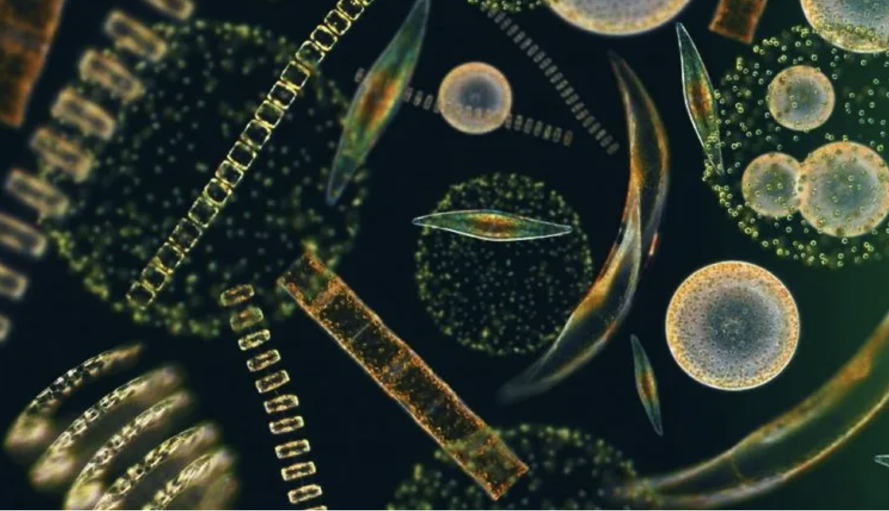
Phytoplankton: tiny plant-like organisms that float or drift in the water
Notes:
Phytoplankton: tiny plant-like organisms that float or drift in the water
Image Source: https://planktonforhealth.co.uk/worlds-finest-marine-phytoplankton-powder/whats-definition-phytoplankton/

Slide 23
Notes:
Let’s check-in for understanding.

Slide 24
What are phytoplankton?
Notes:
What are phytoplankton?
[tiny plant-like organisms that float or drift in the water]

Slide 25
Notes:
That is the basic definition, but there is a bit more you need to know.

Slide 26
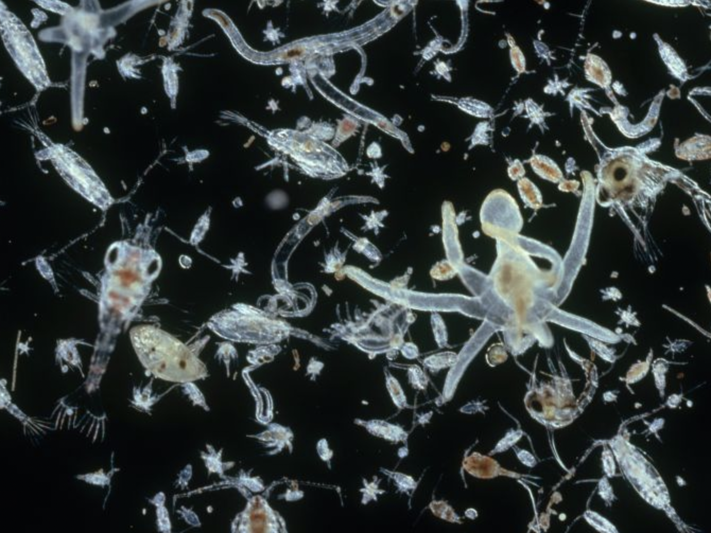
Plankton is a collective term for a diverse community of tiny organisms that live in the ocean. These organisms include both plants and animals.
Notes:
Plankton is a collective term for a diverse community of tiny organisms that live in the ocean. These organisms include both plants and animals.
Image Source: IMAGE BY DR. D. P. WILSON/SCIENCE SOURCE

Slide 27
Phytoplankton are tiny plant-like organisms that harness the power of sunlight to produce their own food through a process called photosynthesis.
Notes:
Phytoplankton are tiny plant-like organisms that harness the power of sunlight to produce their own food through a process called photosynthesis.
Image Source: Collage adapted from drawings and micrographs by Sally Bensusen, NASA EOS Project Science Office

Slide 28
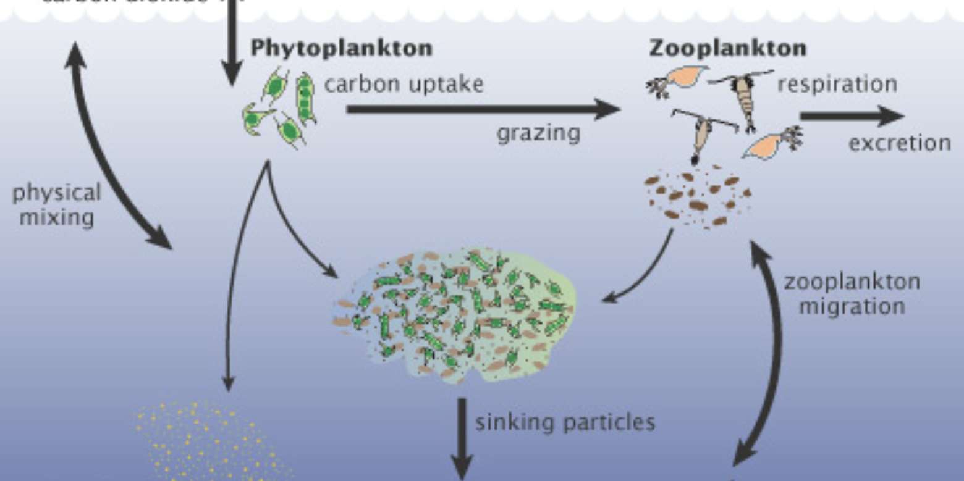
Phytoplankton are the primary producers in the ocean. They produce oxygen and serve as an important source of energy for other organisms.
Notes:
Phytoplankton are the primary producers in the ocean. They produce oxygen and serve as an important source of energy for other organisms.
Image Source: Illustration adapted from A New Wave of Ocean Science, U.S. JGOFS

Slide 29
Notes:
Let’s check-in for understanding.

Slide 30
Plankton includes both plants and .
Notes:
Plankton includes both plants and .
[animals]
Image Source: IMAGE BY DR. D. P. WILSON/SCIENCE SOURCE

Slide 31
Plankton includes both plants and animals.
Notes:
Plankton is a collective term for a diverse community of tiny organisms that live in the ocean. These organisms include both plants and animals.
Image Source: IMAGE BY DR. D. P. WILSON/SCIENCE SOURCE

Slide 32
True of False: Phytoplankton eat other animals and plants to stay alive.
Notes:
True of False: Phytoplankton eat other animals and plants to stay alive.
[False]
Image Source: Collage adapted from drawings and micrographs by Sally Bensusen, NASA EOS Project Science Office

Slide 33
True of False: Phytoplankton eat other animals and plants to stay alive.
Notes:
False: Phytoplankton harness the power of sunlight to produce their own food through a process called photosynthesis.
Image Source: Collage adapted from drawings and micrographs by Sally Bensusen, NASA EOS Project Science Office

Slide 34
Notes:
Now, let’s talk about some examples of phytoplankton.

Slide 35
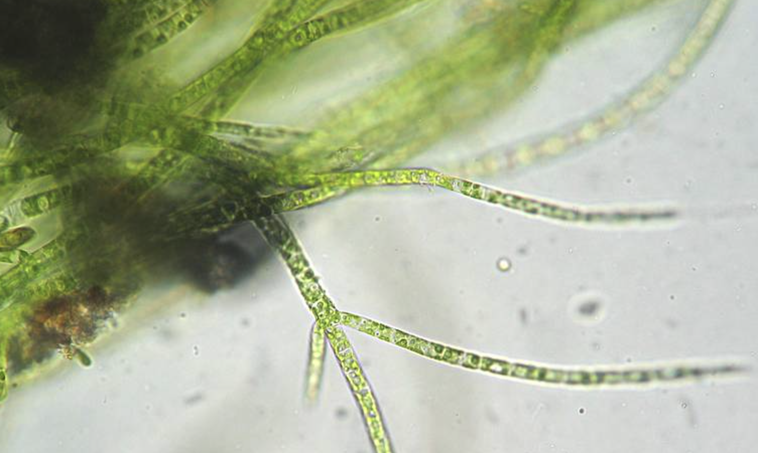
Green algae is an example of phytoplankton. Green algae are tiny floating plants in the water that make food from sunlight, drift in the water, and are important for sea creatures to eat.
Notes:
Green algae is an example of phytoplankton. Green algae are tiny floating plants in the water that make food from sunlight, drift in the water, and are important for sea creatures to eat.
Image Source:

Slide 36
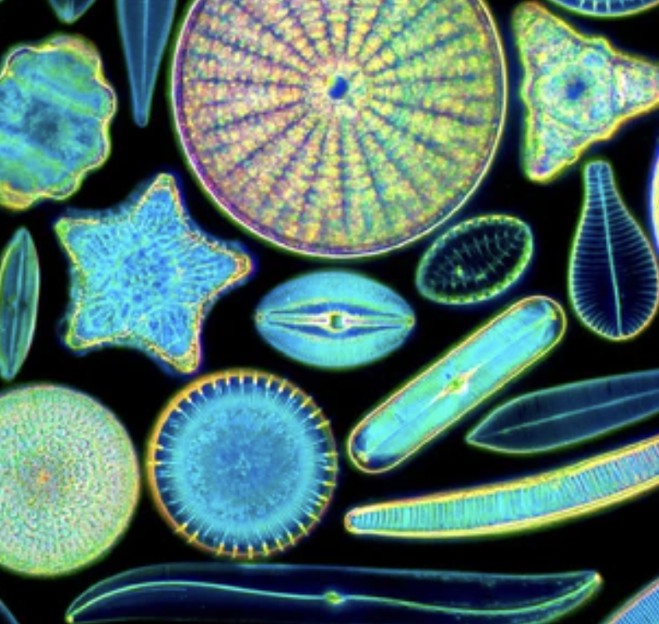
Diatoms are another example of phytoplankton. Diatoms are tiny single-celled algae.
Notes:
Diatoms are another example of phytoplankton. Diatoms are tiny single-celled algae.
Image source: https://moticmicroscopes.com/blogs/articles/diatoms-nature-s-jewels-viewed-with-a-microscope

Slide 37
Notes:
Now, let’s talk about some non-examples of phytoplankton.

Slide 38
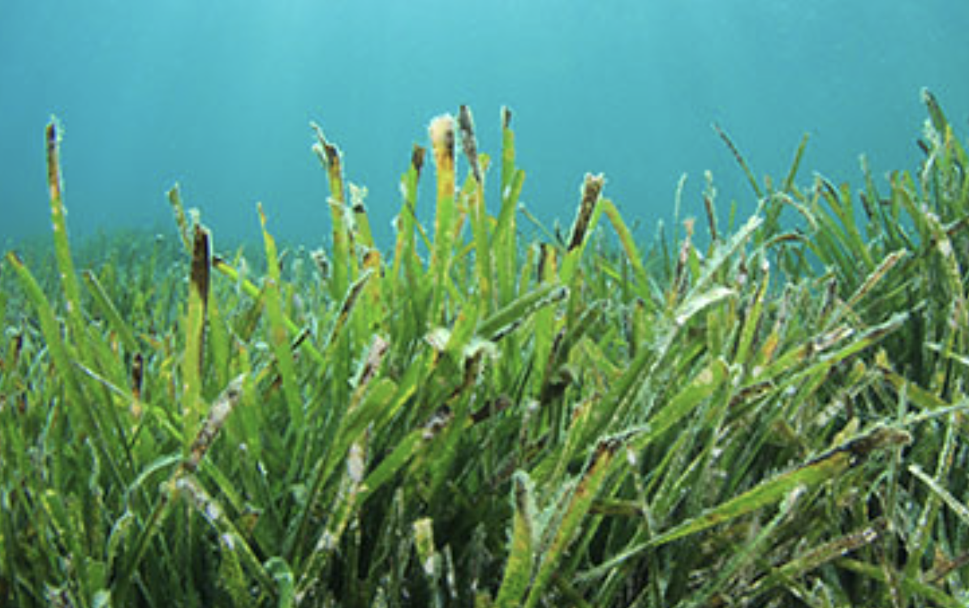
Seagrasses are NOT an example of phytoplankton. Seagrasses are flowering plants that grow in marine environments but are not phytoplankton. They are rooted in the sediment and have a different life cycle.
Notes:
Seagrasses are NOT an example of phytoplankton. Seagrasses are flowering plants that grow in marine environments but are not phytoplankton. They are rooted in the sediment and have a different life cycle.
Image Source: https://www.nwf.org/en/Educational-Resources/Wildlife-Guide/Plants-and-Fungi/Seagrasses

Slide 39
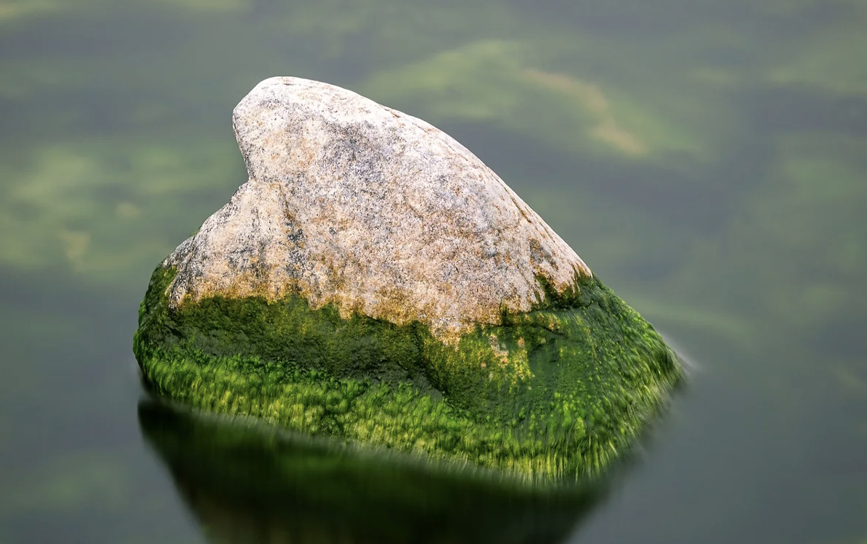
Moss or algae on rocks are also NOT examples of phytoplankton. While these may be algae, they are not phytoplankton. Phytoplankton are characterized by their ability to drift with water currents.
Notes:
Seashells are also NOT an example of plankton. While seashells may drift with ocean currents, they are not living things and, therefore, not plankton.
Image Source: https://www.lakefriendly.ca/post/how-do-algae-affect-water-quality

Slide 40
Notes:
Now let’s pause for a moment to check your understanding.

Slide 41
Why are seagrasses and algae on rocks NOT examples of phytoplankton?
Notes:
Why are seagrasses and algae on rocks NOT examples of phytoplankton?
[They both do not drift in the water and if seagrasses do happen to drift, they are not tiny enough to be considered phytoplankton]

Slide 42
Remember!!!
Notes:
So remember!

Slide 43
Phytoplankton: tiny plant-like organisms that float or drift in the water
Notes:
Phytoplankton: tiny plant-like organisms that float or drift in the water
Image Source: https://planktonforhealth.co.uk/worlds-finest-marine-phytoplankton-powder/whats-definition-phytoplankton/

Slide 44
Notes:
We will now complete this concept map, called a Frayer model, to summarize and further clarify what you have learned about the term phytoplankton.

Slide 45
Definition
Picture
Phytoplankton
Example
How do phytoplankton impact my life?
Notes:
To complete the Frayer model, we will choose from four choices the correct picture, definition, example, and response to the question, “How do phytoplankton impact my life?” Select the best response for each question using the information you just learned. As we select responses, we will see how this model looks filled in for the term phytoplankton.

Slide 46
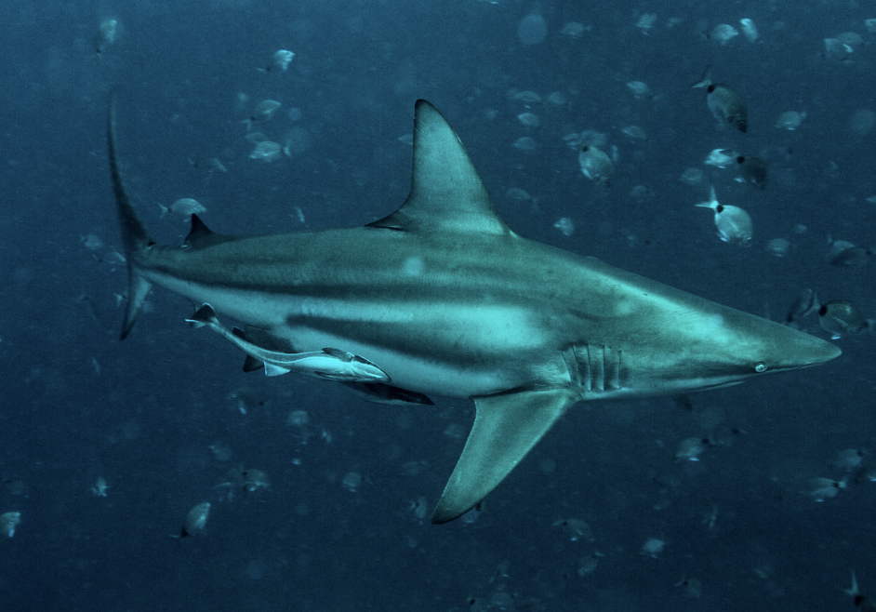
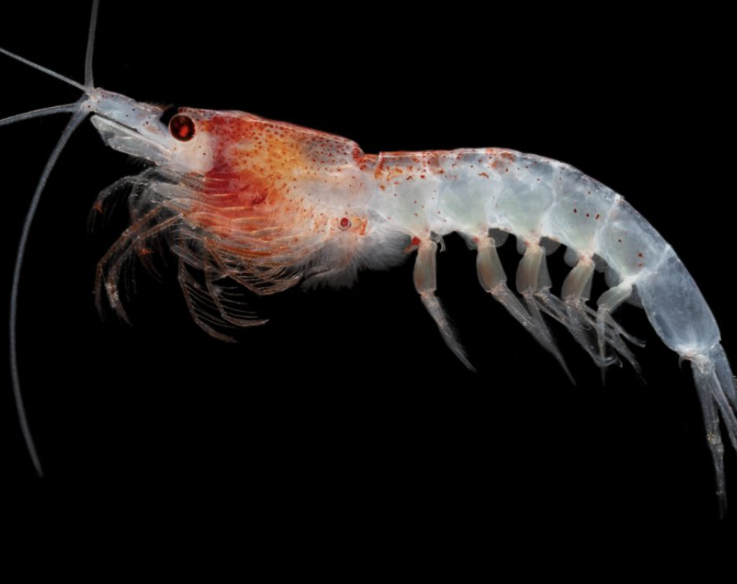
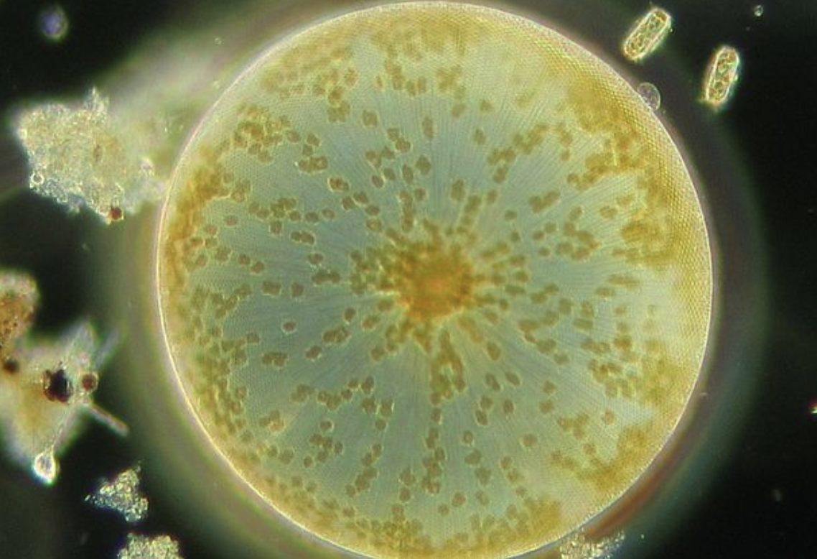
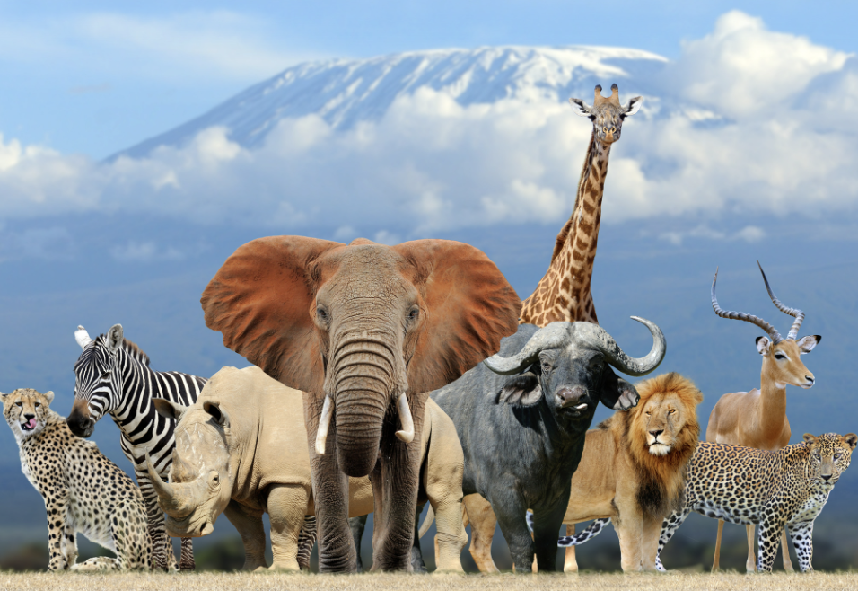
Directions: Choose the correct picture of phytoplankton from the choices below.
A
B
C
D
Notes:
Choose the one correct picture of phytoplankton from these four choices.

Slide 47
Directions: Choose the correct picture of phytoplankton from the choices below.
A
B
C
D
Notes:
Correct! This is a picture of phytoplankton.

Slide 48
Definition
Picture
Phytoplankton
Example
How do phytoplankton impact my life?
Notes:
Here is the Frayer Model with a picture of phytoplankton.

Slide 49
Directions: Choose the correct definition of plankton from the choices below.
A
Tiny plant-like organisms that float or drift in the water
B
Any living thing that lives in the ocean
C
A natural, large body of water surrounded by land
D
Any living thing
Notes:
Choose the correct definition of phytoplankton from the choices below.

Slide 50
Directions: Choose the correct definition of plankton from the choices below.
A
Tiny plant-like organisms that float or drift in the water
B
Any living thing that lives in the ocean
C
A natural, large body of water surrounded by land
D
Any living thing
Notes:
“Tiny plant-like organisms that float or drift in the water” is correct! This is the definition of phytoplankton.

Slide 51
Definition
Picture
Tiny plant-like organisms that float or drift in the water
Phytoplankton
Example
How do phytoplankton impact my life?
Notes:
Here is the Frayer Model with a picture and the definition filled in for phytoplankton : Tiny plant-like organisms that float or drift in the water

Slide 52
Directions: Choose the correct example of plankton from the choices below.
A
Copepods
B
Whales
C
Green Algae
D
Fish
Notes:
Choose the correct example of phytoplankton from the choices below.

Slide 53
Directions: Choose the correct example of plankton from the choices below.
A
Copepods
B
Whales
C
Green Algae
D
Fish
Notes:
“Green Algae” is correct! This is an example of phytoplankton.

Slide 54
Definition
Picture
Tiny plant-like organisms that float or drift in the water
Phytoplankton
Green Algae
Example
How do phytoplankton impact my life?
Notes:
Here is the Frayer Model with a picture, definition, and an example of phytoplankton: Green Algae

Slide 55
Directions: Choose the correct response for “How do phytoplankton impact my life?” from the choices below.
A
Phytoplankton build underwater habitats for marine organisms and that makes me happy.
B
Phytoplankton make the Wi-Fi we use to access the internet
C
Phytoplankton help make a lot of the oxygen we breathe.
D
Phytoplankton help us to learn how to drive.
Notes:
Choose the one correct response for “how do phytoplankton impact my life?” from these four choices.

Slide 56
Directions: Choose the correct response for “How do phytoplankton impact my life?” from the choices below.
A
Phytoplankton build underwater habitats for marine organisms and that makes me happy.
B
Phytoplankton make the Wi-Fi we use to access the internet
C
Phytoplankton help make a lot of the oxygen we breathe.
D
Phytoplankton help us to learn how to drive.
Notes:
“Phytoplankton help make a lot of the oxygen we breathe.” That is correct! This is an example of how phytoplankton impact your life.

Slide 57
Definition
Picture
Tiny plant-like organisms that float or drift in the water
Phytoplankton
Phytoplankton help make a lot of the oxygen we breathe.
Green Algae
Example
How do phytoplankton impact my life?
Notes:
Here is the Frayer Model with a picture, definition, example, and a correct response to “how do phytoplankton impact my life?”: Phytoplankton help make a lot of the oxygen we breathe.

Slide 58
Remember!!!
Notes:
So remember!

Slide 59
Phytoplankton: tiny plant-like organisms that float or drift in the water
Notes:
Phytoplankton: tiny plant-like organisms that float or drift in the water
Image Source: https://planktonforhealth.co.uk/worlds-finest-marine-phytoplankton-powder/whats-definition-phytoplankton/

Slide 60
Big Question: How does the world of plankton, play an important role in helping life in the ocean and influencing the health of our entire planet?
Notes:
Our “big question” is: How does the world of plankton, play an important role in helping life in the ocean and influencing the health of our entire planet?
Does anyone have any additional examples to share that haven’t been discussed yet?
I love all these thoughtful scientific hypotheses! Be sure to keep this question and your predictions in mind as we move through these next few lessons, and we’ll continue to revisit it.

Slide 61
Notes:
Thanks for watching, and please continue watching CAPs available from this website.

Slide 62
This Was Created With Resources From:
Questions or Comments
Michael Kennedy, Ph.D. MKennedy@Virginia.edu
Rachel L Kunemund, Ph.D. rk8vm@virginia.edu

