Slide 1
Intro
“Big Idea” Question
Review Concepts
Check-In Questions
Teacher Engagement
Vocabulary
Student-Friendly Definition
Examples & Non-Examples
Morphological Word Parts
Frayer Model
Simulation/Activity
Notes:
OK everyone, get ready for our next lesson. Just as a reminder, these are the different components that our lesson may include, and you’ll see these icons in the top left corner of each slide so that you can follow along more easily!

Slide 2
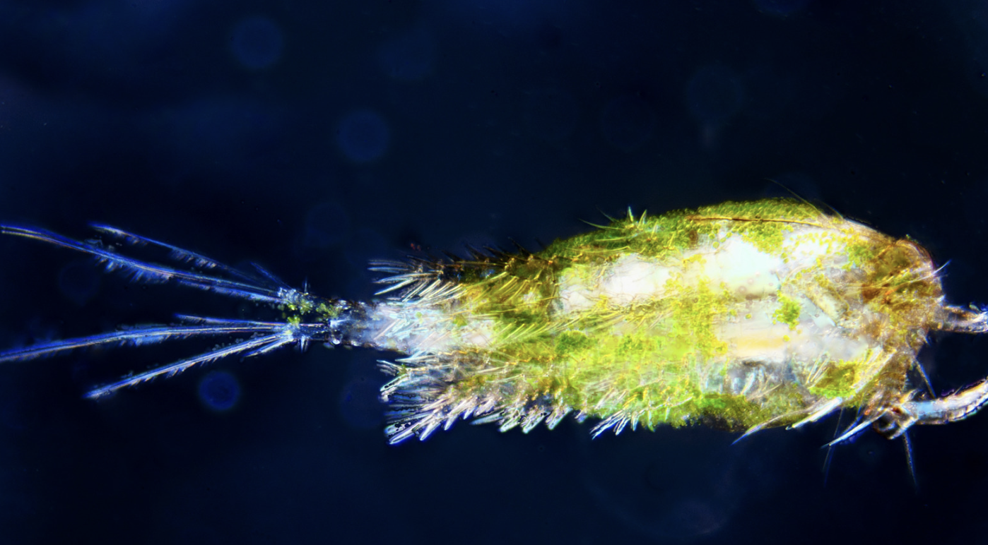
Intro
Plankton
Notes:
Today, we’ll be learning about the word: Plankton.

Slide 3
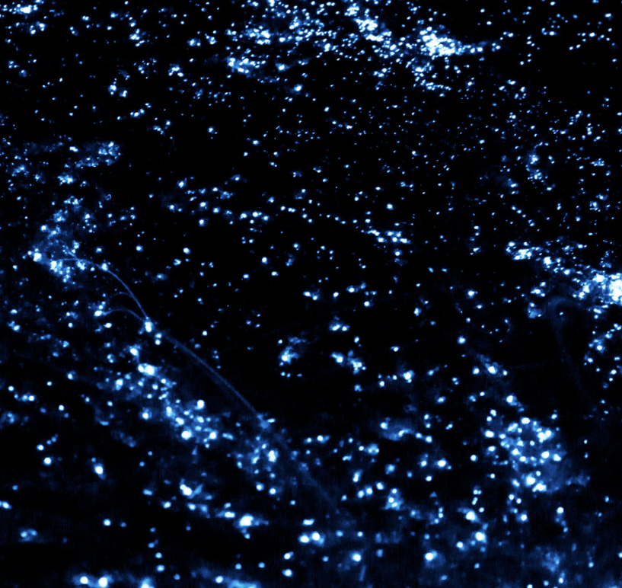
Big Question: How does the world of plankton, play an important role in helping life in the ocean and influencing the health of our entire planet?
Notes:
Our “big question” is: Big Question: How does the world of plankton, play an important role in helping life in the ocean and influencing the health of our entire planet
[Pause and illicit predictions from students.]
I love all these thoughtful scientific hypotheses! Be sure to keep this question and your predictions in mind as we move through these next few lessons, and we’ll continue to revisit it.

Slide 4
Notes:
Before we move on to our new topic, let’s review some other words & concepts that you already learned and make sure you are firm in your understanding.

Slide 5
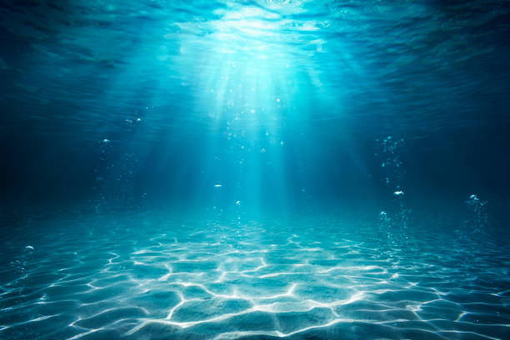
Aquatic: living, growing, or often found in the water
Notes:
Aquatic means something living, growing, or often found in water.

Slide 6
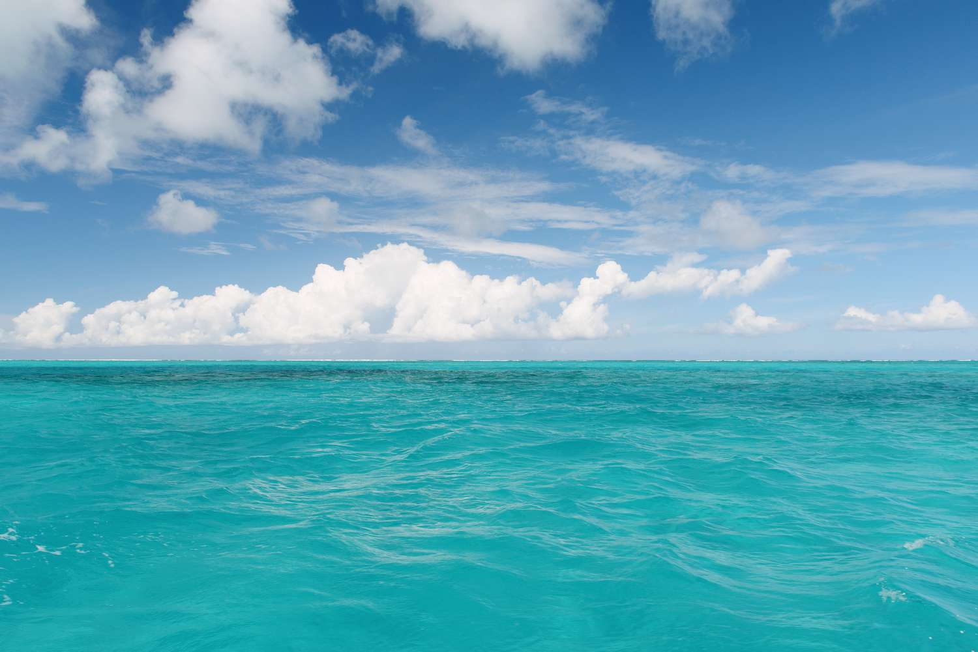
Ocean: A giant body of saltwater.
Notes:
An ocean is a giant body of saltwater.

Slide 7
Organism: any living thing
Notes:
An organism is any living thing.

Slide 8
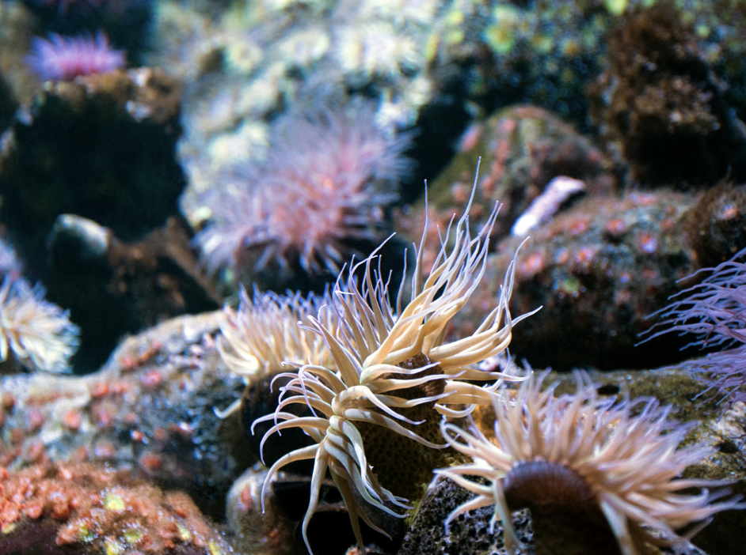
Marine Organism: any living thing that lives in the ocean
Notes:
Marine Organism: any living thing that lives in the ocean

Slide 9
Notes:
Now let’s pause for a moment to review the information we have covered already.

Slide 10
Aquatic means living, growing, or often found in/on…
land
water
Notes:
Aquatic means living, growing, or often found in/on…
[water]

Slide 11
Aquatic means living, growing, or often found in/on…
land
water
Notes:
Aquatic means living, growing, or often found in/on…
[water]

Slide 12
True or False: An ocean is a giant body of fresh water.
Notes:
True or False: An ocean is a giant body of fresh water.
[False]

Slide 13
True or False: An ocean is a giant body of fresh water.
Notes:
False: An ocean is a giant body of saltwater.

Slide 14
Organism: any thing
Notes:
An organism is any thing.
[living]

Slide 15
Organism: any thing
Notes:
Organism: any living thing.

Slide 16
True or False: a marine organism is any living thing that lives on land
Notes:
True or False: a marine organism is any living thing that lives on land
[false]

Slide 17
True or False: a marine organism is any living thing that lives on land
Notes:
False: a marine organism is any living thing that lives in the ocean

Slide 18
Plankton
Notes:
Now that we’ve reviewed, let’s define the term plankton.

Slide 19
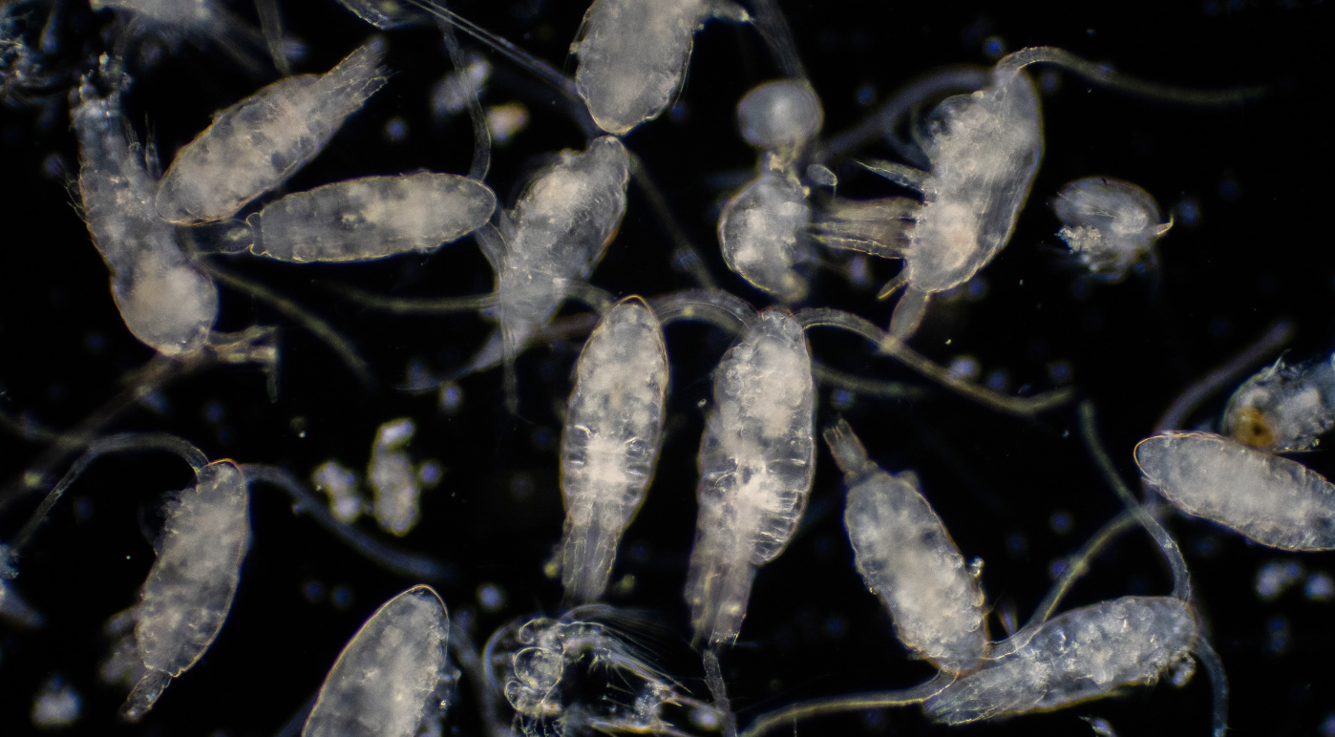
Plankton: tiny organisms that float or drift in the water
Notes:
Plankton: tiny organisms that float or drift in the water

Slide 20
Notes:
Let’s check-in for understanding.

Slide 21
What are plankton?
Notes:
What are plankton?
[tiny organisms that float or drift in the water]

Slide 22
Notes:
That is the basic definition, but there is a bit more you need to know.

Slide 23
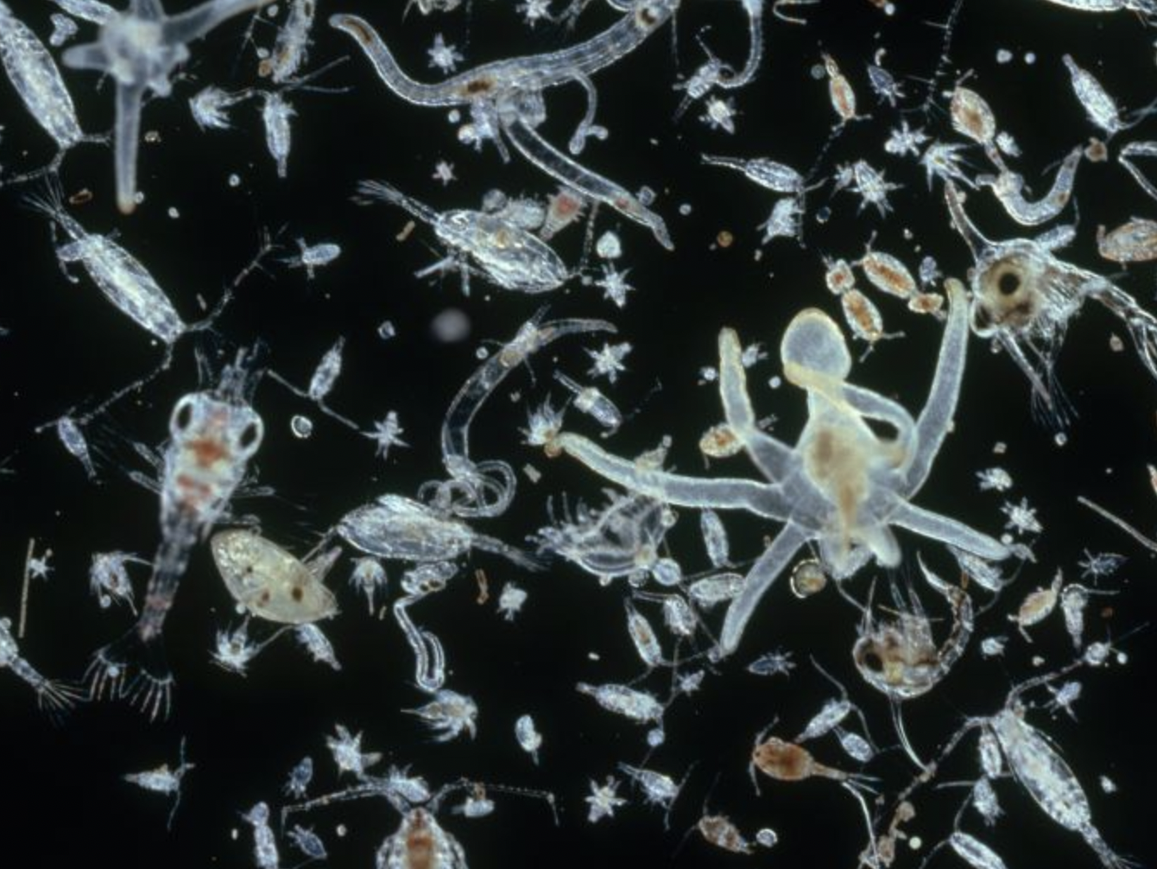
Plankton is a collective term for a diverse community of tiny organisms that live in the ocean. These organisms include both plants and animals.
Notes:
Plankton is a collective term for a diverse community of tiny organisms that live in the ocean. These organisms include both plants and animals.
Image Source: IMAGE BY DR. D. P. WILSON/SCIENCE SOURCE

Slide 24
Phytoplankton are tiny plant-like organisms that harness the power of sunlight to produce their own food through a process called photosynthesis.
Notes:
Phytoplankton are tiny plant-like organisms that harness the power of sunlight to produce their own food through a process called photosynthesis.
Image Source: Collage adapted from drawings and micrographs by Sally Bensusen, NASA EOS Project Science Office

Slide 25
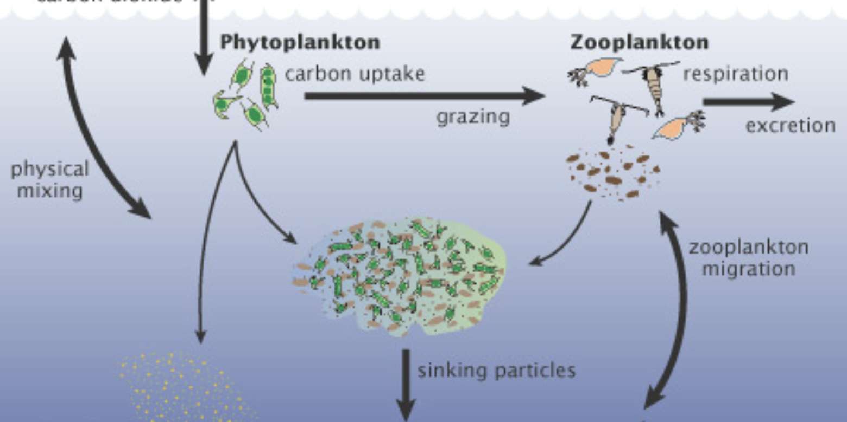
Phytoplankton are the primary producers in the ocean. They produce oxygen and serve as an important source of energy for other organisms.
Notes:
Phytoplankton are the primary producers in the ocean. They produce oxygen and serve as an important source of energy for other organisms.
Image Source: Illustration adapted from A New Wave of Ocean Science, U.S. JGOFS

Slide 26
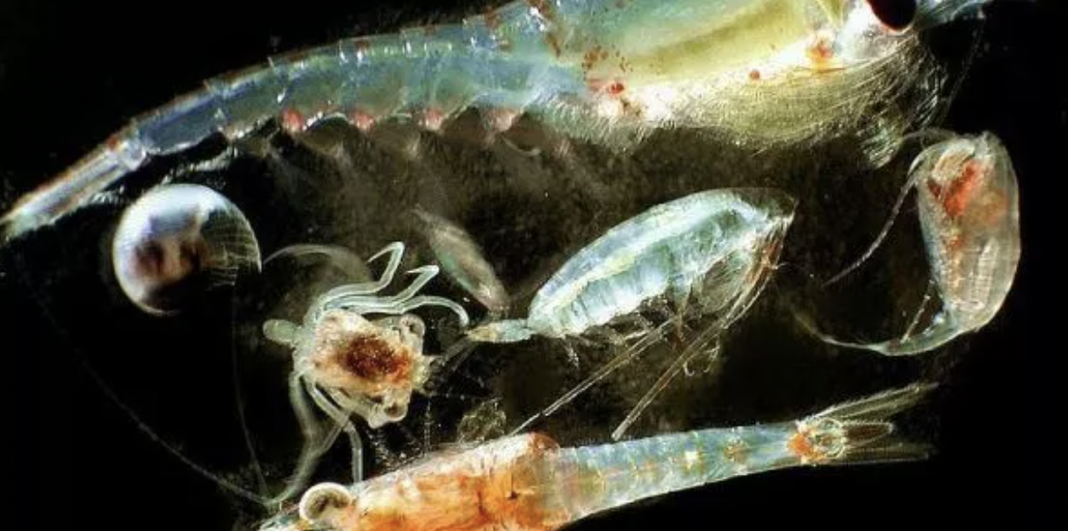
Zooplankton are small animal-like organisms that feed on phytoplankton or other zooplankton.
Notes:
Zooplankton are small animal-like organisms that feed on phytoplankton or other zooplankton.
Image Source: https://biologydictionary.net/zooplankton/

Slide 27
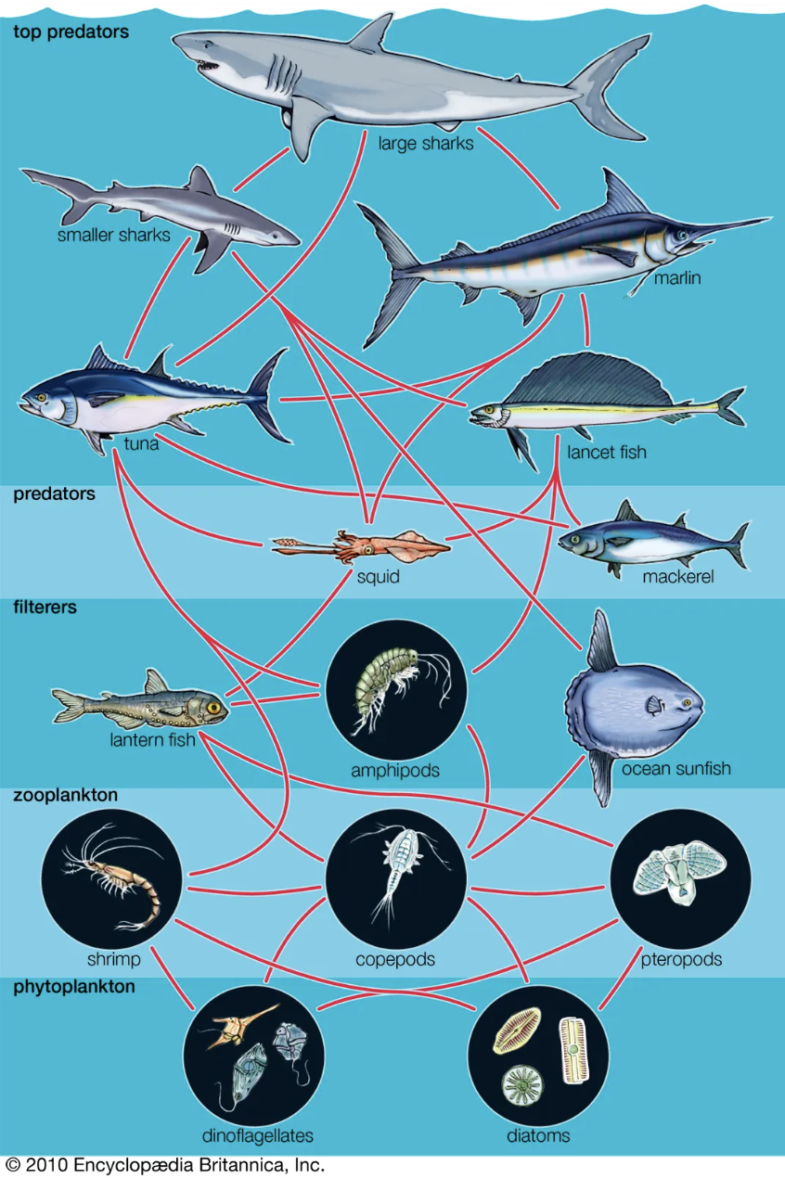
Zooplankton play an important part in controlling the population of phytoplankton and are a key link in transferring energy through the marine food web.
Notes:
Zooplankton play an important part in controlling the population of phytoplankton and are a key link in transferring energy through the marine food web.

Slide 28
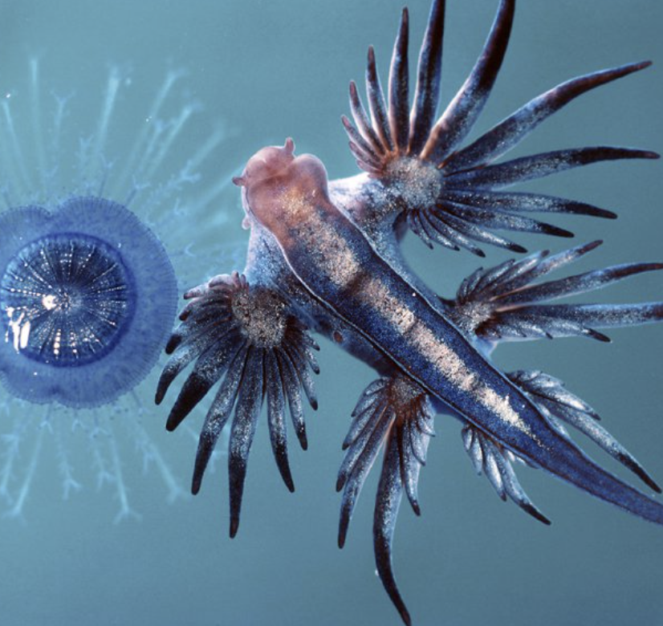
Holoplankton are organisms that spend their entire life cycle as plankton, while meroplankton are organisms that spend only part of their life cycle as plankton before developing into larger forms.
Notes:
Holoplankton are organisms that spend their entire life cycle as plankton, while meroplankton are organisms that spend only part of their life cycle as plankton before developing into larger forms.
Image Source: Blue Sea Slug, Glaucus atlanticus, and Porpita Porpita pacifica. Image: Peter Parks/imagequest3d.com, Peter Parks © Image Quest 3-D

Slide 29
Holoplankton include copepods and krill, while meroplankton include the larval stages of many marine animals like crabs and fish.
Notes:
Holoplankton include copepods and krill, while meroplankton include the larval stages of many marine animals like crabs and fish.
Image Source: https://www.slideserve.com/jacob/life-in-the-sea

Slide 30
Notes:
Let’s check-in for understanding.

Slide 31
True or False: Zooplankton feed on phytoplankton or other zooplankton, while phytoplankton produce their own food.
Notes:
True or False: Zooplankton feed on phytoplankton or other zooplankton, while phytoplankton produce their own food.
[True]

Slide 32
True or False: Zooplankton feed on phytoplankton or other zooplankton, while phytoplankton produce their own food.
Notes:
True: Zooplankton feed on phytoplankton or other zooplankton, while phytoplankton produce their own food.

Slide 33
Holoplankton include:
Copepods and krill
The larval stages of many marine animals like crabs and fish
Whale and dolphins
Notes:
Holoplankton include:
Copepods and krill
The larval stages of many marine animals like crabs and fish
Whale and dolphins
[A. Copepods and krill]
Image Source: https://www.slideserve.com/jacob/life-in-the-sea

Slide 34
Holoplankton include:
Copepods and krill
The larval stages of many marine animals like crabs and fish
Whale and dolphins
Notes:
Holoplankton include:
Copepods and krill
The larval stages of many marine animals like crabs and fish
Whale and dolphins
[A. Copepods and krill]
Image Source: https://www.slideserve.com/jacob/life-in-the-sea

Slide 35
Notes:
Now, let’s talk about some examples of plankton.

Slide 36
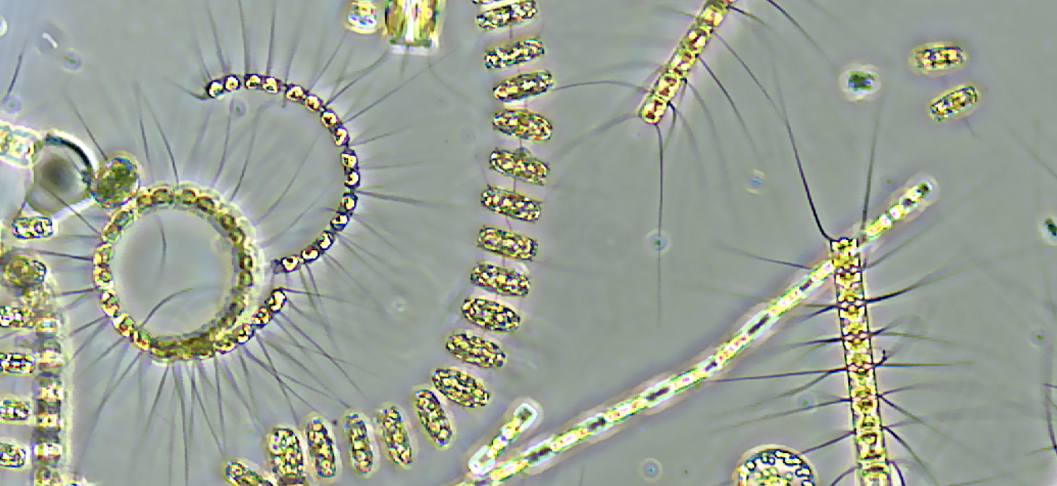
Bacterioplankton is an example of plankton. It is tiny bacteria that float in the water.
Notes:
Bacterioplankton is an example of plankton. It is tiny bacteria that float in the water.
Image Source: NASA. Credits: University of Rhode Island/Stephanie Anderson. - NASA Earth Expeditions

Slide 37
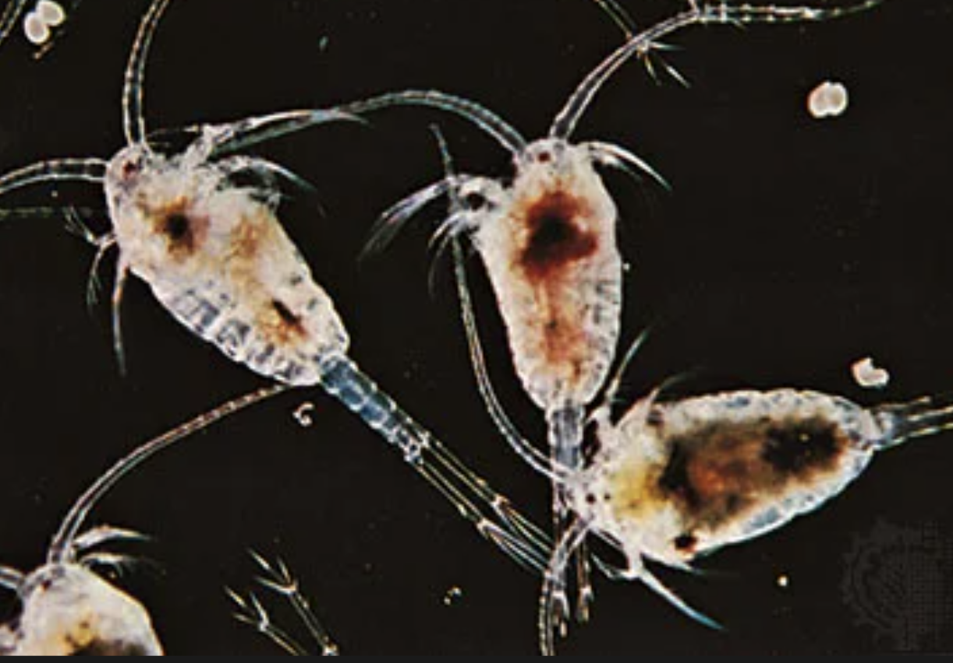
Copepods are another example of plankton, more specifically they are an example of holoplankton. Copepods are small crustaceans.
Notes:
Copepods are another example of plankton, more specifically they are an example of holoplankton. Copepods are small crustaceans.
Image source: Encyclopædia Britannica; https://www.britannica.com/animal/copepod#/media/1/136547/4977

Slide 38
Notes:
Now, let’s talk about some non-examples of plankton.

Slide 39
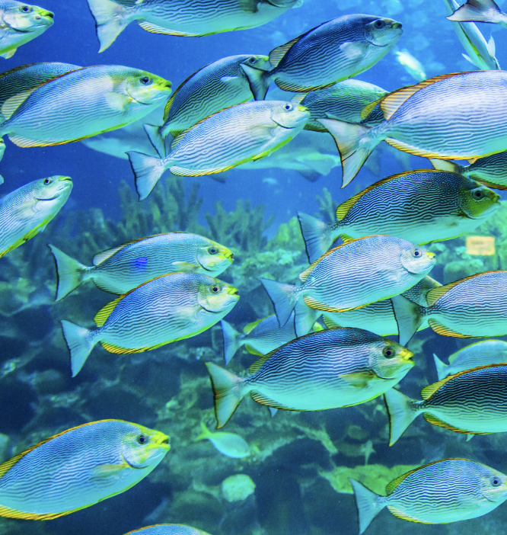
Fish are NOT an example of plankton. Fish are not considered plankton because they are larger organisms that can actively swim against currents.
Notes:
Fish are NOT an example of plankton. Fish are not considered plankton because they are larger organisms that can actively swim against currents.

Slide 40
Seashells are also NOT an example of plankton. While seashells may drift with ocean currents, they are not living things and, therefore, not plankton.
Notes:
Seashells are also NOT an example of plankton. While seashells may drift with ocean currents, they are not living things and, therefore, not plankton.

Slide 41
Notes:
Now let’s pause for a moment to check your understanding.

Slide 42
Why are fish and seashells NOT examples of plankton?
Notes:
Why are fish and seashells NOT examples of plankton?
[fish are too large and seashells are not living]

Slide 43
Remember!!!
Notes:
So remember!

Slide 44
Plankton: tiny organisms that float or drift in the water
Notes:
Plankton: tiny organisms that float or drift in the water

Slide 45
Notes:
We will now complete this concept map, called a Frayer model, to summarize and further clarify what you have learned about the term plankton.

Slide 46
Definition
Picture
Plankton
Example
How do plankton impact my life?
Notes:
To complete the Frayer model, we will choose from four choices the correct picture, definition, example, and response to the question, “How do plankton impact my life?” Select the best response for each question using the information you just learned. As we select responses, we will see how this model looks filled in for the term plankton.

Slide 47
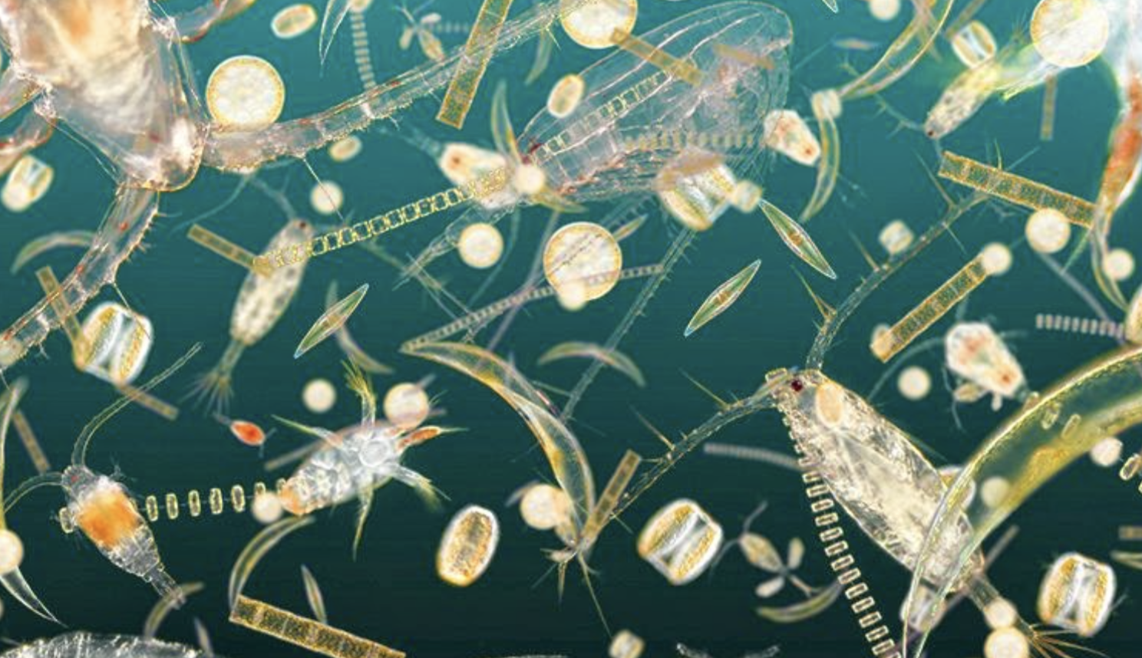
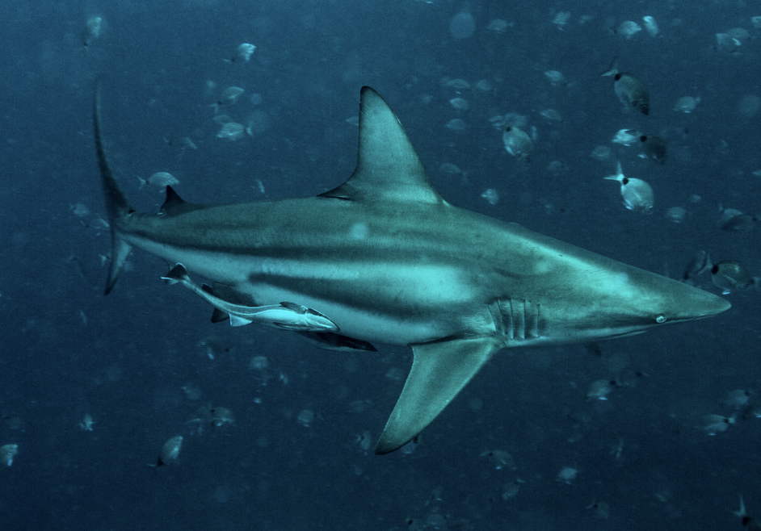
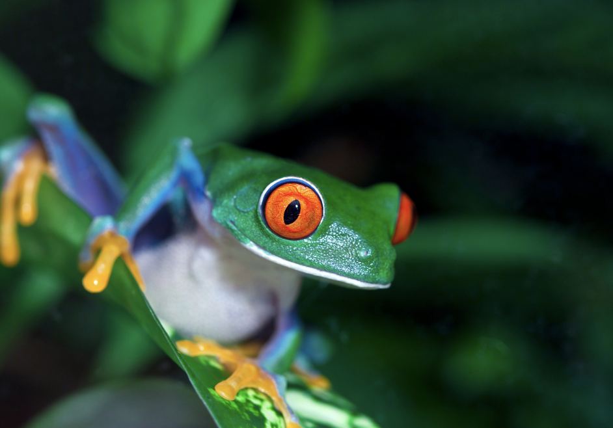
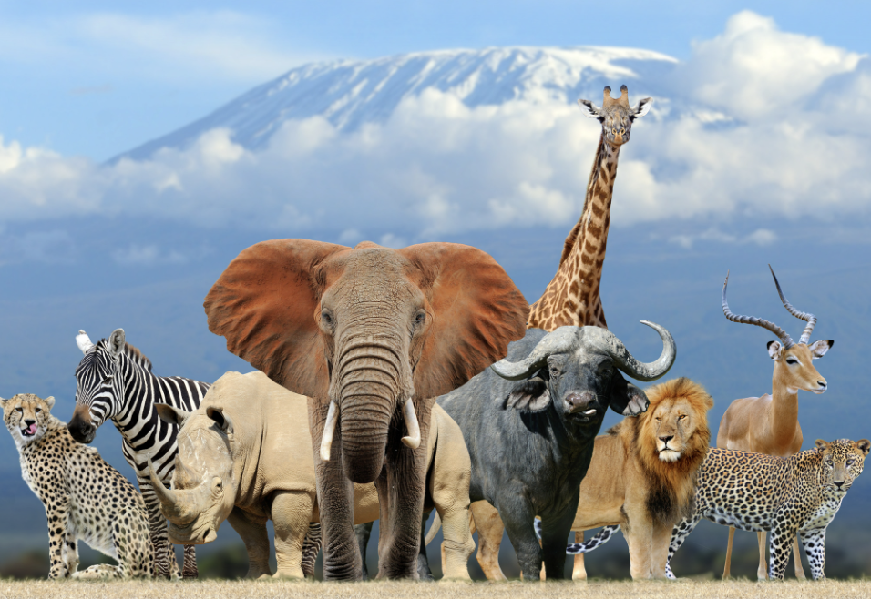
Directions: Choose the correct picture of plankton from the choices below.
A
B
C
D
Notes:
Choose the one correct picture of plankton from these four choices.

Slide 48
Directions: Choose the correct picture of plankton from the choices below.
A
B
C
D
Notes:
Correct! This is a picture of plankton.

Slide 49
Definition
Picture
Plankton
Example
How do plankton impact my life?
Notes:
Here is the Frayer Model with a picture of plankton.

Slide 50
Directions: Choose the correct definition of plankton from the choices below.
A
Any living thing that lives in the ocean
B
A natural, large body of water surrounded by land
C
Tiny organisms that float or drift in the water
D
Any living thing
Notes:
Choose the correct definition of plankton from the choices below.

Slide 51
Directions: Choose the correct definition of plankton from the choices below.
A
Any living thing that lives in the ocean
B
A natural, large body of water surrounded by land
C
Tiny organisms that float or drift in the water
D
Any living thing
Notes:
“Tiny organisms that float or drift in the water” is correct! This is the definition of plankton.

Slide 52
Definition
Picture
Tiny organisms that float or drift in the water
Plankton
Example
How do plankton impact my life?
Notes:
Here is the Frayer Model with a picture and the definition filled in for plankton : Tiny organisms that float or drift in the water

Slide 53
Directions: Choose the correct example of plankton from the choices below.
A
A copepod
B
A whale
C
A tiger
D
A lizard
Notes:
Choose the correct example of plankton from the choices below.

Slide 54
Directions: Choose the correct example of plankton from the choices below.
A
A copepod
B
A whale
C
A tiger
D
A lizard
Notes:
“A copepod” is correct! This is an example of plankton.

Slide 55
Definition
Picture
Tiny organisms that float or drift in the water
Plankton
A copepod
Example
How do plankton impact my life?
Notes:
Here is the Frayer Model with a picture, definition, and an example of plankton: A copepod.

Slide 56
Directions: Choose the correct response for “How do plankton impact my life?” from the choices below.
A
Plankton help us to learn how to drive.
B
Plankton help make the oxygen we breathe.
C
Plankton make the Wi-Fi we use to access the internet
D
Plankton build underwater habitats for marine organisms and that makes me happy.
Notes:
Choose the one correct response for “how do plankton impact my life?” from these four choices.

Slide 57
Directions: Choose the correct response for “How do plankton impact my life?” from the choices below.
A
Plankton help us to learn how to drive.
B
Plankton help make the oxygen we breathe.
C
Plankton make the Wi-Fi we use to access the internet
D
Plankton build underwater habitats for marine organisms and that makes me happy.
Notes:
“Plankton help make the oxygen we breathe.” That is correct! This is an example of how plankton impact your life.

Slide 58
Definition
Picture
Tiny organisms that float or drift in the water
Plankton
A copepod
Plankton help make the oxygen we breathe.
Example
How do plankton impact my life?
Notes:
Here is the Frayer Model with a picture, definition, example, and a correct response to “how do plankton impact my life?”: Plankton help make the oxygen we breathe.

Slide 59
Remember!!!
Notes:
So remember!

Slide 60
Plankton: tiny organisms that float or drift in the water
Notes:
Plankton: tiny organisms that float or drift in the water

Slide 61
Big Question: How does the world of plankton, play an important role in helping life in the ocean and influencing the health of our entire planet?
Notes:
Our “big question” is: How does the world of plankton, play an important role in helping life in the ocean and influencing the health of our entire planet?
Does anyone have any additional examples to share that haven’t been discussed yet?
I love all these thoughtful scientific hypotheses! Be sure to keep this question and your predictions in mind as we move through these next few lessons, and we’ll continue to revisit it.

Slide 62
Notes:
Thanks for watching, and please continue watching CAPs available from this website.

Slide 63
This Was Created With Resources From:
Questions or Comments
Michael Kennedy, Ph.D. MKennedy@Virginia.edu
Rachel L Kunemund, Ph.D. rk8vm@virginia.edu

