Slide 1
Intro
“Big Idea” Question
Review Concepts
Check-In Questions
Teacher Engagement
Vocabulary
Student-Friendly Definition
Examples & Non-Examples
Morphological Word Parts
Frayer Model
Simulation/Activity
Notes:
OK everyone, get ready for our next lesson. Just as a reminder, these are the different components that our lesson may include, and you’ll see these icons in the top left corner of each slide so that you can follow along more easily!

Slide 2
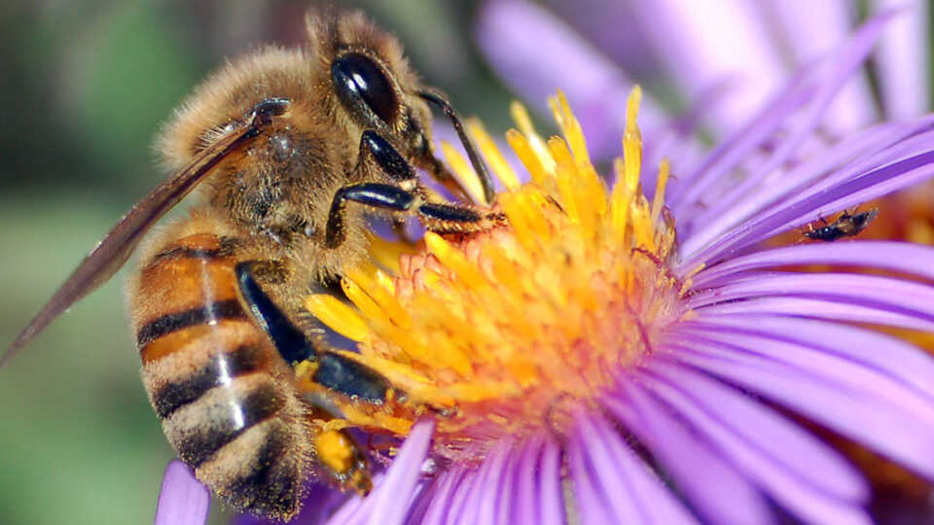
Intro
Pollination
Notes:
Today, we’ll be learning about the word: Pollination.

Slide 3
Big Question: How do plants reproduce?
Notes:
Our “big question” is: How do plants reproduce?
[Pause and illicit predictions from students.]
I love all these thoughtful scientific hypotheses! Be sure to keep this question and your predictions in mind as we move through these next few lessons, and we’ll continue to revisit it.

Slide 4
Notes:
Before we move on to our new topic, let’s review some other words & concepts that you already learned and make sure you are firm in your understanding.

Slide 5
Reproduction: process by which living things create new organisms of their own kind
Notes:
Reproduction is a process by which living things create new organisms of their own kind.

Slide 6
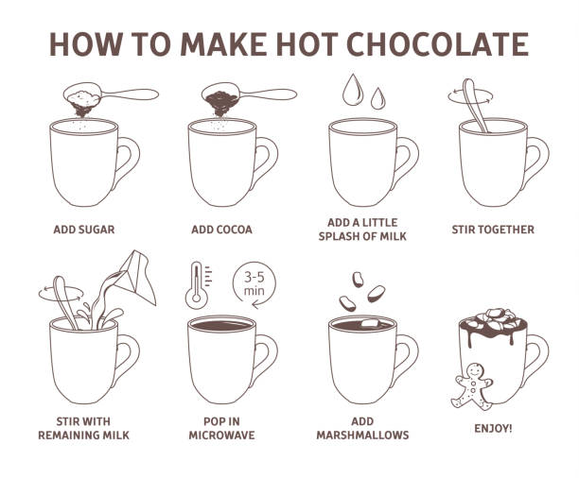
Process: a series of actions.
Notes:
Process is a series of actions. For example making hot chocolate is a process. It takes many actions to make hot chocolate.

Slide 7
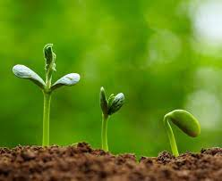
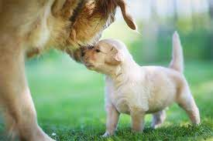
Living Thing: organisms that move, grow, change, and respond to its environment
Notes:
Living things are organisms that grow, change, and respond to its environment.

Slide 8
Notes:
Now let’s pause for a moment to review the information we have covered already.

Slide 9
True or false: Reproduction is a process by which living things create new organisms of their own kind.
True
False
Notes:
True or false: Reproduction is a process by which living things create new organism of their own kind.
[A. True]

Slide 10
True or false: Reproduction is a process by which living things create new organisms of their own kind.
True
False
Notes:
True or false: Reproduction is a process by which living things create new organism of their own kind.
[A. True]

Slide 11
What is another word for a series of actions?
System
Practice
Process
Notes:
What is another word for a series of actions?
[C. Process]

Slide 12
What is another word for a series of actions?
System
Practice
Process
Notes:
What is another word for a series of actions? C. Process

Slide 13
_________ __________ are organisms that move, grow, change, and respond to the environment
Abiotic Factors
Living things
Nonliving things
Notes:
______ _______ are organisms that move, grow, change, and respond to the environment.
[B. Living things]

Slide 14
_________ __________ are organisms that move, grow, change, and respond to the environment
Abiotic Factors
Living things
Nonliving things
Notes:
Living things are organisms that move, grow, change, and respond to the environment.

Slide 15
Pollination
Notes:
Now that we’ve reviewed, let’s define the word pollination.

Slide 16
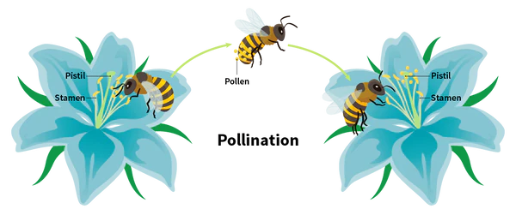
Pollination: the transfer of pollen
Notes:
Pollination is the transfer of pollen.

Slide 17
Notes:
Let’s check-in for understanding.

Slide 18
What is pollination?
Notes:
What is pollination?
[The transfer of pollen.]

Slide 19
Notes:
That is the basic definition, but there is a bit more you need to know.

Slide 20
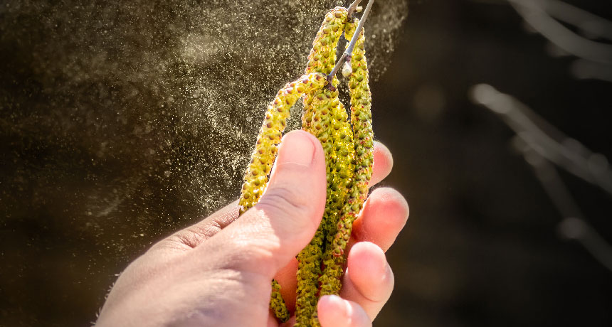
Pollen is a fine powder that causes some plants to form seeds.
Notes:
Pollen is a fine powder that causes some plants to form seeds. Those seeds then help to produce more plants.

Slide 21
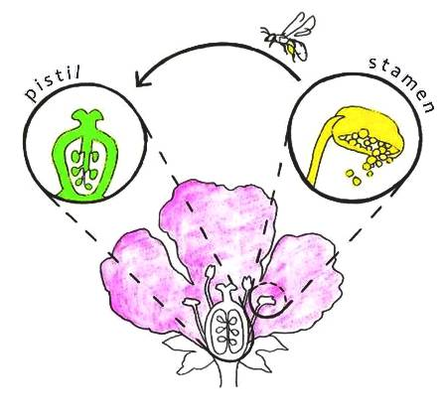
During pollination, pollen is transferred from the stamen to the pistil in a flower.
Notes:
During pollination, pollen is transferred from the stamen to the pistil in a flower. We will cover stamen and pistil in later lessons. For now, just know that the stamen and pistil are reproductive structures in plants.

Slide 22
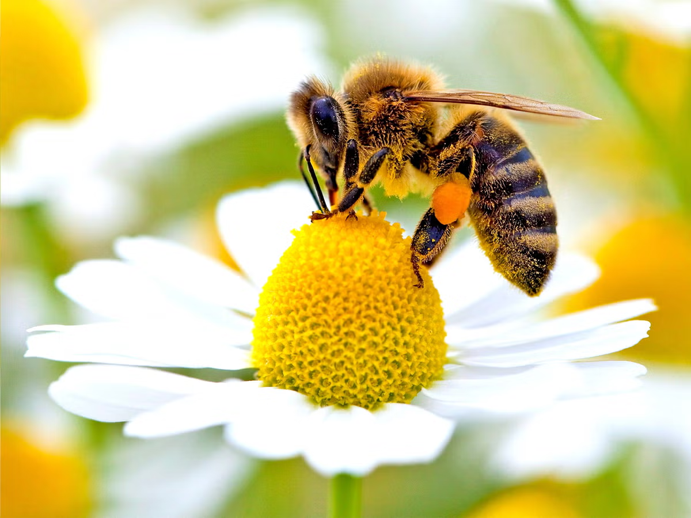
Pollinators help in the pollination process. Bees are the most common pollinators.
Notes:
Pollinators help in the pollination process. Bees are the most common pollinators that are animals. There are other ways that pollination happens…

Slide 23
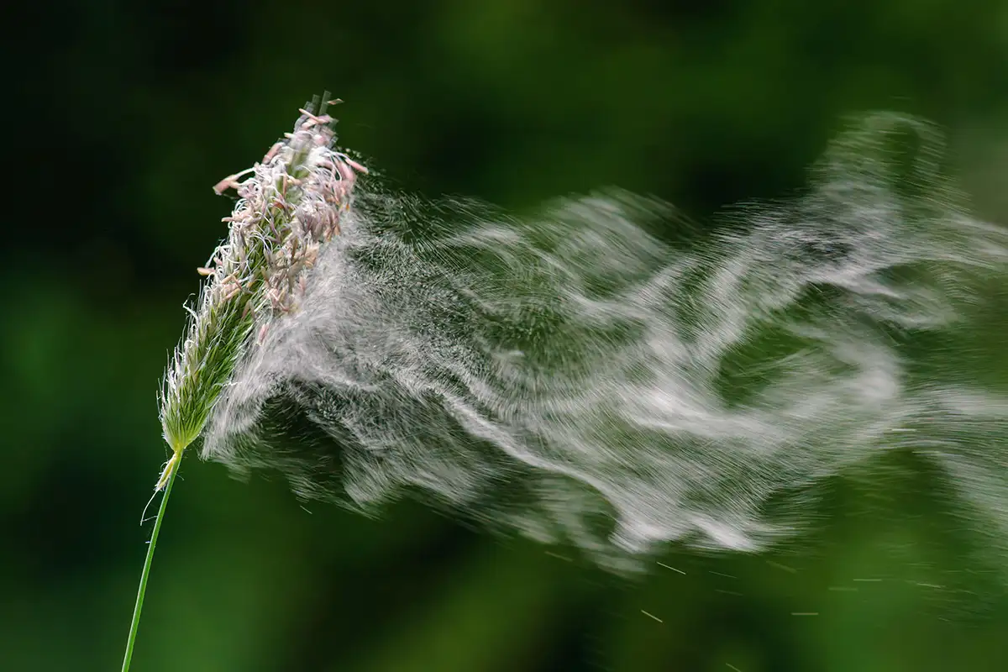
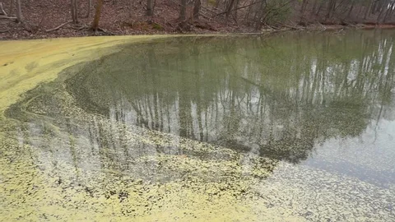
Wind and water can also aid in the pollination process.
Wind
Water
Notes:
Wind and water can also aid in the pollination process.

Slide 24
Notes:
Let’s check-in for understanding.

Slide 25
_______ is a fine powder that causes some plants to form seeds.
Flour
Pollen
Sugar
Notes:
__________ is a fine powder that causes some plants to form seeds.
[B. Pollen]

Slide 26
Pollen is a fine powder that causes some plants to form seeds.
Flour
Pollen
Sugar
Notes:
Pollen is a fine powder that causes some plants to form seeds.
[B. Pollen]

Slide 27
True or false: During pollination, pollen is transferred from the stamen to the pistil in a flower.
True
False
Notes:
True or false: During pollination, pollen is transferred from the stamen to the pistil in a flower..
[A. True]

Slide 28
True or false: During pollination, pollen is transferred from the stamen to the pistil in a flower.
True
False
Notes:
True or false: During pollination, pollen is transferred from the stamen to the pistil in a flower..
[A. True]

Slide 29
________ help in the pollination process. Bees are the most common _________.
Polluters
Pollinators
Notes:
________ help in the pollination process. Bees are the most common ________.
[B. Pollinators]

Slide 30
Pollinators help in the pollination process. Bees are the most common pollinators.
Polluters
Pollinators
Notes:
Pollinators help in the pollination process. Bees are the most common pollinators.
[B. Pollinators]

Slide 31
What are the other two ways that aid pollination?
Notes:
What are the other two ways that aid pollination?
[Wind & Water]

Slide 32
What are the other two ways that aid pollination?
Wind
Water
Notes:
What are the other two ways that aid pollination?
[Wind & Water]

Slide 33
Notes:
Now, let’s talk about some examples of pollination.

Slide 34
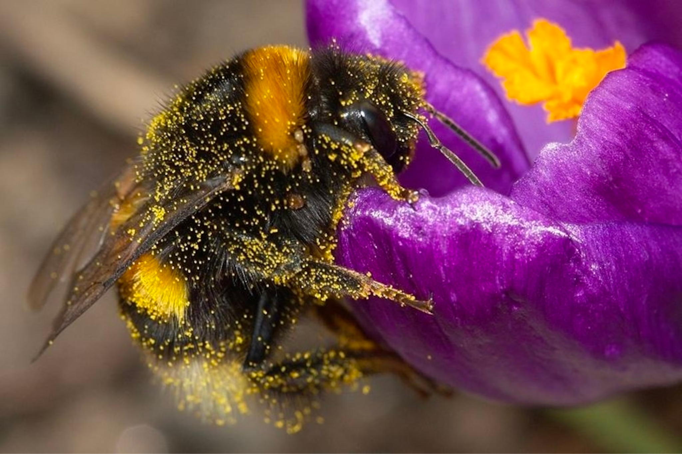
Here is an example of pollination. You can see the pollen on the bee. The bee is transferring that pollen to the flower.
Notes:
Here is an example of pollination. You can see the pollen on the bee. The bee is transferring that pollen to the flower.

Slide 35
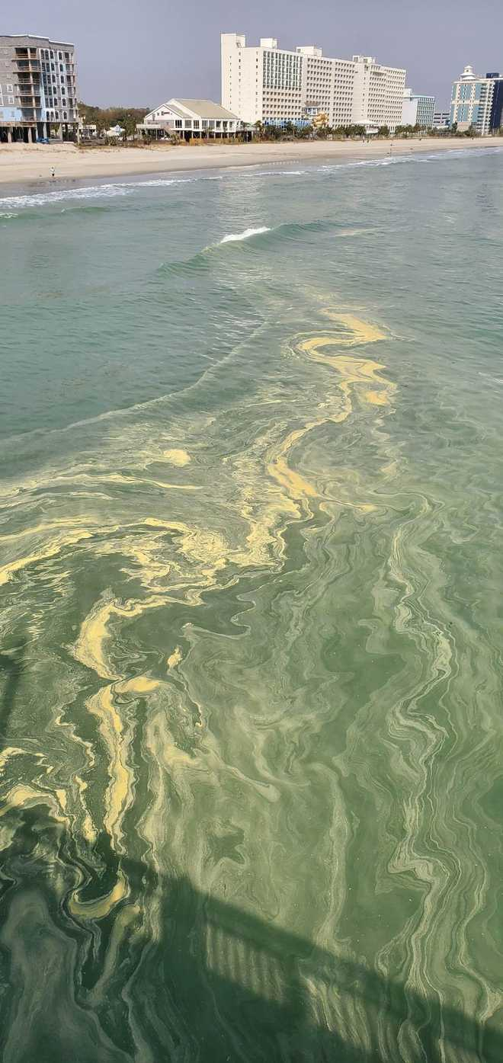
Here is another example of pollination. You can see the pollen on the water. The water is transferring the pollen from one place to another.
Notes:
Here is another example of pollination. You can see the pollen on the water. The water is transferring the pollen from one place to another.

Slide 36
Notes:
Now, let’s talk about some non-examples of pollination.

Slide 37
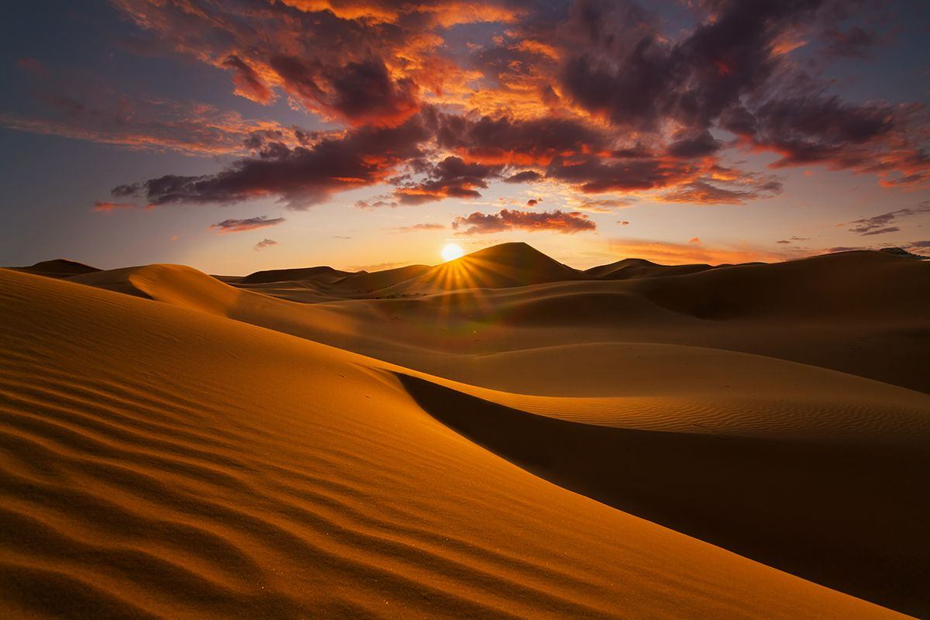
This is NOT an example of pollination. Because there are no flowers in a desert, pollination cannot happen.
Notes:
This is a non-example of pollination. Because there are no flowers in a desert, pollination cannot happen.

Slide 38
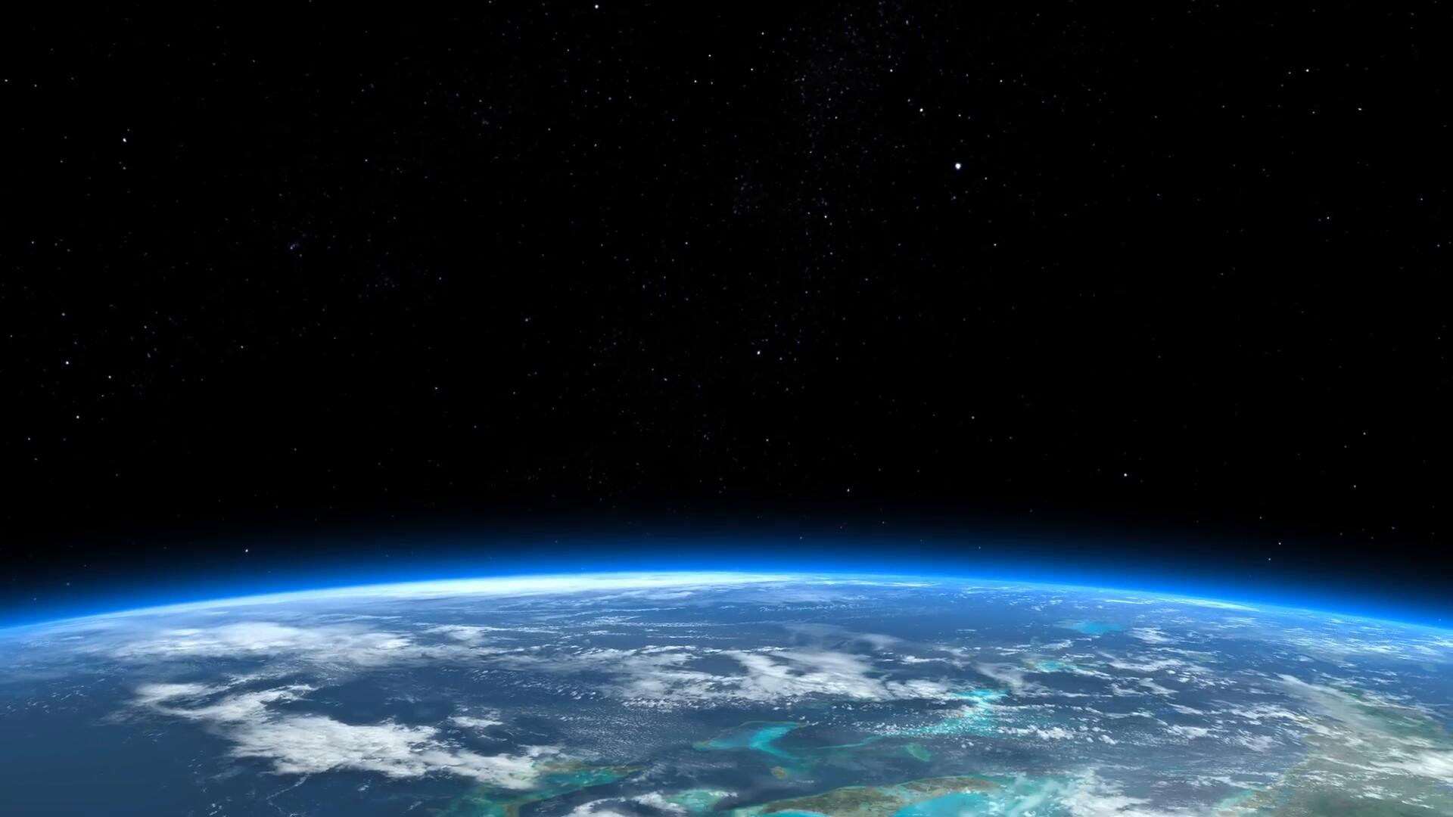
This is also NOT an example of pollination. Because there are no flowers in space, pollination cannot happen here.
Notes:
This is also a non-example of pollination. Because there are no flowers in space, pollination cannot happen here.

Slide 39
Notes:
Now let’s pause for a moment to check your understanding.

Slide 40
Which one is NOT an example of pollination?
Desert
Water
Bee
Notes:
Which one is NOT an example of pollination?
[Desert]

Slide 41
Which one is NOT an example of pollination?
Desert
Water
Bee
Notes:
Which one is NOT an example of pollination?
[Desert]

Slide 42
Remember!!!
Notes:
So remember!

Slide 43
Pollination: the transfer of pollen
Notes:
Pollination is the transfer of pollen.

Slide 44
Notes:
We will now complete this concept map, called a Frayer model, to summarize and further clarify what you have learned about the term pollination.

Slide 45
Definition
Picture
Pollination
Example
How does pollination impact my life?
Notes:
To complete the Frayer model, we will choose from four choices the correct picture, definition, example, and response to the question, “How does pollination impact my life?” Select the best response for each question using the information you just learned. As we select responses, we will see how this model looks filled in for the term pollination.

Slide 46
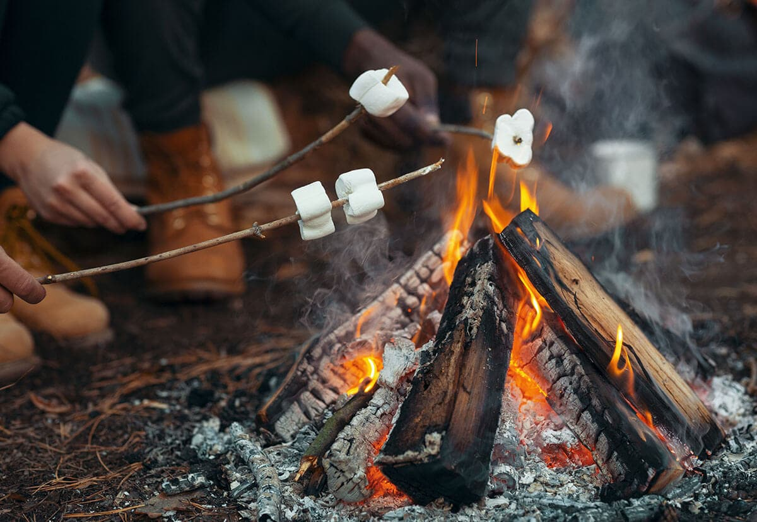
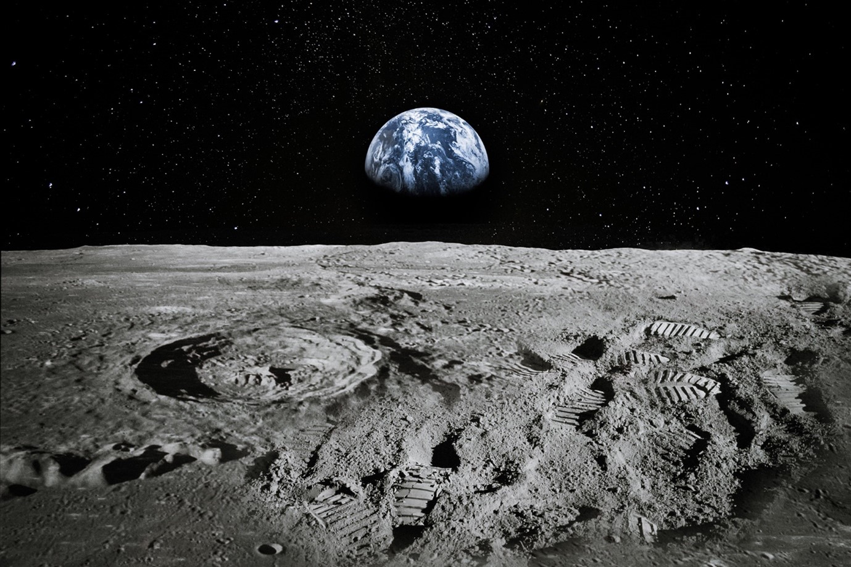
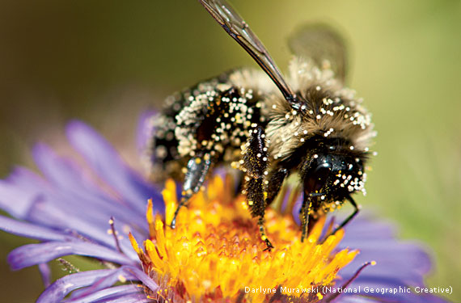
Directions: Choose the correct picture of pollination from the choices below.
A
B
C
D
Notes:
Choose the one correct picture of pollination from these four choices.

Slide 47
Directions: Choose the correct picture of pollination from the choices below.
A
B
C
D
Notes:
This is the picture that shows pollination.

Slide 48
Definition
Picture
Pollination
Example
How does pollination impact my life?
Notes:
Here is the Frayer model filled in with a picture of pollination.

Slide 49
Directions: Choose the correct definition of pollination from the choices below.
A
The transfer of pollution
B
The transfer of pollen
C
The transfer of paint
D
The transfer of energy
Notes:
Choose the one correct definition of pollination from these four choices.

Slide 50
Directions: Choose the correct definition of pollination from the choices below.
A
The transfer of pollution
B
The transfer of pollen
C
The transfer of paint
D
The transfer of energy
Notes:
“The transfer of pollen” is correct! This is the definition of pollination.

Slide 51
Definition
Picture
The transfer of pollen
Pollination
Example
How does pollination impact my life?
Notes:
Here is the Frayer Model with a picture and the definition filled in for pollination: The transfer of pollen.

Slide 52
Directions: Choose the correct example of pollination from the choices below.
A
A pile of sand that is blown by the wind
B
A fire that produces smoke
C
A butterfly taking pollen from one flower to another flower
D
A leaf falling off of a tree
Notes:
Choose the one correct example of pollination from these four choices.

Slide 53
Directions: Choose the correct example of pollination from the choices below.
A
A pile of sand that is blown by the wind
B
A fire that produces smoke
C
A butterfly taking pollen from one flower to another flower
D
A leaf falling off of a tree
Notes:
“A butterfly taking pollen from one flower to another flower” is correct! This is an example of pollination.

Slide 54
Definition
Picture
The transfer of pollen
Pollination
A butterfly taking pollen from one flower to another flower
Example
How does pollination impact my life?
Notes:
Here is the Frayer Model with a picture, definition, and an example of pollination: A butterfly taking pollen from one flower to another flower

Slide 55
Directions: Choose the correct response for “how does pollination impact my life?” from the choices below.
A
Pollination helps the plants I see everyday to reproduce
B
Pollination helps the trees I see everyday to stay in the ground.
C
Pollination helps the animals I see everyday to eat.
D
Pollination helps the animals I see everyday to reproduce.
Notes:
Choose the one correct response for “how does pollination impact my life?” from these four choices.

Slide 56
Directions: Choose the correct response for “how does pollination impact my life?” from the choices below.
A
Pollination helps the plants I see everyday to reproduce
B
Pollination helps the trees I see everyday to stay in the ground.
C
Pollination helps the animals I see everyday to eat.
D
Pollination helps the animals I see everyday to reproduce.
Notes:
“Pollination helps the plants I see everyday to reproduce.” That is correct! This is an example of how pollination impacts your life.

Slide 57
Definition
Picture
The transfer of pollen
Pollination
A butterfly taking pollen from one flower to another flower
Pollination helps the plants I see everyday to reproduce.
Example
How does pollination impact my life?
Notes:
Here is the Frayer Model with a picture, definition, example, and a correct response to “how does pollination impact my life?”: Pollination helps the plants I see everyday to reproduce.

Slide 58
Remember!!!
Notes:
So remember!

Slide 59
Pollination: the transfer of pollen
Notes:
Pollination is the transfer of pollen.

Slide 60
Big Question: How do plants reproduce?
Notes:
Let’s reflect once more on our big question. Our “big question” is: How do plants reproduce?
Does anyone have any additional examples to share that haven’t been discussed yet?

Slide 61
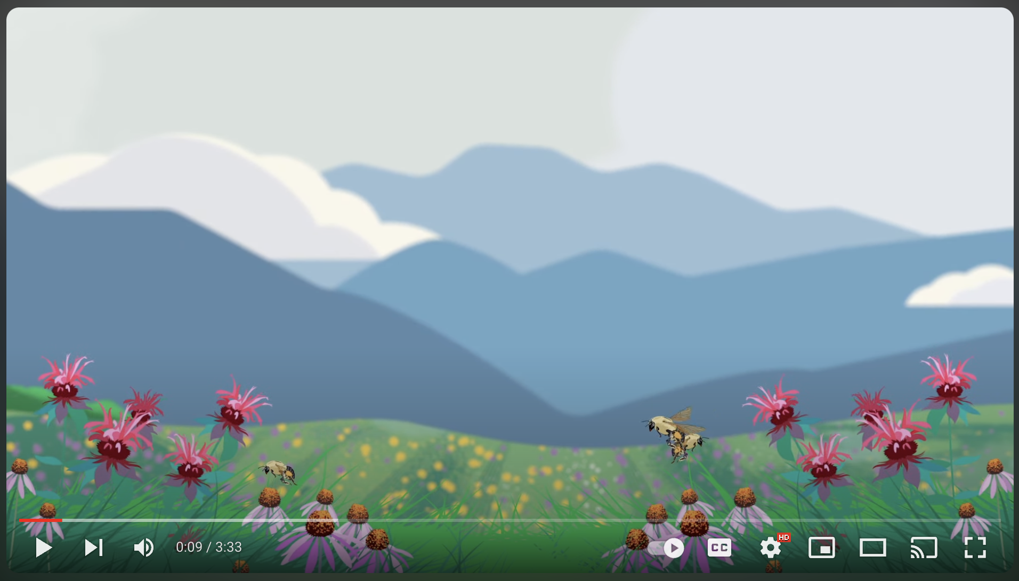
Pollination Video
Pollination Video
Click the link to view a 3-minute video that provides further details on pollination.
Write down 1 or 2 details about pollination that you learned from the video.
Notes:
Click the link above for a YouTube video from NC State about pollination. Have students jot down one or two details they found interesting or surprising. Share the details as a class.

Slide 62
Notes:
Thanks for watching, and please continue watching CAPs available from this website.

Slide 63
This Was Created With Resources From:
Questions or Comments
Michael Kennedy, Ph.D. MKennedy@Virginia.edu
Rachel L Kunemund, Ph.D. rk8vm@virginia.edu

