Slide 1
Intro
“Big Idea” Question
Review Concepts
Check-In Questions
Teacher Engagement
Vocabulary
Student-Friendly Definition
Examples & Non-Examples
Morphological Word Parts
Frayer Model
Simulation/Activity
Notes:
OK everyone, get ready for our next lesson. Just as a reminder, these are the different components that our lesson may include, and you’ll see these icons in the top left corner of each slide so that you can follow along more easily!

Slide 2
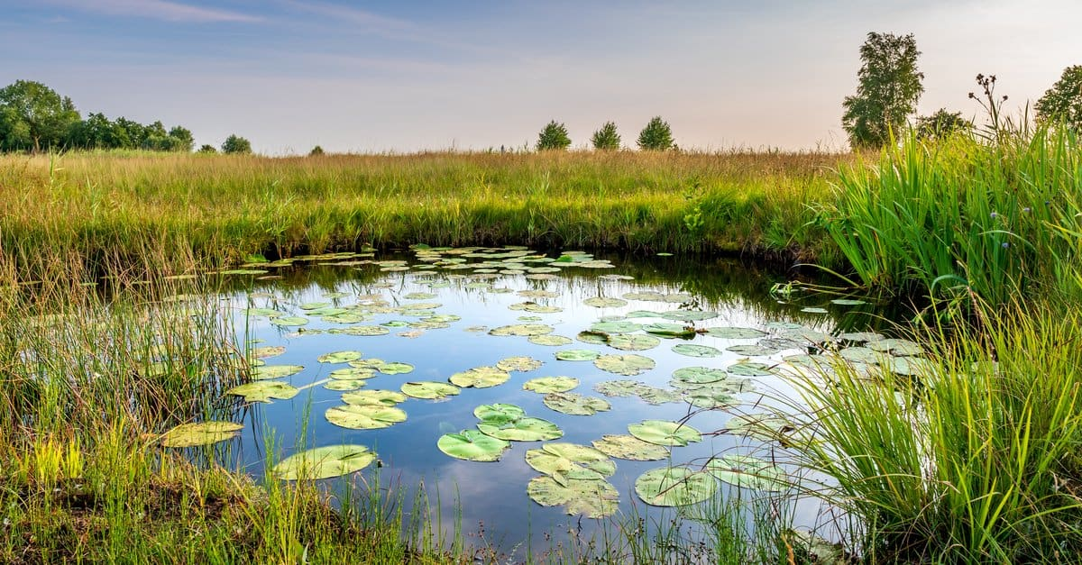
Intro
Pond
Notes:
Today, we’ll be learning about the word: Pond.

Slide 3
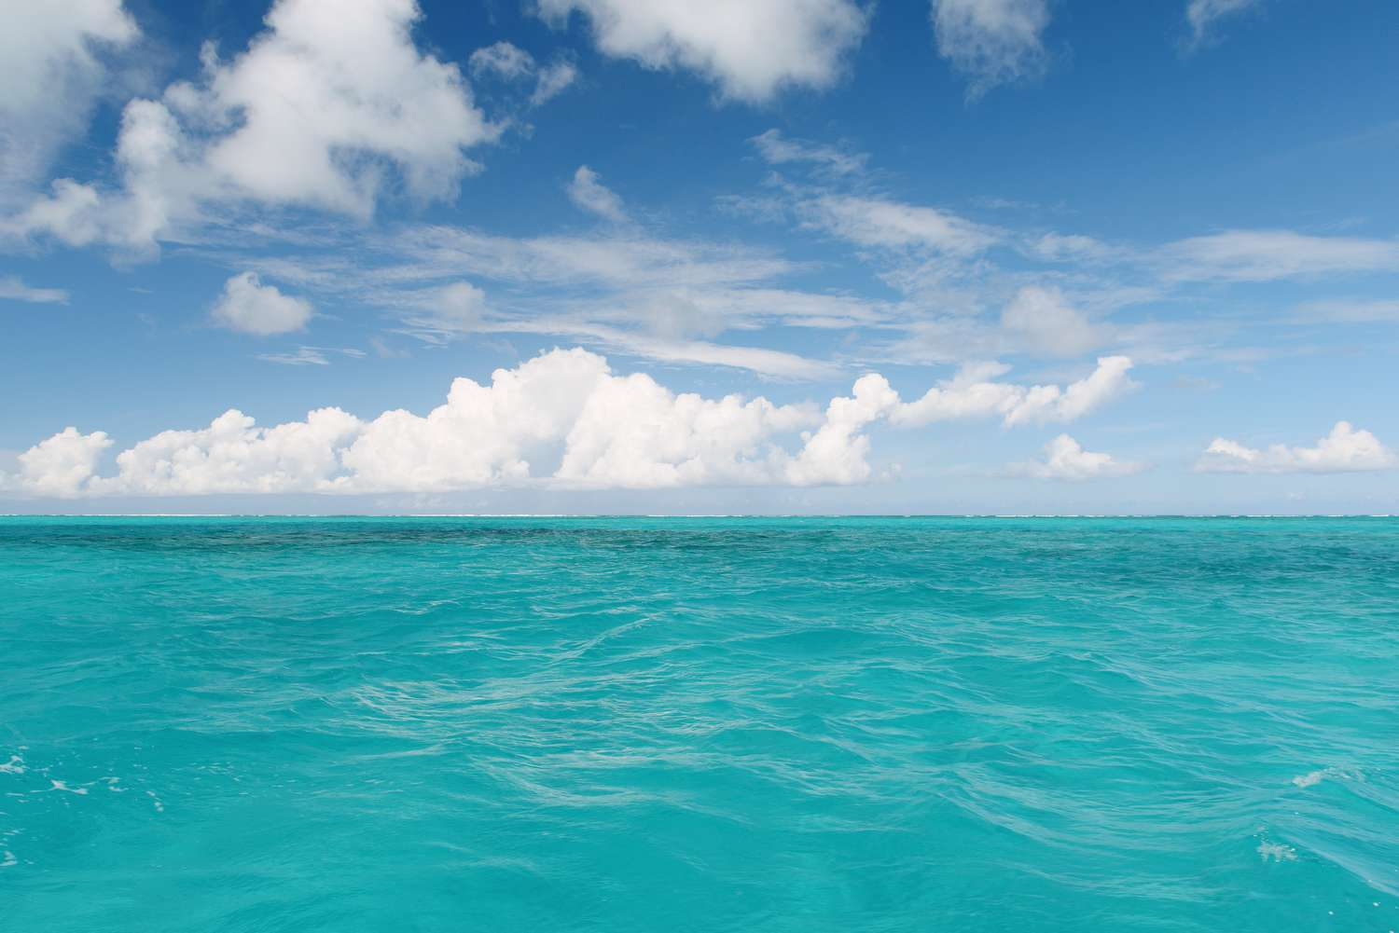
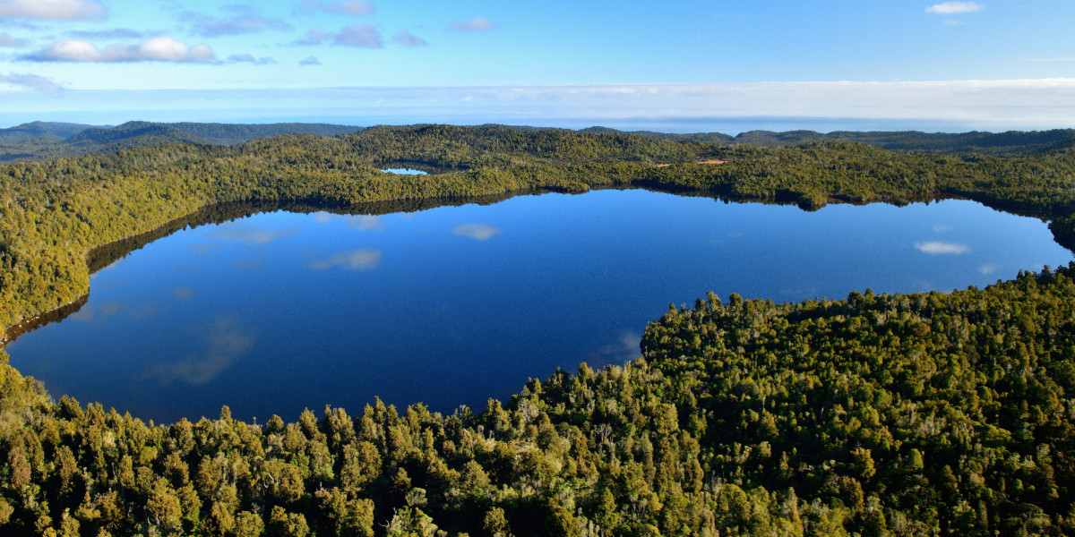
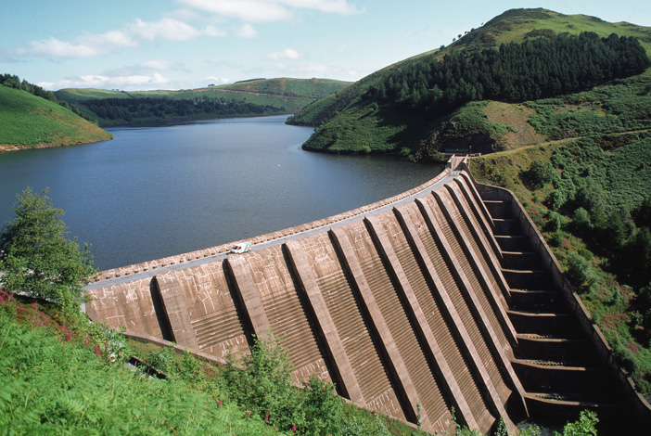
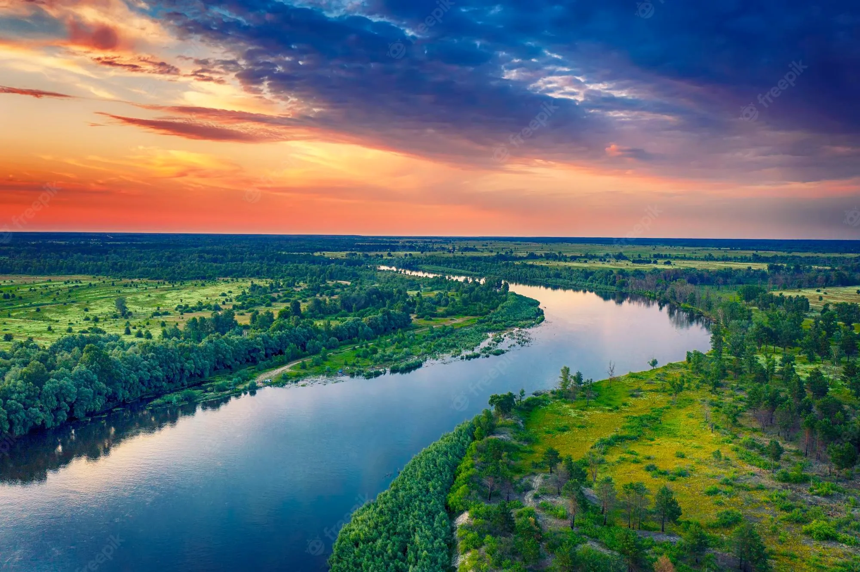
Big Question: What are the differences between lakes, oceans, ponds, reservoirs, and rivers?
Notes:
Our “big question” is: What are the differences between lakes, oceans, ponds, reservoirs, and rivers?
[Pause and illicit predictions from students.]
I love all these thoughtful scientific hypotheses! Be sure to keep this question and your predictions in mind as we move through these next few lessons, and we’ll continue to revisit it.

Slide 4
Notes:
Before we move on to our new topic, let’s review some other words & concepts that you already learned and make sure you are firm in your understanding.

Slide 5
Lake: A natural, large body of water surrounded by land
Notes:
A lake is a natural, large body of water surrounded by land.

Slide 6
Reservoir: A man-made, large body of water surrounded by land.
Notes:
A reservoir is a man-made, large body of water surrounded by land.

Slide 7
Ocean: A giant body of saltwater.
Notes:
An ocean is a giant body of saltwater.

Slide 8
River: A long, winding stream of water that constantly moves.
Notes:
A river is a long, winding stream of water that constantly moves.

Slide 9
Notes:
Now let’s pause for a moment to review the information we have covered already.

Slide 10
A lake is a _____, large body of water surrounded by land.
man-made
natural
Notes:
A lake is a ______, large body of water surrounded by land
[natural]

Slide 11
A lake is a _____, large body of water surrounded by land.
man-made
natural
Notes:
A lake is a ______, large body of water surrounded by land
[natural]

Slide 12
True or false: A reservoir is a man-made, large body of water surrounded by land.
True
False
Notes:
True or false: A reservoir is a man-made, large body of water surrounded by land.
[True]

Slide 13
True or false: A reservoir is a man-made, large body of water surrounded by land.
True
False
Notes:
True or false: A reservoir is a man-made, large body of water surrounded by land.
[True]

Slide 14
An ocean is a giant body of __________.
saltwater
freshwater
Notes:
An ocean is a giant body of __________.
[A. saltwater]

Slide 15
An ocean is a giant body of __________.
saltwater
freshwater
Notes:
An ocean is a giant body of __________.
[A. saltwater]

Slide 16
True or false: A river is a long, winding stream of water that does not move.
True
False
Notes:
True or false: A river is a long, winding stream of water that does not move.
[B. False - remember: a river is a long, winding stream of water that constantly moves.]

Slide 17
True or false: A river is a long, winding stream of water that does not move.
True
False
Notes:
True or false: A river is a long, winding stream of water that does not move.
[B. False - remember: a river is a long, winding stream of water that constantly moves.]

Slide 18
Pond
Notes:
Now that we’ve reviewed, let’s define the phrase pond.

Slide 19
Pond: A small body of water surrounded by land.
Notes:
A pond is a small body of water surrounded by land.

Slide 20
Notes:
Let’s check-in for understanding.

Slide 21
What is a pond?
Notes:
What is a pond?
[A pond is a small body of water surrounded by land.]

Slide 22
Notes:
That is the basic definition, but there is a bit more you need to know.

Slide 23
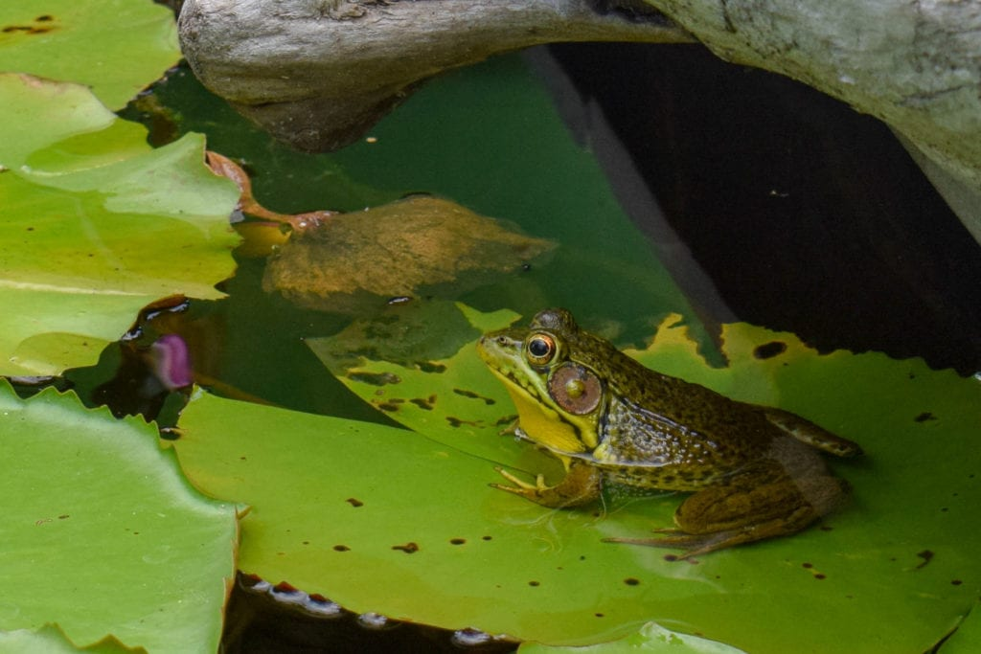
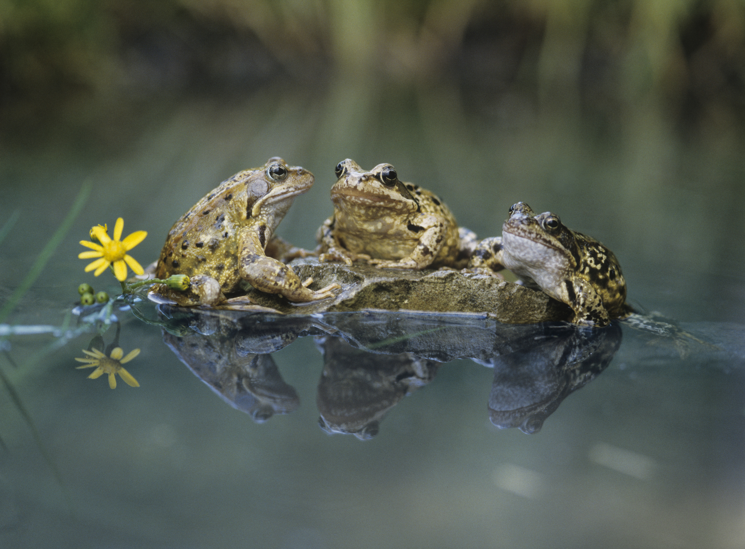
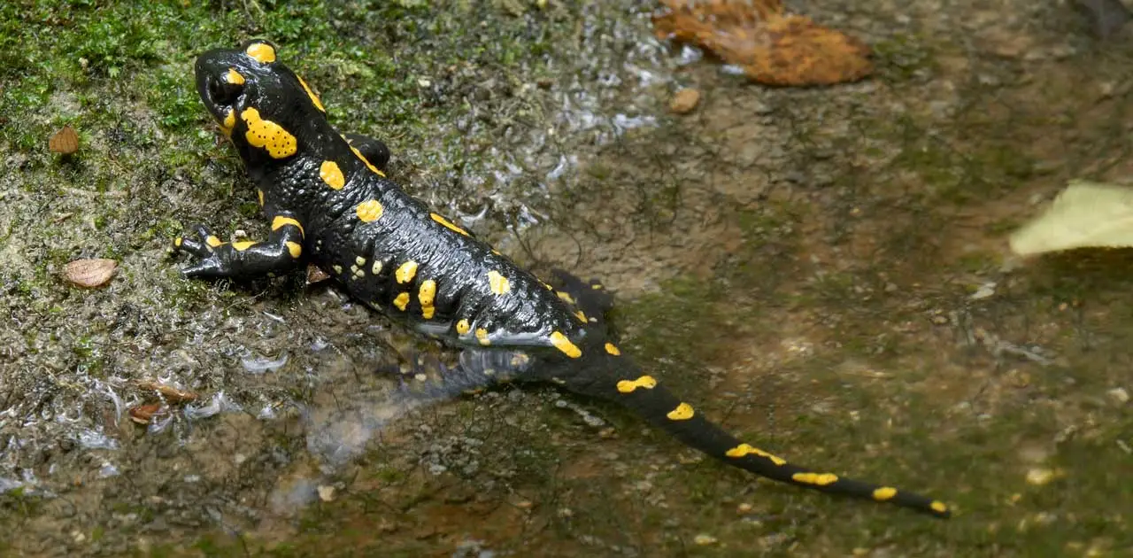
Ponds provide unique habitats for amphibians such as frogs, toads, and salamanders.
frogs
toads
salamanders
Notes:
Ponds provide unique habitats for amphibians such as frogs, toads, and salamanders.

Slide 24
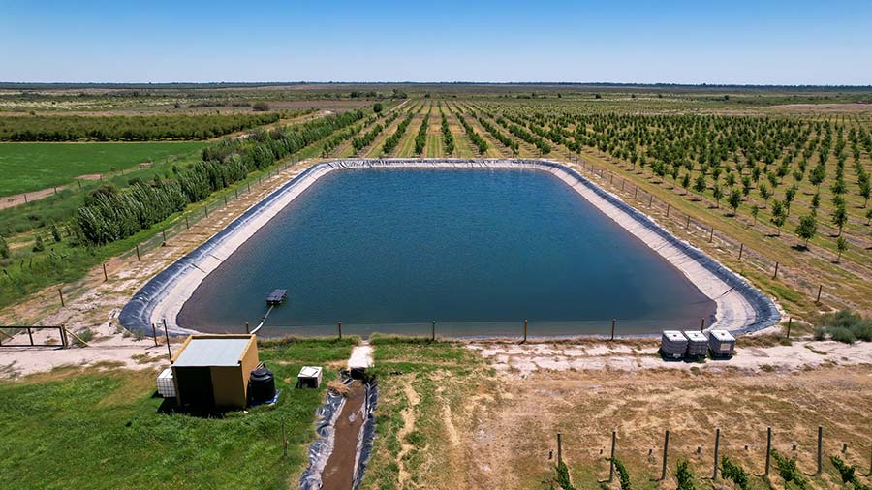
Ponds can also be a source of water for farmers who need to water their fields.
Notes:
Ponds can also be a source of water for farmers who need to water their fields.

Slide 25
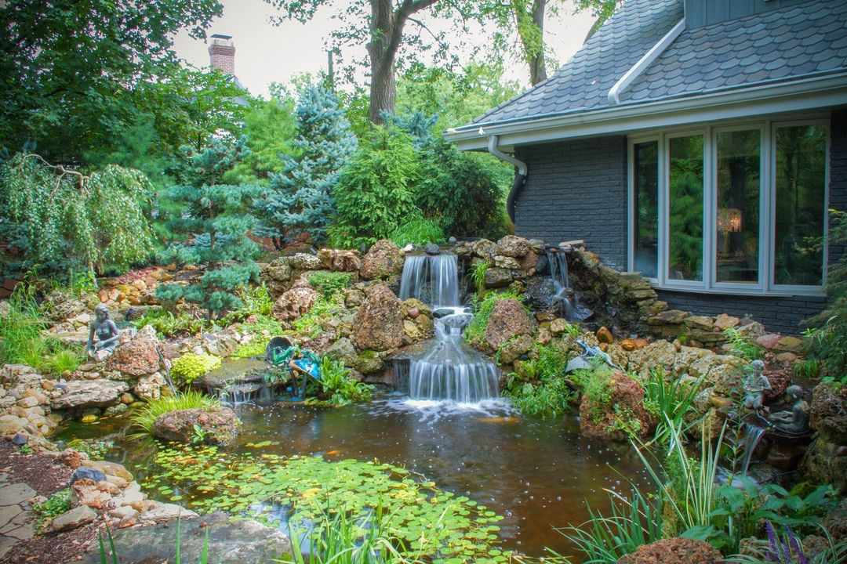
And oftentimes, ponds can be a landscaping feature around many homes.
Notes:
And oftentimes, ponds can be a landscaping feature around many homes.

Slide 26
Notes:
Let’s check-in for understanding.

Slide 27
What are three animals that live in ponds?
frogs
toads
salamanders
Notes:
What are three animals that live in ponds?
[Frogs, toads, salamanders]

Slide 28
What are three animals that live in ponds?
frogs
toads
salamanders
Notes:
What are three animals that live in ponds?
[Frogs, toads, salamanders]

Slide 29
Ponds can also be a source of water for ________ who need to water their fields.
electricians
plumbers
farmers
Notes:
Ponds can also be a source of water for _________ who need to water their fields.
[C. farmers]

Slide 30
Ponds can also be a source of water for farmers who need to water their fields.
electricians
plumbers
farmers
Notes:
Ponds can also be a source of water for _________ who need to water their fields.
[C. farmers]

Slide 31
True or false: Ponds can also be used in landscaping around homes.
True
False
Notes:
True or false: Ponds can also be used in landscaping around homes.
[A. True]

Slide 32
True or false: Ponds can also be used in landscaping around homes.
True
False
Notes:
True or false: Ponds can also be used in landscaping around homes.
[A. True]

Slide 33
Notes:
Now, let’s talk about some examples of pond.

Slide 34
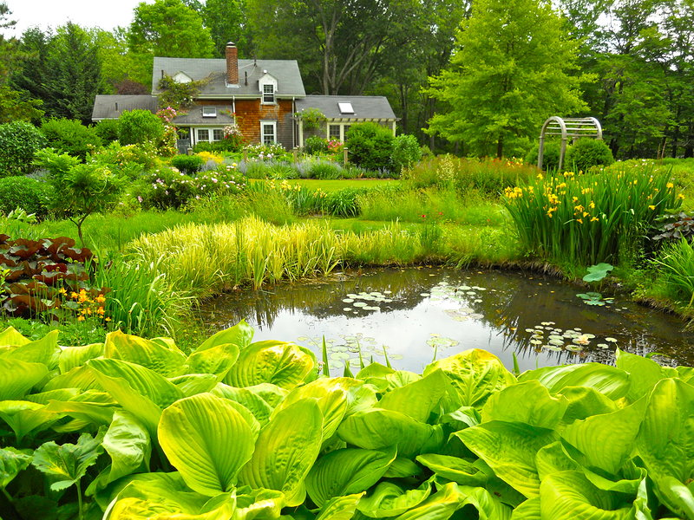
This is an example of a pond. It is a small body of water surrounded by land.
Notes:
This is an example of a pond. It is a small body of water surrounded by land.

Slide 35
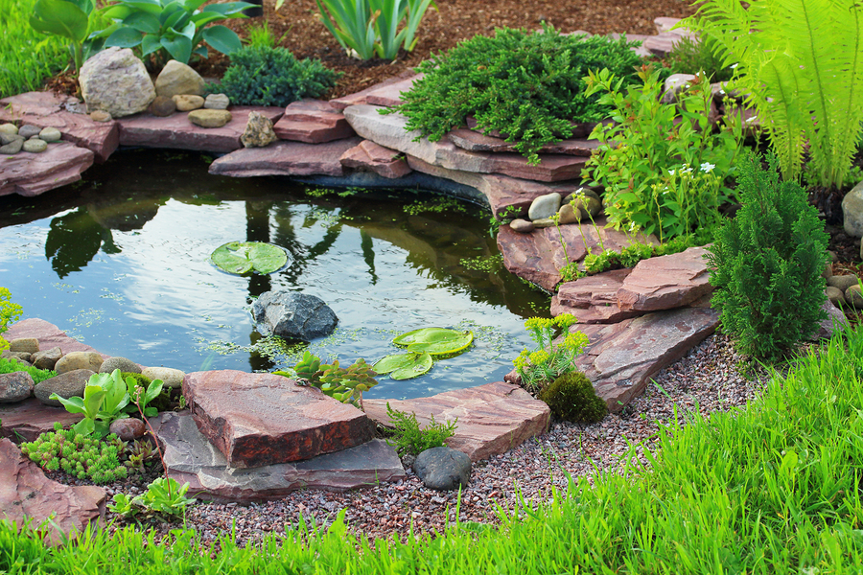
This is also an example of a pond. Again, it is small body of water surrounded by land.
Photo: Georgia Coast Atlas
Notes:
This is also an example of a pond. Again, it is small body of water surrounded by land.

Slide 36
Notes:
Now, let’s talk about some non-examples of pond.

Slide 37
This is not a pond. It is not a small body of water surrounded by land.
Notes:
This is not a pond. It is not a small body of water surrounded by land.

Slide 38
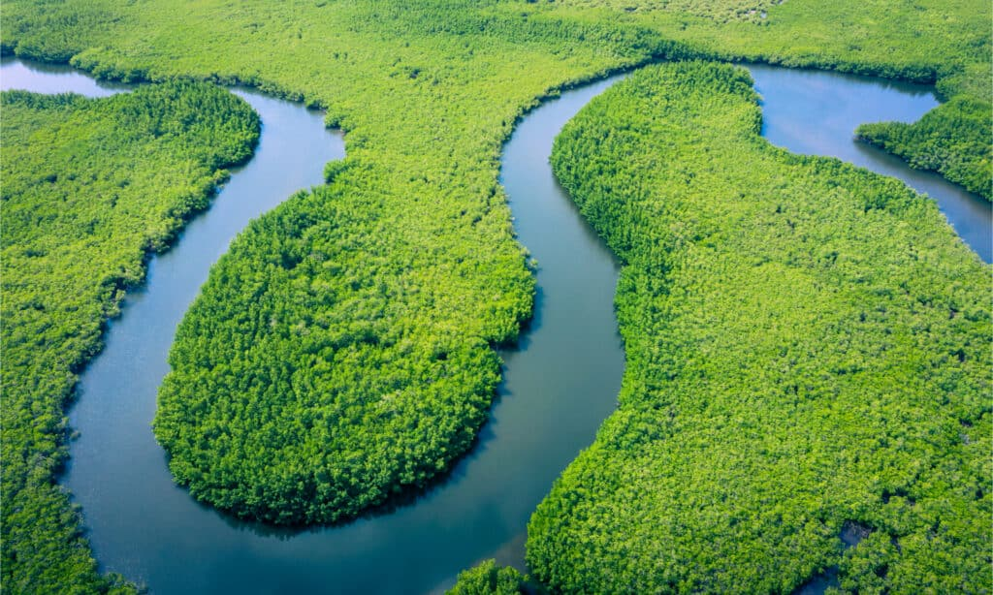
This is also not a pond. It is not a small body of water surrounded by land.
Notes:
This is also not a pond. It is not a small body of water surrounded by land.

Slide 39
Notes:
Now let’s pause for a moment to check your understanding.

Slide 40
Which of these is a pond?
Notes:
Which of these is a pond?
[The left picture.]

Slide 41
Which of these is a pond?
Notes:
Which of these is a pond?
[The left picture.]

Slide 42
Remember!!!
Notes:
So remember!

Slide 43
Pond: A small body of water surrounded by land.
Notes:
A pond is a small body of water surrounded by land.

Slide 44
Notes:
We will now complete this concept map, called a Frayer model, to summarize and further clarify what you have learned about the term pond.

Slide 45
Definition
Picture
Pond
Example
How do ponds impact my life?
Notes:
To complete the Frayer model, we will choose from four choices the correct picture, definition, example, and response to the question, “How do ponds impact my life?” Select the best response for each question using the information you just learned. As we select responses, we will see how this model looks filled in for the term pond.

Slide 46
Directions: Choose the correct picture of a pond from the choices below.
A
B
C
D
Notes:
Choose the one correct picture of a pond from these four choices.

Slide 47
Directions: Choose the correct picture of a pond from the choices below.
A
B
C
D
Notes:
Choose the one correct picture of a pond from these four choices.

Slide 48
Definition
Picture
Pond
Example
How do ponds impact my life?
Notes:
Here is the Frayer model filled in with a picture of a pond.

Slide 49
Directions: Choose the correct definition of a pond from the choices below.
A
A small body of water surrounded by land
B
A natural, large body of water surrounded by land
C
A giant body of saltwater
D
A long, winding stream of water that constantly moves
Notes:
Choose the correct definition of a pond from the choices below.

Slide 50
Directions: Choose the correct definition of a pond from the choices below.
A
A small body of water surrounded by land
B
A natural, large body of water surrounded by land
C
A giant body of saltwater
D
A long, winding stream of water that constantly moves
Notes:
Choose the correct definition of a pond from the choices below.
[A. A small body of water surrounded by land.]

Slide 51
Definition
Picture
A small body of water surrounded by land
Pond
Example
How do ponds impact my life?
Notes:
Here is the Frayer Model with a picture and the definition filled in for a pond: A small body of water surrounded by land.

Slide 52
Directions: Choose the correct example of a pond from the choices below.
A
A small stream flowing into a bigger river
B
A small pool of water caused by rain
C
A small body of water used for farming
D
A small bucket of water
Notes:
Choose the correct example of a pond from the choices below.

Slide 53
Directions: Choose the correct example of a pond from the choices below.
A
A small stream flowing into a bigger river
B
A small pool of water caused by rain
C
A small body of water used for farming
D
A small bucket of water
Notes:
“A small body of water used for farming” is correct! This is an example of a pond.

Slide 54
Definition
Picture
A small body of water surrounded by land
Pond
A small body of water used for farming
Example
How do ponds impact my life?
Notes:
Here is the Frayer Model with a picture, definition, and an example of a pond: A small body of water used for farming.

Slide 55
Directions: Choose the correct response for “How do ponds impact my life?” from the choices below.
A
Ponds give water to farmers to help them create food for us to eat.
B
Ponds provide a steady water source for humans.
C
Ponds give us warmth in the winter.
D
Ponds give humans shelter.
Notes:
Choose the one correct response for “how do ponds impact my life?” from these four choices.

Slide 56
Directions: Choose the correct response for “How do ponds impact my life?” from the choices below.
A
Ponds give water to farmers to help them create food for us to eat.
B
Ponds provide a steady water source for humans.
C
Ponds give us warmth in the winter.
D
Ponds give humans shelter.
Notes:
“Ponds give water to farmers to help them create food for us to eat.” That is correct! This is an example of how ponds impact your life.

Slide 57
Definition
Picture
A small body of water surrounded by land
Pond
A small body of water used for farming
Ponds give water to farmers to help them create food for us to eat.
Example
How do ponds impact my life?
Notes:
Here is the Frayer Model with a picture, definition, example, and a correct response to “how do ponds impact my life?”: Ponds give water to farmers to help them create food for us to eat.

Slide 58
Remember!!!
Notes:
So remember!

Slide 59
Pond: A small body of water surrounded by land.
Notes:
A pond is a small body of water surrounded by land.

Slide 60
Big Question: What are the differences between lakes, oceans, ponds, reservoirs, and rivers?
Notes:
Our “big question” is: What are the differences between lakes, oceans, ponds, reservoirs, and rivers?
Does anyone have any additional examples to share that haven’t been discussed yet?
I love all these thoughtful scientific hypotheses! Be sure to keep this question and your predictions in mind as we move through these next few lessons, and we’ll continue to revisit it.

Slide 61
Extension Activity
Pond Ecosystems
Click the link above for an extension video on pond ecosystems.
Jot down 2 or 3 new facts that you learn about ponds.
Discuss them as a class.
Notes:
Click the link above for an extension video on pond ecosystems. Jot down 2 or 3 new facts that you learn about ponds. Discuss them as a class.

Slide 62
Notes:
Thanks for watching, and please continue watching CAPs available from this website.

Slide 63
This Was Created With Resources From:
Questions or Comments
Michael Kennedy, Ph.D. MKennedy@Virginia.edu
Rachel L Kunemund, Ph.D. rk8vm@virginia.edu

