Slide 1
Intro
“Big Idea” Question
Review Concepts
Check-In Questions
Teacher Engagement
Vocabulary
Student-Friendly Definition
Examples & Non-Examples
Morphological Word Parts
Frayer Model
Simulation/Activity
Notes:
OK everyone, get ready for our next lesson. Just as a reminder, these are the different components that our lesson may include, and you’ll see these icons in the top left corner of each slide so that you can follow along more easily!

Slide 2
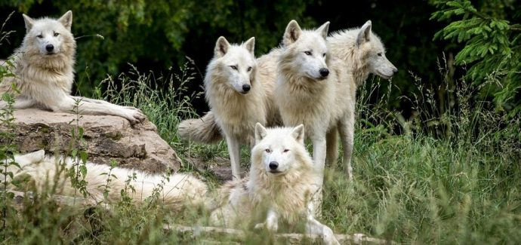
Intro
Population
Notes:
Today, we’ll be learning about the word: Population.

Slide 3
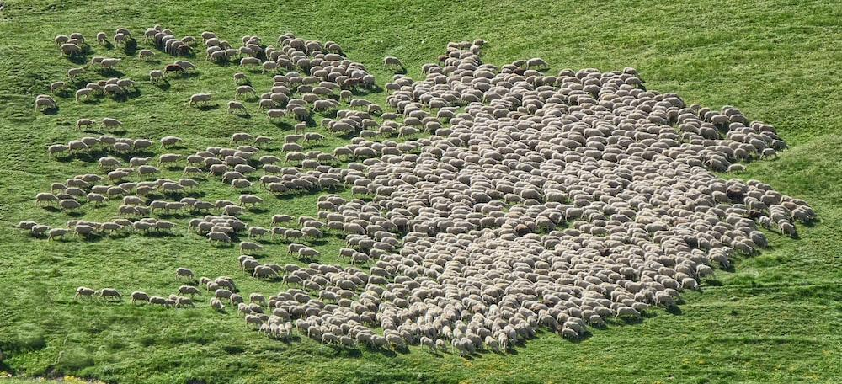
Big Question: What type of living things are in a population and how do they work together?
Notes:
Our “big question” is: What type of living things are in a population and how do they work together?
[Pause and illicit predictions from students.]
I love all these thoughtful scientific hypotheses! Be sure to keep this question and your predictions in mind as we move through these next few lessons, and we’ll continue to revisit it.

Slide 4
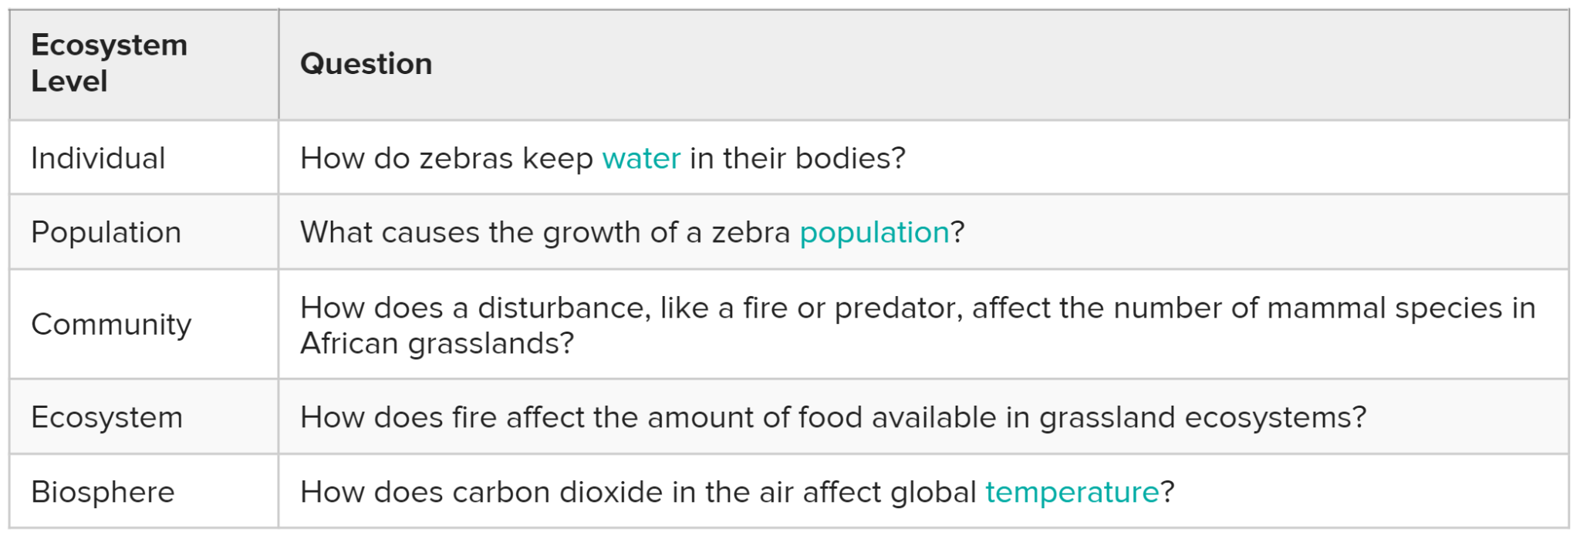
Demonstration
Levels of Scientific Questioning
Scientists study nature at a variety of levels. Today, we are going to look at these different levels of organization and consider why they might be important. Let’s consider the scientific questions below and make some predictions about what the definition of each level is or what other examples might fit into the same category...
Notes:
Feedback: Use the provided questions to engage students in the process of making predictions about ecological levels of organization. For this presentation, you might focus solely on population. Consider drawing connections between the ecological levels and related words that students have used or heard before. Ex) When you think of a population, what comes to mind? What components would you include in describing a “community” as you understand it?

Slide 5
Notes:
Before we move on to our new topic, let’s review some other words & concepts that you already learned and make sure you are firm in your understanding.

Slide 6
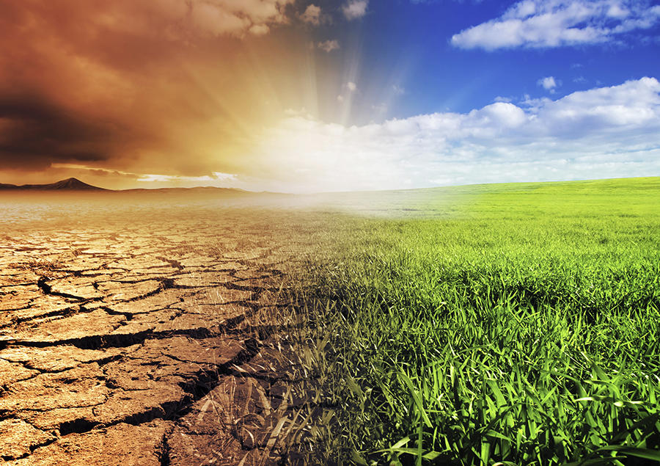
Environment: the surroundings of a person, animal, plant or thing
Notes:
An environment is the surroundings of a person, animal, plant or thing.

Slide 7
Organism: any living thing
Notes:
An organism is any living thing.

Slide 8
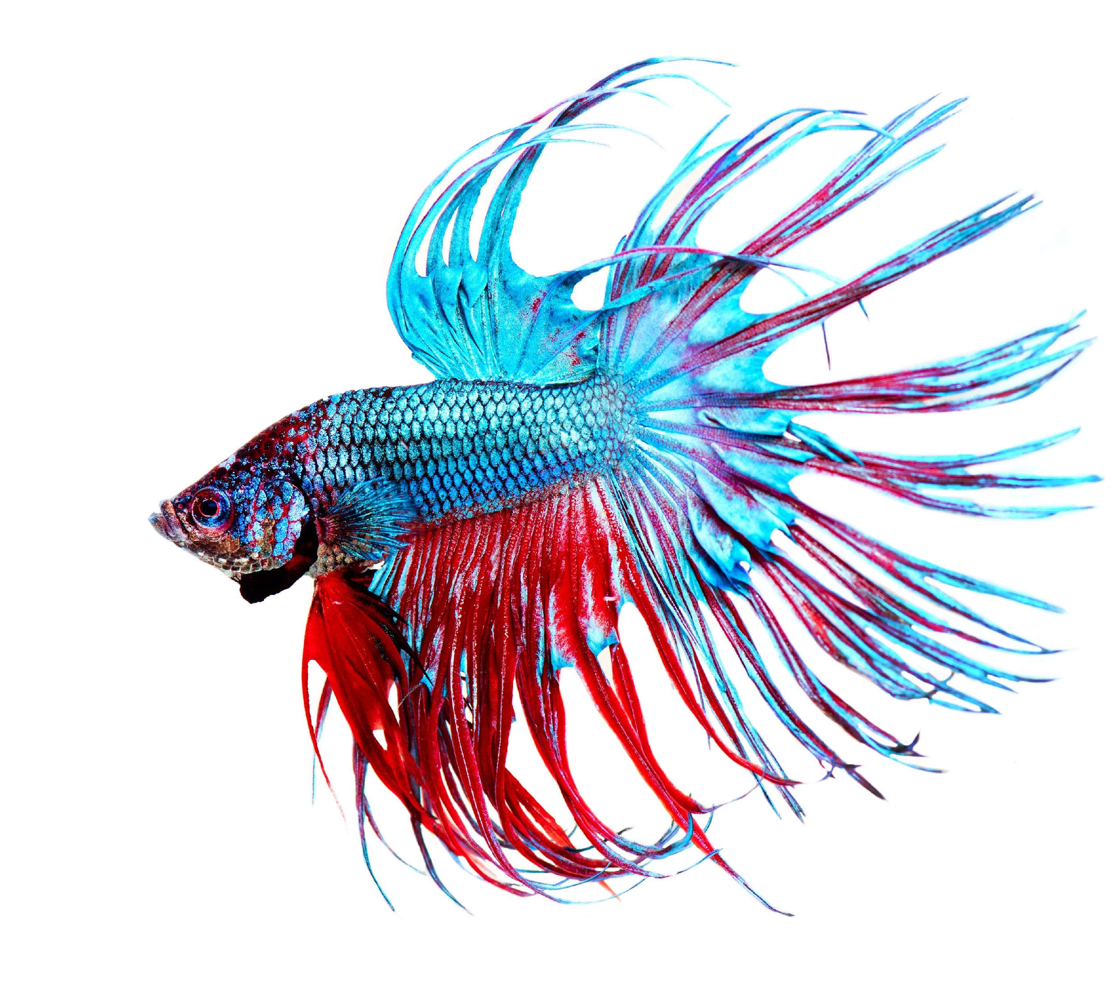
Individual: a single organism
Notes:
An individual is a single organism. This fish is an example of an individual organism.

Slide 9
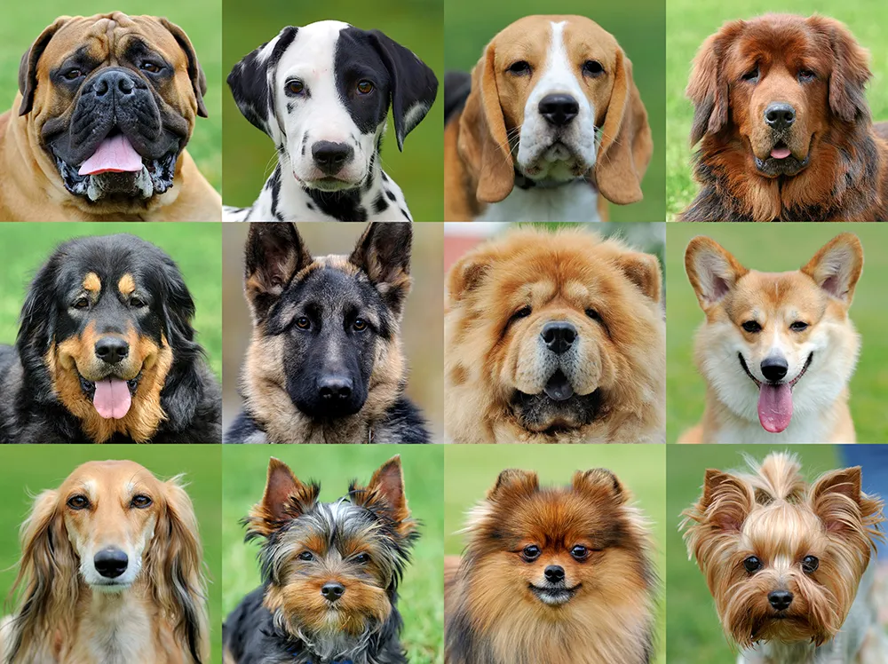
Species: a group of similar organisms that can reproduce
Notes:
Species is a group of similar organisms that can reproduce.

Slide 10
Notes:
Now let’s pause for a moment to review the information we have covered already.

Slide 11
The _________ is the surroundings of a person, animal, plant, or thing.
Environment
Individual
Notes:
The __________ is the surroundings of a person, animal, plant or thing.
[Environment]

Slide 12
The _________ is the surroundings of a person, animal, plant, or thing.
Environment
Individual
Notes:
The [environment] is the surroundings of a person, animal, plant or thing.

Slide 13
An _________ is any living thing.
Notes:
An _________ is any living thing.
[organism]

Slide 14
An organism is any living thing.
Notes:
An [organism] is any living thing.

Slide 15
True or False: A group of similar organisms that can reproduce is a species.
Notes:
True or False: A group of similar organisms that can reproduce is a species.
[True]

Slide 16
True or False: A group of similar organisms that can reproduce is a species.
Notes:
True or False: A group of similar organisms that can reproduce is a species.
[True]

Slide 17
Population
Notes:
Now that we’ve reviewed, let’s define the phrase population.

Slide 18
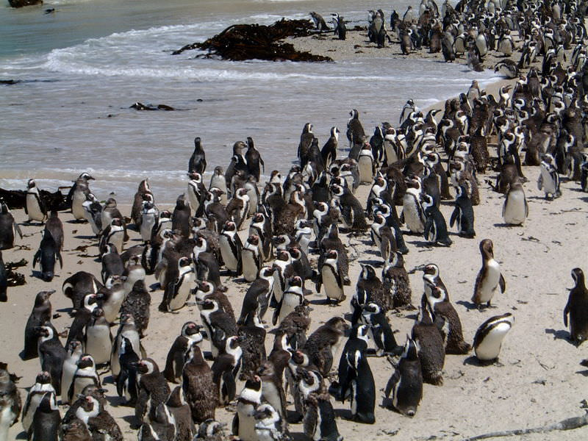
Population: all the organisms of the same species that live in the same place at the same time
Notes:
A population is all the organisms of the same species that live in the same place at the same time.

Slide 19
Notes:
Let’s check-in for understanding.

Slide 20
What is a population?
Notes:
What is a population?
[All the organisms of the same species that live in the same place at the same time.]

Slide 21
Notes:
That is the basic definition, but there is a bit more you need to know.

Slide 22
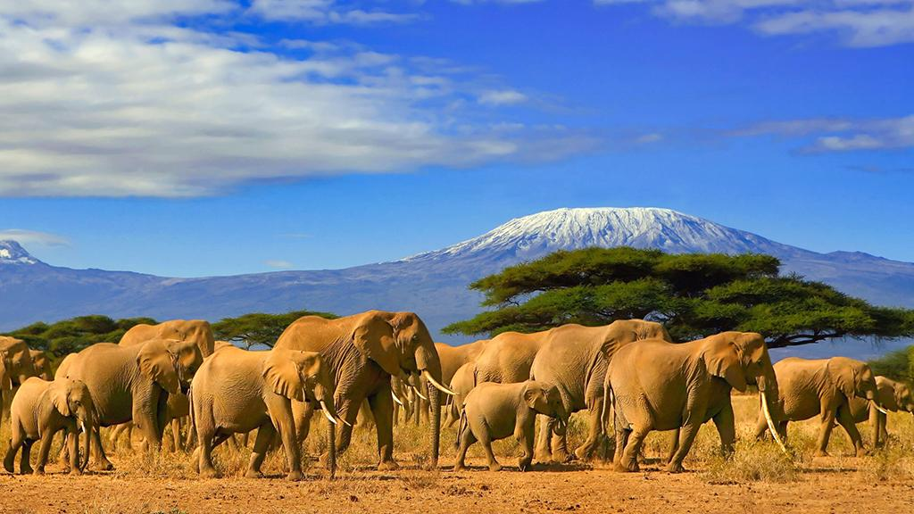
Only organisms, or living things, of the same kind or species
are a population.
In this picture, the elephants make up the population.
Notes:
Only organisms, or living things, of the same kind or species are a population. In this picture, the elephants make up the population.

Slide 23
Individuals, or single organisms, make up populations.
population
individual
One elephant is an individual in the population of all of these elephants in the picture.
Notes:
Individuals, or single organisms, make up populations. One elephant is an individual in the population of all of these elephants in the picture.

Slide 24
For a population to thrive, its members must be able to reproduce. This helps keep the species in the population alive.
This elephant population has survived by making baby elephants.
Notes:
For a population to thrive, its members must be able to reproduce. This helps keep the species in the population alive. This elephant population has survived by making baby elephants.

Slide 25
A population lives in the same place at the same time.
These elephants live in the savanna habitat together.
Notes:
A population lives in the same place at the same time. These elephants live in the savanna habitat together.

Slide 26
Notes:
Let’s check-in for understanding.

Slide 27
Only organisms, or living things, of the ________ kind or species are a population.
Notes:
Only organisms, or living things, of the ________ kind or species are a population.
[same]

Slide 28
Only organisms, or living things, of the same
kind or species are a population.
Notes:
Only organisms, or living things, of the [same] kind or species are a population.

Slide 29
Describe the difference between an individual and a population.
Notes:
Describe the difference between an individual and a population.
[An individual is a single organism, and a population is all of the organisms of the same species that live in the same place at the same time.]

Slide 30
Notes:
Now, let’s talk about some examples of population.

Slide 31
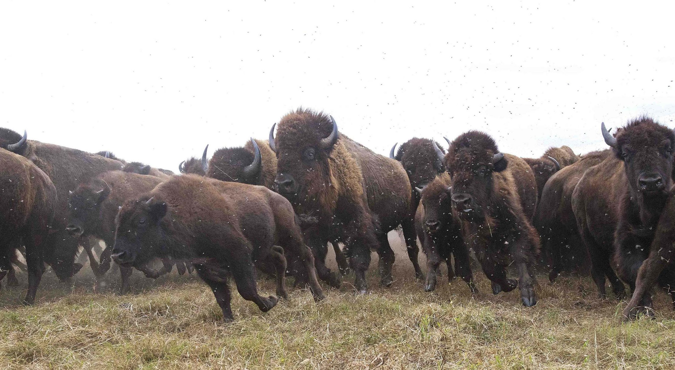
These bison are an example of a population because they are a group of the same types of organisms in the same place.
Notes:
These bison are an example of a population because they are a group of the same types of organisms.

Slide 32
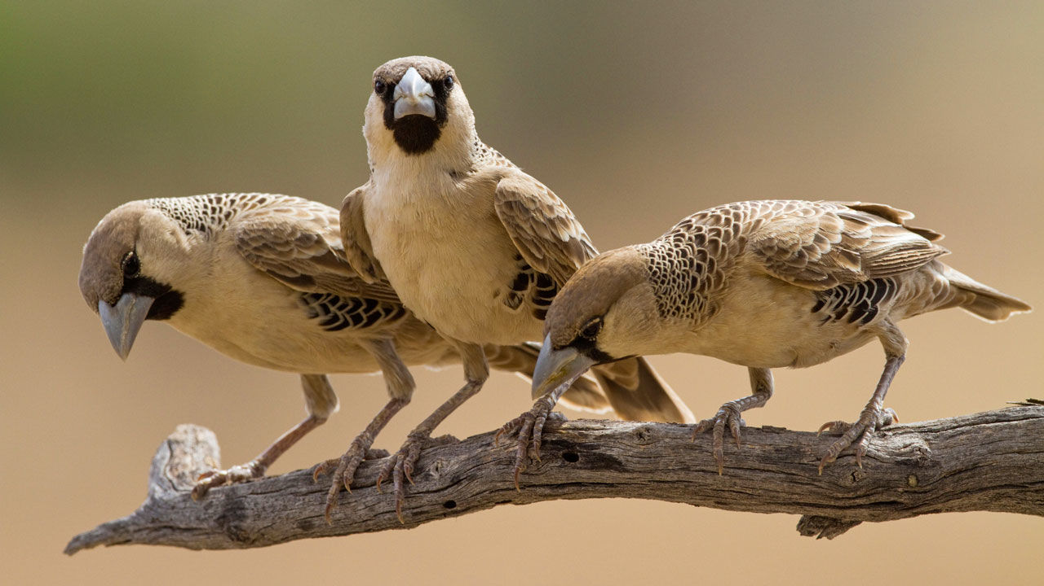
These birds are an example of a population because they are a group of the same types of organisms in the same place.
Notes:
These birds are an example of a population because they are a group of the same types of organisms in the same place.

Slide 33
Notes:
Now, let’s talk about some non-examples of population.

Slide 34
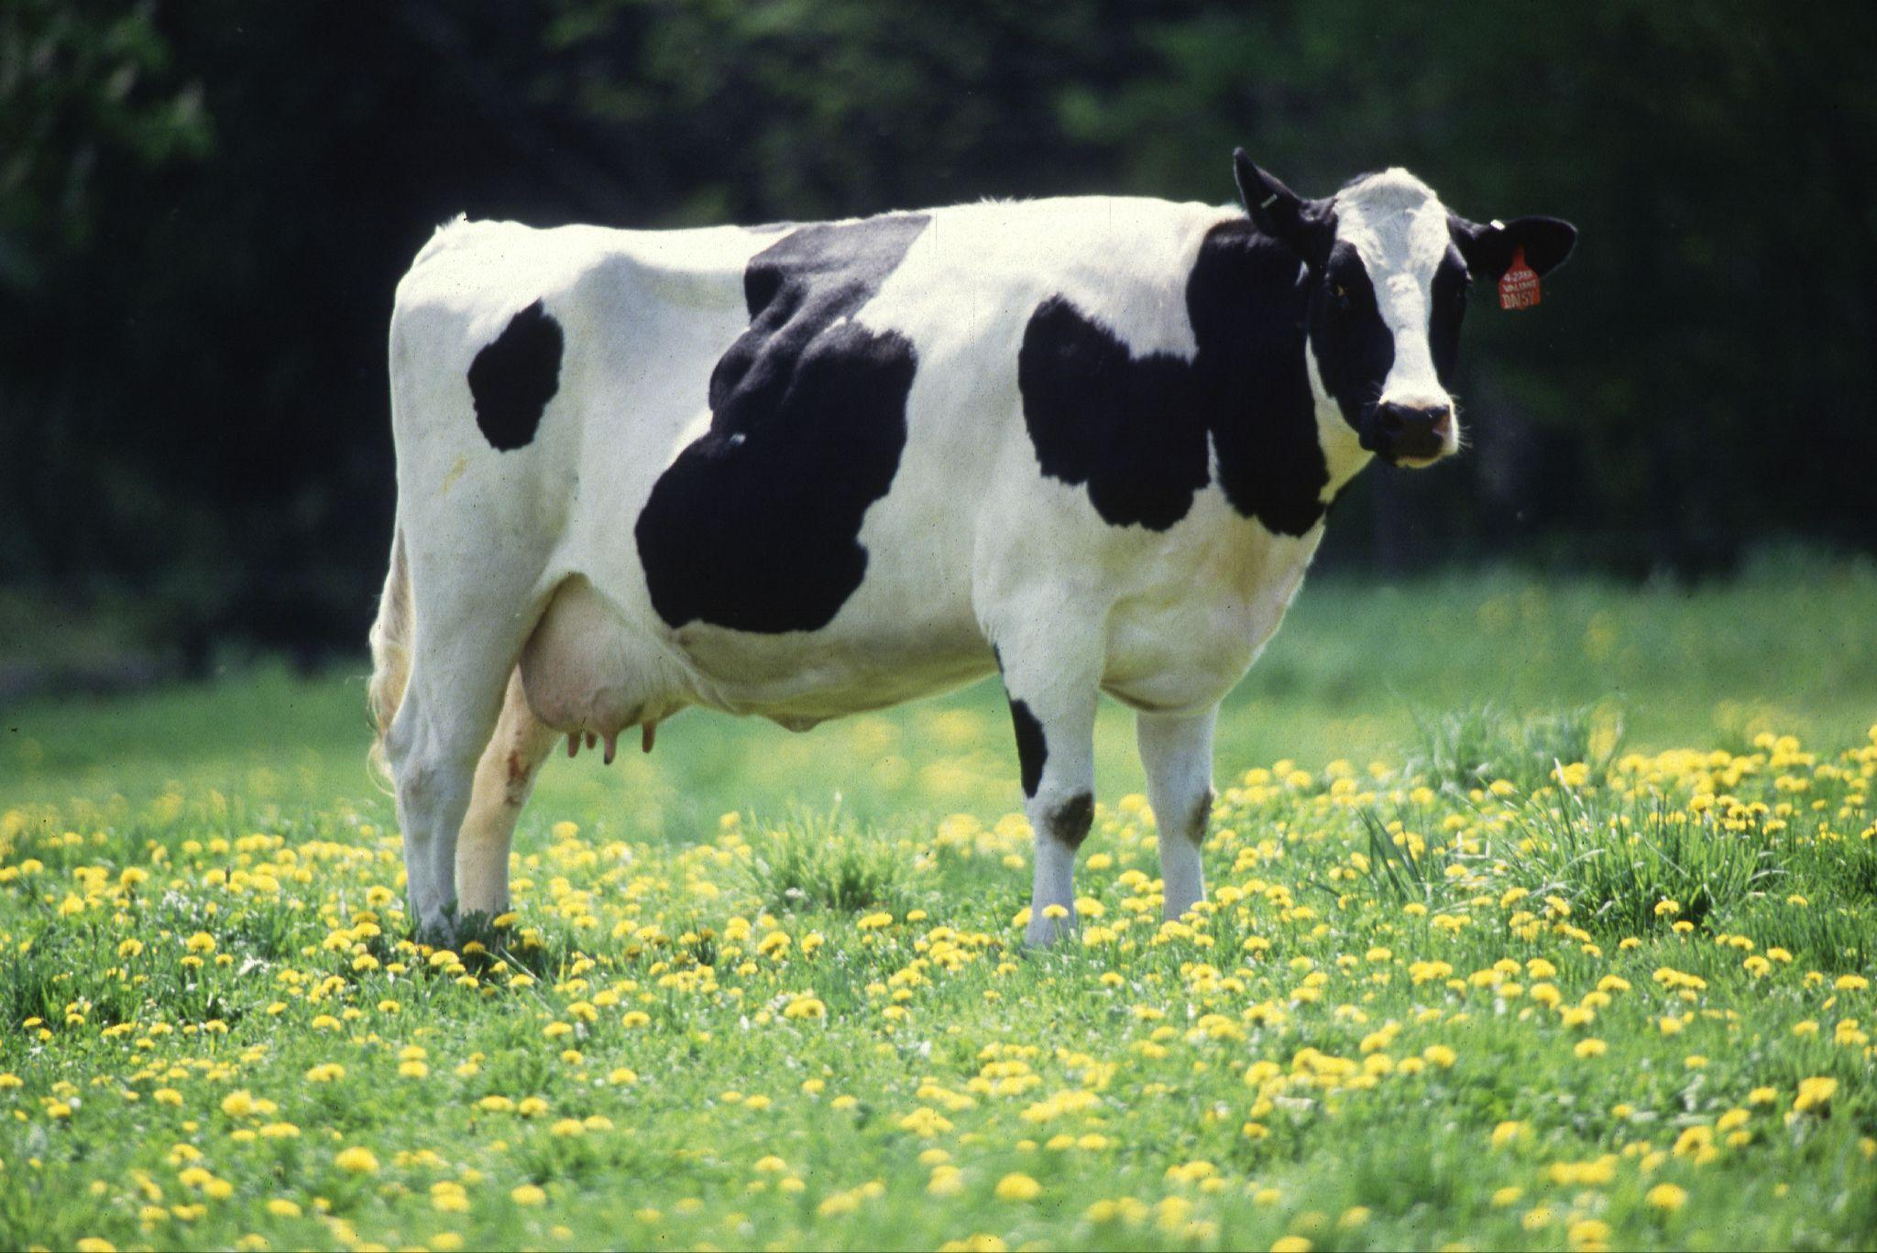
This cow is not an example of a population since it is an individual organism. Populations are a group of the same species of organism.
Notes:
This cow is not an example of a population since it is an individual organism. Populations are a group of the same species of organism.

Slide 35
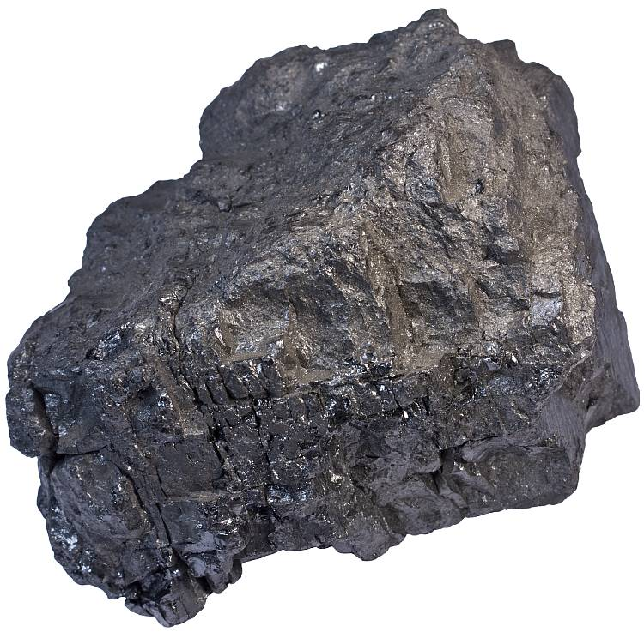
This rock is not an example of a population since it is not a living thing or organism. It cannot reproduce.
Notes:
This rock is not an example of a population since it is not a living thing or organism. It cannot reproduce.

Slide 36
Notes:
Now let’s pause for a moment to check your understanding.

Slide 37
Why are individual organisms not populations?
Notes:
Why are individual organisms not populations?
[Populations are groups of the same species of organisms.]

Slide 38
Why do organisms in populations
need to reproduce?
Notes:
Why do organisms in populations need to reproduce?
[Organisms in populations need to reproduce because it helps keep their species alive.]

Slide 39
Notes:
We can also break down the term population into different word parts to help us remember the meaning. Let’s take a look!

Slide 40
Population
Popul
a tion
(root)
(suffix)
Notes:
The word population can be broken down into two parts - a root and a suffix.

Slide 41
Population
Popul
a tion
(root)
(suffix)
community
Notes:
The root “popul” is used to describe a community.

Slide 42
Population
Popul
a tion
(root)
(suffix)
state, type or condition
Notes:
The suffix “-tion” is used to describe a state, type, or condition of something.

Slide 43
Popul
a tion
Population
A type of community
Notes:
These definitions tell us that a population is a type of community.

Slide 44
Notes:
Let’s check-in for understanding.

Slide 45
How can we use the word parts of population to help us remember the definition of the term?
Population
Popul
a tion
Notes:
How can we use the word parts of population to help us remember the definition of the term?
[The word population can be broken down into two parts.
The root “popul” is used to describe a community.
The suffix “tion” refers to a state, type, or condition.
These definitions tell us that a population is a type of community.]

Slide 46
Remember!!!
Notes:
So remember!

Slide 47
Population: all the organisms of the same species that live in the same place at the same time
Notes:
A population is all the organisms of the same species that live in the same place at the same time.

Slide 48
Notes:
We will now complete this concept map, called a Frayer model, to summarize and further clarify what you have learned about the term population.

Slide 49
Definition
Picture
Population
Example
How do populations impact my life?
Notes:
To complete the Frayer model, we will choose from four choices the correct picture, definition, example, and response to the question, “How do populations impact my life?” Select the best response for each question using the information you just learned. As we select responses, we will see how this model looks filled in for the term population.

Slide 50
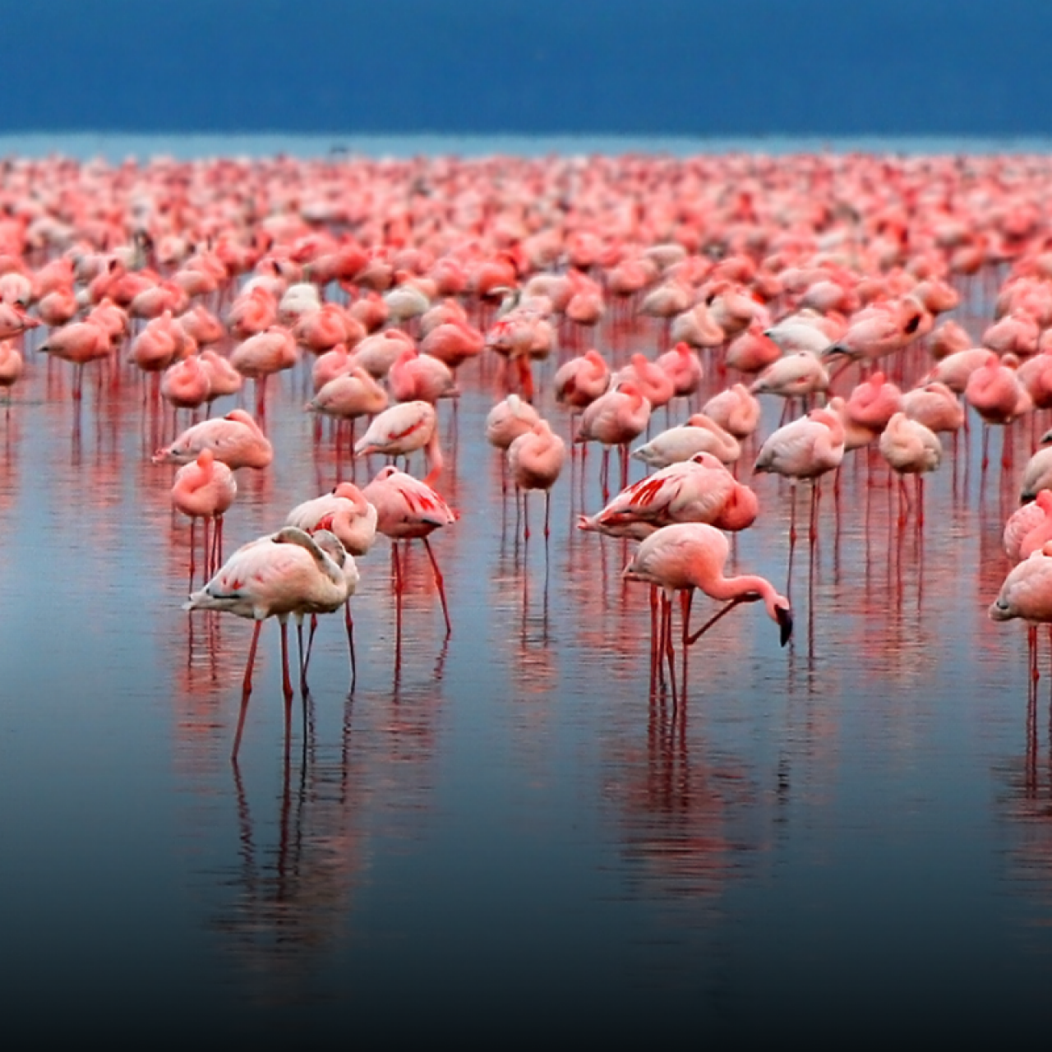
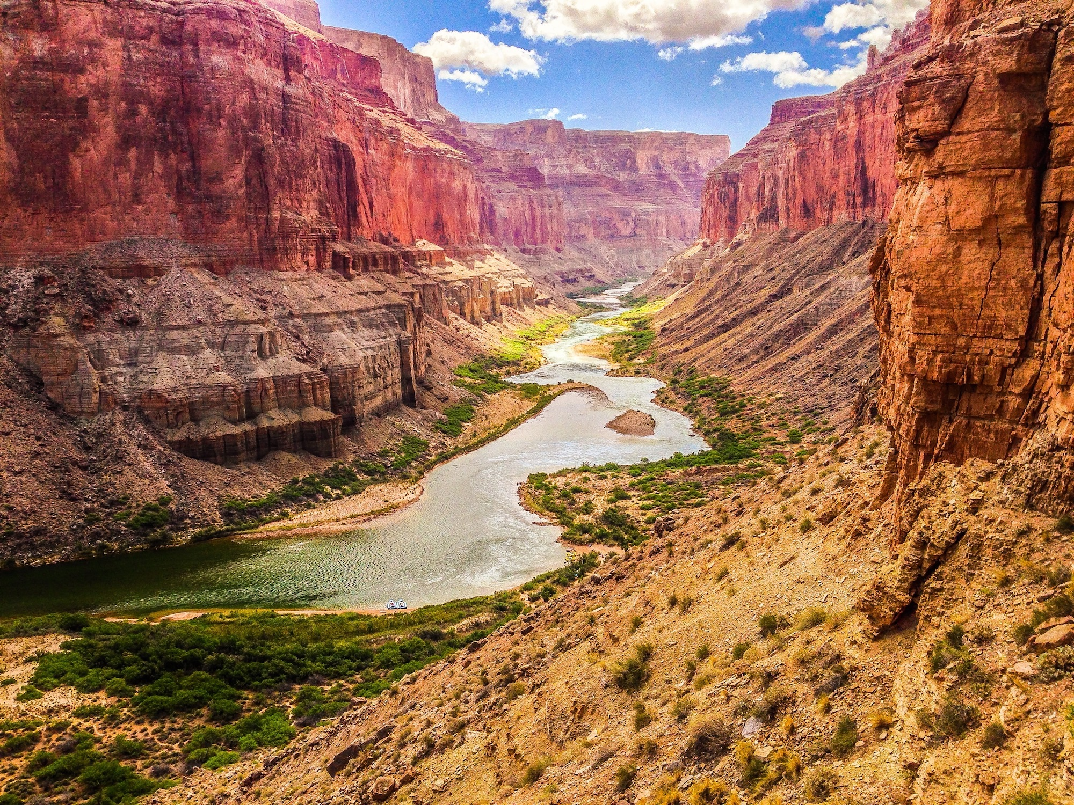
Directions: Choose the correct picture of a Population from the choices below.
A
B
C
D
Notes:
Choose the one correct picture of a population from these four choices.

Slide 51
Directions: Choose the correct picture of a Population from the choices below.
A
B
C
D
Notes:
This is the picture that shows a population.

Slide 52
Definition
Picture
Population
Example
How do populations impact my life?
Notes:
Here is the Frayer model filled in with a picture of population.

Slide 53
Directions: Choose the correct definition of Population from the choices below.
A
The path of energy from producers to consumers
B
All the organisms of the same species that live in the same place at the same time
C
Organisms that eat other organisms for energy
D
Any living thing
Notes:
Choose the one correct definition of population from these four choices.

Slide 54
Directions: Choose the correct definition of Population from the choices below.
A
The path of energy from producers to consumers
B
All the organisms of the same species that live in the same place at the same time
C
Organisms that eat other organisms for energy
D
Any living thing
Notes:
“All the organisms of the same species that live in the same place at the same time” is correct! This is the definition of population.

Slide 55
Definition
Picture
All the organisms of the same species that live in the same place at the same time
Population
Example
How do populations impact my life?
Notes:
Here is the Frayer Model with a picture and the definition filled in for population: All the organisms of the same species that live in the same place at the same time

Slide 56
Directions: Choose the correct example of a Population from the choices below.
A
A group of penguins living in Antarctica
B
A squirrel in a tree
C
A log in a forest
D
A river flowing through a valley
Notes:
Choose the one correct example of a population from these four choices.

Slide 57
Directions: Choose the correct example of a Population from the choices below.
A
A group of penguins living in Antarctica
B
A squirrel in a tree
C
A log in a forest
D
A river flowing through a valley
Notes:
“A group of penguins living in Antarctica” is correct! This is an example of a population.

Slide 58
Definition
Picture
All the organisms of the same species that live in the same place at the same time
Population
A group of penguins living in Antarctica
Example
How do populations impact my life?
Notes:
Here is the Frayer Model with a picture, definition, and an example of a population: A group of penguins living in Antarctica.

Slide 59
Directions: Choose the correct response for “how do populations impact my life?” from the choices below.
A
Populations involve important processes for the human body to breathe which helps me stay alive.
B
Populations explain how weather impacts the environment and how we can protect ourselves.
C
Populations detail important historical findings that shape laws and policies of our government.
D
Populations show us how groups of the same species survive so we can better understand organisms on Earth.
Notes:
Choose the one correct response for “how do populations impact my life?” from these four choices.

Slide 60
Directions: Choose the correct response for “how do populations impact my life?” from the choices below.
A
Populations involve important processes for the human body to breathe which helps me stay alive.
B
Populations explain how weather impacts the environment and how we can protect ourselves.
C
Populations detail important historical findings that shape laws and policies of our government.
D
Populations show us how groups of the same species survive so we can better understand organisms on Earth.
Notes:
“Populations show us how groups of the same species survive so we can better understand organisms on Earth.” That is correct! This is an example of how populations impact your life.

Slide 61
Definition
Picture
All the organisms of the same species that live in the same place at the same time
Population
A group of penguins living in Antarctica
Populations show us how groups of the same species survive so we can better understand organisms on Earth.
Example
How do populations impact my life?
Notes:
Here is the Frayer Model with a picture, definition, example, and a correct response to “how do populations impact my life?”: Populations show us how groups of the same species survive so we can better understand organisms on Earth.

Slide 62
Remember!!!
Notes:
So remember!

Slide 63
Big Question: What type of living things are in a population and how do they work together?
Notes:
Our “big question” is: What type of living things are in a population and how do they work together?
Does anyone have any additional examples to share that haven’t been discussed yet?

Slide 64
Population: all the organisms of the same species that live in the same place at the same time
Notes:
A population is all the organisms of the same species that live in the same place at the same time.

Slide 65
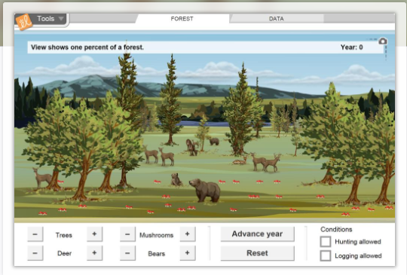
Simulation Activity
Forest Ecosystems Gizmo
Click the link above to access the Forest Ecosystems Gizmo.
In this simulation activity, you’ll observe and manipulate the populations of four creatures (trees, deer, bears, and mushrooms) in a forest, and investigate the feeding relationships in the forest. Pictographs and line graphs show changes in populations over time.
Notes:
Feedback: Providing a simulation activity is a great way to make science thinking visible. In this simulation, students have the opportunity to make predictions and apply an idea to a new situation by changing the variables in the simulation (i.e., populations of creatures).

Slide 66
Notes:
Thanks for watching, and please continue watching CAPs available from this website.

Slide 67
This Was Created With Resources From:
Questions or Comments
Michael Kennedy, Ph.D. MKennedy@Virginia.edu
Rachel L Kunemund, Ph.D. rk8vm@virginia.edu

