Slide 1
Intro
“Big Idea” Question
Review Concepts
Check-In Questions
Teacher Engagement
Vocabulary
Student-Friendly Definition
Examples & Non-Examples
Morphological Word Parts
Frayer Model
Simulation/Activity
Notes:
OK everyone, get ready for our next lesson. Just as a reminder, these are the different components that our lesson may include, and you’ll see these icons in the top left corner of each slide so that you can follow along more easily!

Slide 2
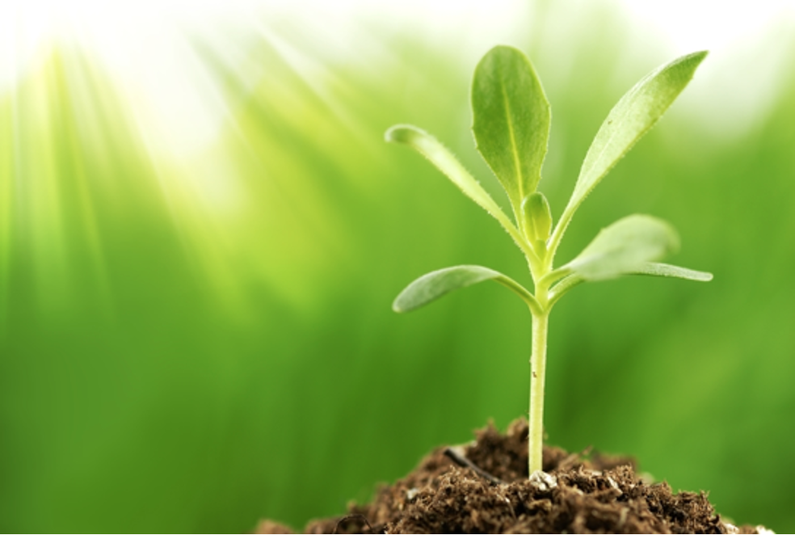
Intro
Producer
Notes:
Today, we’ll be learning about the word: Producer.

Slide 3
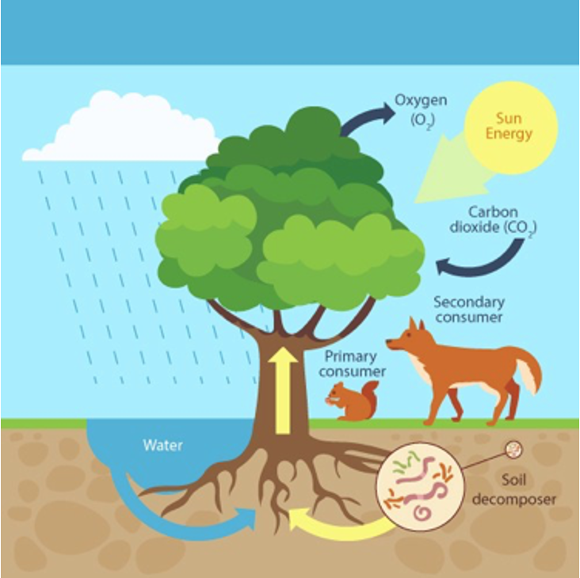
Big Question: How do producers interact with other plants and animals?
Notes:
Our “big question” is: How do producers interact with other plants and animals?
[Pause and illicit predictions from students.]
I love all these thoughtful scientific hypotheses! Be sure to keep this question and your predictions in mind as we move through these next few lessons, and we’ll continue to revisit it.

Slide 4
Notes:
Before we move on to our new topic, let’s review some other words & concepts that you already learned and make sure you are firm in your understanding.

Slide 5
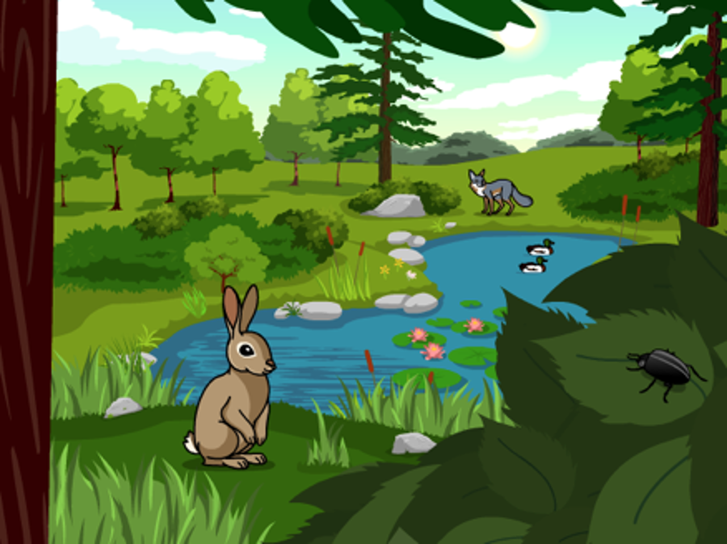
Ecosystem: an area where living and nonliving things interact
Notes:
An ecosystem is an area where living and nonliving things interact.

Slide 6
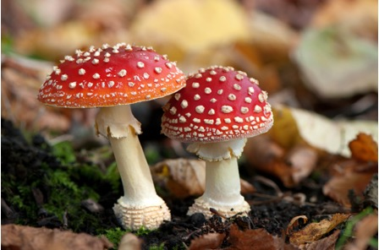
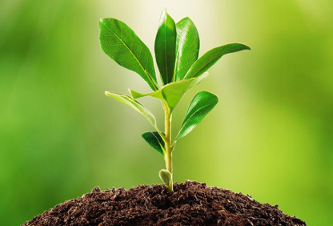
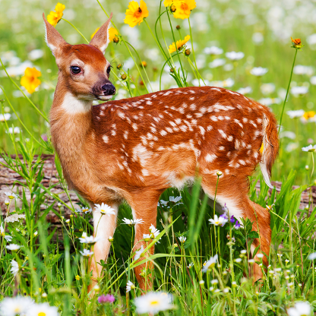
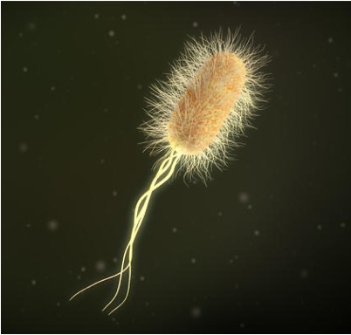
Biotic Factor: living things in an ecosystem
Notes:
Biotic factors are the living things in an ecosystem.

Slide 7
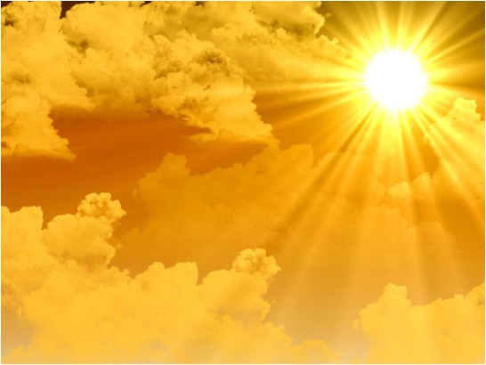
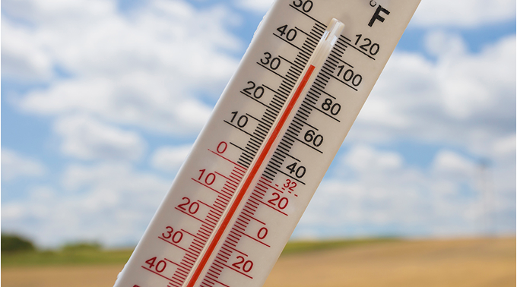
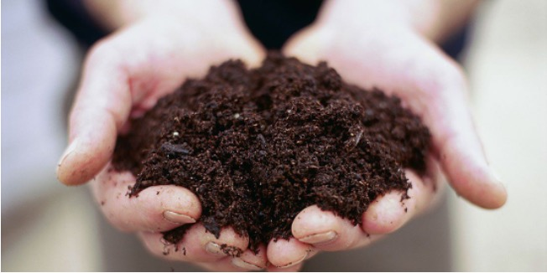
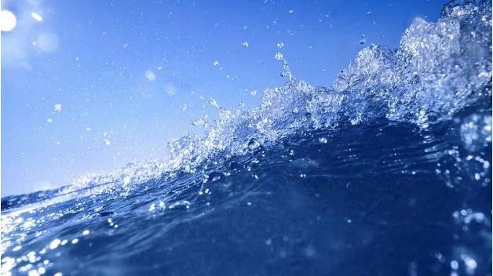
Abiotic Factor: nonliving things in an ecosystem
Notes:
Abiotic factors are nonliving things in an ecosystem.

Slide 8
Notes:
Now let’s pause for a moment to review the information we have covered already.

Slide 9
What is an ecosystem?
Notes:
What is an ecosystem?
[an area where living and nonliving things interact]

Slide 10
What is the difference between biotic and abiotic factors in an ecosystem?
Notes:
What is the difference between biotic and abiotic factors in an ecosystem?
[Biotic are living and abiotic are nonliving things]

Slide 11
Producer
Notes:
Now that we’ve reviewed, let’s define the phrase producer.

Slide 12
Producer: organisms that use energy from the sun to make their own food
Notes:
Producers are living things that use energy from the sun to make their own food.

Slide 13
Notes:
Let’s check-in for understanding.

Slide 14
Producers get energy from the _______ to make their own food.
Notes:
Producers get energy from the ____ to make their own food.
[sun]

Slide 15
Producers get energy from the sun to make their own food.
Notes:
Producers get energy from the sun to make their own food.

Slide 16
Notes:
That is the basic definition, but there is a bit more you need to know.

Slide 17
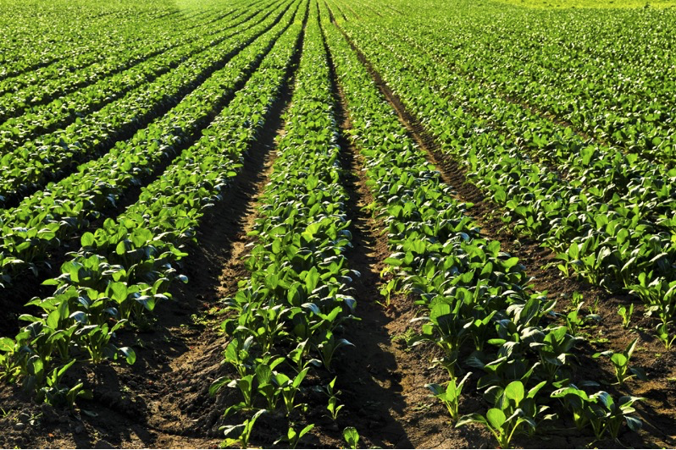
Green plants make their own food using photosynthesis
Notes:
Green plants make their own food using photosynthesis.

Slide 18
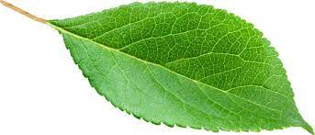
Chlorophyll in the green leaves traps the sun’s energy
Notes:
The chlorophyll in the plant’s leaves traps the sun’s energy so it can be used to create its own food.

Slide 19
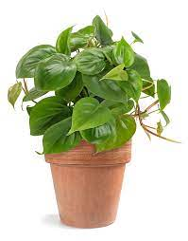
Green plants are producers
Notes:
So, this makes green plants producers.

Slide 20
Notes:
Let’s check-in for understanding.

Slide 21
What process do green plants use to create their own food?
Erosion
Photosynthesis
Melting
Notes:
What process do green plants use to create their own food?
[B. Photosynthesis]

Slide 22
What process do green plants use to create their own food?
Erosion
Photosynthesis
Melting
Notes:
What process do green plants use to create their own food? B. Photosynthesis

Slide 23
The sun’s energy comes is trapped by the plant’s roots.
True
False
Notes:
The sun’s energy is trapped by the plant’s roots.
[False]

Slide 24
The sun’s energy comes is trapped by the plant’s roots.
True
False
Notes:
The sun’s energy is trapped by the plant’s roots. False

Slide 25
Notes:
Now, let’s talk about some examples of producers.

Slide 26
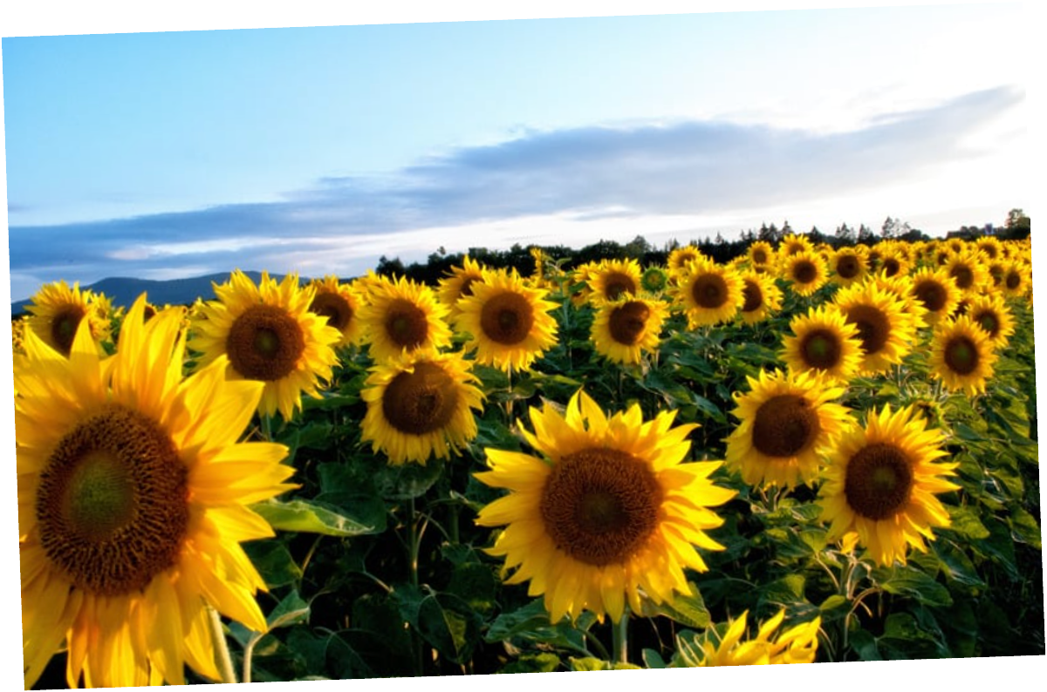
Sunflowers are an example of a producer
Notes:
Here is an example of a producer. Sunflowers use the sun’s energy to make their own food.

Slide 27
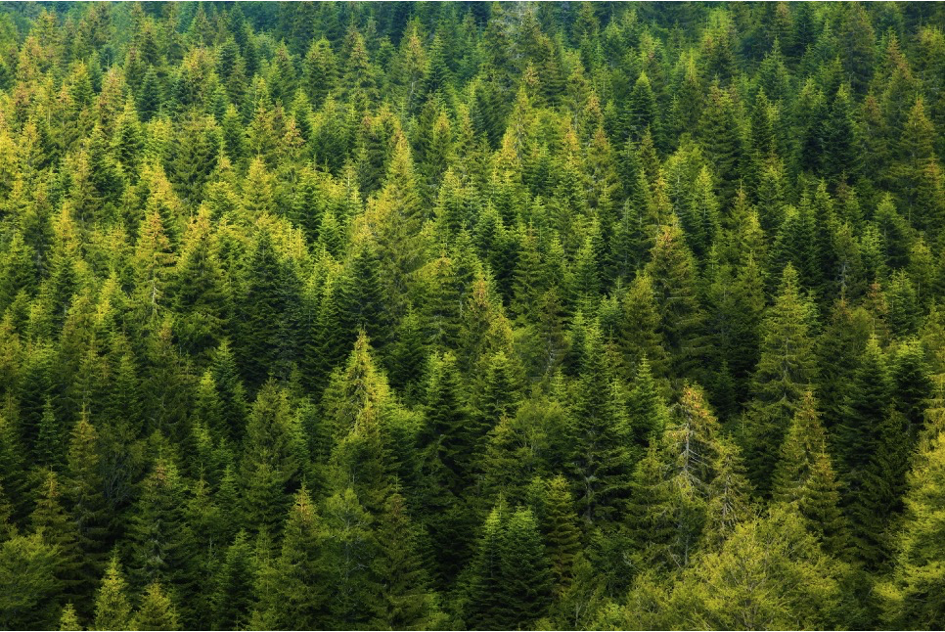
Trees are also an example of a producer
Notes:
Here is another example of producers. The trees in this forest also use photosynthesis to make their own food.

Slide 28
Notes:
Now, let’s talk about some non-examples of producers.

Slide 29
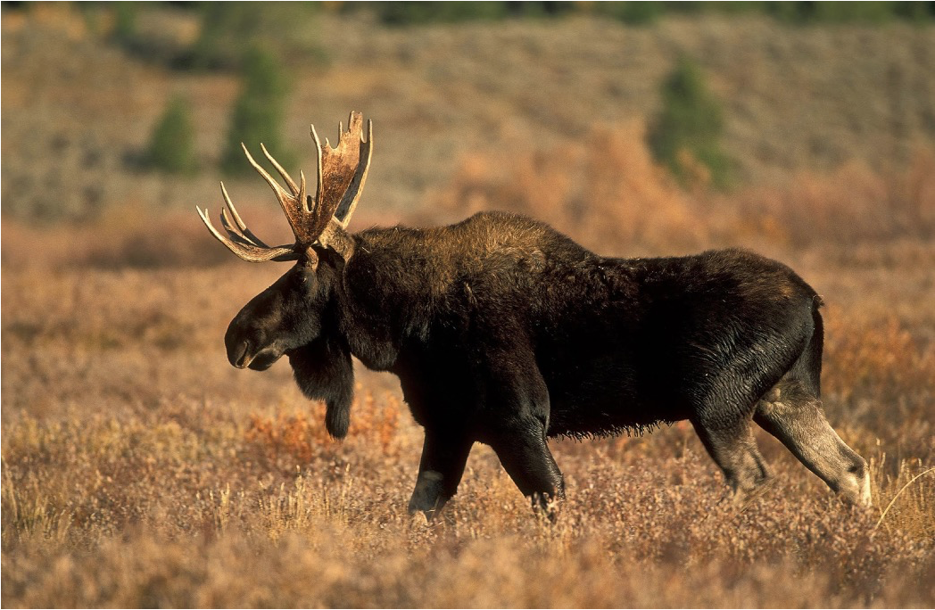
Moose are NOT an example of a producer
Notes:
This is not an example of a producer. Moose cannot make their own food, they must eat plants to get its energy.

Slide 30
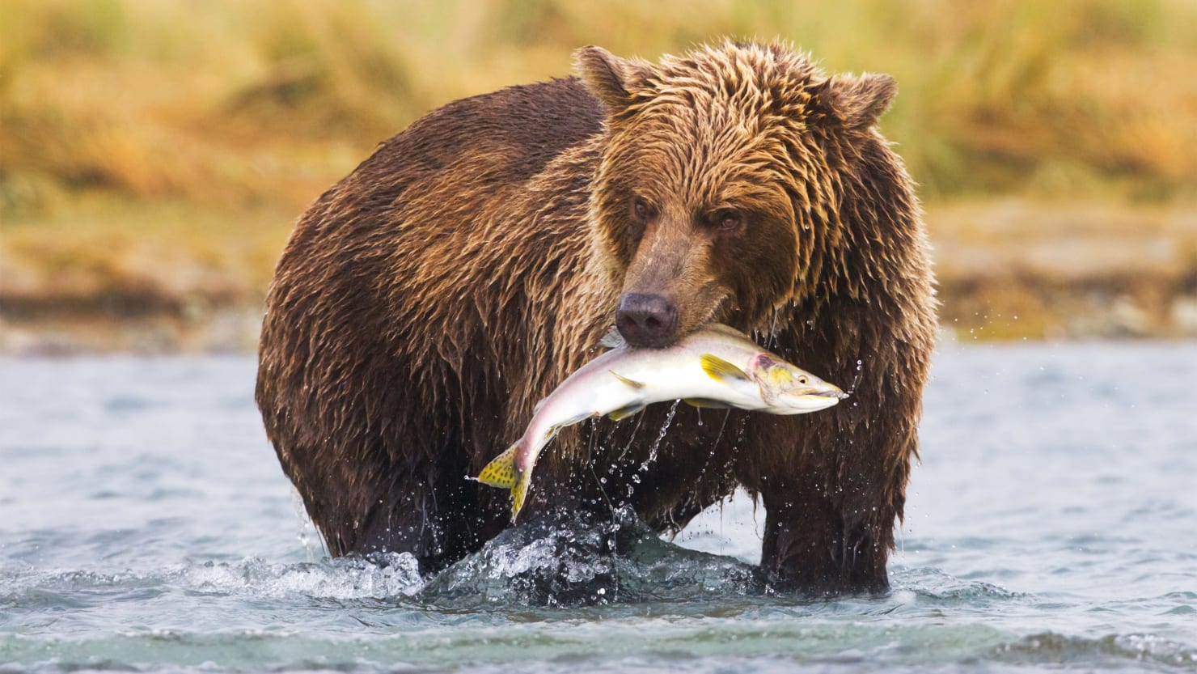
Bears are also NOT an
example of a producer
Notes:
This bear is not a producer because it cannot make its own food. Instead, he eats plants and animals, like this fish, to get its energy.

Slide 31
Notes:
Now let’s pause for a moment to check your understanding.

Slide 32
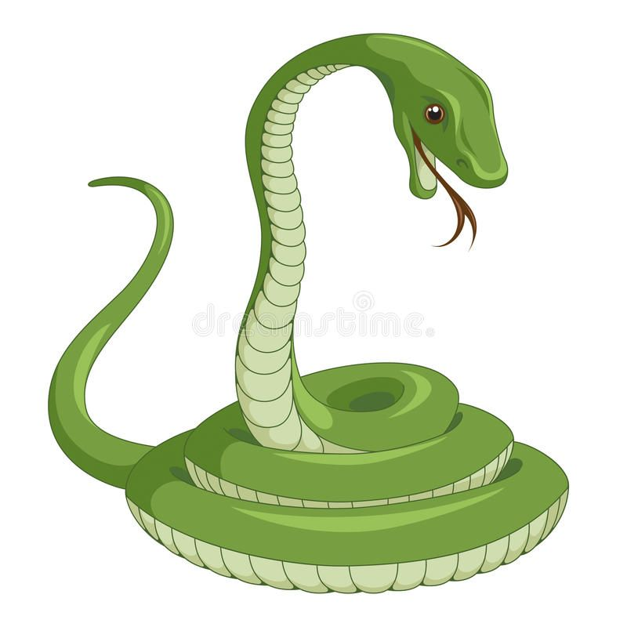
Which one is NOT a producer?
House Plant
Tree
Snake
Notes:
Which one is not a producer?
[Snake]

Slide 33
Which one is NOT a producer?
House Plant
Tree
Snake
Notes:
Which one is not a producer? Snake

Slide 34
Notes:
We can also break down the term producer into different word parts to help us remember the meaning. Let’s take a look!

Slide 35
Producer
(root)
(suffix)
Notes:
We can break up the term producer into two parts: a root and a suffix.

Slide 36
Producer
to make or create
Notes:
First, the root word “produce” means to make or create.

Slide 37
Producer
something that performs an action
Notes:
The suffix -er means something that performs an action.

Slide 38
Produc + er
something that makes or creates
Notes:
So, when you add the suffix, -er to the root word produce, this means someone or something that makes or creates.

Slide 39
So, when we use the term producers, we are talking about organisms that make their own food.
Notes:
So a producer is something that can make or create. Producers in an ecosystem can make or create their own food.

Slide 40
Notes:
Now let’s pause for a moment to check your understanding.

Slide 41
List 3 examples of producers.
Notes:
List three examples of producers.

Slide 42
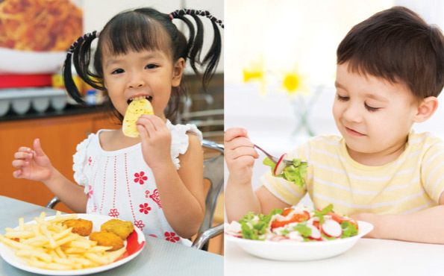
Are people producers?
Notes:
Are people producers?
[No. We cannot create our own food. We have to eat food.]

Slide 43
Remember!!!
Notes:
So remember!

Slide 44
Producer: organisms that use energy from the sun to make their own food
Notes:
Producers are organisms that uses energy from the sun to make their own food.

Slide 45
Notes:
We will now complete this concept map, called a Frayer model, to summarize and further clarify what you have learned about the term producer.

Slide 46
Definition
Picture
Producer
Example
How do producers impact my life?
Notes:
To complete the Frayer model, we will choose from four choices the correct picture, definition, example, and response to the question, “How do producers impact my life?” Select the best response for each question using the information you just learned. As we select responses, we will see how this model looks filled in for the term producer.

Slide 47
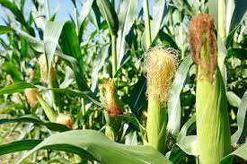
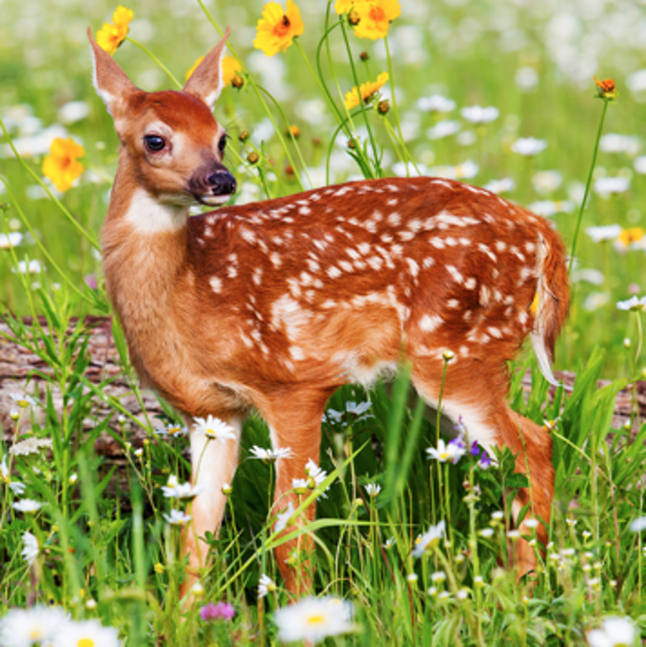
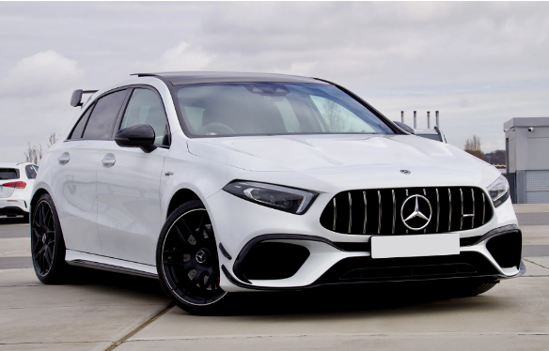
Directions: Choose the correct picture of a producer from the choices below.
A
B
C
D
Notes:
Choose the one correct picture of a producer from these four choices.

Slide 48
Directions: Choose the correct picture of a producer from the choices below.
A
B
C
D
Notes:
You are correct! This is a picture of a producer.

Slide 49
Definition
Picture
Producers
Example
How do producers impact my life?
Notes:
Here is the Frayer model filled in with a picture of a producer.

Slide 50
Directions: Choose the correct definition of producers from the choices below.
A
Organisms that use energy from the sun to make their own food
B
An electric current that can only follow one path
C
A push or pull of an object
D
Anything that has mass and takes up space
Notes:
Choose the one correct definition of producers from these four choices.

Slide 51
Directions: Choose the correct definition of producers from the choices below.
A
s
Organisms that use energy from the sun to make their own food
B
An electric current that can only follow one path
C
A push or pull of an object
D
Anything that has mass and takes up space
Notes:
You are correct! Producers are organisms that use energy from the sun to make their own food.

Slide 52
Definition
Picture
Organisms that use energy from the sun to make their own food
Producer
Example
How do producers impact my life?
Notes:
Here is the Frayer model filled in with a picture of and the definition filled in for producers: organisms that use energy from the sun to make their own food.

Slide 53
Directions: Choose the correct example of a producer from the choices below.
A
sand on the beach
B
cow in the field
C
bird in a tree
D
grass in the yard
Notes:
Choose the one correct example of producers from these four choices.

Slide 54
Directions: Choose the correct example of a producer from the choices below.
A
sand on the beach
B
cow in the field
C
bird in a tree
D
grass in the yard
Notes:
You are correct! An example of a producer is grass in the yard.

Slide 55
Definition
Picture
Organisms that use energy from the sun to make their own food
Producer
grass in the yard
Example
How do producers impact my life?
Notes:
Here is the Frayer model filled in with a picture of, the definition for, and an example of a producer: grass in the yard.

Slide 56
Directions: Choose the correct response for “how do producers impact my life?” from the choices below.
A
They store tiny water droplets that can produce rain
B
They warm up the water I drink
C
They help feed me and the other organisms I eat
D
They protect me from infections so I don’t get sick
Notes:
Choose the one correct response for “how do producers impact my life?” from these four choices.

Slide 57
Directions: Choose the correct response for “how do producers impact my life?” from the choices below.
A
They store tiny water droplets that can produce rain
B
They warm up the water I drink
C
They help feed me and the other organisms I eat.
D
They protect me from infections so I don’t get sick
Notes:
You are correct! Producers help feed me and the other organisms I eat.

Slide 58
Definition
Picture
Organisms that use energy from the sun to make their own food
Producer
grass in the yard
They help feed me and the
other organisms I eat
Example
How do producers impact my life?
Notes:
Here is the Frayer model with a picture, definition, example, and a correct response to “how do producers impact my life?”: They help feed me and the
other organisms I eat.

Slide 59
Remember!!!
Notes:
So remember!

Slide 60
Producer: organisms that use energy from the sun to make their own food
Notes:
Producers are organisms that use energy from the sun to make their own food.

Slide 61
Big Question: How do producers interact with other plants and animals?
Notes:
Our “big question” is: How do producers interact with other plants and animals?

Slide 62
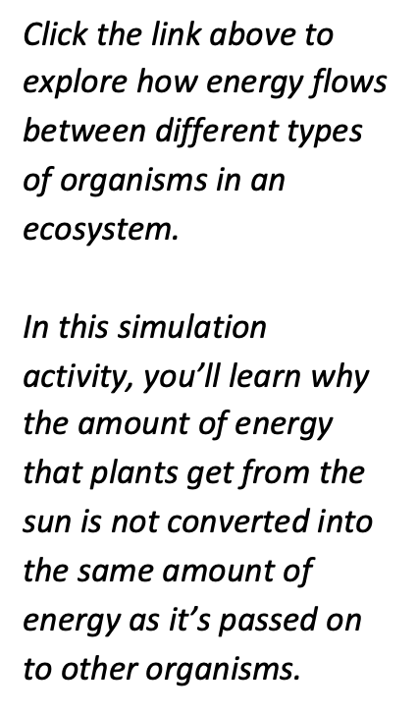
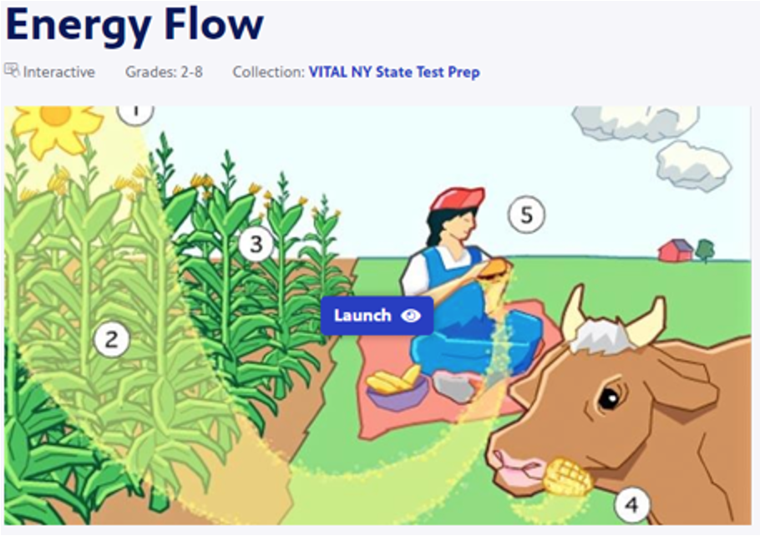
Simulation Activity
Energy Flow Interactive
(PBS Learning Media)
Notes:
Click the link above to explore how energy flows between different types of organisms in an ecosystem.
Feedback: Providing a rationale during this activity helps students make connections and promotes understanding of the content.

Slide 63
Notes:
Thanks for watching, and please continue watching CAPs available from this website.

Slide 64
This Was Created With Resources From:
Questions or Comments
Michael Kennedy, Ph.D. MKennedy@Virginia.edu
Rachel L Kunemund, Ph.D. rk8vm@virginia.edu

