Slide 1
Intro
“Big Idea” Question
Review Concepts
Check-In Questions
Teacher Demo
Vocabulary
Student-Friendly Definition
Examples & Non-Examples
Morphological Word Parts
Simulation/Activity
Notes:
OK everyone, get ready for our next lesson. Just as a reminder, these are the different components that our lesson may include, and you’ll see these icons in the top left corner of each slide so that you can follow along more easily!

Slide 2
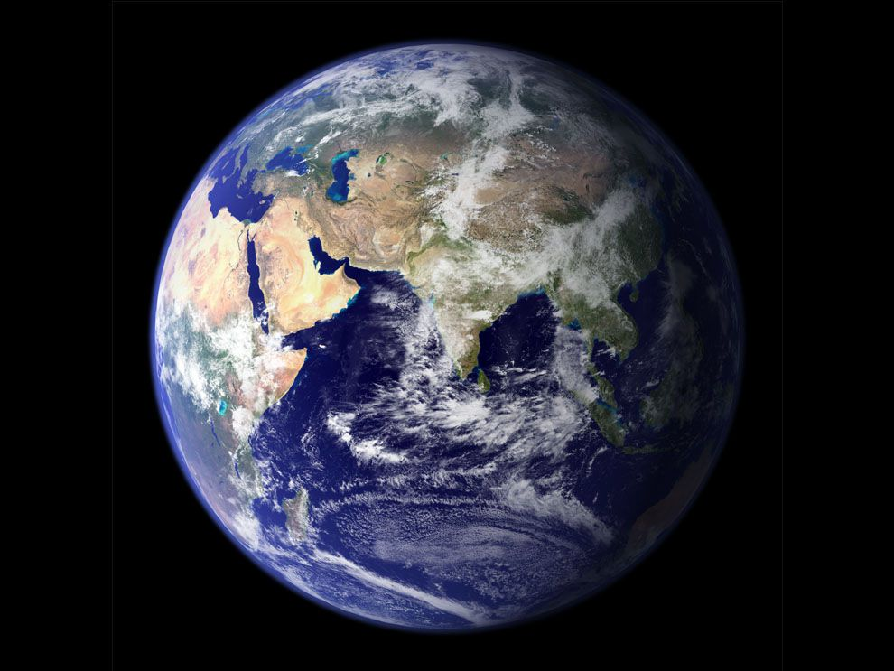
Intro
Properties of the Earth
Notes:
Today we will learn about the properties of the Earth.

Slide 3
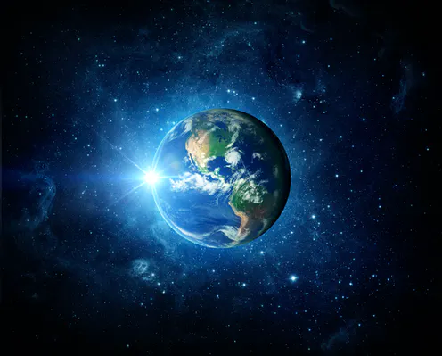
Big Question: What are the unique properties of our Earth?
Notes:
Our “big question” is: What are the unique properties of our Earth?
[Pause and illicit predictions from students.]
I love all these thoughtful scientific hypotheses! Be sure to keep this question and your predictions in mind as we move through these next few lessons, and we’ll continue to revisit it.

Slide 4
Notes:
Before we move on to our new vocabulary term, let’s review some other words & concepts that you already learned and make sure you are firm in your understanding.

Slide 5
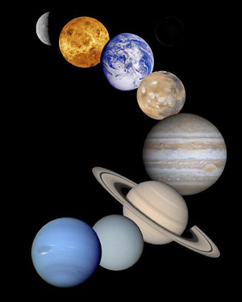
Planet: a body or object in space that revolves around a star and has a spherical shape
Notes:
A planet is a body or object in space that revolves around a star and has a spherical shape.
Feedback: Definitions don't always make a lot of sense for students, so the use of clear language is an important strategy.

Slide 6
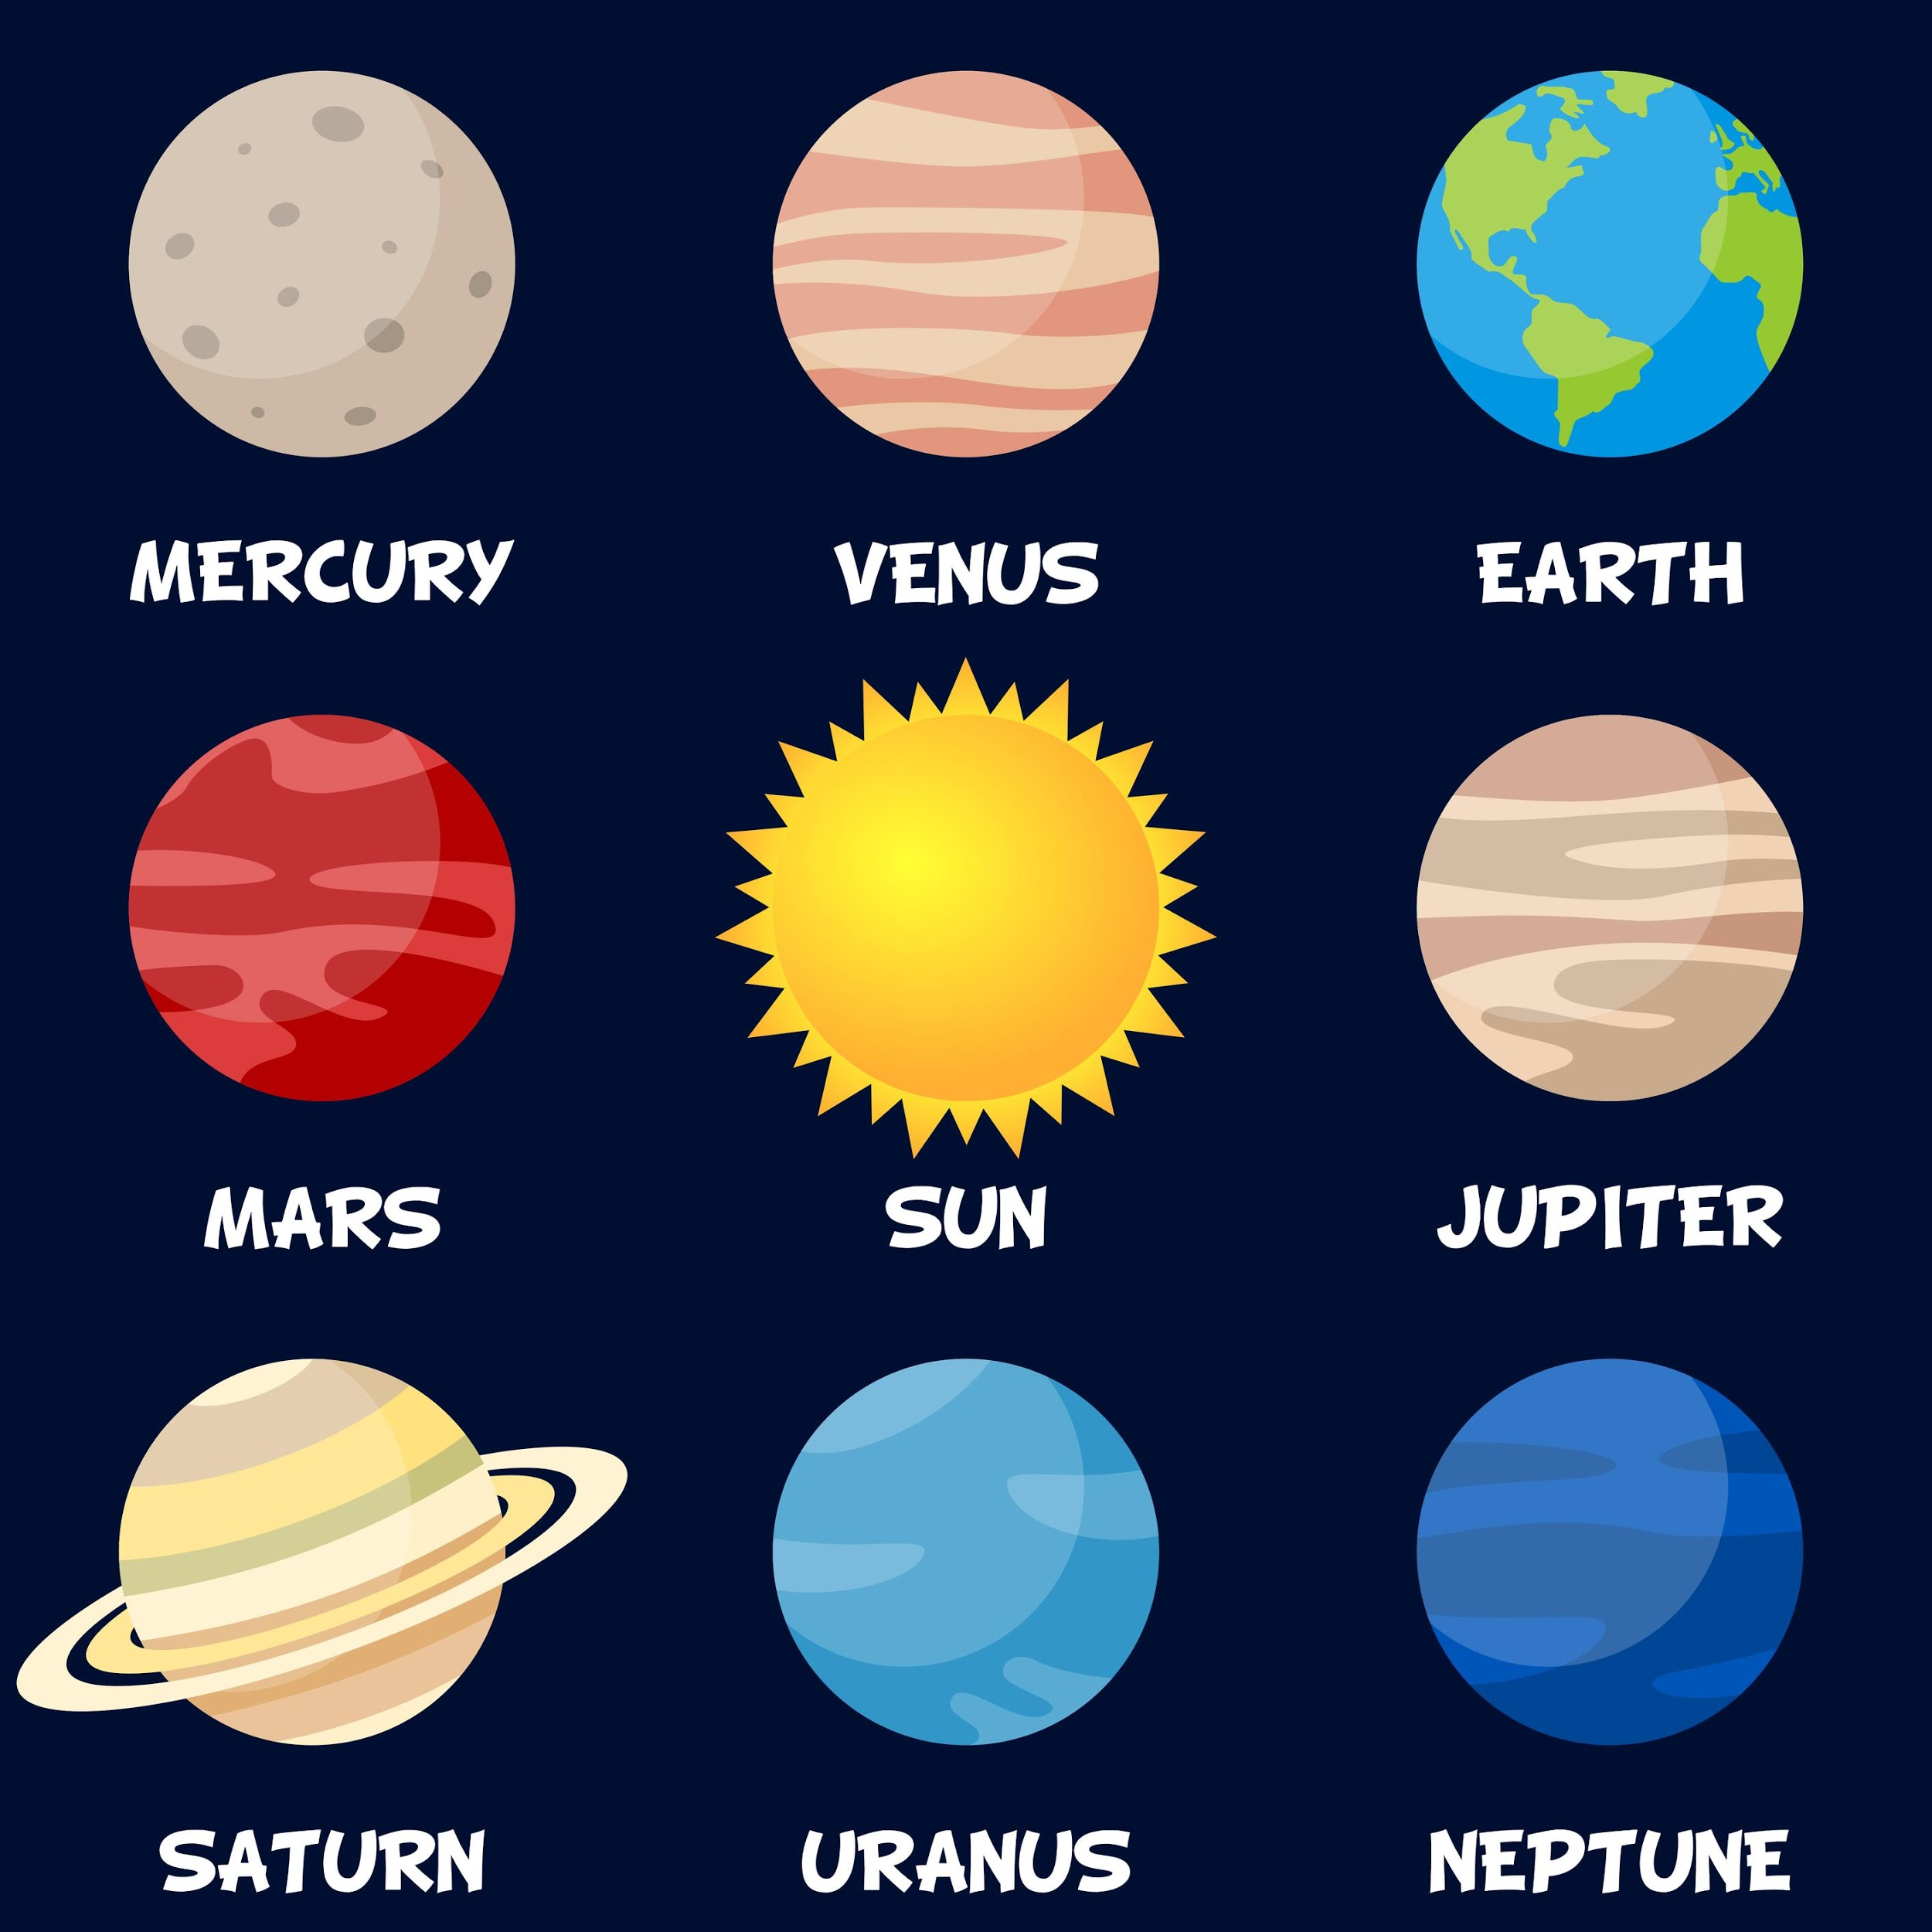
Notes:
Our solar system has 8 planets that revolve around the sun.

Slide 7
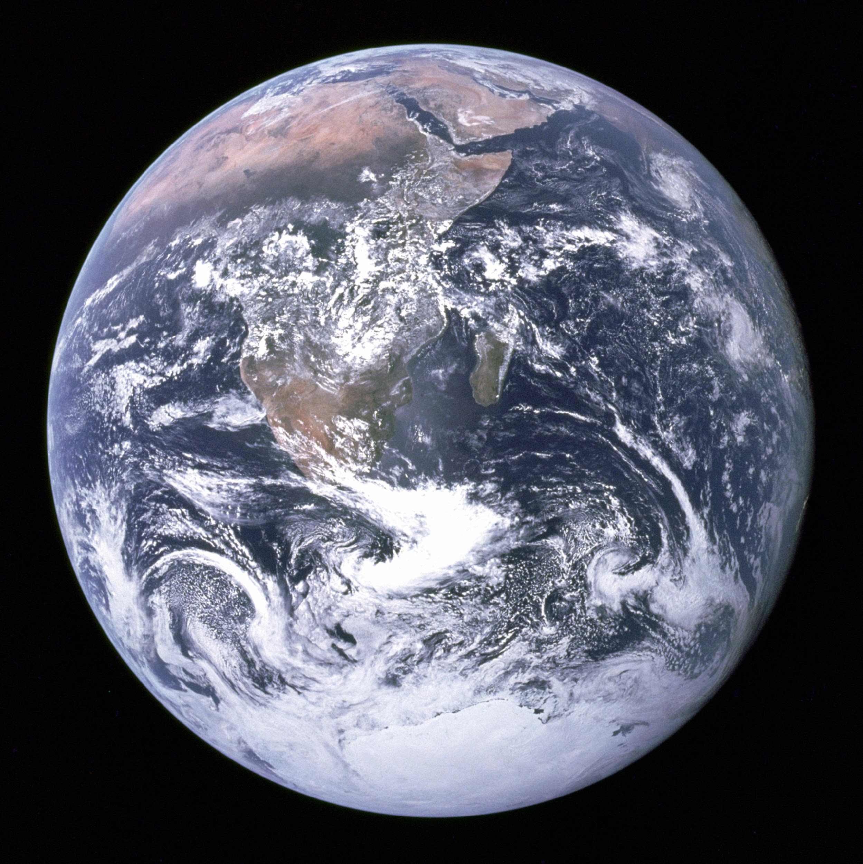
Earth: an inner planet
Notes:
Earth is the 3rd planet from the sun. It is one of the inner planets. Its surface has mountains, valleys, canyons, plains, and more. Most of the surface is water.

Slide 8
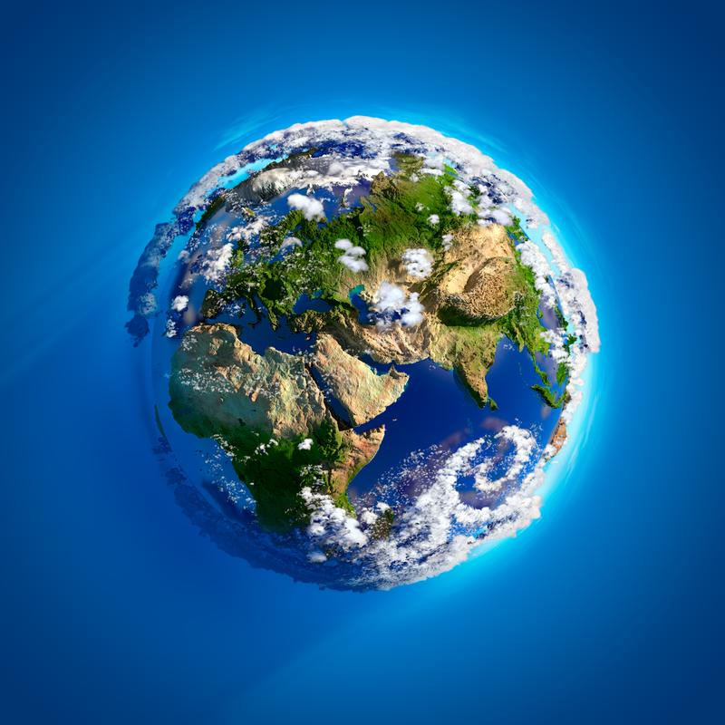
Atmosphere: the layers of gas surrounding the surface of a planet
Notes:
The atmosphere is the layers of gas surrounds the surface of a planet, like the earth. Sometimes the atmosphere is called a “blanket” of gases.

Slide 9
Notes:
Now let’s pause for a moment to check your understanding.

Slide 10
What is a planet?
Notes:
What is a planet?
[A planet is a body or object in space that revolves around a star and has a spherical shape.]

Slide 11
What are the characteristics of Earth?
Notes:
What are the characteristics of Earth?
[Earth is one of the inner planets. Its surface has mountains, valleys, canyons, plains, and more. Most of the surface is water.]

Slide 12
What is the atmosphere?
Notes:
What is the atmosphere?
[The atmosphere is the layers of gas surrounds the surface of a planet, like the earth. Sometimes the atmosphere is called a “blanket” of gases.]

Slide 13
Properties of the Earth
Notes:
Now that we’ve reviewed, let’s define our new term, properties of the Earth.

Slide 14
Properties of the Earth: important characteristics that make Earth different from other planets
Notes:
There are 3 important properties, or characteristics, of the Earth that make it different from other planets. We will learn about them in this lesson. They are:
Protective atmosphere
Rocky surface, mostly water
4.5 billion years old
Feedback: When providing more formal definitions and explicit content, it is helpful to provide students with cues so that they can be prepared and know what to expect.

Slide 15
Notes:
Let’s check-in for understanding.

Slide 16
What are the properties of the Earth?
Notes:
What are the properties of the Earth?
[There are three important properties, or characteristics, of the Earth that make it different from other planets. They are:
Protective atmosphere
Rocky surface, mostly water
4.5 billion years old]

Slide 17
Notes:
That is the basic definition, but there is a bit more you need to know.

Slide 18
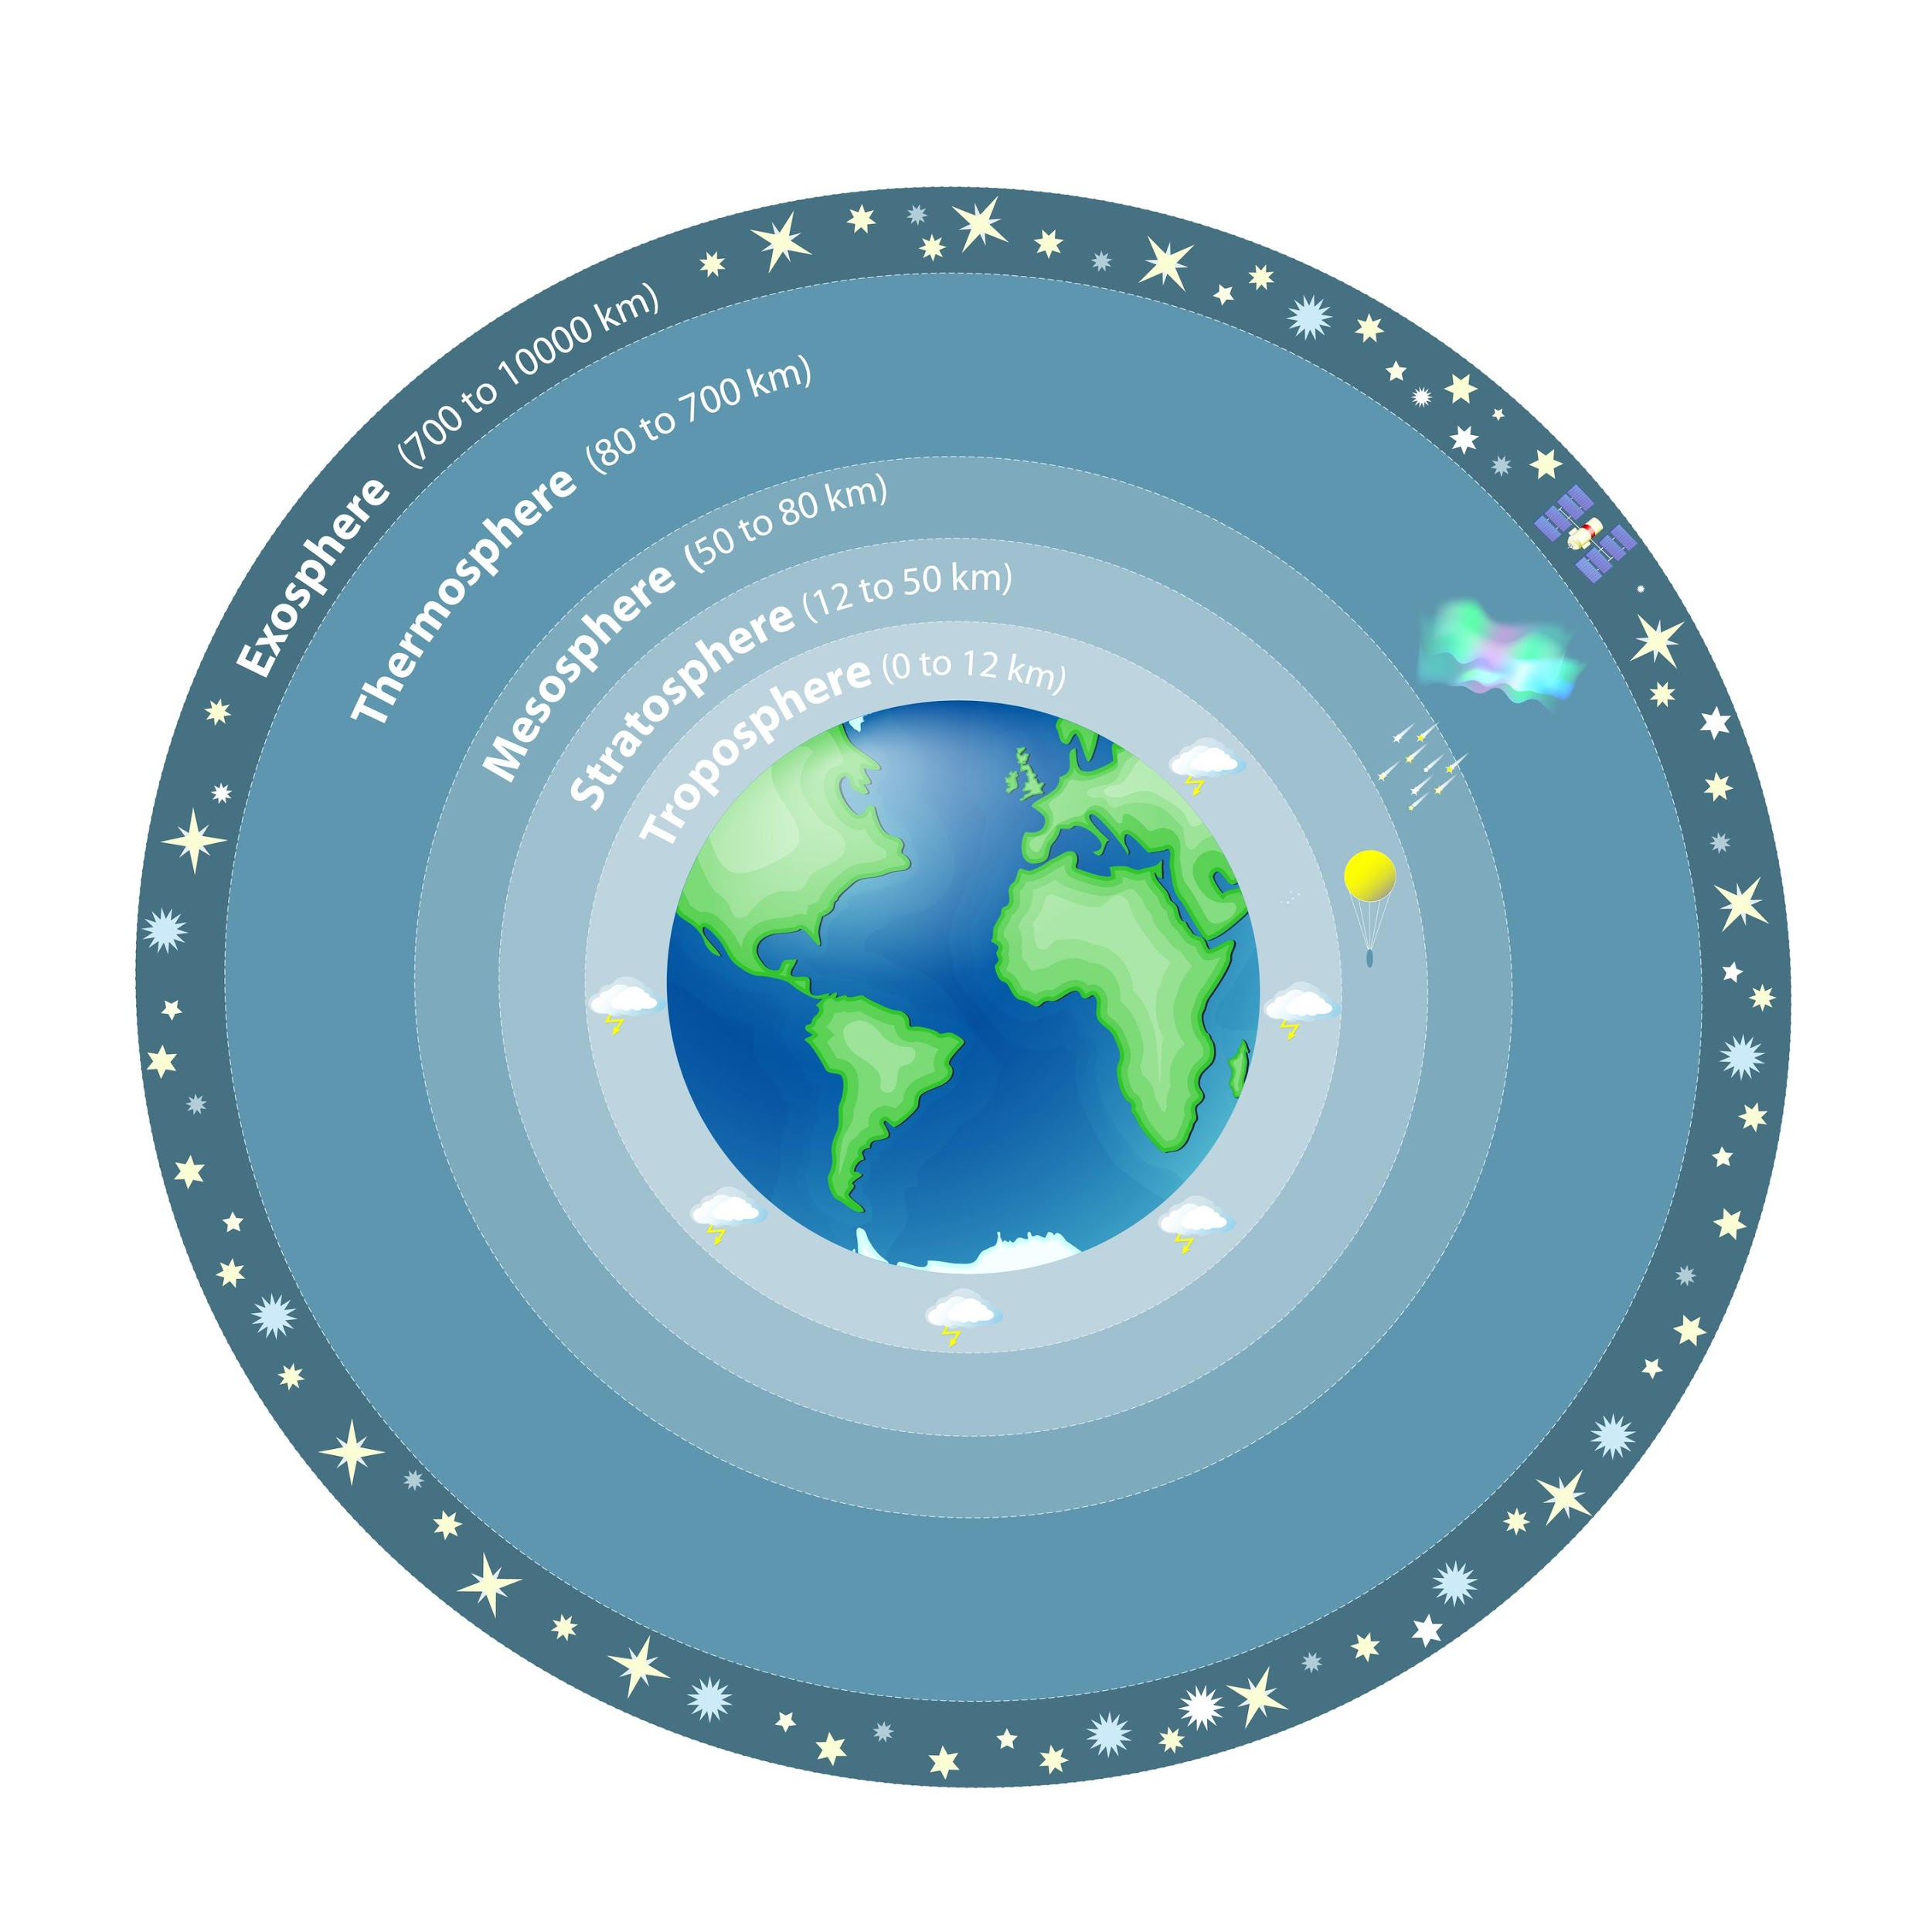
1. Protective Atmosphere
Notes:
First, the earth has a protective atmosphere.

Slide 19
Protective Atmosphere
Mostly Oxygen and Nitrogen
Notes:
Earth’s atmosphere is made up of gases. These are mostly nitrogen and oxygen.

Slide 20
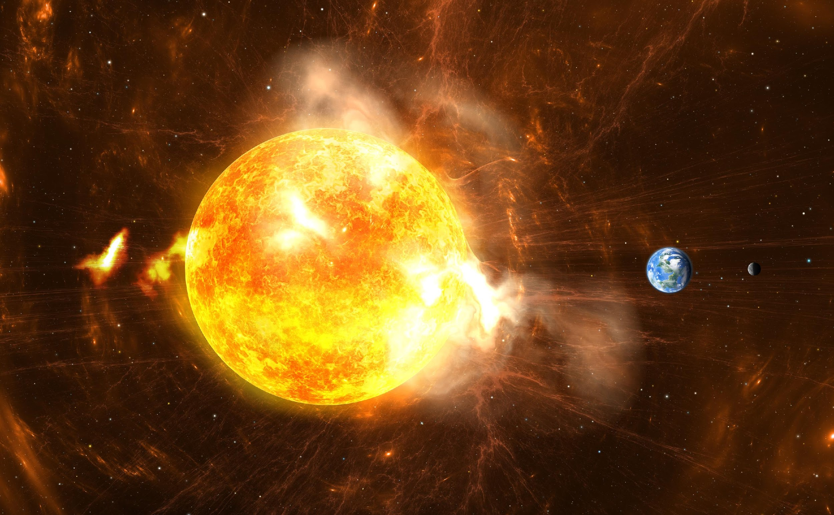
Protective Atmosphere
Notes:
The many layers of Earth’s atmosphere protect it from harmful ultraviolet radiation from the sun.

Slide 21
Notes:
Let’s check-in for understanding.

Slide 22
How is the Earth’s atmosphere protective?
Notes:
How is the Earth’s atmosphere protective?

Slide 23
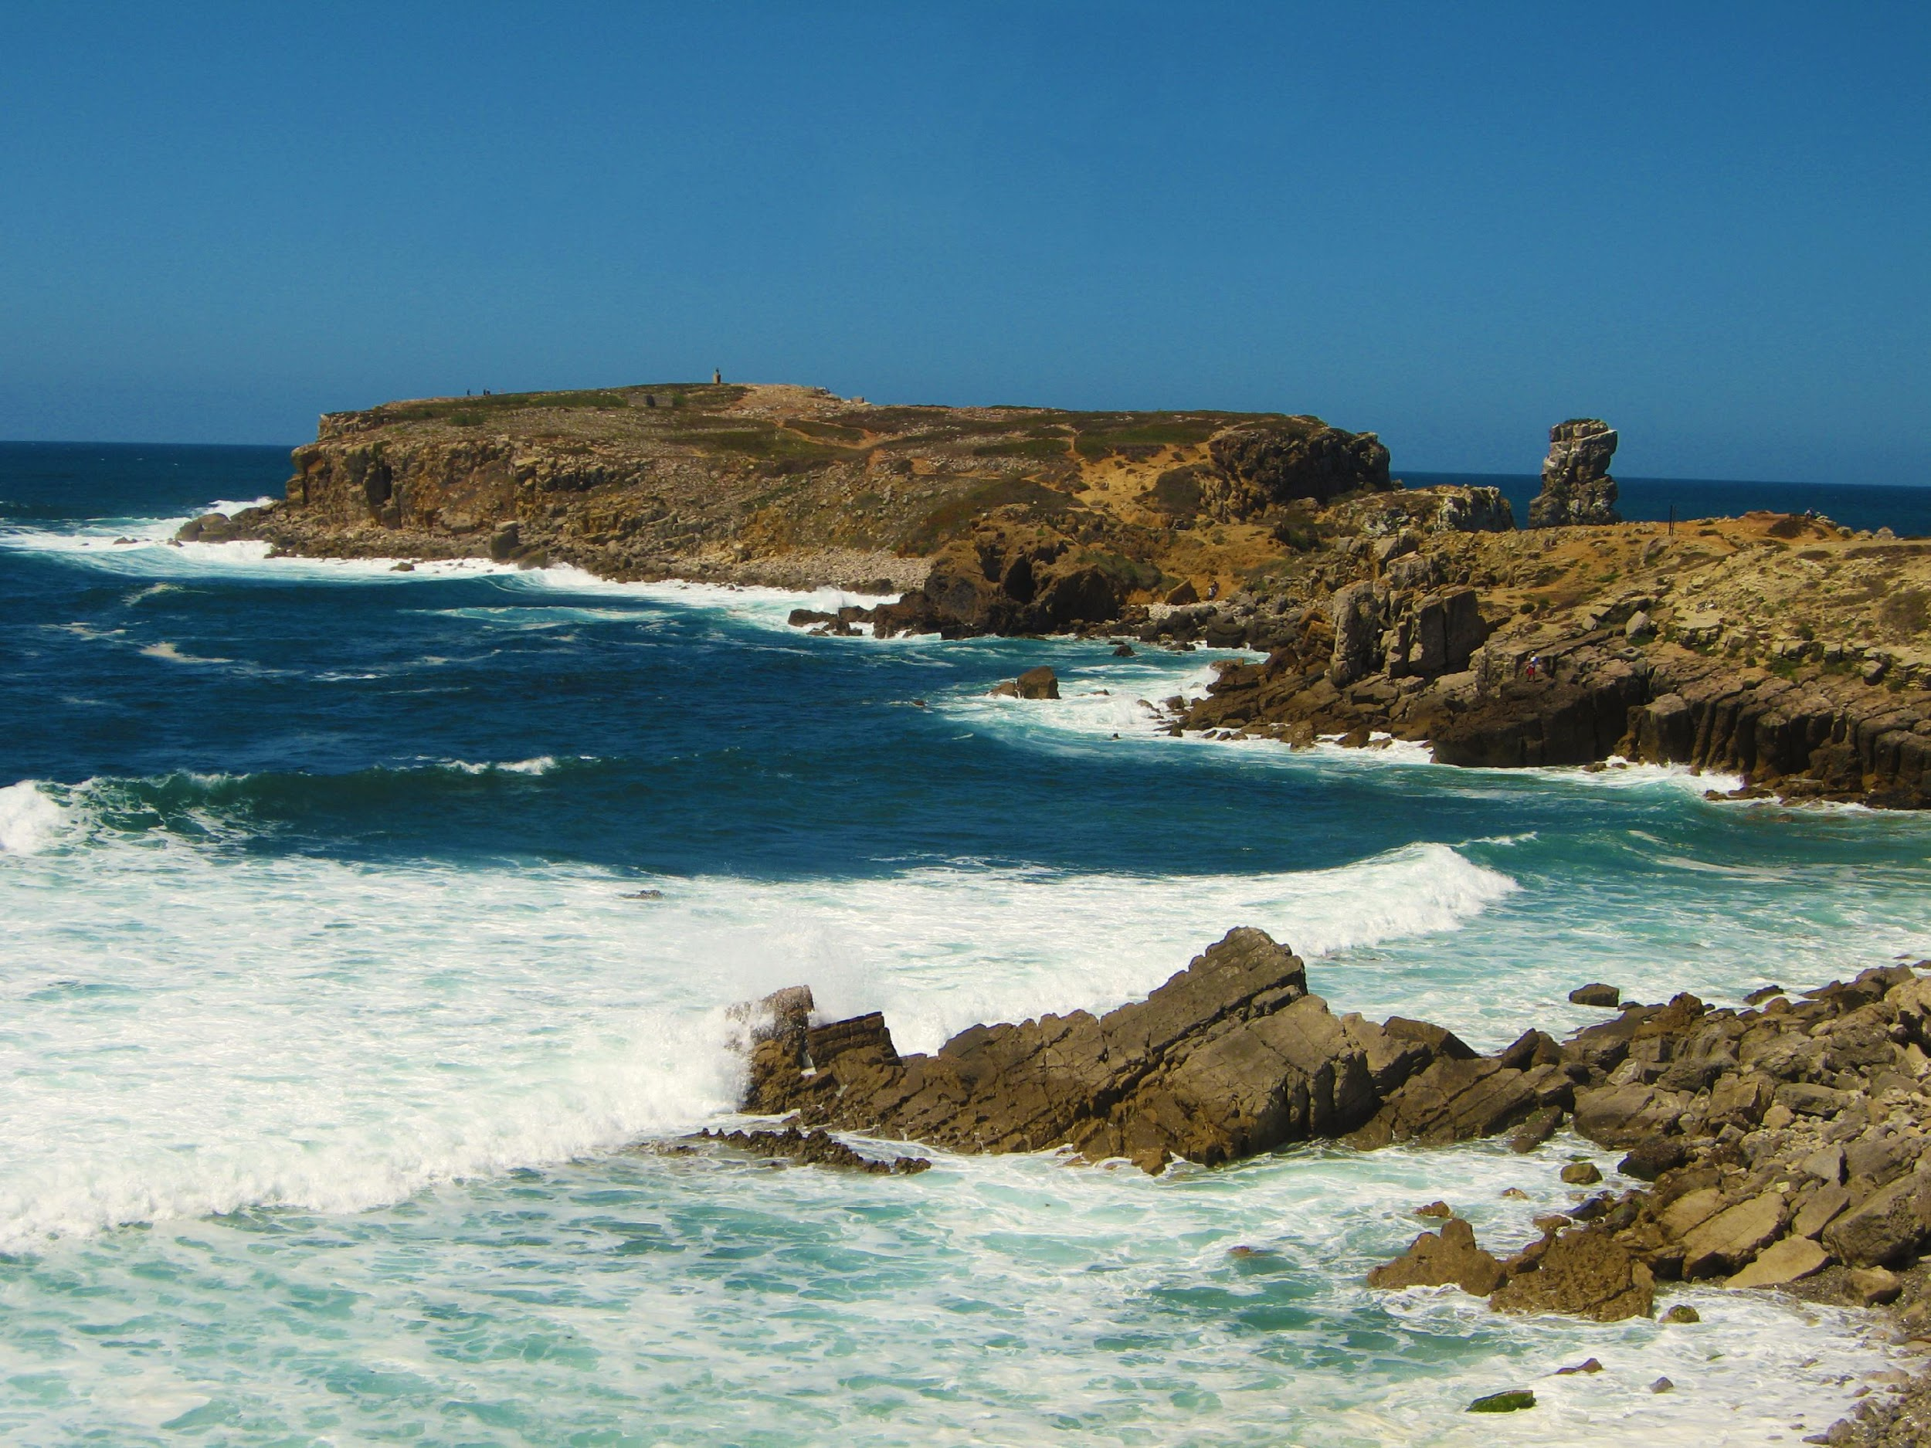
2. Earth is rocky and mostly covered with water
Notes:
The second property of Earth is that is has a rocky surface and is mostly covered with water.

Slide 24
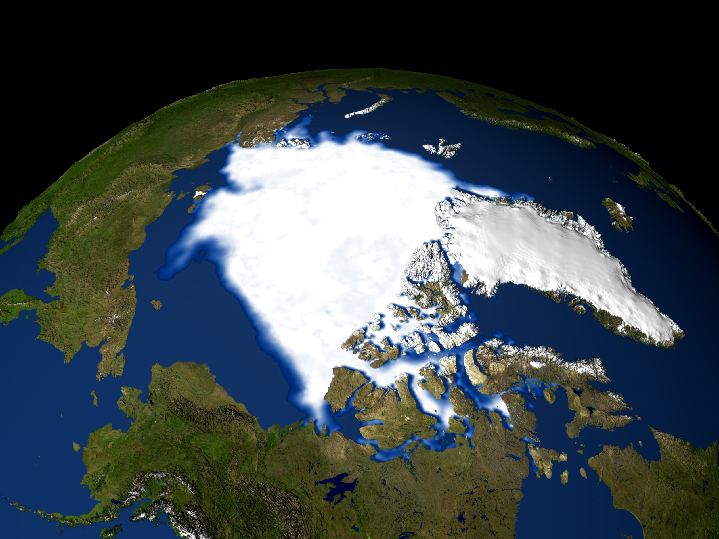
This water is frozen at the poles
Notes:
Most of the water on Earth is frozen at the North and South poles, in the polar ice caps.

Slide 25
Notes:
Let’s check-in for understanding.

Slide 26
What is the second property of Earth?
Notes:
What is the second property of Earth?
[The second property of Earth is that it has a rocky surface and is mostly covered with water.]

Slide 27
True/False: Most of the water on Earth is frozen at the North and South poles.
Notes:
True/False: Most of the water on Earth is frozen at the North and South poles.

Slide 28
True/False: Most of the water on Earth is frozen at the North and South poles.
Notes:
True/False: Most of the water on Earth is frozen at the North and South poles.

Slide 29
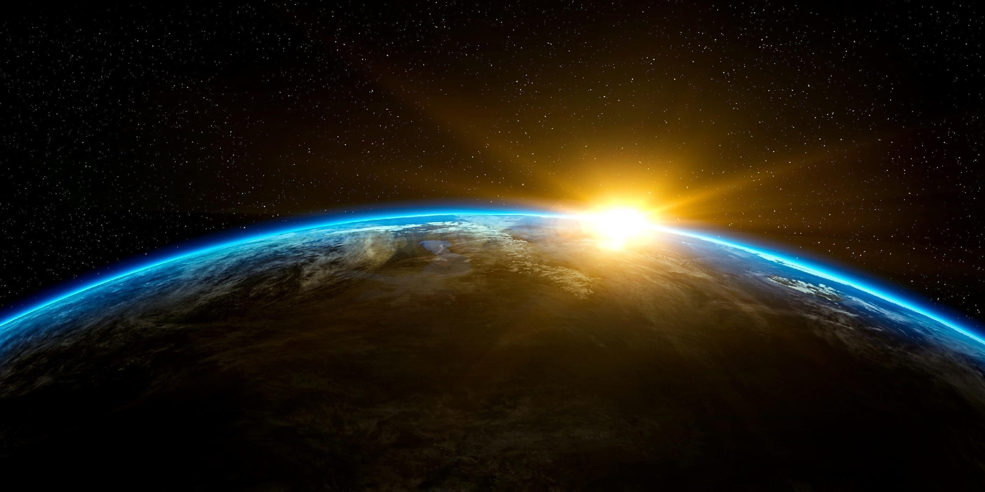
3. Earth is about 4.5 billion years old
Notes:
The third property of Earth is that it is about 4.5 billion years old.

Slide 30
= 4,500,000,000 years
Notes:
That’s a long time!

Slide 31
Notes:
Let’s check-in for understanding.

Slide 32
What is the third property of Earth?
Notes:
What is the third property of Earth?
[The Earth is about 4.5 billion years old.]

Slide 33
Notes:
Let’s check-in for understanding.

Slide 34
What are the three major properties of the Earth?
Notes:
What are the three major properties of the Earth?
Protective atmosphere
Rocky surface, mostly water
4.5 billion years old

Slide 35
What is the atmosphere mostly made up of?
Notes:
What is the atmosphere mostly made up of?
[Oxygen and nitrogen]

Slide 36
What does the atmosphere protect us from?
Notes:
What does the atmosphere protect us from?
[Harmful ultraviolet radiation from the sun]

Slide 37
Where is most of the water on Earth?
Notes:
Where is most of the water on Earth?
[It is located at the poles – frozen]

Slide 38
Remember!!!
Notes:
So remember!

Slide 39
Properties of the Earth: important characteristics that make Earth different from other planets
Notes:
There are 3 important properties, or characteristics, of the Earth that make it different from other planets. We will learn about them in this lesson. They are:
Protective atmosphere
Rocky surface, mostly water
4.5 billion years old

Slide 40
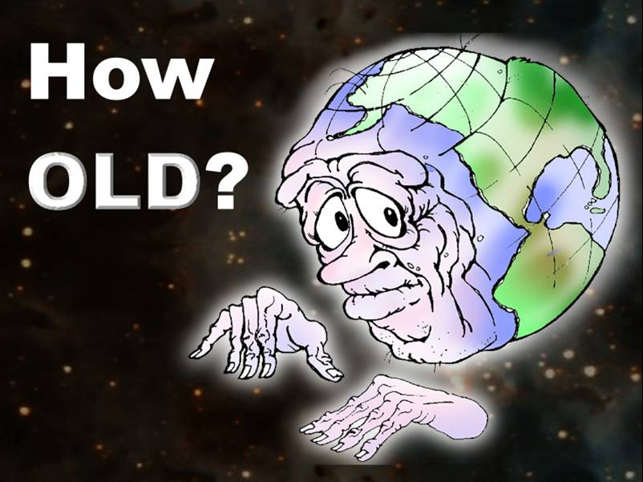
Earth Properties
Rocky
Covered with water
Frozen ice caps
Protective Atmosphere
~4.5 billion years old
Notes:
These are the major properties that we should remember.
Feedback: Using pictures to provide the student with an visual of the properties helps them to better grasp the content.

Slide 41
Big Question: What are the unique properties of our Earth?
Notes:
Explicit cue to revisit the big question at the end of the lesson: Okay everyone. Now that we’ve learned the term, let’s reflect once more on our big question. Was there anything that we predicted earlier that was correct or incorrect? Do you have any new hypotheses to share?
Feedback: Offering students an opportunity to evaluate their earlier hypotheses and make changes based on their new understandings is an important part of the iterative process in science. This is a great opportunity to help students build an epistemic understanding by explicitly stating how continuing to change and build on hypotheses as your knowledge grows is an important part of the discipline of science!

Slide 42
Notes:
Thanks for watching, and please continue watching CAPs available from this website.

Slide 43
This Video Was Created With Resources From:
Questions or Comments
Michael Kennedy, Ph.D. MKennedy@Virginia.edu
Rachel L Kunemund, Ph.D. rk8vm@virginia.edu

