Slide 1
Intro
“Big Idea” Question
Review Concepts
Check-In Questions
Teacher Demo
Vocabulary
Student-Friendly Definition
Examples & Non-Examples
Morphological Word Parts
Simulation/Activity
Notes:
OK everyone, get ready for our next lesson. Just as a reminder, these are the different components that our lesson may include, and you’ll see these icons in the top left corner of each slide so that you can follow along more easily!

Slide 2
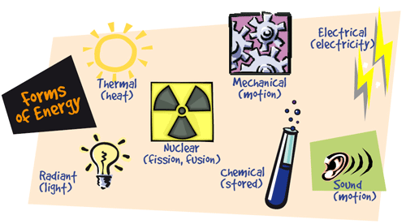
Radiant Energy
Notes:
Today, we will discuss radiant energy.

Slide 3
Big Question: How can radiant energy be converted into other forms of energy?
Notes:
Our “big question” is: How can radiant energy be converted into other forms of energy?
[Pause and illicit predictions from students.]
I love all these thoughtful scientific hypotheses! Be sure to keep this question and your predictions in mind as we move through these next few lessons, and we’ll continue to revisit it.

Slide 4
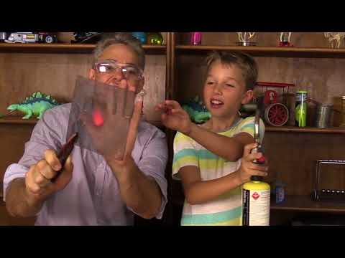
Demonstration
Transfer of heat by radiant energy leads to many interesting effects.
Notes:
Transfer of heat by radiant energy leads to many interesting effects.
Feedback: Engage students in questioning throughout the demonstration to get students to think critically about the content.

Slide 5
Notes:
Before we move on to our new vocabulary term, let’s review some other words & concepts that you already learned and make sure you are firm in your understanding.
Feedback: Reviewing key background knowledge helps lay the context and sets the students up to make sense of the new content you are introducing, it also reinforces previously learned material.

Slide 6
Energy: the ability to do work
Notes:
Energy is the ability to do work. An example can include a man has energy that helps him do his work.

Slide 7
Notes:
An example of energy is a dog eating for energy to run in the park later. Eating is an energy source for both humans and animals.

Slide 8
Notes:
An important source of energy for our planet is the sun.

Slide 9
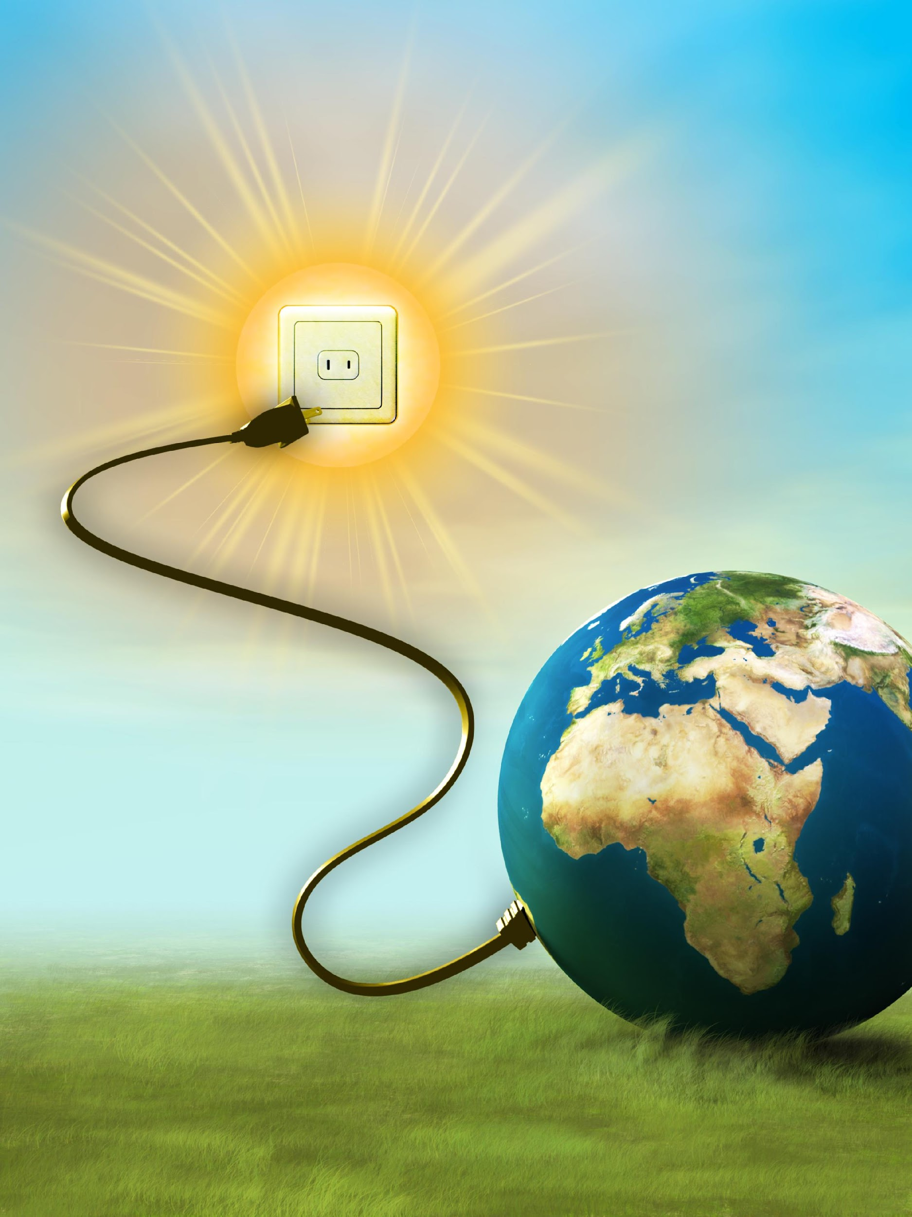
Solar Energy: ability to do work from the sun
Notes:
This type of energy is called solar energy, meaning the ability to do work from the sun. The sun provides a lot of solar energy to Earth that can affects temperatures and seasons around the world.

Slide 10
Notes:
Now let’s pause for a moment to check your understanding.
Feedback: Monitoring understanding during review is an important step before moving on to new material.

Slide 11
Energy is the ability to do _______.
Notes:
Energy is the ability to do _________.

Slide 12
Energy is the ability to do work.
Notes:
Energy is the ability to do work.

Slide 13
True/False: Animals can get energy to do work from eating.
Notes:
True/False: Animals can get energy to do work from eating.

Slide 14
True/False: Animals can get energy to do work from eating.
Notes:
True/False: Animals can get energy to do work from eating.
[True]

Slide 15
Radiant Energy
Notes:
Now that we’ve reviewed, let’s define our new term, radiant energy.

Slide 16
Radiant Energy: light energy, energy from light
Notes:
The energy of electromagnetic spectrum (light waves) is called radiant energy. It is sometimes referred to as light energy, although very little of the electromagnetic spectrum is visible to the human eye.
Feedback: Longer more formal definitions are tricky, use clear language when providing the new definition.

Slide 17
Notes:
Now let’s pause for a moment to check your understanding.

Slide 18
Radiant energy is energy from ________
Notes:
Radiant energy is energy from ______.

Slide 19
Radiant energy is energy from light.
Notes:
Radiant energy is energy from light.
[The energy of electromagnetic spectrum (light waves) is called radiant energy. It is sometimes referred to as light energy, although very little of the electromagnetic spectrum is visible to the human eye.]

Slide 20
Notes:
Now, let’s talk about some examples of radiant energy.
Feedback: Use a clear and explicit explanation that takes the guesswork out of it for students. Using explicit descriptions makes it easier for students to grasp the content.

Slide 21
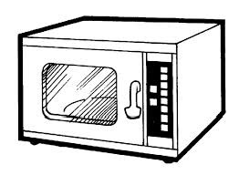
visible light
microwaves, radio waves, and visible light
Notes:
Examples of radiant (light) energy include microwaves radio waves, and visible light, such as lamps.

Slide 22
Forms of energy are all around you.
Notes:
To review, energy comes in many forms and is all around you. Radiant (light) energy is one of those forms.

Slide 23
Notes:
Next, let’s talk about some non-examples of radiant energy.
Feedback: Take a moment to explicitly distinguish between the similarities of the non-examples and the vocabulary term you were covering today. This helps students resolve any misconceptions they may have.

Slide 24
Notes:
This crane is not an example of radiant energy.

Slide 25
Notes:
Now let’s pause for a moment to check your understanding.

Slide 26
Which is not an example of radiant energy?
visible light
Notes:
Which is not an example of radiant energy?

Slide 27
Which is not an example of radiant energy?
visible light
Notes:
Which is not an example of radiant energy?
[A fish is not radiant energy.]

Slide 28
Notes:
To think about the definition of radiant energy, it is helpful to look at its word parts.
Feedback: Break down the vocabulary term into word parts and define each part, this is essential in building student understanding of the word parts.

Slide 29
radiant energy
Notes:
The term radiant has the word radiate in it…

Slide 30
radiant energy
radiate: to emit or give off
Notes:
Which means to emit or give off. So radiant energy radiates from one object to another.

Slide 31
Notes:
Let’s check-in for understanding.

Slide 32
What is radiant energy?
Notes:
What is radiant energy?
[The energy of electromagnetic spectrum (light waves) is called radiant energy. It is sometimes referred to as light energy, although very little of the electromagnetic spectrum is visible to the human eye.]

Slide 33
What is an example of radiant energy?
Notes:
What is an example of radiant energy?

Slide 34
Remember!!!
Notes:
So remember!
Feedback: Repeating important information is a great way to draw students' attention to key content.

Slide 35
Radiant Energy: light energy, energy from light
Notes:
The energy of electromagnetic spectrum (light waves) is called radiant energy. It is sometimes referred to as light energy, although very little of the electromagnetic spectrum is visible to the human eye.

Slide 36
Simulation Activity
Energy Skate Park
Topics
Conservation of Energy
Kinetic Energy
Potential Energy
Thermal Energy
Energy
Friction
Description
Learn about conservation of energy with a skater gal! Explore different tracks and view the kinetic energy, potential energy and friction as she moves. Build your own tracks, ramps, and jumps for the skater.
Notes:
Feedback: Inquiry based activities are great for critical thinking skills.

Slide 37
Big Question: How can radiant energy be converted into other forms of energy?
Notes:
Explicit cue to revisit the big question at the end of the lesson: Okay everyone. Now that we’ve learned the term, let’s reflect once more on our big question. Was there anything that we predicted earlier that was correct or incorrect? Do you have any new hypotheses to share?

Slide 38
Notes:
Thanks for watching, and please continue watching CAPs available from this website.

Slide 39
This Video Was Created With Resources From:
Questions or Comments
Michael Kennedy, Ph.D. MKennedy@Virginia.edu
Rachel L Kunemund, Ph.D. rk8vm@virginia.edu

Slide 40
Intro
“Big Idea” Question
Review Concepts
Check-In Questions
Teacher Demo
Vocabulary
Student-Friendly Definition
Examples & Non-Examples
Morphological Word Parts
Simulation/Activity
Notes:
OK everyone, get ready for our next lesson. Just as a reminder, these are the different components that our lesson may include, and you’ll see these icons in the top left corner of each slide so that you can follow along more easily!

Slide 41
Intro
Absorption
Notes:
Today, we’ll be learning about absorption.

Slide 42
Big Question: How can radiant energy be converted into other forms of energy?
Notes:
Our “big question” is: How can radiant energy be converted into other forms of energy?
[Pause and illicit predictions from students.]
I love all these thoughtful scientific hypotheses! Be sure to keep this question and your predictions in mind as we move through these next few lessons, and we’ll continue to revisit it.

Slide 43
Demonstration
Notes:
Demonstration – Let’s see what absorption looks like!
For this demonstration I am going to be using my microwave.
When I heat up my cold food in the microwaves. The energy from the microwaves are is transferred to the food to make it hot.

Slide 44
Notes:
Now, let’s pause for a moment to check your understanding.
Feedback: Monitoring understanding throughout a demonstration is important to making sure students are grasping this new content.

Slide 45
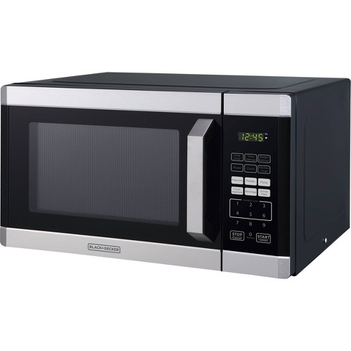
How is using a microwave an example of absorption?
Notes:
How is using a microwave an example of absorption?
[The microwaves (energy) are absorbed into the food to heat it up.]

Slide 46
Notes:
Let’s review some terms & concepts that you already learned and make sure you are firm in your understanding.

Slide 47
Energy: the ability to do work
Notes:
Energy is the ability to do work. An example can include a man has energy that helps him do his work.

Slide 48
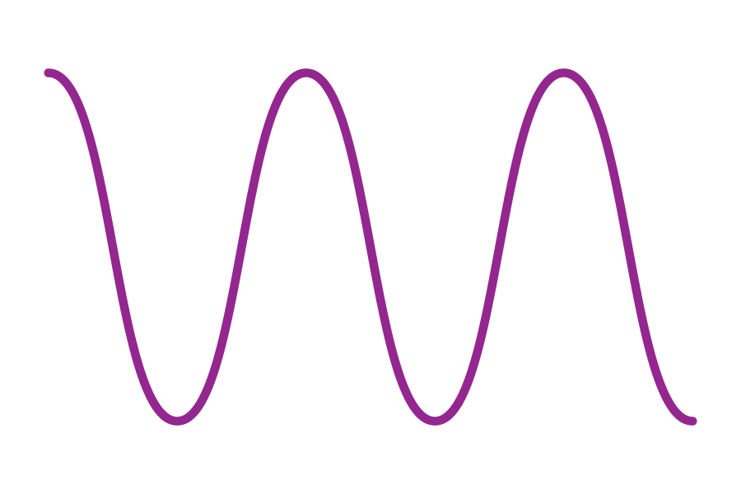
Waves: disturbances that travel through a medium, transporting energy from one location to another without transporting matter
Notes:
Waves are disturbances that travel through a medium, transporting energy from one location to another without transporting matter.

Slide 49
Medium: any material that waves can travel through
Notes:
A medium is any material that waves can travel through.

Slide 50
Visible Light: wavelengths that are visible to the human eye
Notes:
Visible light waves are wavelengths that are visible to the human eye. They are the only waves on the electromagnetic spectrum that are visible. They have wavelengths that are shorter than infrared radiation and longer than ultraviolet radiation. Visible light also has higher frequencies and energy than infrared radiation.

Slide 51
Radiant Energy: light energy, energy from light
Notes:
The energy of electromagnetic spectrum (light waves) is called radiant energy. It is sometimes referred to as light energy, although very little of the electromagnetic spectrum is visible to the human eye.

Slide 52
Notes:
Now, let’s pause for a moment to check your understanding.

Slide 53
Energy is the ability to do _______.
Notes:
Energy is the ability to do _________.

Slide 54
Energy is the ability to do work.
Notes:
Energy is the ability to do work.

Slide 55
What are waves?
Notes:
What are waves?
[Waves are disturbances that travel through a medium, transporting energy from one location to another without transporting matter.]

Slide 56
What is a medium?
Notes:
What is a medium?
[A medium is any material that waves can travel through.]

Slide 57
How is visible light related to the electromagnetic spectrum?
Notes:
How is visible light related to the electromagnetic spectrum?
[Visible light waves are the only waves on the electromagnetic spectrum. They have wavelengths that are shorter than infrared radiation and longer than ultraviolet radiation. Visible light also has higher frequencies and energy than infrared radiation.]

Slide 58
Absorption
Notes:
Now that we’ve reviewed, let’s define our new term, absorption.

Slide 59
Absorption: process of taking in radiant energy
Notes:
Absorption is the process of taking in radiant energy.

Slide 60
Notes:
Let’s check-in for understanding.

Slide 61
What is absorption?
Notes:
What is absorption?
[Absorption is the process of taking in radiant energy.]

Slide 62
Notes:
Now, let’s talk about some examples of absorption.

Slide 63
Notes:
Here the energy is passing through the window. The visible light waves will pass through the window but some of the energy will be absorbed by the window. This will make the window feel hot.

Slide 64
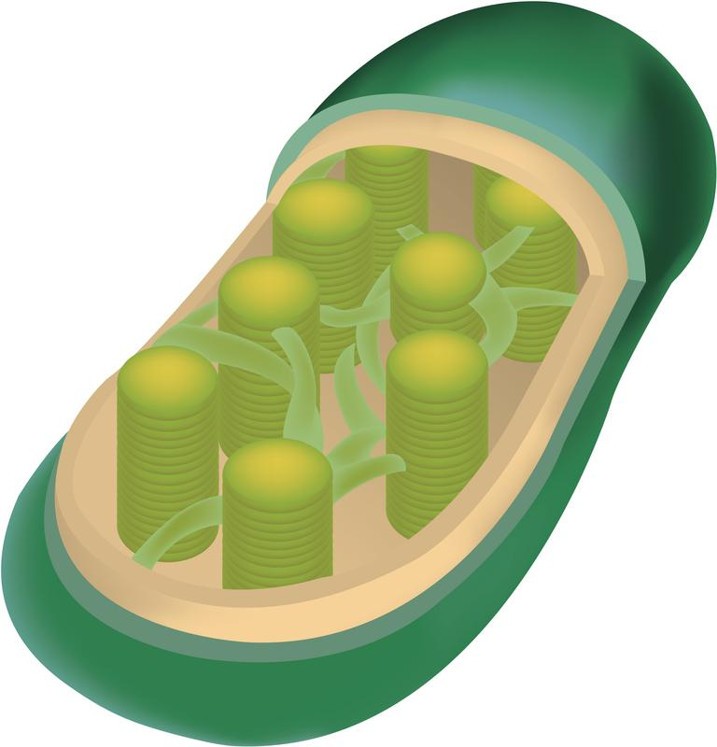
Notes:
Chloroplasts absorb all colors, even though they only reflect green.

Slide 65
Notes:
Next, let’s talk about some non-examples of absorption.

Slide 66
Notes:
White emits all colors of the visible spectrum and does not absorb any of them. Therefore, white is not an example of absorption.

Slide 67
Notes:
Let’s check-in for understanding.

Slide 68
True/False: Chloroplasts only absorb green light.
Notes:
True/False: Chloroplasts only absorb green light.

Slide 69
True/False: Chloroplasts only absorb green light.
Notes:
True/False: Chloroplasts only absorb green light.
[True]

Slide 70
Why is white not an example of absorption?
Notes:
Why is white not an example of absorption?
[White emits all colors of the visible spectrum and does not absorb any of them. Therefore, white is not an example of absorption.]

Slide 71
What is absorption?
Notes:
What is absorption?
[Absorption is the process of taking in radiant energy.]

Slide 72
How do we know that a window has absorbed visible light waves?
Notes:
How do we know that a window has absorbed visible light waves?
[The energy that the window has absorbed makes the window feel warm.]

Slide 73
Remember!!!
Notes:
So remember!

Slide 74
Absorption: the process of taking in radiant energy
Notes:
Absorption is the process of taking in radiant energy.

Slide 75
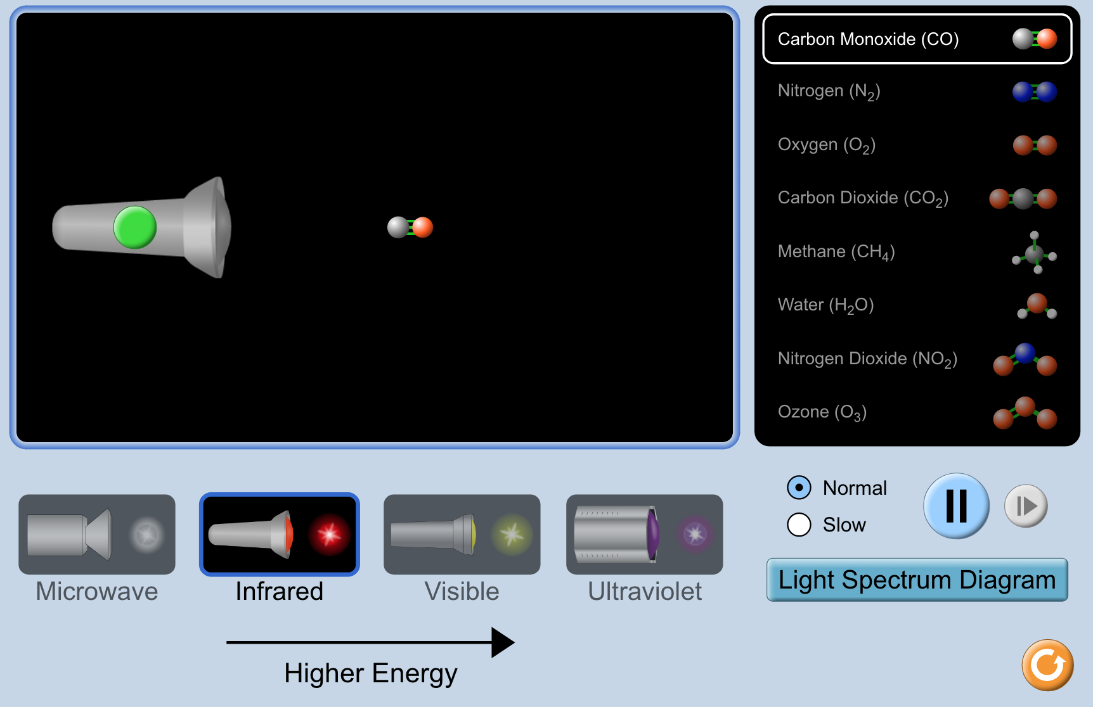
Simulation Activity
Absorption
(Phet)
Click the link above for a simulation to deepen your understanding of absorption.
Notes:
Click the link above for a simulation to deepen your understanding of absorption.

Slide 76
Big Question: How can radiant energy be converted into other forms of energy?
Notes:
Explicit cue to revisit the big question at the end of the lesson: Okay everyone. Now that we’ve learned the term, let’s reflect once more on our big question. Was there anything that we predicted earlier that was correct or incorrect? Do you have any new hypotheses to share?

Slide 77
Notes:
Thanks for watching, and please continue watching CAPs available from this website.

Slide 78
This Video Was Created With Resources From:
Questions or Comments
Michael Kennedy, Ph.D. MKennedy@Virginia.edu
Rachel L Kunemund, Ph.D. rk8vm@virginia.edu

Slide 79
Intro
“Big Idea” Question
Review Concepts
Check-In Questions
Teacher Demo
Vocabulary
Student-Friendly Definition
Examples & Non-Examples
Morphological Word Parts
Simulation/Activity
Notes:
OK everyone, get ready for our next lesson. Just as a reminder, these are the different components that our lesson may include, and you’ll see these icons in the top left corner of each slide so that you can follow along more easily!

Slide 80
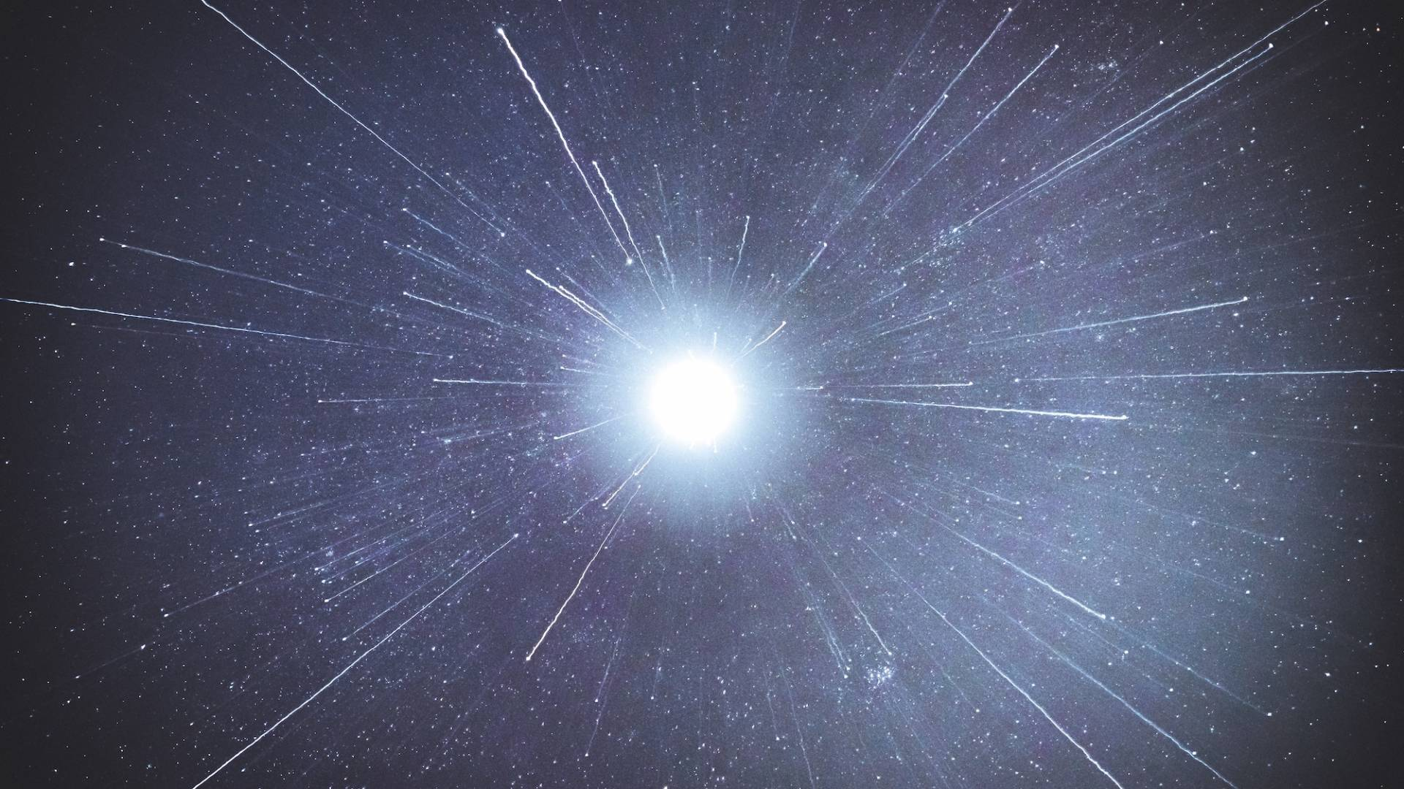
Intro
Emission
Notes:
Today, we will learn about emission.

Slide 81
Big Question: How can radiant energy be converted into other forms of energy?
Notes:
Our “big question” is: How can radiant energy be converted into other forms of energy?
[Pause and illicit predictions from students.]
I love all these thoughtful scientific hypotheses! Be sure to keep this question and your predictions in mind as we move through these next few lessons, and we’ll continue to revisit it.

Slide 82
Demonstration
TEACHER DIRECTIONS:
Materials: Flashlight, clear glass of water, masking tape.
Cover the flashlight with two pieces of masking tape leaving a slit in the middle.
Shine the flashlight through a glass of water onto a black white wall.
The rainbow should appear on the wall.
Lead students in questioning about how rainbows are made and how it relates to light emission.
Notes:
Let’s do a quick demonstration that will help get our brains ready to think about emission, and how it relates to our big question.

Slide 83
Notes:
Now, let’s pause for a moment to check your understanding.

Slide 84
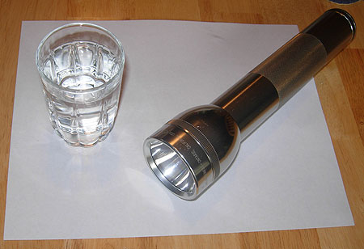
How is a rainbow made?
Notes:
How is a rainbow made?
[A rainbow forms when light emitted from the sun enters a water droplet and reflects into the visible light spectrum.]

Slide 85
Notes:
Let’s review some terms & concepts that you already learned and make sure you are firm in your understanding.

Slide 86
Energy: the ability to do work
Notes:
Energy is the ability to do work. An example can include a man has energy that helps him do his work.

Slide 87
Waves: disturbances that travel through a medium, transporting energy from one location to another without transporting matter
Notes:
Waves are disturbances that travel through a medium, transporting energy from one location to another without transporting matter.

Slide 88
Medium: any material that waves can travel through
Notes:
A medium is any material that waves can travel through.

Slide 89
Visible Light: wavelengths that are visible to the human eye
Notes:
Visible light waves are wavelengths that are visible to the human eye. They are the only waves on the electromagnetic spectrum that are visible. They have wavelengths that are shorter than infrared radiation and longer than ultraviolet radiation. Visible light also has higher frequencies and energy than infrared radiation.

Slide 90
Radiant Energy: light energy, energy from light
Notes:
The energy of electromagnetic spectrum (light waves) is called radiant energy. It is sometimes referred to as light energy, although very little of the electromagnetic spectrum is visible to the human eye.

Slide 91
Absorption: the process of taking in radiant energy
Notes:
Absorption is the process of taking in radiant energy.

Slide 92
Notes:
Now, let’s pause for a moment to check your understanding.

Slide 93
Energy is the ability to do _______.
Notes:
Energy is the ability to do _________.

Slide 94
Energy is the ability to do work.
Notes:
Energy is the ability to do work.

Slide 95
What are waves?
Notes:
What are waves?
[Waves are disturbances that travel through a medium, transporting energy from one location to another without transporting matter.]

Slide 96
What is a medium?
Notes:
What is a medium?
[A medium is any material that waves can travel through.]

Slide 97
How is visible light related to the electromagnetic spectrum?
Notes:
How is visible light related to the electromagnetic spectrum?
[Visible light waves are the only waves on the electromagnetic spectrum. They have wavelengths that are shorter than infrared radiation and longer than ultraviolet radiation. Visible light also has higher frequencies and energy than infrared radiation.]

Slide 98
What is absorption?
Notes:
What is absorption?
[Absorption is the process of taking in radiant energy.]

Slide 99
Emission
Notes:
Now that we’ve reviewed, let’s define our new term, emission.

Slide 100
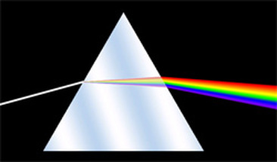
Emission: the process of giving off radiant energy
Notes:
Emission is the process of giving off radiant energy.

Slide 101
Notes:
Let’s check-in for understanding.

Slide 102
What is emission?
Notes:
What is emission?
[Emission is the process of giving off radiant energy.]

Slide 103
Notes:
Now, let’s talk about some examples of emission.

Slide 104
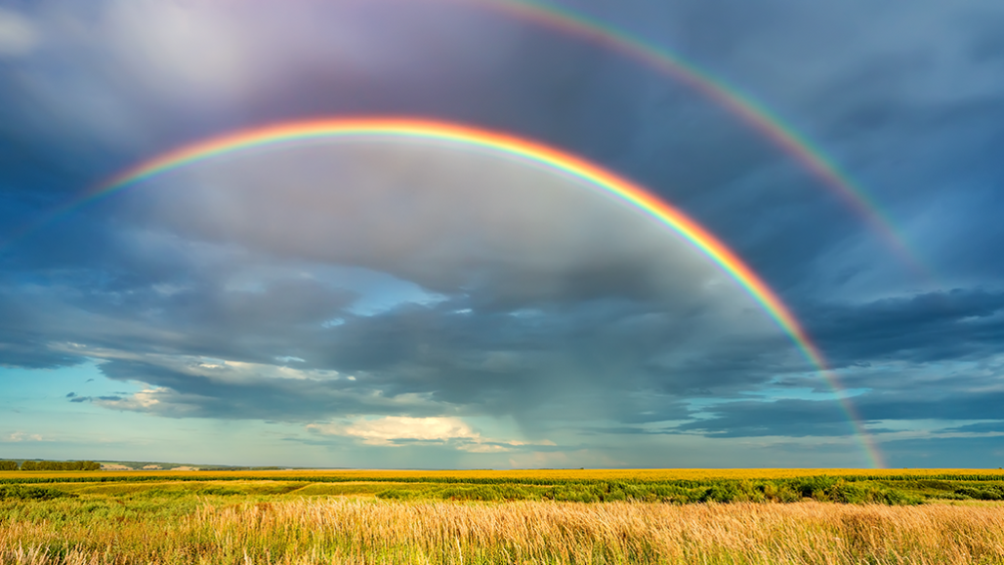
Notes:
A rainbow forms when light emitted from the sun enters a water droplet and reflects into the visible light spectrum. Therefore, a rainbow is an example of light emitted from the sun.

Slide 105
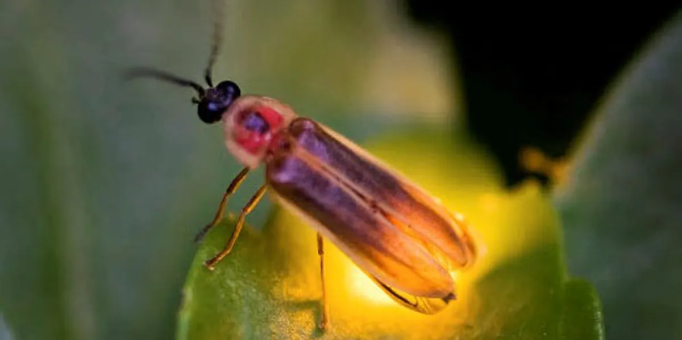
Notes:
Fireflies produce light in their bodies through a special chemical reaction. We can spot fireflies on summer nights because of the light that they emit.

Slide 106
Notes:
When fireworks explode in the sky, the gunpowder reactions produce a lot of energy. Some of that excess energy is emitted as light to make all the cool colors we see.

Slide 107
Notes:
Next, let’s talk about some non-examples of emission.

Slide 108
Notes:
Black absorbs all colors of the visible spectrum and does not emit any of them. Therefore, black is not an example of emission.

Slide 109
Notes:
Let’s check-in for understanding.

Slide 110
Provide one example of emission.
Notes:
Provide one example of emission.

Slide 111
Why is black not an example of emission?
Notes:
Why is black not an example of emission?
[Black absorbs all colors of the visible spectrum and does not emit any of them. Therefore, black is not an example of emission.]

Slide 112
What is emission?
Notes:
What is emission?
[Emission is the process of giving off radiant energy.]

Slide 113
Explain the difference between absorption and emission.
Notes:
Explain the difference between absorption and emission.
[Absorption is the process of taking in radiant energy and emission is the process of giving off radiant energy.]

Slide 114
Remember!!!
Notes:
So remember!

Slide 115
Emission: the process of giving off radiant energy
Notes:
Emission is the process of giving off radiant energy.

Slide 116
Big Question: How can radiant energy be converted into other forms of energy?
Notes:
Explicit cue to revisit the big question at the end of the lesson: Okay everyone. Now that we’ve learned the term, let’s reflect once more on our big question. Was there anything that we predicted earlier that was correct or incorrect? Do you have any new hypotheses to share?

Slide 117
Simulation Activity
Neon Lights
(CK-12)
Click the link above for a simulation to deepen your understanding of emission.
Notes:
Click the link above for a simulation to deepen your understanding of emission.

Slide 118
Notes:
Thanks for watching, and please continue watching CAPs available from this website.

Slide 119
This Video Was Created With Resources From:
Questions or Comments
Michael Kennedy, Ph.D. MKennedy@Virginia.edu
Rachel L Kunemund, Ph.D. rk8vm@virginia.edu

