Slide 1
Intro
“Big Idea” Question
Review Concepts
Check-In Questions
Teacher Engagement
Vocabulary
Student-Friendly Definition
Examples & Non-Examples
Frayer Model
Simulation/Activity
Notes:
OK everyone, get ready for our next lesson. Just as a reminder, these are the different components that our lesson may include, and you’ll see these icons in the top left corner of each slide so that you can follow along more easily!

Slide 2
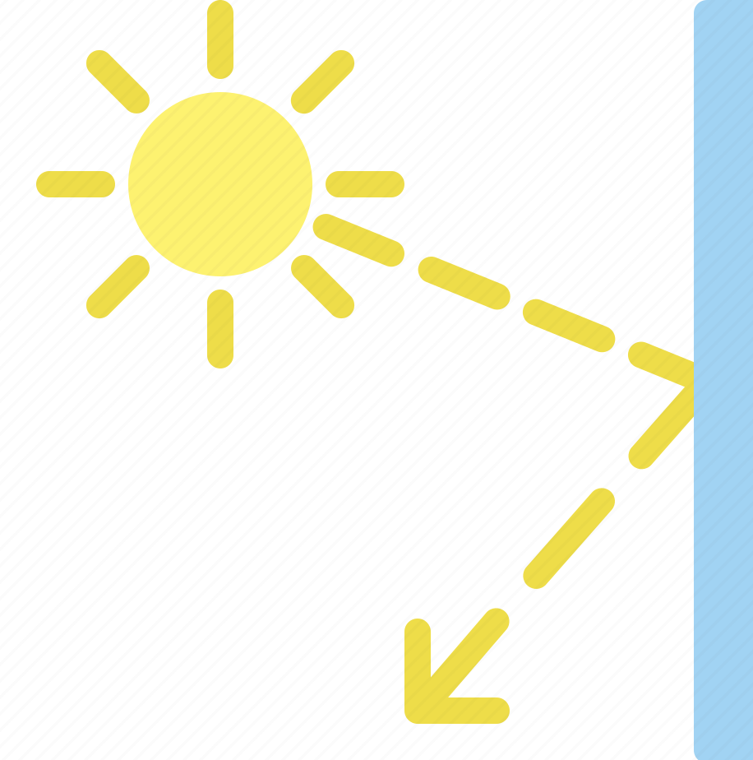
Reflection
Intro
Notes:
Today we’re going to learn about the term reflection.

Slide 3
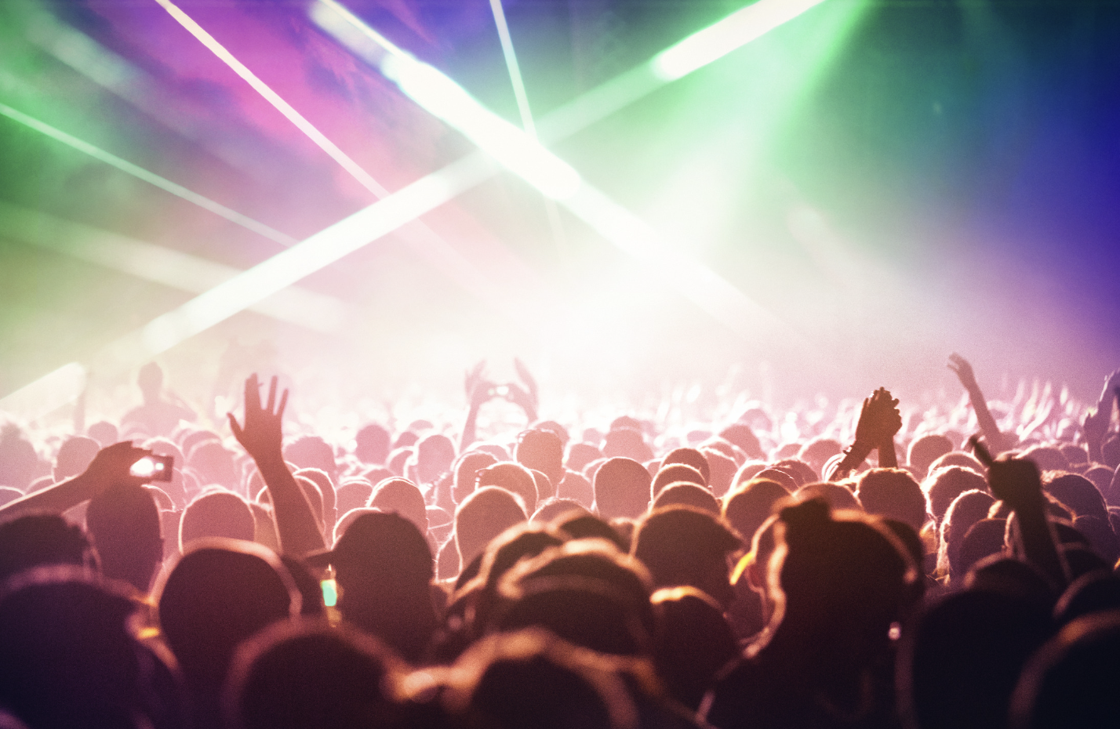
Big Question: How does light bouncing off things affect what we see and how we experience the world around us?
Notes:
Before we start, let’s think about our “big question”: How does light bouncing off things affect what we see and how we experience the world around us?
[Pause and illicit predictions from students.]
I love all these thoughtful scientific hypotheses! Be sure to keep this question and your predictions in mind as we move through these next few lessons, and we’ll continue to revisit it.

Slide 4
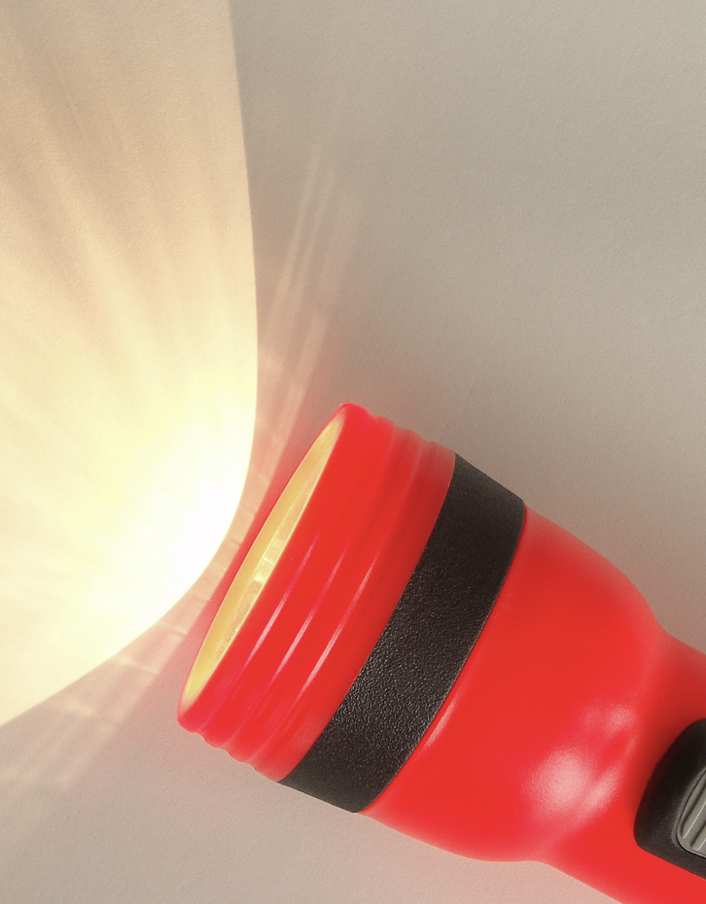
Demonstration
TEACHER DIRECTIONS:
Before viewing: Ask students what they already know about reflection. Tell students today they will be learning about the term reflection.
During: Encourage students to observe how changing the angle of the mirror affects the direction of the reflected light.
After: Tell students that today they will be learning more about the term reflection.
Notes:
Materials Needed:
Mirror
Flashlight
Instructions:
Explain Reflection:
Begin by explaining to the students that reflection is when light bounces back after hitting a surface. Emphasize that mirrors are excellent examples of surfaces that reflect light.
Demonstration Setup:
Hold the mirror upright in a well-lit area, ensuring that it reflects a good amount of light. Place it on a table or hold it at a comfortable height for the students to see clearly.
Use of Flashlight:
In a dimly lit room, use a flashlight to emit a beam of light onto the mirror. Direct the light beam towards the mirror's surface.
Observe Reflection:
Ask the students to observe what happens to the light beam when it hits the mirror. They will see the light bouncing off the mirror's surface and reflecting back towards them.
Experiment with Angles:
Encourage students to observe how changing the angle of the mirror affects the direction of the reflected light. They can also try moving the flashlight to see how the angle of incidence impacts the angle of reflection.
Discuss Reflection:
Discuss the observations with the students. Emphasize that reflection is why we can see ourselves in mirrors and how light bouncing off objects enables us to see those objects.
This hands-on demonstration allows students to visually and actively understand the concept of reflection. It's a simple yet impactful way to show how light behaves when it hits a reflective surface, making
the concept of reflection more tangible for them.

Slide 5
Notes:
Before we move on to our new vocabulary term, let’s review some other words & concepts that you already learned and make sure you are firm in your understanding.

Slide 6
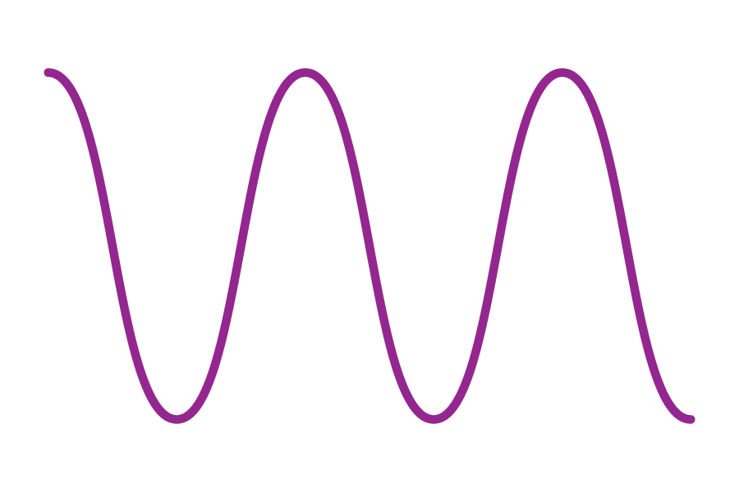
Waves: a pattern of motions that move through stuff, carrying energy from one place to another, but without carrying any matter.
Notes:
Waves are a pattern of motions that move through stuff, carrying energy from one place to another, but without carrying any matter

Slide 7
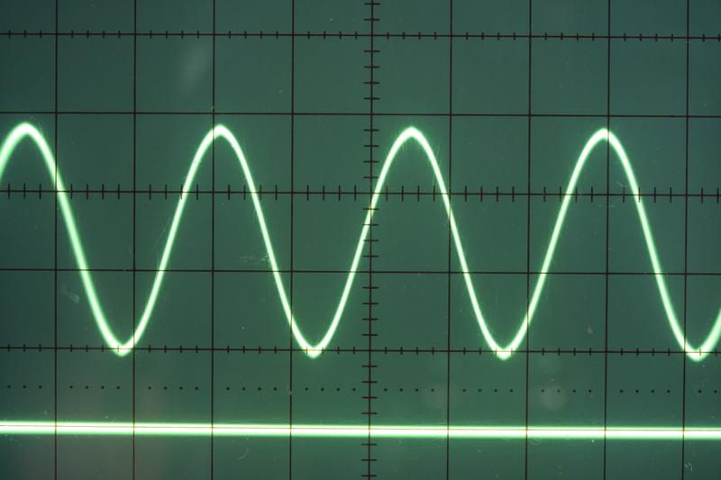
Transverse Waves: waves that travel sideways to the direction they are moving
Notes:
Transverse waves are waves that travel sideways to the direction they are moving.

Slide 8
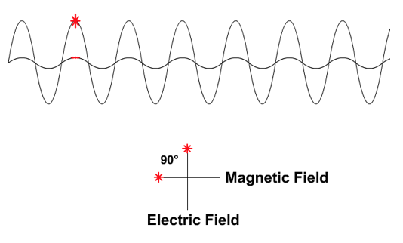
Electromagnetic Waves: waves that are created as a result of vibrations between an electric field and a magnetic field
Notes:
Electromagnetic waves are waves that are created as a result of vibrations between an electric field and a magnetic field.

Slide 9
Electromagnetic Spectrum: range of all types of electromagnetic waves
Notes:
The electromagnetic spectrum is the range of all types of magnetic waves.

Slide 10
Visible Light : the part of the electromagnetic spectrum you can see with your eyes
Notes:
Radiant energy is energy that is radiating continuously from a source.
{the part of the electromagnetic spectrum you can see with your eyes}
Feedback: When providing more student-friendly definitions, it is helpful to provide students with cues so that they can be prepared and know what to expect and be ready to copy down the information.

Slide 11
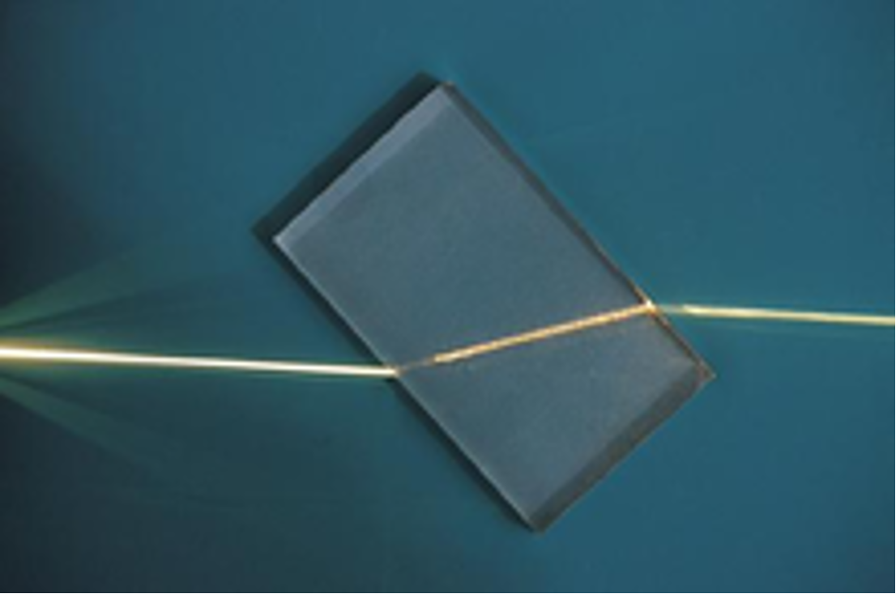
Refraction: bending of light waves when the wave moves from one medium to another
Notes:
Refraction is the bending of light waves when the wave moves from one medium to another.

Slide 12
Notes:
Now let’s pause for a moment to check your understanding.
Feedback: It's really important to make sure that you're providing students with frequent opportunities to respond as you're activating prior knowledge – it will save so you so much time if you confirm understanding before asking them to try something independently.

Slide 13
What is the difference between waves and transverse waves?
Notes:
What is the difference between waves and transverse waves?
[Transverse waves are simply a type of wave that moves sideways to the direction they are moving. This is not the case for all waves.]

Slide 14
What are electromagnetic waves?
Notes:
What are electromagnetic waves?
[Electromagnetic waves are waves that are created as a result of vibrations between an electric field and a magnetic field.]

Slide 15
What is the electromagnetic spectrum?
Notes:
What is the electromagnetic spectrum?
[The electromagnetic spectrum is the range of all types of electromagnetic waves. These are created as result of vibrations between an electric field and a magnetic field.]

Slide 16
The range of all wavelengths that create colors that we can see with our eyes is:
The Visible Light Spectrum
The Electromagnetic Spectrum
The Microwave Spectrum
Notes:
The range of all wavelengths that create colors that we can see with our eyes is:
The Visible Light Spectrum
The Electromagnetic Spectrum
The Microwave Spectrum
[The Visible Light Spectrum]

Slide 17
The range of all wavelengths that create colors that we can see with our eyes is:
The Visible Light Spectrum
The Electromagnetic Spectrum
The Microwave Spectrum
Notes:
The range of all wavelengths that create colors that we can see with our eyes is: The Visible Light Spectrum

Slide 18
is the bending of light waves when the wave moves from one medium to another
Notes:
[Refraction] is the bending of light waves when the wave moves from one medium to another.

Slide 19
Refraction is the bending of light waves when the wave moves from one medium to another
Notes:
[Refraction] is the bending of light waves when the wave moves from one medium to another.

Slide 20
Reflection
Notes:
Now that we’ve reviewed, let’s define our new term, visible light.

Slide 21
Reflection: when light bounces back after hitting a surface.
Notes:
Reflection: when light bounces back after hitting a surface.
Feedback: When providing more student-friendly definitions, it is helpful to provide students with cues so that they can be prepared and know what to expect and be ready to copy down the information.

Slide 22
Notes:
Let’s check-in for understanding.

Slide 23
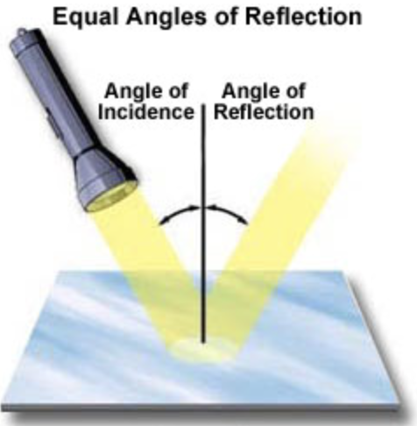
What is a reflection?
Notes:
What is a reflection?
[When light bounces back after hitting a surface.]

Slide 24
Notes:
That is the basic definition, but there is a bit more you need to know.

Slide 25
The angle at which the light wave strikes the surface is the same angle at which the light wave is reflected.
Notes:
The angle at which the light wave strikes the surface is the same angle at which the light wave is reflected.

Slide 26
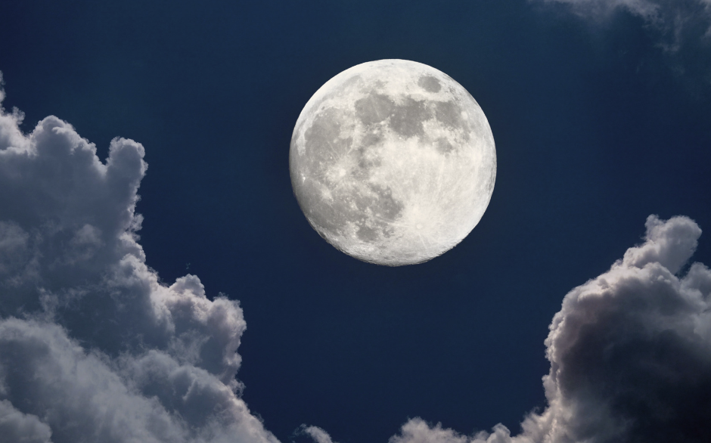
The Moon shines because it reflects sunlight
Notes:
The Moon shines because it reflects sunlight – that's why it's so bright in the night sky!

Slide 27
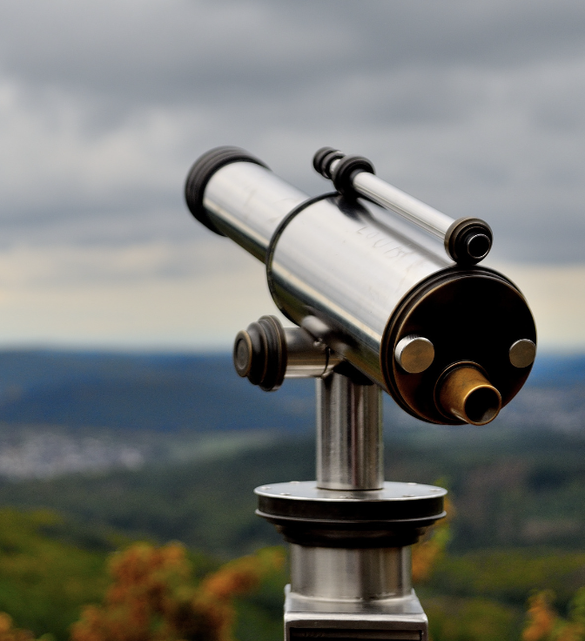
Reflection is used to help things like telescopes and microscopes work.
Notes:
Reflection is used to help things like telescopes and microscopes work. Scientists and engineers use reflection for helpful purposes. In telescopes, mirrors are used to reflect and focus light from distant
stars. In solar panels, specially designed mirrors reflect sunlight onto a central point, creating intense heat that can be converted into energy. Understanding how reflection works helps scientists invent new
technologies that benefit society.

Slide 28
Notes:
Let’s check-in for understanding.

Slide 29
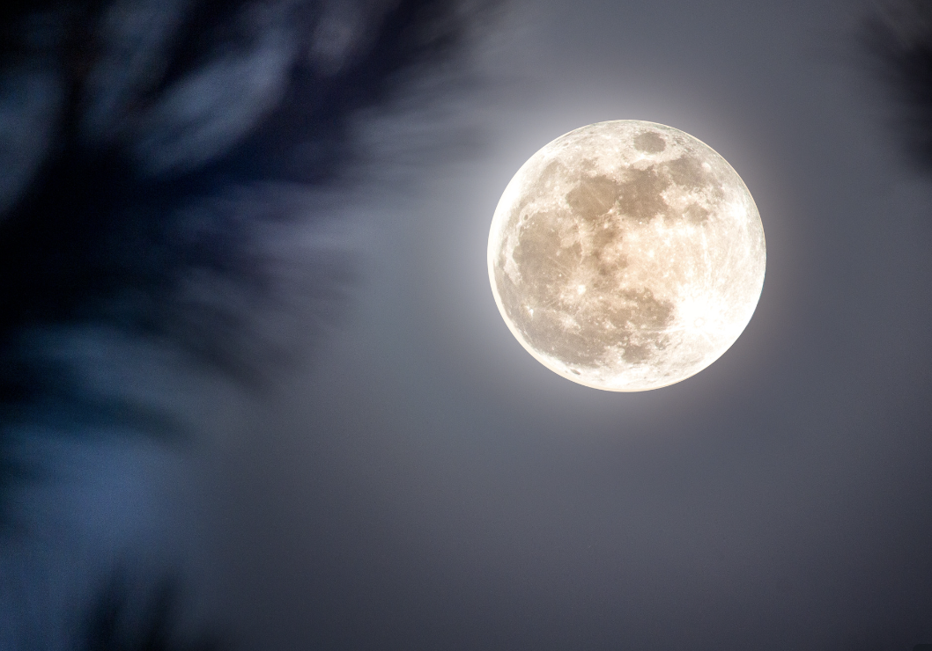
How does the moon shine?
Notes:
How does the moon shine?
[It reflects light from the sun]

Slide 30
The angle at which the light wave strikes the surface is the angle at which the light wave is reflected.
Notes:
The angle at which the light wave strikes the surface is the angle at which the light wave is reflected.
[same]

Slide 31
The angle at which the light wave strikes the surface is the same angle at which the light wave is reflected.
Notes:
The angle at which the light wave strikes the surface is the same angle at which the light wave is reflected.
[same]

Slide 32
Notes:
Now, let’s talk about some examples of visible light.
Feedback: It's good to pick a variety of examples to work through with your students. This prepares them for some types that might trip them up when they try it on their own.

Slide 33
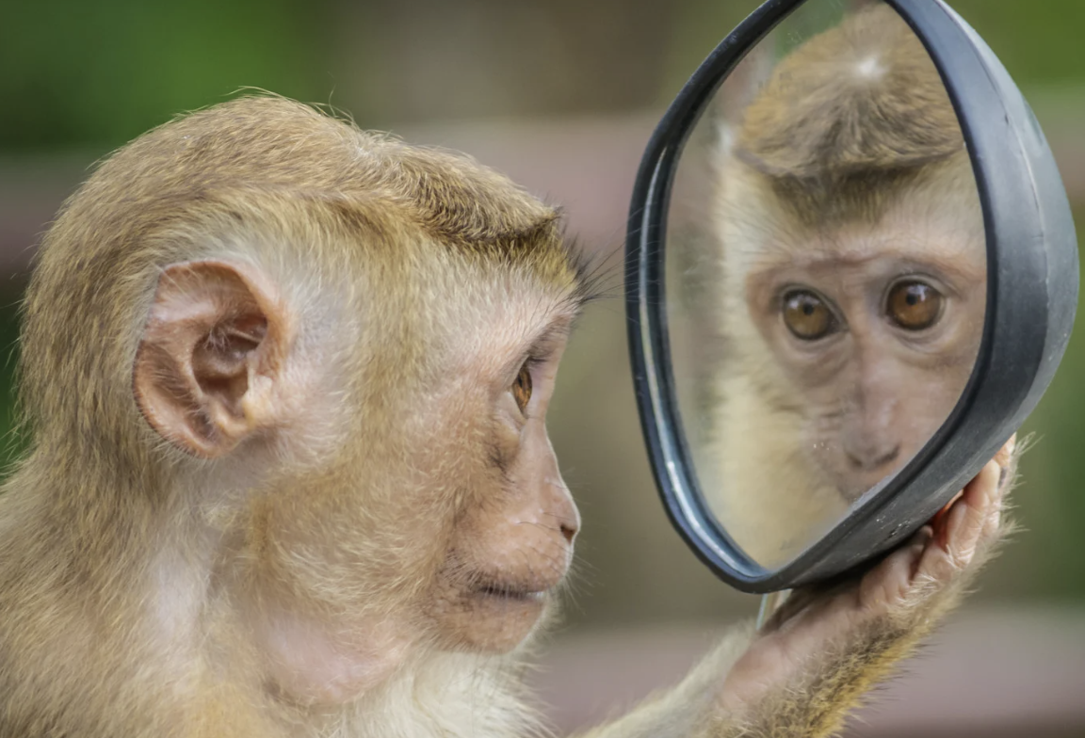
The image of the monkey in the mirror is an example of a reflection.
Notes:
The image of the monkey in the mirror is an example of a reflection. When light waves hit a smooth and shiny surface, like a mirror, they bounce back and create a clear reflection. This is why you can see yourself in a mirror. The mirror reflects the light waves, allowing you to see your image.

Slide 34
The mirrored image here on the water is an example of a reflection.
Notes:
The mirrored image here on the water is an example of a reflection. When light waves hit a calm water surface, they reflect off the water, creating a mirrored image of the surroundings. This reflection is why you can see trees, clouds, and the sky in the water when it's still and quiet, like in a pond or a lake.

Slide 35
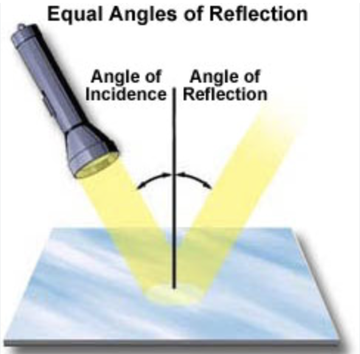
The light of a flashlight bouncing off a surface is an example of a reflection.
Notes:
The light of a flashlight bouncing off a surface is an example of a reflection. If you shine a flashlight on a surface, the light reflects off that surface and illuminates the area. For example, if you shine a
flashlight on a wall, the wall reflects the light, allowing you to see the area that the light reaches. This is how flashlight beams help us see in the dark.

Slide 36
Notes:
Next, let’s talk about some non-examples of visible light.

Slide 37
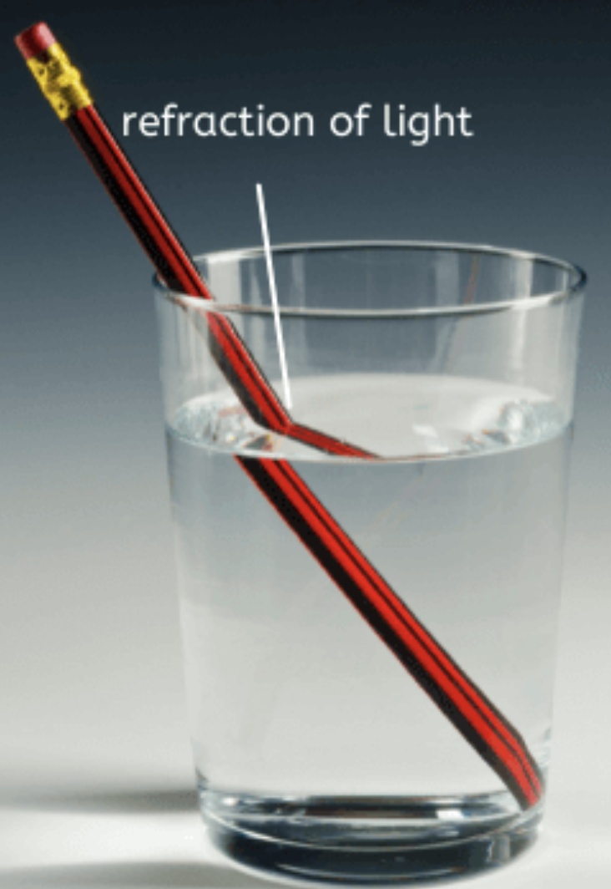
Refraction is NOT an example of a reflection.
Notes:
Refraction is NOT an example of a reflection. Refraction is the bending of light as it passes from one medium to another, like from air to water. This bending happens because the speed of light changes in different substances. Refraction doesn't involve light bouncing back; instead, it changes the direction of light waves.
Feedback: Non-examples often need some explanation to make it clear to students the difference. Using clear and simple language can help with this.

Slide 38
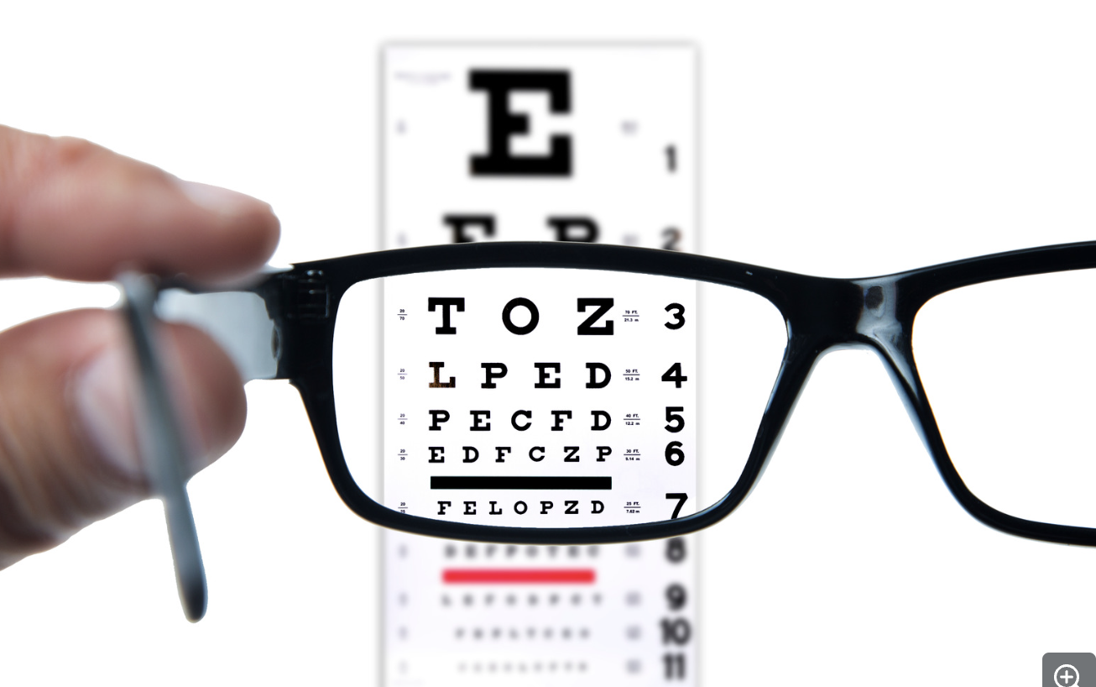
Transparency is NOT an example of a reflection
Notes:
Transparency is NOT an example of a reflection. Transparency refers to the quality of allowing light to pass through without reflecting. Materials like clear glass or water allow light to travel through them without bouncing back. Unlike reflection, transparency doesn't involve light bouncing off a surface.

Slide 39
Notes:
Let’s check-in for understanding.

Slide 40
What are examples of a reflection?
Notes:
What are examples of a reflection?
[Sunlight reflecting off the moon, light reflecting off a body of water, the light of a flashlight bouncing off a surface, an image seen in a mirror]

Slide 41
True/False: Refraction is an example of a reflection of light.
Notes:
True/False: Refraction is an example of a reflection of light.
[False]

Slide 42
True/False: Refraction is an example of a reflection of light.
Notes:
False: Refraction is NOT an example of a reflection of light.

Slide 43
Notes:
We will now complete this concept map, called a Frayer model, to summarize and further clarify what you have learned about the term reflection.

Slide 44
Definition
Picture
Reflection
Example
How do reflections impact my life?
Notes:
To complete the Frayer model, we will choose from four choices the correct picture, definition, example, and response to the question, “How do reflections impact my life?” Select the best response for each question using the information you just learned. As we select responses, we will see how this model looks filled in for the term reflection.

Slide 45
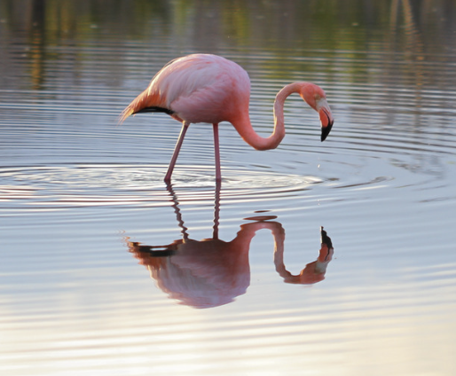
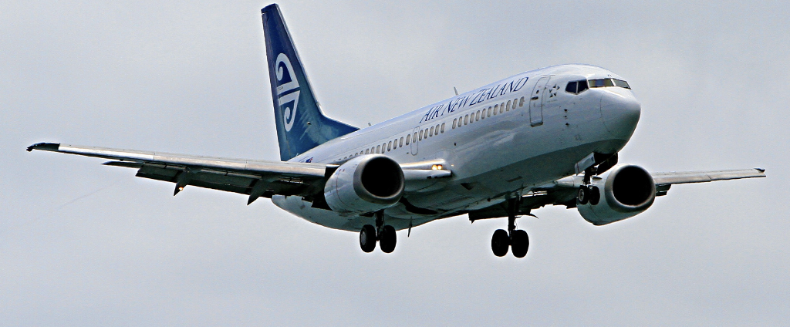
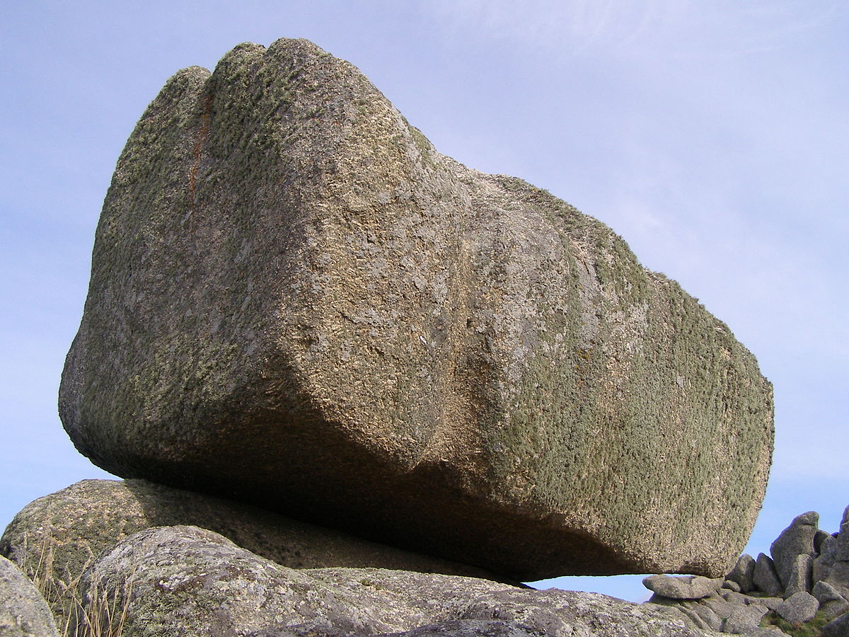
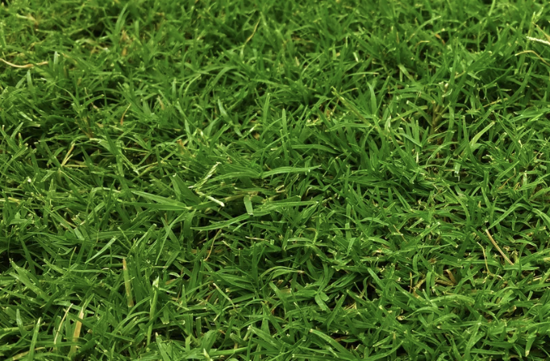
Directions: Choose the correct picture of a reflection from the choices below.
A
B
C
D
Notes:
Choose the one correct picture of a reflection from these four choices.

Slide 46
Directions: Choose the correct picture of a reflection from the choices below.
A
B
C
D
Notes:
This is the picture that shows a reflection. This is a reflection of light; you can see the reflection of the flamingo on the water’s surface.

Slide 47
Definition
Picture
Reflection
Example
How do reflections impact my life?
Notes:
Here is the Frayer model filled in with a picture of a reflection.

Slide 48
Directions: Choose the correct definition of a reflection from the choices below.
A
When light, sound, or heat bounces back after hitting a surface
B
The part of the electromagnetic spectrum that can be seen by the human eye
C
The bending of light waves when the wave moves from one medium to another
D
A material in which electrons can not move around easily
Notes:
Choose the one correct definition of a reflection from these four choices.

Slide 49
Directions: Choose the correct definition of a reflection from the choices below.
A
When light bounces back after hitting a surface
B
The part of the electromagnetic spectrum that can be seen by the human eye
C
The bending of light waves when the wave moves from one medium to another
D
A material in which electrons can not move around easily
Notes:
“When light, sound, or heat bounces back after hitting a surface.” is correct! This is the definition of a reflection.

Slide 50
Definition
Picture
When light bounces back after hitting a surface
Reflection
Example
How do reflections impact my life?
Notes:
Here is the Frayer Model with a picture and the definition filled in for a reflection: When light bounces back after hitting a surface.

Slide 51
Directions: Choose the correct example of a reflection from the choices below.
A
A light switch being turned off
B
A dog chasing after a frisbee
C
A wave in the ocean
D
Sunlight bouncing off the moon
Notes:
Choose the one correct example of a reflection from these four choices.

Slide 52
Directions: Choose the correct example of a reflection from the choices below.
A
A light switch being turned off
B
A dog chasing after a frisbee
C
A wave in the ocean
D
Sunlight bouncing off the moon
Notes:
“Sunlight bouncing off the moon” is correct! This is an example of a reflection.

Slide 53
Definition
Picture
When light bounces back after hitting a surface
Reflection
Sunlight bouncing off the moon
Example
How do reflections impact my life?
Notes:
Here is the Frayer Model with a picture, definition, and an example of a reflection: Sunlight bouncing off the moon

Slide 54
Directions: Choose the correct response for “how do reflections impact my life?” from the choices below.
A
I see my reflection in the mirror every morning. The mirror reflects light, letting me see how I look and helping me get ready for the day.
B
Reflections erode the surface of rocks giving them their shape. Then I find the rocks and add them to my collection.
C
Reflections are the powerhouse of the cell that helps provide energy to my body to keep it functioning properly.
D
I feel reflections of light during my dreams which allows me to sleep longer at night.
Notes:
Choose the one correct response for “how do reflections impact my life?” from these four choices.

Slide 55
Directions: Choose the correct response for “how do reflections impact my life?” from the choices below.
A
I see my reflection in the mirror every morning. The mirror reflects light, letting me see how I look and helping me get ready for the day.
B
Reflections erode the surface of rocks giving them their shape. Then I find the rocks and add them to my collection.
C
Reflections are the powerhouse of the cell that helps provide energy to my body to keep it functioning properly.
D
I feel reflections of light during my dreams which allows me to sleep longer at night.
Notes:
“I see my reflection in the mirror every morning. The mirror reflects light, letting me see how I look and helping me get ready for the day.” That is correct! This is an example of how reflections impact your life.

Slide 56
Definition
Picture
When light bounces back after hitting a surface
Reflection
I see my reflection in the mirror every morning. The mirror reflects light, letting me see how I look and helping me get ready for the day.
Sunlight bouncing off the moon
Example
How do reflections impact my life?
Notes:
Here is the Frayer Model with a picture, definition, example, and a correct response to “how do reflections impact my life?”: I see my reflection in the mirror every morning. The mirror reflects light, letting me see how I look and helping me get ready for the day.

Slide 57
Remember!!!
Notes:
So remember!
Feedback: A good general strategy for information retention is: 1) tell them what you're going to teach them, 2) teach them, and 3) tell them what you just taught them. Make sure to include the third and final step. While it is easy to think a quick review of what you just went over is unnecessary, it can be incredibly useful in helping the students remember the information over the long term.

Slide 58
Reflection: when light bounces back after hitting a surface.
Notes:
Reflection: when light bounces back after hitting a surface.

Slide 59
Big Question: How does light bouncing off things affect what we see and how we experience the world around us?
Notes:
Let’s reflect once more on our big question. Our “big question” is: How does light bouncing off things affect what we see and how we experience the world around us?
Does anyone have any additional examples to share that haven’t been discussed yet?

Slide 60
Notes:
Thanks for watching, and please continue watching CAPs available from this website.

Slide 61
This Video Was Created With Resources From:
Questions or Comments
Michael Kennedy, Ph.D. MKennedy@Virginia.edu
Rachel L Kunemund, Ph.D. rk8vm@virginia.edu

