Slide 1
Intro
“Big Idea” Question
Review Concepts
Check-In Questions
Teacher Engagement
Vocabulary
Student-Friendly Definition
Examples & Non-Examples
Morphological Word Parts
Frayer Model
Simulation/Activity
Notes:
OK everyone, get ready for our next lesson. Just as a reminder, these are the different components that our lesson may include, and you’ll see these icons in the top left corner of each slide so that you can follow along more easily!

Slide 2
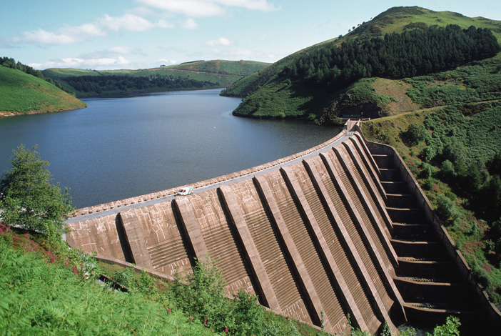
Intro
Reservoir
Notes:
Today, we’ll be learning about the word: Reservoir.

Slide 3
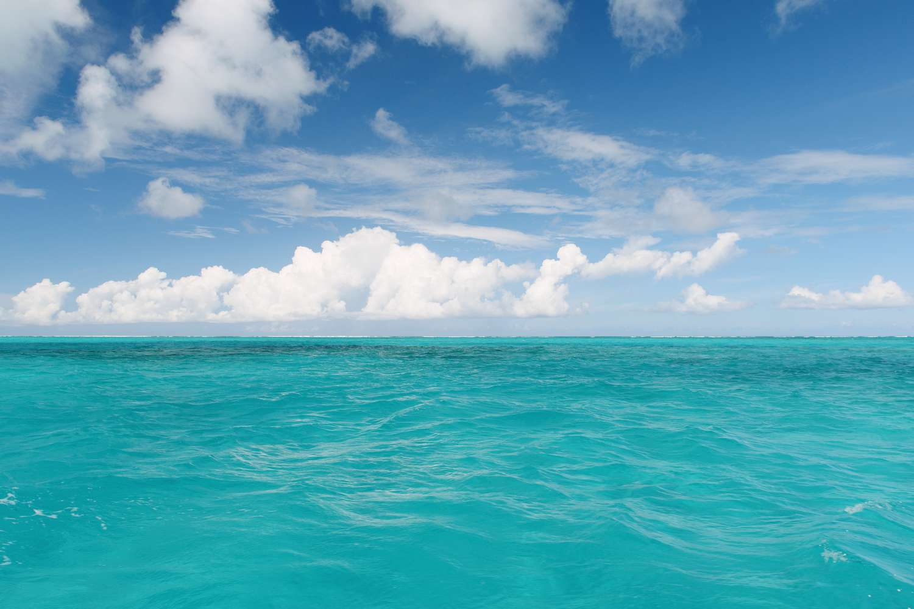
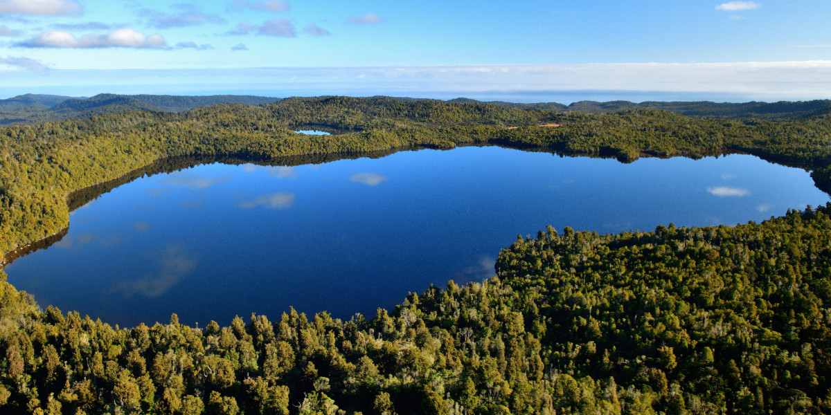
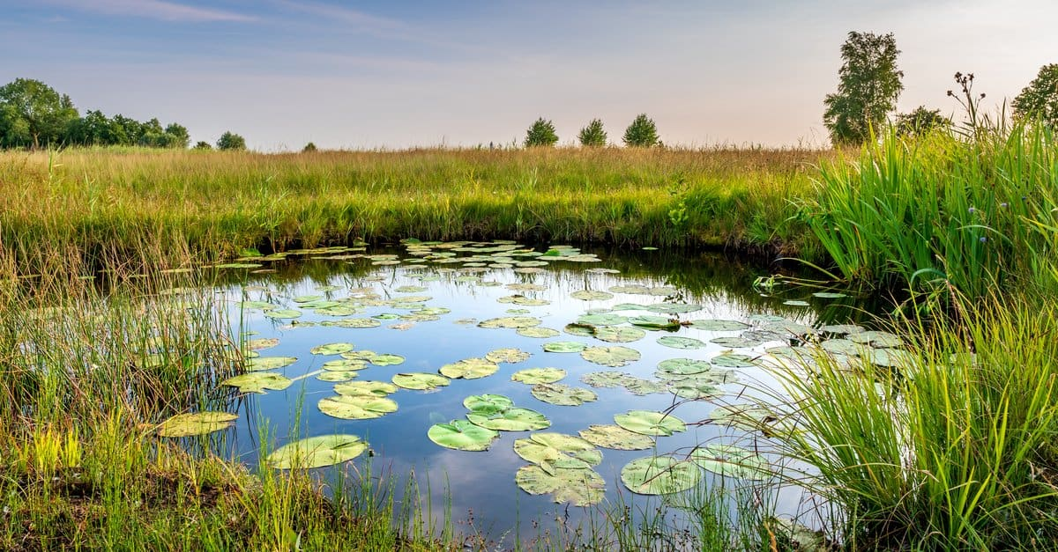
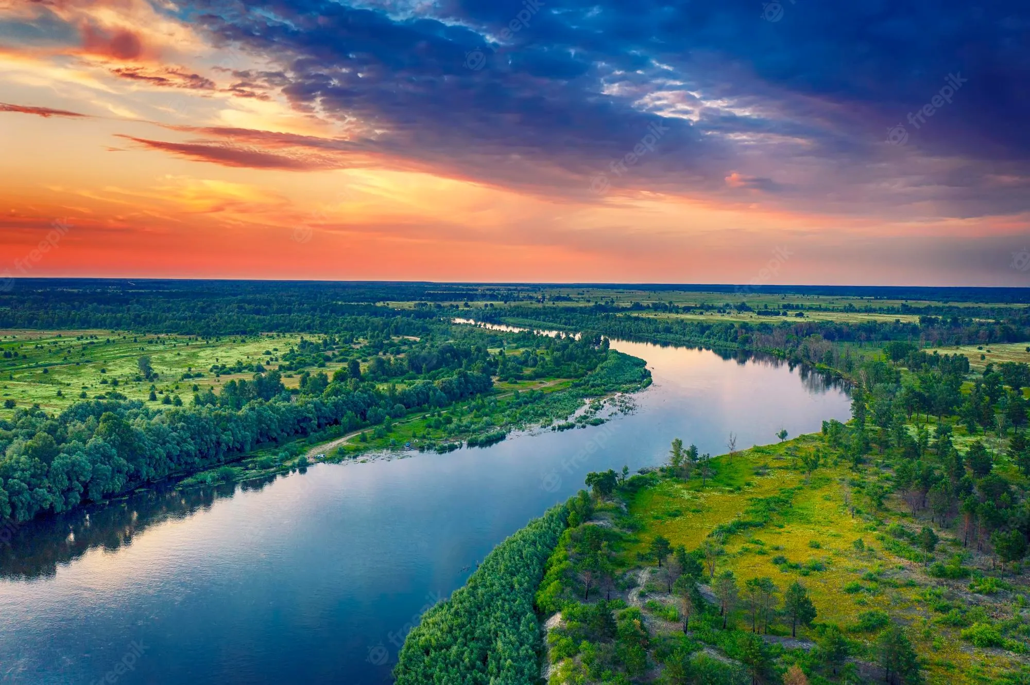
Big Question: What are the differences between lakes, oceans, ponds, reservoirs, and rivers?
Notes:
Our “big question” is: What are the differences between lakes, oceans, ponds, reservoirs, and rivers?
[Pause and illicit predictions from students.]
I love all these thoughtful scientific hypotheses! Be sure to keep this question and your predictions in mind as we move through these next few lessons, and we’ll continue to revisit it.

Slide 4
Notes:
Before we move on to our new topic, let’s review some other words & concepts that you already learned and make sure you are firm in your understanding.

Slide 5
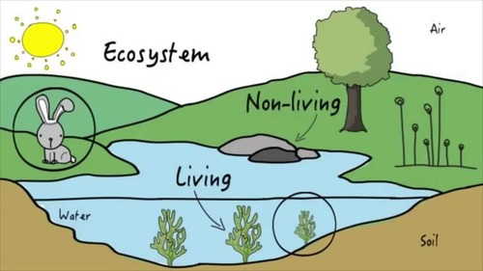
Ecosystem: an area where living and nonliving things interact
Notes:
An ecosystem is an area where living and nonliving things interact.

Slide 6
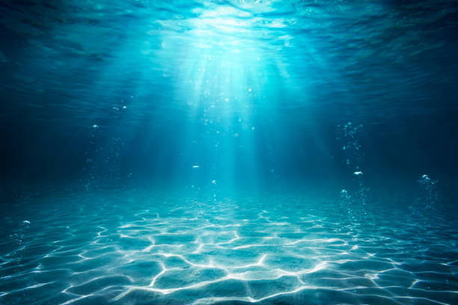
Aquatic: living, growing, or often found in the water
Notes:
Aquatic means something living, growing, or often found in water.

Slide 7
Lake: A natural, large body of water surrounded by land
Notes:
A lake is a natural, large body of water surrounded by land.

Slide 8
Notes:
Now let’s pause for a moment to review the information we have covered already.

Slide 9
An ecosystem is where ______ and _______ things interact.
Notes:
An ecosystem is where ______ and _______ things interact.
[living, non-living]

Slide 10
An ecosystem is where living and non-living things interact.
Notes:
An ecosystem is where ______ and _______ things interact.
[living, non-living]

Slide 11
Aquatic means living, growing, or often found in/on…
land
water
Notes:
Aquatic means living, growing, or often found in/on…
[water]

Slide 12
Aquatic means living, growing, or often found in/on…
land
water
Notes:
Aquatic means living, growing, or often found in/on…
[water]

Slide 13
A lake is a _____, large body of water surrounded by land.
man-made
natural
Notes:
A lake is a ______, large body of water surrounded by land
[natural]

Slide 14
A lake is a _____, large body of water surrounded by land.
man-made
natural
Notes:
A lake is a ______, large body of water surrounded by land
[natural]

Slide 15
Reservoir
Notes:
Now that we’ve reviewed, let’s define the phrase reservoir.

Slide 16
Reservoir: A man-made, large body of water surrounded by land.
Notes:
A reservoir is a man-made, large body of water surrounded by land.

Slide 17
Notes:
Let’s check-in for understanding.

Slide 18
What is a reservoir?
Notes:
What is a reservoir?
[A reservoir is a man-made, large body of water surrounded by land.]

Slide 19
Notes:
That is the basic definition, but there is a bit more you need to know.

Slide 20
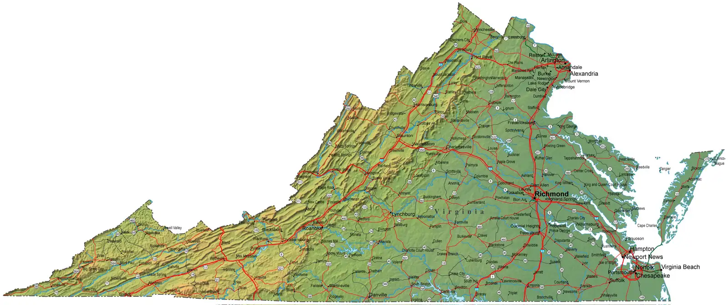
Virginia is home to many reservoirs. Smith Mountain Lake reservoir and Lake Anna reservoir are two popular ones.
Lake Anna
Smith Mountain Lake
Notes:
Virginia is home to many reservoirs. Smith Mountain Lake reservoir and Lake Anna reservoir are two popular ones.

Slide 21
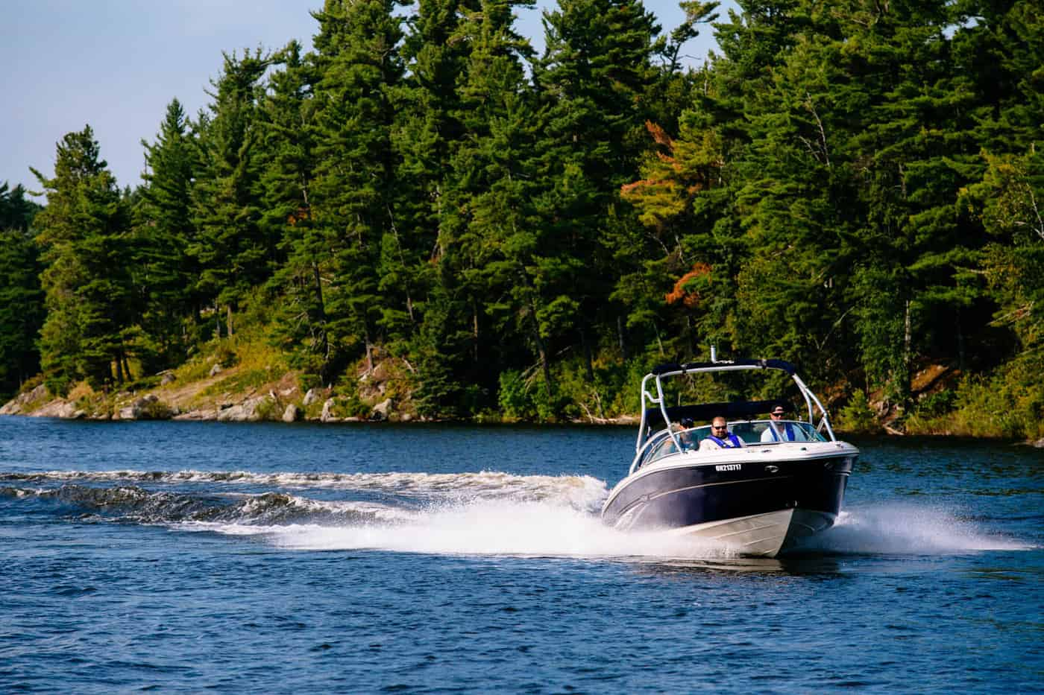
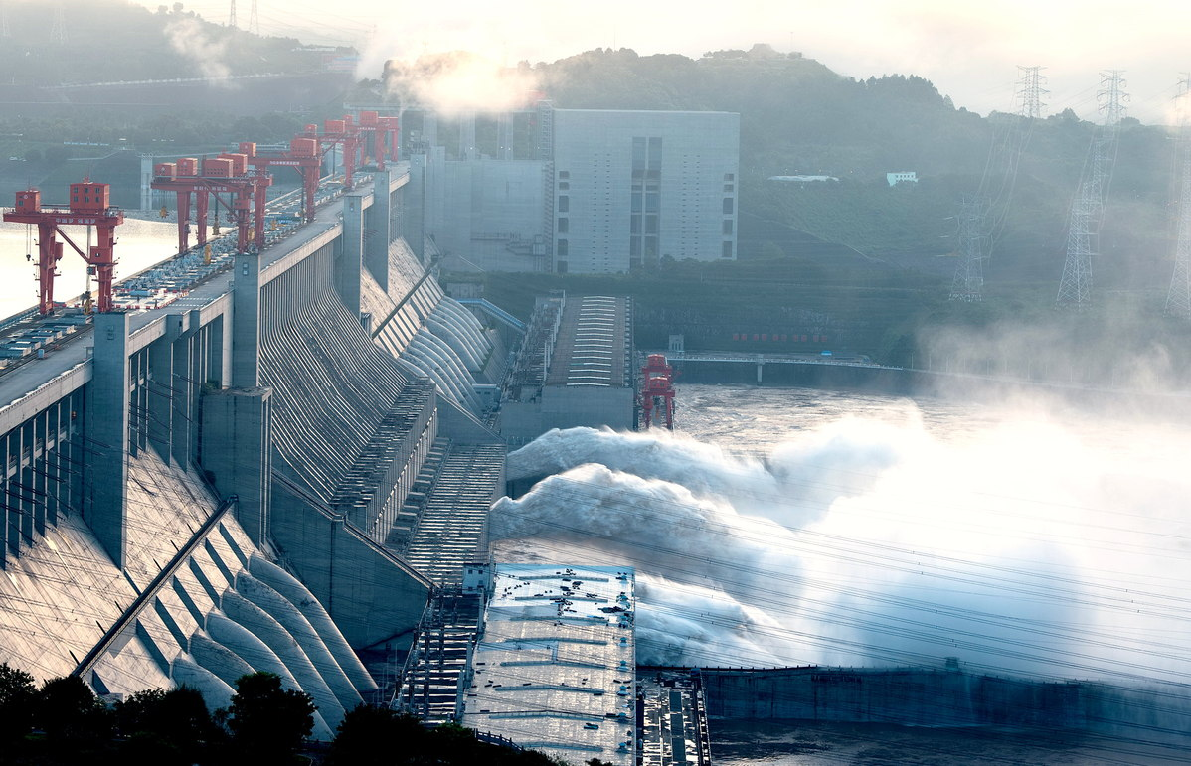
Reservoirs are often used for recreational purposes like boating, fishing, and swimming. Some reservoirs also help with generating electric and flood control.
Notes:
Reservoirs are often used for recreational purposes like boating, fishing, and swimming. Some reservoirs also help with generating electric and flood control.

Slide 22
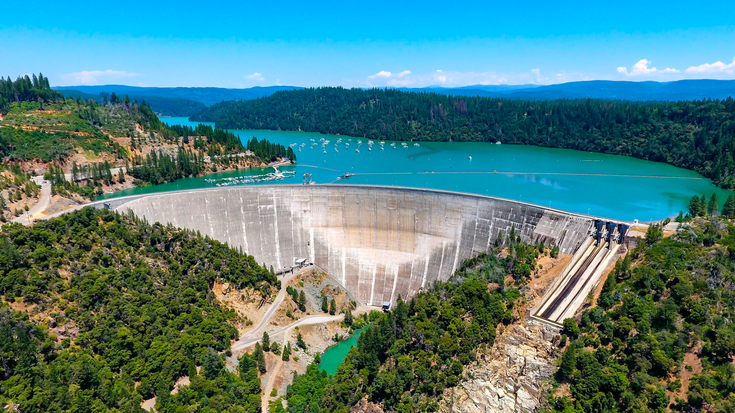
Often, reservoirs have the word “lake” in their names. Smith Mountain Lake and Lake Anna do this. Just remember though, reservoirs are man-made and often have a dam.
reservoir
dam
Notes:
Often, reservoirs have the word “lake” in their names. Smith Mountain Lake and Lake Anna do this. Just remember though, reservoirs are man-made and often have a dam.

Slide 23
Notes:
Let’s check-in for understanding.

Slide 24
True or False: Virginia is home to many reservoirs. Smith Mountain Lake reservoir and Lake Anna reservoir are two popular ones.
True
False
Lake Anna
Smith Mountain Lake
Notes:
True or False: Virginia is home to many reservoirs. Smith Mountain Lake reservoir and Lake Anna reservoir are two popular ones.
[True]

Slide 25
True or False: Virginia is home to many reservoirs. Smith Mountain Lake reservoir and Lake Anna reservoir are two popular ones.
True
False
Lake Anna
Smith Mountain Lake
Notes:
True or False: Virginia is home to many reservoirs. Smith Mountain Lake reservoir and Lake Anna reservoir are two popular ones.
[True]

Slide 26
What are a few ways that reservoirs are used?
Flood control, generating electric
Boating, fishing, swimming
Notes:
What are a few ways that reservoirs are used?
[Recreation (boating, fishing, swimming), flood control, generating electric]

Slide 27
What are a few ways that reservoirs are used?
Flood control, generating electric
Boating, fishing, swimming
Notes:
What are a few ways that reservoirs are used?
[Recreation (boating, fishing, swimming), flood control, generating electric]

Slide 28
True or False: The important fact to remember about reservoirs is that they are man-made.
True
False
Notes:
True or False: The important fact to remember about reservoirs is that they are man-made.
[True]

Slide 29
True or False: The important fact to remember about reservoirs is that they are man-made.
True
False
Notes:
True or False: The important fact to remember about reservoirs is that they are man-made.
[True]

Slide 30
Notes:
Now, let’s talk about some examples of reservoirs.

Slide 31
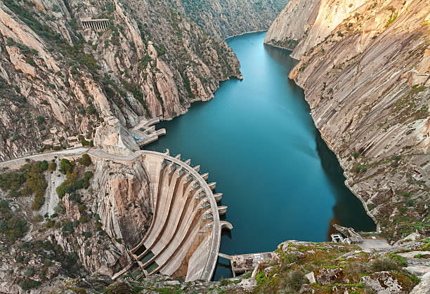
This is an example of a reservoir. It is a man-made body of water surrounded by land.
Man-made portion
Notes:
This is an example of a lake. It is a man-made body of water surrounded by land.

Slide 32
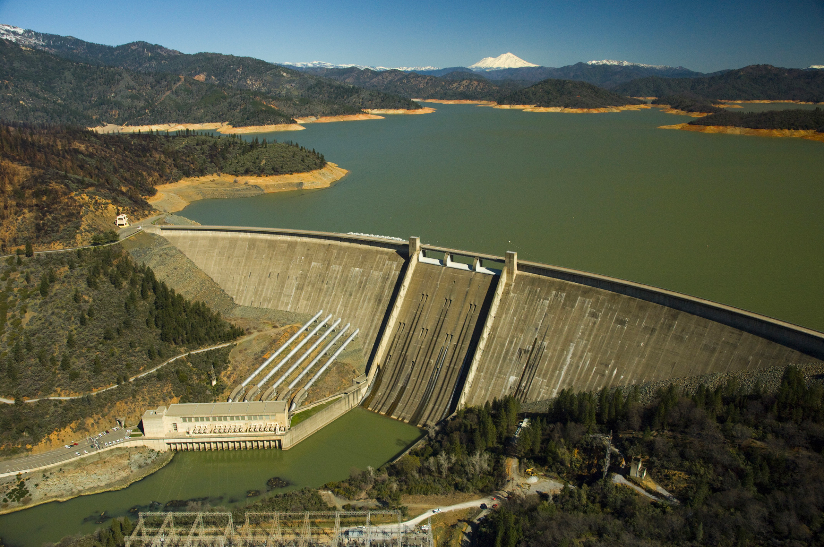
This is a different example of a reservoir. Again, this picture shows a man-made body of water surrounded by land.
Photo: Georgia Coast Atlas
Notes:
This is a different example of a reservoir. Again, this picture shows a man-made body of water surrounded by land.

Slide 33
Notes:
Now, let’s talk about some non-examples of reservoirs.

Slide 34
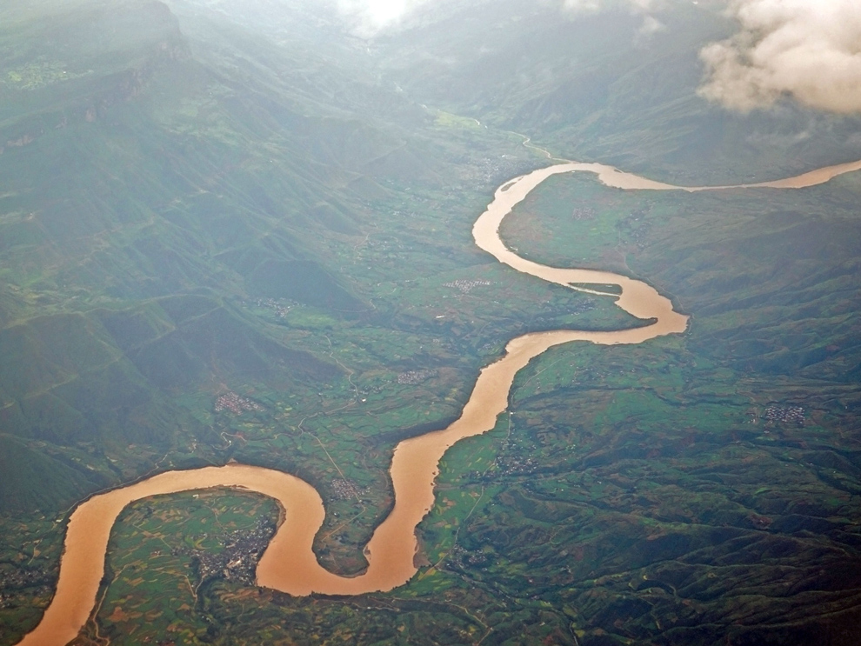
This is not a reservoir. This body of water is natural, not man-made.
Notes:
This is not a reservoir. This body of water is natural, not man-made.

Slide 35
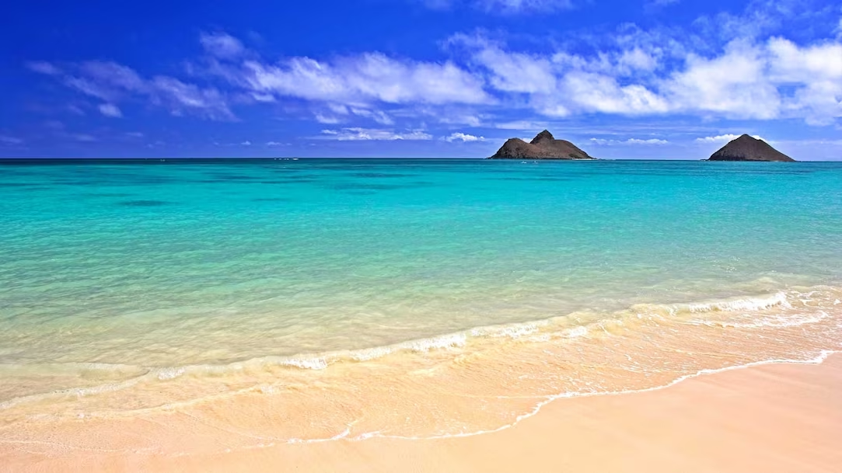
This is also not a reservoir. This body of water is also natural, not man-made.
Notes:
This is also not a reservoir. This body of water is also natural, not man-made.

Slide 36
Notes:
Now let’s pause for a moment to check your understanding.

Slide 37
Which of these is a reservoir?
Notes:
Which of these is a reservoir?
[The right picture.]

Slide 38
Which of these is a reservoir?
Notes:
Which of these is a reservoir?
[The right picture.]

Slide 39
Remember!!!
Notes:
So remember!

Slide 40
Reservoir: A man-made, large body of water surrounded by land.
Notes:
A reservoir is a man-made, large body of water surrounded by land.

Slide 41
Notes:
We will now complete this concept map, called a Frayer model, to summarize and further clarify what you have learned about the term reservoir.

Slide 42
Definition
Picture
Reservoir
Example
How do reservoirs impact my life?
Notes:
To complete the Frayer model, we will choose from four choices the correct picture, definition, example, and response to the question, “How do reservoirs impact my life?” Select the best response for each question using the information you just learned. As we select responses, we will see how this model looks filled in for the term reservoirs.

Slide 43
Directions: Choose the correct picture of a reservoir from the choices below.
A
B
C
D
Notes:
Choose the one correct picture of a reservoir from these four choices.

Slide 44
Directions: Choose the correct picture of a reservoir from the choices below.
A
B
C
D
Notes:
This is the picture that shows a reservoir.

Slide 45
Definition
Picture
Reservoir
Example
How do reservoirs impact my life?
Notes:
Here is the Frayer model filled in with a picture of a reservoir.

Slide 46
Directions: Choose the correct definition of a reservoir from the choices below.
A
A man-made, large body of water surrounded by land
B
A natural, large body of water surrounded by land
C
A giant body of saltwater
D
A long, winding stream of water that constantly moves
Notes:
Choose the correct definition of a reservoir from the choices below.

Slide 47
Directions: Choose the correct definition of a reservoir from the choices below.
A
A man-made, large body of water surrounded by land
B
A natural, large body of water surrounded by land
C
A giant body of saltwater
D
A long, winding stream of water that constantly moves
Notes:
Choose the correct definition of a reservoir from the choices below.
[A. A man-made, large body of water surrounded by land.]

Slide 48
Definition
Picture
A man-made, large body of water surrounded by land
Reservoir
Example
How do reservoirs impact my life?
Notes:
Here is the Frayer Model with a picture and the definition filled in for a reservoir: A man-made, large body of water surrounded by land.

Slide 49
Directions: Choose the correct example of a reservoir from the choices below.
A
A stream flowing between two mountains
B
A large body of water that is formed using a dam
C
A giant body of saltwater
D
A large body of water in a forest
Notes:
Choose the correct example of a reservoir from the choices below.

Slide 50
Directions: Choose the correct example of a reservoir from the choices below.
A
A stream flowing between two mountains
B
A large body of water that is formed using a dam
C
A giant body of saltwater
D
A large body of water in a forest
Notes:
“A large body of water that is formed using a dam” is correct! This is an example of a reservoir.

Slide 51
Definition
Picture
A man-made, large body of water surrounded by land
Reservoir
A large body of water that is formed using a dam
Example
How do reservoirs impact my life?
Notes:
Here is the Frayer Model with a picture, definition, and an example of a reservoir: A large body of water that is formed using a dam.

Slide 52
Directions: Choose the correct response for “How do reservoirs impact my life?” from the choices below.
A
Reservoirs can offer a source for oxygen
B
Reservoirs can offer electricity to homes and recreation
C
Reservoirs can provide an ecosystem for humans
D
Reservoirs give me shelter
Notes:
Choose the one correct response for “how do reservoirs impact my life?” from these four choices.

Slide 53
Directions: Choose the correct response for “How do reservoirs impact my life?” from the choices below.
A
Reservoirs can offer a source for oxygen
B
Reservoirs can offer electricity to homes and recreation
C
Reservoirs can provide an ecosystem for humans
D
Reservoirs give me shelter
Notes:
“Reservoirs can offer electricity to homes and recreation” That is correct! This is an example of how reservoirs impact your life.

Slide 54
Definition
Picture
A man-made, large body of water surrounded by land
Reservoir
A large body of water that is formed using a dam
Reservoirs can offer electricity to homes and recreation
Example
How do reservoirs impact my life?
Notes:
Here is the Frayer Model with a picture, definition, example, and a correct response to “how do reservoirs impact my life?”: Reservoirs can offer electricity to homes and recreation

Slide 55
Remember!!!
Notes:
So remember!

Slide 56
Reservoir: A man-made, large body of water surrounded by land.
Notes:
A reservoir is a man-made, large body of water surrounded by land.

Slide 57
Big Question: What are the differences between lakes, oceans, ponds, reservoirs, and rivers?
Notes:
Our “big question” is: What are the differences between lakes, oceans, ponds, reservoirs, and rivers?
Does anyone have any additional examples to share that haven’t been discussed yet?
I love all these thoughtful scientific hypotheses! Be sure to keep this question and your predictions in mind as we move through these next few lessons, and we’ll continue to revisit it.

Slide 58
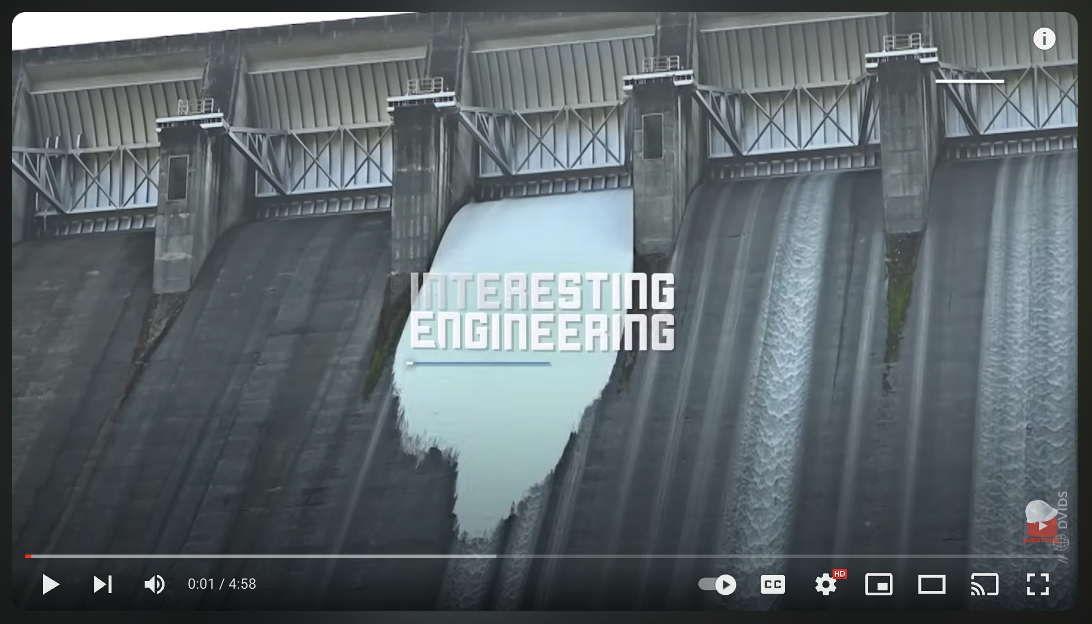
Extension Activity
Interesting Engineering
Click the link above for an extension video about dams and reservoirs.
Jot down 2 or 3 new facts that you learn about dams or reservoirs.
Discuss them as a class.
Notes:
Click the link above for an extension video about dams and reservoirs. Jot down 2 or 3 new facts that you learn about dams or reservoirs. Discuss them as a class.

Slide 59
Notes:
Thanks for watching, and please continue watching CAPs available from this website.

Slide 60
This Was Created With Resources From:
Questions or Comments
Michael Kennedy, Ph.D. MKennedy@Virginia.edu
Rachel L Kunemund, Ph.D. rk8vm@virginia.edu

