Slide 1
Intro
“Big Idea” Question
Review Concepts
Check-In Questions
Teacher Engagement
Vocabulary
Student-Friendly Definition
Examples & Non-Examples
Frayer Model
Simulation/Activity
Notes:
OK everyone, get ready for our next lesson. Just as a reminder, these are the different components that our lesson may include, and you’ll see these icons in the top left corner of each slide so that you can follow along more easily!

Slide 2
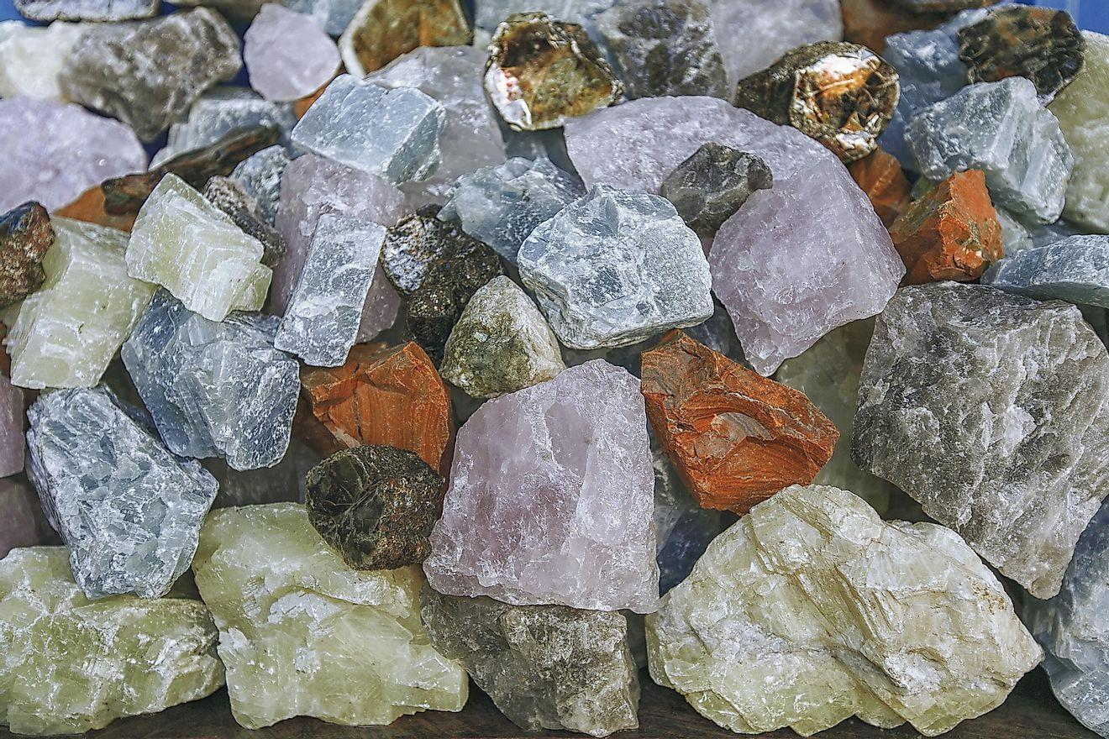
Intro
Rock
Notes:
Today, we’ll be learning about the word: Rock.

Slide 3
Big Question: Why are rocks important and how do they affect the world around us?
Notes:
Our “big question” is: Why are rocks important and how do they affect the world around us? [Pause and illicit predictions from students.]
I love all these thoughtful scientific hypotheses! Be sure to keep this question and your predictions in mind as we move through these next few lessons, and we’ll continue to revisit it.

Slide 4
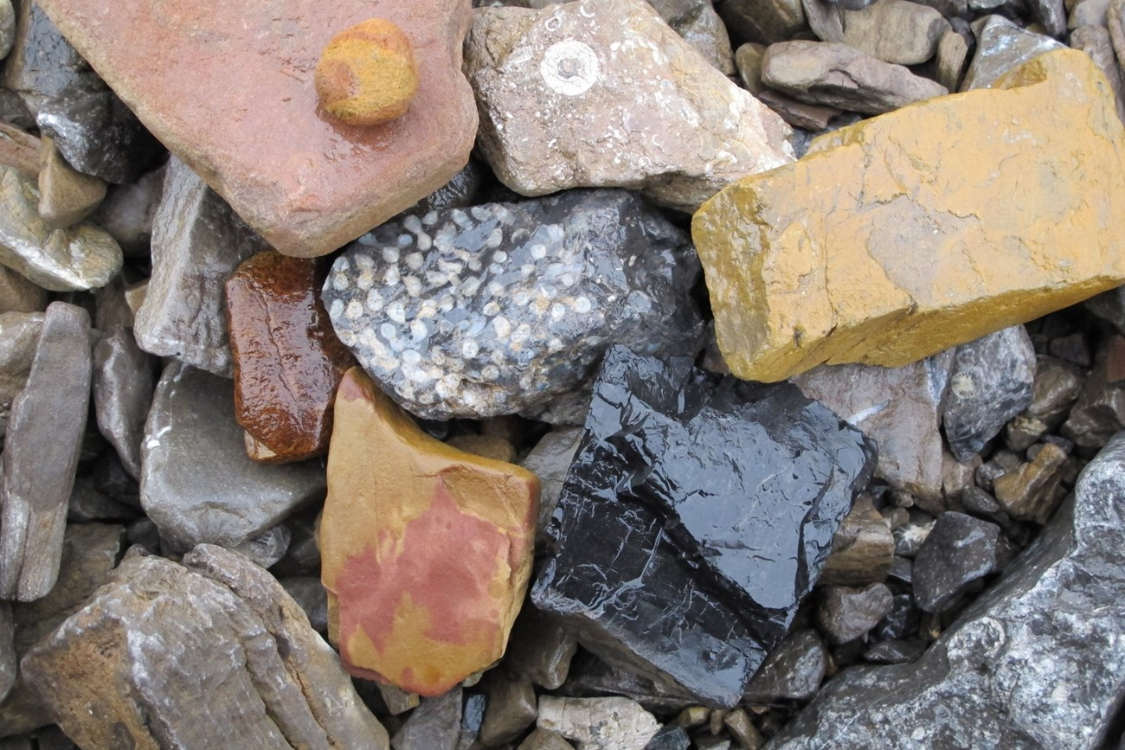
Demonstration
Rocks Galore!
Provide various rock samples containing visible minerals for students to observe. Have students identify minerals they recognize and characteristics of the rocks.
Notes:
Suggested rocks: Granite, Sandstone, Conglomerate
Example characteristics of rocks: Size, Shape, Color, Texture, Hardness, Density

Slide 5
Notes:
Before we move on to our new topic, let’s review some other words & concepts that you already learned and make sure you are firm in your understanding.

Slide 6
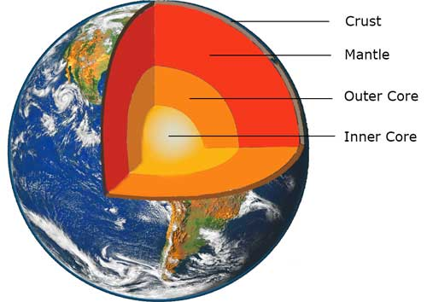
Inner Core: The innermost layer of the Earth
Notes:
Inner Core: The innermost layer of the Earth

Slide 7
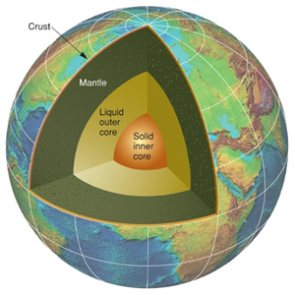
Outer Core: The third layer of the Earth made of liquid iron and nickel
Notes:
Outer Core: The third layer of the Earth made of liquid iron and nickel.

Slide 8
Mantle: The layer of rock between the crust and the outer core
Notes:
Mantle: The layer of rock between the crust and the outer core

Slide 9
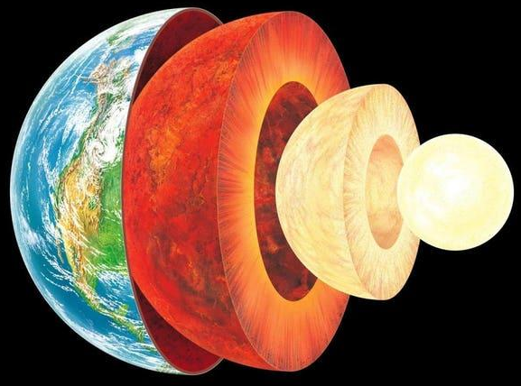
Crust: The outermost shell of the Earth
Crust
Notes:
Crust: The outermost shell of the Earth.
Ask students if they can name the other layers in the picture.

Slide 10
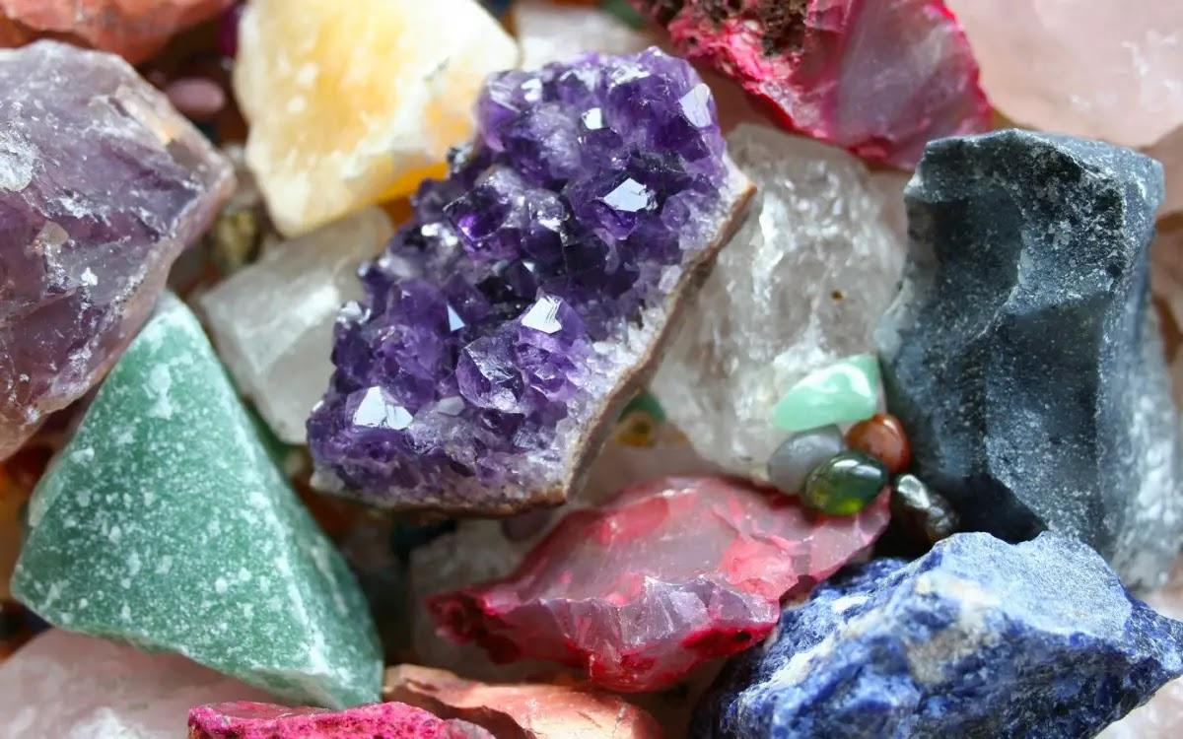
Mineral: Substances that do not come from an animal or plant, the building blocks that make up rocks
Notes:
Mineral: Substances that do not come from an animal or plant, the building blocks that make up rocks

Slide 11
Notes:
Now let’s pause for a moment to review the information we have covered already.

Slide 12
Which is the correct order of the Earth’s layers from top to bottom?
Crust, Mantle, Outer Core, Inner Core
Mantle, Crust, Outer Core, Inner Core
Outer Core, Mantle, Crust, Inner Core
Notes:
Which is the correct order of the Earth’s layers from top to bottom?
[A] Crust, Mantle, Outer Core, Inner Core

Slide 13
Which is the correct order of the Earth’s layers from top to bottom?
Crust, Mantle, Outer Core, Inner Core
Mantle, Crust, Outer Core, Inner Core
Outer Core, Mantle, Crust, Inner Core
Notes:
Which is the correct order of the Earth’s layers from top to bottom?
[A] Crust, Mantle, Outer Core, Inner Core

Slide 14
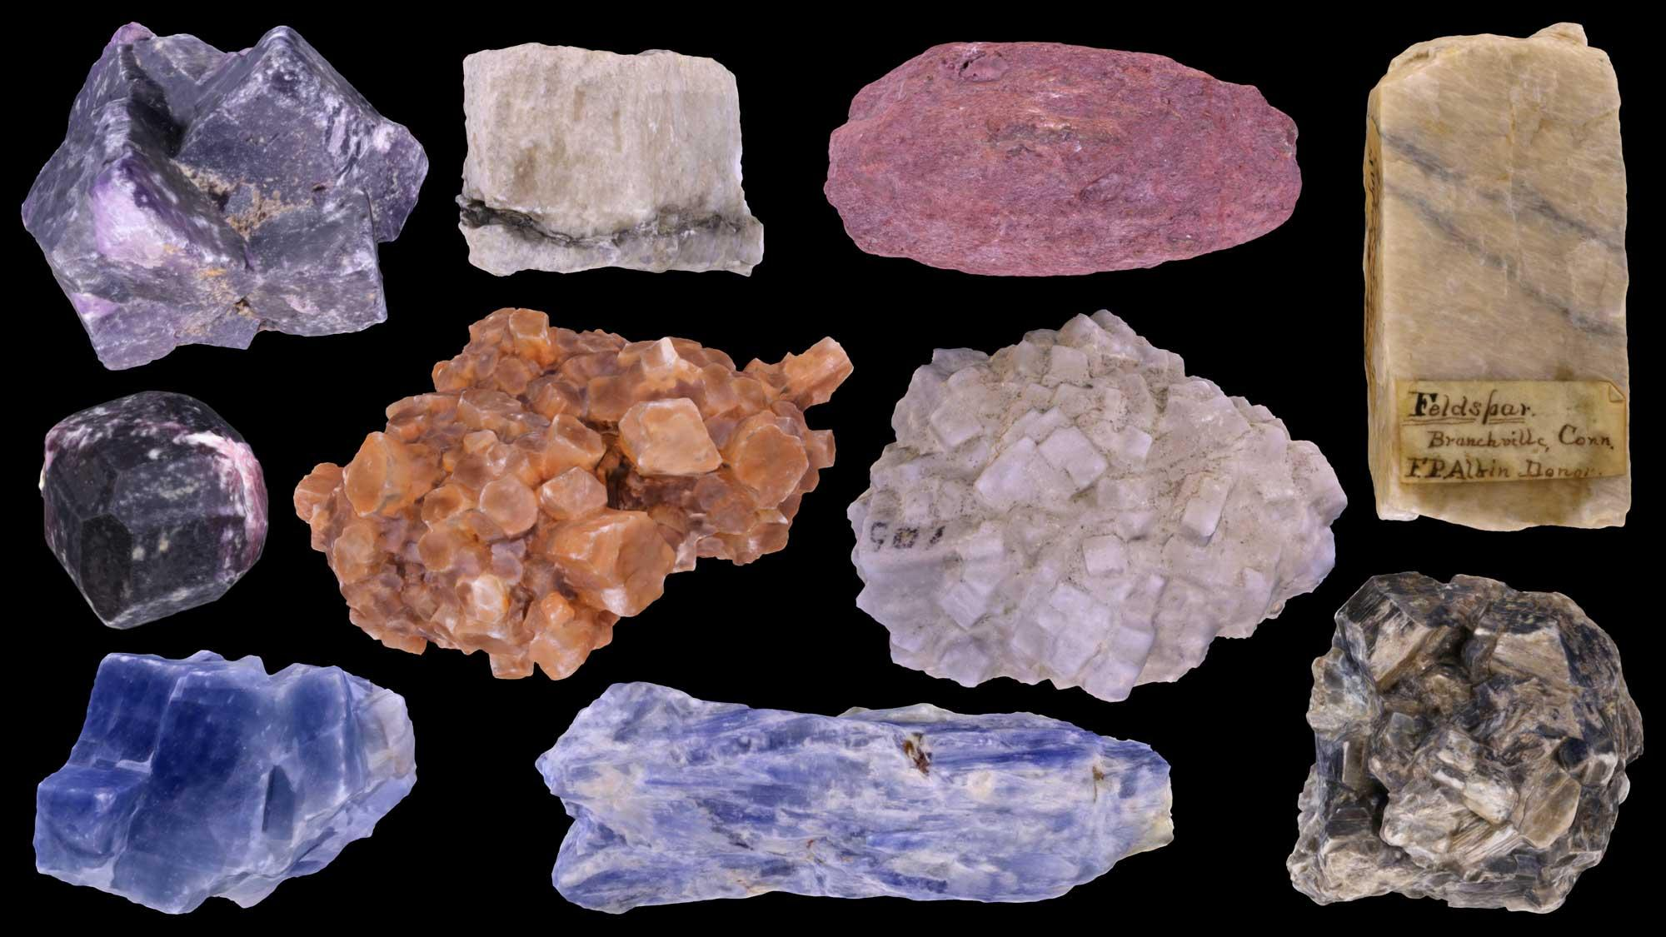
Minerals are substances that ____ come from an animal or plant, the building blocks that make up rocks.
Do
Do not
Notes:
Minerals are substances that do not come from an animal or plant, the building blocks that make up rocks.
[B] Do not

Slide 15
Minerals are substances that do not come from an animal or plant, the building blocks that make up rocks.
Do
Do not
Notes:
Minerals are substances that do not come from an animal or plant, the building blocks that make up rocks.
[B] Do not

Slide 16
Rock
Notes:
Now that we’ve reviewed, let’s define the phrase Rock.

Slide 17
Rock: A solid collection of minerals.
Notes:
Rocks are solid collections of minerals.

Slide 18
Notes:
Let’s check-in for understanding.

Slide 19
What are Rocks?
Notes:
What are rocks?
[A solid collection of minerals.]

Slide 20
Notes:
That is the basic definition, but there is a bit more you need to know.

Slide 21
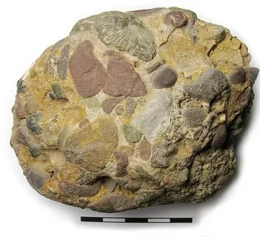
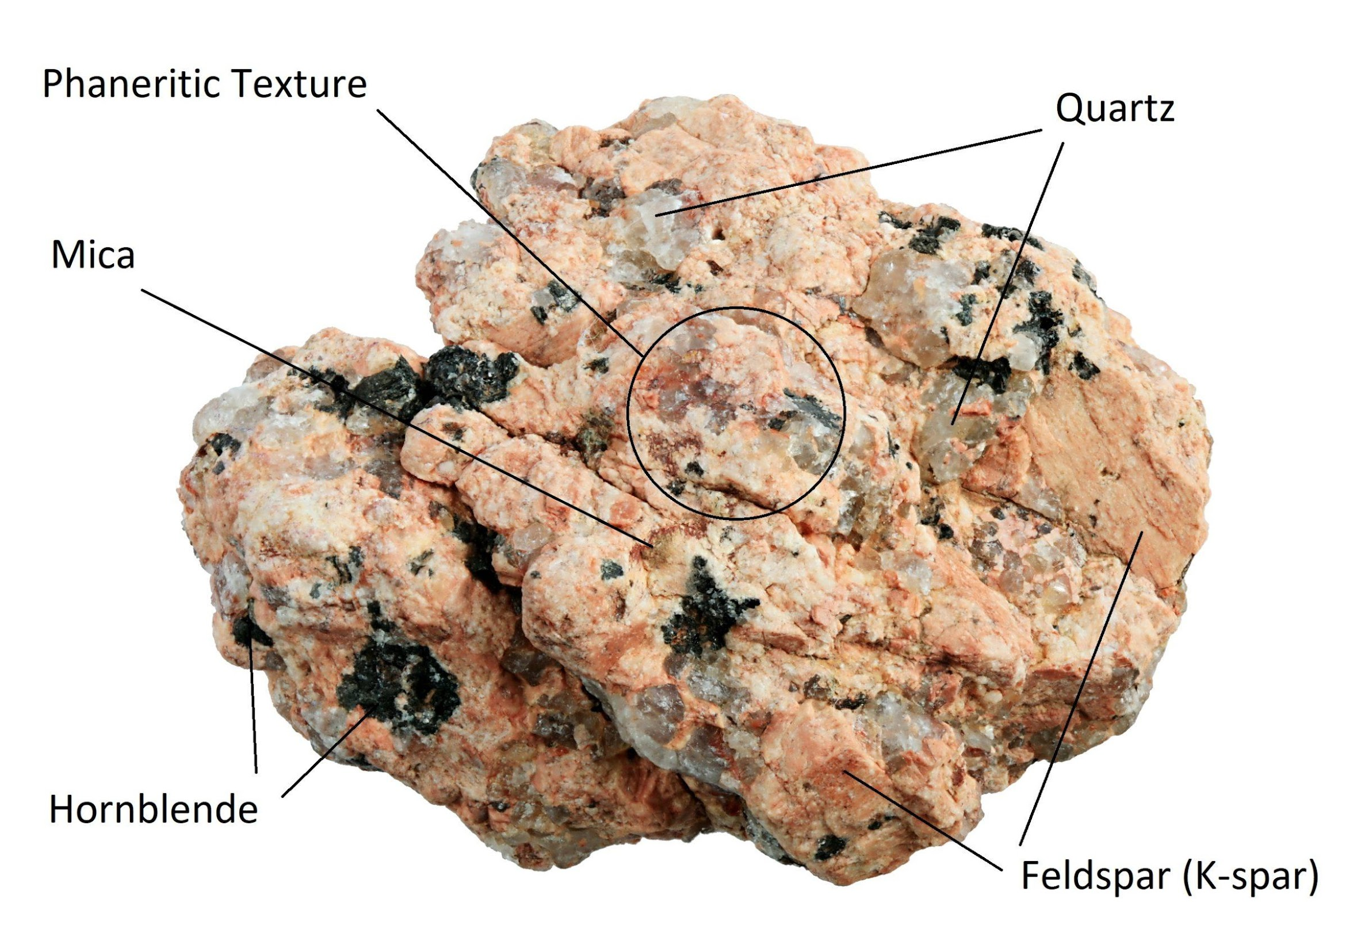
Licensable
Rocks can be made of many minerals.
Conglomerate
Granite
Notes:
Rocks can be made of many minerals.
Look at conglomerate and how many minerals comprise it (quartz pebbles, cobbles, and boulders).
Different rocks tend to be made of different minerals.

Slide 22
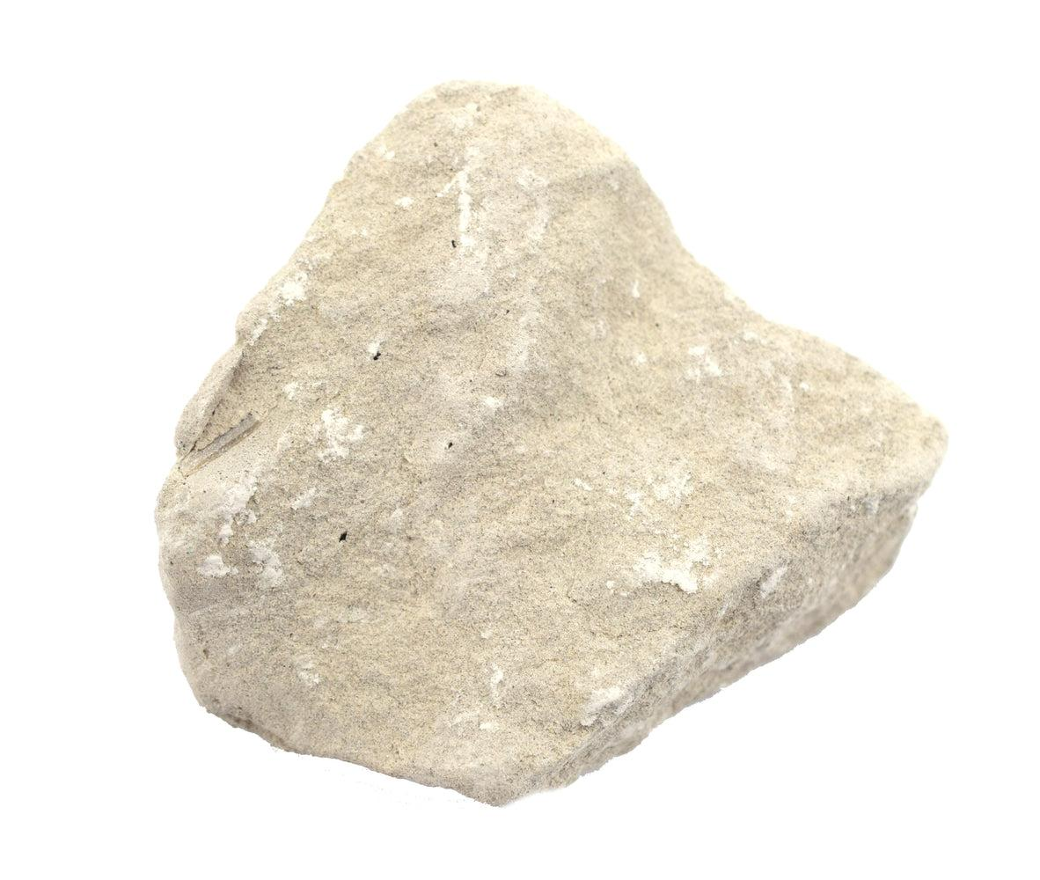
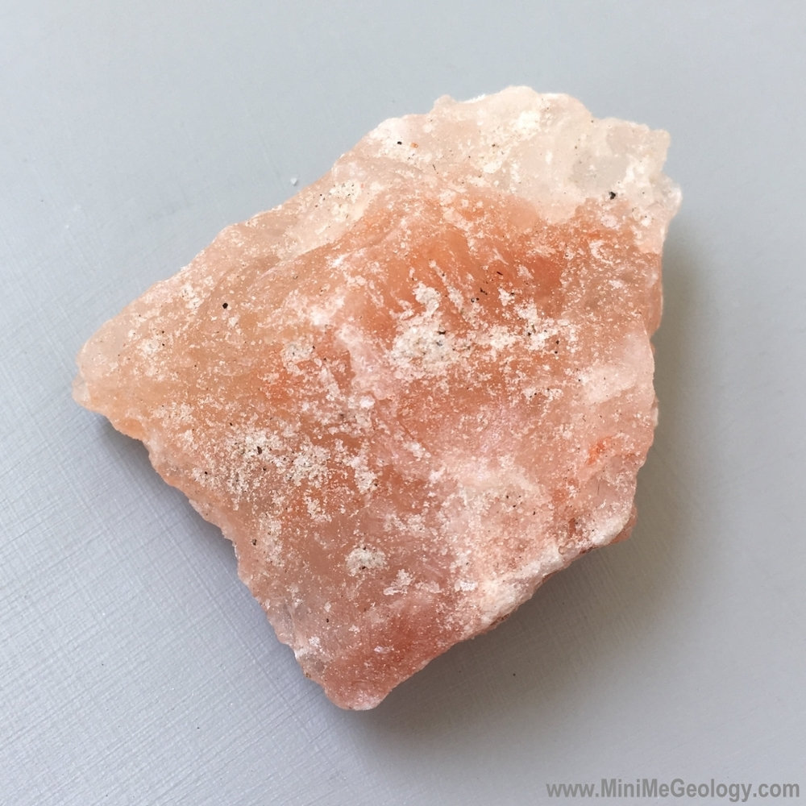
Licensable
Rocks can be made of only one mineral.
Rock Salt (Halite)
Limestone (Calcite)
Notes:
We call this a monomineralic rock.
Examples: rock salt (halite), limestone (calcite), quartzite (quartz)

Slide 23
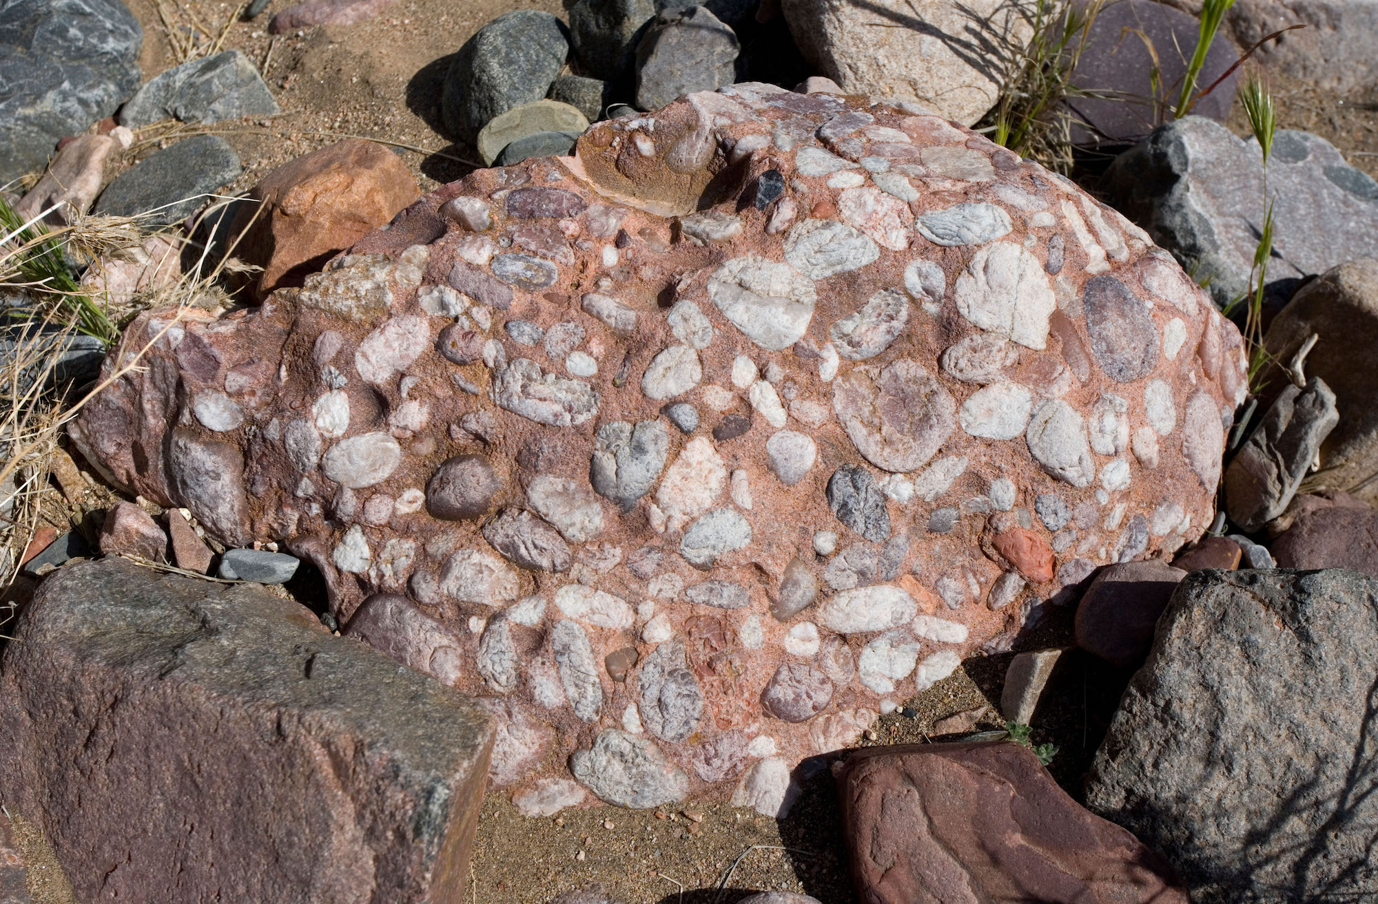
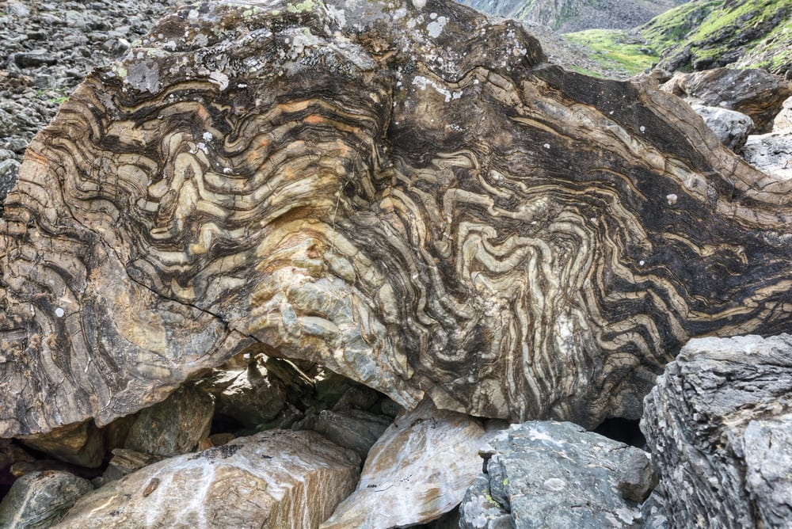
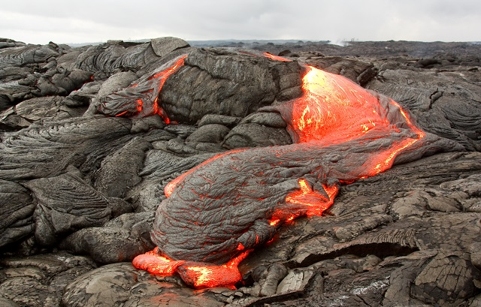
Licensable
There are three types of rocks. Each type forms differently.
Igneous – when lava cools down and solidifies
Sedimentary – when small particles e.g., minerals, organic materials, sand, stick together over time
Metamorphic – when existing rocks undergo temperature, pressure, or chemical change
Notes:
There are three types of rocks. Each type of rock forms differently.
Look at the sedimentary rock! It looks like we saw it a few slides ago. It’s conglomerate!
What does this say about what conglomerate is made of? [Small particles, sediments]

Slide 24
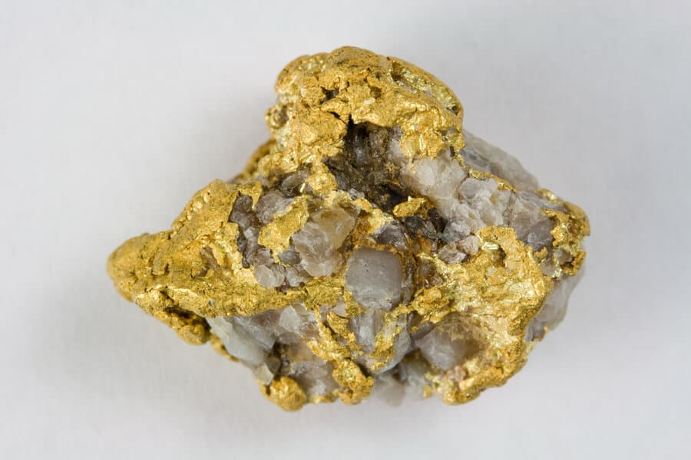
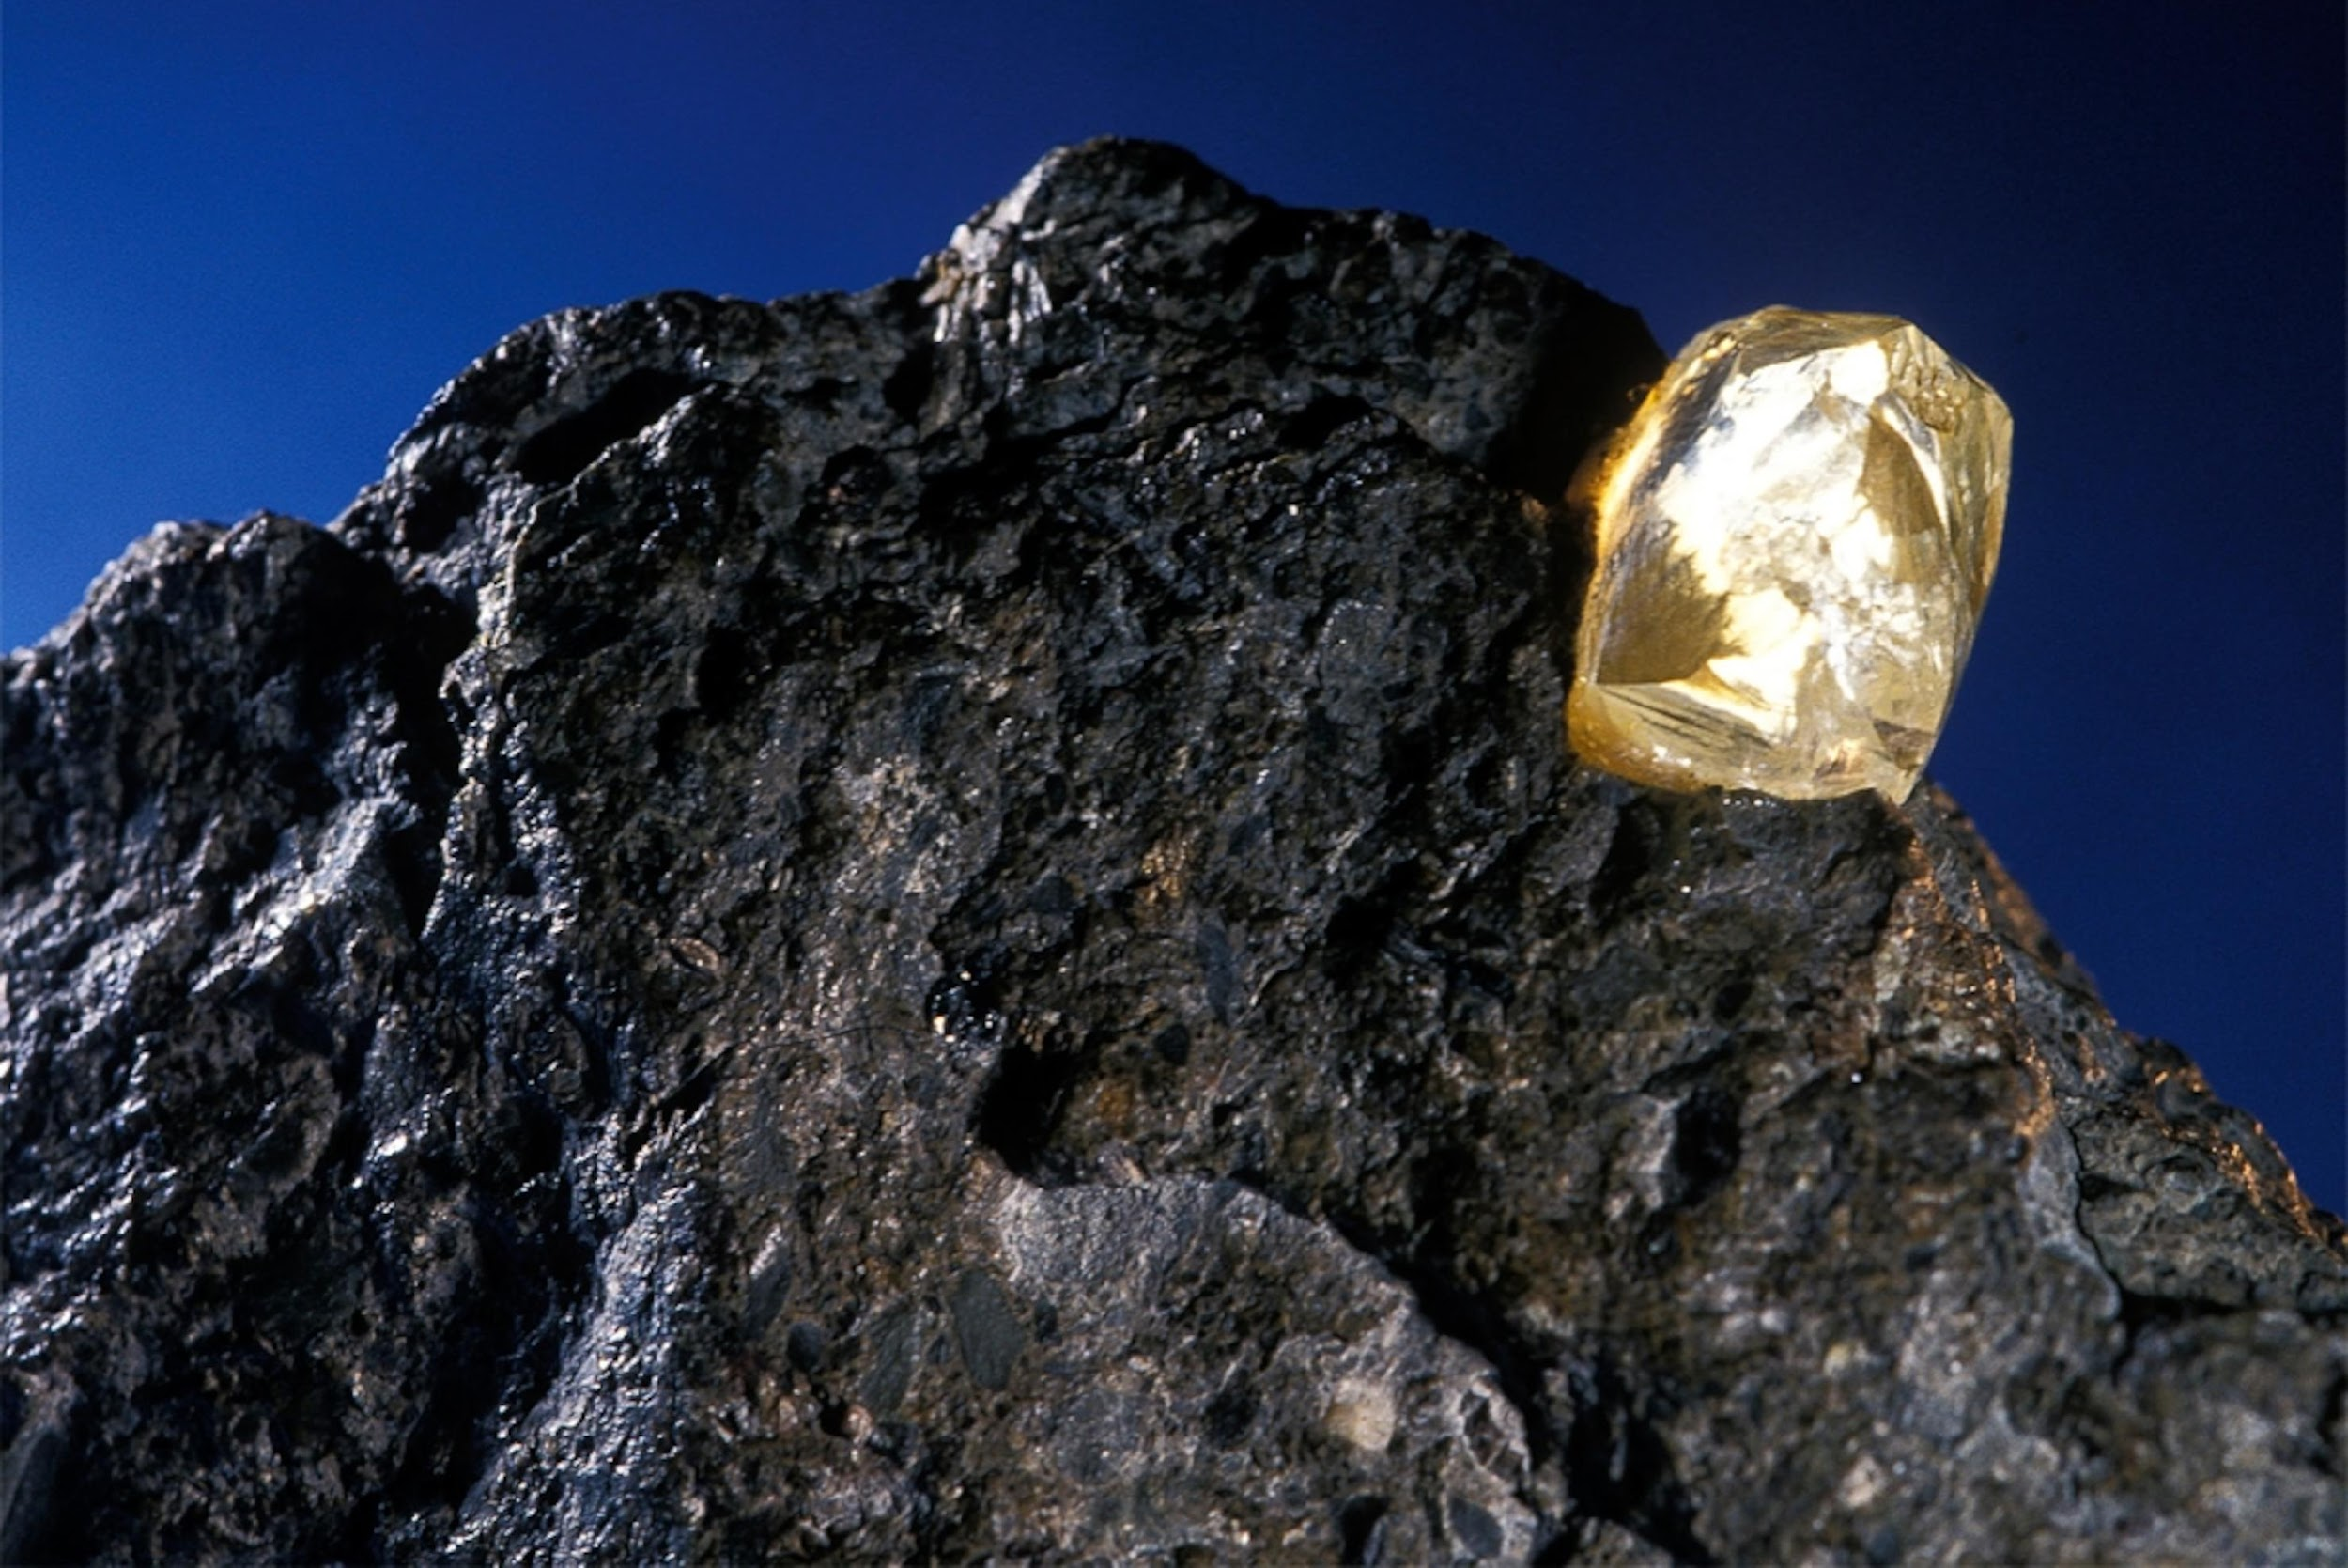
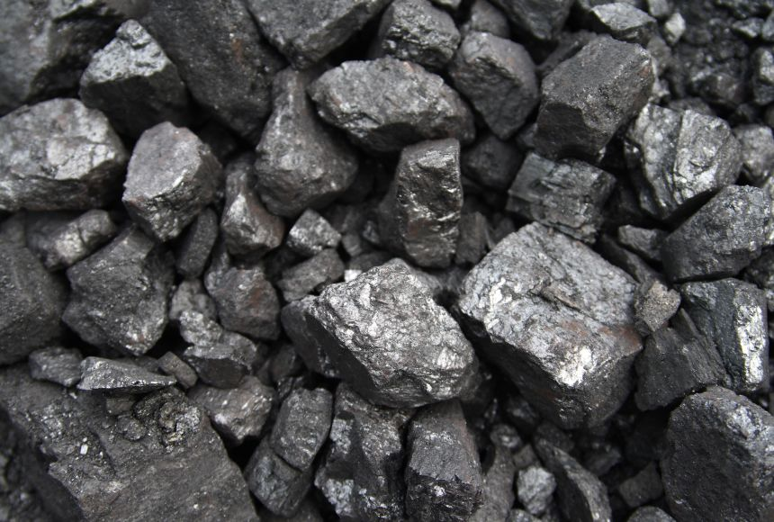
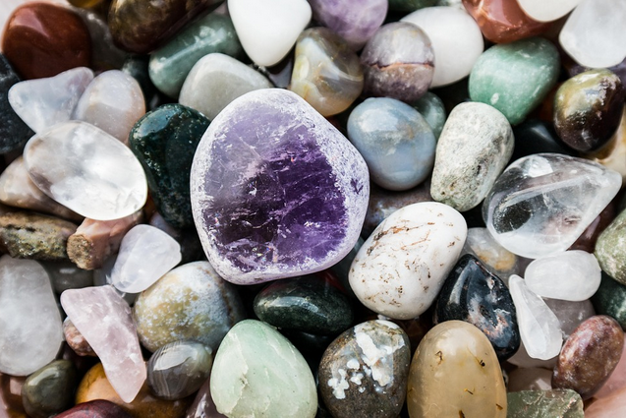
Licensable
Rocks contain many important resources we use.
Notes:
We spend a lot of time and resources into extracting valuable resources from rocks.
Examples: Gold, Diamond, Fossil Fuels, Gemstones (Amethyst)

Slide 25
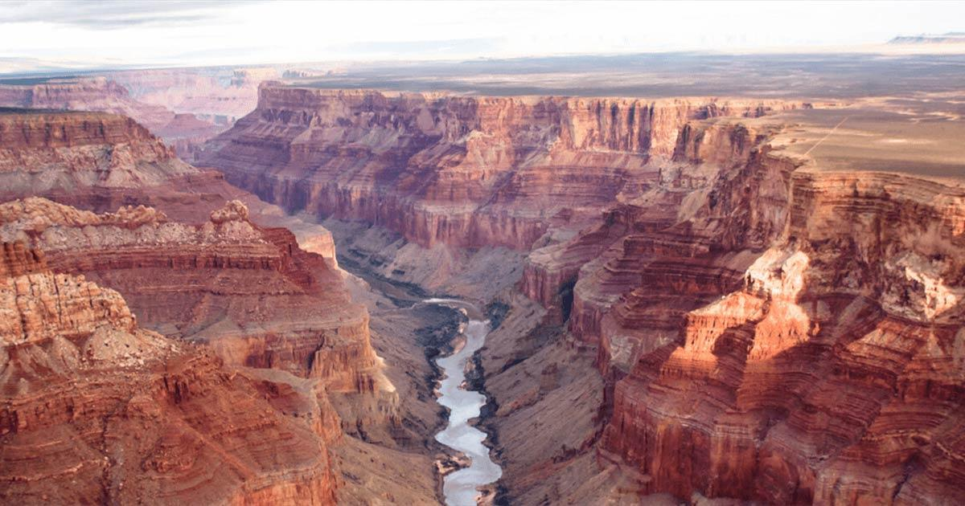
Licensable
Rocks are always undergoing change and being shaped by forces such as wind, water, and ice.
Notes:
Rocks are always undergoing change and being shaped by forces such as wind, water, and ice.
Look at the Grand Canyon and how the elements are shaping the rocks.

Slide 26
Notes:
Let’s check-in for understanding.

Slide 27
Rocks can be made of one or more minerals.
True
False
Notes:
Rocks can be made of one or more minerals.
[True]

Slide 28
Rocks can be made of one or more minerals.
True
False
Notes:
Rocks can be made of one or more minerals.
[True]

Slide 29
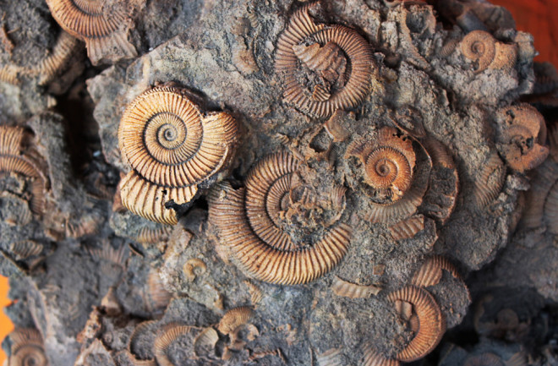
Rocks can be made of which materials?
Particles, sediments, sand, organic material
Living organisms, plastic, metallic objects, glass
Notes:
Rocks can be made of which materials?
[A] Particles, sediments, sand, organic material
The picture shows a sedimentary rock which can contain fossils. However, fossils are not what makes up rocks – they can be found in rocks.
Also, remember that minerals do not come from an animal or plant.

Slide 30
Rocks can be made of which materials?
Particles, sediments, sand, organic material
Living organisms, plastic, metallic objects, glass
Notes:
Rocks can be made of which materials? Particles, sediments, sand, organic material
[A] Particles, sediments, sand, organic material
The picture shows a sedimentary rock which can contain fossils. However, fossils are not what makes up rocks – they can be found in rocks.
Also, remember that minerals do not come from an animal or plant.

Slide 31
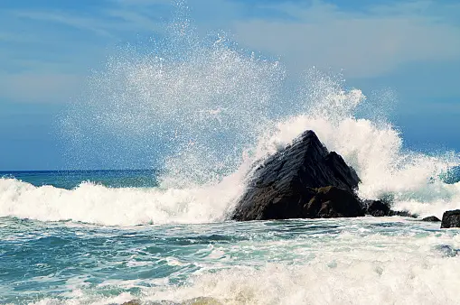
Rocks are _______ and _______ when exposed to the weather and water for long periods of time.
Strengthened, repaired
Worn down, broken
Notes:
Rocks are _______ and _______ when exposed to the weather and water for long periods of time.
[B] Worn down, broken
Look at how the water is hitting the rocks and eroding it.

Slide 32
Rocks are _______ and _______ when exposed to the weather and water for long periods of time.
Strengthened, repaired
Worn down, broken
Notes:
Rocks are _______ and _______ when exposed to the weather and water for long periods of time.
[B] Worn down, broken
Look at how the water is hitting the rocks and eroding it.

Slide 33
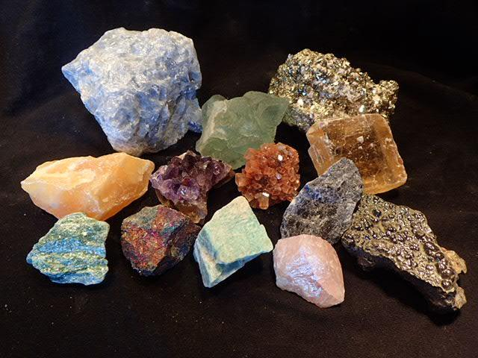
True or False: Minerals are made of rocks.
True
False
Notes:
True or False: Minerals are made of rocks.
[B. False]
Rocks are made of minerals.

Slide 34
True or False: Minerals are made of rocks.
True
False
Notes:
True or False: Minerals are made of rocks.
[B. False]
Rocks are made of minerals.

Slide 35
Notes:
Now, let’s talk about some examples of rocks.

Slide 36
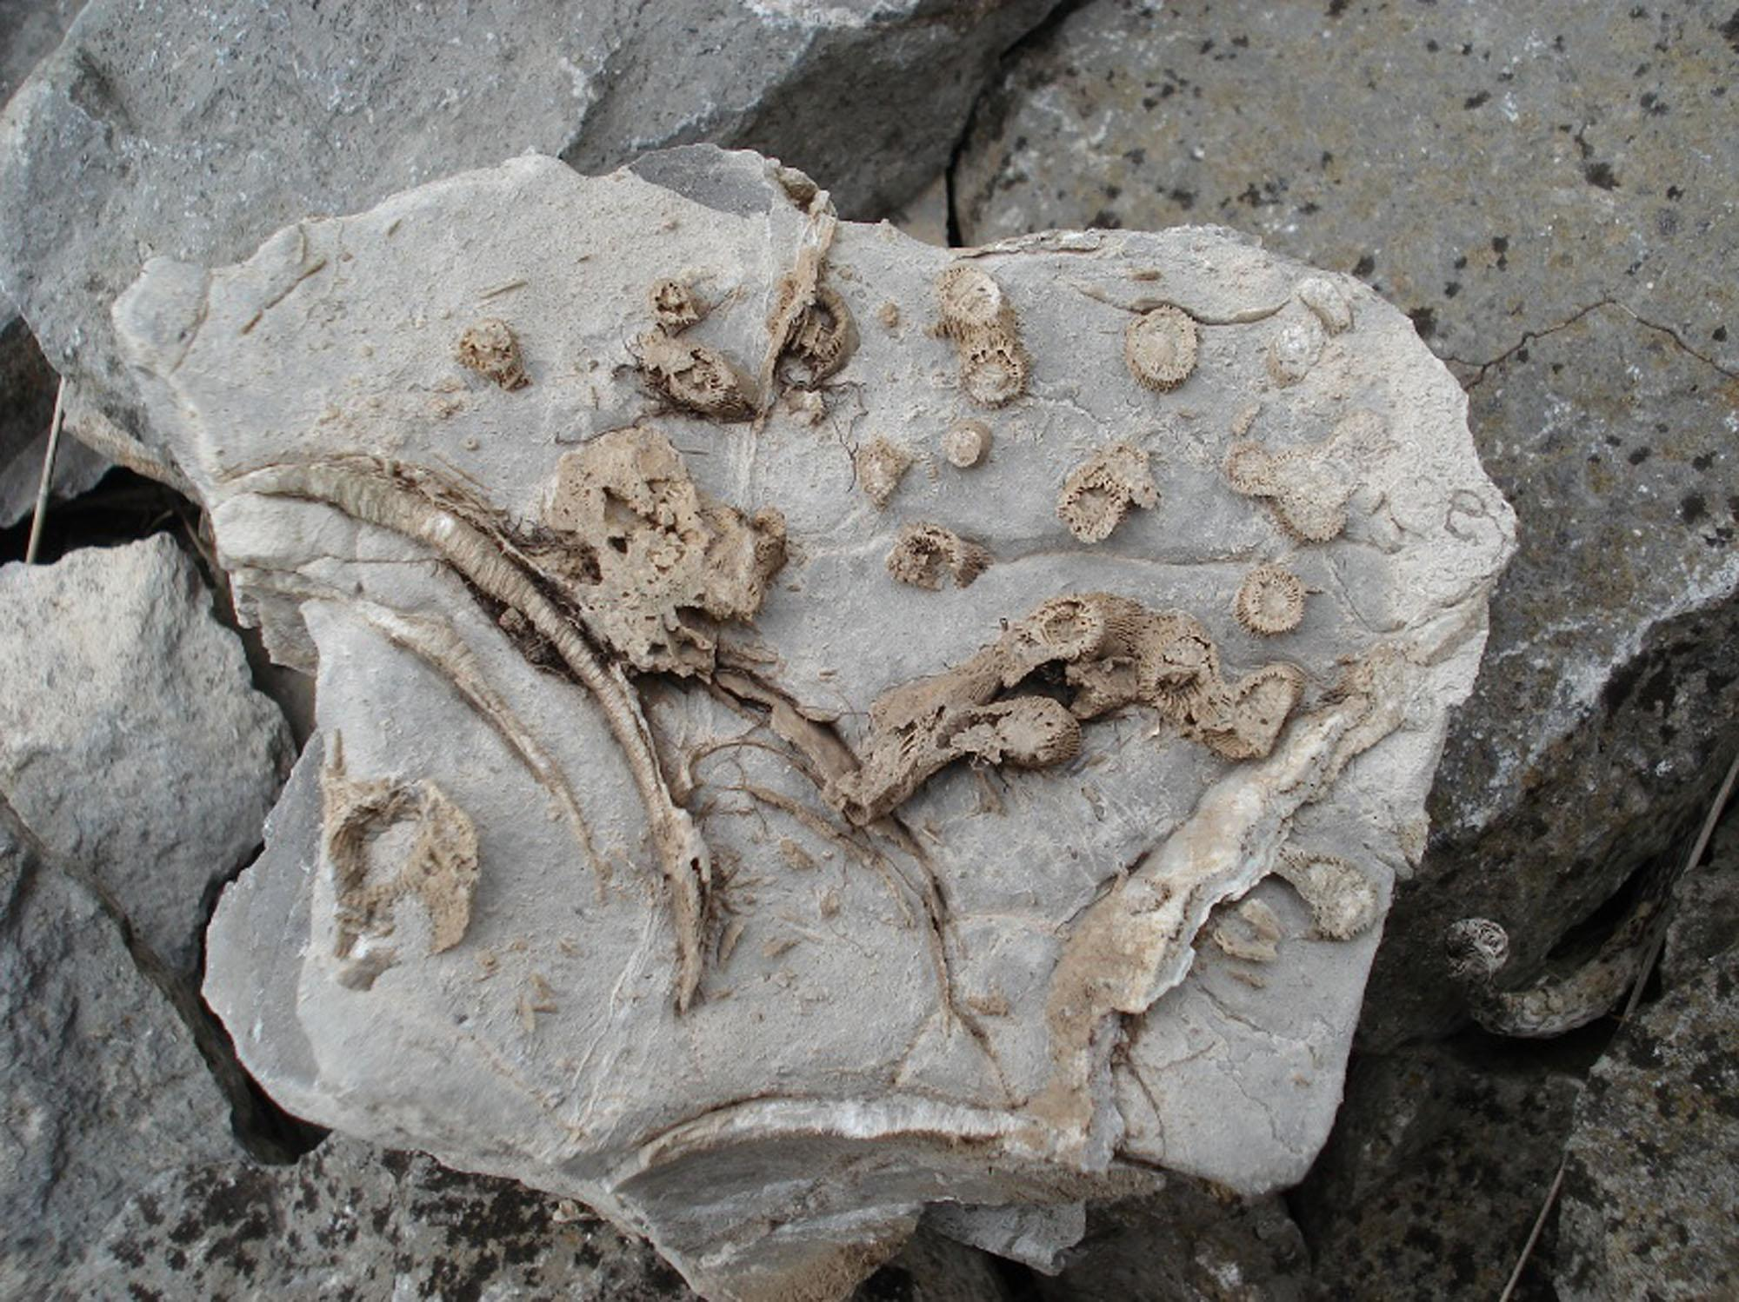
Limestone
Notes:
Limestone is an example of a sedimentary rock.
Limestone is made from calcite or aragonite which contains an abundance of fossils.
Sedimentary rocks can contain fossils.

Slide 37
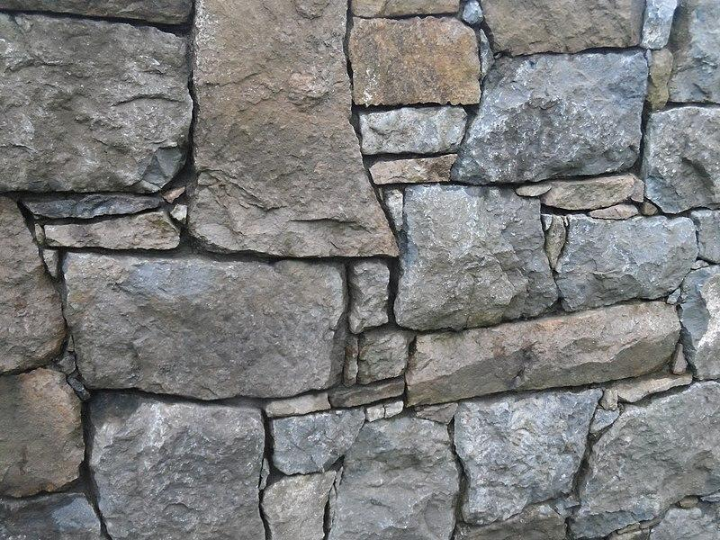
Stone
Notes:
Stones are rocks.
Stones are a piece of rock which is hard and compact. We use stones to build structures such as walls.

Slide 38
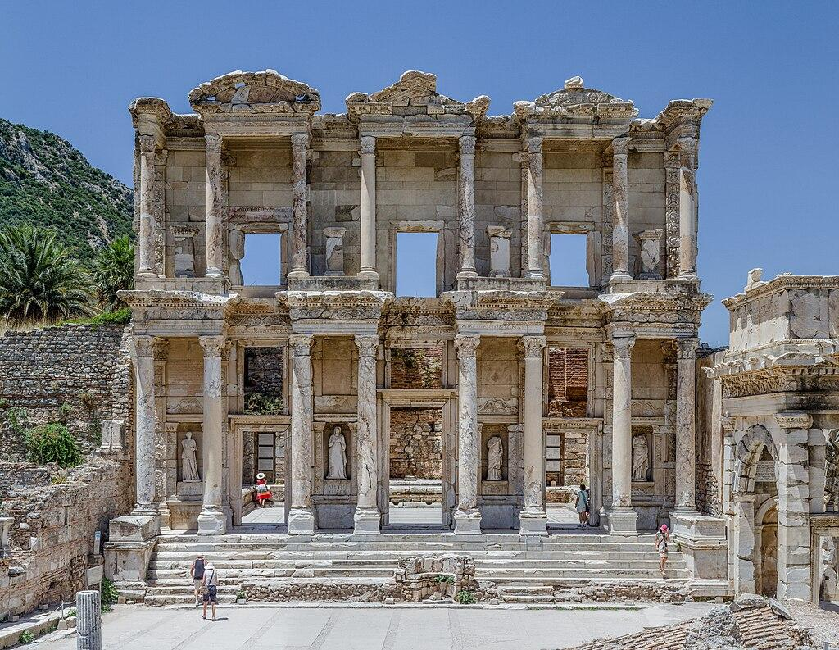
Marble
Notes:
Marble is metamorphosed limestone and is used commonly in sculpture and as a building material.

Slide 39
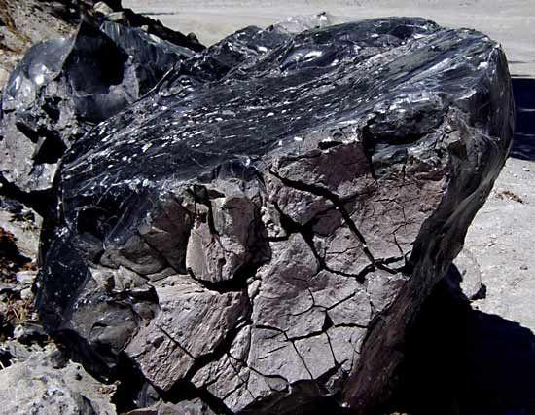
Obsidian
Notes:
Obsidian is an igneous rock that is when lava is cooled rapidly with minimal crystal growth. It is a natural glass.

Slide 40
Notes:
Now, let’s talk about some non-examples of rocks.

Slide 41
Plastic
Notes:
Plastic is not a rock because it is synthetically (man-made) produced.

Slide 42
Synthetic Glass
Notes:
Synthetic glass is not a rock because it is the product of melting and cooling down raw materials e.g., sand.
However, glass can form naturally from volcanic magma (obsidian).

Slide 43
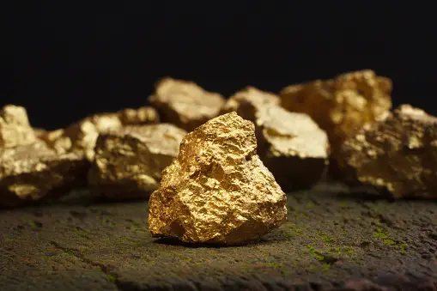
Gold
Notes:
Gold is not a rock but a mineral that often occurs in small quantities in other rocks.

Slide 44
Notes:
Now let’s pause for a moment to check your understanding.

Slide 45
Different rocks are made of different minerals. Explain why this might cause rocks vary in properties such as color, shape, texture, and hardness.
Notes:
Different rocks are made of different minerals. Explain why this might cause rocks vary in properties such as color, shape, texture, and hardness.
Also, have students hypothesize about the properties of igneous, sedimentary, and metamorphic rocks based on how they were formed.

Slide 46
Remember!!!
Notes:
So remember!

Slide 47
Rocks: A solid collection of minerals.
Notes:
Rocks are solid collections of minerals.

Slide 48
Notes:
We will now complete this concept map, called a Frayer model, to summarize and further clarify what you have learned about the term rock.

Slide 49
Definition
Picture
Rocks
Example
How do rocks impact my life?
Notes:
To complete the Frayer model, we will choose from four choices the correct picture, definition, example, and response to the question, “How do rocks impact my life?” Select the best response for each question using the information you just learned. As we select responses, we will see how this model looks filled in for the term rocks.

Slide 50
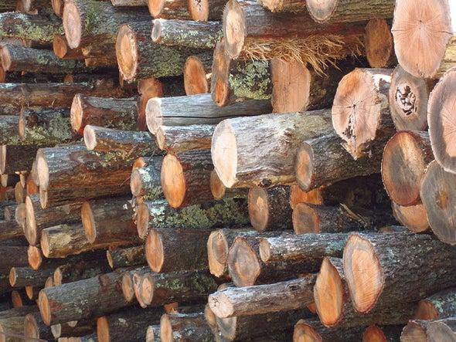
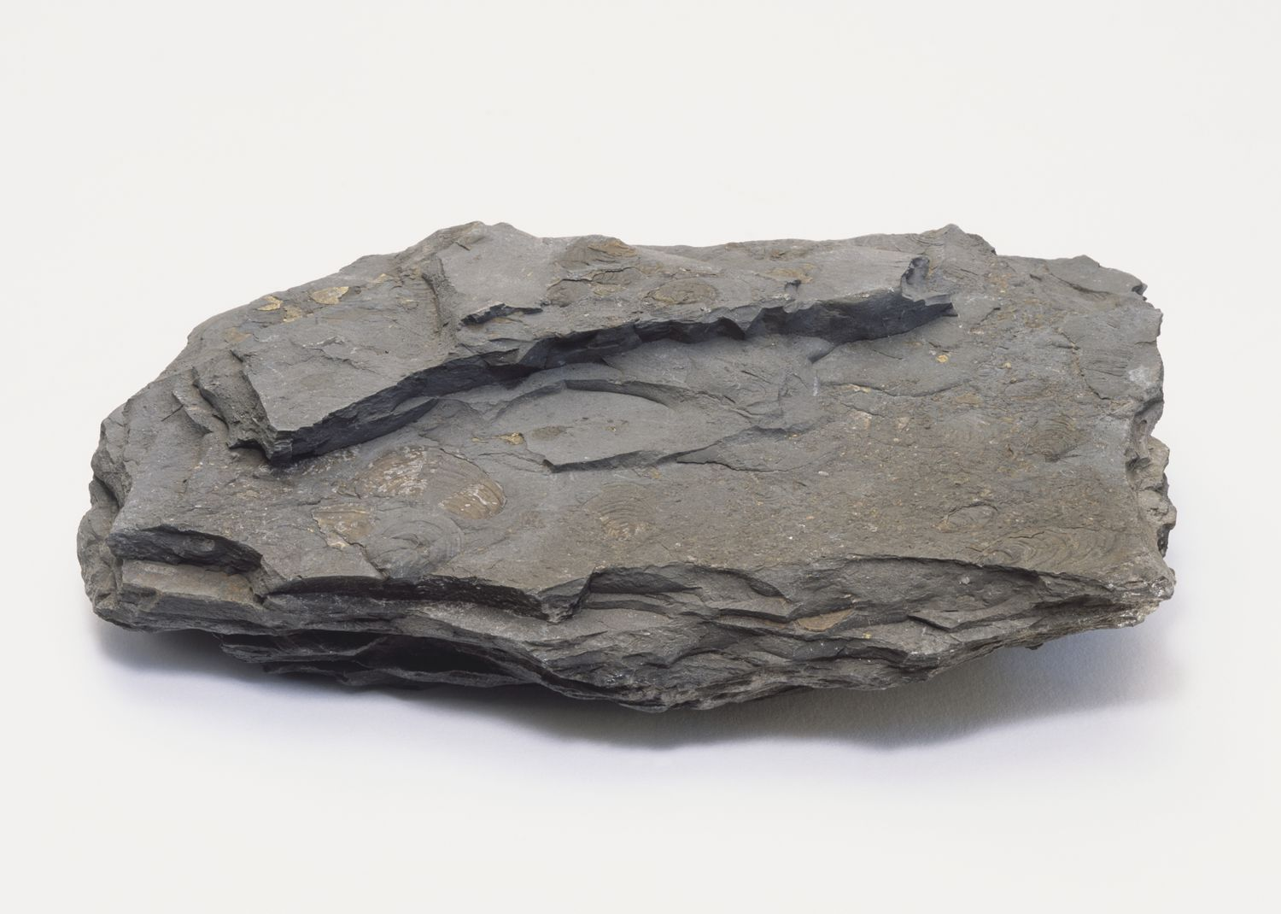
Directions: Choose the correct picture of rock from the choices below.
A
B
C
D
Notes:
This is the picture that shows a rock.

Slide 51
Directions: Choose the correct picture of rock from the choices below.
A
B
C
D
Notes:
This is the picture that shows a rock.

Slide 52
Definition
Picture
Rocks
Example
How do rocks impact my life?
Notes:
Here is the Frayer model filled in with a picture of rock.

Slide 53
Directions: Choose the correct definition of rocks from the choices below.
A
A solid collection of minerals
B
A collection of crystals
C
Something we grow in a lab
D
Fossils
Notes:
Choose the one correct definition of rocks from these four choices.

Slide 54
Directions: Choose the correct definition of rocks from the choices below.
A
A solid collection of minerals
B
A collection of crystals
C
Something we grow in a lab
D
Fossils
Notes:
“A solid collection of minerals” is correct! This is the definition of rock.

Slide 55
Definition
Picture
A solid collection of minerals
Rocks
Example
How do rocks impact my life?
Notes:
Here is the Frayer model filled in with a picture of rock.

Slide 56
Directions: Choose the correct example of rock from the choices below.
A
Plastic
B
Mineral
C
Sandstone
D
Fossil
Notes:
Choose the one correct example of rock from these four choices.

Slide 57
Directions: Choose the correct example of rock from the choices below.
A
Plastic
B
Mineral
C
Sandstone
D
Fossil
Notes:
“Sandstone” is correct! This is an example of rock.

Slide 58
Definition
Picture
A solid collection of minerals
Rocks
Sandstone
Example
How do rocks impact my life?
Notes:
Here is the Frayer Model with a picture, definition, and an example of rock: Sandstone.

Slide 59
Directions: Choose the correct response for “how do rocks impact my life?” from the choices below.
A
Rocks provide the materials for building construction and foundations for homes, schools, and structures.
B
Rocks contribute to the creation of new internet technologies.
C
C
Rocks directly influence the weather in an area.
D
D
Rocks provide us new minerals to use.
Notes:
Choose the one correct response for “how do rocks impact my life?” from these four choices.

Slide 60
Directions: Choose the correct response for “how do rocks impact my life?” from the choices below.
A
Rocks provide the materials for building construction and foundations for homes, schools, and structures.
B
Rocks contribute to the creation of new internet technologies.
C
C
Rocks directly influence the weather in an area.
D
D
Rocks provide us new minerals to use.
Notes:
“Rocks provide the materials for building construction and foundations for homes, schools, and structures.” That is correct! This is an example of how rocks impacts our lives.

Slide 61
Definition
Picture
A solid collection of minerals
Rocks
Rocks provide the materials for building construction and foundations for homes, schools, and structures.
Sandstone
Example
How do rocks impact my life?
Notes:
Here is the Frayer Model with a picture, definition, example, and a correct response to “how do rocks impact my life?”: Rocks provide the materials for building construction and foundations for homes, schools, and structures.

Slide 62
Remember!!!
Notes:
So remember!

Slide 63
Rock: A solid collection of minerals.
Notes:
Rocks are solid collections of minerals.

Slide 64
Big Question: Why are rocks important and how do they affect the world around us?
Notes:
Our “big question” is: Why are rocks important and how do they affect the world around us? [Pause and illicit predictions from students.]
I love all these thoughtful scientific hypotheses! Be sure to keep this question and your predictions in mind as we move through these next few lessons, and we’ll continue to revisit it.

Slide 65
What Rock Is It Made of?
Have students select an object made of rocks and identify the main rocks the object is made of. Then, have students research into what the rocks are made of e.g., minerals, sediments. Students will share their findings next class.
For example:
The marble countertop – marble (metamorphic rock from limestone) – mostly calcite or dolomite
The Taj Mahal, a famous mausoleum in India, is completely made of marble.
Notes:
Have students select an object made of rocks and identify the main rocks the object is made of. Then, have students research into what the rocks are made of. Students will share their findings next class.
For example:
The marble countertop – marble (metamorphic rock from limestone) – mostly calcite or dolomite
Alternatively, you can provide a list of structures/objects for students to select.

Slide 66
Notes:
Thanks for watching, and please continue watching CAPs available from this website.

Slide 67
This Was Created With Resources From:
Questions or Comments
Michael Kennedy, Ph.D. MKennedy@Virginia.edu
Rachel L Kunemund, Ph.D. rk8vm@virginia.edu

