Slide 1
Intro
“Big Idea” Question
Review Concepts
Check-In Questions
Teacher Engagement
Vocabulary
Student-Friendly Definition
Examples & Non-Examples
Frayer Model
Simulation/Activity
Notes:
OK everyone, get ready for our next lesson. Just as a reminder, these are the different components that our lesson may include, and you’ll see these icons in the top left corner of each slide so that you can follow along more easily!

Slide 2
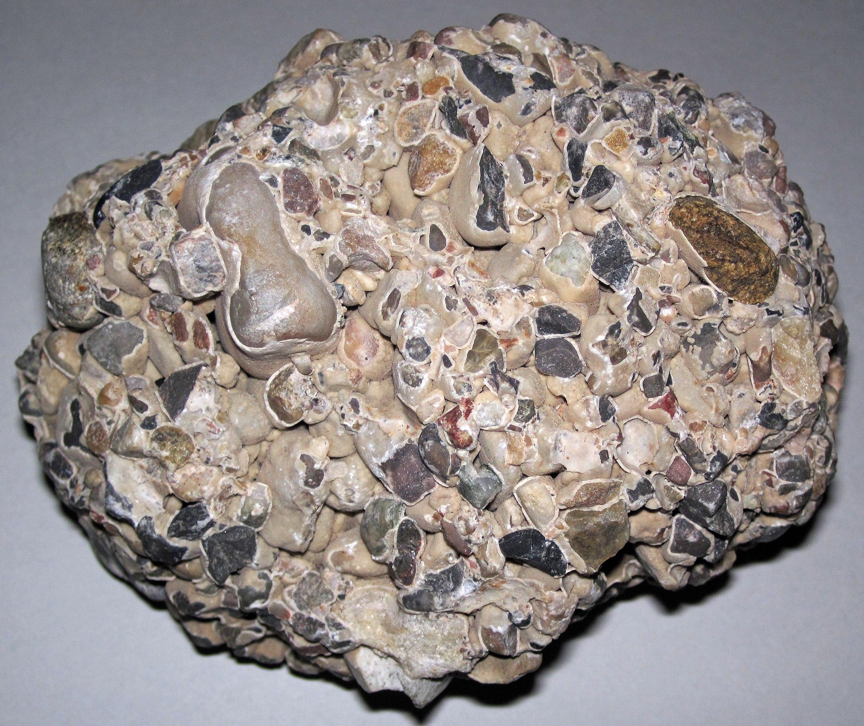
Intro
Sedimentary Rock
Notes:
Today, we’ll be learning about the word: Sedimentary Rock.

Slide 3
Big Question: How do sedimentary rocks form and what stories can they tell us about the past?
Notes:
Our “big question” is: How do sedimentary rocks form and what stories can they tell us about the past? [Pause and illicit predictions from students.]
I love all these thoughtful scientific hypotheses! Be sure to keep this question and your predictions in mind as we move through these next few lessons, and we’ll continue to revisit it.

Slide 4
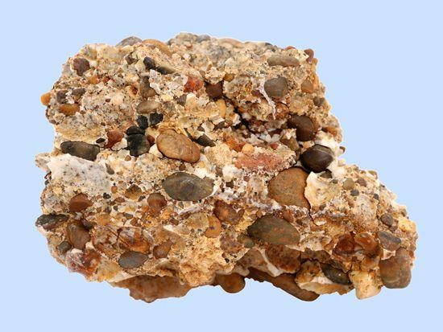
Demonstration
All the minerals!
Provide sedimentary rocks for students to observe the different rocks, minerals, and particles in the rocks. Have students hypothesize how all these rocks and particles stuck together.
Notes:
All the minerals!
Provide sedimentary rocks for students to observe the different rocks, minerals, and particles in the rocks. Have students hypothesize how all these rocks and particles stuck together.
Suggested rock: Conglomerate

Slide 5
Notes:
Before we move on to our new topic, let’s review some other words & concepts that you already learned and make sure you are firm in your understanding.

Slide 6
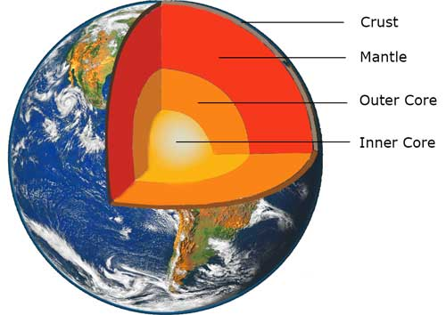
The Layers of the Earth
Notes:
Review the layers of the Earth.

Slide 7
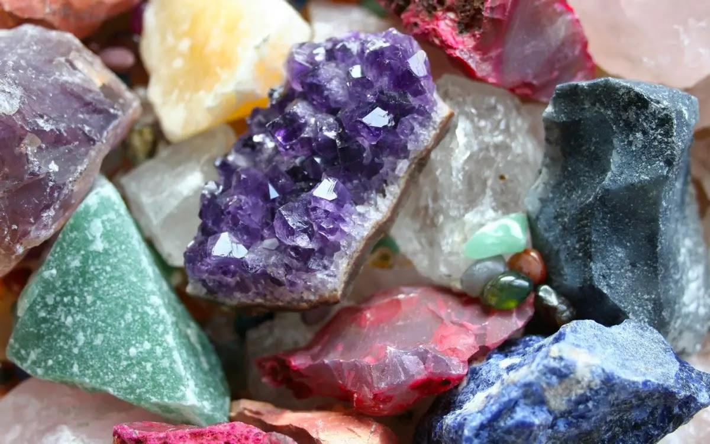
Mineral: Substances that do not come from an animal or plant, the building blocks that make up rocks
Notes:
Mineral: Substances that do not come from an animal or plant, the building blocks that make up rocks

Slide 8
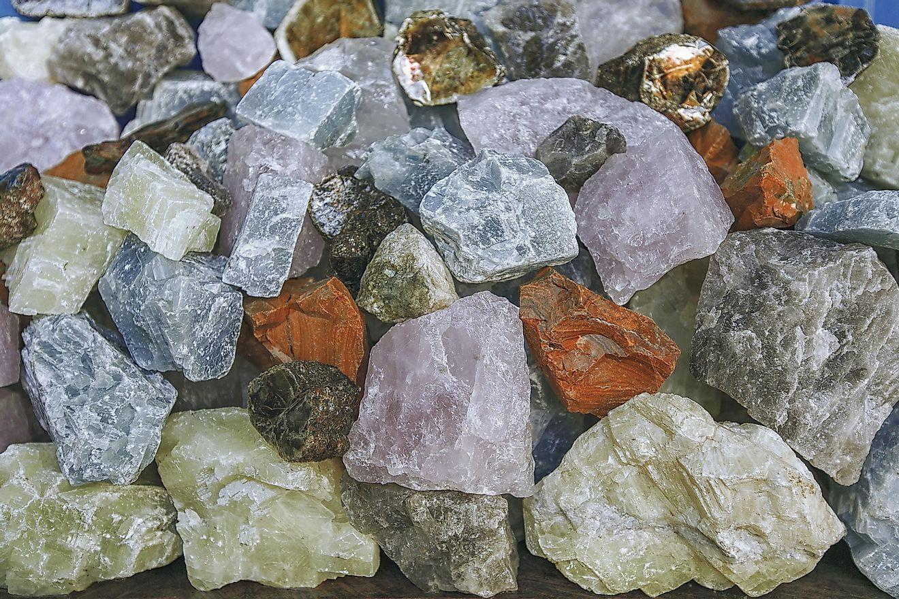
Rock: A solid collection of minerals.
Notes:
Rock: A solid collection of minerals.

Slide 9
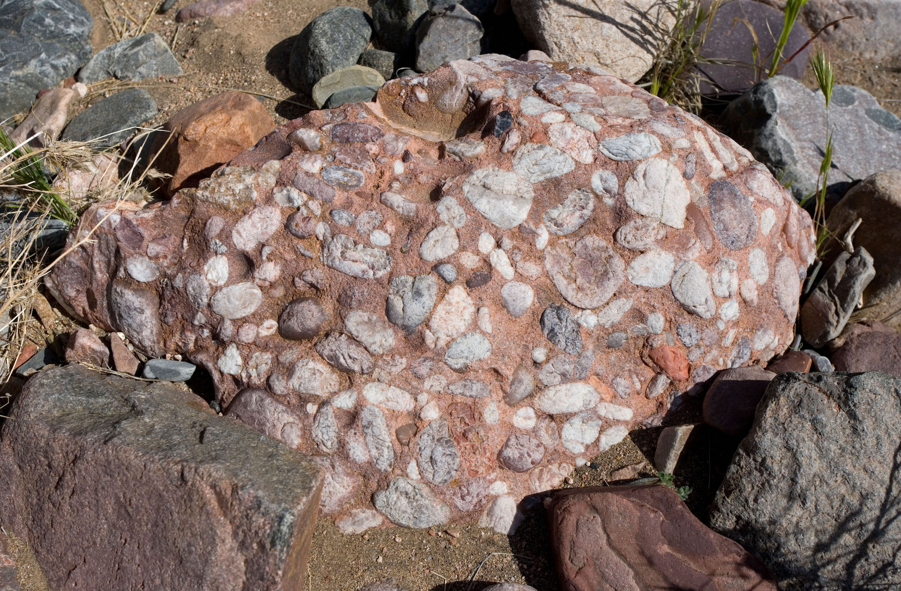
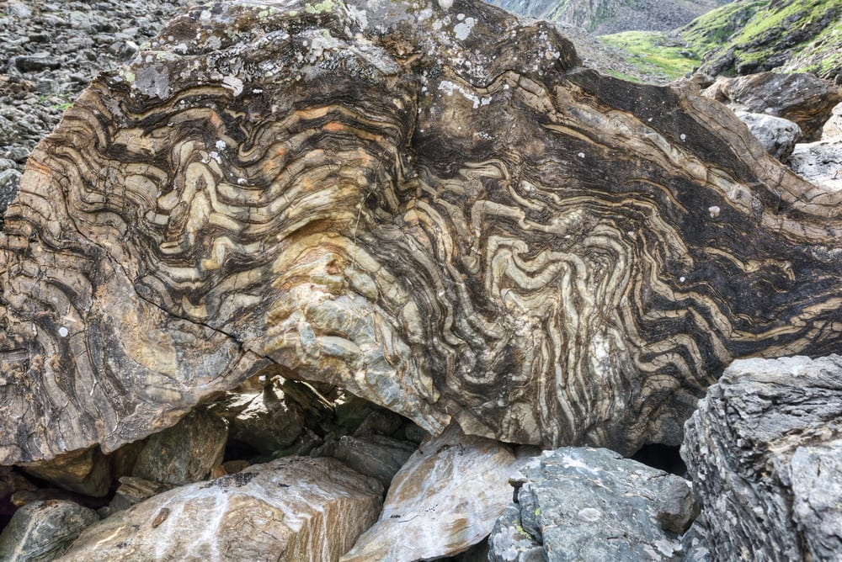
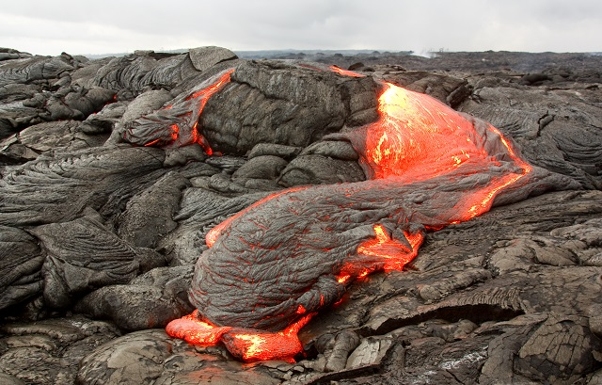
There are three types of rocks. Each type forms differently.
Igneous – when lava cools down and solidifies
Sedimentary – when small particles e.g., minerals, organic materials, sand, stick together over time
Metamorphic – when existing rocks undergo temperature, pressure, or chemical change
Notes:
There are three types of rocks. Each type of rock forms differently.
Today, we will be learning about sedimentary rocks.

Slide 10
Notes:
Now let’s pause for a moment to review the information we have covered already.

Slide 11
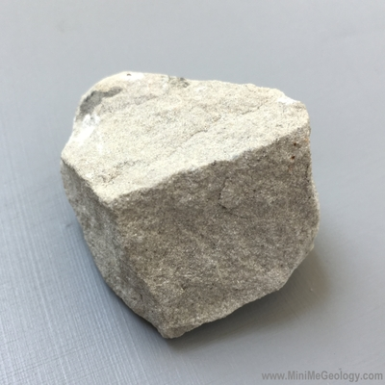
What is the relationship between rocks and minerals?
Rocks are created when minerals go through changes in temperature and pressure.
Rocks are tiny pieces of minerals that stick together over time.
Rocks are made up of one or more mineral.
Notes:
What is the relationship between rocks and minerals?
[C] Rocks are made up of one or more mineral.

Slide 12
What is the relationship between rocks and minerals?
Rocks are created when minerals go through changes in temperature and pressure.
Rocks are tiny pieces of minerals that stick together over time.
Rocks are made up of one or more mineral.
Notes:
What is the relationship between rocks and minerals? Rocks are made up of one or more mineral.
[C] Rocks are made up of one or more mineral.

Slide 13
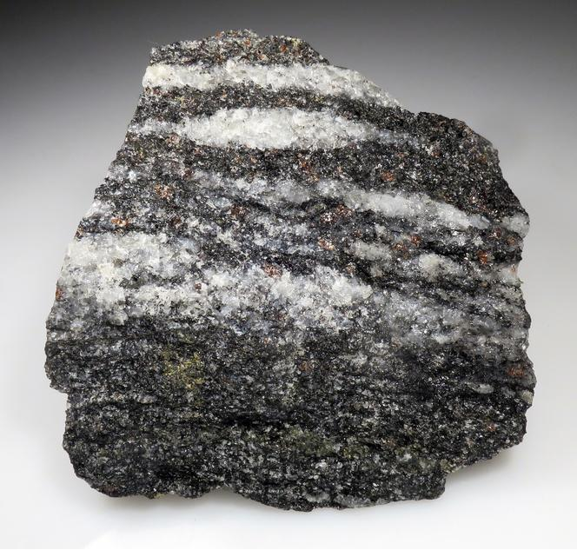
Which of the following materials can rocks not be made of?
Sand particles
Minerals
Former living things
Fossils
Notes:
Which of the following materials can rocks not be made of?
[D] Fossils

Slide 14
Which of the following materials can rocks not be made of?
Sand particles
Minerals
Former living things
Fossils
Notes:
Which of the following materials can rocks not be made of?
[D] Fossils

Slide 15
Sedimentary Rock
Notes:
Now that we’ve reviewed, let’s define the phrase Sedimentary Rock

Slide 16
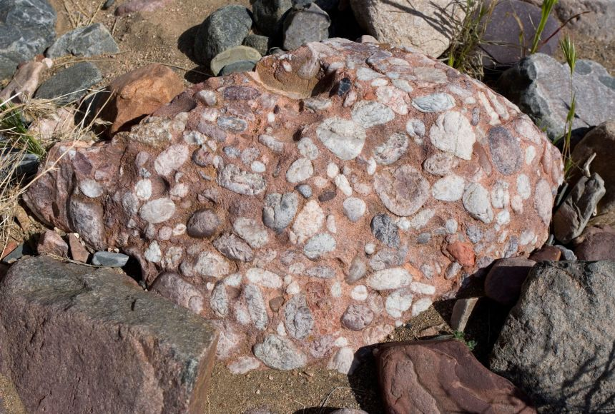
Sedimentary Rock: Rock that forms by collection of existing rocks or pieces of former living things.
Notes:
Sedimentary Rock are rocks that forms by collection of existing rocks or pieces of former living things

Slide 17
Notes:
Let’s check-in for understanding.

Slide 18
What are Sedimentary Rocks?
Notes:
What are sedimentary rocks?
[Rocks that forms by collection of existing rocks or pieces of former living things.]

Slide 19
Notes:
That is the basic definition, but there is a bit more you need to know.

Slide 20
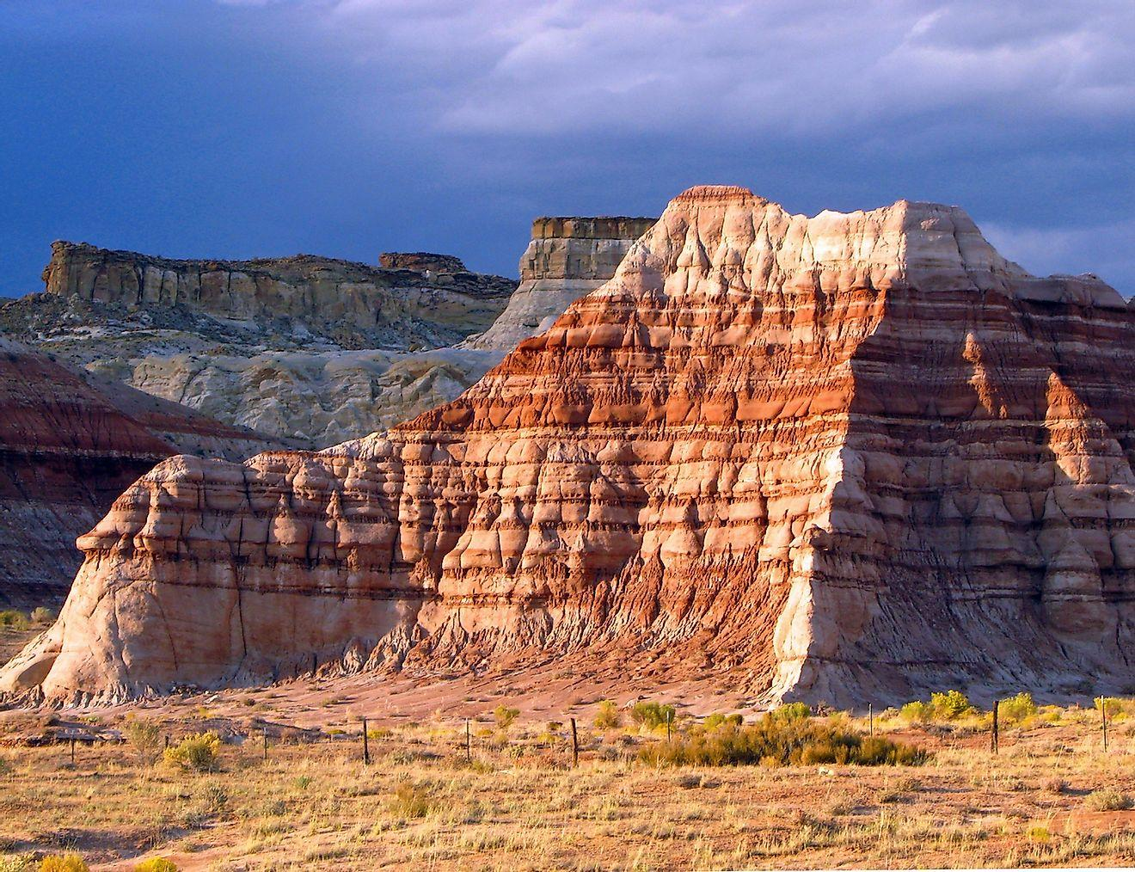
Licensable
Sedimentary rocks are the most common rocks on the Earth’s surface (about 75% of all rocks on the Earth’s surface).
Notes:
Sedimentary Rock are the most common rocks on the Earth’s surface (about 75% of all rocks on the Earth’s surface).
However, they aren’t very common in the crust where igneous and metamorphic rocks are prevalent.

Slide 21
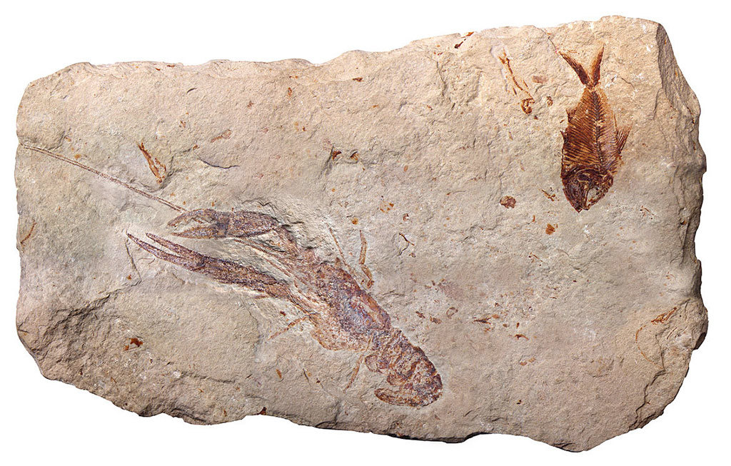
Licensable
Sedimentary rocks are rich in fossils.
Notes:
Sedimentary rocks are rich in fossils.

Slide 22
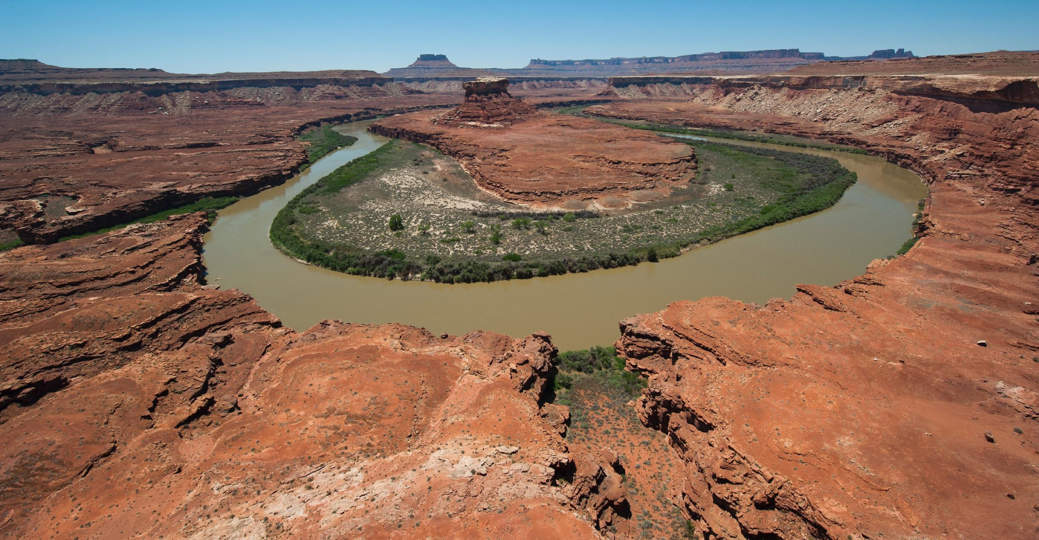
Licensable
The most common processes that create sedimentary rocks include erosion, weathering, and precipitation.
Notes:
The most common processes that create sedimentary rocks include erosion, weathering, and precipitation.

Slide 23
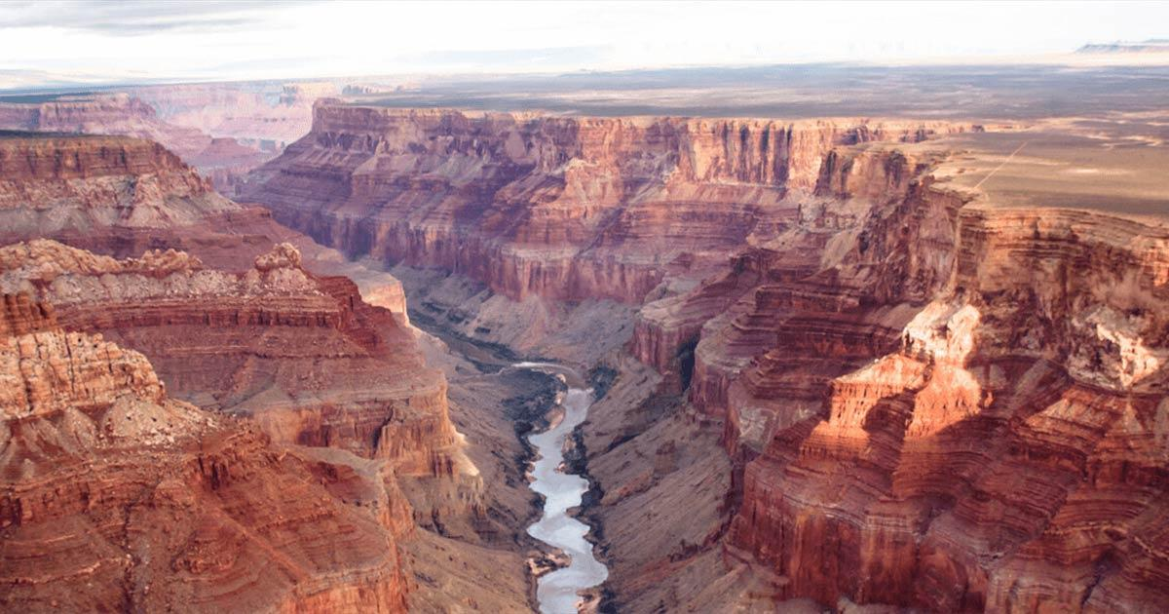
Licensable
Sedimentary rocks tell us about history by showing us how they were formed.
Notes:
For example, the type of fossils or materials in the rock or the erosion in the rock.
The Grand Canyon’s sedimentary rocks show us the history of the canyon.

Slide 24
Notes:
Let’s check-in for understanding.

Slide 25
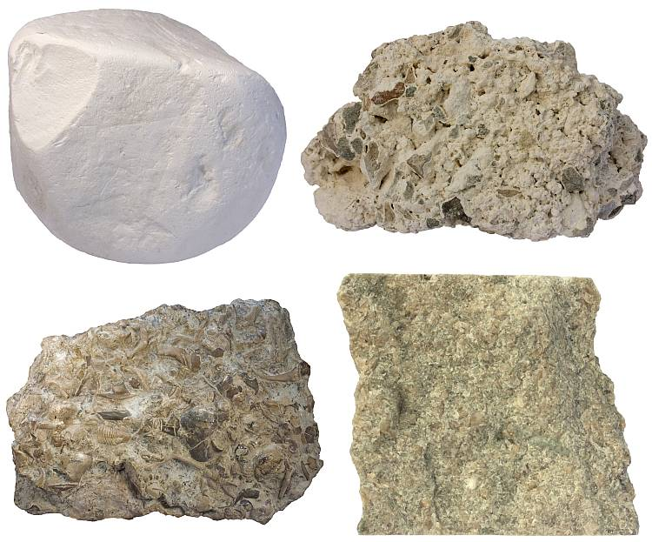
Sedimentary rocks contain particles such as former living things and sand.
True
False
Notes:
Sedimentary rocks contain particles such as former living things and sand.
[True]

Slide 26
Sedimentary rocks contain particles such as former living things and sand.
True
False
Notes:
Sedimentary rocks contain particles such as former living things and sand. True
[True]

Slide 27
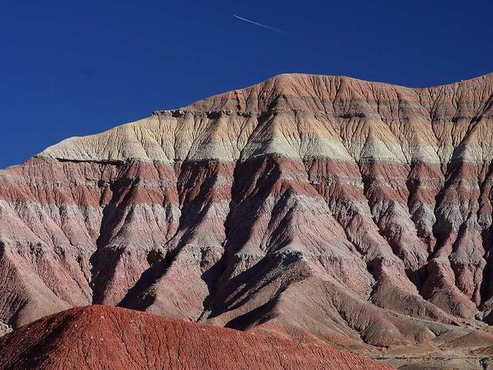
Sedimentary rocks undergo change by the weather and erosion.
True
False
Notes:
Sedimentary rocks undergo change by the weather and erosion.
[True] All rocks undergo change.

Slide 28
Sedimentary rocks undergo change by the weather and erosion.
True
False
Notes:
Sedimentary rocks undergo change by the weather and erosion.
True
[True] All rocks undergo change.

Slide 29
Notes:
Now, let’s talk about some examples of rocks.

Slide 30
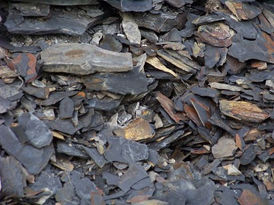
Shale
Notes:
Shale is an example of a sedimentary rock. Shale is the most common sedimentary rock, with over 70% of sedimentary rocks in the crust being shale.

Slide 31
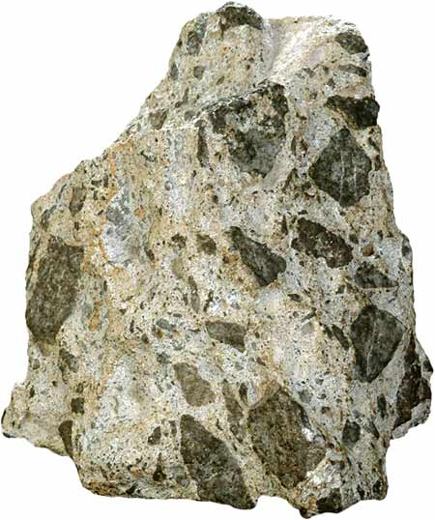
Breccia
Notes:
Breccia is an example of a sedimentary rock.

Slide 32
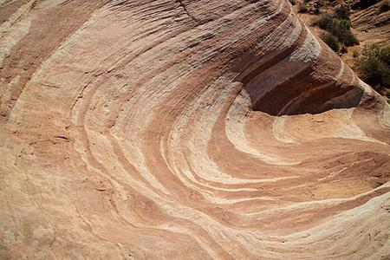
Sandstone
Notes:
Sandstone is an example of a sedimentary rock.
Sandstone is composed of mostly grains of sand being compacted together for millions of years. Sandstone can contain quartz and feldspar.

Slide 33
Notes:
Now, let’s talk about some non-examples of sedimentary rocks.

Slide 34
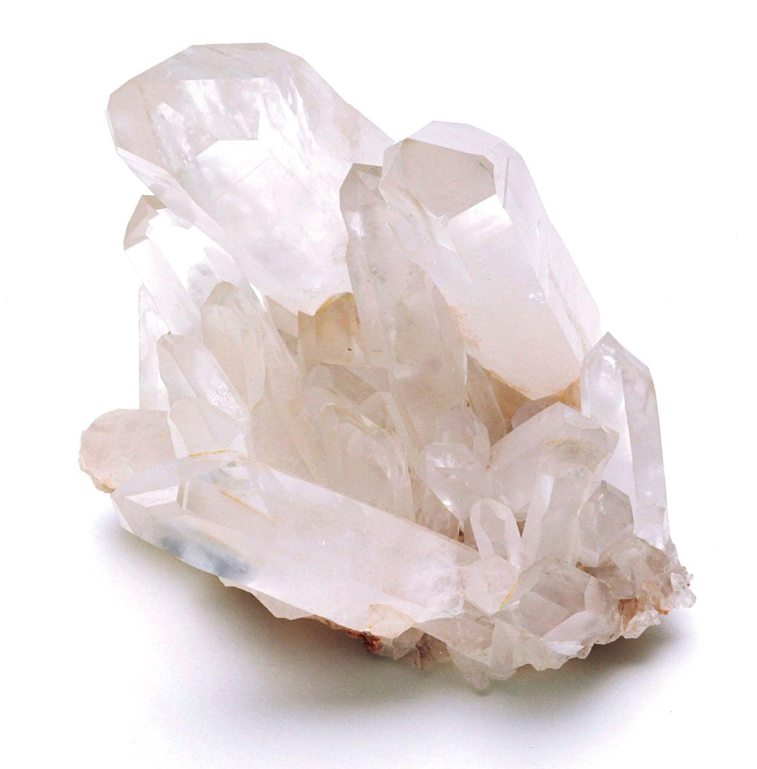
Quartz
Notes:
Quartz is not a sedimentary rock because it is a mineral. However, it can be found in sedimentary rocks.

Slide 35
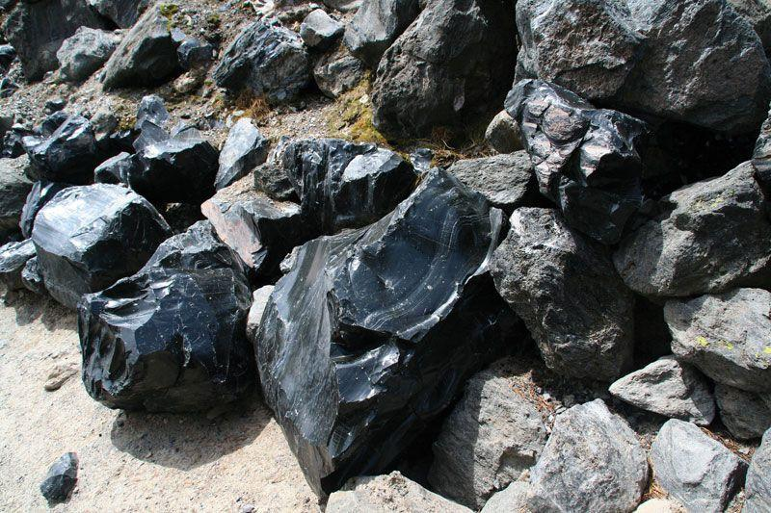
Obsidian
Notes:
Obsidian is an igneous rock that results from cooled lava with minimal crystals.

Slide 36
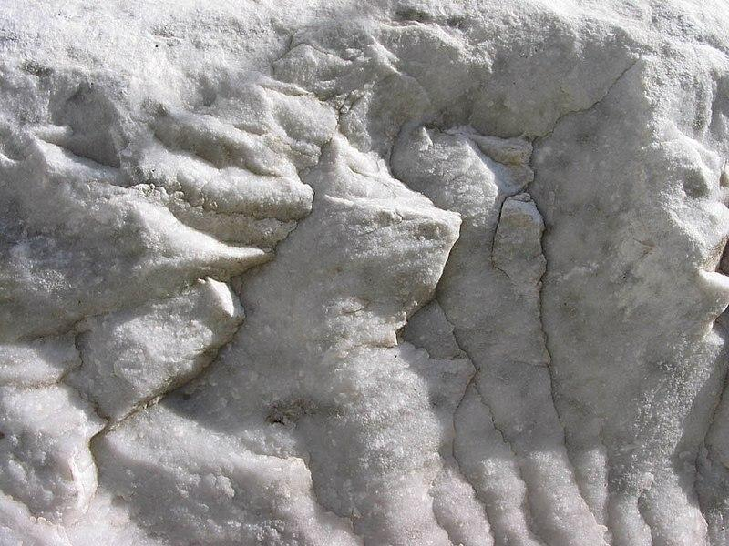
Marble
Notes:
Marble (metamorphic rock) is not a sedimentary rock. However, it metamorphosed limestone (a sedimentary rock).

Slide 37
Notes:
Now let’s pause for a moment to check your understanding.

Slide 38
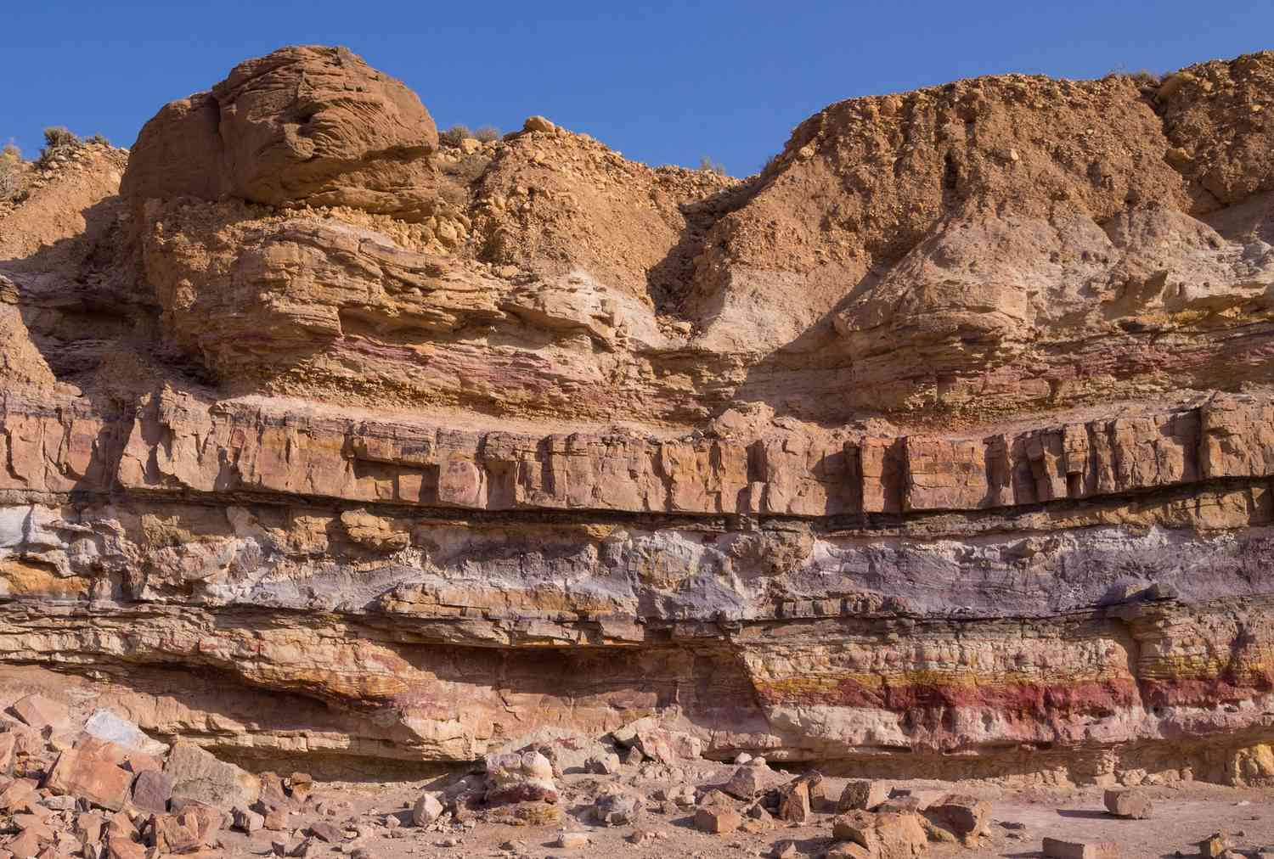
Discuss how sedimentary rocks tell us more about history.
Notes:
Discuss how sedimentary rocks tell us more about history.
Hints
- Fossils
- The layers in the rock
- Climate indicators
- Sediments can reveal the environment of nearby landscapes
- Sea level changes can be reflected in the rock structures

Slide 39
Remember!!!
Notes:
So remember!

Slide 40
Sedimentary Rock: Rock that forms by collection of existing rocks or pieces of former living things.
Notes:
Sedimentary Rock are rocks that forms by collection of existing rocks or pieces of former living things

Slide 41
Notes:
We will now complete this concept map, called a Frayer model, to summarize and further clarify what you have learned about the term sedimentary rock.

Slide 42
Definition
Picture
Sedimentary Rock
How do sedimentary rocks impact my life?
Example
Notes:
To complete the Frayer model, we will choose from four choices the correct picture, definition, example, and response to the question, “How do sedimentary rocks impact my life?” Select the best response for each question using the information you just learned. As we select responses, we will see how this model looks filled in for the term sedimentary rocks.

Slide 43
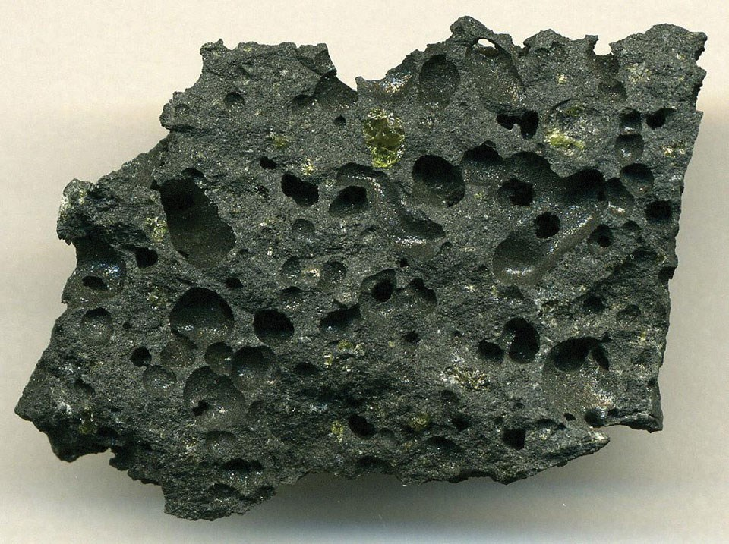
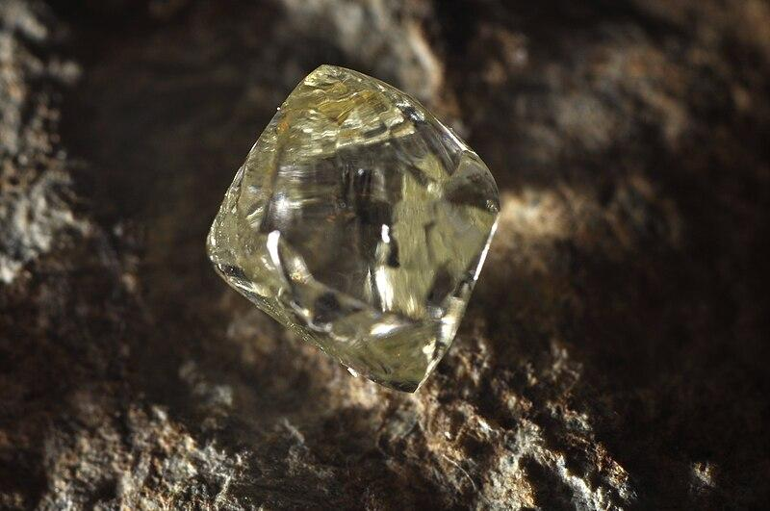
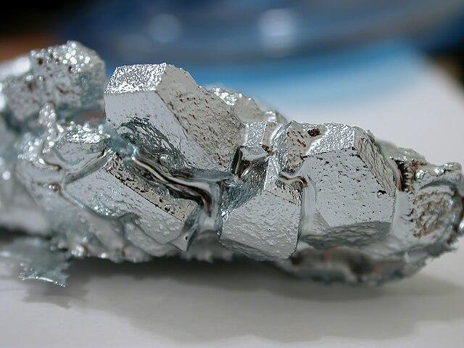
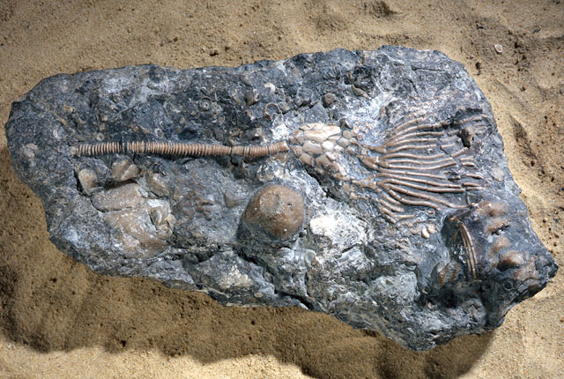
Directions: Choose the correct picture of sedimentary rock from the choices below.
A
B
C
D
Notes:
This is the picture that shows a sedimentary rock.
[D] is correct.
Igneous rock, diamond, gallium (metal), sedimentary rock with fossils

Slide 44
Directions: Choose the correct picture of sedimentary rock from the choices below.
A
B
C
D
Notes:
This is the picture that shows a sedimentary rock.
[D] is correct.
Igneous rock, diamond, gallium (metal), sedimentary rock with fossils

Slide 45
Definition
Picture
Sedimentary Rock
How do sedimentary rocks impact my life?
Example
Notes:
Here is the Frayer model filled in with a picture of sedimentary rock.

Slide 46
Directions: Choose the correct definition of sedimentary rock from the choices below.
A
Rock that forms by collection of existing rocks or pieces of former living things
B
A collection of crystals
C
Something we grow in a lab
D
Fossils
Notes:
Choose the one correct definition of sedimentary rock from these four choices.

Slide 47
Directions: Choose the correct definition of sedimentary rock from the choices below.
A
Rock that forms by collection of existing rocks or pieces of former living things
B
A collection of crystals
C
Something we grow in a lab
D
Fossils
Notes:
“Rock that forms by collection of existing rocks or pieces of former living things” is correct! This is the definition of rock.

Slide 48
Definition
Picture
Rock that forms by collection of existing rocks or pieces of former living things
Sedimentary Rock
How do sedimentary rocks impact my life?
Example
Notes:
Here is the Frayer model filled in with a picture of a sedimentary rock.

Slide 49
Directions: Choose the correct example of a sedimentary rock from the choices below.
A
Plastic
B
Mineral
C
Sandstone
D
Fossil
Notes:
Choose the one correct example of sedimentary rock from these four choices.

Slide 50
Directions: Choose the correct example of a sedimentary rock from the choices below.
A
Plastic
B
Mineral
C
Sandstone
D
Fossil
Notes:
“Sandstone” is correct! This is an example of a sedimentary rock.

Slide 51
Definition
Picture
Rock that forms by collection of existing rocks or pieces of former living things
Sedimentary Rock
Sandstone
How do sedimentary rocks impact my life?
Example
Notes:
Here is the Frayer Model with a picture, definition, and an example of sedimentary rock: Sandstone.

Slide 52
Directions: Choose the correct response for “how do sedimentary rocks impact my life?” from the choices below.
A
Sedimentary rocks contribute to our production of renewable energy sources like wind and solar power.
B
Sedimentary rocks influence our climate.
C
C
Sedimentary rocks reveal to us our earth’s history.
D
D
Sedimentary rocks contain many rocks, minerals, and particles for us to extract resources from.
Notes:
Choose the one correct response for “how do sedimentary rocks impact my life?” from these four choices.

Slide 53
Directions: Choose the correct response for “how do sedimentary rocks impact my life?” from the choices below.
A
Sedimentary rocks contribute to our production of renewable energy sources like wind and solar power.
B
Sedimentary rocks influence our climate.
C
C
Sedimentary rocks reveal to us our earth’s history.
D
D
Sedimentary rocks contain many rocks, minerals, and particles for us to extract resources from.
Notes:
“Sedimentary rocks reveal to us our earth’s history.” That is correct! This is an example of how sedimentary rocks impacts our lives.

Slide 54
Definition
Picture
Rock that forms by collection of existing rocks or pieces of former living things
Sedimentary Rock
Sedimentary rocks reveal to us our earth’s history.
Sandstone
How do sedimentary rocks impact my life?
Example
Notes:
Here is the Frayer Model with a picture, definition, example, and a correct response to “how do sedimentary rocks impact my life?”: Sedimentary Rock provide the materials for building construction and foundations for homes, schools, and structures.

Slide 55
Remember!!!
Notes:
So remember!

Slide 56
Intro
Sedimentary Rock

Slide 57
Big Question: How do sedimentary rocks form and what stories can they tell us about the past?
Notes:
Our “big question” is: How do sedimentary rocks form and what stories can they tell us about the past? [Pause and illicit predictions from students.]
I love all these thoughtful scientific hypotheses! Be sure to keep this question and your predictions in mind as we move through these next few lessons, and we’ll continue to revisit it.

Slide 58
What does this rock say?
Have students select a sedimentary rock (or alternatively, provide them with a rock sample) and have them note the rock’s characteristics and research what the rock is made of.
Then, have the students make hypotheses about the rock e.g., its formation and its environment.
Notes:
Have students select a sedimentary rock (or alternatively, provide them with a rock sample) and have them note the rock’s characteristics and research what the rock is made of.
Then, have the students make hypotheses about the rock e.g., its formation and its environment.

Slide 59
Notes:
Thanks for watching, and please continue watching CAPs available from this website.

Slide 60
This Was Created With Resources From:
Questions or Comments
Michael Kennedy, Ph.D. MKennedy@Virginia.edu
Rachel L Kunemund, Ph.D. rk8vm@virginia.edu

