Slide 1
Intro
“Big Idea” Question
Review Concepts
Check-In Questions
Teacher Demo
Vocabulary
Student-Friendly Definition
Examples & Non-Examples
Morphological Word Parts
Simulation/Activity
Notes:
OK everyone, get ready for our next lesson. Just as a reminder, these are the different components that our lesson may include, and you’ll see these icons in the top left corner of each slide so that you can follow along more easily!

Slide 2
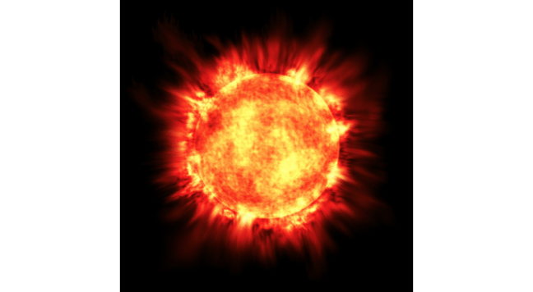
Intro
Solar Energy
Notes:
Today we will learn about solar energy.

Slide 3
Big Question: How do we use Earth’s resources to create energy?
Notes:
Our “big question” is: How do we use Earth’s resources to create energy?
[Pause and illicit predictions from students.]
I love all these thoughtful scientific hypotheses! Be sure to keep this question and your predictions in mind as we move through these next few lessons, and we’ll continue to revisit it.

Slide 4
Notes:
Before we move on to our new vocabulary term, let’s review some other words & concepts that you already learned and make sure you are firm in your understanding.
Feedback: Reviewing key background knowledge helps lay the context and sets the students up to make sense of the new content you are introducing, it also reinforces previously learned material.

Slide 5
Element: a pure substance containing only one type of atom
Notes:
An element is a pure substance containing only one type of atom.

Slide 6
Energy: the ability to cause change
Notes:
Energy is the ability to cause change.

Slide 7
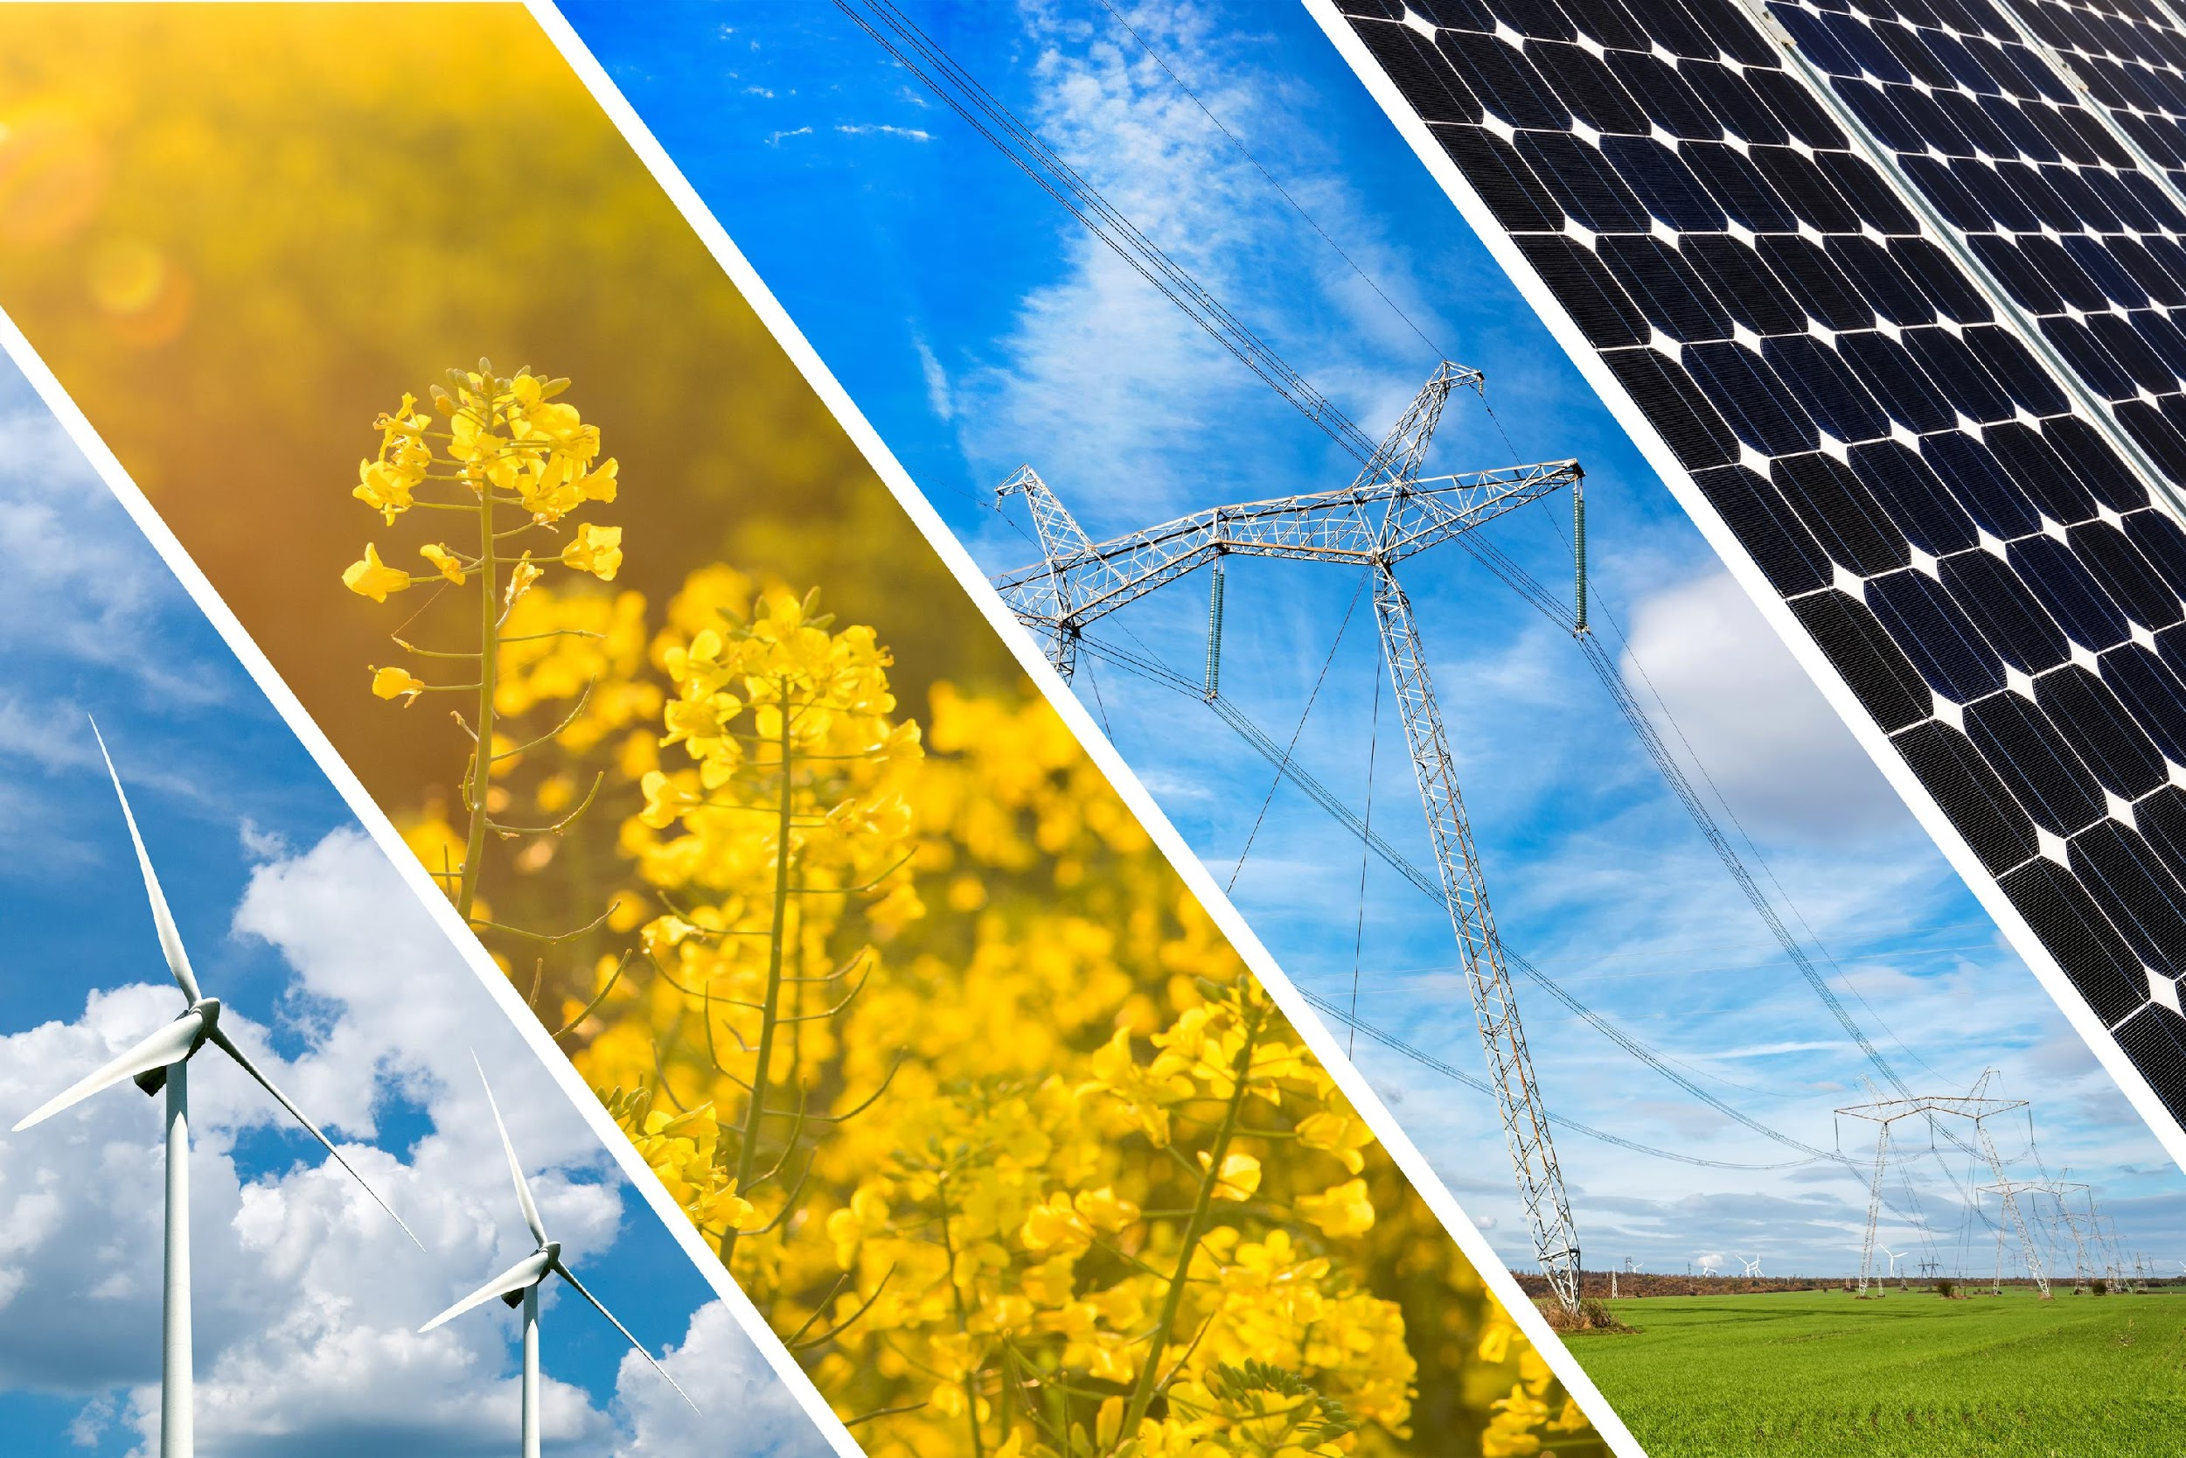
Renewable Resource: a resource that can be reused and replaced naturally
Notes:
A renewable resource is a resource that can be reused and replaced naturally.

Slide 8
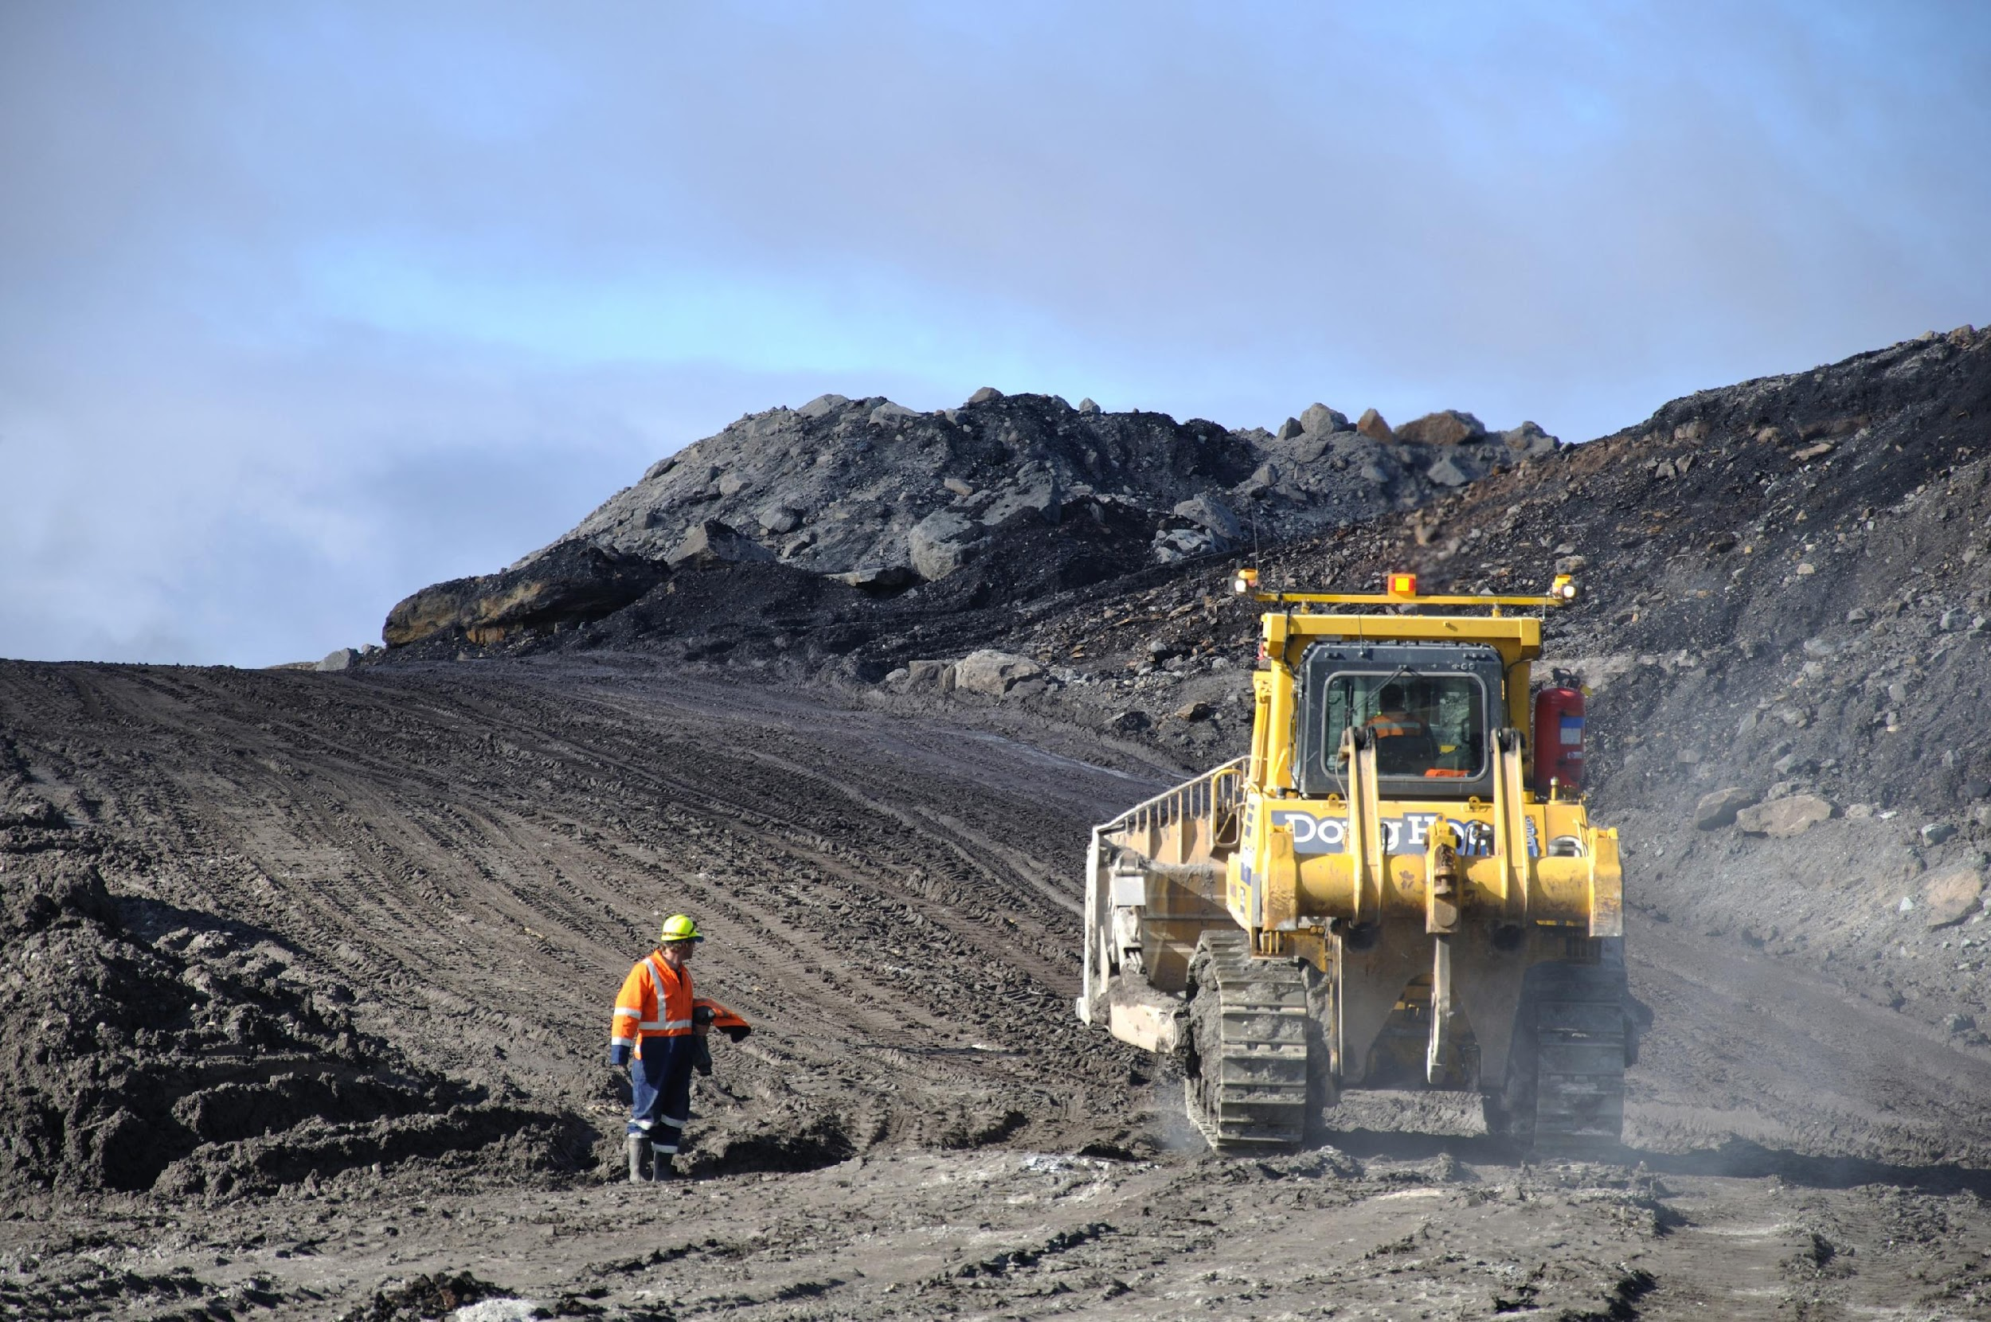
Non-Renewable Resource: a resource that is not replaced by nature quickly enough to match demand
Notes:
A non-renewable resource is a resource that is not replaced by nature quickly enough to match demand.

Slide 9
Notes:
Now, let’s pause for a moment to check your understanding.
Feedback: It is important to monitor understanding during this portion of the lesson to make sure students have a strong foundation on previous terms that will help them better understand today’s new content.

Slide 10
What is an element?
Notes:
What is an element?
[An element is a pure substance containing only one type of atom.]

Slide 11
What is energy?
Notes:
What is energy?
[Energy is the ability to cause change.]

Slide 12
What is a the difference between a renewable and non-renewable resource?
Notes:
What is the difference between a renewable and non-renewable resource?
[A non-renewable resource is a resource that is not replaced by nature quickly enough to match demand (how much it is needed). A renewable resource is a resource that can be reused and replaced naturally.]

Slide 13
Solar Energy
Notes:
Now that we’ve reviewed, let’s define our new term, solar energy.

Slide 14
Solar Energy: energy from the sun
Notes:
Solar energy is energy from the sun.
Feedback: Clear and concise definitions are easier to understand for students.

Slide 15
Notes:
Now, let’s pause for a moment to check your understanding.

Slide 16
What is solar energy?
Notes:
What is solar energy?
[Solar energy is energy from the sun.]

Slide 17
Notes:
That’s the basic definition, but there’s more you need to know.

Slide 18
Notes:
The sun produces energy which warms up the Earth and allows us to live here.

Slide 19
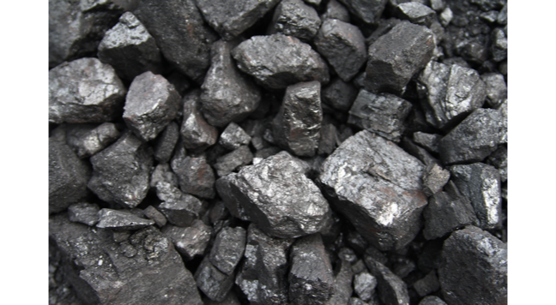
Stored Solar Energy
Notes:
Solar energy can be stored in fossil fuels for long periods of time. We will look more at fossil fuels in a minute.

Slide 20
Solar Energy = Renewable Resource
Notes:
Solar energy is an example of a renewable resource. Every time the sun comes up, there is an opportunity to collect and store solar energy!

Slide 21
Notes:
Now, let’s pause for a moment to check your understanding.

Slide 22
What produces solar energy?
Notes:
What produces solar energy?
[The sun]

Slide 23
Name one place solar energy can be stored.
Notes:
Name one place solar energy can be stored.
[Fossil fuels]

Slide 24
True/False: Solar energy is a non-renewable resource.
Notes:
True/False: Solar energy is a non-renewable resource.

Slide 25
True/False: Solar energy is a non-renewable resource.
Notes:
True/False: Solar energy is a non-renewable resource.
False

Slide 26
Notes:
Now, let’s talk about some examples of solar energy.
Feedback: It is important to not only introduced an example of the term but also included images to go along with it, this is a great way to help students make connections.

Slide 27
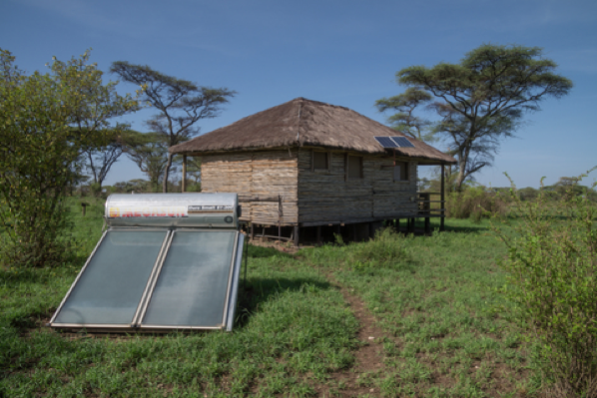
Notes:
These panels are an example of using solar energy as well! They collect energy from the sun. So individuals can collect solar energy, not just big companies!

Slide 28
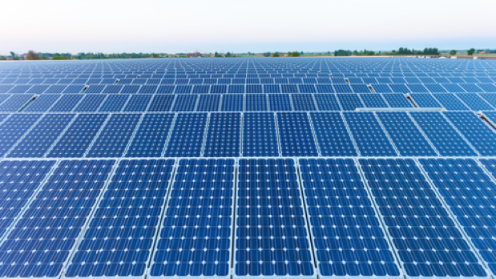
Field of Solar Panels
Notes:
This is a whole field of solar panels. Each of these panels collects and stores energy from the sun to be distributed to homes and businesses in a community.

Slide 29
Notes:
Next, let’s talk about some non-examples of solar energy.
Feedback: Use clear language as you introduce the non-example to make it easier for student to make sense of the difference.

Slide 30
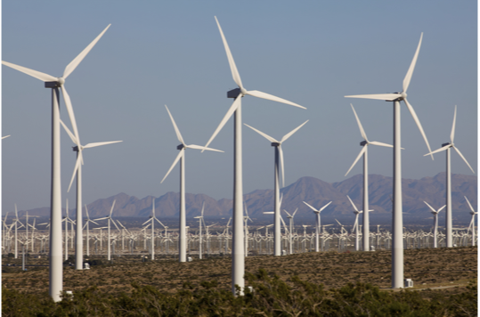
Windmill
Notes:
Windmills are not examples of solar energy. They use energy from the wind.

Slide 31
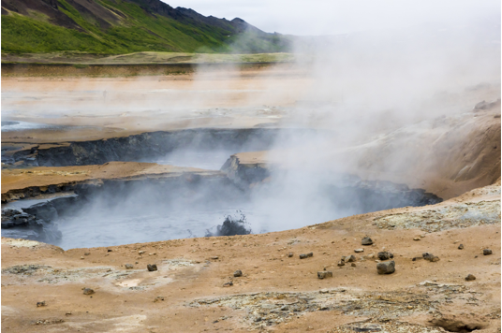
Hot Springs
Notes:
Hot springs are a non-example of solar energy. While both are a source of energy and both involve heat, hot springs are geothermal, which means they come from the Earth. Solar energy is from the sun!

Slide 32
Notes:
Let’s check-in for understanding.

Slide 33
Provide one example of solar energy.
Notes:
Provide one example of solar energy.

Slide 34
Why are hot springs not an example of solar energy?
Notes:
Why are hot springs not an example of solar energy?
[Hot springs are a non-example of solar energy. While both are a source of energy and both involve heat, hot springs are geothermal, which means they come from the Earth. Solar energy is from the sun!]

Slide 35
Notes:
To think about the definition of solar energy, it is helpful to look at its word parts.
Feedback: Break down the vocabulary term into word parts and defined each part, this is essential in building student understanding of the word parts.

Slide 36
Solar Energy
“Solaris” means “of the sun”
Notes:
Solar comes from the latin root “solaris” which means “of the sun.”

Slide 37
Solar Energy
Energy from the sun
Notes:
So, when we put it all together, we get that solar energy is energy from the sun.
Feedback: Once you had broken down the word parts it is important to put it all back together again and review one more time for the students.

Slide 38
Notes:
Let’s check-in for understanding.

Slide 39
What is solar energy?
Notes:
What is solar energy?
[Solar energy is energy from the sun.]

Slide 40
What produces solar energy?
Notes:
What produces solar energy?
[The Sun]

Slide 41
Name one place solar energy can be stored.
Notes:
Name one place solar energy can be stored.
[Fossil fuels]

Slide 42
True/False: Solar energy is a non-renewable resource.
Notes:
True/False: Solar energy is a non-renewable resource.

Slide 43
True/False: Solar energy is a non-renewable resource.
Notes:
True/False: Solar energy is a non-renewable resource.
False

Slide 44
Provide one example of solar energy.
Notes:
Provide one example of solar energy.

Slide 45
Why are hot springs not an example of solar energy?
Notes:
Why are hot springs not an example of solar energy?
[Hot springs are a non-example of solar energy. While both are a source of energy and both involve heat, hot springs are geothermal, which means they come from the Earth. Solar energy is from the sun!]

Slide 46
Remember!!!
Notes:
So remember!
Feedback: Repeating important information is a great way to draw students' attention to key content.

Slide 47
Solar Energy: energy from the sun
Notes:
Solar energy is energy from the sun.

Slide 48
Big Question: How do we use Earth’s resources to create energy?
Notes:
Explicit cue to revisit the big question at the end of the lesson: Okay everyone. Now that we’ve learned the term, let’s reflect once more on our big question. Was there anything that we predicted earlier that was correct or incorrect? Do you have any new hypotheses to share?

Slide 49
Notes:
Thanks for watching, and please continue watching CAPs available from this website.

Slide 50
This Video Was Created With Resources From:
Questions or Comments
Michael Kennedy, Ph.D. MKennedy@Virginia.edu
Rachel L Kunemund, Ph.D. rk8vm@virginia.edu

Slide 51
Intro
“Big Idea” Question
Review Concepts
Check-In Questions
Teacher Demo
Vocabulary
Student-Friendly Definition
Examples & Non-Examples
Morphological Word Parts
Simulation/Activity
Notes:
OK everyone, get ready for our next lesson. Just as a reminder, these are the different components that our lesson may include, and you’ll see these icons in the top left corner of each slide so that you can follow along more easily!

Slide 52
Intro
Fossil Fuels
Notes:
Today we are going to learn about fossil fuels,

Slide 53
Intro
Heat
Notes:
and heat.

Slide 54
Demonstration
Fossil Fuels: Chocolate Chip Mining
TEACHER DIRECTIONS:
Pass out the cookies, plates, and one Cookie Mining Worksheet for each student.
Students will sketch their cookie in two ways and answer the questions on the “Before Mining” side of their worksheet:
In the box on the left, students will make a sketch of their cookie.
In the box on the right, student will draw what fictional habitat is above ground on their cookie. Tell students to imagine that the cookie is actually the bedrock and dirt below ground – the second box is a bird’s eye view of that habitat on top. They should think of this as a fairly large area – the size of a city or national park. It can be a forest, desert, mountain, or any other ecosystem they like.
Pass out the toothpicks and explain that the students are actually coal miners. The chocolate chips in their cookies are the coal deposits underground, and they need to use their tools (toothpicks) to remove as much of that coal as possible. Give them about 5 minutes to “mine” for chocolate chips.
After mining, students will sketch their cookie in two ways and answer the questions again, this time on the “After Mining” section of their worksheet:
In the box on the left, they will make a sketch of their cookie.
In the box on the right, they will compare the damage to the cookie and the “before” image of the habitat to predict what their imaginary habitat looks like now. Encourage them to be specific when drawing and writing about what damage occurred.
Notes:
Let’s do a quick demonstration that will help get our brains ready to think about fossil fuels, and how it relates to our big question.
Feedback: Have students make predictions about the demonstration and make sure all students are actively participating in this portion of the lesson.

Slide 55
Big Question: How do we use Earth’s resources to create energy?
Notes:
Our “big question” is: How do we use Earth’s resources to create energy?
[Pause and illicit predictions from students.]
I love all these thoughtful scientific hypotheses! Be sure to keep this question and your predictions in mind as we move through these next few lessons, and we’ll continue to revisit it.

Slide 56
Notes:
Before we move on to our new vocabulary term, let’s review some other words & concepts that you already learned and make sure you are firm in your understanding.
Feedback: Reviewing key background knowledge helps lay the context and sets the students up to make sense of the new content you are introducing, it also reinforces previously learned material.

Slide 57
Element: a pure substance containing only one type of atom
Notes:
An element is a pure substance containing only one type of atom.

Slide 58
Energy: the ability to cause change
Notes:
Energy is the ability to cause change.

Slide 59
Renewable Resource: a resource that can be reused and replaced naturally
Notes:
A renewable resource is a resource that can be reused and replaced naturally.

Slide 60
Non-Renewable Resource: a resource that is not replaced by nature quickly enough to match demand
Notes:
A non-renewable resource is a resource that is not replaced by nature quickly enough to match demand.

Slide 61
Solar Energy: energy from the sun
Notes:
Solar energy is energy from the sun.

Slide 62
Notes:
Now, let’s pause for a moment to check your understanding.
Feedback: It is important to monitor understanding during this portion of the lesson to make sure students have a strong foundation on previous terms that will help them better understand today’s new content.

Slide 63
What is an element?
Notes:
What is an element?
[An element is a pure substance containing only one type of atom.]

Slide 64
What is energy?
Notes:
What is energy?
[Energy is the ability to cause change.]

Slide 65
What is a the difference between a renewable and non-renewable resource?
Notes:
What is the difference between a renewable and non-renewable resource?
[A non-renewable resource is a resource that is not replaced by nature quickly enough to match demand (how much it is needed). A renewable resource is a resource that can be reused and replaced naturally.]

Slide 66
What is solar energy?
Notes:
What is solar energy?
[Solar energy is energy from the sun.]

Slide 67
Fossil Fuels
Notes:
Now that we’ve reviewed, let’s define our new term, fossil fuels.

Slide 68
Fossil Fuels: energy that comes from the remains of plants and animals
Notes:
Fossil fuels are energy that comes from the remains of plants or animals.

Slide 69
Notes:
Let’s check-in for understanding.

Slide 70
What are fossil fuels?
Notes:
What are fossil fuels?
[Fossil fuels are energy that comes from the remains of plants or animals.]

Slide 71
Notes:
That’s the basic definition, but there’s more you need to know.

Slide 72
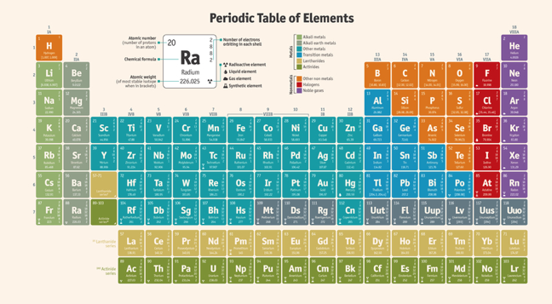
High in hydrogen and carbon
Notes:
Fossil fuels are high in carbon and hydrogen. This is because they are made of plants and animals.

Slide 73
Nonrenewable
Notes:
These types of fuels are nonrenewable because they cannot be replaced in a short amount of time.

Slide 74
Millions of years
Notes:
It takes millions of years to create fossil fuels.

Slide 75
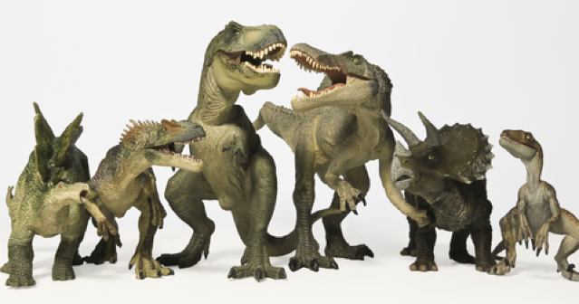
Fossil fuels formed before the dinosaurs!
Notes:
The fossil fuels we use today were formed BEFORE the dinosaurs!

Slide 76
Not a safe or reliable energy option!
Notes:
This means they are not a safe or reliable option for energy!

Slide 77
Notes:
Let’s check-in for understanding.

Slide 78
Which two elements are fossil fuels high in?
Hydrogen and nitrogen
Hydrogen and carbon
Hydrogen and oxygen
Notes:
Which two elements are fossil fuels high in?

Slide 79
Which two elements are fossil fuels high in?
Hydrogen and nitrogen
Hydrogen and carbon
Hydrogen and oxygen
Notes:
Which two elements are fossil fuels high in?
[Hydrogen and carbon]

Slide 80
Which energy source cannot be replaced in a short amount of time?
Water
Wind
Sun
Fossil fuels
Notes:
Which energy source cannot be replaced in a short amount of time?

Slide 81
Which energy source cannot be replaced in a short amount of time?
Water
Wind
Sun
Fossil fuels
Notes:
Which energy source cannot be replaced in a short amount of time?
[Fossil Fuels]

Slide 82
True/False: Fossil fuels are a source of renewable energy.
Notes:
True/False: Fossil fuels are a source of renewable energy.

Slide 83
True/False: Fossil fuels are a source of renewable energy.
Notes:
True/False: Fossil fuels are a source of renewable energy.
[False.]

Slide 84
Notes:
Now, let’s talk about some examples of fossil fuels.

Slide 85
Coal
Notes:
Coal is made from million year old plants. This is an example of fossil fuels because it is the remains of all of those very plants.

Slide 86
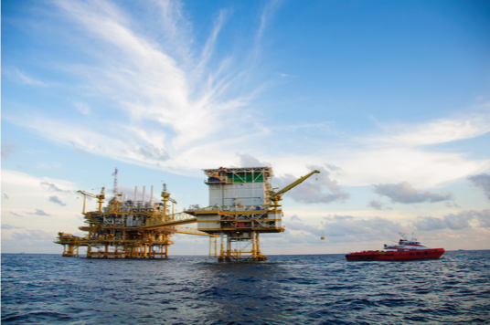
Oil
Notes:
Oil is made from millions of years old plants and animals. Again, it is a fossil fuel because it is made up of the remains of plants and animals from millions of years ago.

Slide 87
Notes:
Next, let’s talk about some non-examples of fossil fuels.

Slide 88
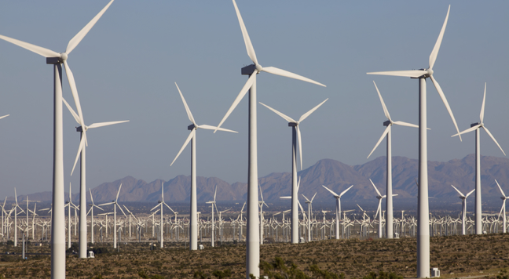
Renewable
Notes:
Renewable energy can be replaced in a short amount of time. Wind is renewable energy. You can replace it in a short amount of time. Renewable energy is the opposite of fuels.

Slide 89
Solar Energy
Notes:
The sun produces renewable energy. This energy does not come from fossil fuels.

Slide 90
Water
Notes:
Water is another source of renewable energy. This energy does not come from fossil fuels.

Slide 91
Notes:
Let’s check-in for understanding.

Slide 92
Provide one example of fossil fuel energy.
Notes:
Provide one example of fossil fuel energy.
[Coal, oil, natural gas]

Slide 93
Is water an example of fossil fuel energy? Explain your response.
Notes:
Is water an example of fossil fuel energy? Explain your response.
[Water is another source of renewable energy. This energy does not come from fossil fuels.]

Slide 94
What are fossil fuels?
Notes:
What are fossil fuels?
[Fossil fuels are energy that comes from the remains of plants or animals.]

Slide 95
Which two elements are fossil fuels high in?
Hydrogen and nitrogen
Hydrogen and carbon
Hydrogen and oxygen
Notes:
Which two elements are fossil fuels high in?

Slide 96
Which two elements are fossil fuels high in?
Hydrogen and nitrogen
Hydrogen and carbon
Hydrogen and oxygen
Notes:
Which two elements are fossil fuels high in?
[Hydrogen and carbon]

Slide 97
Which energy source cannot be replaced in a short amount of time?
Water
Wind
Sun
Fossil fuels
Notes:
Which energy source cannot be replaced in a short amount of time?

Slide 98
Which energy source cannot be replaced in a short amount of time?
Water
Wind
Sun
Fossil fuels
Notes:
Which energy source cannot be replaced in a short amount of time?
[Fossil Fuels]

Slide 99
True/False: Fossil fuels are a source of renewable energy.
Notes:
True/False: Fossil fuels are a source of renewable energy.

Slide 100
True/False: Fossil fuels are a source of renewable energy.
Notes:
True/False: Fossil fuels are a source of renewable energy.
[False.]

Slide 101
Heat
Notes:
Let’s define our new term, heat.

Slide 102
How is energy released from coal?
Notes:
How is energy released from coal?

Slide 103
Oxygen + Heat = Released Energy
Notes:
When oxygen is present such as in the air and heat is added, energy is released.

Slide 104
Add heat
Notes:
When you add heat to a system, it tends to get hotter.

Slide 105
Take away heat
Notes:
When you take away heat, it tends to get colder.

Slide 106
Heat + Coal = released energy
Notes:
When heat is added to coal, it releases energy.

Slide 107
Notes:
Energy can be released as heat, light, sound or kinetic energy.

Slide 108
Notes:
Let’s check-in for understanding.

Slide 109
_____ + Coal = released energy
Notes:
_____ + Coal = released energy

Slide 110
Heat + Coal = released energy
Notes:
Heat + Coal = released energy
Feedback: Give students plenty of opportunities to demonstrate their understanding throughout the lesson. This assures that your students are able to understand the complicated formal definitions.

Slide 111
Remember!!!
Notes:
So remember!
Feedback: Repeating important information is a great way to draw students' attention to key content.

Slide 112
Fossil Fuels: energy that comes from the remains of plants and animals
Notes:
Fossil fuels are energy that comes from the remains of plants or animals.

Slide 113
Oxygen + Heat = Released Energy
Notes:
When oxygen is present such as in the air and heat is added, energy is released.

Slide 114
Big Question: How do we use Earth’s resources to create energy?
Notes:
Explicit cue to revisit the big question at the end of the lesson: Okay everyone. Now that we’ve learned the term, let’s reflect once more on our big question. Was there anything that we predicted earlier that was correct or incorrect? Do you have any new hypotheses to share?

Slide 115
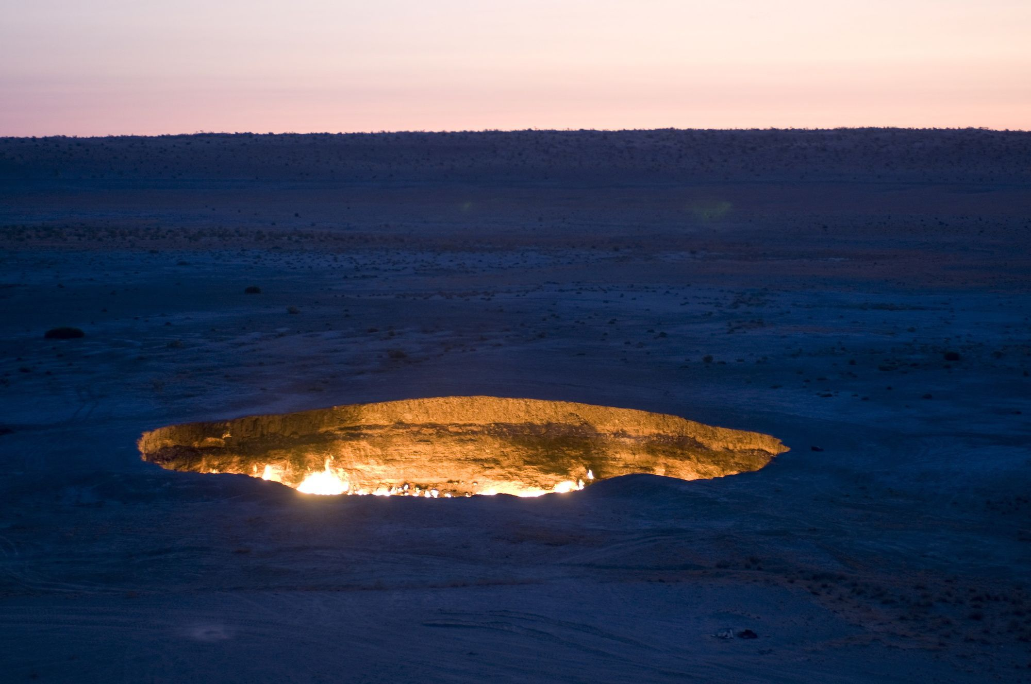
Simulation Activity
Putting the "Fossil" in Fossil Fuels
Students begin their exploration of fossil fuels by looking at video and photographs of the Darvaza gas crater in Turkmenistan and pondering what makes it burn. This is followed by an analysis of the Keeling Curve, a graph of global carbon dioxide levels in the atmosphere over time. Finally, in a class discussion prompted by a thought-provoking photograph, students complete a Know & Need to Know chart on fossil fuels.
Notes:
Students begin their exploration of fossil fuels by looking at video and photographs of the Darvaza gas crater in Turkmenistan and pondering what makes it burn. This is followed by an analysis of the Keeling Curve, a graph of global carbon dioxide levels in the atmosphere over time. Finally, in a class discussion prompted by a thought-provoking photograph, students complete a Know & Need to Know chart on fossil fuels.
Feedback: Have students analyze and interpret data to elevate their understanding of the content and strengthen their critical thinking skills.

Slide 116
Notes:
Thanks for watching, and please continue watching CAPs available from this website.

Slide 117
This Video Was Created With Resources From:
Questions or Comments
Michael Kennedy, Ph.D. MKennedy@Virginia.edu
Rachel L Kunemund, Ph.D. rk8vm@virginia.edu

