Slide 1
Intro
“Big Idea” Question
Review Concepts
Check-In Questions
Teacher Demo
Vocabulary
Student-Friendly Definition
Examples & Non-Examples
Morphological Word Parts
Simulation/Activity
Notes:
OK everyone, get ready for our next lesson. Just as a reminder, these are the different components that our lesson may include, and you’ll see these icons in the top left corner of each slide so that you can follow along more easily!

Slide 2
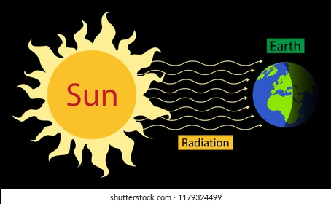
Intro
Solar Radiation
Notes:
Today, we will learn about solar radiation.

Slide 3
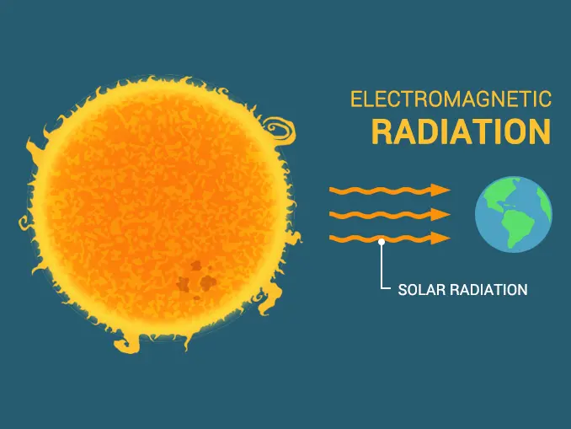
Big Question: How does the Sun provide energy on Earth?
Notes:
Our “big question” is: How does the Sun provide energy on Earth?
[Pause and illicit predictions from students.]
I love all these thoughtful scientific hypotheses! Be sure to keep this question and your predictions in mind as we move through these next few lessons, and we’ll continue to revisit it.

Slide 4
Notes:
Before we move on to our new vocabulary term, let’s review some other words & concepts that you already learned and make sure you are firm in your understanding.
Feedback: Reviewing key background knowledge helps lay the context and sets the students up to make sense of the new content you are introducing, it also reinforces previously learned material.

Slide 5
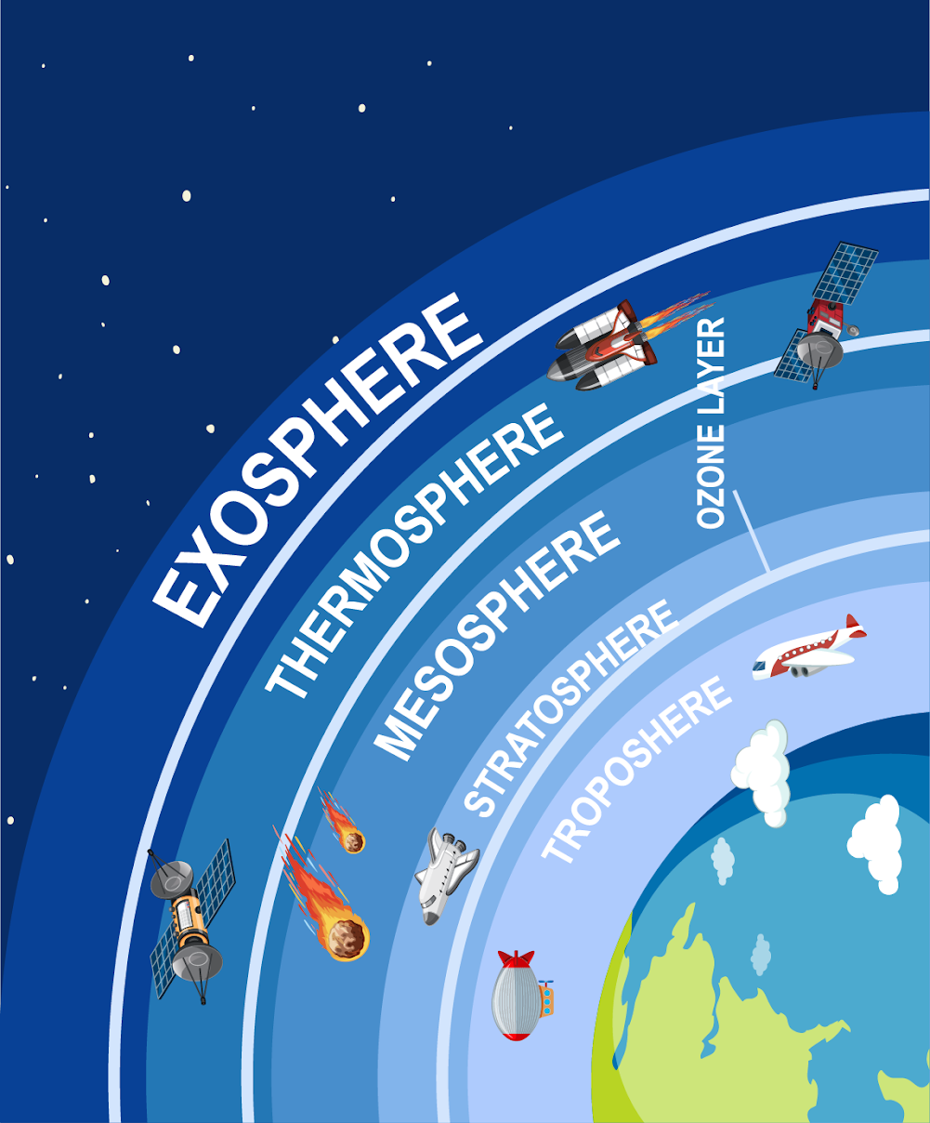
Atmosphere: the layers of gas surrounding the surface of a planet
Notes:
The atmosphere is the layers of gas surrounding the surface of a planet. Sometimes the atmosphere is called a “blanket” of gases.

Slide 6
Energy: the ability to do work
Notes:
Energy is the ability to do work. An example can include a man has energy that helps him do his work.

Slide 7
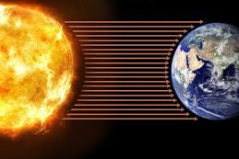
Radiation: the transfer of energy as waves
Notes:
Radiation is the transfer of energy as waves.

Slide 8
Electromagnetic Spectrum: range of all types of electromagnetic waves
Notes:
The electromagnetic spectrum is the range of all types of electromagnetic waves.

Slide 9
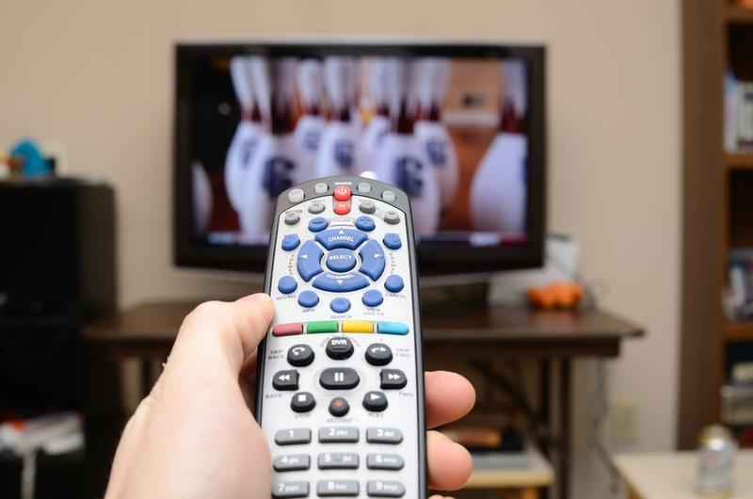
Infrared Radiation
Notes:
Infrared radiation has slightly longer waves than visible light but shorter than microwaves. This means that the frequencies and energy of infrared radiation are little higher than microwaves.

Slide 10
Visible Light Waves
Notes:
Visible light waves are wavelengths that are visible to the human eye. They are the only wavelengths on the electromagnetic spectrum that are visible. The wavelengths are shorter, and have higher frequencies and energy than infrared radiation.

Slide 11
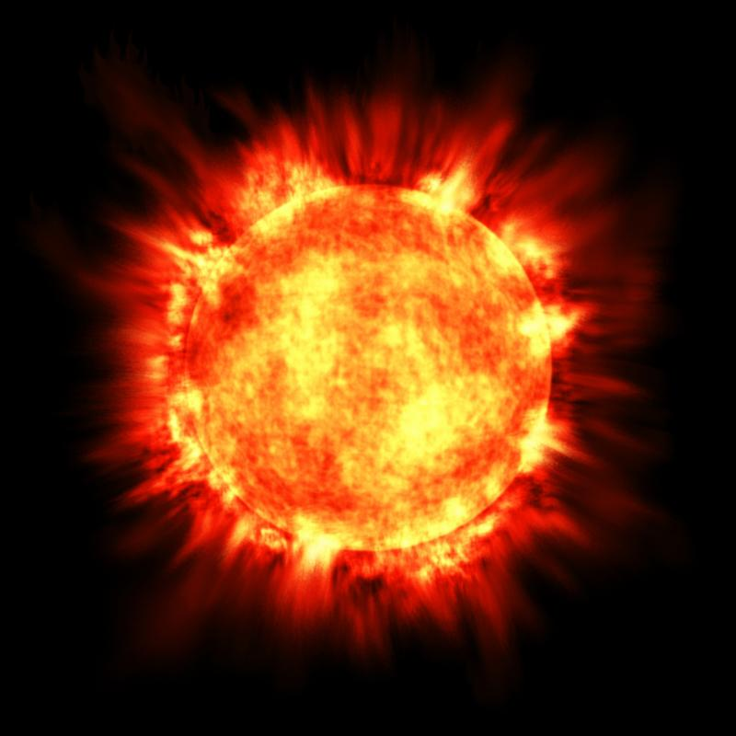
Ultraviolet (UV) Waves
Notes:
Ultraviolet (UV) waves are shorter than visible light but have higher frequencies and energy. The sun emits ultraviolet waves to the earth.

Slide 12
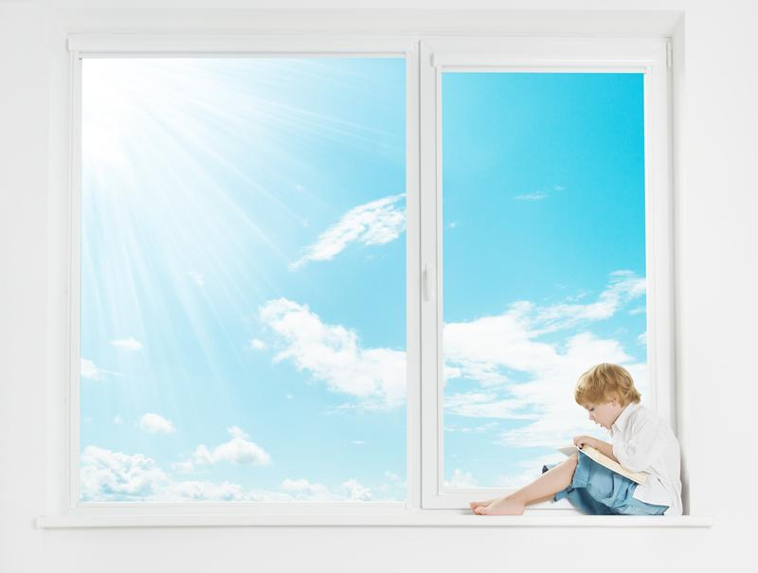
Absorption: the transfer of energy from a wave to the medium it is traveling through
Notes:
Absorption is the transfer of energy from a wave to the medium it is traveling through.

Slide 13
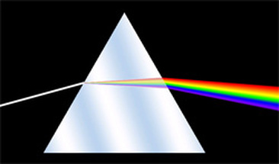
Emission: the transfer of energy from a medium
Notes:
Emission is the transfer of energy from a medium.

Slide 14
Notes:
Now, let’s pause for a moment to check your understanding.
Feedback: Embed plenty of opportunities to check for understanding throughout the review, this is a great way to make sure students are grasping the content you have already covered.

Slide 15
Energy is the ability to do _______.
Notes:
Energy is the ability to do _________.

Slide 16
Energy is the ability to do work.
Notes:
Energy is the ability to do work.

Slide 17
What is the electromagnetic spectrum?
Notes:
What is the electromagnetic spectrum?
[The electromagnetic spectrum is the range of all types of electromagnetic waves. These are created as result of vibrations between an electric field and a magnetic field.]

Slide 18
What is the atmosphere made up of?
Notes:
What is the atmosphere made up of?
[Gas]

Slide 19
What is radiation?
Notes:
What is radiation?
[Radiation is the transfer of energy as waves.]

Slide 20
What is absorption?
Notes:
What is absorption?
[Absorption is the transfer of energy from a wave to the medium it is traveling through.]

Slide 21
What is emission?
Notes:
What is emission?
[Emission is the transfer of energy from a medium.]

Slide 22
Solar Radiation
Notes:
Now that we’ve reviewed, let’s define our new term, solar radiation.

Slide 23
Solar Radiation: electromagnetic radiation emitted from the sun
Notes:
Solar radiation is electromagnetic radiation emitted from the sun.
Feedback: Longer more formal definitions are tricky, use clear language when providing the new definition.

Slide 24
Notes:
Now, let’s pause for a moment to check your understanding.

Slide 25
What is solar radiation?
Notes:
What is solar radiation?
[Solar radiation is electromagnetic radiation emitted from the sun.]

Slide 26
Notes:
That’s the basic definition, but there’s more you need to know.

Slide 27
The sun is the ultimate source of energy on Earth.
Notes:
The sun is the ultimate source of energy on Earth.

Slide 28
The solar radiation given off by the sun falls in the infrared, visible, and ultraviolet parts of the electromagnetic spectrum.
Notes:
The solar radiation given off by the sun is in the infrared, visible, and ultraviolet parts of the electromagnetic spectrum.

Slide 29
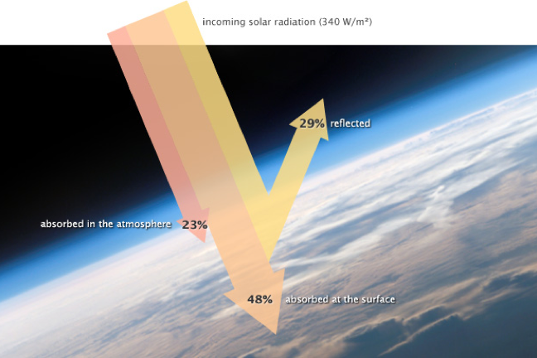
Notes:
Some solar radiation is reflected by the atmosphere, clouds, and the Earth’s surface. About 48% of solar radiation is absorbed by Earth.

Slide 30
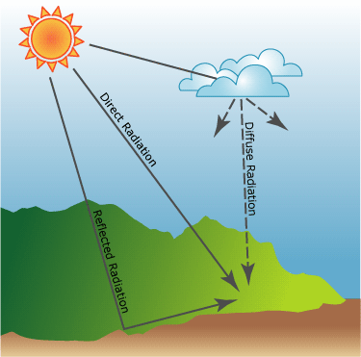
Solar radiation that reaches the ground on Earth is absorbed, scattered, and reflected by the atmosphere.
Notes:
Solar radiation that reaches the ground on Earth is absorbed, scattered, and reflected by components of the atmosphere, such as clouds, water molecules, pollutants, etc.

Slide 31
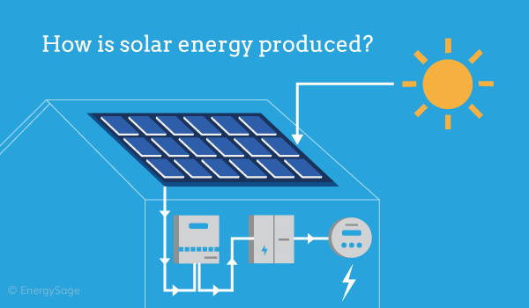
Solar radiation can be captured and turned into useful forms of energy.
Notes:
Solar radiation can be captured and turned into useful forms of energy, such as heat and electricity.

Slide 32
Notes:
Now, let’s pause for a moment to check your understanding.
Feedback: Give students opportunities to demonstrate their understanding. This assures that your students are able to understand the complicated formal definitions.

Slide 33
What is the ultimate source of energy on Earth?
Notes:
What is the ultimate source of energy on Earth?
[The Sun]

Slide 34
What parts of the electromagnetic spectrum does solar radiation exist?
Notes:
What parts of the electromagnetic spectrum does solar radiation exist?
[The solar radiation given off by the sun is in the infrared, visible, and ultraviolet parts of the electromagnetic spectrum.]

Slide 35
Solar radiation that reaches the ground on Earth is absorbed, scattered, and reflected by ______.
Notes:
Solar radiation that reaches the ground on Earth is absorbed, scattered, and reflected by ______.

Slide 36
Solar radiation that reaches the ground on Earth is absorbed, scattered, and reflected by the atmosphere.
Notes:
Solar radiation that reaches the ground on Earth is absorbed, scattered, and reflected by the atmosphere.

Slide 37
What is one way humans use solar radiation?
Notes:
What is one way humans use solar radiation?
[Solar radiation can be captured and turned into useful forms of energy, such as heat and electricity.]

Slide 38
Notes:
Now, let’s talk about some examples of solar radiation.
Feedback: It is important to not only introduce an example of the term but also include images to go along with it, this is a great way to help students make connections.

Slide 39
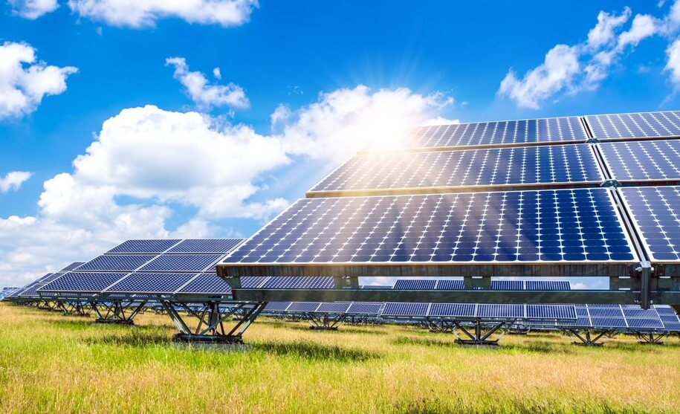
Notes:
Solar radiation can be captured by solar panels and turned into electricity. Many people are now installing solar panels on their roofs to harness this energy from the sun to power their homes.

Slide 40
Notes:
Solar radiation is the energy used to power the process of photosynthesis in planets. Plants take in carbon dioxide, water, and light energy from the sun to produce oxygen and sugar.

Slide 41
Notes:
Solar radiation allows water to heat up, evaporation, and go back into the sky. The water particles heat up by absorbing thermal energy.

Slide 42
Notes:
Next, let’s talk about some non-examples of solar radiation.
Feedback: One important component of using non-examples is by clearly distinguishing similarities and explaining why it is a non-example.

Slide 43
Notes:
Light from lamps is artificial light. Since this light does not come from the sun it is not an example of solar radiation.

Slide 44
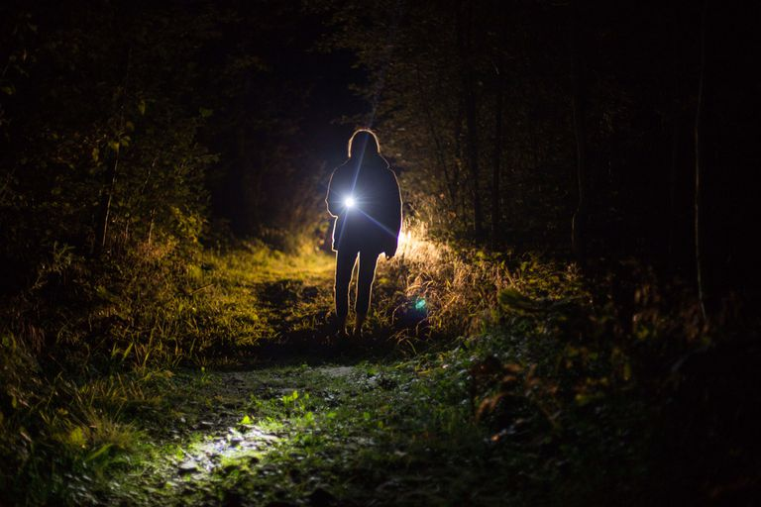
Notes:
Flashlights are another source of artificial light. Light from flashlights does not come from the sun, therefore it is not an example of solar radiation.

Slide 45
Notes:
Let’s check-in for understanding.

Slide 46
How are solar panels and solar radiation connected?
Notes:
How are solar panels and solar radiation connected?
[Solar radiation is captured by solar panels and converted into electricity.]

Slide 47
Provide another example of how solar radiation is used by humans and/or other life.
Notes:
Provide another example of how solar radiation is used by humans and/or other life.

Slide 48
What part of the water cycle is caused by solar radiation?
Notes:
What part of the water cycle is caused by solar radiation?
[Evaporation]

Slide 49
Is a lamp an example of solar radiation? Explain your answer.
Notes:
Is a lamp an example of solar radiation? Explain your answer.
Light from lamps is artificial light. Since this light does not come from the sun it is not an example of solar radiation.

Slide 50
What is solar radiation?
Notes:
What is solar radiation?
[Solar radiation is electromagnetic radiation emitted from the sun.]

Slide 51
What is the ultimate source of energy on Earth?
Notes:
What is the ultimate source of energy on Earth?
[The Sun]

Slide 52
What parts of the electromagnetic spectrum does solar radiation exist?
Notes:
What parts of the electromagnetic spectrum does solar radiation exist?
[The solar radiation given off by the sun is in the infrared, visible, and ultraviolet parts of the electromagnetic spectrum.]

Slide 53
Solar radiation that reaches the ground on Earth is absorbed, scattered, and reflected by ______.
Notes:
Solar radiation that reaches the ground on Earth is absorbed, scattered, and reflected by ______.

Slide 54
Solar radiation that reaches the ground on Earth is absorbed, scattered, and reflected by the atmosphere.
Notes:
Solar radiation that reaches the ground on Earth is absorbed, scattered, and reflected by the atmosphere.

Slide 55
How are solar panels and solar radiation connected?
Notes:
How are solar panels and solar radiation connected?
[Solar radiation is captured by solar panels and converted into electricity.]

Slide 56
Is a lamp an example of solar radiation? Explain your answer.
Notes:
Is a lamp an example of solar radiation? Explain your answer.
[Light from lamps is artificial light. Since this light does not come from the sun it is not an example of solar radiation.]

Slide 57
Remember!!!
Notes:
So remember!
Feedback: Review the key term once more before closing the lesson to ensure that students lock in the definition.

Slide 58
Solar Radiation: electromagnetic radiation emitted from the sun
Notes:
Solar radiation is electromagnetic radiation emitted from the sun.

Slide 59
Big Question: How does the Sun provide energy on Earth?
Notes:
Explicit cue to revisit the big question at the end of the lesson: Okay everyone. Now that we’ve learned the term, let’s reflect once more on our big question. Was there anything that we predicted earlier that was correct or incorrect? Do you have any new hypotheses to share?

Slide 60
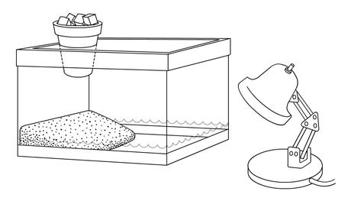
Simulation Activity
Solar Energy and the Water Cycle
Materials: insulated cup, aquarium, water, food color, sand, small jar, ziplock, heat lamp
The teacher will demonstrate a water cycle using a model. The teacher will walk students through each step showing condensation, evaporation, and precipitation.

Slide 61
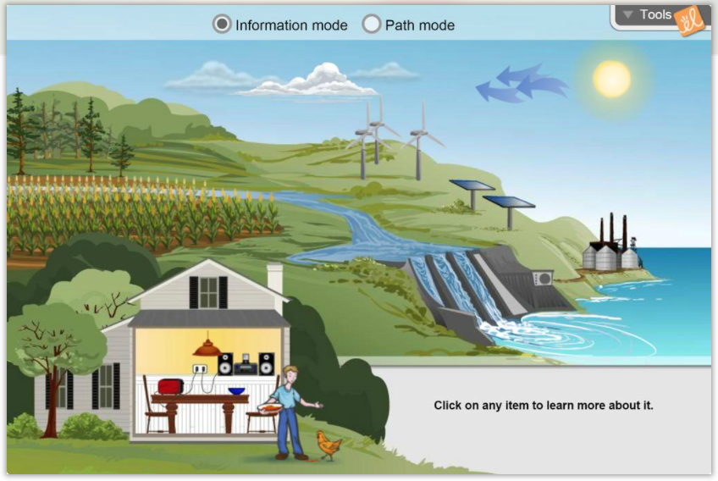
Simulation Activity
Energy Conversions
In this Gizmo, students can discover how living things get energy to move and grow. Students will trace the path of energy and see how energy is converted from one form to another. The energy sources in this Gizmo are renewable.

Slide 62
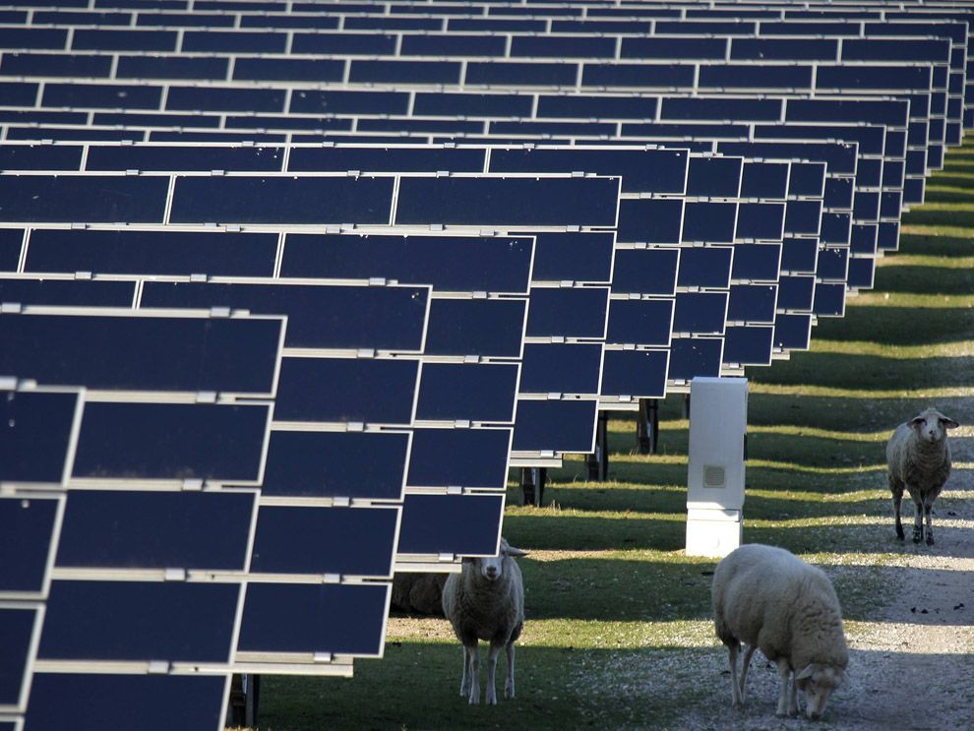
Simulation Activity
Solar Energy and Diversifying Energy Resources
Students analyze the benefits and drawbacks of solar energy by investigating a real-world conflict between farmers and environmentalists in California and a company that wants to build a solar farm nearby. Students read a case scenario, identify specific benefits and drawbacks of the solar farm in the scenario, and write a position statement.

Slide 63
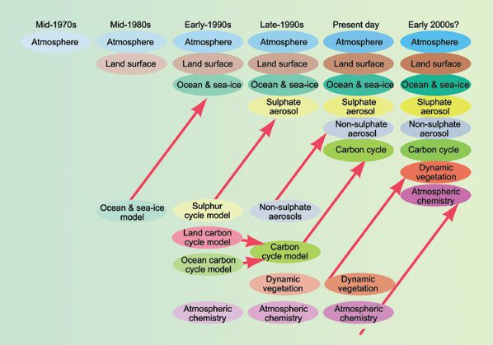
Simulation Activity
Using Models to Make Predictions
Students explore how solar radiation, Earth's surface and oceans, and greenhouse gases interact to cause global warming. They can change variables to determine how much greenhouse gas emissions might need to fall to mitigate the temperature increase.

Slide 64
Notes:
Thanks for watching, and please continue watching CAPs available from this website.

Slide 65
This Video Was Created With Resources From:
Questions or Comments
Michael Kennedy, Ph.D. MKennedy@Virginia.edu
Rachel L Kunemund, Ph.D. rk8vm@virginia.edu

Slide 66
This Video Was Created With Resources From:
Questions or Comments
Michael Kennedy, Ph.D. MKennedy@Virginia.edu
Rachel L Kunemund, Ph.D. rk8vm@virginia.edu

