Slide 1
Intro
“Big Idea” Question
Review Concepts
Check-In Questions
Teacher Demo
Vocabulary
Student-Friendly Definition
Examples & Non-Examples
Morphological Word Parts
Simulation/Activity
Notes:
OK everyone, get ready for our next lesson. Just as a reminder, these are the different components that our lesson may include, and you’ll see these icons in the top left corner of each slide so that you can follow along more easily!

Slide 2
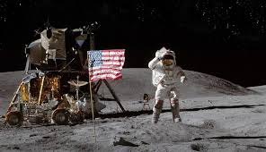
Space Exploration
Intro
Notes:
Today we will learn about space exploration.

Slide 3
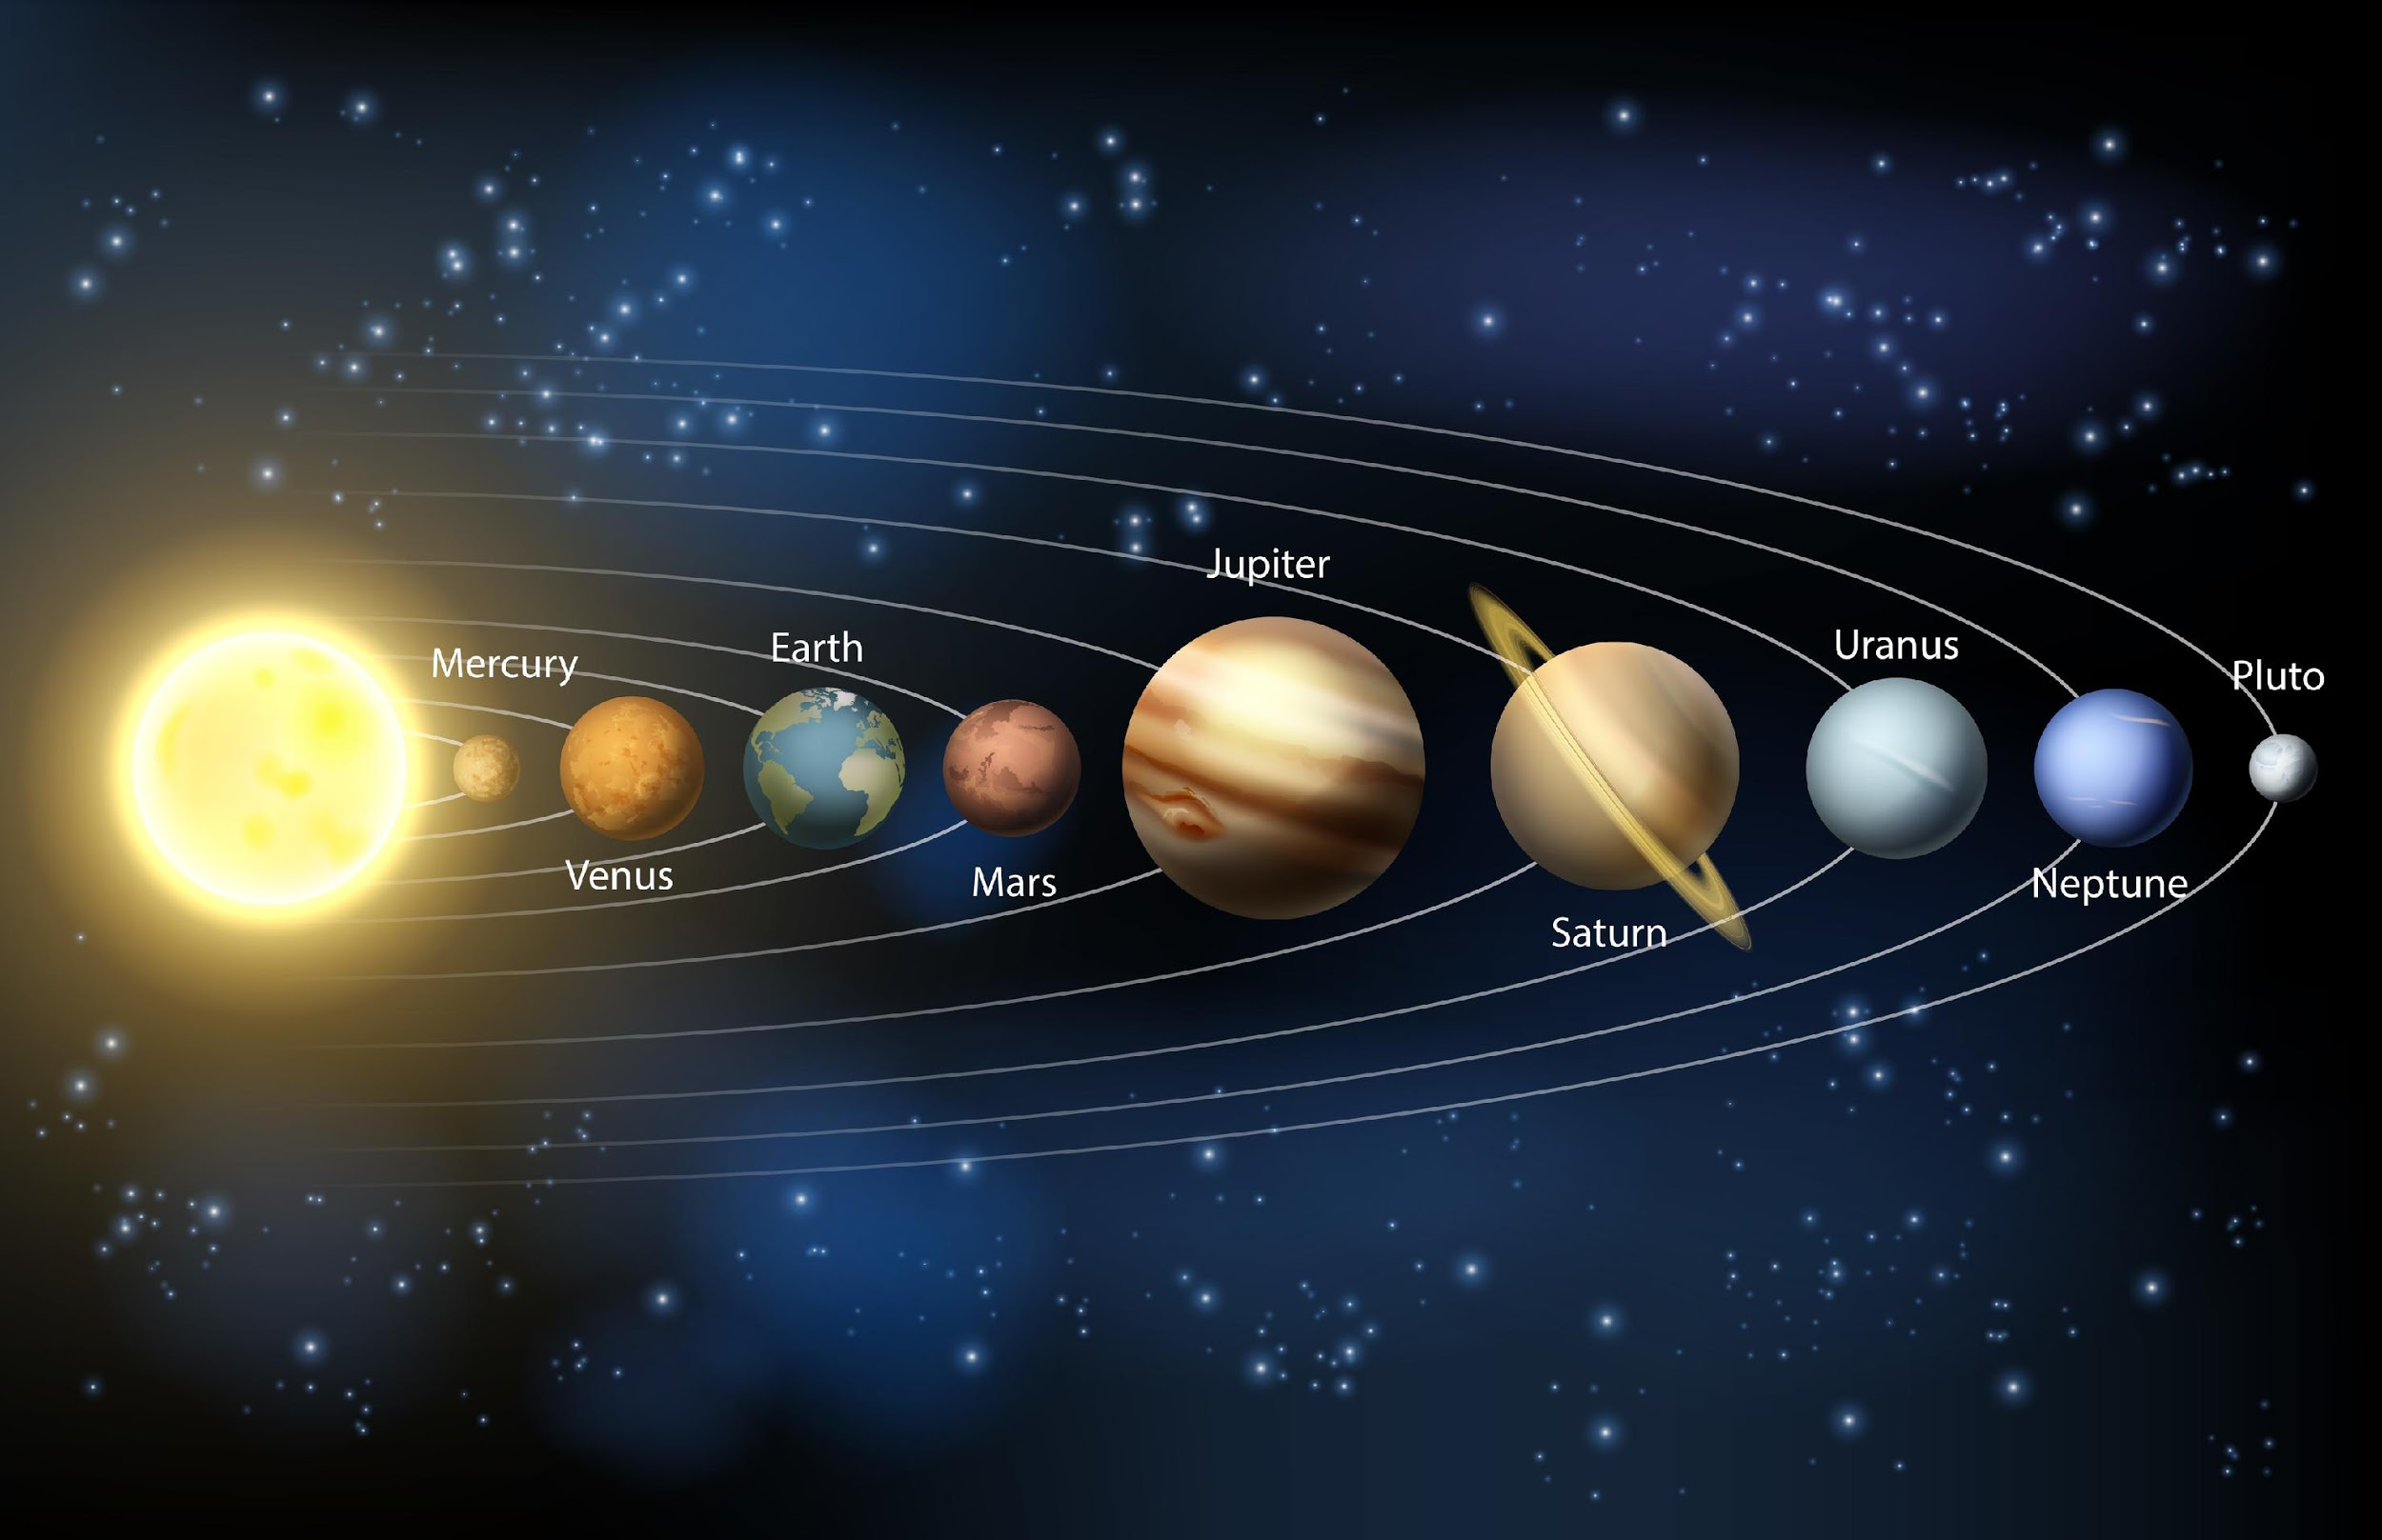
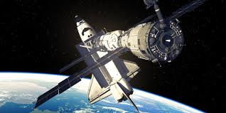
Big Question: How do changes in our technology and exploration of efforts affect our knowledge of the earth and our solar system?
Notes:
Our “big question” is: How do changes in our technology and exploration of efforts affect our knowledge of the earth and our solar system?
[Pause and illicit predictions from students.]
I love all these thoughtful scientific hypotheses! Be sure to keep this question and your predictions in mind as we move through these next few lessons, and we’ll continue to revisit it.
Feedback: Asking students to make predictions about how changes in our technology and exploration of efforts affect of knowledge of the earth and our solar system is a great way to activate and elicit student ideas and prior knowledge. This type of activity is evidence of the teacher planning for students’ engagement with science ideas.

Slide 4
Notes:
Before we move on to our new vocabulary term, let’s review some other words & concepts that you already learned and make sure you are firm in your understanding.

Slide 5
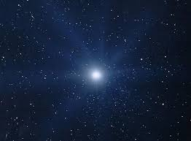
Star: object in space made up of gases such as hydrogen and helium that produce light and heat
Notes:
A star is an object in space made up of gases such as hydrogen and helium that produce light and heat. The sun is a star.

Slide 6
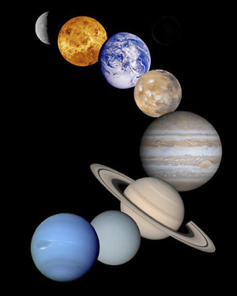
Planet: a body or object in space that revolves around a star and has a spherical shape
Notes:
A planet is a body or object in space that revolves around a star and has a spherical shape.

Slide 7
The Solar System: the sun with all the planets and other bodies that revolve around it
Notes:
The solar system is the sun with all the planets and other bodies that revolve around it.

Slide 8
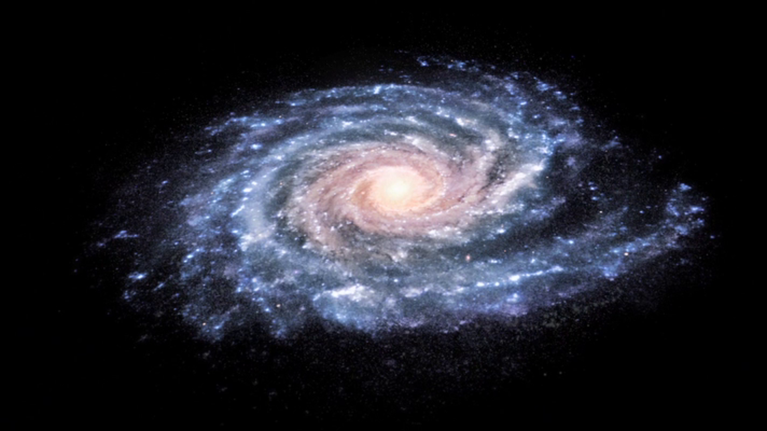
Galaxy: a cluster of stars, dust and gases that are held together with gravity
Notes:
A galaxy is a cluster of stars, dust and gases that are held together with gravity .

Slide 9
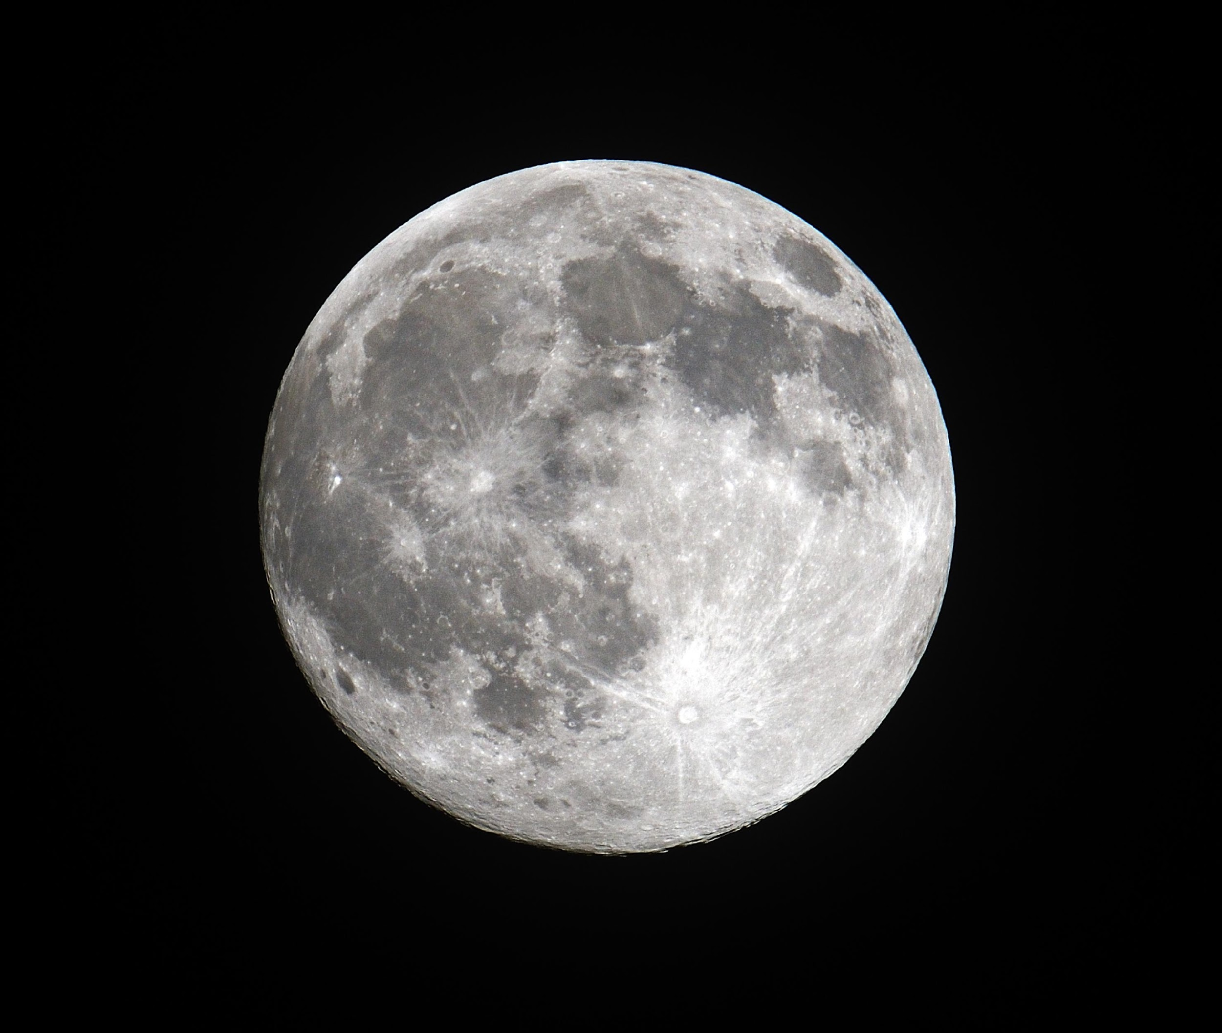
Moon: an object that revolves around a planet and reflects light from the sun
Notes:
A moon is an object that revolves around a planet and reflects light from the sun.

Slide 10
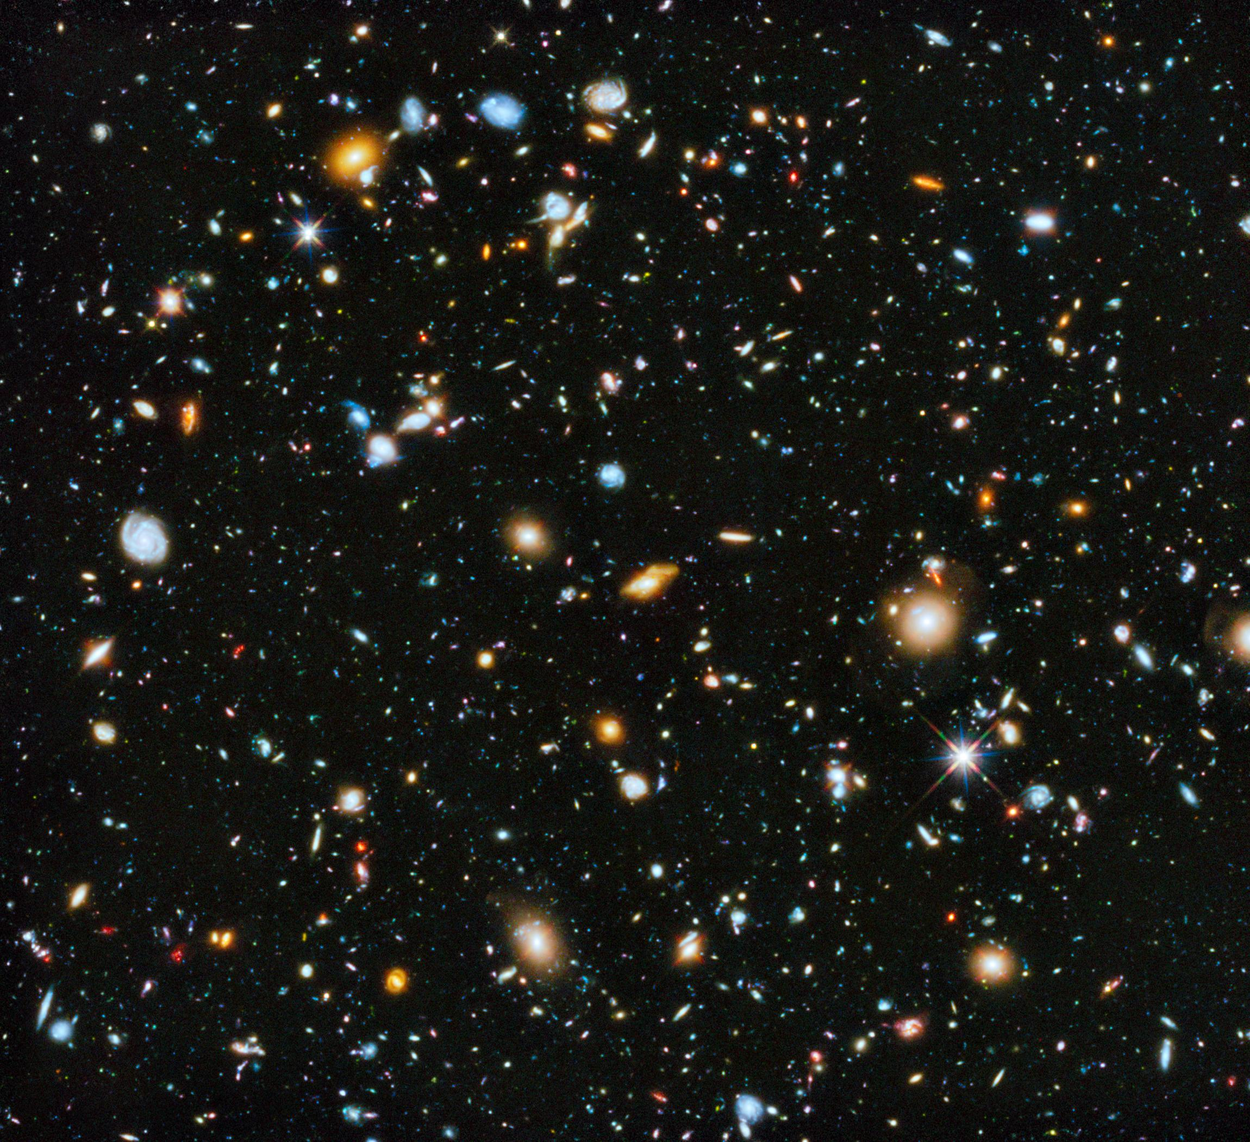
Universe: all of space and everything in it including the solar system, stars, planets, moons, etc.
Notes:
The universe is all of space and everything in it including the solar system, stars, planets, moons, etc.

Slide 11
Notes:
Now let’s pause for a moment to check your understanding.

Slide 12
What is a star?
Notes:
What is a star?
[A star is an object in space made up of gases such as hydrogen and helium that produce light and heat. The sun is a star.]

Slide 13
A planet is a body or object in space that revolves around a _____ and has a _____ shape.
Notes:
A planet is a body or object in space that revolves around a _____ and has a _____ shape.

Slide 14
A planet is a body or object in space that revolves around a star and has a spherical shape.
Notes:
A planet is a body or object in space that revolves around a star and has a spherical shape.

Slide 15
What is a solar system?
Notes:
What is a solar system?
[A solar system is the sun with all the planets and other bodies that revolve around it.]

Slide 16
A galaxy is a cluster of stars, dust and gases that are held together by _____ .
Notes:
A galaxy is a cluster of stars, dust and gases that are held together by _______ .

Slide 17
A galaxy is a cluster of stars, dust and gases that are held together by gravity.
Notes:
A galaxy is a cluster of stars, dust and gases that are held together by gravity.

Slide 18
What is a moon?
Notes:
What is a moon?
[A moon is an object that revolves around a planet and reflects light from the sun.]

Slide 19
What makes up the universe?
Notes:
What makes up the universe?
[The universe is all of space and everything in it including the solar system, stars, planets, moons, etc.]

Slide 20
Space Exploration
Notes:
Now that we’ve reviewed, let’s define our new term, space exploration.
Feedback: Using cues, such as on this slide, helps prepare students for what is coming up next in the lesson. This is important especially for students who may struggle with new vocabulary instruction.

Slide 21
Space Exploration: use of space technology and physical missions to get information and improve our understanding of earth, the solar system, and space
Notes:
Space exploration is the use of space technology and physical missions to gather information and improve our understanding of earth, solar system, and space.

Slide 22
Notes:
Now let’s pause for a moment to check your understanding.

Slide 23
What is space exploration?
Notes:
What is space exploration?
[Space exploration is the use of space technology and physical missions to get information and improve our understanding of earth, the solar system, and space.]

Slide 24
Notes:
That is the basic definition, but there is a bit more you need to know.

Slide 25
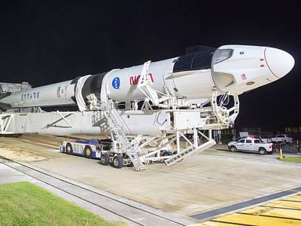
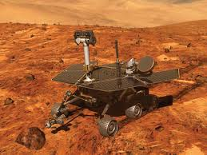
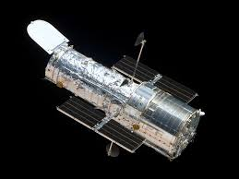
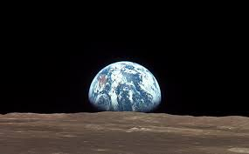
Notes:
There have been many instances of space exploration, we will focus on some of the big events over the past sixty years.

Slide 26
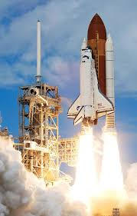
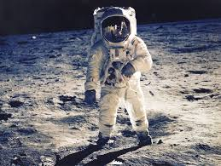
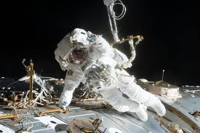
Notes:
And people who have completed various missions to space.

Slide 27
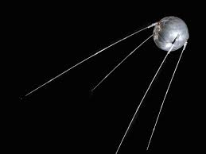
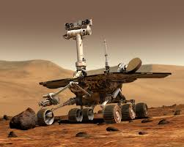
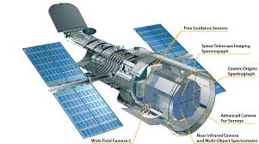
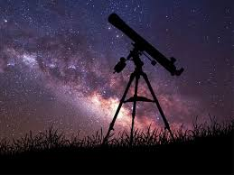
Notes:
These different instances of space exploration included specially designed and space technology.

Slide 28
Notes:
Now let’s pause for a moment to check your understanding.

Slide 29
What is space exploration?
Notes:
What is space exploration?
[Space exploration is the use of space technology and physical missions to gather information and improve our understanding of earth, solar system, and space.]

Slide 30
Space exploration involves both specially designed ___________ and people who have completed various __________ to space.
Notes:
Space exploration involves both specially designed ___________ and people who have completed various __________ to space.

Slide 31
Space exploration involves both specially designed technology and people who have completed various missions to space.
Notes:
Space exploration involves both specially designed technology and people who have completed various missions to space.

Slide 32
Notes:
Let’s dive deeper into space exploration.

Slide 33
First satellite to space
Notes:
Here we will introduce the some of the key events in space exploration.

Slide 34
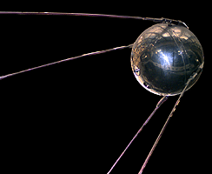
Sputnik 1: the first satellite successfully launched into space and would orbit the earth
1957: Soviet Union
Notes:
Sputnik was the first satellite successfully launched into space and would orbit the earth. Sputnik 1 was launched by the soviet union on October 4, 1957.

Slide 35
First satellite to space
First man in space

Slide 36
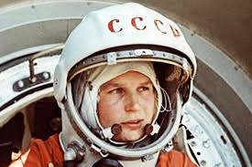
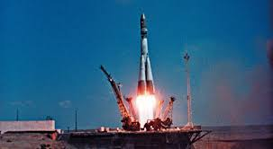
Yuri Gagarin: a soviet cosmonaut, was the first person to enter space. He manned the Vostok 1 spacecraft on April 12, 1961.
Notes:
Yuri Gagarin a soviet cosmonaut, was the first person to enter space. He manned the Vostok 1 spacecraft on April 12, 1961. He spent a total of 108 minutes in space.

Slide 37
First satellite to space
First person in space
Moon landing
Notes:
Feedback: Visuals such as this are a terrific way to help students to organize their new knowledge with pictures and key words as we continue to build this knowledge.

Slide 38
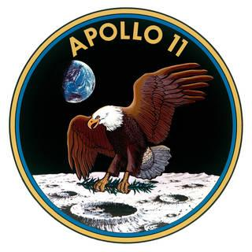
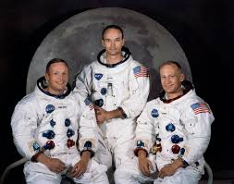
Apollo 11: a U.S mission that resulted in the first lunar landing. The three person crew, Neil Armstrong, Buzz Aldrin, and Michael Collins, safely landed on the moon on July 20, 1969.
"...one small step for a man, one giant leap for mankind"
Notes:
Apollo 11 was a U.S mission that resulted in the first lunar landing. The three person crew, Neil Armstrong, Buzz Aldrin, and Michael Collins, safely landed on the moon on July 20, 1969.

Slide 39
First satellite to space
First person in space
Moon landing
International Space Station

Slide 40
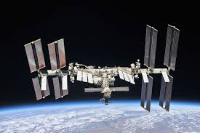
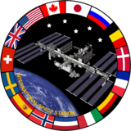
International Space Station: an artificial satellite, launched on November 20, 1998, on which astronauts can stay and visit. It is used for research and space exploration.
Notes:
The international space station was an artificial satellite, launched on November 20, 1998, on which astronauts can stay and visit. The ISS is an international effort with 239 astronauts having visited since its launch.

Slide 41
First satellite to space
First person in space
Moon landing
International Space Station
First orbit of Mercury

Slide 42
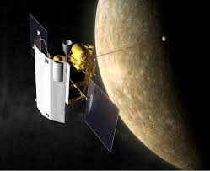
MESSENGER: an unmanned spacecraft, launched in 2004 that successfully completed an orbit of Mercury on March 17, 2011.
Notes:
The messenger was an unmanned spacecraft that was launched in 2004 that successfully completed a complete orbit of Mercury on March 17, 2011.

Slide 43
First satellite to space
First person in space
Moon landing
International Space Station
First orbit of Mercury
Land on Mars

Slide 44
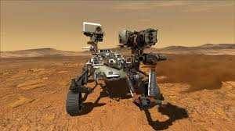
Mars 2020: launched on July 30, 2020, this unmanned NASA rover landed on Mars in February 2021.
Notes:
Mars 2020 is an ongoing mission- launched on July 30, 2020, this NASA rover is landed on Mars on February 18th, 2021. The planned mission is that the rover stay on Mars for 697 days.

Slide 45
Notes:
Now let’s pause for a moment to check your understanding.

Slide 46
What is space exploration?
Notes:
What is space exploration?
[Space exploration is the use of space technology and physical missions to gather information and improve our understanding of earth, solar system, and space.]

Slide 47
________ was the first satellite successfully launched into space and would orbit the earth.
Notes:
_____________ was the first satellite successfully launched into space and would orbit the earth. Sputnik 1 was launched by the soviet union on October 4, 1957.

Slide 48
Sputnik 1 was the first satellite successfully launched into space and would orbit the earth.
Notes:
Sputnik 1 was the first satellite successfully launched into space and would orbit the earth. Sputnik 1 was launched by the soviet union on October 4, 1957.

Slide 49
Who was the first person to successfully enter space?
Notes:
Who was the first person to successfully enter space?
[Yuri Gagarin a soviet cosmonaut, was the first person to enter space. He manned the Vostok 1 spacecraft on April 12, 1961. He spent a total of 108 minutes in space]

Slide 50
What was the Apollo 11 mission?
"...one small step for a man, one giant leap for mankind"
Notes:
What was the Apollo 11 mission?
[Apollo 11 was a U.S mission that resulted in the first lunar landing. The three person crew, Neil Armstrong, Buzz Aldrin, and Michael Collins, safely landed on the moon on July 20, 1969.]

Slide 51
What is the International Space Station?
Notes:
What is the International Space Station?
[The International Space Station an artificial satellite, launched on November 20, 1998, on which astronauts can stay and visit. The ISS is an international effort with 239 astronauts having visited since its launch. It is used for space exploration and research.]

Slide 52
MESSENGER is an an unmanned spacecraft that successfully completed an orbit of _______ in 2011.
Notes:
MESSENGER is an an unmanned spacecraft that successfully completed an orbit of _______ in 2011.

Slide 53
MESSENGER is an an unmanned spacecraft that successfully completed an orbit of Mercury in 2011.
Notes:
MESSENGER is an an unmanned spacecraft that successfully completed an orbit of Mercury in 2011.

Slide 54
What is Mars 2020’s mission?
Notes:
What is Mars 2020’s mission?
[Mars 2020 is an ongoing mission- launched on July 30, 2020, this NASA rover is expected to land on Mars in February 2021. It is planned to land in the Jezero crater on February 18.]

Slide 55
Remember!!!
Notes:
So remember!

Slide 56
Space Exploration: use of space technology and physical missions to gather information and improve our understanding of earth, solar system, and space
Notes:
Space exploration is the use of space technology and physical missions to gather information and improve our understanding of earth, solar system, and space.

Slide 57
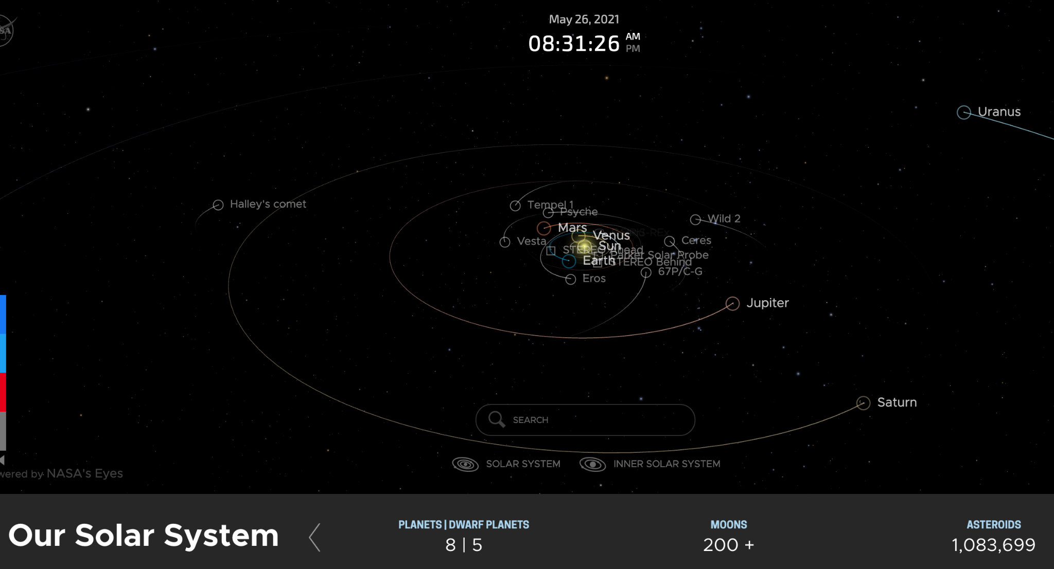
Simulation Activity
Solar System Exploration
Click on the simulation above to explore our Solar System.
Notes:
Feedback: Providing a simulation activity is a great way to make science thinking visible. In this simulation, students have the opportunity to explore the solar system and build their conceptualization of the vastness of the solar system.

Slide 58
Big Question: How to do changes in our technology and exploration of efforts affect our knowledge of the earth and our solar system?
Notes:
Explicit cue to revisit the big question at the end of the lesson: Okay everyone. Now that we’ve learned the term, let’s reflect once more on our big question. Was there anything that we predicted earlier that was correct or incorrect? Do you have any new hypotheses to share?

Slide 59
Notes:
Thanks for watching, and please continue watching CAPs available from this website.

Slide 60
This Video Was Created With Resources From:
Questions or Comments
Michael Kennedy, Ph.D. MKennedy@Virginia.edu
Rachel L Kunemund, Ph.D. rk8vm@virginia.edu

