Slide 1
Intro
“Big Idea” Question
Review Concepts
Check-In Questions
Teacher Engagement
Vocabulary
Student-Friendly Definition
Examples & Non-Examples
Frayer Model
Simulation/Activity
Notes:
OK everyone, get ready for our next lesson. Just as a reminder, these are the different components that our lesson may include, and you’ll see these icons in the top left corner of each slide so that you can follow along more easily!

Slide 2
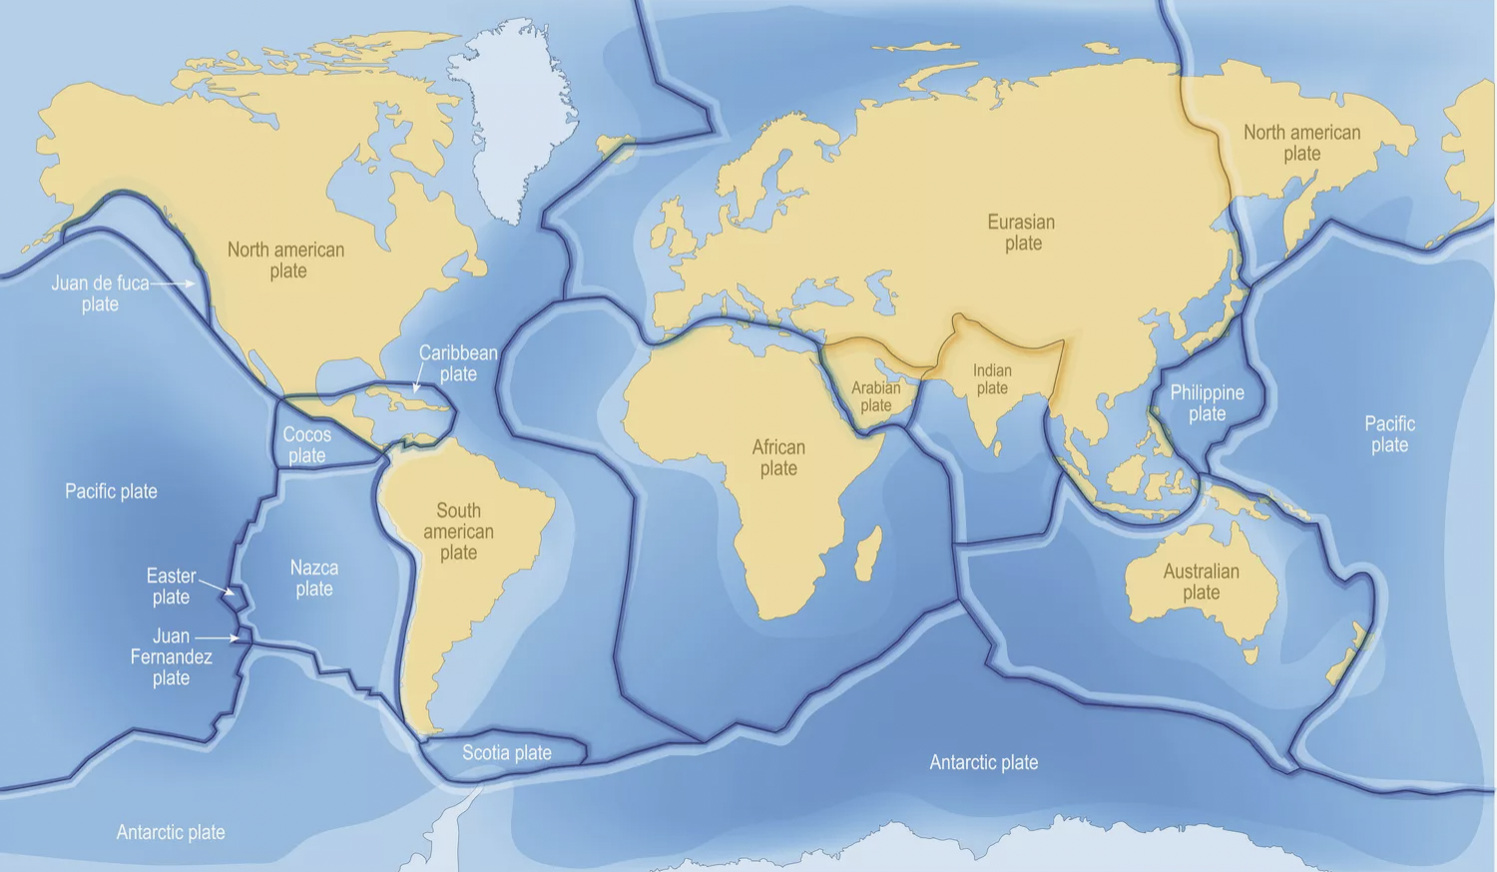
Intro
Tectonic Plates
Notes:
Today, we’ll be learning about the term: Tectonic Plates.

Slide 3
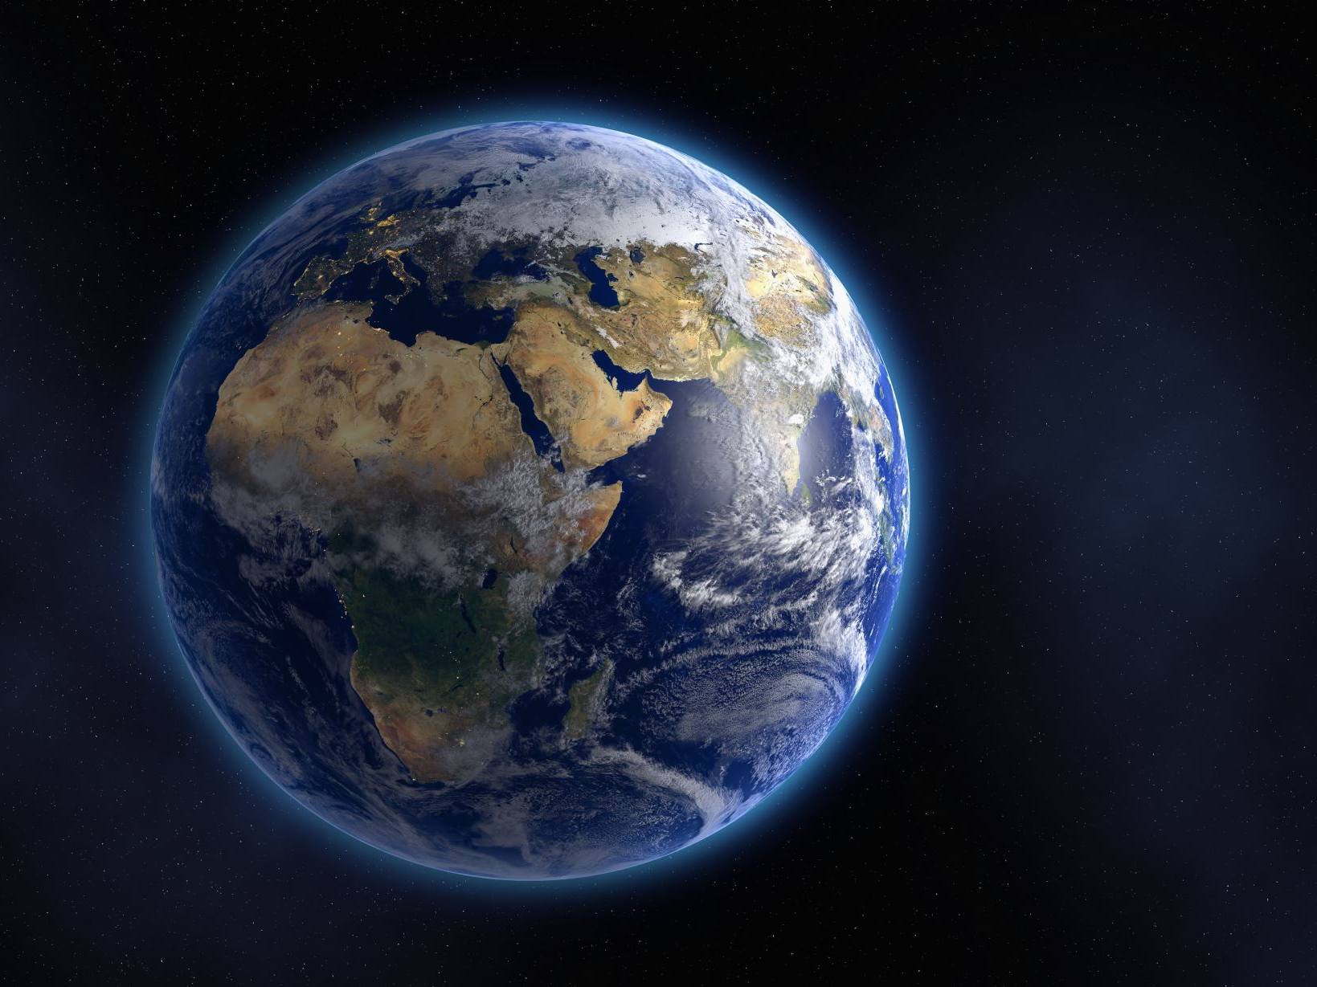
Big Question: How would our world be different if tectonic plates didn't move?
Notes:
Our “big question” is: How would our world be different if tectonic plates didn't move? ?
[Pause and illicit predictions from students.]
I love all these thoughtful scientific hypotheses! Be sure to keep this question and your predictions in mind as we move through these next few lessons, and we’ll continue to revisit it.

Slide 4
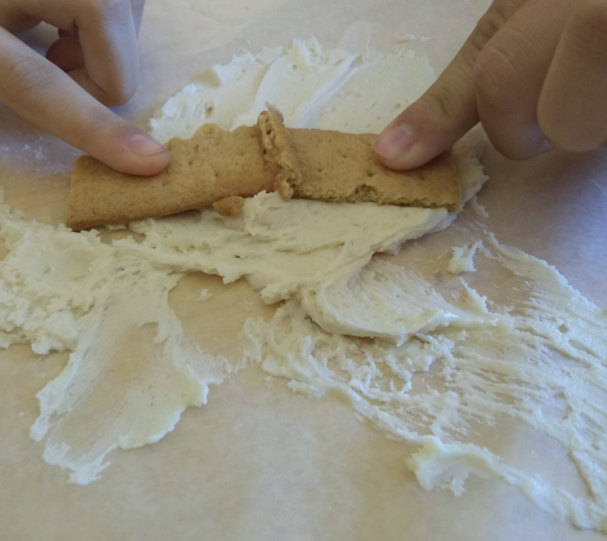
Demonstration
TEACHER DIRECTIONS:
Before viewing: Ask students what they already know about tectonic plates. Tell students today they will be learning about the term tectonic plates.
During: As you move the crackers, the flour underneath may billow up or shift, simulating mantle movement. Encourage students to discuss how these movements relate to earthquakes, volcanic activity, and mountain formation.
After: Tell students that today they will be learning more about the term tectonic plates.
Notes:
An effective and feasible classroom demonstration to teach 5th graders about tectonic plates involves using simple materials to model the movement of these plates. Here's a hands-on activity you can conduct:
Materials Needed:
A large, shallow tray (like a baking tray)
Flour (to represent the Earth's mantle)
Several large crackers or pieces of cardboard (to represent tectonic plates)
Water spray bottle (optional)
Steps:
Fill the Tray: Spread a layer of flour evenly in the tray. This represents the Earth's mantle.
Place the Crackers/Cardboard: Lay the crackers or pieces of cardboard on top of the flour. These represent the tectonic plates. Arrange them so they're touching each other like puzzle pieces.
Demonstrate Plate Movement:
Divergent Boundary: Slowly move two crackers apart from each other to show how new crust is formed, like the mid-Atlantic Ridge.
Convergent Boundary: Push two crackers towards each other until one slides under the other, demonstrating subduction zones and mountain building.
Transform Boundary: Slide two crackers past each other to simulate a transform boundary like the San Andreas Fault.
Observe and Discuss: As you move the crackers, the flour underneath may billow up or shift, simulating mantle movement. Discuss how these movements relate to earthquakes, volcanic activity, and mountain formation.
Optional Water Spray: Lightly spray some areas with water to demonstrate how the addition of water (simulating the ocean) can affect the movement and interaction of plates.
This hands-on demonstration allows students to visually and physically grasp the concept of tectonic plate movement and its consequences, making the learning experience more engaging and memorable.
Based on a quick search, here's what I discovered.

Slide 5
Notes:
Before we move on to our new topic, let’s review some other words & concepts that you already learned and make sure you are firm in your understanding.

Slide 6
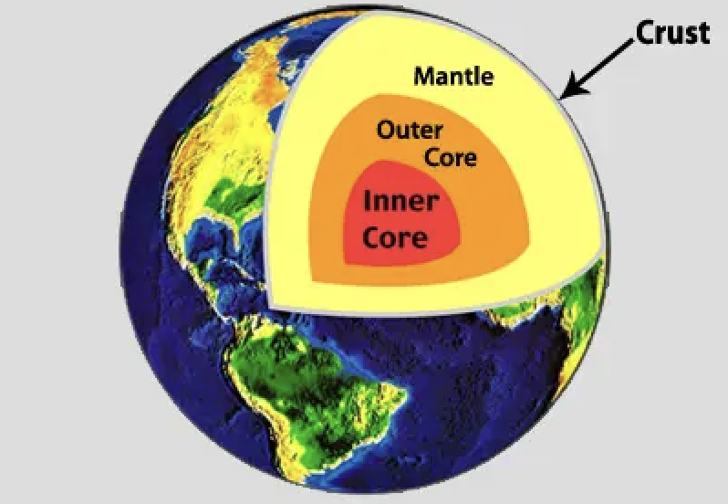
Crust: The outermost shell of the Earth
Notes:
Crust is the outermost shell of the Earth

Slide 7
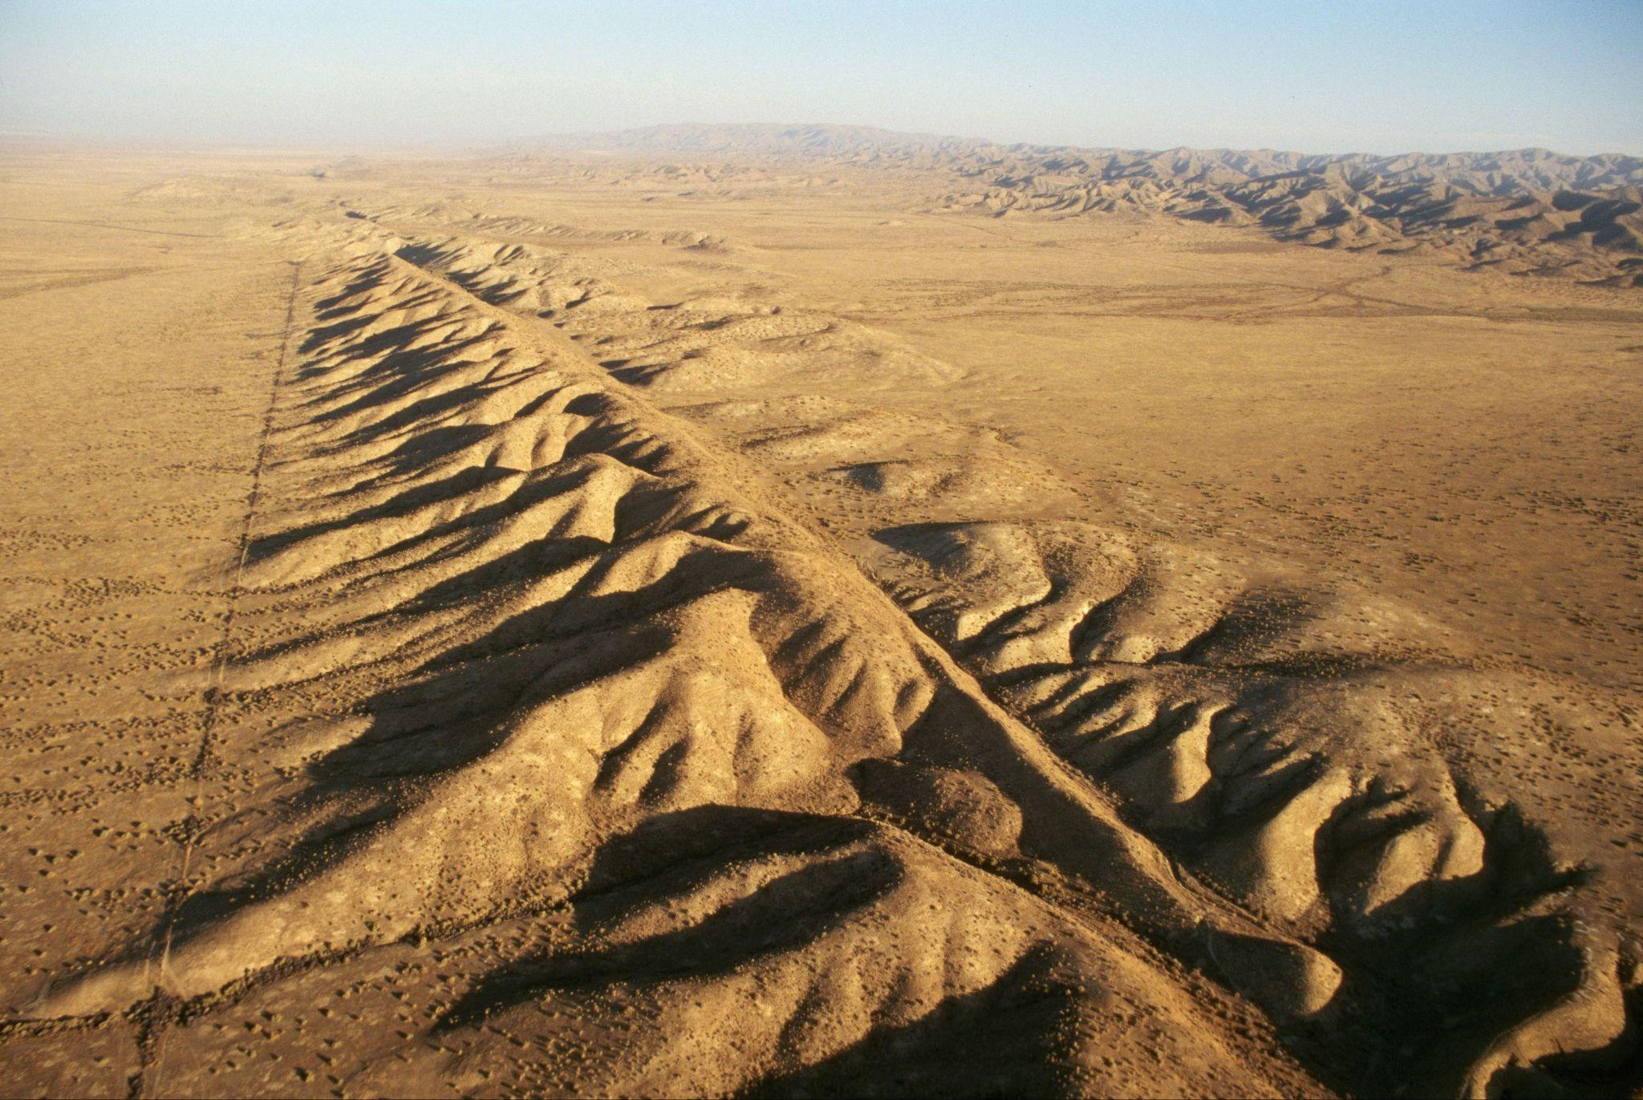
Fault: Long crack in the surface of the Earth
Notes:
A fault is a long crack in the surface of the Earth.

Slide 8
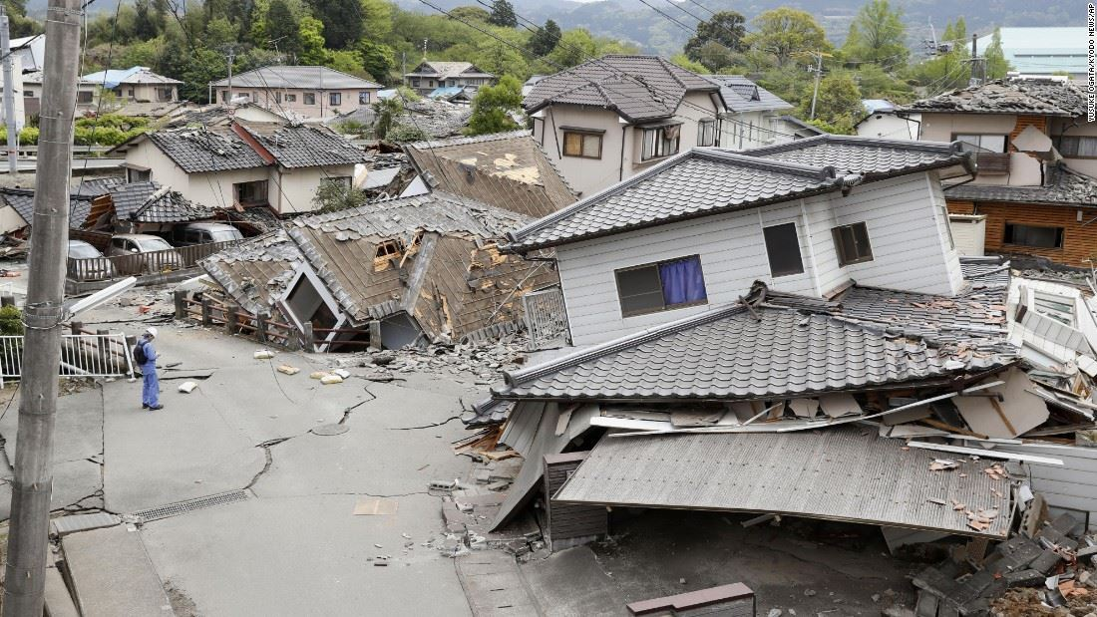
Earthquake: Sudden shaking of the ground caused by the movement of Earth's tectonic plates
Notes:
An earthquake is the sudden shaking of the ground cause by the movement of Earth’s tectonic plates.

Slide 9
Notes:
Now let’s pause for a moment to review the information we have covered already.

Slide 10
The outermost shell of the Earth is called the…
Crust
Core
Notes:
The outermost shell of the Earth is called the…
[Crust]

Slide 11
The outermost shell of the Earth is called the…
Crust
Core
Notes:
The outermost shell of the Earth is called the…
[Crust]

Slide 12
A _____ is a long _____ in the surface of the Earth.
fault, crack
crack, fault
Notes:
A _____ is a long _____ in the surface of the Earth.
[fault, crack]

Slide 13
A _____ is a long _____ in the surface of the Earth.
fault, crack
crack, fault
Notes:
A _____ is a long _____ in the surface of the Earth.
[fault, crack]

Slide 14
True or False: An earthquakes is the sudden shaking of the ground caused by the movement of Earth's tectonic plates
Notes:
True or False: An earthquake is sudden shaking of the ground caused by the movement of Earth’s tectonic plates.
[True}

Slide 15
True or False: Earthquakes are the sudden shaking of the ground caused by the movement of Earth's tectonic plates
Notes:
An earthquake is sudden shaking of the ground caused by the movement of Earth’s tectonic plates.]

Slide 16
Tectonic Plates
Notes:
Now that we’ve reviewed, let’s define the phrase earthquake.

Slide 17
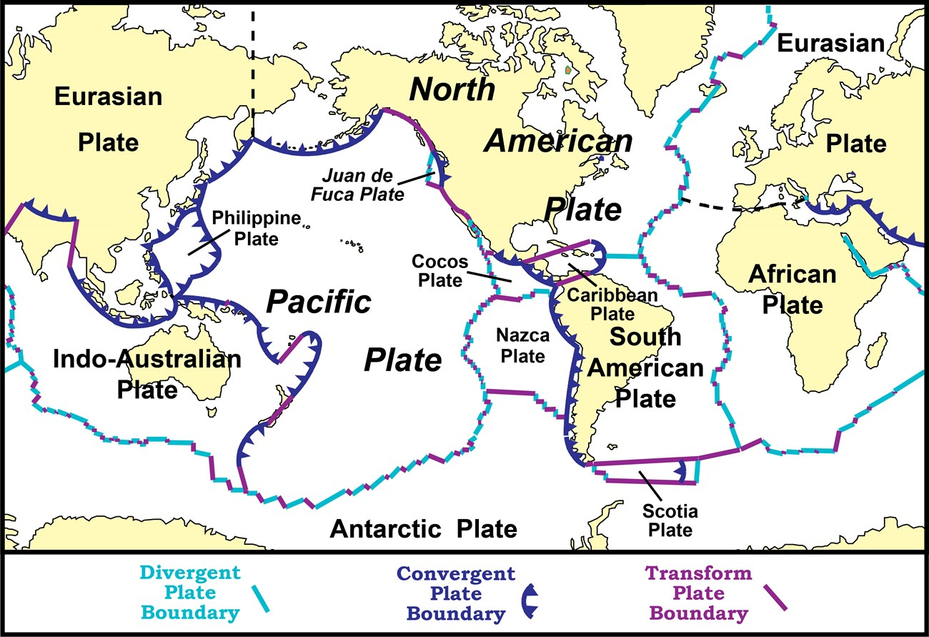
Tectonic Plates: Huge pieces of the Earth's surface that fit together like a puzzle and move very slowly over time
Notes:
Tectonic plates are huge pieces of the Earth’s surface that fit together like a puzzle an d move very slowly over time.

Slide 18
Notes:
Let’s check-in for understanding.

Slide 19
What are tectonic plates?
Notes:
Tectonic plates are huge pieces of the Earth's surface that fit together like a puzzle and move very slowly over time.

Slide 20
Notes:
That is the basic definition, but there is a bit more you need to know.

Slide 21
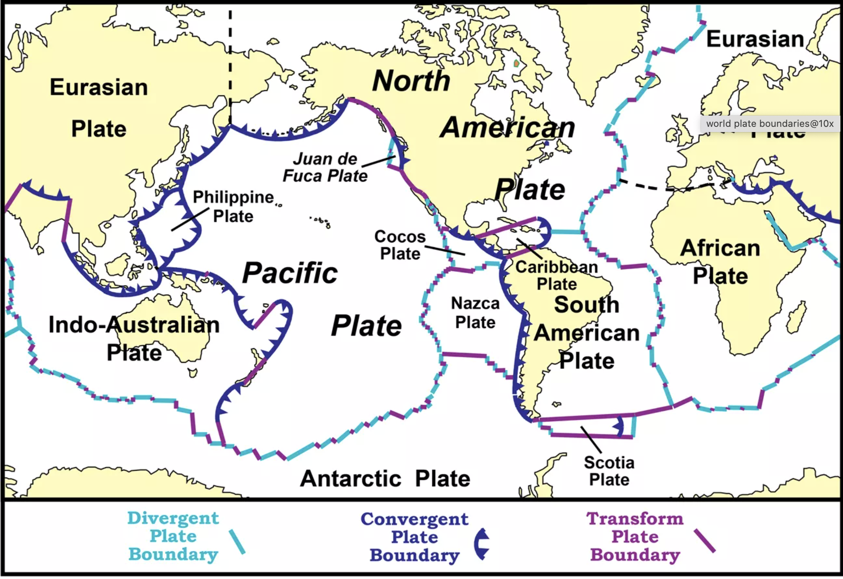
Tectonic plates are like giant, floating puzzle pieces on the Earth's surface. Think of the Earth like a cracked eggshell, with each crack representing a plate boundary.
Notes:
Tectonic plates are like giant, floating puzzle pieces on the Earth's surface. You can compare the Earth to a cracked eggshell, with each crack
representing a plate boundary.

Slide 22
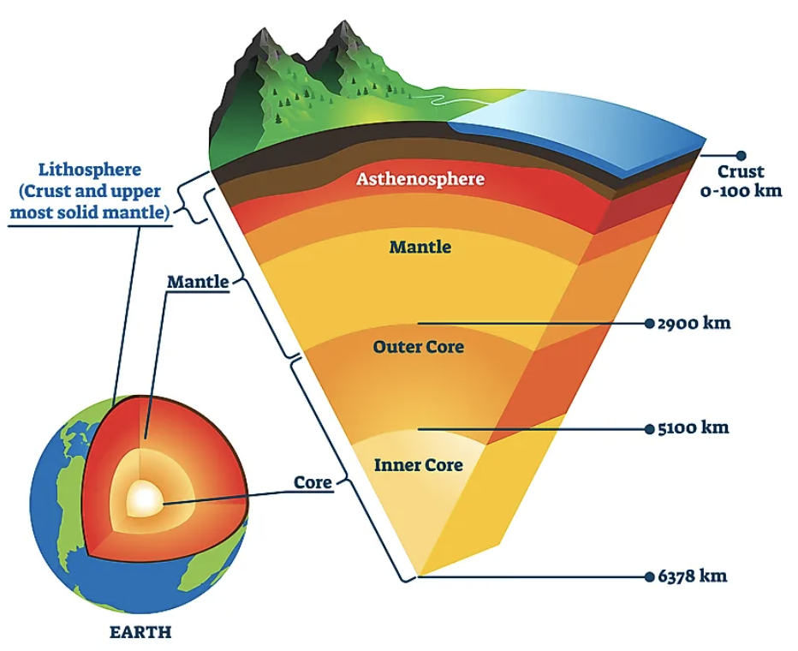
Tectonic plates are part of the Earth's crust and the upper part of the mantle, a layer called the lithosphere.
These plates are made of rocks and can include both land and ocean floor.
Notes:
Tectonic plates are part of the Earth's crust and the upper part of the mantle, a layer called the lithosphere. These plates are made of rocks and can
include both land and ocean floor.

Slide 23
Tectonic plates move very slowly, only a few centimeters each year, which is about as fast as our fingernails grow.
This movement is caused by the heat from the Earth's core, which creates currents in the mantle that move the plates.
Notes:
Tectonic plates move very slowly, only a few centimeters each year, which is about as fast as our fingernails grow. This movement is caused by the
heat from the Earth's core, which creates currents in the mantle that move the plates.

Slide 24
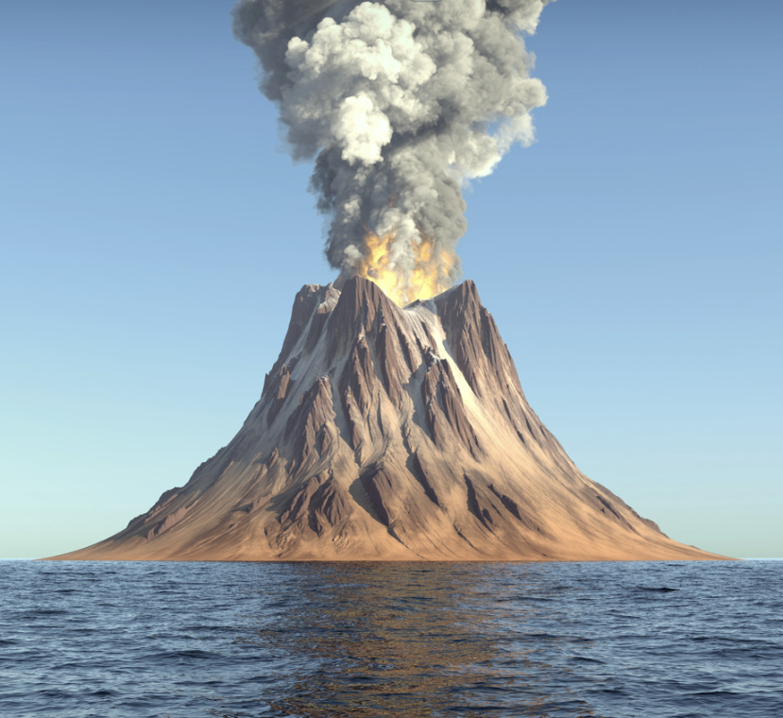
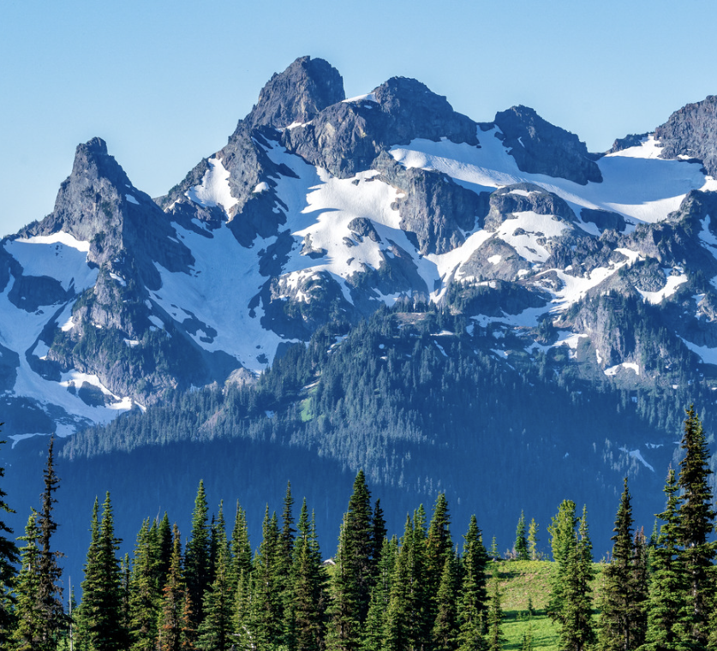
The movement of tectonic plates has shaped the Earth's surface over millions of years, leading to the formation of mountains, volcanoes, and causing earthquakes.
Notes:
The movement of tectonic plates has shaped the Earth's surface over millions of years, leading to the formation of mountains, volcanoes, and causing
earthquakes.

Slide 25
There are three main types of plate boundaries: convergent (where two plates collide), divergent (where two plates move apart), and transform (where two plates slide past each other).
Notes:
There are three main types of plate boundaries: convergent (where two plates collide), divergent (where two plates move apart), and transform (where
two plates slide past each other).

Slide 26
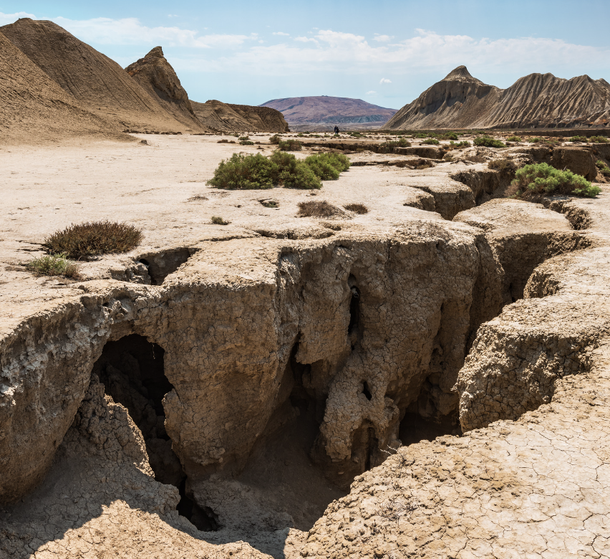
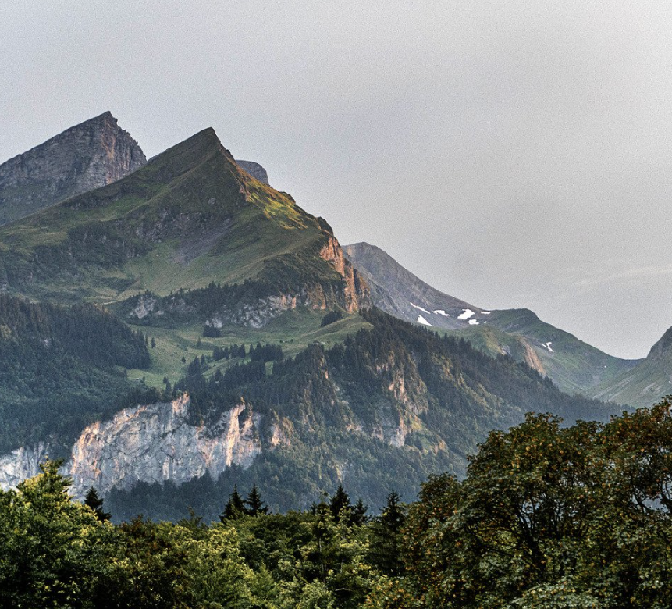
Each type of boundary can create different features or events. For example, mountains can form at convergent boundaries, and earthquakes can occur at transform boundaries.
Notes:
Each type of boundary can create different features or events. For example, mountains can form at convergent boundaries, and earthquakes can occur
at transform boundaries.

Slide 27
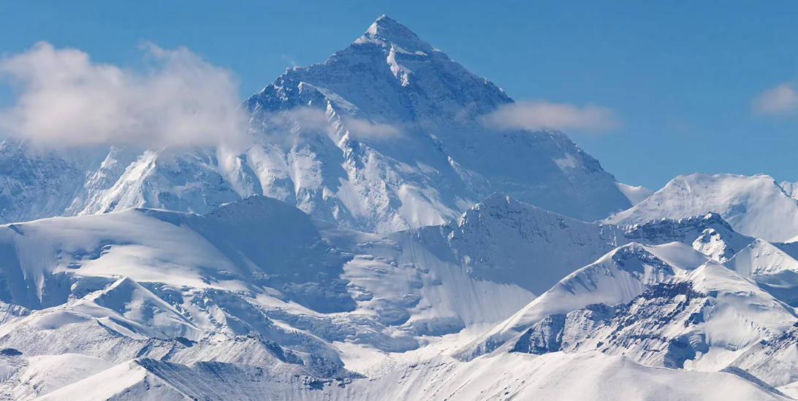
For example, the Himalayas were formed by the Indian Plate colliding with the Eurasian Plate.
Notes:
For example, the Himalayas were formed by the Indian Plate colliding with the Eurasian Plate.

Slide 28
Notes:
Let’s check-in for understanding.

Slide 29
True or False: Tectonic plates are part of the Earth's crust and the upper part of the Outer Core.
Notes:
True or False: Tectonic plates are part of the Earth's crust and the upper part of the Outer Core.
[False, they are part of the lithosphere–part of the Earth’s crust and upper mantle]

Slide 30
True or False: Tectonic plates are part of the Earth's crust and the upper part of the Outer Core.
Notes:
False: Tectonic plates are part of the lithosphere–part of the Earth’s crust and upper mantle

Slide 31
Tectonic plates move very , only a few centimeters each year, which is about as fast as our fingernails grow.
This movement is caused by the from the Earth's core, which creates currents in the mantle that move the plates.
slowly, heat
quickly, cold
Notes:
Tectonic plates move very , only a few centimeters each year, which is about as fast as our fingernails grow. This movement is caused by the
from the Earth's core, which creates currents in the mantle that move the plates.
[A. slowly, heat]

Slide 32
Tectonic plates move very , only a few centimeters each year, which is about as fast as our fingernails grow.
This movement is caused by the from the Earth's core, which creates currents in the mantle that move the plates.
slowly, heat
quickly, cold
Notes:
Tectonic plates move very slowly, only a few centimeters each year, which is about as fast as our fingernails grow. This movement is caused by the
heat from the Earth's core, which creates currents in the mantle that move the plates.

Slide 33
For example, the Himalayas were by the Indian Plate with the Eurasian Plate.
Notes:
For example, the Himalayas were by the Indian Plate with the Eurasian Plate.
[formed, colliding]

Slide 34
For example, the Himalayas were formed by the Indian Plate colliding with the Eurasian Plate.
Notes:
For example, the Himalayas were formed by the Indian Plate colliding with the Eurasian Plate.

Slide 35
Notes:
Now, let’s talk about some examples of earthquakes.

Slide 36
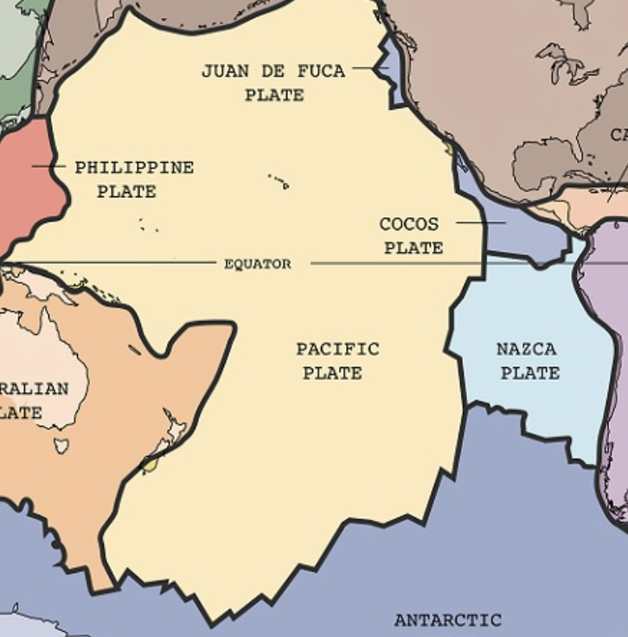
The Pacific Plate is an example of a tectonic plate. It is the largest plate, and it is located under the Pacific Ocean.
Notes:
The Pacific Plate is an example of a tectonic plate. It is the largest plate, and it is located under the Pacific Ocean.

Slide 37
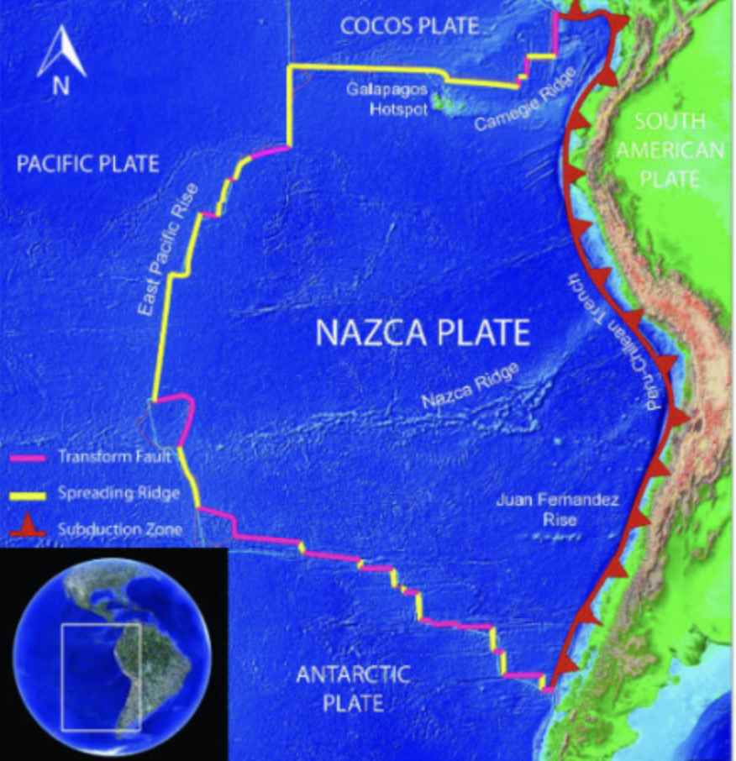
The Nazca Plate is another example of a tectonic plate. It is a minor plate, meaning it is smaller than the major tectonic plates. It is located just west of South America.
Notes:
The Nazca Plate is another example of a tectonic plate. It is a minor plate, meaning it is smaller than the major tectonic plates. It is located just west of South America.

Slide 38
Notes:
Now, let’s talk about some non-examples of earthquakes.

Slide 39
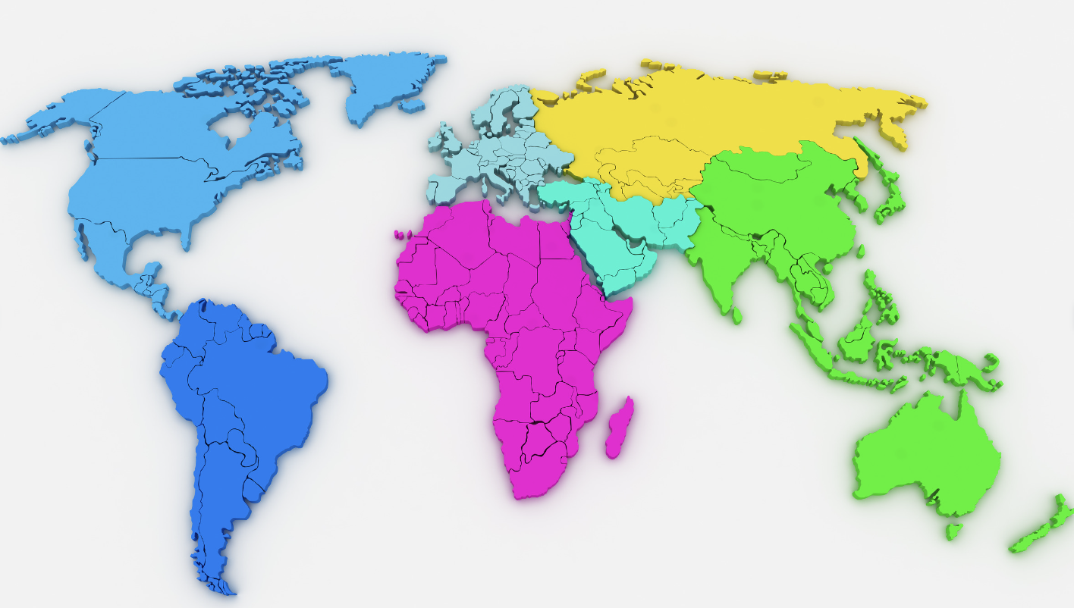
Continents are NOT an example of tectonic plates. Continents are large landmasses, while tectonic plates can consist of both oceanic and continental crust.
Notes:
Some people might confuse continents with tectonic plates, but they are not the same. Continents are large landmasses, while tectonic plates can consist of both oceanic and continental crust. For example, the North American Plate includes not just the continent of North America, but also part of the Atlantic Ocean floor.

Slide 40
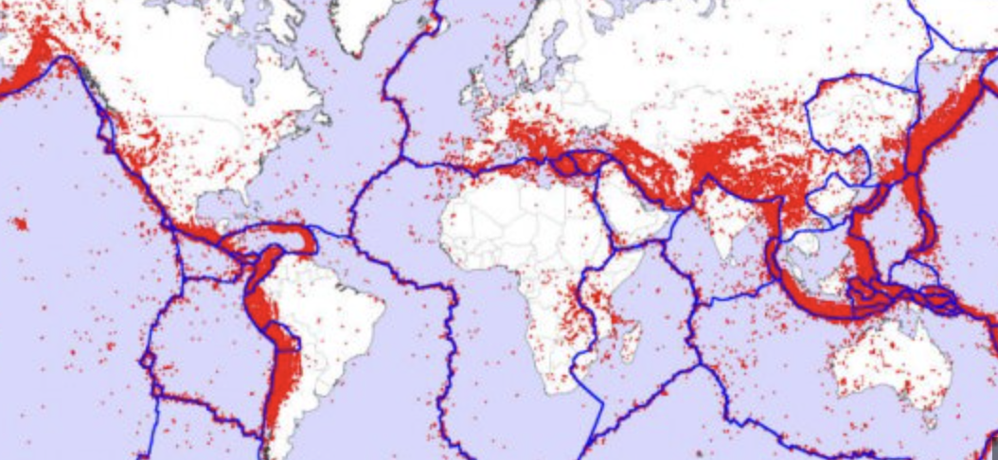
Fault lines are NOT an example of tectonic plates. While they are related (fault lines often occur at plate boundaries), they are NOT plates themselves but fractures in the Earth's crust where plates have slipped past each other.
Notes:
Fault lines, such as the San Andreas Fault in California, are often confused with tectonic plate boundaries. While they are related (fault lines often occur at plate boundaries), they are not plates themselves but fractures in the Earth's crust where plates have slipped past each other.

Slide 41
Notes:
Now let’s pause for a moment to check your understanding.

Slide 42
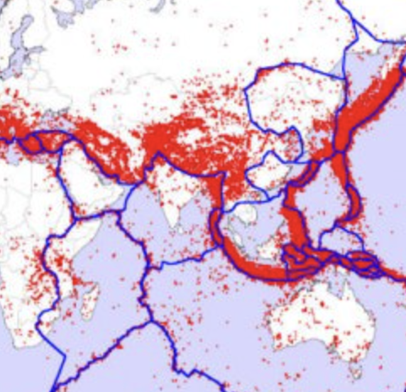
Why are continents and fault lines not examples of tectonic plates?
Notes:
Why are continents and landslides not examples of tectonic plates?
[Continents are not examples of tectonic plates. Continents are large landmasses, while tectonic plates can consist of both oceanic and continental crust. Fault lines are not examples of tectonic plates. Fault lines are fractures in the Earth's crust where plates have slipped past each other]

Slide 43
Remember!!!
Notes:
So remember!

Slide 44
Tectonic Plates: Huge pieces of the Earth's surface that fit together like a puzzle and move very slowly over time
Notes:
Tectonic plates are huge pieces of the Earth’s surface that fit together like a puzzle an d move very slowly over time.

Slide 45
Notes:
We will now complete this concept map, called a Frayer model, to summarize and further clarify what you have learned about the term earthquake.

Slide 46
Definition
Picture
Tectonic Plates
Example
How do tectonic plates impact my life?
Notes:
To complete the Frayer model, we will choose from four choices the correct picture, definition, example, and response to the question, “How do tectonic plates impact my life?” Select the best response for each question using the information you just learned. As we select responses, we will see how this model looks filled in for the term tectonic plates.

Slide 47
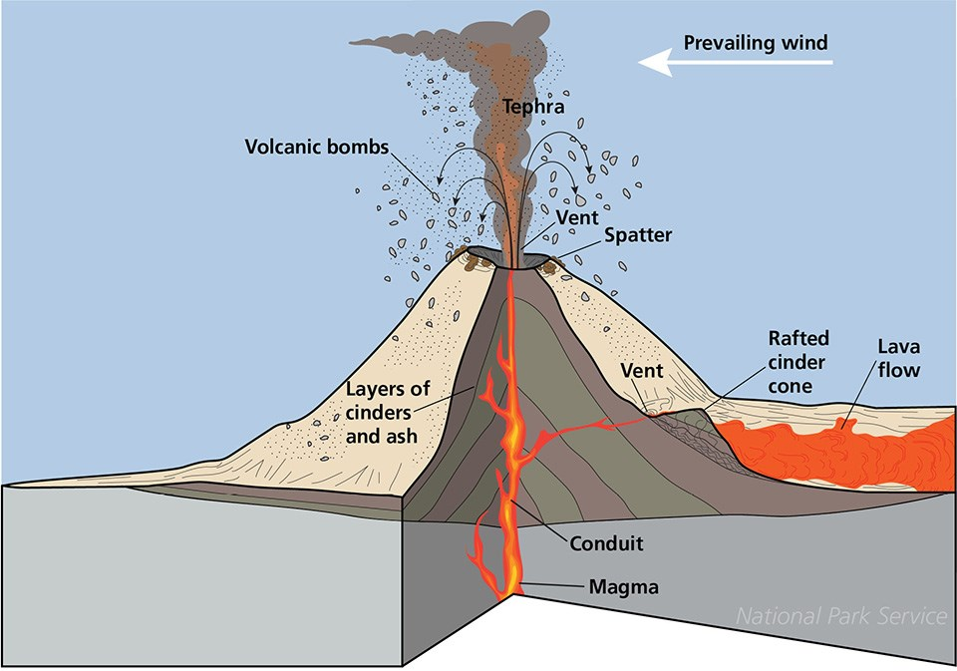
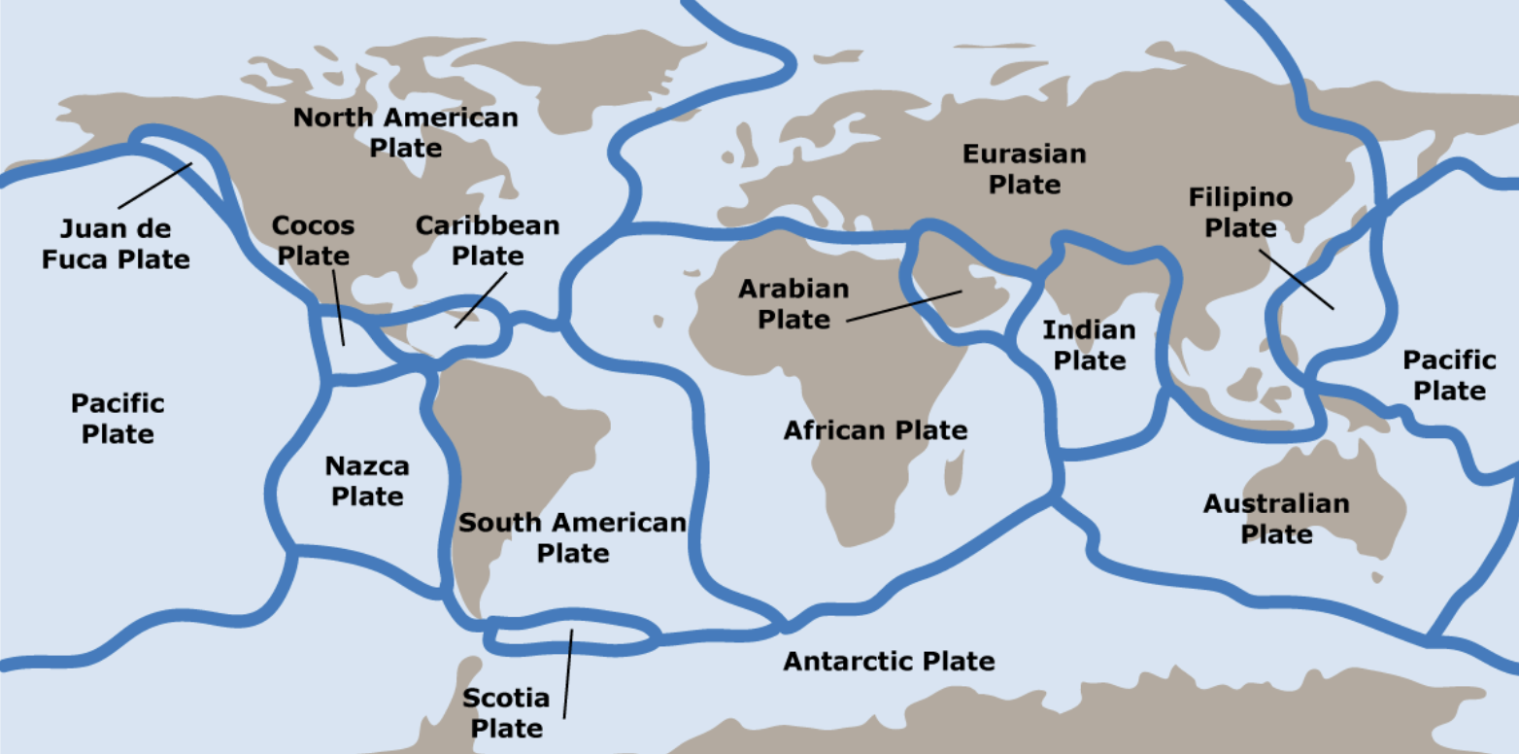
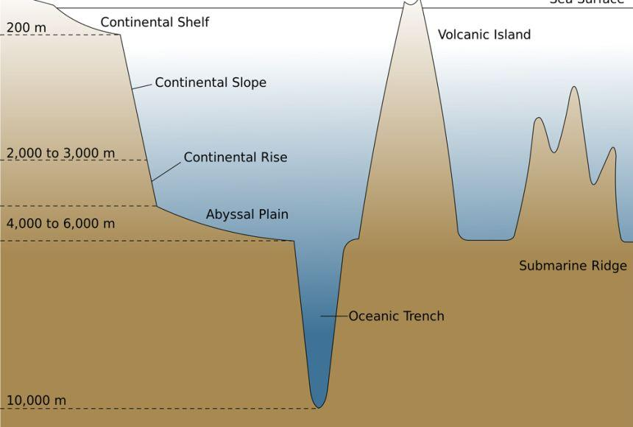
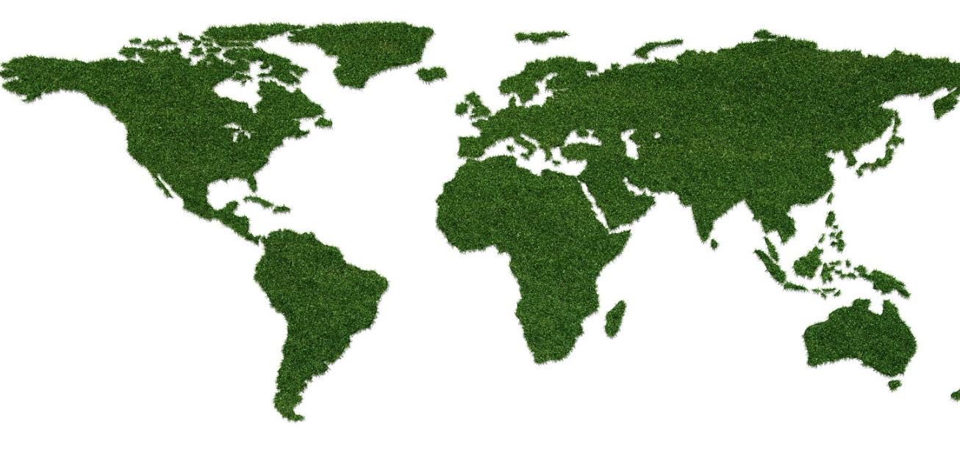
Directions: Choose the correct picture of tectonic plates from the choices below.
A
B
C
D
Notes:
Choose the one correct picture of tectonic plates from these four choices.

Slide 48
Directions: Choose the correct picture of tectonic plates from the choices below.
A
B
C
D
Notes:
This is the picture that shows the tectonic plates.

Slide 49
Definition
Picture
Tectonic Plates
Example
How do tectonic plates impact my life?
Notes:
Here is the Frayer model filled in with a picture of tectonic plates.

Slide 50
Directions: Choose the correct definition of tectonic plates from the choices below.
A
Huge pieces of the Earth's surface that fit together like a puzzle and move very slowly over time
B
The outermost shell of Earth
C
The process of breaking down a rock over a long period of time
D
Sudden shaking of the ground caused by the movement of the Earth’s tectonic plates
Notes:
Choose the one correct definition of tectonic plates from these four choices.

Slide 51
Directions: Choose the correct definition of tectonic plates from the choices below.
A
Huge pieces of the Earth's surface that fit together like a puzzle and move very slowly over time
B
The outermost shell of Earth
C
The process of breaking down a rock over a long period of time
D
Sudden shaking of the ground caused by the movement of the Earth’s tectonic plates
Notes:
“Huge pieces of the Earth's surface that fit together like a puzzle and move very slowly over time” is correct! This is the definition of tectonic plates.

Slide 52
Definition
Picture
Huge pieces of the Earth's surface that fit together like a puzzle and move very slowly over time
Tectonic Plates
Example
How do tectonic plates impact my life?
Notes:
Here is the Frayer Model with a picture and the definition filled in for tectonic plates: Huge pieces of the Earth's surface that fit together like a puzzle and move very slowly over time

Slide 53
Directions: Choose the correct example of tectonic plates from the choices below.
A
Snow sliding down a plane
B
Shaking of the ground that tumbles buildings
C
North American Plate
D
Dirt and other land mass falling into the ocean off a cliff
Notes:
Choose the one correct example of tectonic plates from these four choices.

Slide 54
Directions: Choose the correct example of a tectonic plate from the choices below.
A
Snow sliding down a plane
B
Shaking of the ground that tumbles buildings
C
North American Plate
D
Dirt and other land mass falling into the ocean off a cliff
Notes:
“North American Plate” is correct! This plate covers North America and parts of the Atlantic Ocean. It includes the eastern part of the United States and extends to parts of Siberia in Russia and is an example of a tectonic plate.

Slide 55
Definition
Picture
Huge pieces of the Earth's surface that fit together like a puzzle and move very slowly over time
Tectonic Plates
North American Plate
Example
How do tectonic plates impact my life?
Notes:
Here is the Frayer Model with a picture, definition, and an example of a tectonic plate: North American Plate

Slide 56
Directions: Choose the correct response for “how do tectonic plates impact my life?” from the choices below.
A
Tectonic Plates explain how movement of animals on our planet impacts food and crops we have available to us.
Tectonic Plates can shake buildings, break roads, and sometimes cause power outages, making it important for us to be prepared and know how to stay safe during these shakes.
B
C
Tectonic Plates account for the amount of land we have on our planet versus ocean and tells us where to build habitats.
Tectonic plates moving form mountains and cause earthquakes, which can affect where and how we live. Their movements also create natural wonders like volcanoes and ocean trenches that we can explore and learn about.
D
Notes:
Choose the one correct response for “how do earthquakes impact my life?” from these four choices.

Slide 57
Directions: Choose the correct response for “how do tectonic plates impact my life?” from the choices below.
A
Tectonic Plates explain how movement of animals on our planet impacts food and crops we have available to us.
Tectonic Plates can shake buildings, break roads, and sometimes cause power outages, making it important for us to be prepared and know how to stay safe during these shakes.
B
C
Tectonic Plates account for the amount of land we have on our planet versus ocean, and tells us where to build habitats.
Tectonic plates moving form mountains and cause earthquakes, which can affect where and how we live. Their movements also create natural wonders like volcanoes and ocean trenches that we can explore and learn about.
D
Notes:
“Tectonic plates moving form mountains and cause earthquakes, which can affect where and how we live. Their movements also create natural wonders like volcanoes and ocean trenches that we can explore and learn about.” That is correct! This is an example of how tectonic plates impact your life.

Slide 58
Definition
Picture
Huge pieces of the Earth's surface that fit together like a puzzle and move very slowly over time
Tectonic Plates
Tectonic plates moving form mountains and cause earthquakes, which can affect where and how we live. Their movements also create natural wonders like volcanoes and ocean trenches that we can explore and learn about.
North American Plate
Example
How do tectonic plates impact my life?
Notes:
Here is the Frayer Model with a picture, definition, example, and a correct response to “how do tectonic plates impact my life?”: Tectonic plates moving form mountains and cause earthquakes, which can affect where and how we live. Their movements also create natural wonders like volcanoes and ocean trenches that we can explore and learn about.

Slide 59
Remember!!!
Notes:
So remember!

Slide 60
Tectonic Plates: Huge pieces of the Earth's surface that fit together like a puzzle and move very slowly over time
Notes:
Tectonic plates are huge pieces of the Earth’s surface that fit together like a puzzle an d move very slowly over time.

Slide 61
Big Question: How would our world be different if tectonic plates didn't move?
Notes:
Let’s reflect once more on our big question. Our “big question” is: How would our world be different if tectonic plates didn't move?
Think about the landscapes, natural disasters, and even the climate
Does anyone have any additional examples to share that haven’t been discussed yet?

Slide 62
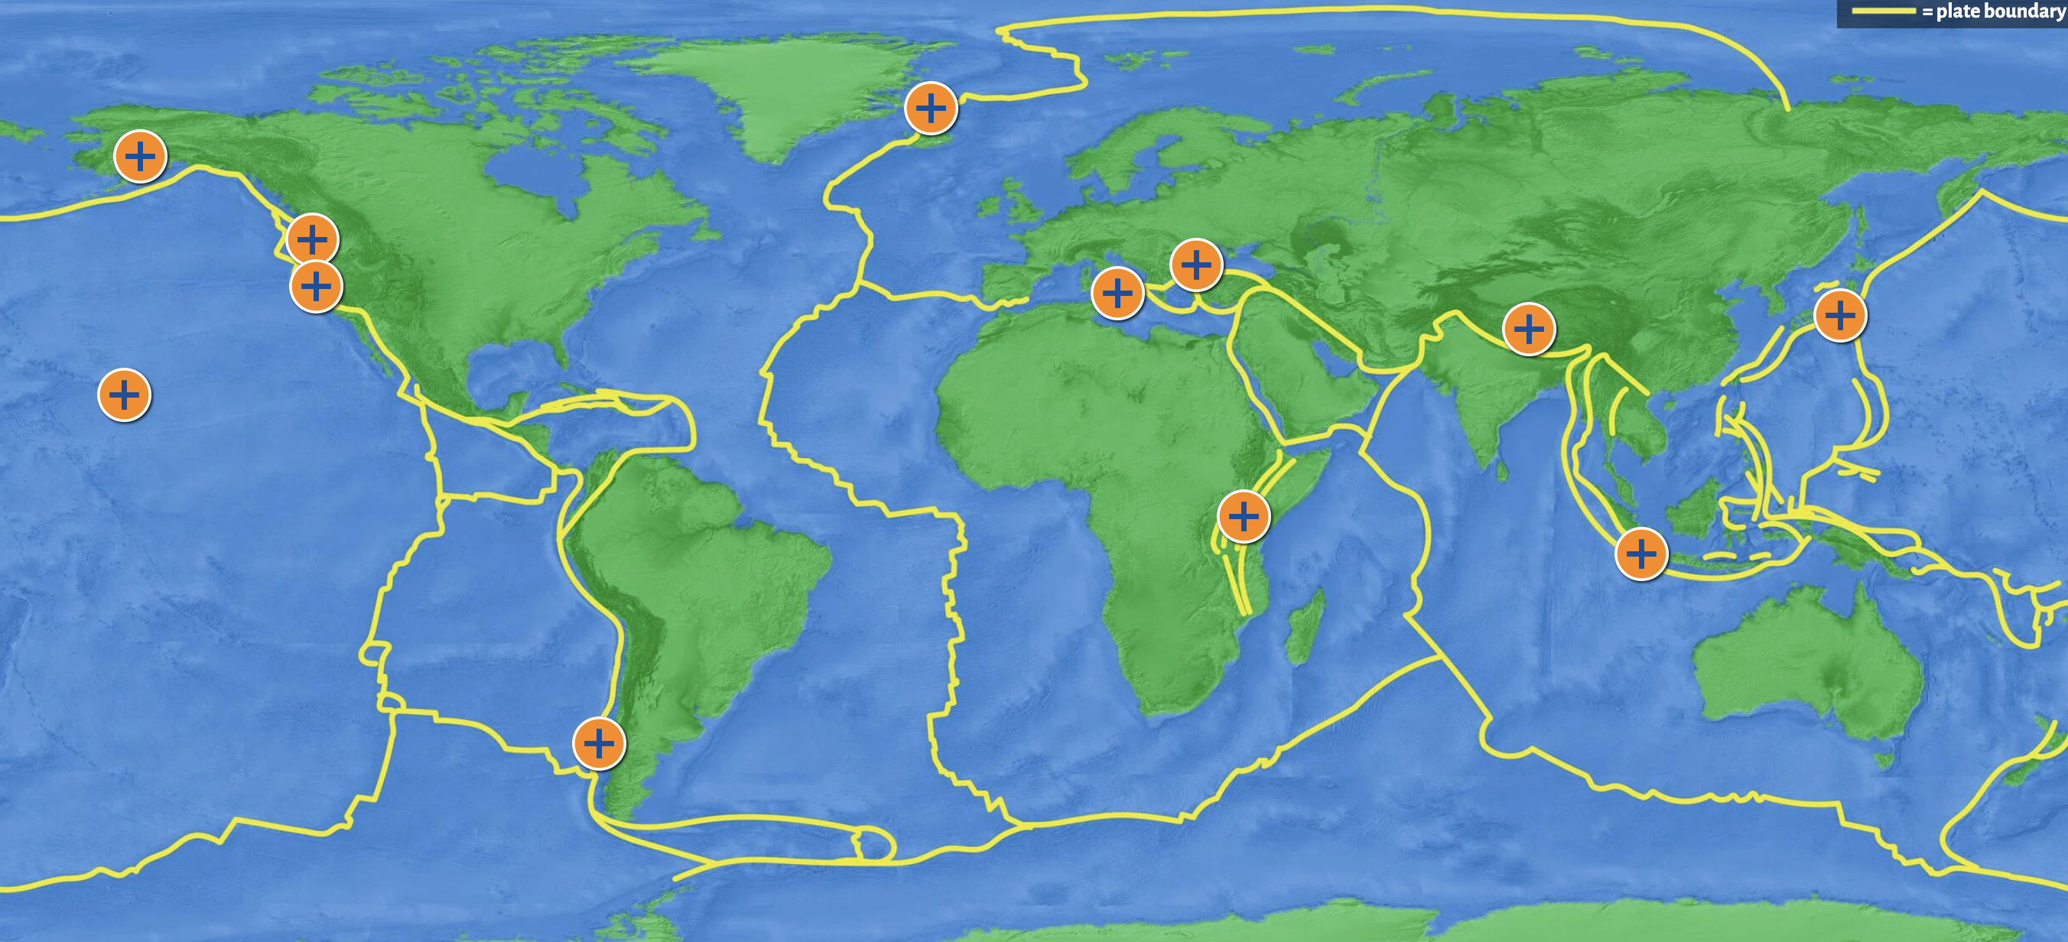
Simulation Activity
Tectonic Plates Simulator
Click the link above for a simulation to deepen your knowledge of tectonic plates.
Notes:
Click the link above for a simulation to deepen your understanding of tectonic plates. In this simulation, you will Click on an orange marker to explore a place on the map. Examine how tectonic plates are moving there. Answer the question and read more about it

Slide 63
Notes:
Thanks for watching, and please continue watching CAPs available from this website.

Slide 64
This Was Created With Resources From:
Questions or Comments
Michael Kennedy, Ph.D. MKennedy@Virginia.edu
Rachel L Kunemund, Ph.D. rk8vm@virginia.edu

