Slide 1
Intro
“Big Idea” Question
Review Concepts
Check-In Questions
Teacher Engagement
Vocabulary
Student-Friendly Definition
Examples & Non-Examples
Morphological Word Parts
Frayer Model
Simulation/Activity
Notes:
OK everyone, get ready for our next lesson. Just as a reminder, these are the different components that our lesson may include, and you’ll see these icons in the top left corner of each slide so that you can follow along more easily!

Slide 2
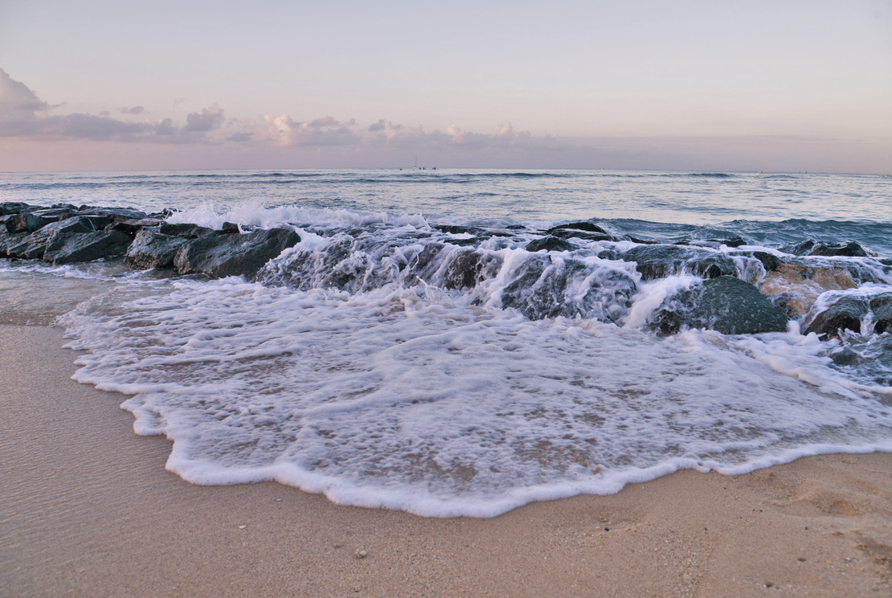
Intro
Tide
Notes:
Today, we’ll be learning about the word: Tide.

Slide 3
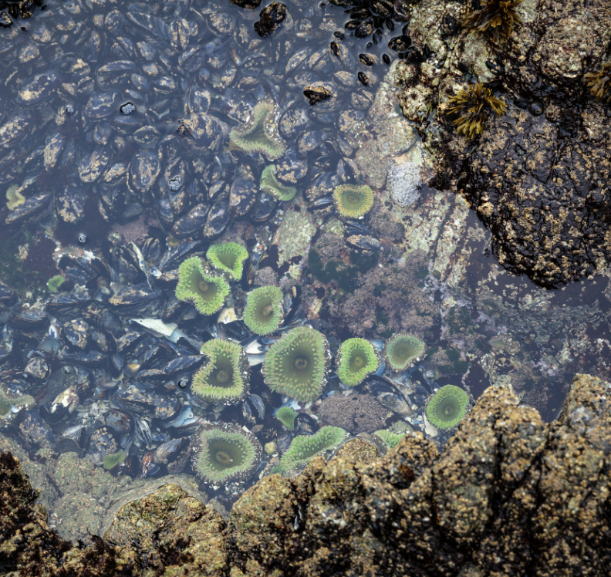
Big Question: How do the daily changes in ocean tides not only shape the coastal environment but also affect the activities of marine life and impact our daily lives on land?
Notes:
Our “big question” is: How do the daily changes in ocean tides not only shape the coastal environment but also affect the activities of marine life and impact our daily lives on land?
[Pause and illicit predictions from students.]
I love all these thoughtful scientific hypotheses! Be sure to keep this question and your predictions in mind as we move through these next few lessons, and we’ll continue to revisit it.

Slide 4
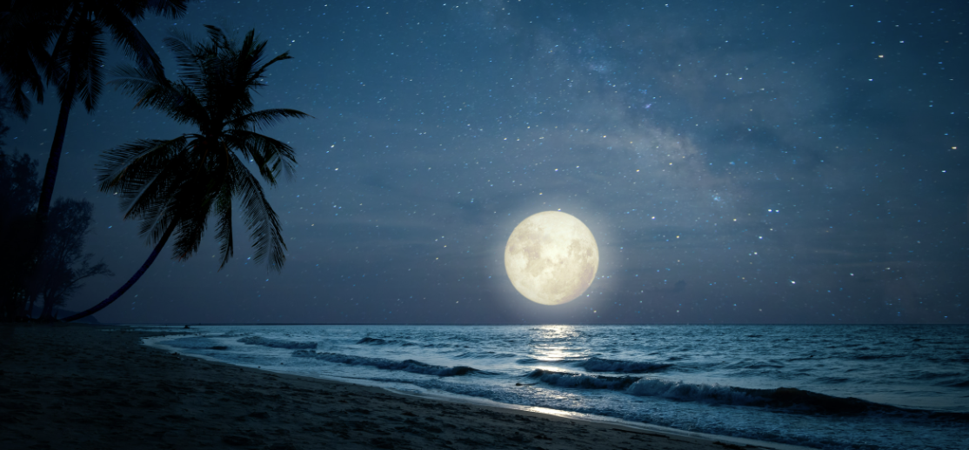
Demonstration
TEACHER DIRECTIONS:
Before viewing: Ask students what they already know about tides. Tell students today they will be learning about tides.
During: Discuss with students how the gravitational pull of the Moon and the Sun influences the water in the ocean, creating tides.
After: Tell students that today they will be learning more about the term tide.
Notes:
A feasible and effective classroom demonstration to teach about tides involves the use of simple materials to illustrate the concept. Here's a demonstration idea:
Materials needed:
A large shallow container (representing a section of the ocean)
Water
A lamp or flashlight (representing the Sun)
A smaller ball or model of the Moon
Optional: Small boats or objects to represent coastal features
Procedure:
Fill the large container with water to create a mini-ocean.
Place the lamp or flashlight at one end to represent the Sun and the smaller ball or model of the Moon on the opposite side.
Discuss with students how the gravitational pull of the Moon and the Sun influences the water in the ocean, creating tides.
Move the Moon model closer to the water to simulate the gravitational pull during a "high tide" and then move it away to simulate a "low tide."
Explore how the position of the Sun and the Moon relative to Earth affects the timing and height of tides.
Discuss how tides impact coastal areas and marine life.
This hands-on demonstration allows students to visualize the gravitational forces at play in generating tides and understand how the positions of the Moon and the Sun influence the ocean's behavior. It also provides an opportunity for interactive discussions and questions.

Slide 5
Notes:
Before we move on to our new topic, let’s review some other words & concepts that you already learned and make sure you are firm in your understanding.

Slide 6
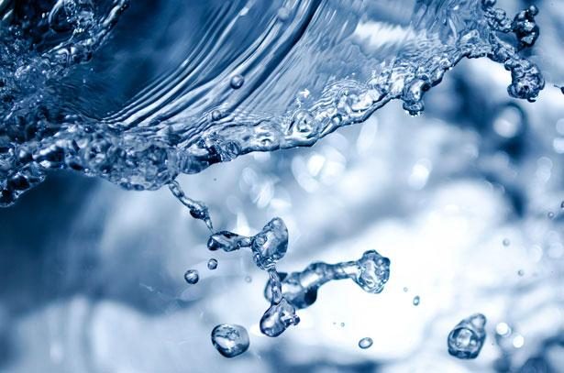
Water: The substance that covers most of the Earth's surface, found in oceans, rivers, lakes, and streams
Notes:
Water: The substance that covers most of the Earth's surface, found in oceans, rivers, lakes, and streams.

Slide 7
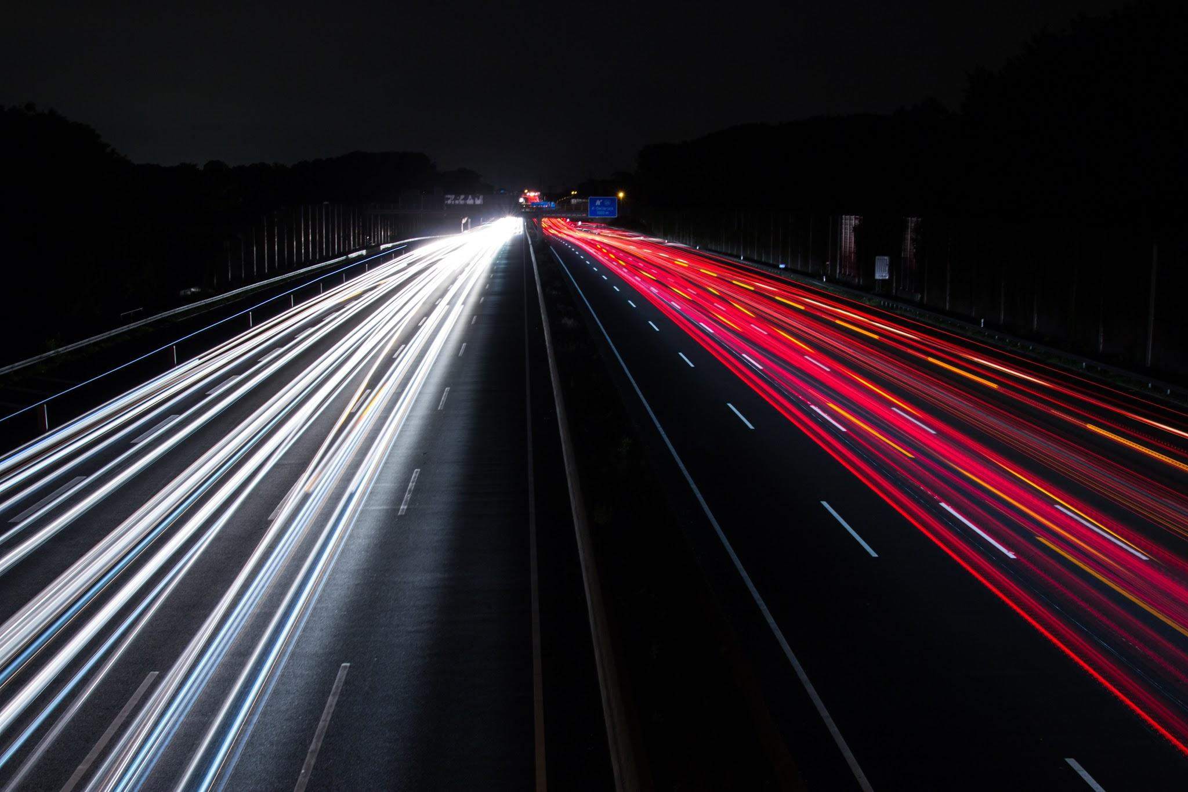
Motion: The act or process of moving or being moved
Notes:
Motion: The act or process of moving or being moved

Slide 8
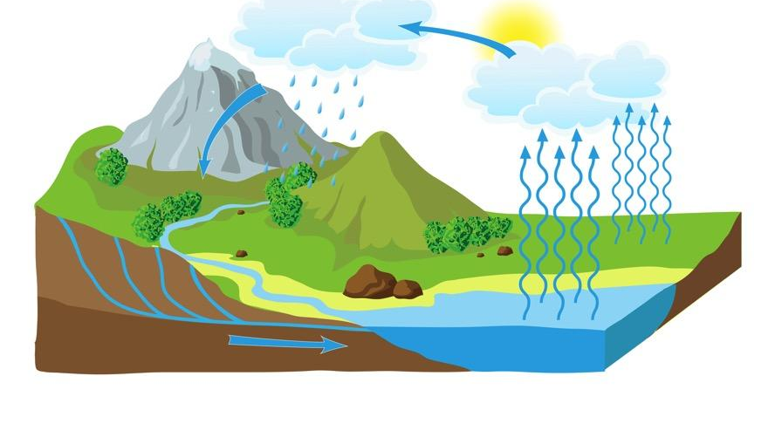
Water Cycle: the process through which water moves from Earth through the atmosphere and returns to Earth
Notes:
The Water Cycle is the process through which water moves from Earth through the atmosphere and returns to Earth.

Slide 9
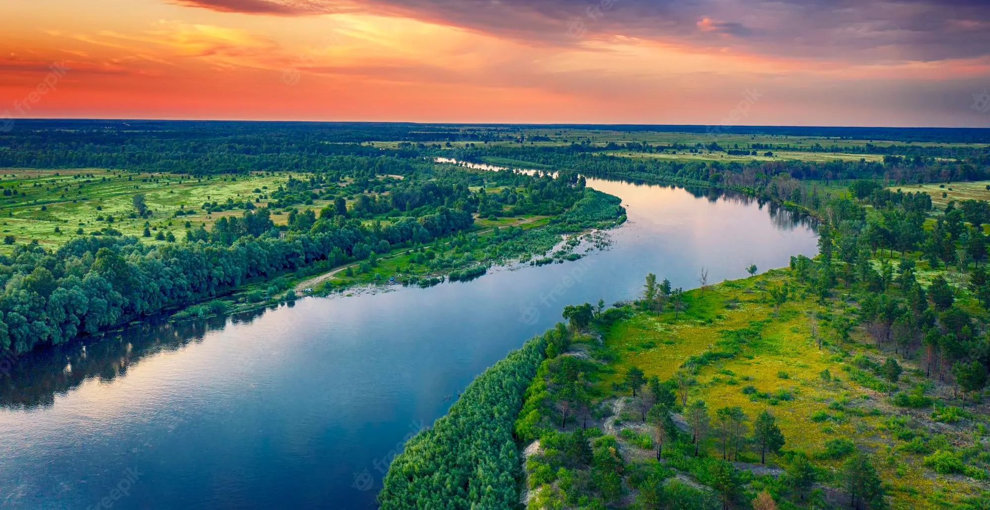
River: A long, winding stream of water that constantly moves.
Notes:
A river is a long, winding stream of water that constantly moves.

Slide 10
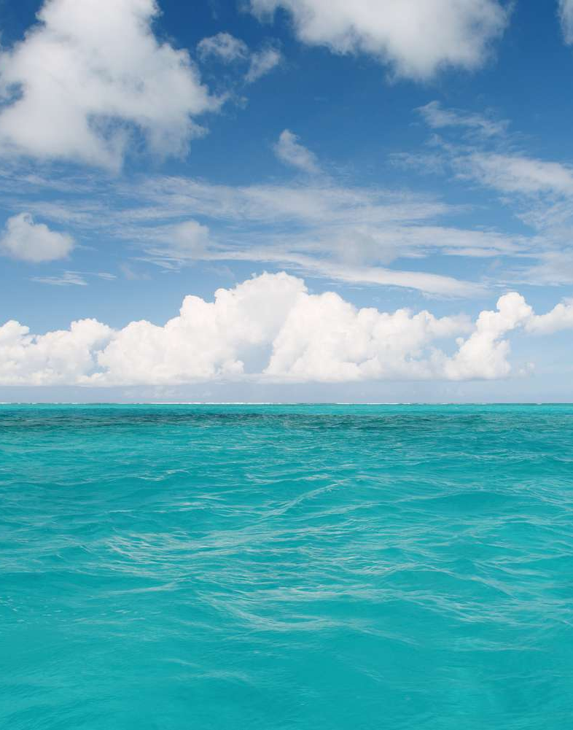
Ocean: A giant body of saltwater.
Notes:
An ocean is a giant body of saltwater.

Slide 11
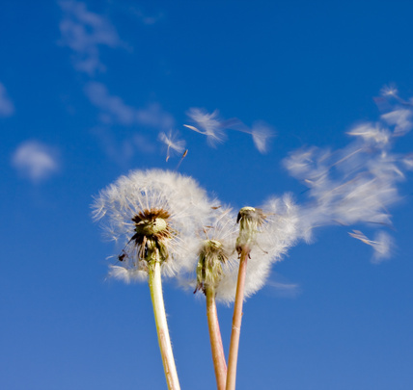
Wind: Moving air, especially a natural flow of air parallel to or along the ground.
Notes:
Wind: Moving air, especially a natural flow of air parallel to or along the ground.

Slide 12
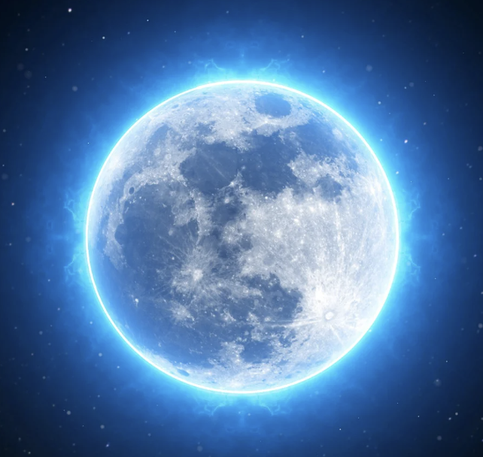
Moon: Earth's natural satellite, that orbits around the Earth
Notes:
Moon: Earth's natural satellite, that orbits around the Earth. Has a key impact on tides.

Slide 13
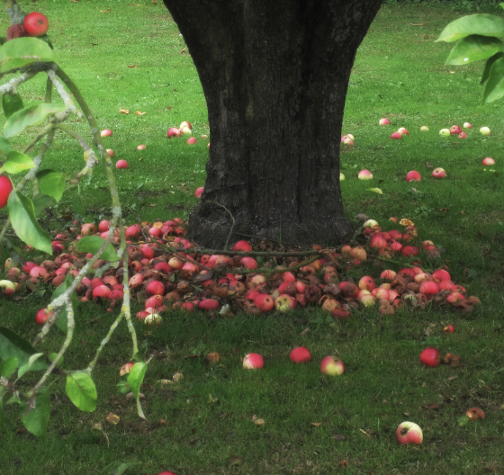
Gravity: The force that pulls objects toward each other
Notes:
Gravity: The force that pulls objects toward each other; Earth's gravity affects the movement of ocean water.

Slide 14
Notes:
Now let’s pause for a moment to review the information we have covered already.

Slide 15
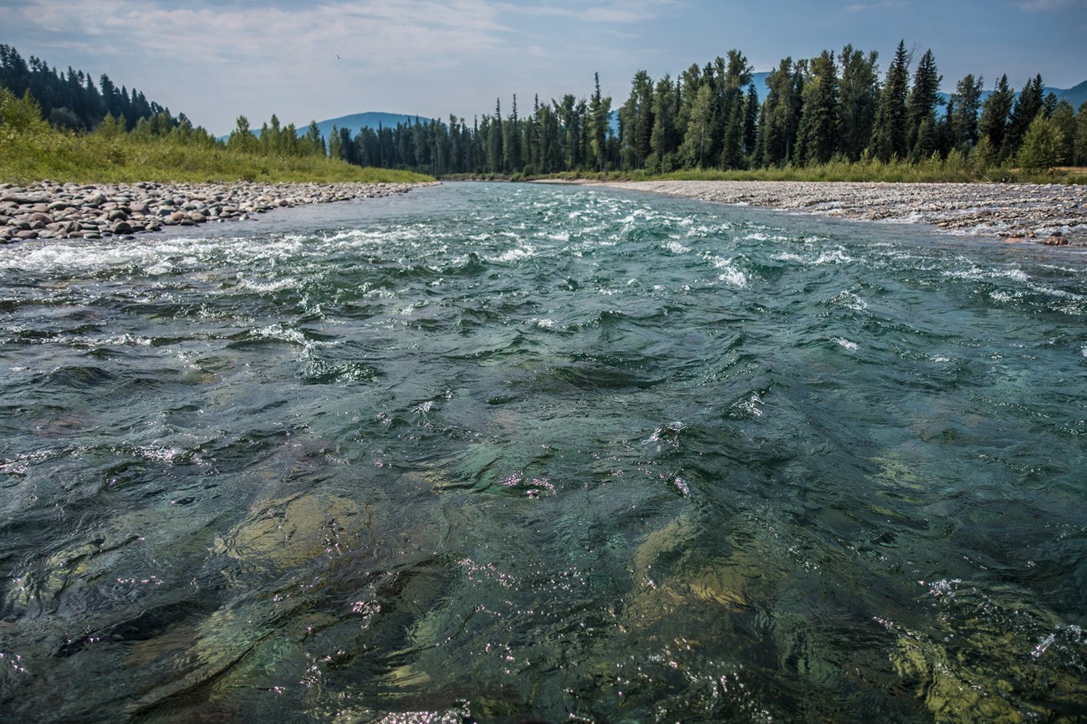
Water: The substance that covers most of the Earth's surface, found in ______
deserts and rocks
outer space
oceans, rives, lakes, and streams
Notes:
Water: The substance that covers most of the Earth's surface, found in ______
c. oceans, rives, lakes, and streams

Slide 16
Water: The substance that covers most of the Earth's surface, found in ______
deserts and rocks
outer space
oceans, rives, lakes, and streams
Notes:
Water: The substance that covers most of the Earth's surface, found in c. oceans, rives, lakes, and streams

Slide 17
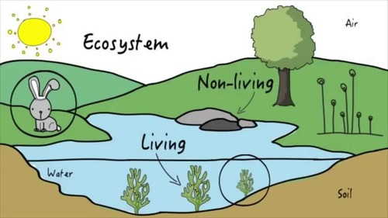
True/False: An ecosystem is an area where living and nonliving things interact
Notes:
True/False: An ecosystem is the area where living and nonliving things interact.
[True]

Slide 18
True/False: An ecosystem is an area where living and nonliving things interact
Notes:
True: An ecosystem is the area where living and nonliving things interact.

Slide 19
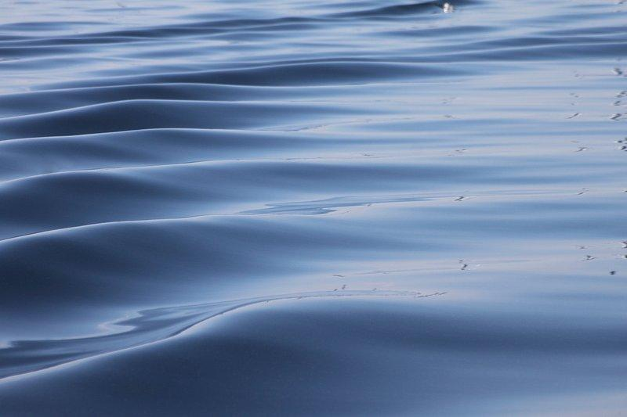
What is the top layer or outermost part of something?
Notes:
What is the top layer or outermost part of something?
the surface

Slide 20
What is the top layer or outermost part of something?
The Surface
Notes:
What is the top layer or outermost part of something? The surface

Slide 21
The act or process of moving or being moved:
motion
lotion
potion
Notes:
The act or process of moving or being moved:
motion

Slide 22
The act or process of moving or being moved:
motion
lotion
potion
Notes:
The act or process of moving or being moved: a. motion

Slide 23
Tide
Notes:
Now that we’ve reviewed, let’s define the phrase tide.

Slide 24
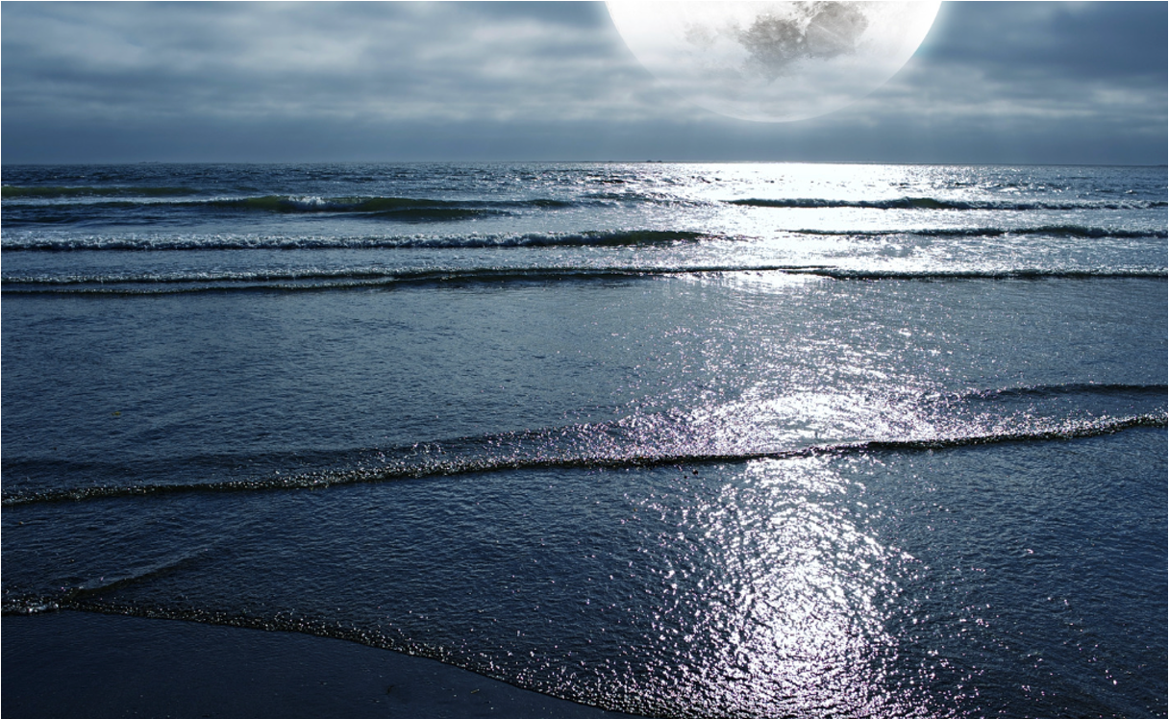
Tide: the regular rising and falling of the sea level caused by the moon and the sun's gravitational pull
Notes:
A tide is the regular rising and falling of the sea level caused by the moon and the sun's gravitational pull

Slide 25
Notes:
Let’s check-in for understanding.

Slide 26
What is a tide?
Notes:
A tide is the regular rising and falling of the sea level caused by the moon and the sun's gravitational pull

Slide 27
Notes:
That is the basic definition, but there is a bit more you need to know.

Slide 28
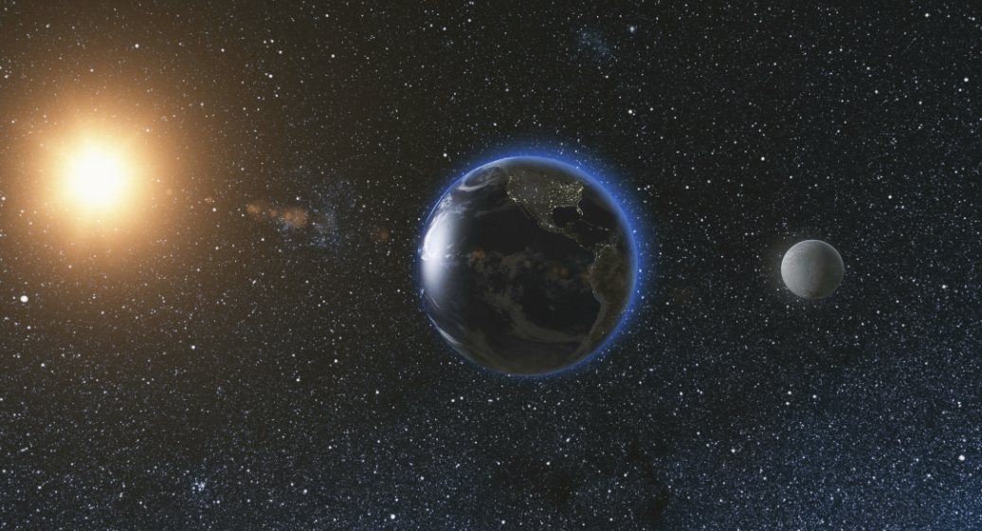
Tides are the regular rising and falling of the sea level. These movements are caused by the gravitational pull of two objects in the sky: the Moon and the Sun.
Notes:
Tides are the regular rising and falling of the sea level. These movements are caused by the gravitational pull of two objects in the sky: the Moon and the Sun.

Slide 29
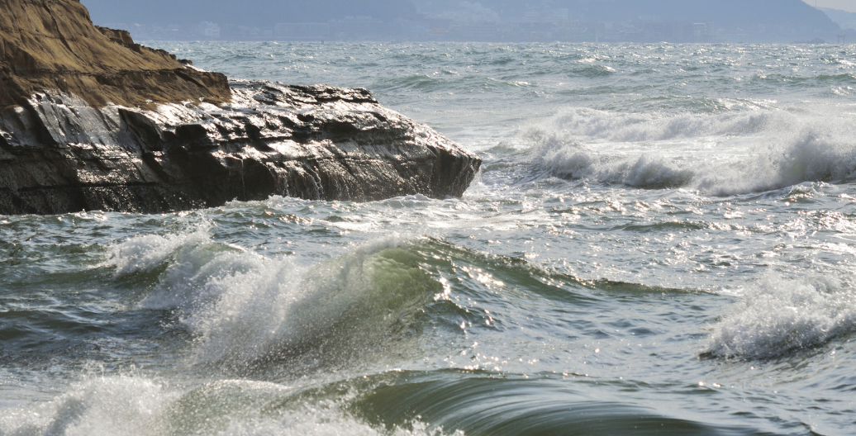
High Tide: When the Moon is directly above a location on Earth, its gravitational pull causes the water on that side to bulge, creating a high tide.
Notes:
High Tide: When the Moon is directly above a location on Earth, its gravitational pull causes the water on that side to bulge, creating a high tide.

Slide 30
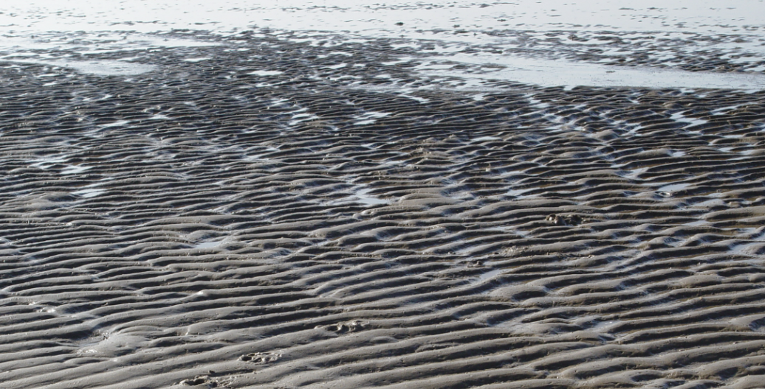
Low Tide: When the Moon is in a different spot, it creates a low tide, where the water seems to retreat, revealing more of the shore.
Notes:
Low Tide: When the Moon is in a different spot, it creates a low tide, where the water seems to retreat, revealing more of the shore.

Slide 31
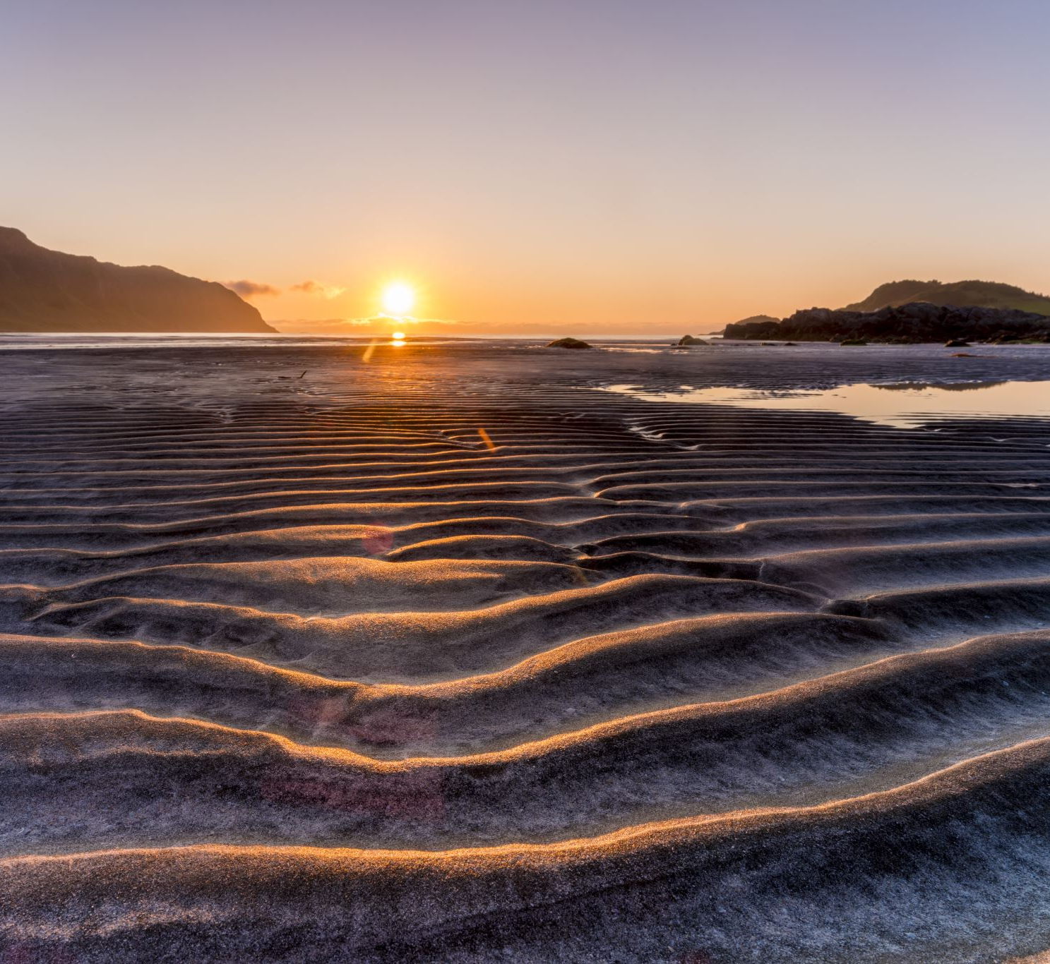
Sun's Influence: The Sun also affects tides. When the Sun and the Moon are aligned, their combined gravitational pull creates extra high tides called spring tides. When they are at right angles, we get neap tides, which are lower.
Notes:
Sun's Influence: The Sun also affects tides. When the Sun and the Moon are aligned, their combined gravitational pull creates extra high tides called spring tides. When they are at right angles, we get neap tides, which are lower.

Slide 32
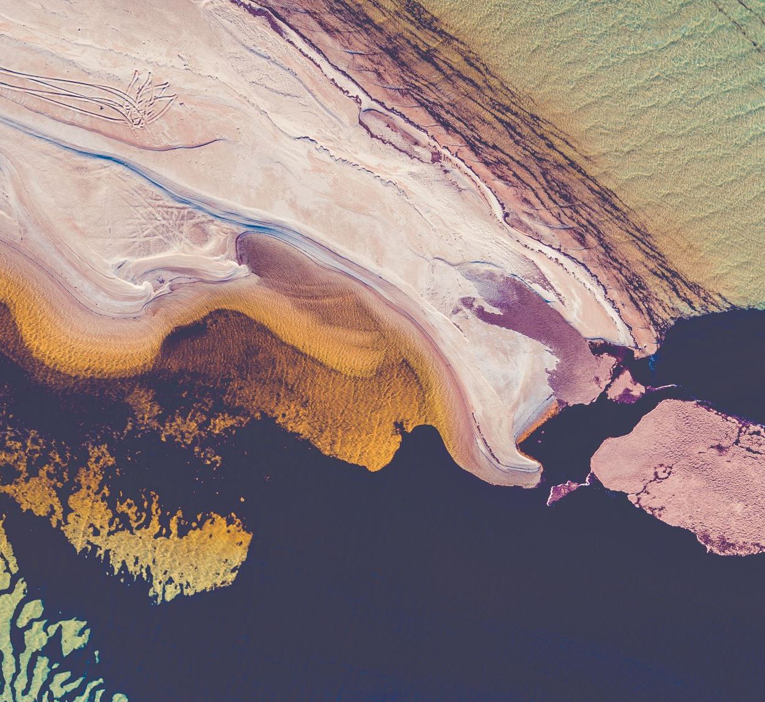
Understanding tides helps us predict when the water will be higher or lower along the coast.
High tides can flood certain areas, while low tides expose tide pools and marine life.
It’s a regular pattern influenced by the gravitational forces between the Earth, Moon, and Sun.
Notes:
Understanding tides helps us predict when the water will be higher or lower along the coast.
High tides can flood certain areas, while low tides expose tide pools and marine life.
It’s a regular pattern influenced by the gravitational forces between the Earth, Moon, and Sun.

Slide 33
Notes:
Let’s check-in for understanding.

Slide 34
What two objects in space cause the tides?
Notes:
What two objects in space cause the tides?
[Moon and Sun]

Slide 35
Match the following:
Low tide
High tide
When the water rises
When the water retreats
Notes:
Match the following:
Low tide
High tide
When the water rises
When the water retreats

Slide 36
Match the following:
B. Low tide
A. High tide
When the water rises
When the water retreats
Notes:
Match the following:
Low tide B.
High tide A.
When the water rises
When the water retreats

Slide 37
Notes:
Now, let’s talk about some examples of tides.

Slide 38
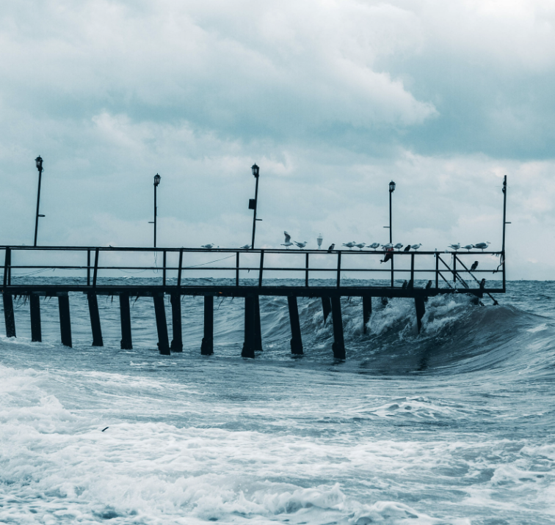
High tide is an example or type of tide. It is when the gravitational pull of the moon causes the water to rise.
Notes:
High tide is an example or type of tide. It is when the gravitational pull of the moon causes the water to rise.

Slide 39
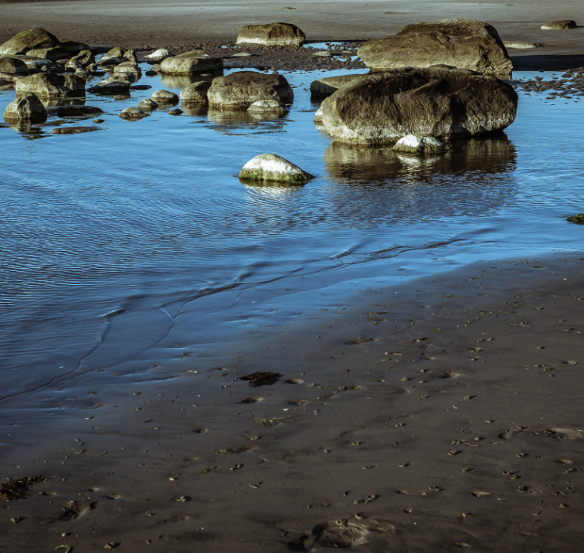
Low tide is also an example or type of tide. This is when the water retreats from the shore.
Notes:
Low tide is also an example or type of tide. This is when the water retreats from the shore.

Slide 40
Notes:
Now, let’s talk about some non-examples of TERM HERE.

Slide 41
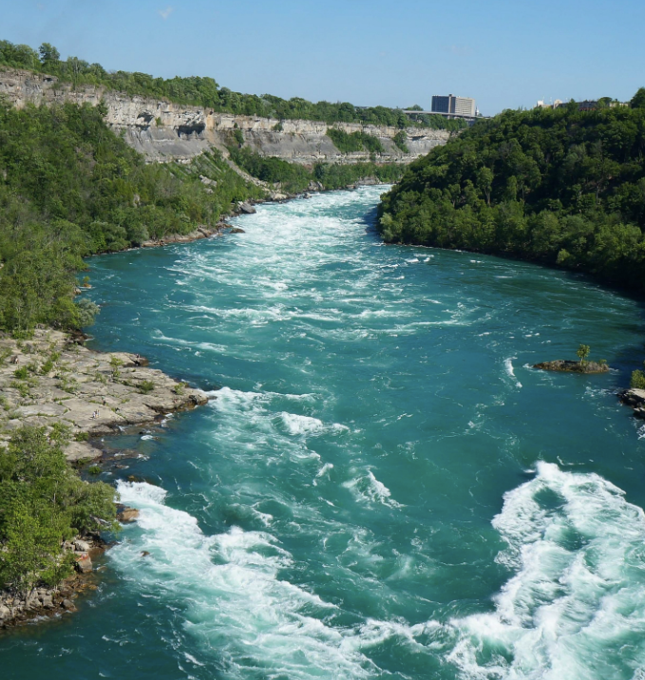
River Flow: The movement of water in a river is NOT an example of a tide. A river flow is a continuous movement of water within a river channel, driven by factors like elevation and rain fall.
Notes:
River Flow: The movement of water in a river is NOT an example of a tide. A river’s flow is a continuous movement of water within a river channel, driven by factors like elevation and rain fall. Tides specifically refer to the rise and fall of sea levels influenced by the gravitational pull of the Moon and the Sun.

Slide 42
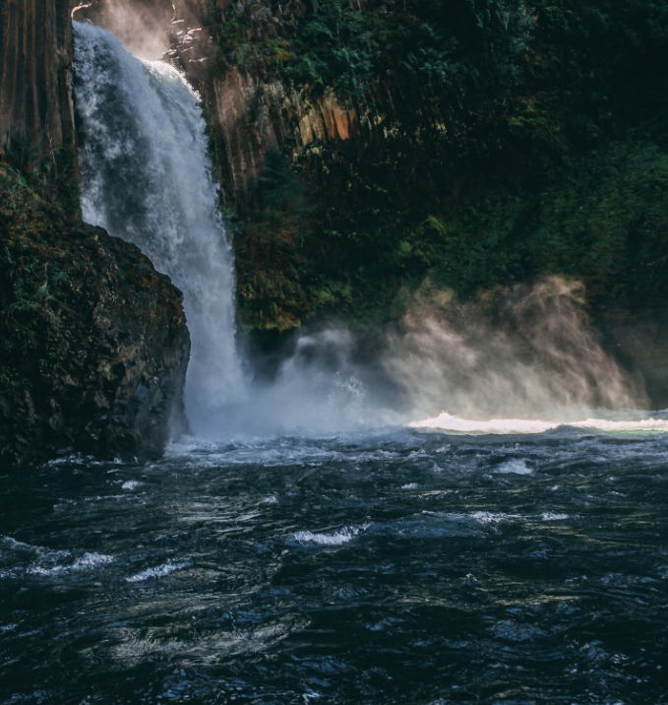
Waterfall: While a waterfall involves the movement of water, the continuous downward flow is NOT an example of a tide.
Notes:
Waterfall: While a waterfall involves the movement of water, the continuous downward flow is NOT an example of a tide. Tides involve the rhythmic rise and fall of sea levels, not a unidirectional
flow.

Slide 43
Notes:
Now let’s pause for a moment to check your understanding.

Slide 44
Why are a river flow and waterfall NOT examples of a tide?
Notes:
Why are a river flow and waterfall not examples of a tide?
[A river flow is a continuous movement of water within a river channel, driven by factors like elevation and rain fall and a waterfall involves the movement of water, the continuous downward flow is not a tide. Tides specifically refer to the rise and fall of sea levels influenced by the gravitational pull of the Moon and the Sun.]

Slide 45
Remember!!!
Notes:
So remember!

Slide 46
Tide: the regular rising and falling of the sea level caused by the moon and the sun's gravitational pull
Notes:
A tide is the regular rising and falling of the sea level caused by the moon and the sun's gravitational pull

Slide 47
Notes:
We will now complete this concept map, called a Frayer model, to summarize and further clarify what you have learned about the term TERM HERE.

Slide 48
Definition
Picture
Tide
Example
How do tides impact my life?
Notes:
To complete the Frayer model, we will choose from four choices the correct picture, definition, example, and response to the question, “How do tides impact my life?” Select the best response for each question using the information you just learned. As we select responses, we will see how this model looks filled in for the term tide.

Slide 49
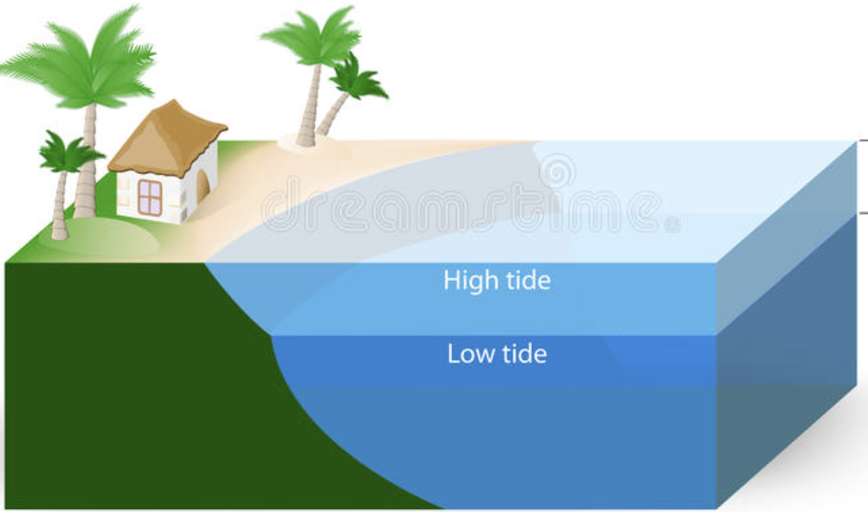
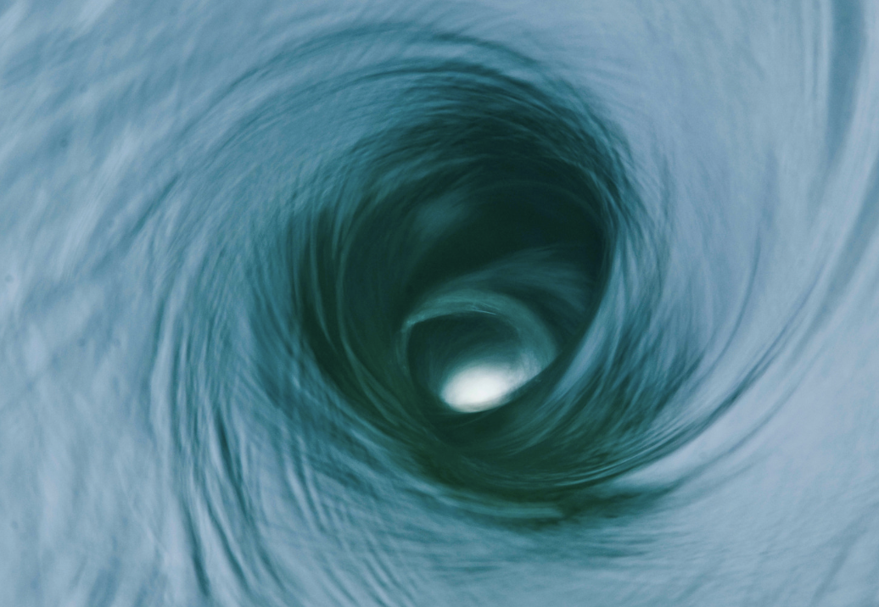
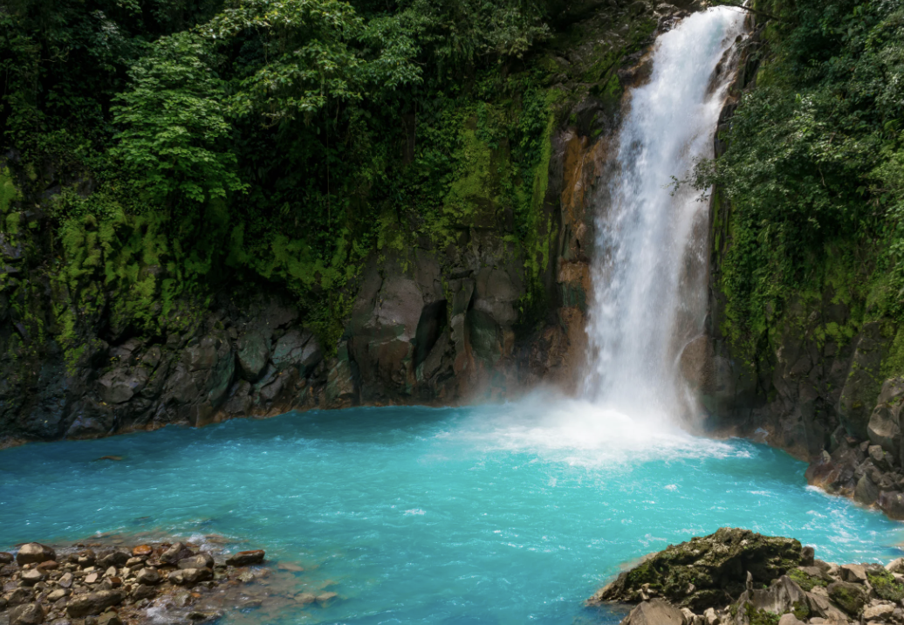
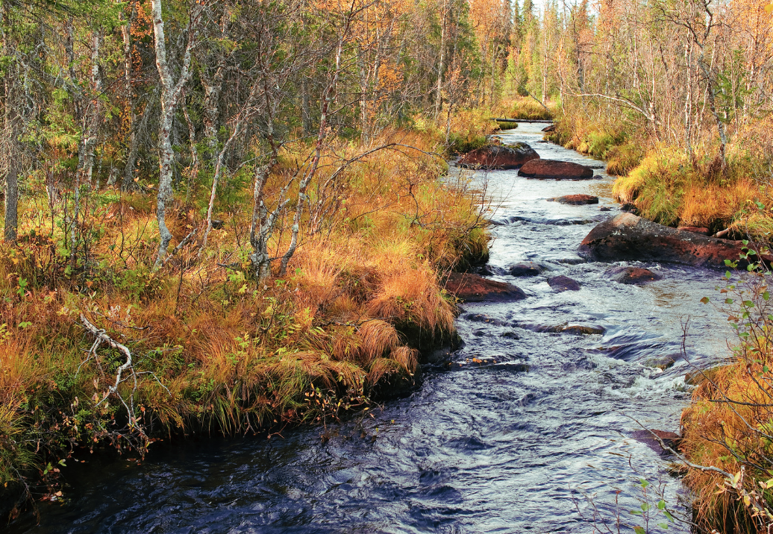
Directions: Choose the correct picture of a tide from the choices below.
A
B
C
D
Notes:
Choose the one correct picture of a tide from these four choices.
Tide image source: https://iilss.net/about-tide-in-the-oceanthe-tidal-ocean/

Slide 50
Directions: Choose the correct picture of a tide from the choices below.
A
B
C
D
Notes:
This is the picture that shows an tide.
Tide image source: https://iilss.net/about-tide-in-the-oceanthe-tidal-ocean/

Slide 51
Definition
Picture
Tide
Example
How do tides impact my life?
Notes:
Here is the Frayer model filled in with a picture of a tide.

Slide 52
Directions: Choose the correct definition of a tide from the choices below.
A
A long, winding stream of water that constantly moves.
B
A large body of saltwater
C
The process of breaking down a rock over a long period of time
D
The regular rising and falling of the sea level caused by the moon and the sun's gravitational pull
Notes:
Choose the one correct definition of a tide from these four choices.

Slide 53
Directions: Choose the correct definition of a tide from the choices below.
A
A long, winding stream of water that constantly moves.
B
A large body of saltwater
C
The process of breaking down a rock over a long period of time
D
The regular rising and falling of the sea level caused by the moon and the sun's gravitational pull
Notes:
“The regular rising and falling of the sea level caused by the moon and the sun's gravitational pull” is correct! This is the definition of a tide.

Slide 54
Definition
Picture
The regular rising and falling of the sea level caused by the moon and the sun's gravitational pull
Tide
Example
How do tides impact my life?
Notes:
Here is the Frayer Model with a picture and the definition filled in for a tide: The regular rising and falling of the sea level caused by the moon and the sun's gravitational pull

Slide 55
Directions: Choose the correct example of a tide from the choices below.
A
A wave
B
Low tide
C
A river
D
A waterfall
Notes:
Choose the one correct example of a tide from these four choices.

Slide 56
Directions: Choose the correct example of a tide from the choices below.
A
A wave
B
Low tide
C
A river
D
A waterfall
Notes:
“Low tide” is correct! This is an example of a tide.

Slide 57
Definition
Picture
The regular rising and falling of the sea level caused by the moon and the sun's gravitational pull
Tide
Low tide
Example
How do tides impact my life?
Notes:
Here is the Frayer Model with a picture, definition, and an example of a tide: Low tide

Slide 58
Directions: Choose the correct response for “how do tides impact my life?” from the choices below.
The ocean's tides can shake buildings, break roads, and sometimes cause power outages, making it important for us to be prepared and know how to stay safe during these shakes.
A
B
The ocean's tides explain how movement of animals on our planet impacts food and crops we have available to us.
C
The ocean's tides account for the amount of land we have on our planet versus ocean and tells us where to build habitats.
The ocean's tides affect your life by deciding when it's best to visit the beach, changing how sea animals act, and influencing certain fishing activities.
D
Notes:
Choose the one correct response for “how do tides impact my life?” from these four choices.

Slide 59
Directions: Choose the correct response for “how do tides impact my life?” from the choices below.
The ocean's tides can shake buildings, break roads, and sometimes cause power outages, making it important for us to be prepared and know how to stay safe during these shakes.
A
B
The ocean's tides explain how movement of animals on our planet impacts food and crops we have available to us.
C
The ocean's tides account for the amount of land we have on our planet versus ocean and tells us where to build habitats.
The ocean's tides affect your life by deciding when it's best to visit the beach, changing how sea animals act, and influencing certain fishing activities.
D
Notes:
“The ocean's tides affect your life by deciding when it's best to visit the beach, changing how sea animals act, and influencing certain fishing activities.” That is correct! This is an example of how tides impact your life.

Slide 60
Definition
Picture
The regular rising and falling of the sea level caused by the moon and the sun's gravitational pull
Tide
The ocean's tides affect your life by deciding when it's best to visit the beach, changing how sea animals act, and influencing certain fishing activities.
Low tide
Example
How do tides impact my life?
Notes:
Here is the Frayer Model with a picture, definition, example, and a correct response to “how do tides impact my life?”: The ocean's tides affect your life by deciding when it's best to visit
the beach, changing how sea animals act, and influencing certain fishing activities.

Slide 61
Remember!!!
Notes:
So remember!

Slide 62
Tide: the regular rising and falling of the sea level caused by the moon and the sun's gravitational pull
Notes:
A tide is the regular rising and falling of the sea level caused by the moon and the sun's gravitational pull

Slide 63
Big Question: How do the daily changes in ocean tides not only shape the coastal environment but also affect the activities of marine life and impact our daily lives on land?
Notes:
Let’s reflect once more on our big question. Our “big question” is: How do the daily changes in ocean tides not only shape the coastal environment but also affect the activities of marine life and impact our daily lives on land?
Does anyone have any additional examples to share that haven’t been discussed yet?

Slide 64
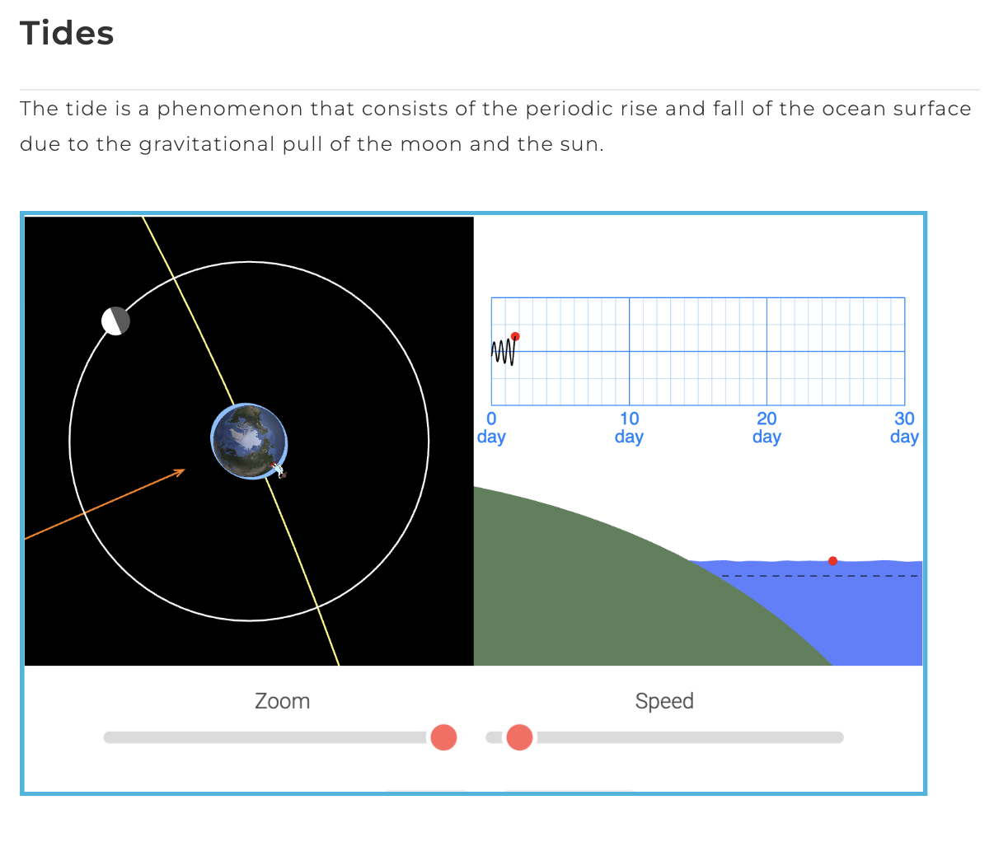
Simulation Activity
Tides Simulator
Click the link above for a simulation to deepen your knowledge of tides.
Notes:
Click the link above for a simulation to deepen your understanding of tides. The online tide simulations on this page help to understand this important phenomenon of nature and what the forces acting on a tide are like.

Slide 65
Notes:
Thanks for watching, and please continue watching CAPs available from this website.

Slide 66
This Was Created With Resources From:
Questions or Comments
Michael Kennedy, Ph.D. MKennedy@Virginia.edu
Rachel L Kunemund, Ph.D. rk8vm@virginia.edu

