Slide 1
Intro
“Big Idea” Question
Review Concepts
Check-In Questions
Teacher Engagement
Vocabulary
Student-Friendly Definition
Examples & Non-Examples
Frayer Model
Simulation/Activity
Notes:
OK everyone, get ready for our next lesson. Just as a reminder, these are the different components that our lesson may include, and you’ll see these icons in the top left corner of each slide so that you can follow along more easily!

Slide 2
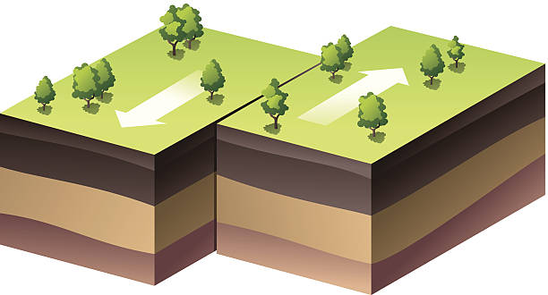
Intro
Transform Boundary
Notes:
Today, we’ll be learning about the word: Transform Boundary.

Slide 3
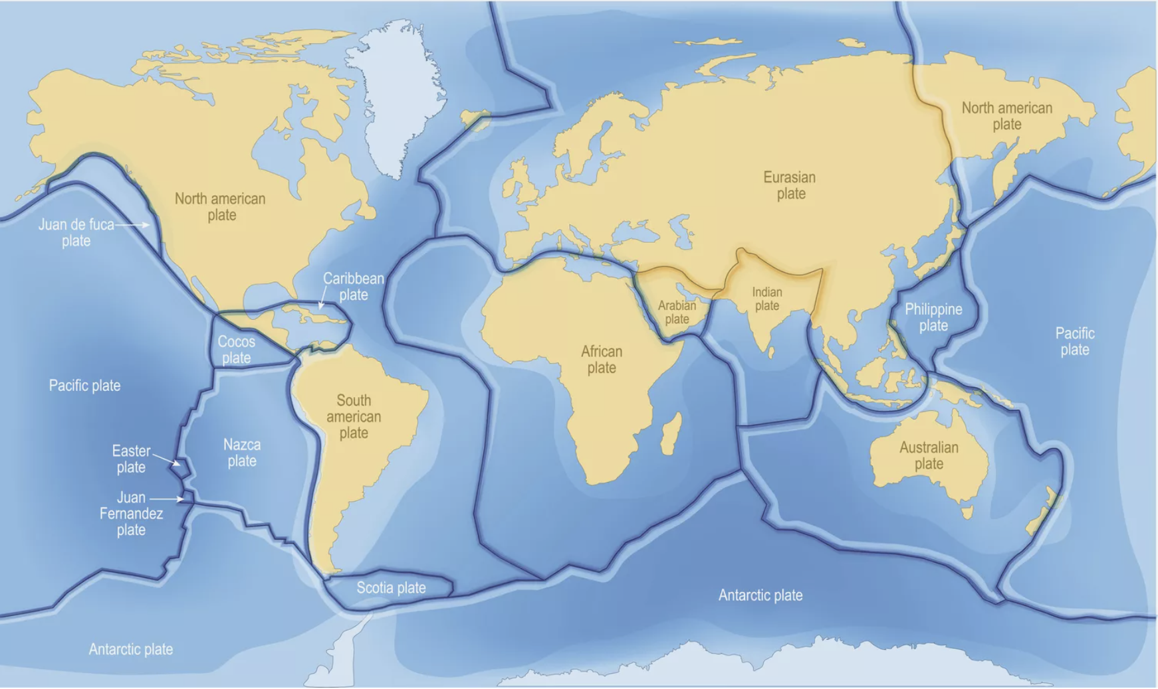
Big Question: What happens when tectonic plates shift?
Notes:
Our “big question” is: What happens when tectonic plates shift?
[Pause and illicit predictions from students.]
I love all these thoughtful scientific hypotheses! Be sure to keep this question and your predictions in mind as we move through these next few lessons, and we’ll continue to revisit it.

Slide 4
Notes:
Before we move on to our new topic, let’s review some other words & concepts that you already learned and make sure you are firm in your understanding.

Slide 5
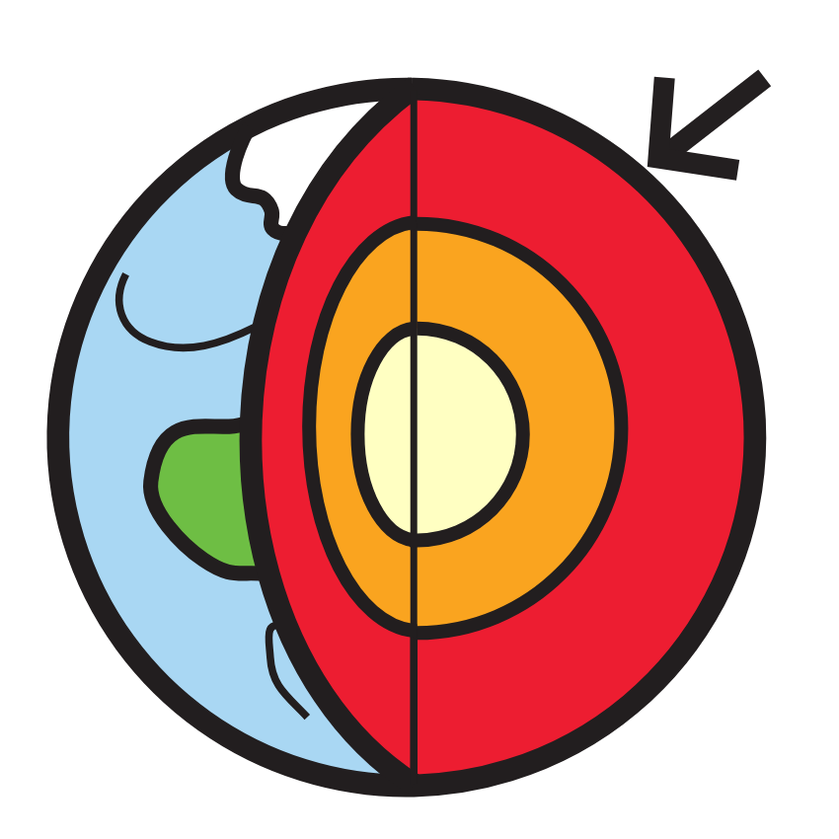
Crust: the outermost shell of the Earth
Notes:
Crust is the outermost shell of the Earth.

Slide 6
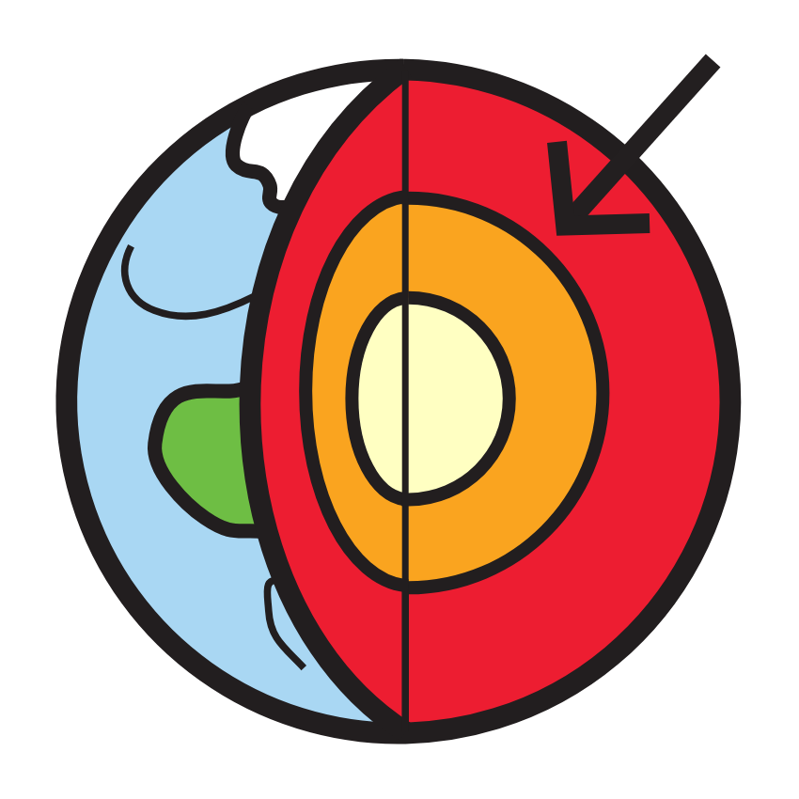
Mantle: the layer of rock between the crust and the outer core
Notes:
Mantle is the layer of rock between the crust and the outer core.

Slide 7
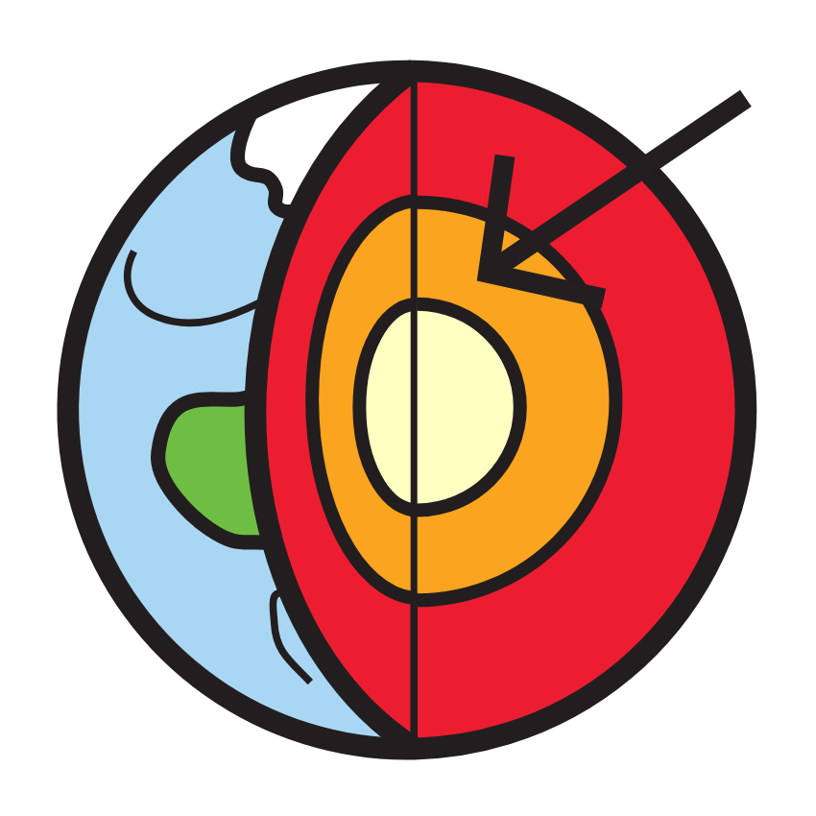
Outer Core: the third layer of the Earth made of liquid iron and nickel
Notes:
The outer core is the third layer of the Earth made of liquid iron and nickel.

Slide 8
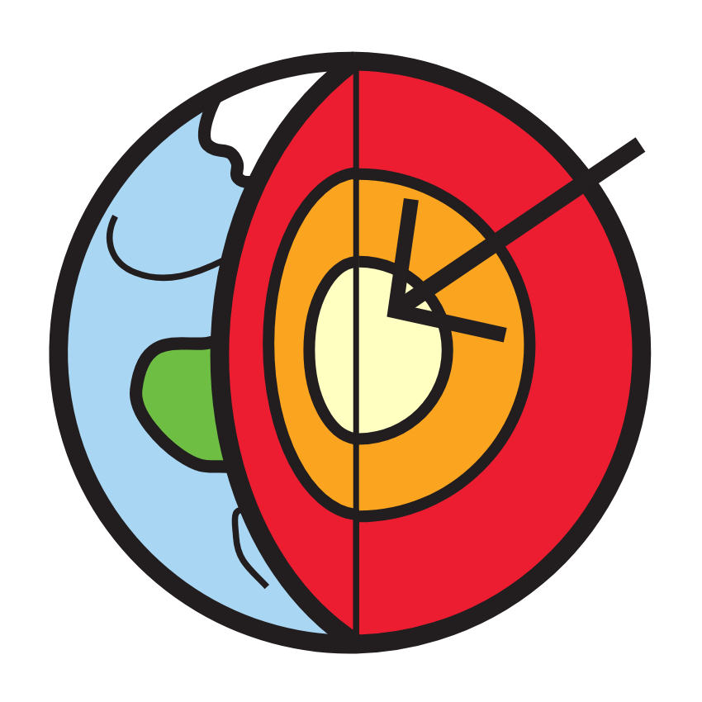
Inner Core: the innermost layer of the Earth
Notes:
The inner core is the innermost layer of the Earth.

Slide 9
Tectonic Plates: huge pieces of the Earth’s surface that fit together like a puzzle and move very slowly over time
Notes:
Tectonic plates are huge pieces of the Earth’s surface that fit together like a puzzle and move very slowly over time.

Slide 10
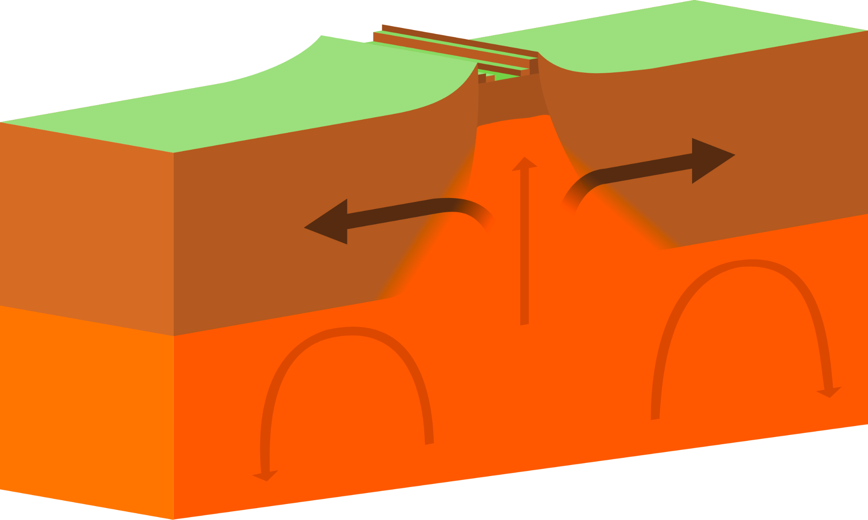
Divergent Boundary: form when two tectonic plates move away from each other
Notes:
Divergent boundaries form when two tectonic plates move away from each other.

Slide 11
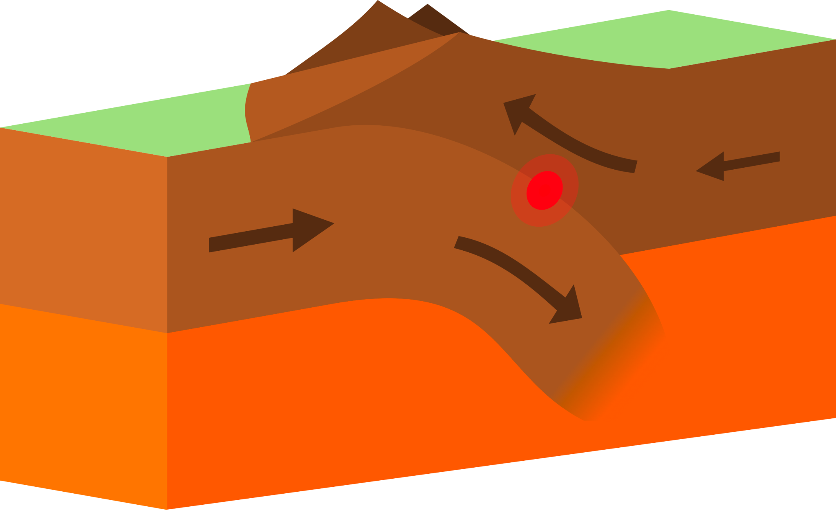
Convergent Boundary: form when two tectonic plates move toward each other
Notes:
Convergent boundaries form when two tectonic plates move toward each other.

Slide 12
Notes:
Now let’s pause for a moment to review the information we have covered already.

Slide 13
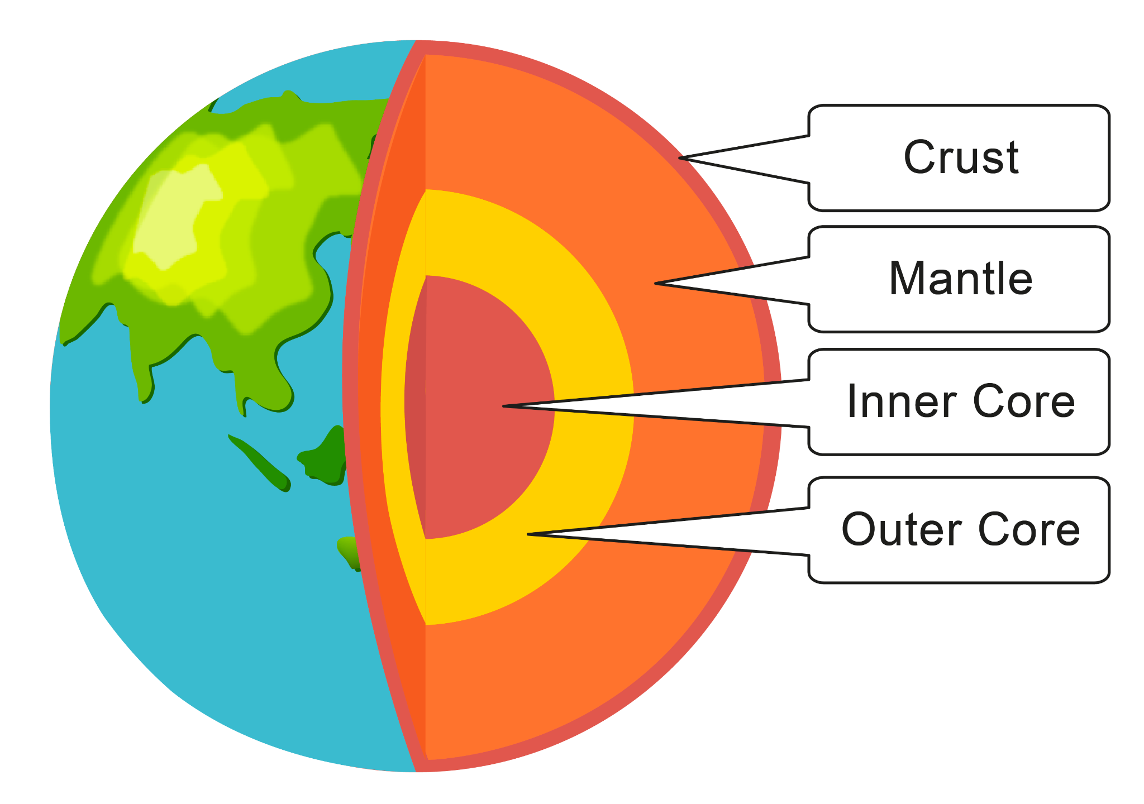
What are the four layers of the Earth?
Notes:
What are the four layers of the Earth?

Slide 14
What are the four layers of the Earth?
Notes:
What are the four layers of the Earth? Crust, Mantle, Inner Core, Outer Core.

Slide 15
Tectonic plates are huge pieces of the Earth’s _______ that fit together like a puzzle and move very slowly over time.
Core
Surface
Notes:
Tectonic plates are huge pieces of the Earth’s [surface] that fit together like a puzzle and move very slowly over time.

Slide 16
Tectonic plates are huge pieces of the Earth’s _______ that fit together like a puzzle and move very slowly over time.
Core
Surface
Notes:
Tectonic plates are huge pieces of the Earth’s [surface] that fit together like a puzzle and move very slowly over time.

Slide 17
Divergent boundaries form when two tectonic plates move _____ each other.
Toward
Away from
Notes:
Divergent boundaries form when two tectonic plates move _____ from each other.

Slide 18
Divergent boundaries form when two tectonic plates move _____ each other.
Toward
Away from
Notes:
Divergent boundaries form when two tectonic plates move _____ from each other. [Away from]

Slide 19
Convergent boundaries form when two tectonic plates move _____ each other.
Toward
Away from
Notes:
Convergent boundaries form when two tectonic plates move _____ from each other.

Slide 20
Convergent boundaries form when two tectonic plates move _____ each other.
Toward
Away from
Notes:
Convergent boundaries form when two tectonic plates move _____ from each other. [Toward]

Slide 21
Transform Boundary
Notes:
Now that we’ve reviewed, let’s define the phrase Transform Boundary.

Slide 22
Transform Boundary: form when two tectonic plates move along or past each other
Notes:
Transform boundaries form when two tectonic plates move along or past each other.

Slide 23
Notes:
Let’s check-in for understanding.

Slide 24
What is a transform boundary?
Notes:
What is a transform boundary?
[Form when two tectonic plates move along or past each other.]

Slide 25
Notes:
That is the basic definition, but there is a bit more you need to know.

Slide 26
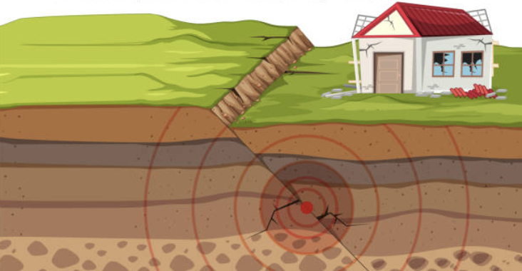
Transform boundaries are often characterized by frequent and sometimes powerful earthquakes.
Notes:
Transform boundaries are often characterized by frequent and sometimes powerful earthquakes.

Slide 27
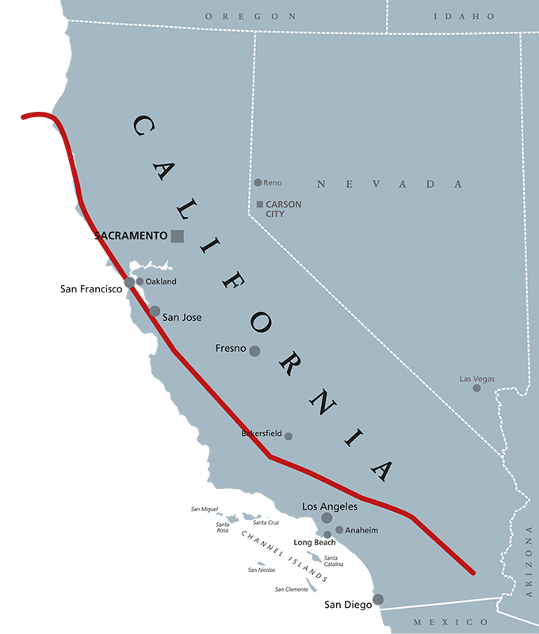
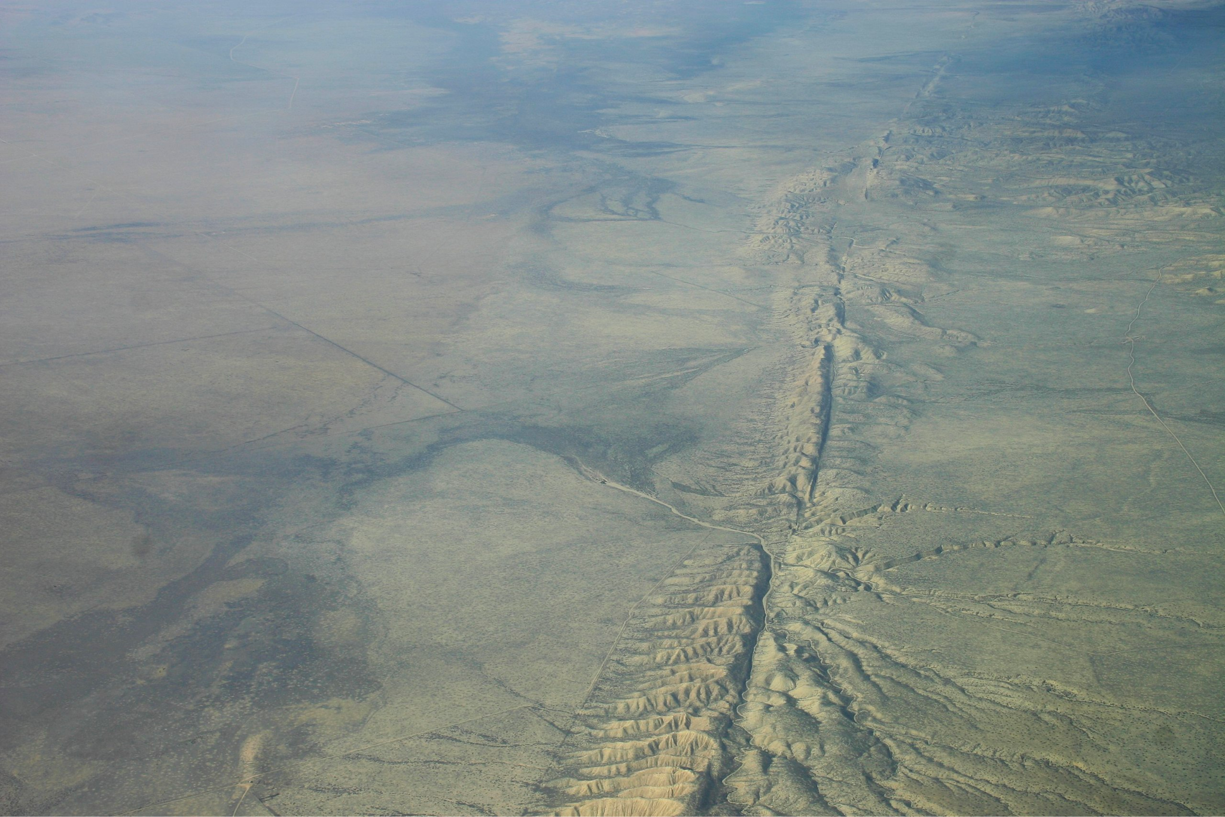
One of the most well known transform boundaries is the San Andreas Fault in California.
Notes:
One of the most well known transform boundaries is the San Andreas Fault in California.

Slide 28
Notes:
Let’s check-in for understanding.

Slide 29
What often happens at transform boundaries?
tornados
hurricanes
earthquakes
Notes:
What often happens at transform boundaries?
[C. earthquakes]

Slide 30
What often happens at transform boundaries?
tornados
hurricanes
earthquakes
Notes:
What often happens at transform boundaries?
[C. earthquakes]

Slide 31
Notes:
Now, let’s talk about some examples of transform boundaries.

Slide 32
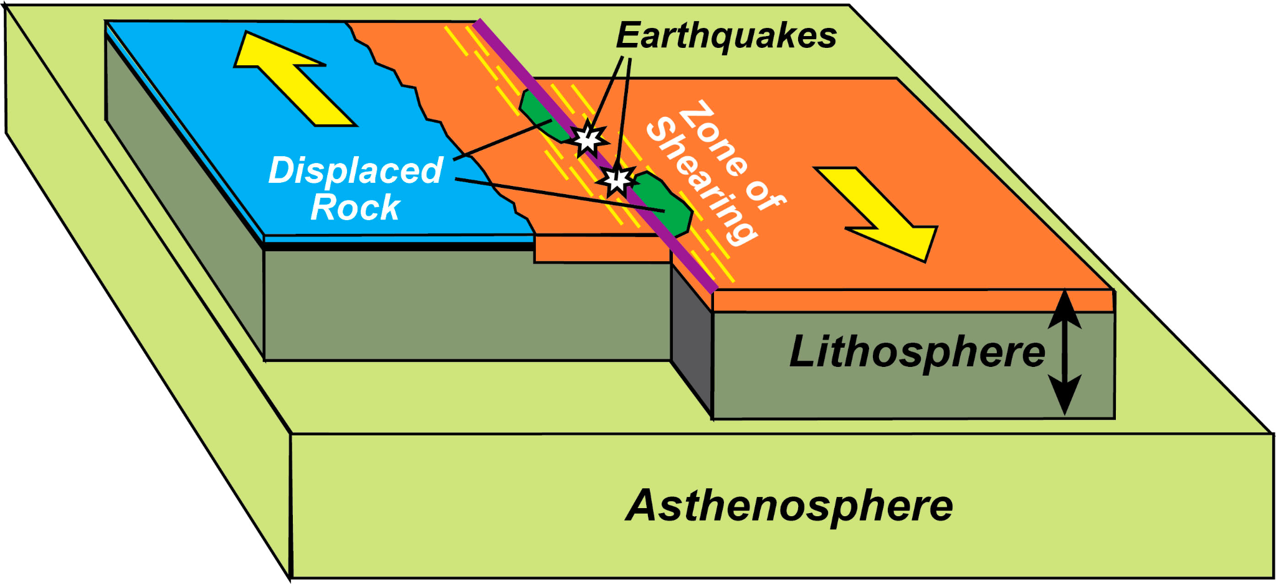
This is an example of a transform boundary. The plates are sliding along or past each other.
Notes:
This is an example of a transform boundary. The plates are sliding along or past each other.

Slide 33
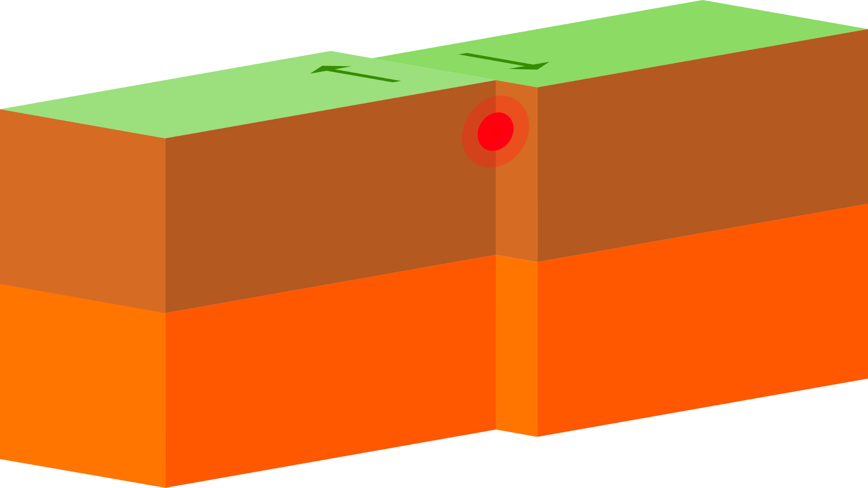
This is an example of a transform boundary. The plates are sliding along or past each other.
Notes:
This is an example of a transform boundary. The plates are sliding along or past each other.

Slide 34
Notes:
Now, let’s talk about some non-examples of transform boundaries.

Slide 35
This is a non-example of a transform boundary. Here, the plates are moving away from each other.
Notes:
This is a non-example of a transform boundary. Here, the plates are moving away from each other.

Slide 36
This is another non-example of a transform boundary. Here, the plates are sliding toward each other.
Notes:
This is another non-example of a convergent boundary. Here, the plates are sliding toward each other.

Slide 37
Notes:
Now let’s pause for a moment to check your understanding.

Slide 38
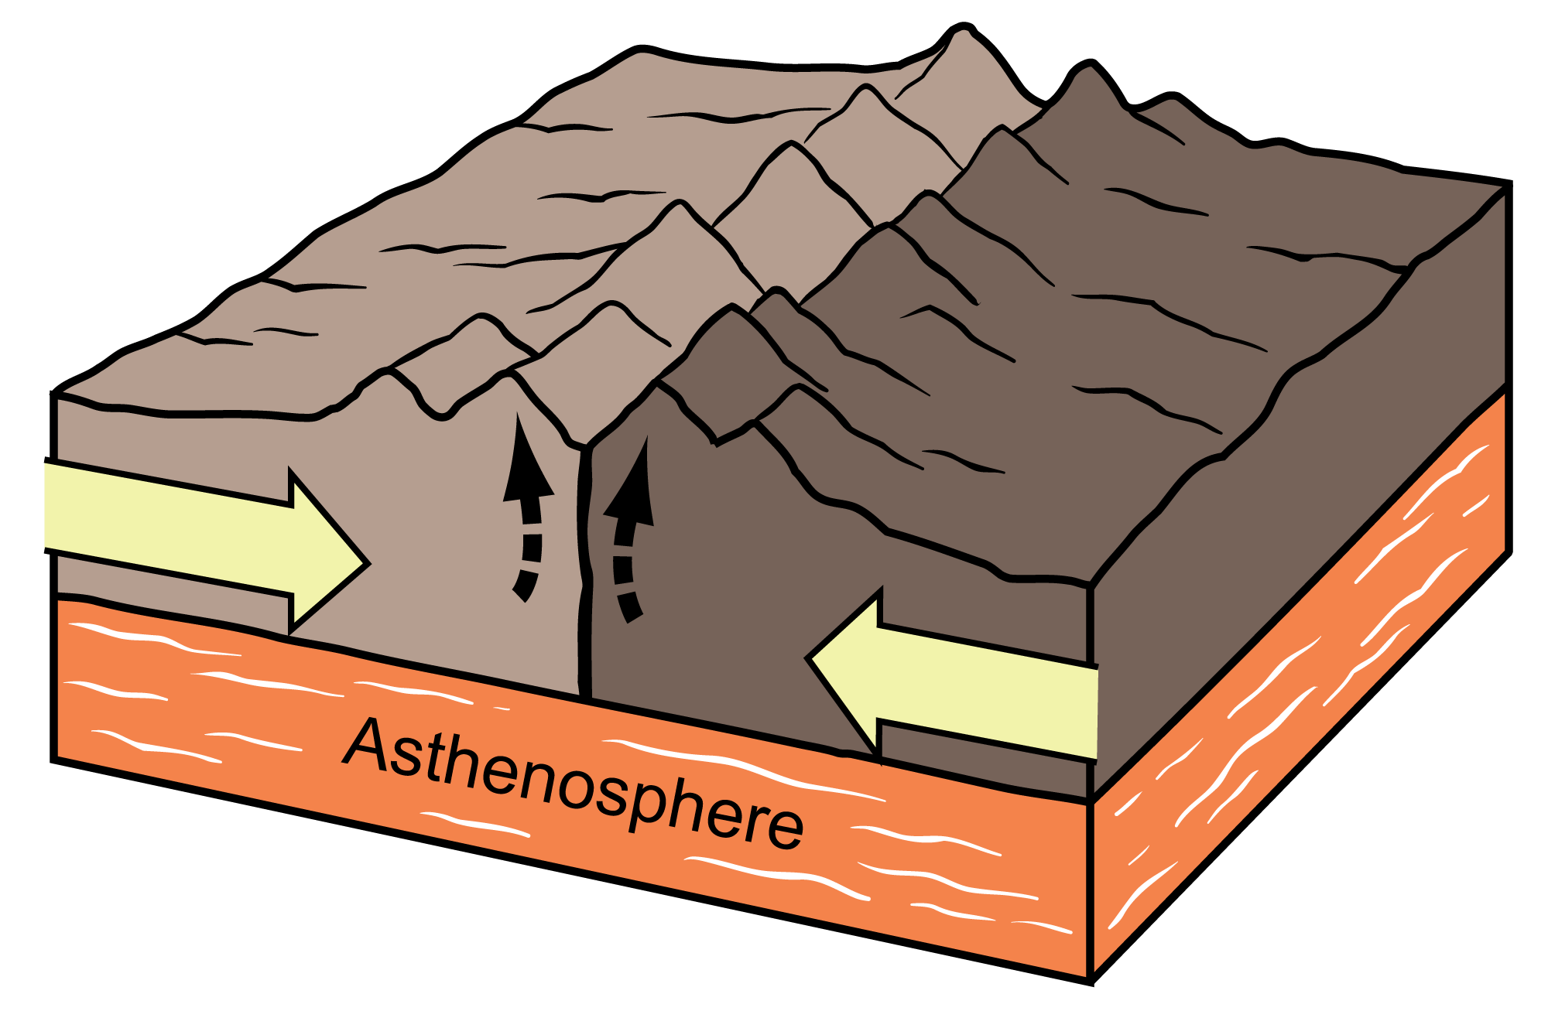
Which is an example of a transform boundary?
Notes:
Which is an example of a transform boundary?

Slide 39
Which is an example of a transform boundary?
Notes:
Which is an example of a transform boundary?

Slide 40
Remember!!!
Notes:
So remember!

Slide 41
Transform Boundary: form when two tectonic plates move along or past each other
Notes:
Transform boundaries form when two tectonic plates move along or past each other.

Slide 42
Notes:
We will now complete this concept map, called a Frayer model, to summarize and further clarify what you have learned about the term transform boundary.

Slide 43
Definition
Picture
Transform Boundary
How does transform boundary
impact my life?
Example
Notes:
To complete the Frayer model, we will choose from four choices the correct picture, definition, example, and response to the question, “How does transform boundary impact my life?” Select the best response for each question using the information you just learned. As we select responses, we will see how this model looks filled in for the term transform boundary.

Slide 44
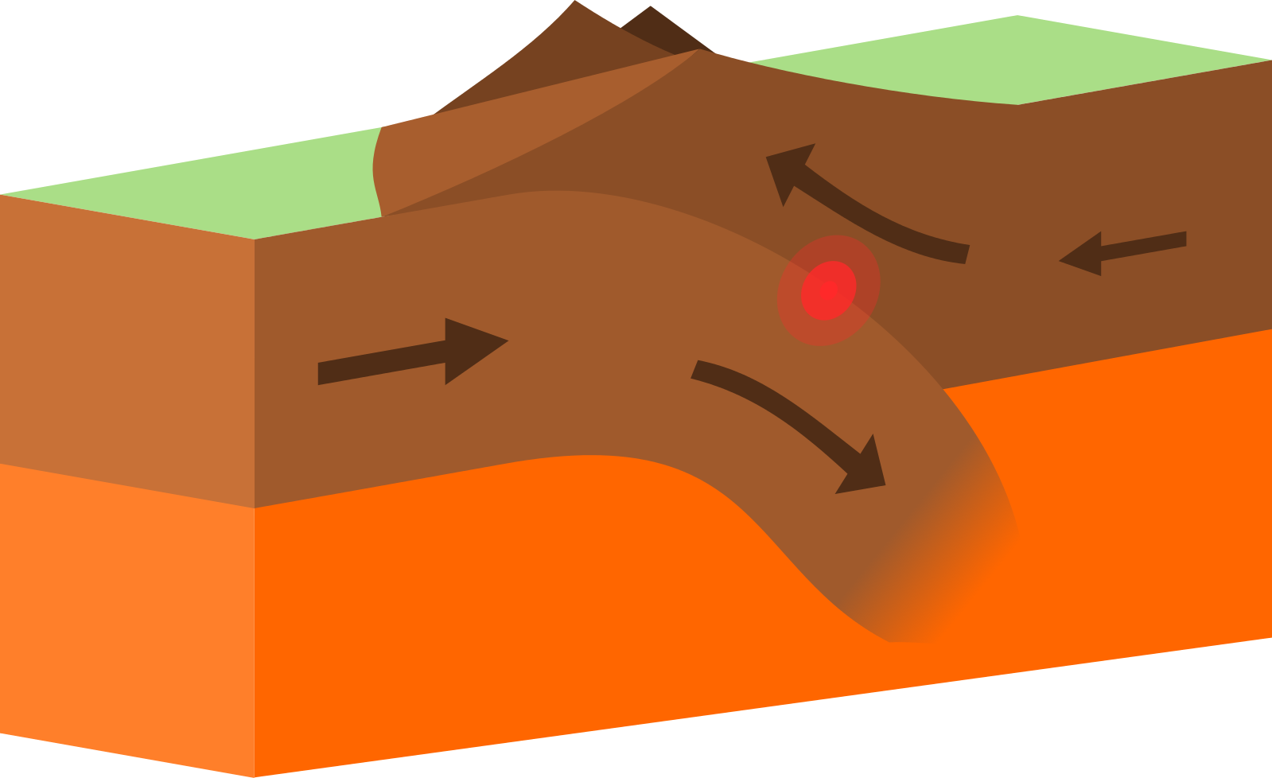
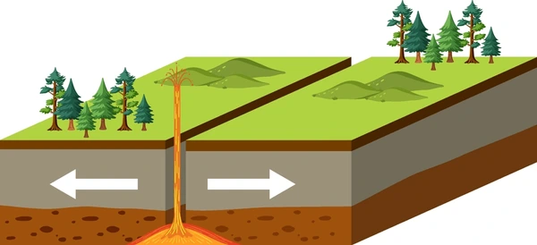
Directions: Choose the correct picture of transform boundary from the choices below.
A
B
C
D
Notes:
Choose the one correct picture of transform boundary from these four choices.

Slide 45
Directions: Choose the correct picture of transform boundary from the choices below.
A
B
C
D
Notes:
Choose the one correct picture of transform boundary from these four choices.

Slide 46
Definition
Picture
Transform Boundary
How does transform boundary
impact my life?
Example
Notes:
Here is the Frayer model filled in with a picture of transform boundary.

Slide 47
Directions: Choose the correct definition of transform boundary from the choices below.
A
Forms when two tectonic plates move toward each other
B
Forms when two tectonic plates move away from each other
C
Forms when two tectonic plates move along or past each other
D
Forms when two tectonic plates create a volcano
Notes:
Choose the one correct definition of transform boundary from these four choices.

Slide 48
Directions: Choose the correct definition of transform boundary from the choices below.
A
Forms when two tectonic plates move toward each other
B
Forms when two tectonic plates move away from each other
C
Forms when two tectonic plates move along or past each other
D
Forms when two tectonic plates create a volcano
Notes:
“Forms when two tectonic plates move along or past each other” is correct! This is the definition of transform boundary.

Slide 49
Definition
Picture
Forms when two tectonic plates move along or past each other
Transform Boundary
How does transform boundary
impact my life?
Example
Notes:
Here is the Frayer Model with a picture and the definition filled in for transform boundary: Forms when two tectonic plates move along or past each other.

Slide 50
Directions: Choose the correct example of transform boundary from the choices below.
A
A mountain
B
An earthquake
C
A hurricane
D
A rift valley
Notes:
Choose the one correct example of transform boundary from these four choices.

Slide 51
Directions: Choose the correct example of transform boundary from the choices below.
A
A mountain
B
An earthquake
C
A hurricane
D
A rift valley
Notes:
“An earthquake” is correct! This is an example of transform boundary.

Slide 52
Definition
Picture
Forms when two tectonic plates move along or past each other
Transform Boundary
An earthquake
How does transform boundary
impact my life?
Example
Notes:
Here is the Frayer Model with a picture, definition, and an example of transform boundary: An earthquake.

Slide 53
Directions: Choose the correct response for “how does transform boundary impact my life?” from the choices below.
A
I might experience a hurricane caused by a transform boundary.
B
I might experience a tornado caused by a transform boundary.
C
I might experience a thunderstorm caused by a transform boundary.
D
I might experience an earthquake caused by a transform boundary.
Notes:
Choose the one correct response for “how does transform boundary impact my life?” from these four choices.

Slide 54
Directions: Choose the correct response for “how does transform boundary impact my life?” from the choices below.
A
I might experience a hurricane caused by a transform boundary.
B
I might experience a tornado caused by a transform boundary.
C
I might experience a thunderstorm caused by a transform boundary.
D
I might experience an earthquake caused by a transform boundary.
Notes:
You chose “I might experience an earthquake caused by a transform boundary.” That is correct! This is an example of how transform boundaries impacts your life.

Slide 55
Definition
Picture
Forms when two tectonic plates move along or past each other
Transform Boundary
I might experience an earthquake caused by a transform boundary.
An earthquake
How does transform boundary
impact my life?
Example
Notes:
Here is the Frayer Model with a picture, definition, example, and a correct response to “how does transform boundary impact my life?”: I might experience an earthquake caused by a transform boundary.

Slide 56
Remember!!!
Notes:
So remember!

Slide 57
Transform Boundary: form when two tectonic plates move along or past each other
Notes:
Transform boundaries form when two tectonic plates move along or past each other.

Slide 58
Big Question: What happens when tectonic plates shift?
Notes:
Our “big question” is: What happens when tectonic plates shift?
Does anyone have any additional examples to share that haven’t been discussed yet?

Slide 59
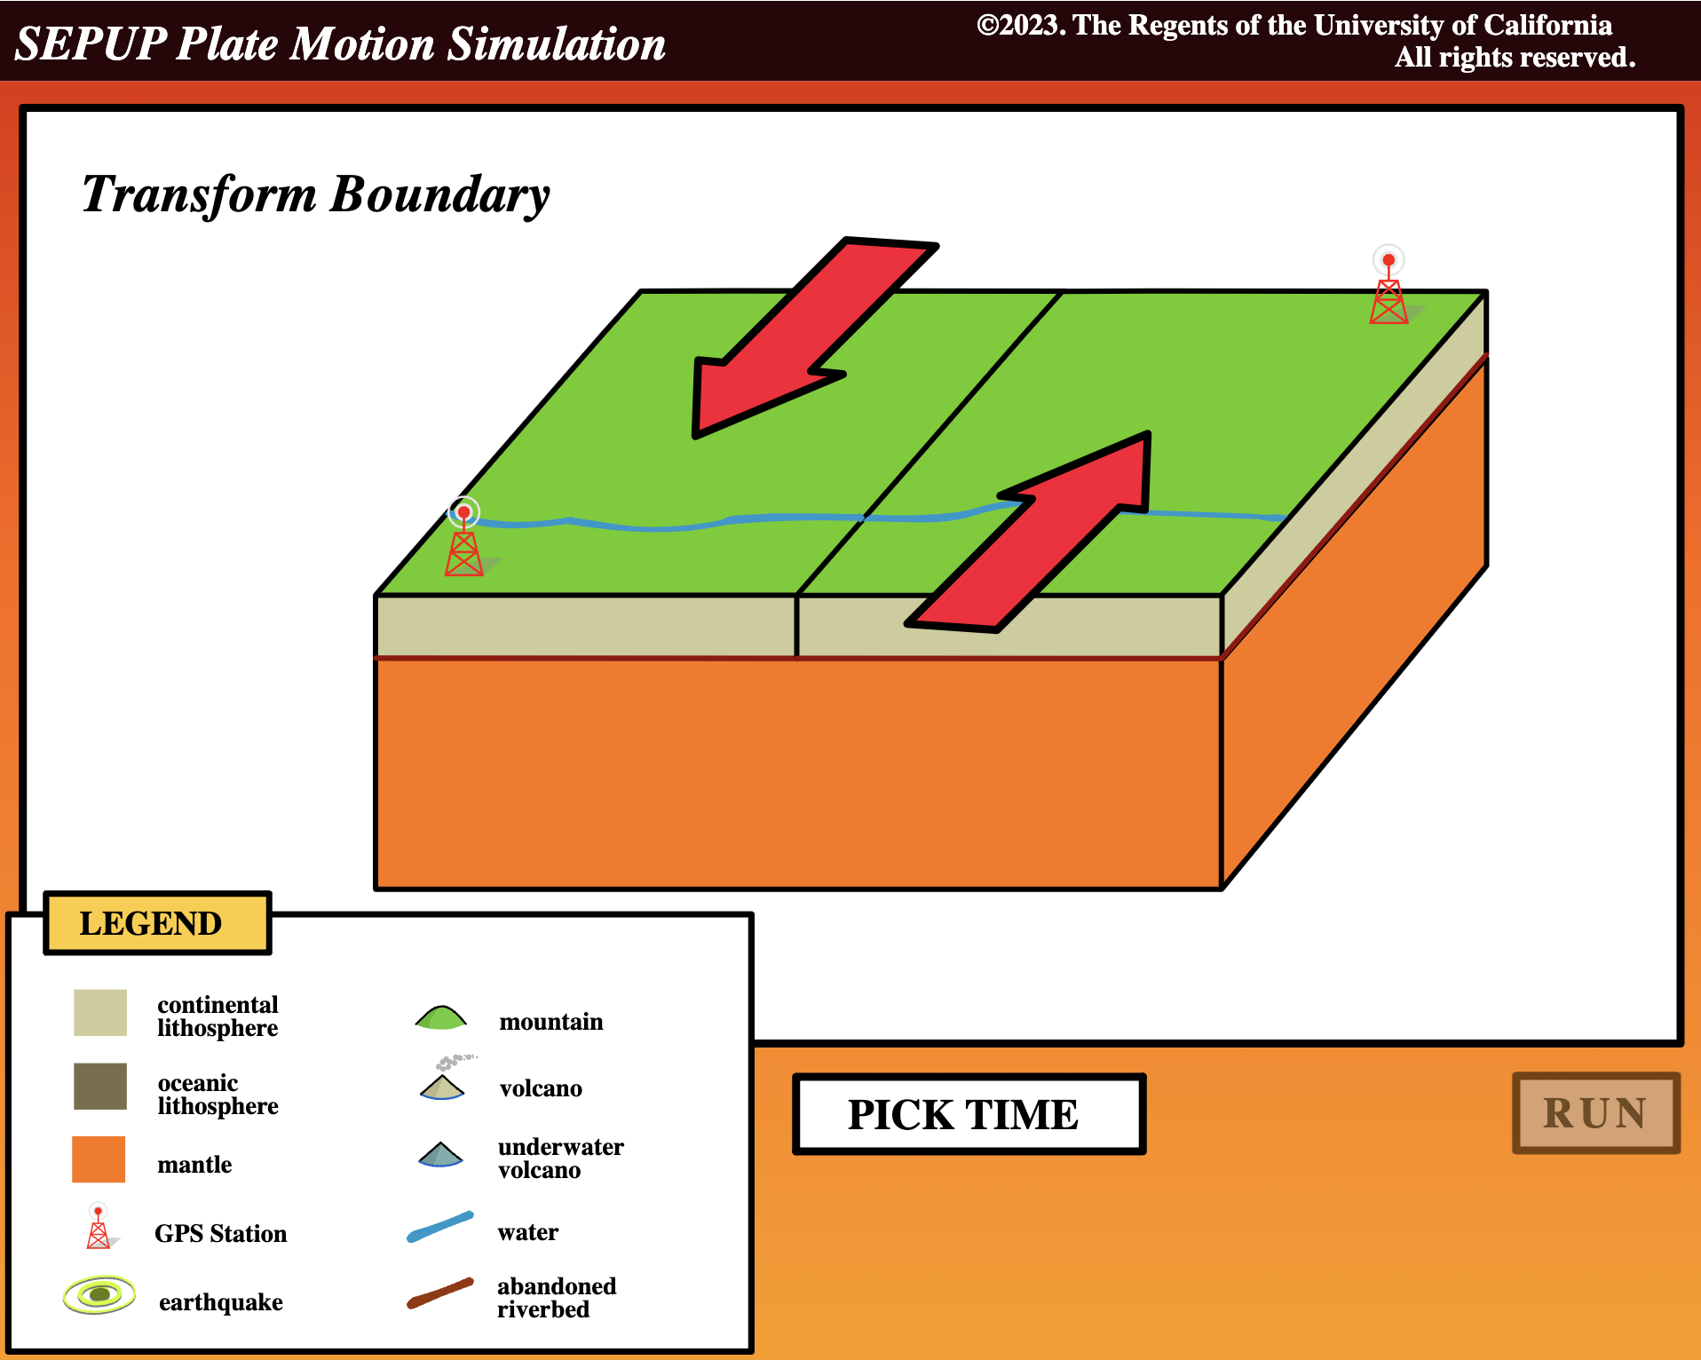
Simulation Activity
The Lawrence Hall of Science
Transform Boundary
Click the link above for a simulation to deepen your understanding of transform boundaries.
Have students select transform boundary from the options and see what happens as time passes.
Make notes of observations and wonderings as you change values of time

Slide 60
Notes:
Thanks, and please continue watching and using CAPs available from this website.

Slide 61
This Was Created With Resources From:
Questions or Comments
Michael Kennedy, Ph.D. MKennedy@Virginia.edu
Rachel L Kunemund, Ph.D. rk8vm@virginia.edu

