Slide 1
Intro
“Big Idea” Question
Review Concepts
Check-In Questions
Teacher Engagement
Vocabulary
Student-Friendly Definition
Examples & Non-Examples
Frayer Model
Simulation/Activity
Notes:
OK everyone, get ready for our next lesson. Just as a reminder, these are the different components that our lesson may include, and you’ll see these icons in the top left corner of each slide so that you can follow along more easily!

Slide 2
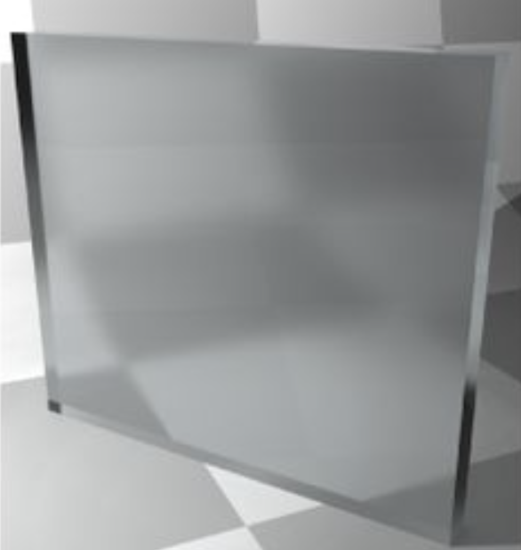
Translucent
Intro
Notes:
Today we’re going to learn about visible light.

Slide 3
Big Question: How does understanding how light works with materials shape our daily experiences?
Notes:
Before we start, let’s think about our “big question”: How does understanding how light works with materials shape our daily experiences?"
[Pause and illicit predictions from students.]
I love all these thoughtful scientific hypotheses! Be sure to keep this question and your predictions in mind as we move through these next few lessons, and we’ll continue to revisit it.

Slide 4
Demonstration
Transparent/Translucent/Opaque
TEACHER DIRECTIONS:
Before viewing: Ask students what they already know about things that are translucent. Tell students today they will be learning about the things that are translucent.
During: Discuss the differences between transparent, translucent, and opaque materials based on the experiment. Encourage students to think of other materials they encounter in daily life that fall into these categories.
After: Tell students that today they will be learning more about the term translucent.
Notes:
Materials Needed:
Clear glass or plastic container
Water
Clear plastic cup
Wax paper
Aluminum foil
Flashlight
Instructions:
Transparent Container:
Fill a clear glass or plastic container with water. Explain to the students that the container is transparent because they can see through it and light passes through it.
Transparent Plastic Cup:
Show a clear plastic cup to the students. Explain that it's also transparent because it lets light pass through. Hold it against a light source to demonstrate this.
Translucent Material - Wax Paper:
Take a piece of wax paper and hold it up to the light. Explain that wax paper is translucent because it allows some light to pass through, but not as clearly as transparent materials.
Opaque Material - Aluminum Foil:
Take a piece of aluminum foil and hold it up to the light. Explain that aluminum foil is opaque because it doesn't allow light to pass through at all.
Experiment:
Shine a flashlight from behind each material (transparent container, plastic cup, wax paper, and aluminum foil) to demonstrate how light behaves differently with each material. Students can observe how much light passes through or if it's blocked entirely.
Discussion:
Discuss the differences between transparent, translucent, and opaque materials based on the experiment. Encourage students to think of other materials they encounter in daily life that fall into these categories.
This hands-on experiment provides a clear visual demonstration of how different materials interact with light, helping students understand the concept of transparency in a practical and engaging way.

Slide 5
Notes:
Before we move on to our new vocabulary term, let’s review some other words & concepts that you already learned and make sure you are firm in your understanding.

Slide 6
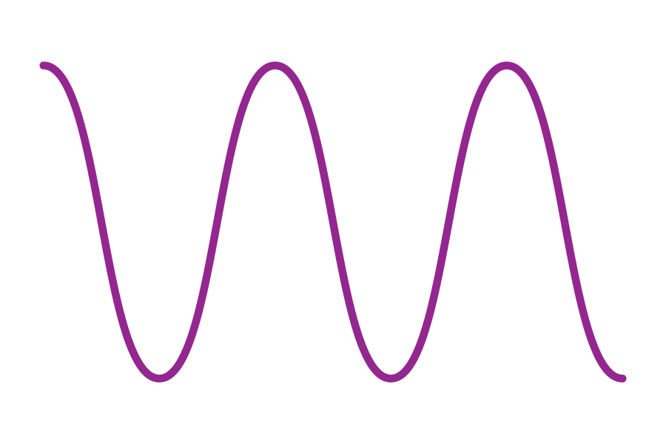
Waves: a pattern of motions that move through stuff, carrying energy from one place to another, but without carrying any matter.
Notes:
Waves are a pattern of motions that move through stuff, carrying energy from one place to another, but without carrying any matter

Slide 7
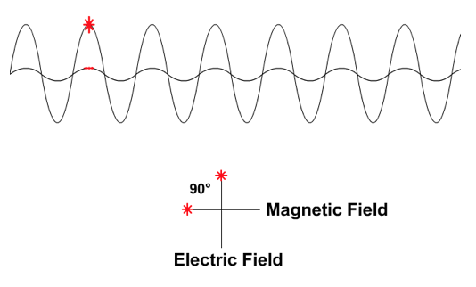
Electromagnetic Waves: waves that are created as a result of vibrations between an electric field and a magnetic field
Notes:
Electromagnetic waves are waves that are created as a result of vibrations between an electric field and a magnetic field.

Slide 8
Electromagnetic Spectrum: range of all types of electromagnetic waves
Notes:
The electromagnetic spectrum is the range of all types of magnetic waves.

Slide 9
Visible Light: wavelengths on the electromagnetic spectrum that people can see with their eyes
Notes:
Visible light are wavelengths on the electromagnetic spectrum that people can see with their eyes
Feedback: When providing more student-friendly definitions, it is helpful to provide students with cues so that they can be prepared and know what to expect and be ready to copy down the information.

Slide 10
Visible Light Spectrum: the range of all wavelengths that create colors that we can see with our eyes.
Notes:
The Visible Light Spectrum is the range of all wavelengths that create colors that we can see with our eyes.

Slide 11
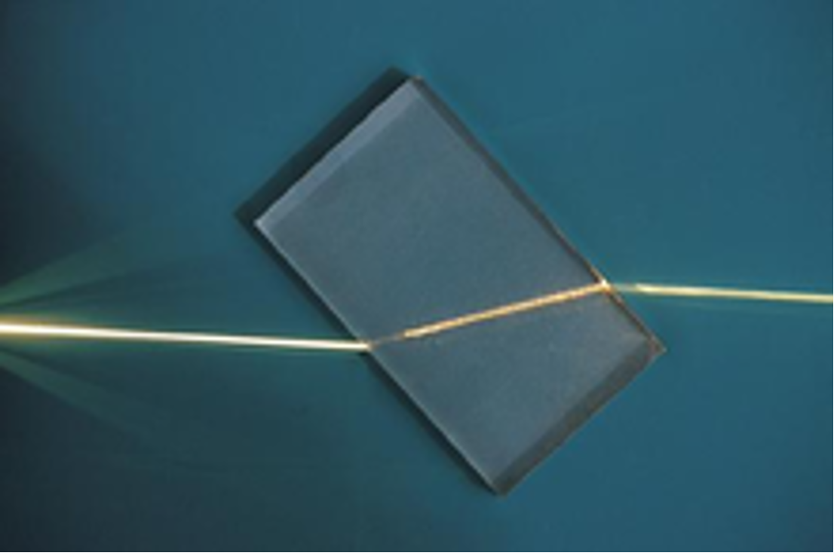
Refraction: bending of light waves when the wave moves from one medium to another
Notes:
Refraction is the bending of light waves when the wave moves from one medium to another.

Slide 12
Reflection: when light bounces back after hitting a surface.
Notes:
Reflection is when light bounces back after hitting a surface.

Slide 13
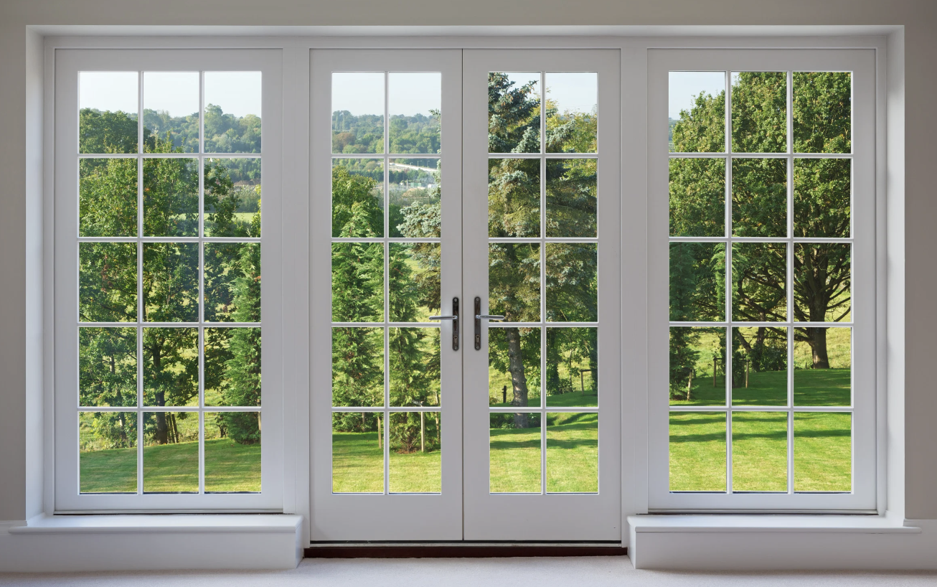
Transparent: when light can travel through an object, and you can see clearly through it
Notes:
Transparent: when light can travel through an object, and you can see clearly through it

Slide 14
Notes:
Now let’s pause for a moment to check your understanding.
Feedback: It's really important to make sure that you're providing students with frequent opportunities to respond as you're activating prior knowledge – it will save so you so much time if you confirm understanding before asking them to try something independently.

Slide 15
What are electromagnetic waves?
Notes:
What are electromagnetic waves?
[Electromagnetic waves are waves that are created as a result of vibrations between an electric field and a magnetic field.]

Slide 16
What is the electromagnetic spectrum?
Notes:
What is the electromagnetic spectrum?
[The electromagnetic spectrum is the range of all types of electromagnetic waves. These are created as result of vibrations between an electric field and a magnetic field.]

Slide 17
The range of all wavelengths that create colors that we can see with our eyes is:
The Visible Light Spectrum
The Electromagnetic Spectrum
The Microwave Spectrum
Notes:
The range of all wavelengths that create colors that we can see with our eyes is:
The Visible Light Spectrum
The Electromagnetic Spectrum
The Microwave Spectrum
[The Visible Light Spectrum]

Slide 18
The range of all wavelengths that create colors that we can see with our eyes is:
The Visible Light Spectrum
The Electromagnetic Spectrum
The Microwave Spectrum
Notes:
The range of all wavelengths that create colors that we can see with our eyes is: The Visible Light Spectrum

Slide 19
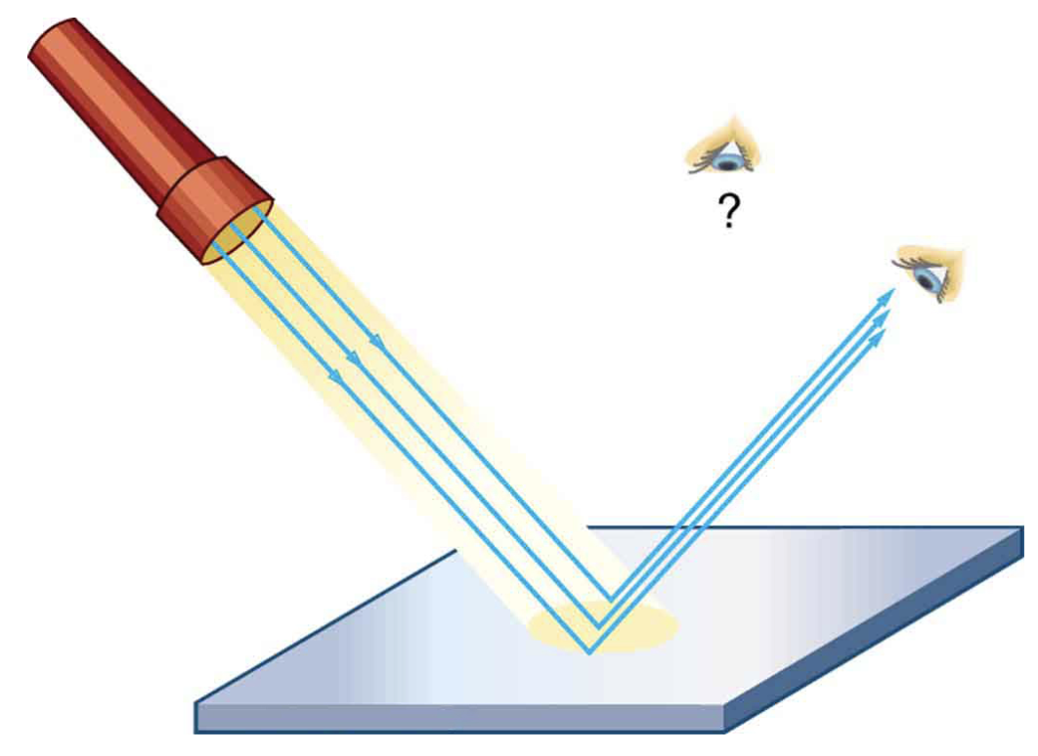
What is the difference between reflection and refraction?
Notes:
What is the difference between reflection and refraction?
[Reflection is when light bounces back after hitting a surface and Refraction is the bending of light waves when the wave moves from one medium to another]

Slide 20
Transparent: when can travel through an object, and you can see through it
Notes:
Transparent: when can travel through an object, and you can see through it

Slide 21
Transparent: when light can travel through an object, and you can see clearly through it
Notes:
Transparent: when can travel through an object, and you can see through it

Slide 22
Translucent
Notes:
Now that we’ve reviewed, let’s define our new term, visible light.

Slide 23
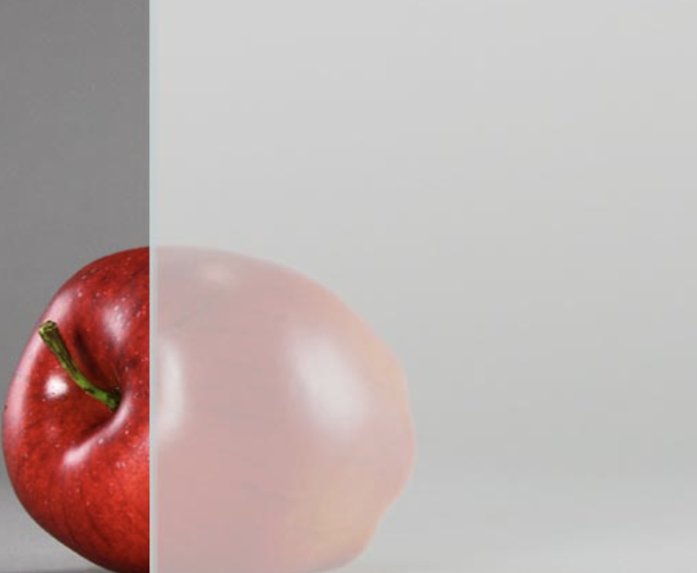
Translucent: when some light can pass through an object, but you can’t see clearly through it
Notes:
Translucent: when some light can travel through an object, but you can’t see clearly through it

Slide 24
Notes:
Let’s check-in for understanding.

Slide 25
What does translucent mean?
Notes:
What does translucent mean?
[When light, sound, or heat bounces back after hitting a surface.]

Slide 26
Notes:
That is the basic definition, but there is a bit more you need to know.

Slide 27
Stained glass windows are made of translucent glass
Notes:
Think about beautiful stained-glass windows in old churches. They are made of translucent glass, creating mesmerizing patterns when sunlight passes through. Architects often use translucent materials to create inviting and beautiful spaces while balancing light and privacy.

Slide 28
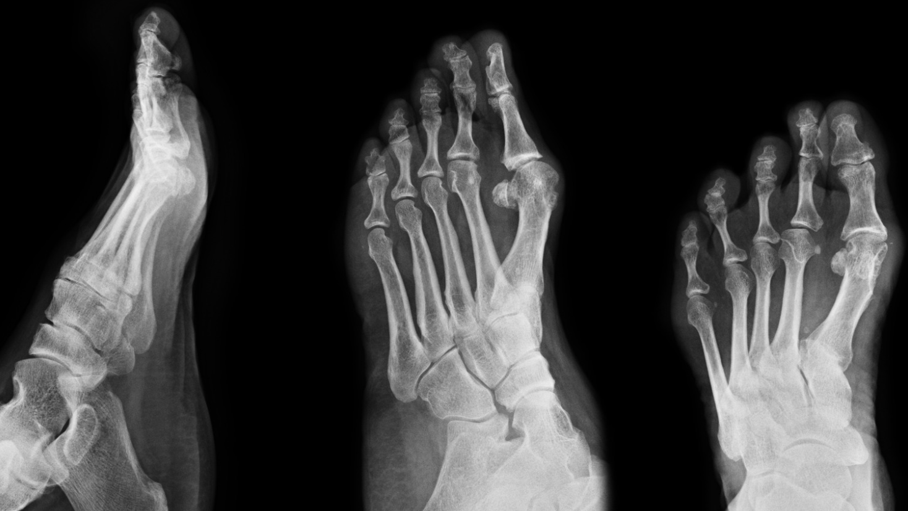
Translucent materials are used in medical imaging, like X-ray films.
Notes:
Translucent materials are used in medical imaging, like X-ray films. These materials allow a controlled number of X-rays to pass through the body, helping doctors see bones and tissues. It's crucial for
diagnosing injuries and illnesses.

Slide 29
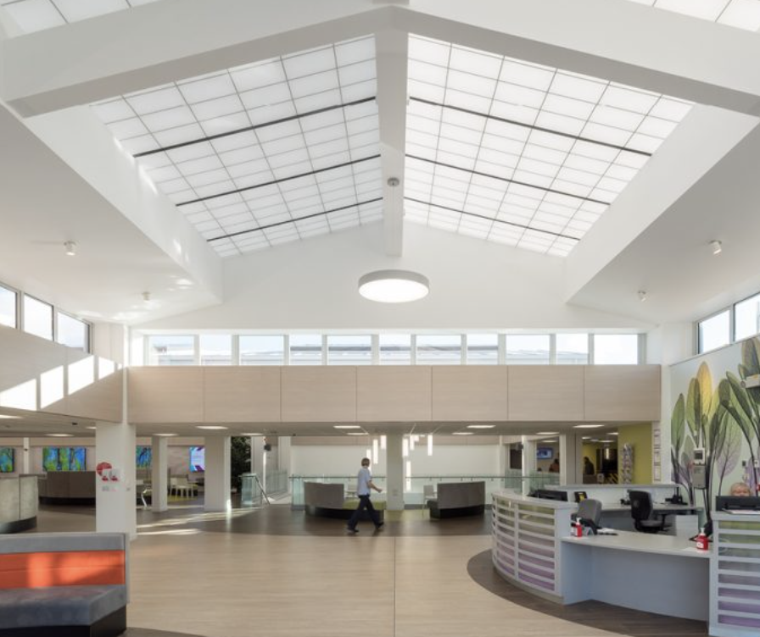
Translucent materials can spread natural out inside buildings
Notes:
Translucent materials can spread natural out inside buildings.
[sunlight]

Slide 30
Translucent materials can spread natural sunlight out inside buildings
Notes:
Translucent materials can spread natural out inside buildings.
[sunlight]

Slide 31
Notes:
Let’s check-in for understanding.

Slide 32
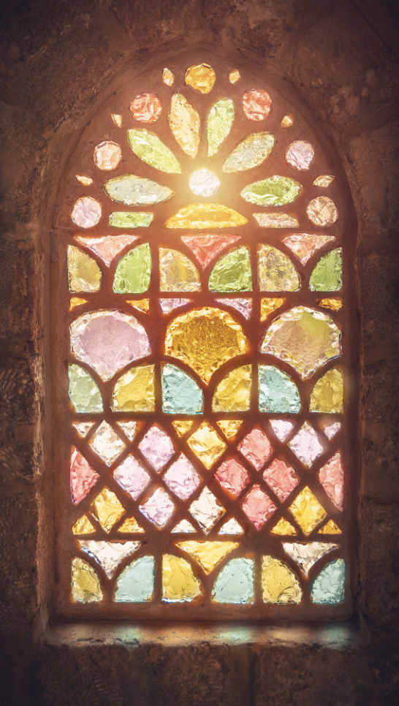
Stained glass windows are made of:
Translucent glass
Transparent glass
Opaque glass
Notes:
Stained glass windows are made of:
Translucent glass
Transparent glass
Opaque glass
[translucent glass]

Slide 33
Stained glass windows are made of:
Translucent glass
Transparent glass
Opaque glass
Notes:
Stained glass windows are made of:
Translucent glass

Slide 34
True/False: Translucent materials are used in X-ray films.
Notes:
True/False: Translucent materials are used in X-ray films to help control the number of X-rays to pass through the body.
[True]

Slide 35
True/False: Translucent materials are used in X-ray films.
Notes:
True: Translucent materials are used in X-ray films.

Slide 36
Translucent materials can spread natural sunlight out inside buildings
Notes:
Translucent materials can spread natural sunlight out inside buildings, reducing the need for artificial lighting during the day. This practice is known as daylighting, and it saves energy and lowers
electricity bills.

Slide 37
Notes:
Now, let’s talk about some examples of visible light.
Feedback: It's good to pick a variety of examples to work through with your students. This prepares them for some types that might trip them up when they try it on their own.

Slide 38
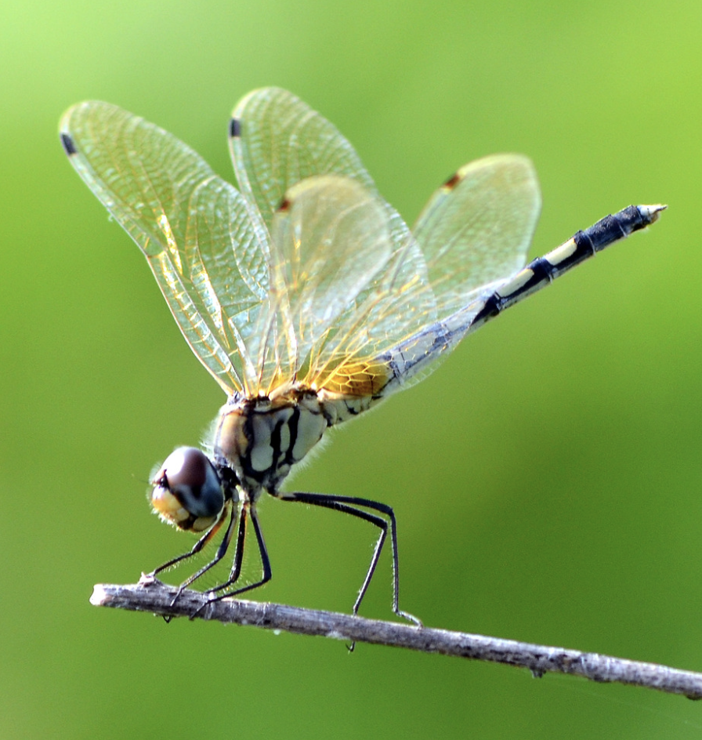
A dragonfly’s wings are an example of something that is translucent
Notes:
A dragonfly’s wings are an example of something that is translucent. Some light can through their wings, but you can’t see clearly through them.

Slide 39
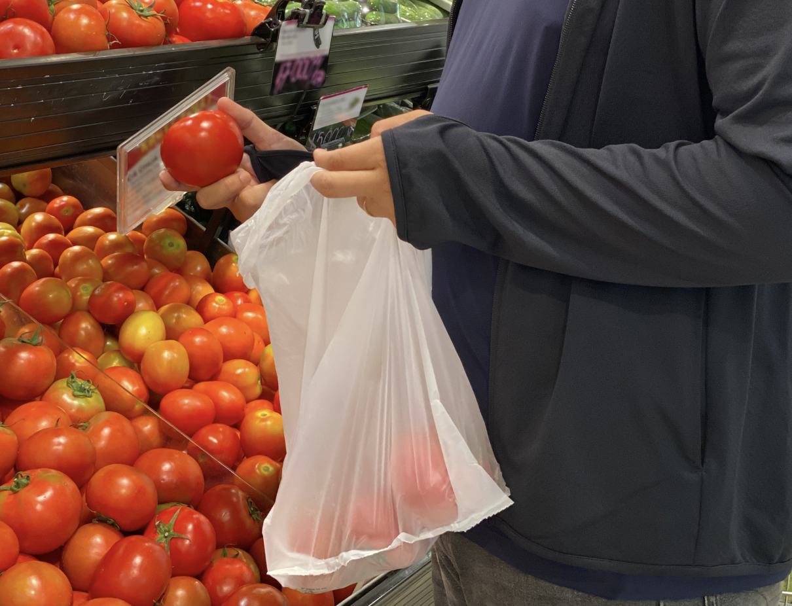
Grocery story plastic bags are an example of something translucent
Notes:
Grocery story plastic bags are another example of something translucent.

Slide 40
Notes:
Next, let’s talk about some non-examples of visible light.

Slide 41
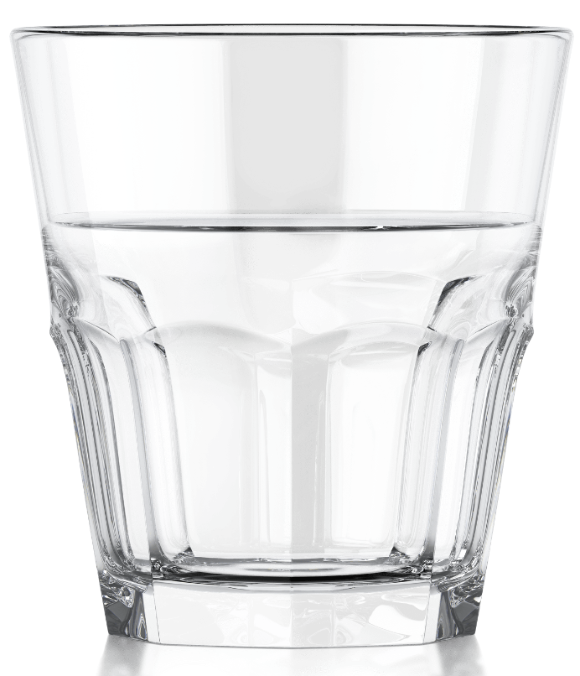
A clear glass is NOT an example of something translucent
Notes:
A clear glass is NOT an example of something translucent. A clear glass is transparent since it allows light to pass through and you can see through it clearly.
Feedback: Non-examples often need some explanation to make it clear to students the difference. Using clear and simple language can help with this.

Slide 42
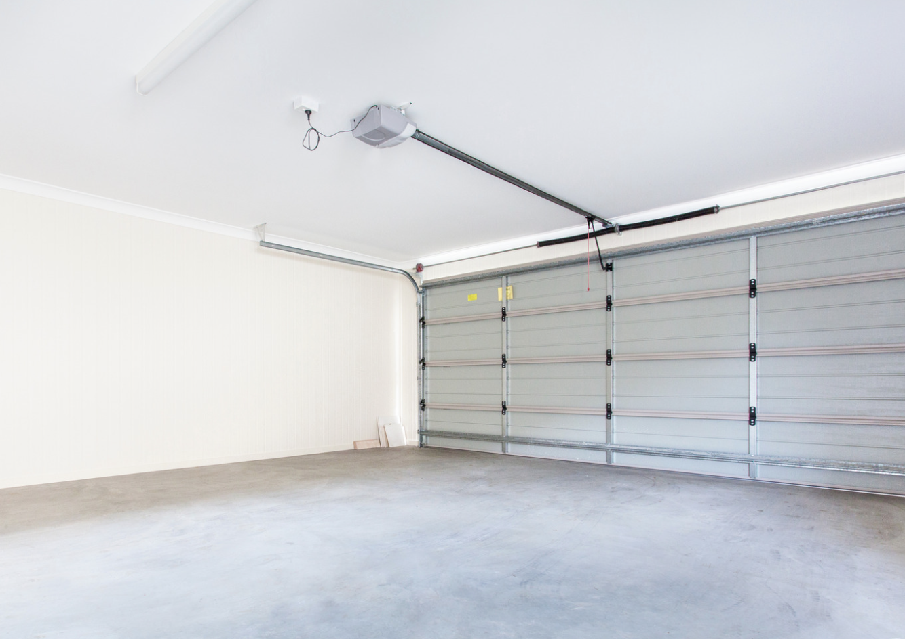
A metal garage door is NOT an example of something translucent
Notes:
A metal garage door is NOT an example of something translucent. A metal garage door is opaque, meaning no light passes through and you cannot see through it clearly.

Slide 43
Notes:
Let’s check-in for understanding.

Slide 44
What are examples of things that are translucent?
Notes:
What are examples of things that are translucent?
[dragonfly wings, plastic shopping bags, stained-glass windows, frosted windows, wax paper]

Slide 45
True/False: A metal garage door is translucent
Notes:
True/False: A metal garage door is translucent.
[False]

Slide 46
True/False: A metal garage door is translucent
Notes:
False: A metal garage door is NOT translucent, a metal garage door is opaque, no light can pass through it.

Slide 47
Notes:
We will now complete this concept map, called a Frayer model, to summarize and further clarify what you have learned about the term reflection.

Slide 48
Definition
Picture
Translucent
How do things that are translucent impact my life?
Example
Notes:
To complete the Frayer model, we will choose from four choices the correct picture, definition, example, and response to the question, “How do things that are translucent impact my life?
?” Select the best response for each question using the information you just learned. As we select responses, we will see how this model looks filled in for the term translucent.

Slide 49
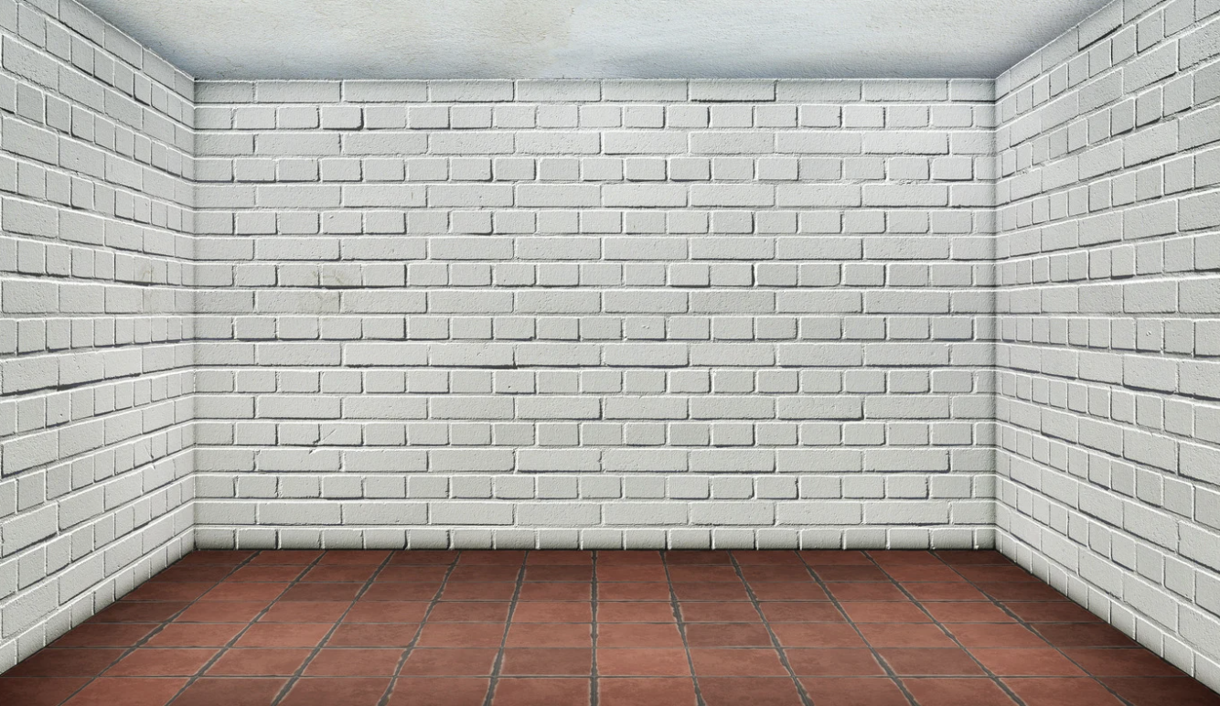
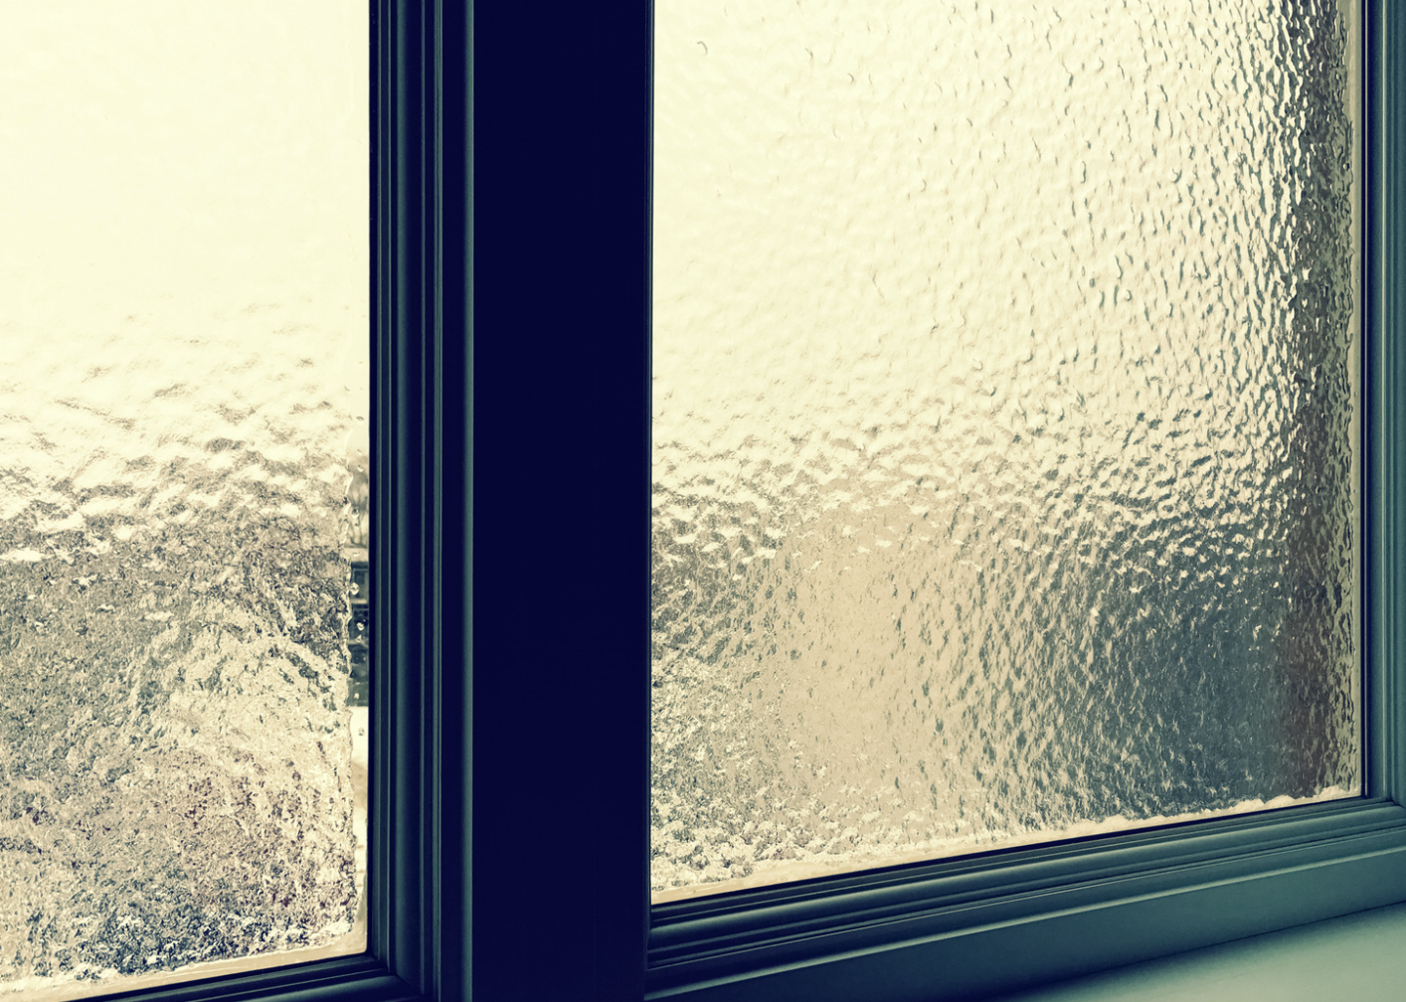
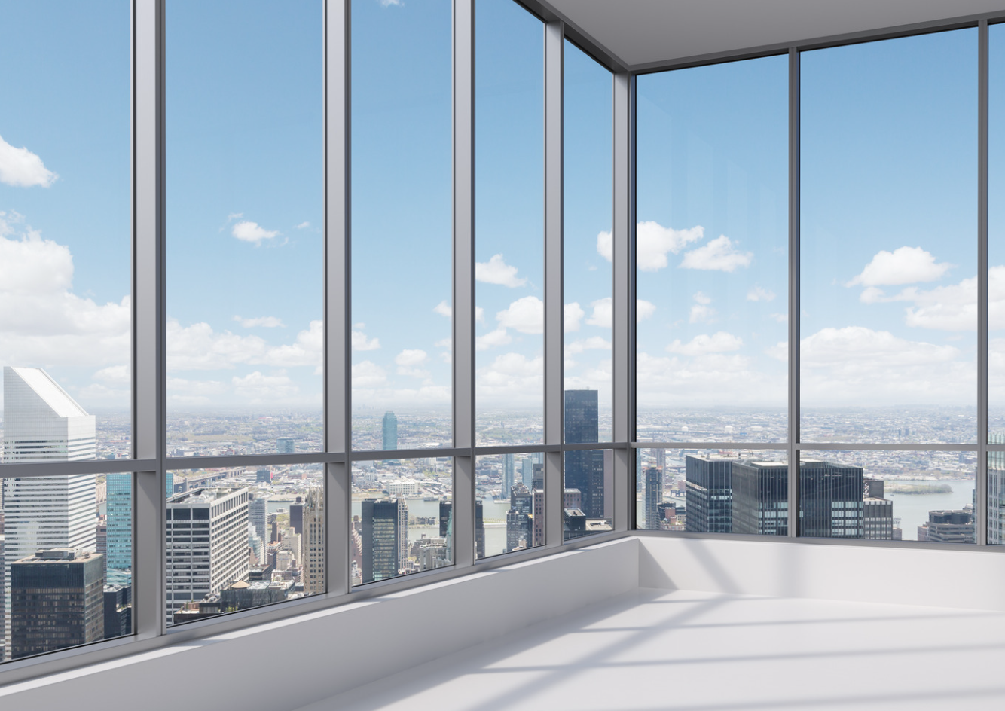
Directions: Choose the correct picture of something translucent from the choices below.
A
B
C
D
Notes:
Choose the one correct picture of something translucent from these four choices.

Slide 50
Directions: Choose the correct picture of something translucent from the choices below.
A
B
C
D
Notes:
This is the picture that shows something that is translucent. These are privacy glass windows that let some light pass through, but you cannot see through them clearly.

Slide 51
Definition
Picture
Translucent
How do things that are translucent impact my life?
Example
Notes:
Here is the Frayer model filled in with a picture of something that is translucent.

Slide 52
Directions: Choose the correct definition of translucent from the choices below.
A
When light, sound, or heat bounces back after hitting a surface
B
When some light can pass through an object, but you can’t see clearly through it
C
When no light can pass through something, and you can not see through it
D
When light can travel through an object, and you can see clearly through it
Notes:
Choose the one correct definition of translucent from these four choices.

Slide 53
Directions: Choose the correct definition of translucent from the choices below.
A
When light, sound, or heat bounces back after hitting a surface
B
When some light can pass through an object, but you can’t see clearly through it
C
When no light can pass through something, and you can not see through it
D
When light can travel through an object, and you can see clearly through it
Notes:
“When some light can pass through an object, but you can’t see clearly through it.” is correct! This is the definition of translucent.

Slide 54
Definition
Picture
When some light can pass through an object, but you can’t see clearly through it
Translucent
How do things that are translucent impact my life?
Example
Notes:
Here is the Frayer Model with a picture and the definition filled in for translucent: When some light can pass through an object, but you can’t see clearly through it.

Slide 55
Directions: Choose the correct example of something that is translucent from the choices below.
A
Car windshield
B
Construction paper
C
Wax paper
D
Blackout curtains
Notes:
Choose the one correct example of something that is translucent from these four choices.

Slide 56
Directions: Choose the correct example of something that is translucent from the choices below.
A
Car windshield
B
Construction paper
C
Wax paper
D
Blackout curtains
Notes:
“Wax paper” is correct! This is an example of something that is translucent. It lets some light pass through it, but you cannot see through it clearly.

Slide 57
Definition
Picture
When some light can pass through an object, but you can’t see clearly through it
Translucent
Wax paper
How do things that are translucent impact my life?
Example
Notes:
Here is the Frayer Model with a picture, definition, and an example of something that is translucent: Wax paper.

Slide 58
Directions: Choose the correct response for “How do things that are translucent impact my life?” from the choices below.
A
Translucent things block all sunlight from entering buildings. This helps to keep the buildings and people inside them, like me, cool in the summer.
B
I see my reflection in the mirror every morning. The mirror is always translucent, letting me clearly see how I look and helping me get ready for the day.
C
Translucent things like frosted glass provide privacy in bathrooms or other spaces, allowing me to see and enjoy the light from outside, but preventing people outside to see clearly inside.
D
Translucent things are used to help pull the moon toward earth and that affects the weather.
Notes:
Choose the one correct response for “How do things that are translucent impact my life?” from these four choices.

Slide 59
Directions: Choose the correct response for “How do things that are translucent impact my life?” from the choices below.
A
Translucent things block all sunlight from entering buildings. This helps to keep the buildings and people inside them, like me, cool in the summer.
B
I see my reflection in the mirror every morning. The mirror is always translucent, letting me clearly see how I look and helping me get ready for the day.
C
Translucent things like frosted glass provide privacy in bathrooms or other spaces, allowing me to see and enjoy the light from outside, but preventing people outside to see clearly inside.
D
Translucent things are used to help pull the moon toward earth and that affects the weather.
Notes:
“Translucent things like frosted glass provide privacy in bathrooms or other spaces, allowing me to see and enjoy the light from outside, but preventing people outside to see clearly inside.” That is correct! This is an example of how translucent things impacts your life.

Slide 60
Definition
Picture
When some light can pass through an object, but you can’t see clearly through it
Translucent
Translucent things like frosted glass provide privacy in bathrooms or other spaces, allowing me to see and enjoy the light from outside, but preventing people outside to see clearly inside.
Wax paper
How do things that are translucent impact my life?
Example
Notes:
Here is the Frayer Model with a picture, definition, and an example of something that is translucent: Wax paper.

Slide 61
Remember!!!
Notes:
So remember!
Feedback: A good general strategy for information retention is: 1) tell them what you're going to teach them, 2) teach them, and 3) tell them what you just taught them. Make sure to include the third and final step. While it is easy to think a quick review of what you just went over is unnecessary, it can be incredibly useful in helping the students remember the information over the long term.

Slide 62
Translucent: when some light can pass through an object, but you can’t see clearly through it
Notes:
Translucent means when some light can travel through an object, but you can’t see clearly through it

Slide 63
Big Question: How does understanding how light works with materials shape our daily experiences?
Notes:
Let’s reflect once more on our big question. Our “big question” is: How does understanding how light works with materials shape our daily experiences?
Does anyone have any additional examples to share that haven’t been discussed yet?

Slide 64
Notes:
Thanks for watching, and please continue watching CAPs available from this website.

Slide 65
This Video Was Created With Resources From:
Questions or Comments
Michael Kennedy, Ph.D. MKennedy@Virginia.edu
Rachel L Kunemund, Ph.D. rk8vm@virginia.edu

