Slide 1
Intro
“Big Idea” Question
Review Concepts
Check-In Questions
Teacher Engagement
Vocabulary
Student-Friendly Definition
Examples & Non-Examples
Frayer Model
Simulation/Activity
Notes:
OK everyone, get ready for our next lesson. Just as a reminder, these are the different components that our lesson may include, and you’ll see these icons in the top left corner of each slide so that you can follow along more easily!

Slide 2
Intro
Transparent
Notes:
Today we’re going to learn about visible light.

Slide 3
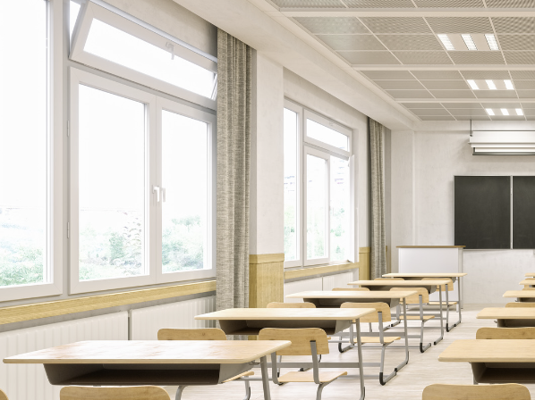
Big Question: How do things that are transparent impact people’s environments and their daily lives?
Notes:
Before we start, let’s think about our “big question”: How do things that are transparent impact people’s environments and their daily lives?
[Pause and illicit predictions from students.]
I love all these thoughtful scientific hypotheses! Be sure to keep this question and your predictions in mind as we move through these next few lessons, and we’ll continue to revisit it.

Slide 4
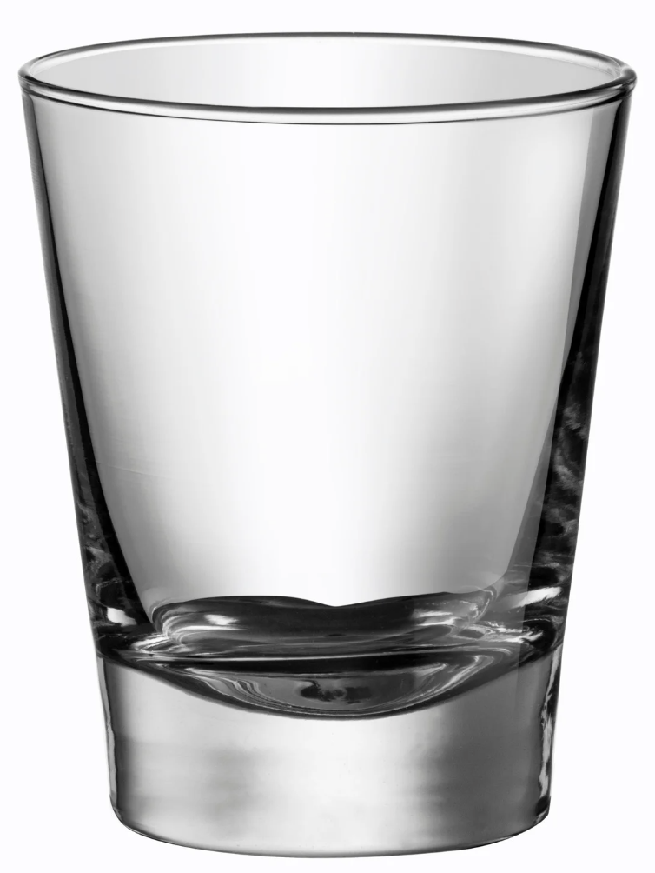
Demonstration
Transparent/Translucent/Opaque
TEACHER DIRECTIONS:
Before viewing: Ask students what they already know about things that are transparent. Tell students today they will be learning about the things that are transparent.
During: Discuss the differences between transparent, translucent, and opaque materials based on the experiment. Encourage students to think of other materials they encounter in daily life that fall into these categories.
After: Tell students that today they will be learning more about the term transparent.
Notes:
Materials Needed:
Clear glass or plastic container
Water
Clear plastic cup
Wax paper
Aluminum foil
Flashlight
Instructions:
Transparent Container:
Fill a clear glass or plastic container with water. Explain to the students that the container is transparent because they can see through it and light passes through it.
Transparent Plastic Cup:
Show a clear plastic cup to the students. Explain that it's also transparent because it lets light pass through. Hold it against a light source to demonstrate this.
Translucent Material - Wax Paper:
Take a piece of wax paper and hold it up to the light. Explain that wax paper is translucent because it allows some light to pass through, but not as clearly as transparent materials.
Opaque Material - Aluminum Foil:
Take a piece of aluminum foil and hold it up to the light. Explain that aluminum foil is opaque because it doesn't allow light to pass through at all.
Experiment:
Shine a flashlight from behind each material (transparent container, plastic cup, wax paper, and aluminum foil) to demonstrate how light behaves differently with each material. Students can observe how much light passes through or if it's blocked entirely.
Discussion:
Discuss the differences between transparent, translucent, and opaque materials based on the experiment. Encourage students to think of other materials they encounter in daily life that fall into these categories.
This hands-on experiment provides a clear visual demonstration of how different materials interact with light, helping students understand the concept of transparency in a practical and engaging way.

Slide 5
Notes:
Before we move on to our new vocabulary term, let’s review some other words & concepts that you already learned and make sure you are firm in your understanding.

Slide 6
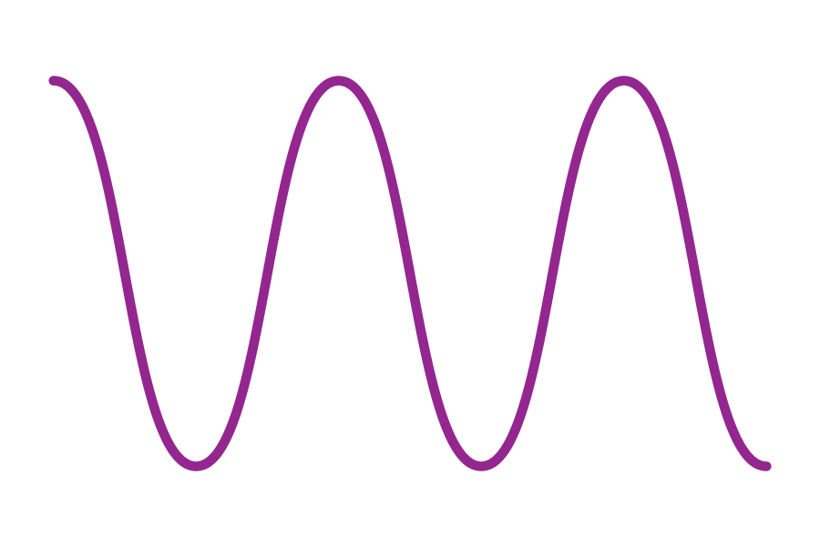
Waves: a pattern of motions that move through stuff, carrying energy from one place to another, but without carrying any matter.
Notes:
Waves are a pattern of motions that move through stuff, carrying energy from one place to another, but without carrying any matter

Slide 7
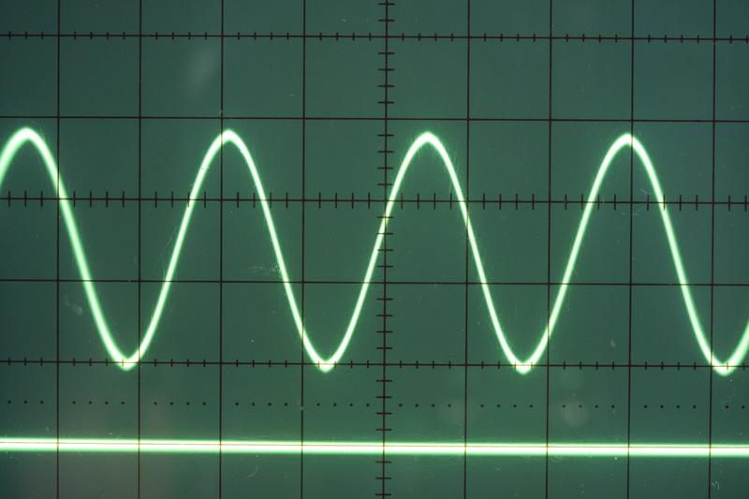
Transverse Waves: waves that travel sideways to the direction they are moving
Notes:
Transverse waves are waves that travel sideways to the direction they are moving.

Slide 8
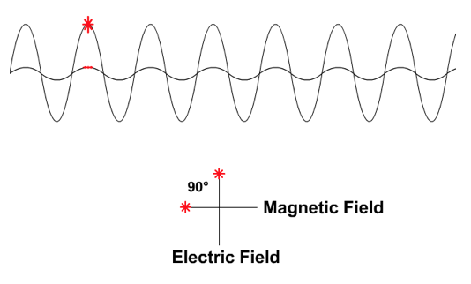
Electromagnetic Waves: waves that are created as a result of vibrations between an electric field and a magnetic field
Notes:
Electromagnetic waves are waves that are created as a result of vibrations between an electric field and a magnetic field.

Slide 9
Electromagnetic Spectrum: range of all types of electromagnetic waves
Notes:
The electromagnetic spectrum is the range of all types of magnetic waves.

Slide 10
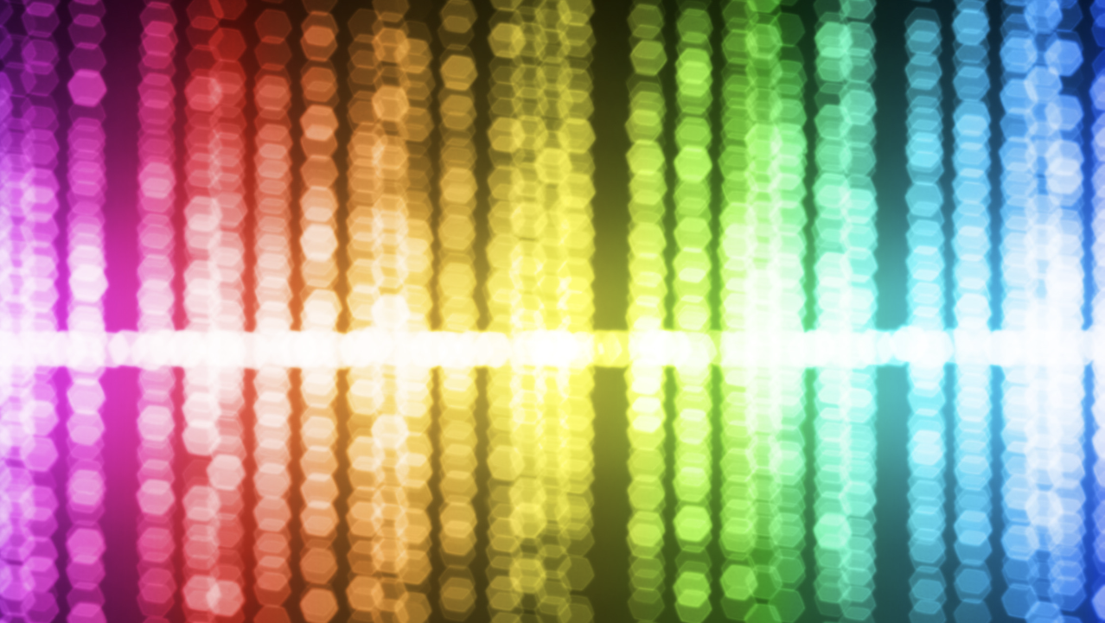
Visible Light: wavelengths on the electromagnetic spectrum that people can see with their eyes
Notes:
Visible light are wavelengths on the electromagnetic spectrum that people can see with their eyes
Feedback: When providing more student-friendly definitions, it is helpful to provide students with cues so that they can be prepared and know what to expect and be ready to copy down the information.

Slide 11
Visible Light Spectrum: the range of all wavelengths that create colors that we can see with our eyes.
Notes:
The Visible Light Spectrum is the range of all wavelengths that create colors that we can see with our eyes.

Slide 12
Reflection: when light, sound, or heat bounces back after hitting a surface.
Notes:
A reflection is when light, sound, or heat bounces back after hitting a surface.

Slide 13
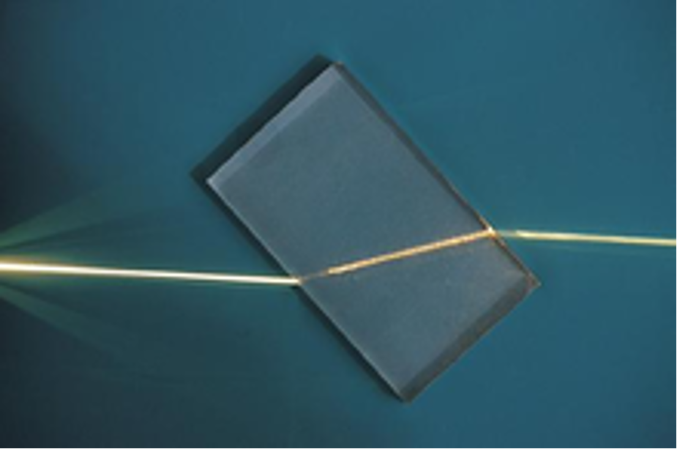
Refraction: bending of light waves when the wave moves from one medium to another
Notes:
Refraction is the bending of light waves when the wave moves from one medium to another.

Slide 14
Notes:
Now let’s pause for a moment to check your understanding.
Feedback: It's really important to make sure that you're providing students with frequent opportunities to respond as you're activating prior knowledge – it will save so you so much time if you confirm understanding before asking them to try something independently.

Slide 15
What is the difference between waves and transverse waves?
Notes:
What is the difference between waves and transverse waves?
[Transverse waves are simply a type of wave that moves sideways to the direction they are moving. This is not the case for all waves.]

Slide 16
What are electromagnetic waves?
Notes:
What are electromagnetic waves?
[Electromagnetic waves are waves that are created as a result of vibrations between an electric field and a magnetic field.]

Slide 17
What is the electromagnetic spectrum?
Notes:
What is the electromagnetic spectrum?
[The electromagnetic spectrum is the range of all types of electromagnetic waves. These are created as result of vibrations between an electric field and a magnetic field.]

Slide 18
True/False: Visible Light is wavelengths on the electromagnetic spectrum that people can see with their eyes
Notes:
True/False: Visible Light is wavelengths on the electromagnetic spectrum that people can see with their eyes
[True]

Slide 19
True/False: Visible Light is wavelengths on the electromagnetic spectrum that people can see with their eyes
Notes:
True: Visible Light is wavelengths on the electromagnetic spectrum that people can see with their eyes

Slide 20
is the bending of light waves when the wave moves from one medium to another
Notes:
[Refraction] is the bending of light waves when the wave moves from one medium to another.

Slide 21
Refraction is the bending of light waves when the wave moves from one medium to another
Notes:
[Refraction] is the bending of light waves when the wave moves from one medium to another.

Slide 22
Transparent
Notes:
Now that we’ve reviewed, let’s define our new term, transparent.

Slide 23
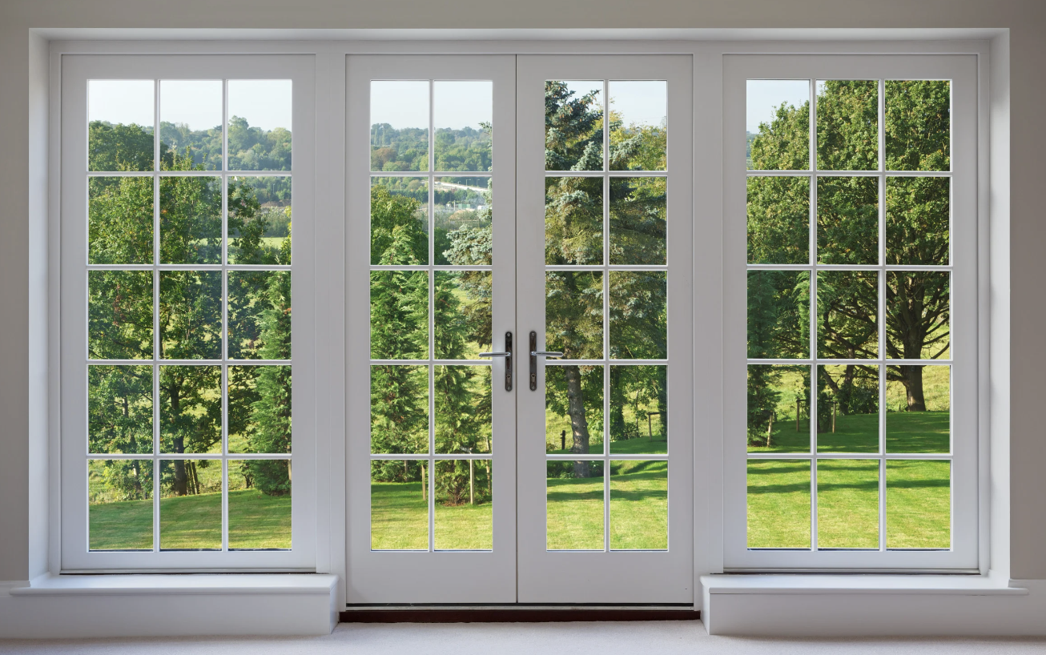
Transparent: when light can travel through an object, and you can see clearly through it
Notes:
Transparent: when light can travel through an object, and you can see clearly through it
Feedback: When providing more student-friendly definitions, it is helpful to provide students with cues so that they can be prepared and know what to expect and be ready to copy down the information.

Slide 24
Notes:
Let’s check-in for understanding.

Slide 25
What does transparent mean?
Notes:
What is does transparent mean?
[when light can travel through an object, and you can see clearly through it.]

Slide 26
Notes:
That is the basic definition, but there is a bit more you need to know.

Slide 27
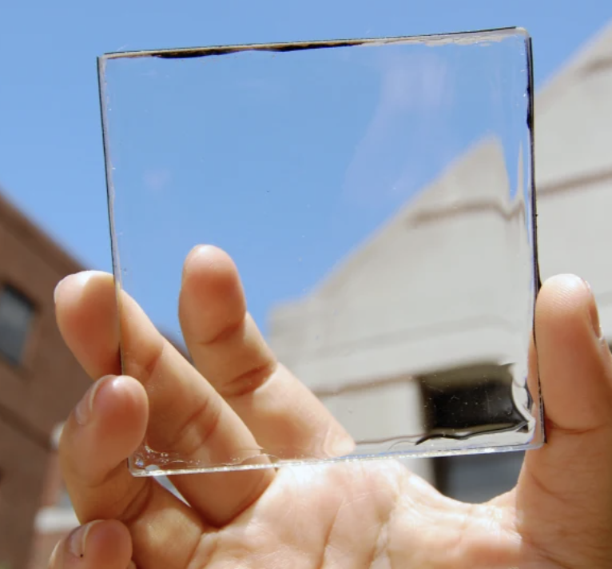
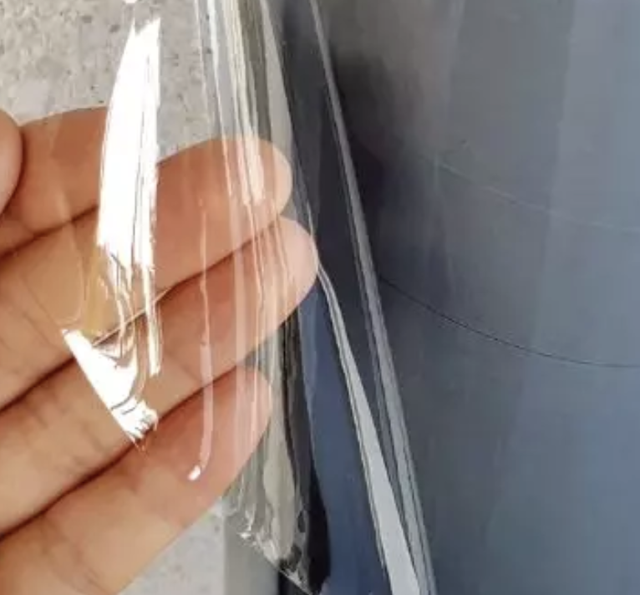
Transparent materials allow light to pass through them clearly without bending or scattering the light waves
Notes:
Transparent materials, like clear plastic, glass, or water, allow light to pass through them clearly without bending or scattering the light waves. Think of a clear glass window – you can see through it, and it lets sunlight in, illuminating the room.

Slide 28
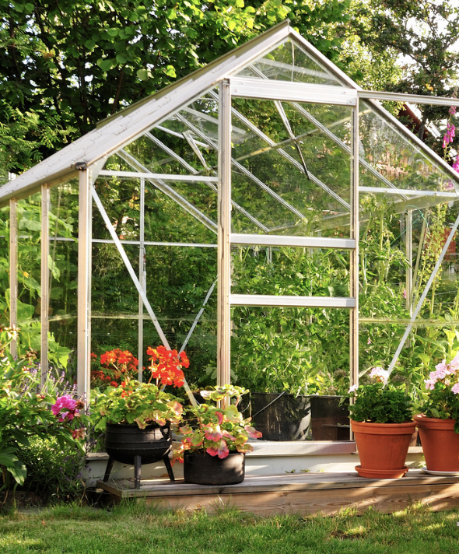
Transparent materials are used in greenhouses.
Notes:
Transparent materials, like glass or clear plastic, are used in greenhouses. Sunlight passes through the transparent walls and roof, creating a warm and well-lit environment for plants to grow. This helps in
agriculture by providing ideal conditions for plants to thrive, ensuring a steady supply of fresh fruits and vegetables.

Slide 29
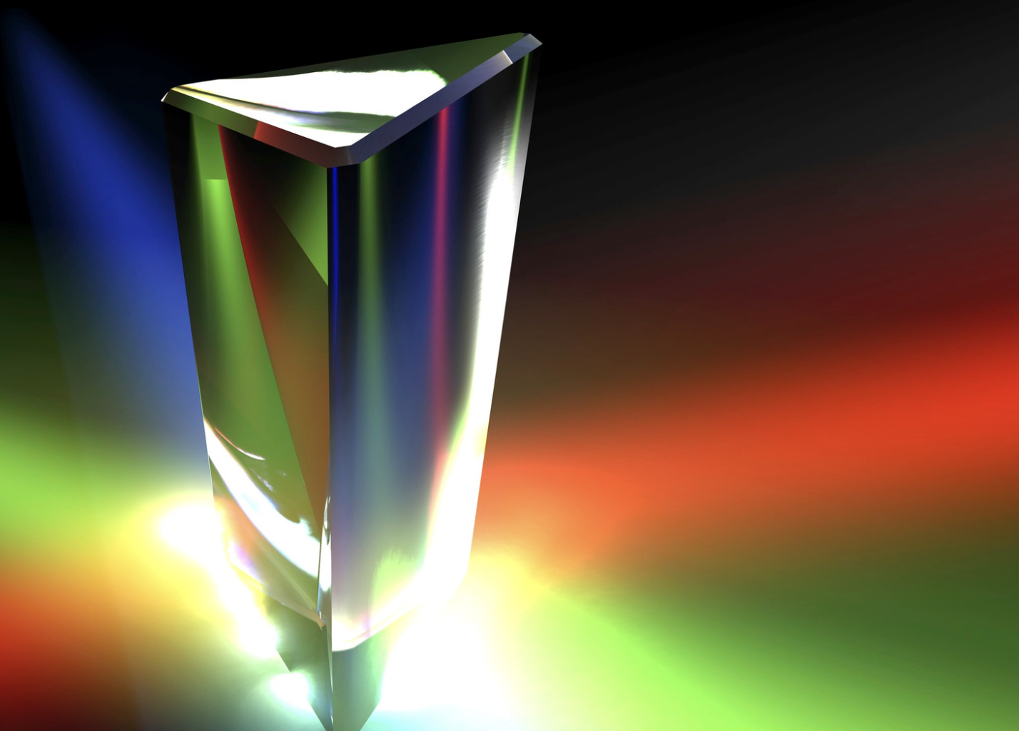
Artists and scientists often use transparent materials to create optical illusions
Notes:
Artists and scientists often use transparent materials to create optical illusions. For instance, a glass prism can split white light into its various colors, creating a rainbow effect. This phenomenon
demonstrates how transparent materials can manipulate light, leading to beautiful visual experiences.

Slide 30
Notes:
Let’s check-in for understanding.

Slide 31
Transparent materials allow to pass through them without bending or scattering the light waves
Notes:
Transparent materials allow to pass through them without bending or scattering the light waves.
[light, clearly]

Slide 32
Transparent materials allow light to pass through them clearly without bending or scattering the light waves
Notes:
Transparent materials allow light to pass through them clearly without bending or scattering the light waves

Slide 33
Notes:
Now, let’s talk about some examples of things that are transparent.
Feedback: It's good to pick a variety of examples to work through with your students. This prepares them for some types that might trip them up when they try it on their own.

Slide 34
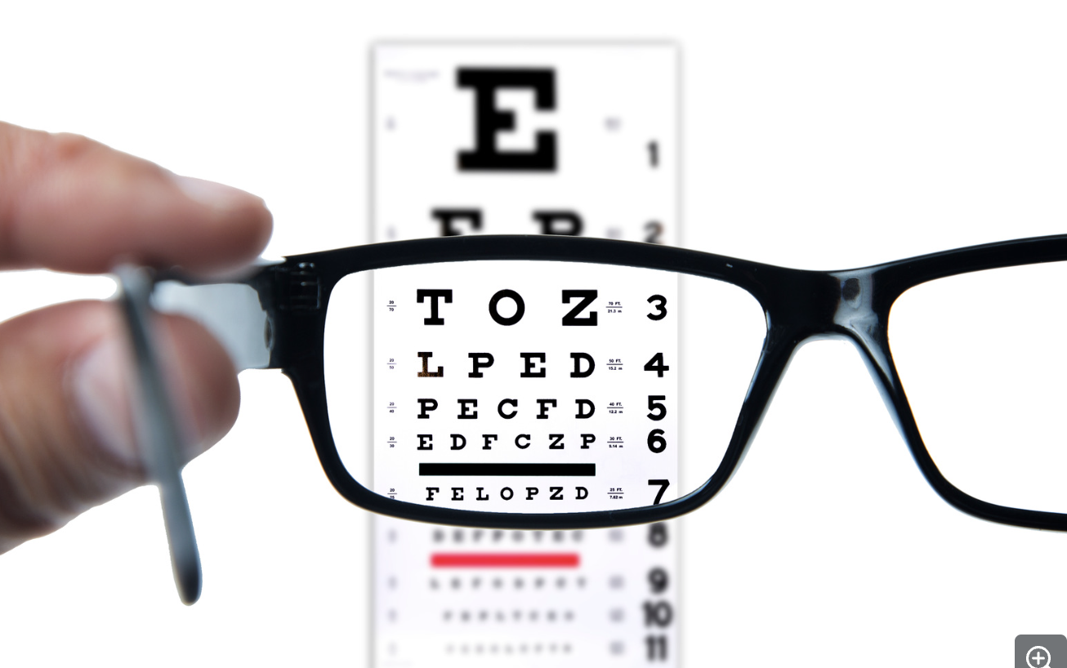
The lenses in eyeglasses are an example of something that is transparent
Notes:
The lenses in eyeglasses are an example of something that is transparent. Eyeglasses use transparent lenses to help people see better

Slide 35
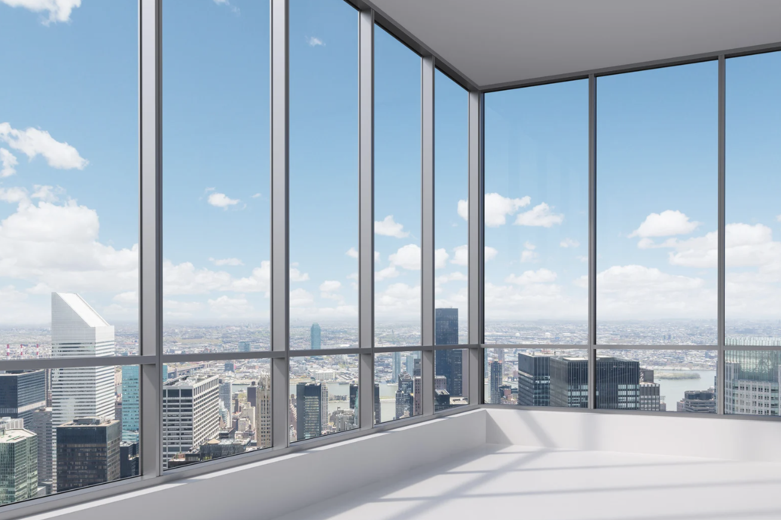
Windows are another example of something that is transparent
Notes:
Windows in buildings and cars are an example of something that is transparent. They allow us to see outside and bring natural light inside.

Slide 36
Another example of something transparent are car windshields.
Notes:
Another example of something transparent are car windshields. Car windshields need to be transparent so we can clearly see through them as we drive.

Slide 37
Notes:
Next, let’s talk about some non-examples of visible light.

Slide 38
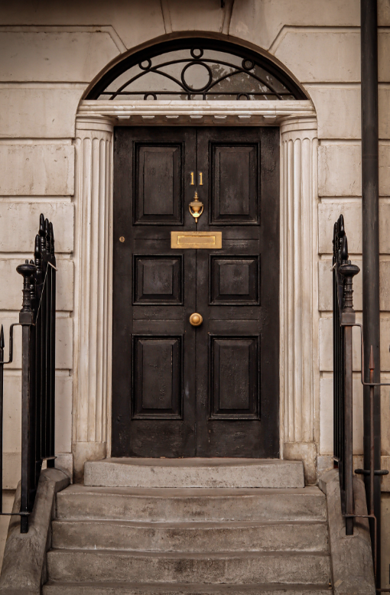
A wooden door is NOT an example of something transparent.
Notes:
A wooden door is NOT an example of something transparent. You cannot see through a wooden door.
Feedback: Non-examples often need some explanation to make it clear to students the difference. Using clear and simple language can help with this.

Slide 39
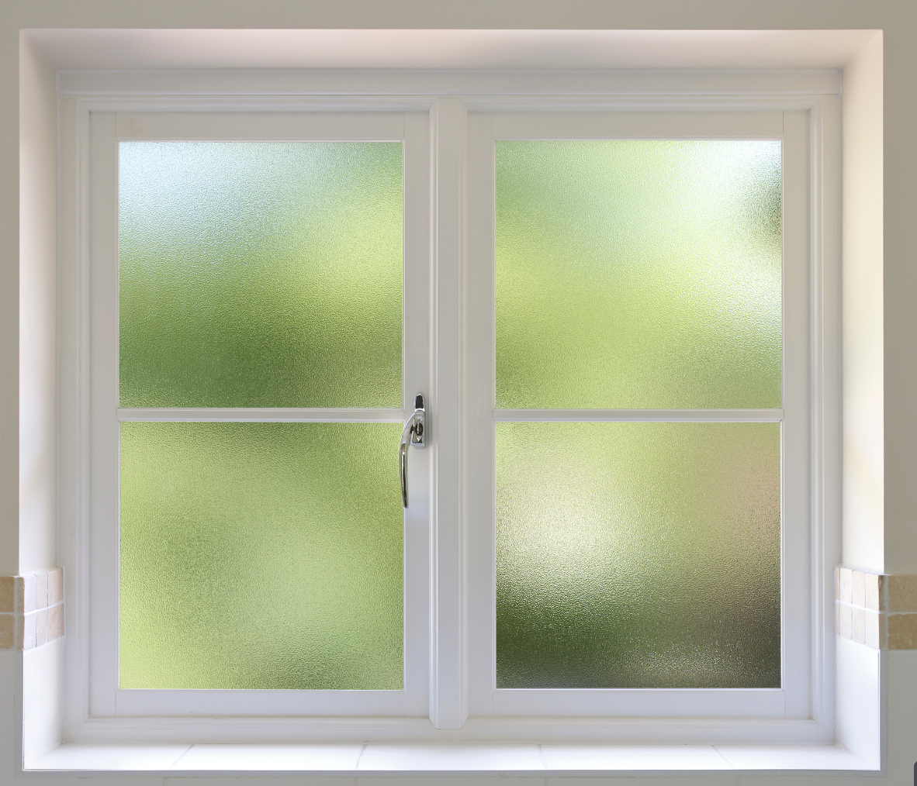
Frosted glass is NOT an example of something transparent.
Notes:
Frosted glass is NOT an example of something transparent. Frosted glass is not completely clear like regular glass; it is treated to create a slightly rough surface. This rough surface scatters light as it
Passes through, making the glass translucent. While you cannot see clearly through frosted glass, it still allows some light to pass through, diffusing it in a way that provides privacy while still letting in light.
Frosted glass is often used in windows, shower doors, and partitions to balance privacy and illumination in various settings.

Slide 40
Notes:
Let’s check-in for understanding.

Slide 41
What are examples of things that are transparent?
Notes:
What are examples of things that are transparent?
[Car windshields, glasses lenses, windows]

Slide 42
True/False: Frosted glass is an example of something that is transparent.
Notes:
True/False: Frosted glass is an example of something that is transparent.
[False]

Slide 43
True/False: Frosted glass is an example of something that is transparent.
Notes:
False: Frosted glass is an example of something that is transparent.

Slide 44
Notes:
We will now complete this concept map, called a Frayer model, to summarize and further clarify what you have learned about the term transparent.

Slide 45
Definition
Picture
Transparent
How do things that are transparent impact my life?
Example
Notes:
To complete the Frayer model, we will choose from four choices the correct picture, definition, example, and response to the question, “How do things that are transparent impact my life?” Select the best response for each question using the information you just learned. As we select responses, we will see how this model looks filled in for the term transparent.

Slide 46
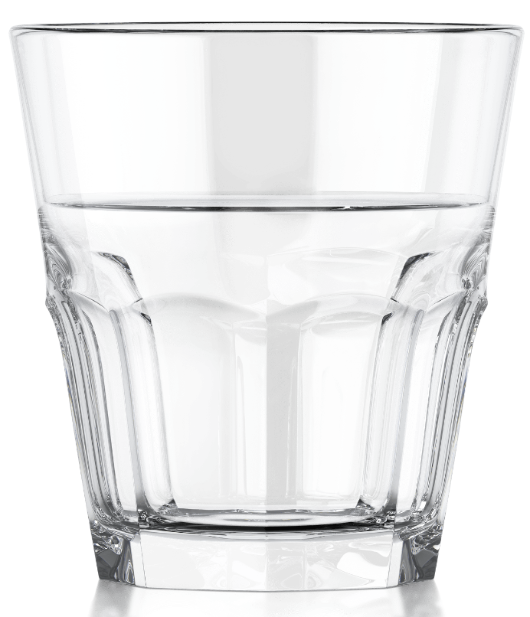
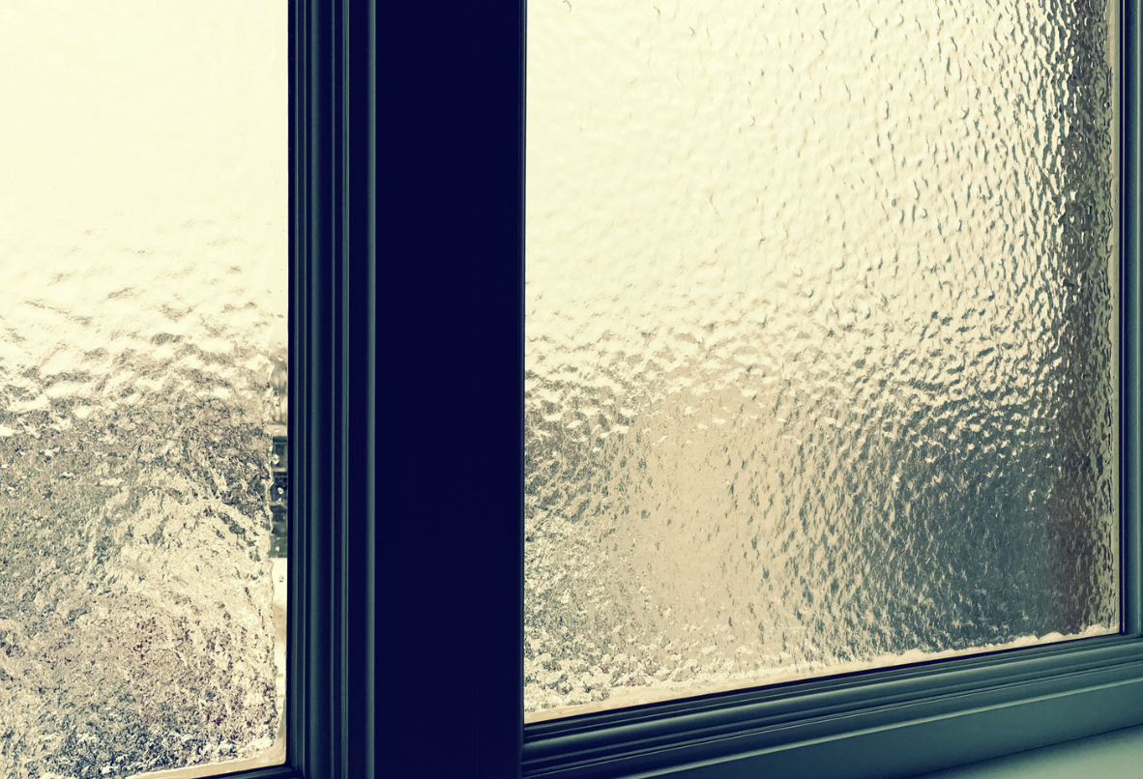
Directions: Choose the correct picture of something transparent from the choices below.
A
B
C
D
Notes:
Choose the one correct picture of something transparent from these four choices.

Slide 47
Directions: Choose the correct picture of something transparent from the choices below.
A
B
C
D
Notes:
This is the picture that shows something that is transparent. This is glass of water; you can see clearly through this glass.

Slide 48
Definition
Picture
Transparent
How do things that are transparent impact my life?
Example
Notes:
Here is the Frayer model filled in with a picture of something that is transparent.

Slide 49
Directions: Choose the correct definition of transparent from the choices below.
A
Wavelengths on the electromagnetic spectrum that people can see with their eyes
B
The bending of light waves when the wave moves from one medium to another
C
When light, sound, or heat bounces back after hitting a surface
D
When light can travel through an object, and you can see clearly through it
Notes:
Choose the one correct definition of transparent from these four choices.

Slide 50
Directions: Choose the correct definition of transparent from the choices below.
A
Wavelengths on the electromagnetic spectrum that people can see with their eyes
B
The bending of light waves when the wave moves from one medium to another
C
When light, sound, or heat bounces back after hitting a surface
D
When light can travel through an object, and you can see clearly through it
Notes:
“When light can travel through an object, and you can see clearly through it.” is correct! This is the definition of transparent.

Slide 51
Definition
Picture
When light can travel through an object, and you can see clearly through it
Transparent
How do things that are transparent impact my life?
Example
Notes:
Here is the Frayer Model with a picture and the definition filled in for transparent: When light can travel through an object, and you can see clearly through it

Slide 52
Directions: Choose the correct example of something that is transparent from the choices below.
A
A metal garage door
B
A tin roof
C
A clean sliding glass door
D
Muddy water
Notes:
Choose the one correct example of something that is transparent from these four choices.

Slide 53
Directions: Choose the correct example of something that is transparent from the choices below.
A
A metal garage door
B
A tin roof
C
A clean sliding glass door
D
Muddy water
Notes:
“A clean sliding glass door” is correct! This is an example of something that is transparent.

Slide 54
Definition
Picture
When light can travel through an object, and you can see clearly through it
Transparent
A clean sliding glass door
How do things that are transparent impact my life?
Example
Notes:
Here is the Frayer Model with a picture, definition, and an example of something that is transparent: A clean sliding glass door.

Slide 55
Directions: Choose the correct response for “how do things that are transparent impact my life?” from the choices below.
A
Transparent materials are used in microscopes. They enable doctors to see things more clearly, like germs, to help know how to keep me healthy.
B
Transparent objects are used in my food to make it taste better.
C
Transparent materials are used to help pull the moon toward earth and that affects the weather.
D
Transparent objects block the sun and keep me cool.
Notes:
Choose the one correct response for “how do things that are transparent impact my life?” from these four choices.

Slide 56
Directions: Choose the correct response for “how do things that are transparent impact my life?” from the choices below.
A
Transparent materials are used in microscopes. They enable doctors to see things more clearly, like germs, to help know how to keep me healthy.
B
Transparent objects are used in my food to make it taste better.
C
Transparent materials are used to help pull the moon toward earth and that affects the weather.
D
Transparent objects block the sun and keep me cool.
Notes:
“Transparent materials are used in microscopes. They enable doctors to see things more clearly, like germs, to help know how to keep me healthy.” That is correct! This is an example of how things that are transparent impacts your life.

Slide 57
Definition
Picture
When light can travel through an object, and you can see clearly through it
Transparent
Transparent materials are used in microscopes. They enable doctors to see things more clearly, like germs, to help know how to keep me healthy.
A clean sliding glass door
How do things that are transparent impact my life?
Example
Notes:
Here is the Frayer Model with a picture, definition, example, and a correct response to “how do things that are transparent impact my life?”: Transparent materials are used in microscopes. They enable doctors to see things more clearly, like germs, to help know how to keep me healthy.

Slide 58
Remember!!!
Notes:
So remember!
Feedback: A good general strategy for information retention is: 1) tell them what you're going to teach them, 2) teach them, and 3) tell them what you just taught them. Make sure to include the third and final step. While it is easy to think a quick review of what you just went over is unnecessary, it can be incredibly useful in helping the students remember the information over the long term.

Slide 59
Transparent: when light can travel through an object, and you can see clearly through it
Notes:
Transparent: when light can travel through an object, and you can see clearly through it

Slide 60
Big Question: How do things that are transparent impact people’s environments and their daily lives?
Notes:
Let’s reflect once more on our big question. Our “big question” is: How do things that are transparent impact people’s environments and their daily lives?
Does anyone have any additional examples to share that haven’t been discussed yet?

Slide 61
Notes:
Thanks for watching, and please continue watching CAPs available from this website.

Slide 62
This Video Was Created With Resources From:
Questions or Comments
Michael Kennedy, Ph.D. MKennedy@Virginia.edu
Rachel L Kunemund, Ph.D. rk8vm@virginia.edu

