Slide 1
Intro
“Big Idea” Question
Review Concepts
Check-In Questions
Teacher Demo
Vocabulary
Student-Friendly Definition
Examples & Non-Examples
Morphological Word Parts
Simulation/Activity
Notes:
OK everyone, get ready for our next lesson. Just as a reminder, these are the different components that our lesson may include, and you’ll see these icons in the top left corner of each slide so that you can follow along more easily!

Slide 2
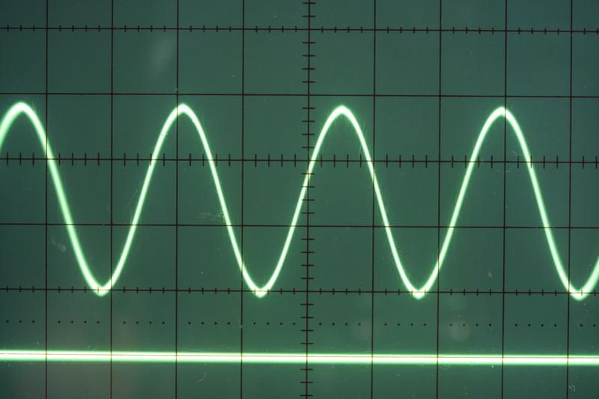
Intro
Transverse Waves
Notes:
Today we will learn about transverse waves.

Slide 3
Big Question: What are the characteristics of transverse waves?
Notes:
Our “big question” is: What are the characteristics of transverse waves?
[Pause and illicit predictions from students.]
I love all these thoughtful scientific hypotheses! Be sure to keep this question and your predictions in mind as we move through this lesson, and we’ll revisit it.
Feedback: Introducing an overarching “big question” at the beginning of a lesson can focus students’ attention and help to emphasize the most important concepts.

Slide 4
Notes:
Before we move on to our new vocabulary term, let’s review some other words & concepts that you already learned and make sure you are firm in your understanding.
Feedback: It is important when reviewing previously learned material that you pause and check for understanding, if students are grasping previous material you may need to tailor your instruction.

Slide 5
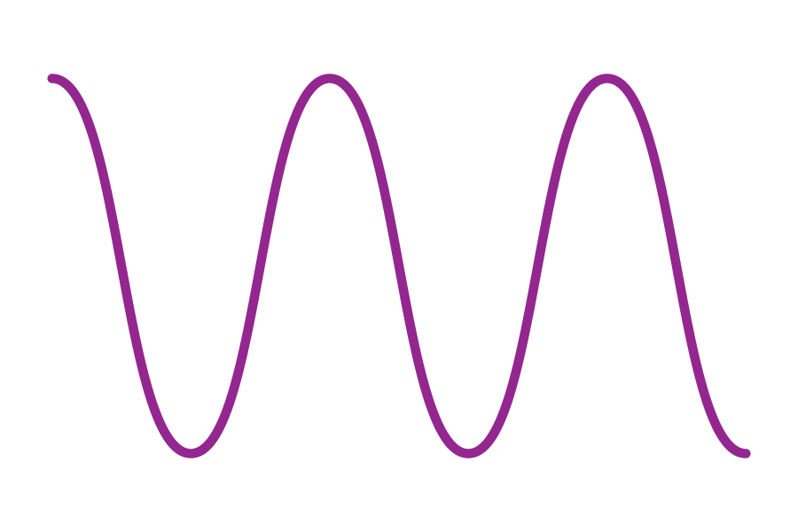
Waves: disturbances that travel through a medium, moving energy from one location to another without moving matter
Notes:
Waves are disturbances that travel through a medium, transporting energy from one location to another without transporting matter.

Slide 6
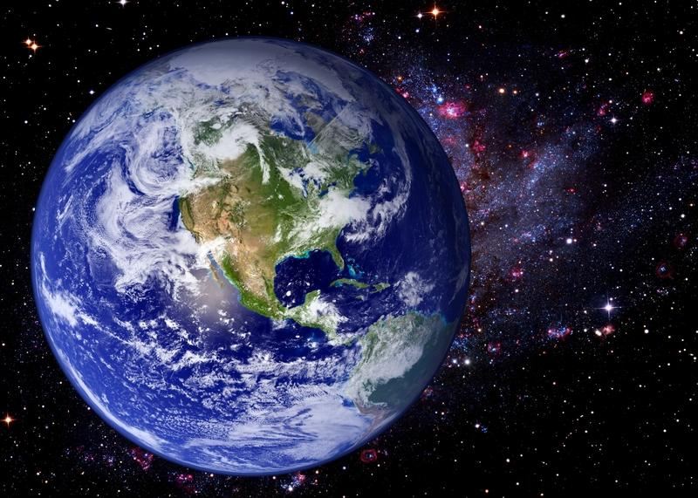
Medium: any material that waves can travel through
Notes:
A medium is any material that waves can travel through.

Slide 7
Notes:
Now let’s pause for a moment to check your understanding.

Slide 8
What are waves?
Notes:
What are waves?
[Waves are disturbances that travel through a medium, transporting energy from one location to another without transporting matter.]

Slide 9
How is a medium related to waves?
Notes:
How is a medium related to waves?
[A medium is any kind of material that waves can travel through.]

Slide 10
Transverse Waves
Notes:
Now that we’ve reviewed, let’s define our new term, transverse waves.

Slide 11
Transverse Waves: waves that travel perpendicularly to the direction they are moving
Notes:
Transverse waves are waves that travel perpendicularly to the direction they are moving.

Slide 12
Notes:
Let’s check-in for understanding.

Slide 13
What are transverse waves?
Notes:
What are transverse waves?
[Transverse waves are waves that travel perpendicularly to the direction they are moving.]

Slide 14
Notes:
That is the basic definition, but there is a bit more you need to know.

Slide 15
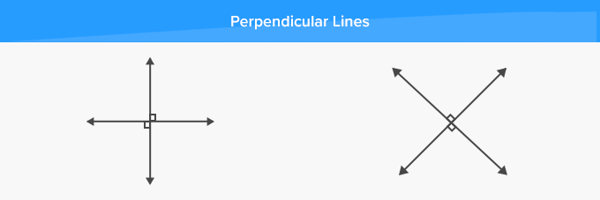
Perpendicular: at a right angle (90º)
Notes:
By perpendicular, we mean “at a right angle”
Feedback: It can be helpful to break the definition down and explicitly explain each part to help students understand the whole definition.

Slide 16
Notes:
Here we can see how the waves move up and down as they travel from left to right.

Slide 17
Characteristics of Waves
Notes:
Let’s take a look at the characteristics of waves.

Slide 18
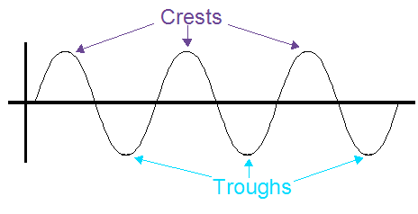
Notes:
Transverse waves have crests. A crest is the highest point of a wave.
Feedback: Remember to use images with introducing new content such as student-friendly definitions it can help students remember key points and make sense of the new information.

Slide 19
Notes:
Transverse waves have troughs. A trough is the lowest point of a wave.

Slide 20
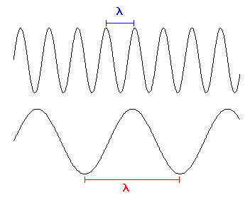
Notes:
We can measure the wavelength of transverse waves. Wavelength is the distance between two successive crests or troughs of a wave.

Slide 21
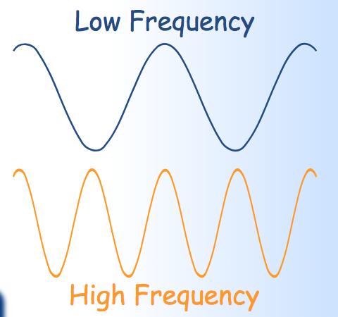
Notes:
We can also measure the frequency of transverse waves. Frequency is the number of waves that pass a fixed point in unit time.

Slide 22
Notes:
Wavelength and frequency are inversely related. The longer the wavelength, the lower the frequency of the wave. The shorter the wavelength, the higher the frequency of the wave.

Slide 23
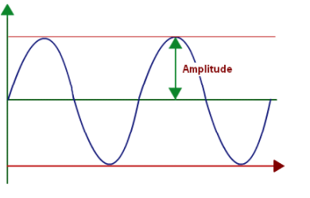
Notes:
We can measure the amplitude of transverse waves. Amplitude is the maximum amount of displacement of a particle on the medium from its position. In short, the amplitude is the displacement from rest to crest or from rest to trough.

Slide 24
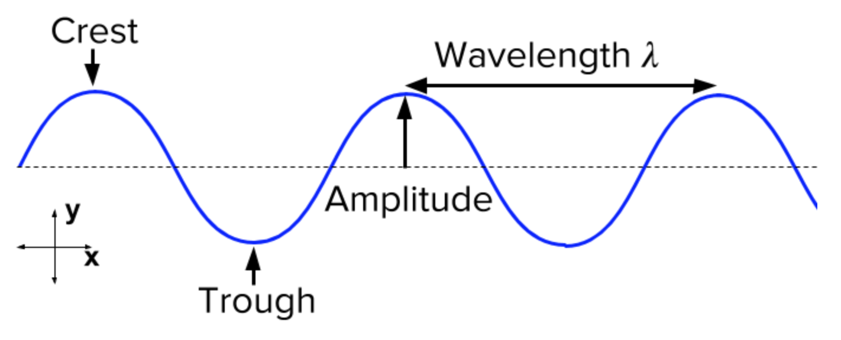
Transverse Wave Diagram
Notes:
Here we can see a diagram of transverse waves. Each part of the wave that we just learned is labeled (crest, trough, amplitude, and wavelength). We could also measure the frequency, but that depends on the unit of time we decide to measure it.

Slide 25
Notes:
Let’s check-in for understanding.

Slide 26
What are some characteristics of transverse waves?
Notes:
What are some characteristics of transverse waves?
[Frequency, amplitude, wavelength, crest/trough, etc.]

Slide 27
Notes:
Now, let’s talk about some examples of transverse waves.

Slide 28
Notes:
Electromagnetic waves, including all those on the spectrum, are examples of transverse waves. These waves travel perpendicularly to the direction they are moving.

Slide 29
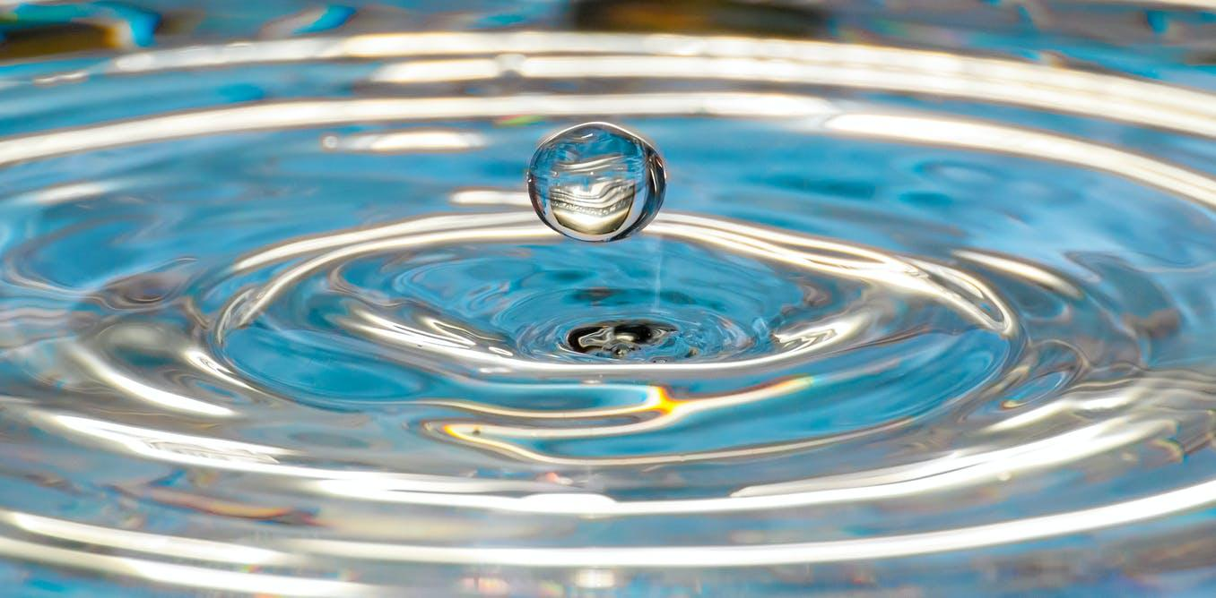
Notes:
Ripples on the surface of water are examples of transverse waves. These ripples move perpendicularly to the direction they are moving.

Slide 30
Notes:
Let’s check-in for understanding.

Slide 31
What are some examples of transverse waves?
Notes:
What are some examples of transverse waves?
[Waves on the electromagnetic spectrum (x-rays, gamma rays, visible light, uv rays, etc.),
ripples in water, etc.]

Slide 32
Demonstration
Notes:
Demonstration – Let’s see what transverse waves look like!
For this demonstration, all I need is a slinky.
I need to hold the slinky horizontally. Hold one end of the slinky still and move the other end up and down. This motion is creating the motion of a transverse wave.
Transverse waves move perpendicularly in the direction they are moving, which is what the slinky is doing when I move it like this.
Feedback: Keep in mind that an organized structure and a clear demonstration will help your students understand the content and make predictions. Have everything (materials, guiding questions, etc.) ready before reaching this point in the lesson.

Slide 33
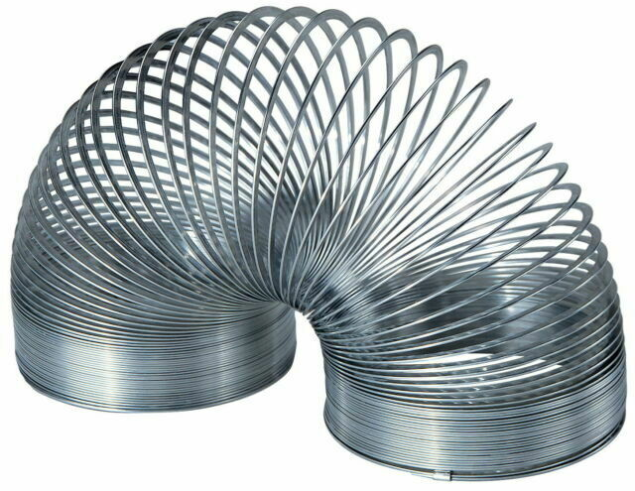
Materials:
Slinky
Student helper
Steps:
1. Call a student to come up
2. Have them hold one end of the slinky while you walk a few feet away holding the other end
3. Move the slinky to create waves
4. Talk about the parts of the wave and how it moves
5. Ask the students what they think would happen if you moved further/closer to the student or moved the slinky faster or slower-how would this change waves?
Notes:
In this demonstration, how is a slinky an example of a transverse wave?

Slide 34
Notes:
Let’s check-in for understanding.

Slide 35
In this demonstration, how is a slinky an example of a transverse wave?
Notes:
In this demonstration, how is a slinky an example of a transverse wave?

Slide 36
What are transverse waves?
Notes:
What are transverse waves?
[Transverse waves are waves that travel perpendicularly to the direction they are moving.]
Feedback: When introducing new vocabularies, it is crucial to require the students to give out their own interpretation. I would strongly encourage you to ask students to explain the concept in their own words.

Slide 37
How are electromagnetic waves examples of transverse waves?
Notes:
How are electromagnetic waves examples of transverse waves?
[These waves travel perpendicularly to the direction they are moving. They have all the characteristics of transverse waves.]

Slide 38
Describe wavelength and frequency. What is their relationship?
Notes:
Describe wavelength and frequency. What is their relationship?
[Wavelength is the distance between two successive crests or troughs of a wave.
Frequency is the number of waves that pass a fixed point in unit time.
Wavelength and frequency are inversely related. The longer the wavelength, the lower the frequency of the wave. The shorter the wavelength, the higher the frequency of the wave.]

Slide 39
How are crests and troughs related?
Notes:
How are crests and troughs related?
[Crests and troughs are the extreme points of a wave. Crests are the highest point and troughs are the lowest point of a wave.]

Slide 40
What information does amplitude give us about a wave?
Notes:
What information does amplitude give us about a wave?
[Amplitude tells us the maximum displacement of a particle on the medium from its rest position. It can tell us the displacement from rest to crest or the displacement from rest to trough.]

Slide 41
Notes:
The questions you answer next will help you to complete the Frayer model.

Slide 42
Draw a diagram of a transverse wave. Make sure to label all the parts.
Notes:
Draw a diagram of a transverse wave. Make sure to label all the parts.

Slide 43
Definition
Picture
Transverse Waves
Example
How do transverse waves impact my life?
Notes:
Here is the Frayer Model again. You will now answer the question below and other questions to complete the Frayer model. Select the best response for each question using the information you just learned. As you select responses, you will see how this model looks filled in for the term Transverse Waves. Once you answer a question, click the arrow on the bottom right to continue.

Slide 44
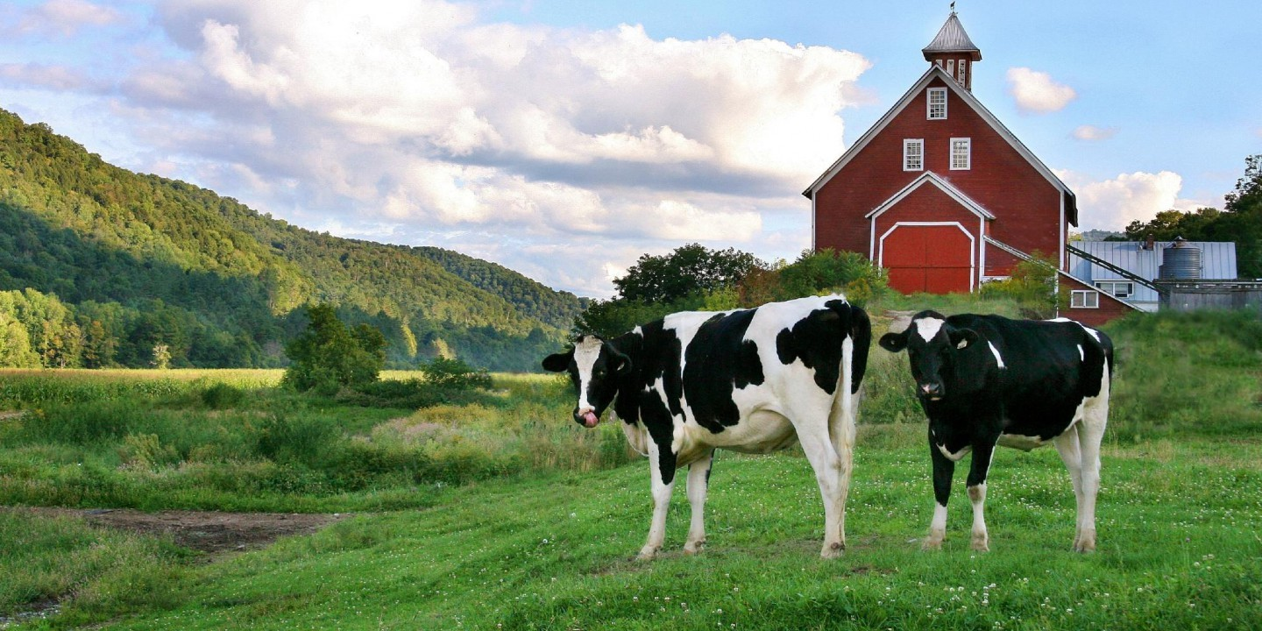
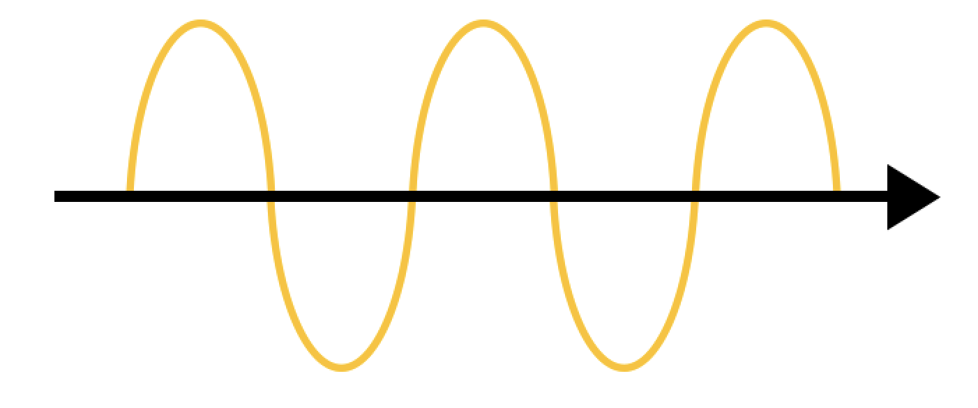
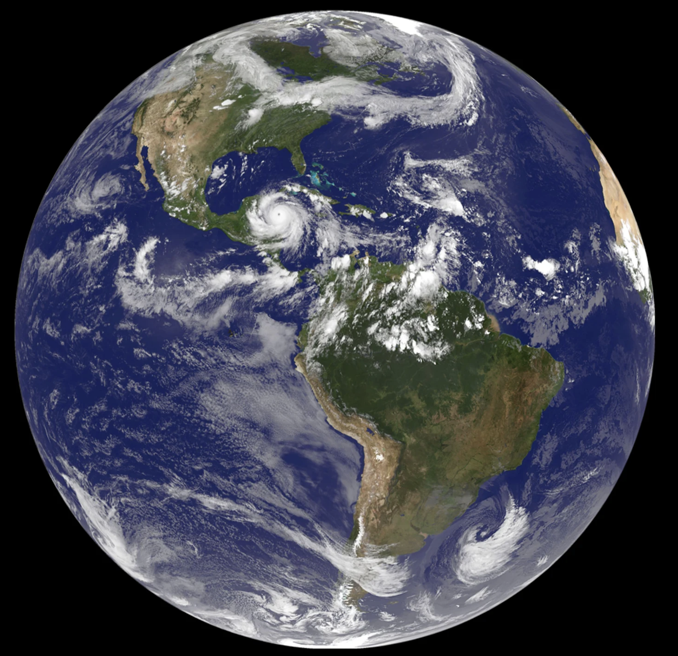
Directions: Choose the correct picture of
Transverse Waves from the choices below.
A
B
C
D
Notes:
Choose the one correct picture of Transverse Waves from these four choices and drag and place it in the picture box below.

Slide 45
Directions: Choose the correct picture of
Transverse Waves from the choices below.
A
B
C
D
Notes:
You chose the picture that shows Transverse Waves.

Slide 46
Definition
Picture
Transverse Waves
Example
How do transverse waves impact my life?
Notes:
Here is the Frayer Model filled in with a picture of Transverse Waves.

Slide 47
Directions: Choose the correct definition of
Transverse Waves from the choices below.
A
Waves that travel perpendicularly to the direction they are moving
B
An animal that hunts and eats other animals
C
A place where animals and plants live together
D
A state of matter with tightly packed particles
Notes:
Choose the one correct definition of Transverse Waves from these four choices and drag and place it in the definition box below.

Slide 48
Directions: Choose the correct definition of
Transverse Waves from the choices below.
A
Waves that travel perpendicularly to the direction they are moving
B
An animal that hunts and eats other animals
C
A place where animals and plants live together
D
A state of matter with tightly packed particles
Notes:
You chose “Waves that travel perpendicularly to the direction they are moving.” This is correct! This is the definition of Transverse Waves.

Slide 49
Definition
Picture
Waves that travel perpendicularly to the direction they are moving
Transverse Waves
Example
How do transverse waves impact my life?
Notes:
Here is the Frayer Model with a picture and the definition filled in for Transverse Waves: Waves that travel perpendicularly to the direction they are moving.

Slide 50
Directions: Choose the correct example of
Transverse Waves from the choices below.
A
A baby crawling
B
The rainforest
C
Ripples in a lake
D
A house being built
Notes:
Choose the one correct example of a Transverse Waves from these four choices and drag and place it in the example box below.

Slide 51
Directions: Choose the correct example of
Transverse Waves from the choices below.
A
A baby crawling
B
The rainforest
C
Ripples in a lake
D
A house being built
Notes:
You chose “Ripples in a lake.” This is an example of Transverse Waves!

Slide 52
Definition
Picture
Waves that travel perpendicularly to the direction they are moving
Transverse Waves
Ripples in a lake
Example
How do transverse waves impact my life?
Notes:
Here is the Frayer Model with a picture, definition, and an example of a Transverse Waves: Ripples in a lake.

Slide 53
Directions: Choose the correct response for “how do transverse waves impact my life?” from the choices below.
A
Transverse waves impact my life by enabling us to see colors, hear sounds, and use technologies for communication and entertainment.
B
Transverse waves impact my life by explaining how weather works so we can build structures to protect us from the elements.
C
Transverse waves impact my life by teaching us how our bodies work so we can be healthy.
D
Transverse waves impact my life by showing how plants and animals interact with one another so we can make healthy choices in our lives.
Notes:
Choose the one correct response for “how do transverse waves impact my life?” from these four choices and drag and place it in the box below.

Slide 54
Directions: Choose the correct response for “how do transverse waves impact my life?” from the choices below.
A
Transverse waves impact my life by enabling us to see colors, hear sounds, and use technologies for communication and entertainment.
B
Transverse waves impact my life by explaining how weather works so we can build structures to protect us from the elements.
C
Transverse waves impact my life by teaching us how our bodies work so we can be healthy.
D
Transverse waves impact my life by showing how plants and animals interact with one another so we can make healthy choices in our lives.
Notes:
You chose “Transverse waves impact my life by enabling us to see colors, hear sounds, and use technologies for communication and entertainment.” That is correct! This is an example of how transverse waves impacts your life.

Slide 55
Definition
Picture
Waves that travel perpendicularly to the direction they are moving
Transverse Waves
Transverse waves impact my life by enabling us to see colors, hear sounds, and use technologies for communication and entertainment.
Ripples in a lake
Example
How do transverse waves impact my life?
Notes:
Here is the Frayer Model with a picture, definition, example, and a correct response to “how do transverse waves impact my life?”: Transverse waves impact my life by enabling us to see colors, hear sounds, and use technologies for communication and entertainment.

Slide 56
Remember!!!
Notes:
So remember!

Slide 57
Transverse Waves: waves that travel perpendicularly to the direction they are moving
Notes:
Transverse waves are waves that travel perpendicularly to the direction they are moving.

Slide 58
Notes:
Transverse waves have crests and troughs.
A crest is the highest point of a wave.
A trough is the lowest point of a wave.

Slide 59
Notes:
We can measure the wavelength of transverse waves. Wavelength is the distance between two successive crests or troughs of a wave.

Slide 60
Notes:
We can also measure the frequency of transverse waves. Frequency is the number of waves that pass a fixed point in unit time.

Slide 61
Notes:
Wavelength and frequency are inversely related. The longer the wavelength, the lower the frequency of the wave. The shorter the wavelength, the higher the frequency of the wave.

Slide 62
Notes:
We can measure the amplitude of transverse waves. Amplitude is the maximum amount of displacement of a particle on the medium from its position. In short, the amplitude is the displacement from rest to crest or from rest to trough.

Slide 63
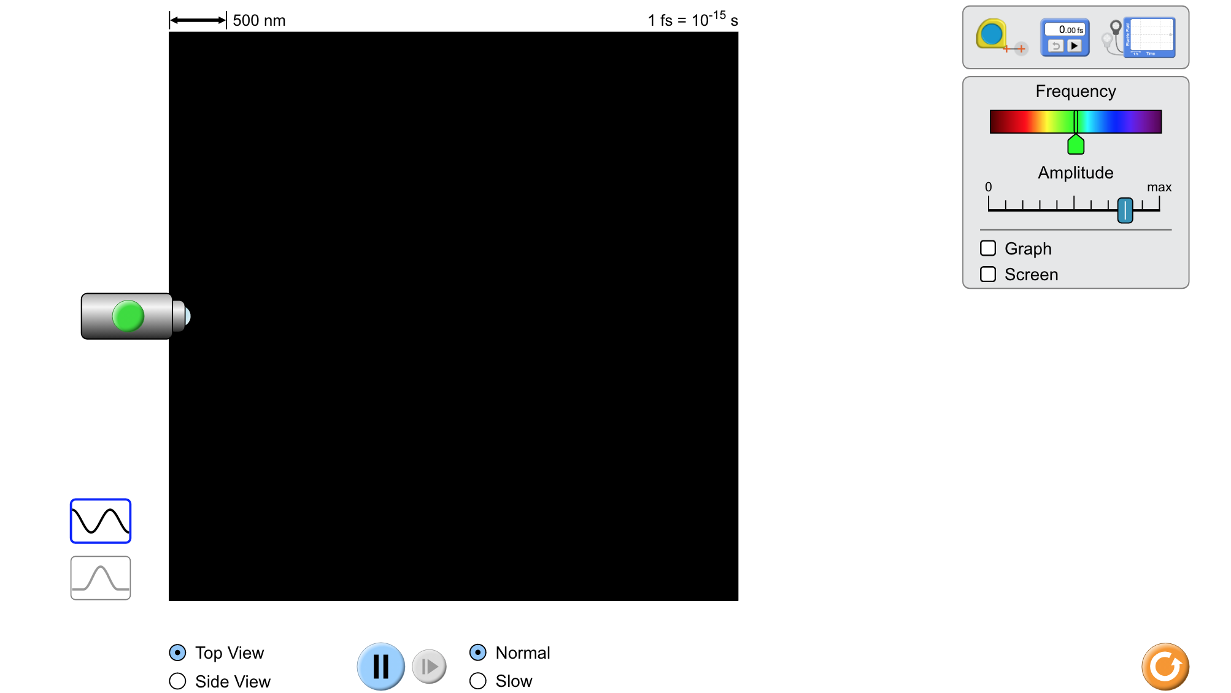
Simulation Activity
Transverse Waves
(Phet)
Click the link above for a simulation to deepen your understanding of transverse waves.
Notes:
Feedback: Remember to try and scaffold instruction to encourage students to build and use models when working through an inquiry-based problem, this will help deepen their understanding of the content

Slide 64
Big Question: What are the characteristics of transverse waves?
Notes:
Explicit cue to revisit the big question at the end of the lesson: Okay everyone. Now that we’ve learned the term, let’s reflect once more on our big question. Was there anything that we predicted earlier that was correct or incorrect? Do you have any new hypotheses to share?
Feedback: Remember, it is important that students have an opportunity to ask questions at the end of the lesson so that they can clarify their own understanding, some students may need a clear cue that it is their turn to ask questions.

Slide 65
Notes:
Thanks for watching, and please continue watching CAPs available from this website!

Slide 66
This Video Created With Resources From:
Questions or Comments
Michael Kennedy, Ph.D. MKennedy@Virginia.edu
Rachel L Kunemund, Ph.D. rk8vm@virginia.edu

