Slide 1
Intro
“Big Idea” Question
Review Concepts
Check-In Questions
Teacher Demo
Vocabulary
Student-Friendly Definition
Examples & Non-Examples
Morphological Word Parts
Frayer Model
Simulation/Activity
Notes:
OK everyone, get ready for our next lesson. Just as a reminder, these are the different components that our lesson may include, and you’ll see these icons in the top left corner of each slide so that you can follow along more easily!

Slide 2
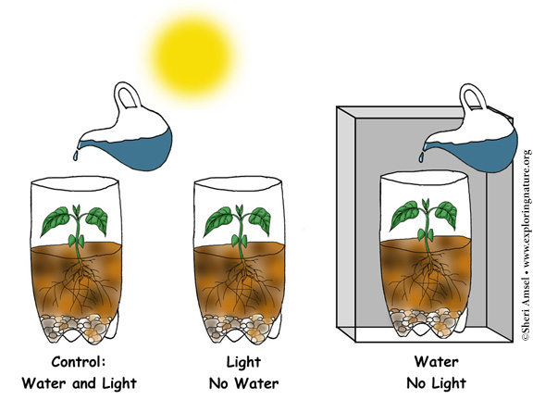
Variable
Intro
Notes:
Today we will learn about variables.

Slide 3
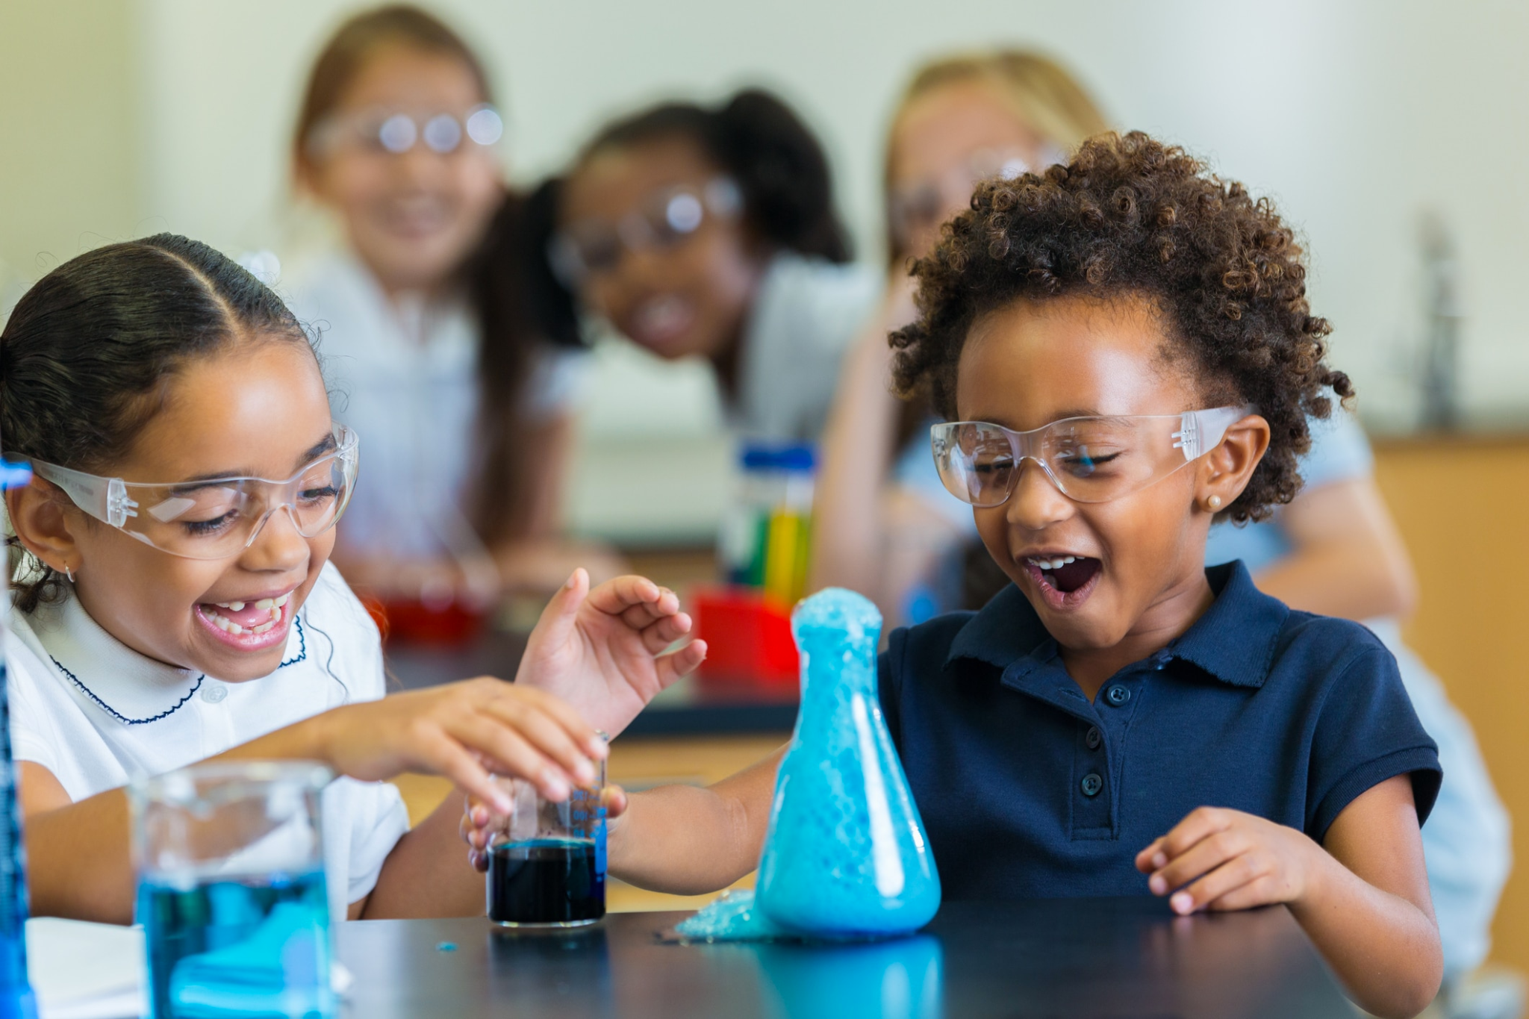
Big Question: How do variables in scientific experiments help us learn about our world?
Notes:
Our “big question” is: How do variables in scientific experiments help us learn about the world?
[Pause and illicit predictions from students.]
I love all these thoughtful scientific hypotheses! Be sure to keep this question and your predictions in mind as we move through these next few lessons, and we’ll continue to revisit it.
Feedback: Asking students to make predictions about how variables are related to our scientific knowledge is a great way to activate and elicit student ideas and prior knowledge. This type of activity is evidence of the teacher planning for students’ engagement with science ideas.

Slide 4
Notes:
Before we move on to our new vocabulary term, let’s review some other words & concepts that you already learned and make sure you are firm in your understanding.

Slide 5
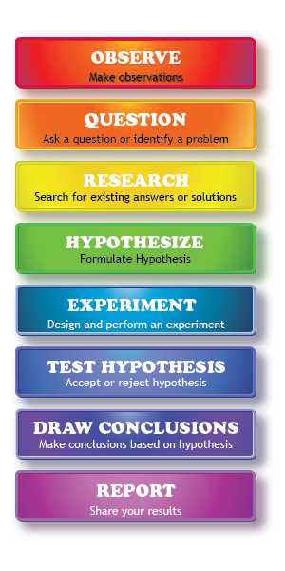
Scientific Method: steps that investigators follow to answer questions about the natural world
Notes:
One term that you’ve likely heard in class before is the scientific method. The scientific method is a series of steps that investigators follow to answer questions about the natural world. By following the same steps, investigators are able to discover new things about our world and check the work of other scientists. Here are a few of those steps:

Slide 6
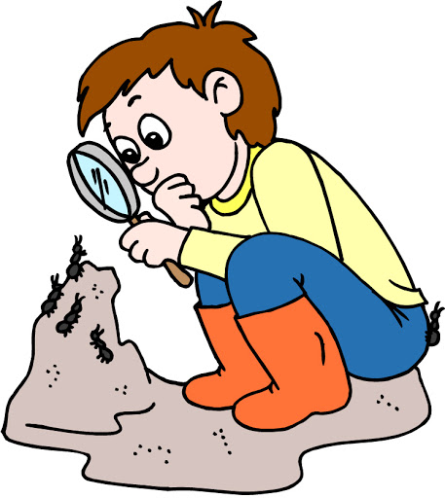
Observation
Notes:
The scientific method always begins with making an observation, or noticing something interesting that you’d like to learn more about.

Slide 7
Question
Notes:
Next, you start to ask questions about the interesting things you observe. You may even notice a problem that needs fixing.

Slide 8
Research
Notes:
This leads you to doing some research into different answers and solutions that may already exist about that topic. Research helps you to further develop your own ideas about how to answer your question or fix the problem.

Slide 9
Hypothesis
Notes:
Researching your topic helps you form ideas and make a hypothesis. A hypothesis is an “educated guess” that you can test. In a hypothesis, you predict what you think will happen and why.

Slide 10
Experiment
Notes:
Next, you test your hypothesis in an experiment. Experiments are well-planned and each step is written down so other scientists can test the results. Data is recorded so you can decide if you hypothesis was correct.

Slide 11
Draw Conclusions & Share Results
Notes:
Finally, you share your results with others about whether your hypothesis was supported or not. Sharing results is important so everyone can learn the answer to your questions.

Slide 12
Notes:
Now let’s pause for a moment to check your understanding.

Slide 13
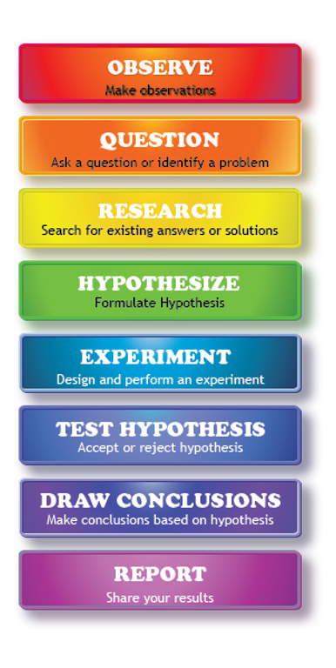
What are the steps that investigators follow to answer questions about the natural world called?
Scientific Method
Observation
Results
Notes:
What are the steps that investigators follow to answer questions about the natural world called?
[A. Scientific Method]

Slide 14
What are the steps that investigators follow to answer questions about the natural world called?
Scientific Method
Observation
Results
Notes:
The steps that investigators follow to answer questions about the natural world are called the scientific method.

Slide 15
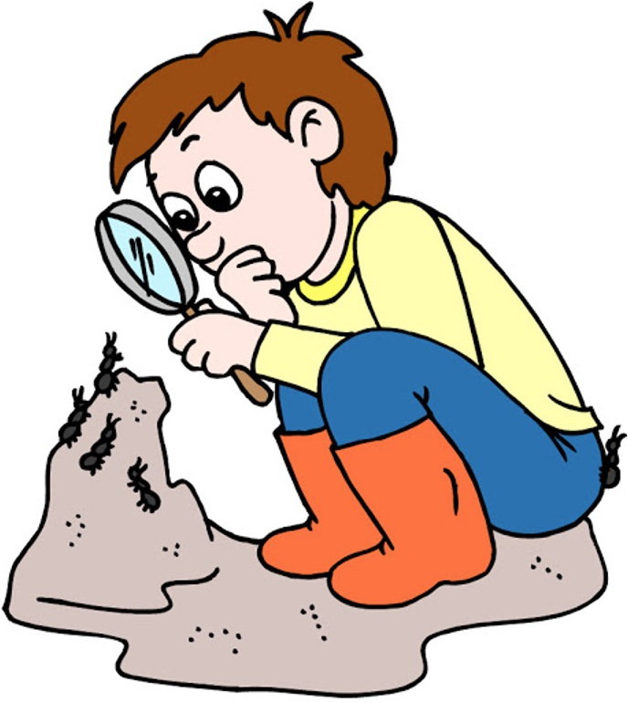
The first step in the scientific method is _____________.
Notes:
The first step in the scientific method is _____________.
[Observation]

Slide 16
The first step in the scientific method is observation.
Notes:
The first step in the scientific method is observation.

Slide 17
Scientists test their hypothesis in an ____________.
Notes:
Scientists test their hypothesis in an ___________.
[Experiment]

Slide 18
Scientists test their hypothesis in an experiment.
Notes:
Scientists test their hypothesis in an experiment.

Slide 19
Variable
Notes:
Now that we’ve reviewed, let’s define our new term, variable.
Feedback: Using cues, such as on this slide, helps prepare students for what is coming up next in the lesson. This is important especially for students who may struggle with new vocabulary instruction.

Slide 20
Variable: something that can change or be changed in an experiment
Notes:
A variable is something that can change or be changed in an experiment.

Slide 21
Notes:
Now let’s pause for a moment to check your understanding.

Slide 22
What is a variable?
Notes:
What is a variable?
[A variable is something that can change or be changed in an experiment .]

Slide 23
Notes:
That is the basic definition, but there is a bit more you need to know.

Slide 24
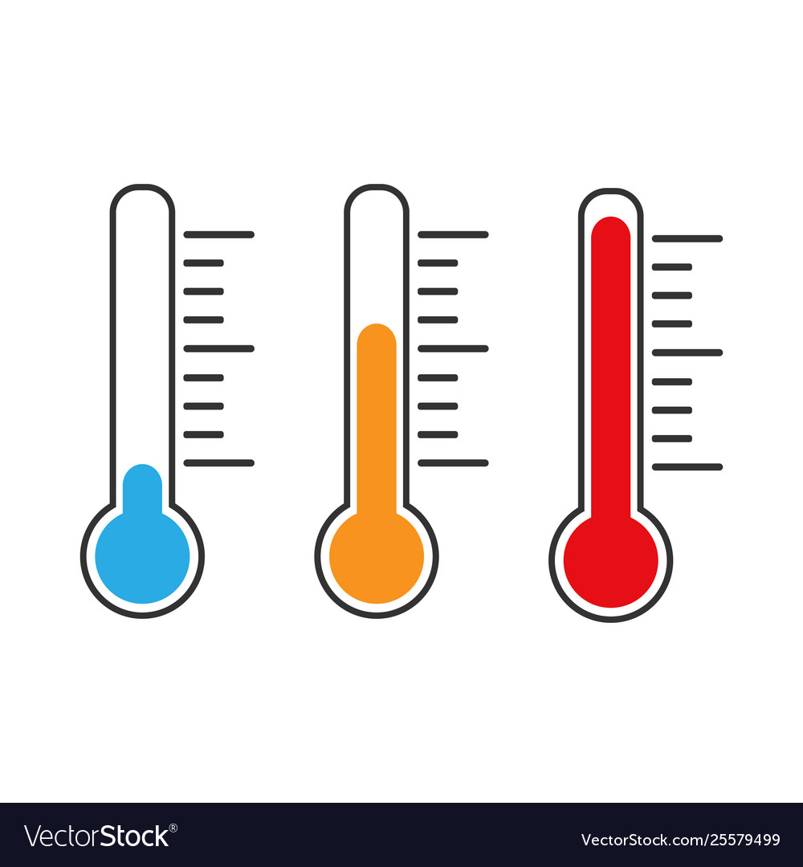
Notes:
Variables need to be able to change in some way. Temperature is a common variable because you can easily change to temperature to be hotter or colder.

Slide 25
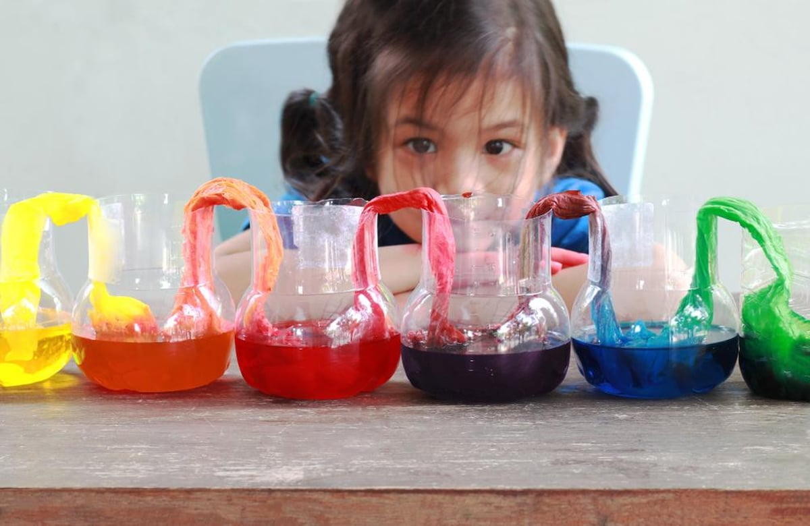
Notes:
Variables can also have different characteristics from each other, like different colors, flavors, or kinds. No matter how the variables change, it is important that scientists know the differences.

Slide 26
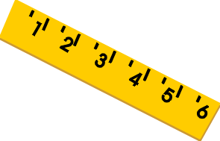
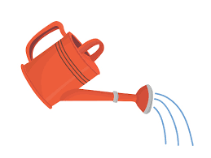
Notes:
There are three different kinds of variables in an experiment: independent, dependent, and control variables.

Slide 27
light
dark
Notes:
An independent variable is the variable that the scientist purposely changes in an experiment. Here, the scientist is changing the amount of light each plant gets. Light is the independent variable.

Slide 28
light
dark
Notes:
An dependent variable is observed by the scientist. It is changed by the independent variable rather than the scientist directly. Here, light caused the plants to grow to different heights. The height of the plants is the dependent variable.

Slide 29
light
dark
Notes:
A control variable are things that the scientist decides not to change during the experiment. Here, each plant gets the same amount of water. Because water is the same for both plants, it is a control variable.

Slide 30
Notes:
Now let’s pause for a moment to check your understanding.

Slide 31
What is a variable?
Notes:
What is a variable?
[A variable is something that can change or be changed in an experiment .]

Slide 32
Variables need to be able to ____________.
Notes:
Variables need to be able to ___________.
[Change]

Slide 33
Variables need to be able to change.
Notes:
Variables need to be able to change.

Slide 34
What are the three types of variables?
Notes:
What are the three types of variables?
Feedback: Including some visual aids in this portion of the lesson is helpful for students to be able to understand the new content.

Slide 35
What are the three types of variables?
Independent
Variable
Dependent
Variable
Control
Variable
Notes:
What are the three types of variables? Independent, dependent, and control.
Feedback: Including some visual aids in this portion of the lesson is helpful for students to be able to understand the new content.

Slide 36
Notes:
Now, let’s talk about some examples of variables.

Slide 37
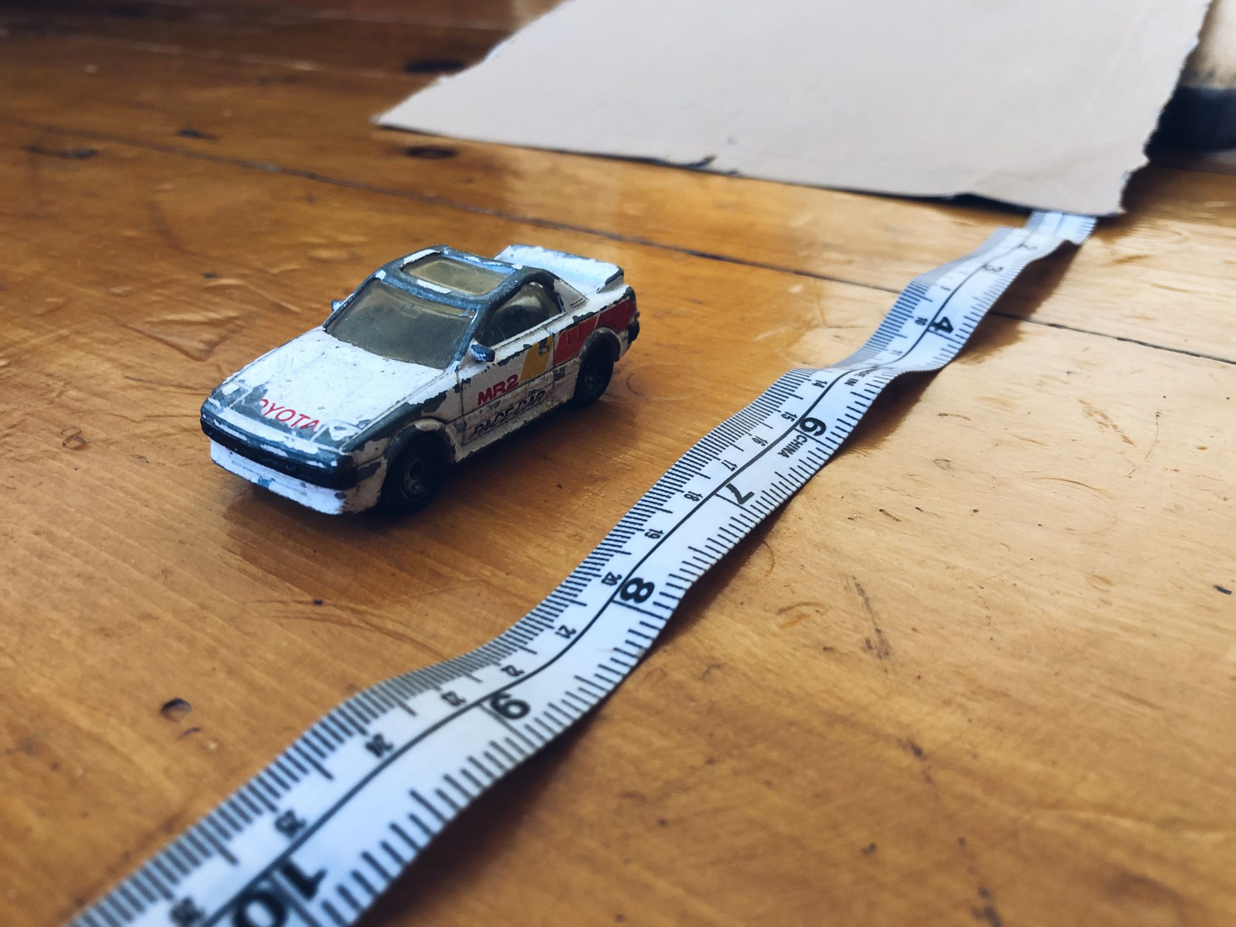
Notes:
Distance or length is a common variable that scientists measure in an experiment. For example, scientists change the length of a ramp to see how far the toy car will go.

Slide 38
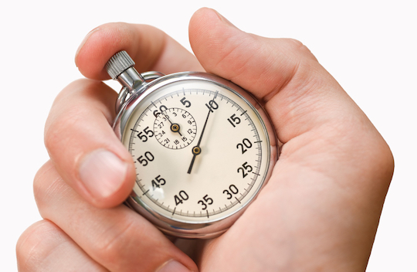
Notes:
Another example of a variable is time. Scientist may need to measure how long something takes to happen, like how long it takes different size ice cubes to melt.

Slide 39
Notes:
Next, let’s talk about some non-examples of variables.
Feedback: Offering clear and explicit explanation for non-examples is a great way for students to make sense of the new content. Explanations for non-examples are provided in the slides below.

Slide 40
Notes:
Science equipment, like test tubes or microscopes, are not kinds of variables. These supplies help us measure or observe the things we are interested in, but they usually do not change during an experiment.

Slide 41
Notes:
Data is not a kind of variable. It is the information scientists collect about variables that they can analyze later. Data does not change, it is only a record of what happened during the experiment.

Slide 42
Notes:
Now let’s pause for a moment to check your understanding.

Slide 43
Which one is NOT an example of a variable?
Time
Length
Microscope
Notes:
Which one is NOT an example of a variable?
[Microscope]

Slide 44
Which one is NOT an example of a variable?
Time
Length
Microscope
Notes:
Which one is NOT an example of a variable? Microscope

Slide 45
Label the three kinds of variables
Notes:
Label the three kinds of variables.
[Independent, Dependent, Control]
Feedback: Including some visual aids in this portion of the lesson is helpful for students to be able to understand the new content.

Slide 46
Label the three kinds of variables
Independent
Variable
Dependent
Variable
Control
Variable
Notes:
Label the three kinds of variables: Independent, dependent, and control.
Feedback: Including some visual aids in this portion of the lesson is helpful for students to be able to understand the new content.

Slide 47
Remember!!!
Notes:
So remember!

Slide 48
Variable: something that can change or be changed in an experiment
Notes:
A variable is something that can change or be changed in an experiment.

Slide 49
Notes:
We can also break down the term variable into different word parts to help us remember the meaning. Let’s take a look!

Slide 50
Variable
(root word)
(suffix)
Notes:
We can break up the term variable into two parts: a root word and a suffix.

Slide 51
Variable
Vari = different or changing
Notes:
First, we have the root word “vari” which means "different” or “changing”.

Slide 52
Variable
-able = able to be
Notes:
Next, we have the suffix “-able”. This means something “able to be”

Slide 53
Vari able
Variable
able to be changed
Notes:
So when we put it all together, variable means something that is able to be changed. In an experiment, the variable is something that is able to be changed or observed changing by the investigators.

Slide 54
Notes:
We will now complete this concept map, called a Frayer model, to summarize and further clarify what you have learned about the term variable.

Slide 55
Definition
Picture
Variable
Example
How do variables impact my life?
Notes:
To complete the Frayer model, we will choose from four choices the correct picture, definition, example, and response to the question, “How do variables impact my life?” Select the best response for each question using the information you just learned. As we select responses, we will see how this model looks filled in for the term variable.

Slide 56
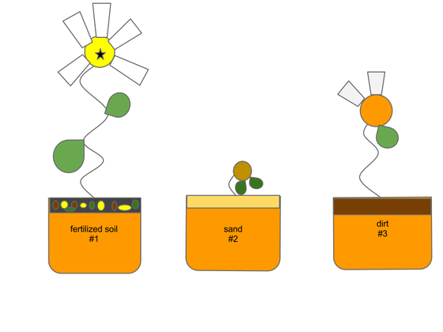
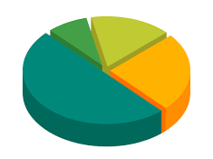
Directions: Choose the correct picture of a
variable from the choices below.
A
B
C
D
Notes:
Choose the one correct picture of variable from these four choices.

Slide 57
Directions: Choose the correct picture of a
variable from the choices below.
A
B
C
D
Notes:
This is the picture that shows a variable.

Slide 58
Definition
Picture
Variable
Example
How do variables impact my life?
Notes:
Here is the Frayer model filled in with a picture of variable.

Slide 59
Directions: Choose the correct definition of
variable from the choices below.
A
explains why matter exists in different phases (i.e. solid, liquid, gas)
B
anything that has mass and takes up space
C
energy in an electric current
D
something that can change or be changed in an experiment
Notes:
Choose the one correct definition of variable from these four choices.

Slide 60
Directions: Choose the correct definition of
variable from the choices below.
A
explains why matter exists in different phases (i.e. solid, liquid, gas)
B
anything that has mass and takes up space
C
energy in an electric current
D
something that can change or be changed in an experiment
Notes:
“Something that can change or be changed in an experiment” is correct! This is the definition of variable.

Slide 61
Definition
Picture
something that can change or be changed in an experiment
Variable
Example
How do variables impact my life?
Notes:
Here is the Frayer Model with a picture and the definition filled in for variable: something that can change or be changed in an experiment.

Slide 62
Directions: Choose the correct example of
a variable from the choices below.
A
The sun setting each evening
B
Different weights of objects falling to the ground
C
A hurricane making landfall
D
A cat taking a nap in a chair
Notes:
Choose the one correct example of a variable from these four choices.

Slide 63
Directions: Choose the correct example of
a variable from the choices below.
A
The sun setting each evening
B
Different weights of objects falling to the ground
C
A hurricane making landfall
D
A cat taking a nap in a chair
Notes:
“Different weights of objects falling to the ground” is correct! This is an example of a variable.

Slide 64
Definition
Picture
something that can change or be changed in an experiment
Variable
Different weights of objects falling to the ground
Example
How do variables impact my life?
Notes:
Here is the Frayer Model with a picture, definition, and an example of variable: different weight of objects falling to the ground.

Slide 65
Directions: Choose the correct response for “how do variables impact my life?” from the choices below.
A
Variables explain how our cells work and give us energy for our daily activities.
B
Variables help us see changes in an experiment so we can learn more about how our world works.
C
Variables explain the different kinds of weather we experience each day.
D
Variables protect our planet from harmful radiation from the Sun.
Notes:
Choose the one correct response for “how do variables impact my life?” from these four choices.

Slide 66
Directions: Choose the correct response for “how do variables impact my life?” from the choices below.
A
Variables explain how our cells work and give us energy for our daily activities.
B
Variables help us see changes in an experiment so we can learn more about how our world works.
C
Variables explain the different kinds of weather we experience each day.
D
Variables protect our planet from harmful radiation from the Sun.
Notes:
“Variables help us see changes in an experiment so we can learn more about how our world works.” That is correct! This is an example of how variables impact your life.

Slide 67
Definition
Picture
something that can change or be changed in an experiment
Variable
Variables help us
see changes in an experiment so we can learn more about how our world works.
Different weights of objects falling to the ground
Example
How do variables impact my life?
Notes:
Here is the Frayer Model with a picture, definition, example, and a correct response to “how do variables impact my life?”: Variables help us see changes in an experiment so we can learn more about how our world works.

Slide 68
Big Question: How do variables in scientific experiments help us learn about our world?
Notes:
Our “big question” is: How do variables in science experiments help us learn about our world?
[Pause and illicit predictions from students.]
I love all these thoughtful scientific hypotheses! Be sure to keep this question and your predictions in mind as we move through these next few lessons, and we’ll continue to revisit it.

Slide 69
Notes:
Thanks for watching, and please continue watching CAPs available from this website.

Slide 70
This Video Was Created With Resources From:
Questions or Comments
Michael Kennedy, Ph.D. MKennedy@Virginia.edu
Rachel L Kunemund, Ph.D. rk8vm@virginia.edu

