Slide 1
Intro
“Big Idea” Question
Review Concepts
Check-In Questions
Teacher Engagement
Vocabulary
Student-Friendly Definition
Examples & Non-Examples
Frayer Model
Simulation/Activity
Notes:
OK everyone, get ready for our next lesson. Just as a reminder, these are the different components that our lesson may include, and you’ll see these icons in the top left corner of each slide so that you can follow along more easily!

Slide 2
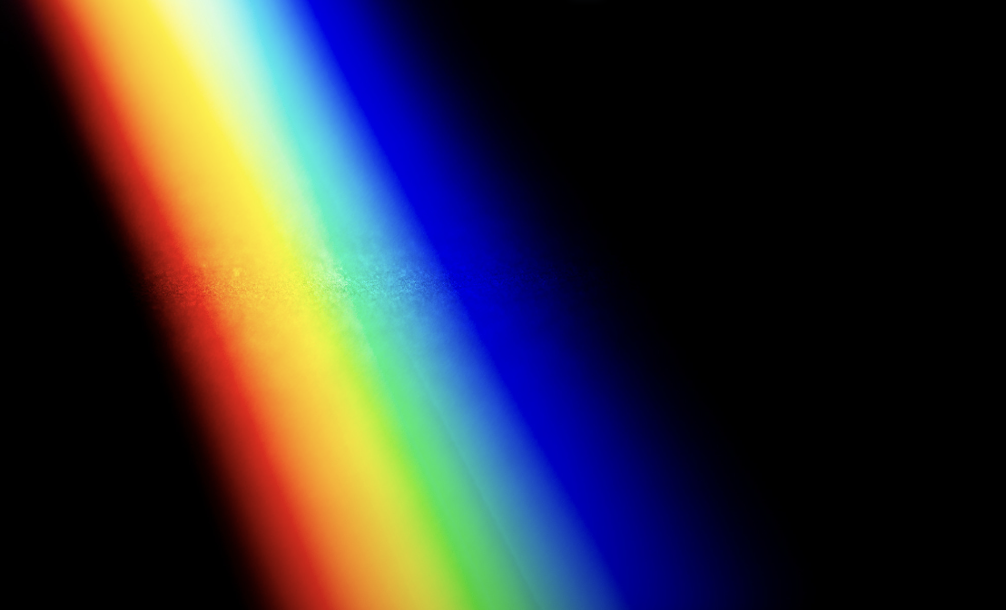
Intro
Visible Light Spectrum
Notes:
Today we’re going to learn about visible light.

Slide 3
Big Question: How do we experience the visible light spectrum in everyday life?
Notes:
Let’s reflect once more on our big question. Our “big question” is: How do we experience the visible light spectrum in everyday life?
Does anyone have any additional examples to share that haven’t been discussed yet?

Slide 4
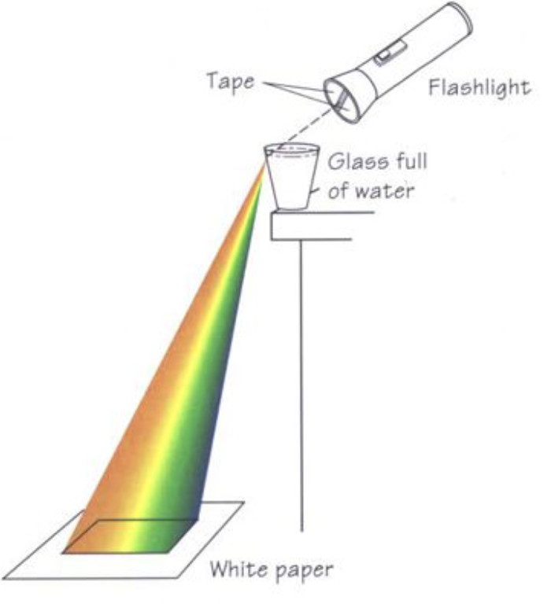
Demonstration
Rainbow making demonstration
TEACHER DIRECTIONS:
Before viewing: Ask students what they already know about visible light. Tell students today they will be learning about the visible light spectrum.
During: Encourage students to observe the order of the colors in the spectrum (red, orange, yellow, green, blue, indigo, violet) and discuss how this experiment relates to real-life phenomena like rainbows and prisms.
After: Tell students that today they will be learning more about the visible light spectrum.
Notes:
Materials Needed:
A glass of water
A flashlight
A white piece of paper
A dark room
Instructions:
Set the Stage:
Dim the lights in the classroom to create a dark environment. The darker the room, the better the colors will show up.
Fill the Glass:
Fill the glass with water. Make sure it's filled almost to the top.
Shine the Flashlight:
Shine the flashlight through the side of the glass, so the light passes through the water.
Observe and Enjoy:
Hold the white piece of paper on the other side of the glass, opposite to where the light is entering. You should start seeing a beautiful spectrum of colors on the paper.
Explanation:
When the light from the flashlight passes through the water, it gets bent (refracted). Different colors of light bend by different amounts. This bending of light separates the colors and creates a rainbow
effect. This experiment mimics the process of how rainbows are formed in nature when sunlight passes through raindrops.
You can explain to the students that this experiment demonstrates how white light, which appears colorless, is made up of a mixture of different colors. Each color bends differently, so when they
pass through the water, they spread out and become visible as a spectrum.
Encourage students to observe the order of the colors in the spectrum (red, orange, yellow, green, blue, indigo, violet) and discuss how this experiment relates to real-life phenomena like rainbows and
prisms. You can also discuss the concept of refraction and how it plays a crucial role in the formation of rainbows and other optical phenomena.

Slide 5
Notes:
Before we move on to our new vocabulary term, let’s review some other words & concepts that you already learned and make sure you are firm in your understanding.

Slide 6
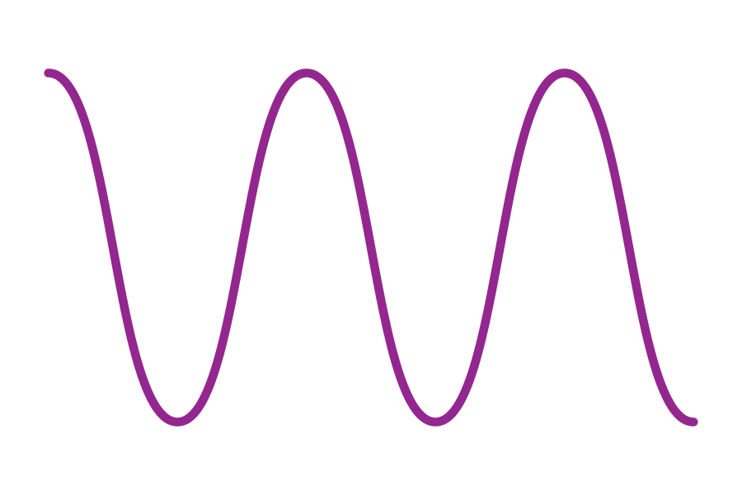
Waves: a pattern of motions that move through stuff, carrying energy from one place to another, but without carrying any matter.
Notes:
Waves are a pattern of motions that move through stuff, carrying energy from one place to another, but without carrying any matter

Slide 7
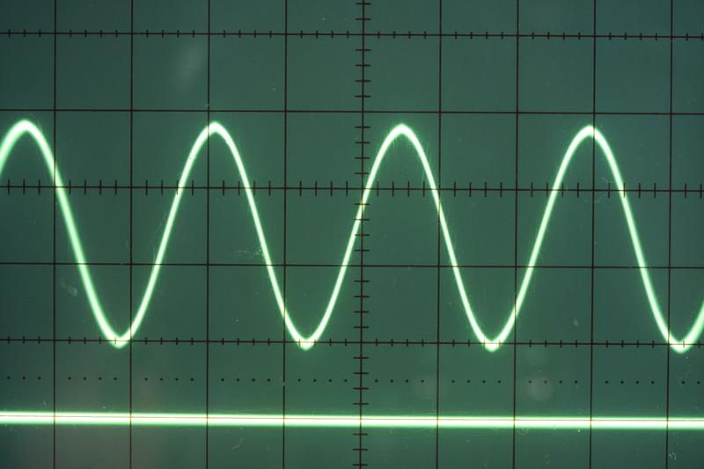
Transverse Waves: waves that travel sideways to the direction they are moving
Notes:
Transverse waves are waves that travel sideways to the direction they are moving.

Slide 8
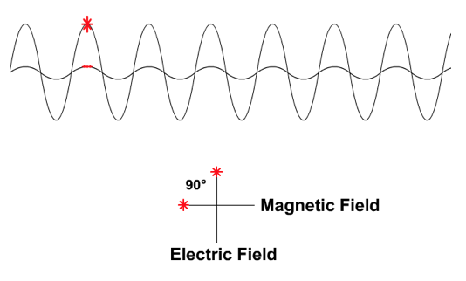
Electromagnetic Waves: waves that are created as a result of vibrations between an electric field and a magnetic field
Notes:
Electromagnetic waves are waves that are created as a result of vibrations between an electric field and a magnetic field.

Slide 9
Electromagnetic Spectrum: range of all types of electromagnetic waves
Notes:
The electromagnetic spectrum is the range of all types of magnetic waves.

Slide 10
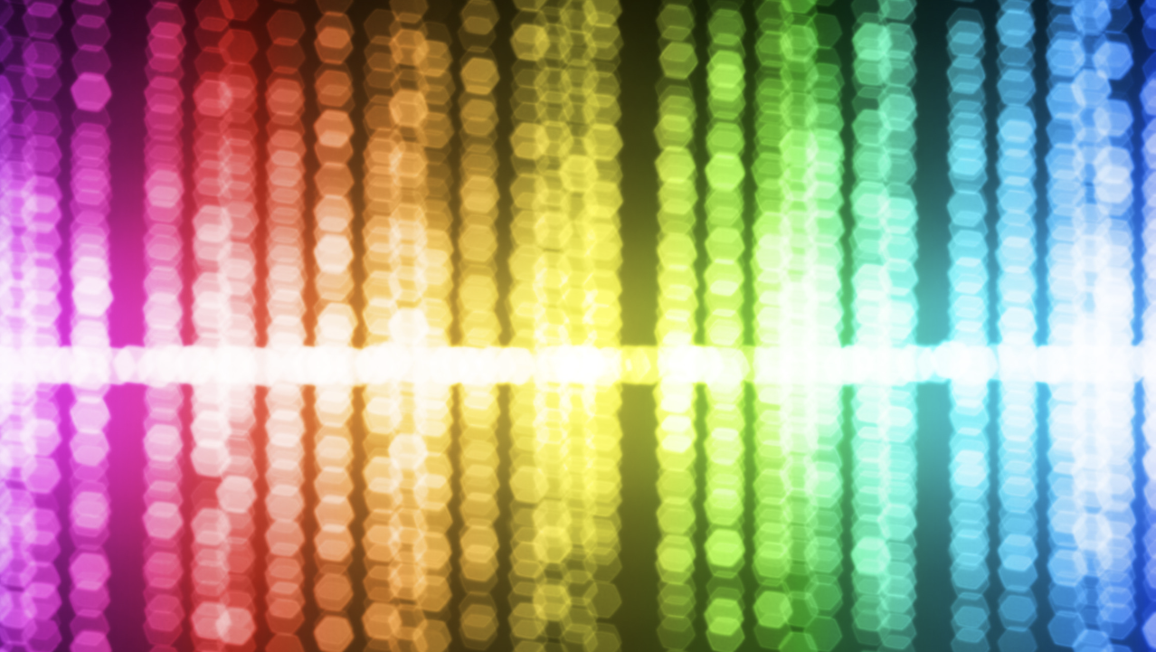
Visible Light: wavelengths on the electromagnetic spectrum that people can see with their eyes
Notes:
Visible light are wavelengths on the electromagnetic spectrum that people can see with their eyes
Feedback: When providing more student-friendly definitions, it is helpful to provide students with cues so that they can be prepared and know what to expect and be ready to copy down the information.

Slide 11
Notes:
Now let’s pause for a moment to check your understanding.
Feedback: It's really important to make sure that you're providing students with frequent opportunities to respond as you're activating prior knowledge – it will save so you so much time if you confirm understanding before asking them to try something independently.

Slide 12
What is the difference between waves and transverse waves?
Notes:
What is the difference between waves and transverse waves?
[Transverse waves are simply a type of wave that moves sideways to the direction they are moving. This is not the case for all waves.]

Slide 13
What are electromagnetic waves?
Notes:
What are electromagnetic waves?
[Electromagnetic waves are waves that are created as a result of vibrations between an electric field and a magnetic field.]

Slide 14
What is the electromagnetic spectrum?
Notes:
What is the electromagnetic spectrum?
[The electromagnetic spectrum is the range of all types of electromagnetic waves. These are created as result of vibrations between an electric field and a magnetic field.]

Slide 15
True/False: Visible light is any wavelength on the electromagnetic spectrum that people can see with their eyes
Notes:
True/False: Visible light is any wavelength on the electromagnetic spectrum that people can see with their eyes
[True]

Slide 16
True/False: Visible light is any wavelength on the electromagnetic spectrum that people can see with their eyes
Notes:
True: Visible light is any wavelength on the electromagnetic spectrum that people can see with their eyes

Slide 17
Visible Light Spectrum
Notes:
Now that we’ve reviewed, let’s define our new term, visible light.

Slide 18
Visible Light Spectrum: the range of all wavelengths that create colors that we can see with our eyes.
Notes:
The Visible Light Spectrum is the range of all wavelengths that create colors that we can see with our eyes.

Slide 19
Notes:
Let’s check-in for understanding.

Slide 20
What is the visible light spectrum?
Notes:
What is the visible light spectrum?
The Visible Light Spectrum is the range of all wavelengths that create colors that we can see with our eyes.

Slide 21
Notes:
That is the basic definition, but there is a bit more you need to know.

Slide 22
The visible light spectrum is the entire part of the electromagnetic spectrum you can see with your eyes.
Notes:
The visible light spectrum is the entire part of the electromagnetic spectrum you can see with your eyes.

Slide 23
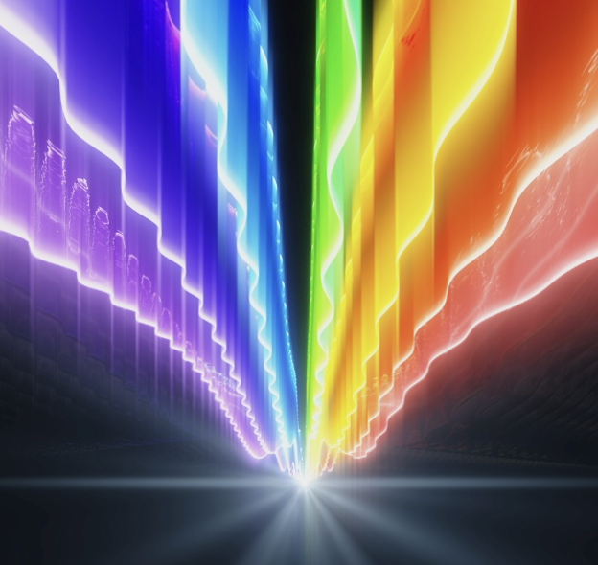
Travels as waves
Notes:
Visible light travels in the form of waves. These waves move in straight lines unless they encounter an obstacle or a different medium (like air changing to water or glass).

Slide 24
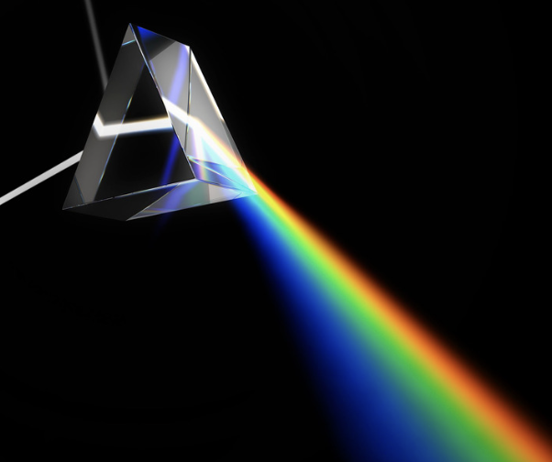
As visible light shines through a prism we see all the different colors as their wavelengths change
Notes:
As visible light shines through a prism we see all the different colors as their wavelengths change

Slide 25
Notes:
Let’s check-in for understanding.

Slide 26
How does visible light travel?
Notes:
How does visible light travel?
[Visible light travels in the form of waves. These waves move in straight lines unless they encounter an obstacle or a different medium (like air changing to water or glass).

Slide 27
True/False: As visible light shines through a prism we see all the different colors as their wavelengths change
Notes:
True/False: As visible light shines through a prism we see all the different colors as their wavelengths change
[True]

Slide 28
True/False: As visible light shines through a prism we see all the different colors as their wavelengths change
Notes:
True/False: As visible light shines through a prism we see all the different colors as their wavelengths change
[True]

Slide 29
The visible light spectrum is part of the larger spectrum.
Notes:
The visible light spectrum is part of the larger spectrum.
[electromagnetic]

Slide 30
The visible light spectrum is part of the larger electromagnetic spectrum.
Notes:
The visible light spectrum is part of the larger electromagnetic spectrum.

Slide 31
Notes:
Now, let’s talk about some examples of visible light.
Feedback: It's good to pick a variety of examples to work through with your students. This prepares them for some types that might trip them up when they try it on their own.

Slide 32
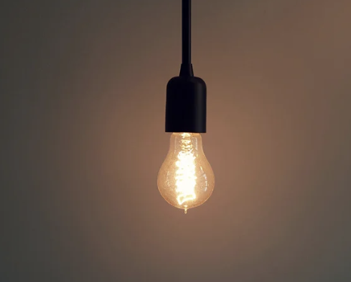
The light that shines from the light bulb is an example of waves located within the visible light spectrum
Notes:
The light that shines from the light bulb is an example of waves located within the visible light spectrum. The lightbulb emits visible light that you can see.

Slide 33
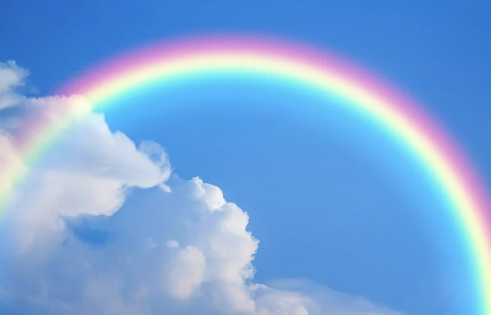
The colors of the rainbow are examples of waves located within the visible light spectrum
Notes:
The colors of the rainbow are examples of waves located within the visible light spectrum. We can see all the colors because the light has passed through a prism like a drop of water.

Slide 34
Notes:
Next, let’s talk about some non-examples of visible light.

Slide 35
Sound Waves are NOT an example of waves found on the visible light spectrum
Notes:
Sound waves are not an example of waves found on the visible light spectrum. They are waves of mechanical energy and require a medium to pass through and we cannot see them.
Feedback: Non-examples often need some explanation to make it clear to students the difference. Using clear and simple language can help with this.

Slide 36
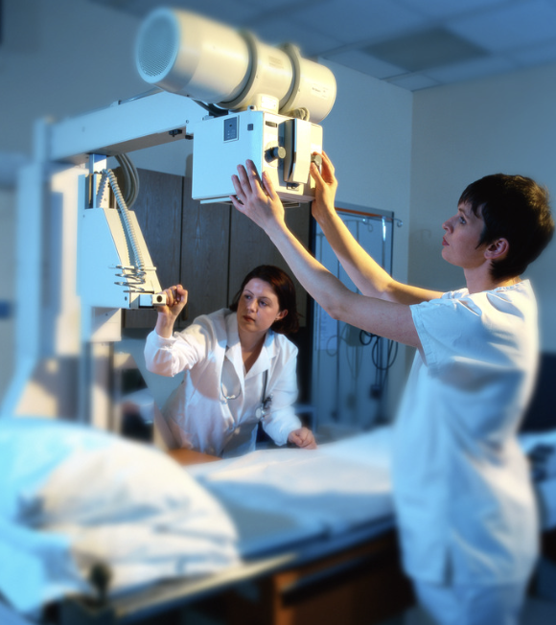
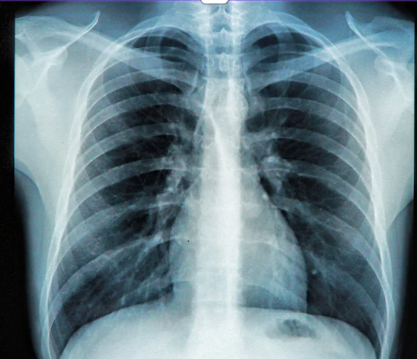
X-Rays are NOT an example of waves found on the visible light spectrum
Notes:
X-rays are not part of the visible light spectrum. You can not see the rays coming out of the x-ray machine, but you can see the image it produces through technology

Slide 37
Notes:
Let’s check-in for understanding.

Slide 38
The colors of the are examples of waves located within the visible light .
Notes:
The colors of the are examples of waves located within the visible light .
[rainbow, spectrum]

Slide 39
The colors of the rainbow are examples of waves located within the visible light spectrum.
Notes:
The colors of the rainbow are examples of waves located within the visible light spectrum.

Slide 40
True/False: Sound Waves are an example of waves found on the visible light spectrum
Notes:
True/False: Sound Waves are an example of waves found on the visible light spectrum
[False]

Slide 41
True/False: Sound Waves are an example of waves found on the visible light spectrum
Notes:
False: Sound Waves are NOT an example of waves found on the visible light spectrum

Slide 42
Notes:
We will now complete this concept map, called a Frayer model, to summarize and further clarify what you have learned about the term visible light spectrum.

Slide 43
Definition
Picture
Visible Light Spectrum
How does the visible light spectrum impact my life?
Example
Notes:
To complete the Frayer model, we will choose from four choices the correct picture, definition, example, and response to the question, “How does the visible light spectrum impact my life?” Select the best response for each question using the information you just learned. As we select responses, we will see how this model looks filled in for the term visible light spectrum.

Slide 44
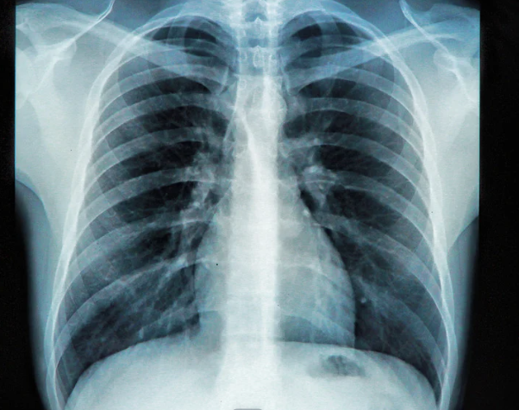
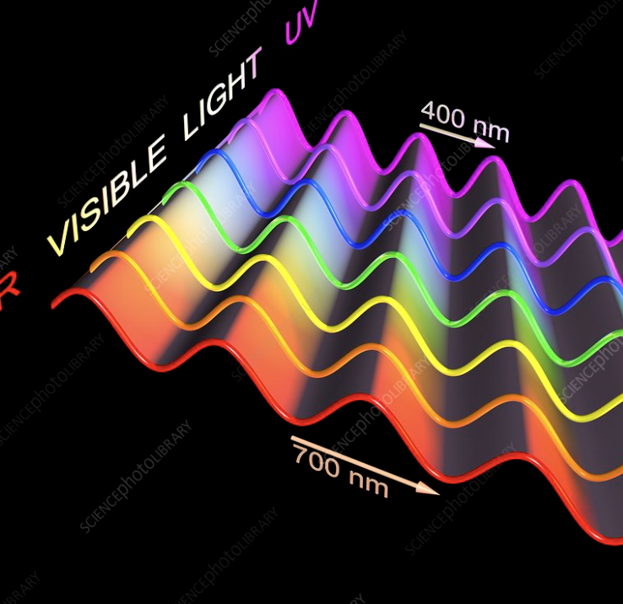
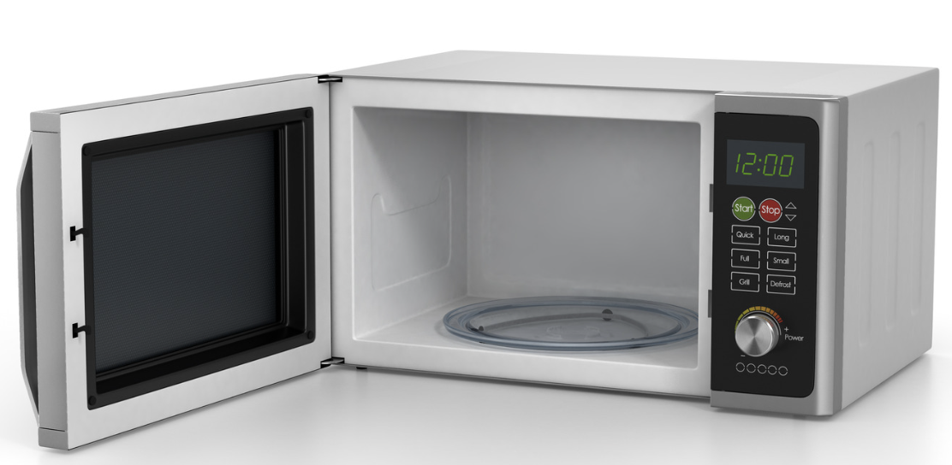
Directions: Choose the correct picture of visible light spectrum from the choices below.
A
B
C
D
Notes:
Choose the one correct picture of the visible light spectrum from these four choices.

Slide 45
Directions: Choose the correct picture of visible light spectrum from the choices below.
A
B
C
D
Notes:
This is the picture that shows the visible light spectrum.

Slide 46
Definition
Picture
Visible Light
How does the visible light spectrum impact my life?
Example
Notes:
Here is the Frayer model filled in with a picture of the visible light spectrum.

Slide 47
Directions: Choose the correct definition of visible light spectrum from the choices below.
A
A repeating motion that carries energy from one place to another.
B
The range of all wavelengths that create colors that we can see with our eyes.
C
The range of your arm from when you relax it to when you stretch it out completely
D
The range of all types of electromagnetic waves
Notes:
Choose the one correct definition of visible light spectrum from these four choices.

Slide 48
Directions: Choose the correct definition of visible light spectrum from the choices below.
A
A repeating motion that carries energy from one place to another.
B
The range of all wavelengths that create colors that we can see with our eyes.
C
The range of your arm from when you relax it to when you stretch it out completely
D
The range of all types of electromagnetic waves
Notes:
“The range of all wavelengths that create colors that we can see with our eyes..” is correct! This is the definition of visible light spectrum.

Slide 49
Definition
Picture
The range of all wavelengths that create colors that we can see with our eyes.
Visible Light Spectrum
How does the visible light spectrum impact my life?
Example
Notes:
Here is the Frayer Model with a picture and the definition filled in for visible light spectrum: The range of all wavelengths that create colors that we can see with our eyes.

Slide 50
Directions: Choose the correct example of the visible light spectrum from the choices below.
A
A slice of pizza
B
When light shines through a soap bubble
C
A radio station
D
An X-Ray machine
Notes:
Choose the one correct example of the visible light spectrum from these four choices.

Slide 51
Directions: Choose the correct example of the visible light spectrum from the choices below.
A
A slice of pizza
B
The colors seen when light shines through a soap bubble
C
A radio station
D
An X-Ray machine
Notes:
“The colors seen when light shines through a soap bubble” is correct! This is an example of the visible light spectrum.

Slide 52
Definition
Picture
The range of all wavelengths that create colors that we can see with our eyes.
Visible Light Spectrum
The colors seen when light shines through a soap bubble
How does the visible light spectrum impact my life?
Example
Notes:
Here is the Frayer Model with a picture, definition, and an example of the visible light spectrum: The colors seen when light shines through a soap bubble.

Slide 53
Directions: Choose the correct response for “how does the visible light spectrum impact my life?” from the choices below.
A
The visible light spectrum is in the food we eat and give us the nutrition our bodies need to survive
B
The visible light spectrum is why I can hear all different types of musical notes and enjoy the music that I stream.
C
The visible light spectrum is why I can see different colors like red, green, and blue.
D
The visible light spectrum uses its gravitational pull to create tides in the oceans. The ocean tides impact climate and the seasons where I live here on Earth.
Notes:
Choose the one correct response for “how does the visible light spectrum impact my life?” from these four choices.

Slide 54
Directions: Choose the correct response for “how does the visible light spectrum impact my life?” from the choices below.
A
The visible light spectrum is in the food we eat and give us the nutrition our bodies need to survive
B
The visible light spectrum is why I can hear all different types of musical notes and enjoy the music that I stream.
C
The visible light spectrum is why I can see different colors like red, green, and blue.
D
The visible light spectrum uses its gravitational pull to create tides in the oceans. The ocean tides impact climate and the seasons where I live here on Earth.
Notes:
“The visible light spectrum is why I can see different colors like red, green, and blue.” That is correct! This is an example of how the visible light spectrum impacts your life.

Slide 55
Definition
Picture
The range of all wavelengths that create colors that we can see with our eyes.
Visible Light Spectrum
The visible light spectrum is why I can see different colors like red, green, and blue.
The colors seen when light shines through a soap bubble
How does the visible light spectrum impact my life?
Example
Notes:
Here is the Frayer Model with a picture, definition, example, and a correct response to “how does the visible light spectrum impact my life?”: The visible light spectrum is why I can see different colors like red, green, and blue.

Slide 56
Remember!!!
Notes:
So remember!
Feedback: A good general strategy for information retention is: 1) tell them what you're going to teach them, 2) teach them, and 3) tell them what you just taught them. Make sure to include the third and final step. While it is easy to think a quick review of what you just went over is unnecessary, it can be incredibly useful in helping the students remember the information over the long term.

Slide 57
Visible Light Spectrum: the range of all wavelengths that create colors that we can see with our eyes.
Notes:
The Visible Light Spectrum is the range of all wavelengths that create colors that we can see with our eyes.

Slide 58
Big Question: How do we experience the visible light spectrum in everyday life?
Notes:
Let’s reflect once more on our big question. Our “big question” is: How do we experience the visible light spectrum in everyday life?
Does anyone have any additional examples to share that haven’t been discussed yet?

Slide 59
Notes:
Thanks for watching, and please continue watching CAPs available from this website.

Slide 60
This Video Was Created With Resources From:
Questions or Comments
Michael Kennedy, Ph.D. MKennedy@Virginia.edu
Rachel L Kunemund, Ph.D. rk8vm@virginia.edu

