Slide 1
Intro
“Big Idea” Question
Review Concepts
Check-In Questions
Teacher Demo
Vocabulary
Student-Friendly Definition
Examples & Non-Examples
Morphological Word Parts
Simulation/Activity
Notes:
OK everyone, get ready for our next lesson. Just as a reminder, these are the different components that our lesson may include, and you’ll see these icons in the top left corner of each slide so that you can follow along more easily!

Slide 2
Intro
Water
Notes:
Today we will learn about water.

Slide 3
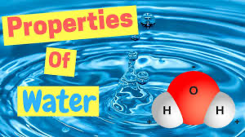
Big Question: What are the properties of water, and how does water play a role in the natural environment around us?
Notes:
Our “big question” is: What are the properties of water, and how does water play a role in the natural environment?
[Pause and illicit predictions from students.]
I like all of these predictions! Keep thinking about how to answer our big questions as we learn more about water.

Slide 4
Demonstration
Water Experiment
TEACHER DIRECTIONS:
TEACHER DIRECTIONS:
Before viewing, ask students to recall information about states of matter (solid, liquid, gas, what they remember about each phase, etc. Also ask them what they know about water.). After viewing, ask students to share observations, relating those observations back to these characteristics of both the states of matter and water. Tell students that they are going to be learning more about water and the properties of water.
You may also choose to do this experiment live for students (on video meeting platform or face-to-face). You can set up the materials – bowl of ice, (show it melting but a have separate bowl of water for time purposes), then a pot to boil the water to show it changing to a gas. If doing this experiment real time, be sure to ask students questions to keep them engaged (eg What do you notice? Why do you think that is happening? What is happening to the water?).
Notes:
Let’s do a quick demonstration that will help get our brains ready to think about water.

Slide 5
Notes:
Before we move on to our new vocabulary term, let’s review some other words & concepts that you already learned and make sure you are firm in your understanding.

Slide 6
Atom: Smallest whole unit of matter
Notes:
And an atom is the smallest whole unit of matter. All matter is made up of atoms.

Slide 7
Matter: has mass and takes up space
Notes:
Matter is anything that has mass and takes up space.

Slide 8
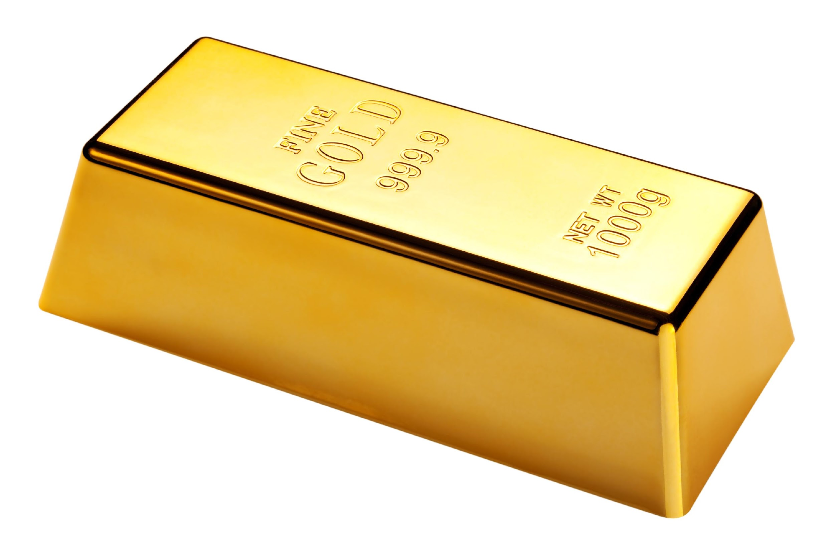
Element: a pure substance containing only one type of atom
Notes:
An element is a pure substance containing only one type of atom

Slide 9
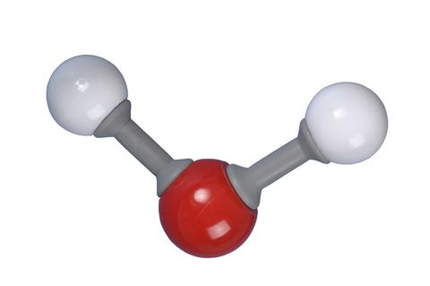
Molecule: particle containing two or more atoms of the same OR different elements
Notes:
A molecule is a particle containing two or more atoms of the same OR different elements.

Slide 10
Solid: has molecules that are tightly packed together in a fixed pattern
Notes:
A solid has molecules that are tightly packed together in a fixed pattern. The molecules in a solid cannot move around.

Slide 11
Liquid: has molecules that are close together but can move around
Notes:
A liquid has molecules that are close together but are not in a fixed pattern. The molecules in a liquid can move around.

Slide 12
Gas: has molecules that are spread far apart and are constantly moving
Notes:
A gas has molecules that are spread far apart and are constantly moving.

Slide 13
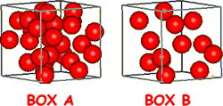
Density:
Mass per unit of volume
Notes:
Density is the mass per unit of volume of a substance. This will always remain constant---or the same---for a compound or element.

Slide 14
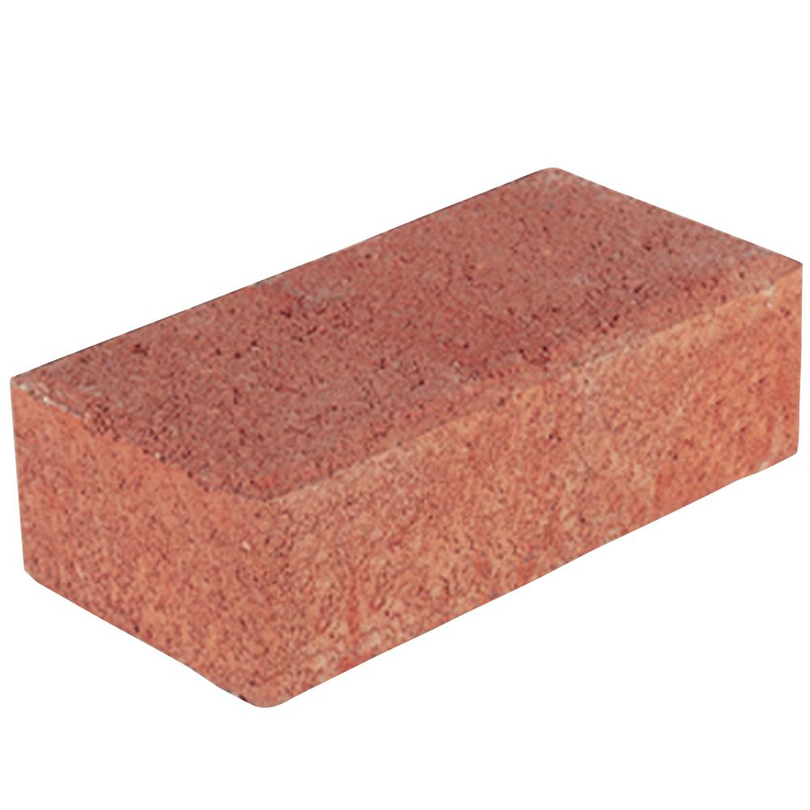
Heavy + Compact = Highly Dense
Notes:
If something is heavy and compact, or doesn’t take up a lot of space, then it has high density

Slide 15
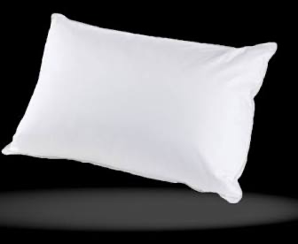
Takes up Space + Light = Low Density
Notes:
If an object takes up space but is light, then it has low density. Think about a pillow. A pillow is bigger than a brick (takes up more space), but it is much lighter than a brick so it has lower density.

Slide 16
Notes:
Now let’s pause for a moment to check your understanding.

Slide 17
What is the relationship between matter and atoms?
Notes:
What is the relationship between matter and atoms?
[Atoms are the smallest unit of whole matter.]

Slide 18
What is the difference between an element and a molecule?
Notes:
What is the difference between an element and a molecule?
[An element is a pure substance containing only one type of atom, but a molecule contains two or more atoms of the same or different elements.]

Slide 19
Describe the molecules in a solid.
Notes:
Describe the molecules in a solid.
[Tightly packed together in a fixed pattern]

Slide 20
What is the difference between the molecules in a liquid and a gas?
Notes:
What is the difference between the molecules in a liquid and a gas?
[A liquid has molecules that are close together but can move around, but a gas has molecules that are spread far apart and are constantly moving.]

Slide 21
Which is more dense, the brick or the pillow, and why?
Notes:
Which is more dense, the brick or the pillow, and why?
[The brick is more dense because it is heavy and compact.]

Slide 22
Water
Notes:
Now that we’ve reviewed, let’s define our new term, water.

Slide 23
Water: Liquid made up of 2 hydrogen atoms and 1 oxygen atom
O
H
H
Notes:
Water is a liquid made up of 2 hydrogen atoms and 1 oxygen atom. Water is essential for life.

Slide 24
Notes:
Now let’s pause for a moment to check your understanding.

Slide 25
What is the definition of water?
O
H
H
Notes:
What is the definition of water?
[Water is a liquid made up of 2 hydrogen atoms and 1 oxygen atom. Water is essential for life.]

Slide 26
Notes:
That is the basic definition, but there is a bit more you need to know.

Slide 27
O
bond
bond
H
H
Notes:
Each hydrogen atom is bonded to the oxygen atom.

Slide 28
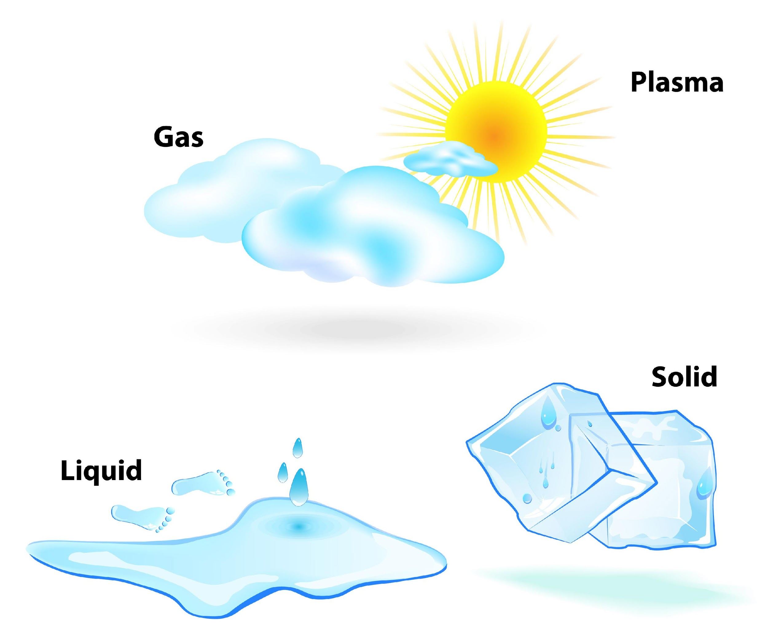
Notes:
Water is unique because it is the only compound that commonly exists in all three states of matter (solid, liquid, and gas) on Earth.

Slide 29
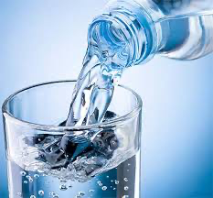
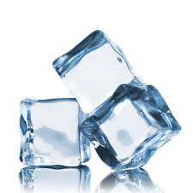
Liquid water is more dense than solid water
Notes:
Density is important to remember when we look at the different states of water. Remember if something is heavy and compact it is highly dense. If something takes up space and is light it has low density. Since water can take the shape of the container it is in and it is more compact, it is more dense than solid water.

Slide 30
Notes:
Now let’s pause for a moment to check your understanding.

Slide 31
What is the definition of water?
O
H
H
Notes:
What is the definition of water?
[Water is a liquid made up of 2 hydrogen atoms and 1 oxygen atom. Water is essential for life.]

Slide 32
What makes water unique?
O
H
H
Notes:
What makes water unique?
[Water is unique because it is the only compound that commonly exists in all three states of matter (solid, liquid, and gas) on Earth.]

Slide 33
Is water more dense in liquid or solid form?
Notes:
Is water more dense in liquid or solid form?
[Since water can take the shape of the container it is in and it is more compact, it is more dense than solid water.]

Slide 34
Notes:
Let’s look at some examples of water.

Slide 35
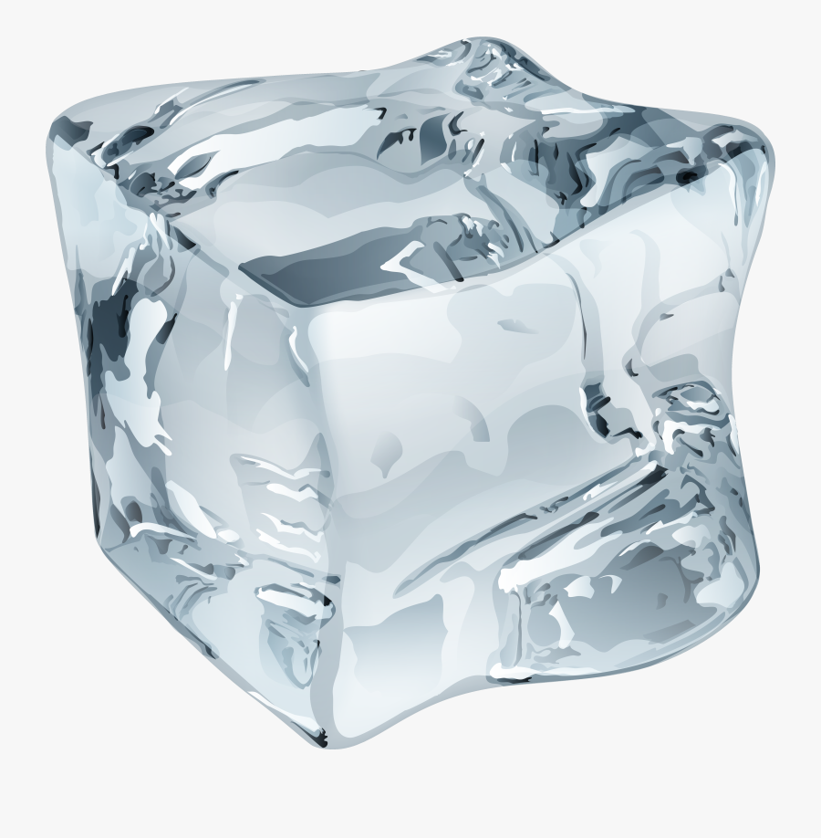
O
H
H
Notes:
This ice cube is an example of water, it is just water in its solid state. Although it is a solid, it still has 2 hydrogen atoms and 1 oxygen atom.

Slide 36
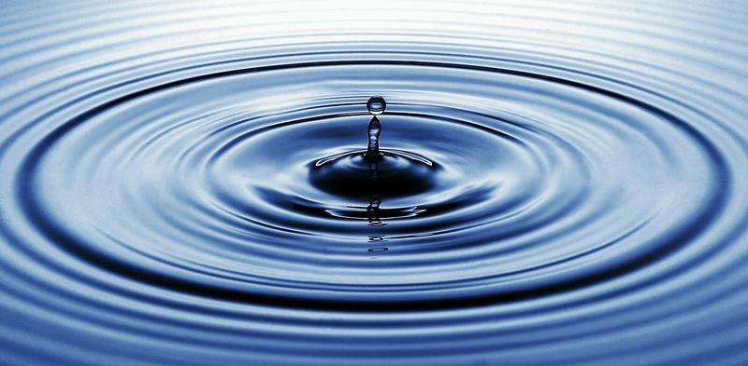
O
H
H
Notes:
This is another example of water. Here, water is in its liquid state. It is water because there are 2 hydrogen atoms and one oxygen atom bonded together. The difference here is the bonds are weaker, so the liquid can move in the container.

Slide 37
O
H
H
Notes:
Water vapor or steam is still a form of water. Here, we have water in a different state (Gas). It is still oxygen and hydrogen. Here the bonds are very weak, so the gas can move outside of the container.

Slide 38
Notes:
Now let’s pause for a moment to check your understanding.

Slide 39
This is a solid, how is it an example of water?
O
H
H
Notes:
How is this solid an example of water?
[This ice cube is an example of water, it is just water in its solid state. Although it is a solid, it still has 2 hydrogen atoms and 1 oxygen atom.]

Slide 40
Notes:
Next, let’s talk about some non-examples of water.

Slide 41
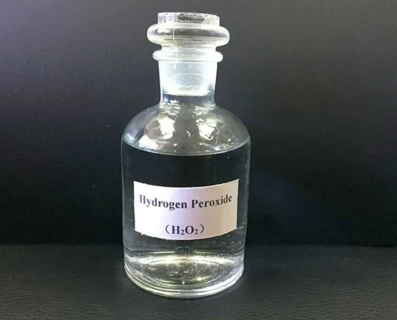
Notes:
Hydrogen peroxide is a non-example of water. Though it is a clear liquid, this compound is made up of 2 hydrogen atoms and 2 oxygen atoms. Water is made up of 2 hydrogen atoms and 1 oxygen atom.

Slide 42
Notes:
Now let’s pause for a moment to check your understanding.

Slide 43
Why is hydrogen peroxide a non-example of water?
Notes:
Why is hydrogen peroxide a non-example of water?
[Hydrogen peroxide is made of a 2 hydrogen atoms and 2 oxygen atoms. Water is made up of 2 hydrogen atoms and 1 oxygen atom.]

Slide 44
What atoms make up water?
Notes:
What atoms make up water?
[Water is a liquid made up of 2 hydrogen atoms and 1 oxygen atom. Water is essential for life.]

Slide 45
True/False: Water is the only compound that exists in all three states of matter?
Notes:
True: Water is unique because it is the only compound that commonly exists in all three states of matter (solid, liquid, and gas) on Earth

Slide 46
True/False: Water is the only compound that exists in all three states of matter?
Notes:
True: Water is unique because it is the only compound that commonly exists in all three states of matter (solid, liquid, and gas) on Earth

Slide 47
Is water more dense in liquid or solid form?
Notes:
Why is liquid water more dense than solid water?
[Remember if something is heavy and compact it is highly dense. If something takes up space and is light it has low density. Since water can take the shape of the container it is in and it is more compact, it is more dense than solid water.]

Slide 48
Remember!!!
Notes:
So remember!

Slide 49
Water: Liquid made up of 2 hydrogen atoms and 1 oxygen atom
O
H
H
Notes:
Water is a liquid made up of 2 hydrogen atoms and 1 oxygen atom. Water is essential for life.

Slide 50
Simulation Activity
Water Gizmo
(Explore Learning)
Click the link above to explore how water can change its state.
In this simulation activity, you’ll see what happens to water to change it into a solid, liquid, and gas. You can also use the magnifying glass to look at the molecules of each state of matter to determine if it is a solid, liquid, or gas.

Slide 51
Big Question: What are the properties of water, and how does water play a role in the natural environment around us?
Notes:
Our “big question” is: What are the properties of water, and how does water play a role in the natural environment?
[Pause and illicit predictions from students.]
What have we learned to help answer our question? Have our hypothesis changed?

Slide 52
Notes:
Thanks for watching, and please continue watching CAPs available from this website.

Slide 53
This Video Was Created With Resources From:
Questions or Comments
Michael Kennedy, Ph.D. MKennedy@Virginia.edu
Rachel L Kunemund, Ph.D. rk8vm@virginia.edu

Slide 54
Intro
“Big Idea” Question
Review Concepts
Check-In Questions
Teacher Demo
Vocabulary
Student-Friendly Definition
Examples & Non-Examples
Morphological Word Parts
Simulation/Activity
Notes:
OK everyone, get ready for our next lesson. Just as a reminder, these are the different components that our lesson may include, and you’ll see these icons in the top left corner of each slide so that you can follow along more easily!

Slide 55
Polarity
Intro
O
-
+
+
H
H
Notes:
Today we will learn about polarity.

Slide 56
Big Question: What are the properties of water, and how does water play a role in the natural environment around us?
Notes:
Our “big question” is: What are the properties of water, and how does water play a role in the natural environment?
[Pause and illicit predictions from students.]
I like all of these predictions! Keep thinking about how to answer our big questions as we learn more about water.

Slide 57
Demonstration
Polarity Experiment
TEACHER DIRECTIONS:
TEACHER DIRECTIONS:
TEACHER DIRECTIONS:
Before viewing, ask students to recall information about water. After viewing, ask students to share observations, relating those observations back to what they know about water.
You may also choose to do this experiment live for students (on video meeting platform or face-to-face). You can set up the materials – stream of water an a a charged balloon (rubbing it on shirt, etc to get it full of electrons. Once you do that, you will move the balloon towards the water, and the stream will bend. Tell students that the reason the water looks like it bends is because of a term we will learn called polarity.
Notes:
Let’s do a quick demonstration that will help get our brains ready to think about polarity.
Start at 4:45 on the video.

Slide 58
Notes:
Before we move on to our new vocabulary term, let’s review some other words & concepts that you already learned and make sure you are firm in your understanding.

Slide 59
Atom: Smallest whole unit of matter
Notes:
And an atom is the smallest whole unit of matter. All matter is made up of atoms.

Slide 60
Matter: has mass and takes up space
Notes:
Matter is anything that has mass and takes up space.

Slide 61
Element: a pure substance containing only one type of atom
Notes:
An element is a pure substance containing only one type of atom

Slide 62
Molecule: particle containing two or more atoms of the same OR different elements
Notes:
A molecule is a particle containing two or more atoms of the same OR different elements.

Slide 63
Water: Liquid made up of 2 hydrogen atoms and 1 oxygen atom
O
H
H
Notes:
Water is a liquid made up of 2 hydrogen atoms and 1 oxygen atom. Water is essential for life.

Slide 64
O
bond
bond
H
H
Notes:
Each hydrogen atom is bonded to the oxygen atom.

Slide 65
Notes:
Let’s check-in for understanding.

Slide 66
What is the relationship between matter and atoms?
Notes:
What is the relationship between matter and atoms?
[Atoms are the smallest unit of whole matter.]

Slide 67
What is the difference between an element and a molecule?
Notes:
What is the difference between an element and a molecule?
[An element is a pure substance containing only one type of atom, but a molecule contains two or more atoms of the same or different elements.]

Slide 68
What atoms bond to make water?
Notes:
What atoms bond to make water?
[Water is a liquid made up of 2 hydrogen atoms and 1 oxygen atom.]

Slide 69
Polarity
Notes:
Now let’s look at what we mean by polarity.

Slide 70
Polarity: one side has a negative charge and the other has a positive charge
-
O
+
+
H
H
Notes:
Polarity means that one side of the molecule or other object has a negative charge and one side of the molecule has a positive charge. Think of it like a magnet, one side of the magnetic! If you put two magnets together they will repel because like charges repel (like the balloon and the water!)

Slide 71
Notes:
Let’s check-in for understanding.

Slide 72
What does polarity mean?
-
O
+
+
H
H
Notes:
What does polarity mean?
[Polarity means that one side has a negative charge and the other has a positive charge.]

Slide 73
Notes:
That is the basic definition, but there is a bit more you need to know.

Slide 74
Water Molecule = Polar
-
O
+
+
H
H
Notes:
When hydrogen and oxygen atoms bond together, the new molecule becomes polarized. It now has a negative charge on one end (the oxygen atom), and positive charges on the other (one on each hydrogen atom).

Slide 75
Notes:
Let’s check-in for understanding.

Slide 76
Polarity: one side has a _____ charge and the other has a _____ charge
-
O
+
+
H
H
Notes:
Polar: one side has a _____ charge and the other has a _____ charge

Slide 77
Polarity: one side has a negative charge and the other has a positive charge
-
O
+
+
H
H
Notes:
Polarity means that one side of the molecule or other object has a negative charge and one side of the molecule has a positive charge. Think of it like a magnet, one side of the magnetic! If you put two magnets together they will repel because like charges repel (like the balloon and the water!)

Slide 78
How is a water molecule polar?
-
O
+
+
H
H
Notes:
How is a water molecule polar?
[When hydrogen and oxygen atoms bond together, the new molecule becomes polarized. It now has a negative charge on one end (the oxygen atom), and positive charges on the other (one on each hydrogen atom).]

Slide 79
Notes:
Now, let’s talk about some examples of polarity.

Slide 80
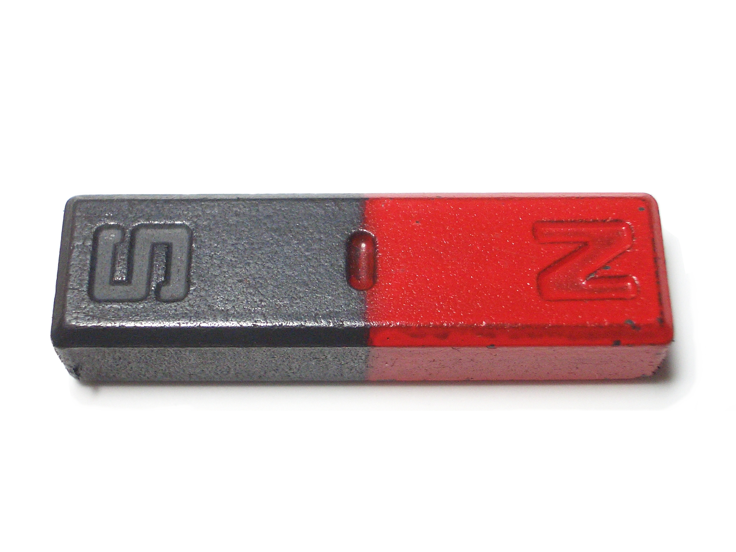
Notes:
Magnets are polar – each pole, or end, of a magnet has its own magnetic field. These fields are opposite of each other (one positive one negative).

Slide 81
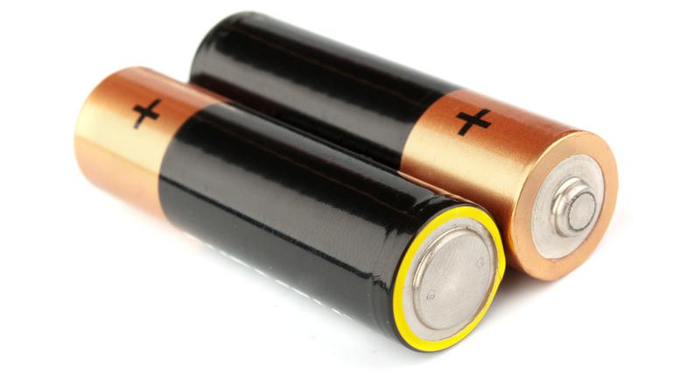
+
-
Notes:
Another object that is polar is a battery. One end of the battery is negative, and the other end is positive.

Slide 82
-
O
+
+
H
H
Notes:
Remember, water is also polar. It is polar because oxygen makes one side negative, and the two hydrogen atoms are positive.

Slide 83
Notes:
Let’s check-in for understanding.

Slide 84
What are some examples of polarity (other than water)?
Notes:
What are some examples of polarity (other than water)?
[Battery, magnet…]

Slide 85
Notes:
Next, let’s talk about some non-examples of polarity.

Slide 86
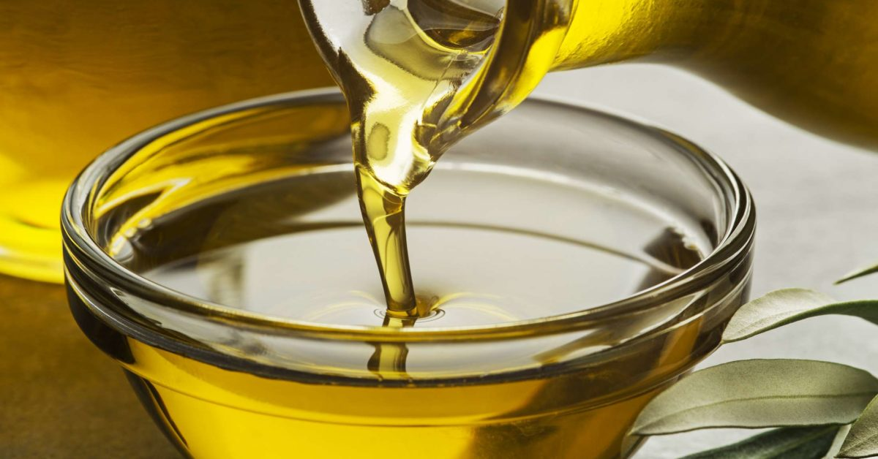
Notes:
Oils and fats are examples of non-polar molecules. This is why water and oil don’t mix!

Slide 87
Notes:
Let’s check-in for understanding.

Slide 88
Which is not an example of a polar molecule?
Notes:
Which is not an example of a polar molecule?

Slide 89
Which is not an example of a polar molecule?
Notes:
Which is not an example of a polar molecule?
[Oils and fats are examples of non-polar molecules. This is why water and oil don’t mix!]

Slide 90
What does polarity mean?
-
O
+
+
H
H
Notes:
What does polarity mean?
[Polarity means that one side of the molecule or other object has a negative charge and one side of the molecule has a positive charge.]

Slide 91
Why is water polar?
-
O
+
+
H
H
Notes:
Why is water polar?
[When oxygen and hydrogen bond, the side with oxygen is negative and the side with hydrogen is positive, so one side is negative and the other is positive.]

Slide 92
Name an example of something that is polar (other than water).
Notes:
Name an example of something that is polar (other than water).
[Battery, magnet…]

Slide 93
Remember!!!
Notes:
So remember!

Slide 94
Polarity: one side that has a negative charge and another that has a positive charge
-
O
+
+
H
H
Notes:
Polarity means that one side of the molecule or other object has a negative charge and one side of the molecule has a positive charge.

Slide 95
Big Question: What are the properties of water, and how does water play a role in the natural environment?
Notes:
Our “big question” is: What are the properties of water, and how does water play a role in the natural environment?.
[Pause and illicit predictions from students.]
What have we learned to help answer our question? Have our hypothesis changed?

Slide 96
Notes:
Thanks for watching, and please continue watching CAPs available from this website.

Slide 97
This Video Was Created With Resources From:
Questions or Comments
Michael Kennedy, Ph.D. MKennedy@Virginia.edu
Rachel L Kunemund, Ph.D. rk8vm@virginia.edu

Slide 98
Intro
“Big Idea” Question
Review Concepts
Check-In Questions
Teacher Demo
Vocabulary
Student-Friendly Definition
Examples & Non-Examples
Morphological Word Parts
Simulation/Activity
Notes:
OK everyone, get ready for our next lesson. Just as a reminder, these are the different components that our lesson may include, and you’ll see these icons in the top left corner of each slide so that you can follow along more easily!

Slide 99
Intro
Three Properties of Water
- Surface tension
- Adhesion
- Cohesion
Notes:
We are going to learn about the three properties of water.

Slide 100
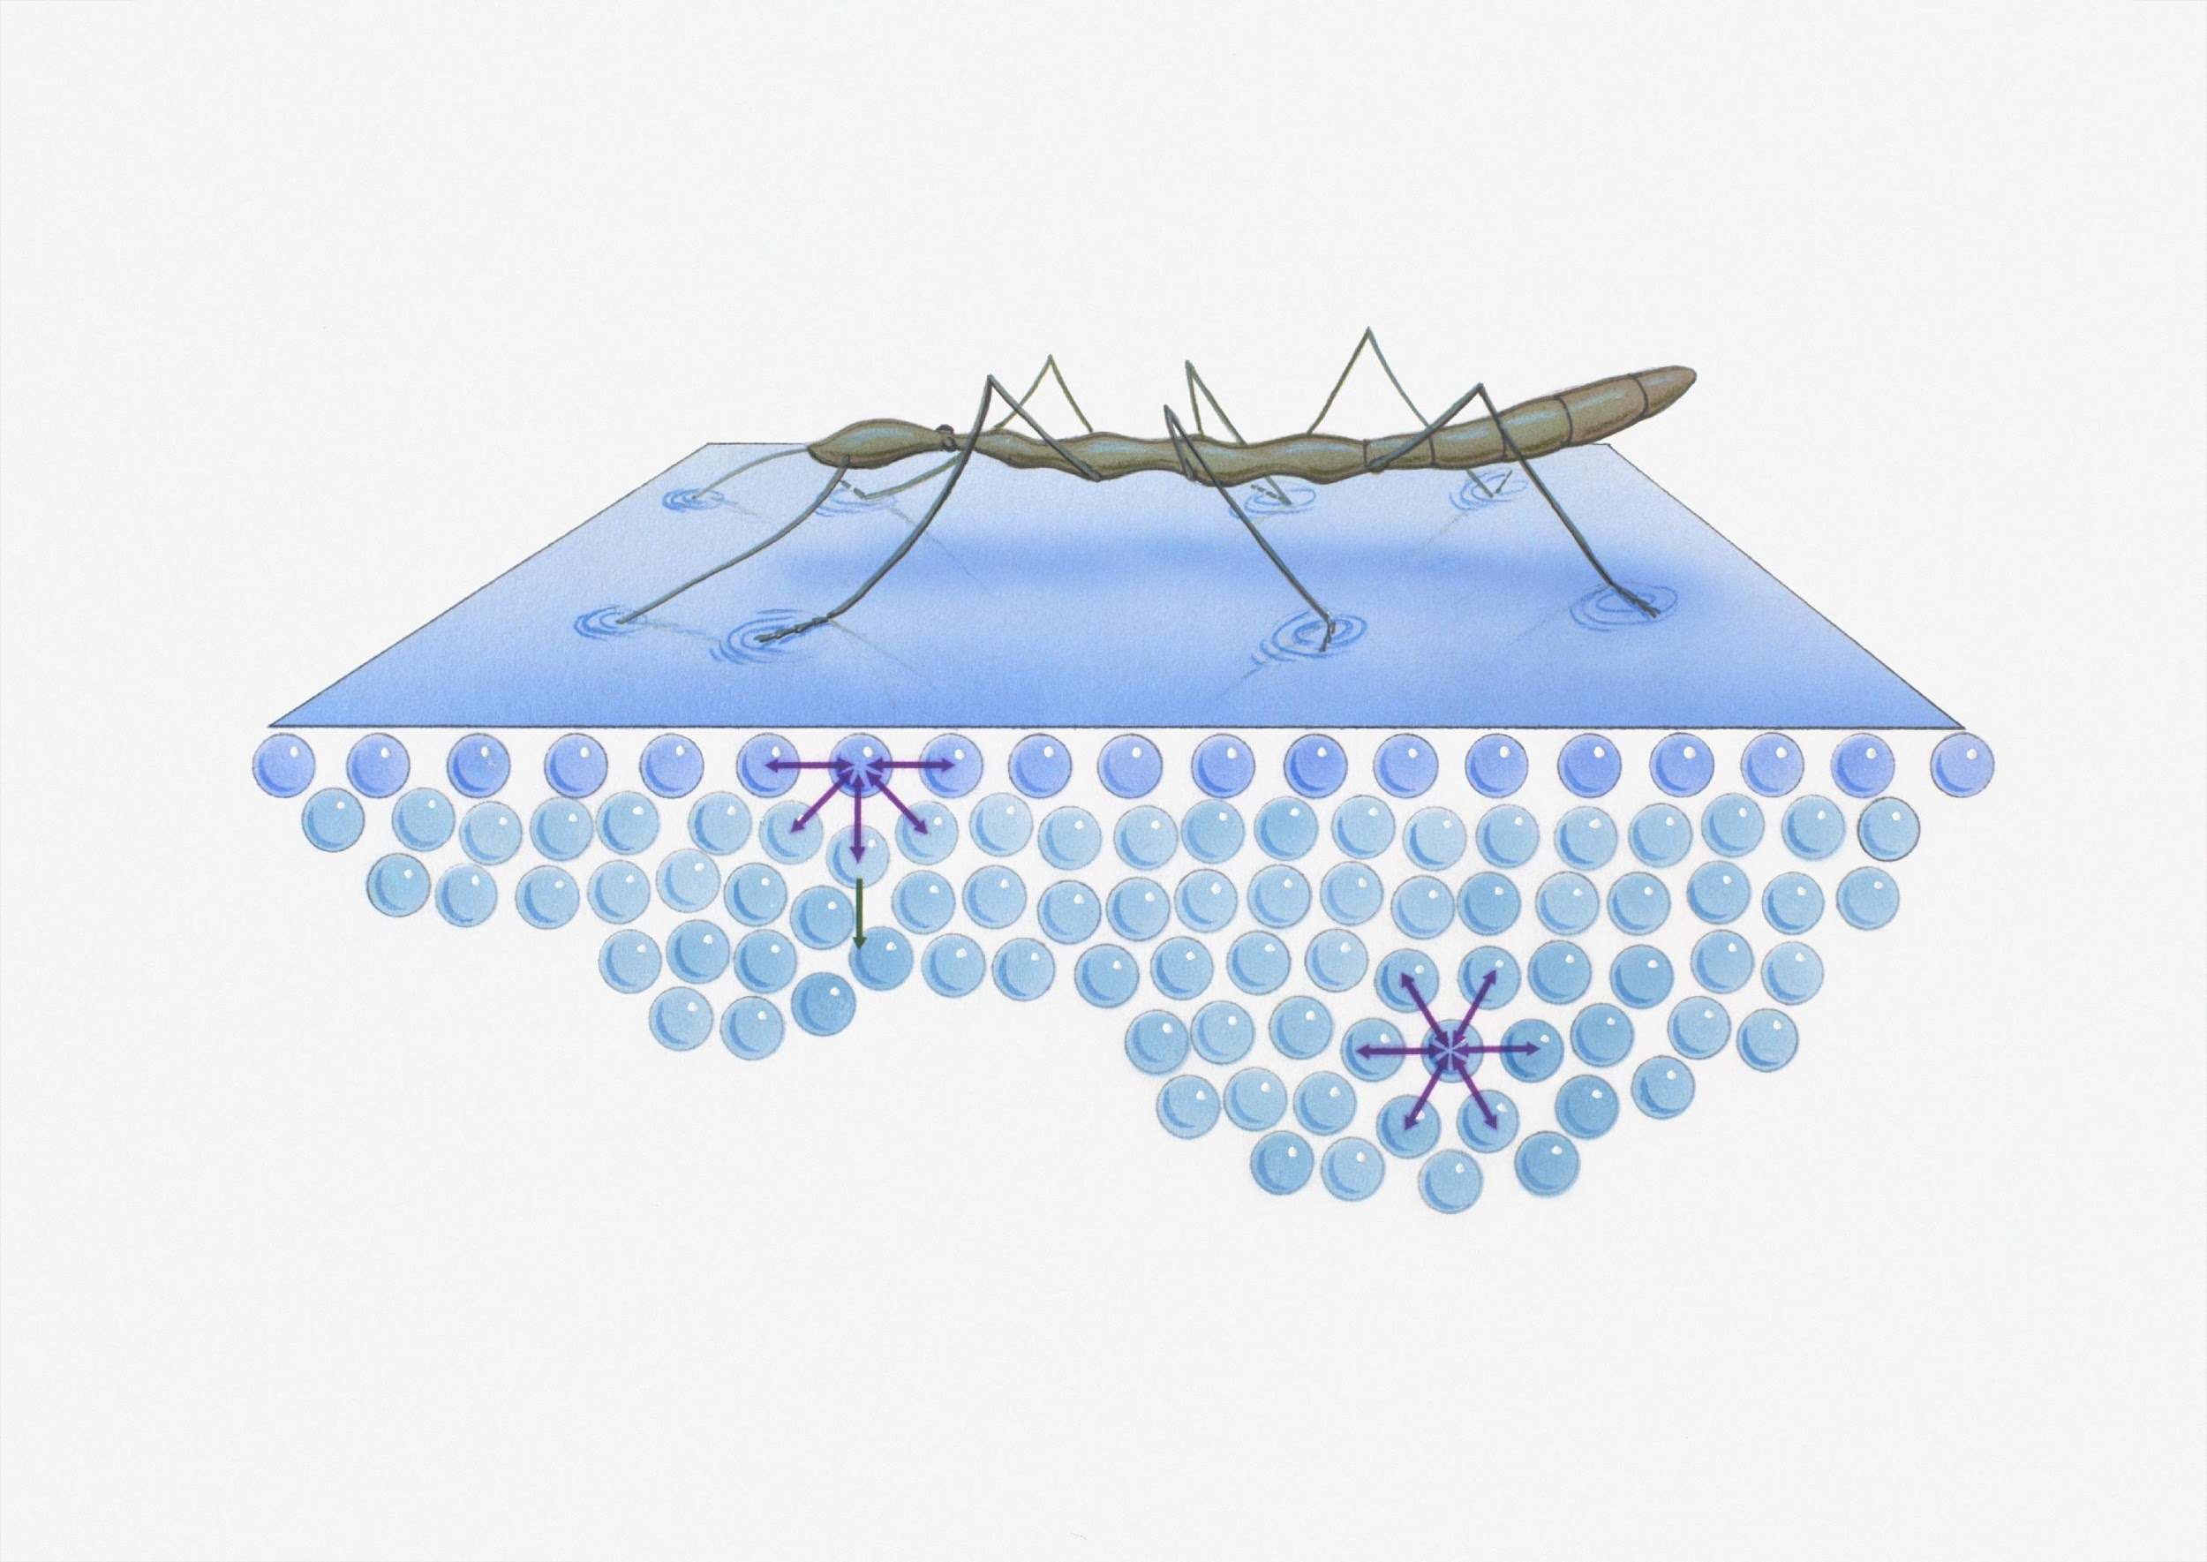
Surface Tension
Intro
Notes:
Today, we will learn about surface tension.

Slide 101
Big Question: What are the properties of water, and how does water play a role in the natural environment?
Notes:
Our “big question” is: What are the properties of water, and how does water play a role in the natural environment?
[Pause and illicit predictions from students.]
What have we learned to help answer our question? Have our hypothesis changed?

Slide 102
Demonstration
Surface Tension
TEACHER DIRECTIONS:
Before viewing, ask students to recall information about water. After viewing, ask students to share observations, relating those observations back to what they know about water. Tell students that the leaf is able to float because of a new term they will learn: surface tension. (If not live, here is a Youtube video.)
You may also choose to do this experiment live for students (on video meeting platform or face-to-face). You can set up the materials – water and a leaf. Place a leaf on the water and have students observe what they notice (i.e. how is the leaf on the water and not sinking?).
Notes:
Let’s do a quick demonstration that will help get our brains ready to think about surface tension, and why it is a property of water

Slide 103
Notes:
Before we move on to our new vocabulary term, let’s review some other words & concepts that you already learned and make sure you are firm in your understanding.

Slide 104
Atom: Smallest whole unit of matter
Notes:
An atom is the smallest whole unit of matter. All matter is made up of atoms.

Slide 105
Matter: has mass and takes up space
Notes:
Matter is anything that has mass and takes up space.

Slide 106
Element: a pure substance containing only one type of atom
Notes:
An element is a pure substance containing only one type of atom

Slide 107
Molecule: particle containing two or more atoms of the same OR different elements
Notes:
A molecule is a particle containing two or more atoms of the same OR different elements.

Slide 108
Water: Liquid made up of 2 hydrogen atoms and 1 oxygen atom
O
H
H
Notes:
Water is a liquid made up of 2 hydrogen atoms and 1 oxygen atom. Water is essential for life.

Slide 109
Polarity: one side that has a negative charge and another that has a positive charge
-
O
+
+
H
H
Notes:
Polarity means that one side of the molecule or other object has a negative charge and one side of the molecule has a positive charge.

Slide 110
Notes:
Now let’s pause for a moment to check your understanding.

Slide 111
What is the relationship between matter and atoms?
Notes:
What is the relationship between matter and atoms?
[Atoms are the smallest unit of whole matter.]

Slide 112
What is the difference between an element and a molecule?
Notes:
What is the difference between an element and a molecule?
[An element is a pure substance containing only one type of atom, but a molecule contains two or more atoms of the same or different elements.]

Slide 113
What atoms bond to make water?
Notes:
What atoms bond to make water?
[Water is a liquid made up of 2 hydrogen atoms and 1 oxygen atom.]

Slide 114
Why is water polar?
-
O
+
+
H
H
Notes:
Why is water polar?
[When oxygen and hydrogen bond, the side with oxygen is negative and the side with hydrogen is positive, so one side is negative and the other is positive.]

Slide 115
Surface Tension
Notes:
Now that we’ve reviewed, let’s define our new term, surface tension..

Slide 116
Surface Tension: created when molecules in a liquid, such as water, link together by polar attraction
Notes:
Surface tension is created when molecules in a liquid, such as water, link together by polar attraction. It is property of a liquid that lets it resist an external force.

Slide 117
Notes:
Now let’s pause for a moment to check your understanding.

Slide 118
What is surface tension?
Notes:
What is surface tension?
[Surface tension is created when molecules in a liquid, such as water, link together by polar attraction. It is property of a liquid that lets it resist an external force.]

Slide 119
Notes:
That is the basic definition, but there is a bit more you need to know.

Slide 120
Polar Molecules -> Surface Tension
O
-
+
+
H
H
Notes:
Surface tension is created by molecules linked together by polar attraction.

Slide 121
Notes:
Now let’s pause for a moment to check your understanding.

Slide 122
What is the relationship between surface tension and polarity?
-
O
+
+
H
H
Notes:
What is the relationship between surface tension and polarity?
[Surface tension is created when molecules in a liquid, such as water, link together by polar attraction.]

Slide 123
Notes:
Now, let’s talk about some examples of surface tension.

Slide 124
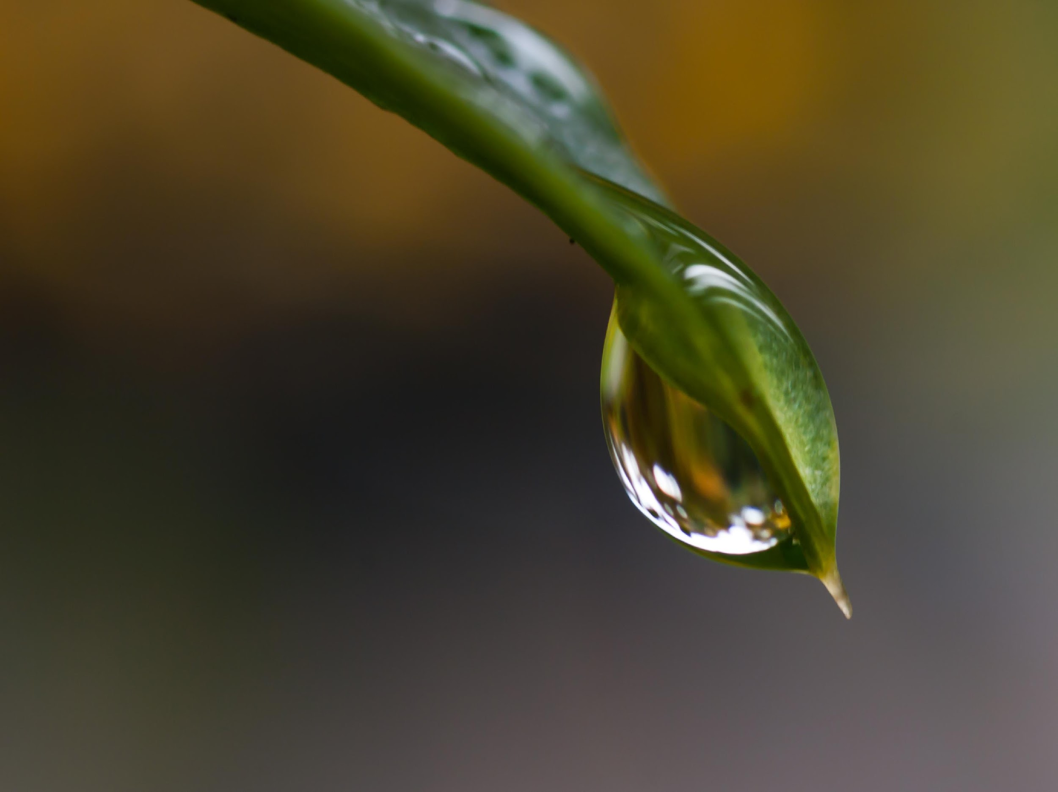
surface tension
Notes:
Surface tension is what allows droplets of water to form. It works like a membrane around the liquid water.

Slide 125
Notes:
This leaf on top of this water is resting on the surface tension. Even though the leaf’s molecules are more dense than the water’s molecules, surface tension allows the leaf to rest on top of the water.

Slide 126
Notes:
Let’s check-in for understanding.

Slide 127
How is this leaf staying on top of the water?
Notes:
How is this leaf staying on top of the water?
[This leaf on top of this water is resting on the surface tension. Even though the leaf’s molecules are more dense than the water’s molecules, surface tension allows the leaf to rest on top of the water.]

Slide 128
Notes:
Next, let’s talk about some non-examples of surface tension.

Slide 129
Notes:
Floating in water is not the same as surface tension. Floating also has to do with an upward force and not surface tension, so this is not an example of surface tension.

Slide 130
Notes:
Let’s check-in for understanding.

Slide 131
Why is floating not an example of surface tension?
Notes:
Why is floating not an example of surface tension?
[Floating in water is not the same as surface tension. Floating also has to do with an upward force and not surface tension, so this is not an example of surface tension.]

Slide 132
What is surface tension?
Notes:
What is surface tension?
[Surface tension is created when molecules in a liquid, such as water, link together by polar attraction.]

Slide 133
How is surface tension created?
O
-
+
+
H
H
Notes:
How is surface tension created?
[Surface tension is created by molecules linked together by polar attraction.]

Slide 134
Is floating the same as surface tension? Why or why not?
Notes:
Is floating the same as surface tension? Why or why not?
[Floating in water is not the same as surface tension. Floating also has to do with an upward force and not surface tension, so this is not an example of surface tension.]

Slide 135
Remember!!!
Notes:
So remember!

Slide 136
Surface Tension: created when molecules in a liquid, such as water, link together by polar attraction
Notes:
Surface tension is created when molecules in a liquid, such as water, link together by polar attraction. It is a property of a liquid that lets it resist an external force.

Slide 137
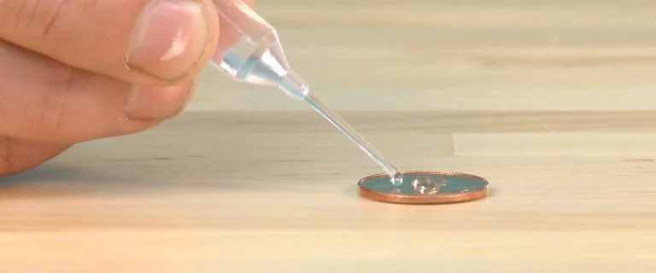
Lab Activity
Drops on a Coin
Have students complete the above activity individually or in small groups. Students will explore surface tension on a coin and how different substances can affect the surface tension of water on a coin.

Slide 138
Big Question: What are the properties of water, and how does water play a role in the natural environment?
Notes:
Our “big question” is: What are the properties of water, and how does water play a role in the natural environment?
[Pause and illicit predictions from students.]
What have we learned to help answer our question? Have our hypothesis changed?

Slide 139
Notes:
Thanks for watching, and please continue watching CAPs available from this website.

Slide 140
This Video Was Created With Resources From:
Questions or Comments
Michael Kennedy, Ph.D. MKennedy@Virginia.edu
Rachel L Kunemund, Ph.D. rk8vm@virginia.edu

Slide 141
Intro
“Big Idea” Question
Review Concepts
Check-In Questions
Teacher Demo
Vocabulary
Student-Friendly Definition
Examples & Non-Examples
Morphological Word Parts
Simulation/Activity
Notes:
OK everyone, get ready for our next lesson. Just as a reminder, these are the different components that our lesson may include, and you’ll see these icons in the top left corner of each slide so that you can follow along more easily!

Slide 142
Intro
Three Properties of Water
- Surface tension
- Adhesion
- Cohesion
Notes:
We are going to learn about the three properties of water.

Slide 143
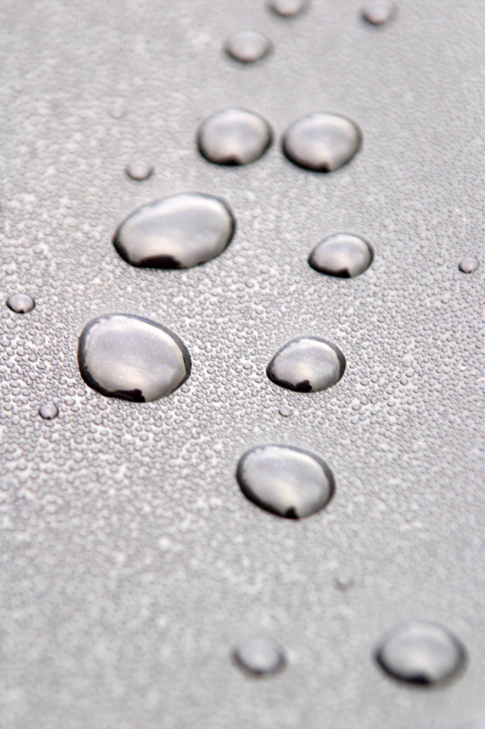
Intro
Adhesion
Notes:
We have learned about the first property of water: surface tension, now we are going to focus on adhesion.

Slide 144
Big Question: What are the properties of water, and how does water play a role in the natural environment?
Notes:
Our “big question” is: What are the properties of water, and how does water play a role in the natural environment?
[Pause and illicit predictions from students.]
What have we learned to help answer our question? Have our hypothesis changed?

Slide 145
Demonstration
Pouring Water into a Glass Experiment
TEACHER DIRECTIONS:
Before viewing, ask students to recall information about water (i.e. what properties of water have we learned so far?). After viewing, ask students to share observations, relating those observations back to the properties of water. Explain that this experiment works because of two properties of water we will learn: cohesion and adhesion. Today, we will be looking at adhesion. You may also choose to do this experiment live for students (on video meeting platform or face-to-face). You can set up the materials – String, measuring cup, food coloring, water, empty glass cup.
Notes:
Let’s do a quick demonstration that will help get our brains ready to think about water and the properties of water. This will also help us think about our big question.

Slide 146
Notes:
Before we move on to our new vocabulary term, let’s review some other words & concepts that you already learned and make sure you are firm in your understanding.

Slide 147
Atom: Smallest whole unit of matter
Notes:
An atom is the smallest whole unit of matter. All matter is made up of atoms.

Slide 148
Matter: has mass and takes up space
Notes:
Matter is anything that has mass and takes up space.

Slide 149
Element: a pure substance containing only one type of atom
Notes:
An element is a pure substance containing only one type of atom

Slide 150
Molecule: particle containing two or more atoms of the same OR different elements
Notes:
A molecule is a particle containing two or more atoms of the same OR different elements.

Slide 151
Water: Liquid made up of 2 hydrogen atoms and 1 oxygen atom
O
H
H
Notes:
Water is a liquid made up of 2 hydrogen atoms and 1 oxygen atom. Water is essential for life.

Slide 152
Polarity: one side that has a negative charge and another that has a positive charge
-
O
+
+
H
H
Notes:
Polarity means that one side of the molecule or other object has a negative charge and one side of the molecule has a positive charge.

Slide 153
Surface Tension: created when molecules in a liquid, such as water, link together by polar attraction
Notes:
Surface tension is created when molecules in a liquid, such as water, link together by polar attraction. It is a property of liquid that lets it resist an external force.

Slide 154
Notes:
Now let’s pause for a moment to check your understanding.

Slide 155
What is the relationship between matter and atoms?
Notes:
What is the relationship between matter and atoms?
[Atoms are the smallest unit of whole matter.]

Slide 156
What is the difference between an element and a molecule?
Notes:
What is the difference between an element and a molecule?
[An element is a pure substance containing only one type of atom, but a molecule contains two or more atoms of the same or different elements.]

Slide 157
What atoms bond to make water?
Notes:
What atoms bond to make water?
[Water is a liquid made up of 2 hydrogen atoms and 1 oxygen atom.]

Slide 158
Why is water polar?
-
O
+
+
H
H
Notes:
Why is water polar?
[When oxygen and hydrogen bond, the side with oxygen is negative and the side with hydrogen is positive, so one side is negative and the other is positive.]

Slide 159
What is surface tension?
Notes:
What is surface tension?
[Surface tension is created when molecules in a liquid, such as water, link together by polar attraction.]

Slide 160
How is surface tension created?
O
-
+
+
H
H
Notes:
How is surface tension created?
[Surface tension is created by molecules linked together by polar attraction.]

Slide 161
Adhesion
Notes:
Now let’s talk about another property of water, adhesion.

Slide 162
Adhesion: the ability of water molecules to stick to other types of molecules
Notes:
Adhesion is the ability of water molecules to stick to other types of molecules.

Slide 163
Notes:
Now let’s pause for a moment to check your understanding.

Slide 164
What is adhesion?
Notes:
What is adhesion?
[Adhesion is the ability of water molecules to stick to other types of molecules.]

Slide 165
Notes:
That is the basic definition, but there is a bit more you need to know.

Slide 166
Notes:
Water molecules stick to other types of molecules—or adhere—more easily than they stick to each other. Water molecules at the surface adhere with the molecules that make up other surfaces.

Slide 167
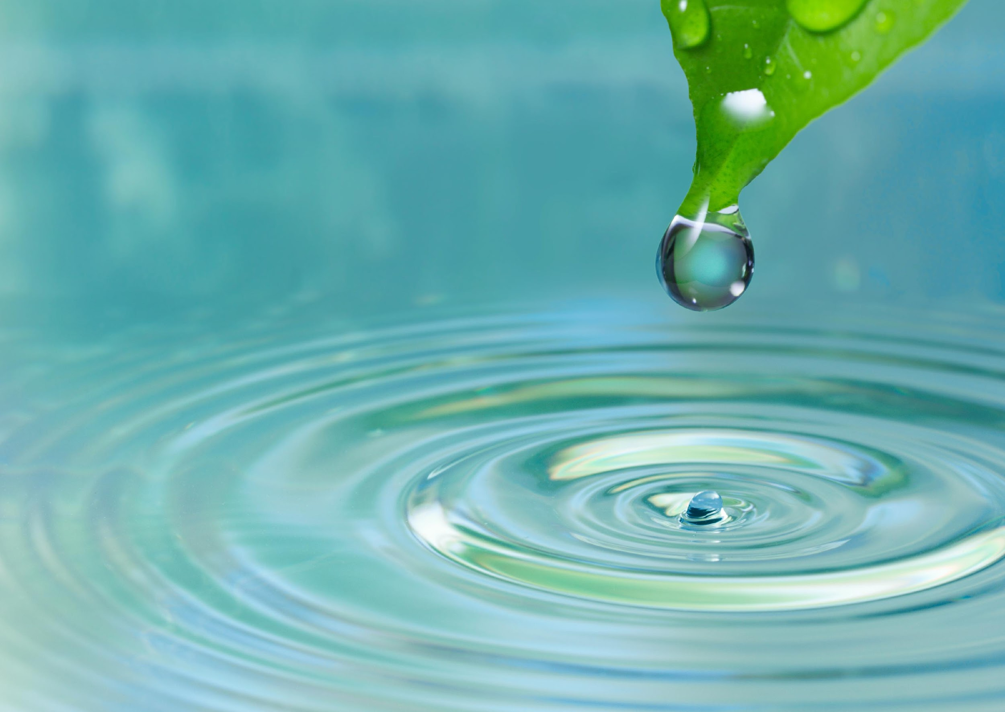
Notes:
And it drops very slowly off of this leaf because of adhesion. The water molecules are different than the molecules that form the leaf so they adhere.

Slide 168
Notes:
Now let’s pause for a moment to check your understanding.

Slide 169
Adhesion: the ability of water molecules to _____ to other types of molecules
Notes:
Adhesion is the ability of water molecules to ______ to other types of molecules.

Slide 170
Adhesion: the ability of water molecules to stick to other types of molecules
Notes:
Adhesion is the ability of water molecules to stick to other types of molecules.

Slide 171
True/False: Water molecules stick more easily to each other than other molecules.
Notes:
True/False: Water molecules stick more easily to each other than other molecules.

Slide 172
True/False: Water molecules stick more easily to each other than other molecules.
Notes:
True/False: Water molecules stick more easily to each other than other molecules.
Water molecules stick more easily to other molecules than to each other.

Slide 173
Notes:
Now, let’s talk about some examples of adhesion.

Slide 174
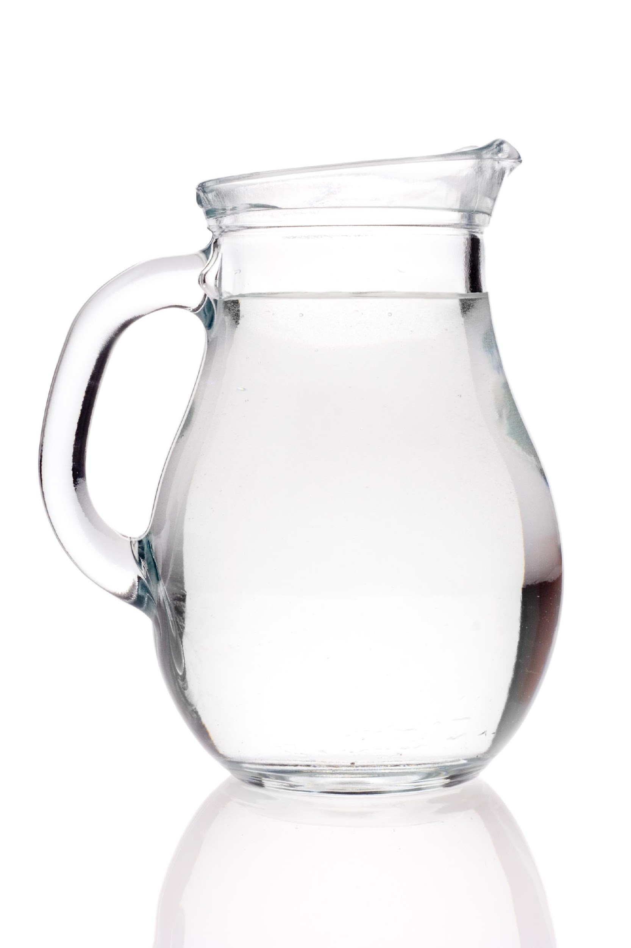
Notes:
This water adheres to the sides of the jar. They are made of different types of molecules.

Slide 175
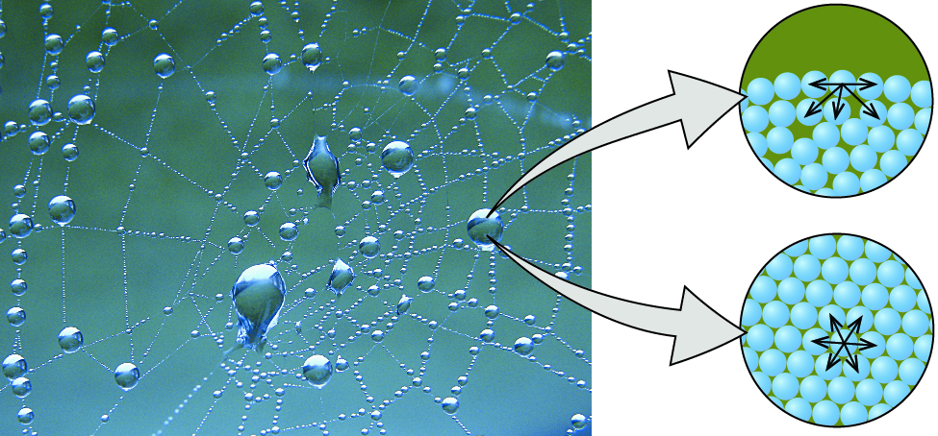
Notes:
Water droplets adhere to the spider web. They are made up different types of molecules.

Slide 176
Notes:
Now let’s pause for a moment to check your understanding.

Slide 177
What is an example of adhesion that we did not discuss?
Notes:
What is an example of adhesion that we did not discuss?

Slide 178
Notes:
Next, let’s talk about some non-examples of adhesion.

Slide 179
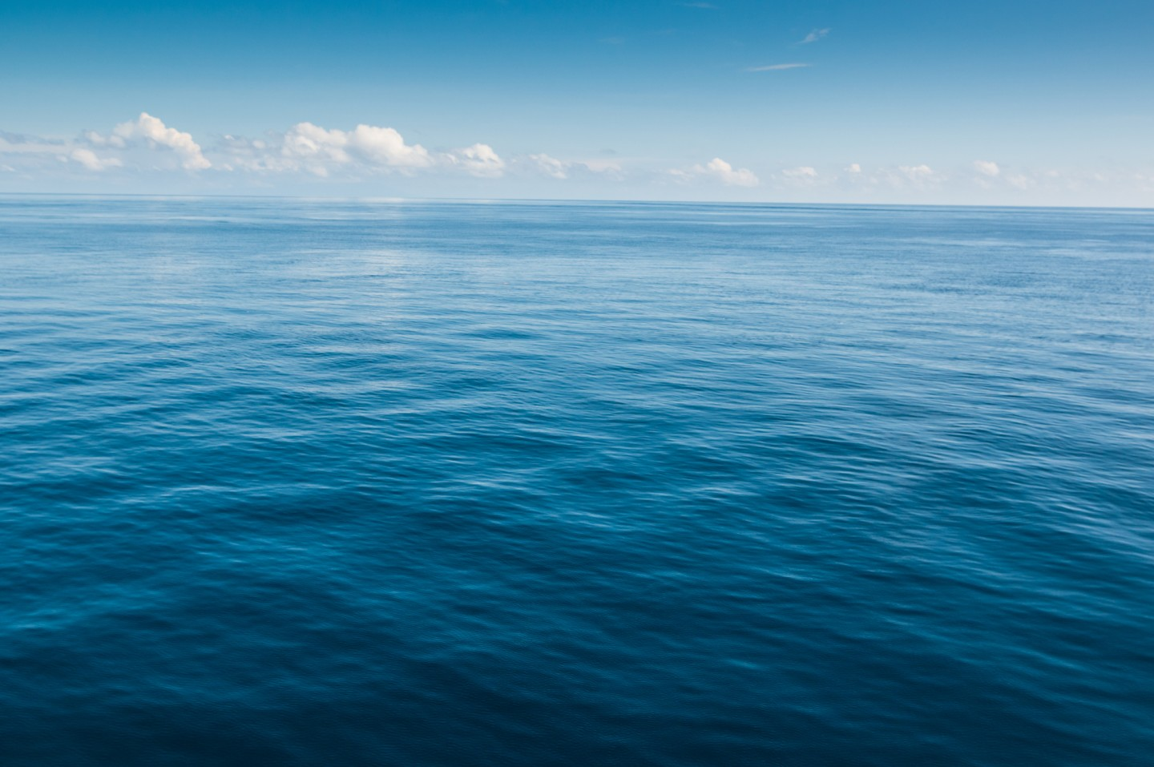
Notes:
In the ocean water molecules stick together by sticking to other water molecules. This is not an example of adhesion because water molecules are sticking to each other.

Slide 180
Notes:
Now let’s pause for a moment to check your understanding.

Slide 181
Why is the ocean a non-example of adhesion?
Notes:
Why is the ocean a non-example of adhesion?
[In the ocean, water molecules stick together by sticking to other water molecules. In adhesion, water molecules stick to other types of molecules.]

Slide 182
Notes:
Now, we are going to breakdown the word adhesion.

Slide 183
Adhesion
Ad -hes -ion
Notes:
The word adhesion can be broken into three parts. The prefix “ad”, root word “-hes”, and the suffix “-ion.”

Slide 184
Adhesion
Ad
Prefix “to”
Notes:
The prefix ad means “to”.

Slide 185
Adhesion
hes
From Latin haerere “to stick”
Notes:
The root hes comes from the latin word haerere which means to stick.

Slide 186
Adhesion
ion
Suffix ion “the state of”; Noun form of an adjective
Notes:
The suffix “ion” means “the state of”, and is used in English to form a noun from a Latin adjective in this case harere.

Slide 187
Ad hes ion
Adhesion
The ability to stick together
Notes:
So, when you put it all together, you get the definition: the ability to stick together.

Slide 188
Notes:
Let’s check-in for understanding.

Slide 189
How can we use the word parts of adhesion help us remember the definition of the term?
Adhesion
Ad -hes -ion
Notes:
How can we use the word parts of adhesion help us remember the definition of the term?
[The prefix ad means “to”.
The root hes comes from the latin word haerere which means to stick.
The suffix “ion” means “the state of”, and is used in English to form a noun from a Latin adjective in this case harere.
So, when you put it all together, you get the definition: the ability to stick together.]

Slide 190
What is adhesion?
Notes:
What is adhesion?
[Adhesion is the ability of water molecules to stick to other types of molecules.]

Slide 191
What is the difference between surface tension and adhesion?
Notes:
What is the difference between surface tension and adhesion?
[Adhesion is when water molecules stick to other molecules. Surface tension is the property of water that lets it resist an external force.]

Slide 192
List the properties of water you have learned so far.
-
O
+
+
H
H
Notes:
List the properties of water you have learned so far.
[Water is polar, has surface tension and adhesion.]

Slide 193
Remember!!!
Notes:
So remember!

Slide 194
Adhesion: the ability of water molecules to stick to other types of molecules
Notes:
Adhesion is the ability of water molecules to stick to other types of molecules.

Slide 195
Lab Activity
Review the penny drop experiment.
Notes:
Not all terms will have a simulation. If you have one you can insert it here.

Slide 196
Big Question: What are the properties of water, and how does water play a role in the natural environment?
Notes:
Our “big question” is: What are the properties of water, and how does water play a role in the natural environment?
[Pause and illicit predictions from students.]
What have we learned to help answer our question? Have our hypothesis changed?

Slide 197
Notes:
Thanks for watching, and please continue watching CAPs available from this website.

Slide 198
This Video Was Created With Resources From:
Questions or Comments
Michael Kennedy, Ph.D. MKennedy@Virginia.edu
Rachel L Kunemund, Ph.D. rk8vm@virginia.edu

Slide 199
Intro
“Big Idea” Question
Review Concepts
Check-In Questions
Teacher Demo
Vocabulary
Student-Friendly Definition
Examples & Non-Examples
Morphological Word Parts
Simulation/Activity
Notes:
OK everyone, get ready for our next lesson. Just as a reminder, these are the different components that our lesson may include, and you’ll see these icons in the top left corner of each slide so that you can follow along more easily!

Slide 200
Intro
Three Properties of Water
- Surface tension
- Adhesion
- Cohesion
Notes:
We are going to learn about the three properties of water.

Slide 201
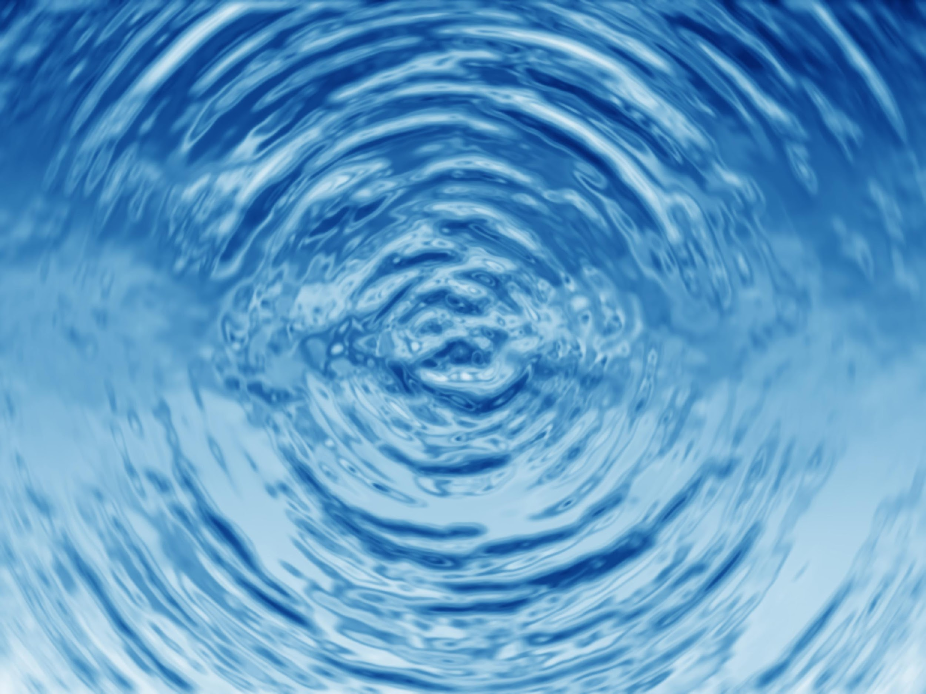
Cohesion
Intro
Notes:
We’ve already learned about surface tension and adhesion. Today we are going to focus on cohesion.

Slide 202
Big Question: What are the properties of water, and how does water play a role in the natural environment?
Notes:
Our “big question” is: What are the properties of water, and how does water play a role in the natural environment?
[Pause and illicit predictions from students.]
How has what we learned changed our hypotheses. What did we know/what did we learn?

Slide 203
Demonstration
Pouring Water into a Glass Experiment
TEACHER DIRECTIONS:
Before viewing, ask students to recall information about water (i.e. what properties of water have we learned so far?). After viewing, ask students to share observations, relating those observations back to the properties of water. Explain that this experiment works because of two properties of water. We have already learned about adhesion, so now we will focus on cohesion (ask students what they think cohesion is based on the experiment). You may also choose to do this experiment live for students (on video meeting platform or face-to-face). You can set up the materials – String, measuring cup, food coloring, water, empty glass cup.
Notes:
**You have done this experiment already, however, it also shows cohesion and would be good to do again so students can see how cohesion and adhesion are related.**

Slide 204
Notes:
Before we move on to our new vocabulary term, let’s review some other words & concepts that you already learned and make sure you are firm in your understanding.

Slide 205
Atom: Smallest whole unit of matter
Notes:
An atom is the smallest whole unit of matter. All matter is made up of atoms.

Slide 206
Matter: has mass and takes up space
Notes:
Matter is anything that has mass and takes up space.

Slide 207
Element: a pure substance containing only one type of atom
Notes:
An element is a pure substance containing only one type of atom.

Slide 208
Molecule: particle containing two or more atoms of the same OR different elements
Notes:
A molecule is a particle containing two or more atoms of the same OR different elements.

Slide 209
Water: Liquid made up of 2 hydrogen atoms and 1 oxygen atom
O
H
H
Notes:
Water is a liquid made up of 2 hydrogen atoms and 1 oxygen atom. Water is essential for life.

Slide 210
Polarity: one side that has a negative charge and another that has a positive charge
-
O
+
+
H
H
Notes:
Polarity means that one side of the molecule or other object has a negative charge and one side of the molecule has a positive charge.

Slide 211
Surface Tension: created when molecules in a liquid, such as water, link together by polar attraction
Notes:
Surface tension is created when molecules in a liquid, such as water, link together by polar attraction. It is a property of a liquid that lets it resist an external force.

Slide 212
Adhesion: the ability of water molecules to stick to other types of molecules
Notes:
Adhesion is the ability of water molecules to stick to other types of molecules.

Slide 213
Notes:
Now let’s pause for a moment to check your understanding.

Slide 214
What is the relationship between matter and atoms?
Notes:
What is the relationship between matter and atoms?
[Atoms are the smallest unit of whole matter.]

Slide 215
What is the difference between an element and a molecule?
Notes:
What is the difference between an element and a molecule?
[An element is a pure substance containing only one type of atom, but a molecule contains two or more atoms of the same or different elements.]

Slide 216
What atoms bond to make water?
Notes:
What atoms bond to make water?
[Water is a liquid made up of 2 hydrogen atoms and 1 oxygen atom.]

Slide 217
Why is water polar?
-
O
+
+
H
H
Notes:
Why is water polar?
[When oxygen and hydrogen bond, the side with oxygen is negative and the side with hydrogen is positive, so one side is negative and the other is positive.]

Slide 218
What is surface tension?
Notes:
What is surface tension?
[Surface tension is created when molecules in a liquid, such as water, link together by polar attraction.]

Slide 219
How is surface tension created?
O
-
+
+
H
H
Notes:
How is surface tension created?
[Surface tension is created by molecules linked together by polar attraction.]

Slide 220
What is adhesion?
Notes:
What is adhesion?
[Adhesion is the ability of water molecules to stick to other types of molecules.]

Slide 221
What is the difference between surface tension and adhesion?
Notes:
What is the difference between surface tension and adhesion?
[Adhesion is when water molecules stick to other molecules. Surface tension is the property of water that lets it resist an external force.]

Slide 222
Cohesion
Notes:
Now that we’ve reviewed, let’s define our new term, cohesion.

Slide 223
Cohesion: the ability of water molecules to stick to other water molecules
Notes:
Cohesion is the ability of water molecules stick to other water molecules.

Slide 224
Notes:
Now let’s pause for a moment to check your understanding.

Slide 225
What is cohesion?
Notes:
What is cohesion?
[Cohesion is the ability of water molecules stick to other water molecules.]

Slide 226
Notes:
That is the basic definition, but there is a bit more you need to know.

Slide 227
Notes:
In addition to being able to stick to other types of molecules, water molecules can also stick to other water molecules—or cohere. The molecules deep in the water cohere with each other.

Slide 228
Adhesion
Cohesion
Other Molecules + Water
Water only
Sticking Together
Notes:
Adhesion and Cohesion are different, but both have to do with sticking together. The difference is that water sticks together with other molecules in adhesion, and in cohesion, water sticks to itself.

Slide 229
Notes:
Now let’s pause for a moment to check your understanding.

Slide 230
Cohesion: the ability of water molecules to stick to other ____ molecules
Notes:
Cohesion is the ability of water molecules stick to other water molecules

Slide 231
Cohesion: the ability of water molecules to stick to other water molecules
Notes:
Cohesion is the ability of water molecules stick to other water molecules

Slide 232
Adhesion
Cohesion
Other Molecules + Water
Water only
_______
_______
Notes:
Fill in the blank.

Slide 233
Adhesion
Cohesion
Other Molecules + Water
Water only
Sticking Together
Notes:
Sticking together

Slide 234
Notes:
Now, let’s talk about some examples of cohesion.

Slide 235
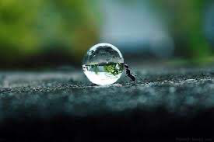
Notes:
This water droplet formed because of cohesion. Water molecules sticking together, caused this bigger water droplet to form.

Slide 236
Notes:
Now let’s pause for a moment to check your understanding.

Slide 237
Why is this an example of cohesion?
Notes:
Why is this an example of cohesion?
[This water droplet formed because of cohesion. Water molecules sticking together, caused this bigger water droplet to form.]

Slide 238
Can you think of another example of cohesion?
Notes:
Can you think of another example of cohesion?

Slide 239
Notes:
Next, let’s talk about some non-examples of cohesion.

Slide 240
Notes:
The water sticking to the spider web is not an example of cohesion, it is an example of adhesion because the water molecules are sticking to different molecules (spider web). The molecules themselves formed because of cohesion, but they are sticking to the spider web because of adhesion.

Slide 241
Notes:
Now let’s pause for a moment to check your understanding.

Slide 242
Why is this a non-example of cohesion?
Notes:
Why is this a non-example of cohesion?
[The water sticking to the spider web is not an example of cohesion, it is an example of adhesion because the water molecules are sticking to different molecules (spider web). The molecules themselves formed because of cohesion, but they are sticking to the spider web because of adhesion.]

Slide 243
Notes:
Now, let’s breakdown the word cohesion.

Slide 244
Cohesion
Co -hes -ion
(prefix)
(root word)
(suffix)
Notes:
The word cohesion can be broken up into three parts.

Slide 245
Cohesion
Co-
Together
Notes:
The prefix “co-” means “together”.

Slide 246
Cohesion
-hes
From Latin “haerere” meaning “to stick”
Notes:
We can think back to adhesion. Both cohesion and adhesion come from the same latin word: haerere meaning to stick. So not only are their meanings similar, the way we break them down is also similar.

Slide 247
Cohesion
-ion
Suffix ion “the state of”; noun form of an adjective
Notes:
The suffix “ion” means “the state of”, and is used in English to form a noun from a Latin adjective in this case harere.

Slide 248
Co -hes -ion
Cohesion
To stick together
Notes:
So when you add the prefix co (together) with the hes (latin root haerere) meaning to stick and the suffix -ion, we get the definition to stick together.

Slide 249
Notes:
Let’s check-in for understanding.

Slide 250
How can we use the word parts of cohesion help us remember the definition of the term?
Cohesion
Co -hes -ion
(prefix)
(root word)
(suffix)
Notes:
How can we use the word parts of cohesion help us remember the definition of the term?
[The prefix “co-” means “together”.
We can think back to adhesion. Both cohesion and adhesion come from the same latin word: haerere meaning to stick. So not only are their meanings similar, the way we break them down is also similar.
The suffix “ion” means “the state of”, and is used in English to form a noun from a Latin adjective in this case harere.
So when you add the prefix co (together) with the hes (latin root haerere) meaning to stick and the suffix -ion, we get the definition to stick together.]

Slide 251
What is cohesion?
Notes:
What is cohesion?
[Cohesion is the ability of water molecules stick to other water molecules.]

Slide 252
What is the relationship between adhesion and cohesion?
Adhesion
Cohesion
Notes:
What is the relationship between adhesion and cohesion?

Slide 253
What is the relationship between adhesion and cohesion?
Adhesion
Cohesion
Other Molecules + Water
Water only
Sticking Together
Notes:
What is the relationship between adhesion and cohesion?
[Adhesion and Cohesion are different, but both have to do with sticking together. The difference is that water sticks together with other molecules in adhesion, and in cohesion, water sticks to itself.]

Slide 254
Describe another property of water.
-
O
+
+
H
H
Notes:
Describe another property of water.
[Surface tension: property of a liquid that lets it resist an external force
Polarity: one side has a negative charge and the other has a positive charge]

Slide 255
Remember!!!
Notes:
So remember!

Slide 256
Cohesion: the ability of water molecules to stick to other water molecules
Notes:
Cohesion is the ability of water molecules stick to other water molecules

Slide 257
Lab Activity
Review the penny drop experiment.
Notes:
Not all terms will have a simulation. If you have one you can insert it here.

Slide 258
Big Question: What are the properties of water, and how does water play a role in the natural environment?
Notes:
Our “big question” is: What are the properties of water, and how does water play a role in the natural environment?
[Pause and illicit predictions from students.]
What have we learned to help answer our question? Have our hypotheses changed?

Slide 259
Notes:
Thanks for watching, and please continue watching CAPs available from this website.

Slide 260
This Video Was Created With Resources From:
Questions or Comments
Michael Kennedy, Ph.D. MKennedy@Virginia.edu
Rachel L Kunemund, Ph.D. rk8vm@virginia.edu

Slide 261
Intro
“Big Idea” Question
Review Concepts
Check-In Questions
Teacher Demo
Vocabulary
Student-Friendly Definition
Examples & Non-Examples
Morphological Word Parts
Simulation/Activity
Notes:
OK everyone, get ready for our next lesson. Just as a reminder, these are the different components that our lesson may include, and you’ll see these icons in the top left corner of each slide so that you can follow along more easily!

Slide 262
Intro
Notes:
Now that we have learned about water and the properties of water, we are going to learn about the different types of water on Earth.

Slide 263
Salt Water
Intro
Notes:
We are going to define salt water.

Slide 264
Big Question: What are the properties of water, and how does water play a role in the natural environment?
Notes:
Our “big question” is: What are the properties of water, and how does water play a role in the natural environment?
[Pause and illicit predictions from students.]
What have we learned to help answer our question? Have our hypothesis changed?

Slide 265
Demonstration
Fresh and Salt Water
TEACHER DIRECTIONS:
Before viewing, ask students to recall information about water (e.g. what are the properties of water.). After viewing, ask students to share observations about the types of water on Earth.
You may also choose to do this experiment live for students (on video meeting platform or face-to-face). You can also get a pitcher of water, a test-tube, and salt to help explain salt/fresh water on Earth to students to help activate background knowledge.
Notes:
Let’s watch a quick video that will help get us thinking about the second part of our big question. We already know about the properties of water, now let’s take a look at the role water plays in the natural environment.

Slide 266
Notes:
Before we move on to our new vocabulary term, let’s review some other words & concepts that you already learned and make sure you are firm in your understanding.

Slide 267
Water: Liquid made up of 2 hydrogen atoms and 1 oxygen atom
O
H
H
Notes:
Water is a liquid made up of 2 hydrogen atoms and 1 oxygen atom. Water is essential for life.

Slide 268
Polarity: one side that has a negative charge and another that has a positive charge
-
O
+
+
H
H
Notes:
Polarity means that one side of the molecule or other object has a negative charge and one side of the molecule has a positive charge.

Slide 269
Surface Tension: created when molecules in a liquid, such as water, link together by polar attraction
Notes:
Surface tension is created when molecules in a liquid, such as water, link together by polar attraction. It is a property of a liquid that lets it resist an external force.

Slide 270
Adhesion: the ability of water molecules to stick to other types of molecules
Notes:
Adhesion is the ability of water molecules to stick to other types of molecules.

Slide 271
Cohesion: the ability of water molecules to stick to other water molecules
Notes:
Cohesion is the ability of water molecules stick to other water molecules.

Slide 272
Notes:
Now let’s pause for a moment to check your understanding.

Slide 273
Why is water polar?
-
O
+
+
H
H
Notes:
Why is water polar?
[When oxygen and hydrogen bond, the side with oxygen is negative and the side with hydrogen is positive, so one side is negative and the other is positive.]

Slide 274
What is surface tension?
Notes:
What is surface tension?
[Surface tension is created when molecules in a liquid, such as water, link together by polar attraction.]

Slide 275
How is surface tension created?
O
-
+
+
H
H
Notes:
How is surface tension created?
[Surface tension is created by molecules linked together by polar attraction.]

Slide 276
What is the difference between surface tension and adhesion?
Notes:
What is the difference between surface tension and adhesion?
[Adhesion is when water molecules stick to other molecules. Surface tension is the property of water that lets it resist an external force.]

Slide 277
What is the relationship between adhesion and cohesion?
Adhesion
Cohesion
Notes:
What is the relationship between adhesion and cohesion?

Slide 278
What is the relationship between adhesion and cohesion?
Adhesion
Cohesion
Other Molecules + Water
Water only
Sticking Together
Notes:
What is the relationship between adhesion and cohesion?
[Adhesion and Cohesion are different, but both have to do with sticking together. The difference is that water sticks together with other molecules in adhesion, and in cohesion, water sticks to itself.]

Slide 279
Salt Water
Notes:
Now that we’ve reviewed, let’s define our new term, salt water.

Slide 280
Salt Water: water that has a very large amount of salt in it
Notes:
Salt water is water that has a very large amount of salt in it. On earth, salt water is mostly found in oceans.

Slide 281
Notes:
Now let’s pause for a moment to check your understanding.

Slide 282
What is salt water?
Notes:
What is salt water?
[Salt water is water that has a very large amount of salt in it. On earth, salt water is mostly found in oceans.]

Slide 283
Notes:
That is the basic definition, but there is a bit more you need to know.

Slide 284
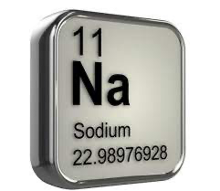
Notes:
Sodium and chloride are the most abundant salt elements in the ocean making up 85% of all salt elements in the ocean.

Slide 285
Notes:
2/3 [two-thirds] of the water on earth is ocean salt water.

Slide 286
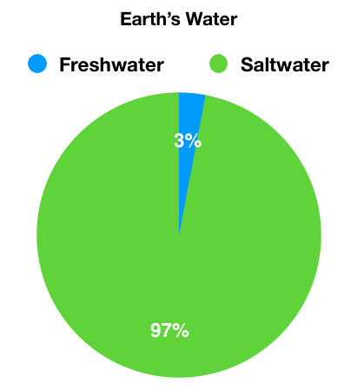
Notes:
Of all water on Earth, salt water makes up 97.5% of it.

Slide 287
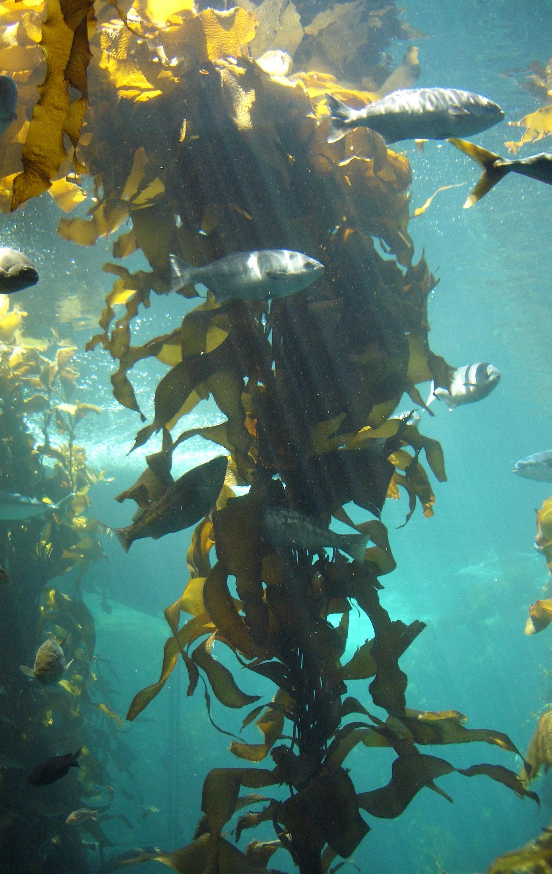
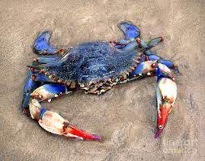
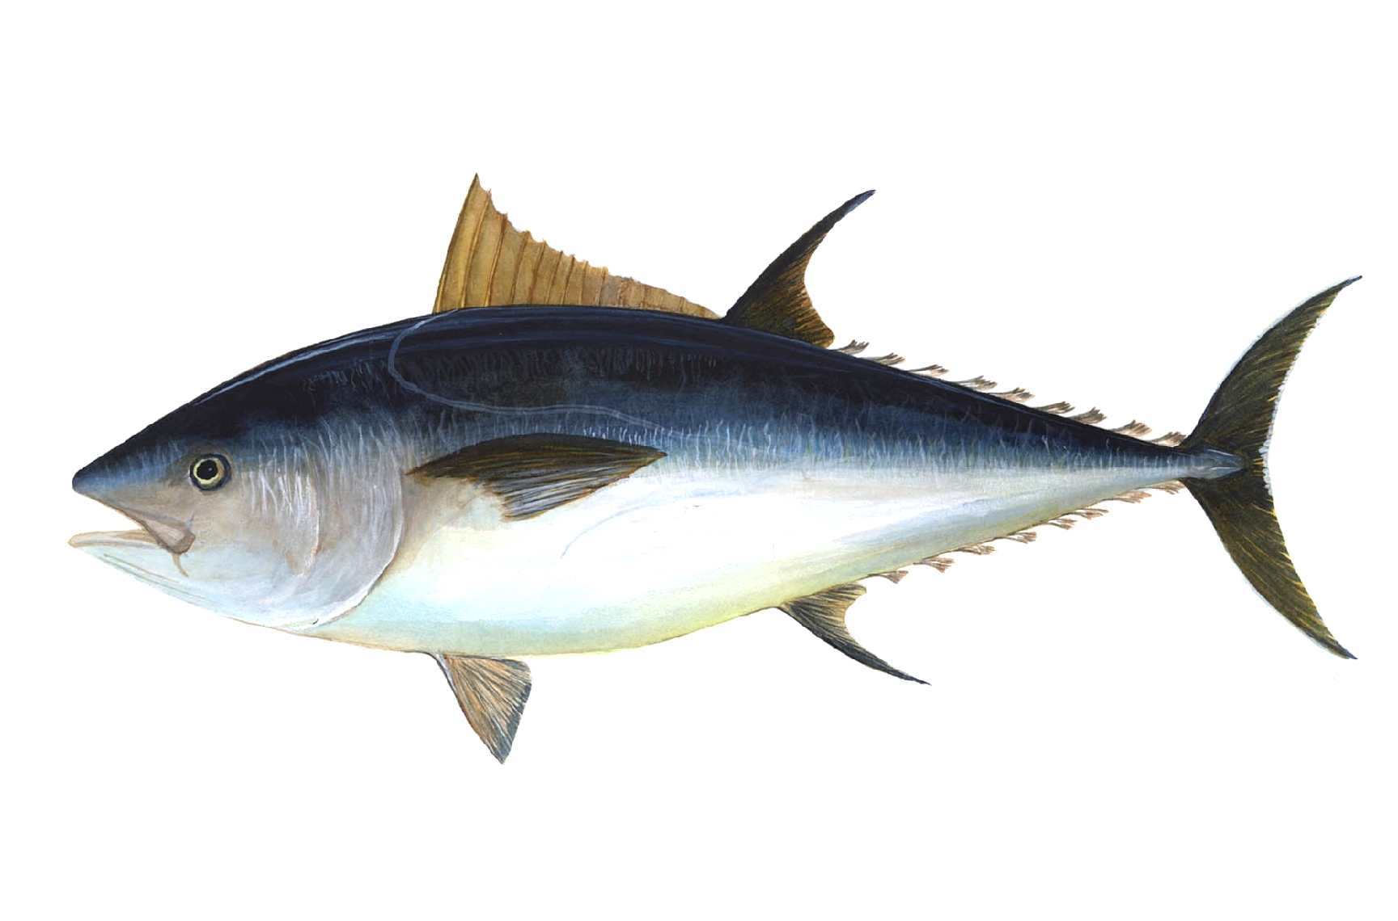
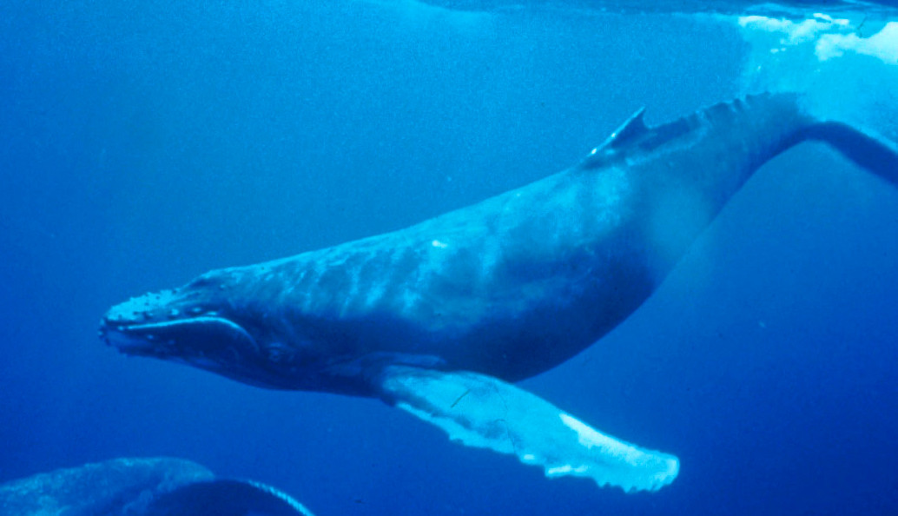
Salt Water Species
Sea Kelp
Blue Crab
Whale
Tuna
Notes:
Different species of fish and other organisms live in different kinds of water. Salt water organisms can’t survive in fresh water, and freshwater organisms can’t survive in salt water. These are just a few examples of salt water species, however, that are many more species of saltwater species

Slide 288
Notes:
Now let’s pause for a moment to check your understanding.

Slide 289
What are some salt water species?
Notes:
What are some salt water species?
[Different species of fish and other organisms live in different kinds of water. Salt water organisms can’t survive in fresh water, and freshwater organisms can’t survive in salt water. These are just a few examples of salt water species, however, that are many more species of saltwater species.]

Slide 290
Notes:
Now, let’s talk about some examples of salt water.

Slide 291
Notes:
Oceans are examples of salt water.

Slide 292
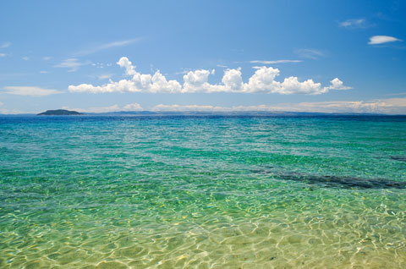
Notes:
Seas are examples of salt water. This is the Mediterranean Sea.

Slide 293
Notes:
Let’s check-in for understanding.

Slide 294
What is an example of salt water you have seen?
Notes:
What is an example of salt water you have seen?

Slide 295
Notes:
Next, let’s talk about some non-examples of salt water.

Slide 296
Notes:
Ponds are a non-example of salt water because they do not contain salt

Slide 297
Notes:
This lake is also not salt water. There are no salt elements in this lake.

Slide 298
Notes:
Let’s check-in for understanding.

Slide 299
Why isn’t this lake considered salt water?
Notes:
Why isn’t this lake considered salt water?
[This lake is also not salt water. There are no salt elements in this lake.]

Slide 300
What is salt water?
Notes:
What is salt water?
[Salt water is water that has a very large amount of salt in it. On earth, salt water is mostly found in oceans.]

Slide 301
What are the most abundant salt elements in the ocean?
Notes:
What are the most abundant salt elements in the ocean?
[Sodium and Chloride are the most abundant salt elements in the ocean making up 85% of all salt elements in the ocean.]

Slide 302
Why is salt water important to the natural environment?
Sea Kelp
Blue Crab
Whale
Tuna
Notes:
Why is salt water important to the natural environment?
[Salt water is important because it is an important environment for certain species. Species that live in salt water can’t live in fresh water.]

Slide 303
Remember!!!
Notes:
So remember!

Slide 304
Salt Water: water that has a very large amount of salt in it
Notes:
Salt water is water that has a very large amount of salt in it. On earth, salt water is mostly found in oceans.

Slide 305
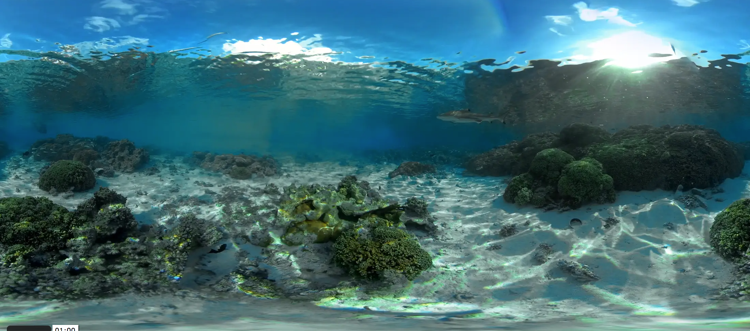
Simulation Activity
Deep Sea Exploration
In this simulation, students can choose between four videos that they can explore. Each video is from a different ocean in the world, and the students can have a 360 view of the environment. During the simulation, students should take notice of the plants, animals and even divers, and reflect on what they notice. Did they see some of the wildlife they learned about? How is it different or similar from wildlife near them? Why is it important to keep the oceans healthy?

Slide 306
Big Question: What are the properties of water, and how does water play a role in the natural environment?
Notes:
Our “big question” is: What are the properties of water, and how does water play a role in the natural environment?
[Pause and illicit predictions from students.]
What have we learned to help answer our question? Have our hypothesis changed?

Slide 307
Notes:
Thanks for watching, and please continue watching CAPs available from this website.

Slide 308
This Video Was Created With Resources From:
Questions or Comments
Michael Kennedy, Ph.D. MKennedy@Virginia.edu
Rachel L Kunemund, Ph.D. rk8vm@virginia.edu

Slide 309
Intro
“Big Idea” Question
Review Concepts
Check-In Questions
Teacher Demo
Vocabulary
Student-Friendly Definition
Examples & Non-Examples
Morphological Word Parts
Simulation/Activity
Notes:
OK everyone, get ready for our next lesson. Just as a reminder, these are the different components that our lesson may include, and you’ll see these icons in the top left corner of each slide so that you can follow along more easily!

Slide 310
Intro
Notes:
We have learned about one type of water on earth: Salt water. Not we are going to learn about the other type of water: Fresh water

Slide 311
Fresh Water
Intro
Notes:
Today we are going to focus on fresh water.

Slide 312
Big Question: What are the properties of water, and how does water play a role in the natural environment?
Notes:
Our “big question” is: What are the properties of water, and how does water play a role in the natural environment?
[Pause and illicit predictions from students.]
What have we learned to help answer our question? Have our hypothesis changed?

Slide 313
Demonstration
TEACHER DIRECTIONS:
You can review the demonstration that was shown with salt water, however, you may not feel the need to do a demonstration with every term.

Slide 314
Notes:
Before we move on to our new vocabulary term, let’s review some other words & concepts that you already learned and make sure you are firm in your understanding.

Slide 315
Water: Liquid made up of 2 hydrogen atoms and 1 oxygen atom
O
H
H
Notes:
Water is a liquid made up of 2 hydrogen atoms and 1 oxygen atom. Water is essential for life.

Slide 316
Polarity: one side that has a negative charge and another that has a positive charge
-
O
+
+
H
H
Notes:
Polarity means that one side of the molecule or other object has a negative charge and one side of the molecule has a positive charge.

Slide 317
Surface Tension: created when molecules in a liquid, such as water, link together by polar attraction
Notes:
Surface tension is created when molecules in a liquid, such as water, link together by polar attraction. It is a property of a liquid that lets it resist an external force.

Slide 318
Adhesion: the ability of water molecules to stick to other types of molecules
Notes:
Adhesion is the ability of water molecules to stick to other types of molecules.

Slide 319
Cohesion: the ability of water molecules to stick to other water molecules
Notes:
Cohesion is the ability of water molecules stick to other water molecules

Slide 320
Salt Water: water that has a very large amount of salt in it
Notes:
Salt water is water that has a very large amount of salt in it. On earth, salt water is mostly found in oceans.

Slide 321
Notes:
Now let’s pause for a moment to check your understanding.

Slide 322
Why is water polar?
-
O
+
+
H
H
Notes:
Why is water polar?
[When oxygen and hydrogen bond, the side with oxygen is negative and the side with hydrogen is positive, so one side is negative and the other is positive.]

Slide 323
What is surface tension?
Notes:
What is surface tension?
[Surface tension is created when molecules in a liquid, such as water, link together by polar attraction.]

Slide 324
How is surface tension created?
O
-
+
+
H
H
Notes:
How is surface tension created?
Surface tension is created by molecules linked together by polar attraction.]

Slide 325
What is the difference between surface tension and adhesion?
Notes:
What is the difference between surface tension and adhesion?
[Adhesion is when water molecules stick to other molecules. Surface tension is the property of water that lets it resist an external force.]

Slide 326
What is the relationship between adhesion and cohesion?
Adhesion
Cohesion
Notes:
Adhesion and Cohesion are important to water, but have to do with sticking together. The difference is that water sticks together with other molecules in adhesion, and in cohesion, water sticks to itself.

Slide 327
What is the relationship between adhesion and cohesion?
Adhesion
Cohesion
Other Molecules + Water
Water only
Sticking Together
Notes:
What is the relationship between adhesion and cohesion?
[Adhesion and Cohesion are different, but both have to do with sticking together. The difference is that water sticks together with other molecules in adhesion, and in cohesion, water sticks to itself.]

Slide 328
What are the most abundant salt elements in the ocean?
Notes:
What are the most abundant salt elements in the ocean?
[Sodium and Chloride are the most abundant salt elements in the ocean making up 85% of all salt elements in the ocean.]

Slide 329
Why is salt water important to the natural environment?
Sea Kelp
Blue Crab
Whale
Tuna
Notes:
Why is salt water important to the natural environment?
[Salt water is important because it is an important environment for certain species. Species that live in salt water can’t live in fresh water.]

Slide 330
Fresh Water
Notes:
Now that we’ve reviewed, let’s define our new term, producer.

Slide 331
Fresh Water: water that does not have salt in it
Notes:
Fresh water is water that does not have salt in it. Sometimes we use the term fresh water to mean “not from the ocean.”

Slide 332
Notes:
Now let’s pause for a moment to check your understanding.

Slide 333
What is fresh water?
Notes:
What is fresh water?
[Water that does not have salt in it.]

Slide 334
Notes:
That is the basic definition, but there is a bit more you need to know.

Slide 335
Notes:
Unlike salt water, fresh water only makes up 2.5% of all water on Earth.

Slide 336
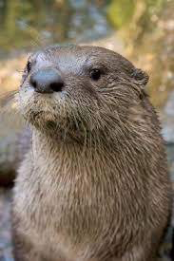
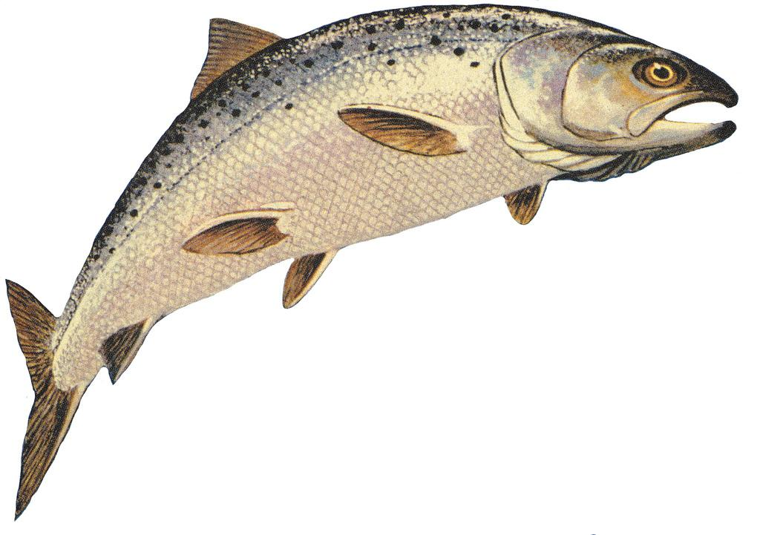
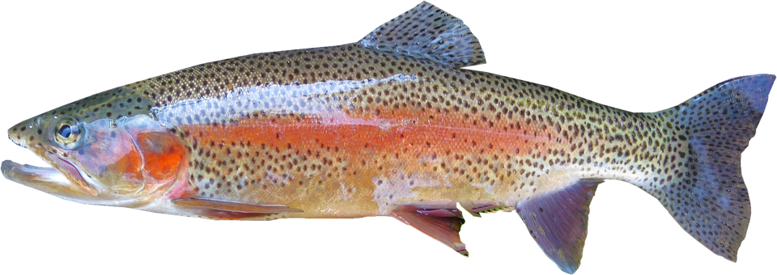
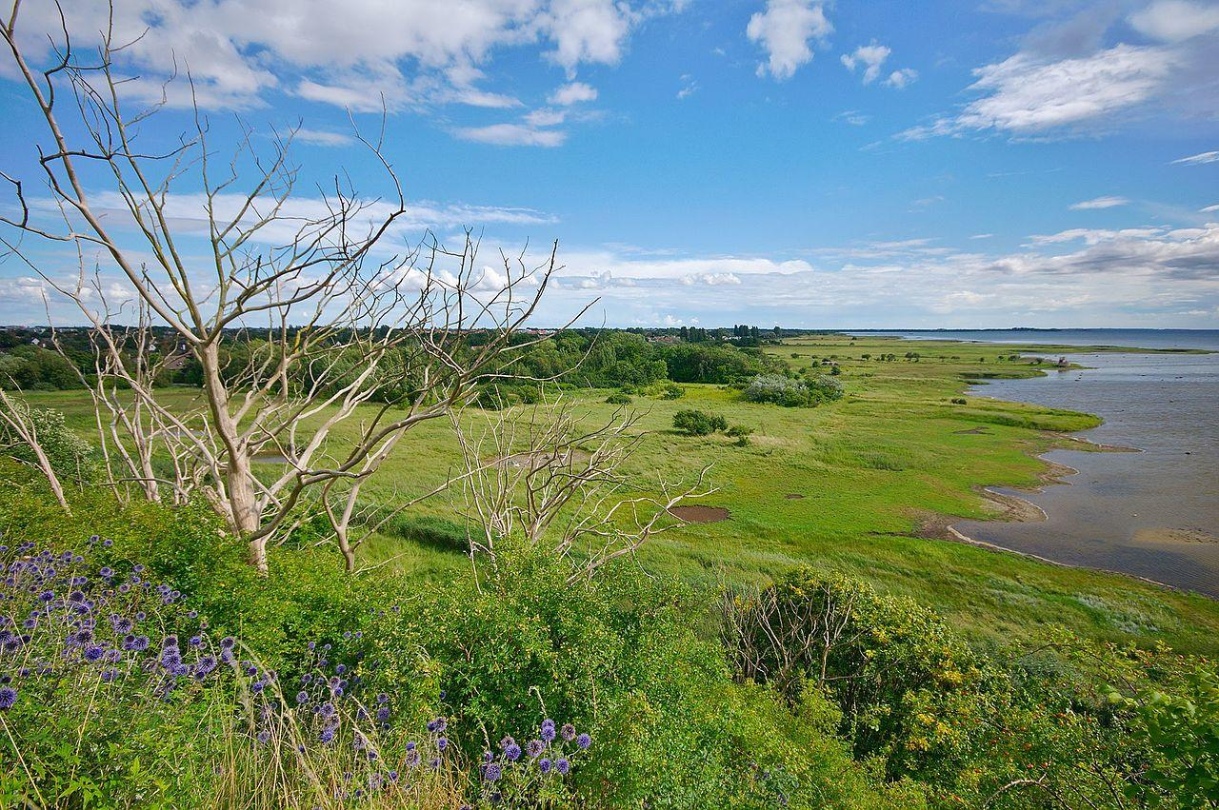
Fresh Water Species
River Otter
Salmon
Trout
Marsh
Notes:
Different species of fish and other organisms live in different kinds of water. Remember, freshwater species can’t live in salt water. There are also species of birds and other animals that depend on fresh water.

Slide 337
Notes:
We also need fresh water. Without fresh water, we can’t survive!

Slide 338
Notes:
Now let’s pause for a moment to check your understanding.

Slide 339
What are some fresh water species?
Notes:
What are some fresh water species?

Slide 340
Notes:
Now, let’s talk about some examples of fresh water.

Slide 341
Notes:
The Great Lakes (in blue) are an example of fresh water.

Slide 342
Notes:
Rivers are examples of fresh water.

Slide 343
Notes:
Now let’s pause for a moment to check your understanding.

Slide 344
Do you know of any examples of fresh water that you may have seen? (Lakes, Rivers)
Notes:
Do you know of any examples of fresh water that you may have seen? (Lakes, Rivers)

Slide 345
Notes:
Next, let’s talk about some non-examples of fresh water.

Slide 346
Notes:
Oceans are not an example of fresh water. Oceans are salt water.

Slide 347
Notes:
Now let’s pause for a moment to check your understanding.

Slide 348
Why are oceans not considered fresh water?
Notes:
Why are oceans not considered fresh water?
[Oceans are not an example of fresh water. Oceans are salt water.]

Slide 349
What is fresh water?
Notes:
Fresh water is water that does not have salt in it. Sometimes we use the term fresh water to mean “not from the ocean.”

Slide 350
Name an example of a fresh water species.
Notes:
Name an example of a fresh water species.
[Salmon, river otter, trout, etc…]

Slide 351
What role does fresh water play in the environment?
River Otter
Salmon
Trout
Notes:
What role does fresh water play in the environment?
[Certain species need fresh water to survive. Although people don’t live in fresh water, we need it to survive!]

Slide 352
Remember!!!
Notes:
So remember!

Slide 353
Fresh Water: water that does not have salt in it.
Notes:
Fresh water is water that does not have salt in it. Sometimes we use the term fresh water to mean “not from the ocean.”

Slide 354
Simulation Activity
Availability of Fresh Water
In this simulation, students explore how water moves above and below Earth’s surface by using interactive computational models. Students will examine the supply and demand issues around local water sources and meet a hydrogeologist who introduces some of the issues around the sustainability of freshwater resources around the world.

Slide 355
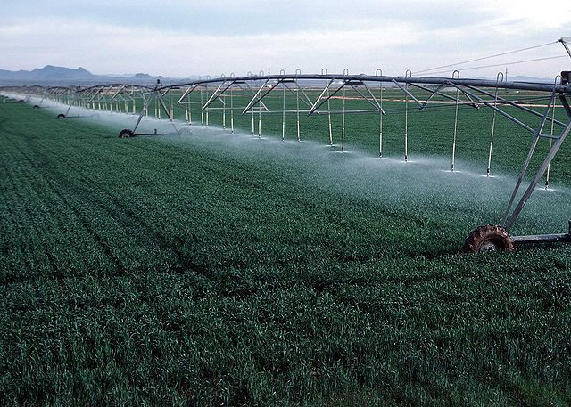
Simulation Activity
Using Fresh Water
In this simulation, students explore maps to discover the distribution of fresh water resources on Earth, and examine graphs to discover how fresh water supplies are used by humans.

Slide 356
Big Question: What are the properties of water, and how does water play a role in the natural environment?
Notes:
Our “big question” is: What are the properties of water, and how does water play a role in the natural environment?
[Pause and illicit predictions from students.]
What have we learned to help answer our question? Have our hypothesis changed? What did we already know and what did we learn?

Slide 357
Notes:
Thanks for watching, and please continue watching CAPs available from this website.

Slide 358
This Video Was Created With Resources From:
Questions or Comments
Michael Kennedy, Ph.D. MKennedy@Virginia.edu
Rachel L Kunemund, Ph.D. rk8vm@virginia.edu

