Slide 1
“Big Idea” Question
Teacher Demo
Review Concepts
Check-In Questions
Vocabulary
Student-Friendly Definition
Examples & Non-Examples
Morphological Word Parts
Simulation/Activity
Notes:
OK everyone, get ready for our next lesson. Just as a reminder, these are the different components that our lesson may include, and you’ll see these icons in the top left corner of each slide so that you can follow along more easily!

Slide 2
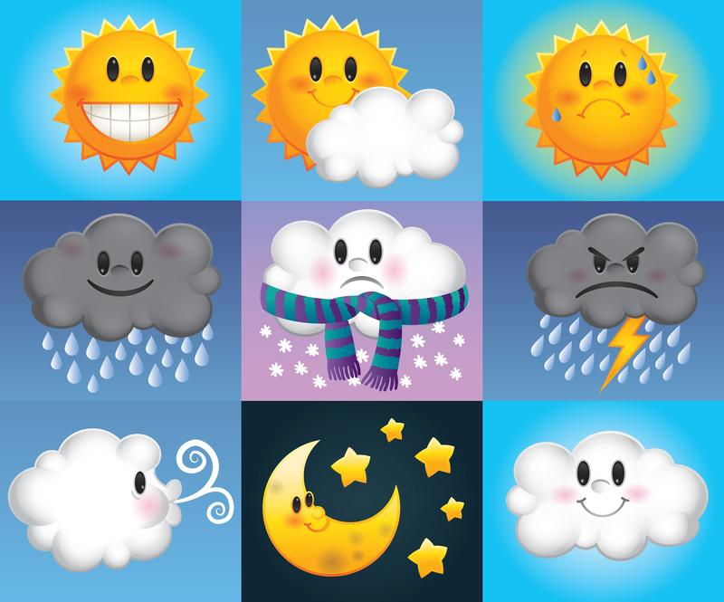
Intro
Weather
Notes:
Today we will learn about weather.

Slide 3
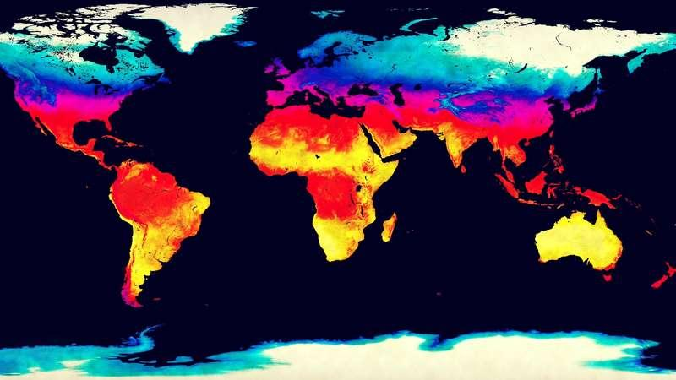
Big Question: What is the difference between weather and climate?
Notes:
Our “big question” is: What is the difference between weather and climate?
[Pause and illicit predictions from students.]
I love all these thoughtful scientific hypotheses! Be sure to keep this question and your predictions in mind as we move through these next few lessons, and we’ll continue to revisit it.

Slide 4
Demonstration
Weather Sensory Bottles
TEACHER DIRECTIONS:
Before: Put together a class set of weather sensory bottles. Do not label the bottles. Ask students to list some weather phenomenon they know of or have experienced.
During: Pass the weather sensory bottles around the classroom and have students identify the type of weather depicted in each one.
After: Tell students that today they will learn more about weather and what affects it.
Notes:
What type of weather have you experienced before? What is your favorite type of weather?
Feedback: Make demonstration organized so it is easy for the students to follow along.

Slide 5
Notes:
Now let’s pause for a moment to check your understanding.
Feedback: By providing a lot of opportunities to respond throughout demonstration you help ensure that your students are grasping this new content.

Slide 6
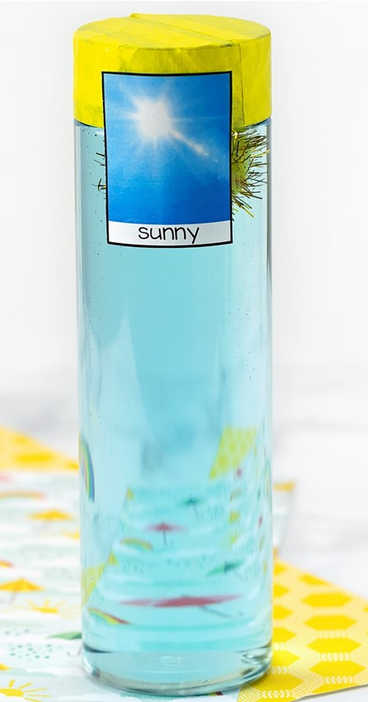
What type of weather is shown in this bottle?
Notes:
What type of weather is shown in this bottle? (*Provide wait time and give specific feedback based on student responses.)
Sunny

Slide 7
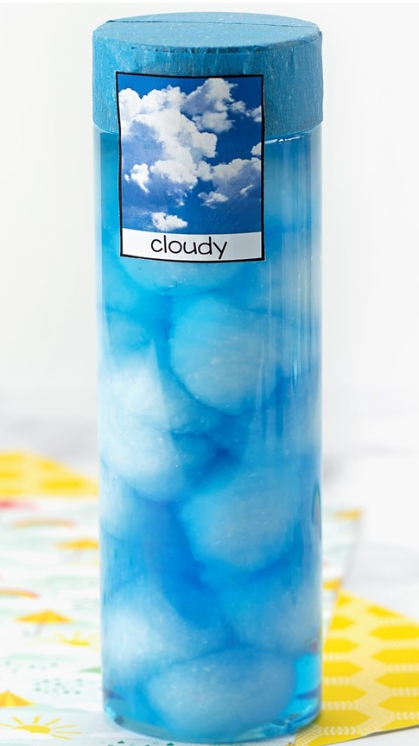
What type of weather is shown in this bottle?
Notes:
What type of weather is shown in this bottle? (*Provide wait time and give specific feedback based on student responses.)
Cloudy

Slide 8
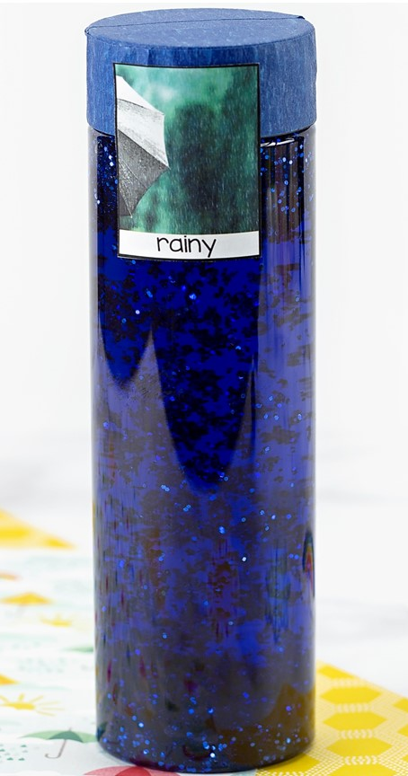
What type of weather is shown in this bottle?
Notes:
What type of weather is shown in this bottle? (*Provide wait time and give specific feedback based on student responses.)
Rainy

Slide 9
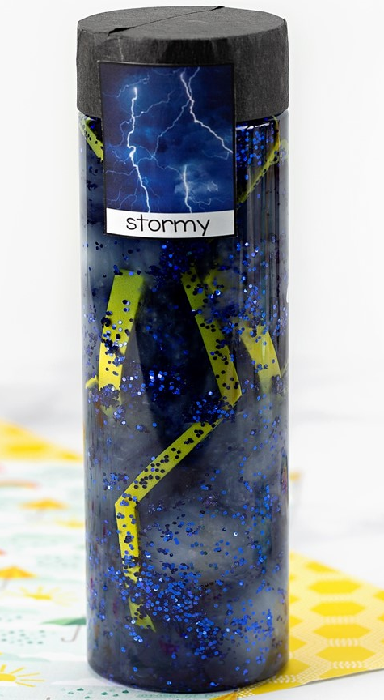
What type of weather is shown in this bottle?
Notes:
What type of weather is shown in this bottle? (*Provide wait time and give specific feedback based on student responses.)
Stormy

Slide 10
What type of weather is shown in this bottle?
Notes:
What type of weather is shown in this bottle? (*Provide wait time and give specific feedback based on student responses.)
Windy

Slide 11
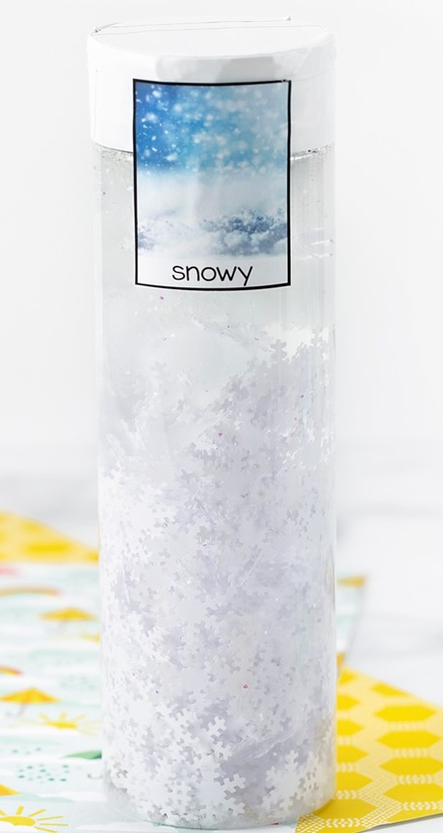
What type of weather is shown in this bottle?
Notes:
What type of weather is shown in this bottle? (*Provide wait time and give specific feedback based on student responses.)
Snowy

Slide 12
Notes:
Before we move on to our new vocabulary term, let’s review some other words & concepts that you already learned and make sure you are firm in your understanding.
Feedback: Reviewing key background knowledge helps lay the context and sets the students up to make sense of the new content you are introducing, it also reinforces previously learned material.

Slide 13
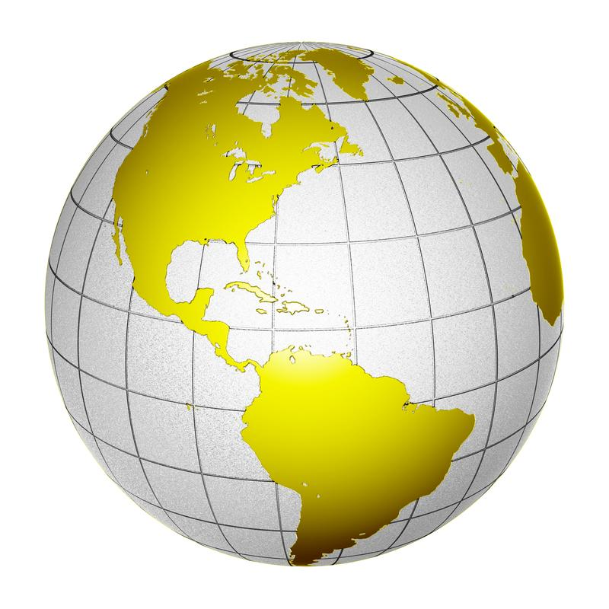
Latitude: a measure of the relative distance north or south of the equator
Notes:
Latitude is a measure of the relative distance north or south of the equator. When we look at a globe or map, these lines are horizontal - like the rungs on a ladder.

Slide 14
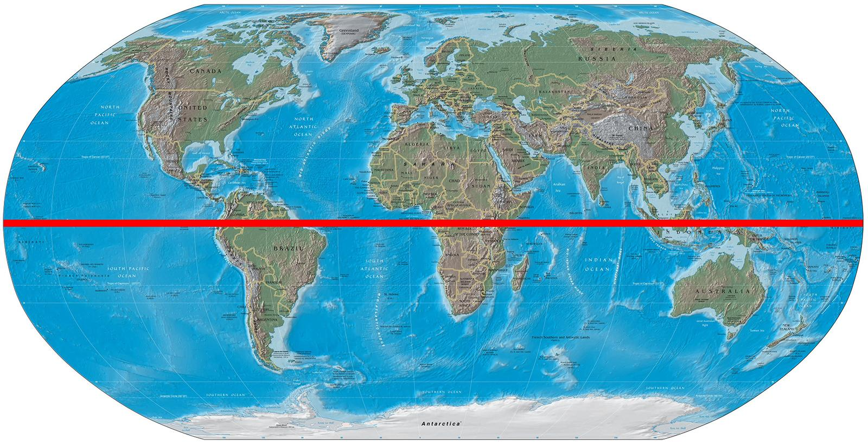
Equator: a latitudinal line that is equal distance from the north and south poles
Notes:
The equator is a latitudinal line that is equal distance from the north and south poles.

Slide 15
Notes:
Now let’s pause for a moment to check your understanding.
Feedback: Monitoring understanding during review is an important step before moving on to new material.

Slide 16
The equator is a _________ line.
Longitudinal
Latitudinal
Notes:
The equator is a ___________ line. (*Provide wait time and give specific feedback based on student responses)

Slide 17
The equator is a _________ line.
Longitudinal
Latitudinal
Notes:
The equator is a ___________ line. (*Provide wait time and give specific feedback based on student responses)
[Latitudinal]

Slide 18
What is latitude?
Notes:
What is latitude? (*Provide wait time and give specific feedback based on student responses)
[Latitude is a measure of the relative distance north or south of the equator. When we look at a globe or map, these lines are horizontal.]

Slide 19
Weather
Notes:
Now that we’ve reviewed, let’s define our new term, weather.

Slide 20
Weather: the conditions of the atmosphere at a certain time and place
Notes:
Weather is the conditions of the atmosphere at a certain time and place.
Feedback: Longer more formal definitions are tricky, use clear language when providing the new definition.

Slide 21
Notes:
Let’s check-in for understanding.

Slide 22
What is weather?
Notes:
What is weather? (*Provide wait time and give specific feedback based on student responses)
[Weather is the conditions of the atmosphere at a certain time and place.]

Slide 23
Notes:
That is the basic definition, but there is a bit more you need to know.

Slide 24
Notes:
So, what factors affect weather?

Slide 25
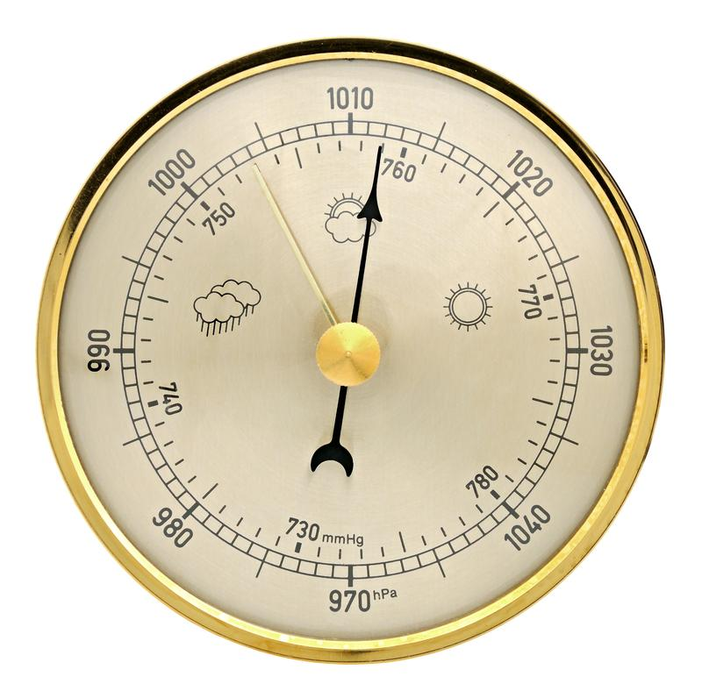
Air Pressure
Notes:
Weather is affected by air pressure. Air pressure is the weight that presses down on everything that it touches.

Slide 26
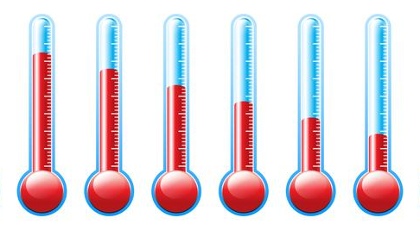
Air Temperature
Notes:
Weather is also affected by air temperature. For example, if it is below 32 degrees it snows, but if it is above 32 degrees it rains.

Slide 27
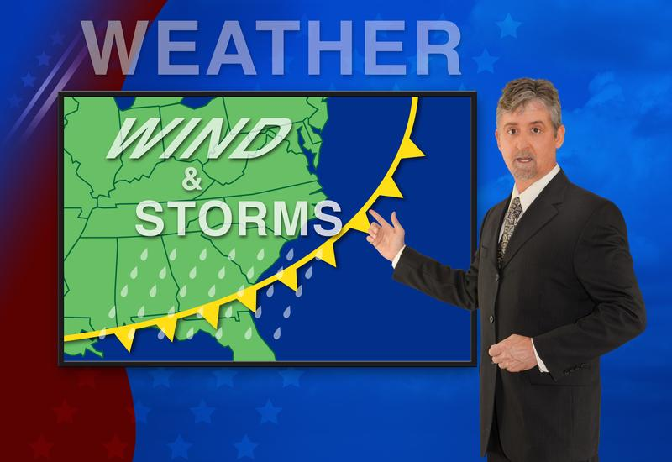
Wind Patterns
Notes:
Weather is also affected by wind patterns. This happens because wind patterns determine where hot and cold air blow.

Slide 28
Humidity
Notes:
Lastly, weather is also affected by humidity. Humidity is the moisture in the air.

Slide 29
Notes:
Let’s check-in for understanding.
Feedback: It is important to create opportunities during this portion of the lesson monitor understanding. This is a key strategy to ensure everyone is on track.

Slide 30
What factors affect weather?
Notes:
What factors affect weather? (*Provide wait time and give specific feedback based on student responses)
[Air pressure, air temperature, wind patterns, and humidity]

Slide 31
Let’s brainstorm, why do you think these factors affect weather?
Notes:
Let’s brainstorm, why do you think these factors affect weather? (*Provide wait time and give specific feedback based on student responses)
Encourage students to come up with their own thoughts and ideas.

Slide 32
Notes:
Although we are impacted by the weather every day, let’s remind ourselves of some examples of weather.
Feedback: When you were introducing examples, use clear and easy to understand language.

Slide 33
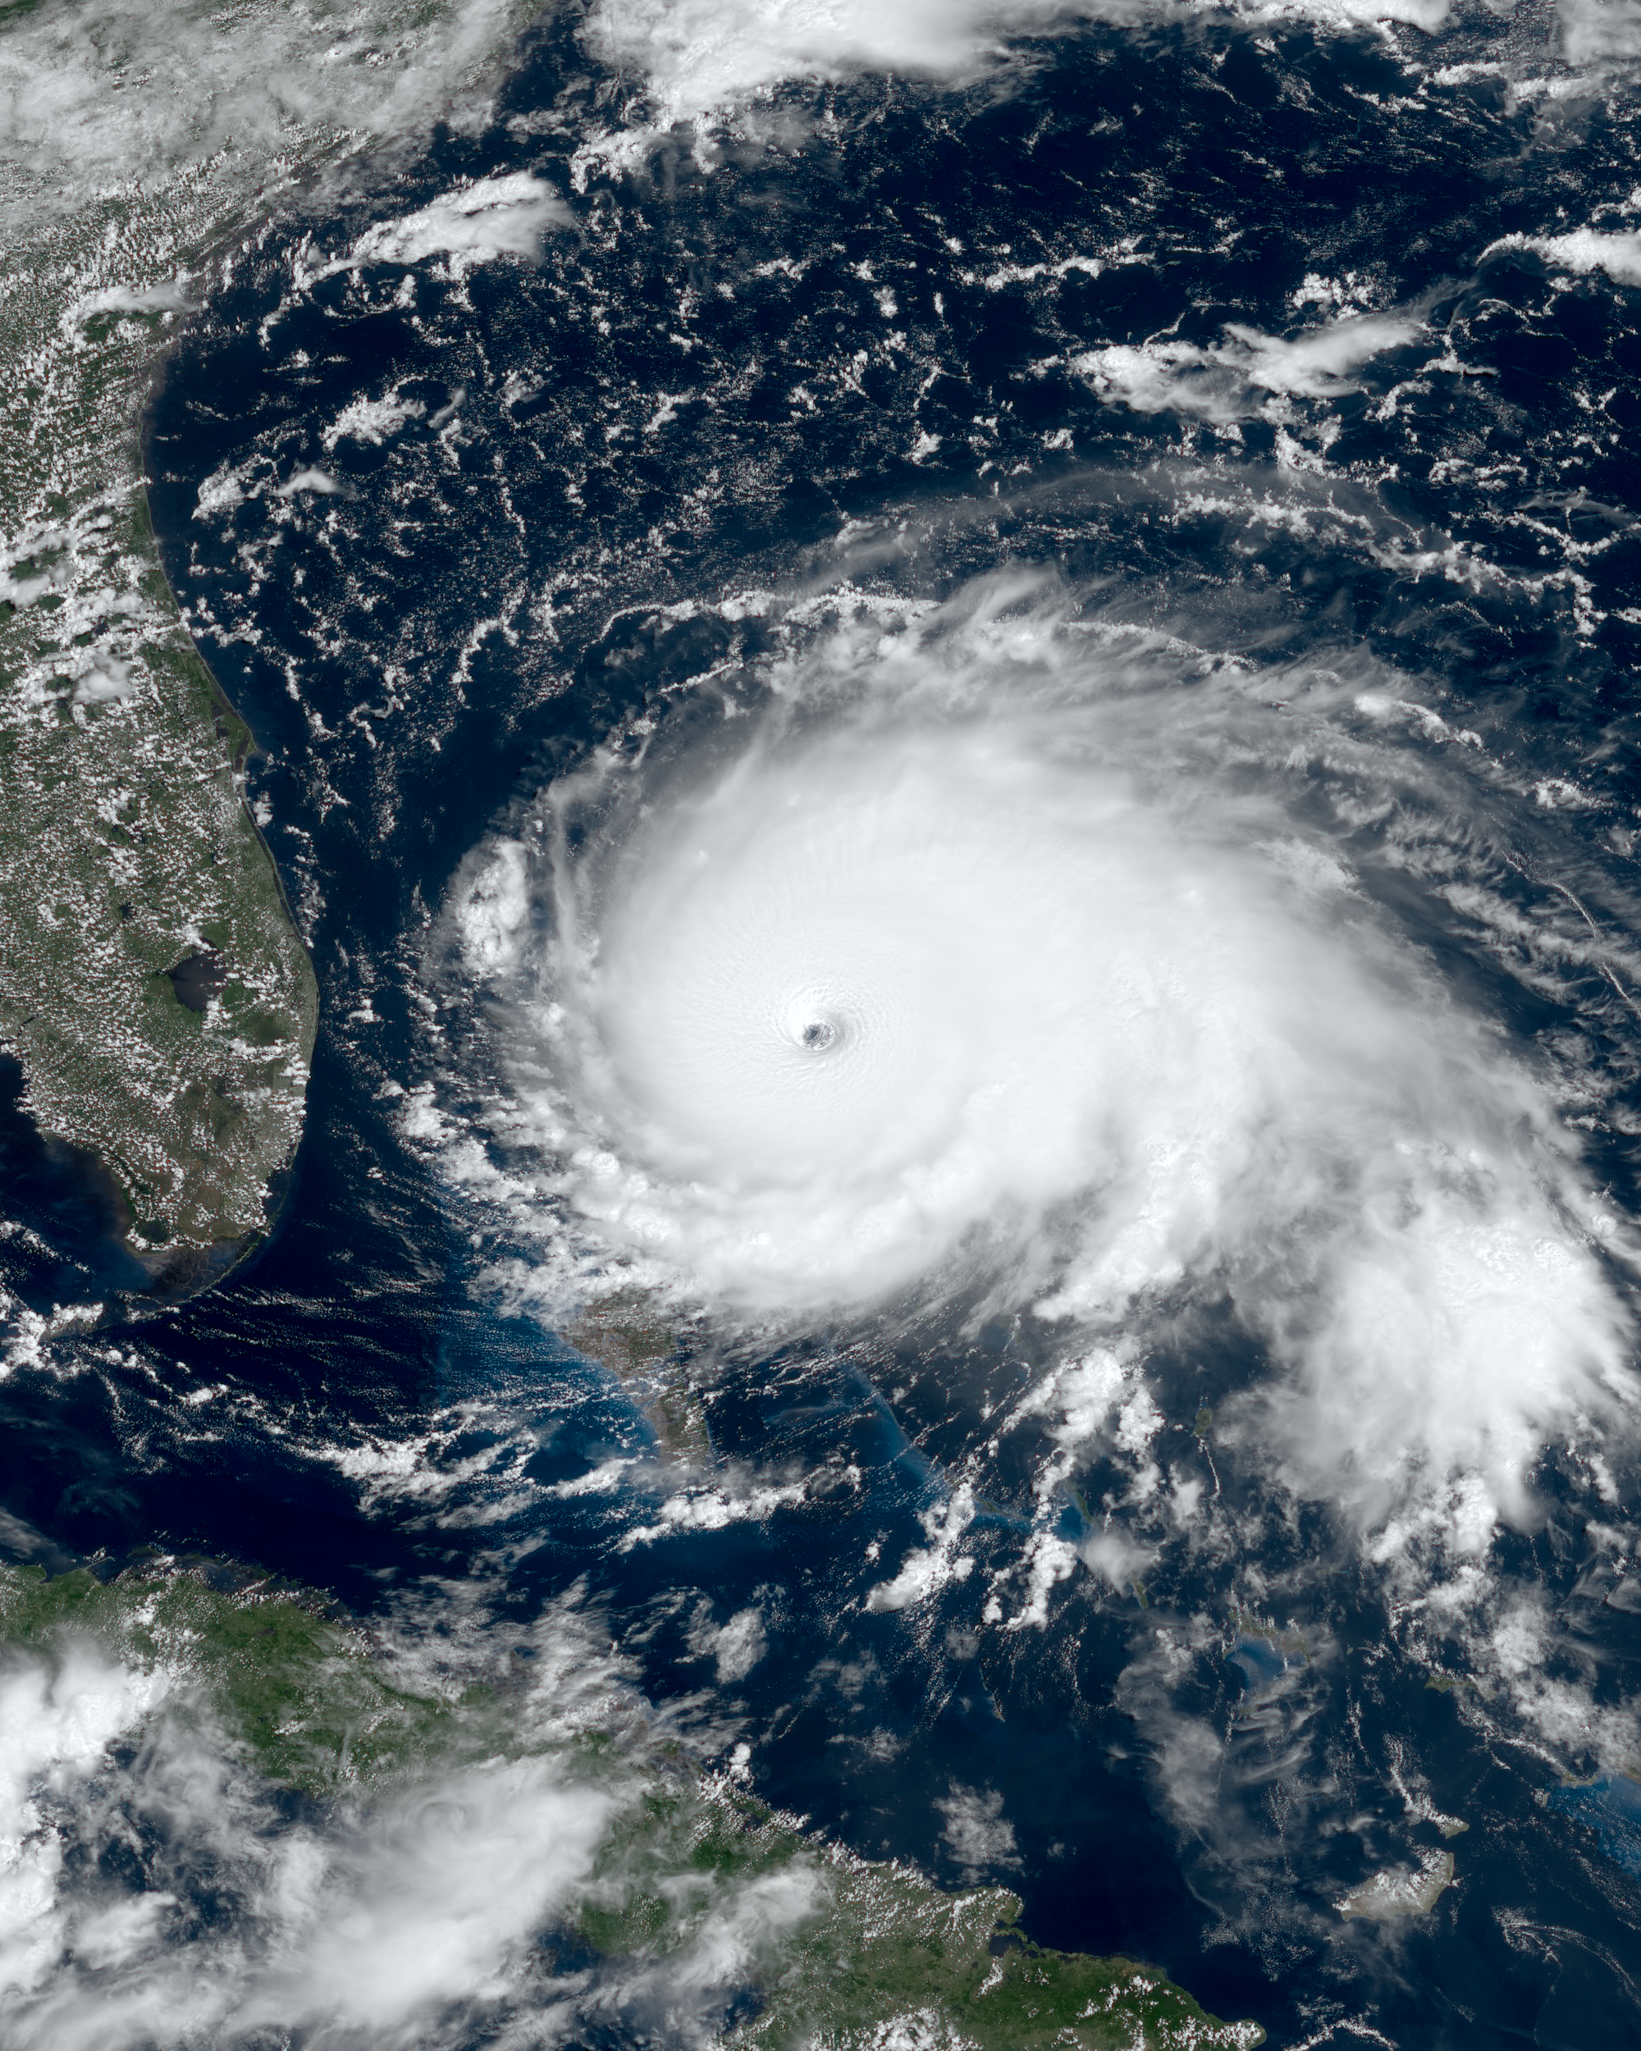
Notes:
A hurricane is an example of more extreme weather. Multiple factors that impact weather come together when there is a hurricane.

Slide 34
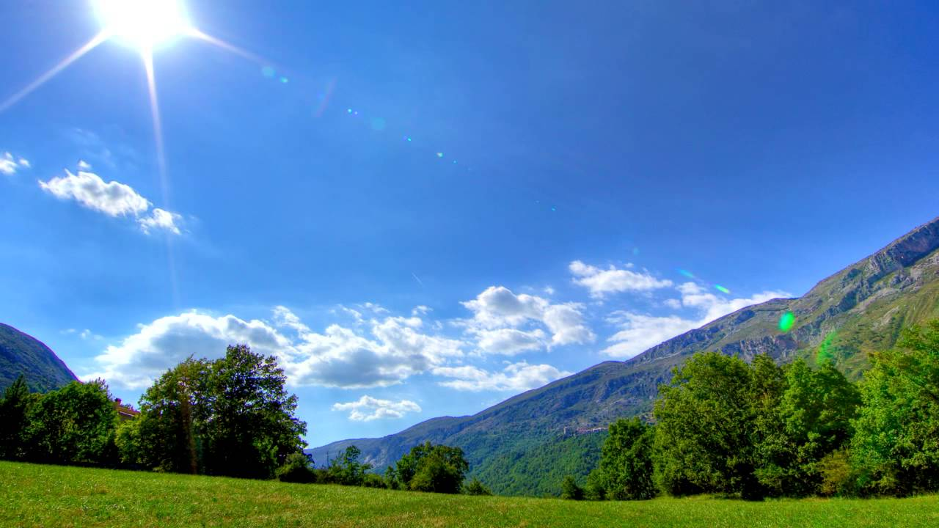
Notes:
A sunny day is an example of the weather. It is much less extreme than hurricanes.

Slide 35
Notes:
Let’s check-in for understanding.

Slide 36
What are some examples of weather that I didn’t show you?
Notes:
What are some examples of weather that I didn’t show you? (*Provide wait time and give specific feedback based on student responses)

Slide 37
Notes:
Now let’s look at a non-example of weather.
Feedback: One important component of using non-examples is by clearly distinguishing similarities and explaining why it is a non-example.

Slide 38
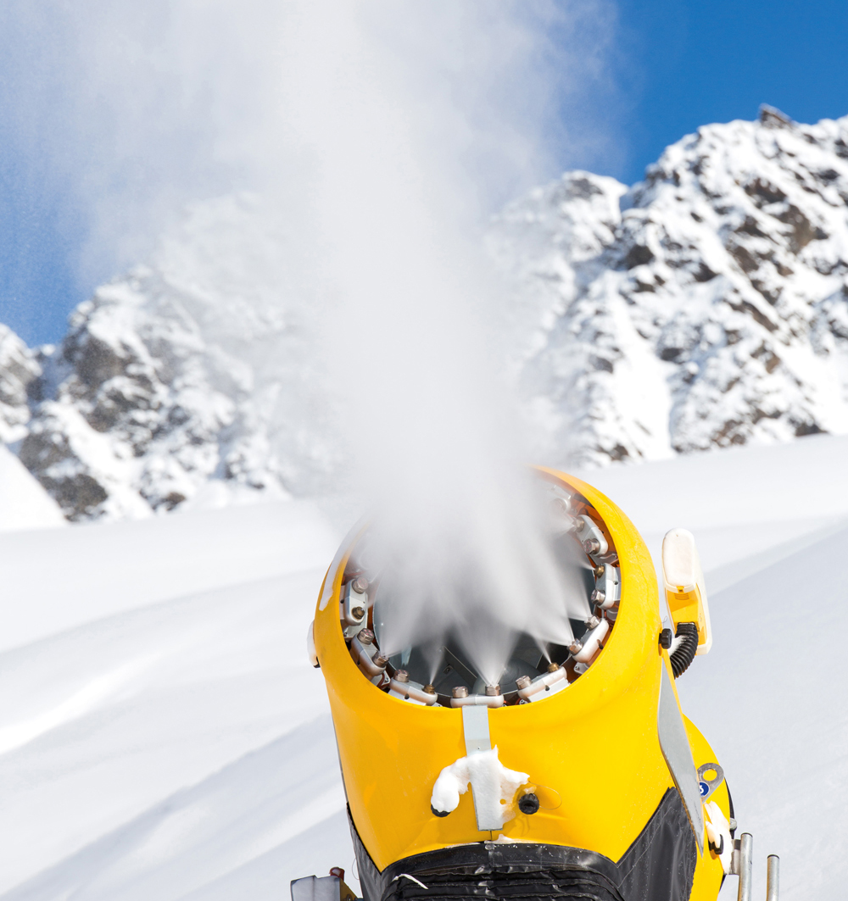
Notes:
Snow machines are used to make snow for ski resorts when snow does not naturally occur. Even though these machines make snow, they do not affect the state of the atmosphere.

Slide 39
Notes:
Let’s check-in for understanding.

Slide 40
What are some non-examples of weather that I didn’t show you?
NON
Notes:
What are some non-examples of weather that I didn’t show you? (*Provide wait time and give specific feedback based on student responses)

Slide 41
Notes:
Let’s check-in for understanding.

Slide 42
What is weather?
Notes:
What is weather? (*Provide wait time and give specific feedback based on student responses)
[Weather is the conditions of the atmosphere at a certain time and place.]

Slide 43
What are 4 things that affect weather?
Notes:
What are 4 things that affect weather? (*Provide wait time and give specific feedback based on student responses)
[Air pressure, air temperature, wind patterns, and humidity]

Slide 44
Remember!!!
Notes:
So remember!
Feedback: Review the key term once more before closing the lesson to lock in students’ understanding.

Slide 45
Weather: the conditions of the atmosphere at a certain time and place
Notes:
Weather is the conditions of the atmosphere at a certain time and place.

Slide 46
Big Question: What is the difference between weather and climate?
Notes:
Explicit cue to revisit the big question at the end of the lesson: Okay everyone. Now that we’ve learned the term, weather, let’s reflect once more on our big question. Was there anything that we predicted earlier that was correct or incorrect? Do you have any new hypotheses to share?

Slide 47
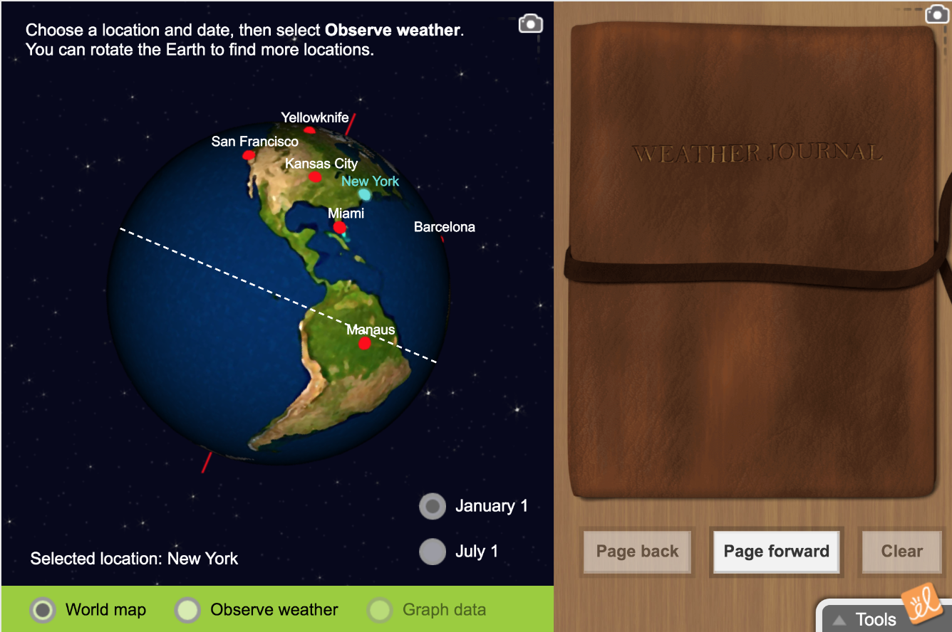
Simulation Activity
Observing Weather
(Gizmos)
Click the link above for a simulation to deepen your understanding of weather.
“In this lesson, students will practice using a thermometer, anemometer, rain gauge, and hygrometer to record weather conditions in a variety of locations and dates. This lesson uses U.S. customary units.”
Notes:
Click the link above for a simulation to deepen your understanding of weather.

Slide 48
Notes:
Thanks for watching!

Slide 49
This Video Created With Resources From:
Questions or Comments
Michael Kennedy, Ph.D. MKennedy@Virginia.edu
Rachel L Kunemund, Ph.D. rk8vm@virginia.edu

Slide 50
“Big Idea” Question
Teacher Demo
Review Concepts
Check-In Questions
Vocabulary
Student-Friendly Definition
Examples & Non-Examples
Morphological Word Parts
Simulation/Activity
Notes:
OK everyone, get ready for our next lesson. Just as a reminder, these are the different components that our lesson may include, and you’ll see these icons in the top left corner of each slide so that you can follow along more easily!

Slide 51
Intro
Climate
Notes:
Today we’re going to learn about climate.

Slide 52
Big Question: What is the difference between weather and climate?
Notes:
Before we start, let’s think about our “big question”: What is the difference between weather and climate? We recently learned about weather, so what predictions do you have to share about the difference between weather and climate?
[Pause and illicit predictions from students.]
I love all these thoughtful scientific hypotheses! Be sure to keep this question and your predictions in mind as we move through these next few lessons, and we’ll continue to revisit it.

Slide 53
Notes:
Before we move on to our new vocabulary term, let’s review some other words & concepts that you already learned and make sure you are firm in your understanding.

Slide 54
Latitude: a measure of the relative distance north or south of the equator
Notes:
Latitude is a measure of the relative distance north or south of the equator. When we look at a globe or map, these lines are horizontal.

Slide 55
Equator: a latitudinal line that is equal distance from the north and south poles
Notes:
The equator is a latitudinal line that is equal distance from the north and south poles.

Slide 56
Weather: the conditions of the atmosphere at a certain time and place
Notes:
Weather is the conditions of the atmosphere at a certain time and place.

Slide 57
Notes:
Now let’s pause for a moment to check your understanding.

Slide 58
The equator is a _________ line.
Longitudinal
Latitudinal
Notes:
The equator is a ___________ line. (*Provide wait time and give specific feedback based on student responses)

Slide 59
The equator is a _________ line.
Longitudinal
Latitudinal
Notes:
The equator is a ___________ line. (*Provide wait time and give specific feedback based on student responses)
[Latitudinal]

Slide 60
What is latitude?
Notes:
What is latitude? (*Provide wait time and give specific feedback based on student responses)
[Latitude is a measure of the relative distance north or south of the equator. When we look at a globe or map, these lines are horizontal.]

Slide 61
What is weather? Why might it be important to know what the weather is?
Notes:
What is weather? Why might it be important to know what the weather is? (*Provide wait time and give specific feedback based on student responses)
[Weather is the conditions of the atmosphere at a certain time and place.]

Slide 62
Climate
Notes:
Now that we’ve reviewed, let’s define our new term, climate.

Slide 63
Climate: pattern of weather over time in a specific location
Notes:
Climate is the pattern of weather over time in a specific location.

Slide 64
Notes:
Let’s check-in for understanding.

Slide 65
Climate is a _____ of weather over time in a specific ______.
Notes:
Climate is a _____ of weather over time in a specific ______.(*Provide wait time and give specific feedback based on student responses)
[Climate is the pattern of weather over time in a specific location.]

Slide 66
Climate is a pattern of weather over time in a specific location.
Notes:
Climate is a pattern of weather over time in a specific location.(*Provide wait time and give specific feedback based on student responses)
[Climate is the pattern of weather over time in a specific location.]

Slide 67
Notes:
That is the basic definition, but there is a bit more you need to know.

Slide 68
Latitude
Notes:
Climate is affected by latitude. The closer you are to the equator, the warmer the climate.

Slide 69
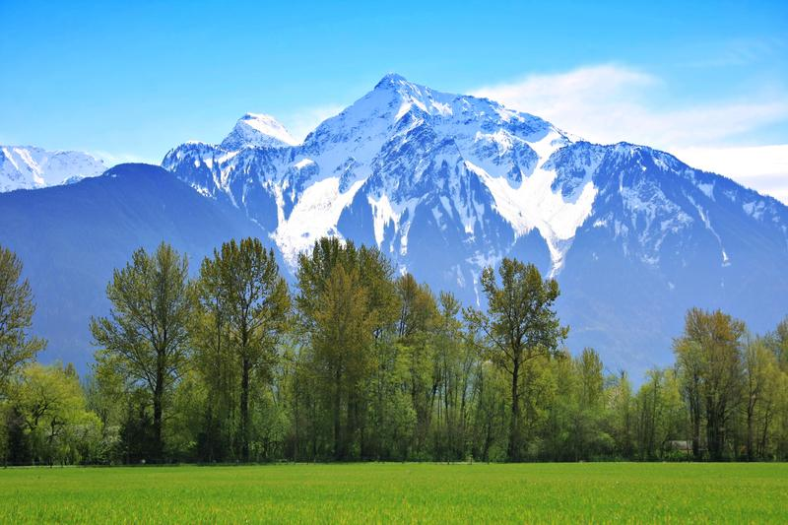
Altitude
Notes:
Altitude is how high you are above sea level. The Rocky Mountains’ tops have snow because there altitude is much higher than the plains below.

Slide 70
Notes:
Climate is also impacted by altitude. As altitude increases, the temperature decreases. This is why there is always snow on Mt. Everest.

Slide 71
Notes:
Let’s check-in for understanding.

Slide 72
What factors impact climate?
Notes:
What factors impact climate? (*Provide wait time and give specific feedback based on student responses)
[Latitude and altitude]

Slide 73
Notes:
Now, let’s talk about some examples of climate.

Slide 74
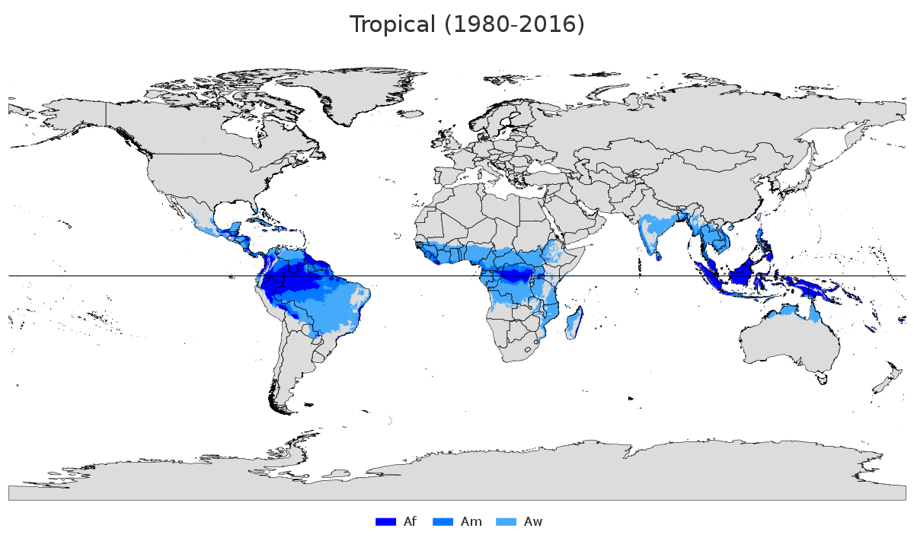
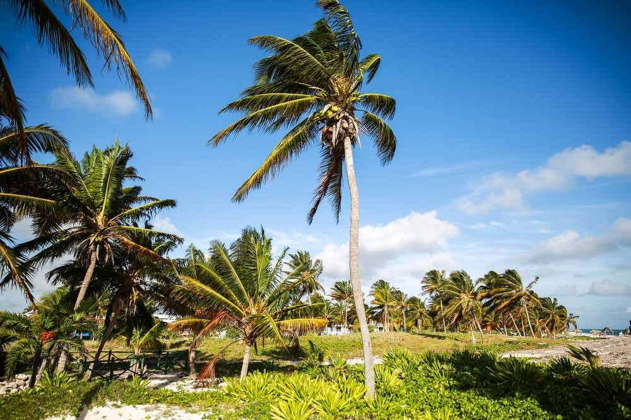
Notes:
One common climate is a tropical climate. Some characteristics of this type of climate include a temperature on average 64 degrees or higher, a wet and dry season, and intense sunlight.

Slide 75
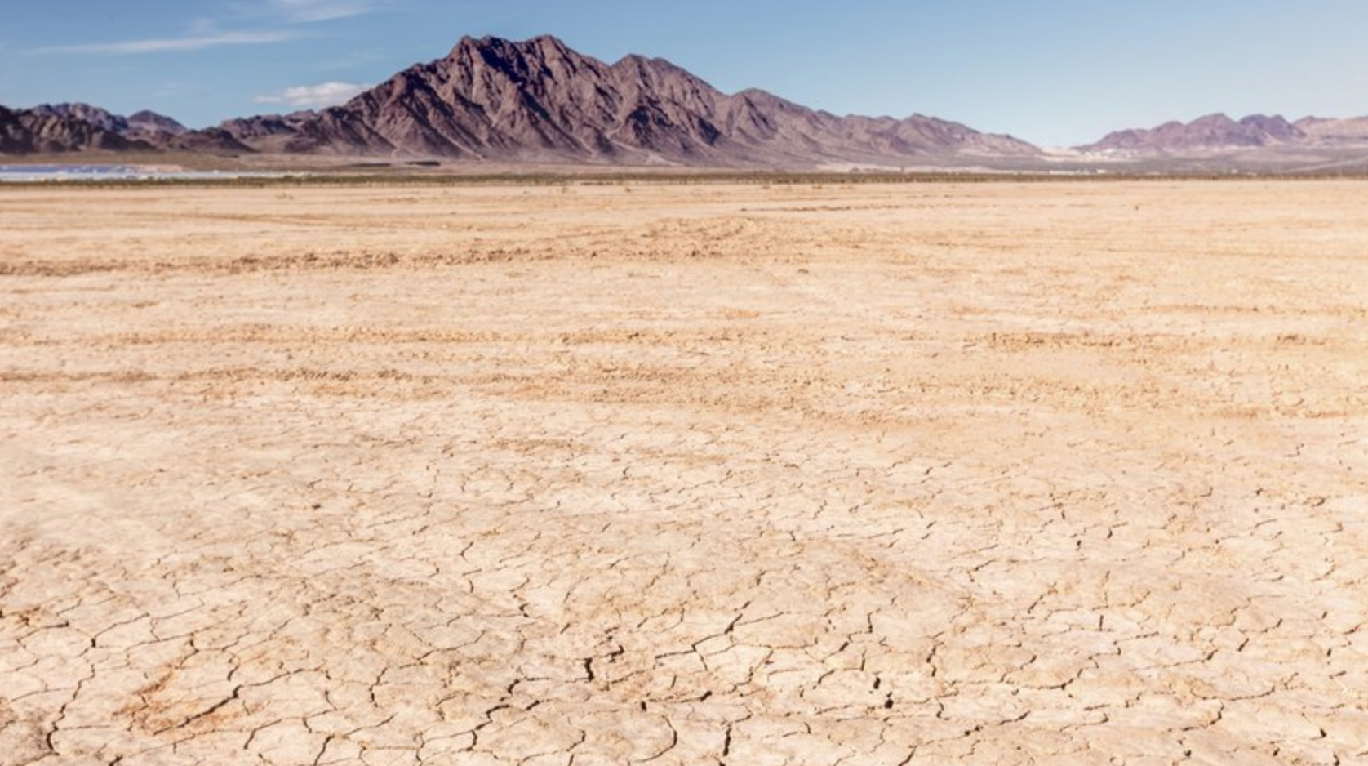
Notes:
Another common climate is a dry climate. Characteristics of this type of climate include low precipitation, high evaporation rates, and wide temperature swings daily and seasonally.

Slide 76
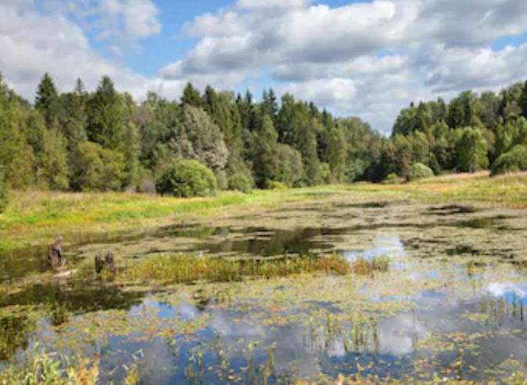
Notes:
Another common climate is temperate climate. Characteristics of this type of climate include, four seasons and moderate weather. There are no extremes.

Slide 77
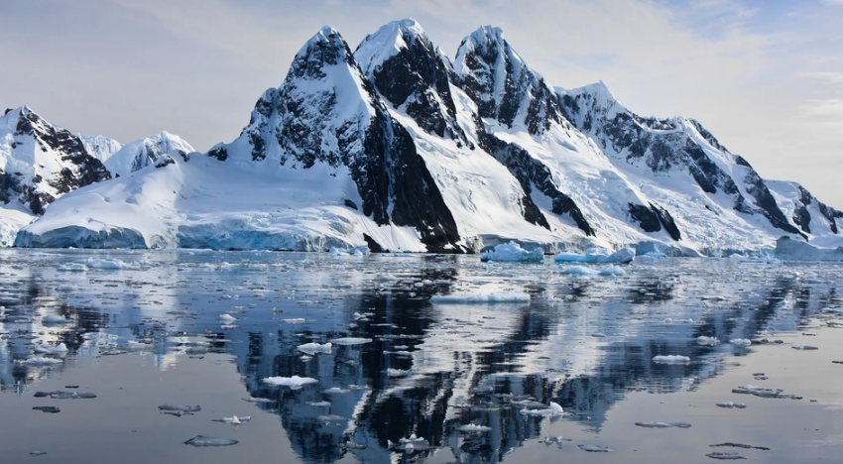
Notes:
Another common climate is polar climate. Characteristics of this type of climate include, cool summers and cold winters, as well as permanent or semi-permanent layers of ice.

Slide 78
Notes:
Let’s check-in for understanding.

Slide 79
What are some examples of climate?
Notes:
What are some examples of climate? (*Provide wait time and give specific feedback based on student responses)

Slide 80
Notes:
Now let’s look at a non-example of climate.

Slide 81
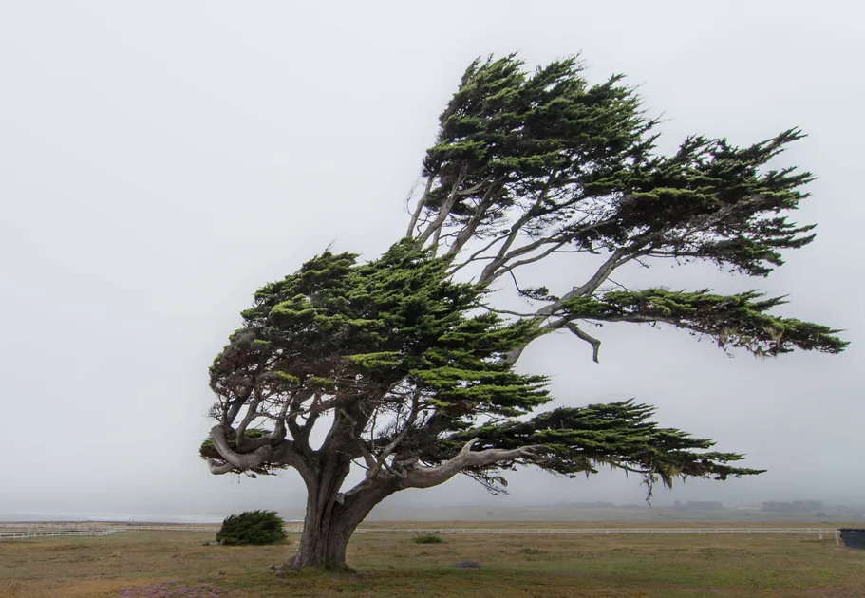
Notes:
Windy is a word used to describe weather since it describes the conditions of the atmosphere at a certain time and place.

Slide 82
Notes:
Let’s check-in for understanding.

Slide 83
What are some non-examples of climate?
NON
Notes:
What are some non-examples of climate? (*Provide wait time and give specific feedback based on student responses)

Slide 84
Notes:
Let’s check-in for understanding.
Feedback: You did a great job today by giving students opportunities to demonstrate their understanding. This assures that your students are able to understand the complicated formal definitions.

Slide 85
What is a climate?
Notes:
What is a climate? (*Provide wait time and give specific feedback based on student responses)
[Climate is the pattern of weather over time in a specific location.]

Slide 86
What are some factors that affect climate?
Notes:
What are some factors that affect climate? (*Provide wait time and give specific feedback based on student responses)
[Latitude, altitude]

Slide 87
Remember!!!
Notes:
So remember!

Slide 88
Climate: pattern of weather over time in a specific location
Notes:
Climate is the pattern of weather over time in a specific location.

Slide 89
Big Question: What is the difference between weather and climate?
Notes:
Explicit cue to revisit the big question at the end of the lesson: Okay everyone. Now that we’ve learned the term, climate, let’s reflect once more on our big question. Was there anything that we predicted earlier that was correct or incorrect? Do you have any new hypotheses to share?

Slide 90
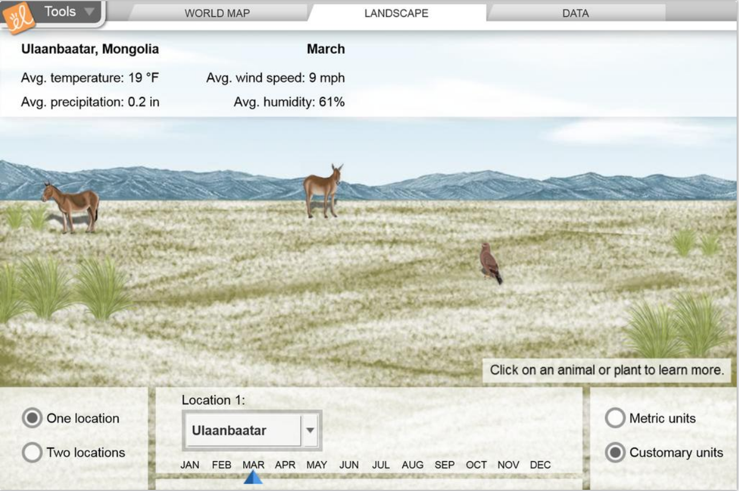
Simulation Activity
Comparing Climate
(Gizmos)
Click the link above for a simulation to deepen your understanding of climate.
“Compare average temperatures, precipitation, humidity, and wind speed for a variety of locations across the globe. Explore the influence of latitude, proximity to oceans, elevation, and other factors on climate. Observe how animals and plants are adapted to climate and their environment. This lesson uses U.S. customary units.”
Notes:
Click the link above for a simulation to deepen your understanding of climate.

Slide 91
Notes:
Thanks for watching, and please continue watching CAPs available from this website!

Slide 92
This Video Created With Resources From:
Questions or Comments
Michael Kennedy, Ph.D. MKennedy@Virginia.edu
Rachel L Kunemund, Ph.D. rk8vm@virginia.edu

