Slide 1
Intro
“Big Idea” Question
Review Concepts
Check-In Questions
Teacher Engagement
Vocabulary
Student-Friendly Definition
Examples & Non-Examples
Frayer Model
Simulation/Activity
Notes:
OK everyone, get ready for our next lesson. Just as a reminder, these are the different components that our lesson may include, and you’ll see these icons in the top left corner of each slide so that you can follow along more easily!

Slide 2
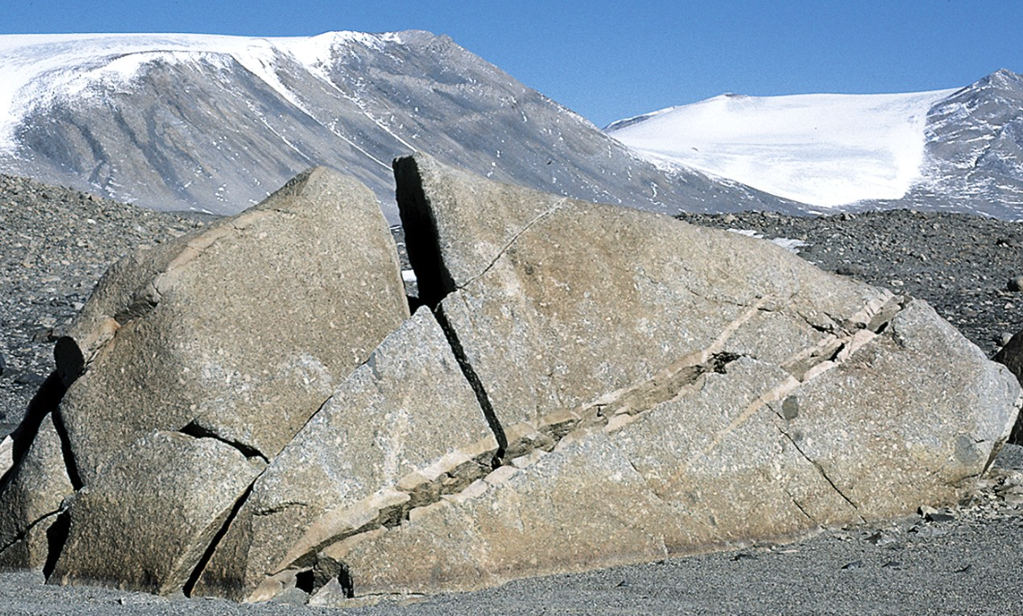
Intro
Weathering
Notes:
Today, we’ll be learning about the word: Weathering.

Slide 3
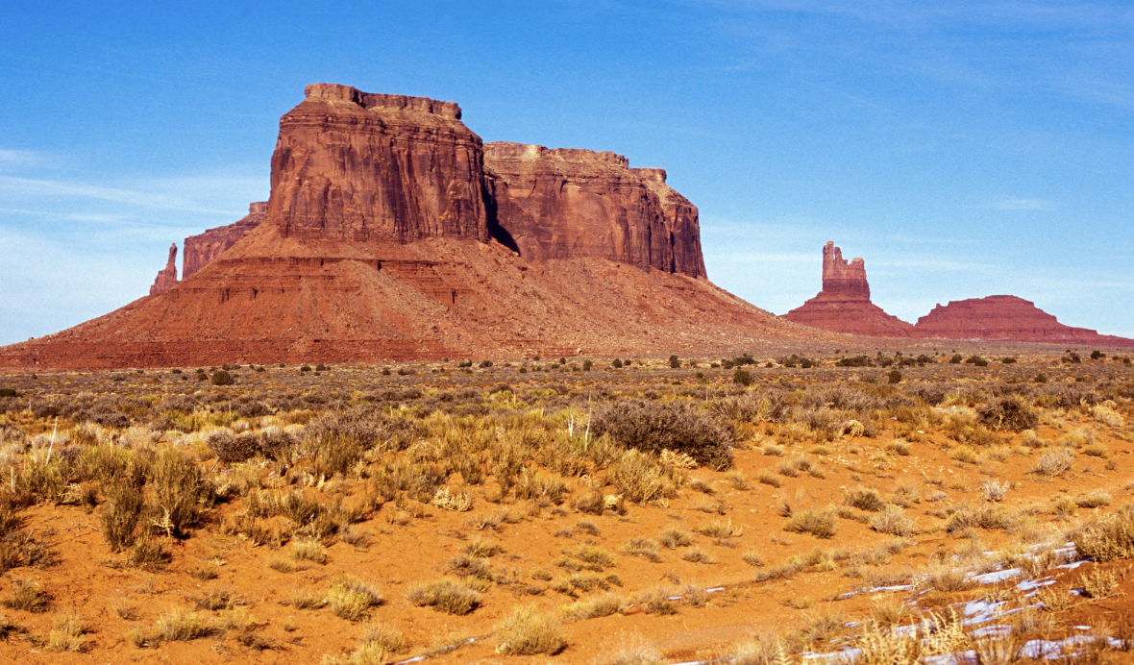
Big Question: In what ways does weathering play a role in shaping our environment and the Earth's surface?
Notes:
Our “big question” is: In what ways does weathering play a role in shaping our environment and the Earth's surface?
I love all these thoughtful scientific hypotheses! Be sure to keep this question and your predictions in mind as we move through these next few lessons, and we’ll continue to revisit it.

Slide 4
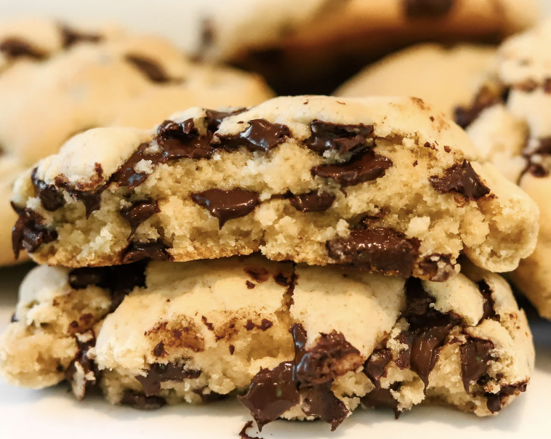
Demonstration
TEACHER DIRECTIONS:
Before viewing: Ask students what they already know about weathering. Tell students today they will be learning about the term weathering.
During: Have students observe and record the changes in their cookies over a set period. Encourage discussions on the observed effects.
After: Tell students that today they will be learning more about the term weathering.
Notes:
Materials needed:
Chocolate chip cookies (several for each student or group)
Small plastic bags
Plastic cups
Water
Toothpicks or small plastic utensils
Procedure:
Introduction: Begin by discussing with students what weathering is and why it's essential in shaping the Earth's surface.
Prediction: Ask students to predict what might happen to a cookie when it is exposed to certain "weathering agents."
Experiment: Provide each student or group with a chocolate chip cookie. Instruct them to represent different weathering processes using the following methods:
Physical Weathering: Break the cookie into pieces to simulate processes like wind, water, or ice breaking rocks.
Chemical Weathering: Dip a cookie piece in water to represent how rain can chemically break down rocks over time.
Biological Weathering: Use a toothpick or utensil to create holes or scratches in the cookie, symbolizing the impact of living organisms.
Observation: Have students observe and record the changes in their cookies over a set period. Encourage discussions on the observed effects.
Conclusion: Discuss the observed changes, relating them back to real-world weathering processes. Emphasize that weathering is a gradual but significant force that shapes the Earth's surface.
This hands-on activity allows students to actively engage with the concept of weathering and visually understand how different processes contribute to the breaking down of materials over time.

Slide 5
Notes:
Before we move on to our new topic, let’s review some other words & concepts that you already learned and make sure you are firm in your understanding.

Slide 6
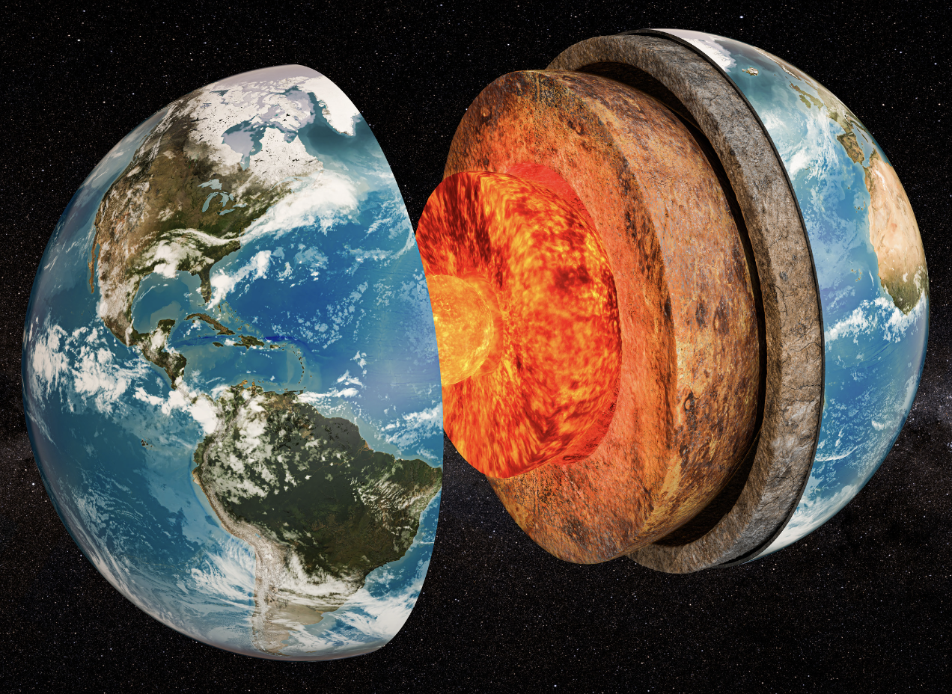
The Earth’s System: The interconnected components that work together to form the Earth.
Notes:
The Earth’s System: The interconnected components that work together to form the Earth.

Slide 7
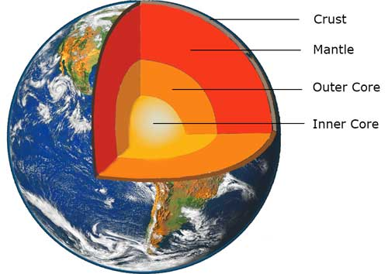
The Layers of the Earth
Notes:
Review the layers of the Earth. Crust, Mantle, Outer Core, and Inner Core

Slide 8
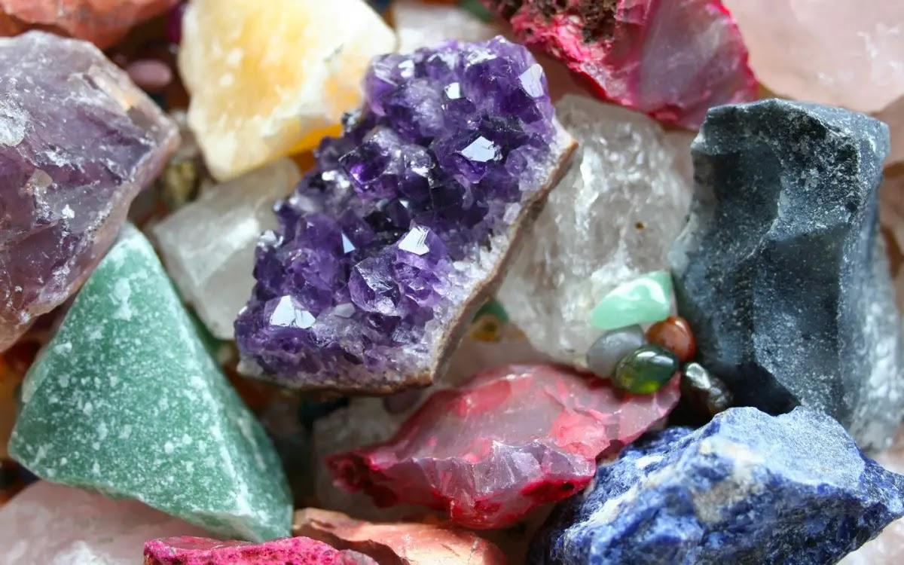
Mineral: Substances that do not come from an animal or plant, the building blocks that make up rocks
Notes:
Mineral: Substances that do not come from an animal or plant, the building blocks that make up rocks

Slide 9
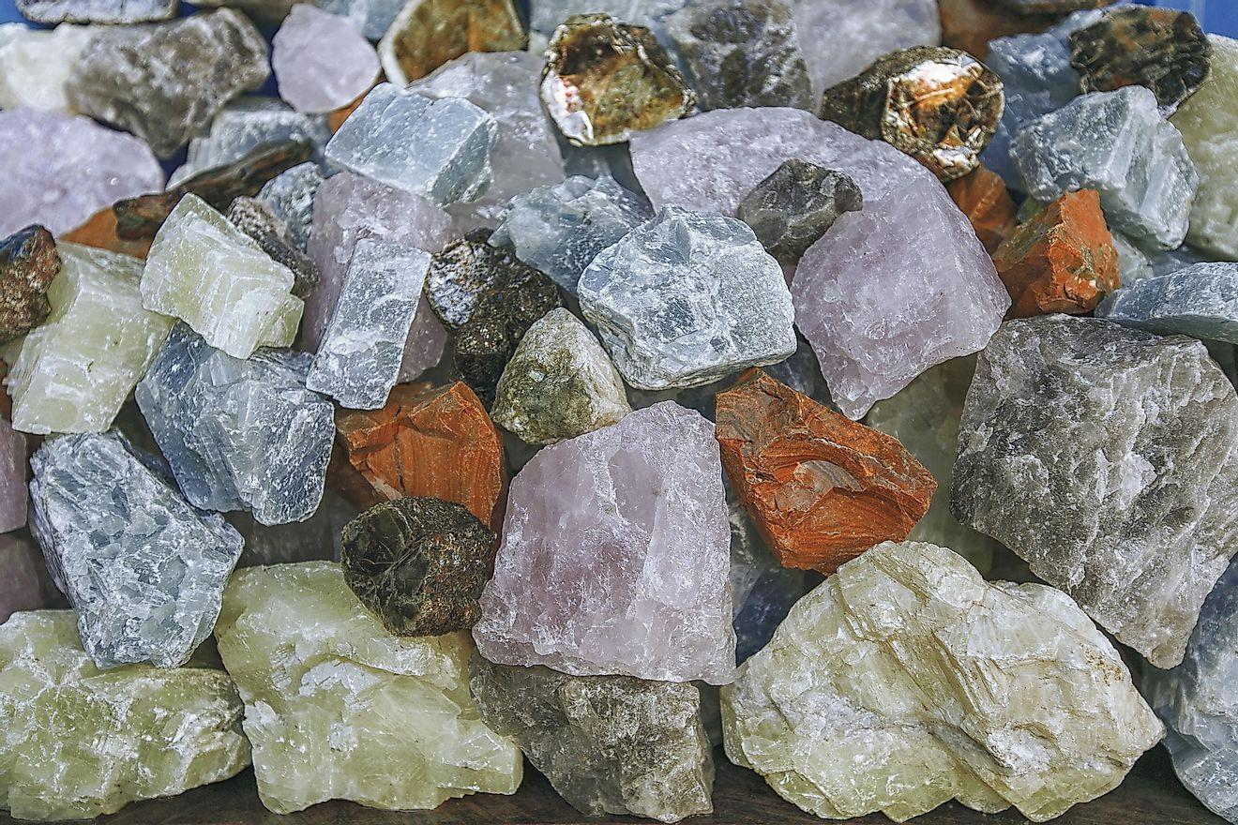
Rock: A solid collection of minerals.
Notes:
Rock: A solid collection of minerals.

Slide 10
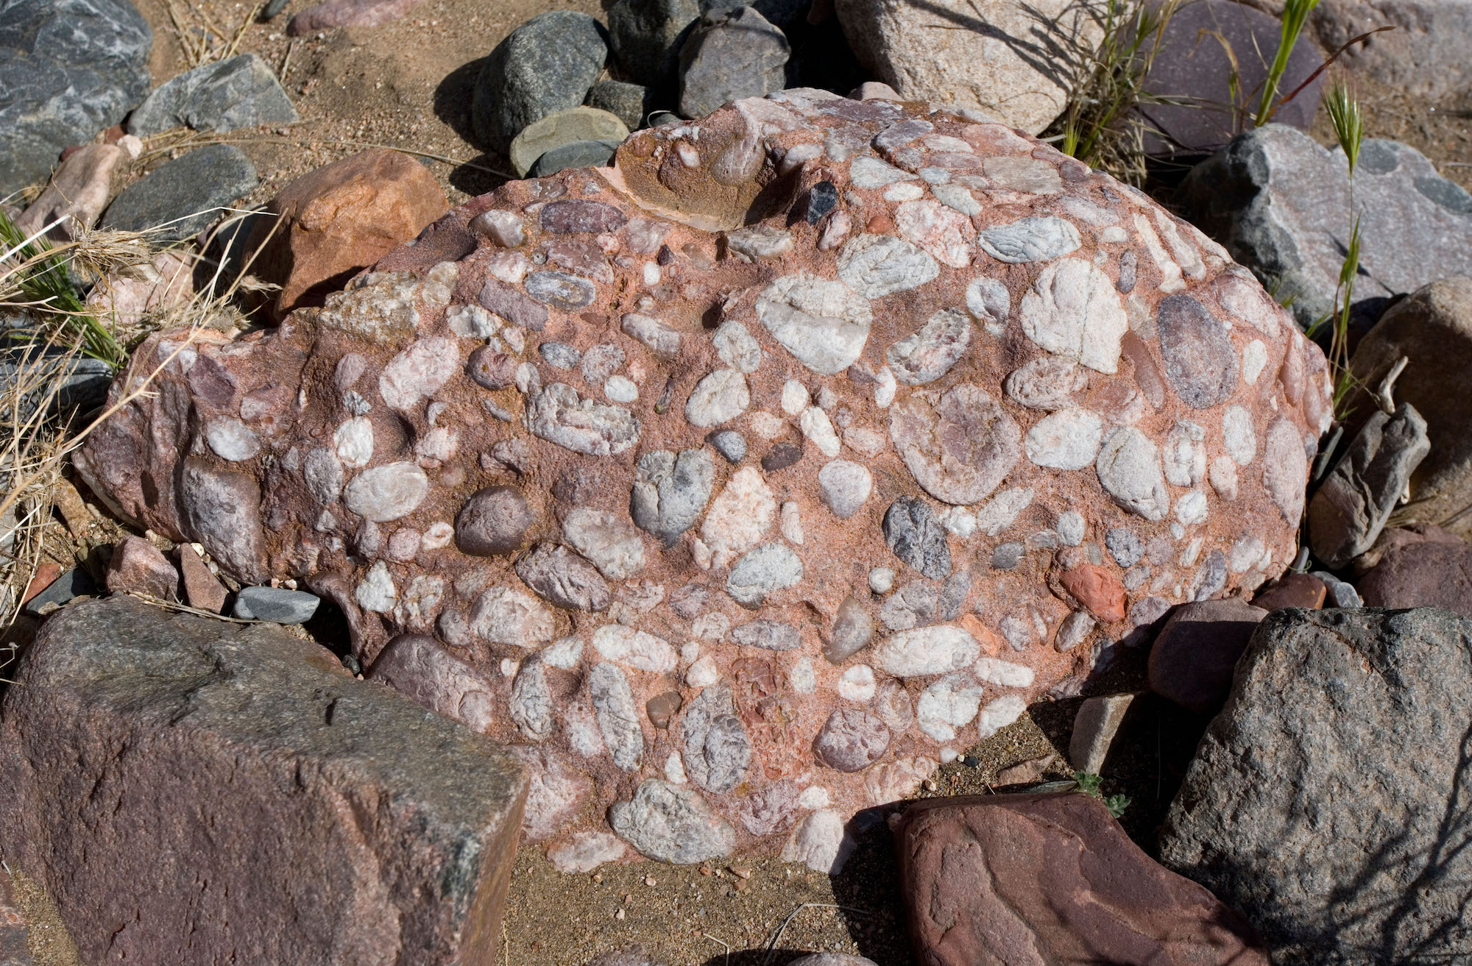
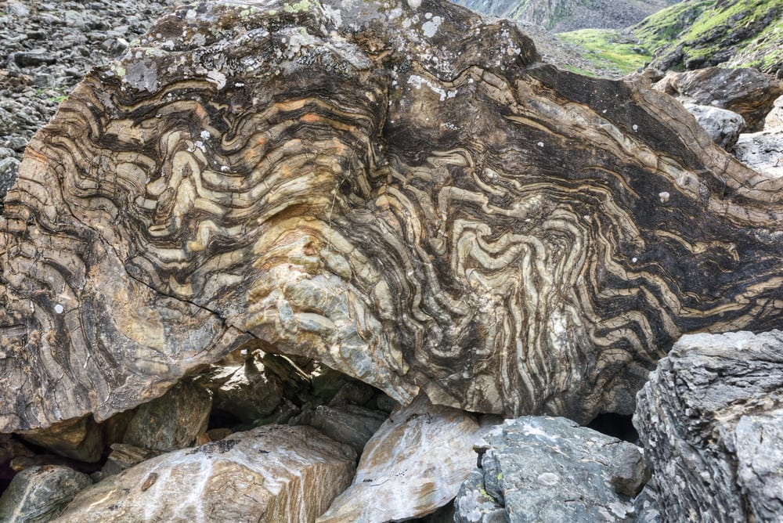
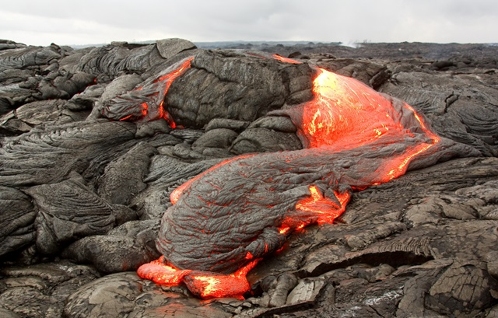
There are three types of rocks. Each type forms differently.
Igneous – when lava cools down and solidifies
Sedimentary – when small particles e.g., minerals, organic materials, sand, stick together over time
Metamorphic – when existing rocks undergo temperature, pressure, or chemical change
Notes:
There are three types of rocks. Each type of rock forms differently.
Today, we will be learning about sedimentary rocks.

Slide 11
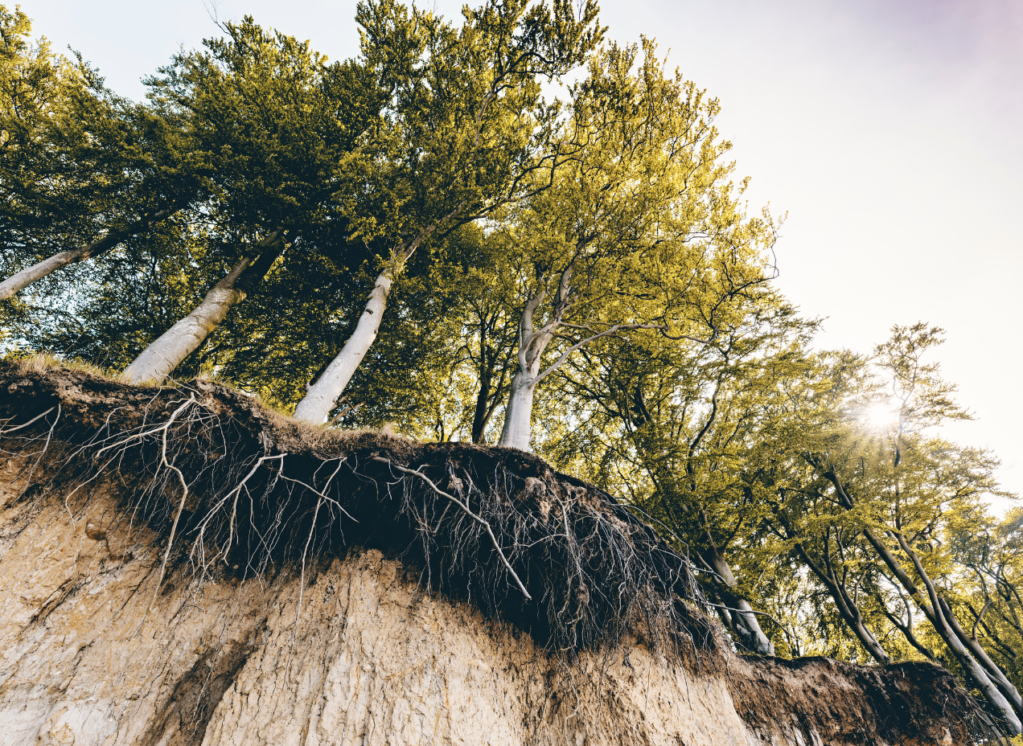
Erosion: Earth materials (rock, soil) are worn away and moved by wind and water
Notes:
Erosion: Earth materials (rock, soil) are worn away and moved by wind and water

Slide 12
Deposition: dropping of sediment to a new location
Notes:
Deposition is the dropping of sediment to a new location

Slide 13
Notes:
Now let’s pause for a moment to review the information we have covered already.

Slide 14
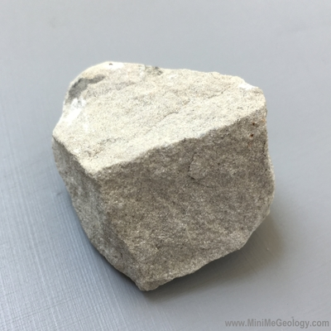
What is the relationship between rocks and minerals?
Rocks are created when minerals go through changes in temperature and pressure.
Rocks are tiny pieces of minerals that stick together over time.
Rocks are made up of one or more mineral.
Notes:
What is the relationship between rocks and minerals?
[C] Rocks are made up of one or more mineral.

Slide 15
What is the relationship between rocks and minerals?
Rocks are created when minerals go through changes in temperature and pressure.
Rocks are tiny pieces of minerals that stick together over time.
Rocks are made up of one or more mineral.
Notes:
What is the relationship between rocks and minerals? Rocks are made up of one or more mineral.
[C] Rocks are made up of one or more mineral.

Slide 16
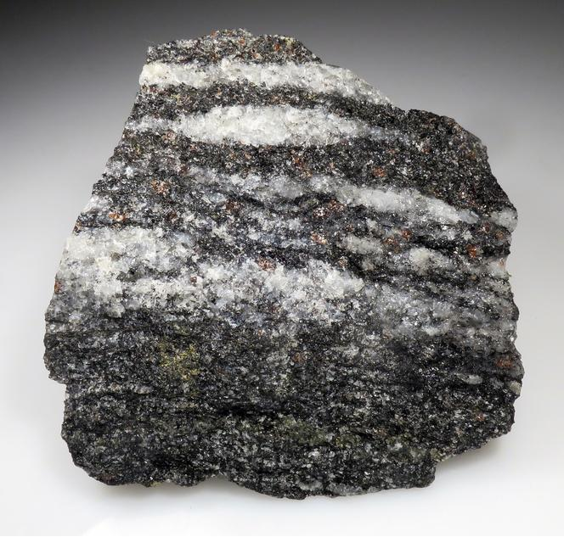
Which of the following materials can rocks not be made of?
Sand particles
Minerals
Former living things
Fossils
Notes:
Which of the following materials can rocks not be made of?
[D] Fossils

Slide 17
Which of the following materials can rocks not be made of?
Sand particles
Minerals
Former living things
Fossils
Notes:
Which of the following materials can rocks not be made of?
[D] Fossils

Slide 18
Erosion: Earth materials (rock, soil) are worn away and moved by and .
Notes:
Erosion: Earth materials (rock, soil) are worn away and moved by and .
[wind, water]

Slide 19
Erosion: Earth materials (rock, soil) are worn away and moved by wind and water.
Notes:
Erosion: Earth materials (rock, soil) are worn away and moved by and .
[wind, water]

Slide 20
True or False: Deposition is the dropping of sediment to a new location
Notes:
True or False: Deposition is the dropping of sediment to a new location
[True]

Slide 21
True or False: Deposition is the dropping of sediment to a new location
Notes:
True : Deposition is the dropping of sediment to a new location

Slide 22
Weathering
Notes:
Now that we’ve reviewed, let’s define the phrase Weathering

Slide 23
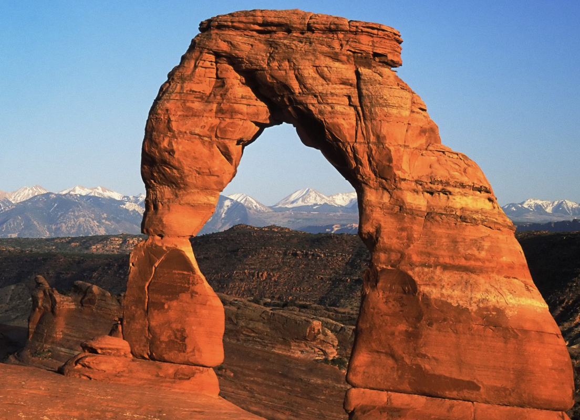
Weathering: the process of breaking down rock over long periods of time
Notes:
Weathering: the process of breaking down rock over long periods of time

Slide 24
Notes:
Let’s check-in for understanding.

Slide 25
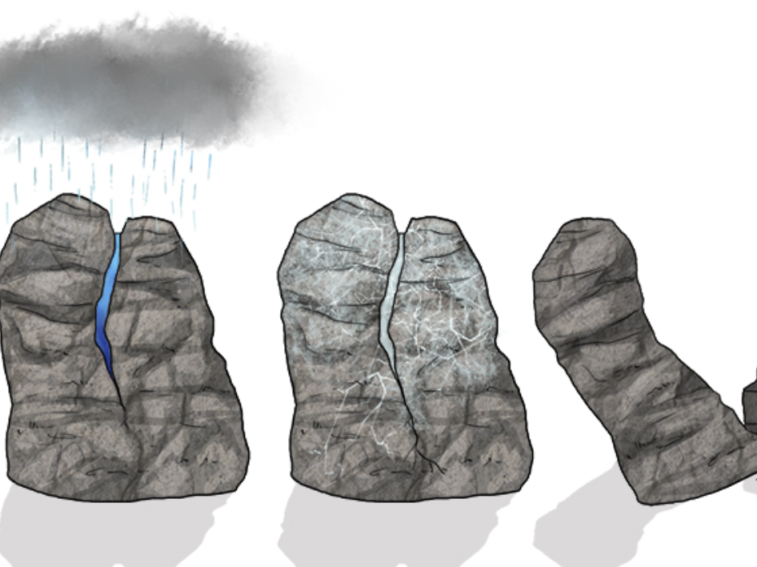
What is weathering?
Notes:
What is weathering?
[Weathering: the process of breaking down rock over long periods of time]

Slide 26
Notes:
That is the basic definition, but there is a bit more you need to know.

Slide 27
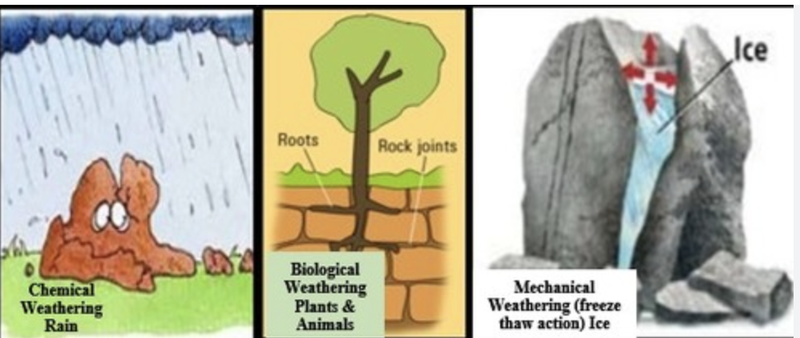
Weathering happens in three main ways: mechanical weathering, chemical weathering, and biological weathering.
Notes:
Weathering happens in three main ways: mechanical weathering, chemical weathering, and biological weathering.

Slide 28
Mechanical weathering is where rocks break into smaller pieces without changing their composition. Mechanical weathering includes processes like freeze-thaw, where water seeps into cracks, freezes, and expands, breaking the rock apart. Another example is abrasion, where rocks rub against each other, wearing away over time.
Notes:
Mechanical weathering is where rocks break into smaller pieces without changing their composition. Mechanical weathering includes processes like freeze-thaw, where water seeps into cracks, freezes, and expands, breaking the rock apart. Another example is abrasion, where rocks rub against each other, wearing away over time.

Slide 29
Chemical weathering is where rocks change chemically over time. Chemical weathering involves changes to a rock's minerals through chemical reactions. For instance, rainwater mixed with carbon dioxide can form a weak acid that dissolves certain minerals in rocks.
Notes:
Chemical weathering is where rocks change chemically over time. Chemical weathering involves changes to a rock's minerals through chemical reactions. For instance, rainwater mixed with carbon dioxide can form a weak acid that dissolves certain minerals in rocks.

Slide 30
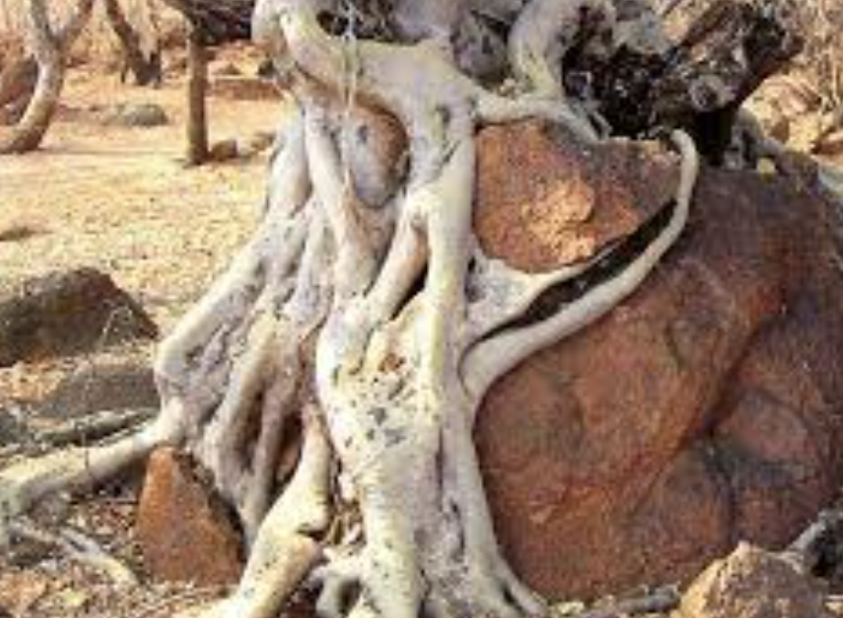
Biological weathering is when living things, like plants and animals, break down rocks. For example, tree roots growing into rocks and animals burrowing can cause the rocks to break over time.
Notes:
Biological weathering is when living things, like plants and animals, break down rocks. For example, tree roots growing into rocks and animals burrowing can cause the rocks to break over time.

Slide 31
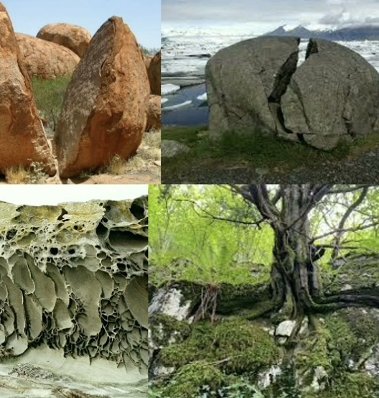
Weathering doesn't happen the same everywhere. Different climates, types of rock, and the presence of living organisms can influence how quickly or slowly weathering occurs.
Notes:
Weathering doesn't happen the same everywhere. Different climates, types of rock, and the presence of living organisms can influence how quickly or slowly weathering occurs.

Slide 32
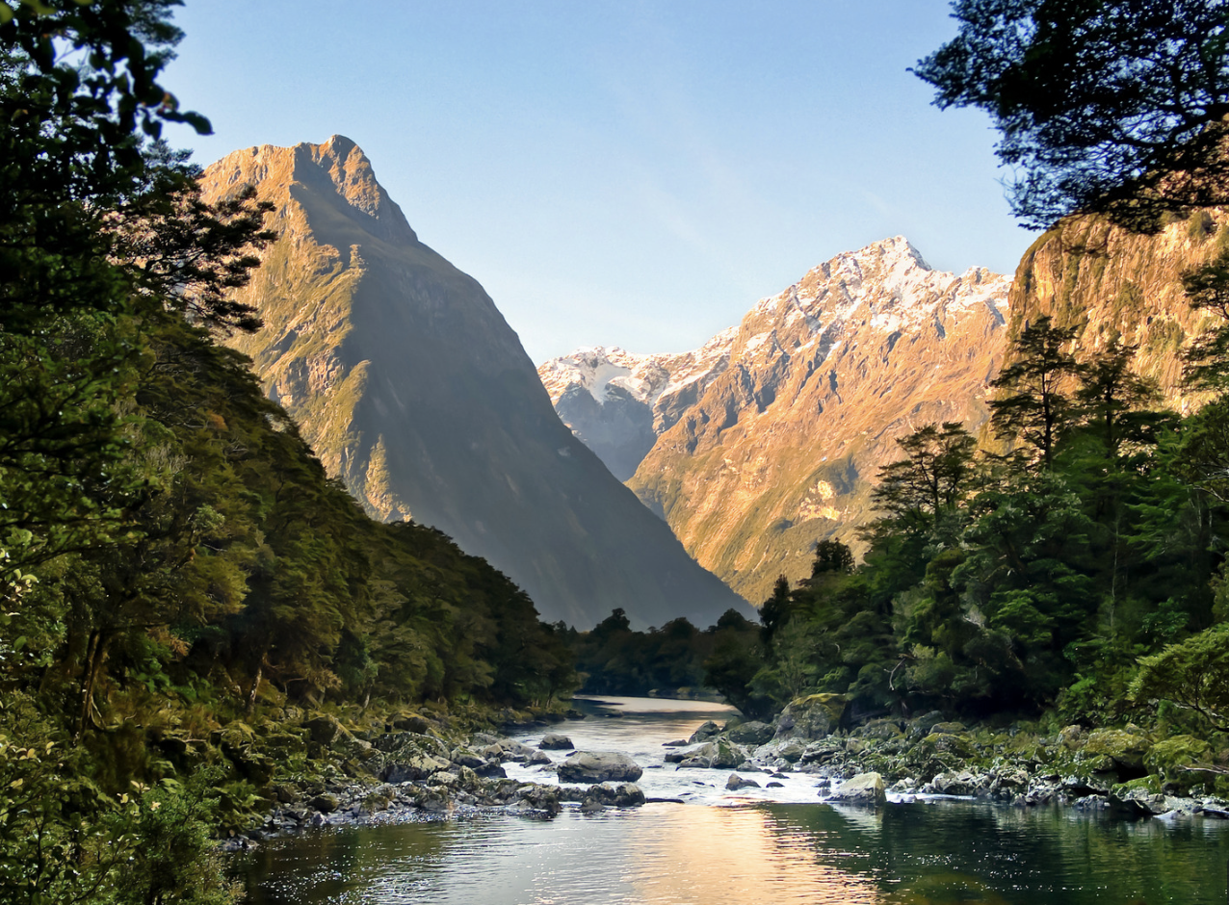
Weathering plays a key role in creating various landforms. For example, valleys can form as rivers erode rocks over time, and caves can develop through a combination of mechanical and chemical weathering.
Notes:
Weathering plays a key role in creating various landforms. For example, valleys can form as rivers erode rocks over time, and caves can develop through a combination of mechanical and chemical weathering.

Slide 33
Humans can influence weathering too. Activities like mining, deforestation, and pollution can accelerate weathering processes.
Notes:
Humans can influence weathering too. Activities like mining, deforestation, and pollution can accelerate weathering processes.

Slide 34
Weathering is a slow process that occurs over long periods. It's one of the reasons landscapes change over millions of years.
Notes:
Weathering is a slow process that occurs over long periods. It's one of the reasons landscapes change over millions of years.

Slide 35
Notes:
Let’s check-in for understanding.

Slide 36
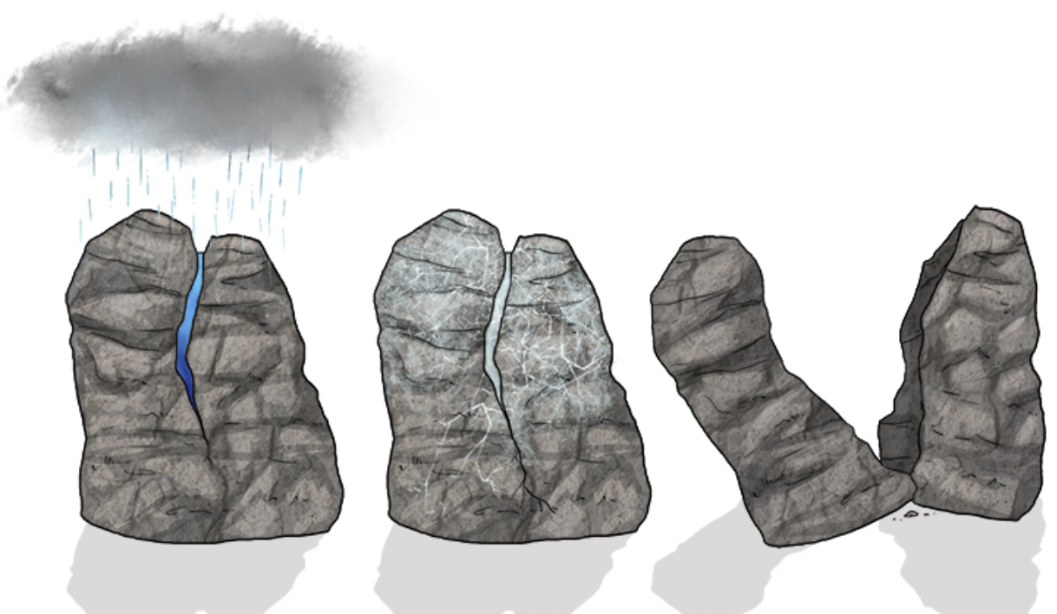
What are the three main ways weathering happens?
Notes:
What are the three main ways weathering happens?
[Mechanical, chemical, and biological]

Slide 37
True or False: Weathering is a quick process.
Notes:
True or False: Weathering is a quick process.
[False]

Slide 38
True or False: Weathering is a quick process.
Notes:
False: Weathering is a SLOW process.

Slide 39
Notes:
Now, let’s talk about some examples of rocks.

Slide 40
Freeze-Thaw Weathering is an example of weathering. Imagine a rock with cracks. Water seeps into the cracks. When it freezes, it expands, putting pressure on the rock and causing it to break.
Notes:
Freeze-Thaw Weathering is an example of weathering. Imagine a rock with cracks. Water seeps into the cracks. When it freezes, it expands, putting pressure on the rock and causing it to break.

Slide 41
Chemical Weathering with Acid is an example of weathering. Acids in rainwater can react with minerals in rocks, changing their composition.
Notes:
Chemical Weathering with Acid is an example of weathering. Acids in rainwater can react with minerals in rocks, changing their composition.

Slide 42
Notes:
Now, let’s talk about some non-examples of sedimentary rocks.

Slide 43
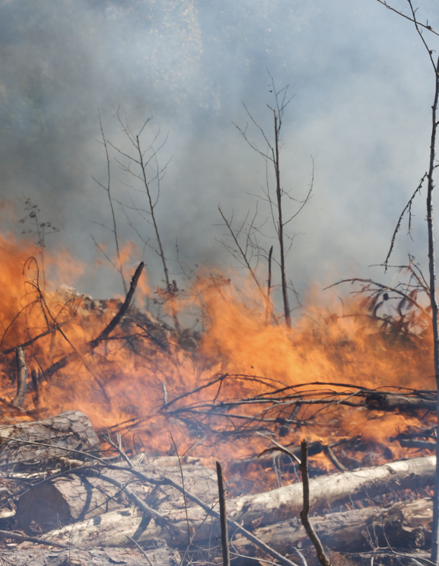
Burning wood is NOT an example of weathering. While burning wood changes its form, it's a chemical change caused by combustion, not a weathering process.
Notes:
Burning wood is NOT an example of weathering. While burning wood changes its form, it's a chemical change caused by combustion, not a weathering process.

Slide 44
Melting ice is NOT an example of weathering. Melting ice is a physical change caused by an increase in temperature, and it doesn't involve the alteration or breakdown of rocks.
Notes:
Melting ice is NOT an example of weathering. Melting ice is a physical change caused by an increase in temperature, and it doesn't involve the alteration or breakdown of rocks.

Slide 45
Notes:
Now let’s pause for a moment to check your understanding.

Slide 46
Why are burning wood and melting ice not examples of weathering?
Notes:
Why are burning wood and melting ice not examples of weathering?
[Burning wood is not an example of weathering because it is a chemical change caused by combustion, not a weathering process. Melting ice is not an example of weathering because it is a physical change caused by an increase in temperature, and it doesn't involve the alteration or breakdown of rocks.]

Slide 47
Remember!!!
Notes:
So remember!

Slide 48
Weathering: the process of breaking down rock over long periods of time
Notes:
Weathering: the process of breaking down rock over long periods of time

Slide 49
Notes:
We will now complete this concept map, called a Frayer model, to summarize and further clarify what you have learned about the term weathering.

Slide 50
Definition
Picture
Weathering
Example
How does weathering impact my life?
Notes:
To complete the Frayer model, we will choose from four choices the correct picture, definition, example, and response to the question, “How does weathering impact my life?” Select the best response for each question using the information you just learned. As we select responses, we will see how this model looks filled in for the term weathering.

Slide 51
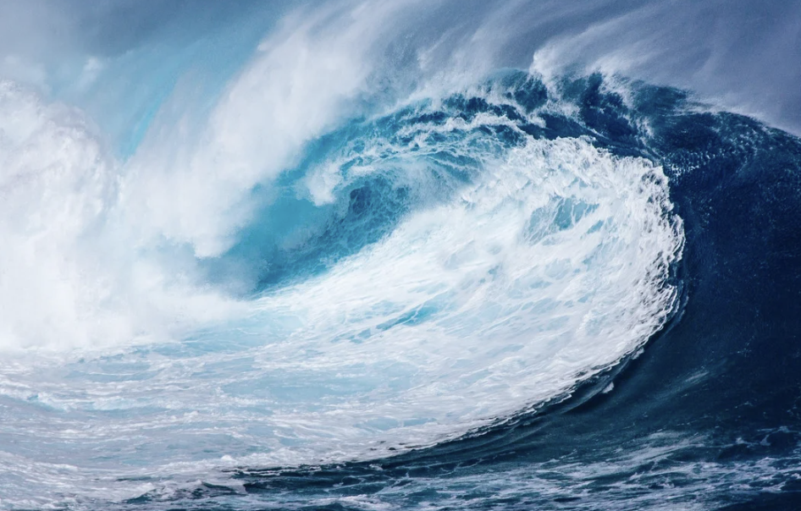
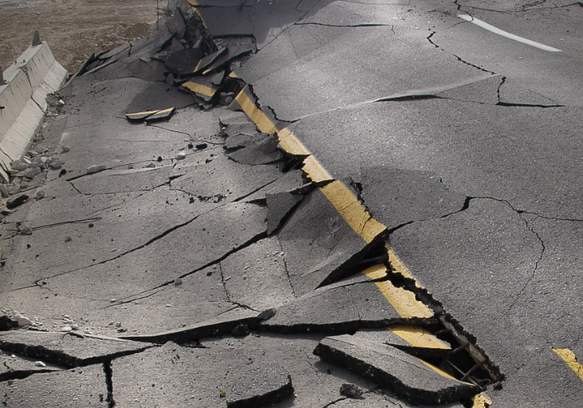
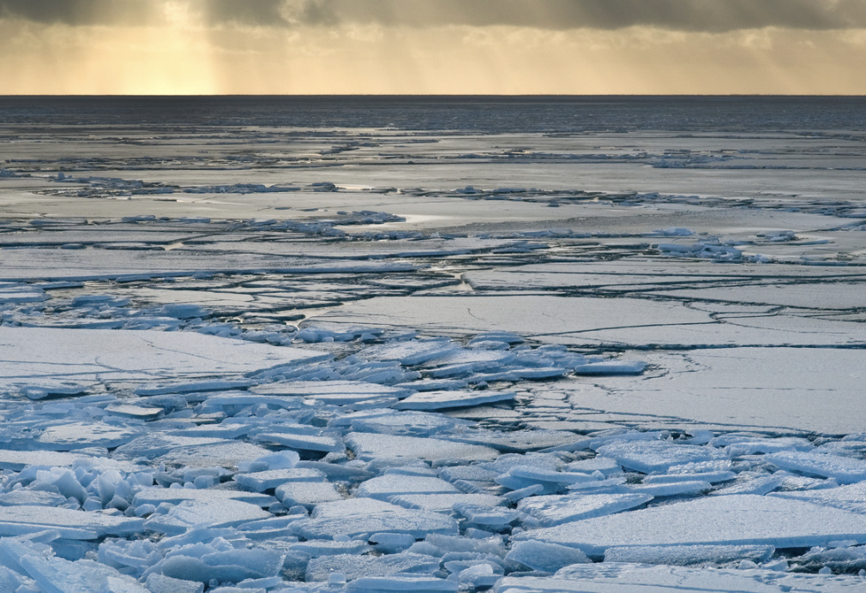
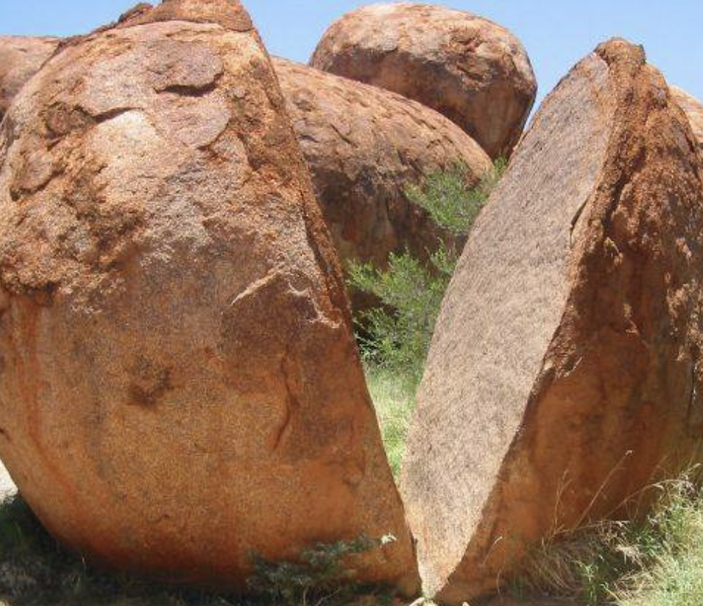
Directions: Choose the correct picture of weathering from the choices below.
A
B
C
D
Notes:
Choose the correct picture of weathering from these four choices.

Slide 52
Directions: Choose the correct picture of weathering from the choices below.
A
B
C
D
Notes:
This is the picture that shows weathering.

Slide 53
Definition
Picture
Weathering
Example
How does weathering impact my life?
Notes:
Here is the Frayer model filled in with a picture of weathering.

Slide 54
Directions: Choose the correct definition of weathering from the choices below.
A
Substances that do not come from an animal or plant, the building blocks that make up rocks
B
Earth materials (rock, soil) are worn away and moved by wind and water
C
The process of breaking down rock over long periods of time
D
The dropping of sediment to a new location
Notes:
Choose the one correct definition of weathering from these four choices.

Slide 55
Directions: Choose the correct definition of weathering from the choices below.
A
Substances that do not come from an animal or plant, the building blocks that make up rocks
B
Earth materials (rock, soil) are worn away and moved by wind and water
C
The process of breaking down rock over long periods of time
D
The dropping of sediment to a new location
Notes:
“The process of breaking down rock over long periods of time” is correct! This is the definition of weathering.

Slide 56
Definition
Picture
The process of breaking down rock over long periods of time
Weathering
Example
How does weathering impact my life?
Notes:
Here is the Frayer Model with a picture and the definition filled in for weathering: The process of breaking down rock over long periods of time

Slide 57
Directions: Choose the correct example of weathering from the choices below.
A
Acids in rainwater changing what rocks are made of
B
Volcanic Eruption
C
Landslides cause by earthquakes
D
Ice melting
Notes:
Choose the one correct example of weathering from these four choices.

Slide 58
Directions: Choose the correct example of weathering from the choices below.
A
Acids in rainwater changing what rocks are made of
B
Volcanic Eruption
C
Landslides cause by earthquakes
D
Ice melting
Notes:
“Acids in rainwater changing the composition of rocks” is correct! These are examples of weathering.

Slide 59
Definition
Picture
The process of breaking down rock over long periods of time
Weathering
Acids in rainwater changing what rocks are made of
Example
How does weathering impact my life?
Notes:
Here is the Frayer Model with a picture, definition, and an example of weathering: Acids in rainwater changing what rocks are made of.

Slide 60
Directions: Choose the correct response for “how does weathering impact my life?” from the choices below.
A
Weathering contributes to our production of renewable energy sources like wind and solar power.
B
Weathering influences our climate.
C
Weathering makes rocks change and shapes the land around us over time. It makes the world look different!
C
D
D
Weathering is glass breaking. This is used to create different art pieces that we can look at and enjoy.
Notes:
Choose the one correct response for “how does weathering impact my life?” from these four choices.

Slide 61
Directions: Choose the correct response for “how does weathering impact my life?” from the choices below.
A
Weathering contributes to our production of renewable energy sources like wind and solar power.
B
Weathering makes rocks change and shapes the land around us over time. It makes the world look different!
C
C
Weathering influences our climate.
D
D
Weathering is glass breaking. This is used to create different art pieces that we can look at and enjoy.
Notes:
“Weathering makes rocks change and shapes the land around us over time. It makes the world look different!” That is correct! This is an example of how weathering impacts our lives.

Slide 62
Definition
Picture
The process of breaking down rock over long periods of time
Weathering
Weathering makes rocks change and shapes the land around us over time. It makes the world look different!
Acids in rainwater changing what rocks are made of
Example
How does weathering impact my life?
Notes:
Here is the Frayer Model with a picture, definition, example, and a correct response to “how does deposition impact my life?”: Weathering makes rocks change and shapes the land around us over time. It makes the world look different!

Slide 63
Remember!!!
Notes:
So remember!

Slide 64
Weathering: the process of breaking down rock over long periods of time
Notes:
Weathering: the process of breaking down rock over long periods of time

Slide 65
Big Question: In what ways does weathering play a role in shaping our environment and the Earth's surface?
Notes:
Let’s reflect once more on our big question. Our “big question” is: In what ways does weathering play a role in shaping our environment and the Earth's surface?
Does anyone have any additional examples to share that haven’t been discussed yet?

Slide 66
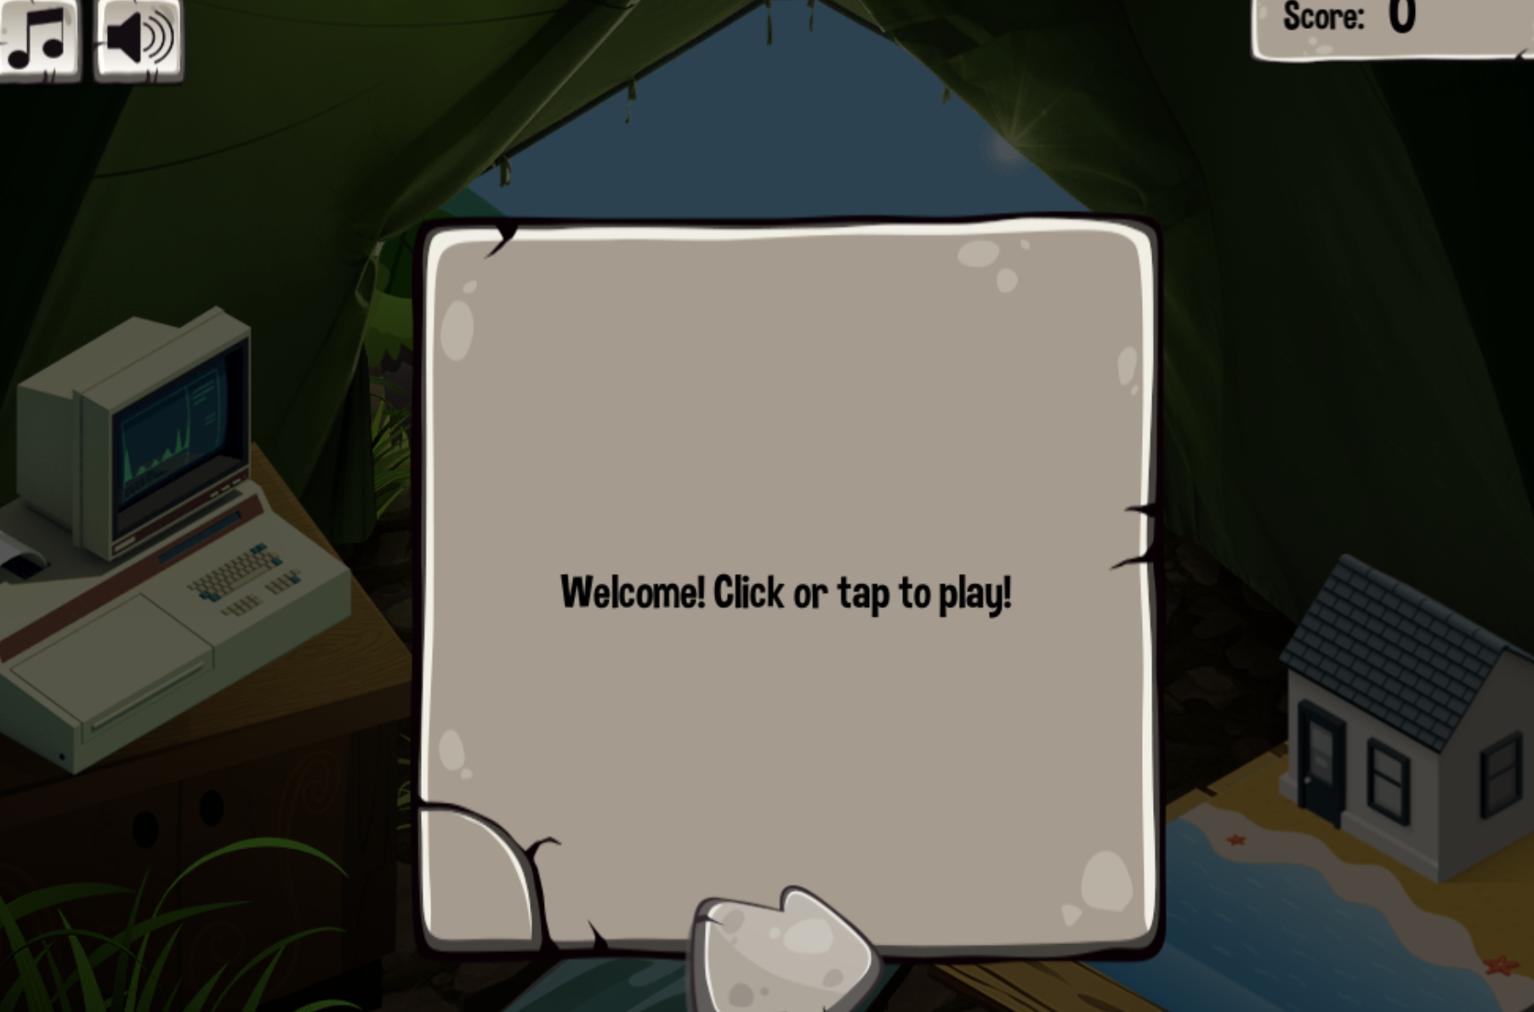
Simulation Activity
Weathering and Erosion Simulator
Click the link above for a simulation to deepen your knowledge of weathering.
Notes:
Click the link above for a simulation to deepen your understanding of weathering. In this simulation, you will meet Walter, a friendly animal who will guide you on your quest for knowledge about erosion and weathering. You will begin your journey by doing different activities to that will simulate weathering and erosion. The game continues with a variety of activities and information. At the end, you will play a bonus arcade game to award you for your good work.

Slide 67
Notes:
Thanks for watching, and please continue watching CAPs available from this website.

Slide 68
This Was Created With Resources From:
Questions or Comments
Michael Kennedy, Ph.D. MKennedy@Virginia.edu
Rachel L Kunemund, Ph.D. rk8vm@virginia.edu

