Slide 1
Intro
“Big Idea” Question
Review Concepts
Check-In Questions
Teacher Demo
Vocabulary
Student-Friendly Definition
Examples & Non-Examples
Morphological Word Parts
Simulation/Activity
Notes:
OK everyone, get ready for our next lesson. Just as a reminder, these are the different components that our lesson may include, and you’ll see these icons in the top left corner of each slide so that you can follow along more easily!

Slide 2
Weathering
Intro
Notes:
Today we are going to be learning about weathering.

Slide 3
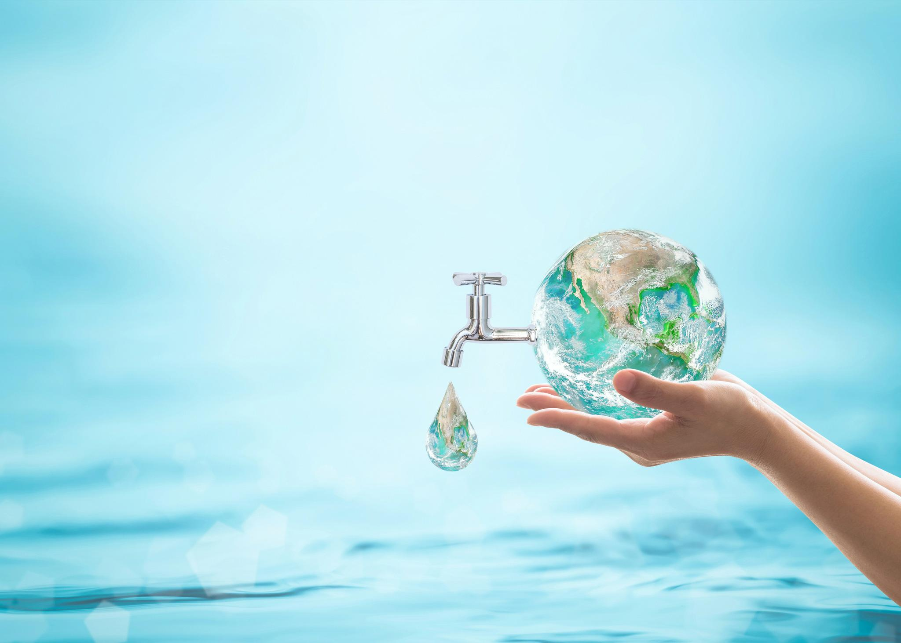
Big Question: How does water play a role in different processes on Earth? What are some examples of how you use water everyday?
Notes:
Our “big question” is: How does water play a role in different processes on Earth? What are some examples of how you use water everyday?
[Pause and illicit predictions from students.]
I love all these thoughtful scientific hypotheses! Be sure to keep this question and your predictions in mind as we move through these next few lessons, and we’ll continue to revisit it.
Feedback: Asking students to make predictions about the role that water plays in different processes on Earth as well as examples from their everyday life is a great way to activate and elicit student ideas and prior knowledge. This type of activity is evidence of the teacher planning for students’ engagement with science ideas.

Slide 4
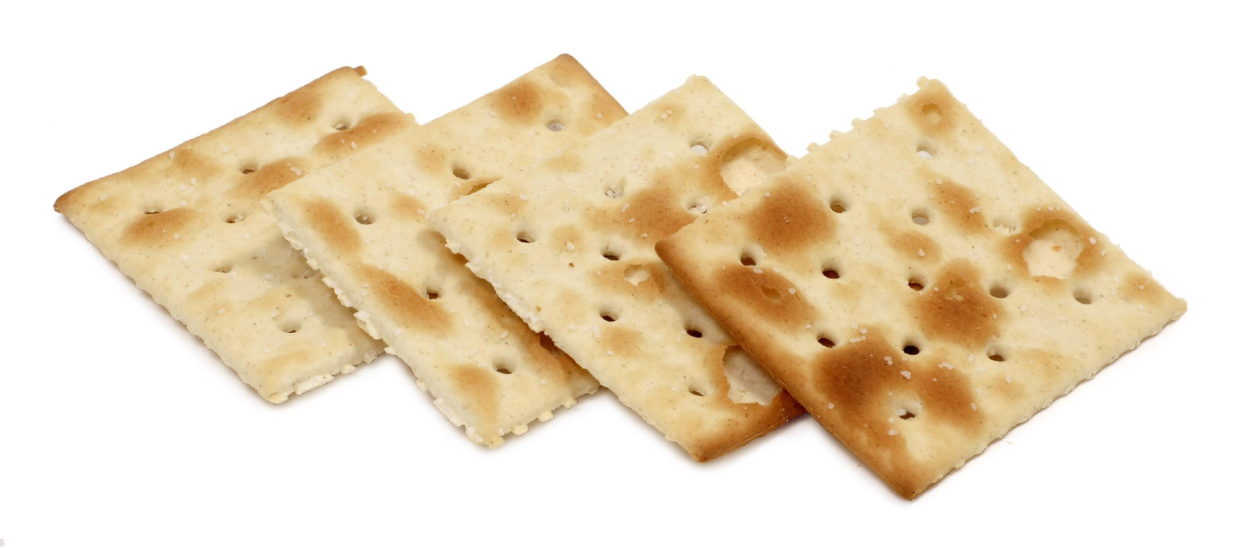
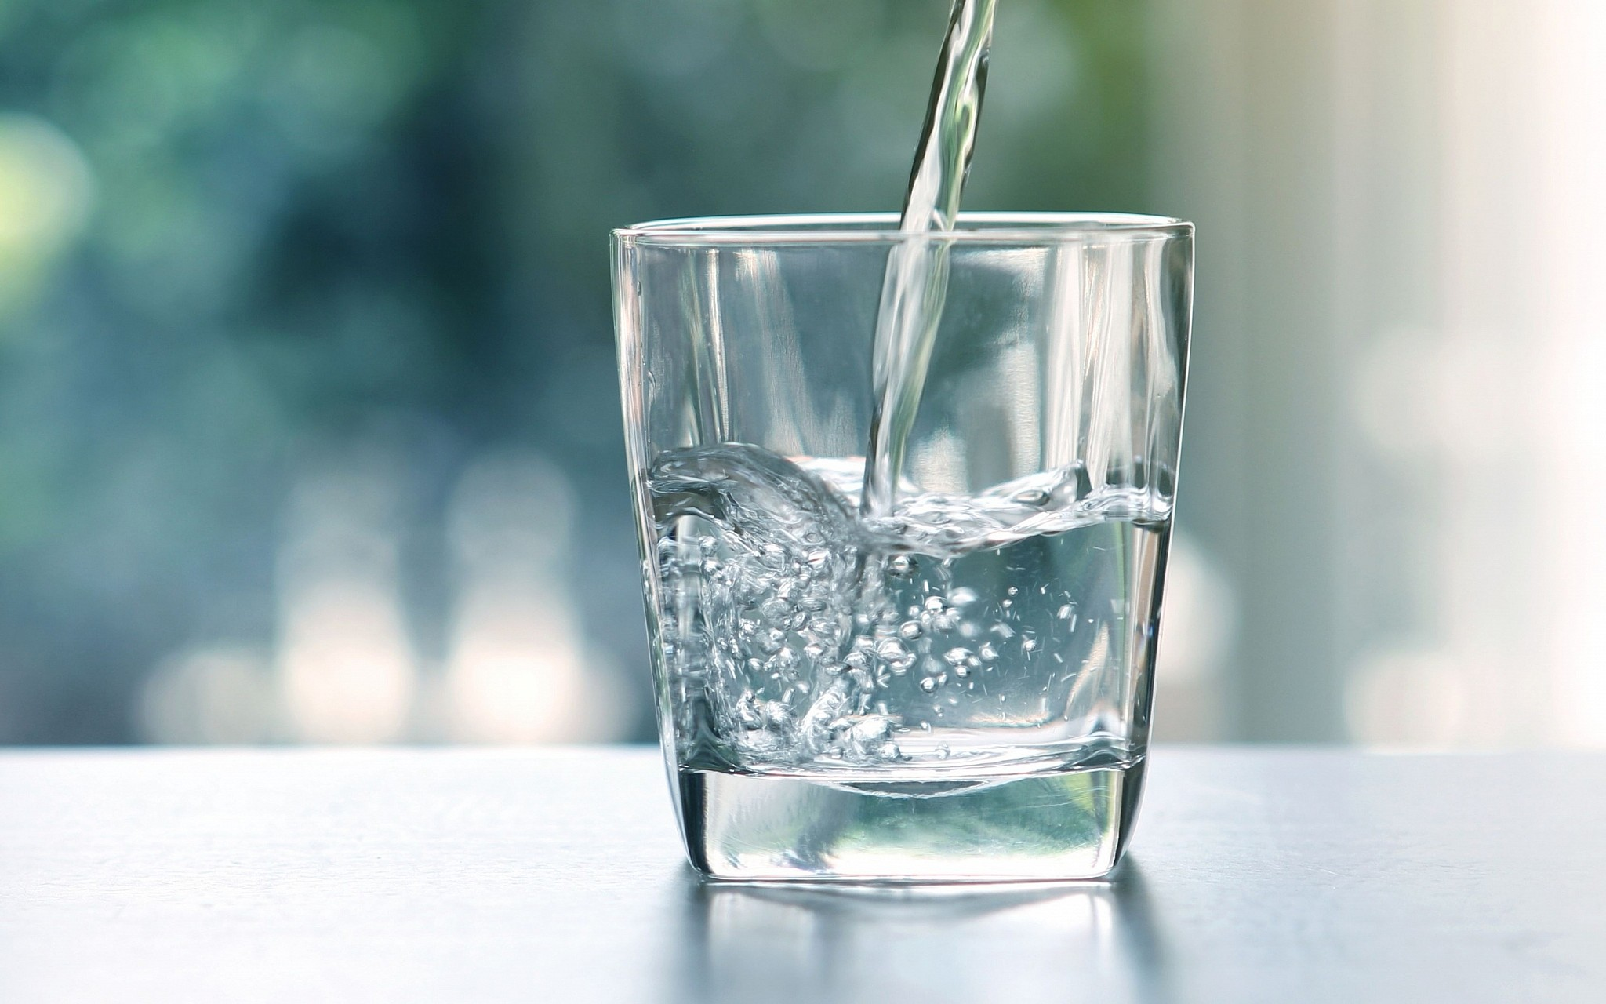
Demonstration
Materials: crackers and a clear container with water in it
Teacher Directions:
Before beginning the demonstration, remind students to pay close attention and make note of any observations they may have as you conduct the demonstration. To demonstrate physical (mechanical) weathering, use your hands to break the crackers into smaller pieces. To demonstrate chemical weathering, put the cracker pieces into the water and let them soak for a minute or so, until they become soft (think wet sand!). Engage students in a discussion around the following questions:
Explain what happened when I broke up the cracker with my hands.
This was an example of physical weathering. When the crackers went through this process, would you say that the crackers were still crackers? Why or why not?
Explain what happened when the crackers were soaked in water.
This was an example of chemical weathering. When the crackers went through this process, would you say that the crackers were still crackers? Why or why not?
How do you think this demonstration could be applied to rocks or other materials on Earth?
Notes:
Let’s do a quick demonstration that will help get our brains ready to think about weathering, and how this process relates to our big question.
Feedback: This demonstration is a great way to introduce students to an investigation. In your classroom, you may encourage students to plan and conduct this investigation more independently since a large component of inquiry-based activities is encouraging student thinking and independence. As suggested by the slide, beginning with open-ended questions, followed by providing explicit explanations, and then asking probing questions is a great way to engage students in a discussion while also providing clear explanations.

Slide 5
Notes:
Before we move on to our new vocabulary term, let’s review some other words & concepts that you already learned and make sure you are firm in your understanding.

Slide 6
Water is an important compound involved in many different Earth processes.
Notes:
Water is an extremely important compound involved in the many different Earth processes. It covers about 2/3 of the Earth’s surface.

Slide 7
Water can exist as a solid, liquid, or gas.
Notes:
Water can exist as a liquid, solid, or a gas.

Slide 8
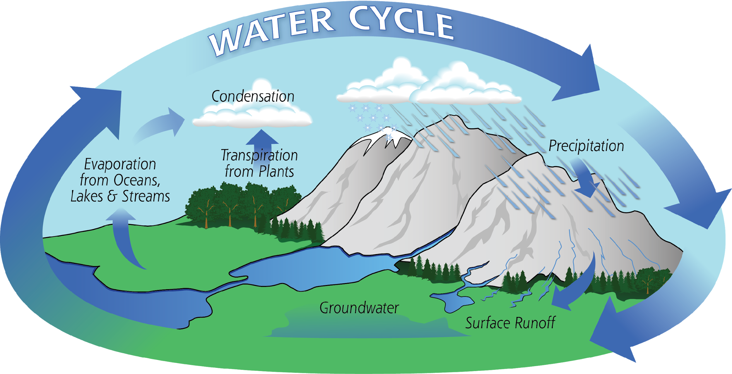
Notes:
The water cycle is a process that moves water, in its different forms, through the Earth’s surface and atmosphere.
Feedback: Including an image of this process, to accompany the student friendly language, is a great way to clearly and concisely discuss this term and help students to better grasp the content.

Slide 9
Sediment: matter that settles to the bottom of a body of water.
Notes:
Sediment is matter that settles to the bottom of a body of water. Sand is a form of sediment.

Slide 10
Notes:
Now let’s pause for a moment to check your understanding.

Slide 11
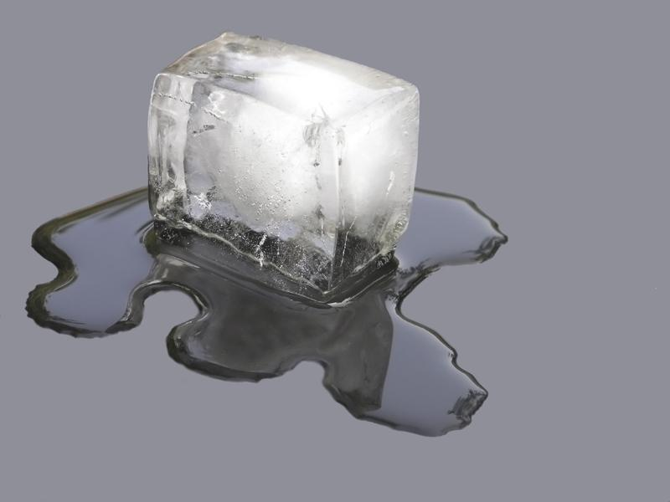
What different forms can water exist as?
Notes:
What different forms can water exist as?
[Solid, liquid, or gas]

Slide 12
Explain how water moves about the Earth to support the Earth's different processes.
Notes:
Explain how water moves about the Earth to support the Earth's’ different processes.
[Answers will vary, but students should mention the water cycle. Illicit examples of water cycle movement if not given.]
Feedback: Asking open-ended questions is a great way to gauge student understanding in depth and engage students. This gives students an opportunity to truly apply what they learned. Be sure to give feedback to validate their responses and encourage future participation.

Slide 13
What is sediment?
Notes:
Matter that settles to the bottom of a body of water.

Slide 14
Weathering
Notes:
Now, let’s define weathering.

Slide 15
Weathering: the process of breaking down rock over long periods of time
Notes:
Weathering is the process of breaking down rock over long periods of time.
Feedback: Giving explicit and clear explanations is a great way to help students to make sense of new content!

Slide 16
Notes:
That is the basic definition, but there is a bit more you need to know.

Slide 17
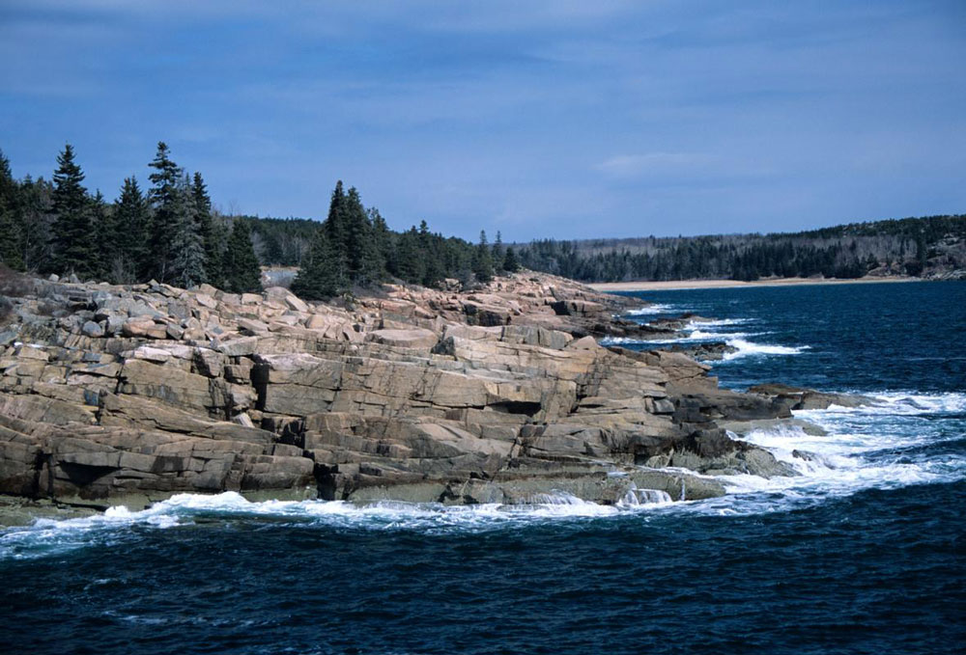
Water contributes to weathering
Notes:
Water contributes to weathering. Whether it exists as ice, rain, snow, or part of a body of water, it shapes our environment through weathering.

Slide 18
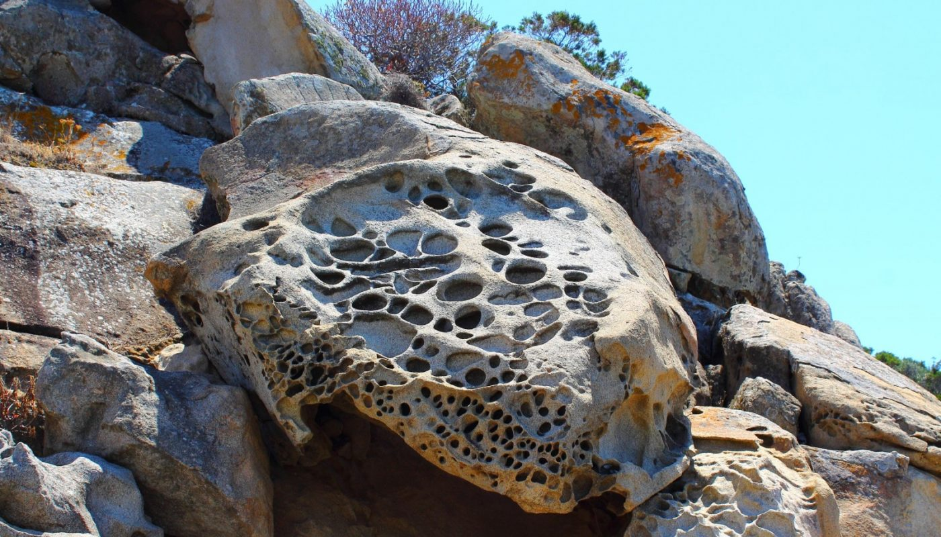
Weathering breaks down rock, but does NOT involve movement.
Notes:
Weathering breaks down rock but does NOT involve movement.

Slide 19
Weathering
Physical
(mechanical)
Chemical
Notes:
There are two different types of weathering. There is physical weathering (sometimes called mechanical weathering), and chemical weathering.

Slide 20
Weathering
Physical
(mechanical)
Chemical
Notes:
Let’s look at physical weathering first.
Feedback: Visuals like this help to cue the students to prepare for what is coming next and organize content.

Slide 21
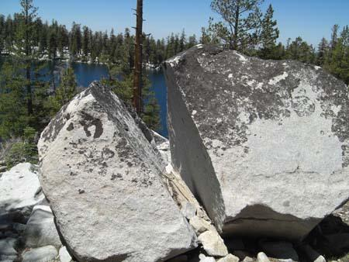
Physical weathering = rocks break down into smaller pieces
Notes:
Physical weathering happens when rocks break down into smaller pieces, such as the formation of sand on beaches. When waves crash down in the ocean, rocks at the bottom of the water get lifted up and bump into other rocks, creating sand. The main idea is that the object itself does not change, just the size. No chemical change has occurred.

Slide 22
Weathering
Physical
(mechanical)
Chemical
Notes:
Now let’s look at chemical weathering.

Slide 23
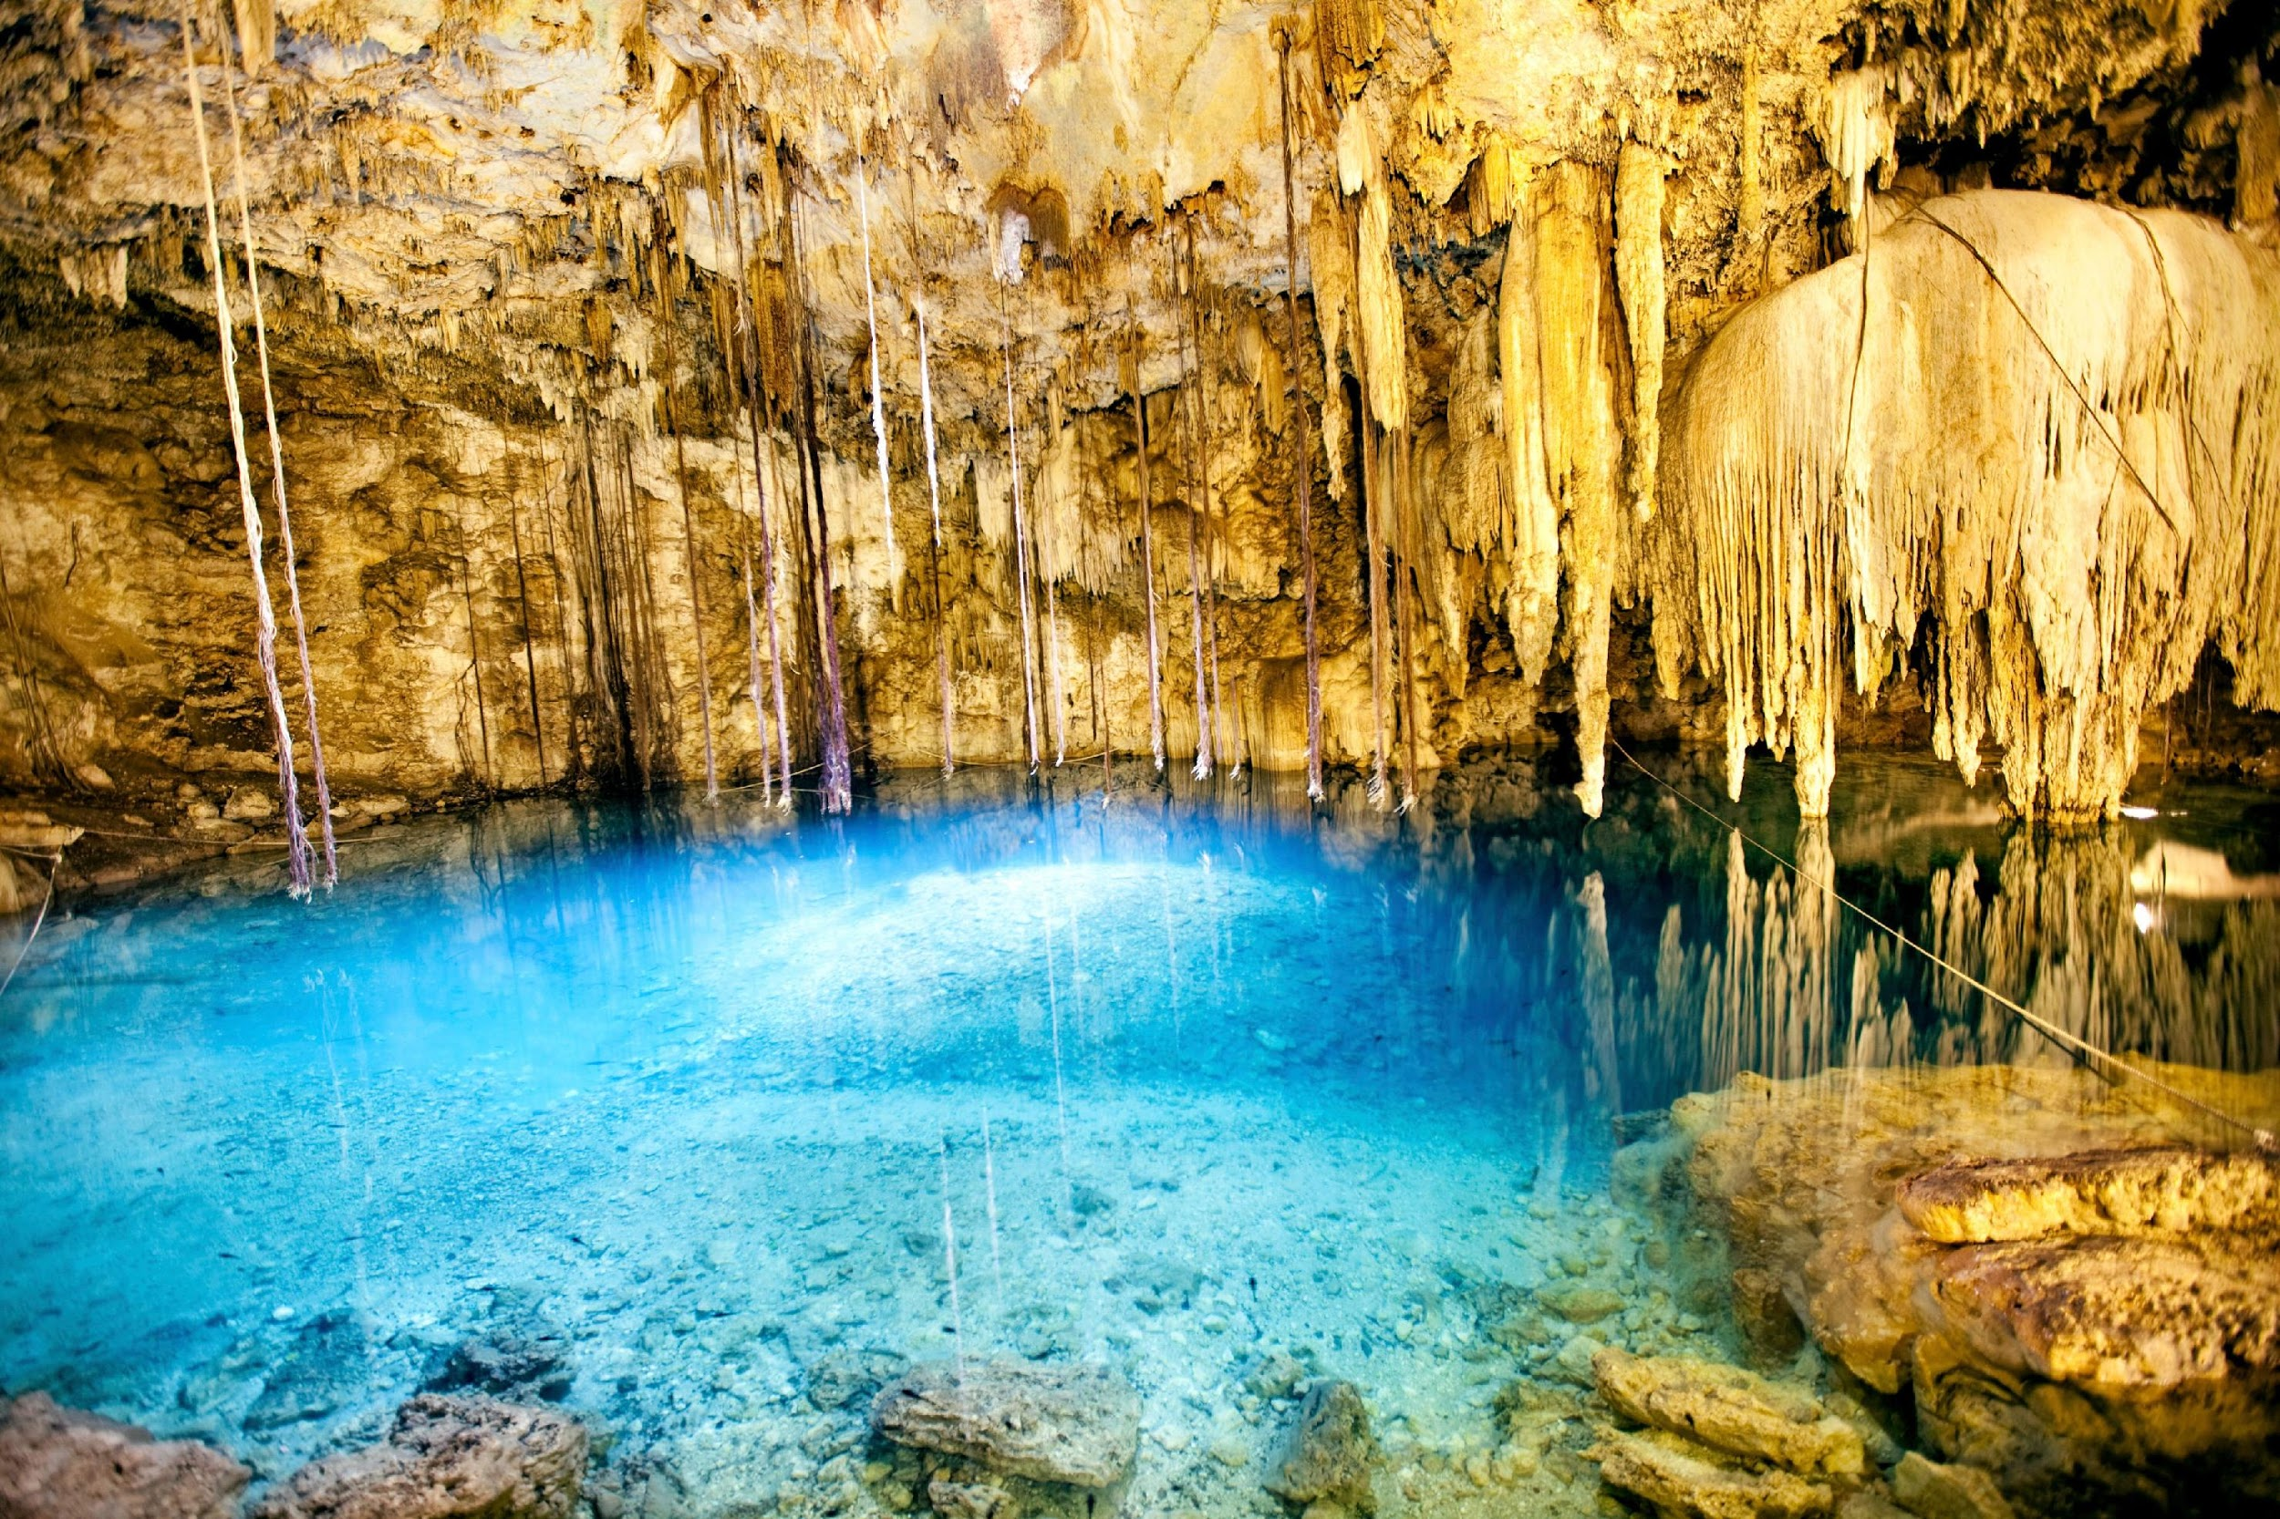
Chemical weathering = rocks break down in reaction to chemical changes
Notes:
Chemical weathering happens when rocks break down in reaction to chemical changes. When water mixes with things like acid, oxygen, and carbon, chemical weathering occurs. This is how caves are formed.

Slide 24
Notes:
Now let’s pause for a moment to check your understanding.

Slide 25
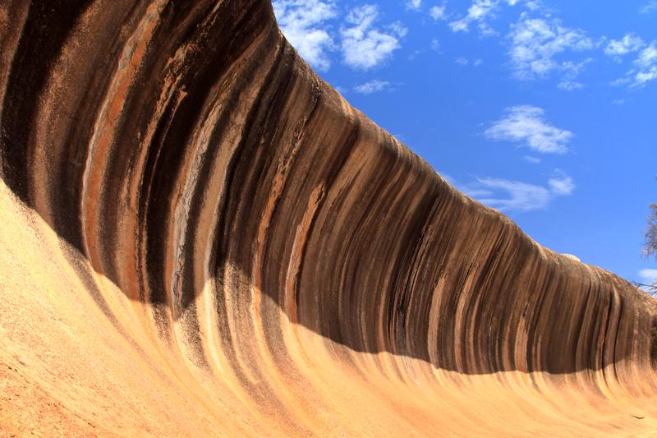
What is weathering?
Notes:
What is weathering?
[The process of breaking down rock over long periods of time.]

Slide 26
What are the two different types of weathering that occur on Earth?
Notes:
What are the two different types of weathering that occur on Earth?
[Physical weathering and chemical weathering.]

Slide 27
Describe the difference between the process of physical weathering and chemical weathering.
Notes:
Describe the difference between physical weathering and chemical weathering.
[Answers will vary, but students should mention physical weathering just breaks down rock into smaller pieces, while chemical weathering breaks down rock by chemical means (e.g., acid, oxygen, and carbon with water).]

Slide 28
Notes:
Now, let’s talk about some examples of weathering.

Slide 29
Notes:
Weathering helped form the Appalachian Mountains.

Slide 30
Notes:
Potholes in the road are also made by weathering.

Slide 31
Notes:
The Grand Canyon is another example of something that was formed by weathering.

Slide 32
Notes:
Now let’s pause for a moment to check your understanding.

Slide 33
What is one other real-world example of weathering that you can think of?
Notes:
What is one other real-world example of weathering that you can think of?
Feedback: Eliciting student ideas and helping students to make connections between new content and their knowledge of science in their everyday lives helps them to solidify their new understandings. This is also an opportunity for you to gauge their understanding and give feedback based on their ideas.

Slide 34
Notes:
Next, let’s talk about some non-examples of weathering.
Feedback: Non-examples often need some explanation to make it clear to students the difference, so in the following slides it is important to use clear and simple language!

Slide 35
Notes:
Fault lines break rock apart, but they are NOT an example of weathering. Fault lines are caused by movement in the tectonic plates under Earth’s surface that occurs from earthquakes.

Slide 36
Notes:
A forest fire is not an example of weathering.

Slide 37
Notes:
Now let’s pause for a moment to check your understanding.

Slide 38
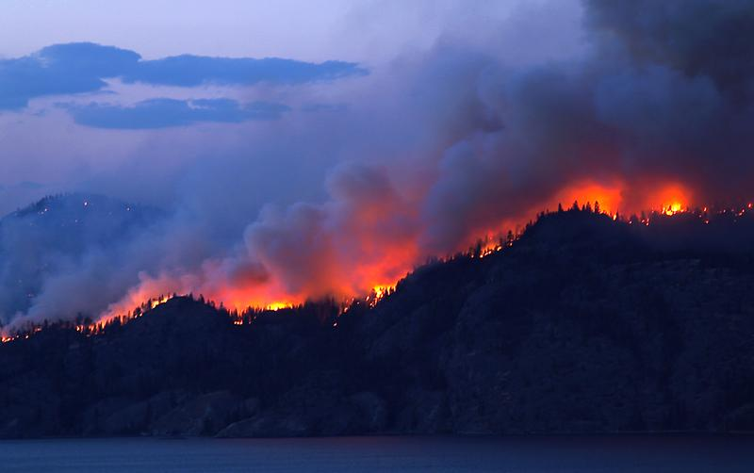
Why is a forest fire NOT an example of weathering?
Notes:
Why is a forest fire NOT an example of weathering?
[Because rocks are not being broken down by physical or chemical means.]

Slide 39
What is weathering?
Notes:
What is weathering?
[The process of breaking down rock over long periods of time.]

Slide 40
Describe the difference between the process of physical weathering and chemical weathering.
Notes:
Describe the difference between physical weathering and chemical weathering.
[Answers will vary, but students should mention physical weathering just breaks down rock into smaller pieces, while chemical weathering breaks down rock by chemical means (e.g., acid, oxygen, and carbon with water).]

Slide 41
Remember!!!
Notes:
So remember!

Slide 42
Weathering: the process of breaking down rock over long periods of time
Notes:
Weathering is the process of breaking down rock over long periods of time.

Slide 43
Weathering
Physical
(mechanical)
Chemical
Notes:
There are two different types of weathering. There is physical weathering (sometimes called mechanical weathering), and chemical weathering.

Slide 44
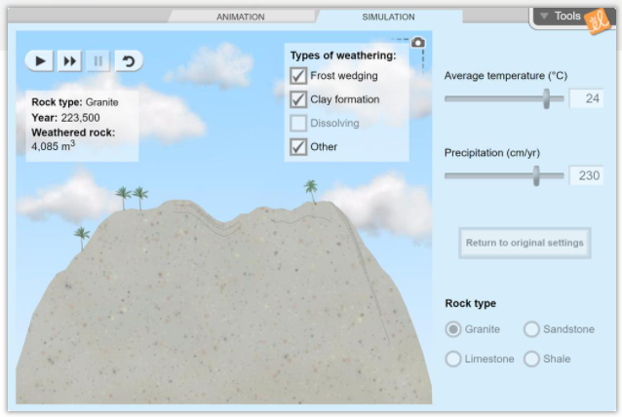
Simulation Activity
Weathering Gizmo
Click the link above to access the Gizmo simulation activity pertaining to weathering.
In this activity, you’ll learn about the different types of physical and chemical weathering, then use a simulation to model the effects of weathering on different types of rocks in varying climate conditions.
Notes:
Feedback: This slide sets a clear rationale for this activity. This simulation is important to make science thinking visible to students through models. Using the simulation to model the effects of weathering on different types of rocks in varying climate conditions with enable students to apply the model to various situations. To help students make sense of the simulation, and offer varying levels of support, you may consider adding questions for your students during the simulation.

Slide 45
Big Question: How does water play a role in different processes on Earth? What are some examples of how you use water everyday?
Notes:
Explicit cue to revisit the big question at the end of the lesson: Okay everyone. Now that we’ve learned the term, weathering, let’s reflect once more on our big question. Was there anything that we predicted earlier that was correct or incorrect? Do you have any new hypotheses to share?

Slide 46
Notes:
Thanks for watching, and please continue watching CAPs available from this website.

Slide 47
This Video Was Created With Resources From:
Questions or Comments
Michael Kennedy, Ph.D. MKennedy@Virginia.edu
Rachel L Kunemund, Ph.D. rk8vm@virginia.edu

Slide 48
Intro
“Big Idea” Question
Review Concepts
Check-In Questions
Teacher Demo
Vocabulary
Student-Friendly Definition
Examples & Non-Examples
Morphological Word Parts
Simulation/Activity
Notes:
OK everyone, get ready for our next lesson. Just as a reminder, these are the different components that our lesson may include, and you’ll see these icons in the top left corner of each slide so that you can follow along more easily!

Slide 49
Erosion
Intro
Notes:
Today we are going to learn about erosion.

Slide 50
Big Question: How does water play a role in different processes on Earth? What are some examples of how you use water everyday?
Notes:
Our “big question” is: How does water play a role in different processes on Earth? What are some examples of how you use water everyday?
[Pause and illicit predictions from students.]
I love all these thoughtful scientific hypotheses! Be sure to keep this question and your predictions in mind as we move through these next few lessons, and we’ll continue to revisit it.

Slide 51
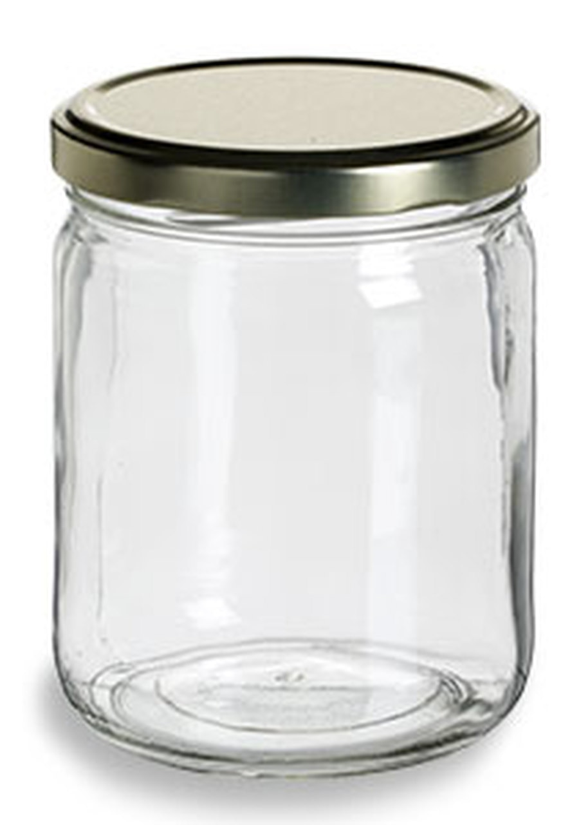
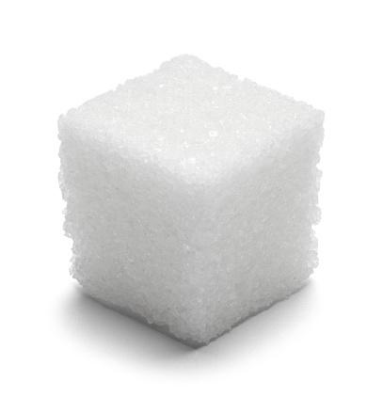
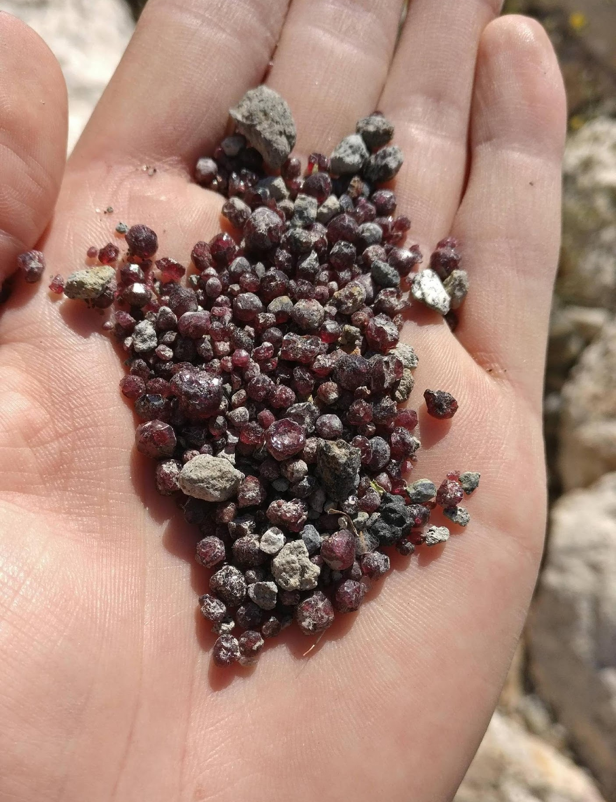
Demonstration
Materials: container with lid (and water in it!), sugar cube (1-2), and a handful of small gravel/stones
Teacher Directions:
Before beginning the demonstration, remind students to pay close attention and make note of any observations they may have as you conduct the demonstration. To model how erosion breaks down rocks when they are tumbled with sand in a body of water (e.g., ocean or river), place the sugar cube(s) and a small handful of gravel into a jar with water and close the lid. Vigorously shake the jar (~3 minutes) and engage students in a discussion around the following questions:
What happened to the sugar cubes when I shook the jar?
What happened to the gravel when I shook the jar?
Why do you think the two materials reacted differently to the jar shaking?
How would you describe water’s role in this process?
How do you think this demonstration could be applied to rocks or other materials on Earth?
Notes:
Let’s do a quick demonstration that will help get our brains ready to think about erosion, and how this process relates to our big question.
Feedback: This demonstration offers a clear and logical order of steps that help students make sense of the activity and stay engaged. Be sure to keep the students engaged throughout the demonstration, high levels of engagement are important for student understanding and participation.

Slide 52
Notes:
Before we move on to our new vocabulary term, let’s review some other words & concepts that you already learned and make sure you are firm in your understanding.
Feedback: It is important to repeat key information to draw students’ attention to key content as is done in the following slides. This helps to keep students from becoming overwhelmed.

Slide 53
Water is an important compound involved in many different Earth processes.
Notes:
Water is an extremely important compound involved in the many different Earth processes. It covers about 2/3 of the Earth’s surface.

Slide 54
Water can exist as a solid, liquid, or gas.
Notes:
Water can exist as a liquid, solid, or a gas.

Slide 55
Notes:
The water cycle is a process that moves water, in its different forms, through the Earth’s surface and atmosphere.

Slide 56
Sediment: matter that settles to the bottom of a body of water.
Notes:
Sediment is matter that settles to the bottom of a body of water. Sand is a form of sediment.

Slide 57
Weathering: the process of breaking down rock over long periods of time
Notes:
Weathering is the process of breaking down rock over long periods of time.

Slide 58
Weathering
Physical
(mechanical)
Chemical
Notes:
There are two different types of weathering. There is physical weathering (sometimes called mechanical weathering), and chemical weathering.

Slide 59
Notes:
Now let’s pause for a moment to check your understanding.

Slide 60
What different forms can water exist as?
Notes:
What different forms can water exist as?
[Solid, liquid, or gas]

Slide 61
Explain how water moves about the Earth to support the Earth’s different processes.
Notes:
Explain how water moves about the Earth to support the Earth’s different processes.
[Answers will vary, but students should mention the water cycle. Illicit examples of water cycle movement if not given.]

Slide 62
What is sediment?
Notes:
What is sediment?
[Matter that settles to the bottom of a body of water.]

Slide 63
What is weathering?
Notes:
What is weathering?
[The process of breaking down rock over long periods of time.]

Slide 64
Describe the difference between the process of physical weathering and chemical weathering.
Notes:
Describe the difference between physical weathering and chemical weathering.
[Answers will vary, but students should mention physical weathering just breaks down rock into smaller pieces, while chemical weathering breaks down rock by chemical means (e.g., acid, oxygen, and carbon with water).]

Slide 65
Erosion
Notes:
Now, let’s define erosion.

Slide 66
Erosion: Earth materials (rock, soil) are worn away and moved by wind and water
Notes:
Erosion happens when Earth materials, like rocks and soil, are worn away and moved by wind and water.

Slide 67
Notes:
Now let’s pause for a moment to check your understanding.

Slide 68
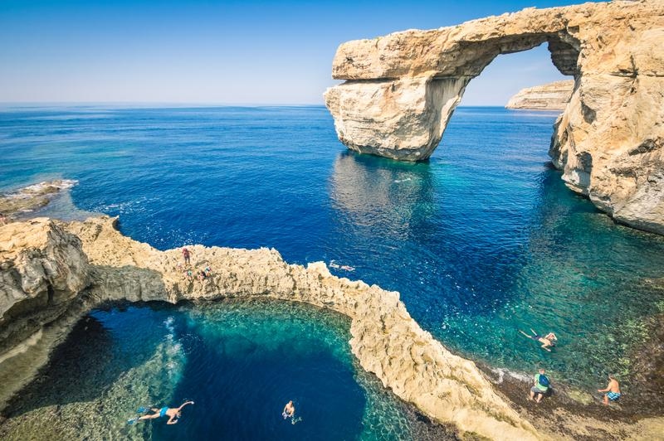
What is erosion?
Notes:
What is erosion?
[Earth materials like soil and rock are worn away and moved by wind and water.]

Slide 69
Notes:
That is the basic definition, but there is a bit more you need to know.

Slide 70
Weathering and erosion work together to shape the environment.
Notes:
Weathering and erosion work together to shape the environment.

Slide 71
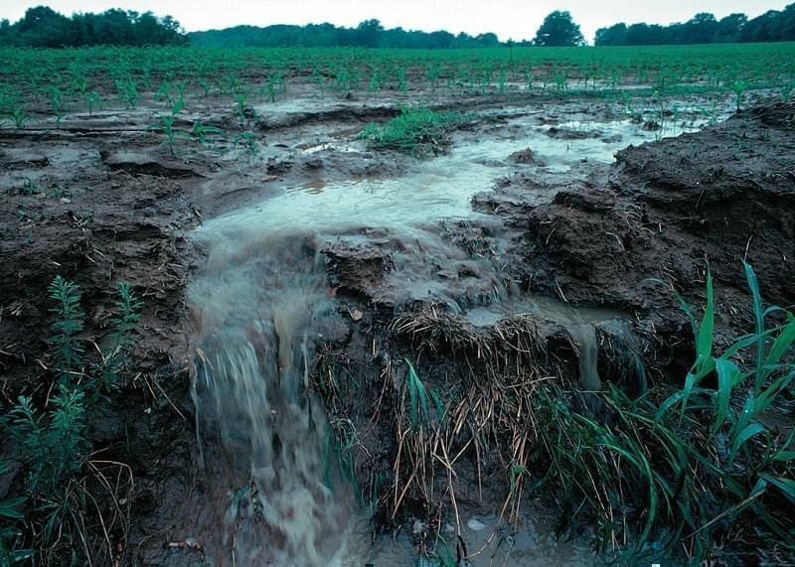
Water also contributes to erosion.
Notes:
Like weathering, water also contributes to erosion. The water rushing across the Earth’s surface breaks down soil and rock and carries it away.

Slide 72
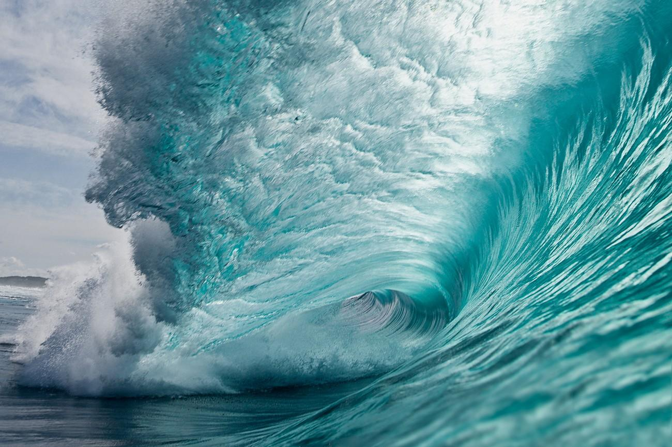
The big difference between erosion and weathering is MOVEMENT.
Notes:
The big difference between erosion and weathering is MOVEMENT.

Slide 73
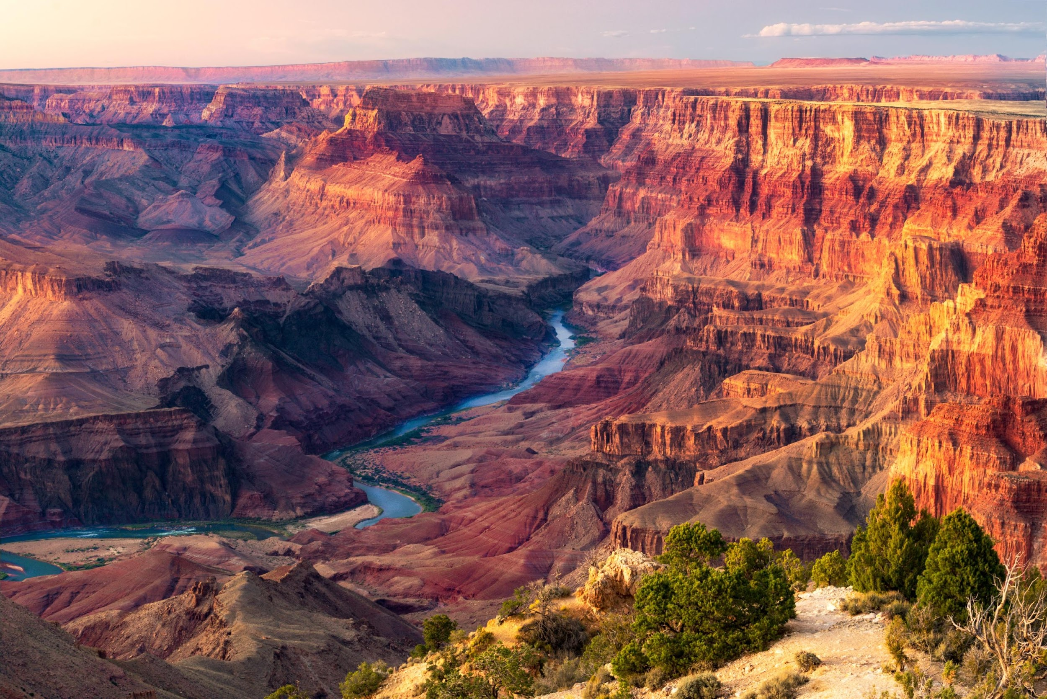
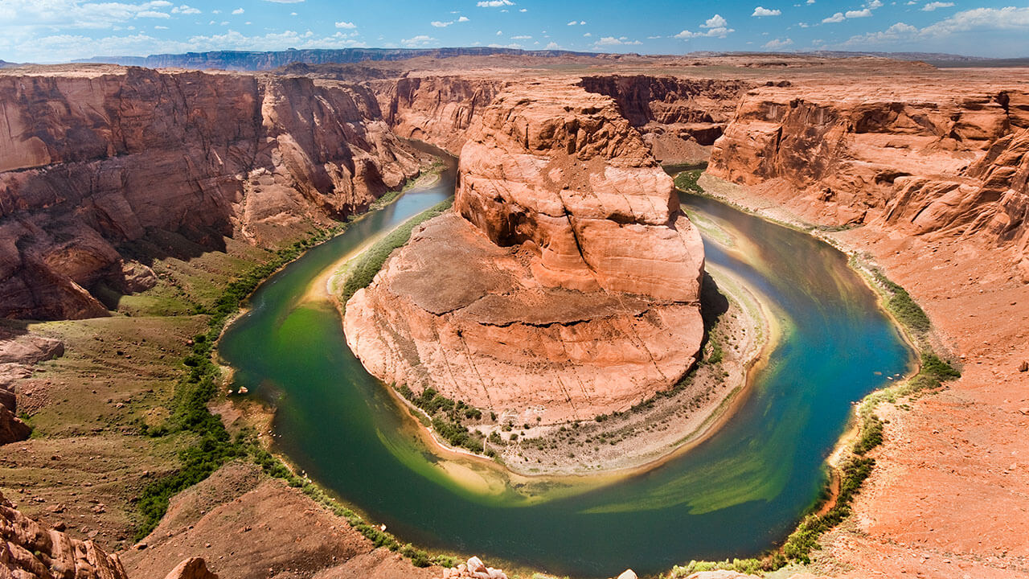
EROSION
WEATHERING
Notes:
The Grand Canyon is a good example of these two things working together. When the Colorado River is flowing through the Grand Canyon, the water carves away at the rock and takes small pieces with it. But when the water is sitting still in some area, the algae and other chemicals that have collected in the water will weather the rock.
Feedback: Using clear and concise language and providing images will help students to better grasp the concepts. In this slide, comparing the two terms directly is particularly helpful.

Slide 74
Notes:
Now let’s pause for a moment to check your understanding.

Slide 75
What is erosion?
Notes:
What is erosion?
[Earth materials like soil and rock are worn away and moved by wind and water.]

Slide 76
How do erosion and weathering work together?
EROSION
WEATHERING
Notes:
How do erosion and weathering work together?
[Answers will vary; students should mention the commonalities and differences described.]
Feedback: Asking students open-ended questions offers opportunities for students to show their depth of knowledge and build understanding together as well as enables you to offer feedback.

Slide 77
Notes:
Now, let’s talk about some examples of erosion.

Slide 78
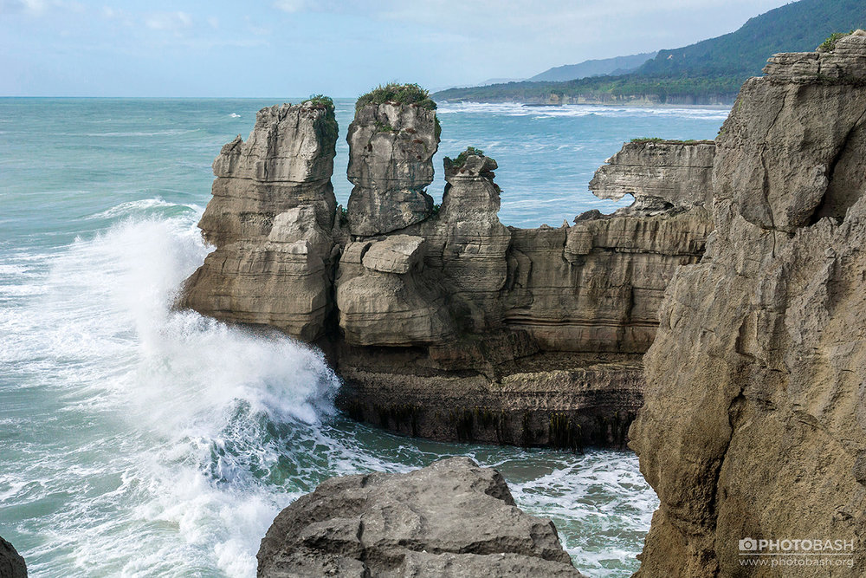
Notes:
Waves crashing against the sides of rock is one example of erosion.

Slide 79
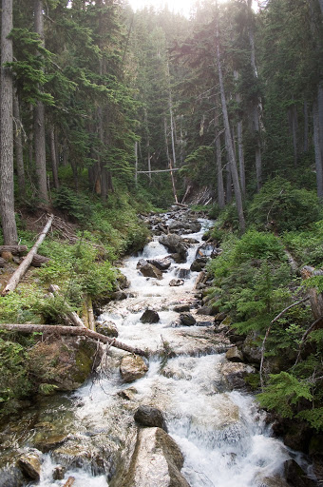
Notes:
A rushing stream in a forest is another example of erosion.

Slide 80
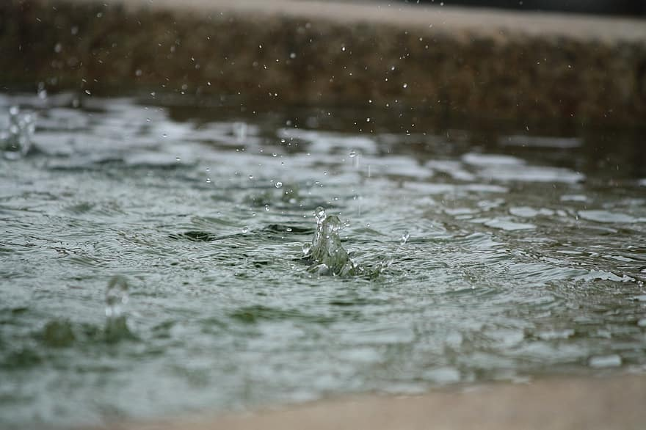
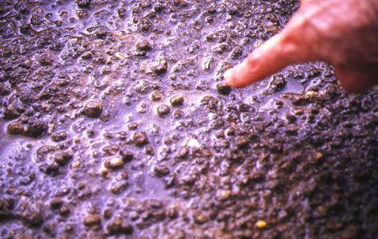
Notes:
Splashing rainfall can also cause erosion.

Slide 81
Notes:
Let’s check-in for understanding.

Slide 82
Name two other real-world examples of erosion.
Notes:
Name two other real-world examples of erosion.
[Answers will vary.]

Slide 83
Notes:
Next, let’s talk about some non-examples of erosion.

Slide 84
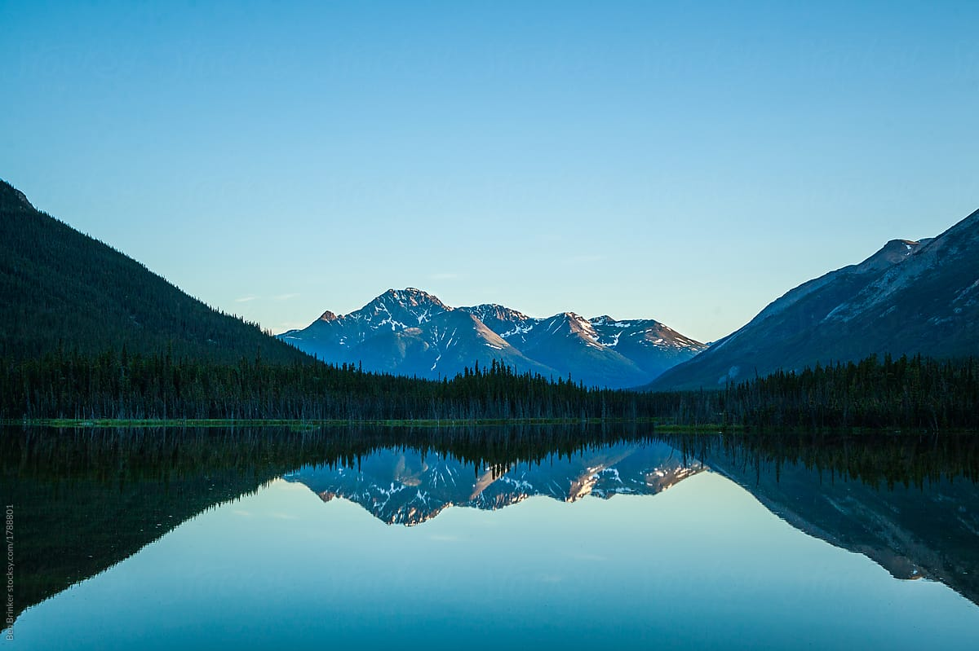
Notes:
This lake is NOT an example of erosion. Although it can weather the Earth around it, it’s not moving so it’s not eroding anything.

Slide 85
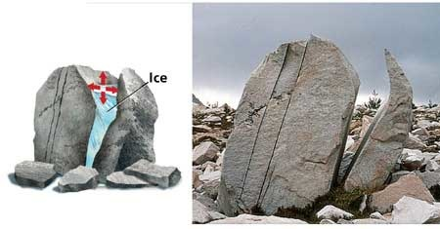
Notes:
Frost, or ice wedging is NOT an example of erosion. Water settled in a crack in the rock and when it froze, the rock cracked more. This is actually a type of weathering.

Slide 86
Notes:
Let’s check-in for understanding.

Slide 87
Why is a lake NOT an example of erosion?
Notes:
Why is a lake NOT an example of erosion?
[Although it can weather the Earth around it, it’s not moving so it’s not eroding anything.]
Feedback: In the slides above, offering examples and non-examples helps to mitigate misconceptions for students.

Slide 88
Notes:
Now, we are going to breakdown the word erosion.

Slide 89
Erosion
E -ros -ion
Notes:
The word erosion can be broken into three parts. The prefix “e”, root word “-ros”, and the suffix “-ion.”
Feedback: When breaking words down into morphological parts, the use of clear language is essential.

Slide 90
Erosion
E
Prefix “away”
Notes:
The prefix e means “away”.

Slide 91
Erosion
ros
From Latin rodere “to scrape”
Notes:
The root ros comes from the latin word rodere which means to scrape.

Slide 92
Erosion
ion
Suffix ion “the state of”; Noun form an adjective
Notes:
The suffix “ion” means “the state of”, and is used in English to form a noun from a Latin adjective in this case harere.

Slide 93
E ros ion
Erosion
To scrape away
Notes:
So, when you put it all together, you get the definition: to scrape away.

Slide 94
Notes:
Let’s check-in for understanding.

Slide 95
How can we use the word parts of erosion to help us remember the definition of the term?
Erosion
E -ros -ion
Notes:
How can we use the word parts of erosion to help us remember the definition of the term?
[The prefix e means “away”.
The root ros comes from the latin word rodere which means to scrape.
The suffix “ion” means “the state of”, and is used in English to form a noun from a Latin adjective in this case harere.
So, when you put it all together, you get the definition: to scrape away.]

Slide 96
What is erosion?
Notes:
What is erosion?
[Earth materials like soil and rock are worn away and moved by wind and water.]

Slide 97
How is erosion different from weathering?
EROSION
WEATHERING
Notes:
How is erosion different from weathering?
[Answers will vary]

Slide 98
What are some examples of erosion?
Notes:
What are some examples of erosion?
[Answers will vary.]

Slide 99
Remember!!!
Notes:
So remember!

Slide 100
Erosion: Earth materials (rock, soil) are worn away and moved by wind and water
Notes:
Erosion happens when Earth materials, like rocks and soil, are worn away and moved by wind and water.

Slide 101
Weathering and erosion work together to shape the environment.
Notes:
Weathering and erosion work together to shape the environment.

Slide 102
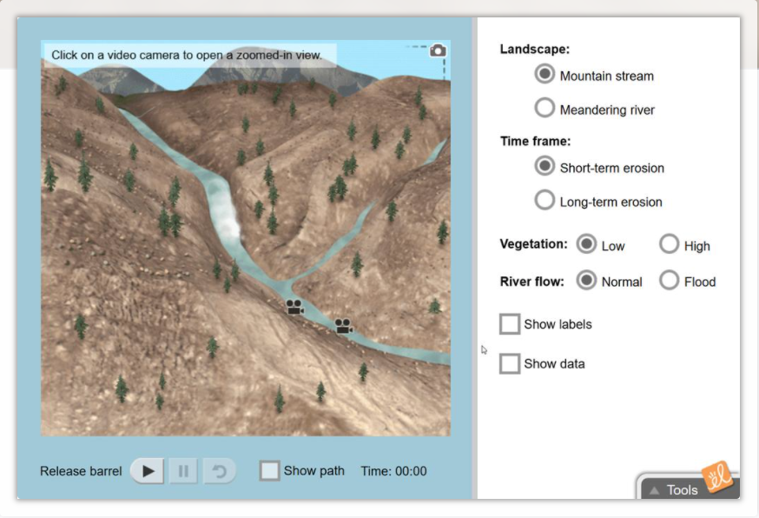
Simulation Activity
River Erosion Gizmo
Click the link above to access the Gizmo simulation activity pertaining to erosion.
In this activity, you’ll learn how river erosion affects landscapes in the short term and over long periods of time.
Notes:
Feedback: The three simulations in these slides are important to make science thinking visible through modeling. Enabling students to modify the model based on different variables (i.e., landscape, time frame, vegetation, and river flow in the river erosion gizmo) enables them to apply the model to new situations and build understandings. You may consider adding questions to the simulations which you choose to implement. To avoid burn-out, you may choose to implement one simulation here and another as a review later in your unit or give students options of simulations to complete based on their interests and as extension activities when other work is completed.

Slide 103
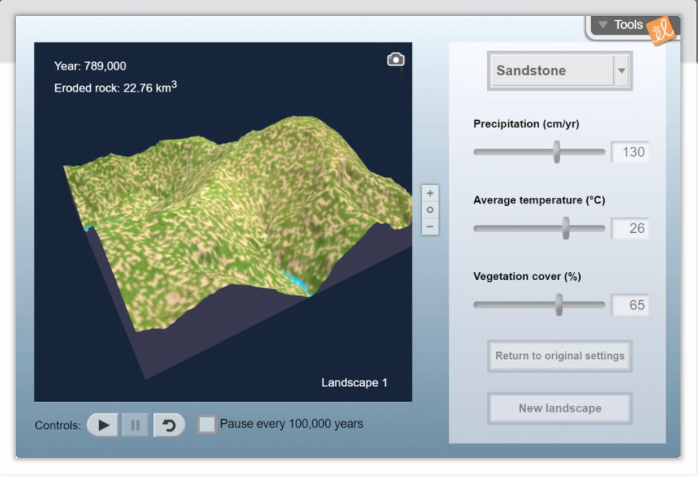
Simulation Activity
Erosion Rates Gizmo
Click the link above to access the Gizmo simulation activity pertaining to erosion.
In this activity, you’ll observe how the landscape evolves over time as it is shaped by the forces of flowing water.

Slide 104
Simulation Activity
Weathering and Erosion
Click the link above to access the interactive activity pertaining to weathering and erosion.
In this activity, you’ll learn about weathering and erosion and simulate the two processes.

Slide 105
Big Question: How does water play a role in different processes on Earth? What are some examples of how you use water everyday?
Notes:
Explicit cue to revisit the big question at the end of the lesson: Okay everyone. Now that we’ve learned the term, weathering, let’s reflect once more on our big question. Was there anything that we predicted earlier that was correct or incorrect? Do you have any new hypotheses to share?

Slide 106
Notes:
Thanks for watching, and please continue watching CAPs available from this website.

Slide 107
This Video Was Created With Resources From:
Questions or Comments
Michael Kennedy, Ph.D. MKennedy@Virginia.edu
Rachel L Kunemund, Ph.D. rk8vm@virginia.edu

Slide 108
Intro
“Big Idea” Question
Review Concepts
Check-In Questions
Teacher Demo
Vocabulary
Student-Friendly Definition
Examples & Non-Examples
Morphological Word Parts
Simulation/Activity
Notes:
OK everyone, get ready for our next lesson. Just as a reminder, these are the different components that our lesson may include, and you’ll see these icons in the top left corner of each slide so that you can follow along more easily!

Slide 109
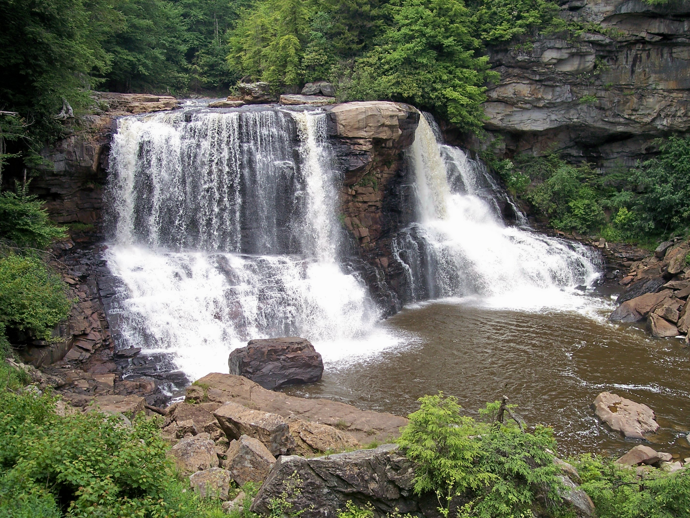
Deposition
Intro
Notes:
Today we are going to learn about deposition.

Slide 110
Big Question: How does water play a role in different processes on Earth? What are some examples of how you use water everyday?
Notes:
Our “big question” is: How does water play a role in different processes on Earth? What are some examples of how you use water everyday?
[Pause and illicit predictions from students.]
I love all these thoughtful scientific hypotheses! Be sure to keep this question and your predictions in mind as we move through these next few lessons, and we’ll continue to revisit it.
Feedback: These questions help the teacher to activate prior knowledge and support students to make connections between real-life situations and the new concepts that they are learning.

Slide 111
Demonstration
Deposition Demonstration
Materials: sheet pan, damp sand, straw, ice cubes, watering can, pitcher of water
Teacher Directions:
Either play the video above or perform the demonstration in class. Before beginning the demonstration, remind students what they have learned about weathering and erosion. Remind students to pay close attention and make note of any observations they may have as you conduct the demonstration. During and after the demonstration, engage students in a discussion around the following questions:
What is at the bottom of the tray after water is poured on the sand?
What is the outcome of wind blowing on the sand?
How do rain affect weathering, erosion, and deposition?
How would you describe water’s role in this process?
How do you think this demonstration could be applied to rocks or other materials on Earth?
Notes:
Let’s do a quick demonstration that will help get our brains ready to think about deposition and how this process relates to our big question.
Feedback: During demonstrations such as this, it is important to consistently confirm students’ understanding such as with the questions listed in the slides. This helps to keep students engaged as well as helps you to determine if anyone needs any extra explanation.

Slide 112
Notes:
Before we move on to our new vocabulary term, let’s review some other words & concepts that you already learned and make sure you are firm in your understanding.
Feedback: When reviewing previously learned material, it is important to monitor understanding before moving on to new material. This is a great opportunity to provide opportunities for students to respond and engage with the content by calling on students and encouraging their participation.

Slide 113
Water is an important compound involved in many different Earth processes.
Notes:
Water is an extremely important compound involved in the many different Earth processes. It covers about 2/3 of the Earth’s surface.

Slide 114
Water can exist as a solid, liquid, or gas.
Notes:
Water can exist as a liquid, solid, or a gas.

Slide 115
Notes:
The water cycle is a process that moves water, in its different forms, through the Earth’s surface and atmosphere.

Slide 116
Sediment is matter that settles to the bottom of a body of water.
Notes:
Sediment is matter that settles to the bottom of a body of water. Sand is a form of sediment.

Slide 117
Weathering: the process of breaking down rock over long periods of time
Notes:
Weathering is the process of breaking down rock over long periods of time.

Slide 118
Weathering
Physical
(mechanical)
Chemical
Notes:
There are two different types of weathering. There is physical weathering (sometimes called mechanical weathering), and chemical weathering.

Slide 119
Erosion: Earth materials (rock, soil) are worn away and moved by wind and water
Notes:
Erosion happens when Earth materials, like rocks and soil, are worn away and moved by wind and water.

Slide 120
Notes:
Now let’s pause for a moment to check your understanding.

Slide 121
What different forms can water exist as?
Notes:
What different forms can water exist as?
[Solid, liquid, or gas]

Slide 122
Explain how water moves about the Earth to support the Earth’s different processes.
Notes:
Explain how water moves about the Earth to support the Earth’s different processes.
[Answers will vary, but students should mention the water cycle. Illicit examples of water cycle movement if not given.]

Slide 123
What is sediment?
Notes:
What is sediment?
[Matter that settles to the bottom of a body of water.]

Slide 124
What is weathering?
Notes:
What is weathering?
[The process of breaking down rock over long periods of time.]

Slide 125
Describe the difference between the process of physical weathering and chemical weathering.
Notes:
Describe the difference between physical weathering and chemical weathering.
[Answers will vary, but students should mention physical weathering just breaks down rock into smaller pieces, while chemical weathering breaks down rock by chemical means (e.g., acid, oxygen, and carbon with water).]

Slide 126
What is erosion?
Notes:
What is erosion?
[Erosion happens when Earth materials, like rocks and soil, are worn away and moved by wind and water.]

Slide 127
Deposition
Notes:
Now, let’s define deposition.

Slide 128
Deposition: dropping of sediment to a new location
Notes:
Deposition is the dropping of sediment to a new location.
Feedback: Using clear language during the definition will help to mitigate student confusion.

Slide 129
Notes:
Now let’s pause for a moment to check your understanding.

Slide 130
What is deposition?
Notes:
What is deposition?
[Deposition is the dropping of sediment to a new location.]

Slide 131
Notes:
That is the basic definition, but there is a bit more you need to know.

Slide 132
Weathering, erosion, AND deposition work together to shape the environment.
Notes:
Weathering, erosion, AND deposition work together to shape the environment. Sediment is created through weathering, carried away through erosion, and brought to a new location by deposition.
*Weathering breaks the sediment, erosion takes the sediment, and deposition drops the sediment in a new place.*

Slide 133
Water also contributes to deposition.
Notes:
Like weathering and erosion, water also contributes to deposition. The water rushing across the Earth’s surface carries sediment and drops it in a new location.

Slide 134
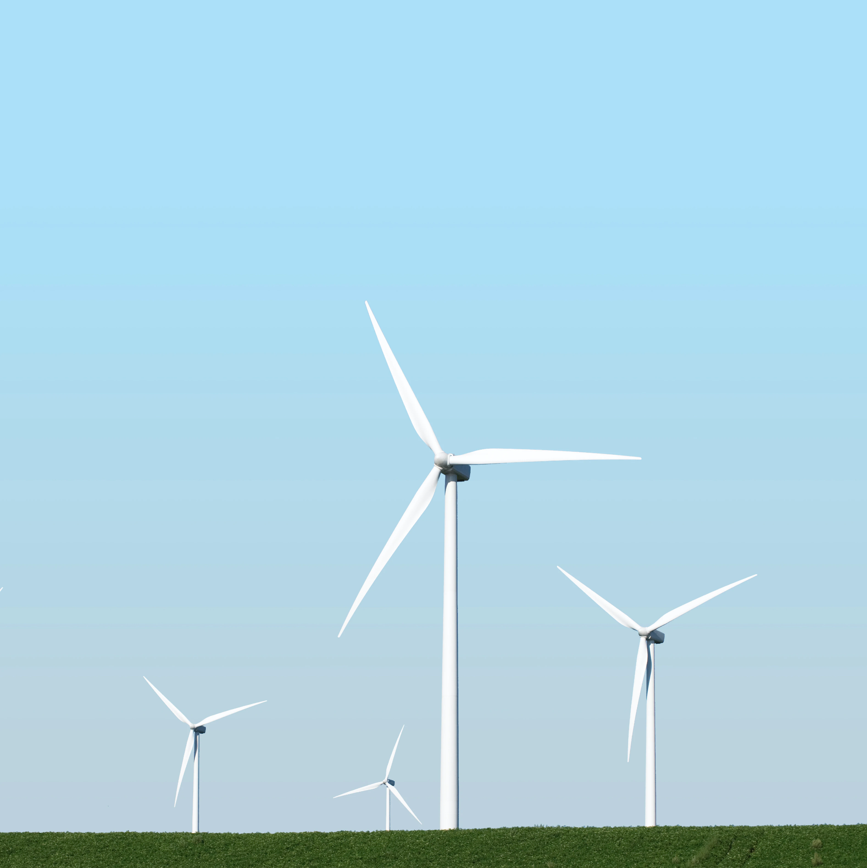
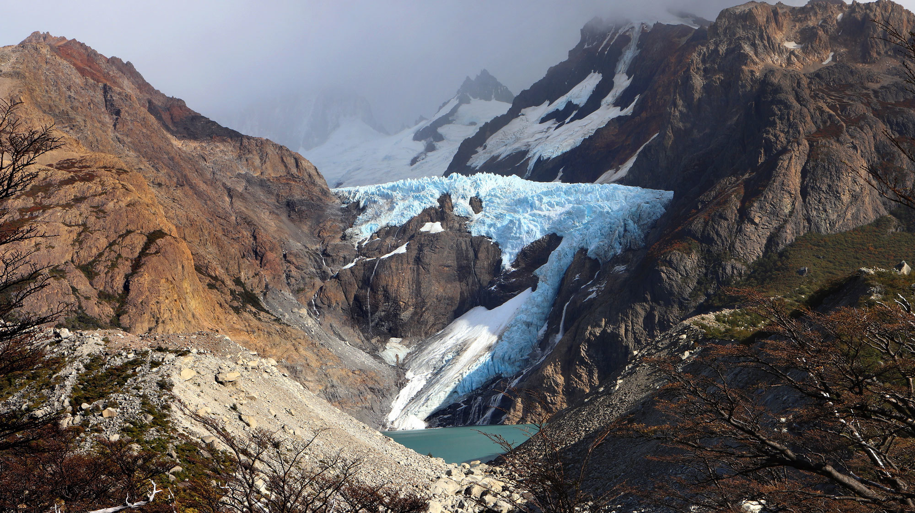
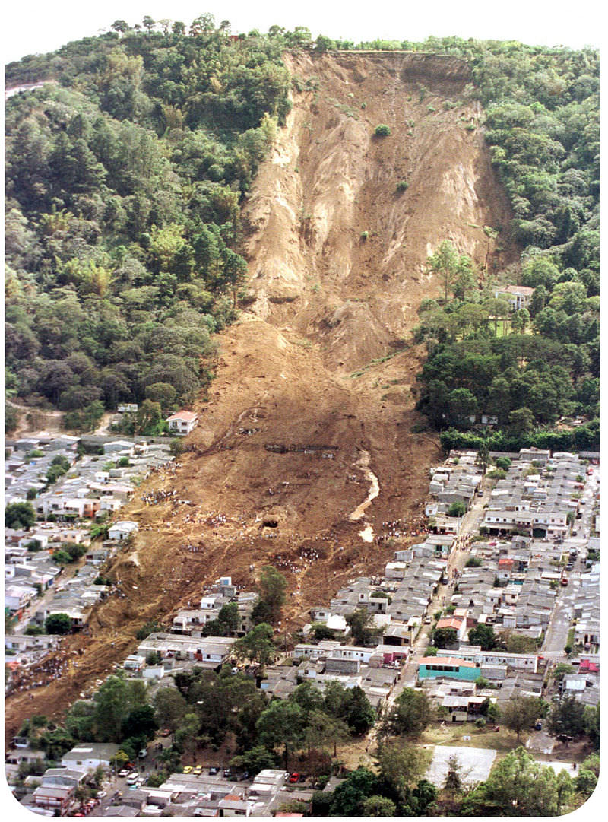
Deposition occurs by wind, water, ice, or gravity.
Notes:
In the process of deposition, sediment is carried to new locations by wind, water, ice, or gravity.

Slide 135
Notes:
Now let’s pause for a moment to check your understanding.

Slide 136
What is deposition?
Notes:
What is deposition?
[Deposition is the dropping of sediment to a new location.]

Slide 137
How do weathering, erosion, and deposition all work together?
WEATHERING
DEPOSITION
EROSION
Notes:
How do weathering, erosion, and deposition all work together?
[Answers will vary; students should mention the commonalities and differences described.]
Feedback: It is important when planning questions for students to also consider non-normative, partially normative, and normative answers. What do you expect or hope students to answer? What are common misunderstandings that you can already plan responses to? This planning will help you to lighten your own cognitive load during discussions and be able to more effectively respond to atypical student ideas.

Slide 138
What four methods can cause deposition?
Notes:
What four methods can cause deposition?
[Wind, water, ice, and gravity]

Slide 139
Notes:
Now, let’s talk about some examples of deposition.

Slide 140
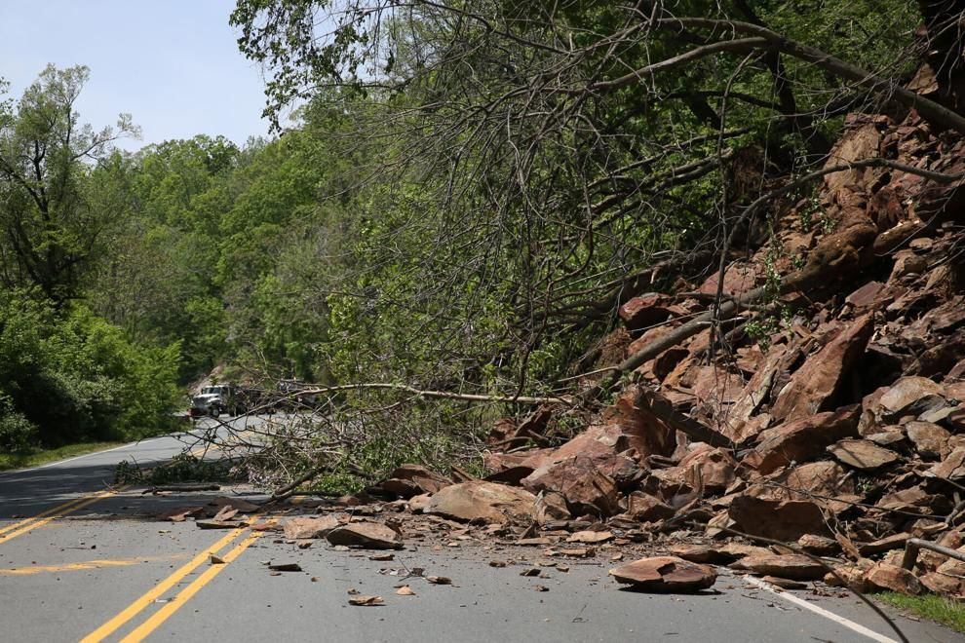
Notes:
Rock slides are one example of deposition. During a rock slide, gravity causes rocks and sediment to fall to a new location.

Slide 141
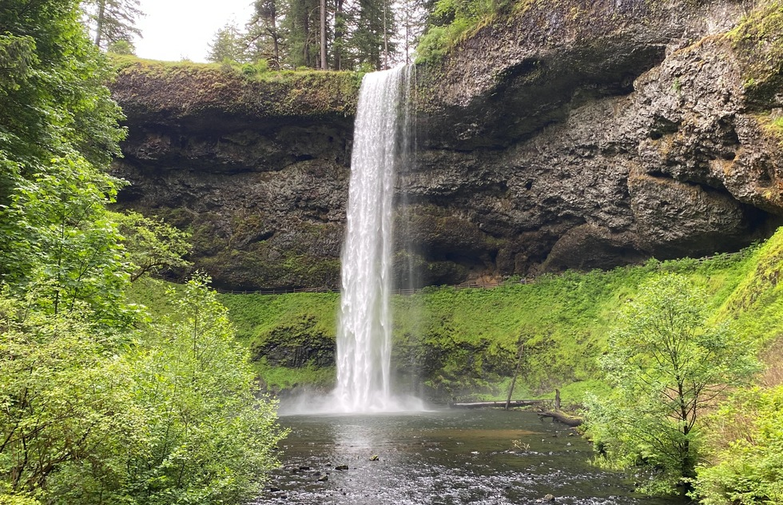
Notes:
Waterfalls can carry sediment from one location to another. Sediment dropped at the bottom of a waterfall demonstrates deposition.

Slide 142
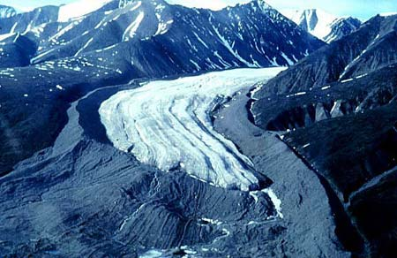
Notes:
As glaciers move, the carry sediment along the way thereby dropping it in new locations. Glaciers can cause deposition.

Slide 143
Notes:
Let’s check-in for understanding.

Slide 144
Name two other real-world examples of deposition.
Notes:
Name two other real-world examples of deposition.
[Answers will vary.]

Slide 145
Notes:
Next, let’s talk about some non-examples of deposition.

Slide 146
Notes:
This river in the Grand Canyon is NOT an example of deposition. The river is still and so is weathering the Earth around it. The river is not moving so it is not carrying sediment and dropping it in a new location.
Feedback: One important component of using non-examples is clearly distinguishing similarities and differences to explain why it is a non-example. Including images as part of your non-example helps students to recognize these similarities and differences.

Slide 147
Notes:
Splashing rainfall is NOT an example of deposition. Splashing rainfall wears away at the sediment on the ground. Deposition is the process of dropping sediment in a new location.

Slide 148
Notes:
Let’s check-in for understanding.

Slide 149
Why is this river in the Grand Canyon NOT an example of deposition?
Notes:
Why is this river in the Grand Canyon NOT an example of deposition?
[The river is not moving so it is not carrying sediment and dropping it in a new location.]

Slide 150
Notes:
Now, we are going to breakdown the word deposition.

Slide 151
Deposition
Deposit -ion
Notes:
The word deposition can be broken into three parts. The root word “deposit” and the suffix “-ion.”

Slide 152
Deposition
Deposit
From Latin deponere “to lay aside”
Notes:
The root deposit comes from the latin word deponere which means to lay aside.

Slide 153
Deposition
ion
Suffix ion “the state of”; Noun form an adjective
Notes:
The suffix “ion” means “the state of”, and is used in English to form a noun from a Latin adjective in this case harere.

Slide 154
Deposit ion
Deposition
To lay aside
Notes:
So, when you put it all together, you get the definition: to lay aside.
Feedback: Breaking down words into morphological parts and then reuniting the word parts are crucial steps to help students understand each individual word part and the whole picture, as shown in this slide and the slides above.

Slide 155
Notes:
Let’s check-in for understanding.

Slide 156
How do the word parts of deposition help us remember the definition of the term?
Deposition
Deposit -ion
Notes:
How do the word parts of deposition help us remember the definition of the term?
[The root deposit comes from the latin word deponere which means to lay aside.
The suffix “ion” means “the state of”, and is used in English to form a noun from a Latin adjective in this case harere.
So, when you put it all together, you get the definition: to lay aside.]

Slide 157
What is deposition?
Notes:
What is deposition?
[Deposition is the dropping of sediment to a new location.]

Slide 158
How do weathering, erosion, and deposition all work together?
WEATHERING
DEPOSITION
EROSION
Notes:
How do weathering, erosion, and deposition all work together?
[Answers will vary; students should mention the commonalities and differences described.]

Slide 159
What are some examples of deposition?
Notes:
What are some examples of deposition?
[Answers will vary.]

Slide 160
Remember!!!
Notes:
So remember!

Slide 161
Deposition: dropping of sediment to a new location
Notes:
Deposition is the dropping of sediment to a new location.

Slide 162
Weathering, erosion, AND deposition work together to shape the environment.
Notes:
Weathering, erosion, AND deposition work together to shape the environment. Sediment is created through weathering, carried away through erosion, and brought to a new location by deposition.
*Weathering breaks the sediment, erosion takes the sediment, and deposition drops the sediment in a new place.*

Slide 163
Big Question: How does water play a role in different processes on Earth? What are some examples of how you use water everyday?
Notes:
Explicit cue to revisit the big question at the end of the lesson: Okay everyone. Now that we’ve learned the term, weathering, let’s reflect once more on our big question. Was there anything that we predicted earlier that was correct or incorrect? Do you have any new hypotheses to share?
Feedback: Offering students an opportunity to evaluate their earlier hypotheses and make changes based on their new understandings is an important part of the iterative process in science. This is a great opportunity to help students build an epistemic understanding by explicitly stating how continuing to change and build on hypotheses as your knowledge grows is an important part of the discipline of science!

Slide 164
Notes:
Thanks for watching, and please continue watching CAPs available from this website.

Slide 165
This Video Was Created With Resources From:
Questions or Comments
Michael Kennedy, Ph.D. MKennedy@Virginia.edu
Rachel L Kunemund, Ph.D. rk8vm@virginia.edu

