Slide 1
Intro
“Big Idea” Question
Review Concepts
Check-In Questions
Teacher Engagement
Vocabulary
Student-Friendly Definition
Examples & Non-Examples
Morphological Word Parts
Frayer Model
Simulation/Activity
Notes:
OK everyone, get ready for our next lesson. Just as a reminder, these are the different components that our lesson may include, and you’ll see these icons in the top left corner of each slide so that you can follow along more easily!

Slide 2
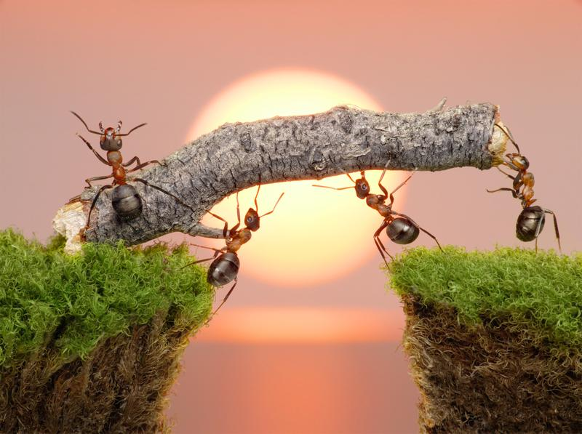
Work
Intro
Notes:
Today, we’ll be learning about the word: Work.

Slide 3
Big Question: How does energy create work?
Notes:
Our “big question” is: How does energy create work?
[Pause and illicit predictions from students.]
I love all these thoughtful scientific hypotheses! Be sure to keep this question and your predictions in mind as we move through these next few lessons, and we’ll continue to revisit it.

Slide 4
Notes:
Before we move on to our new topic, let’s review some other words & concepts that you already learned and make sure you are firm in your understanding.

Slide 5
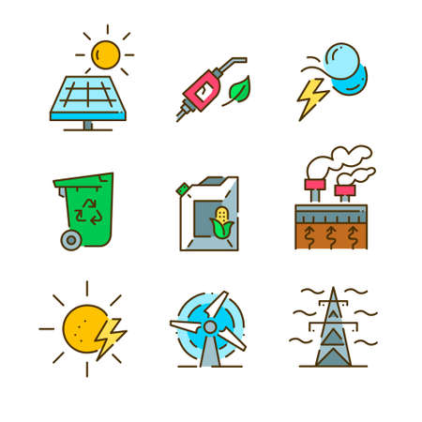
Energy: the ability to cause change
Notes:
Energy is the ability to cause change.

Slide 6
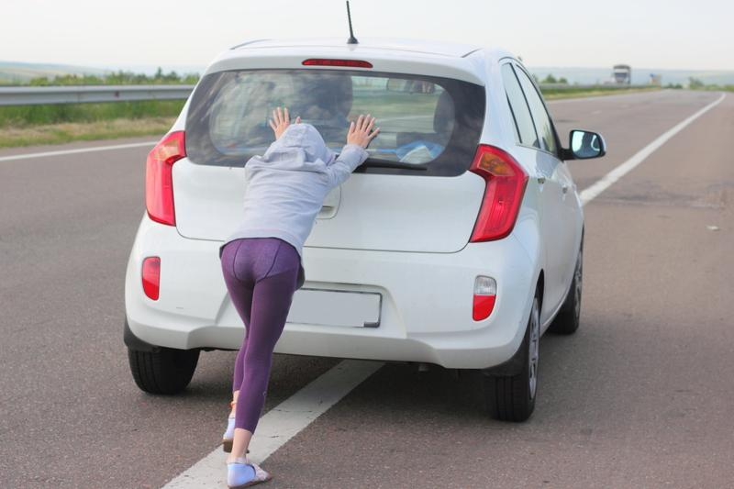
Force: push or pull on an object
Notes:
Force is a push or pull on an object.

Slide 7
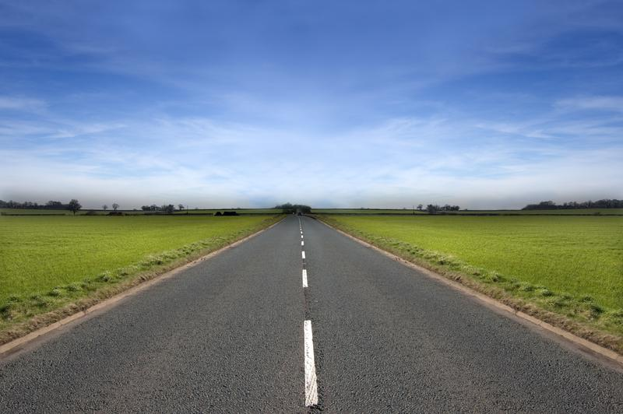
Distance: how far an object travels
Notes:
Distance is how far an object travels.

Slide 8
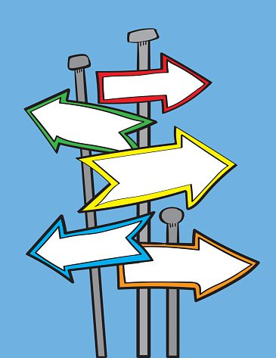
Direction: where something moves or points
Notes:
Direction is where something moves or points.

Slide 9
Notes:
Now let’s pause for a moment to review the information we have covered already.

Slide 10
________ is the ability to cause change.
Energy
Work
Notes:
__________ is the ability to cause change.
[Energy]

Slide 11
________ is the ability to cause change.
Energy
Work
Notes:
__________ is the ability to cause change.
[Energy]

Slide 12
True or False: Force is the push or pull of an object.
True
False
Notes:
True or False: Force is the push or pull of an object.

Slide 13
True or False: Force is the push or pull of an object.
True
False
Notes:
True or False: Force is the push or pull of an object.
[True]

Slide 14
____________ is where something moves or points.
Distance
Direction
Notes:
_______ is where something moves or points.
[Direction]

Slide 15
____________ is where something moves or points.
Distance
Direction
Notes:
[Direction] is where something moves or points.

Slide 16
Work
Notes:
Now that we’ve reviewed, let’s define the phrase work.

Slide 17
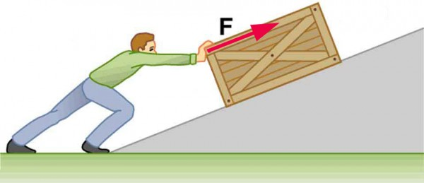
Work: a force acting upon an object causing the object to move in the direction of that force
Notes:
Work is a force acting upon an object causing the object to move in the direction of that force.

Slide 18
Notes:
Let’s check-in for understanding.

Slide 19
What is work?
Notes:
What is work?
[Work is a force acting upon an object causing the object to move in the direction of that force.]

Slide 20
Notes:
That is the basic definition, but there is a bit more you need to know.

Slide 21
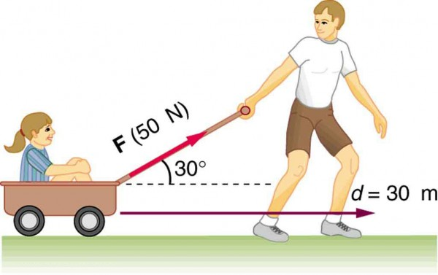
Work measures the energy transfer that occurs when a force causes an object to move.
Notes:
Work is a measure of energy transfer that occurs when a force is applied to an object and causes the object to move a certain distance in the direction of the force. Work measures the energy transfer that occurs when a force causes an object to move.

Slide 22
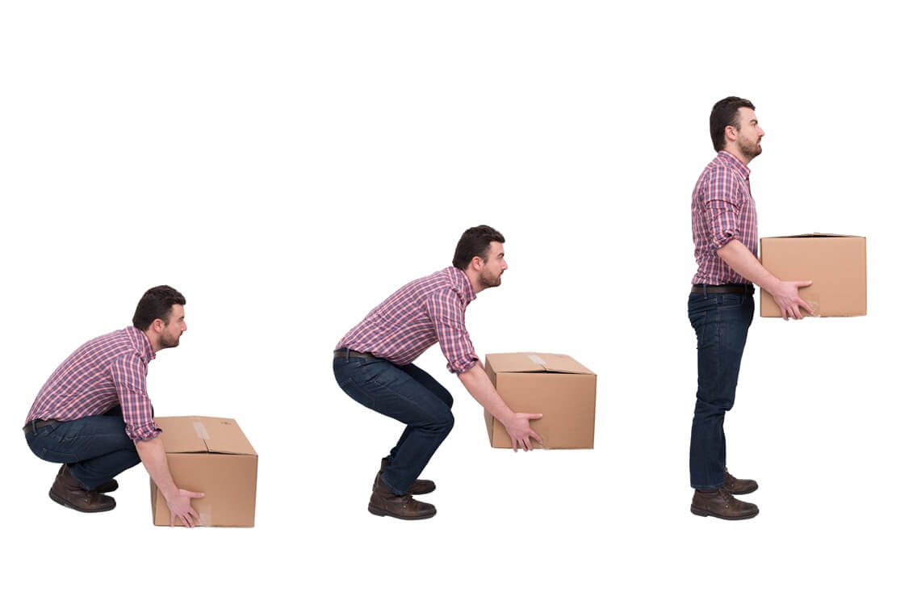
Work is done when energy is transferred from one system or form to another.
Notes:
Work is done when energy is transferred from one system or form to another. For instance, when you lift an object against gravity, you're doing work because you're transferring energy by adding potential energy to the object.

Slide 23
Notes:
Let’s check-in for understanding.

Slide 24
Work measures the _____ transfer that occurs when a _____ causes an object to _____.
Notes:
Work measures the ____ transfer that occurs when a _____ causes an object to _______.
[energy, force, move]

Slide 25
Work measures the energy transfer that occurs when a force causes an object to move.
Notes:
Work measures the [energy] transfer that occurs when a [force] causes an object to [move].

Slide 26
True or False: Work is done when energy is transferred from one system or form to another.
True
False
Notes:
True or False: Work is done when energy is transferred from one system or form to another.
True
False

Slide 27
True or False: Work is done when energy is transferred from one system or form to another.
True
False
Notes:
True: Work is done when energy is transferred from one system or form to another.

Slide 28
Notes:
Now, let’s talk about some examples of work.

Slide 29
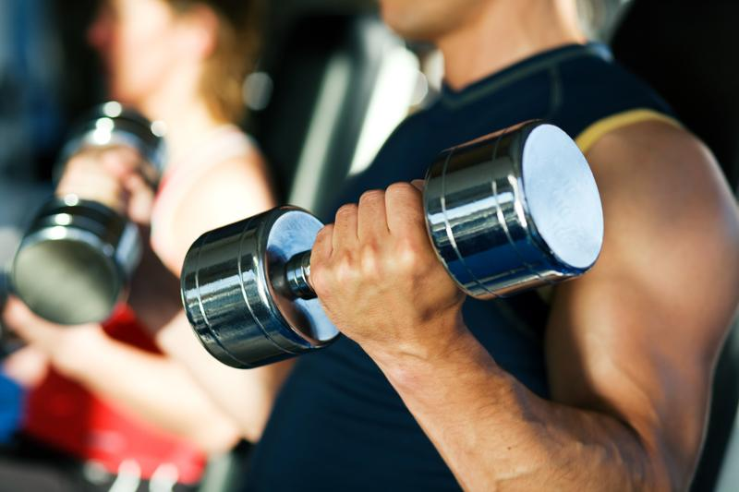
Lifting Dumbells
Notes:
This is an example of work. The man is exerting a force on the dumbells to move them in the direction he wants. In this case, he is pulling them towards him.

Slide 30
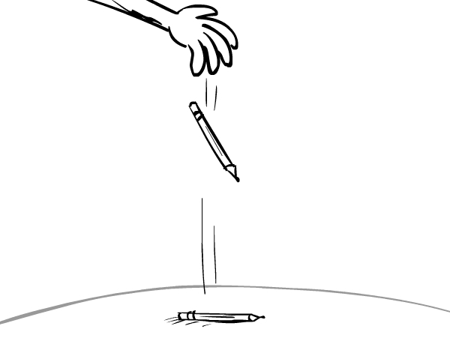
Pencil falling to the floor
Notes:
This pencil falling to the floor is an example of work. The force in this example is gravity, which is pulling the pencil to the ground. The pencil moves in the direction of the force, to the ground, meaning that work has occurred.

Slide 31
Notes:
Let’s check-in for understanding.

Slide 32
What is work?
Notes:
What is work?
[Work is a force acting upon an object causing the object to move in the direction of that force.]

Slide 33
Notes:
Now, let’s talk about some non-examples of work.

Slide 34
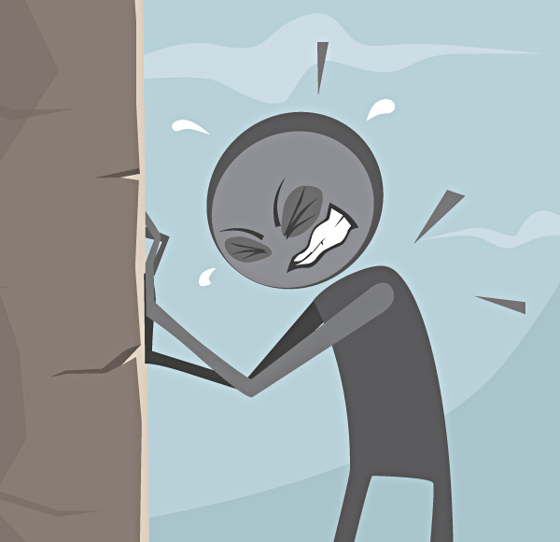
Pushing a wall
Notes:
In this picture, the person is exerting a force on the wall by pushing it. However, the wall is not moving in the direction that the person is pushing the wall. So, even though there is a force, because the object has not moved in the direction of the force, no work has occurred.
Feedback: Remember to take a moment to explicitly distinguish between the similarities of the non-examples and the vocabulary term you were covering today. This helps students resolve any misconceptions they may have.

Slide 35
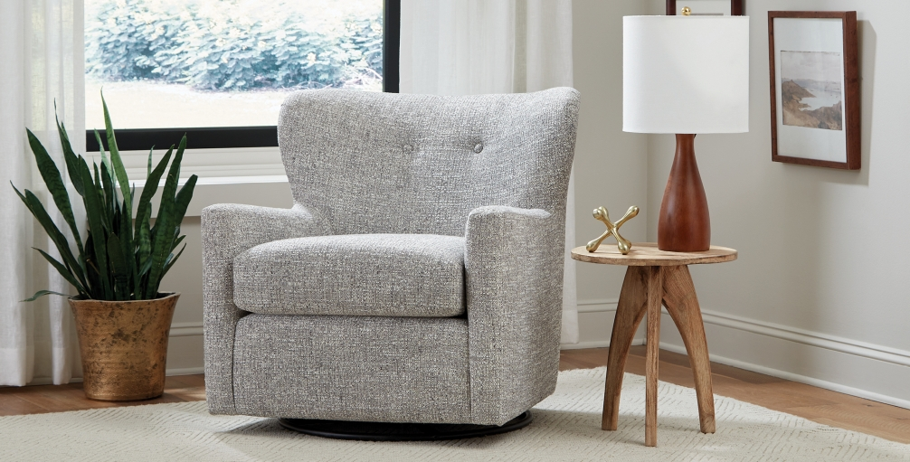
Objects at rest
Notes:
In this picture, we see a living room. The furniture in this room are objects at rest because they do not have any forces pushing or pulling them. Since there is no force, no work is happening.
Feedback: Remember to take a moment to explicitly distinguish between the similarities of the non-examples and the vocabulary term you were covering today. This helps students resolve any misconceptions they may have.

Slide 36
Notes:
Now let’s pause for a moment to check your understanding.

Slide 37
How is force related to work?
Notes:
How is force related to work?
[Force is the push or pull of an object. Work is a force acting upon an object causing the object to move in the direction of that force.]

Slide 38
Notes:
We can also break down the term work into different word parts to help us remember the meaning. Let’s take a look!

Slide 39
Work
(root)
Notes:
We can break up the term work into one part: the root.

Slide 40
Work
physical or mental effort used to achieve a result or accomplish a task
Notes:
The root “work” means the physical or mental effort exerted to achieve a result or accomplish a task.

Slide 41
Work
physical effort used to achieve a result
Notes:
So when look at the word work and think about it scientifically it means the physical effort used to achieve a result. This result is when the object moves in the direction of the force used by the physical effort.

Slide 42
Notes:
Let’s check-in for understanding.

Slide 43
How can we use the word parts of work to help us remember the definition of the term?
Work
(root)
Notes:
How can we use the word parts of work to help us remember the definition of the term?
[The root work means physical or mental effort used to achieve a result or accomplish a task.
So when we put it all together, work means the physical effort used to achieve a result. This result is when the object moves in the direction of the force used by the physical effort.]

Slide 44
Remember!!!
Notes:
So remember!

Slide 45
Work: a force acting upon an object causing the object to move in the direction of that force
Notes:
Work is a force acting upon an object causing the object to move in the direction of that force.

Slide 46
Notes:
We will now complete this concept map, called a Frayer model, to summarize and further clarify what you have learned about the term work.

Slide 47
Definition
Picture
Work
Example
How does work impact my life?
Notes:
To complete the Frayer model, we will choose from four choices the correct picture, definition, example, and response to the question, “How does work impact my life?” Select the best response for each question using the information you just learned. As we select responses, we will see how this model looks filled in for the term work.

Slide 48
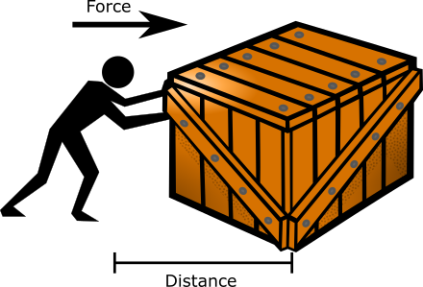
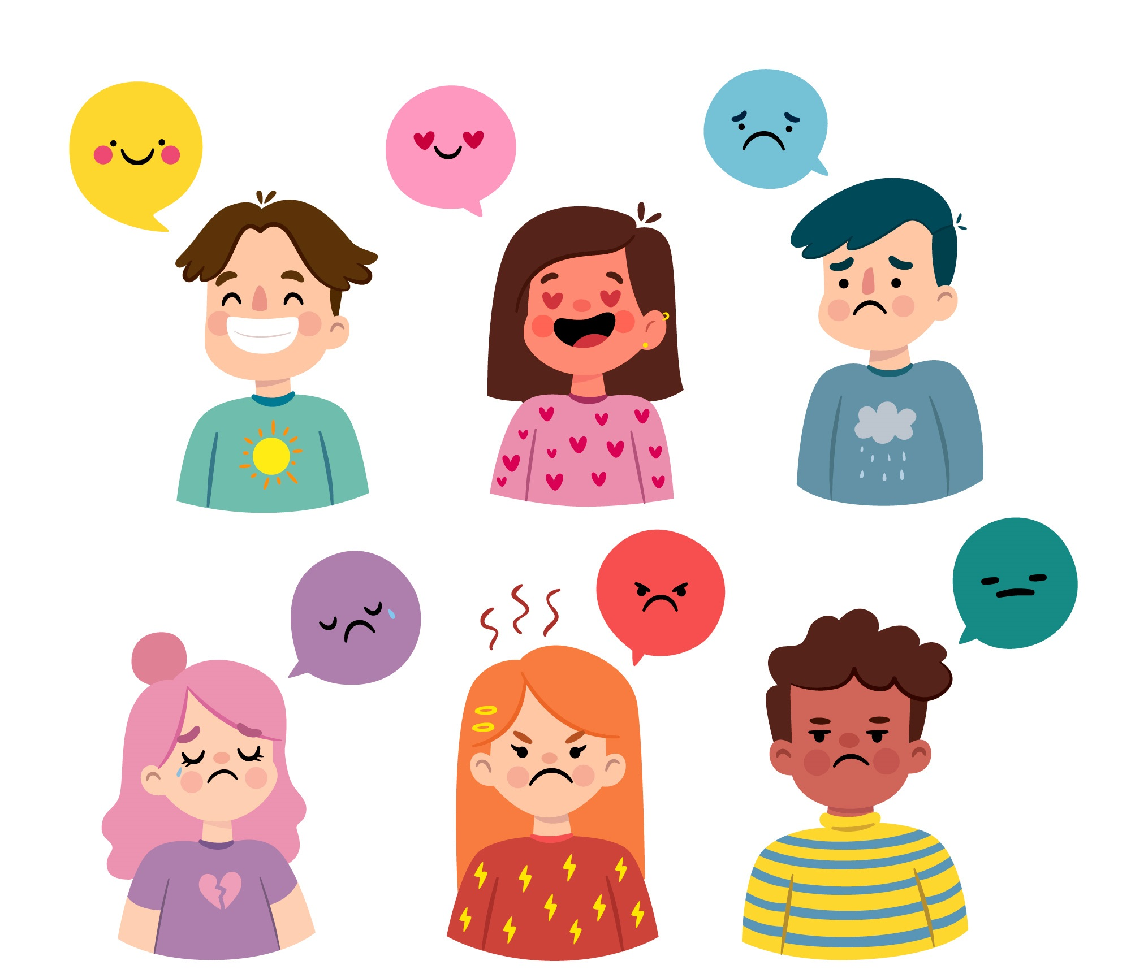
Directions: Choose the correct picture of Work from the choices below.
A
B
C
D
Notes:
Choose the one correct picture of work from these four choices.

Slide 49
Directions: Choose the correct picture of Work from the choices below.
A
B
C
D
Notes:
This is the picture that showswork.

Slide 50
Definition
Picture
Work
Example
How does work impact my life?
Notes:
Here is the Frayer model filled in with a picture of work.

Slide 51
Directions: Choose the correct definition of Work from the choices below.
A
Using less of a resource to make it last longer
B
A force acting upon an object causing the object to move in the direction of that force
C
A push or pull of an object
D
The ability to cause change
Notes:
Choose the one correct definition of work from these four choices.

Slide 52
Directions: Choose the correct definition of Work from the choices below.
A
Using less of a resource to make it last longer
B
A force acting upon an object causing the object to move in the direction of that force
C
A push or pull of an object
D
The ability to cause change
Notes:
“A force acting upon an object causing the object to move in the direction of that force” is correct! This is the definition of work.

Slide 53
Definition
Picture
A force acting upon an object causing the object to move in the direction of that force
Work
Example
How does work impact my life?
Notes:
Here is the Frayer Model with a picture and the definition filled in for work: A force acting upon an object causing the object to move in the direction of that force.

Slide 54
Directions: Choose the correct example of Work from the choices below.
A
A basil plant planted in a garden box
B
A full glass of water
C
A person pushing a lawnmower
D
A car parked in someone’s driveway
Notes:
Choose the one correct example of work from these four choices.

Slide 55
Directions: Choose the correct example of Work from the choices below.
A
A basil plant planted in a garden box
B
A full glass of water
C
A person pushing a lawnmower
D
A car parked in someone’s driveway
Notes:
“A person pushing a lawnmower” is correct! This is an example of work.

Slide 56
Definition
Picture
A force acting upon an object causing the object to move in the direction of that force
Work
A person pushing a lawnmower
Example
How does work impact my life?
Notes:
Here is the Frayer Model with a picture, definition, and an example of work: A person pushing a lawnmower.

Slide 57
Directions: Choose the correct response for “how does work impact my life?” from the choices below.
A
Work explains why and how far objects move in our environment when forces act upon them.
B
Work explains weather and the seasons of our planet, helping us understand our environment better.
C
Work explains how plants grow fruits and vegetables that we can eat to be healthy.
Work converts energy from the Sun into electricity that we can use in our everyday lives and to survive.
D
Notes:
Choose the one correct response for “how does work impact my life?” from these four choices.

Slide 58
Directions: Choose the correct response for “how does work impact my life?” from the choices below.
A
Work explains why and how far objects move in our environment when forces act upon them.
B
Work explains weather and the seasons of our planet, helping us understand our environment better.
C
Work explains how plants grow fruits and vegetables that we can eat to be healthy.
Work converts energy from the Sun into electricity that we can use in our everyday lives and to survive.
D
Notes:
“Work explains why and how far objects move in our environment when forces act upon them” That is correct! This is an example of how work impacts your life.

Slide 59
Definition
Picture
A force acting upon an object causing the object to move in the direction of that force
Work
Work explains why and how far objects move in our environment when forces act upon them.
A person pushing a lawnmower
Example
How does work impact my life?
Notes:
Here is the Frayer Model with a picture, definition, example, and a correct response to “how does work impact my life?”: Work explains why and how far objects move in our environment when forces act upon them.

Slide 60
Remember!!!
Notes:
So remember!

Slide 61
Work: a force acting upon an object causing the object to move in the direction of that force
Notes:
Work is a force acting upon an object causing the object to move in the direction of that force.

Slide 62
Big Question: How does energy create work?
Notes:
Let’s reflect once more on our big question. Our “big question” is: How does energy create work?
Does anyone have any additional examples to share that haven’t been discussed yet?

Slide 63
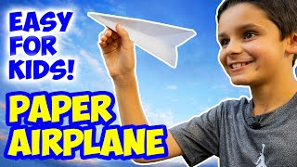
Demonstration
Paper Airplanes
TEACHER DIRECTIONS: Using the materials provided and the YouTube video below, have students build their own paper airplanes. Then, have students 1) throw the paper airplanes with not a lot of force, 2) more force, 3) in a few different directions.
Materials: letter-size (8.5 x 11) sheet of paper for each person, marker or other writing utensil for each person
Notes:
Using the YouTube video embedded on the slide, guide students on how to . After students have built their paper airplanes, select a location (classroom, hallway, etc.) for them to throw their airplanes. Use the reflection questions on the next slide to guide students’ thinking with this activity.
Link to YouTube video: https://www.youtube.com/watch?v=7Cy3lRJGiR4

Slide 64
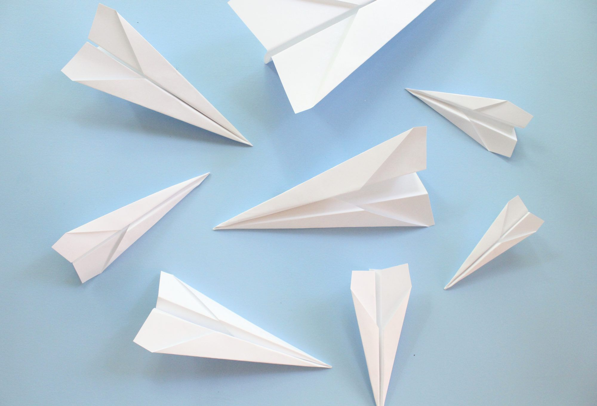
Reflection Activity
Ask yourselves…
What happened with the paper airplane when I threw it with not a lot of force?
What happened with the paper airplane when I threw it with a lot of force?
Did the paper airplane go in the direction you threw each time? Why or why not?
How can work help explain the movement of the paper airplane?
Notes:
After throwing their paper airplanes, have students reflect on these questions in table groups. Then, discuss as a whole class. Discuss how the “level” of work might have dictated how far the plane flew, but certainly the direction it moved in.

Slide 65
Intro
“Big Idea” Question
Review Concepts
Check-In Questions
Teacher Engagement
Vocabulary
Student-Friendly Definition
Examples & Non-Examples
Morphological Word Parts
Frayer Model
Simulation/Activity
Notes:
OK everyone, get ready for our next lesson. Just as a reminder, these are the different components that our lesson may include, and you’ll see these icons in the top left corner of each slide so that you can follow along more easily!

Slide 66
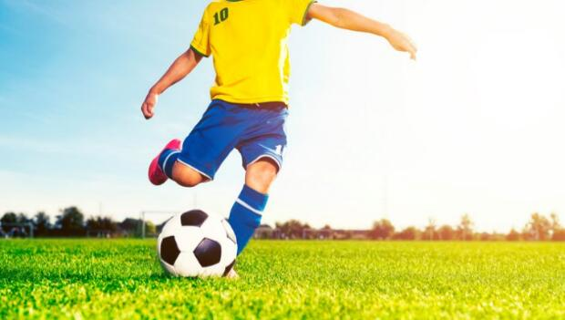
Intro
Inertia
Notes:
Today, we’ll be learning about the word: Inertia.

Slide 67
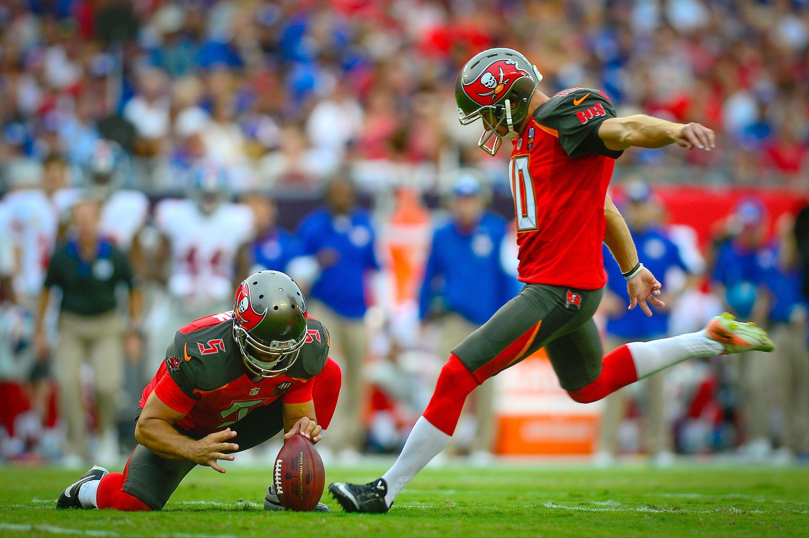
Big Question: Why do things keep moving or stay still unless a force acts on them?
Notes:
Our “big question” is: Why do things keep moving or stay still unless a force acts on them?
[Pause and illicit predictions from students.]
I love all these thoughtful scientific hypotheses! Be sure to keep this question and your predictions in mind as we move through these next few lessons, and we’ll continue to revisit it.

Slide 68
Notes:
Before we move on to our new topic, let’s review some other words & concepts that you already learned and make sure you are firm in your understanding.

Slide 69
Energy: the ability to cause change
Notes:
Energy is the ability to cause change.

Slide 70
Force: push or pull on an object
Notes:
Force is a push or pull on an object.

Slide 71
Direction: where something moves or points
Notes:
Direction is where something moves or points.

Slide 72
Work: a force acting upon an object causing the object to move in the direction of that force
Notes:
Work is a force acting upon an object causing the object to move in the direction of that force.

Slide 73
Notes:
Now let’s pause for a moment to review the information we have covered already.

Slide 74
True or False: Force is the push or pull of an object.
True
False
Notes:
True or False: Force is the push or pull of an object.

Slide 75
True or False: Force is the push or pull of an object.
True
False
Notes:
True or False: Force is the push or pull of an object.
[True]

Slide 76
______ is a force acting upon an object causing the object to move in the direction of that force.
Work
Energy
Notes:
_____ is a force acting upon an object causing the object to move in the direction of that force.
[Work]

Slide 77
______ is a force acting upon an object causing the object to move in the direction of that force.
Work
Energy
Notes:
[Work] is a force acting upon an object causing the object to move in the direction of that force.

Slide 78
Inertia
Notes:
Now that we’ve reviewed, let’s define the phrase inertia.

Slide 79
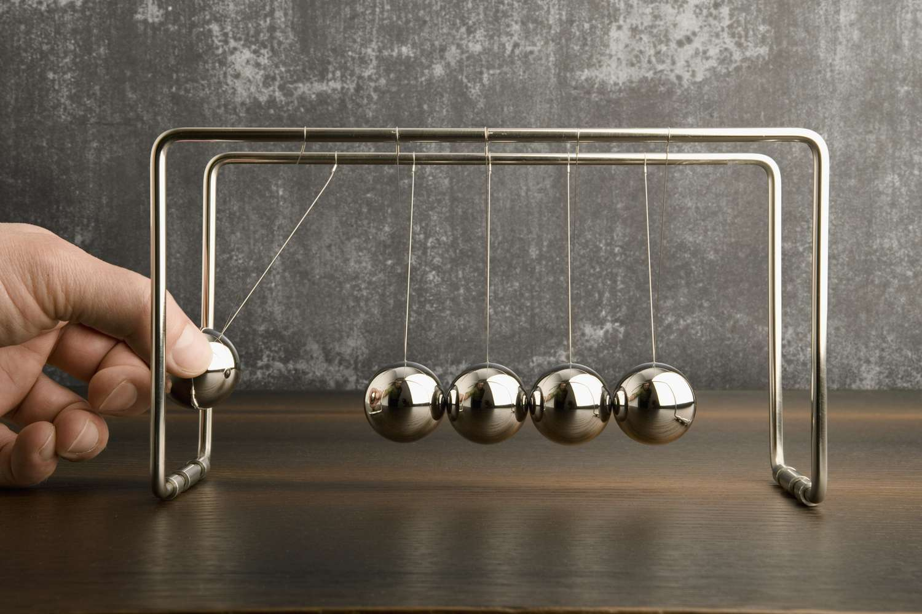
Inertia: tendency of an object to resist change in motion
Notes:
Inertia is the tendency of an object to resist change in motion.

Slide 80
Notes:
Let’s check-in for understanding.

Slide 81
What is inertia?
Notes:
What is inertia?
[Inertia is the tendency of an object to resist change in motion.]

Slide 82
Notes:
That is the basic definition, but there is a bit more you need to know.

Slide 83
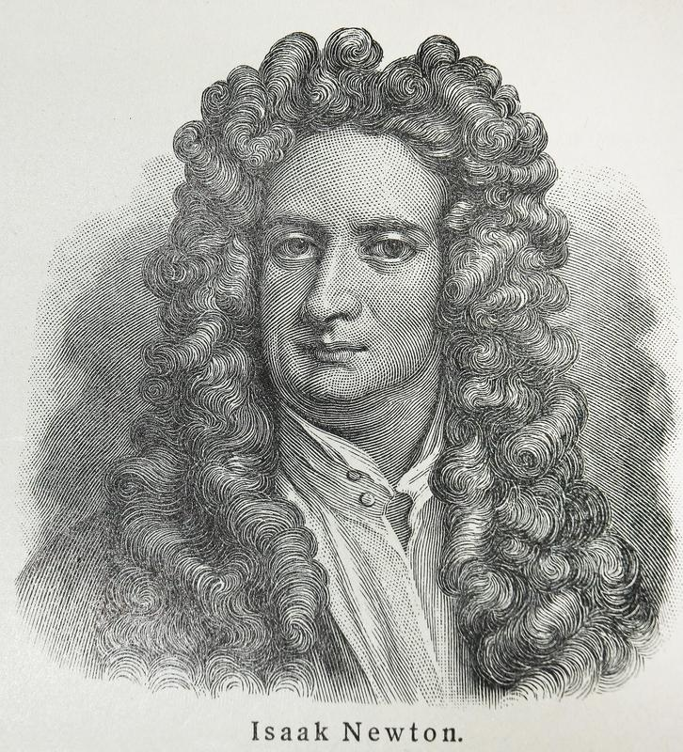
Inertia is Newton’s First Law of Motion.
Notes:
Newton's First Law of Motion is also known as the law of inertia. It says that an object will stay still or keep moving in a straight line unless a force pushes or pulls on it. In simpler terms, things like to stay the way they are unless something makes them change. For example, a soccer ball won't start rolling unless you kick it, and a car won't stop unless you hit the brakes because they both have this thing called inertia that makes them resist changes in motion.

Slide 84
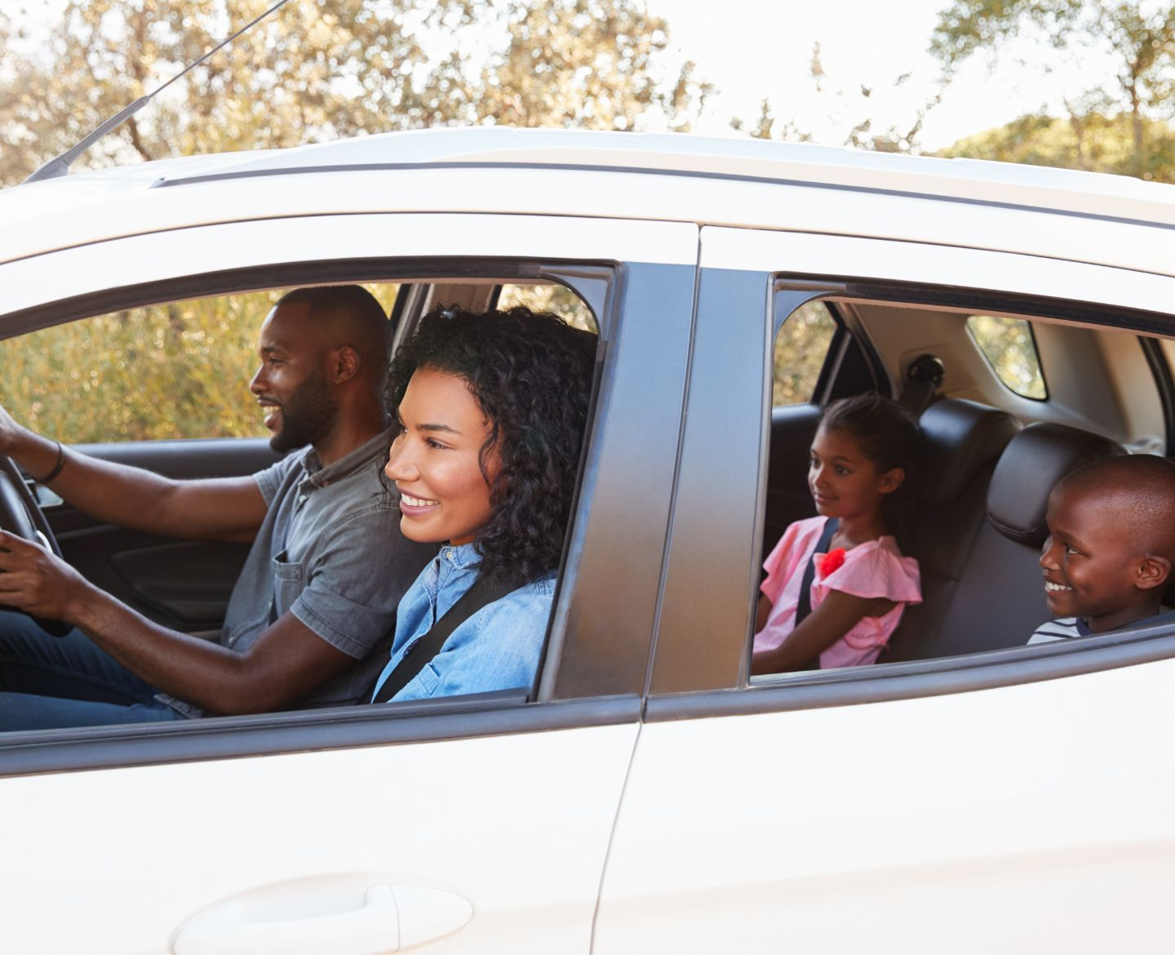
Inertia means things want to keep doing what they are doing.
Notes:
Inertia means things want to stay keep doing what they are doing. For example, if you're sitting in a car that's not moving, you stay still unless someone, usually the driver, pushes the gas pedal to make the car go. That's because you and the car have something called inertia. You want to stay still until something makes you move.

Slide 85
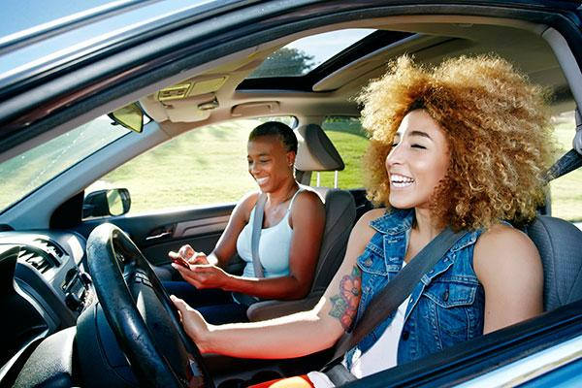
Notes:
But, if the car is already moving, and the driver suddenly stops, you feel like you're pushed forward. That's because, even though the car stopped, your body wants to keep moving at the same speed. Your body wanted to keep doing what it was doing, which was moving along with the car. Inertia is why you wear a seatbelt in the car. If the car suddenly stops, your seatbelt keeps you from flying forward because it's helping you overcome your inertia.

Slide 86
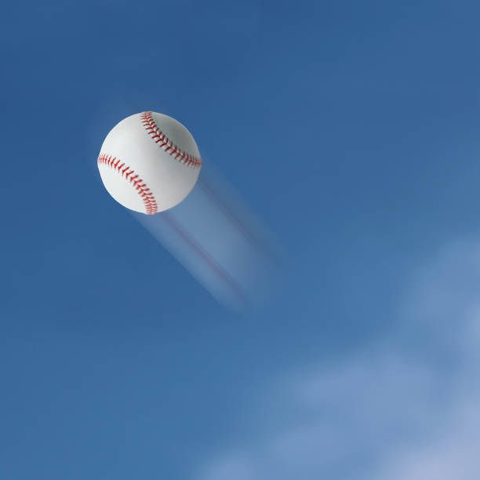
Objects like to stay still if they’re still and like to stay moving if they are moving.
Notes:
Inertia is like a "stay as you are" property. Objects like to stay still if they're still, and they like to stay moving if they're moving, until something else pushes or pulls them to change. For example, a baseball at rest on a field will stay at rest until someone picks it up. A baseball flying through the air will continue to fly through the air until it is caught or hits another object. Overall, inertia means objects resist change in the state of motion they are in.

Slide 87
Notes:
Let’s check-in for understanding.

Slide 88
True or False: Inertia is Newton’s First Law of Motion.
Notes:
True or False: Inertia is Newton’s First Law of Motion.
[True]

Slide 89
True: Inertia is Newton’s First Law of Motion.
Notes:
True: Inertia is Newton’s First Law of Motion.

Slide 90
Objects like to _____ still if they’re still and like to _____ moving if they are moving.
Notes:
Objects like to ______ still fio they’re still and like to ______ moving if they are moving.
[stay, stay]

Slide 91
Objects like to stay still if they’re still and like to stay moving if they are moving.
Notes:
Objects like to [stay] still fio they’re still and like to [stay] moving if they are moving.

Slide 92
Notes:
Now, let’s talk about some examples of inertia.

Slide 93
Driving in a car
Notes:
When you are driving in a car, your body is moving at the same speed as the car.

Slide 94
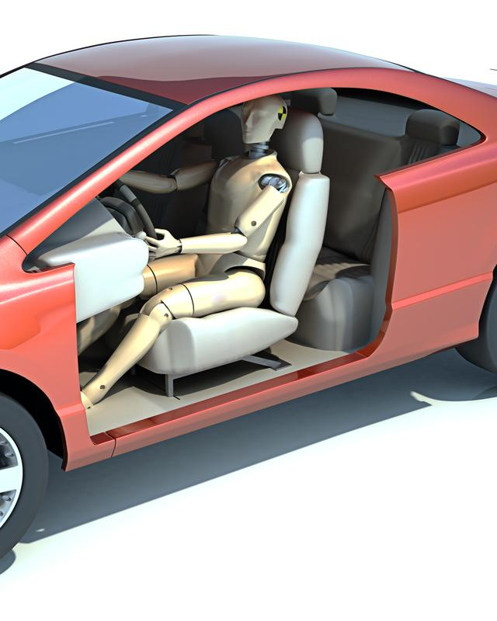
Crash Test Dummy
Notes:
But, when you get in an accident, your car is hit by another force. Not you. You continue to move forward because of inertia – your body is resisting the change in motion.

Slide 95
Notes:
Let’s check-in for understanding.

Slide 96
What is inertia?
Notes:
What is inertia?
[Inertia is the tendency of an object to resist change in motion.]

Slide 97
Notes:
Now, let’s talk about some non-examples of inertia.

Slide 98
Notes:
A person painting a picture is not an example of inertia. The person painting the picture starts and stops motion and staying at rest. They are choosing to exert force or not at different times.

Slide 99
Notes:
A sunset is not an example of inertia. As the sun dips below the horizon, it reflects different light fragments that changes color of the sky. Objects are not moving or staying at rest.

Slide 100
Notes:
Now let’s pause for a moment to check your understanding.

Slide 101
How does inertia apply to objects both at rest and in motion?
Notes:
How does inertia apply to objects both at rest and in motion?
[Inertia means objects resist change to the state of motion they are in. If they are at rest, they want to stay at rest. If they are in motion, they want to stay in motion. That is, until another force acts on them.]

Slide 102
Notes:
We can also break down the term inertia into different word parts to help us remember the meaning. Let’s take a look!

Slide 103
Inertia
(root)
(suffix)
Notes:
We can break up the term inertia into two parts: root and suffix.

Slide 104
Inertia
Inert = Not moving; inactive
Notes:
First, we have the root “inert” which means not moving or inactive.

Slide 105
Inertia
-ia = a particular state or condition
Notes:
-ia is the suffix. The “-ia” suffix means a particular state or condition.

Slide 106
Work
physical or mental effort used to achieve a result or accomplish a task
Notes:
The root “work” means the physical or mental effort exerted to achieve a result or accomplish a task.

Slide 107
Inert ia
Inertia
An inactive state
Notes:
So when we put it all together, inertia means an inactive state.

Slide 108
Notes:
Let’s check-in for understanding.

Slide 109
How can we use the word parts of inertia to help us remember the definition of the term?
Inertia
(root)
(suffix)
Notes:
How can we use the word parts of inertia to help us remember the definition of the term?
[The root inert means not moving or inactive.
-ia is the suffix meaning a particular state or condition.
So when we put it all together, inertia means an inactive state. In this case, something has inertia because it does not want to change its state of motion, so it remains an inactive state until a forces acts upon it.]

Slide 110
Remember!!!
Notes:
So remember!

Slide 111
Inertia: tendency of an object to resist change in motion
Notes:
Inertia is a tendency of an object to resist change in motion.

Slide 112
Notes:
We will now complete this concept map, called a Frayer model, to summarize and further clarify what you have learned about the term inertia.

Slide 113
Definition
Picture
Inertia
Example
How does inertia impact my life?
Notes:
To complete the Frayer model, we will choose from four choices the correct picture, definition, example, and response to the question, “How does inertia impact my life?” Select the best response for each question using the information you just learned. As we select responses, we will see how this model looks filled in for the term inertia.

Slide 114
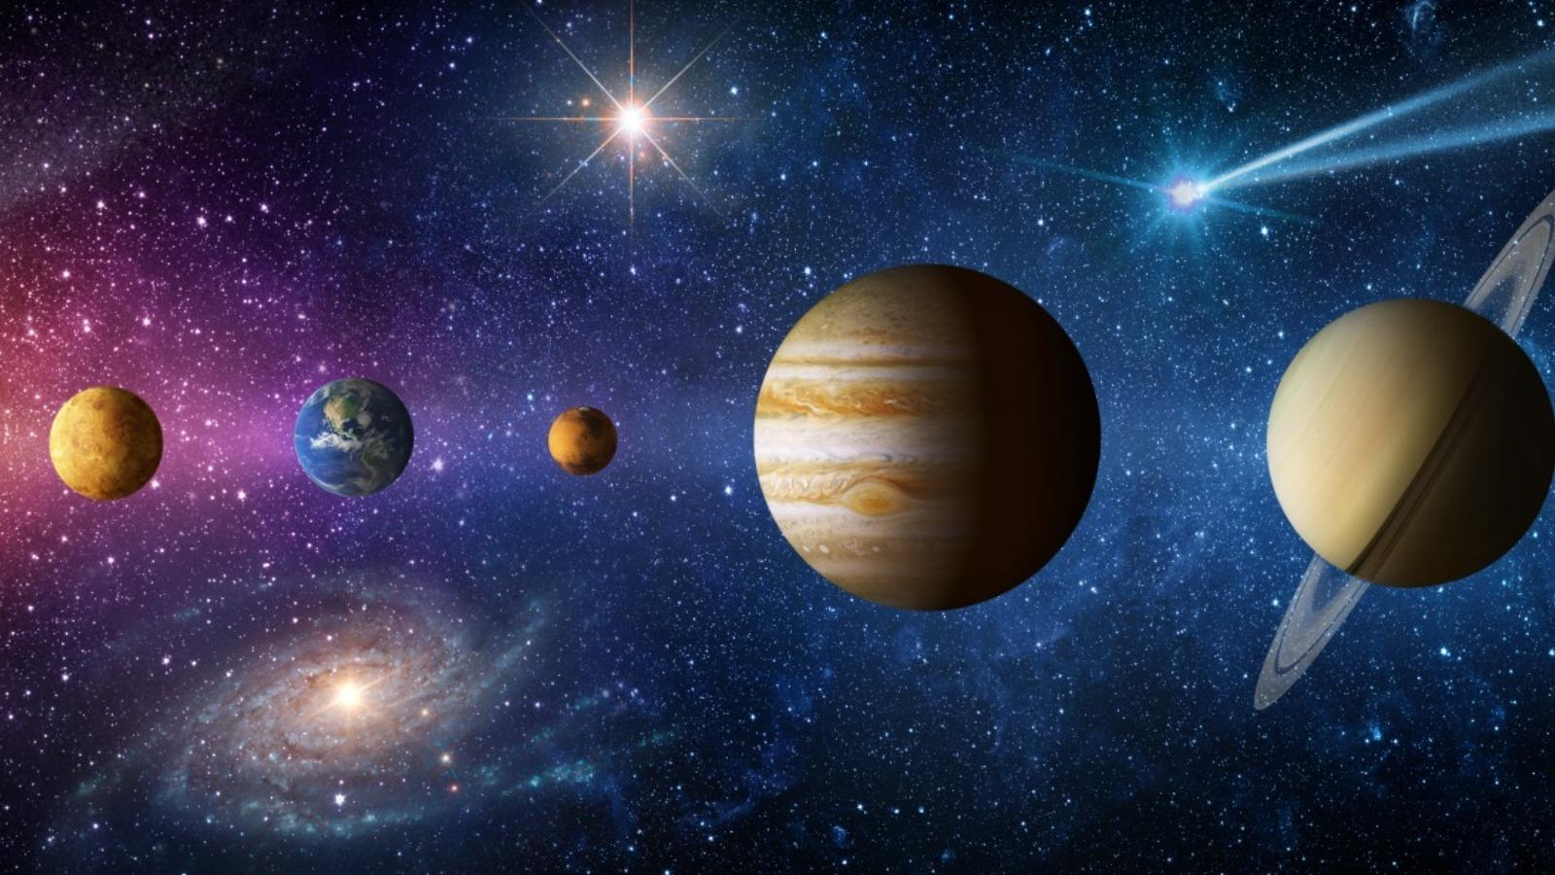
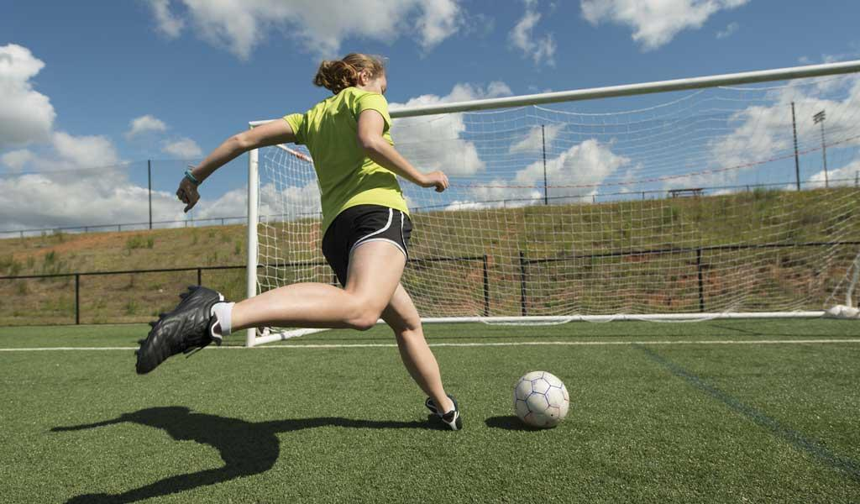
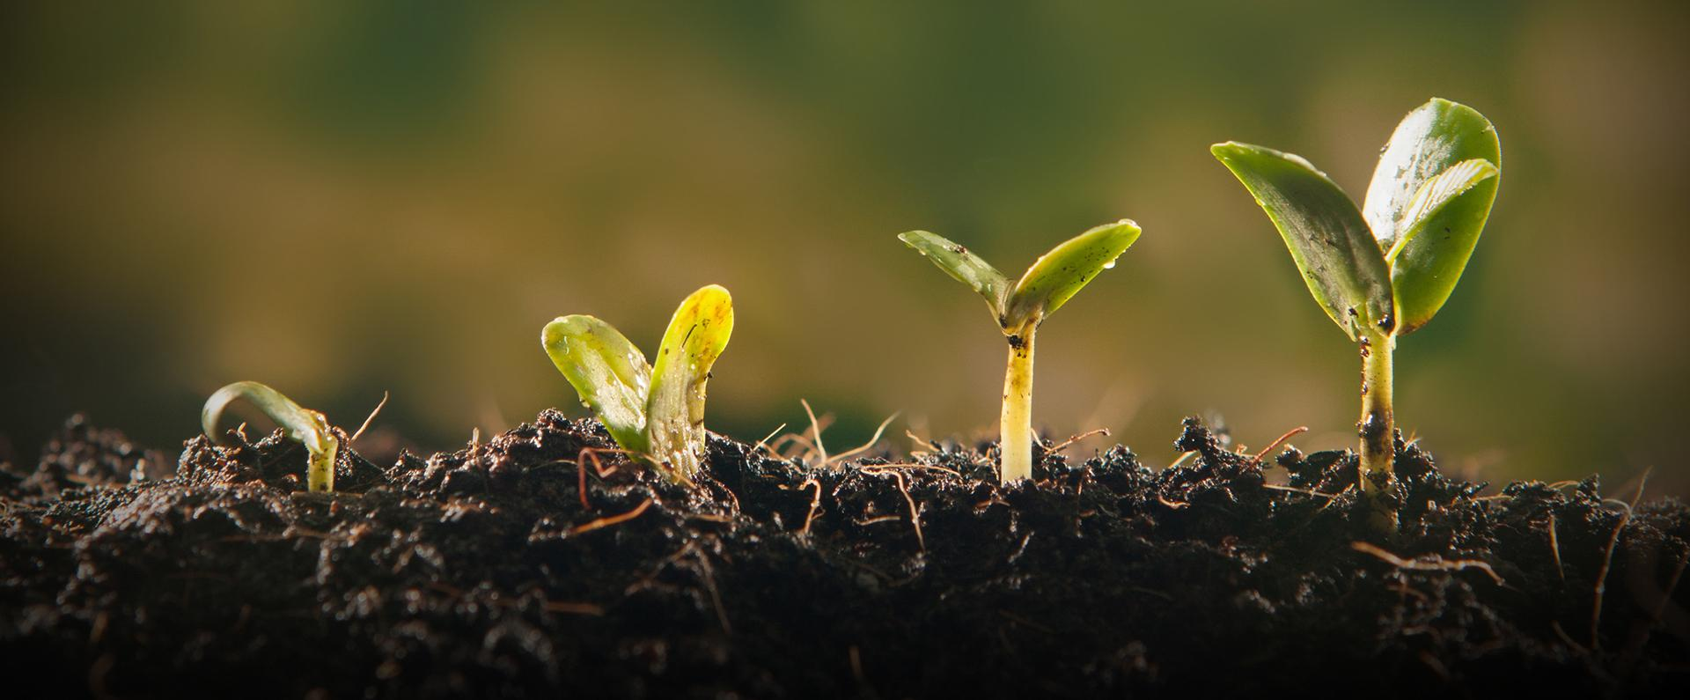
Directions: Choose the correct picture of Inertia from the choices below.
A
B
C
D
Notes:
Choose the one correct picture of inertia from these four choices.

Slide 115
Directions: Choose the correct picture of Inertia from the choices below.
A
B
C
D
Notes:
This is the picture that shows inertia.

Slide 116
Definition
Picture
Inertia
Example
How does inertia impact my life?
Notes:
Here is the Frayer model filled in with a picture of inertia.

Slide 117
Directions: Choose the correct definition of Inertia from the choices below.
A
The smallest unit of matter
B
Tendency of an object to resist change in motion
C
A push or pull of an object
D
Flows in only one direction
Notes:
Choose the one correct definition of inertia from these four choices.

Slide 118
Directions: Choose the correct definition of Inertia from the choices below.
A
The smallest unit of matter
B
Tendency of an object to resist change in motion
C
A push or pull of an object
D
Flows in only one direction
Notes:
“Tendency of an object to resist change in motion” is correct! This is the definition of inertia.

Slide 119
Definition
Picture
Tendency of an object to resist change in motion
Inertia
Example
How does inertia impact my life?
Notes:
Here is the Frayer Model with a picture and the definition filled in for tendency: Tendency of an object to resist change in motion.

Slide 120
Directions: Choose the correct example of Inertia from the choices below.
A
Clouds forming
B
Rain and wind
C
A parked car
D
Dreaming during sleep
Notes:
Choose the one correct example of inertia from these four choices.

Slide 121
Directions: Choose the correct example of Inertia from the choices below.
A
Clouds forming
B
Rain and wind
C
A parked car
D
Dreaming during sleep
Notes:
“A parked car” is correct! This is an example of inertia.

Slide 122
Definition
Picture
Tendency of an object to resist change in motion
Inertia
A parked car
Example
How does inertia impact my life?
Notes:
Here is the Frayer Model with a picture, definition, and an example of inertia: A parked car.

Slide 123
Directions: Choose the correct response for “how does inertia impact my life?” from the choices below.
A
Inertia is the force that protects Earth from outer space.
B
Inertia is responsible for the air we breathe in order to survive.
C
Inertia explains why it is hard to start moving, stop moving, or change how objects are moving.
Inertia demonstrates the power of the different types of weather in our environment.
D
Notes:
Choose the one correct response for “how does inertia impact my life?” from these four choices.

Slide 124
Directions: Choose the correct response for “how does inertia impact my life?” from the choices below.
A
Inertia is the force that protects Earth from outer space.
B
Inertia is responsible for the air we breathe in order to survive.
C
Inertia explains why it is hard to start moving, stop moving, or change how objects are moving.
Inertia demonstrates the power of the different types of weather in our environment.
D
Notes:
“Inertia explains why it is hard to start moving, stop moving, or change how objects are moving.” That is correct! This is an example of how inertia impacts your life.

Slide 125
Definition
Picture
Tendency of an object to resist change in motion
Inertia
Inertia explains why it is hard to start moving, stop moving, or change how objects are moving.
A parked car
Example
How does inertia impact my life?
Notes:
Here is the Frayer Model with a picture, definition, example, and a correct response to “how does inertia impact my life?”: Inertia explains why it is hard to start moving, stop moving, or change how objects are moving.

Slide 126
Remember!!!
Notes:
So remember!

Slide 127
Inertia: tendency of an object to resist change in motion
Notes:
Inertia is a tendency of an object to resist change in motion.

Slide 128
Big Question: Why do things keep moving or stay still unless a force acts on them?
Notes:
Let’s reflect once more on our big question. Our “big question” is: Why do things keep moving or stay still unless a force acts on them?
Does anyone have any additional examples to share that haven’t been discussed yet?

Slide 129
Simulation Activity
Newton’s 1st Law of Motion
(Physics Classroom)
Click the link above for a simulation to deepen your understanding of inertia, which is Newton’s First Law of Motion.
Notes:
Feedback: It is really helpful for students when you provided a rationale for this activity, as this really supports students' understanding of how it relates to the topic you're covering.

Slide 130
Notes:
Thanks for watching, and please continue watching CAPs available from this website.

Slide 131
This Was Created With Resources From:
Questions or Comments
Michael Kennedy, Ph.D. MKennedy@Virginia.edu
Rachel L Kunemund, Ph.D. rk8vm@virginia.edu

