Slide 1
Intro
“Big Idea” Question
Review Concepts
Check-In Questions
Teacher Engagement
Vocabulary
Student-Friendly Definition
Examples & Non-Examples
Morphological Word Parts
Frayer Model
Simulation/Activity
Notes:
OK everyone, get ready for our next lesson. Just as a reminder, these are the different components that our lesson may include, and you’ll see these icons in the top left corner of each slide so that you can follow along more easily!

Slide 2
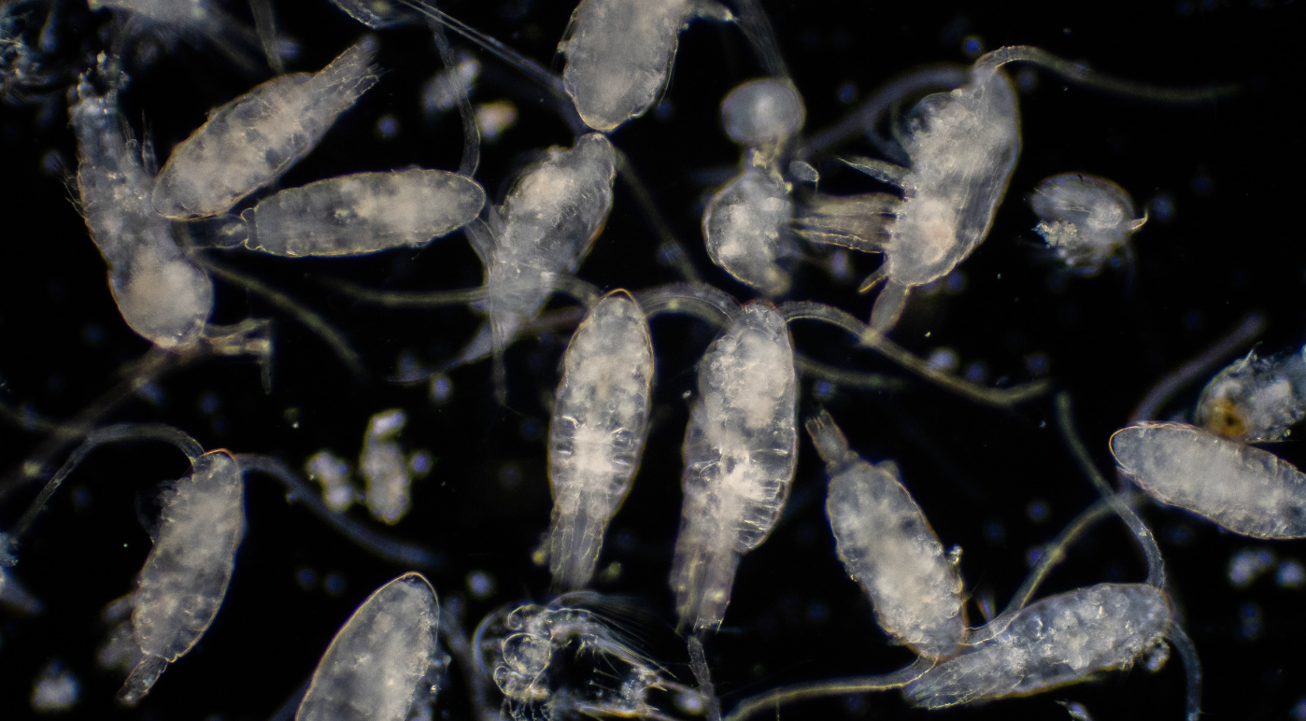
Intro
Zooplankton
Notes:
Today, we’ll be learning about the word: Zooplankton.

Slide 3
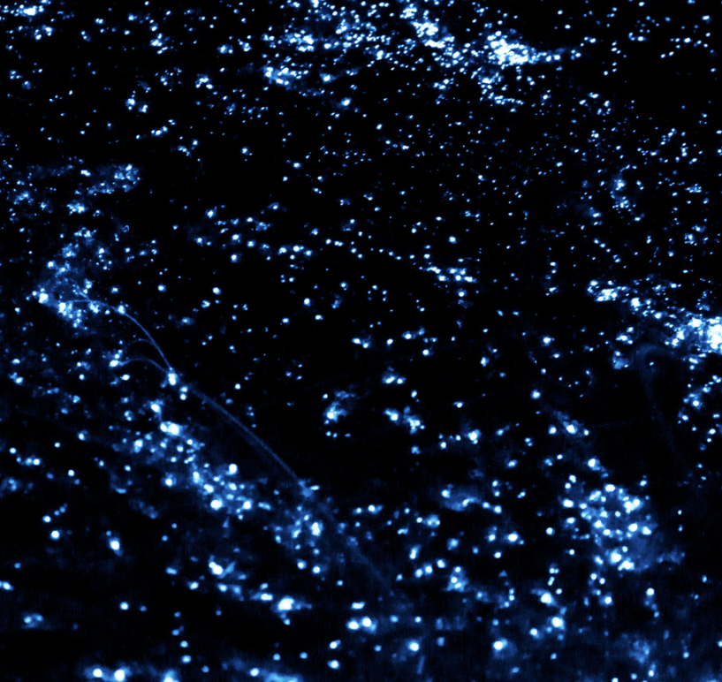
Big Question: How does the world of plankton, play an important role in helping life in the ocean and influencing the health of our entire planet?
Notes:
Our “big question” is: Big Question: How does the world of plankton, play an important role in helping life in the ocean and influencing the health of our entire planet
[Pause and illicit predictions from students.]
I love all these thoughtful scientific hypotheses! Be sure to keep this question and your predictions in mind as we move through these next few lessons, and we’ll continue to revisit it.

Slide 4
Notes:
Before we move on to our new topic, let’s review some other words & concepts that you already learned and make sure you are firm in your understanding.

Slide 5
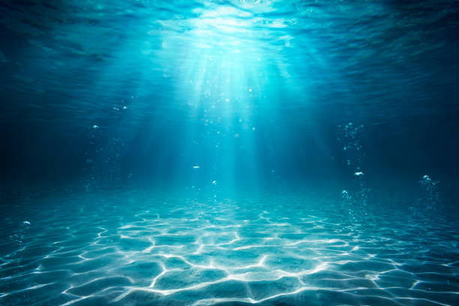
Aquatic: living, growing, or often found in the water
Notes:
Aquatic means something living, growing, or often found in water.

Slide 6
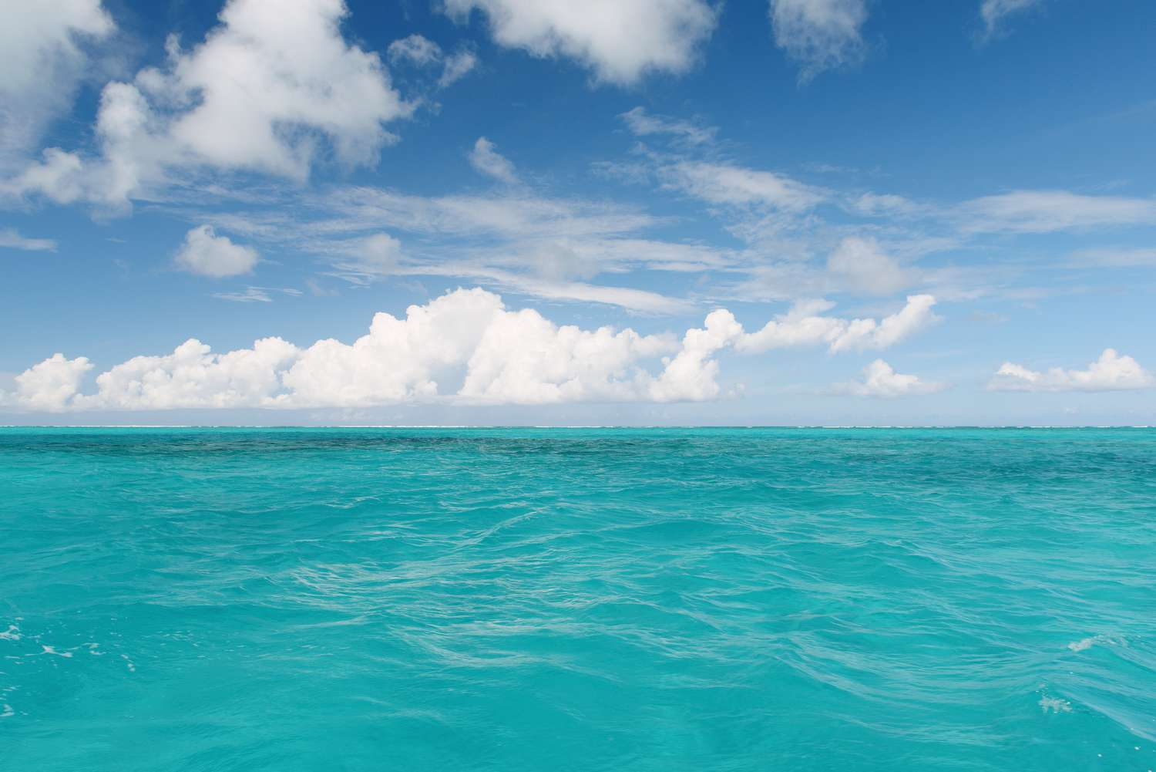
Ocean: A giant body of saltwater.
Notes:
An ocean is a giant body of saltwater.

Slide 7
Organism: any living thing
Notes:
An organism is any living thing.

Slide 8
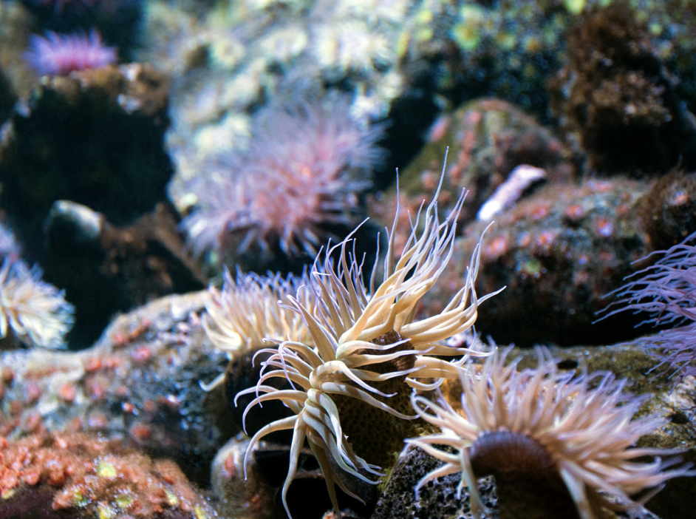
Marine Organism: any living thing that lives in the ocean
Notes:
Marine Organism: any living thing that lives in the ocean

Slide 9
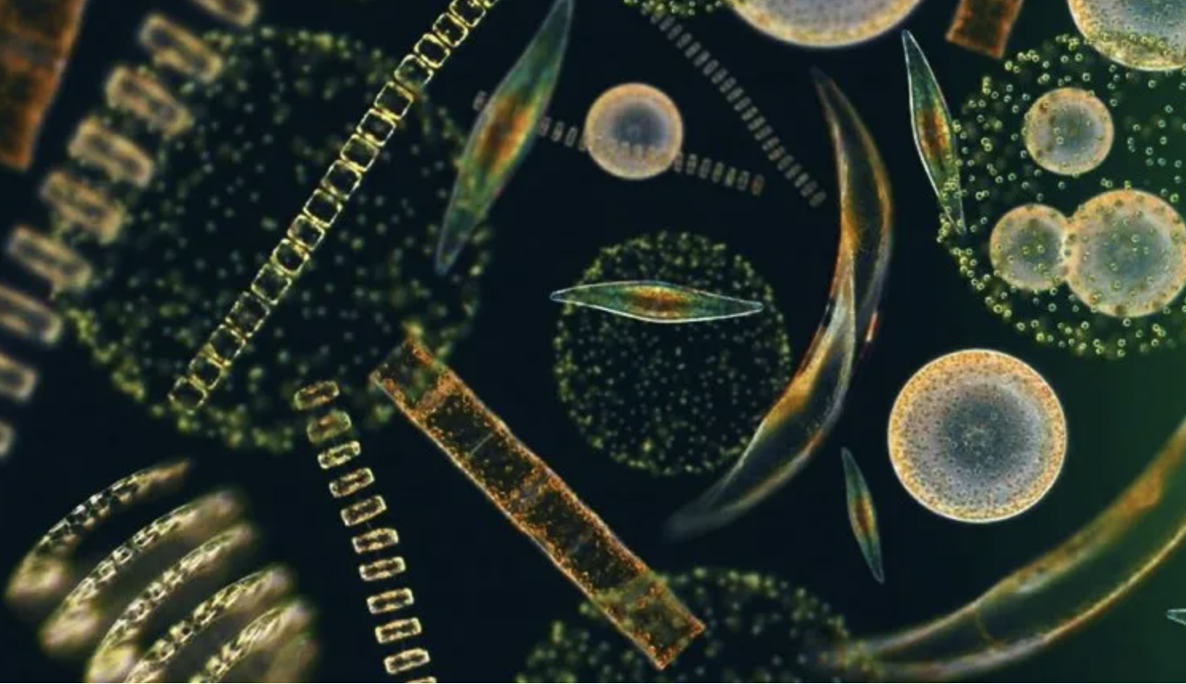
Phytoplankton: tiny plant-like organisms that float or drift in the water
Notes:
Plankton: tiny plant-like organisms that float or drift in the water
Image Source: https://planktonforhealth.co.uk/worlds-finest-marine-phytoplankton-powder/whats-definition-phytoplankton/

Slide 10
Notes:
Now let’s pause for a moment to review the information we have covered already.

Slide 11
Aquatic means living, growing, or often found in/on…
land
water
Notes:
Aquatic means living, growing, or often found in/on…
[water]

Slide 12
Aquatic means living, growing, or often found in/on…
land
water
Notes:
Aquatic means living, growing, or often found in/on…
[water]

Slide 13
True or False: An ocean is a giant body of fresh water.
Notes:
True or False: An ocean is a giant body of fresh water.
[False]

Slide 14
True or False: An ocean is a giant body of fresh water.
Notes:
False: An ocean is a giant body of saltwater.

Slide 15
Organism: any thing
Notes:
An organism is any thing.
[living]

Slide 16
Organism: any thing
Notes:
Organism: any living thing.

Slide 17
True or False: a marine organism is any living thing that lives on land
Notes:
True or False: a marine organism is any living thing that lives on land
[false]

Slide 18
True or False: a marine organism is any living thing that lives on land
Notes:
False: a marine organism is any living thing that lives in the ocean

Slide 19
True of False: Phytoplankton are tiny animal-like organisms that float or drift in the water
Notes:
True of False: Phytoplankton are tiny animal-like organisms that float or drift in the water
[False]
Image Source: https://planktonforhealth.co.uk/worlds-finest-marine-phytoplankton-powder/whats-definition-phytoplankton/

Slide 20
True of False: Phytoplankton are tiny animal-like organisms that float or drift in the water
Notes:
False: Phytoplankton are tiny plant-like organisms that float or drift in the water
Image Source: https://planktonforhealth.co.uk/worlds-finest-marine-phytoplankton-powder/whats-definition-phytoplankton/

Slide 21
Zooplankton
Notes:
Now that we’ve reviewed, let’s define the term plankton.

Slide 22
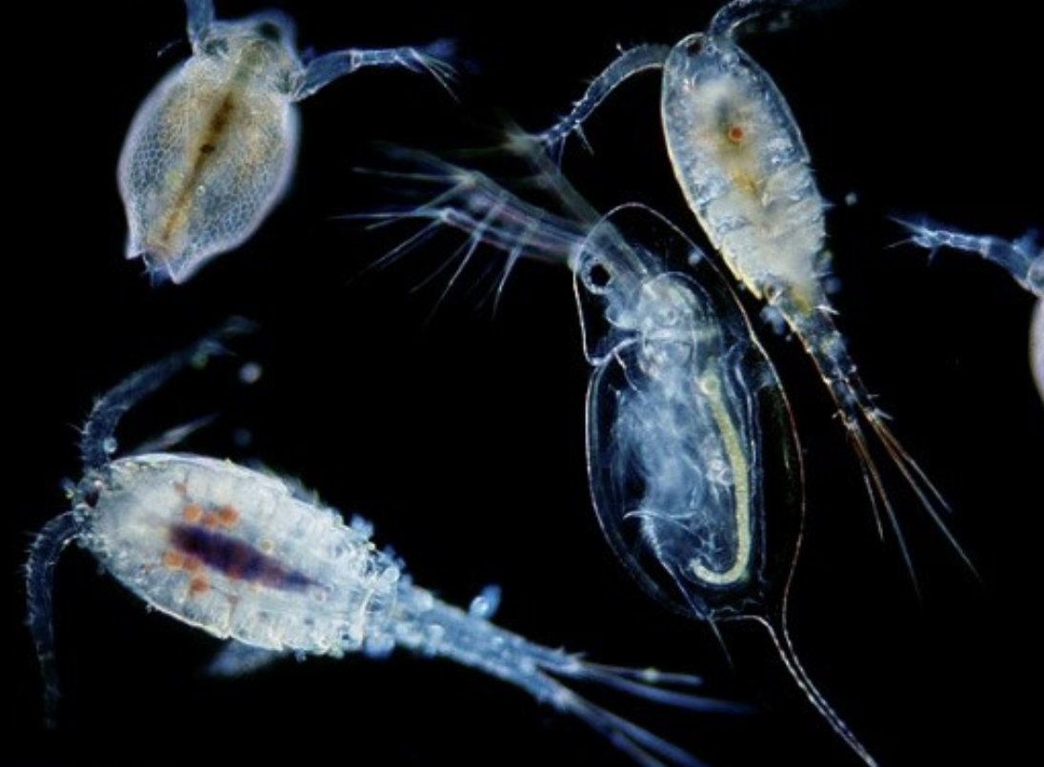
Zooplankton: tiny animal-like organisms that float or drift in the water
Notes:
Zooplankton: tiny animal-like organisms that float or drift in the water

Slide 23
Notes:
Let’s check-in for understanding.

Slide 24
What are zooplankton?
Notes:
What are zooplankton?
[tiny animal-like organisms that float or drift in the water]

Slide 25
Notes:
That is the basic definition, but there is a bit more you need to know.

Slide 26
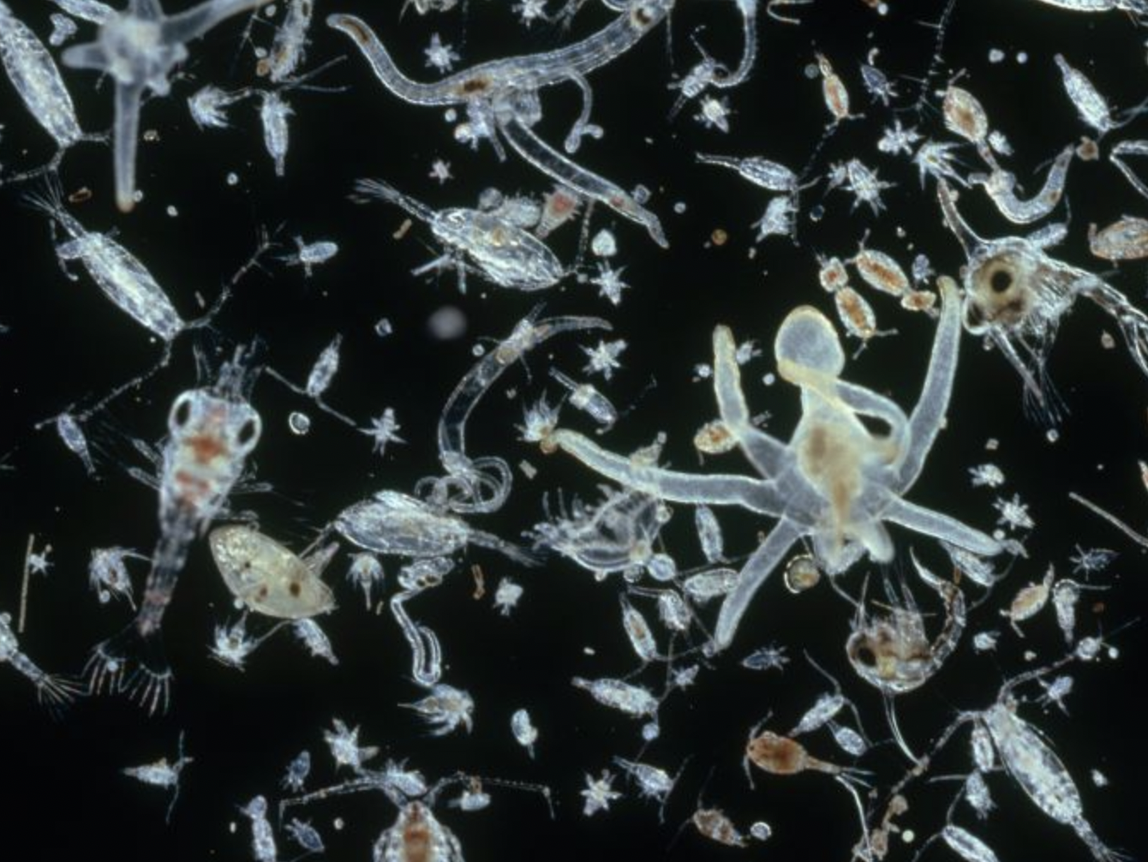
Plankton is a collective term for a diverse community of tiny organisms that live in the ocean. These organisms include both plants and animals.
Notes:
Plankton is a collective term for a diverse community of tiny organisms that live in the ocean. These organisms include both plants and animals.
Image Source: IMAGE BY DR. D. P. WILSON/SCIENCE SOURCE

Slide 27
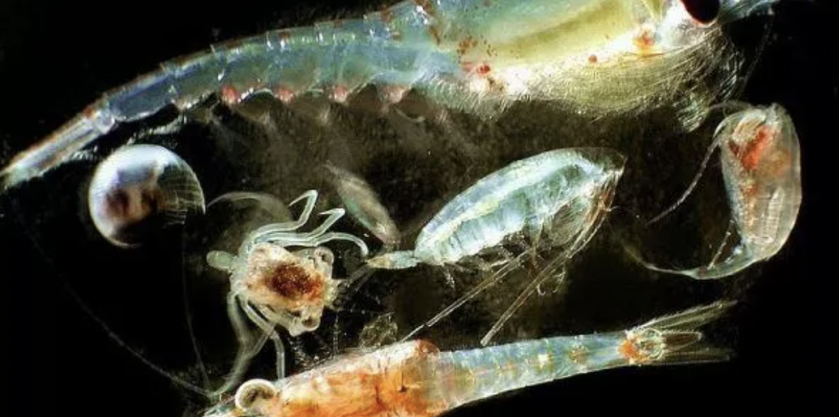
Zooplankton are small animal-like organisms that feed on phytoplankton or other zooplankton.
Notes:
Zooplankton are small animal-like organisms that feed on phytoplankton or other zooplankton.
Image Source: https://biologydictionary.net/zooplankton/

Slide 28
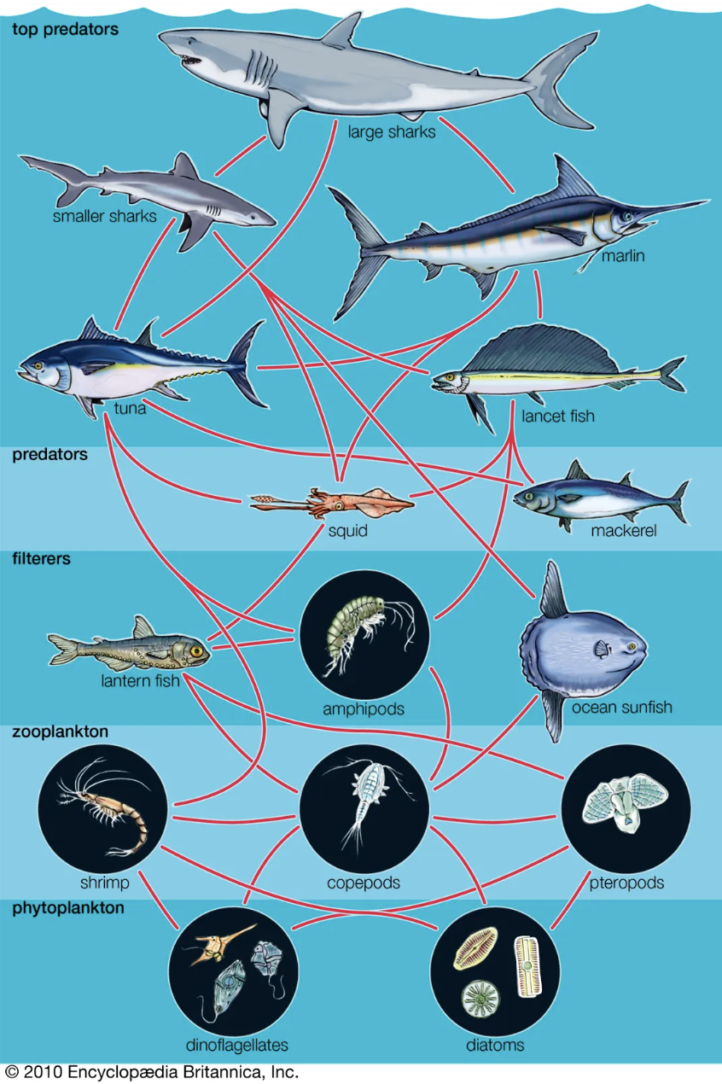
Zooplankton play an important part in controlling the population of phytoplankton and are a key link in transferring energy through the marine food web.
Notes:
Zooplankton play an important part in controlling the population of phytoplankton and are a key link in transferring energy through the marine food web.

Slide 29
Notes:
Let’s check-in for understanding.

Slide 30
True or False: Zooplankton feed on phytoplankton or other zooplankton, while phytoplankton produce their own food.
Notes:
True or False: Zooplankton feed on phytoplankton or other zooplankton, while phytoplankton produce their own food.
[True]

Slide 31
True or False: Zooplankton feed on phytoplankton or other zooplankton, while phytoplankton produce their own food.
Notes:
True: Zooplankton feed on phytoplankton or other zooplankton, while phytoplankton produce their own food.

Slide 32
Notes:
Now, let’s talk about some examples of ocean.

Slide 33
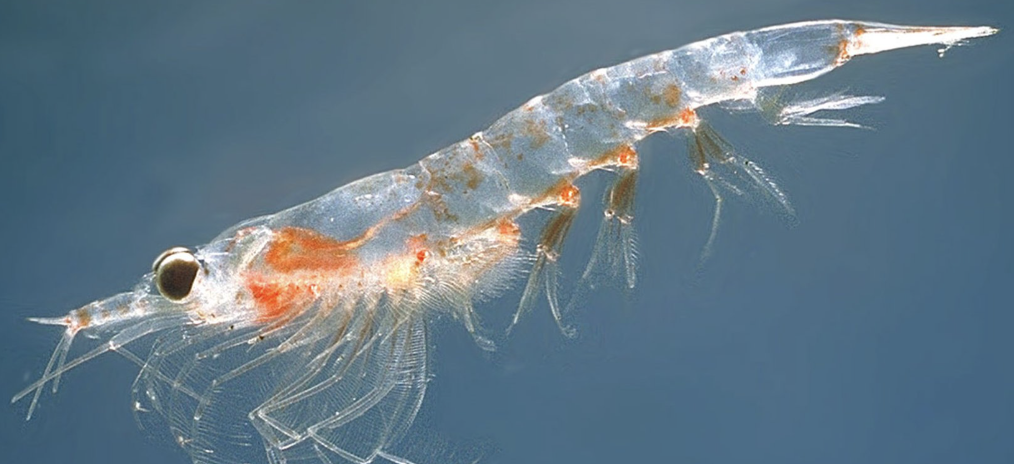
Krill are an example of zooplankton. Krill are tiny shrimp like creatures.
Notes:
Krill is an example of zooplankton. Krill are tiny shrimp like creatures.
Image Source: Øystein Paulsen - MAR-ECO CC BY-SA 3.0

Slide 34
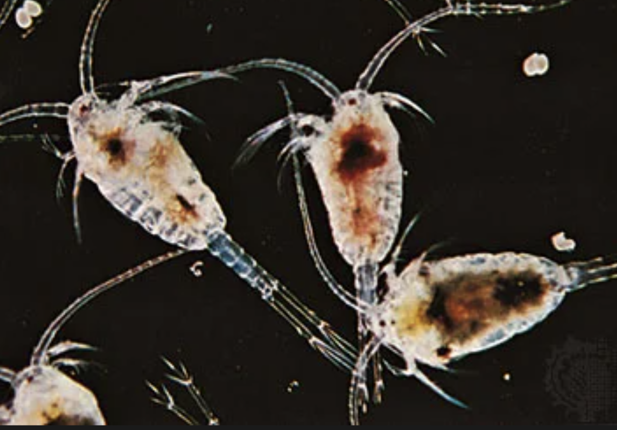
Copepods are another example of zooplankton. Copepods are small crustaceans.
Notes:
Copepods are another example of zooplankton. Copepods are small crustaceans.
Image source: Encyclopædia Britannica; https://www.britannica.com/animal/copepod#/media/1/136547/4977

Slide 35
Notes:
Now, let’s talk about some non-examples of ocean.

Slide 36
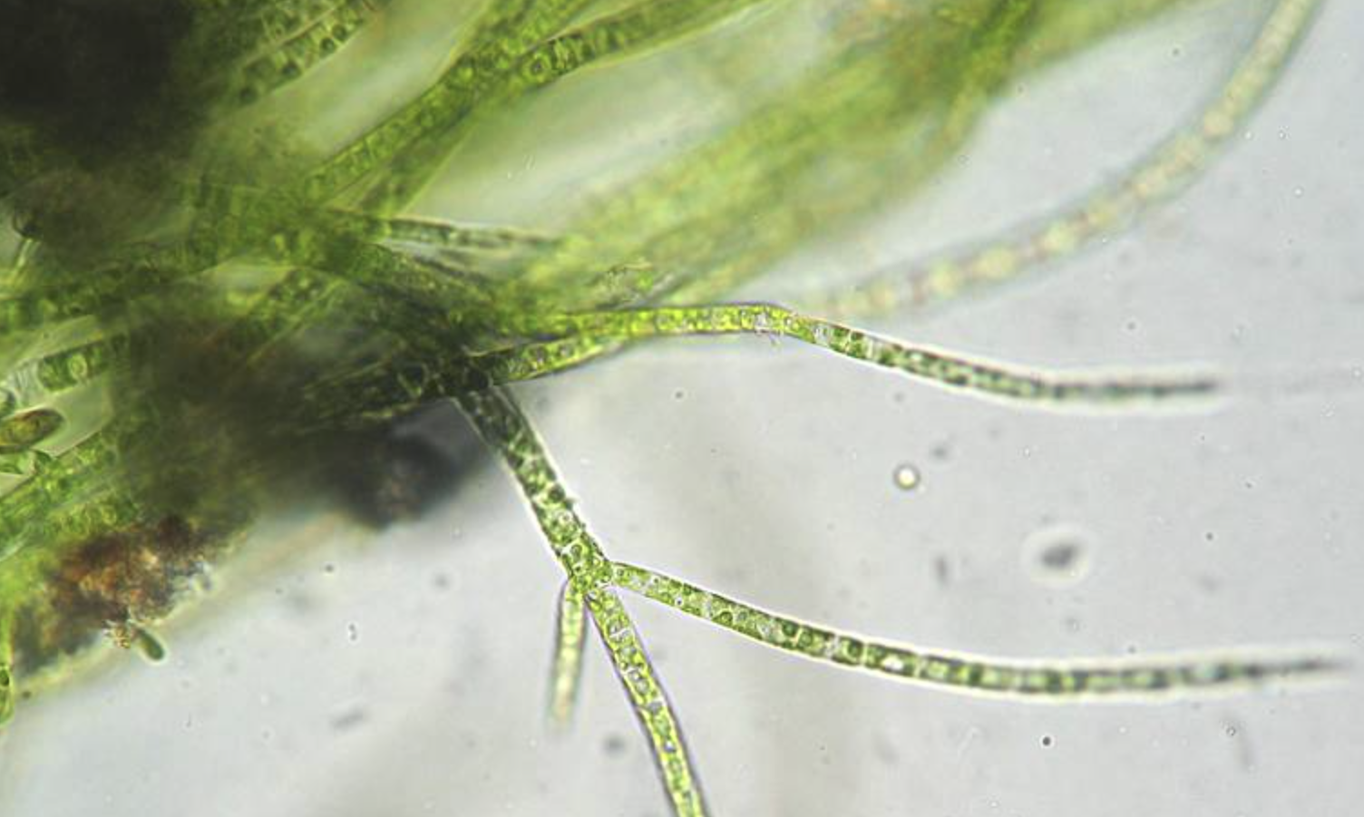
Green algae is NOT an example of zooplankton. Green algae are tiny floating plants in the water that make food from sunlight, drift in the water, and are important for sea creatures to eat.
Notes:
Green algae is NOT an example of zooplankton. Green algae are tiny floating plants in the water that make food from sunlight, drift in the water, and are important for sea creatures to eat.
Image Source: Kristian Peters http://www.korseby.net/outer/flora/algae/index.html

Slide 37
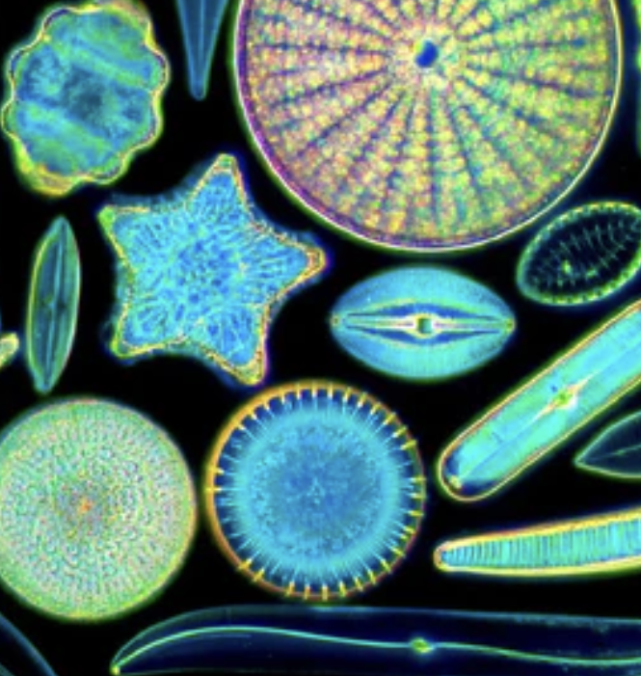
Diatoms are also NOT example of zooplankton. Diatoms are tiny single-celled algae, which are plant-like not animal-like.
Notes:
Diatoms are also NOT example of zooplankton. Diatoms are tiny single-celled algae, which are plant-like not animal-like.
Image source: https://moticmicroscopes.com/blogs/articles/diatoms-nature-s-jewels-viewed-with-a-microscope

Slide 38
Notes:
Now let’s pause for a moment to check your understanding.

Slide 39
Why are green algae and diatoms NOT examples of zooplankton?
Notes:
Why are green algae and diatoms NOT examples of zooplankton?
[both are plant-like and thus they are examples of phytoplankton NOT zooplankton]

Slide 40
Remember!!!
Notes:
So remember!

Slide 41
Zooplankton: tiny animal-like organisms that float or drift in the water
Notes:
Zooplankton: tiny animal-like organisms that float or drift in the water

Slide 42
Notes:
We will now complete this concept map, called a Frayer model, to summarize and further clarify what you have learned about the term zooplankton.

Slide 43
Definition
Picture
Zooplankton
Example
How do zooplankton impact my life?
Notes:
To complete the Frayer model, we will choose from four choices the correct picture, definition, example, and response to the question, “How do zooplankton impact my life?” Select the best response for each question using the information you just learned. As we select responses, we will see how this model looks filled in for the term zooplankton.

Slide 44
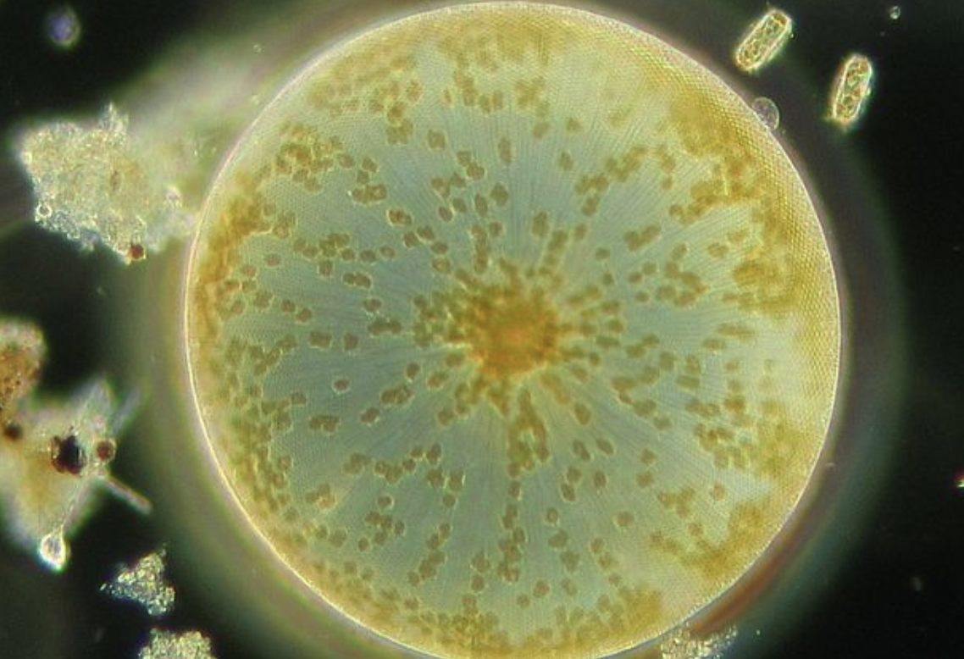
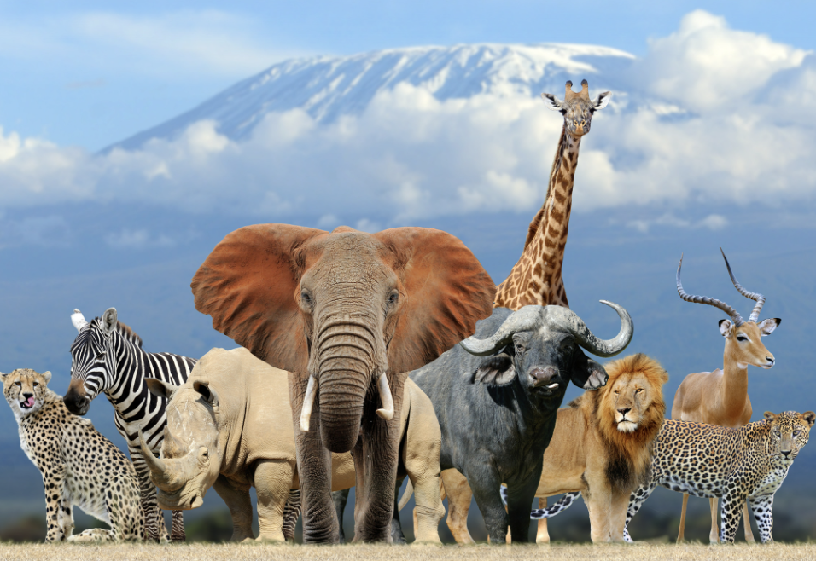
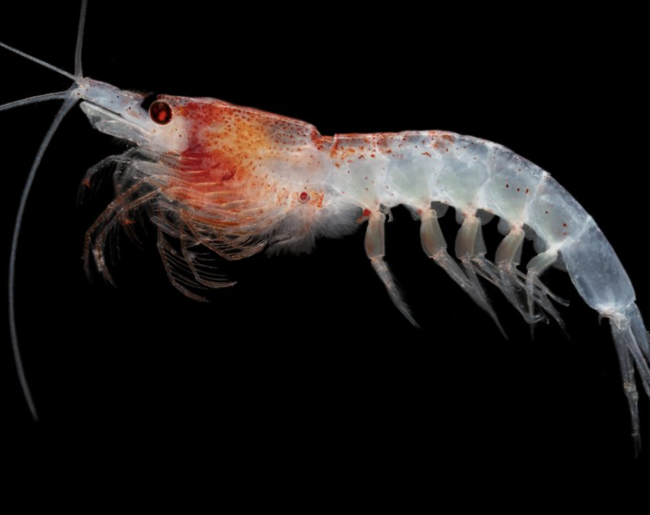
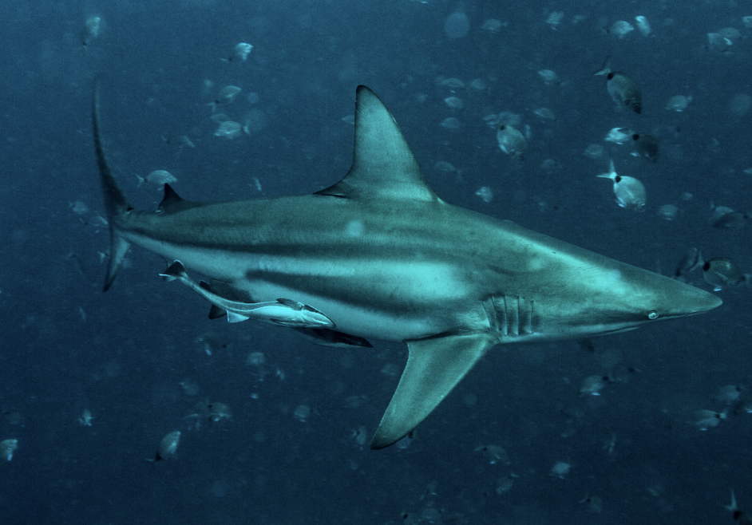
Directions: Choose the correct picture of zooplankton from the choices below.
A
B
C
D
Notes:
Choose the one correct picture of zooplankton from these four choices.

Slide 45
Directions: Choose the correct picture of zooplankton from the choices below.
A
B
C
D
Notes:
Correct! This is a picture of zooplankton.

Slide 46
Definition
Picture
Zooplankton
Example
How do zooplankton impact my life?
Notes:
Here is the Frayer Model with a picture of zooplankton.

Slide 47
Directions: Choose the correct definition of zooplankton from the choices below.
A
Tiny animal-like organisms that float or drift in the water
B
A natural, large body of water surrounded by land
C
Tiny plant-like organisms that float or drift in the water
D
Any living thing
Notes:
Choose the correct definition of zooplankton from the choices.

Slide 48
Directions: Choose the correct definition of zooplankton from the choices below.
A
Tiny animal-like organisms that float or drift in the water
B
A natural, large body of water surrounded by land
C
Tiny plant-like organisms that float or drift in the water
D
Any living thing
Notes:
“Tiny animal-like organisms that float or drift in the water” is correct! This is the definition of zooplankton.

Slide 49
Definition
Picture
Tiny animal-like organisms that float or drift in the water
Zooplankton
Example
How do zooplankton impact my life?
Notes:
Here is the Frayer Model with a picture and the definition filled in for zooplankton : Tiny animal-like organisms that float or drift in the water

Slide 50
Directions: Choose the correct example of plankton from the choices below.
A
A copepod
B
A whale
C
Green Algae
D
A lizard
Notes:
Choose the correct example of zooplankton from the choices below.

Slide 51
Directions: Choose the correct example of plankton from the choices below.
A
A copepod
B
A whale
C
Green Algae
D
A lizard
Notes:
“A copepod” is correct! This is an example of zooplankton.

Slide 52
Definition
Picture
Tiny animal-like organisms that float or drift in the water
Zooplankton
A copepod
Example
How do zooplankton impact my life?
Notes:
Here is the Frayer Model with a picture, definition, and an example of zooplankton: A copepod.

Slide 53
Directions: Choose the correct response for “How do plankton impact my life?” from the choices below.
A
Zooplankton help us to learn how to drive.
B
Zooplankton help make the oxygen we breathe.
C
Zooplankton provide food for larger animals, impacting the seafood we enjoy and the overall health of the oceans.
D
Zooplankton build underwater habitats for marine organisms and that makes me happy.
Notes:
Choose the one correct response for “how do zooplankton impact my life?” from these four choices.

Slide 54
Directions: Choose the correct response for “How do plankton impact my life?” from the choices below.
A
Zooplankton help us to learn how to drive.
B
Zooplankton help make the oxygen we breathe.
C
Zooplankton provide food for larger animals, impacting the seafood we enjoy and the overall health of the oceans.
D
Zooplankton build underwater habitats for marine organisms and that makes me happy.
Notes:
“Zooplankton provide food for larger animals, impacting the seafood we enjoy and the overall health of the oceans..” That is correct! This is an example of how zooplankton impact your life.

Slide 55
Definition
Picture
Tiny animal-like organisms that float or drift in the water
Zooplankton
Zooplankton provide food for larger animals, impacting the seafood we enjoy and the overall health of the oceans.
A copepod
Example
How do zooplankton impact my life?
Notes:
Here is the Frayer Model with a picture, definition, example, and a correct response to “how do zooplankton impact my life?”: Zooplankton provide food for larger animals, impacting the seafood we enjoy and the overall health of the oceans.

Slide 56
Remember!!!
Notes:
So remember!

Slide 57
Zooplankton: tiny animal-like organisms that float or drift in the water
Notes:
Zooplankton: tiny animal-like organisms that float or drift in the water

Slide 58
Big Question: How does the world of plankton, play an important role in helping life in the ocean and influencing the health of our entire planet?
Notes:
Our “big question” is: How does the world of plankton, play an important role in helping life in the ocean and influencing the health of our entire planet?
Does anyone have any additional examples to share that haven’t been discussed yet?
I love all these thoughtful scientific hypotheses! Be sure to keep this question and your predictions in mind as we move through these next few lessons, and we’ll continue to revisit it.

Slide 59
Notes:
Thanks for watching, and please continue watching CAPs available from this website.

Slide 60
This Was Created With Resources From:
Questions or Comments
Michael Kennedy, Ph.D. MKennedy@Virginia.edu
Rachel L Kunemund, Ph.D. rk8vm@virginia.edu

